Slide 1
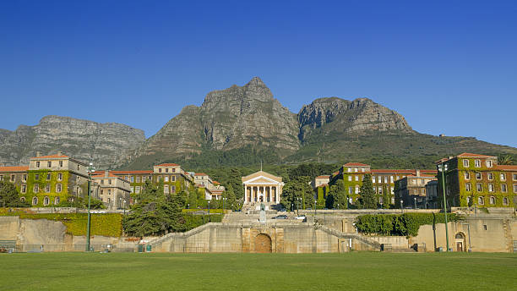
Distant history: how the bootstrap theory impacted on particle physics
Chris Damerell
18 January 2023
Prof Robin Cherry,
PhD Cambridge
Late 1950’s, early ‘60s: The outpouring of discoveries in particle physics *(Michael Riordan)

Slide 2
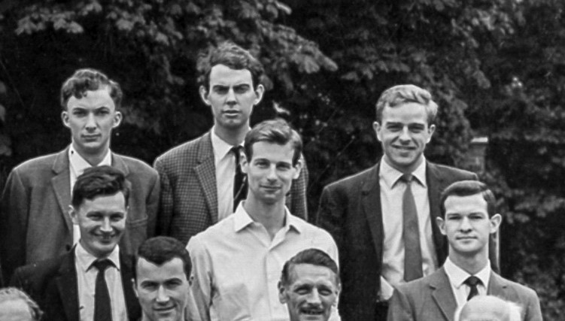
Advice from Godfrey Stafford, and the following day, my introduction to Denys Wilkinson at Oxford U, September 1962*
Miraculously, Arthur Clegg, Bill Williams, Chris Johnson, David Newton and Neil Middlemas got me in through the back door
Denys’s subsequent kindness to me when I moved to Brookhaven Lab in 1966
J Emmerson, T Quirk, D Newton,
N Middlemas, J Madden, Ch D
1964
Neil (to whose memory I dedicate this talk) quickly taught me all I needed to switch from vacuum tubes to transistors, and hence to successfully commission Bill’s spark chamber control module. No need for Regge poles.
Good advice from James Watson (co-discoverer of DNA) to young scientists – on his retirement

Slide 3
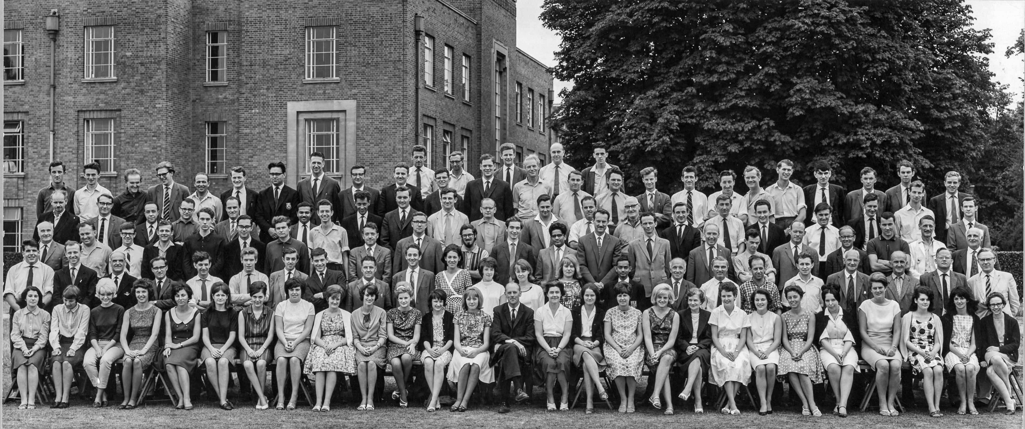
Official photo of Nuclear Physics Dept, June 1964. 5 months after Nick Samios discovered the Ω⁻ at Brookhaven, using the newly commissioned 33 GeV AGS, from which he produced a beautiful K⁻ beam at 5 GeV
Vicki Weisskopf on:
accelerator builders
experimentalists
theorists
in the days of Ch Columbus
A few oddities about this photo. Only two group leaders (George Chadwick and Michael Grace), not one female physicist, but a huge team of ‘scanning girls’, members of the Bubble Chamber Group. Also Cyril Band.

Slide 4
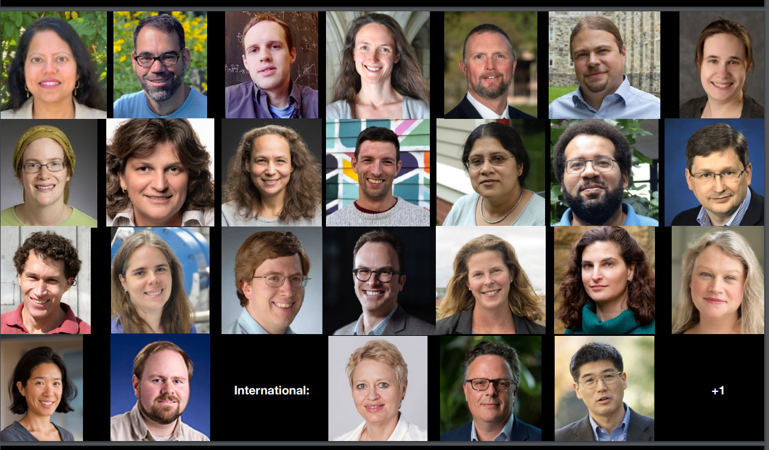
P5 Panel: H Murayama Chair, K Heeger Deputy Chair, J Hewett HEPAP Chair, plus 29 members, 14 female, 15 male. Average age ~45
P M
Beate Heinemann
Christos Touramanis
Shoji Asai

Slide 5
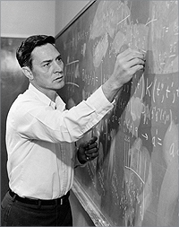
So what was this Bootstrap Theory?
* ‘Each particle helps to generate other particles, which in turn generate it. In this circular and violently nonlinear situation, it is possible to imagine that no free parameters appear and that the only self-consistent set of particles is the one we find in Nature.’
Jan 1963, Seminar in 21 Banbury Rd by Geoffrey Chew
Dalitz accused of antagonising the distinguished speaker: the discussion about future accelerators (Nimrod, ZGS/ Brookhaven AGS, CERN PS/ even the Berkeley ‘200 BeV machine’). Had Ian Corbett and I just joined a dying field?

Slide 6
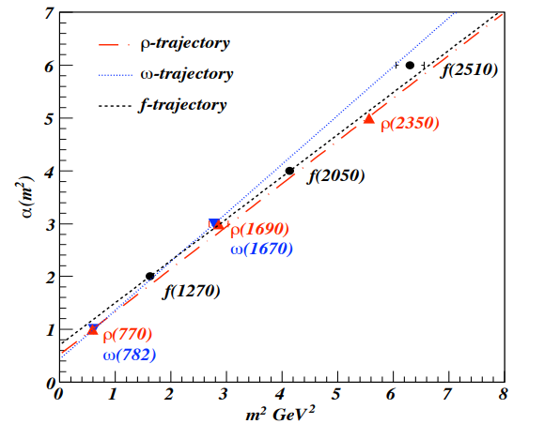
These straight-line Regge trajectories were hailed as predictions of the Bootstrap Theory, not bending over at high mass ‘as otherwise expected’
In the region of negative m², these trajectories reflected the scattering amplitude as fn of t, the square of the 4-momentum transfer for the crossed reaction:
the Pomeron/f⁰ trajectory for elastic scattering
the ρ trajectory for π ⁻- p charge exchange, etc
so they needed to be (provisionally) adjusted to match the data
I diligently pursued this physics for 8 years, with groups measuring precise differential cross-sections of charge exchange (Oxford U, Nimrod at RHEL), baryon exchange (C-bug group, AGS at BNL) and hypercharge exchange (RHEL/B’ham/CERN, CERN PS)
‘The straight-line Regge trajectories were later understood as arising from massless endpoints on rotating relativistic strings.’
Pardon?
Will QCD some day throw some light on this?
J^{P} = 1-, 3-, 5-
J^{P} = 1-, 3-
J^{P} = 2+, 4+, 6+

Slide 7
The work of my group in support of the bootstrap theory culminated in precise measurements of hypercharge exchange reactions on the PS (Expt S120). There were major technical challenges.
My lessons from Ted Kycia and Roy Rubinstein, and Blair Ratcliff’s lessons from Jerry Vavra, and a gifted PAG technician (John Mackin) enabled us to pull the Cerenkov mirrors out of the fire, but at an unexpected cost …
Geoff Manning saw our quandry as a basic lack of organisation on my part: my approach to group meetings was ‘a complete waste of time’. His stern words transformed by working practices for the next 30 years – a wonderful boss!
Building on the eventual success of S120, we started to think about advancing the hypercharge exchange frontier at the SPS, then under construction. The only route appeared to be a focusing spectrometer with μm tracking precision. We feared that this might be beyond us, but prepared to take the plunge.

Slide 8
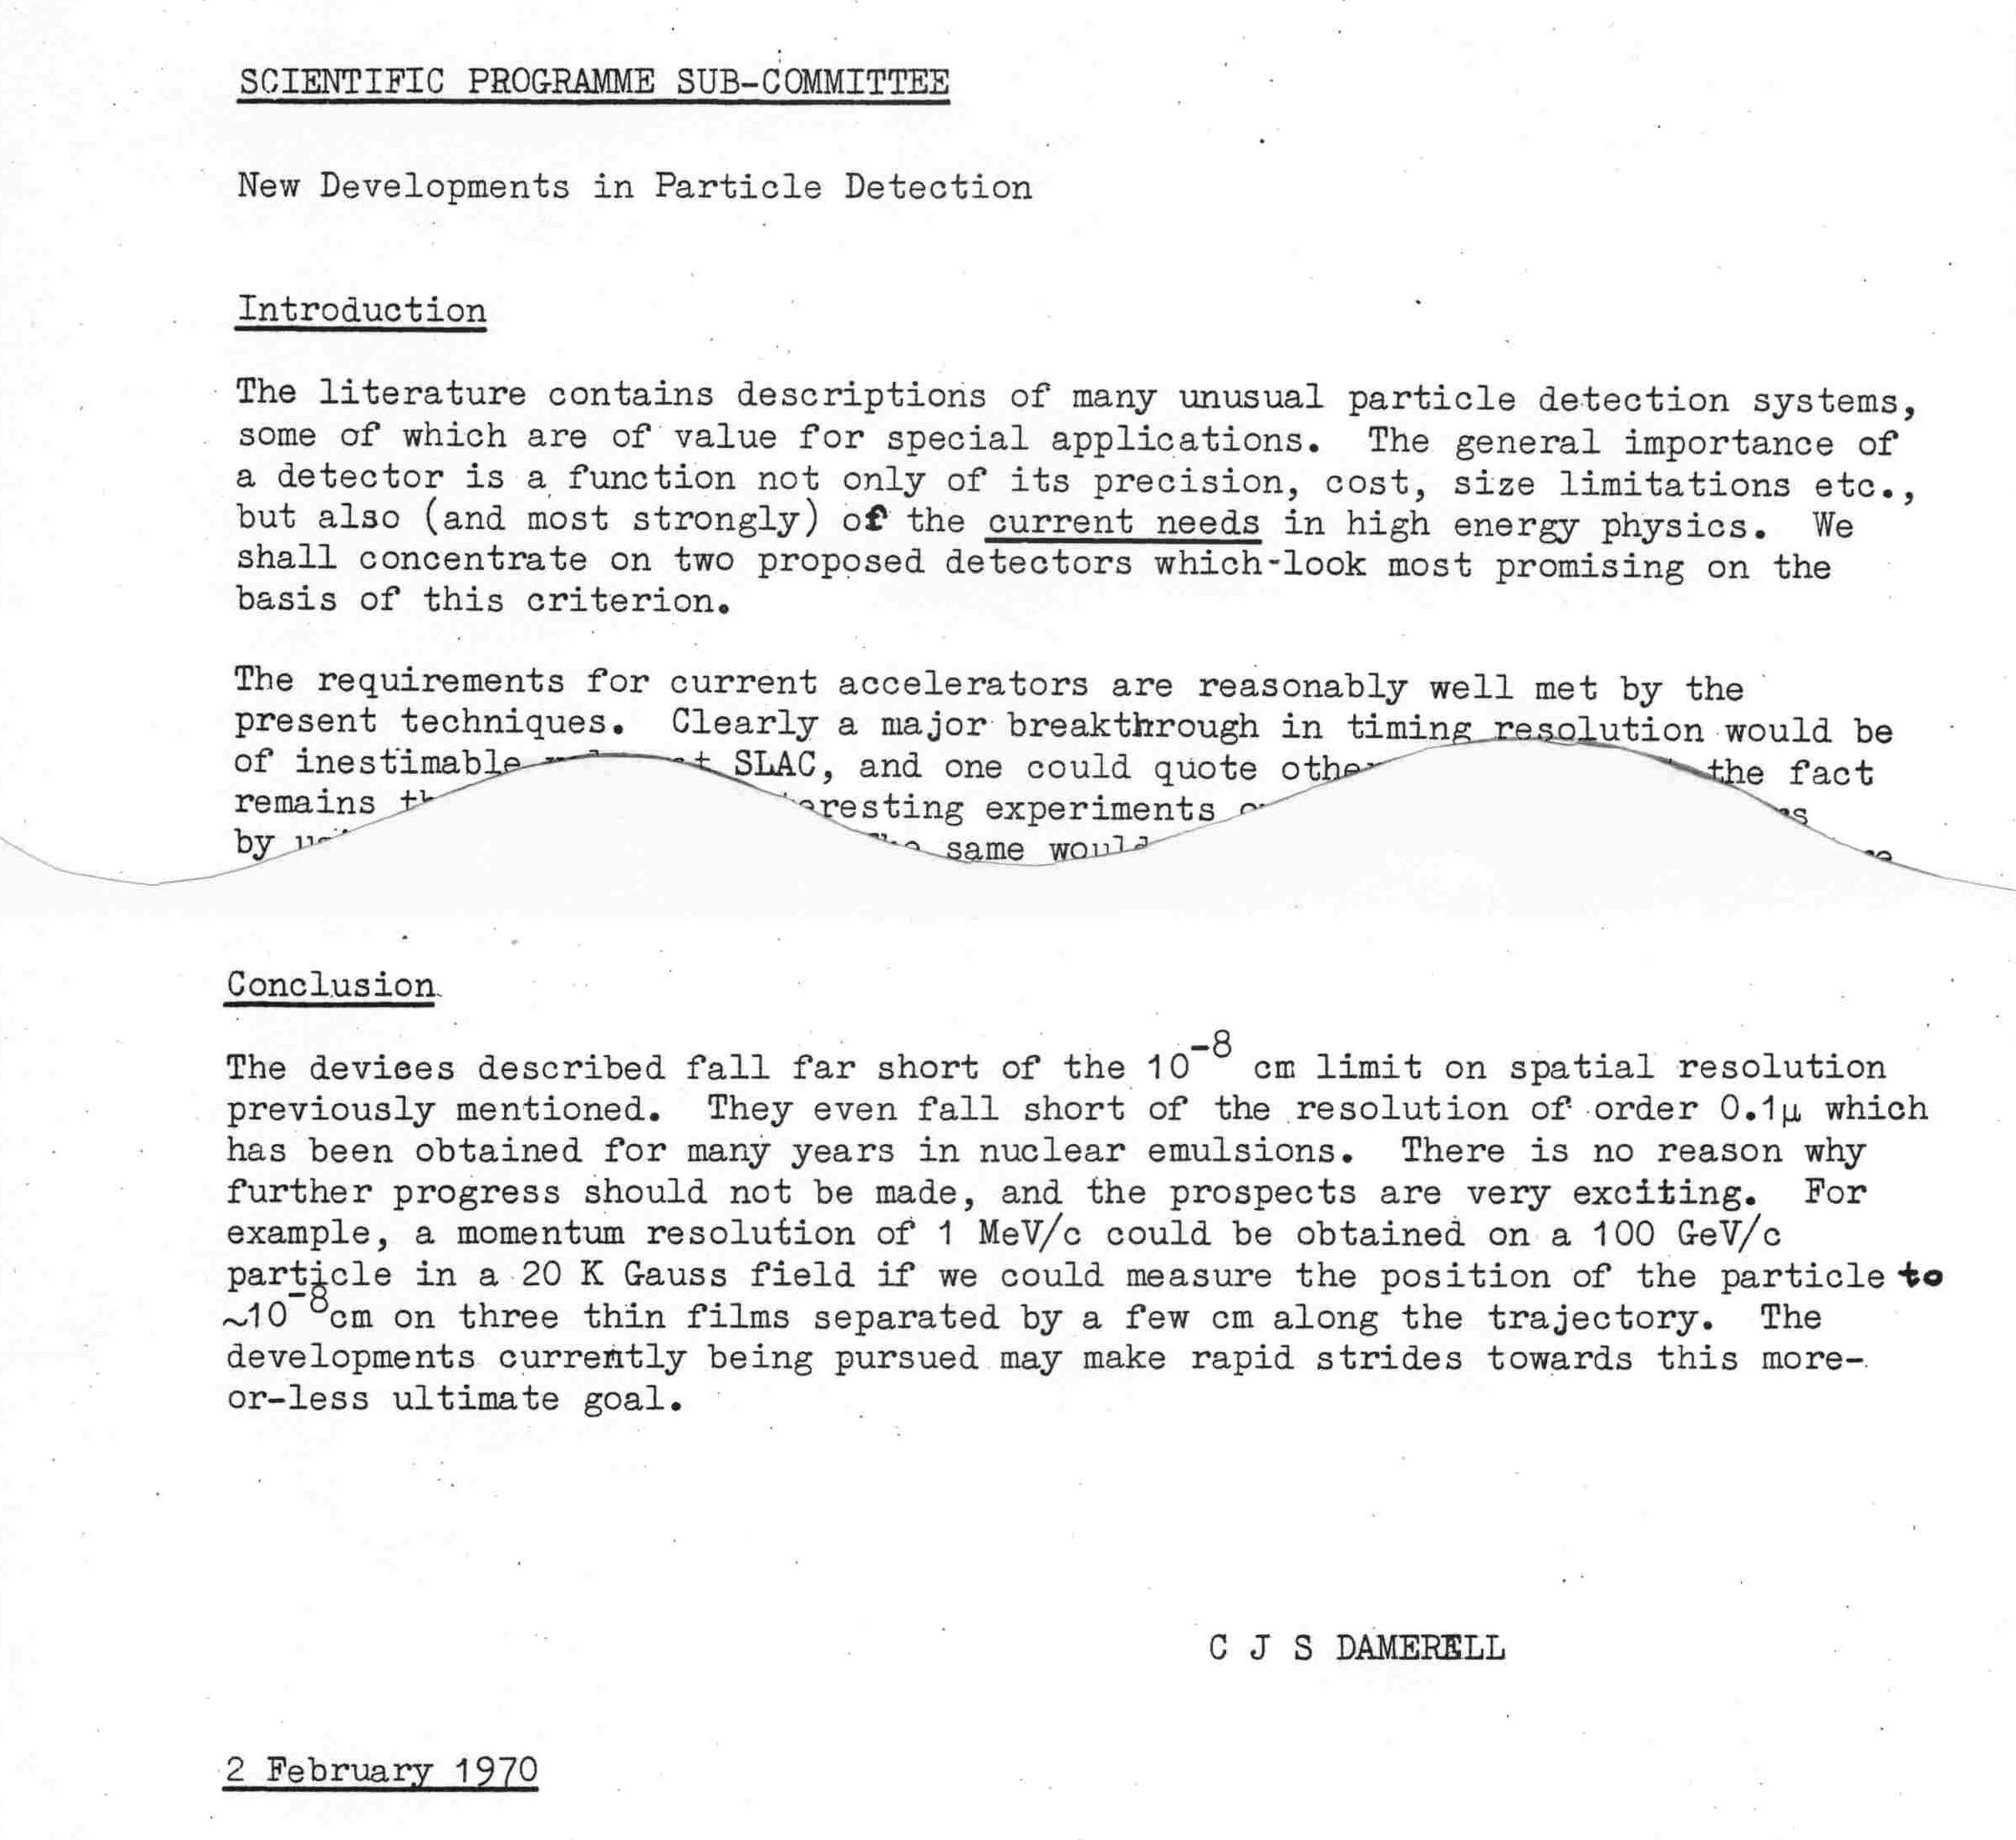
Walking with Geoff Manning into work from the car park ….
Visit to LBL (Alvarez Group), striving unsuccessfully with liquid xenon MWPCs
Our daughter Silvana, now Project Manager for the world wide network Lightsources.org, was 2 weeks old

Slide 9
We eventually dropped this focusing spectrometer initiative. Not only the experimental difficulties, but the timescale for QCD to handle soft processes started to drag out far beyond the initially claimed ‘6 months’. It’s now 50 years and counting, so the physics case has faded entirely.
Georges Charpak (rapporteur at EPS Conference, Palermo, 1975) considered the gaseous drift chamber to be the ultimate tracking detector – nothing more would ever be needed.
But interest in high precision tracking was already enjoying an upsurge, following the discovery of charm, the lifetime estimates of Gaillard, Lee and Rosner, then the unexpectedly long-lived B hadrons. We still needed a condensed medium for high precision vertex detectors, but please not liquid!
Our carefully prepared proposal to the PPESP (thanks to GM) to develop ultra-thin silicon pixel detectors was rejected with two words: ‘too speculative’. Fortunately, dear Erwin Gabathuler came to the rescue
How things have changed – every vertex detector for flavour tagging now uses silicon pixels, even LHCb which for many years continued with microstrips.

Slide 10
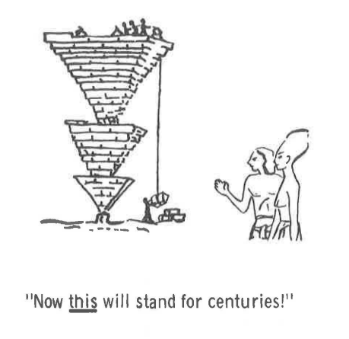
The Bootstrap Theory rose to the summit of its influence during 1966 *
Then things started to move fast, for 10 years:
pioneering electron-nucleon deep inelastic scattering experiments at SLAC (1967-1973), (partons discovered)
high energy neutrino-nucleon scattering at SPS and Fermilab, (identification of partons as fractionally chgd quarks)
high energy muon-nucleon scattering experiments at SPS (EMC, …) and Fermilab (PDFs and more, in nucleon)
discovery of the charm quark at SPEAR in 1974/5
discovery of the bottom quark in E288 at Fermilab in 1977
These decisive developments almost buried the bootstrap theory
QCD emerged and gained substance between 1973 and 1979 (discovery of the gluon at PETRA).
As to QCD explaining all the soft physics, with which the bootstrap had made little progress: ‘Give us 6 months!’
R Cutkosky, Bootstrap Mechanisms *
Abdus Salam, Summary talk
Oxford Particle Physics Conf, 1965
The Ox Roast!

Slide 11
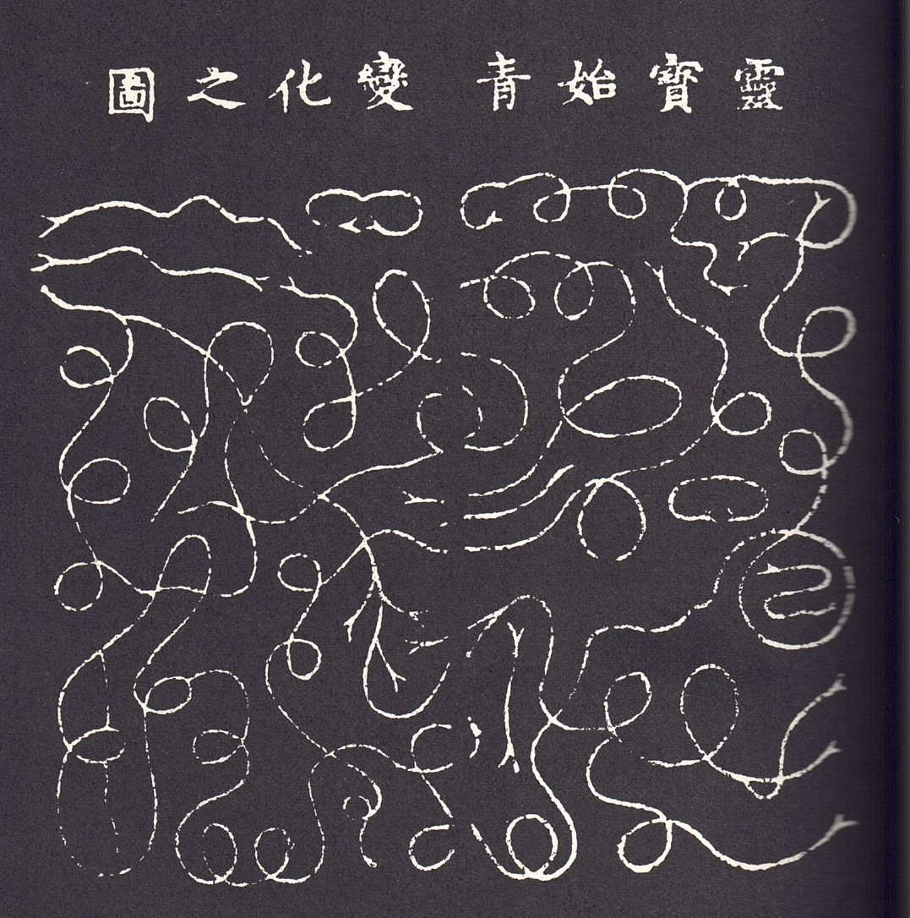
Geoffrey Chew continued to lead the Theoretical Physics Group at UC Berkeley for many years. He never abandoned the bootstrap concept, and his doctoral students included:
David Gross - NP 2004 with Frank Wilczek and David Politzer for discovery of asymptotic freedom, leading to QCD
John H Schwarz – one of the pioneers of string theory.
Echoes of the Bootstrap Theory can be found in string theory, and who knows, our multi-coloured and multi-flavoured quarks and gluons may some day prove to be composed of some universal string, knotted and vibrating differently foe each species, in some N-dimensional space, each receiving its mass (or not, in the case of the photon) by tangling in its own way with the fog of virtual Higgs bosons …
Maybe Chew had the right idea, but was applying it one layer of the cosmic onion too soon?
Diagram of change. Taoist Canon
Northern Sung dynasty 960-1127 AD
Fritjof Capra – The Tao of Physics
If there’s interest, Laotse’s vision from 2500 years ago

Slide 12
Thanks to Steve Watts, and to Foteini and Feckson (RAL Library):
Helge Kragh. Higher Speculations : Grand Theories and Failed Revolutions in Physics and Cosmology, OUP, 2011.
Chapter 6: The Rise and Fall of the Bootstrap Programme
P 150 ‘The non-reality of the space-time continuum, and hence of all field theories’ (Well, I think newborn babies pretty soon develop an acute awareness of both space and time – specially when tired or hungry)
P 152 Wow! Mρ = 650 MeV, but what’s a Feynman diagram doing here?
P 155 Feynman’s opinion of the bootstrap approach
P 157 Resurgence of field theories (Glashow, Weinberg, Salam: t’Hooft– and NOT in nuclear structure, Denys
P 160 Freeman Dyson and his high expectations of the Creator as physicist *
------------------------------
Full circle to Feynman’s school pal Raymond Smullyan, from Far Rockaway, Queens, New York: ‘Is God a Taoist?’ An imagined conversation about free will between a mortal human and God

Slide 13
Conclusions/takeaways
If you’re a young scientist, heed the words of James Watson
Equally so for senior scientists; we should all help our young colleagues to achieve their heartfelt goals, even when they don’t coincide with our own, and allow them to learn from their mistakes, not belittle them. We can all remember our own worst blunders, even though we tend to bury them.
Nobody should be ‘too busy’ to help someone who is struggling, nor too timid about ‘reputational damage’ to take action against bullies and tyrants. It’s always tempting to take the easy way out, but ‘truth will out’.
Particle physics is certainly not an ‘island of excellence’, loftily beyond the need to improve itself. There are many examples of spiteful bosses bullying young colleagues and driving them out of our field, and malicious cabals undermining rival projects by sabotage, such as the subversive trashing of ILC in 2008
Do watch Lia Merminga’s HEPAP address, 8-9 December 2022, specially her last slide on changes coming to Fermilab this year. There are good reasons for hope!
Looking forward to the International Linear Collider Workshop (LCWS2023) at SLAC, 15-19 May 2023, which will allow hybrid participation. An exciting opportunity to achieve a broad perspective on the future Higgs Factory, helping to inform P5 and combining the regional ECFA and Snowmass studies towards a world-wide consensus, free of the usual propaganda …

Slide 14
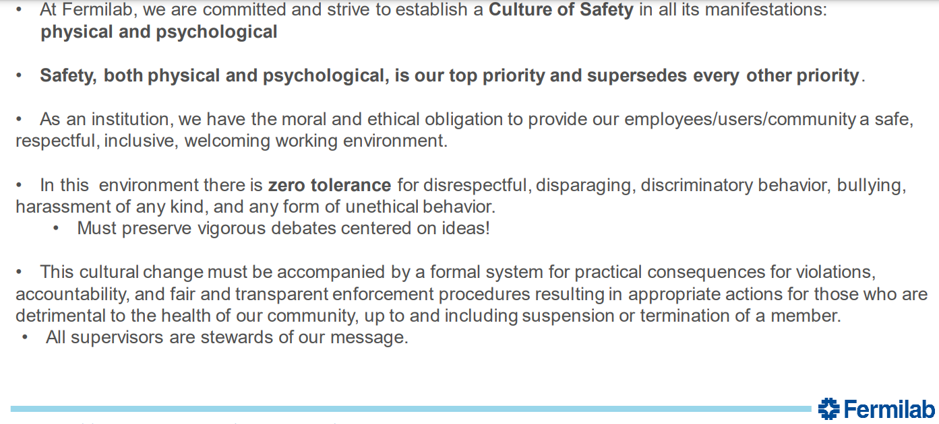
If time permits, the remarkable story of Chew’s engagement in the Manhattan Project from 1942, aged 19

Slide 15
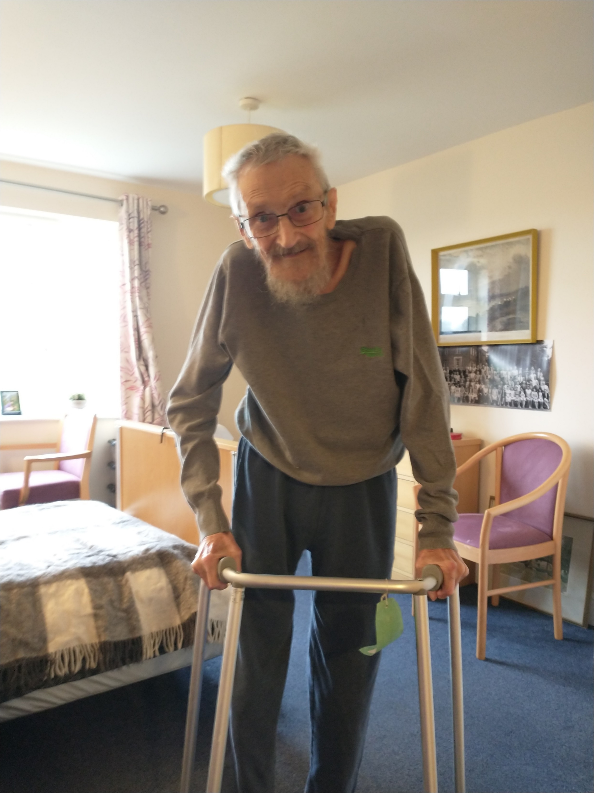
One good turn …
At age 91, I helped Neil to walk again, months after a fall in which he fractured two of his vertebrae
He died aged 92 in a ward for complex conditions in the JR, on 16th December 2022.
He was loved by all his carers – a good man, considerate and courteous and still enjoyed a good argument, to his last days.

Slide 16
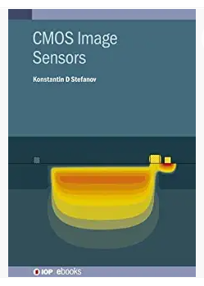
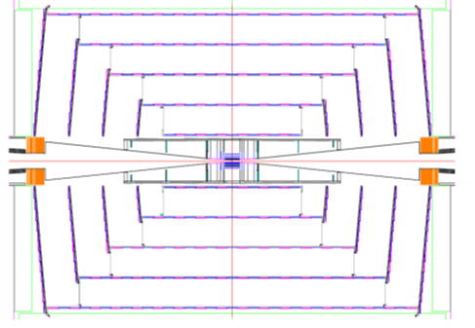
Latest News Flash
$2.9M FY22
$5.4M FY23
ILC/C-cubed detector optimisation study
Lindsey Gray, Fermilab Key4HEP
Su Dong, SLAC Physics of all backgrounds
Lorenzo Rota, Alex Habib, SLAC;
Konstantin Stefanov, Open U
65 nm CMOS pixels with Walter Snoeys WP1.2 Insufficiently ‘agnostic’ for UK support
Weekly meetings towards LCWS2023

Slide 17
If time permits …
https://ahf.nuclearmuseum.org/voices/oral-histories/geoffrey-chews-interview/

Slide 18
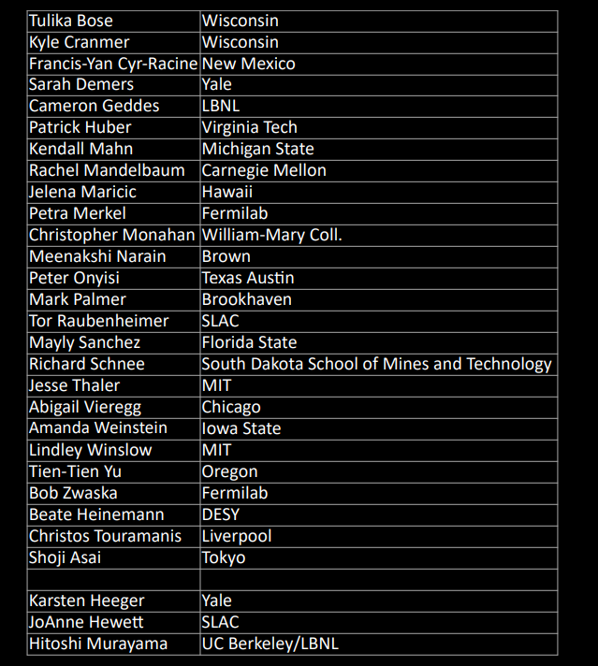
Particle Physics Projects Prioritisation Panel (P5) 2023

