Slide 1


$K_{L}$-Facility
Mikhail Bashkanov

Slide 2
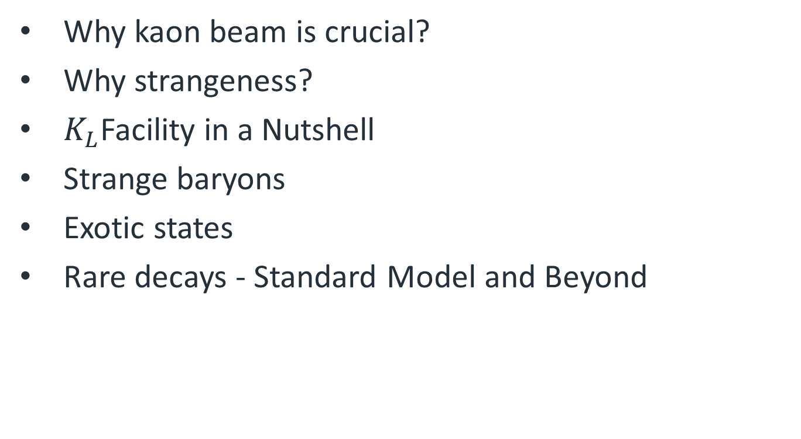
Outlook
Why kaon beam is crucial?
Why strangeness?
$K_{L}$Facility in a Nutshell
Strange baryons
Exotic states
Rare decays - Standard Model and Beyond
2

Slide 3
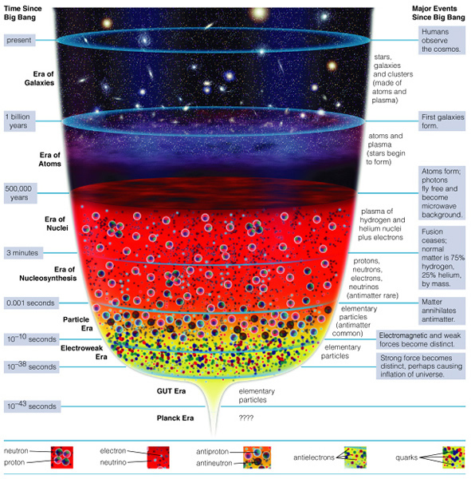
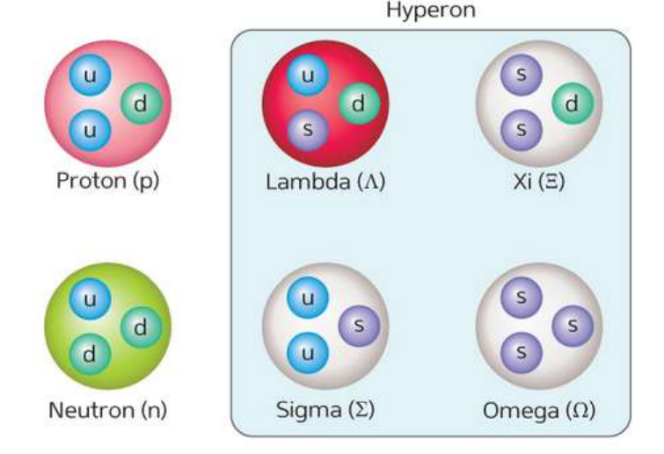
The Early Universe was Strange
Nearly equal amount of u,d,s quarks

Slide 4
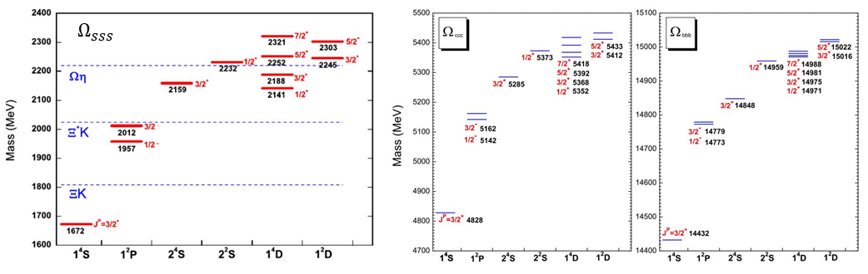
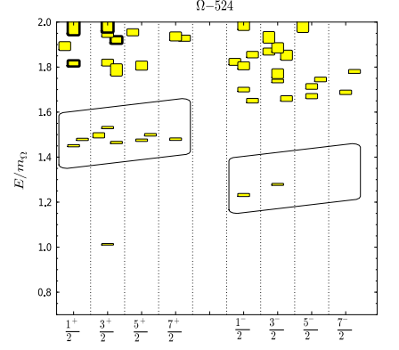
Fingerprints of QCD
Lattice QCD predictions are more accurate for “strange” sector compare to “light”
Production rates are higher than charm/bottom
The early Universe cooling
Level splitting is optimal

Slide 5
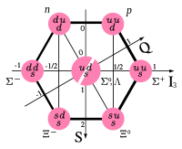
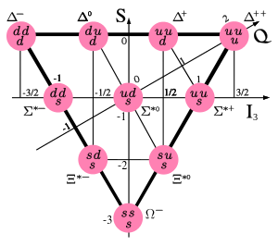
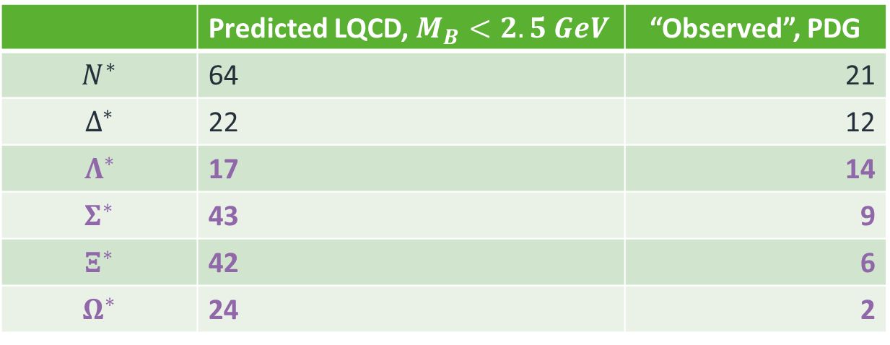
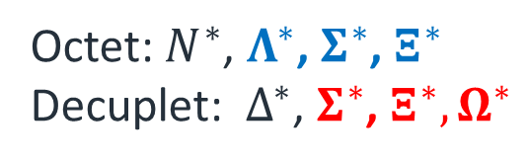
Hyperons
Octet: $N^{∗}$, $Λ^{∗}$, $Σ^{∗}$, $Ξ^{∗}$
Decuplet: $Δ^{∗}$, $Σ^{∗}$, $Ξ^{∗}, Ω^{∗}$
 | Predicted LQCD, $M_{B}<2.5 GeV$ | “Observed”, PDG
$$N^{∗}$$ | 64 | 21
$$Δ^{∗}$$ | 22 | 12
$$Λ^{∗}$$ | 17 | 14
$$Σ^{∗}$$ | 43 | 9
$$Ξ^{∗}$$ | 42 | 6
$$Ω^{∗}$$ | 24 | 2
5

Slide 6



















Strange beams?
$$K_{L}$$
$$Σ^{∗}$$
$$K^{+}$$
$$K$$
$$N$$
$$Ξ^{∗}$$
Direct $Σ^{∗}$ production
$$Λ$$
$$π^{+}$$
$$γ$$
$$π^{−}$$
$$K^{0}$$
$$N^{∗}$$
$$Σ^{∗}$$
$$K^{+}$$
Associated production
$$K$$
$$N$$
$$Ξ^{∗}$$
$$Λ$$
6

Slide 7
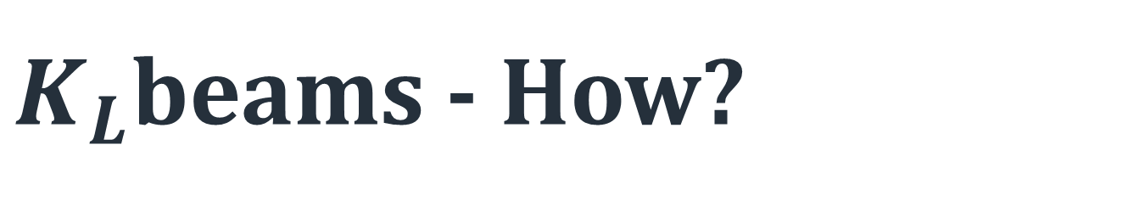
$K_{L}$beams - How?

Slide 8
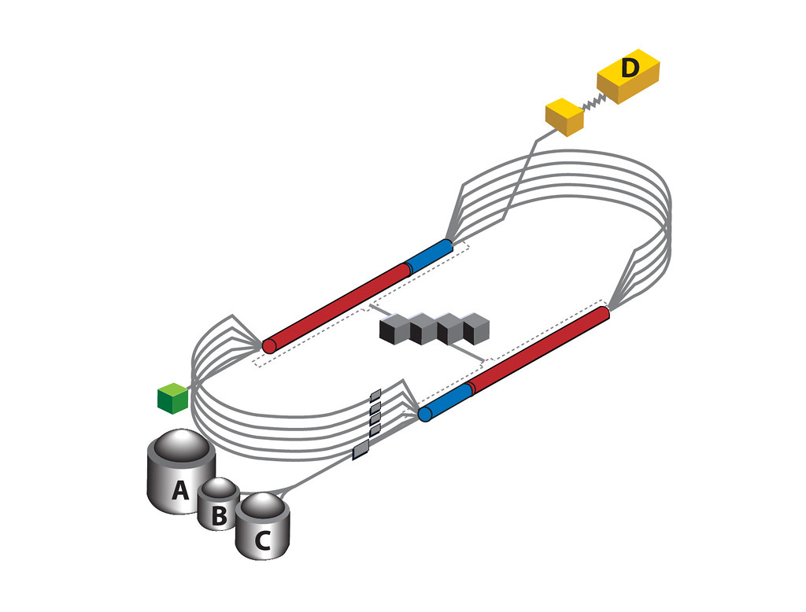
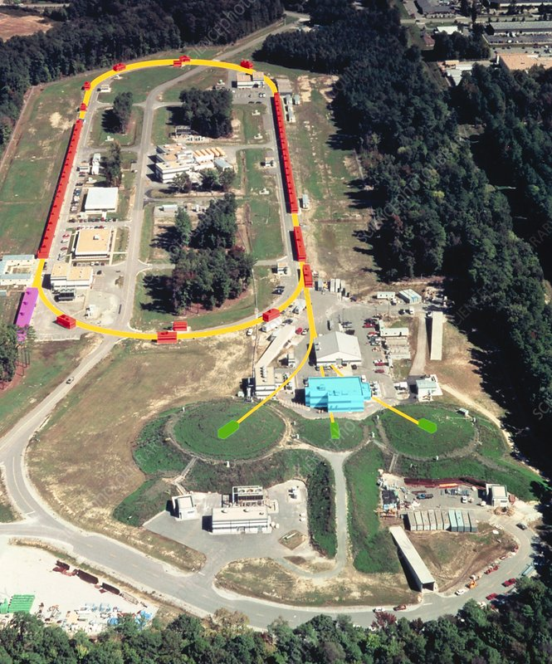
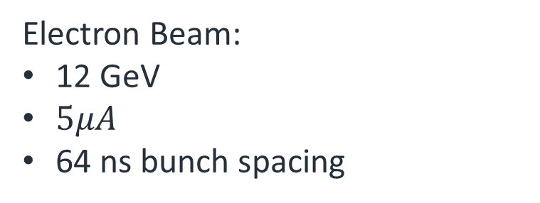
KLF, step 1 (CEBAF)
JLAB
KLF
Electron Beam:
12 GeV
$5μA$
64 ns bunch spacing
8

Slide 9
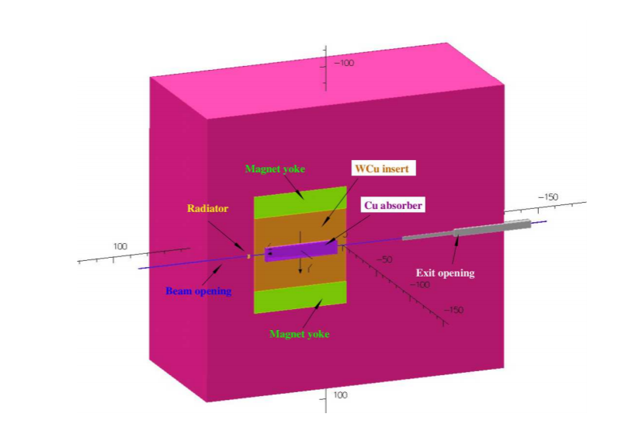


KLF, step 2 (Compact Photon source)
$$e^{−}$$
$$γ$$
CPS:
10% RL copper radiator
60kW heat
~100t shielding
Brightest manmade source of photons of these energies
9

Slide 10
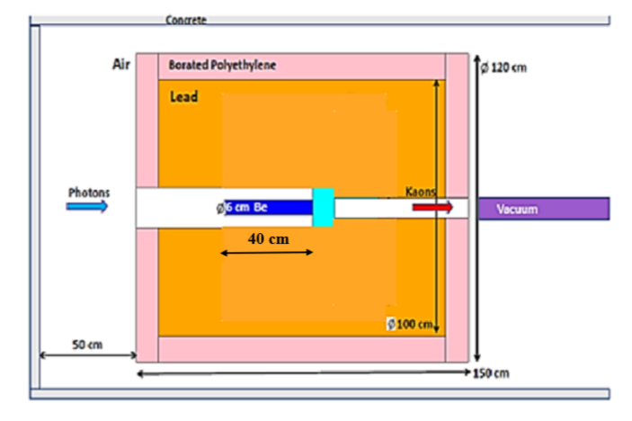



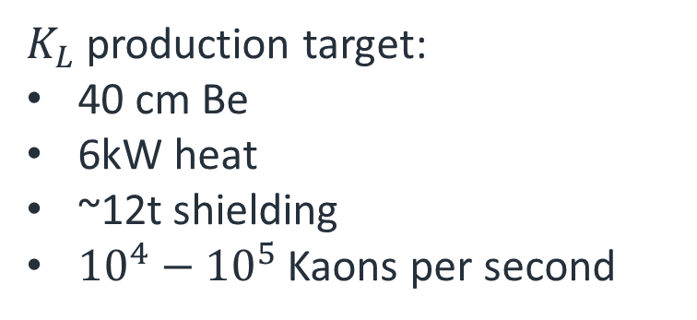
KLF, step 3 ($K_{L}$ production target)
$$γ$$
$$K_{L}$$
$K_{L}$ production target:
40 cm Be
6kW heat
~12t shielding
${10}^{4}−{10}^{5}$ Kaons per second
10

Slide 11
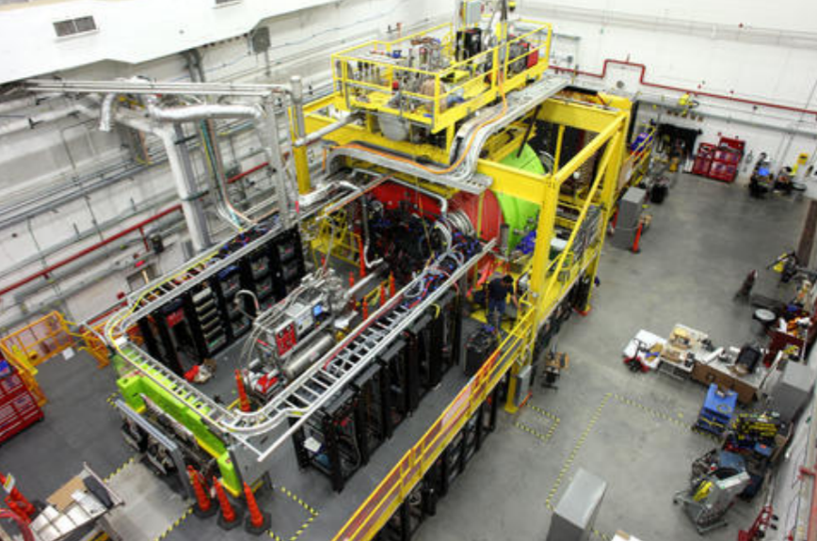
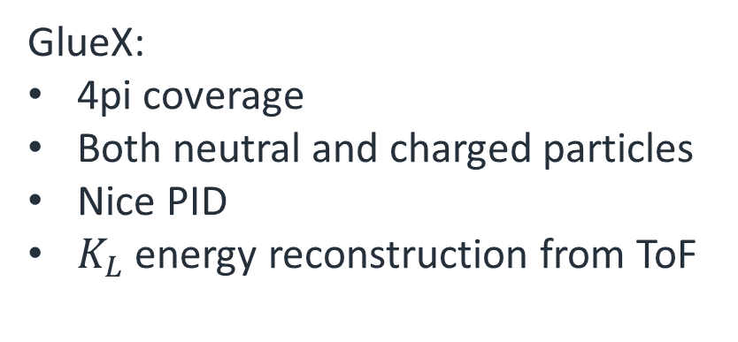


KLF, step 4 (GlueX)
$$Λ$$
$$K_{L}$$
$$π^{+}$$
24m time-of -flight
GlueX:
4pi coverage
Both neutral and charged particles
Nice PID
$K_{L}$ energy reconstruction from ToF
11

Slide 12
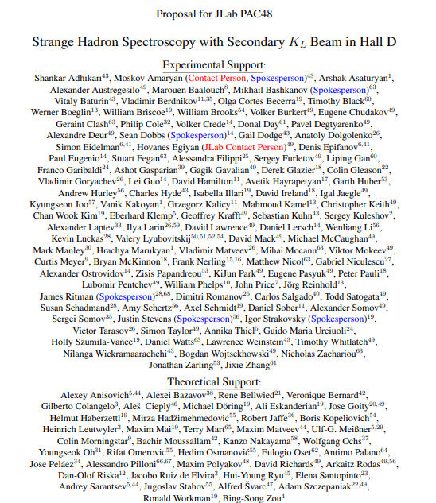
KLF highlights
Largest collaboration at proposal stage
~$2 for the beamline modifications & new targets
200 days allocated beamtime
>1Bn kaons/day
3 OoM higher Kaon tagged flux
12

Slide 13
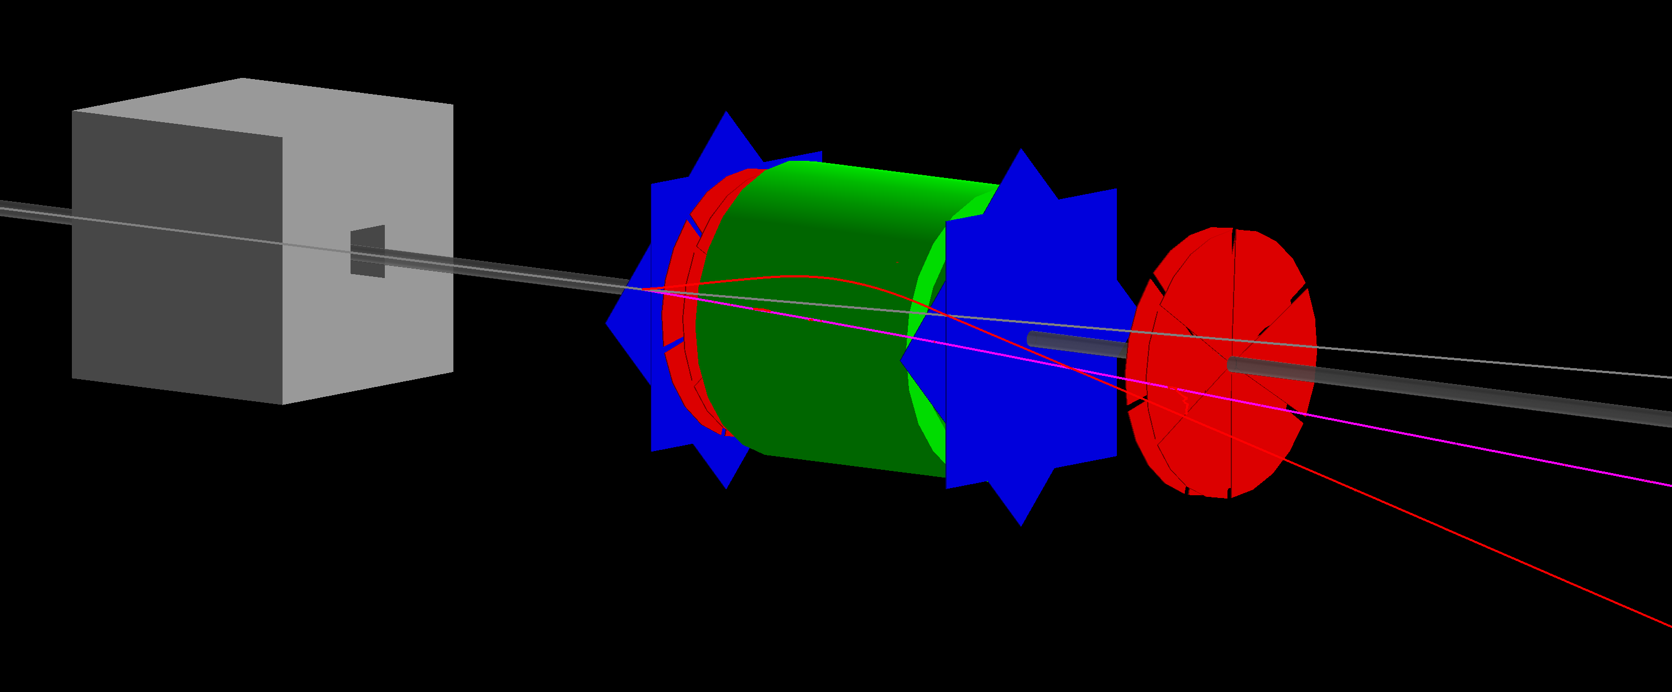



Flux Monitor
Trackers
ToF
Magnet
$$ν$$
$$μ$$
$$π$$
UK contribution
13

Slide 14
Strangeness – a new window into QCD exotics

Slide 15
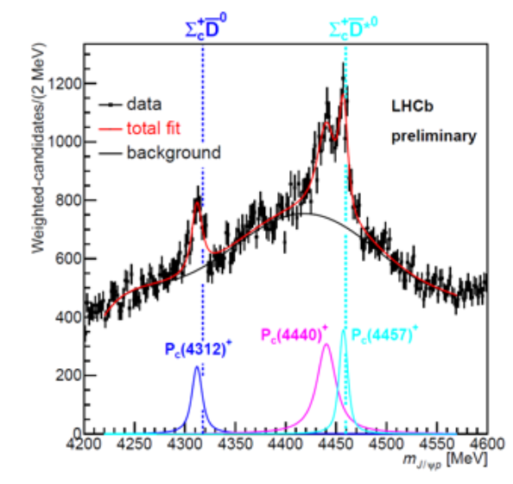
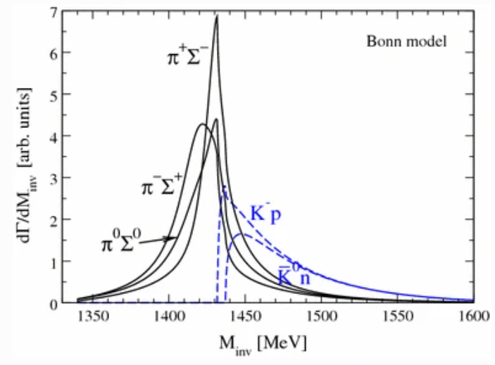



Strangeness is a key
Many thresholds
  Cusps
  Molecules
  Tetraquarks
  Pentaquarks
  Hexaquarks
$$Λ_{b}→J/ψΛ(1405)$$
L. Roca, M. Mai, E. Oset & Ulf-G. Meißner
$Λ\left(1405\right)↔πΣ/\overline{K}N$-molecule
$P\left(4450\right)↔{\overline{D}}^{∗}Σ_{c}$-molecule
15

Slide 16
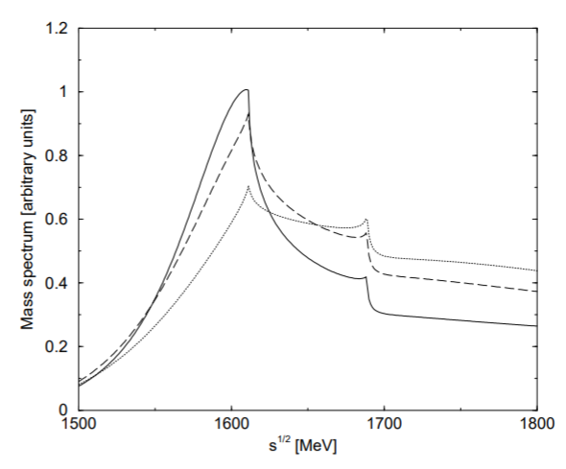



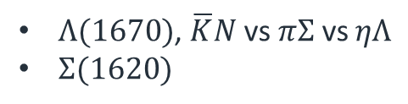

Molecules and cusps
$$Λ_{b}→J/ψΛ(1405)$$
Many thresholds
  Cusps
  Molecules
  Dynamic resonances
$Λ(1670)$, $\overline{K}N$vs $πΣ$ vs $ηΛ$
$Σ(1620)$
L. Roca, M. Mai, E. Oset & Ulf-G. Meißner
$$Ξ(1620)$$
States?
Decay channels?
Resolution?
$$Ξπ,Λ\overline{K},Σ\overline{K},Ξη$$
$$M(Ξπ)$$
A. Ramos, E. Oset , C. Bennhold
16

Slide 17
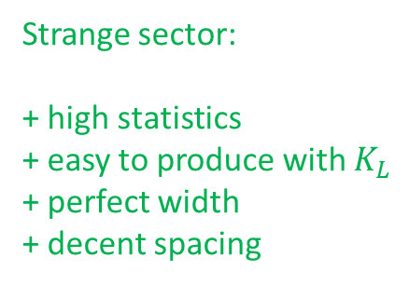
Strangeness is a key
Many thresholds
  Cusps
  Molecules
  Dynamic resonances
Light quark sector:
+ high statistics
+ easy to produce
too broad
too many interferences
Strange sector:
+ high statistics
+ easy to produce with $K_{L}$
+ perfect width
+ decent spacing
Heavy quark sector:
- low statistics
- hard to produce
- too narrow
17

Slide 18
Standard Model and Beyond

Slide 19
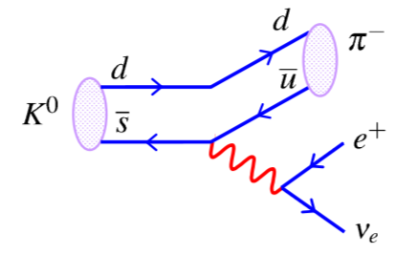
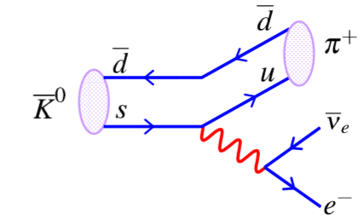


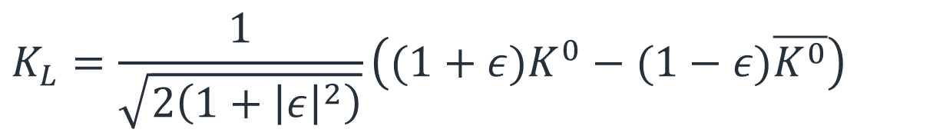
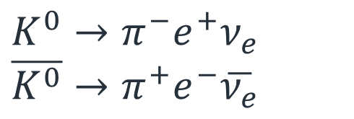

CP in $K_{L}$
$$K^{0}→π^{−}e^{+}ν_{e}$$
$$\overline{K^{0}}→π^{+}e^{−}\overline{ν_{e}}$$
$$K_{L}=\frac{1}{\sqrt{2\left(1+{\left|ε\right|}^{2}\right)}}\left((1+ε)K^{0}−(1−ε)\overline{K^{0}}\right)$$
$\left|ε\right|∼6.6⋅{10}^{−3}→$ CP is violated !
KLF: 1Bn $K_{L}$ per day
19

Slide 20
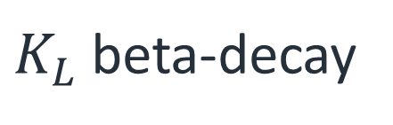
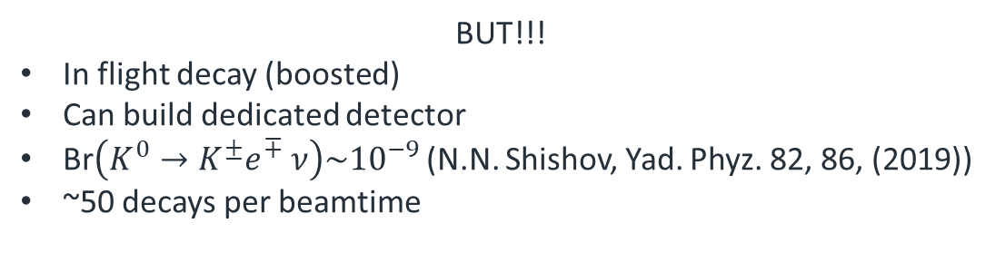
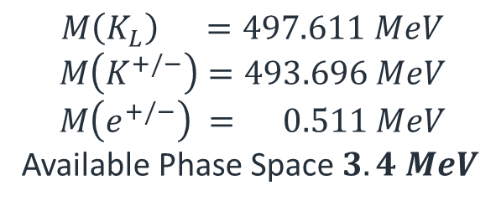
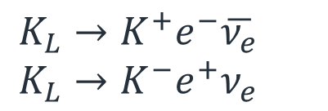
Rare decays
Firs ever measurement of KL beta decay
Physics beyond SM
  Rare final state
  Precise calculations
$K_{L}$ beta-decay
$$M\left(K_{L}\right) =497.611 MeV$$
$$M\left(K^{+/−}\right)=493.696 MeV$$
$$M\left(e^{+/−}\right) = 0.511 MeV$$
Available Phase Space $3.4 MeV$
$$K_{L}→K^{+}e^{−}\overline{ν_{e}}$$
$$K_{L}→K^{−}e^{+}ν_{e}$$
BUT!!!
In flight decay (boosted)
Can build dedicated detector
Br$\left(K^{0}→K^{±}e^{∓} ν\right)\sim {10}^{−9}$ (N.N. Shishov, Yad. Phyz. 82, 86, (2019))
~50 decays per beamtime
20

Slide 21
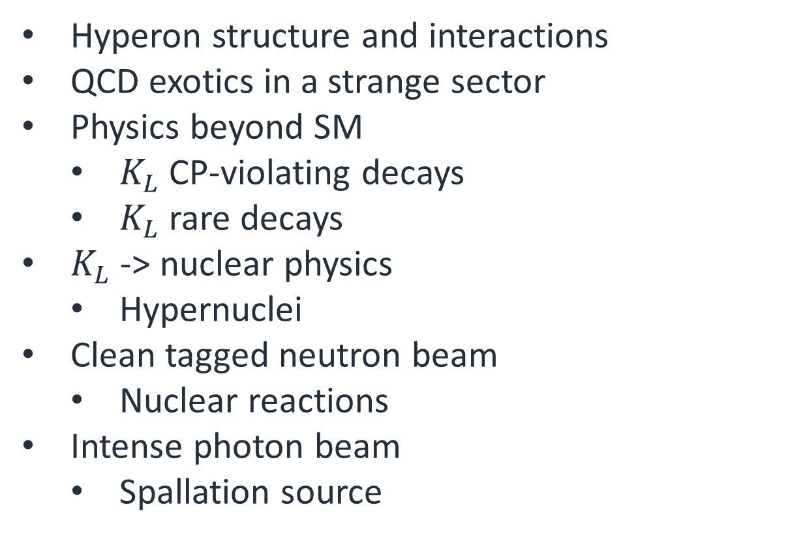
Science landscape with KLF
Hyperon structure and interactions
QCD exotics in a strange sector
Physics beyond SM
  $K_{L}$ CP-violating decays
  $K_{L}$ rare decays
$K_{L}$ -> nuclear physics
  Hypernuclei
Clean tagged neutron beam
  Nuclear reactions
Intense photon beam
  Spallation source
21

Slide 22
Conclusion
KL beam facility is under construction
Commencing 2026 – largest collaboration in JLab history
Exciting possibilities to elucidate strange quark sector
  Up to 1 new particle per week of beamtime
Technical design/prototyping/construction
New collaborators welcome!!!
More information at https://wiki.jlab.org/klproject
22

Slide 23


IOP 2023

Slide 24
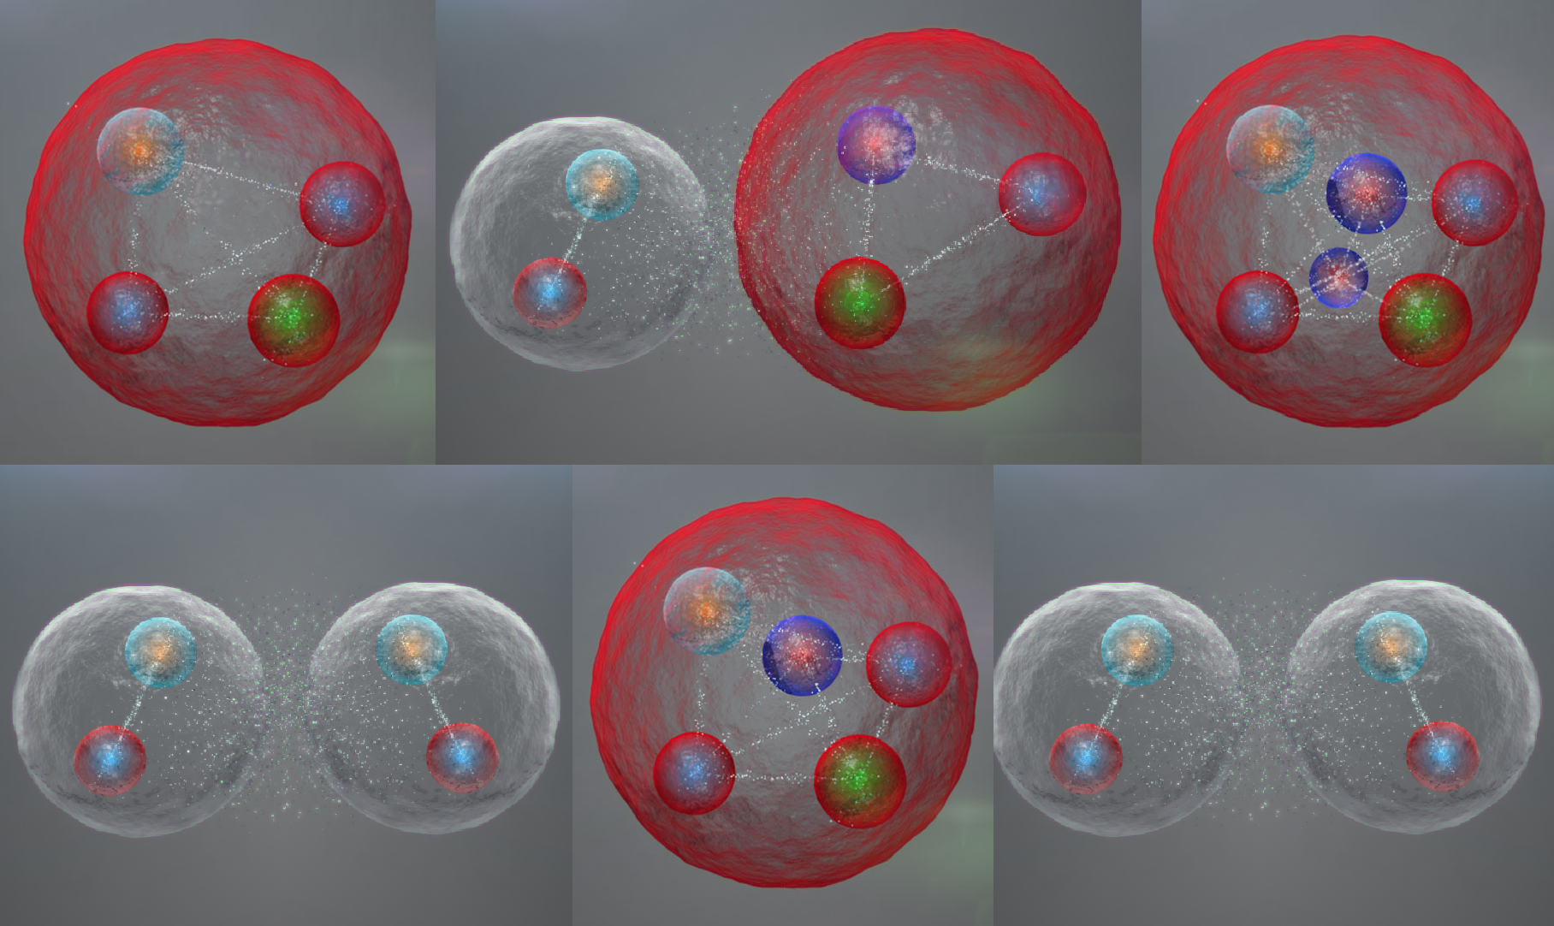



Exotic hadron spectroscopy workshop 2023
19–21 Apr 2023 Durham
This is the fourth in a series of workshops on this topic, following previous events at the University of Edinburgh and the University of York:
2016, Edinburgh
2017, Edinburgh
2019, York

Slide 25
Back up slides

Slide 26
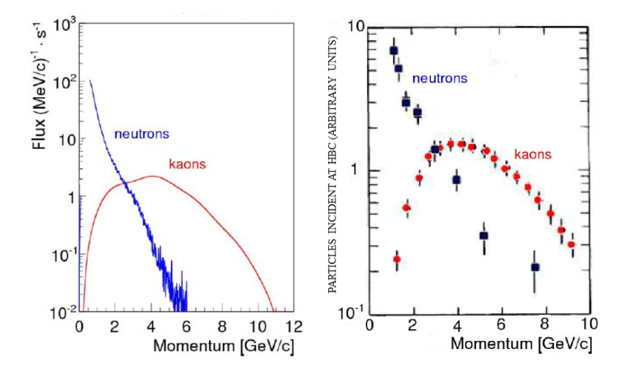
KLF beams
KLF (simulation)
SLAC (measurements)
26

Slide 27

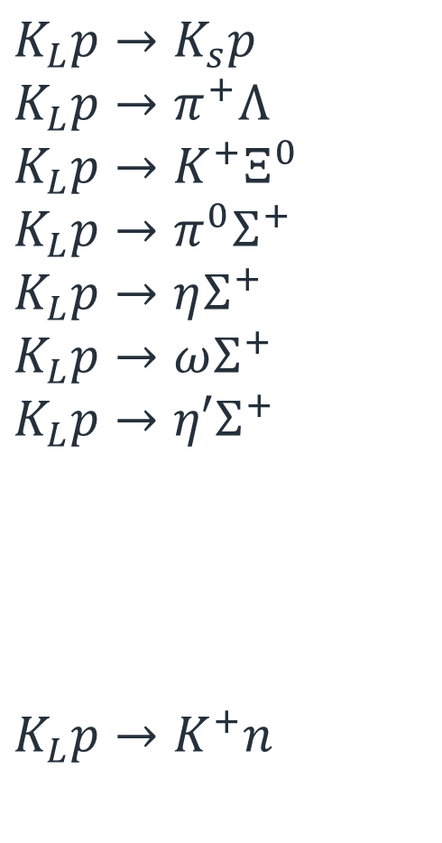
Sigma factory
$$K_{L}p→K_{s}p$$
$$K_{L}p→π^{+}Λ$$
$$K_{L}p→K^{+}Ξ^{0}$$
$$K_{L}p→π^{0}Σ^{+}$$
$$K_{L}p→ηΣ^{+}$$
$$K_{L}p→ωΣ^{+}$$
$$K_{L}p→η′Σ^{+}$$
$$K_{L}p→K^{+}n$$
2 Body Final state
Pure $Σ^{∗}$ channels
Self-polarising observables
Non-resonant background
27

Slide 28
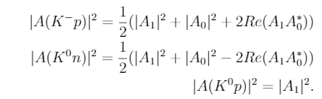
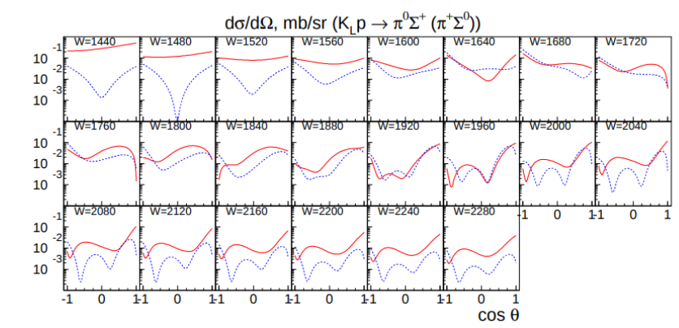

New findings: $πΛ/πΣ$
Isospin amplitudes
arXiv:2008.08215v3
KLF proposal 2020
28

Slide 29
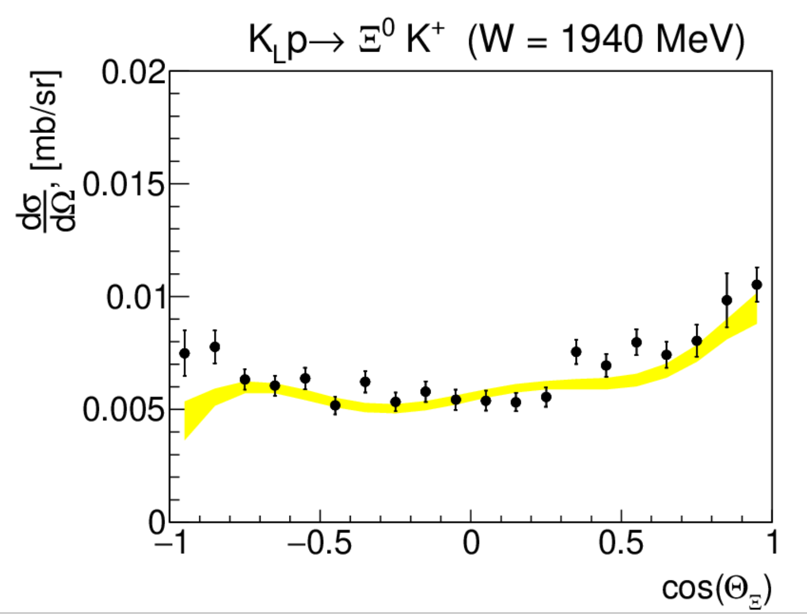
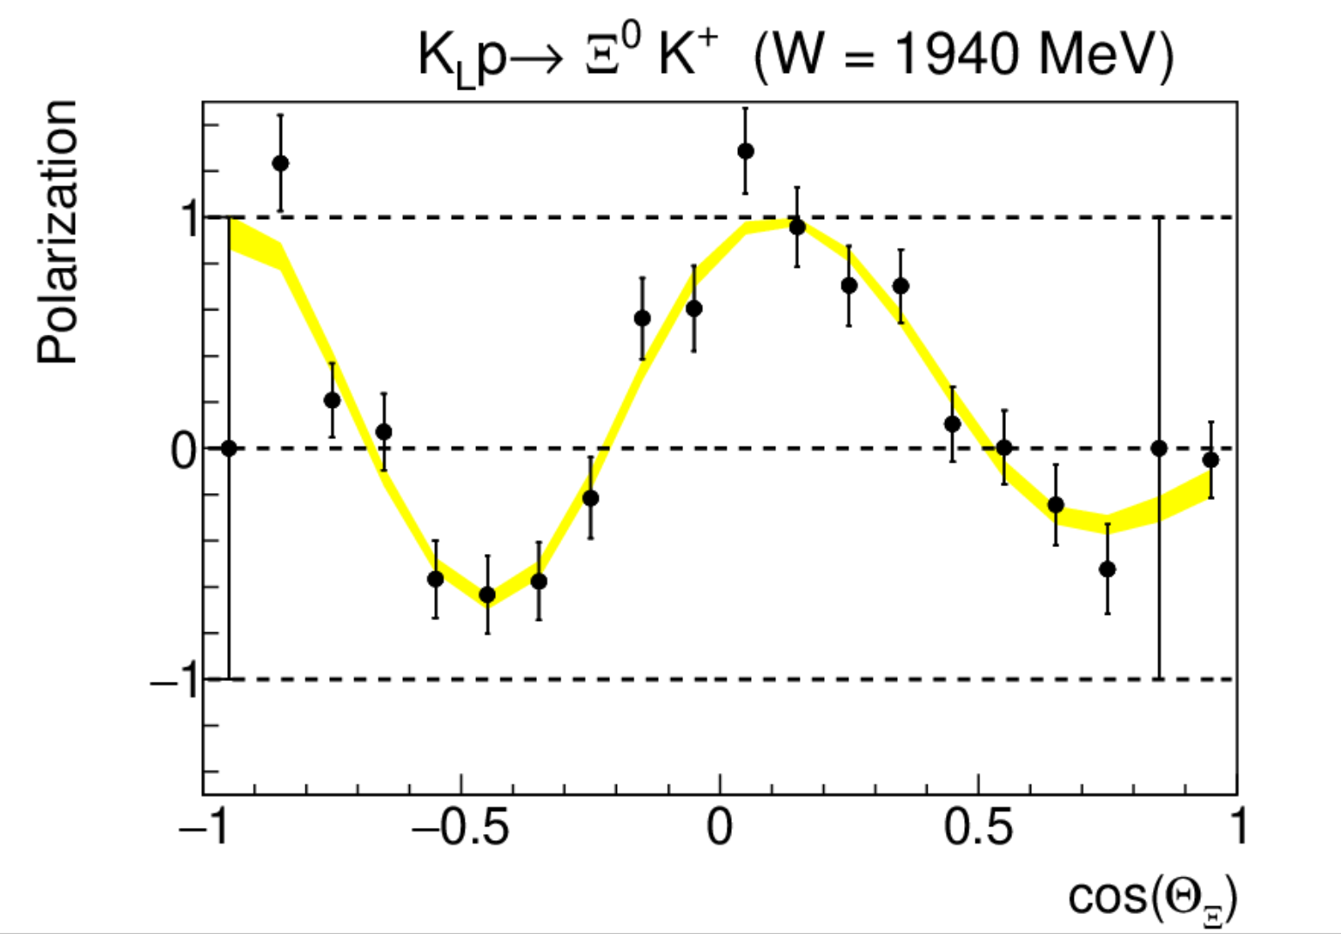
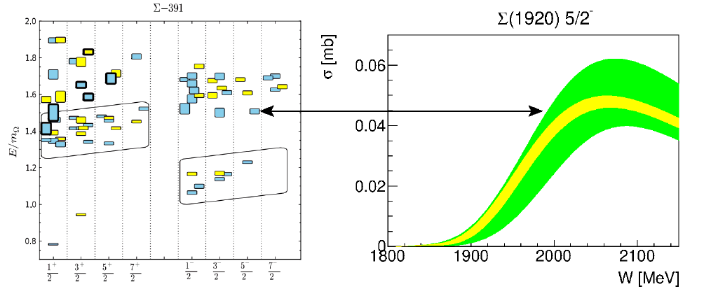

Expected results
$$K_{L}p→K^{+}Ξ^{0}$$
20 days
100 days
29

Slide 30
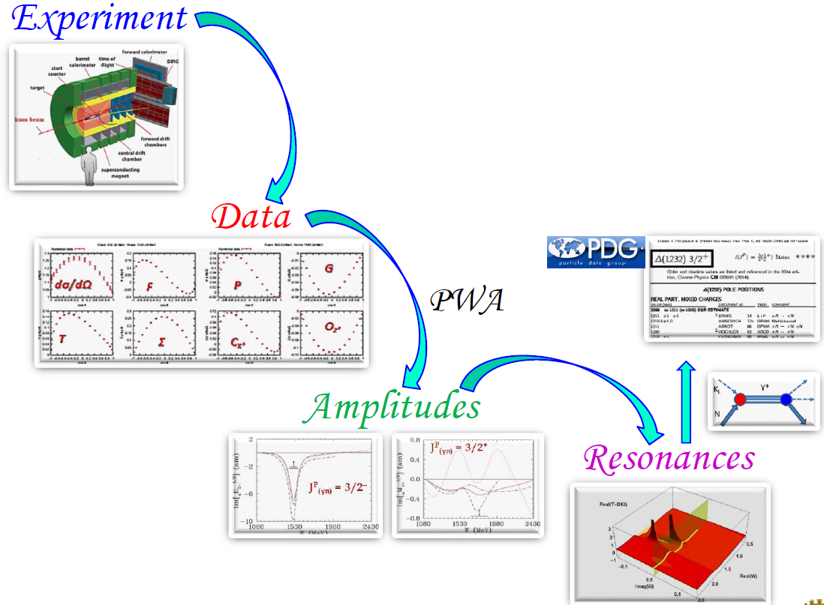
Strategies: bottom → up vs top → down
from I. Strakovsky
30

Slide 31

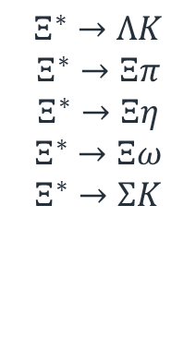

Excited $Ξ^{∗}$ in associated production
$$K^{+}$$
$$K_{L}$$
$$Ξ^{∗}→ΛK$$
$$Ξ^{∗}→Ξπ$$
$$Ξ^{∗}→Ξη$$
$$Ξ^{∗}→Ξω$$
$$Ξ^{∗}→ΣK$$
$$K$$
$$N$$
$$Ξ^{∗}$$
$$Λ$$
$$K_{L}n→K^{+}Ξ^{−}→K^{+}ΛK^{−}$$
31

Slide 32
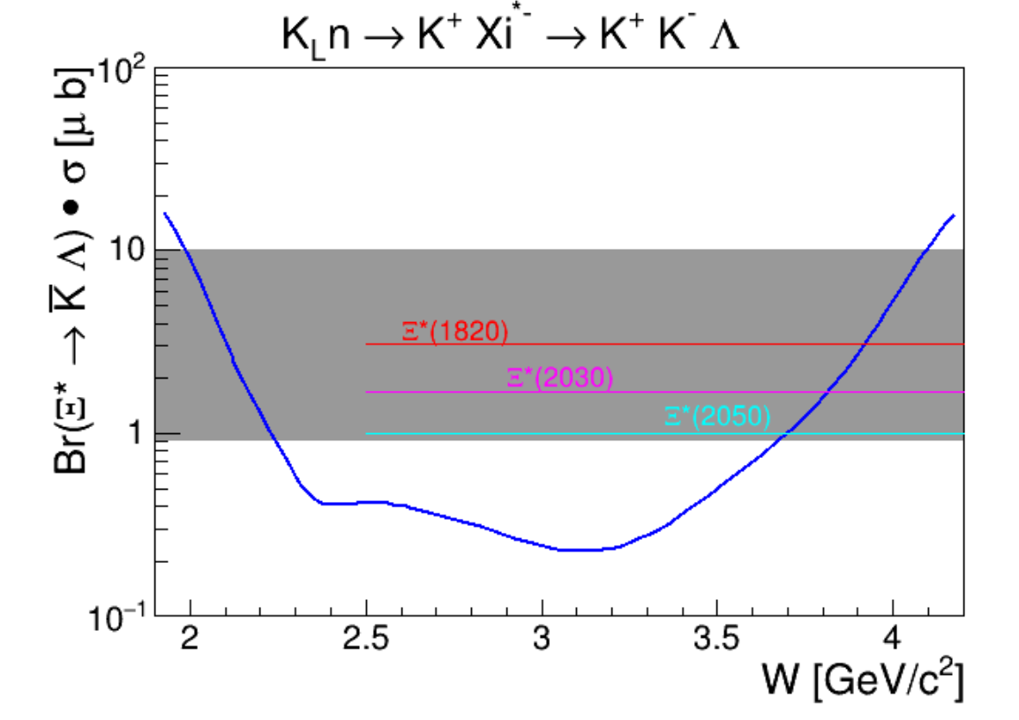








$Ξ^{∗}$ discovery potential
$$K^{+}$$
$$K_{L}$$
$$K^{−}$$
$$K_{L}n→K^{+}Ξ^{∗−}→K^{+}ΛK^{−}$$
$$n$$
$$Ξ^{∗}$$
$$Λ$$
100 days experiment
32

Slide 33








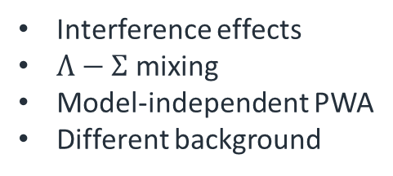




Excited $Λ^{∗}$
$$π^{+}$$
$$K_{L}$$
$$K^{+}$$
Associated production
$$p$$
$$Λ^{∗}$$
$$Ξ^{−}$$
$$K_{L}$$
$$Λ^{∗}$$
$$K^{+}$$
Direct formation
$$n$$
$$Ξ^{−}$$
Interference effects
$Λ−Σ$ mixing
Model-independent PWA
Different background
33

Slide 34
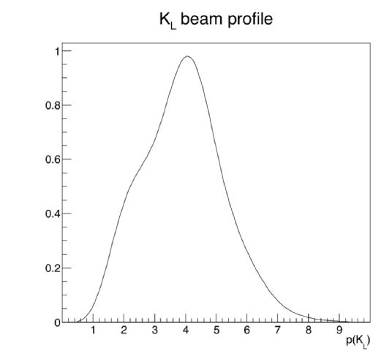
KLF spectroscopy
Direct formation
Meson spectroscopy
Associated production
34

Slide 35
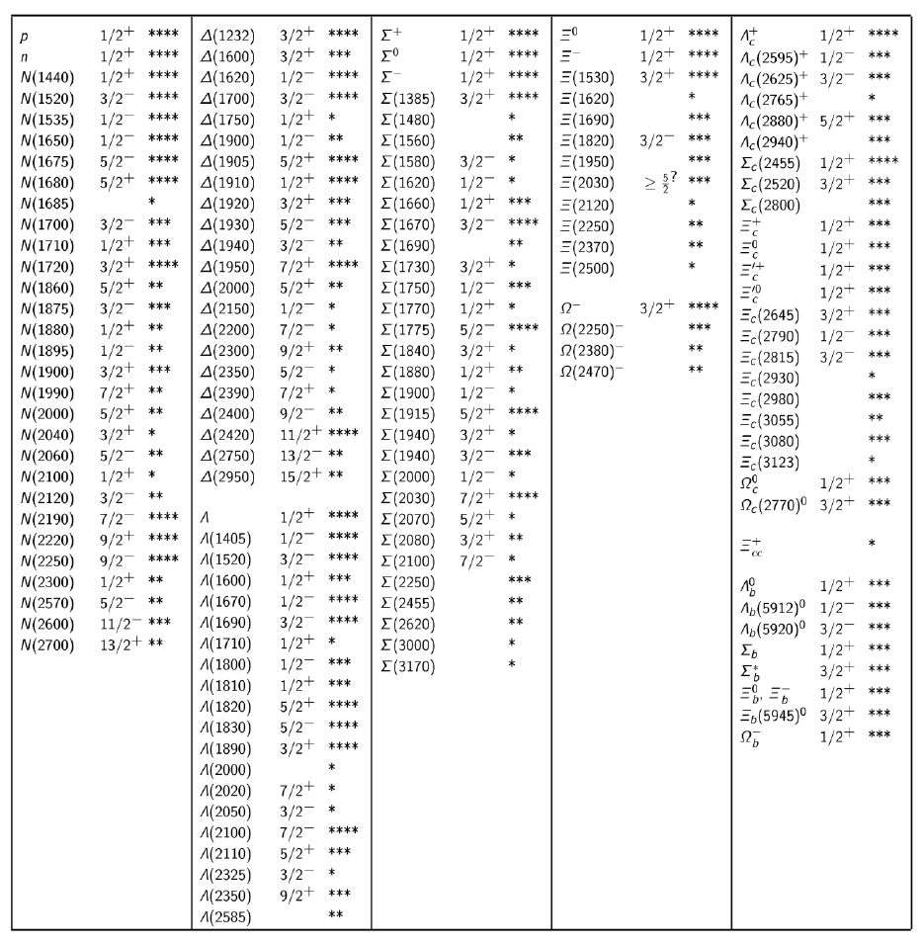

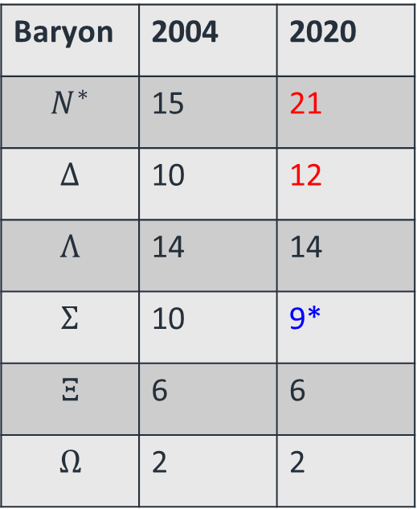
Baryon summary table, PDG
Number of 3- and 4-star Resonances
Baryon | 2004 | 2020
$$N^{∗}$$ | 15 | 21
$$Δ$$ | 10 | 12
$$Λ$$ | 14 | 14
$$Σ$$ | 10 | 9*
$$Ξ$$ | 6 | 6
$$Ω$$ | 2 | 2
*$Σ\left(2250\right)$ was downgraded

Slide 36

Extracting particle properties
Kaon beam brings one unit of strangeness:
No associated kaons for $Λ^{∗},Σ^{∗}$ production
1 associated kaon for $Ξ^{∗}$
2 associated kaons for $Ω^{∗}$
Good
Acceptable
Simplified,
model dependent analysis only
36

Slide 37
Strange beams?
$$K_{L}$$
$$Σ^{∗}$$
$$K^{+}$$
$$K$$
$$N$$
$$Ξ^{∗}$$
Direct $Σ^{∗}$ production
$$Λ$$
37

Slide 38


KLF properties
Intense $K_{L}$ beam $∼{10}^{4}$kaons/s on a target
  Broad momentum range
    Controlled by Flux Monitor
  Excellent W reconstruction
    Time-of-flight
    Final state
Proton and neutron target
  Approved 100 days $LH_{2}$target
  Approved 100 days $LD_{2}$target
Low background level
Exclusive final states
Up to 1 new discovered particle per week of beamtime.
ToF
Final State
38

