Slide 1
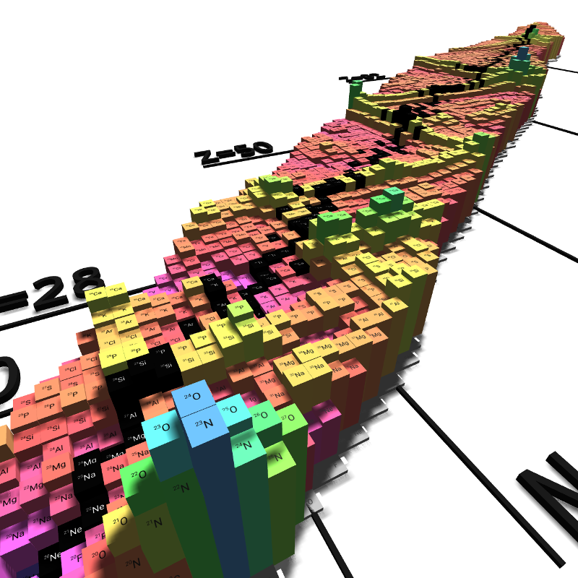

Nuclear structure under extreme conditions
Esra Yüksel
University of surrey

Slide 2
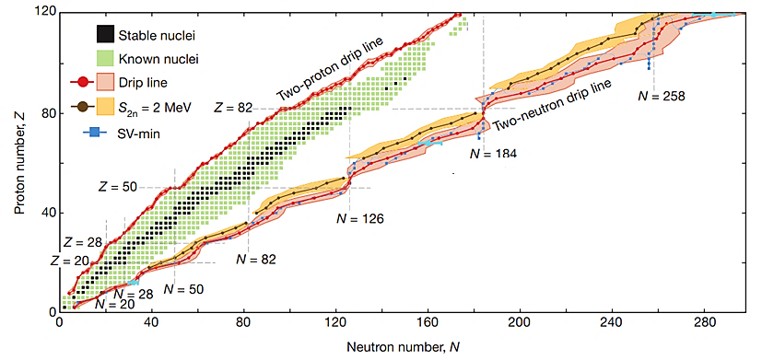
Nuclear Landscape
Presently, we have experimental data for nearly 3000 nuclides, and it is predicted that nearly 8000 should exist.
Studying the changes in nuclear properties is not only important for nuclear physics, but also for some astrophysical events, e.g., modelling the stellar evolution, supernova explosion, and the synthesis of chemical elements in the universe.
Figure 1: Nuclear Landscape. The figure is taken from ‘The limits of the nuclear landscape’. Jochen Erler et. Al., Nature Vol. 486, 509–512 (2012).
Notes:
Considerable amount of work has been devoted to study the ground-state properties of nuclei at zero temperature.
Modern nuclear structure theory has evolved from macroscopic and microscopic studiesof phenomena in stable nuclei towards regions of exotic, short-lived nuclei far fromthe valley of stability, and nuclear astrophysics applications. The principal challengeis to build a consistent microscopic theoretical framework that will provide a unified description of bulk properties, nuclear excitations and reactions.

Slide 3
Nuclear Landscape
Presently, we have experimental data for nearly 3000 nuclides, and it is predicted that nearly 8000 should exist.
Studying the changes in nuclear properties is not only important for nuclear physics, but also for some astrophysical events, e.g., modelling the stellar evolution, supernova explosion, and the synthesis of chemical elements in the universe.
What do we need?
Masses, half-lives, decay modes, GDR, GTR …
How do nuclear properties and excitations evolve with increasing nucleon number/temperature?
Figure 1: Nuclear Landscape. The figure is taken from ‘The limits of the nuclear landscape’. Jochen Erler et. Al., Nature Vol. 486, 509–512 (2012).
Notes:
Considerable amount of work has been devoted to study the ground-state properties of nuclei at zero temperature.
Modern nuclear structure theory has evolved from macroscopic and microscopic studiesof phenomena in stable nuclei towards regions of exotic, short-lived nuclei far fromthe valley of stability, and nuclear astrophysics applications. The principal challengeis to build a consistent microscopic theoretical framework that will provide a unified description of bulk properties, nuclear excitations and reactions.

Slide 4
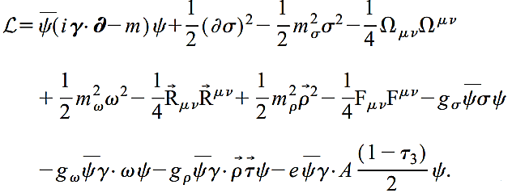

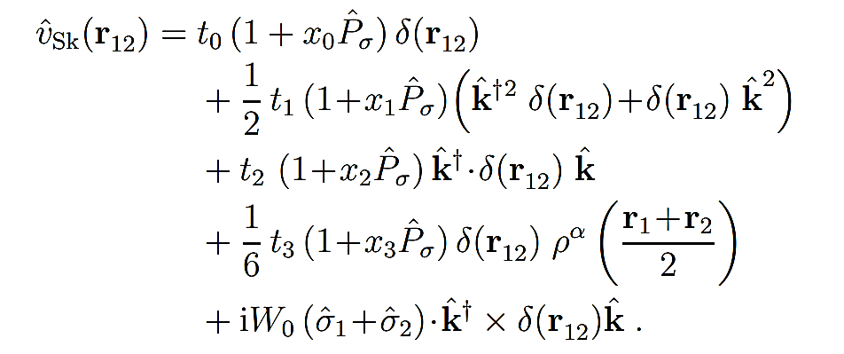

Nuclear energy density functionals (NEDF)
Based on effective interactions, Nuclear Energy Density Functionals are successful in the description of static and dynamic properties of nuclei.
Effective interaction between nucleons is represented by a functional which depends on the densities and currents.
Relativistic models: a nucleus is described as a system of Dirac nucleons coupled to exchange mesons through an effective Lagrangian.
Interaction terms
Free nucleon
Free meson fields
Non-Relativistic models: Based on Hamiltonians with effective interactions of nucleons.
Central term
The constants
$t0, t1, t2, t3,x0, x1, x2, x3,α, W0$
are Skyrme parameters
Non-local term
Density dependent term
Spin-orbit term
Notes:
By using the variational principle with Lagrangian density, one can obtain hamiltonion density.
Euler-Lagrange equations → enenrgy momentum tensor zeroth component.
Variations of the energy density funcionals wrt dirac spinor (single nucleon dirac equation), meson fields (Helmotz equations.) and Possion eqaution for the EM field.
The couplings of the sigma and omega fields are density dependent.

Slide 5
Nuclear excitations at zero and finite temperature

Slide 6
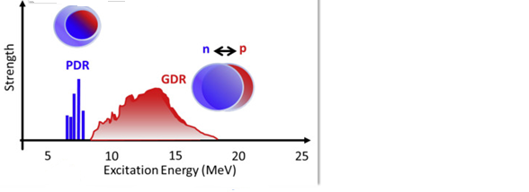
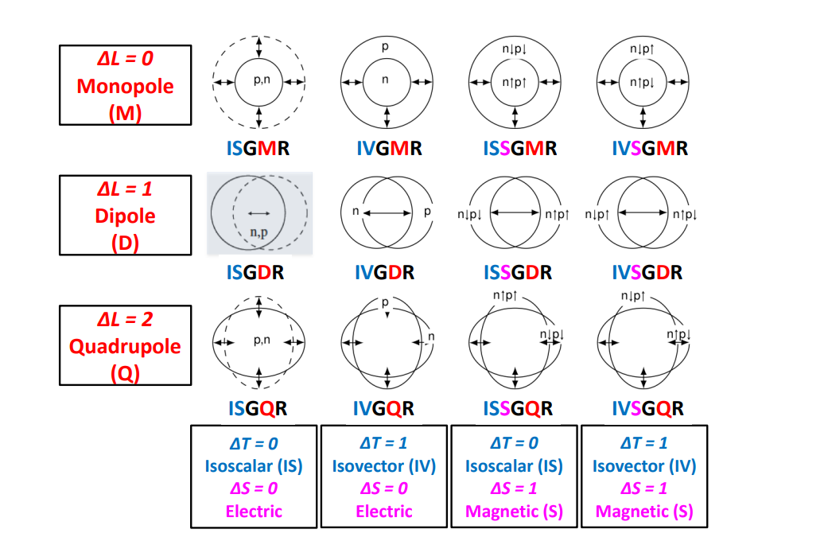
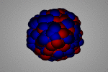
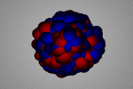
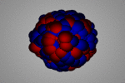
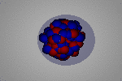
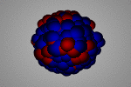
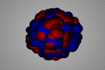
Nuclear excitations: Giant Resonances in nuclei
Isoscalar
Isovector
Monopole
GMR
Dipole
GDR
Self-consistent mean-field theories (HF(B), Q(RPA)) are standing as the prominent tools for calculations.
Quadrupole
GQR
Figure 2: Schematic representation of giant resonances.
Ref: Kernphysik Homepage( H.J.Wollersheim ) (gsi.de)
Notes:
WITHIN A CLASSICAL PICTURE: EM INTERACTING PROBES BASICALLY EXCITE PROTONS PROTONS DRAG NEUTRONS THANKS TO THE NUCLEAR STRONG INTERACTION.
WHEN NEUTRONS APPROACH TO MUCH TO PROTONS, THEY ARE PUSHED OUT.

Slide 7
Nuclear excitations: Giant Resonances in nuclei
Isoscalar
Isovector
Monopole
GMR
Dipole
GDR
Self-consistent mean-field theories (HF(B), Q(RPA)) are standing as the prominent tools for calculations.
Quadrupole
GQR
Finite temperature calculations need extra work!
Figure 2: Schematic representation of giant resonances.
Ref: Kernphysik Homepage( H.J.Wollersheim ) (gsi.de)
Notes:
WITHIN A CLASSICAL PICTURE: EM INTERACTING PROBES BASICALLY EXCITE PROTONS PROTONS DRAG NEUTRONS THANKS TO THE NUCLEAR STRONG INTERACTION.
WHEN NEUTRONS APPROACH TO MUCH TO PROTONS, THEY ARE PUSHED OUT.

Slide 8
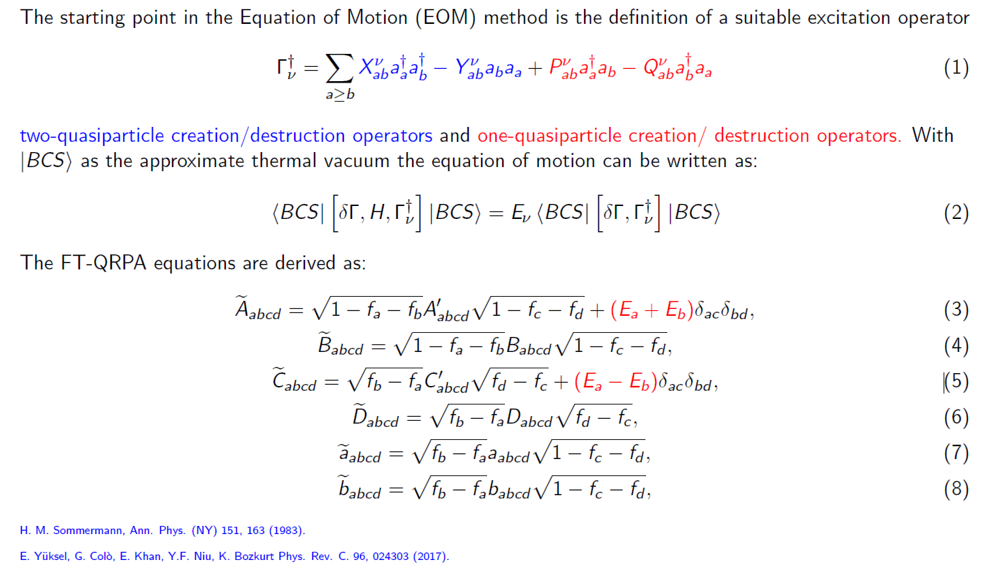
Finite temperature QRPA

Slide 9
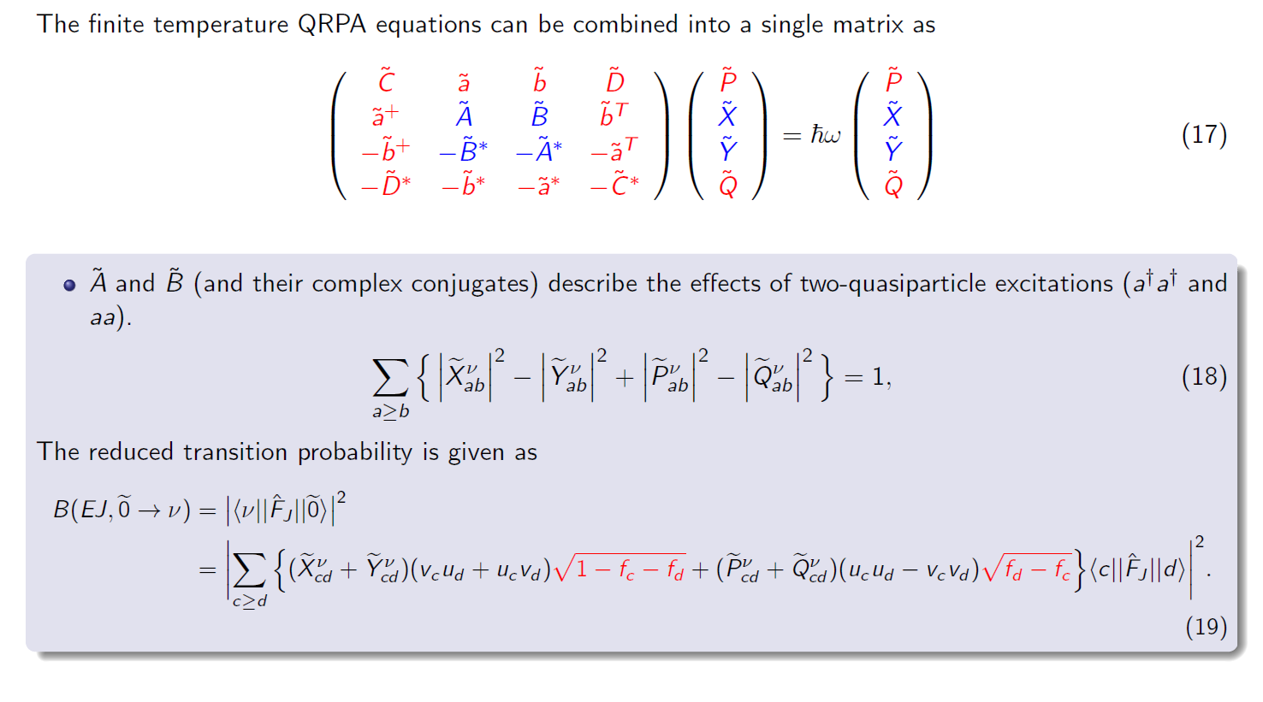
Finite temperature QRPA

Slide 10
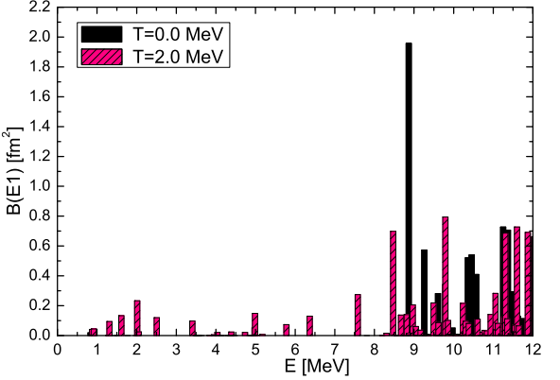
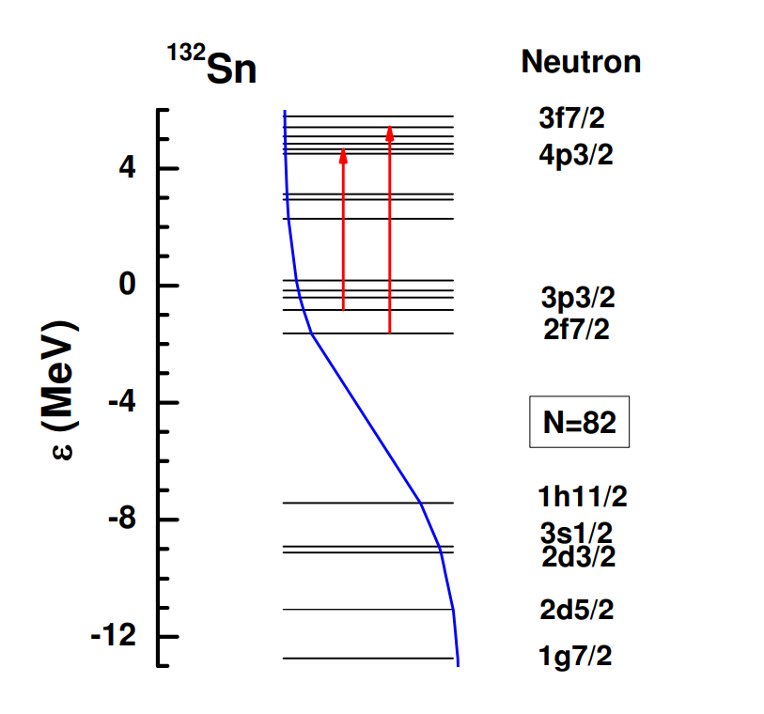
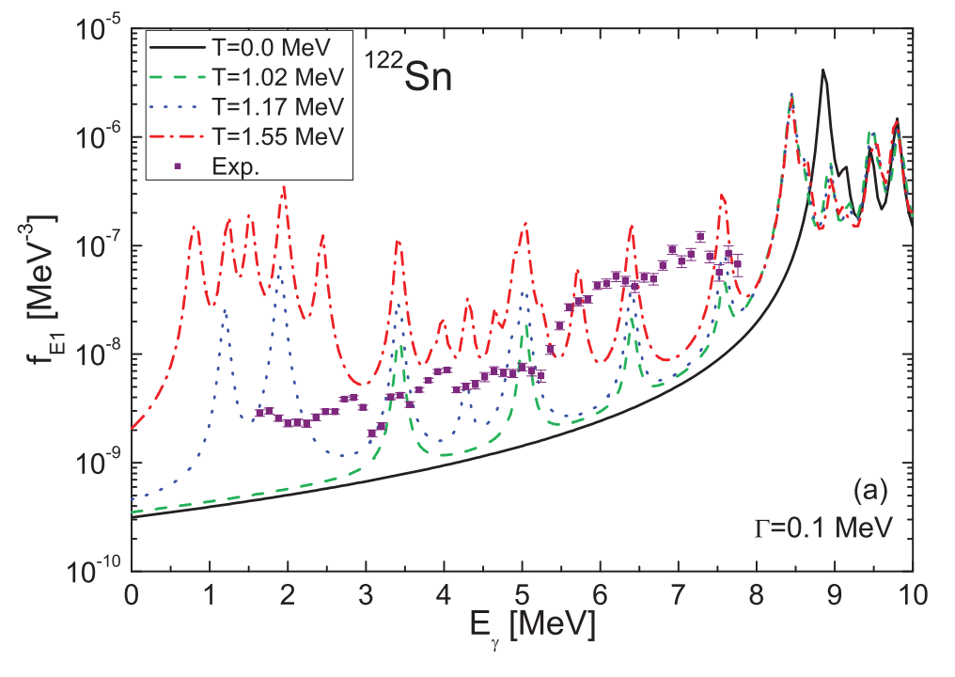
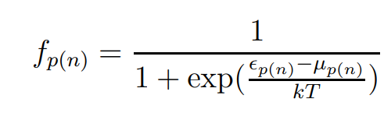
Isovector dipole excitations at finite temperatures
Thermal unblocking of states!
Figure 3: The reduced transition probabilities for the isovector dipole excitations.
E. Yüksel, G. Colò, E. Khan, Y. F. Niu, and K. Bozkurt, Phys. Rev. C 96, 024303, (2017).
The γ -ray strength function
Notes:
The isovector dipole strength is not sensitive to the temperature effects up to T=1.0 MeV.
Even at higher temperatures, the IVGDR peak is slightly modified, whereas collectivity is destroyed.
Temperature leads to the fragmentation and distribution of the pygmy dipole resonance strength towards lower energies due to the opening of the new excitation channels.
Continuum plays an important role!

Slide 11
Isoscalar quadrupole excitations at finite temperatures
Figure 4: The isoscalar quadrupole response in ¹²⁰Sn using the FT-Q(RPA) and SLy5 interaction at finite temperatures.
FT-RPA and FT-QRPA results are quite different both in the high-energy and low-energy regions.
This difference indicates the important role of pairing correlations in open-shell nuclei at finite temperatures.
E. Yüksel, G. Colò, E. Khan, Y. F. Niu, and K. Bozkurt, Phys. Rev. C 96, 024303, (2017).

Slide 12
Spin-isospin response at finite temperature

Slide 13
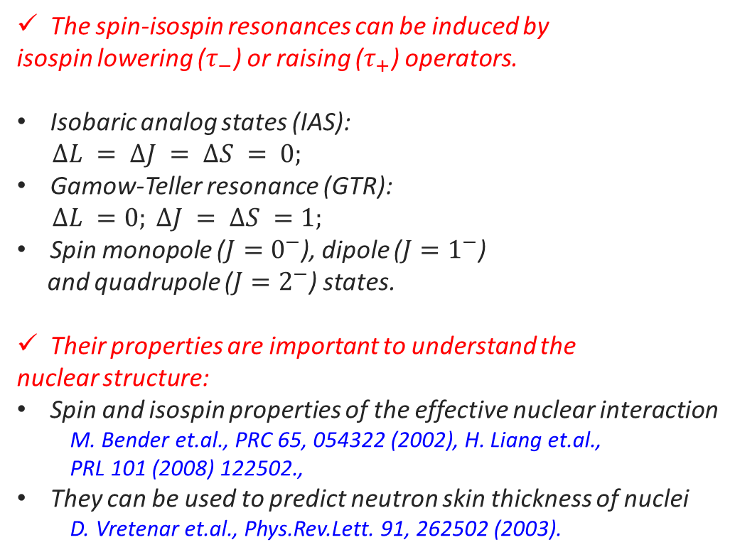
Spin-isospin excitations
The spin-isospin resonances can be induced by
isospin lowering ($τ_{−}$) or raising ($τ_{+}$) operators.
Isobaric analog states (IAS):
$$∆L = ∆J = ∆S = 0;$$
Gamow-Teller resonance (GTR):
$$∆L =0; ∆J = ∆S =1;$$
Spin monopole ($J=0^{−}$), dipole ($J=1^{−}$)
and quadrupole ($J=2^{−}$) states.
Their properties are important to understand the
nuclear structure:
Spin and isospin properties of the effective nuclear interaction
M. Bender et.al., PRC 65, 054322 (2002), H. Liang et.al.,
PRL 101 (2008) 122502.,
They can be used to predict neutron skin thickness of nuclei
D. Vretenar et.al., Phys.Rev.Lett. 91, 262502 (2003).
Figure 5: (a) Fermi (b) Gamow-Teller transitions.
F. Osterfeld, Rev. Mod. Phys., 64, 491557 (1992).

Slide 14
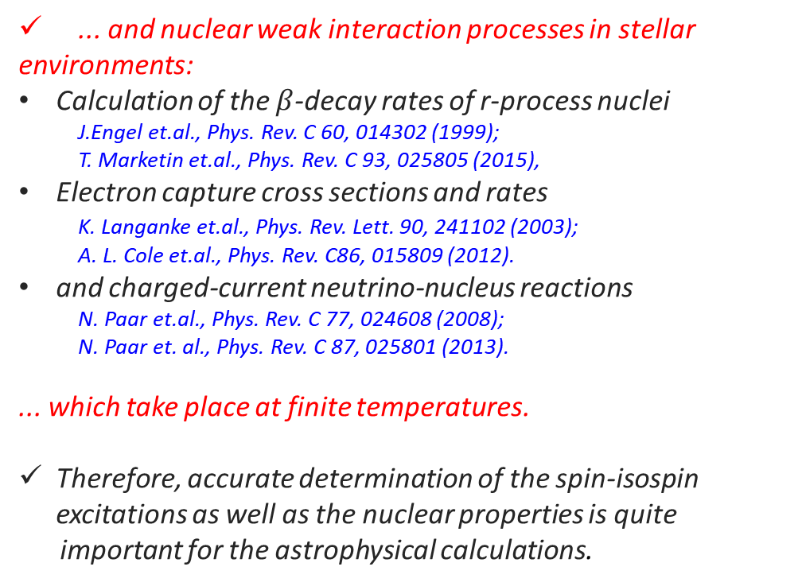
Spin-isospin excitations
... and nuclear weak interaction processes in stellar
environments:
Calculation of the $β$-decay rates of r-process nuclei
J.Engel et.al., Phys. Rev. C 60, 014302 (1999);
T. Marketin et.al., Phys. Rev. C 93, 025805 (2015),
Electron capture cross sections and rates
K. Langanke et.al., Phys. Rev. Lett. 90, 241102 (2003);
A. L. Cole et.al., Phys. Rev. C86, 015809 (2012).
and charged-current neutrino-nucleus reactions
N. Paar et.al., Phys. Rev. C 77, 024608 (2008);
N. Paar et. al., Phys. Rev. C 87, 025801 (2013).
... which take place at finite temperatures.
Therefore, accurate determination of the spin-isospin excitations as well as the nuclear properties is quite
important for the astrophysical calculations.
Figure 6: Beta decay half lifes.
T. Marketin, et.al., PRC 93, 025805 (2016).
Figure 7: Electron capture cross sections are calculated using FT-PNRPA.
Y.F. Niu et.al., PRC 83, 045807 (2011).

Slide 15
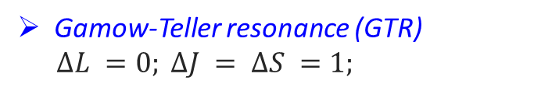
Gamow-Teller response at finite temperature
Gamow-Teller resonance (GTR)
$$∆L =0; ∆J = ∆S =1;$$
Figure Credit: F. Osterfeld, Rev. Mod. Phys., 64, 491557 (1992).
Accurate determination of the spin-isospin excitations is quite important for the astrophysical calculations!
E. Yüksel, N. Paar, G. Colò, E. Khan, and Y. F. Niu, Phys. Rev. C 101, 044305, (2020).
Figure 8: Gamow-Teller response at finite temperatures using relativistic and nonrelativistic functionals.
Notes:
GTR is associated with spin tranfer of one unit, isospin transfer of one unit, and no angular momentum transfer.
(p,n) or (n,p ) experiments
The Gamow-Teller (GT) giant resonance is a key-state for nuclear spin-physics. It is not only just one of the
typical nuclear collective states, but also related deeply to many fundamental problems of the spin-degrees of
freedom in nuclei.

Slide 16
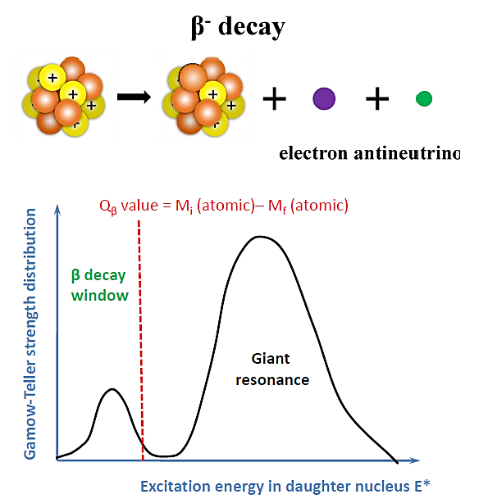
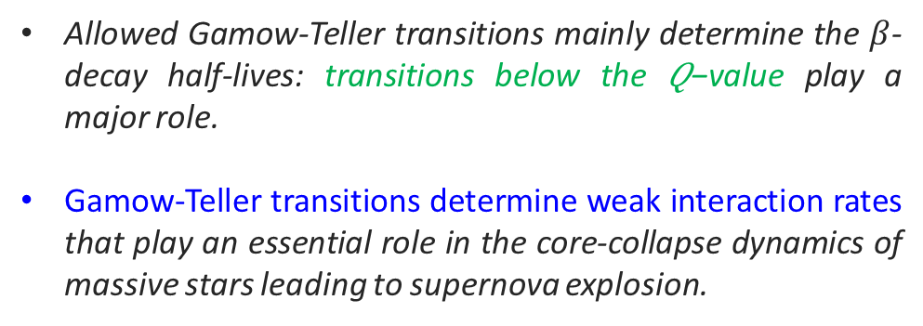

Beta-decay half-lives at finite temperature
${{}_{Z}^{A}X}_{N} →$ ${{}_{ Z+1}^{A}X}_{N−1}+ e^{−}+\overline{ν_{e}}$
Allowed Gamow-Teller transitions mainly determine the $β$-decay half-lives: transitions below the 𝑄−value play a major role.
Gamow-Teller transitions determine weak interaction rates that play an essential role in the core-collapse dynamics of massive stars leading to supernova explosion.
Do nuclear decay rates depend on temperature?
Evolution of beta-decay half-lives in stellar environments?
Notes:
Beta decay occurs in a nucleus with too many protons or too many neutrons,
And one of the protons or neutrons is transformed into the other.
In beta minus decay, a neutron decays into a proton, an electron, and an antineutrino: n Æ p + e - +.
In beta plus decay, a proton decays into a neutron, a positron, and a neutrino: p Æ n + e+ +n. Both reactions occur because in different regions of the Chart of the Nuclides.

Slide 17
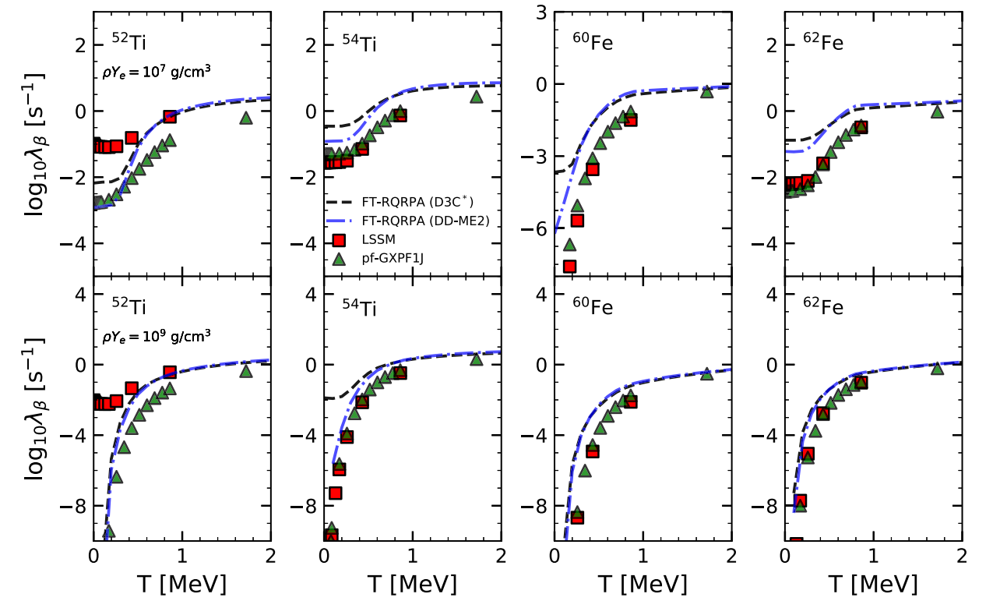
Beta-decay rates at finite temperature
Only Gamow-Teller excitations are included for comparison with shell model results.
Two different relativistic functionals: DD-ME2 and D3C*.
β-decay rates significantly decrease with increasing density.
Increasing rates with increasing temperature.
A. Ravlić, E. Yüksel, Y. F. Niu, and N. Paar, Phys. Rev. C 104, 054318, 2021
Figure 9: Beta decay rates at finite temperatures. Shell model results are also provided for comparison.

Slide 18
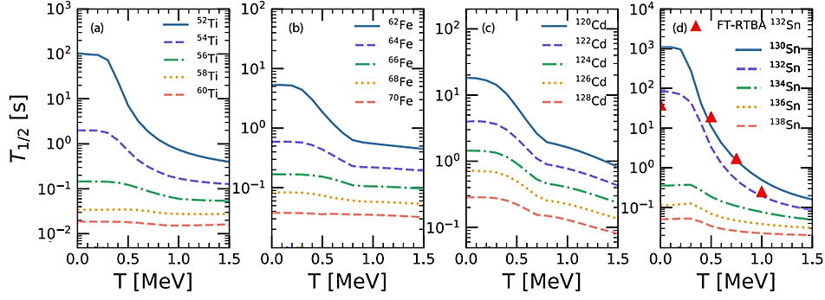
Beta-decay half-lives at finite temperature
Figure 10: Total β-decay half-lives T_{1/2} for Ti, Fe, Cd, and Sn isotopes as a function of temperature.
Temperature has a considerable impact on nuclei with long β-decay half-lives at zero temperature, whereas its effect is smaller in short-lived nuclei.
A. Ravlić, E. Yüksel, Y. F. Niu, and N. Paar, Phys. Rev. C 104, 054318, 2021

Slide 19
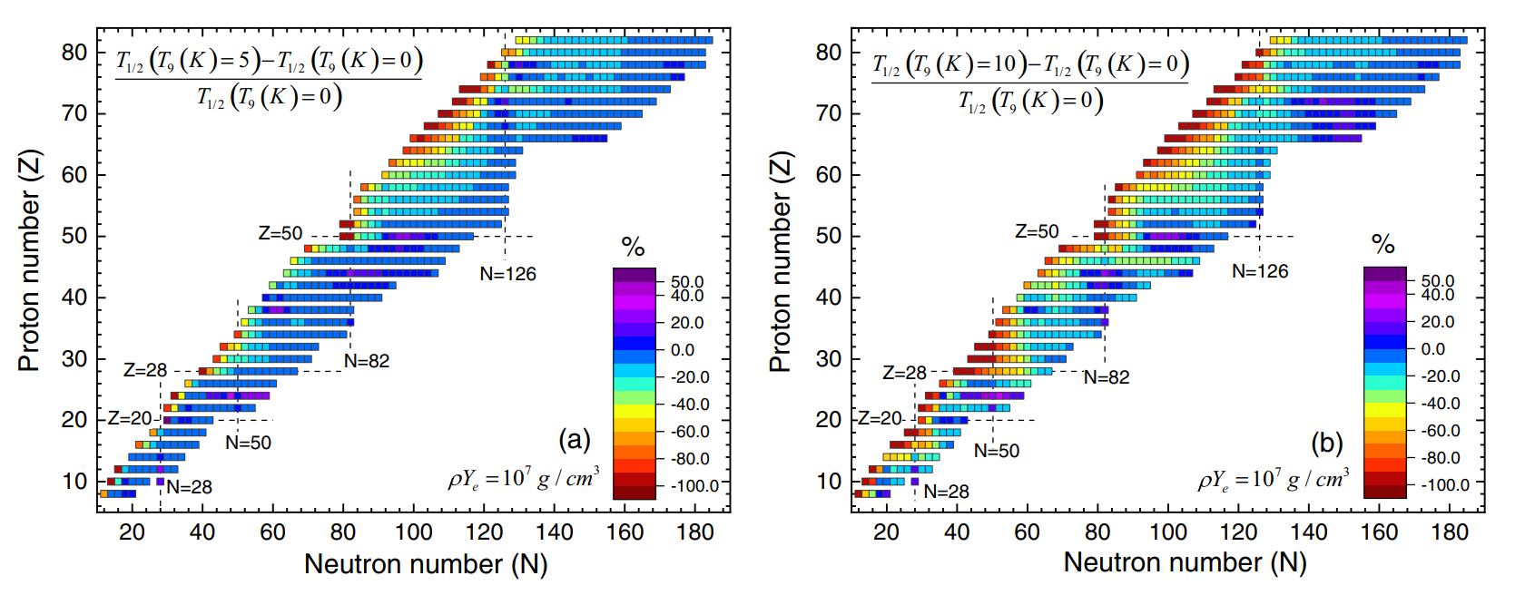
Large-scale calculations at finite temperature
Figure 11: The percentage change of the β-decay half-lives T_{1/2} at finite temperatures T9(K) = 5, T9(K) = 10 with respect to T9(K) = 0.01
A. Ravlić, E. Yüksel, Y. F. Niu, and N. Paar, Phys. Rev. C 104, 054318, 2021

Slide 20
THANK YOU
Any questions?
COLLABORATORS
Nils Paar - University of Zagreb, Croatia.
Ante Ravlic - University of Zagreb, Croatia.
Tamara Niksic - University of Zagreb, Croatia.
Yifei Niu - Lanzhou University, China.
Gianluca Colo - Universita degli Studi di Milano, Italy.
Elias Khan - IJCLab, Universit´e Paris-Saclay, France.
Jean-Paul Ebran- CEA,DAM, DIF, Arpajon, France.
Florian Mercier, IJCLab, Universit´e Paris-Saclay, France.
Kutsal Bozkurt, Yildiz Technical University, Istanbul, Turkey.

