Slide 1
Update on Early Career Researcher Forum
J. Henderson for the ECR Committee

Slide 2
ECR Forum
Overview
Goal of the ECR forum is to provide opportunities to early career researchers that aren’t covered elsewhere (e.g. in the summer school)
We want to develop a sense of community among ECRs that might have been lost during the 2020/21 pandemic years
Give ECRs the necessary information and context to make improved applications and proposals further down the academic path and advice for those who wish to leave the field
Current strategy: Annual events, alternating between career development and scientific workshops
Funding: IoP Group funds and JH’s UKRI FLF – for future events will look into additional sources (e.g. STFC)
Inaugural event in 2021 (at the IoP) was successful, but attendance wasn’t high (COVID, COP21, experimental clashes).

Slide 3
ECR Workshop 2022 – Career development
At University of York
Hosted at Kings Manor Ron Cooke Hub at the University of York with a lot of local support.
Focus on CV and proposal writing, proposal presentations and often overlooked aspects of a successful proposal: commercialisation and outreach.
Two half days (to minimise travel expenses) with ~35 attendees in person + ~5 online.
Contribution from UKRI to discuss R4RI narrative CVs.
Special thanks to:
York: Taryn Bell, Andrew Hirst, James Cubiss, Andrew Pratt, Alison Laird, Christian Diget, Adam Featherstone
Surrey: Dan Doherty
UKRI: Peter Henly

Slide 4
The schedule
Thursday:
12:30 – Arrival and Coffee
13:00 – Welcome (J. Henderson)
13:15 – R4RI – Narrative CVs for UKRI (P. Henly, UKRI)
13:45 – CVs for academia (T. Bell, York Fellowships)
14:15 – CVs for industry (A. Hirst, White Rose Industrial Physics Academy)
14:45 – Q&A and discussion
15:00 – Coffee break
15:30 – Proposal writing (T. Bell, York Fellowships)
15:50 – Fellowship proposals, a recent example (J. Cubiss)
16:00 – Group exercise, proposal discussion
16:30 – Writing a lay-summary
17:00 – End day one
17:30 – Pizza and refreshments in the Physics Department kitchen
Friday:
08:30 – Coffee
09:00 – Commercialisation and Impact (A. Featherstone, Commercialisation Fellow)
09:30 – ECR Public Engagement
(J. Henderson for P. Papadakis)
09:45 – Outreach (C. Diget)
10:15 – Q&A and discussion
10:30 – Coffee break
11:00 – Elevator pitch session and Panel Discussion (A. Laird [York], D. Doherty [Surrey], A. Pratt [York])
13:00 – End and discussions

Slide 5
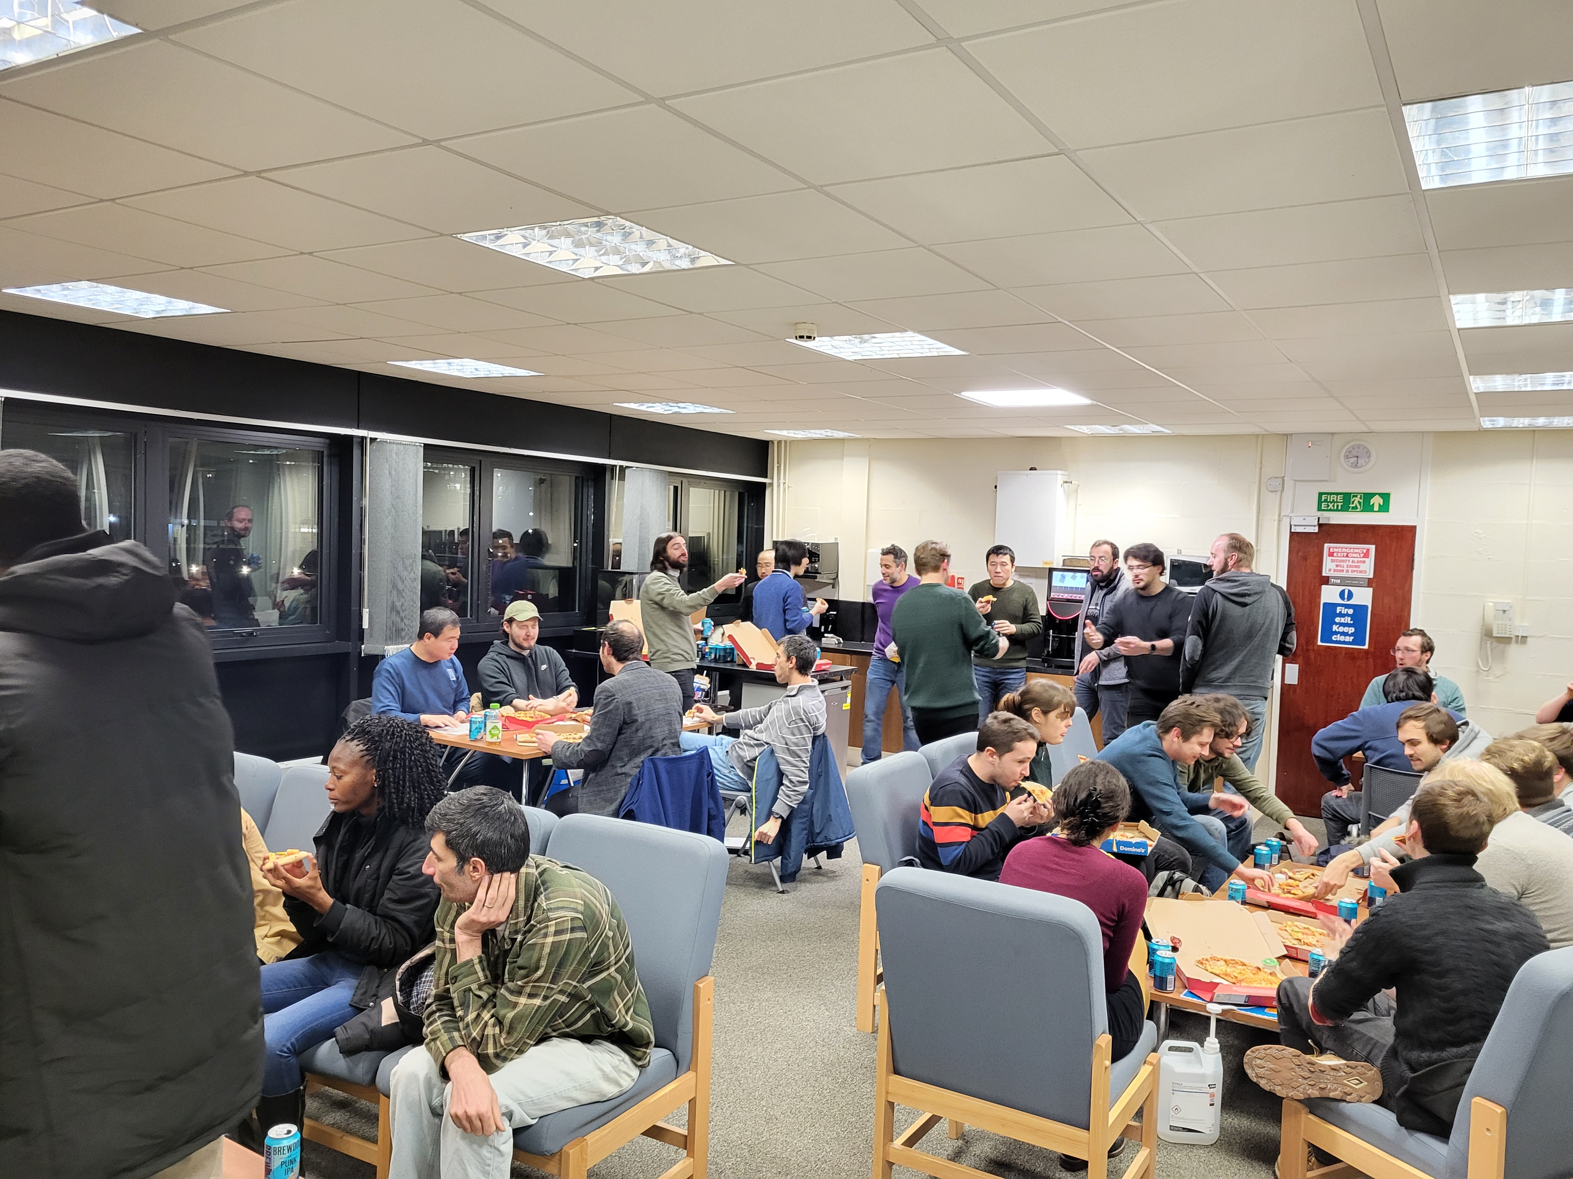
The schedule
Thursday:
12:30 – Arrival and Coffee
13:00 – Welcome (J. Henderson)
13:15 – R4RI – Narrative CVs for UKRI (P. Henly, UKRI)
13:45 – CVs for academia (T. Bell, York Fellowships)
14:15 – CVs for industry (A. Hirst, White Rose Industrial Physics Academy)
14:45 – Q&A and discussion
15:00 – Coffee break
15:30 – Proposal writing (T. Bell, York Fellowships)
15:50 – Fellowship proposals, a recent example (J. Cubiss)
16:00 – Group exercise, proposal discussion
16:30 – Writing a lay-summary
17:00 – End day one
17:30 – Pizza and refreshments in the Physics Department kitchen
Friday:
08:30 – Coffee
09:00 – Commercialisation and Impact (A. Featherstone, Commercialisation Fellow)
09:30 – ECR Public Engagement
(J. Henderson for P. Papadakis)
09:45 – Outreach (C. Diget)
10:15 – Q&A and discussion
10:30 – Coffee break
11:00 – Elevator pitch session and Panel Discussion (A. Laird [York], D. Doherty [Surrey], A. Pratt [York])
13:00 – End and discussions

Slide 6
Feedback
Solicited feedback via a Google Form. To date 9 responses, all from in-person attendees, all positive. Scores out of 5:
9/9 were satisfied with the event generally (7/9 gave 5/5)
9/9 found the event helpful and relevant for career development (6/9 gave 5/5)
9/9 rated the location positively (3/9 gave 5/5, note the location changed at short notice)
9/9 would recommend the event
7/9 rated the CV session positively (6/9 gave 5/5, 2/9 gave 3/5)
8/9 rated the proposal writing positively (6/9 gave 5/5, 1/9 gave 3/5)
8/9 rated the commercialisation and outreach session positively (6/9 gave 5/5, 1/9 gave 3/5)
9/9 rated the elevator pitch session positively (5/9 gave 5/5)

Slide 7
Future events
In 2023 we would like to host a science focused event at the IoP (convenience and budget) – ideally we will get ECRs to help organise
We will investigate additional avenues of funding to allow for either support for travel expenses or to allow for e.g. invited speakers to come from abroad – need to be careful not to clash with IoP NP conference
In 2024 we will look to organise a career development workshop again. Our experience in York was that the local support was invaluable, so will likely aim to host at a university.
Ongoing national journal club organised by Jacob Heery and Laetitia Canete (both Surrey). Goal is to build a community and give the opportunity for smaller groups. Please encourage your ECRs to attend.
Also open to any suggestions – get in touch!

Slide 8
ECR forum committee
A fluid group, mainly IoP group members.
Chair: Jack Henderson
Members: Waris Ali, Liam Gaffney, Rachel Montgomery, Philippos Papadakis, Stefanos Paschalis, David Sharp, Nick Zachariou
Anyone interested in helping out, let me know

