Slide 1
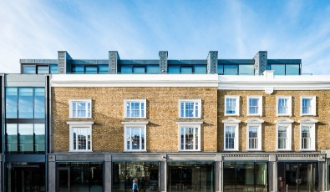
Overview
IOP committee
Membership
Events
Funded in 2022
To come in 2023
Conference services
Early career prize
Nuclear Physics Community Meeting 2023
D. Sharp – Nuclear Physics Group Chair

Slide 2
IOP Nuclear Physics Group Committee
Committee is diverse with members from academia and industry both in the UK and internationally.
Elections took place last year leading to new member
Represented UK institutions
AWE, Culham, Daresbury, Glasgow, Liverpool, NNL, Manchester, Surrey, York.
Topical areas represented
Hadron Structure, Nuclear Structure, Nuclear Data, Nuclear Fusion, Nuclear Industry, Nuclear Technology, Detector Development.
Elections 2023
Chair, Secretary, 3 ordinary members.
Chair | Dr David Sharp
Secretary | Dr James Benstead
Treasurer | Dr Stefanos Paschalis
Ordinary Member | Mrs Latha Chappa
Ordinary Member | Dr Liam Gaffney
Ordinary Member | Dr Jack Henderson
Ordinary Member | Dr Rachel Montgomery
Ordinary Member | Mr Lee Packer
Ordinary Member | Dr Philippos Papadakis
Ordinary Member | Mr Malik Salaam
Early Career Scientist | Miss Bethany Slingsby
Early Career Scientist | Dr Waris Ali

Slide 3
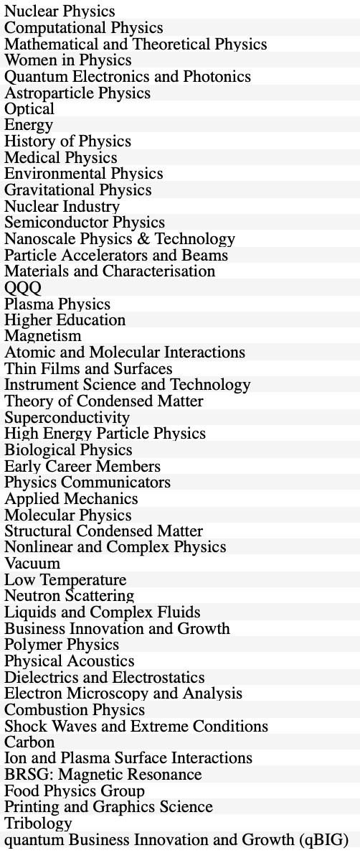
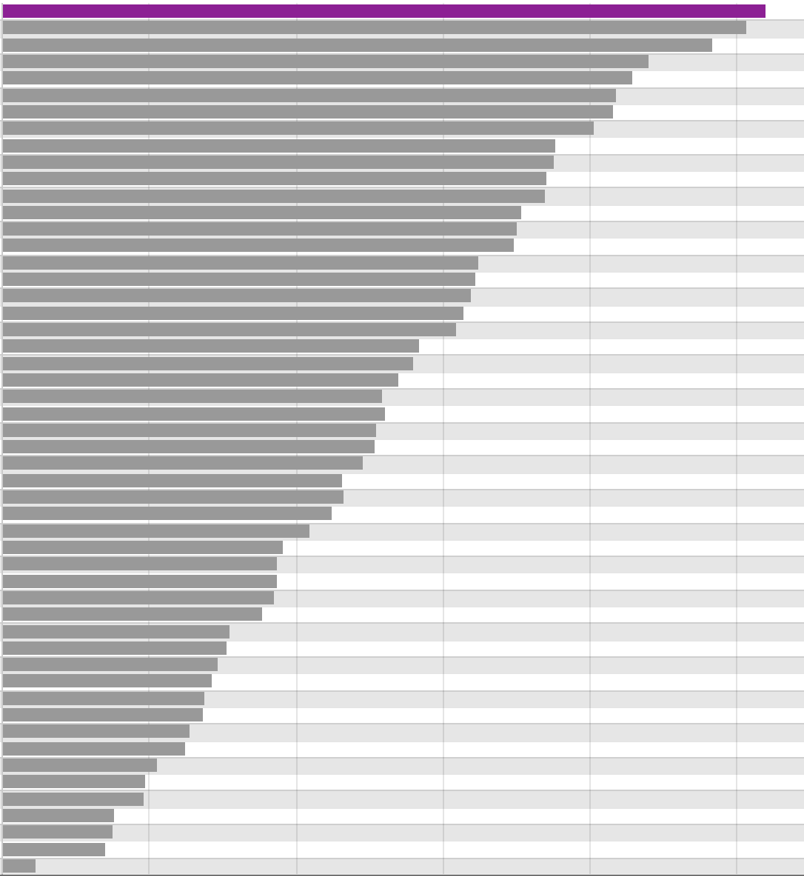
Membership
Nuclear Physics Group is the largest IOP special interest group – 2600 members.
Largest for female members – F=26%
10th youngest average age 50% < 25 years old (F=33%)

Slide 4
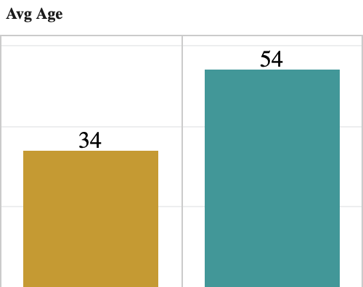
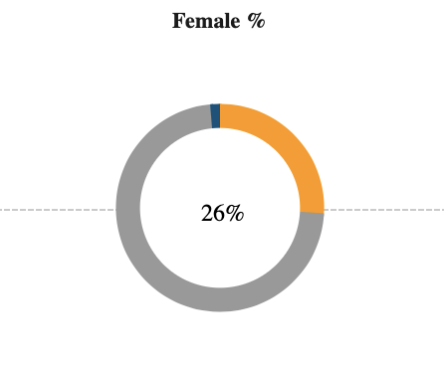
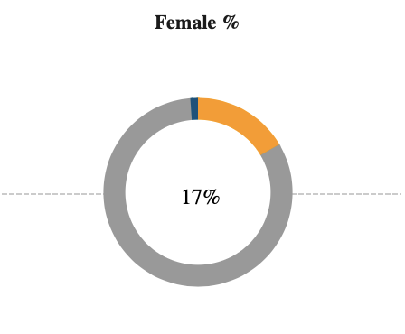
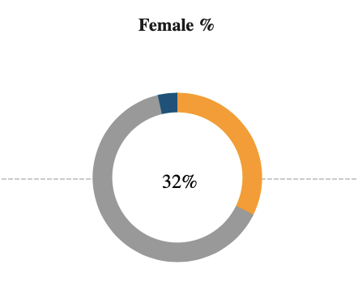
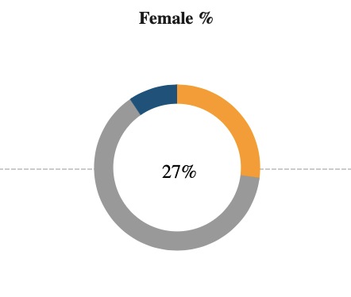
Membership
Nuclear Physics Group is the largest IOP special interest group – 2600 members
(12% IOP membership).
Largest for female members – F=26%
10th youngest average age 44% < 25 years old (F=32%)
All members
NPG
IOP
NPG
IOP
<25 years
36% of IOP members < 25 years are members of NPG

Slide 5
Funding for events
Half-day event £500 (£750)
One-day event* £1000 (£1500)
Multi-day conference £1000 (£1500) for the first day, plus £500 (£750) for each additional day
Contact david.sharp@manchester.ac.uk and Stefanos Paschalis stefanos.paschalis@york.ac.uk
2022 sponsored events
IOP NPG conference – Surrey
Nuclear Physics Summer School – Sheffield (D. Doherty talk)
International Symposium on Multiparticle Dynamics– Pitlochry Joint with HEPP and APP
n_ToF collaboration meeting – Edinburgh
Early Career Researcher Forum – York (J. Henderson)
2023 funding £9k
IOP NPG conference (3) – York
Charge-plunger techniques workshop (1) – UWS
Quantum effects near threshold (3) – Edinburgh
Early Career Researcher Forum – TBC
£3k currently unallocated but 2 requests already.
Any requests for 2023 events should be sent to committee by end January for consideration.

Slide 6
IOP NGP Conference 2023

Slide 7
IOP Nuclear Physics Group Members Colloquia
Coordinated by IOP NPG – Liam Gaffney
Organised by a different research group each month.
Invited speakers – plenary plus ECR talks.
Links to the recorded events can be found on the group webpages
https://www.iop.org/physics-community/special-interest-groups/nuclear-physics-group#gref

Slide 8
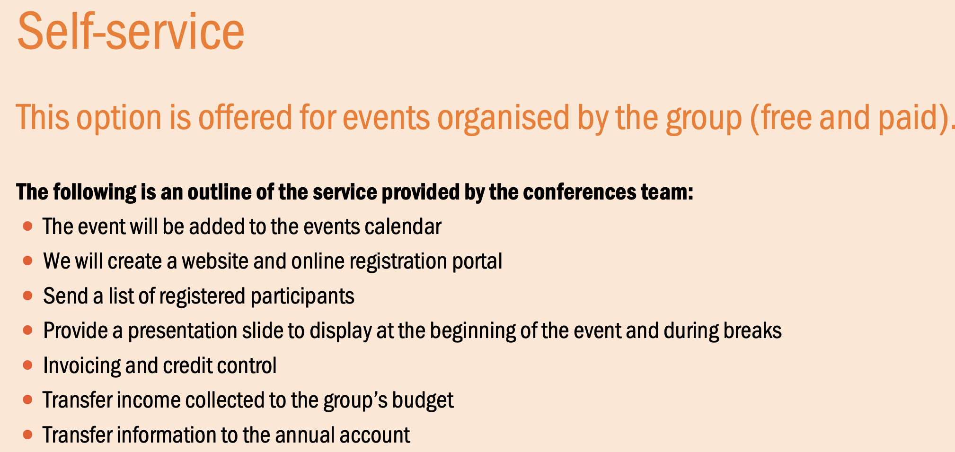
IOP events services
Recommended for half/one-day meetings, small workshops etc

Slide 9
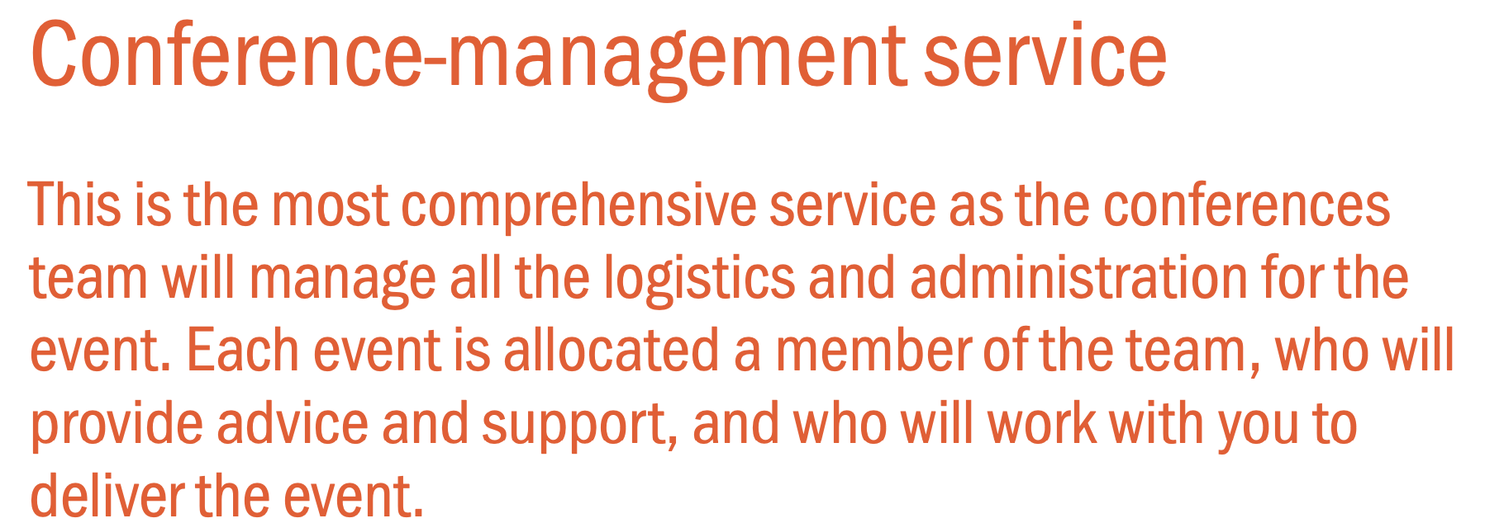
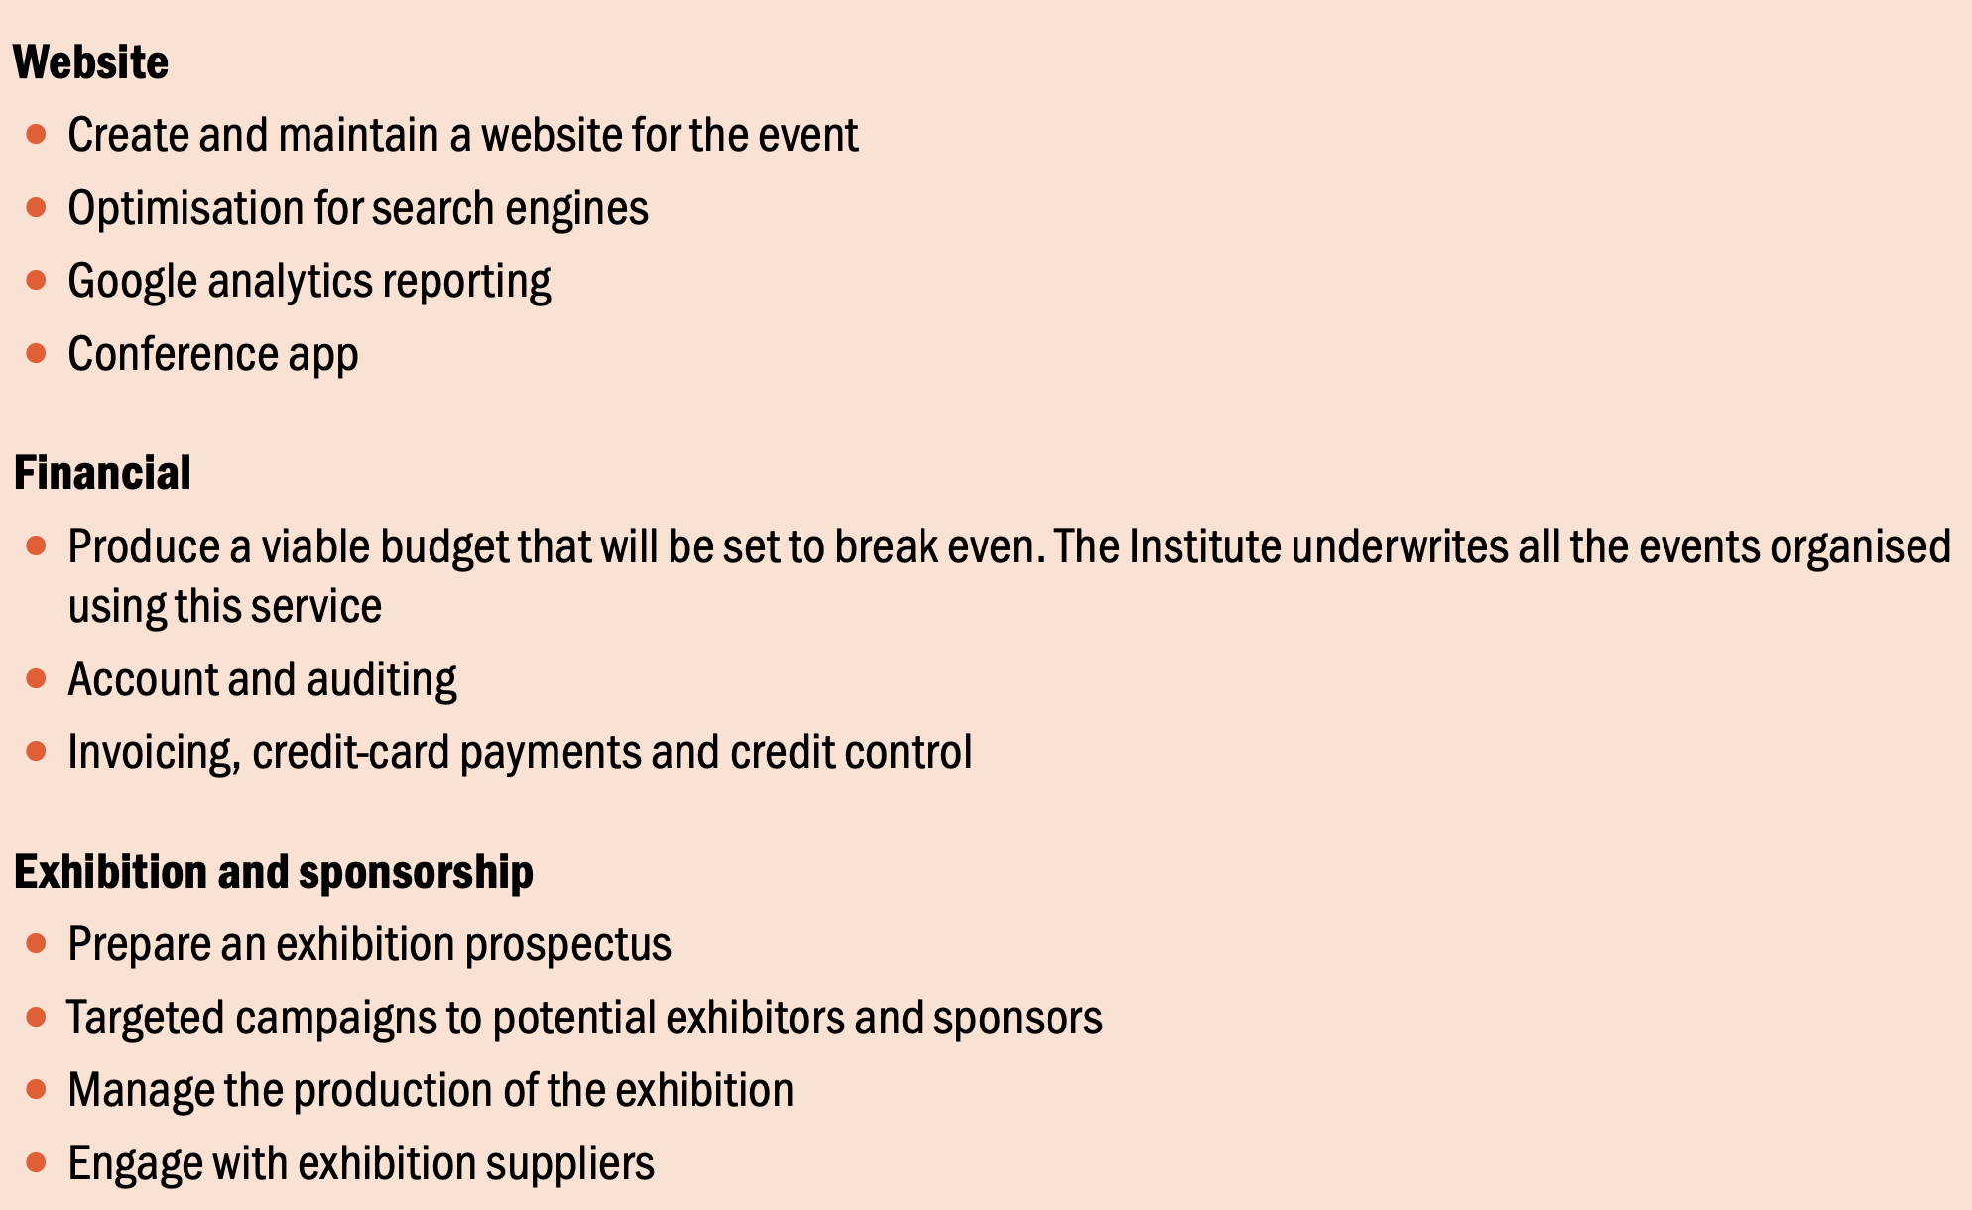
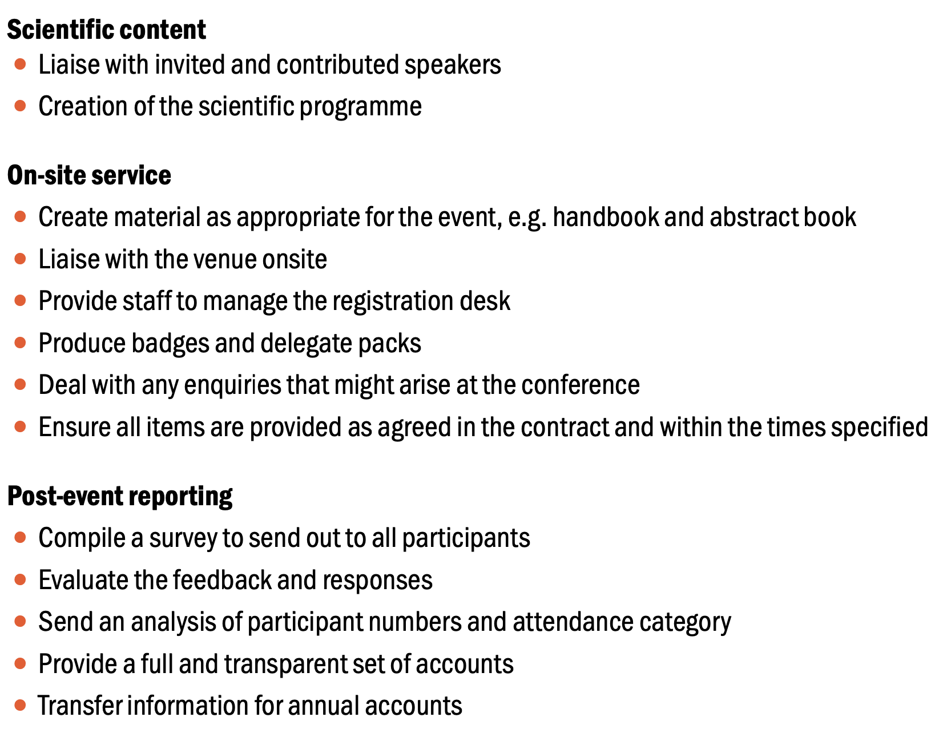
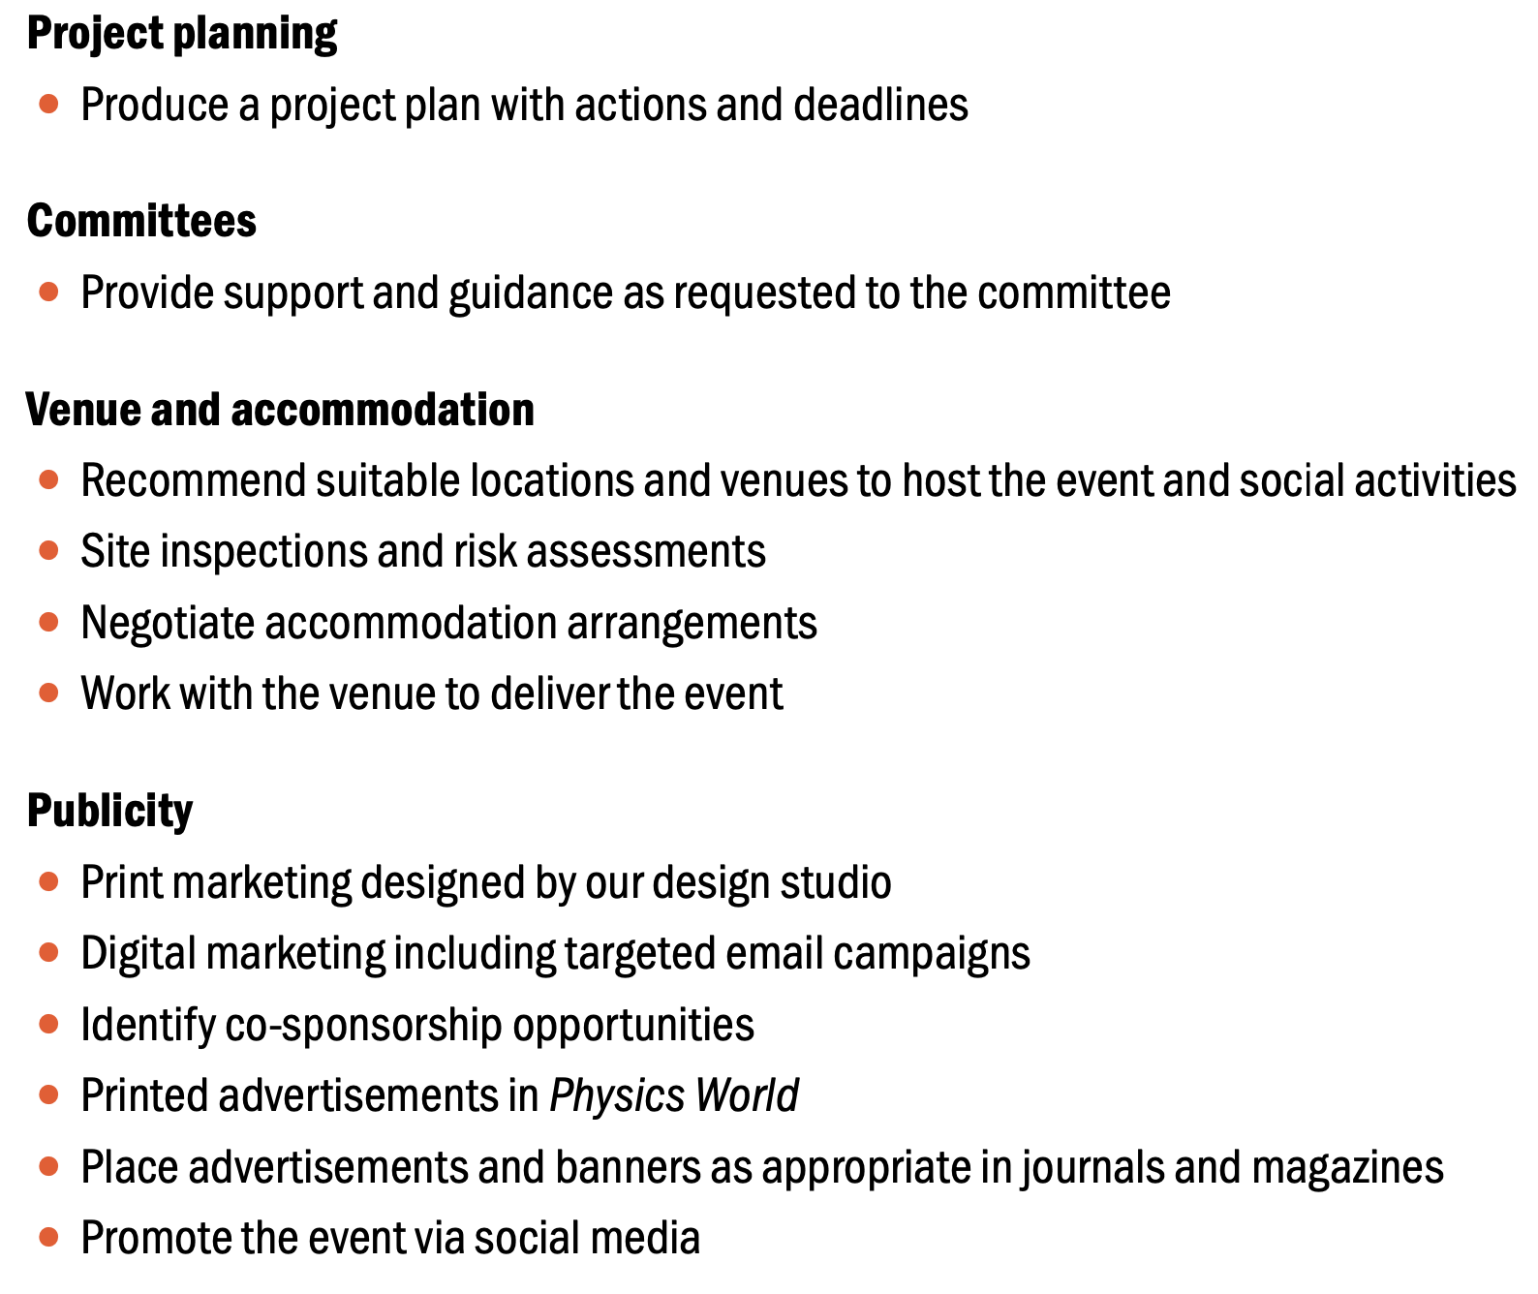
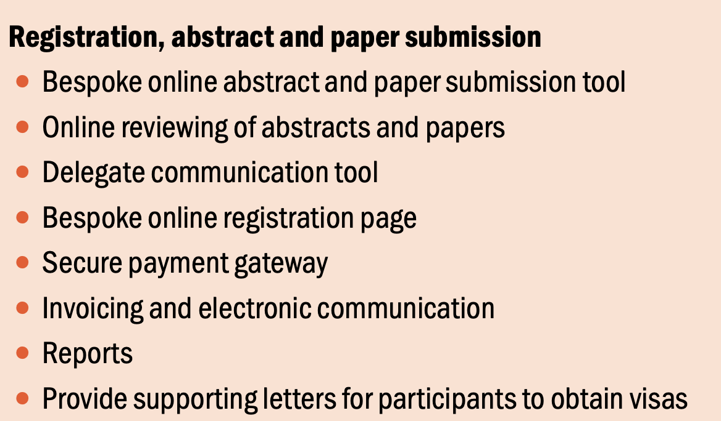
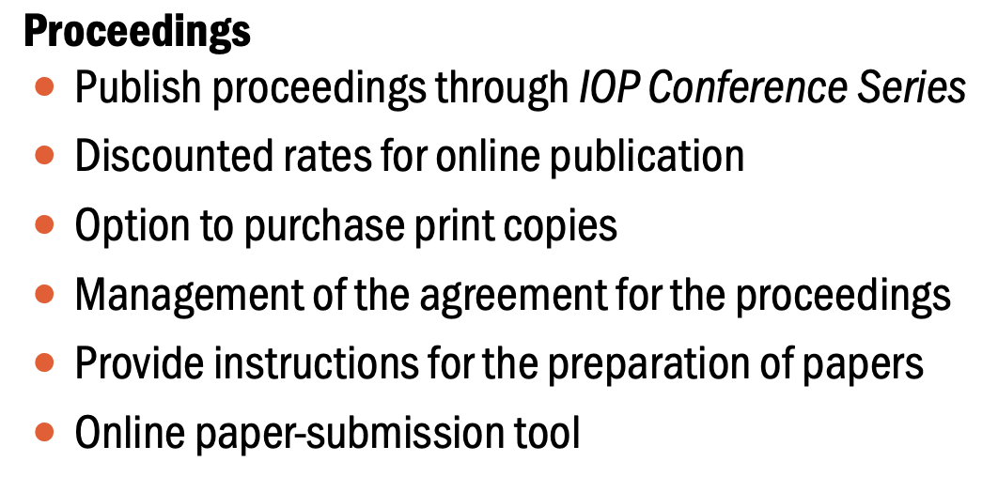
IOP events services

Slide 10
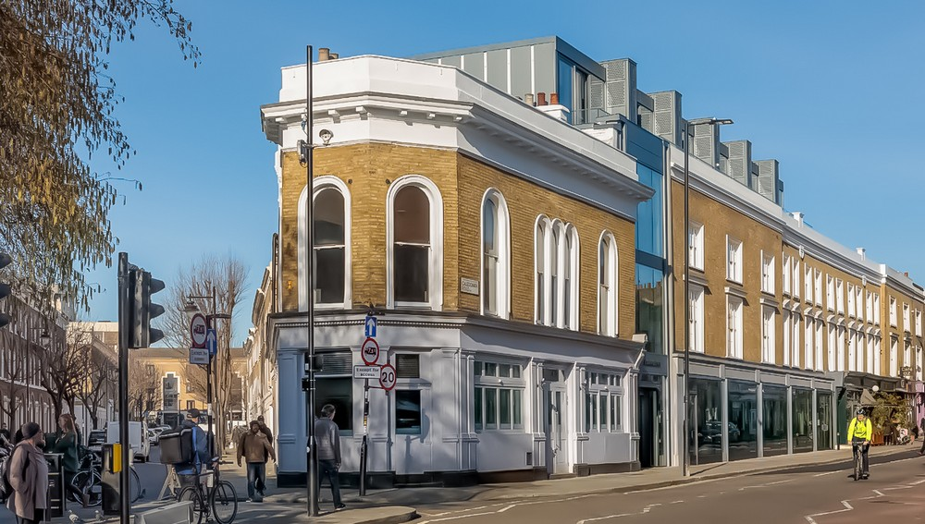
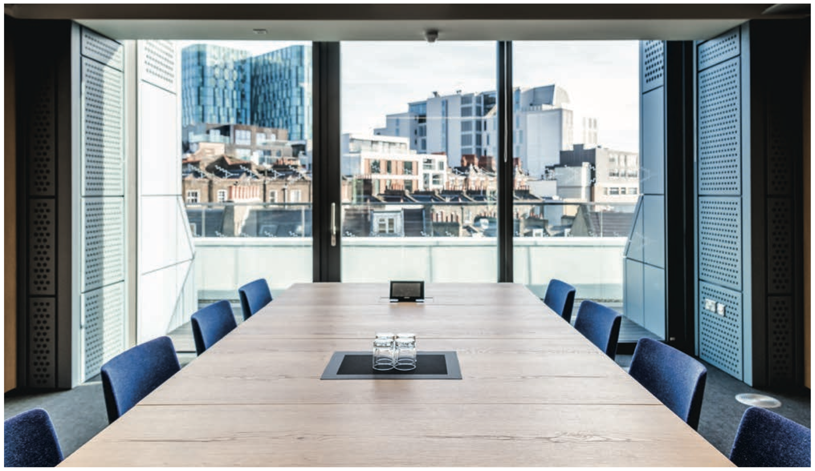
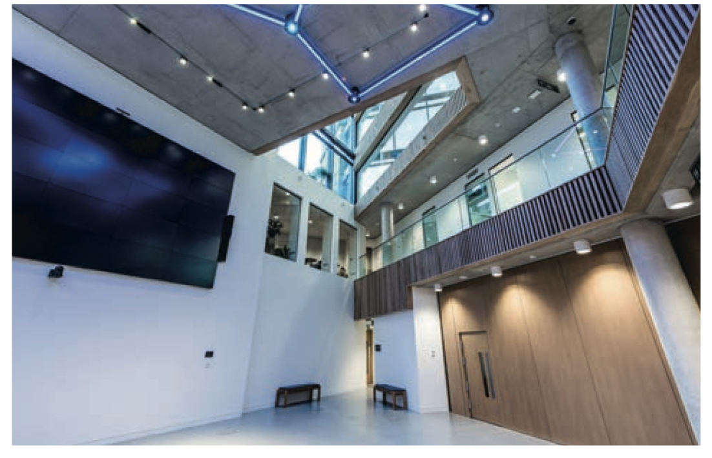
IOP events services
IOP Building
Members lounge – computer access, power sockets, tea and coffee.
3 meeting rooms and 4 seminar rooms.
FREE TO MEMBERS – coffee and tea complimentary at events
To book a room roombookings@iop.org
For events use conference team conferences@iop.org

Slide 11
Early career researcher prize
Deadline 16th January (supporting statements 31st January)
Open to researchers in experimental or theoretical nuclear physics in fundamental or applied areas.
<6 years post doctoral experience or 10 years since start of first employment.
Nomination form and supporting statement from referee.
https://www.iop.org/physics-community/special-interest-groups/nuclear-physics-group/early-career-researcher-prize

