Slide 1
Report from the EPSRC Nuclear Community
Malcolm Joyce
m.joyce@Lancaster.ac.uk

Slide 2
Overview
Portfolio
NNUF
CDT activities
Some examples of managed programmes
Fusion

Slide 3
Nuclear fission portfolio summary
Scope:
waste management and decommissioning
fuel recycling and reprocessing
efficient and safer fuels
reactor plant life extension
advanced nuclear technologies
new nuclear builds
existing operations
regulation
public acceptability
geological waste disposal.
Current status:
84 grants, ~£144M which includes:
NNUF (~£100M)
CDTs
Managed programmes, TRANSCEND, RAIN etc.
Networks
Considers priorities identified by:
NIRAB
BEIS
the Energy Innovation Board,
and challenges faced by NDA and NNL
Appeals to related themes:
Energy
Manufacturing the future

Slide 4
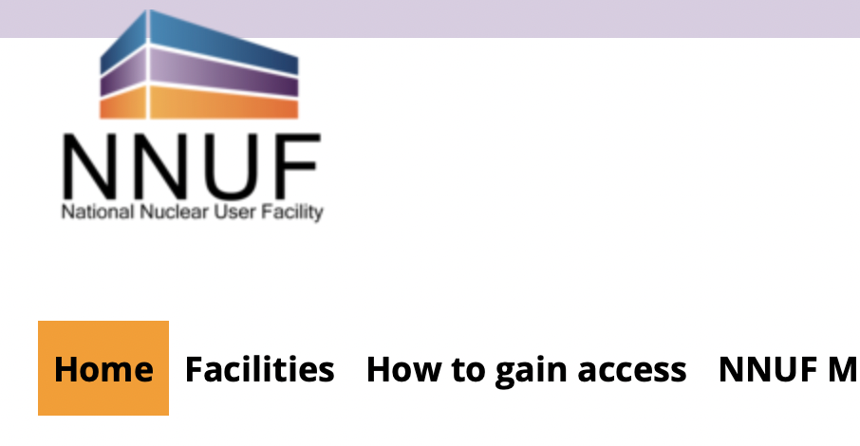
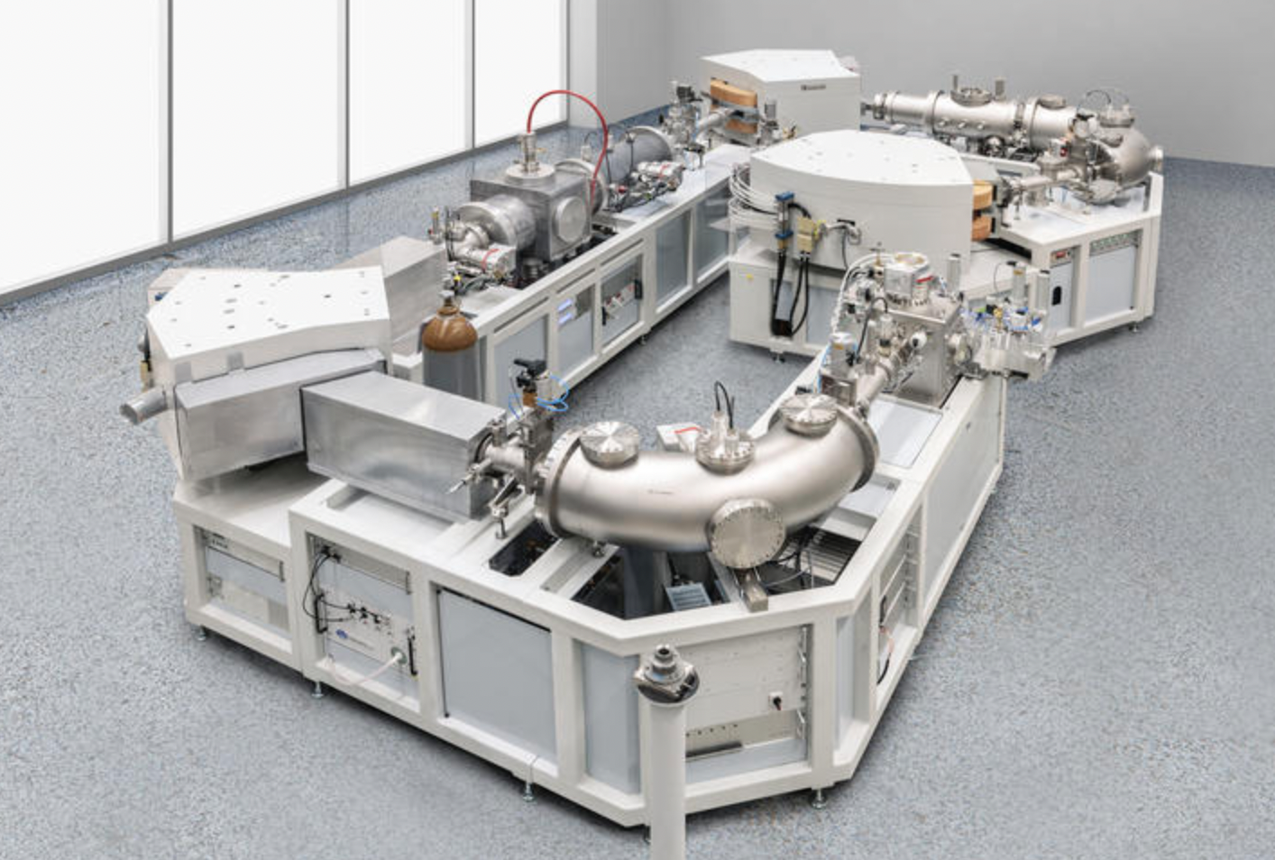
National Nuclear User Facility (NNUF)
A £100M investment in nuclear research facilities for radioactive materials, including managed access fund
Example facility: Accelerator Mass Spectrometer for the trace actinide assay
Access fund process:
Liaise with facility host (see website)
Complete proforma for access funds
Application must support UK program
Do the work!

Slide 5
Centres for Doctoral Training
GREEN:
Lancaster, Leeds, Liverpool, Manchester, Sheffield: Scott Heath (Manchester)
Nuclear Energy Futures:
Imperial, Cambridge, Bristol, OU and Bangor: Mark Wenman (Imperial)
Fusion:
Durham, Liverpool, Manchester, Oxford, York: Howard Wilson (York)
CDT call for outlines closing early February 2023, general call and a separate call for CDTs in artificial intelligence

Slide 6
Civil nuclear research with Japan Phase-10
UK-Japan on-line workshop 23/24 January 2023
To profile what the Phase-10 call will entail
Identify priorities
Match-make…please email me at m.joyce@lancaster.ac.uk…etc.
If like Phase-9, then:
Total fund £1M, award range across £250k-£500k
Closing date: June 2023
Focus on challenges relevant to Fukushima and Sellafield:
radioactive waste, robotics, fuel debris materials, decommissioning.
There is an associated network: ‘JUNO’

Slide 7
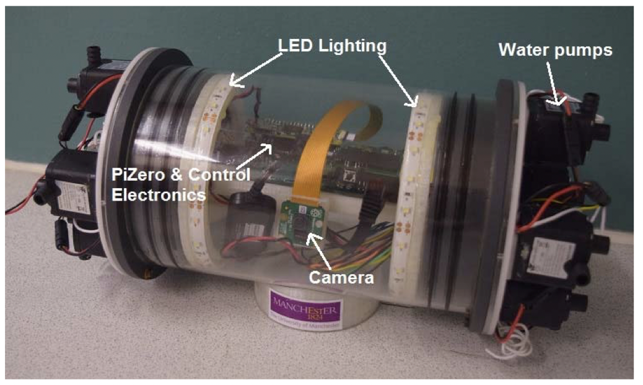
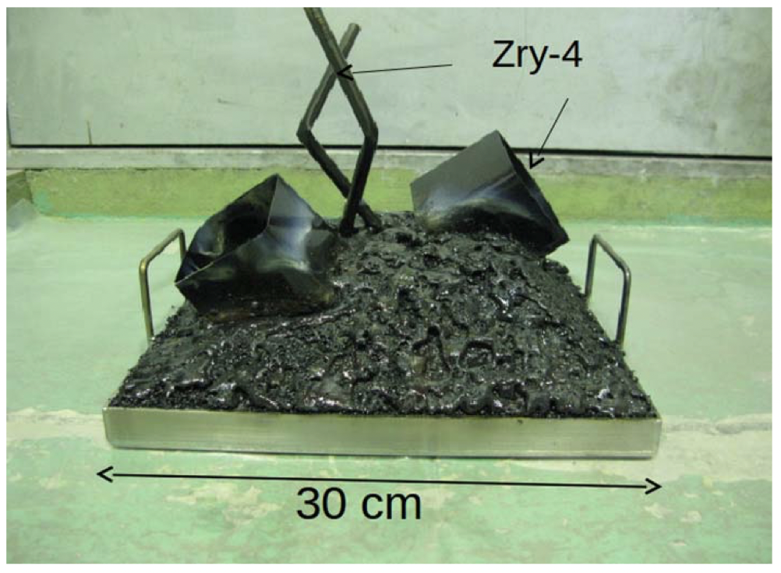
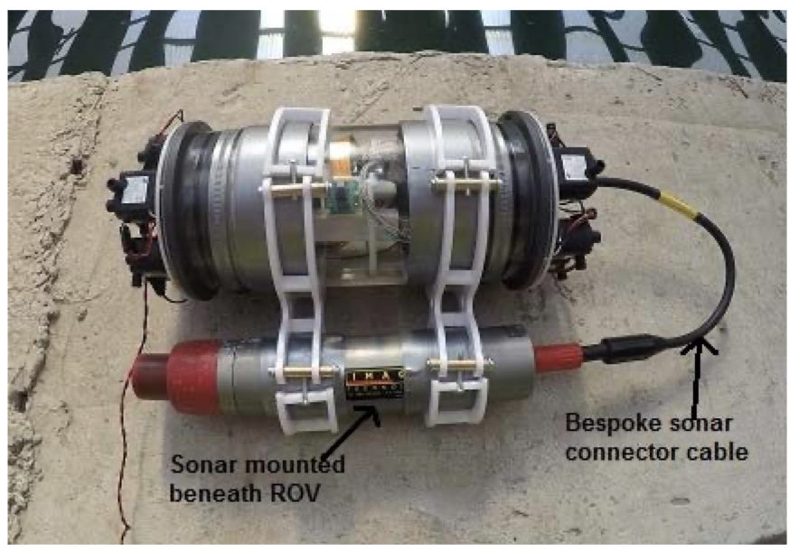
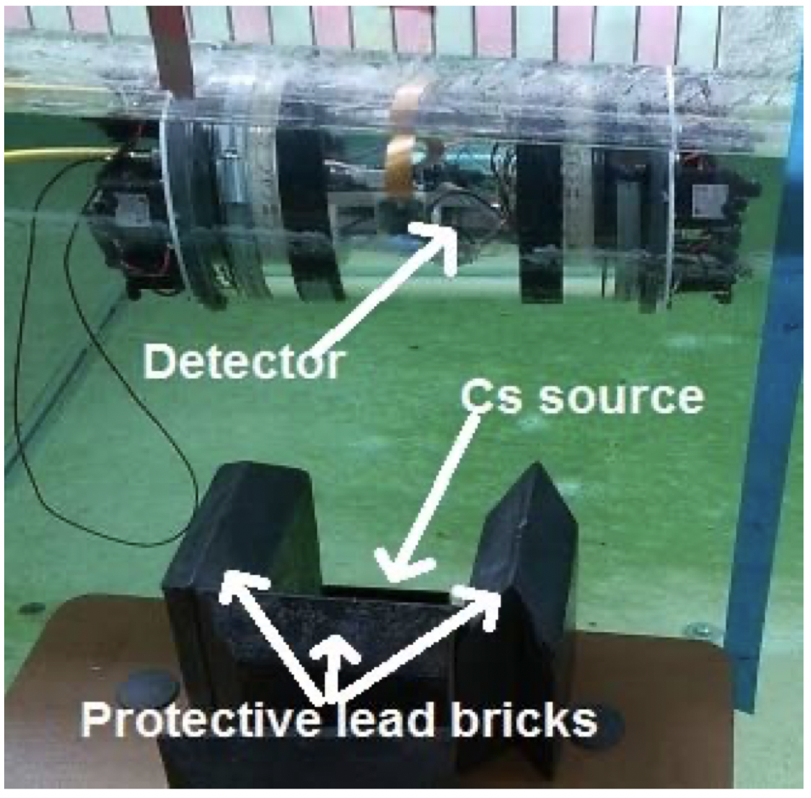
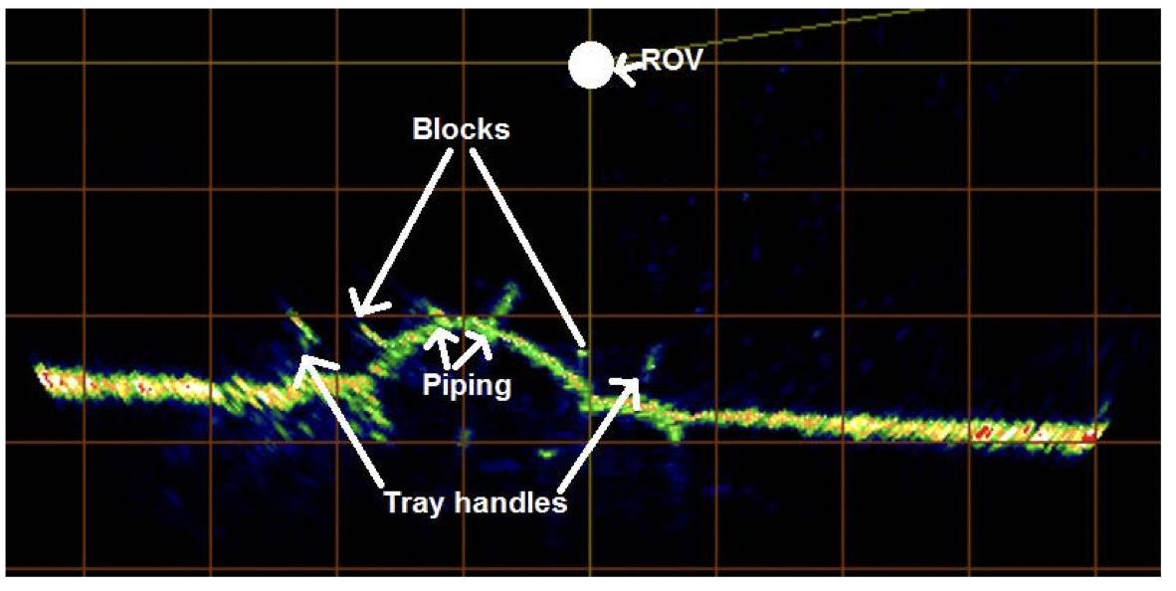
Example project
Development of a Radiological Characterization Submersible ROV for Use at Fukushima Daiichi
Nancekievill, M., Jones, A.R., Joyce, M.J., ...Katoh, M., Nishimura, K.
IEEE Transactions on Nuclear Science, 2018, 65(9), pp. 2565–2572

Slide 8
Other international joint programmes
UK-India:
Similar to the UK-Japan activity in format but with a different focus.
Focus on nuclear challenges relevant to India and the UK:
Joining technologies.
There is an associated network: ‘UKINN’ (led by Karl Whittle).
A call anticipated in 2023 but no current details.
UK-Korea
US-Nuclear Energy University Partnership (US-NEUP), call expected 2024

Slide 9
Managed programmes
TRANSCEND:
11 universities
8 industrial partners
Waste management
Decommissioning
Spent fuel
Nuclear materials
Ending 2023
ATLANTIC
MIDAS

Slide 10
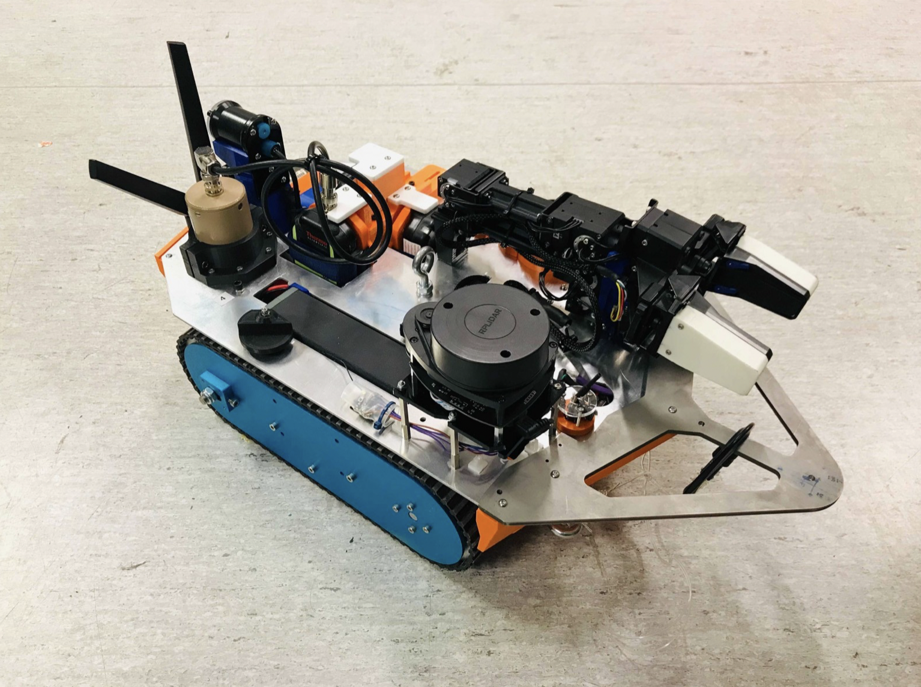
RAIN – Robotics and Artificial Intelligence in Nuclear
11 university partners
UKAEA ‘RACE
Led to the NNUF ‘hot robotics’ facility
Combining gamma spec with autonomous vehicles
Ended June 2022

Slide 11
UKAEA Magnetic Fusion Research
£43.2M programme
2019-2022
EPSRC, BEIS and EUROfusion, covering:
funding for the upgrade to Mega Amp Spherical Tokamak (MAST)
UK research programme
UK host funding for operating the Joint European Torus (JET) which UKAEA operates for the collective EUROfusion programme.
Strategy:
Supporting JET to reduce risk on ITER
Support research on MAST
Research on materials and technology to support ITER
Support MAST upgrade

Slide 12
Thank you for your attention Questions?

