Slide 1
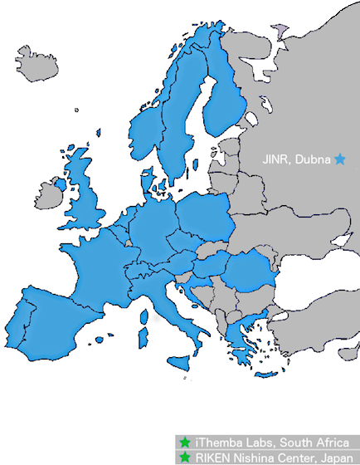
News from NuPECC
Rodi Herzberg
David Ireland
www.nupecc.org

Slide 2
What is NuPECC
NuPECC is an Expert Committee of the European Science Foundation (ESF).
The Committee membership is formed from European institutions and research facilities involved in nuclear science. The Committee may appoint Associated Members and Observers.
The objective of NuPECC is to:
strengthen European Collaboration in nuclear science by supporting collaborative ventures between research groups within Europe;
promote nuclear physics and its trans-disciplinary use in applications for societal benefit.

Slide 3
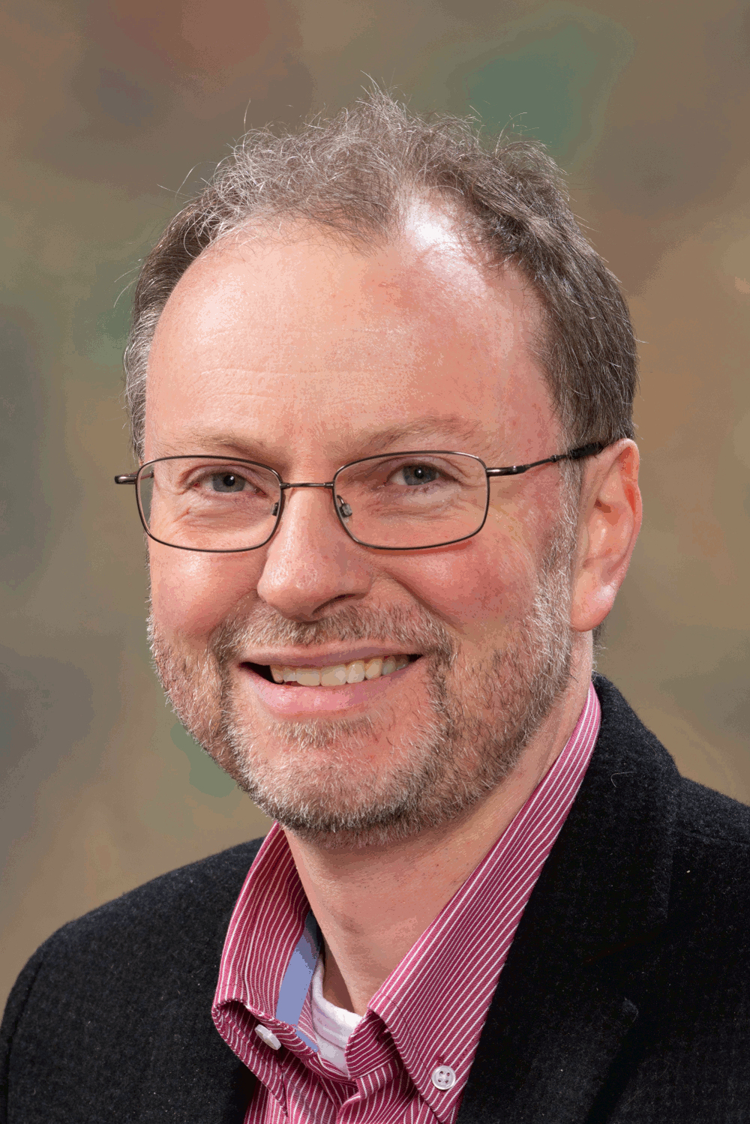
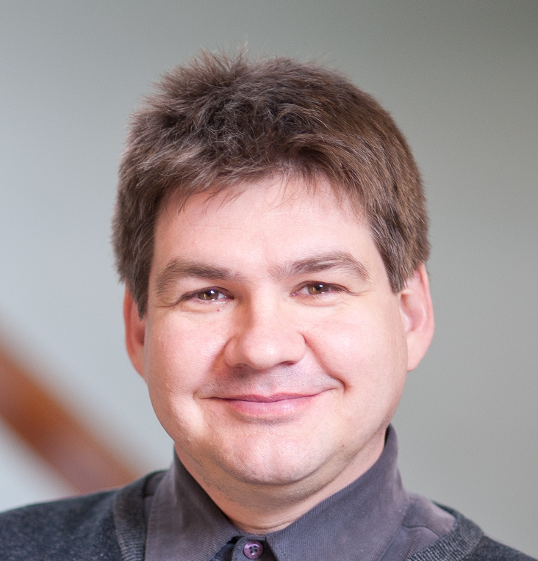
Management Team UK Members
Marek Lewitowicz
Chair
Eberhard Widmann
Vice-Chair
Sissy Koerner
Scientific Secretary
Paul Greenlees
Treasurer
David Ireland
Glasgow
Rodi Herzberg
Liverpool
Monthly meetings to follow-up on all NuPECC activities
Preparation of NuPECC meetings
Notes:
Marek has these meetings at least once a month, sometimes more often.

Slide 4
Activities
Meetings with national Funding Agencies (UK was in 2018)
Latest Report: Nuclear Physics in Everyday Life
Long Range Plan Evaluation
Long Range Plan 2024

Slide 5
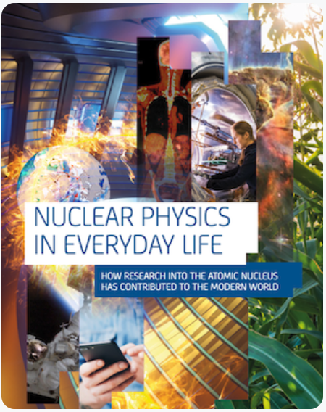
Nuclear Physics in Everyday Life
This 100-page report describes how research into the atomic nucleus has contributed to the modern world. It contains chapters on ``The origin of the elements’’, ``Climate and environment’’, ``Energy’’, ``Health’’, ``Forensics’’, and ``Space’’ amongst others.
The full report can be found here.

Slide 6
Long Range Plan Evaluation
LRP makes many recommendations – how effective are they?
Detailled analysis of the outcomes, with reference to the recommendations.
The report is available at https://www.nupecc.org/

Slide 7
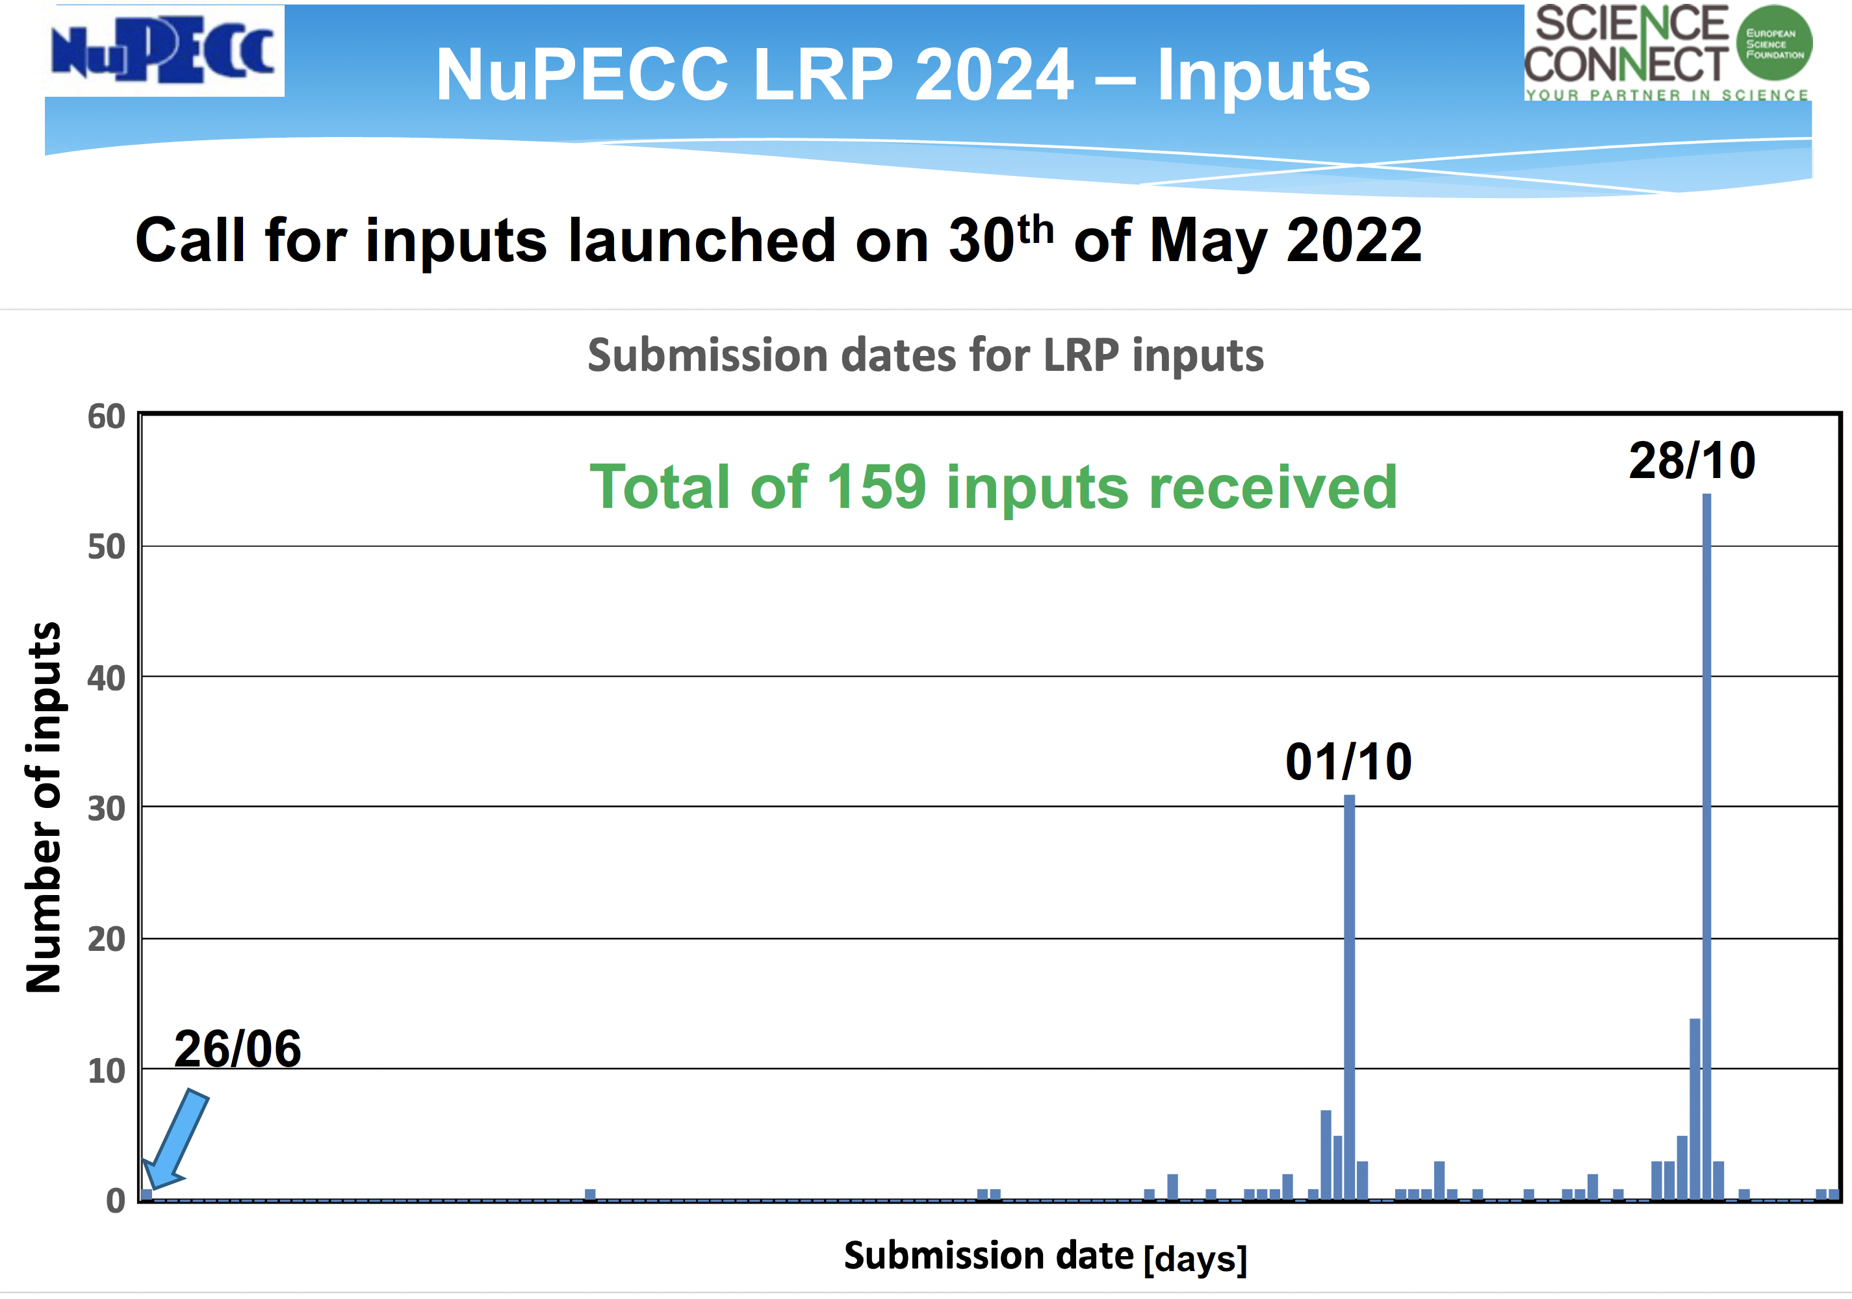
Long Range Plan 2024
Process has started.
Bottom Up!
Community input
was sought and
received.

Slide 9
TWGs are now being proposed and formed:
you may be approached!

Slide 10
Timeline LRP24

