Slide 1
CMS Experiment
C. H. Shepherd-Themistocleous

Slide 2
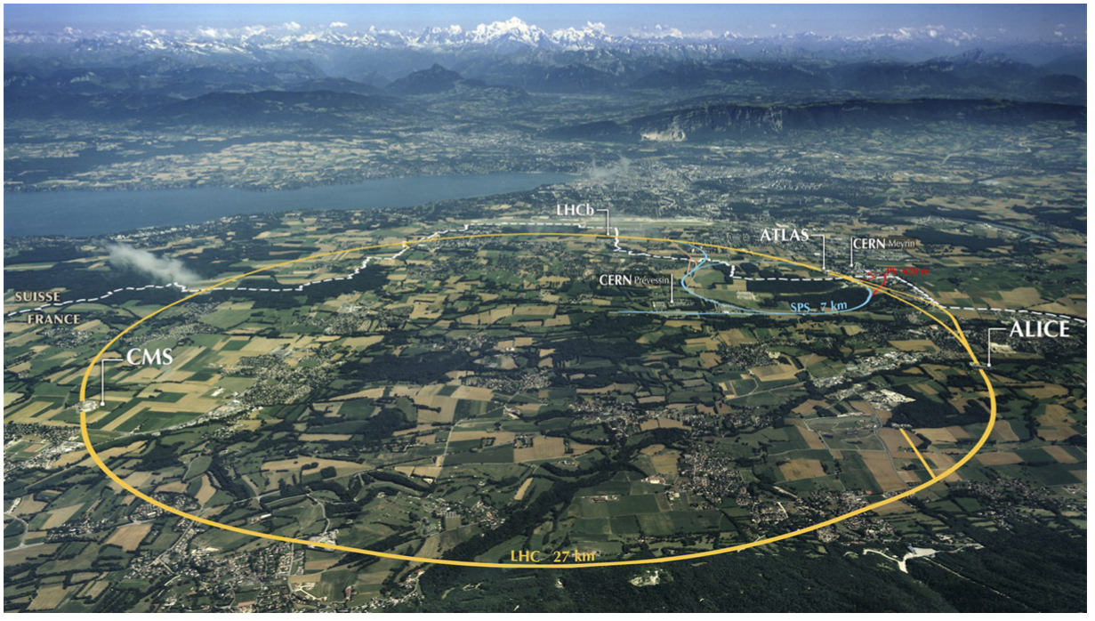
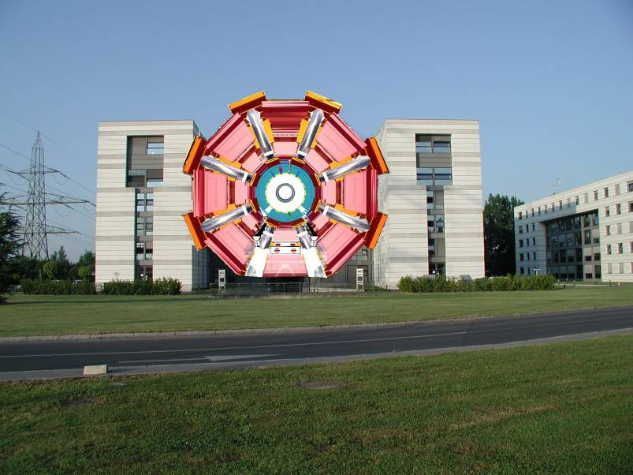
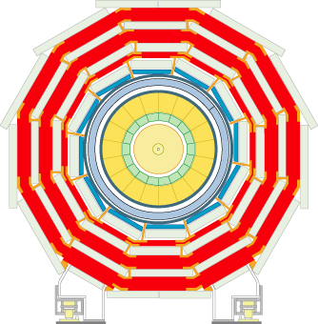
Large Hadron Collider
ATLAS
The Compact Muon Solenoid

Slide 3
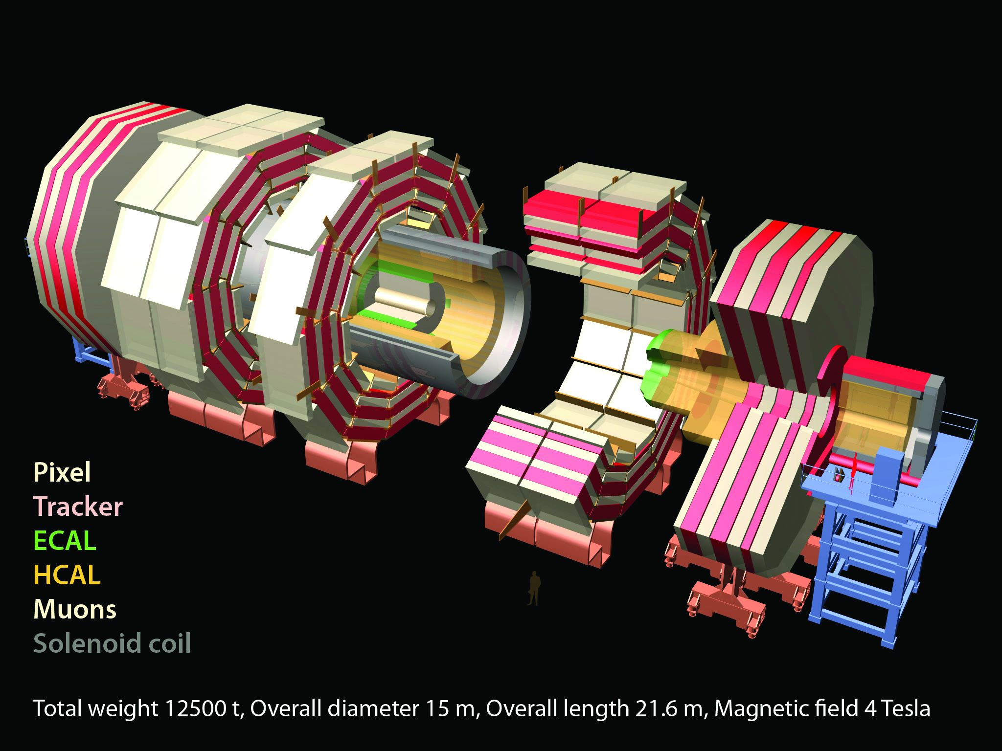

Slide 4
CMS PhD projects
Three projects:
  Project 4: "CMS ECAL Upgrade & Beyond-SM Physics" (PPD/Bristol)
  Project 5: "CMS Tracker Upgrade & Exotic Higgs Physics" (PPD/Bristol)​
  Project 6: "CMS L1 Trigger Upgrade & Beyond-SM Physics (PPD/Bristol)
  Al​​l encompass fast electronics, use of FPGAs and BSM physics searches

Slide 5



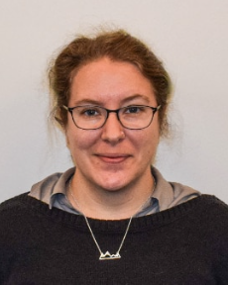

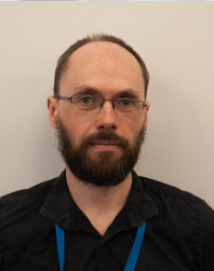
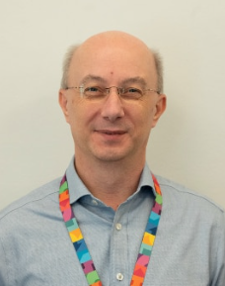

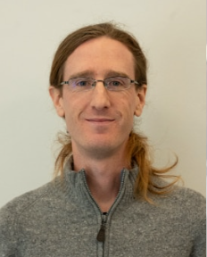
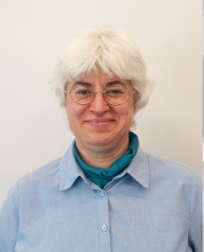

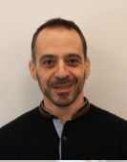
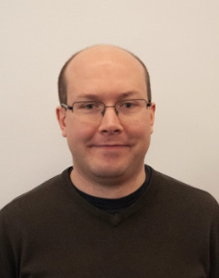
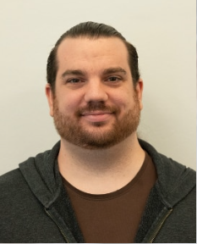
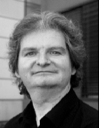






CMS Group

Slide 6
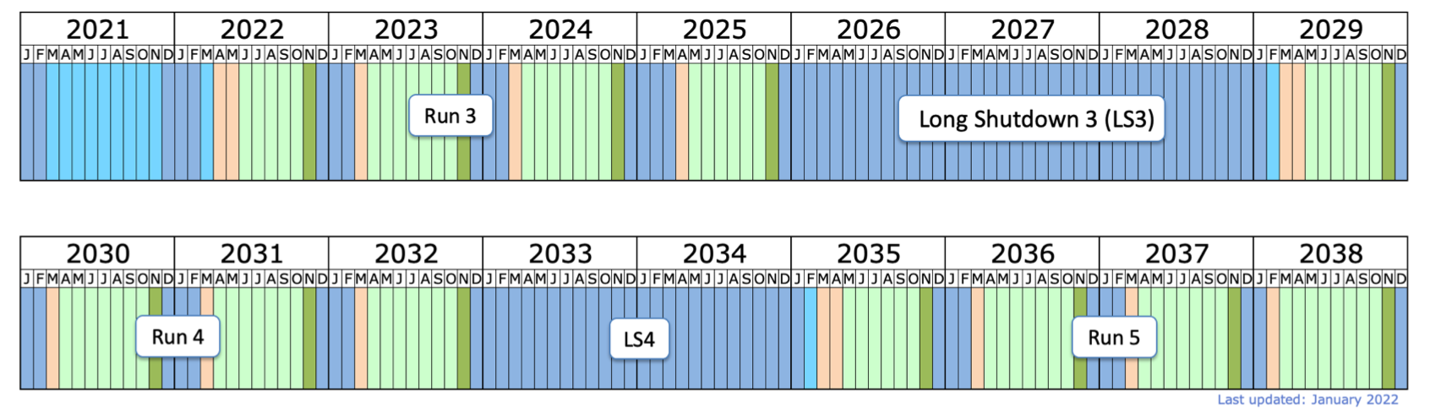
LHC and Run 3
Run 3 (2022-2025)
  More than double dataset 190 + 270 fb⁻¹
  Energy 13.6 TeV slightly higher
  Perfect time for PhD to get most from Phase I data
Upgrade for Run 4
  Major detector component replacements using cutting edge technologies

Slide 7
HL-LHC Upgrades

Slide 8
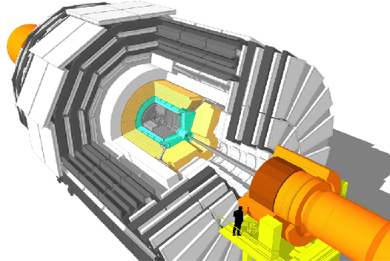
Upgrade of CMS for HL-LHC
L1-Trigger/HLT/DAQ
https://cds.cern.ch/record/2714892
https://cds.cern.ch/record/2283193
Tracks in L1-Trigger at 40 MHz
PFlow selection 750 kHz L1 output
HLT output 7.5 kHz
40 MHz data scouting
Barrel Calorimeters
https://cds.cern.ch/record/2283187
ECAL crystal granularity readout at 40 MHz with precise timing for e/γ at 30 GeV
ECAL and HCAL new Back-End boards
Muon systems
https://cds.cern.ch/record/2283189
DT & CSC new FE/BE readout
RPC back-end electronics
New GEM/RPC 1.6 < η < 2.4
Extended coverage to η ≃ 3
Calorimeter Endcap
https://cds.cern.ch/record/2293646
3D showers and precise timing
Si, Scint+SiPM in Pb/W-SS
Beam Radiation Instr. and Luminosity
http://cds.cern.ch/record/002706512
Bunch-by-bunch luminosity measurement: 1% offline, 2% online
Tracker https://cds.cern.ch/record/2272264
Si-Strip and Pixels increased granularity
Design for tracking in L1-Trigger
Extended coverage to η ≃ 3.8
MIP Timing Detector
https://cds.cern.ch/record/2667167
Precision timing with:
  Barrel layer: Crystals + SiPMs
  Endcap layer: Low Gain Avalanche Diodes

Slide 9
Upgrade of CMS for HL-LHC
L1-Trigger/HLT/DAQ
https://cds.cern.ch/record/2714892
https://cds.cern.ch/record/2283193
Tracks in L1-Trigger at 40 MHz
PFlow selection 750 kHz L1 output
HLT output 7.5 kHz
40 MHz data scouting
Barrel Calorimeters
https://cds.cern.ch/record/2283187
ECAL crystal granularity readout at 40 MHz with precise timing for e/γ at 30 GeV
ECAL and HCAL new Back-End boards
Muon systems
https://cds.cern.ch/record/2283189
DT & CSC new FE/BE readout
RPC back-end electronics
New GEM/RPC 1.6 < η < 2.4
Extended coverage to η ≃ 3
Calorimeter Endcap
https://cds.cern.ch/record/2293646
3D showers and precise timing
Si, Scint+SiPM in Pb/W-SS
Beam Radiation Instr. and Luminosity
http://cds.cern.ch/record/002706512
Bunch-by-bunch luminosity measurement: 1% offline, 2% online
Tracker https://cds.cern.ch/record/2272264
Si-Strip and Pixels increased granularity
Design for tracking in L1-Trigger
Extended coverage to η ≃ 3.8
MIP Timing Detector
https://cds.cern.ch/record/2667167
Precision timing with:
  Barrel layer: Crystals + SiPMs
  Endcap layer: Low Gain Avalanche Diodes

Slide 10
Electromagnetic Calorimeter

Slide 11
CMS Electromagnetic Calorimeter (ECAL)
The CMS ECAL is a highly-granular crystal calorimeter - excellent energy and position resolution, radiation tolerance and fast response
The ECAL was a crucial element in the discovery of the Higgs Boson in 2012, in the two golden discovery channels: H→γγ, H→ZZ→4l
RAL PPD responsibilities: Design, Delivery, Installation, and Operation of the ECAL
Elements of the ECAL
Construction and installation of the ECAL

Slide 12
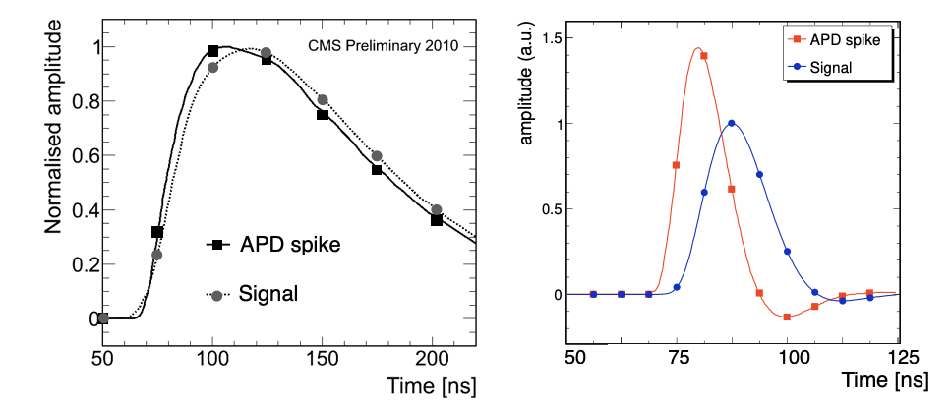
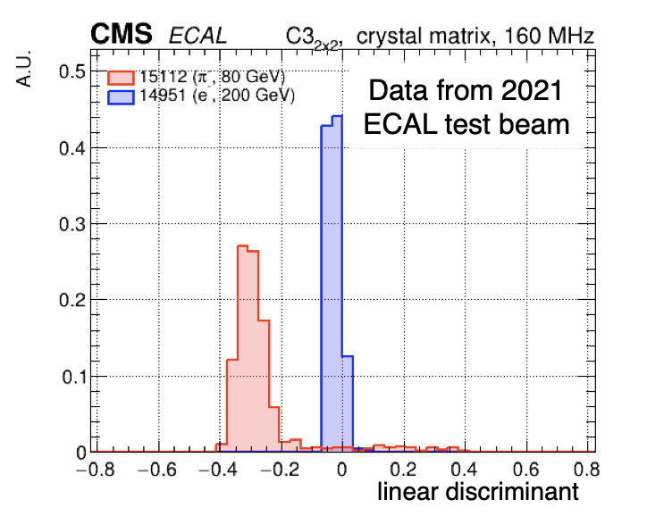
ECAL/BSM Physics PhD project
Improved pulse shape discrimination
The ECAL electronics upgrade for HL-LHC will:
  Significantly improve timing and spatial information to the Level-1 trigger
  Enables advanced reconstruction algorithms in new and powerful off-detector FPGAs
You will:
  Develop and test advanced algorithms using High Level Synthesis (HLS) to reject anomalous signals in ECAL (“APD spikes”) in the Level-1 trigger using pulse shape discrimination techniques and topological information.
  Participate in test beam campaigns and analyse new and existing test beam data.
  Participate in the refurbishment of ECAL with new electronics in 2026
Current
Upgrade
Pulse shape analysis of test beam data
spikes
electrons
Supervisors: David Petyt (RAL), Henning Flaecher (Bristol)

Slide 13
Track Finder

Slide 14
Track Finder
Silicon tracker to be completely replaced for HL-LHC
Enables track finding at in Level 1 trigger.
Completely new capability

Slide 15
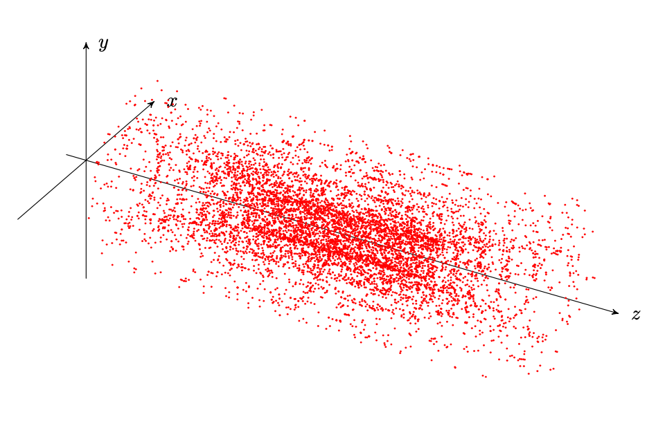
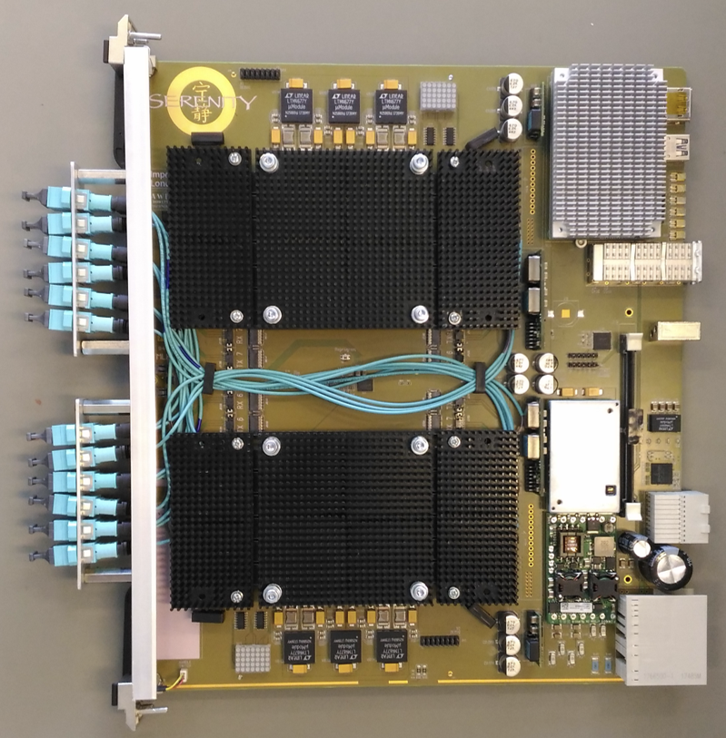
Project 5: CMS Tracker Upgrade & Exotic Higgs Physics
You will:
Develop and refine the L1 tracking algorithm
Write HLS or VHDL firmware to deploy on FPGAs.
Using simulation of HL-LHC events study the performance of the track reconstruction
Participate in integration work at CERN using the fast electronics developed for the HL-LHC upgrades
Search for evidence of BSM Physics (see later)

Slide 16
Level 1 Trigger

Slide 17
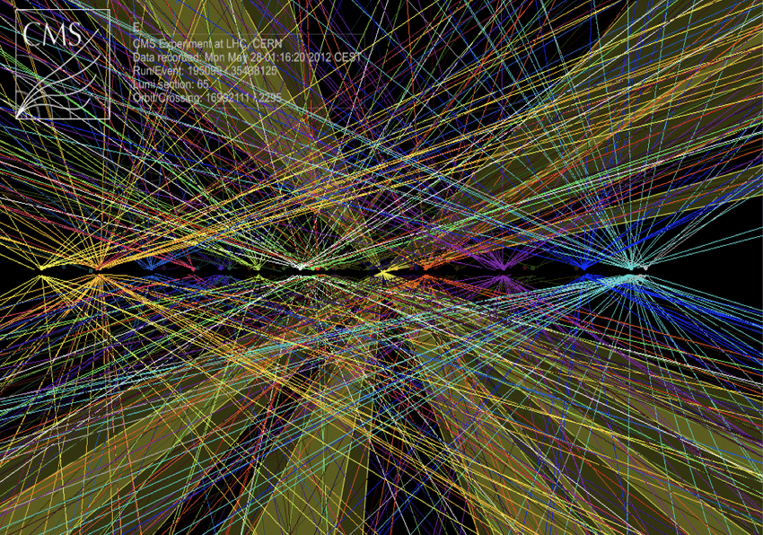
Level-1 Trigger
Decides whether high-granularity data will be read out from detector
  Bunch crossing 40MHz – L1 output 750kHz
  > 99% of collision data discarded
  L1T identifies the most interesting events - critical role in data acquisition!
Receives coarse granularity data from all major detector systems.
  Must combine this data to reconstruct event within 12µs
  Jets, electrons, photons, muons, missing energy
  Dealing with ~200 interactions a major challenge
Tracks available in L1T for the first time, enabling paradigm shift in algorithms
Tracks alone can give interaction point
Can reconstruct objects only from tracks
(e.g. jets), or combine with calorimeters

Slide 18
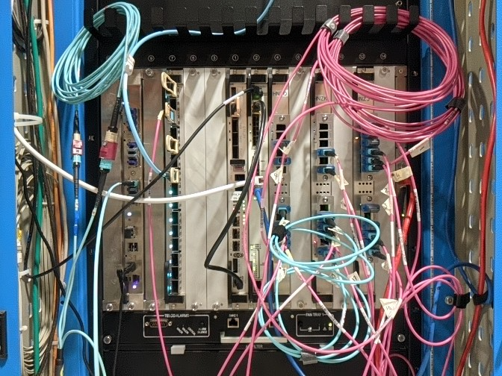
Level-1 Trigger Upgrade
Current system will be replaced with latest technologies (FPGAs & optics)
  Hundreds of FPGA-based boards
  Thousands of 25Gbps links
  3Tbps I/O per board
A complex distributed system!
  Individual boards need to be operated coherently as a single system, e.g. sychronise clocks, align input data
  Setting up test system at CERN to integrate different board designs and algorithms, and verify operation of the system.

Slide 19
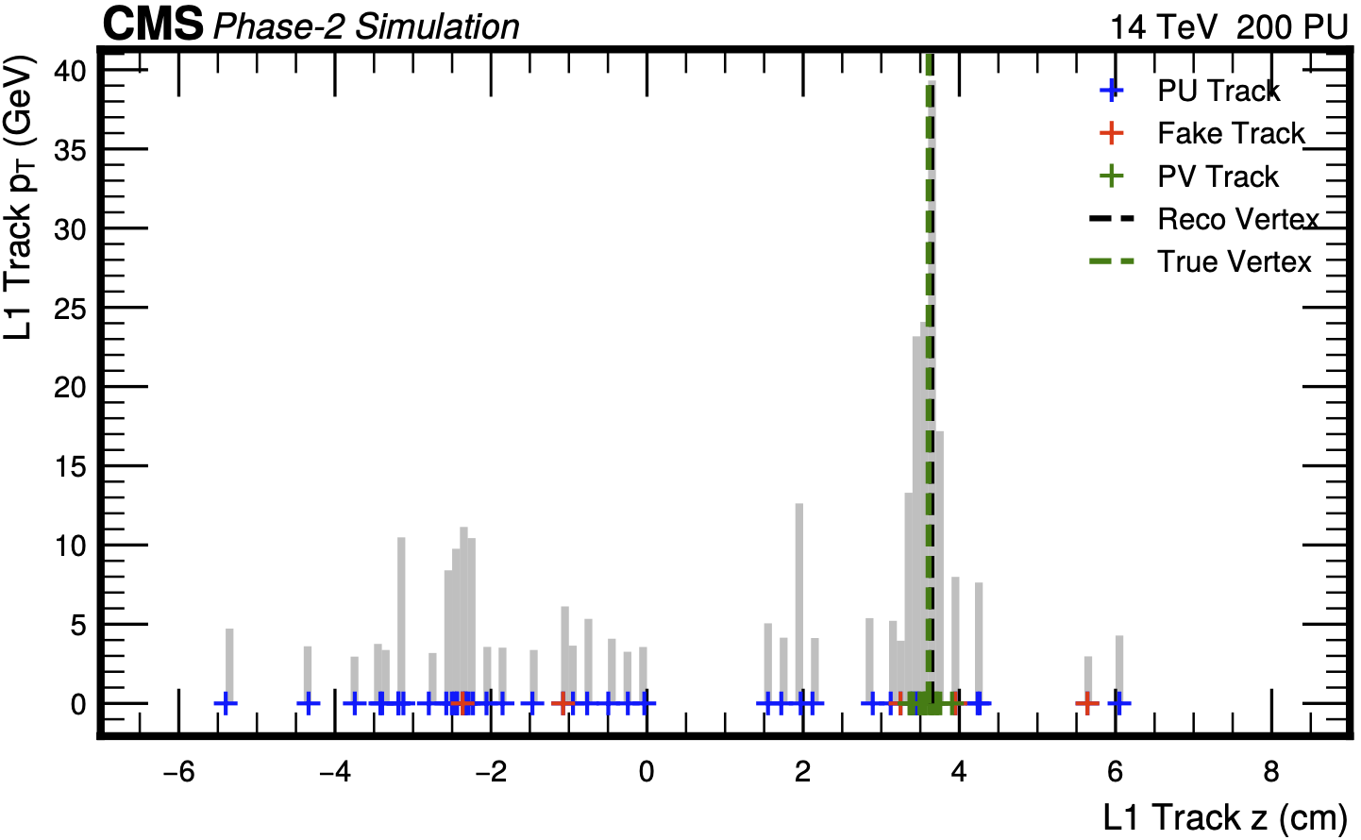
L1T & BSM Physics PhD Project
Supervisors: Tom Williams (RAL) & Sudan Paramesvaran (Bristol)
You will:
Play a key role in developing new L1T particle reconstruction/ID algorithms
  All stages: Conceptual design → performance measurements → firmware implementation → test in hardware
Set up test systems at CERN and perform integration tests
Search for evidence of BSM physics
Gain valuable skills in the process!
  Software & firmware development
  Including using modern tools, like HLS
  Data analysis
  ML, e.g. graph NNs & auto-encoders

Slide 20
Physics Analysis

Slide 21
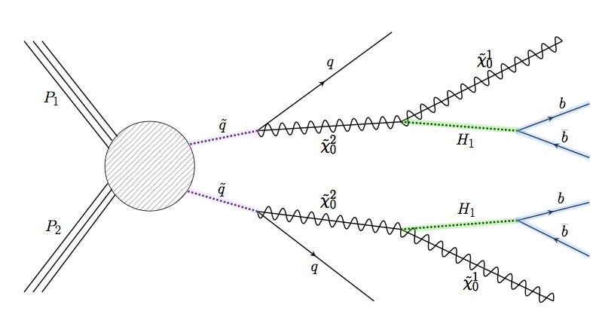
Physics Analyses
Fat Jet
Fat Jet
NMSSM Light Higgs – 7 Higgs bosons – found one so far ☺
This analysis would be the evidence of SUSY in this scenario
Particular feature no observable missing energy
“Fat jets” & double b-tagging. Use neural nets.
Initial analysis good. Will develop scenarios with theorists.

Slide 22
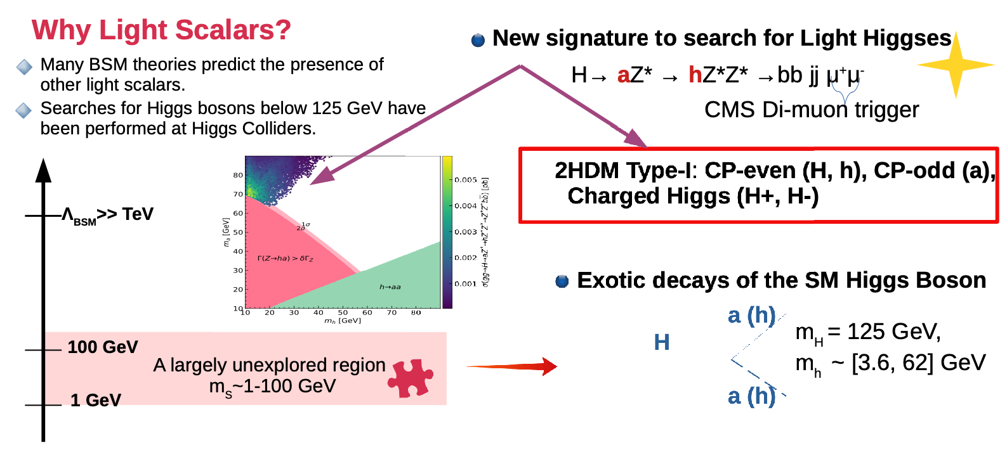
Two Higgs Doublet Models (2HDM)

Slide 23
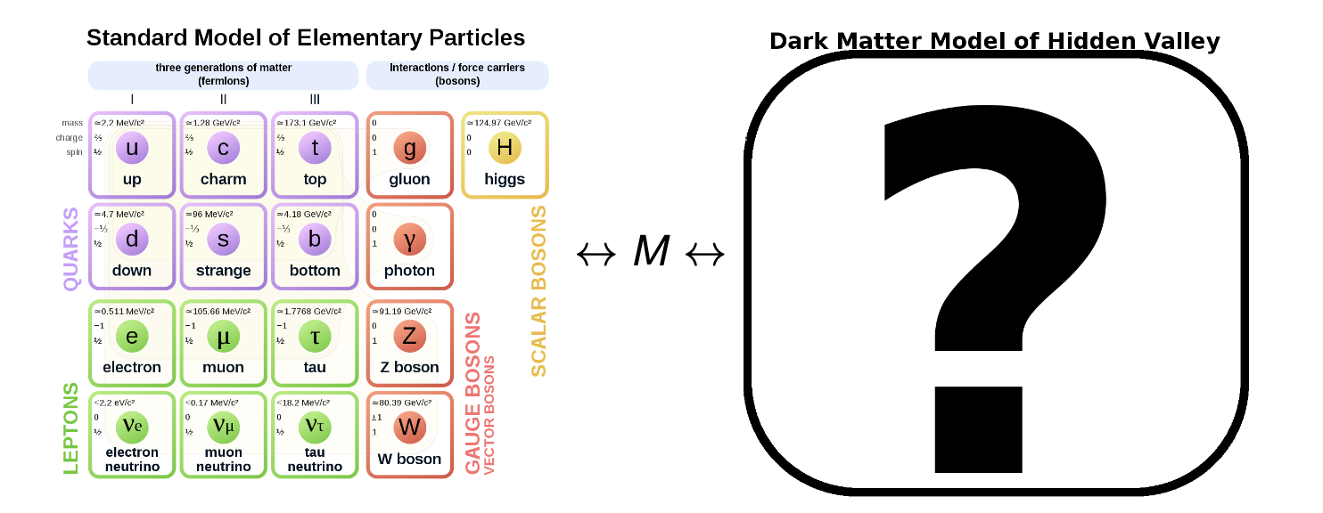
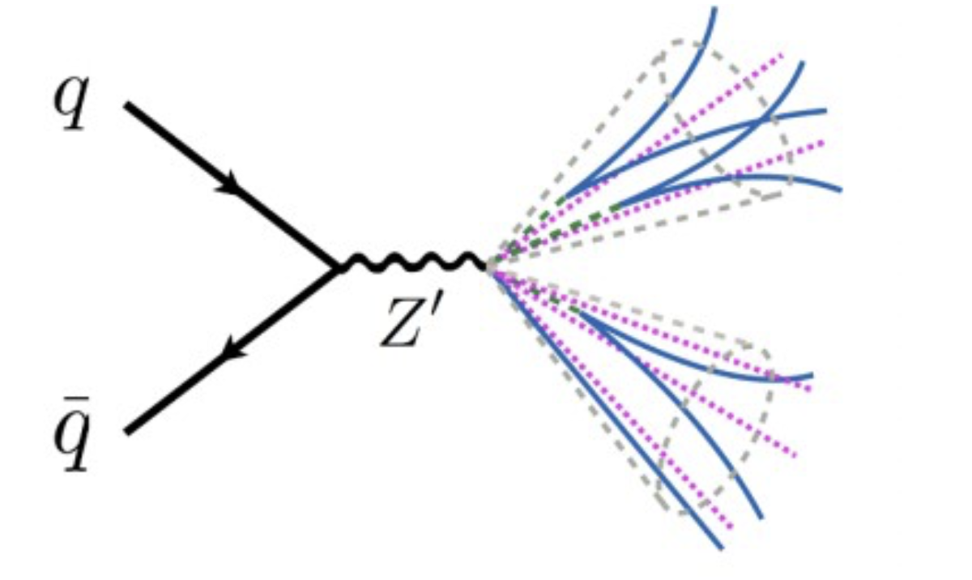
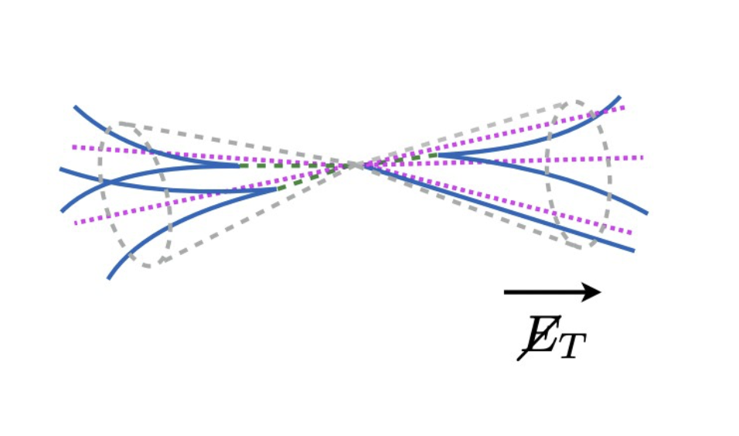
Semi-visible jets
Identify semi-visible jets
using auto-encoder NNs.
Do not need signal model for this approach!

Slide 24
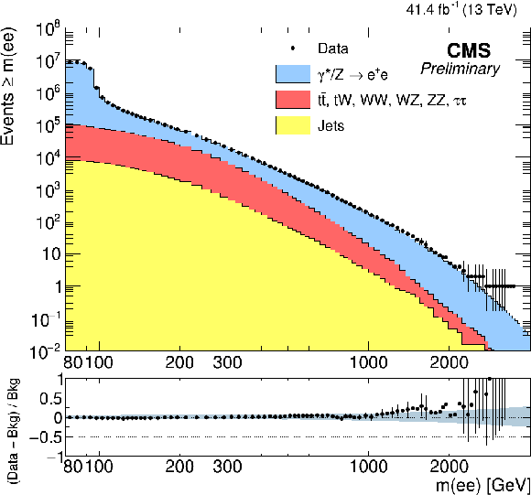
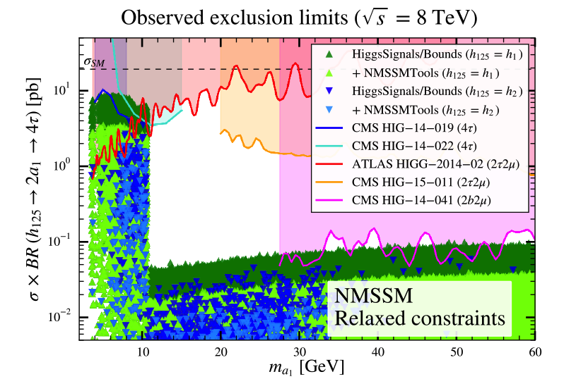
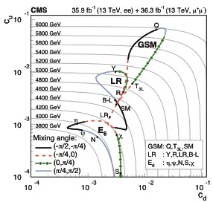
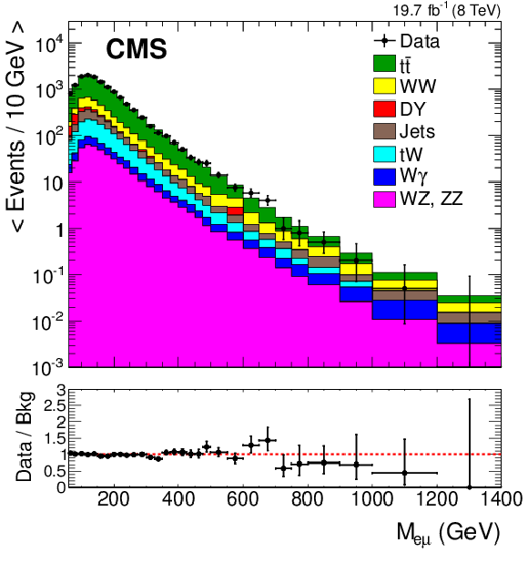
Past Physics Analyses & Phenomenology
Z’ search a long standing analysis. High energy electrons and HLT
Exploit eμ for QBH search
Boosted Z

Slide 25
CMS PhD projects
Three projects:
  Project 4: "CMS ECAL Upgrade & Beyond-SM Physics" (PPD/Bristol)
    David Petyt & Henning Flaecher
  Project 5: "CMS Tracker Upgrade & Exotic Higgs Physics" (PPD/Bristol)​
    Ian Tomalin & Joel Goldstein
  Project 6: "CMS L1 Trigger Upgrade & Beyond-SM Physics (PPD/Bristol)
    Tom Williams & Sudan Paramesvaran
  Al​​l encompass fast electronics, use of FPGAs and BSM physics searches

Slide 26
Backup slides

Slide 27
Project
Project will encompass:
BSM physics analysis focusing on more realistic models beyond MSSM.
Explore potential of NMSSM with enlarged Higgs sector.
Develop complex jet reconstruction and tagging. Exploit ML techniques
Develop algorithms for the HL-LHC upgrade of the L1 trigger. Exploit new structure concept and tracks never before available.
Challenge of reconstruction of jets online.
Make use of the information provided by other areas of group

Slide 28
CMS : What we work on
Electromagnetic
Calorimeter
Trigger
(L1 & HLT)
Silicon Tracker
Computing
(T1 & T2)
Physics Analysis
Phenomenology
(NExT Institute)
Design
Construction
Operation
Upgrades

