Slide 1
RAL/PPD PhD Studentship Practicalities
Ian Tomalin

Slide 2
RAL Particle Physics PhD Studentships
RAL Particle Physics Dept. offers 11 funded PhD studentships starting in Autumn 2023:
Project 1: "Neutrino physics with T2K & Hyper-Kamiokande" (PPD/Lancaster)​
Project 2: "Muon Collider physics studies" (PPD/Warwick)
Project 3: "Muon Collider machine-detector interface studies" (PPD/Oxford/JAI)​
Project 4: "CMS ECAL Upgrade & Beyond-SM Physics" (PPD/Bristol)
Project 5: "CMS Tracker Upgrade & Exotic Higgs Physics" (PPD/Bristol)​
Project 6: "CMS L1 Trigger Upgrade & Beyond-SM Physics (PPD/Bristol)​​
Project 7: "LHCb Mighty Tracker & New Physics" (PPD/Manchester)
Project 8: "Dark Matter Search with Proportional Counters" (​PPD/Birmingham)​​
Project 9: "Silicon Detectors for the DarkSide20k dark matter experiment" (PPD/Oxford)
Project 10: "Long-baseline atom interferometry with AION" (PPD/Cambridge)​
Project 11: "Next-generation neutrino experiments in nuStorm" (PPD/Warwick)​
Each has partner university, as RAL can't award degrees.
Student will be blessed with 2 supervisors (RAL + university)!

Slide 3
RAL Particle Physics PhD Studentships
Each PhD is 3.5 years long, with typically:
First 2 terms based at university for lectures/courses there.
Then year based at RAL, including additional lectures.
Then year away at experiment (e.g. CERN in Geneva).
Then back to RAL to complete research & write up thesis.
We provide STFC PhD Funding , covering the partner university's "home fees" & a stipend for the student's living costs & expenses.
If a candidate must pay the more expensive "overseas" fees, and can't pay the difference in fees themself, the university sometimes finds a solution, if the candidate is particularly excellent.

Slide 4
RAL/PPD PhD Open Day - for students visiting RAL in person
Details (& maps) in https://indico.stfc.ac.uk/event/678/overview
Morning R68/CR13 (10-12am): Presentations on the 11 PhD projects.
Lunchtime R68/CR13: Sign up (via whiteboard) for individual chats with PhD supervisors.
We’ve already signed you up for chats on the 2 projects mentioned in your application.
You can take it in turn sign up for chats on up to 4 additional projects.
Afternoon R1 (1-4pm): Individual chats in 11 small offices.
Each chat is 18 mins long + 2 mins walking time.
50% of time for you to ask questions to supervisors. 50% for them to get to know you.
In free slots, chat informally to current students/staff in PPD Exhibition Room or relax in Coffee Lounge.
Quick get-together in R68/CR13 (4pm) to wrap up.

Slide 5
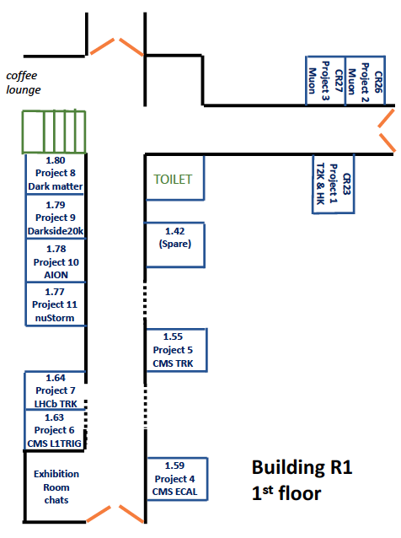

Slide 6
RAL/PPD PhD Open Day - for students participating via ZOOM
Details (& maps) in https://indico.stfc.ac.uk/event/678/overview
Morning (10-12am): Presentations on the 11 PhD projects.
Afternoon: Sign up (via Doodle Polls in indico) for individual Zoom chats with PhD supervisors.
You can sign up for chats on up to 6 projects.
Various times (different for each project) on 24th. Feb.: Individual chats in 11 ZOOM rooms.
(Except for two projects, when the chats are on 27th Feb.).
Each chat is 18 mins long + 2 mins connection time.
50% of time for you to ask questions to supervisors. 50% for them to get to know you.

Slide 7
After the Open Day & Chats
All students list of all the PhD projects for which they wish to be considered, in decreasing order of preference in survey https://forms.gle/hdqDQq4scFsjwKMt6
e.g. 3, 7, 2, 1, 11, 8.
The supervisors of each project indicate which students they’d like to invite to formal interview.
We assign of students to individual projects.
Student submits formal application to partner university (if not already done).
Formal interview of student with project supervisors (perhaps as part of university interviews)

