Slide 1




Installation Project Status
Extreme Photonics Applications Centre (EPAC)
Steph Tomlinson EPAC Senior Engineer Manager
Jodie Smith EPAC Installation Manager

Slide 2
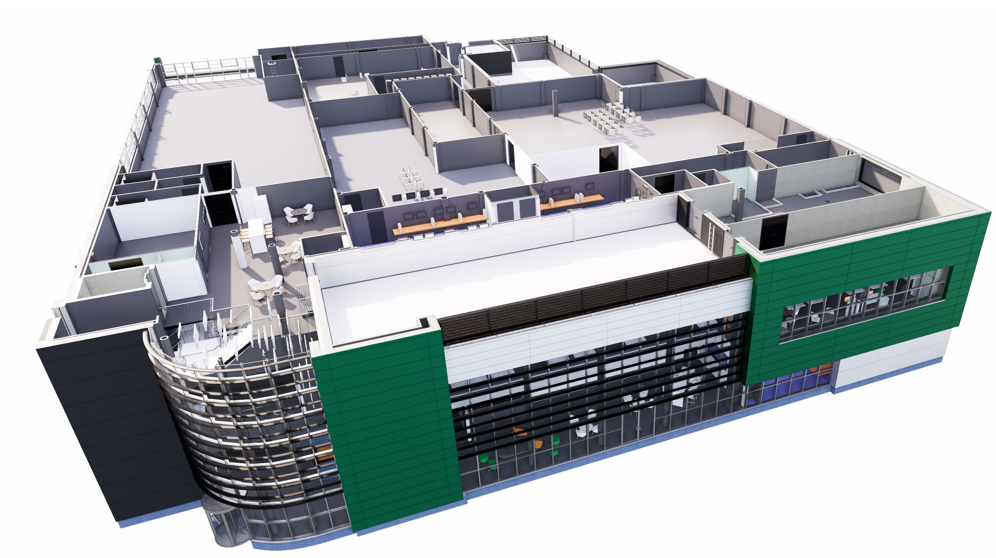
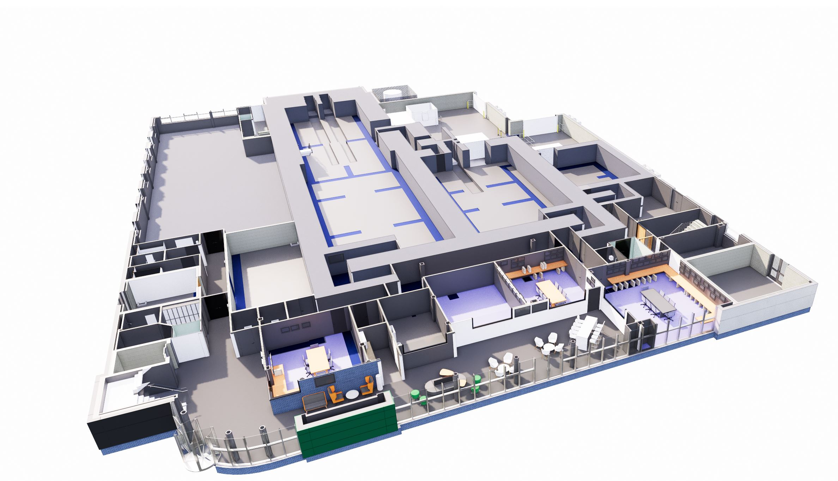
Outline of Content
Progress Since Building Handover
  Surveys
  LN2 tank and pipework
  Lab specific services
  Fire proofing
  Pump laser installation
  EA1 Preparation Works
Forward Look
Challenging Installation Activities
  Beam propagation
  Compressor chamber install

Slide 3
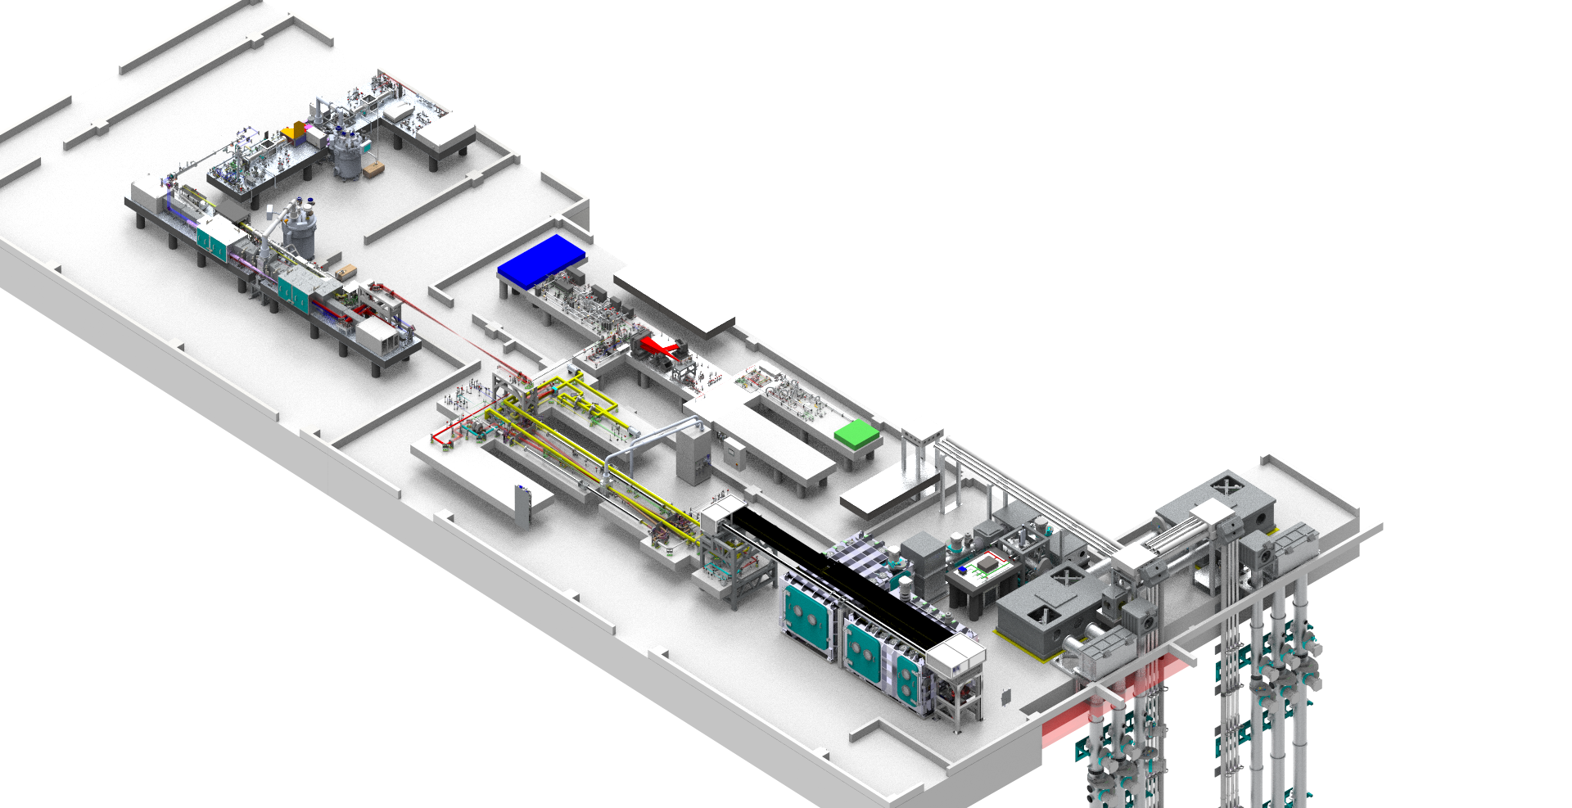
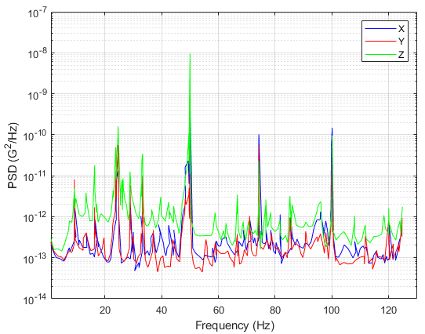
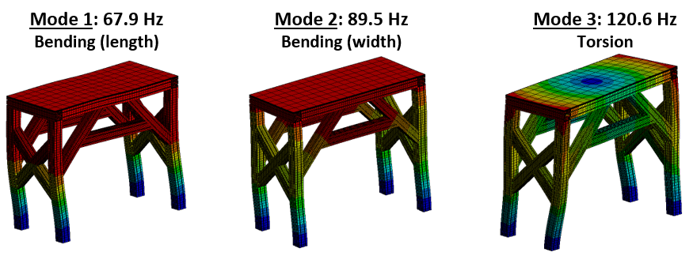
Stability - Building Vibration Survey
Stability
  Complex beam transport across the whole facility
  Design structures and mounting systems to avoid resonances
  Aim for high stiffness structure with natural frequency greater than 100Hz
Vibration Data
  Baseline survey through entire building prior to any installation
  5GB of data collected on all critical floors and walls
  Impact of ISIS Facility

Slide 4
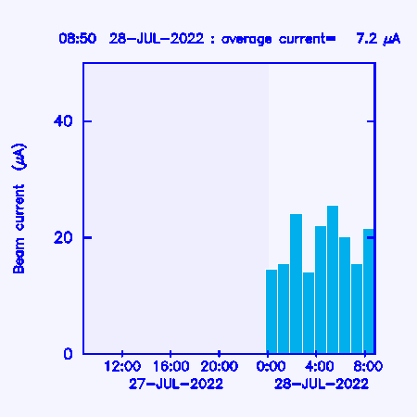
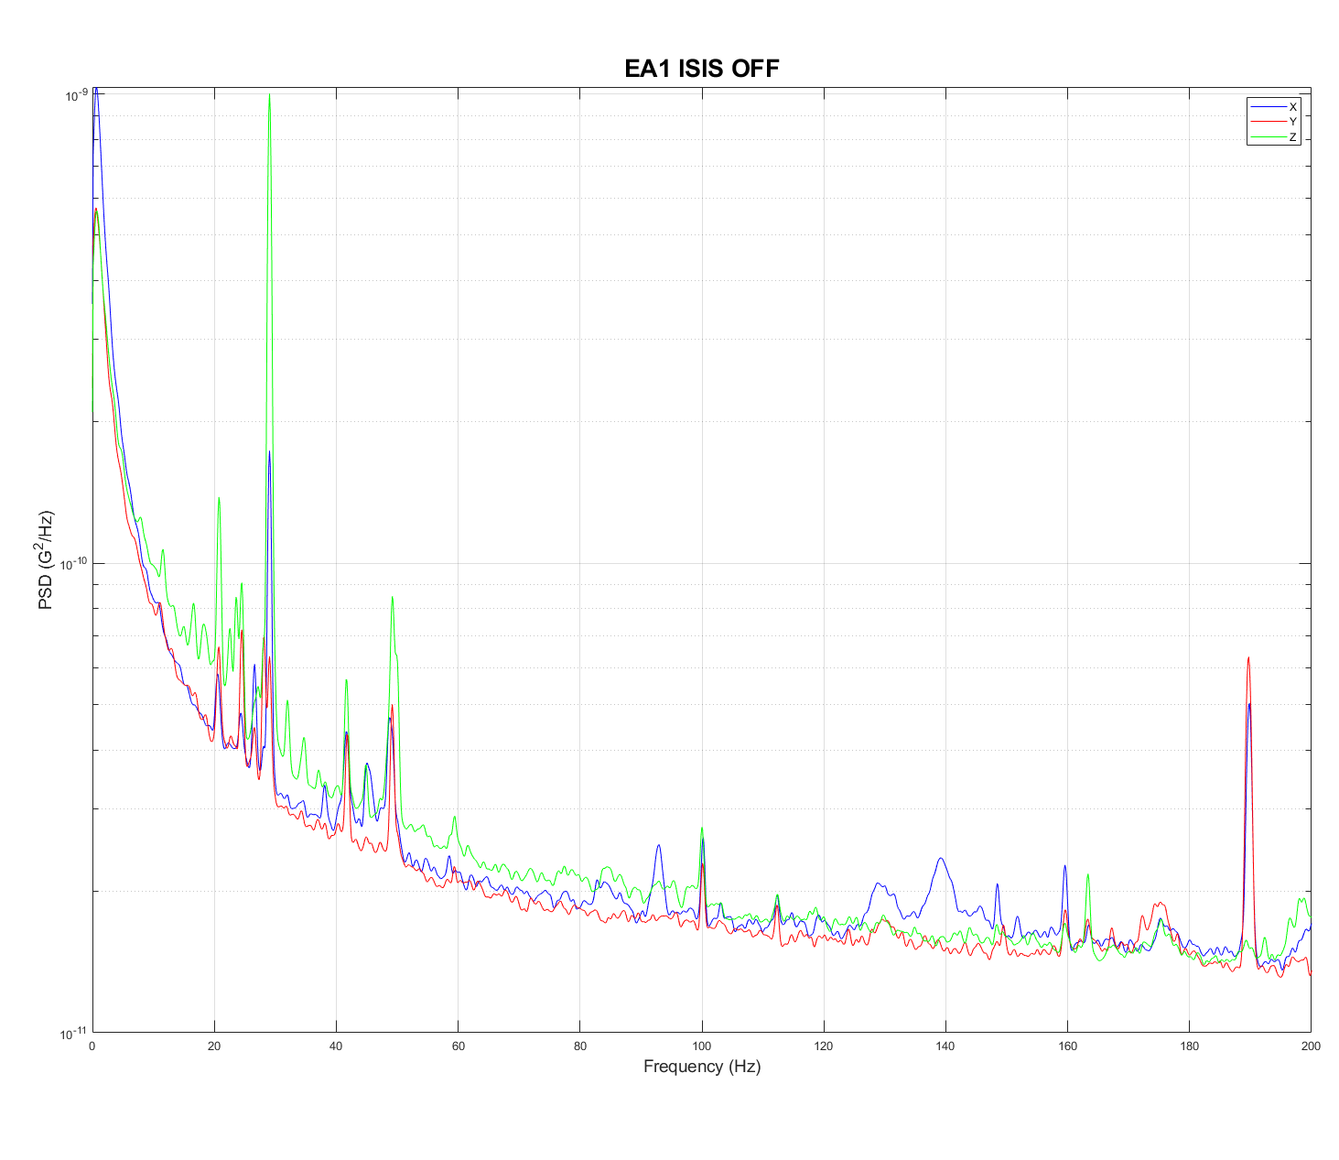
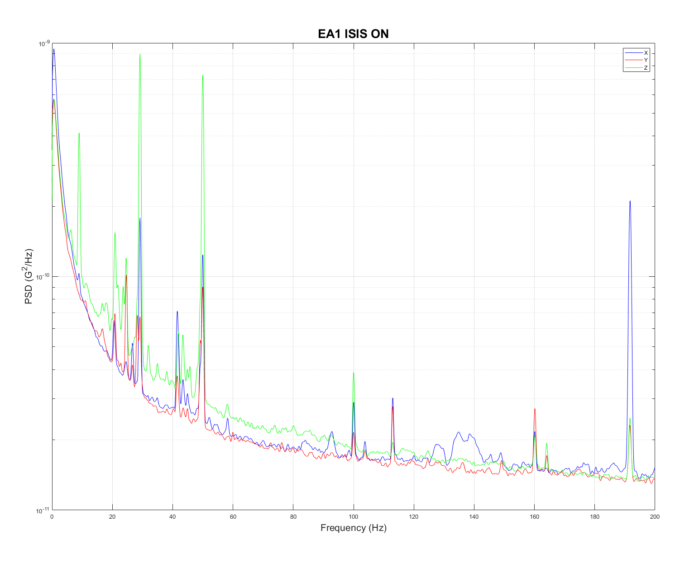
Stability - Building Vibration Survey
10⁻⁹
10⁻⁹
10⁻¹⁰
10⁻¹⁰
NIF floor spec
Low levels of vibration above 60Hz
Peaks at 30Hz, 50Hz, 190Hz
50Hz peak occurs when ISIS is operating, but PSD is an order of magnitude less than seen in Gemini

Slide 5
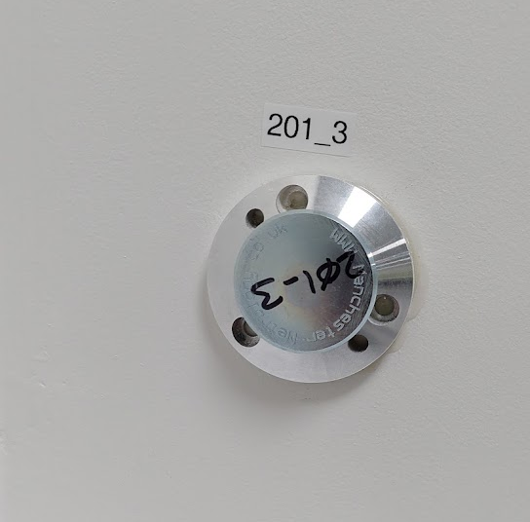
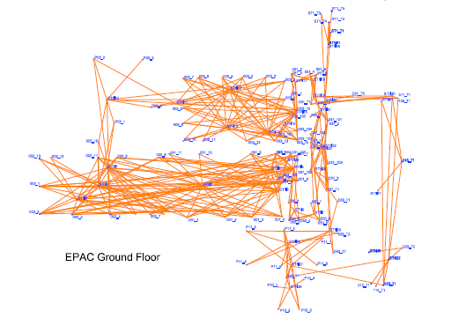
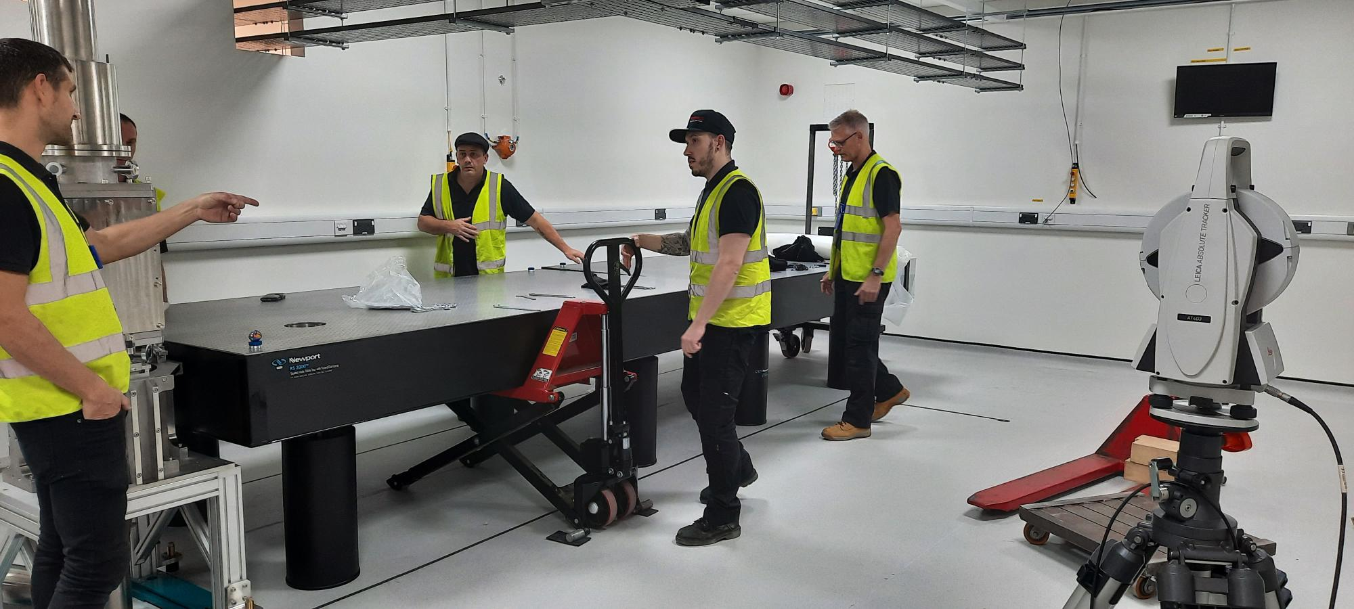
Alignment Nest and Survey
Network set-up across building
Complete survey of walls and floors
Installation in any area to same datum
Now in use for component installation
Building Network Survey Reference (175 in total)
Laser Survey Equipment
Component Survey Reference

Slide 6
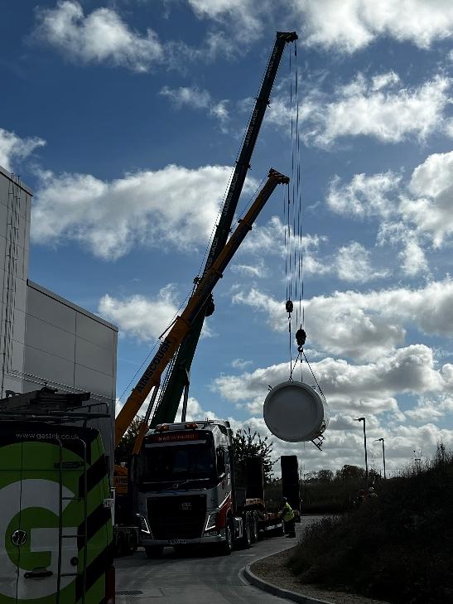
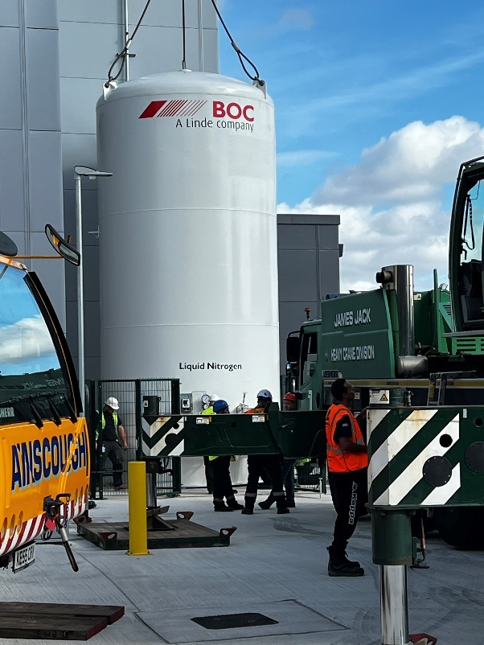
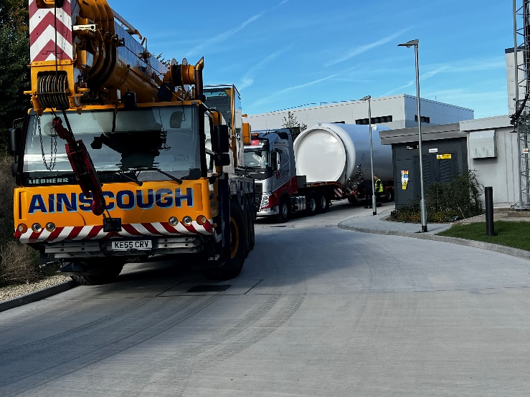
Installation of the LN2 tank
400l tank to store LN2
Required to supply the cryostats for the pump laser system
Estimate the need to fill every two weeks during operation

Slide 7
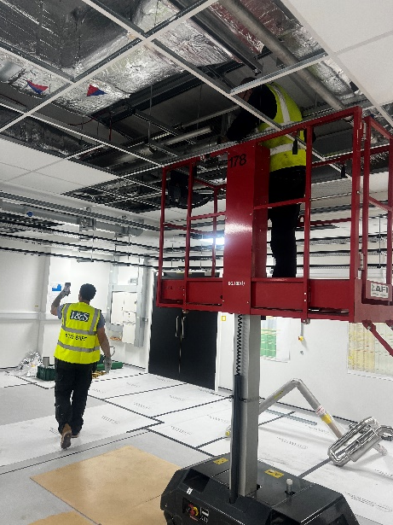
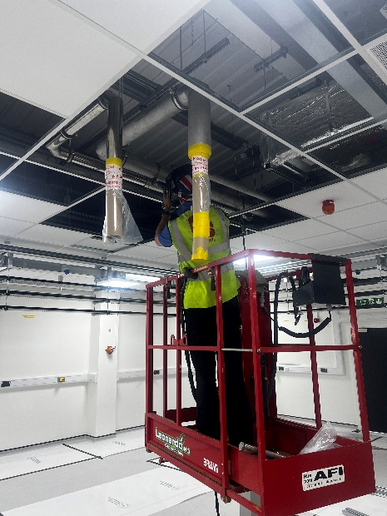
Installation of the LN2 pipework for pump laser
LN2 pipework to transport LN2 from outside tank into the pump room for use in cryostats
Normal Exhaust lines to take cold GN2 (boil off) to safe external location
Emergency Exhaust (from pressure relief valves) lines to take any gases to safe external termination point

Slide 8
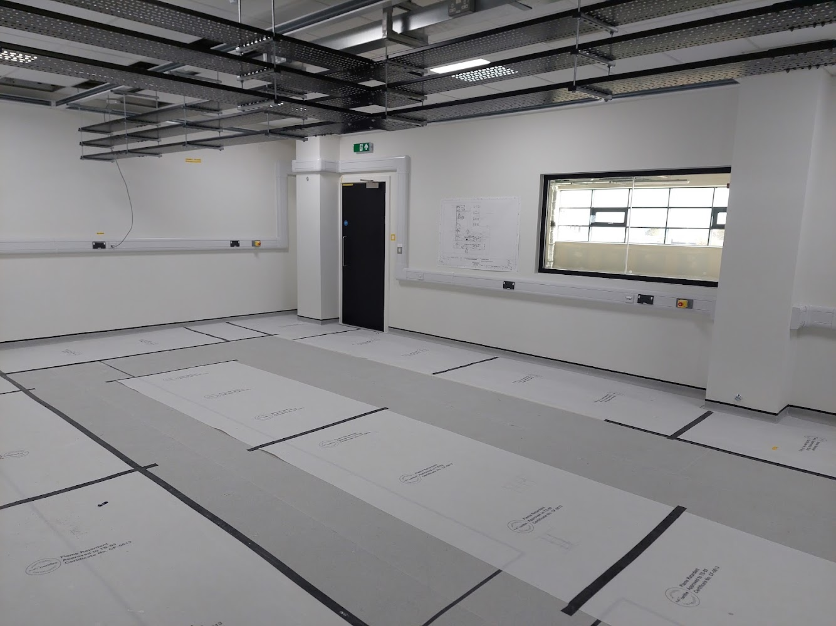
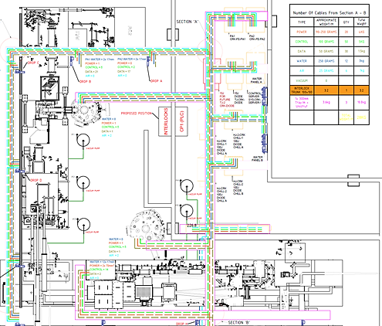
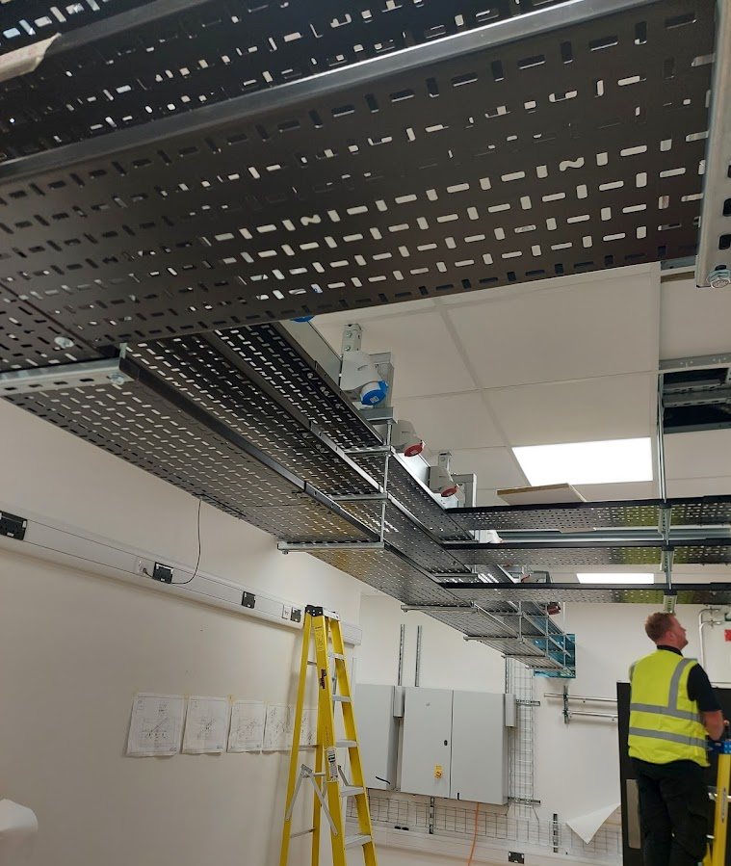
Installation of cable containment pump laser and rack room
Last ISTAC this proposed services layout was shown for the pump laser area
The 3 tiered cable gantry and interlock trunking has been installed throughout this area.
  Top layer power
  Mid layer control and data cables
  Bottom layer mechanical services (gas and water)

Slide 9
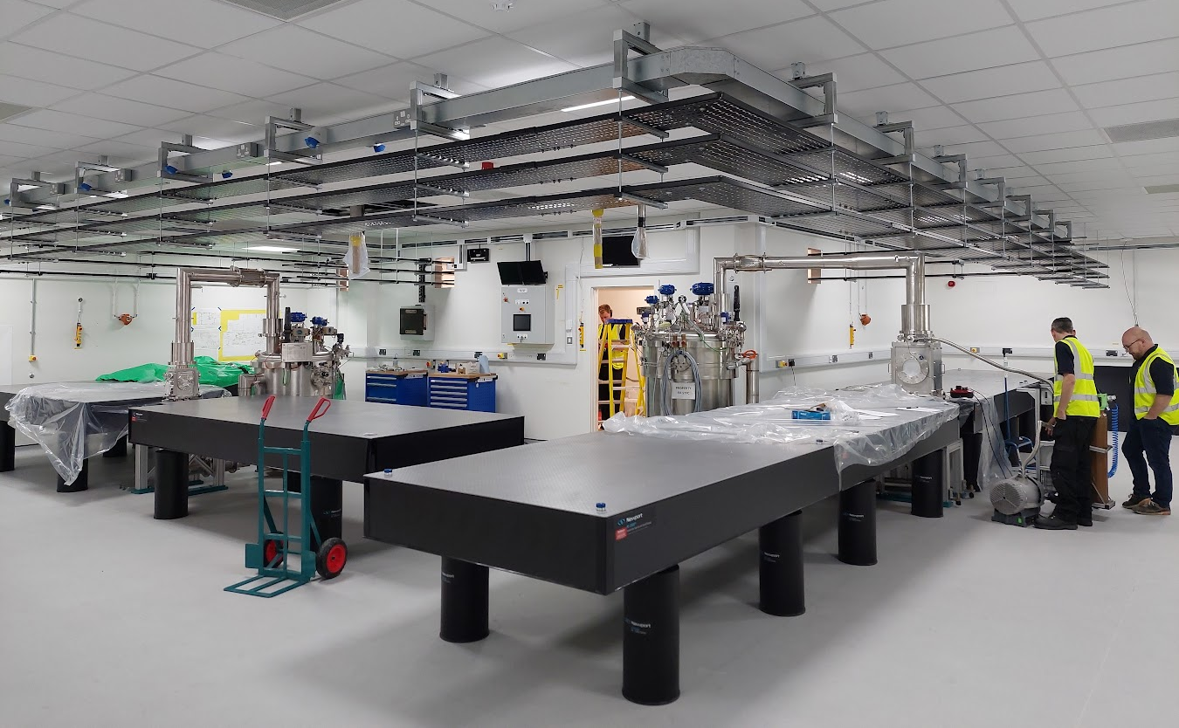
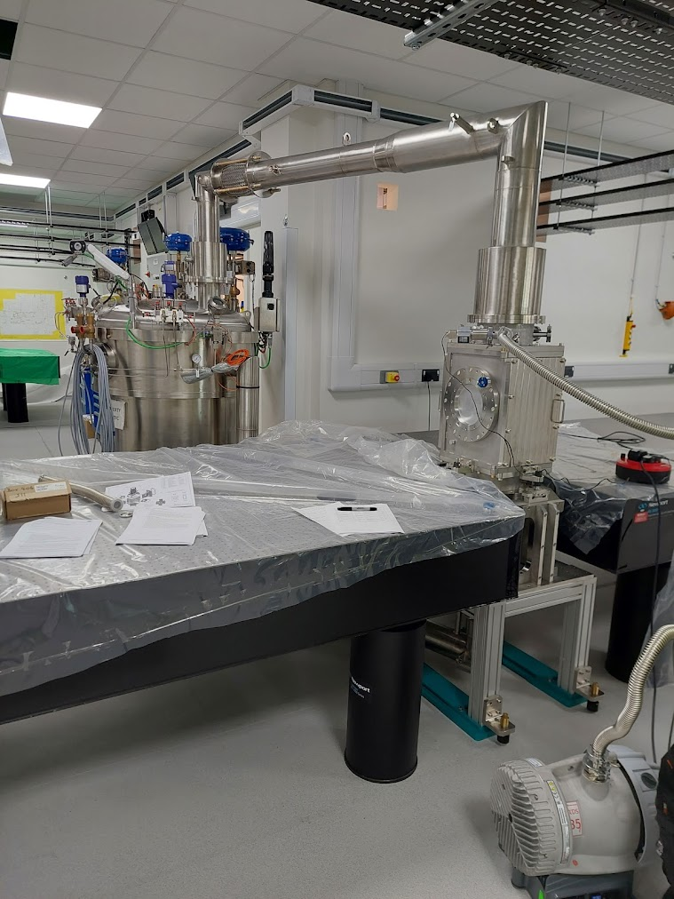
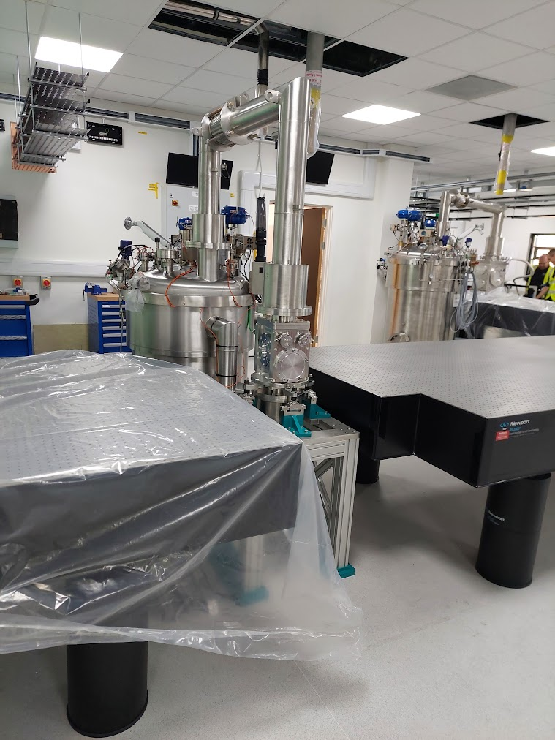
Pump laser equipment install
Optical tables installed into the room
  Including pre-built front end table
Amplifier heads and cryostats installed
  Including base plate fixed to the floor to allow easy repositioning
Notes:
Using alignment survey nests essential for ensuring equipment in the correct place. – issue with the floor level

Slide 10
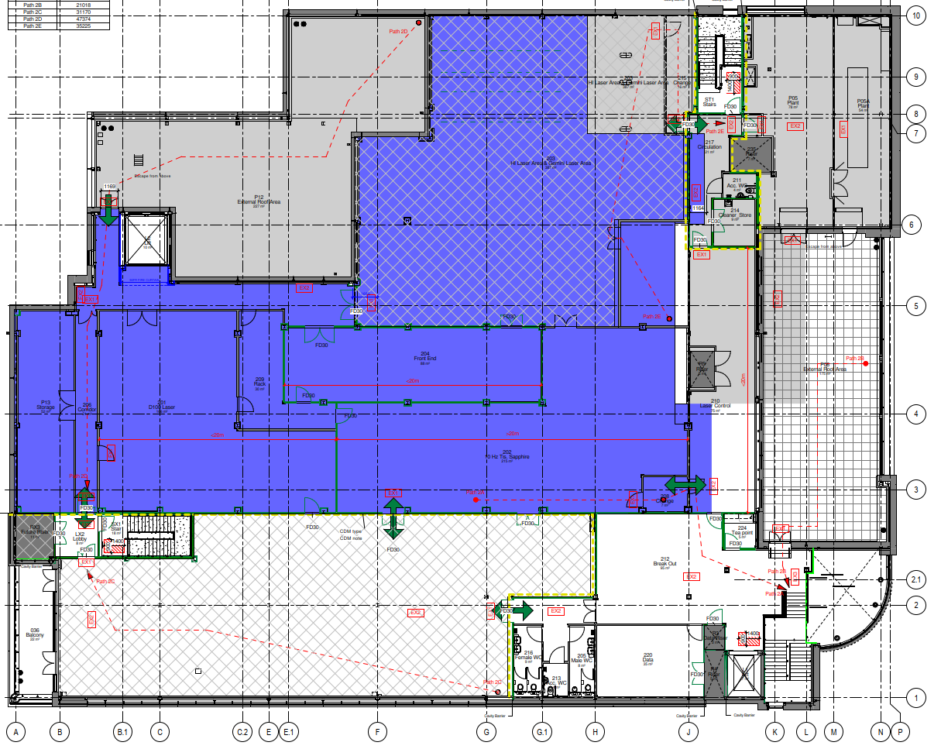
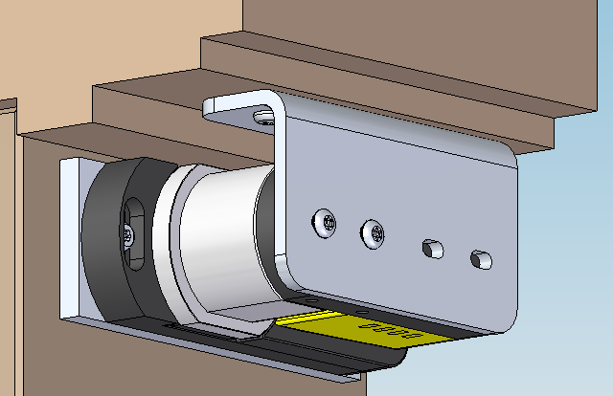
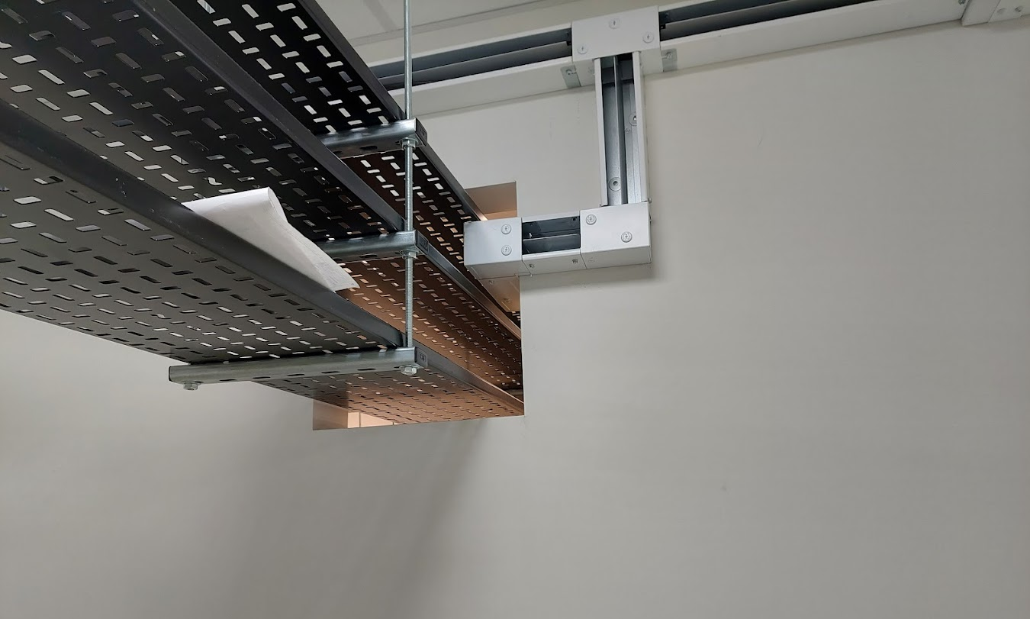
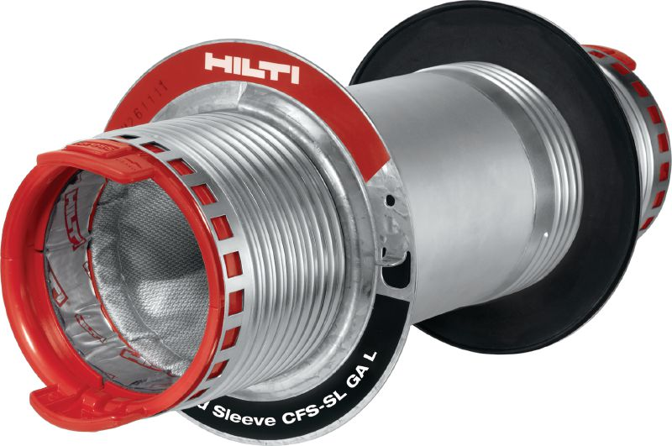
Challenging Installation: Fire proofing
Fire compartments on the 2nd floor are breached as a result of the apertures between rooms for services and lasers
Fire stopping deployed must allow for future installation of services
Fire doors fixtures are subject to particular regulations
Modification of fire doors for interlocks
Fire proofing multi-layer gantry

Slide 11
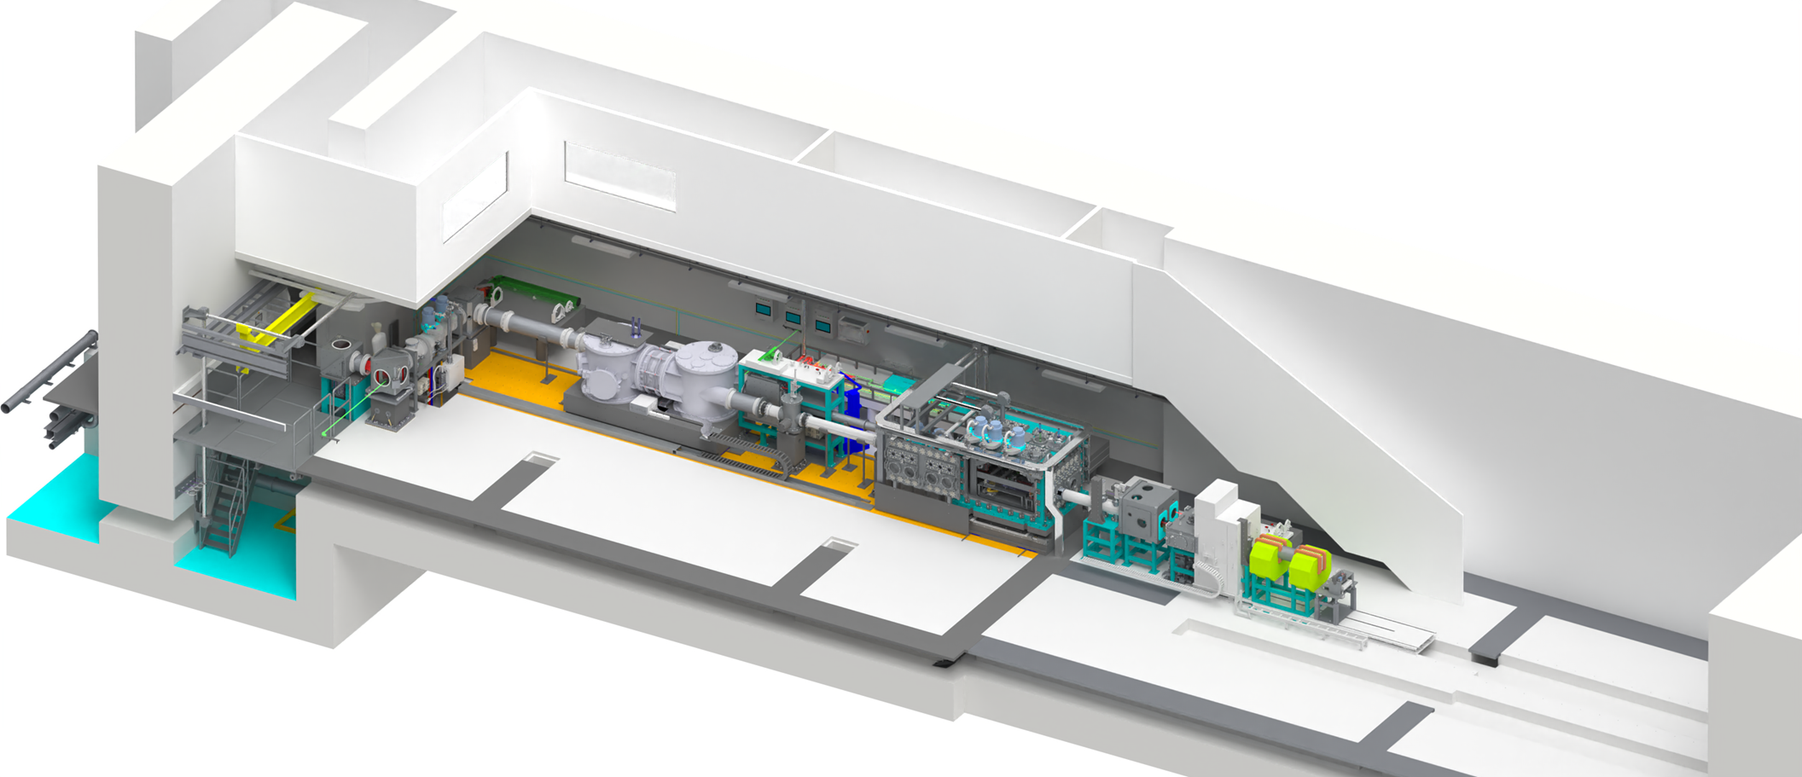
Ground Floor look ahead 2022 - 2024
Jan '23
Apr '23
Jul '23
Oct '23
Jan '24
Apr '24
Jul '24
Oct '24
Floor Preparation
Nov 22 - Jan 23
EA1 Main Services
Jan – Dec 23
Target Chamber
Sep 23 – Jan 24
EA1 Specific Services
Feb – Mar 24
Beam Propagation Pit & Diagnostics
Activity | Start | End
Installation | Sep 23 | Nov 23
Focusing Chamber
Jul – Sep 23
Beam Propagation Pit
Sept – Nov 23
Beam Propagation
Dec 23 – Mar 24
Beam Prop ready
Tue 27/08/24
EA1 complete
Tue 17/12/24
Target Chamber and Internals
Activity | Start | End
Installation | Sep 23 | Jan 24
Focussing Chamber and Translating Base
Activity | Start | End
Floor Preparation | Nov 22 | Jan 23
Installation | Jul 23 | Sep 23
Beam Propagation
Activity | Start | End
Installation | Dec 23 | Mar 24

Slide 12
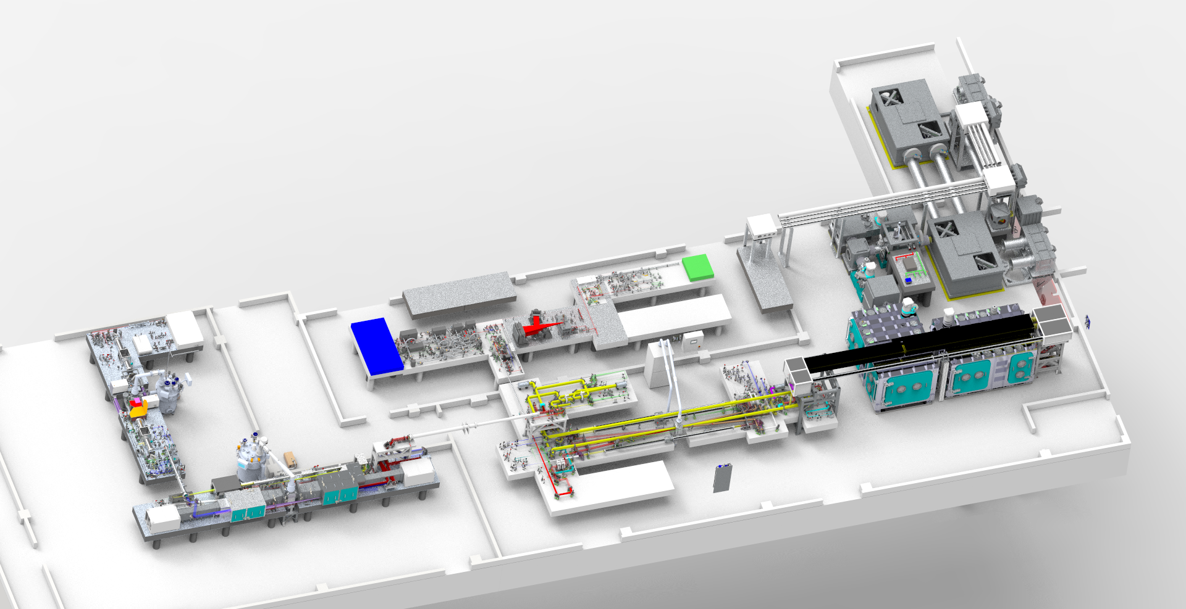
Second floor look ahead 2022 to 2023
Beam Propagation
Activity | Start | End
Preparation Work | Jan 23 | Mar 23
Installation | Jun 23 | Sept 23
Front End
Activity | Start | End
Services | Jan 23 | Mar 23
Installation | Mar 23 | Oct 23
Pump Laser
Activity | Start | End
Services | Aug 22 | Dec 22
Installation | Nov 22 | Jun 23
Floor plan with key dates shown
Compressor & Switchyard Area
Activity | Start | End
Preparation Work | Jan 23 | Mar 23
Sep '22
Nov '22
Jan '23
Mar '23
May '23
Jul '23
Sep '23
Nov '23
Pump Laser Services
Aug – Dec 22
Front End Services
Jan – Apr 23
Ti-Sapphire Services
Apr – Aug 23
Pump Laser Installation
Nov 22 – Jun 23
Beam Propagation Installation Jun – Sept 23
Compressor & Beam Prop Prep Jan – Mar 23
Ti-Sapphire Installation
May – Aug 23
Front End Installation
Mar – Oct 23
Pump ready
Thu 28/09/23
Front End ready
Fri 27/10/23

Slide 13
Switchyard
Activity | Start | End
Services | Oct 23 | Sept 24
Installation | Jan 24 | Jun 24
Second floor look ahead 2023 to 2024
Sep '23
Nov '23
Jan '24
Mar '24
May '24
Jul '24
Sep '24
Nov '24
Riser Services Sept – Nov 23
Compressor Installation
Nov 23 – Jan 24
Switchyard and Compressor Input Installation
Feb – Jun 24
Switch & Comp Services
Jun – Sept 24
Ti-Sapphire Installation B
Sept – Nov 23
Pump ready
Thu 28/09/23
Front End ready
Fri 27/10/23
Ti-Sapphire ready
Tue 04/06/24
Beam Prop ready
Tue 27/08/24
Ti-Sapphire
Activity | Start | End
Services | Mar 23 | July 23
Installation | May 23 | Nov 23
Compressor
Activity | Start | End
Preparation Work | Jan 23 | Mar 23
Chambers Install | Nov 23 | Jan 24
Internals Install | Jan 24 | Apr 24

Slide 14
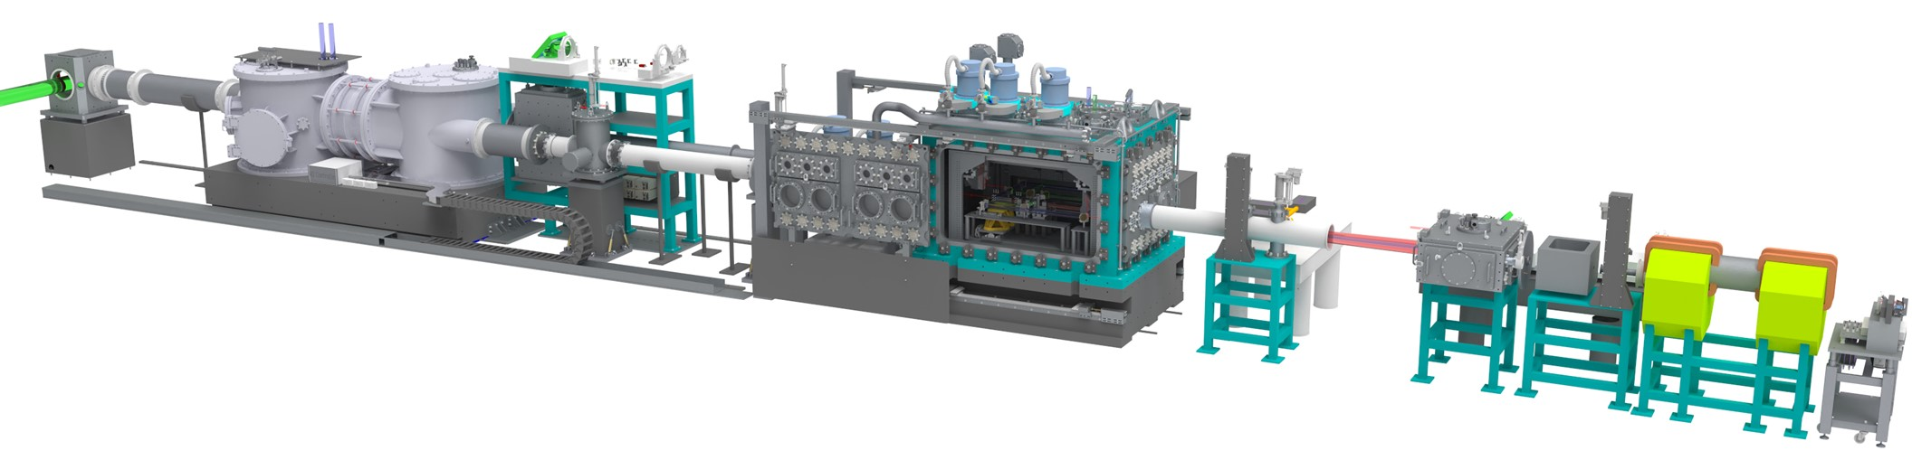
Challenging Installations
Majority of installation activities within normal CLF scope through facility upgrades and projects such as HILASE and D100X:
  Optical tables & support structures,
  Mounts and optics,
  Large vacuum chambers and vacuum systems
  Mechanical and electrical services
  Cryostats and cooling systems
Challenging installations are where:
  Large crane operations and very complex lifting activity
  Restricted access or limited local lifting provision
  Civil engineering or building activities required

Slide 15
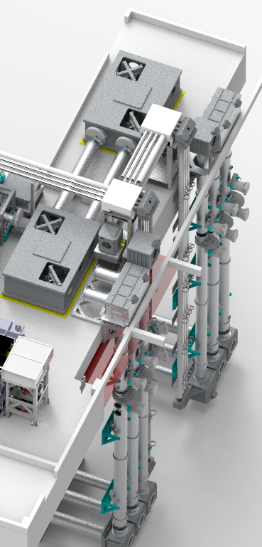
Challenging Installation: Beam Propagation
Priority installation activity as requires space for a crane at top of the riser
Challenging due to:
  Assembly spanning three floors
  Assembly passing through bunker wall
  Restricted height at second floor
  Restricted access in some areas
  Maintaining cleanliness for vacuum use
  Delicate sealing surfaces

Slide 16
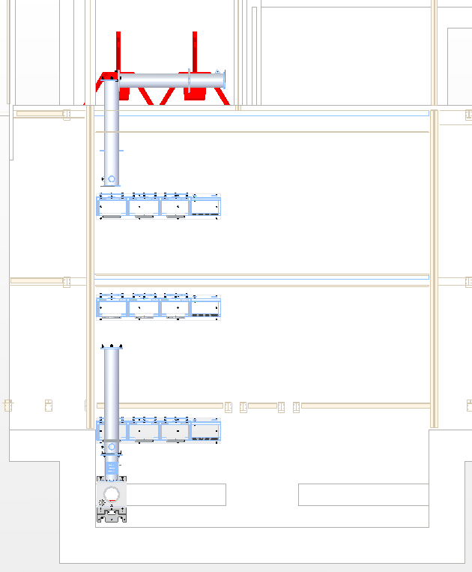
Challenging Installation: Beam Propagation
Install activities
  Chemical anchors support brackets
  Lifting
  Alignment with survey network
  Sealing and leak checking of each section
  Fire Proofing
Requires a combination of:
  External expertise
  CLF expertise
Second Floor
First Floor
Ground Floor
Pit Floor

Slide 17
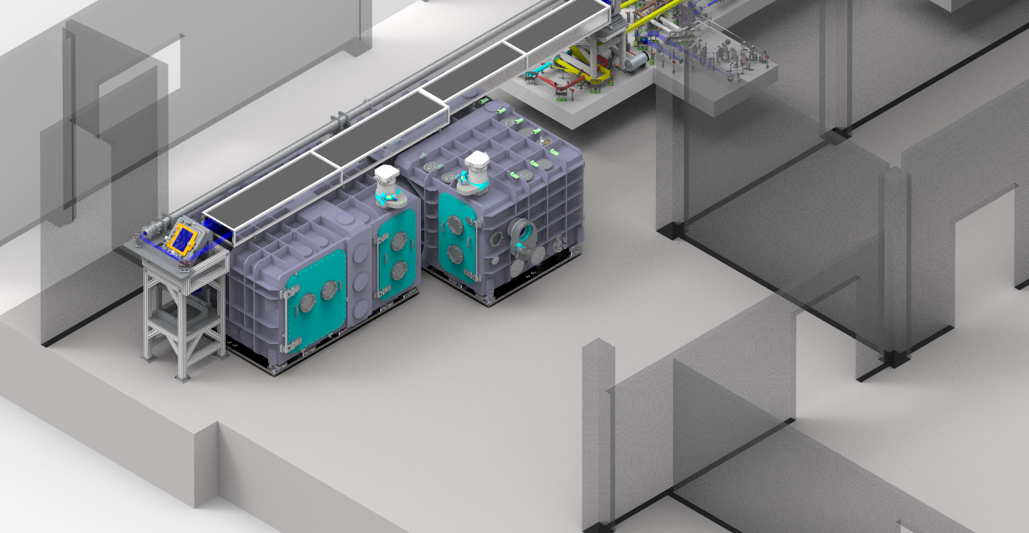
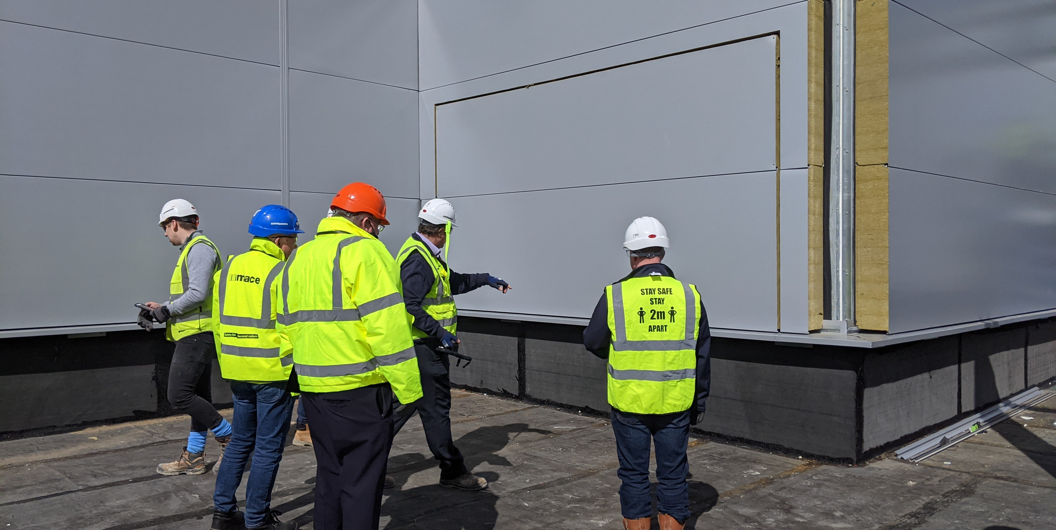
Challenging Installation: Compressor Chamber
Install activities
  Preparation of floor & cast base plates
  Removal of demountable wall and building cladding
  Delivery to site
  Lift onto roof and through aperture
  Position, Survey and Affix to base supports
  Site acceptance Test (Leak Check)
  Installation of internal components

Slide 18
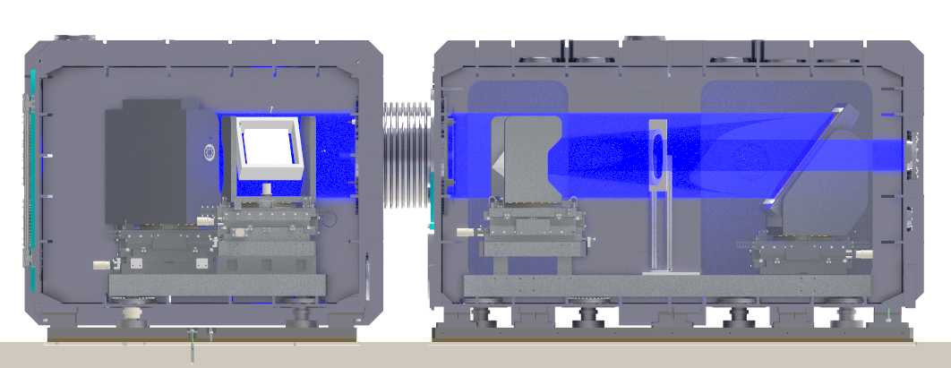
Challenging Installation: Compressor Chamber
Challenging due to:
  No overhead lifting provision in laboratory
  Access through an aperture in weather sealed wall
  External crane loading area floor loading
  Restricted height in laboratory
  Inclement weather in November
Structural Engineering Assessments
Planning to engage lifting company
Aperture in cladding
External Crane loading area

Slide 19
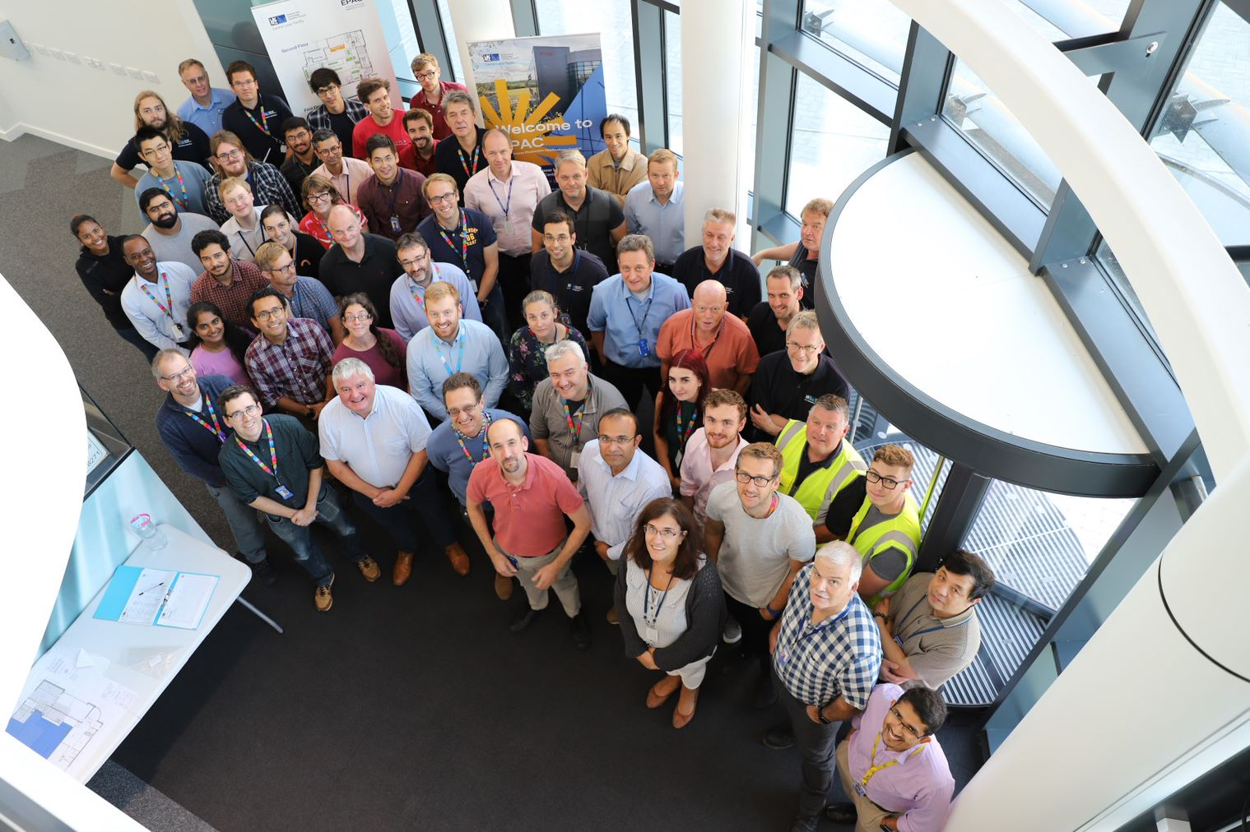
Installation Summary
Survey network established and in use
Baseline vibration dataset obtained allowing changes to be monitored
Experienced staff with required skill sets for majority of installation activities
External expertise being obtained for challenging installations

Slide 20





Thank you
Extreme Photonics Applications Centre (EPAC)
Science and Technology Facilities Council
@STFC_Matters
Science and Technology Facilities Council
Notes:
The abstract pattern can be removed or repositioned if required. Be careful to ‘Send to Back’ so that it does not obscure any important information.

Slide 21
Second floor look ahead 2022 - 2023
Sep '22
Nov '22
Jan '23
Mar '23
May '23
Jul '23
Sep '23
Nov '23
Start
Mon 08/08/22
Pump Laser Services
Mon 15/08/22 - Fri 23/12/22
Front End Services
Mon 09/01/23 - Mon 03/04/23
Ti-Sapphire Services
Tue 04/04/23 - Mon 07/08/23
Pump Laser Installation
Mon 07/11/22 - Fri 16/06/23
Beam Propogation Installation
Fri 30/06/23 - Fri 22/09/23
Compressor & Beam Prop Prep
Mon 16/01/23 - Fri 31/03/23
Ti-Sapphire Installation A
Fri 05/05/23 - Thu 03/08/23
Floor plan with key dates shown
Front End Installation
Fri 31/03/23 - Fri 27/10/23
Front End ready
Fri 27/10/23
Pump ready
Thu 28/09/23

Slide 22
Second floor look ahead 2023 - 2024
Sep '23
Nov '23
Jan '24
Mar '24
May '24
Jul '24
Sep '24
Nov '24
Riser Services
Mon 25/09/23 - Fri 17/11/23
Compressor Installation
Fri 24/11/23 - Wed 31/01/24
Switchyard and Compressor Input Installation
Thu 01/02/24 - Wed 19/06/24
Switch & Comp Services
Thu 20/06/24 - Wed 11/09/24
Ti-Sapphire Installation B
Mon 25/09/23 - Fri 17/11/23
Beam Prop ready
Tue 27/08/24
Pump ready
Thu 28/09/23
Front End ready
Fri 27/10/23
Ti-Sapphire ready
Tue 04/06/24
EA1 complete
Tue 17/12/24

Slide 23
Ground Floor look ahead 2022 - 2024
Jan '23
Apr '23
Jul '23
Oct '23
Jan '24
Apr '24
Jul '24
Oct '24
Floor Preparation
Mon 21/11/22 - Fri 20/01/23
EA1 Main Services
Mon 23/01/23 - Fri 22/12/23
EA1 Specific Services
Fri 02/02/24 - Thu 28/03/24
Focussing Chamber
Fri 07/07/23 - Thu 31/08/23
Beam Propagation Pit
Fri 01/09/23 - Thu 26/10/23
Target Chamber
Fri 10/11/23 - Thu 01/02/24
Beam Propagation
Fri 02/02/24 - Thu 28/03/24
Beam Prop ready
Tue 27/08/24
EA1 complete
Tue 17/12/24

