Slide 1
EPAC operations: Diagnostics, alignment and shot mode

Slide 2
Content
Operational laser modes
Daily start up and alignment procedure
Full power shot checks
Repetition rate change procedure
Diagnostics
Auto-alignment

Slide 3
Operational laser modes
Experience gained from Gemini operations has shown that the users require access to range of energies to setup, characterise and perform their experiments
To provide a range of energy to the users, the laser will be operated under a selection of power modes
4 modes have been defined that range from μJ to the J level
Each mode offers a selection of activities that can be undertaken in the Experimental Areas

Slide 4
Operational Laser Power Modes
Mode 1
Maximum energy of system
Used for data taking
Potential for creating radiological hazard
Mode 2
Maximum energy from Front End
Used for testing/calibration
Mode 3
1% of Front End energy to allow limited procedures in experimental areas
Used for tuning and timing
Laser hazard
Mode 4
0.05% of Front End energy to a level that it is ‘safe’ to work in experimental areas
Used for alignment

Slide 5
EPAC daily start-up and alignment
Alignment for each section follows a standardised procedure:
Verify the alignment of the section with its internal CW
Receive pulsed beam from previous section
Match the pulsed beam to input references in the current section
Verify pulsed beam alignment through the section
Each section can be aligned in parallel
The alignment is done with CW first
Each section of the system has CW lasers and fixed input references
Reliable and stable input beam
Matching and handover
Beam from previous area is matched to the fixed input references using pairs of dedicated mirrors

Slide 6
Remote warm-up
EPAC daily start-up and alignment
Warm up front end pumps
Warm up front end oscillator
Start Pump
cryostats
EA internal
CW verification
Front-end
Ti:Sapphire
Pump
Experimental area
Verify CW to EA input diagnostics
TI:S CW
verification
Compressor
CW verification
CW available
CW verification
Front end seed and ps OPA
Verify pulsed beam to EA input diagnostics
Align FE to
Ti:S input diagnostics
Ti:S verification
with FE beam
Compressor verification with
FE beam
Compression measurement
Modes 2 3 4
available
(low power)
Front end
ns OPA
Wavefront
measurement
Low power verification
Compression and wavefront measurements
Pump FE
verification
Output diagnostics verification
10J verification
Pump laser IR ready
SHG verification
Full power
run-up
Ti:S full power checks
Full power through compressor
Compressed
full power
checks
Full power available for shot start procedure
100J verification

Slide 7
EPAC full power shot checks
Pump FE verification
Front end/pre amp start up
Check front end alignment
Front end pulsed mode/energy ramp
10 J verification
Switch on/Stabilise 10 J pumps
Check 10J alignment - CW only
Check overlap 10J CW and FE pulsed
100J verification
Search pump room
Switch on/ Stabilise 100J pumps
Check 100J alignment - CW only
Check overlap 100J CW and TJ pulsed
Set CW pump beam for SHG alignment
Front-end
Ti:Sapphire
Pump
Experimental area
Ti:S multi-pass initial checks
Switch on Ti:S crystal cooling
Check CW alignment of Ti:S multipass
Set VSF lenses for HP mode
Set AO for HP mode
EA1
(Start tape drives)
Ti:S multi-pass pulsed checks
Align pulsed beam through multi-pass
Check wavefront and optimise
Output beam energy stable
Output beam profile good
Pinhole beam centricity good
Lock output pointing
Open wall shutter to Target Area
Front end checks
Output energy correct and stable
Output beam profile good
Output spectrum shape good/stable
Output pointing good/locked
Insert fast output beam dump
Remove post compressor beam dump
Remove fast output beam dump
Close wall shutter from front end
Move in Ti:S output beam diverter
SHG checks
Align beam using Green CW to Ti:S
Turn on Dark field through SHG
Check/set Ti:S cooling for FP
Short pulse checks
Check compressor CW alignment
Check compression
PFT checks
Optimise post comp wavefront
Alignment checks
NF & FF into area are good (FP leakage diagnostics)
Activate beam pointing stabilisation
Activate defocus stabilisation
Turn on gas
Compressed full power checks
Remove fast output beam dump
Propagate full Energy through compressor
Allow for thermal equilibrium
Set/measure pulse duration
Check PFT
Check/correct wavefront
Insert fast output beam dump
Insert post compressor beam dump
Remove fast output beam dump
Hand control to EA1
Open wall shutter to pump room
Ti:S full power checks
Check HP alignment of multi-pass
Set diagnostics for FP
Set VSF lenses for timed FP
Time pump beams for FP
Check FP beam energy to be correct
Measure/set wavefront to be correct
Check beam NF profiles
Switch on output pointing
Full power shots
Check CW IR pump beam to LBO crystal
Check alignment of pulse beam at ~5 J
Open diverter
Align to the Ti:S 20% efficiency ~1 J green
Close diverter to green dump
Ramp up pump for required green energy
Output energy correct/ Check pulse shape
Set multi-pass VSF lenses for de-timed alignment
Pump Ti:S with beams de-timed
Allow fully pumped Ti:S crystal to hit thermal stability
mode
Post shot wind down procedures

Slide 8
EPAC full power shot checks
Pump FE verification
Front end/pre amp start up
Check front end alignment
Front end pulsed mode/energy ramp
10 J verification
Switch on/Stabilise 10 J pumps
Check 10J alignment - CW only
Check overlap 10J CW and FE pulsed
100J verification
Search pump room
Switch on/ Stabilise 100J pumps
Check 100J alignment - CW only
Check overlap 100J CW and TJ pulsed
Set CW pump beam for SHG alignment
Front-end
Ti:Sapphire
Pump
Experimental area
Ti:S multi-pass initial checks
Switch on Ti:S crystal cooling
Check CW alignment of Ti:S multipass
Set VSF lenses for HP mode
Set AO for HP mode
EA1
(Start tape drives)
Ti:S multi-pass pulsed checks
Align pulsed beam through multi-pass
Check wavefront and optimise
Output beam energy stable
Output beam profile good
Pinhole beam centricity good
Lock output pointing
Open wall shutter to Target Area
Front end checks
Output energy correct and stable
Output beam profile good
Output spectrum shape good/stable
Output pointing good/locked
Insert fast output beam dump
Remove post compressor beam dump
Remove fast output beam dump
Close wall shutter from front end
Move in Ti:S output beam diverter
SHG checks
Align beam using Green CW to Ti:S
Turn on Dark field through SHG
Check/set Ti:S cooling for FP
Short pulse checks
Check compressor CW alignment
Check compression
PFT checks
Optimise post comp wavefront
Alignment checks
NF & FF into area are good (FP leakage diagnostics)
Activate beam pointing stabilisation
Activate defocus stabilisation
Turn on gas
Compressed full power checks
Remove fast output beam dump
Propagate full Energy through compressor
Allow for thermal equilibrium
Set/measure pulse duration
Check PFT
Check/correct wavefront
Insert fast output beam dump
Insert post compressor beam dump
Remove fast output beam dump
Hand control to EA1
Open wall shutter to pump room
Ti:S full power checks
Check HP alignment of multi-pass
Set diagnostics for FP
Set VSF lenses for timed FP
Time pump beams for FP
Check FP beam energy to be correct
Measure/set wavefront to be correct
Check beam NF profiles
Switch on output pointing
Full power shots
Check CW IR pump beam to LBO crystal
Check alignment of pulse beam at ~5 J
Open diverter
Align to the Ti:S 20% efficiency ~1 J green
Close diverter to green dump
Ramp up pump for required green energy
Output energy correct/ Check pulse shape
Set multi-pass VSF lenses for de-timed alignment
Pump Ti:S with beams de-timed
Allow fully pumped Ti:S crystal to hit thermal stability
mode
Post shot wind down procedures

Slide 9
EPAC full power shot checks
Pump FE verification
Front end/pre amp start up
Check front end alignment
Front end pulsed mode/energy ramp
10 J verification
Switch on/Stabilise 10 J pumps
Check 10J alignment - CW only
Check overlap 10J CW and FE pulsed
100J verification
Search pump room
Switch on/ Stabilise 100J pumps
Check 100J alignment - CW only
Check overlap 100J CW and TJ pulsed
Set CW pump beam for SHG alignment
Front-end
Ti:Sapphire
Pump
Experimental area
Ti:S multi-pass initial checks
Switch on Ti:S crystal cooling
Check CW alignment of Ti:S multipass
Set VSF lenses for HP mode
Set AO for HP mode
EA1
(Start tape drives)
Ti:S multi-pass pulsed checks
Align pulsed beam through multi-pass
Check wavefront and optimise
Output beam energy stable
Output beam profile good
Pinhole beam centricity good
Lock output pointing
Open wall shutter to Target Area
Front end checks
Output energy correct and stable
Output beam profile good
Output spectrum shape good/stable
Output pointing good/locked
Insert fast output beam dump
Remove post compressor beam dump
Remove fast output beam dump
Close wall shutter from front end
Move in Ti:S output beam diverter
SHG checks
Align beam using Green CW to Ti:S
Turn on Dark field through SHG
Check/set Ti:S cooling for FP
Short pulse checks
Check compressor CW alignment
Check compression
PFT checks
Optimise post comp wavefront
Alignment checks
NF & FF into area are good (FP leakage diagnostics)
Activate beam pointing stabilisation
Activate defocus stabilisation
Turn on gas
Compressed full power checks
Remove fast output beam dump
Propagate full Energy through compressor
Allow for thermal equilibrium
Set/measure pulse duration
Check PFT
Check/correct wavefront
Insert fast output beam dump
Insert post compressor beam dump
Remove fast output beam dump
Hand control to EA1
Open wall shutter to pump room
Ti:S full power checks
Check HP alignment of multi-pass
Set diagnostics for FP
Set VSF lenses for timed FP
Time pump beams for FP
Check FP beam energy to be correct
Measure/set wavefront to be correct
Check beam NF profiles
Switch on output pointing
Full power shots
Check CW IR pump beam to LBO crystal
Check alignment of pulse beam at ~5 J
Open diverter
Align to the Ti:S 20% efficiency ~1 J green
Close diverter to green dump
Ramp up pump for required green energy
Output energy correct/ Check pulse shape
Set multi-pass VSF lenses for de-timed alignment
Pump Ti:S with beams de-timed
Allow fully pumped Ti:S crystal to hit thermal stability
mode
Post shot wind down procedures

Slide 10
Repetition rate change
The system will feature set points for various parts, to automate part of the process of changing repetition rate
After the set point changes, alignment is confirmed before full energy ramp-up
Can be done in parallel across various sections

Slide 11
Repetition rate change procedure
Front-end
Ti:Sapphire multipass
Pump
SHG
Change Pockels cell trigger rate
Change fast diverter operation
No change to OPA operation
Change pump timings
Change AO settings
Change pre-LBO waveplate setting
Full alignment confirmation
Full energy
run-up
Send pump to LBO and let green output stabilise
Change LBO angle and temperature
Change lens positions
Check cryostat cooling flow
Change pump transport lens position
Change Ti:S cooling parameters
Change astigmatism corrector settings
CW and pulsed alignment check
Full energy run-up
Move Ti:S telescope lenses to set positions
Adjust PFT compensator
Change AO settings

Slide 12
EPAC Diagnostics
The diagnostics perform range functions in EPAC
Depending on the diagnostic type it serves one or more of these functions
The Control System has overarching view of diagnostics to ensure each section of laser is operating to the specified requirements and safely

Slide 13
Diagnostic role classification
Verification and performance
Setup and alignment
Machine safety
Automation
FROG
Beam specification
Pointing Camera
Increased system stability
Useful / Helpful
Known failure modes
Dark-fields

Slide 14
System Performance
Spatial
Data acquisition
Front End
Energy
E
Verification and performance
Spectral
ν
Control System
Spatial
Machine safety
Temporal
t
Automation
TiSa Amp
Energy
Setup and alignment
Spectral
Temporal
Spatial
Spatial
Energy
Compressor
Energy
Spatial
Temporal
Pump
Spectral
Energy
Experimental Area
Temporal

Slide 15
Auto-alignment and fast stabilisation
EPAC features two methods to stabilise beam pointing
Auto-alignment
Uses cameras and motorised mirrors
Uses the main beam
Compensates slow drifts and variations
Fast stabilisation
Uses position-sensitive detectors and a piezo-driven mirror
Uses 2 dedicated CW beams
Suppresses vibrations and jitter fast than 10 Hz

Slide 16
Auto-alignment strategy
Objectives
Maintain pointing through the system during an operations day
Compensate slow drifts (sub-Hz operating frequency)
The initial approach: less is more
Design a stable laser and add loops in key locations to the automated system
Become more familiar with the system and adapt
Can be upsized or downsized as we gather more experience
Many mirror mounts include actuators for accessibility reasons, can be changed from remote-operated to automatic

Slide 17
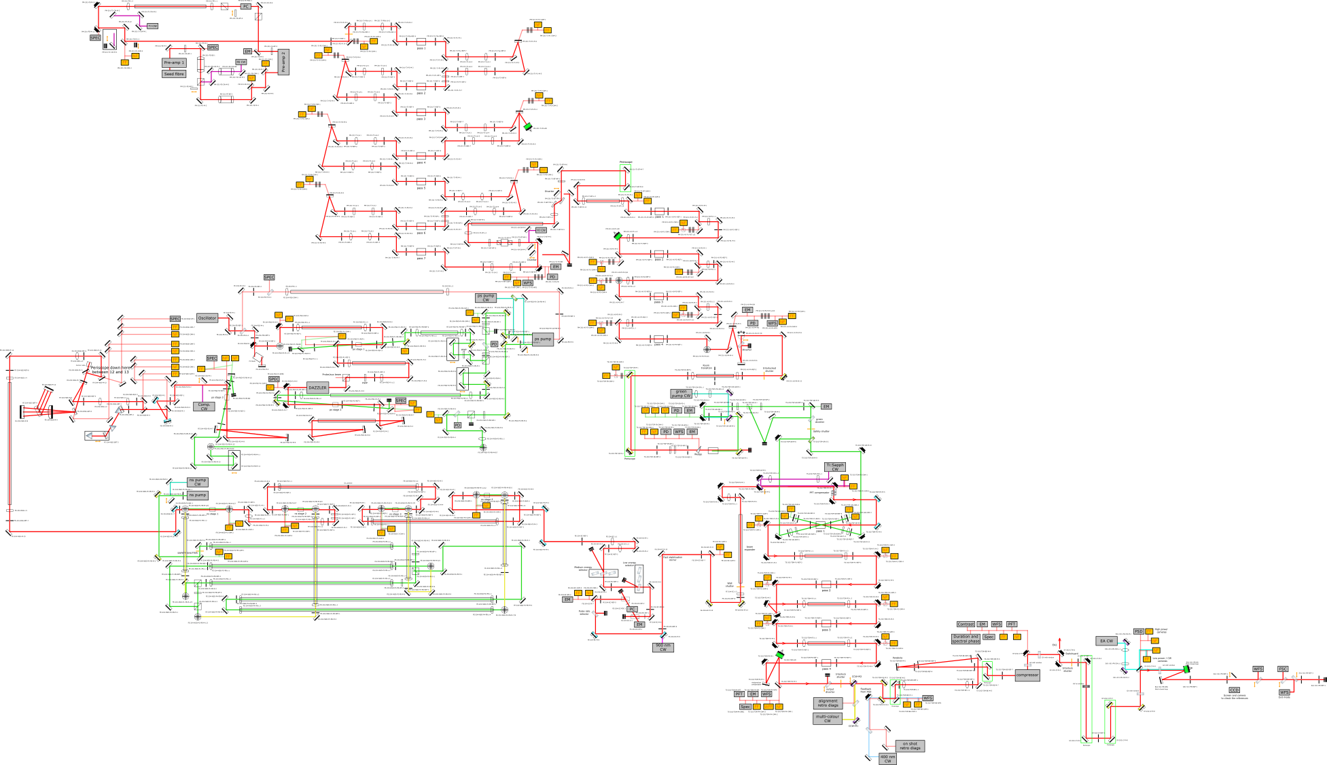
Auto-alignment implementation

Slide 18
Auto-alignment implementation
Initial positions for mirror actuators and cameras have been defined
Auto-align algorithm already demonstrated in testbed systems for various scenarios of perturbations and calibrations
Notes:
Mention redundant physical references as well

Slide 19
EPAC auto-alignment and stabilisation
Auto-alignment
control system
Drift compensation
Closed feedback
loop
Closed feedback
loop
Closed feedback
loop
Closed feedback
loop
Closed feedback
loop
Closed feedback
loop
Beam position on cameras
Actuators on mirror mounts
EPAC pump
Front-end
Ti:Sapphire
multi-pass
Compressor
Beam
transport
Experimental
area
Interaction chamber

Slide 20
Fast stabilisation strategy
Objectives
On-shot stabilisation
Suppress jitter and vibrations faster than 10 Hz
Dedicated CW beams used to stabilise faster than the system’s repetition rate
900 nm CW to measure jitter at the Ti:Sapph multi-pass
400 nm CW to measure jitter at the compressor and beam transport
Piezo-driven mirror with a 1 kHz operating frequency after the front-end

Slide 21
EPAC auto-alignment and stabilisation
Auto-alignment
control system
Drift compensation
Closed feedback
loop
Closed feedback
loop
Closed feedback
loop
Closed feedback
loop
Closed feedback
loop
Closed feedback
loop
Beam position on cameras
Actuators on mirror mounts
EPAC pump
Front-end
Ti:Sapphire
multi-pass
Compressor
Beam
transport
Experimental
area
Interaction chamber
1 kHz piezo
actuator
900 nm
CW
Position-sensitive detector
400 nm
CW
Position-sensitive detector
Fast stabilisation
control system
On-shot stabilisation
(up to 1 kHz frequency)

Slide 22
Conclusion
We have defined the operational laser modes of EPAC
We have defined a set of facility procedures focusing standardisation and enabling parallel tasks
Daily start up and alignments
Full power shot checks
Repetition rate change procedure
We have an integrated approach to the diagnosis of the laser
We have an auto-alignment and stabilisation system under development

