Slide 1
Data Management in EPAC
ISTAC report

Slide 2
Outline
Overview of the Data Management in EPAC
Update on Data Management System Development and Testing
End-to-End Testing
CT in EPAC
Next steps

Slide 3
Recap:Top-Level Data Management Architecture
Fast & extensible Pipelines
Data services
Instruments (DAQ)
Data analysis
Direct access
Broker
Short-term data store
Long-term data store
Data archive
Expandable
~100-200TB
Data access
Being spec’d
Located in EPAC building
Located in Scientific Computing Building
Most of these are being prototyped

Slide 4
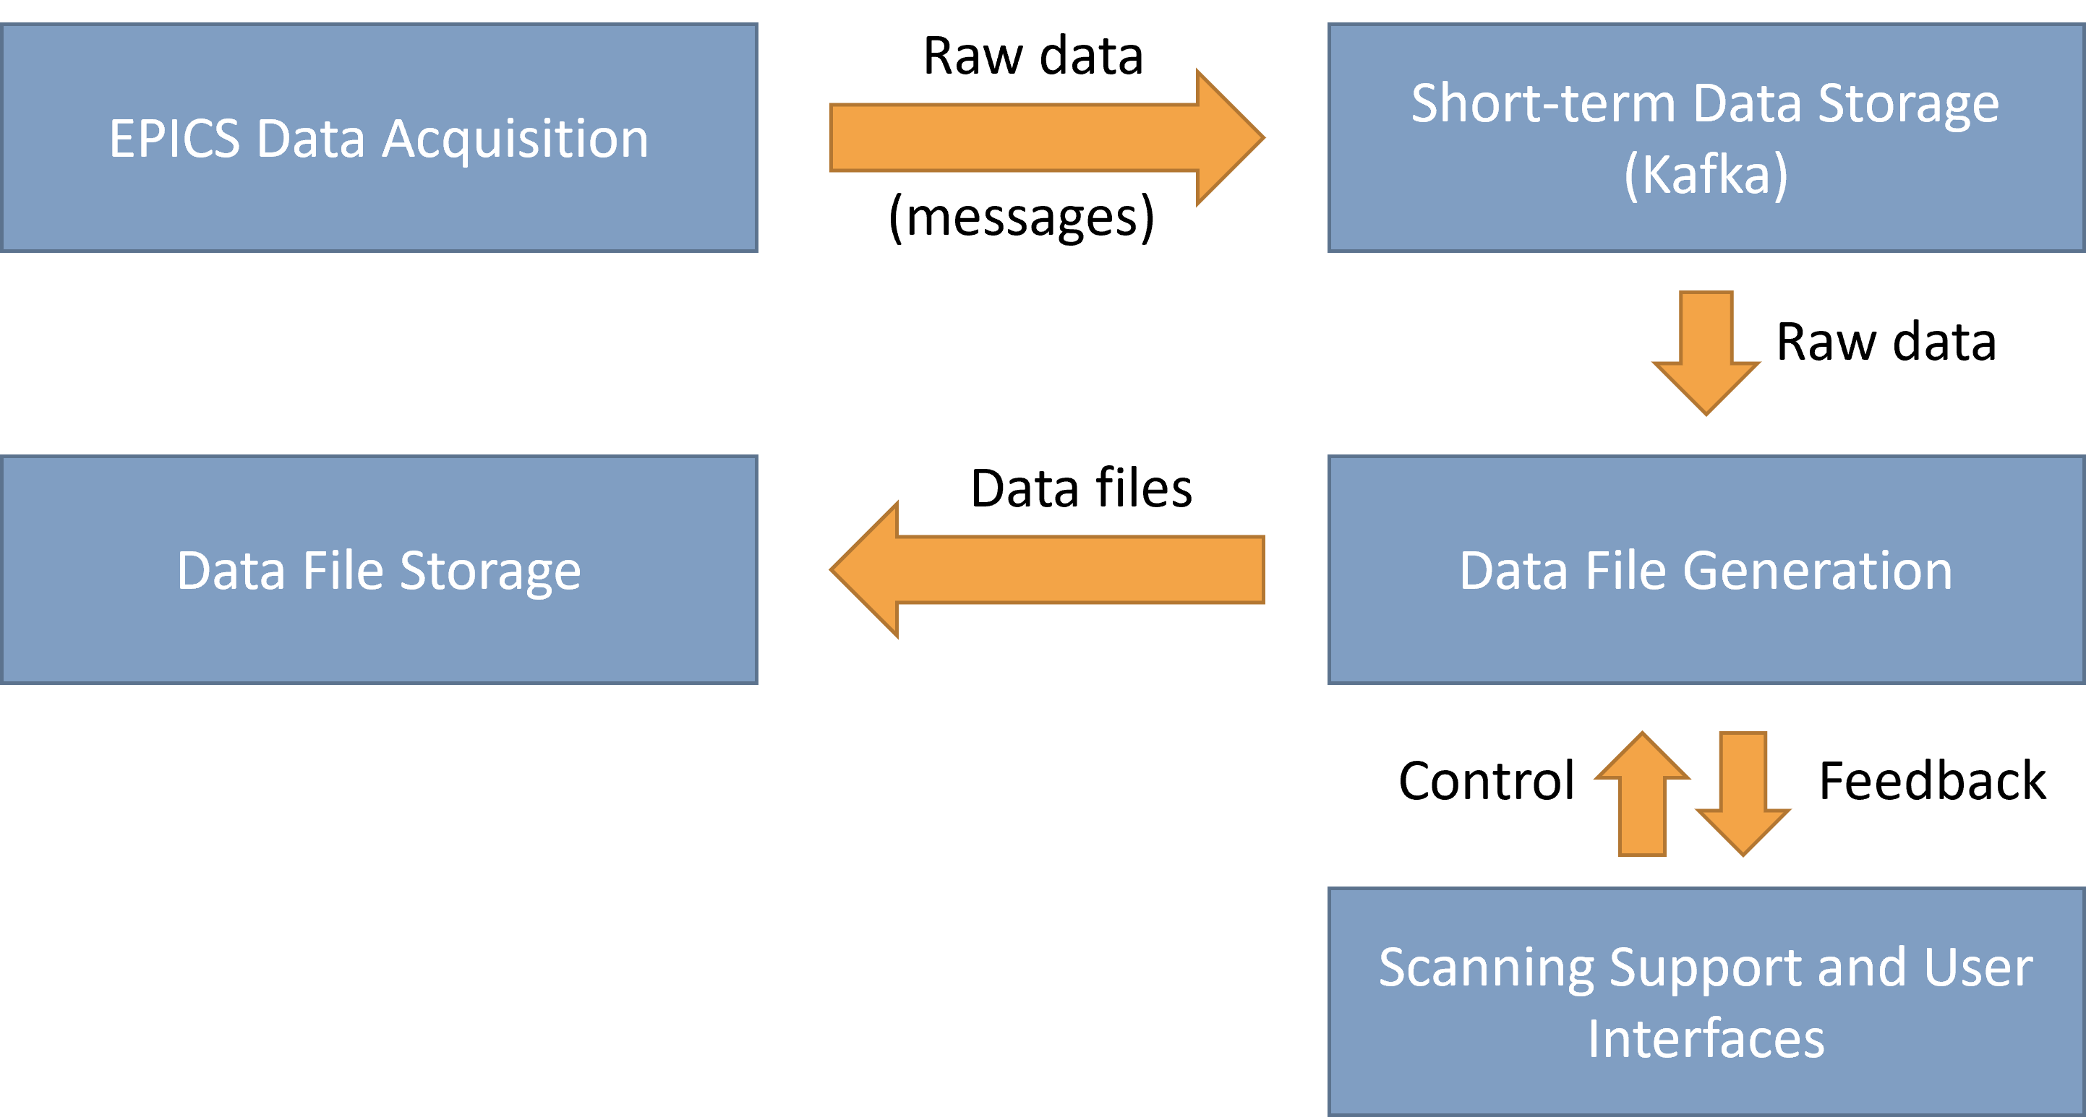
Top Level Data flow and control
Data
Control

Slide 5
Detailed structure of DMS
Data is recorded using EPICS and sent to Kafka
Kafka stores all data briefly. Anything connected to Kafka can choose what data it consumes.
Data in Kafka can be accessed through a user interface during this time
Devices – scalars
IOC
Kafka
Short-term data display
EPICS-Kafka forwarder
Devices – waveforms
IOC
Devices – images
IOC
ADKafka
File writer
Pulse ID generator
DAQ manager: an intermediate DAQ organizer with a developer interface. Useful for commissioning/test experiments.
You can specify the number of laser, destination folder for the data streams etc.
Upload manager
Local file storage
DAQ manager
Control system interface
Facility Data Pipeline (SCD)
Operations Gateway
Developer interface
DAaaS
DAaaS
GUI
Experimental Orchestrator will provide more advanced data control scans and feedback-based experiments.
Specialised GUIs could be provided for different purposes
Experiment orchestrator
GUI
We have an option of a local storage, but the main storage will be in the Scientific Computing Infrastructure.
GUI

Slide 6
Detailed structure of DMS
Data is recorded using EPICS and sent to Kafka
Kafka stores all data briefly. Anything connected to Kafka can choose what data it consumes.
Data in Kafka can be accessed through a user interface during this time
Devices – scalars
IOC
Kafka
Short-term data display
EPICS-Kafka forwarder
Devices – waveforms
IOC
Devices – images
IOC
ADKafka
File writer
Pulse ID generator
DAQ manager: an intermediate DAQ organizer with a developer interface. Useful for commissioning/test experiments.
You can specify the number of laser, destination folder for the data streams etc.
Upload manager
Local file storage
DAQ manager
Control system interface
Facility Data Pipeline (SCD)
Operations Gateway
Developer Interface
Developer interface
DAaaS
GUI
Experimental Orchestrator will provide more advanced data control scans and feedback-based experiments.
Specialised GUIs could be provided for different purposes
DAaaS
Experimental Orchestrator will provide more advanced data control scans and feedback-based experiments.
Specialised GUIs could be provided for different purposes
Experiment orchestrator
GUI
We have an option of a local storage, but the main storage will be in the Scientific Computing Infrastructure.
GUI

Slide 7
Outline
Concepts of Data Management in EPAC
Update on Data Management System Development and Testing
End-to-End Testing
CT in EPAC
Next steps

Slide 8
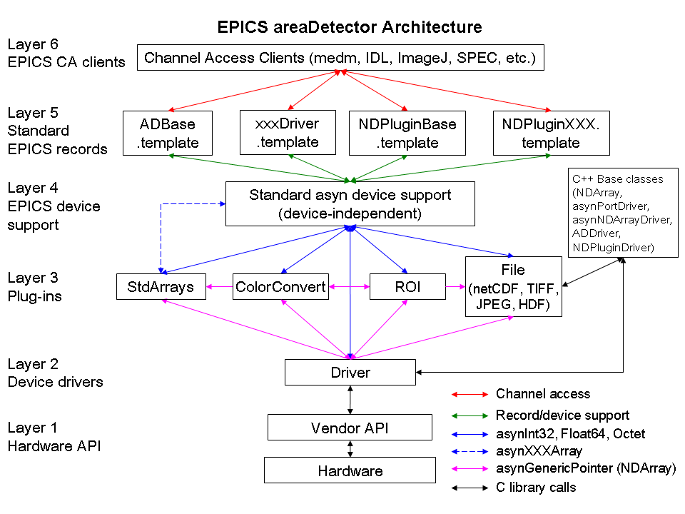
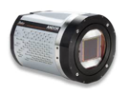
DAQ: EPICS areaDetector will be the first interface
(An EPICS framework to support 2-D detectors)
Widely used in synchrotron and accelerator beamlines (eg. Diamond, ISIS, ESS, ESRF…) and ELI
Basic parameters for all detectors – E.g. exposure time, start acquisition, etc.
Easy to implement new detectors – Single device-driver C++ file to write.
Middle-level plug-ins to add additional capability: Simple analysis, file saving, etc.
– Device independent, work with all drivers
areaDetector will be used for almost all diagnostics in EPAC

Slide 9
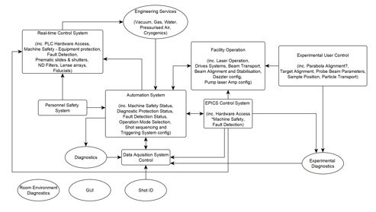
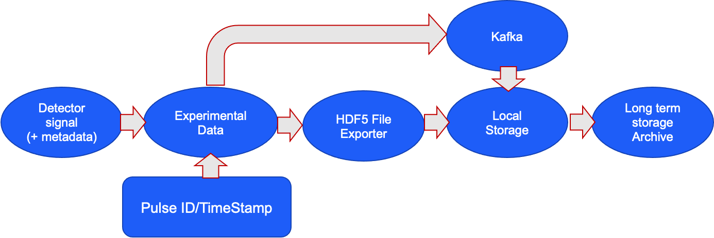
DAQ interfaces with the control system
Three main requirements for the control system
1. Follow a set of instructions provided by DAQ and Experimental Orchestrator*
e.g. rotate a sample through 180 degrees in 1-degree steps and take data for 1 second at each angle
2. Associate each piece of data with a unique Shot ID
3. Provide plugins to DAQ (EPICS AD)
Collaborating with Diamond and ISIS on this
CLF staff in Diamond on secondment
*Described later
Notes:
Tine to update the diagrams

Slide 10
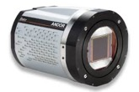
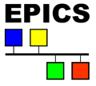
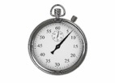
End-to-end data flow
Data Pipeline 1
The DAQ system to send data to live feed or Kafka, along with metadata
Kafka will keep all data in a log. This data buffer means we don't need to write data to files immediately
Data Pipeline 2: Direct File Writing
Data from multiple instruments directly written into NeXus file
Diamond takes this approach for high data-rate detectors (Odin)
EPAC will have this option for certain detectors (eg. Hexitek)
EPICS areaDetector
Experiment: 456
200 laser pulses starting at 1228
Detector2
Mode: 4
Gain: 27 dB
Detector3
Mode: 3
Gain: 13 dB
Timestamp from FPGA

Slide 11
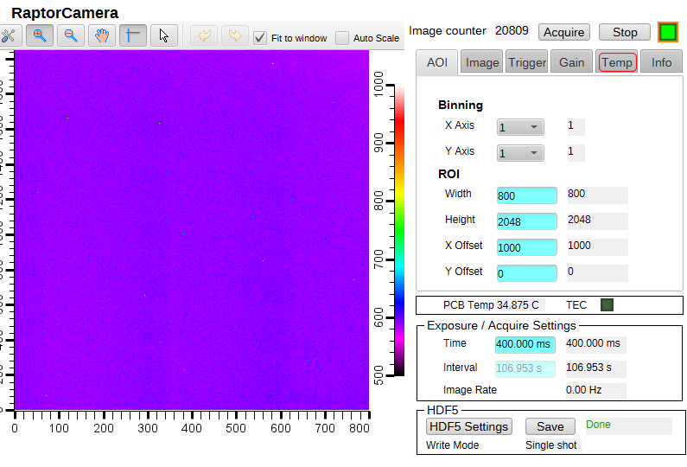
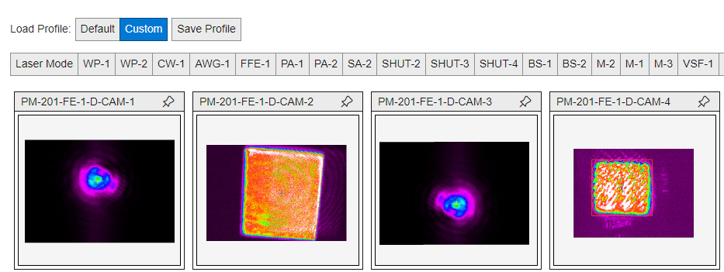
Progress update
Drivers for most detectors exist already and have been tested successfully
Drivers are developed where built-in modules are not available (eg. Raptor camera driver)
Control System Studio provides the stand-alone interface for display during the commissioning
We are planning to use Blazor for more complex displays that aggregate data from many instruments and provide advanced features (configurable layouts, user-profile preferences, access controls etc.)

Slide 12
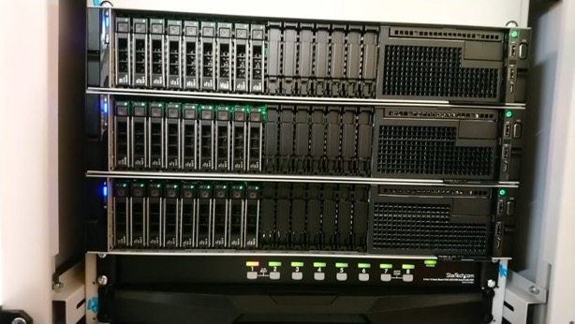
Data Broker Benchmarking
Servers now setup in TA1. Will provide
Stress test for Kafka
Stress test for networks
Testing DAQ modules/AD-Kafka
Throughput
Latency
HDF5 writers
Local storage
This should be scalable to EPAC
Benchmarking in collaboration with ISIS and Diamond

Slide 13
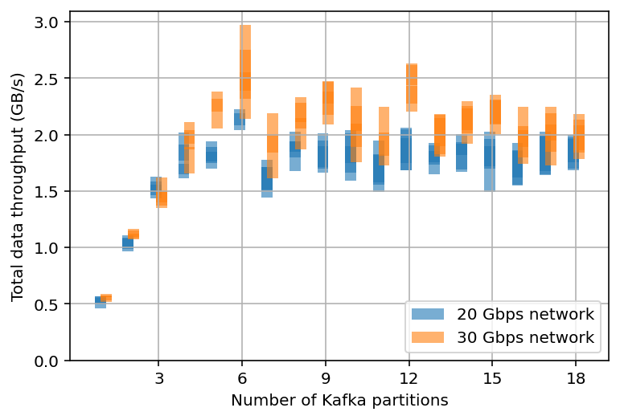
Data Broker Benchmarking
Data rate vs Processing speed tests for Kafka servers in TA1
Tests show that we can easily cope with 2GB/s data rates with just 3 servers
This is scalable to higher values but this is good enough for the first few years of EPAC by adding more servers
Diamond has also tested Kafka up to 10Gb/s

Slide 14
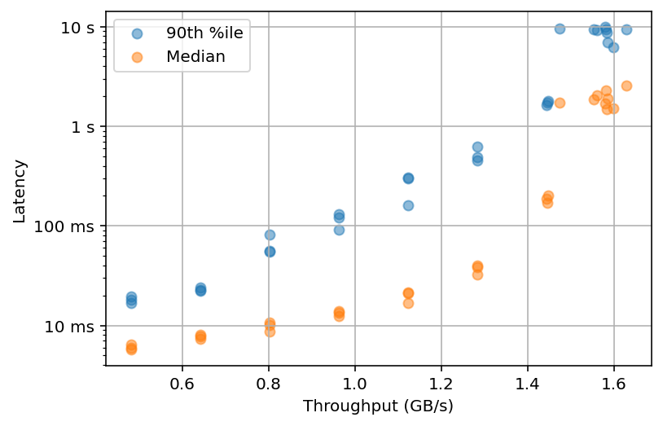
Data Broker Benchmarking
Latency could in principle limit the “real time” nature of data processing
We can get to <100ms level latency at the moment
Latency vs throughput can be tuned further by improving the network speed, installing SSD’s etc. and by adding more servers
This will not be an issue for most of what we want to do in EPAC

Slide 15
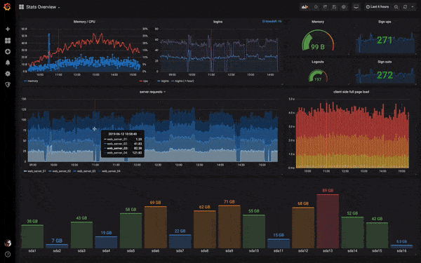
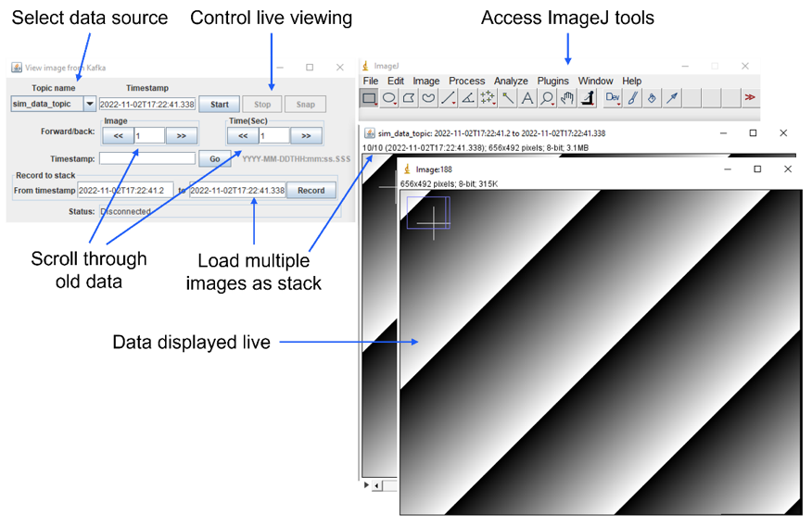
Data access from Kafka
Multiple complementary solutions will be needed for display of live and recent data
Routine live data display will be through EPICS archiver – exploring Grafana (same as what ELI is using) for this.
Developing plugins to access image data from Kafka (ImageJ)
By integrating with ImageJ, users will have access to a wide variety of image analysis tools without needing to write any code.
This plugin can display live data, or it can fetch data from a given timestamp. It can also load data from a given time range into an ImageJ stack.

Slide 16
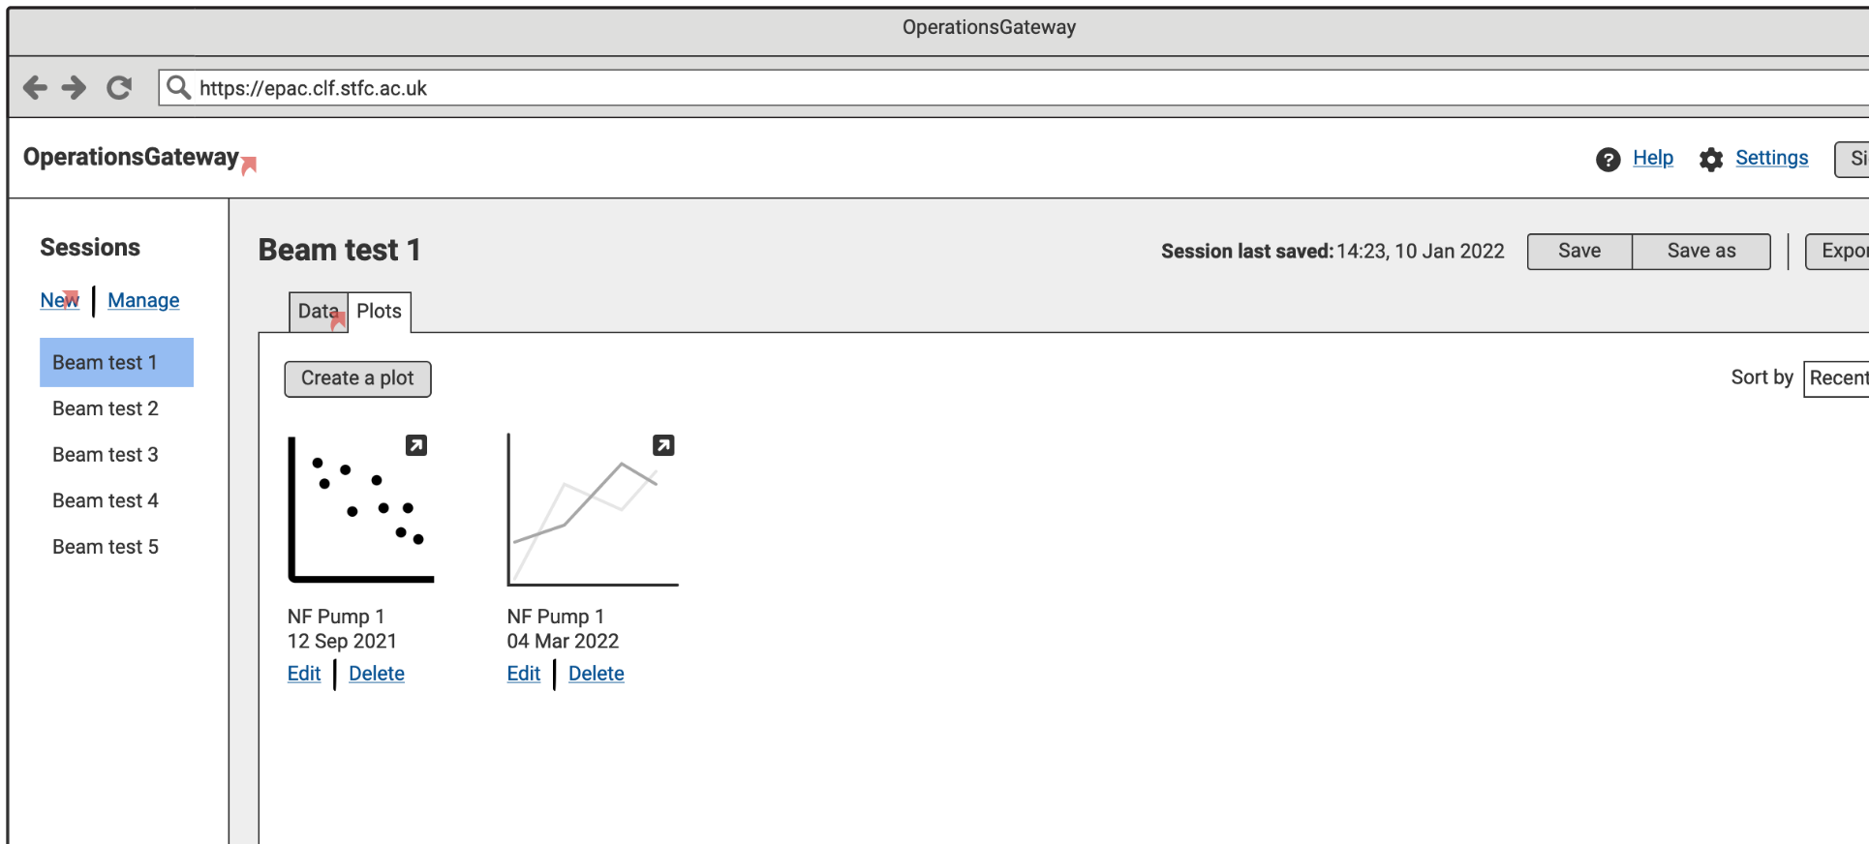
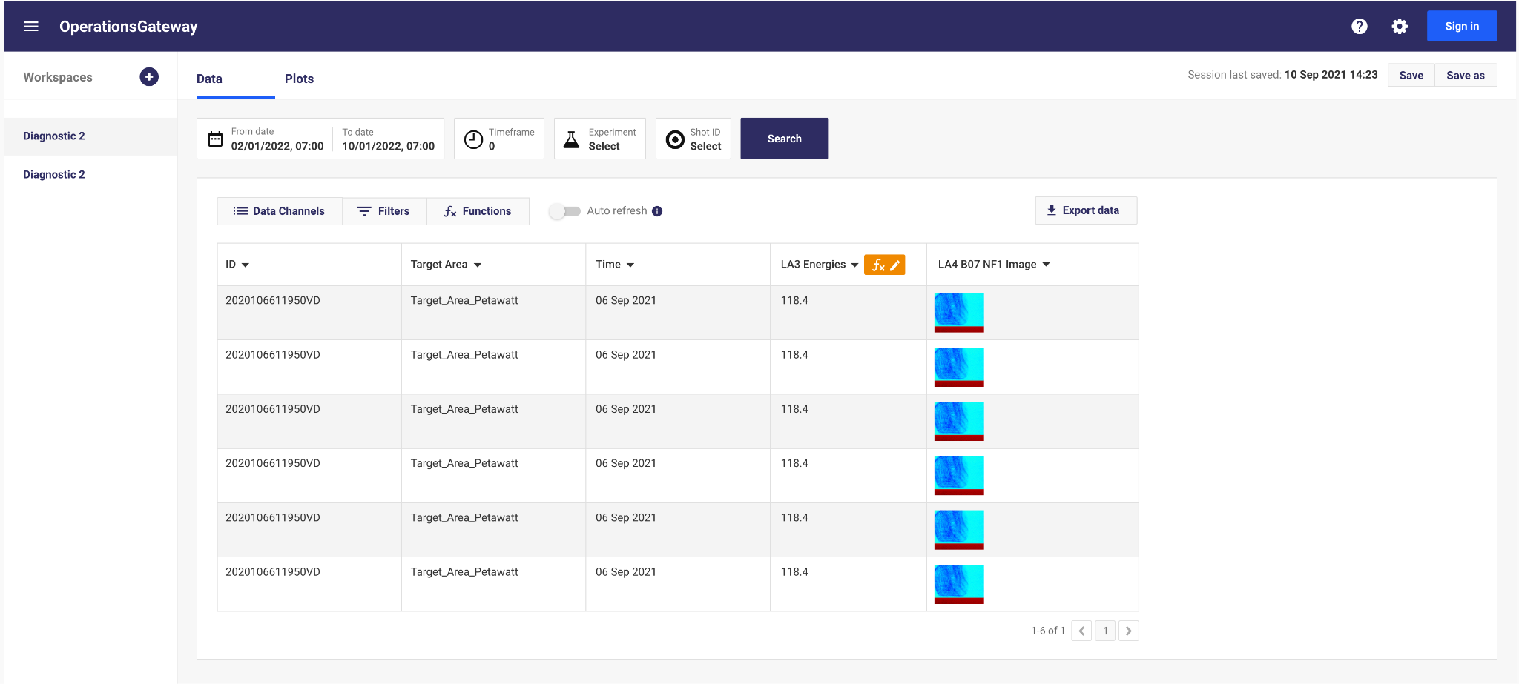
A data discovery, visualisation and analysis tool for EPAC operational data
Diagnostic data from EPAC
Controls/options when viewing images and traces
In-built functions and filters
Plotting functionality - including exporting data and plots
Advanced search interface
Coping with larger amounts of data
Low and high-fidelity mock-ups have been produced to facilitate discussion with potential users and guide software development

Slide 17
Outline
Concepts of Data Management in EPAC
Update on Data Management System Development and Testing
End-to-End Testing
CT in EPAC
Next steps

Slide 18
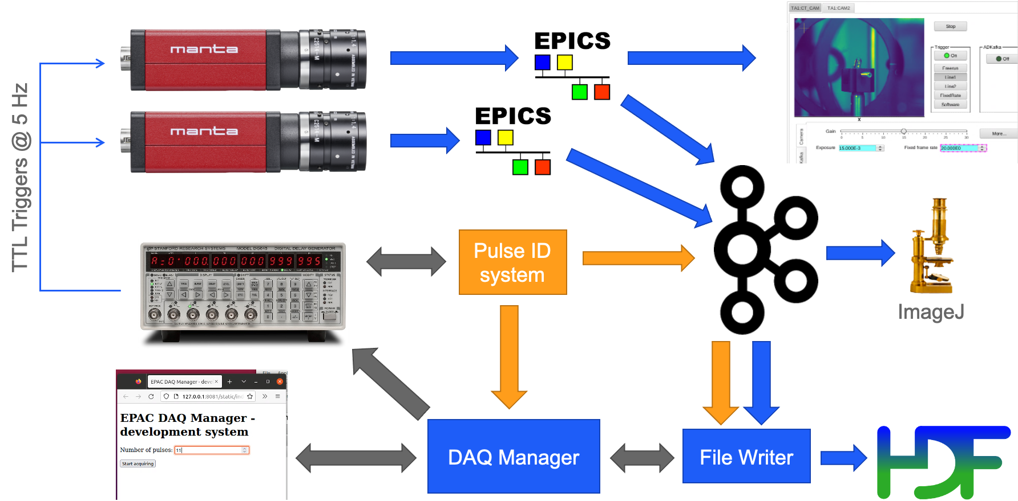
End-to-End Testing (integration)

Slide 19
End-to-End Testing: control system interface

Slide 20
End-to-End Testing: live display with Kafka

Slide 21
End-to-End Testing: End-to-End DAQ

Slide 22
Outline
Overview of the Data Management in EPAC
Update on Data Management System Development and Testing
End-to-End Testing
CT in EPAC
Next steps

Slide 23
Interactive reconstruction under development
Developed by CCPi/SCD
Interface for two main stages: pre-processing and reconstruction (FBP)
Develop the tools for pre-processing
Agnostic to the reconstruction algorithm
Interface for interactive reconstruction
Different stages will have different views and interactivity
Controls include: definition of ROI, voxel size, filter
Run full & partial reconstructions
View output data with CILViewer

Slide 24
Current Status
Pipeline for CT recon with
GUI
Handles Nexus & lab-based XCT data files
Processing:
Beam profile correction
Transmission to Absorption Conversion
Centre of Rotation Correction
Reconstruction
Interactively configure process list
Export of process list for re-running
Interactive data visualisation in each step
DAaaS deployment

Slide 25
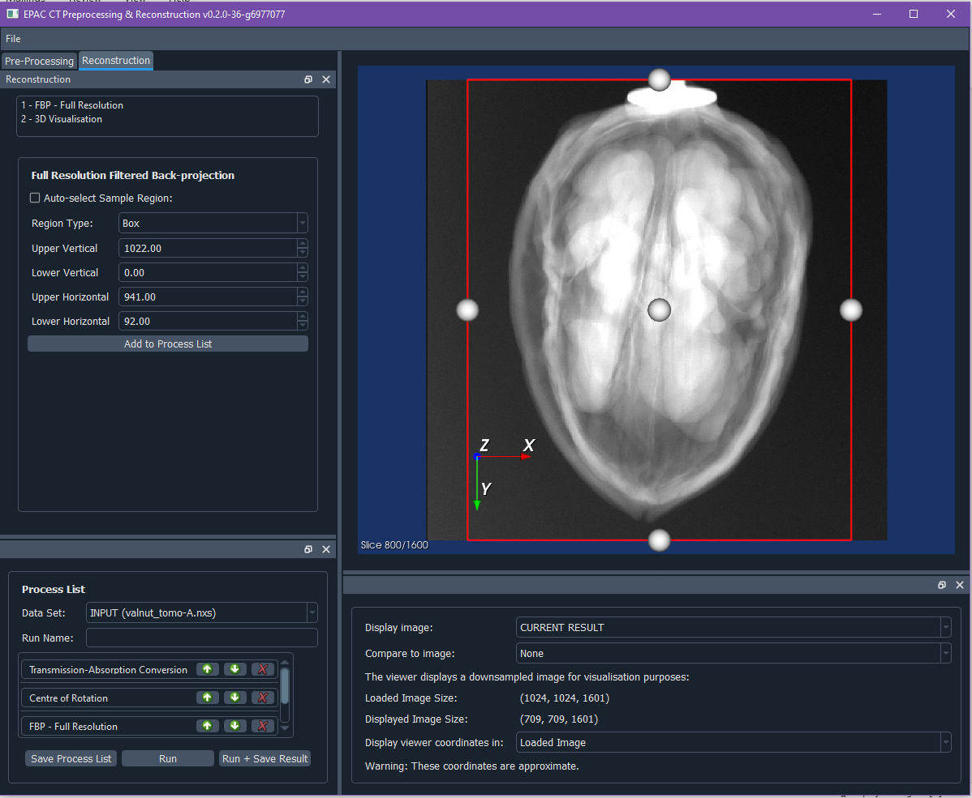
GUI
Example of interactively choosing reconstruction volume of interest
Configuration parameters for current step
Process List
User creates their own process list adding any number of pre-processing and recon steps.
Writing out resulting dataset is optional – a big time saver.
Option to save process list to file, allowing it to be run again.

Slide 26
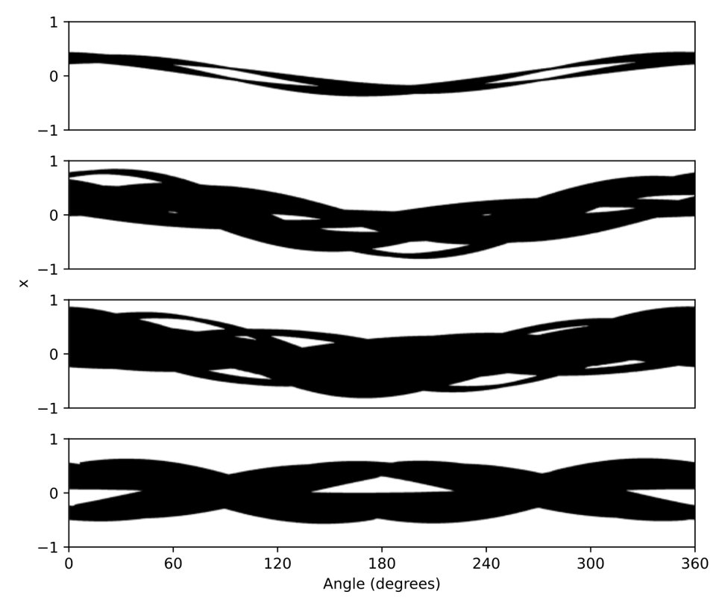
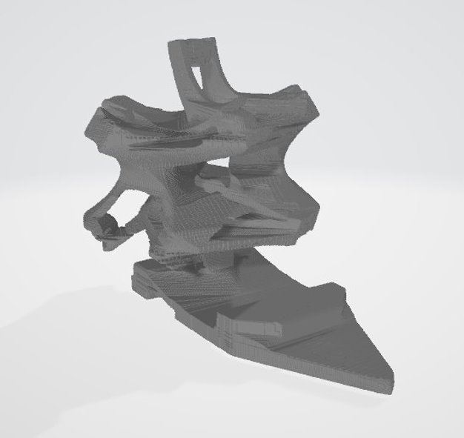
CT beamline prototype
Imaging system
Rotational sample stage
Diffuse backlight
Setting up a Computer Tomography test beamline in TA2/TA1
Needs coordination of multiple system components
Experimental Orchestrator
Control/Drive System
DAQ
Data Management System Elements
Imaging system
Plan is to integrate this with the GUI solutions SCD is developing
3D model reconstruction
Line by line conversion to sinogram
“Visible Hull” reconstruction
Shadowgram with diffuse backlight
Binary light sinogram

Slide 27
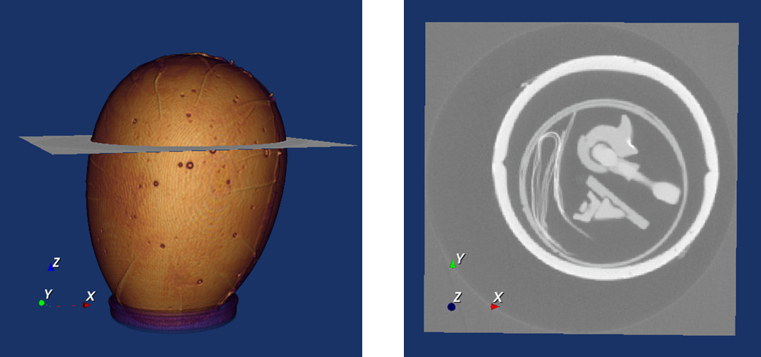
Work in progress
Work in Progress
Future Additions
Loading in process lists from files.
Investigating beam profile correction procedures from EPAC and WMG
Improving ease of interaction with the viewer
Development driven also by feedback from wider CT community via CCPi
Centre of Rotation Correction
Manual adjustments
Dual Slice
Fast low-res reconstruction
Viewer enhancement to show full-size data
Iterative reconstruction
Real-time CT (ReCAST 3D)
Workshop in the New Year to discuss specs and capabilities and get feedback

Slide 28
Outline
Overview of the Data Management in EPAC
Update on Data Management System Development and Testing
End-to-End Testing
CT in EPAC
Next steps

Slide 29
Experimental orchestrator and user interface for DAQ
User interface
WP9
User interface
Will allow users to do scans/experimental runs in an automated way (i.e. move drives, move sample, adjust diagnostic settings, triggers etc.). This is what makes Diamond DAQ user-friendly
Will allow users to pick and choose diagnostics for acquisition
Allow specific triggering/timing requirements for diagnostics
Visualisation of some data and custom live analysis
Diamond uses GDA – this is going to be replaced by Bluesky. This orchestrate experiments (i.e. move drives, take data, do scans etc.)
We might use a consultant for this work (ex. Diamond)
Data Management System
View data live
Control data recording
Data Acquisition System Backend
Control instruments
View data live
Control data recording
Control instruments
Notes:
* Bluesky should be thought of as a toolbox or framework rather than a complete system. It's a set of tools we can use to build a system, and we can use a few of them or all of them. * I don't think there's a standard UI for Bluesky; at least not yet. * Bluesky and GDA go beyond Mirage and DARB: they don't just acquire data, they orchestrate experiments. That is, they can move motors around to do scans, and Bluesky even has some experimental features to have a shared scan "queue" that multiple users can edit. *Bluesky is starting to look very promising. It may significantly reduce the amount of work we need to do, but it won't do everything for us. We probably want our own software developers to work on it, since we can't rely on other facilities producing (and releasing!) exactly what we need.

Slide 30
Data Pipeline for EPAC – by SCD
Data storage
Data stored online for some time (few months)
Later transferred to tape archive (long-term)
SCD is developing a data pipeline for EPAC
Working to design end to end pipeline, accounting for existing tools, services, and expertise in SCD.
Currently doing a gap analysis to enable full programme of work
Existing tools have funding and development plans in place – funded by SCD, IRIS, ALC and EPAC
Data access
DAaaS
Analyse data without downloading it
Share software environments and code
Data Analysis
Download data files
Special bulk data transfer systems
Data curation and cataloguing tools
Provide DOIs to data sets
Make sure data is searchable
FAIR data

Slide 31
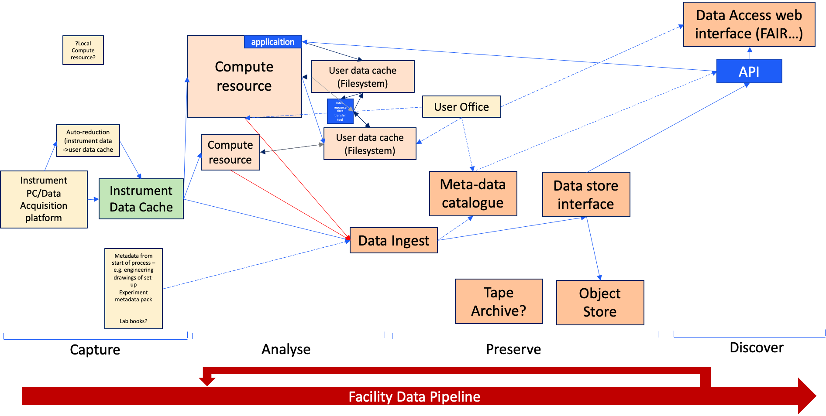
Data Pipeline for EPAC – by SCD
Scientist in the facility performing experiment
Scientist analysing their experimental data
Scientist/facility scientist choses which user data to preserve/publish alongside instrument data and edits/amends/adds any additional metadata
Publicly accessible FAIR data

Slide 32
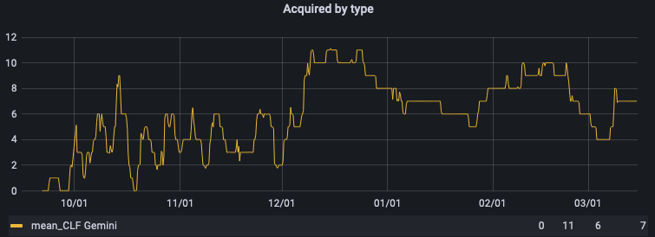
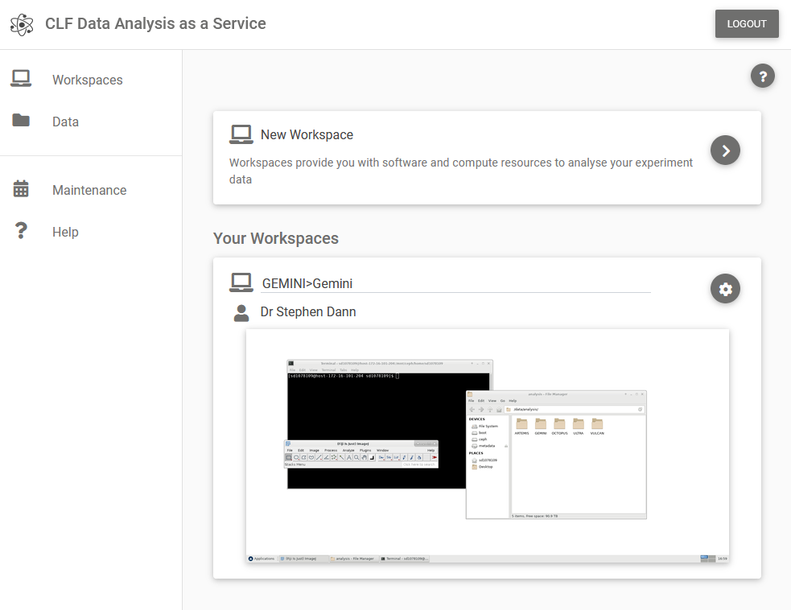
DAaaS is already in use in our facilities
2021 October
04/10/2021 Gemini Onboard
2021 November
01/11/2021 Artemis Onboard
15/11/2022 DAaaS Introduction Video issued to users
2021 December
12/2021 User group mail set up:
CLF-DAaaS-user-contact@stfc.ac.uk
12/2021 User Feedback meetings with Gemini and Artemis
2022
03/2022 3-month Review meetings with Gemini and Artemis
06/2022 Data Services Group will work on Backup and Archive Solution

Slide 33
Summary and outlook
Currently developing, prototyping and testing different components for data management in EPAC
Have setup strong collaborations with Diamond, ISIS and Scientific Computing Department – have over 25 people contributing to various elements
A good fraction of DAQ is being prototyped
CCPi/SCD developing a large part of CT solution – CLF will do integration/laser-specific pre-processing. Planning to test these in the CT beamline in Astra
Data storage and curation policies being developed
There is now an opportunity to have joint studentships through ALC
https://www.scd.stfc.ac.uk/Pages/Ada-Lovelace-Centre-Studentships.aspx

Slide 34
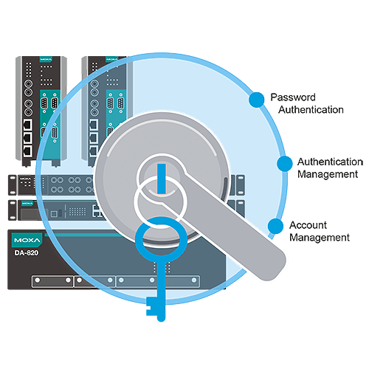
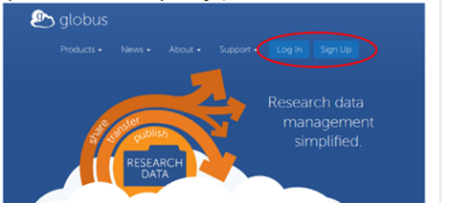
Storing Deleting data may be equally important
Dealing with Commercial-sensitive data (will be working with Diamond on this):
Identifying commercially sensitive experiments from beginning
Sensitive experiments get an identifier like in Diamond: IN and SN
Developing different policies for IN-tagged experiments in terms of storage and access
Provision to delete data after a stipulated time
Data upload to client’s servers (eg. Globus)
In discussion with DSTL/MoD regarding MoD data handling

Slide 35
Overview
Acquire
Store
Analyse
Archive
Many diagnostics and detectors producing data at high repetition rates
Current estimates ~ 5 GB/s peak – 10Hz, if we move all data through system
Data transfer may not be very easy
Data volume/experiment could be significant; will need centralised storage and management.
Annual data volume could be 1-2 PB at the start (but could be theoretically 10’s of PB, if we chose to save everything),
Depends on operational modes –we will need to be choosy
Data analysis packages need to be included
Remote analysis may be necessary because of data volumes
Not all users will have the capability for specialised data analysis tools (eg. Computer Tomography)

Slide 36
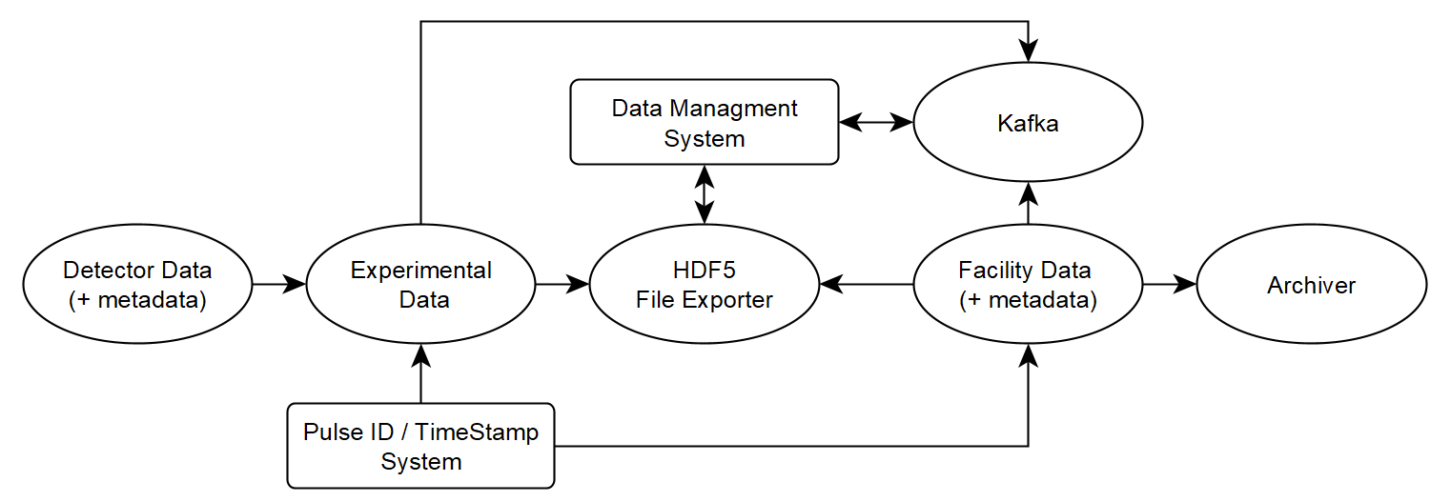
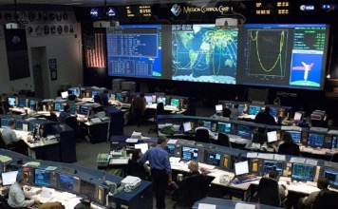
Data doesn’t flow through control system
It sits outside EPICS Channel Access
Multiple layers of areaDetector enables different data treatments
Modular by design
Low fidelity data will be used for visualisation,
where time is not important.

Slide 37
Design challenges: will Kafka slow things down?
Having Kafka may be a solution for a facility like EPAC with 100’s of diagnostics
However, there may be a performance impact for very high data rates
Diamond tested Kafka up to 10GB/s with 2/3 standard servers and it performed fine
They decided against it only because it needed to access files in between and since Diamond doesn’t have 100’s of diagnostics that keep changing, they didn’t have the benefit of Kafka
For high-data rate processing, we plan to have a Hybrid system where the metadata can be routed through Kafka while the data itself can be written directly to storage
Next steps:
Recruiting a specialist
Benchmarking the system in Astra

Slide 38
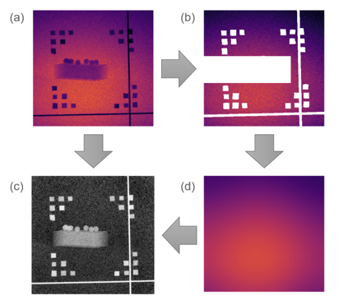
Laser-driven sources: additional complications
Conical beam
Radiation intensity, pointing, and beam profile are liable to change from one laser pulse to the next. This may require special pre-processing plugins
May need flatfield information every shot. This, in principle, can be obtained but need to incorporate into Savu
Will need special plugins to pre-process images with phase contrast enhancement
Filters for “special noise patterns” by hard x-rays depositing their energy in a shower across multiple nearby pixels

Slide 39
Day 2 technical/operational Challenges
Data Management
Timing System and Time Stamps: How do you identify a pulse? Need a compatible solution with the control system. Planning to use FPGA. Will prototype this
Designing the system to cope with data rates/volume: Benchmarking planned using existing facilities (eg. TA1): Planning to work with Diamond on this
Storing Data is Expensive (~0.5M/PB): forming a data archiving policy is important. SCD doing the development
Computer Tomography
Integration of CT components can be tricky. Need specialised knowledge and effort.
High-resolution tomographic reconstruction is computer-intensive. Will require dedicated HPC access. Exact solution TBD
Real-time CT is in R&D stage. Developments ongoing in Diamond and ISIS, which we aim to exploit – with dedicated effort. Recruitment for a CT person underway but very low number of applicants

Slide 40
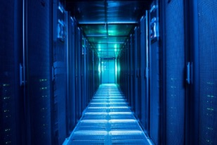
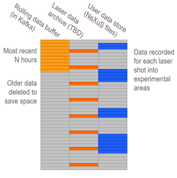
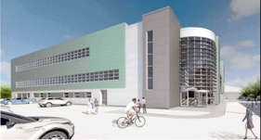
Data Storage
Finished file
Transfer to main data store
Scientific Computing Department
Store in EPAC building temporarily. 2-4 weeks

Slide 41
Digital Lab book
Implemented in ELI
Replaces the “hard-copy” lab books used for experiments
Records all the associated “metadata”
Allows users to perform on-the-spot calculations on the data and save the results
We may want to have a “standardized solution” - makes it easier for the user community

Slide 42
Data pipeline 2 : Direct File Exporter
Route 2
Experiment: 456
200 laser pulses starting at 1228
Detector2
Mode: 4
Gain: 27 dB
Detector3
Mode: 3
Gain: 13 dB
Data Acquisition software:
EPICS areaDetector
Route 1
Message
From: Detector3
Timestamp: 1234
Data:
Metadata:
Mode: 3
Gain: 13 dB
Data from multiple instruments directly written into NeXus file
Diamond takes this approach for high data-rate detectors (Odin)
Timestamp from FPGA
Instrument

Slide 43
Data pipeline 1 : Data acquisition
The DAQ system to send data to live feed or Kafka, along with metadata
Kafka will keep all data in a log. This data buffer means we don't need to write data to files immediately
For really high-data rates, Kafka may reduce performance
EPAC will have option to directly store data from high-data rate instruments (eg. Raptor, Hexitech)
Instrument
Timestamp from FPGA
Message
From: Detector3
Timestamp: 1234
Data:
Metadata:
Mode: 3
Gain: 13 dB
Live display in control rooms
Data Acquisition software:
EPICS areaDetector

Slide 44
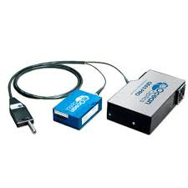
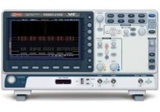
Data Broker – Apache Kafka
Kafka is a platform for processing streams of data
Widely used in businesses
Used for scientific data in ISIS and ESS
Services communicate by sending messages to each other
Data can be embedded in messages or saved in another system
Messages retained for some time
Storage capacity can be expanded
Instruments
Any other capabilities
Data written to files
Data processed live

Slide 45
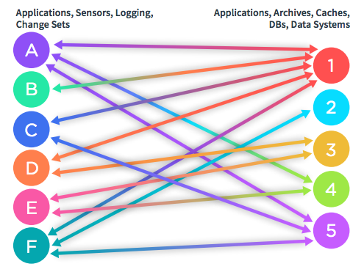
Dealing with Data
Option A: Instruments feeding into one data store directly
Acquire
Acquire
Acquire
Store
Acquire
Acquire
Quite fast
Direct recording requires dedicated data pipelines per instrument
Architecture can be cumbersome
Significant organisational and scalability issues, especially with changes and future upgrades

Slide 46
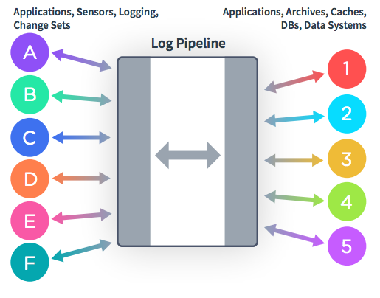
Concept of a Data Broker
Option B: Add an intermediate “data broker”
Capturing data in real-time from event sources in the form of streams of events; storing these event streams; manipulating, processing, and reacting to the event streams in real-time as well as retrospectively; and routing the event streams to different destination technologies as needed
Acquire
Acquire
Acquire
Broker
Store
Acquire
Acquire
Decoupling data producers from consumers makes it easier to:
Change/expand the data store (including file format)
Add new instruments – much more scalable
Add new data consumers e.g. live processing/display for some data
Keep a buffer of raw data
Monitor the whole process

Slide 47
Automation via script

