Slide 1
EPAC Compressor
ISTAC Meeting, December 2022

Slide 2
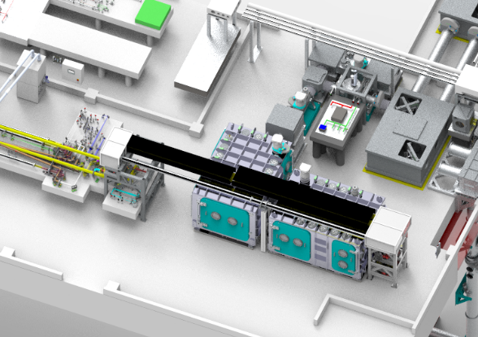
Compressor Overview
Objective
Routinely compress EPAC pulses to 1 PW without introducing degrading effects to the laser pulses for experiments.
Pre-compressor.
  3-colour CW alignment + pilot beam
Beam expansion to 220mm.
Chamber and Opto-mechanics.
Compressor Optics.
Post-Compressor Diagnostics.
  Pulse duration, contrast, near-field, far-field, darkfield, wavefront, spectral phase.
5
2
1
3 & 4
Pulse energy out | 30 J
Pulse duration | ≤ 30 fs FWHM
Pulse repetition rate | 10 Hz, 1 Hz, Shot on demand
Input beam size | 220 mm FWHM
Input beam shape | Circular, super-Gaussian
Transmission Bandwidth | 750 – 860 nm

Slide 3
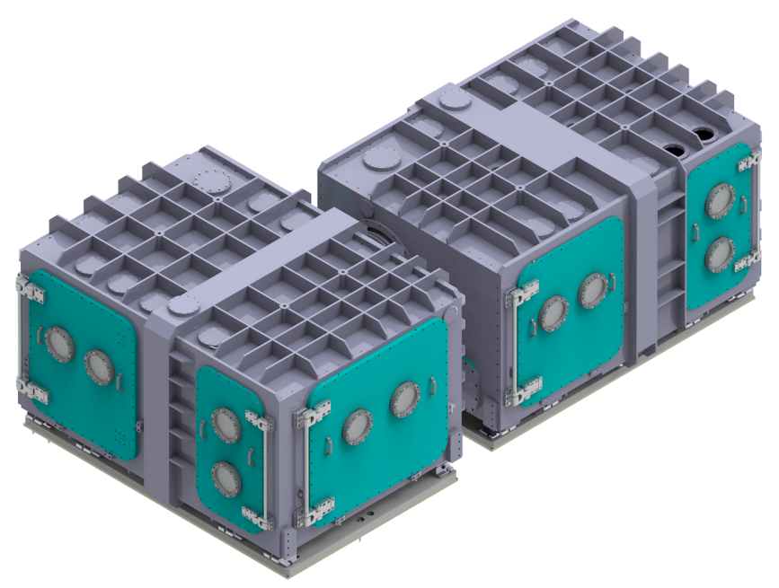
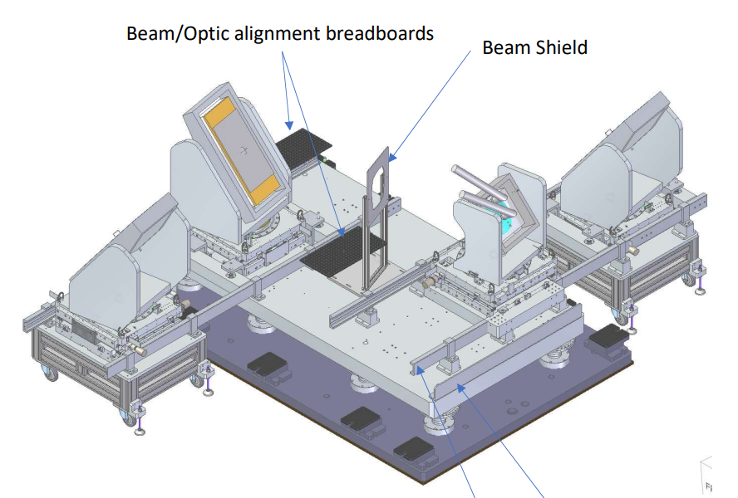
Compressor Chamber
Formed of 2 sub-compressors in an L-shape design.
Breadboard and breadboard supports isolated from chamber structure to minimise optic movement.
Detailed analysis and manufacture awarded to Added Value Solutions, they provided Vulcan OPPEL compressor chamber and ELI-NP and ELI Beamlines target chambers.
Installation method covered in “Installation status and forward plan” talk later today.
Chamber delivery scheduled Oct-23
Breadboard
Floor Plate
Strengthening
Rib
Resin Base
Loading Rail
Notes:
An order for the compressor chambers & flexible inter-connection has been placed with AVS of Spain who specialise in equipment for the Science & Space markets. They offer a design, analysis, manufacture & test services which should ensure a well-integrated package when complete.
The manufacturing design is nearing completion, the overall structure & appearance are close to the original proposed design concept, some changes are necessary based on the structural design analysis results.

Slide 4
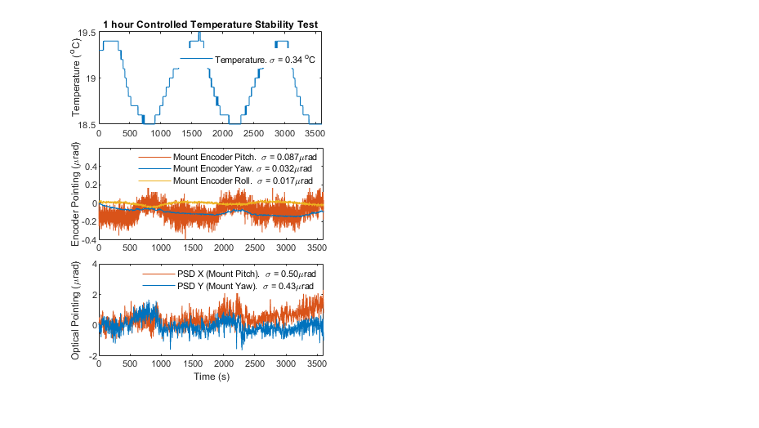
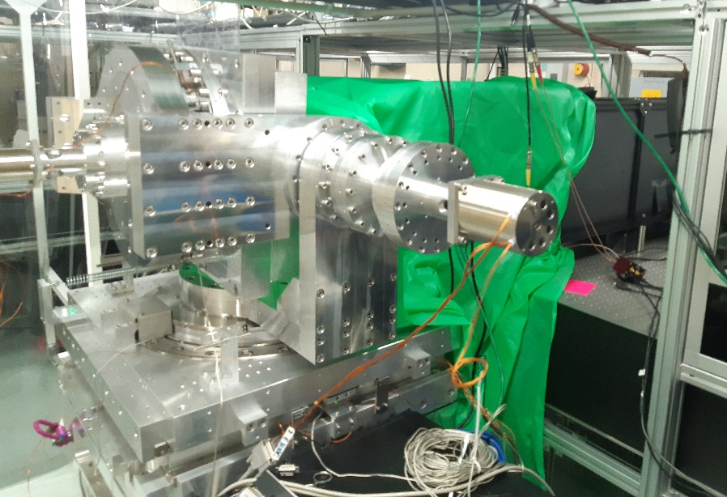
Compressor Grating Mounts
Better than 2 μrad pointing stability is required from the grating mounts.
VOPPEL Grating Mount Testing: achieved <0.5 μrad stability and 0.2 μrad resolution.
This mount is compatible within the current EPAC chamber space. A future revised design will consider thermal performance and grating cooling capability.
VOPPEL/EPAC Grating Mount
Optical Diagnostic
Optical diagnostic projected a 120mm beam onto a mounted mirror. This is retro-reflected back to a position sensitive detector (PSD).
Encoders
Optical encoders used in closed-loop for precise and accurate motion.
Notes:
The optic mounts lower stages will be a modified version of the Voppel mounts which in testing have shown to be a stable platform for both mirror & grating operation.

Slide 5
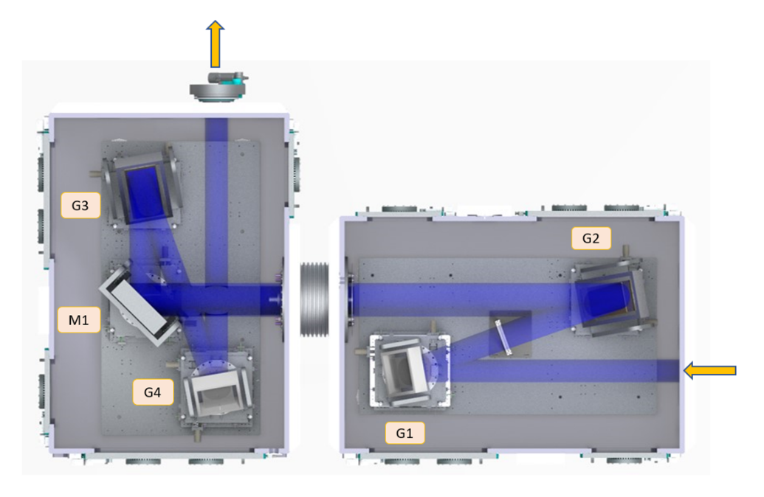
Compressor Gratings
Requirements:
Efficient diffraction, >90% per grating for 750-860 nm.
High damage threshold. Tested and proven > 200mJ / cm² LIDT in vacuum for long-term 1 PW, 10 Hz.
Minimal deformation. Optic sag (gravity) + Thermal Expansion (1PW, 10Hz) < 80 nm.
  Modelling capability.
  Engineering solutions. Passive/active cooling.
  Thermal expansion induced by laser absorption from the grating coating.
Ongoing optic/engineering challenge.
Apertures | 300 x 300 mm , 760 x 300 mm
Line density | 1480 lines / mm
Incidence angle | 37.24° (Littrow), 10° out-of-plane.
Peak fluence @ 1PW | 80mJ / cm² (30 fs)
30 J Out
G3
G2
M1
G4
50 J In
G1

Slide 6
Grating Options - 1
1. Gold.
  ~4.9% absorption. Previous modelling indicated active cooling is required for 10 Hz operation.
  (Uncooled) CLF Gemini observed white deposit over time. RF cleaning was applied when efficiency dropped to <80%, recovering to ~90%.
Etched Glass Grating + Gold Overcoat
Supplier | Diffraction Efficiency
PGL | 94% modelled
LLNL | 93.8% modelled, 91.5% measured
JY Horiba
LLNL also produce Chrome/HfO2 grooved sublayer with + Au overcoat:
94.3% efficiency measured.
ELI-Beamlines, L3-HAPLS Gratings
2. Hybrid (Gold + dielectric). DISCONTINUED
  Plymouth Grating Laboratory (PGL) investigated a gold grating with multilayer-dielectric (MLD) overcoat.
  96% diffraction efficiency (modelled) + 2.7% absorption.
  Aspect ratio of dielectric fins too narrow and unstable.

Slide 7
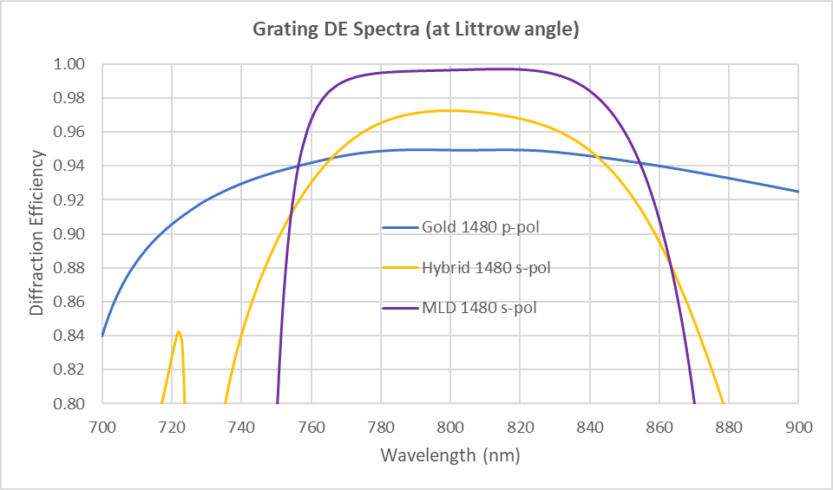
Grating Options – 2
3. Multi-layer dielectric (MLD).
  PGL also developed for the CLF a new coating to work at the EPAC diffracted + out-of-plane angle. A highly-reflective interference coating is laid with a thick SiO2 top layer for the grating to be written.
  98% diffraction efficiency (modelled)
  <<0.01% absorption modelled
Four 50 mm aperture MLD test samples manufactured
Test sample(s) LiDT and diffraction efficiency investigated

Slide 8
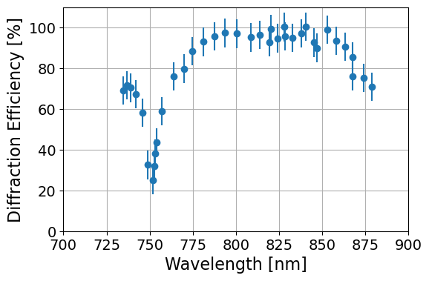
MLD: Diffraction Efficiency
Modelling indicated <0.01% absorption in the coating layers and an efficiency minima at 725nm, outside the EPAC laser bandwidth.
Measurements of the DE has highlighted an absorption peak at 750nm, verified by narrowband power measurement at this wavelength.
Additional 3.5% output energy loss.
Manufacturability question over short wavelength DE for 50 mm samples.
  Recently commissioned CLF Gemini MLD gratings DE correctly centred at 800nm, with an absorption peak at 743nm.
  PGL is performing some modelling to understand the source of error and methods to monitor & correct during coating.
PGL measurement
Notes:
Significantly narrower bandwidth capability, with rapid fall off

Slide 9
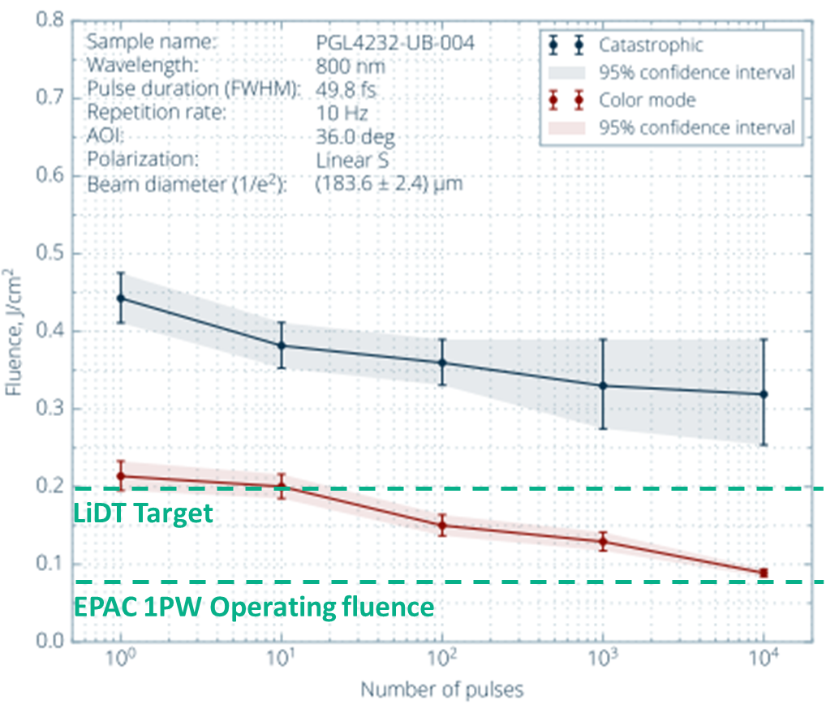
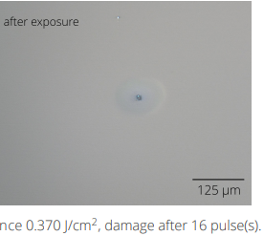
MLD LIDT Testing (Lidaris)
A test sample was characterised at an LiDT facility.
Measured: 360 mJ/ cm² catastrophic LiDT,
89 mJ / cm² ‘colour mode’ LiDT
Catastrophic Damage
Colour Mode Damage
370 mJ/cm²,
damage after
16 pulses
164 mJ/cm²,
damage after
10,000 pulses
Impact of colour mode damage on compression and efficiency poorly understood.
Further assessment required at 1M-on-1 (underway) Raster scan 10,000-on-1 (underway)
Notes:
One of the test gratings were sent to Lidaris facility for detailed characterisation of the laser induced damage threshold (LiDT) under vacuum. 50fs, 10Hz pulses of 180 μm diameter were used.

Slide 10
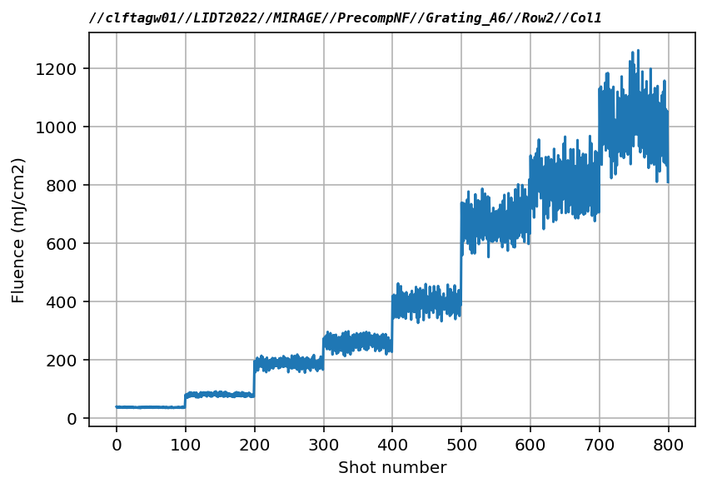
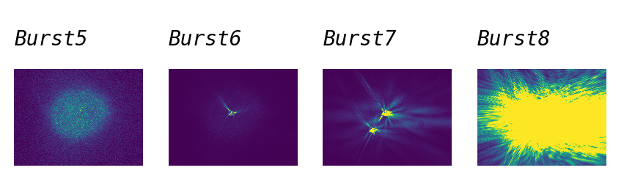
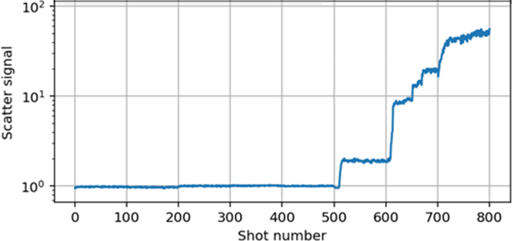
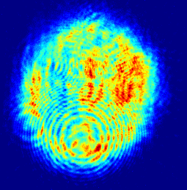
MLD LiDT Testing (in-house, CLF)
LiDT test performed with Gemini TA2 50 fs, 10 Hz beam.
Catastrophic damage detected with online diagnostic.
1mm beam diameter.
Energy ramp at each target site, which anneals the coating.
100-on-1 LiDT energy ramp up measured >400 mJ / cm²
10,000-on-1 (with annealing). LiDT > 280 mJ / cm²
B1….
B6
LiDT
^{(Catastrophic)}
EPAC 1PW
Scatter Diagnostic
Burst1-5
1mm beam profile on sample
Notes:
Add catastrophic image
Separate slide ATA2 test

Slide 11
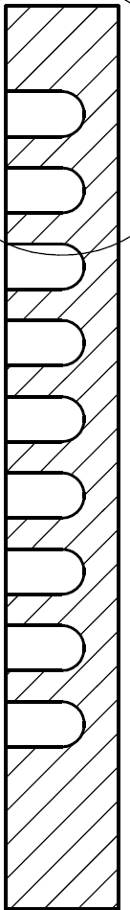
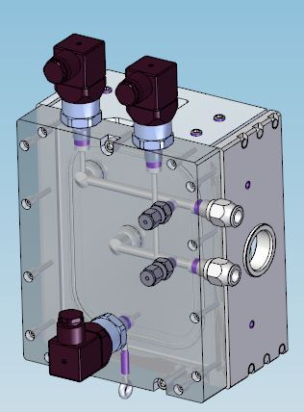
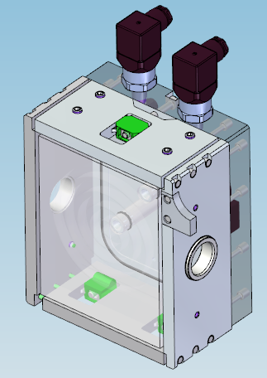
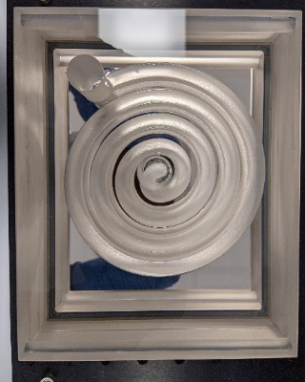
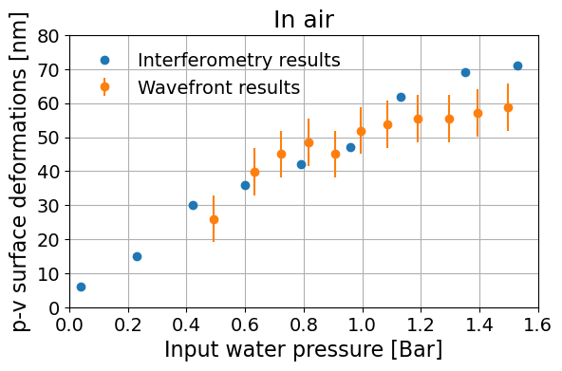
Cooled Substrate
Two 160 mm x 130 mm ULE 7973 low expansion fused silica substrate with a cooling channel were manufactured.
One was silver coated as mirror and the other sent to PGL to manufacture a cooled gold grating.
Substrate
Cooled substrate mounting scheme
Leak tested under pressure in air and in vacuum.
Static water pressure dependence on reflected wavefront observed.
Beam pointing instability from water pressure/flow:
  6 μrad @ 0.5 Bar, 12 μrad @ 1 Bar.

Slide 12
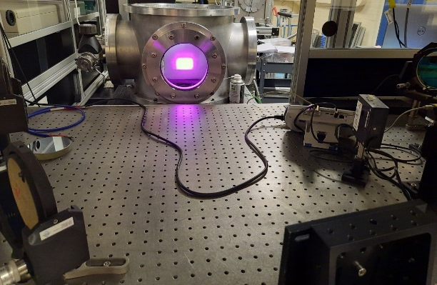
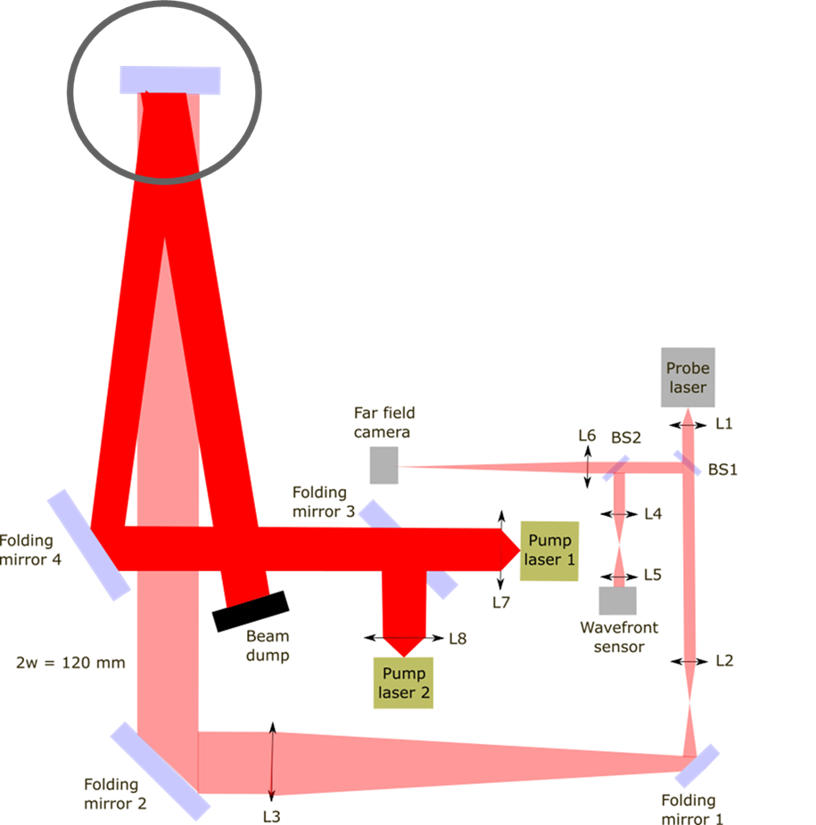
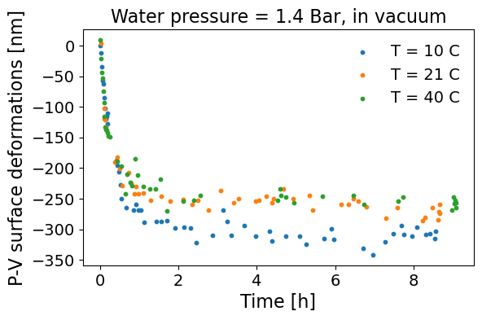
Cooled Mirror Testing
The water-cooled silver coated mirror substrate was heated with 120W 800nm diode laser beam diameter 2w=50mm, in air and under vacuum.
Sample
Vacuum
Window
Water temperature dependence observed.
We overlooked the absorption of the window!
Significant heating and deformation (~250 nm) observed.
Notes:
Water turbulence, solutions?

Slide 13
Grating Substrates
Use low co-efficient of thermal expansion (CTE) glass ceramic to minimise distortion due to thermal loading .
All materials considered have varying grades/classes of materials with improved CTE tolerance:
Zerodur (Schott).
  High bubble content -> polishing problematic.
  Thermal Hysteresis -> CTE variance.
ULE 7973 (Corning).
  Preferred substrate from all grating manufacturers.
  Very long lead times (stopped manufacture).
  ULE 7972 (Corning) possible alternative.
Clear-ceram-Z (Ohara)
  Comparable to Corning ULE and available with relatively short lead time.
Material | Thermal conductivity (W/m.K) | Specific Heat (J/g.C) | Thermal Exp Coeff (ppm or e-6)
Corning 7980 | 1.38 | 0.768 | 0.569
Schott Zerodur | 1.46 | 0.8 | hysteresis
Corning 7973 | 1.31 | 0.767 | 0.03
ClearCeram Z | 1.51-1.52 | 0.777 | 0.015
Notes:
>>More introduction thermal loading
>>Slide 7973 vs 7972. and/or overlay CTE graph
Low expansion Glass Ceramics have amorphous and crystalline phases in the material.
Amorphous phase has positive CTE but the crystalline phase has negative CTE.
Control of the ratio of these phases allows them to compensate each other resulting in net zero CTE.
The zero CTE point is usually at 20°C, but can be tailored.
However, each batch will have slight variations so there can be a +/-10°C difference in the zero point depending on grade.
The CTE variance with temperature is in the Ansys model parameters

Slide 14
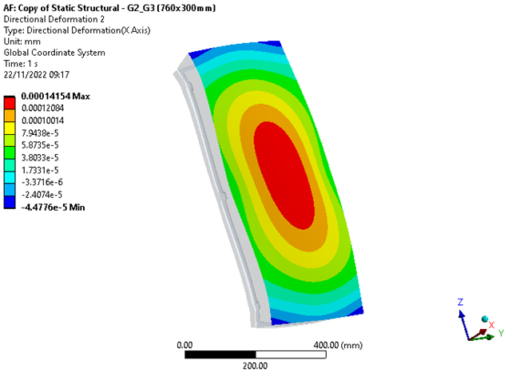
Cooled Gold Modelling
Continued thermal modelling is needed to benchmark to experimental results, assess the use of alternative substrates to ULE 7973 and evaluate the impact of structural + thermal deformations on the gratings surfaces.
  Current modelling confirms 1 Hz uncooled operation will have negligible, ~3 nm, deformation of grating surfaces.
G2/G3 Thermal deformation.
30W absorbed
  Optimize active cooling design
  Revise passive cooling, like use of high emissivity UHV coatings to increase passive radiative cooling effects (80% of heat extraction).
Notes:
Quote thermal only

Slide 15
Grating Summary
 | Cooled gold gratings | MLDs | Uncooled gold gratings
Substrate Material | Low availability, ULE 7972 under investigation. | Low availability, ULE 7972 under investigation. | Different options available Identified one option (Clear Ceram Z)
Diffraction efficiency | Good | Require more stable production from manufacture | Good
Design maturity | Require cooling channel design, discussion with substrate manufacture and mount design. | Confirm LiDT. | Performance proved @ 1Hz
Readiness | Cooled grating test required. Not available for commissioning. | Long manufacture time, colour mode damage and longevity require investigation. Not available for commissioning. | Different suppliers available. Available for commissioning
Max rep. rate to specs | 10Hz | 10Hz | 1Hz

Slide 16
Conclusions
Compressor vacuum chamber on track and tested similar grating mounts.
Manufactures and tested a first cooled substrate with silver coating, gold grating under manufacture.
Low availability of Corning 7973, different substrates under evaluation (Clear Ceram Z and Corning 7972).
More investigation is required on thermal load of input window.
MLD grating promising for 10Hz operation, further test and development required.
Waiting gold cooled grating sample for testing, further development required.
Proposing to use uncooled gold grating for test compression and 1Hz commission while developing MLD & cooled gold grating.
Notes:
Footprint G2/G3 full size

Slide 17


Slide 18
Prototype Cooled Mirror Testing
A water-cooled 160 mm x 130 mm ULE 7973 silver coated mirror substrate was heated with 120W 800nm diode laser under vacuum.
Stable & leak tested under pressure & under vacuum for many hours without issue.
Testing is necessary to determine viability of cooling scheme under vacuum when scaled to full aperture gratings.
Sample
Vacuum
Window
Substrate
Cooled substrate mounting scheme
Notes:
Water turbulence, solutions?

Slide 19
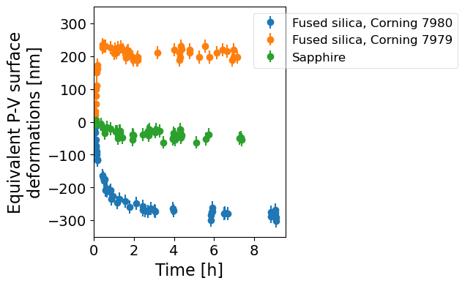
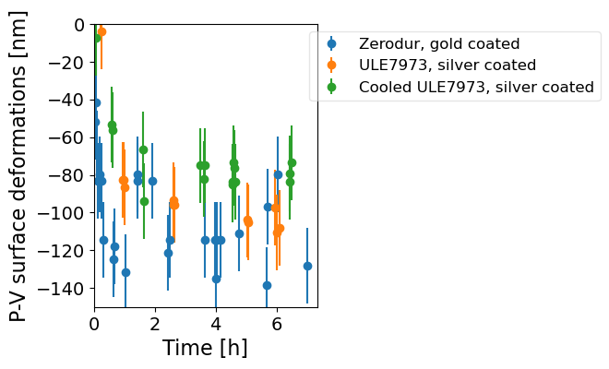
Cooled Mirror Testing - 2
Tested 3 different windows in air using uncooled ULE 7973 mirror:
Corning 7980 20mm thick;
Corning 7979 20mm thick;
Sapphire 2mm thick
Sapphire window lower impact on the wavefront.
Sapphire window was used to test three mirrors under vacuum:
Zerodur, gold coated;
ULE 7973 uncooled, silver coated;
ULE 7973 cooled, silver coated.
Water cooling at T = 21 C and p = 0.5 Bar

Slide 20
Cooled Mirror Results
IN PROGRESS
Static water pressure dependence on reflected wavefront observed.
Water temperature dependence observed.
  New heating problem found! Significant window heating and deformation (~250 nm) observed. Looking into using sapphire laser windows as alternative to fused silica.
Beam pointing instability from water pressure/flow:
  6 μrad @ 0.5 Bar. 12 μrad @ 1 Bar.
  x8 larger mass of full-sized gratings likely to damp this.
Future:
Results with sapphire vacuum window.
Test substrate (130 x 160 mm) with cooled metallic grating in manufacture.
Notes:
Update (image/graphs) on sapphire window?
Future: recoat to gold, also a gold grating coming.
Water pressure effect.
Water turbulence, solutions?

Slide 21
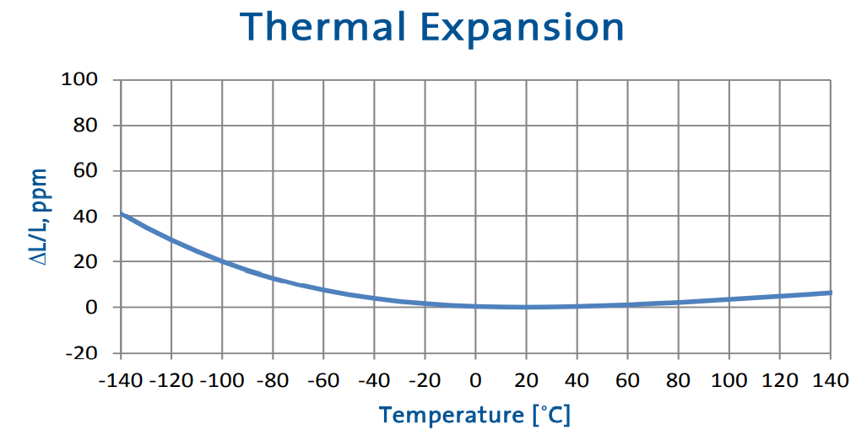
Grating Substrates
Use low co-efficient of thermal expansion (CTE) glass ceramic to minimise distortion due to thermal loading .
All materials considered have varying grades/classes of materials with improved CTE tolerance:
Zerodur (Schott).
  High bubble content -> polishing problematic.
  Thermal Hysteresis -> CTE variance.
ULE 7973 (Corning).
  Preferred substrate from all grating manufacturers.
  Very long lead times (stopped manufacture).
Clear-ceram-Z (Ohara)
  Comparable to Corning ULE and available with relatively short lead time.
Region of negative CTE below zero point – heat input will cause contraction
Zero point can vary per batch, which makes modelling accuracy difficult
Notes:
>>More introduction thermal loading
>>Slide 7973 vs 7972. and/or overlay CTE graph
Low expansion Glass Ceramics have amorphous and crystalline phases in the material.
Amorphous phase has positive CTE but the crystalline phase has negative CTE.
Control of the ratio of these phases allows them to compensate each other resulting in net zero CTE.
The zero CTE point is usually at 20°C, but can be tailored.
However, each batch will have slight variations so there can be a +/-10°C difference in the zero point depending on grade.
The CTE variance with temperature is in the Ansys model parameters

Slide 22

EPAC Pump Laser
EPAC Front End
Beam propagation
Pump A
Pump B
Green conversion
Ti:Sa High Energy Amplifier
Compressor

Slide 23
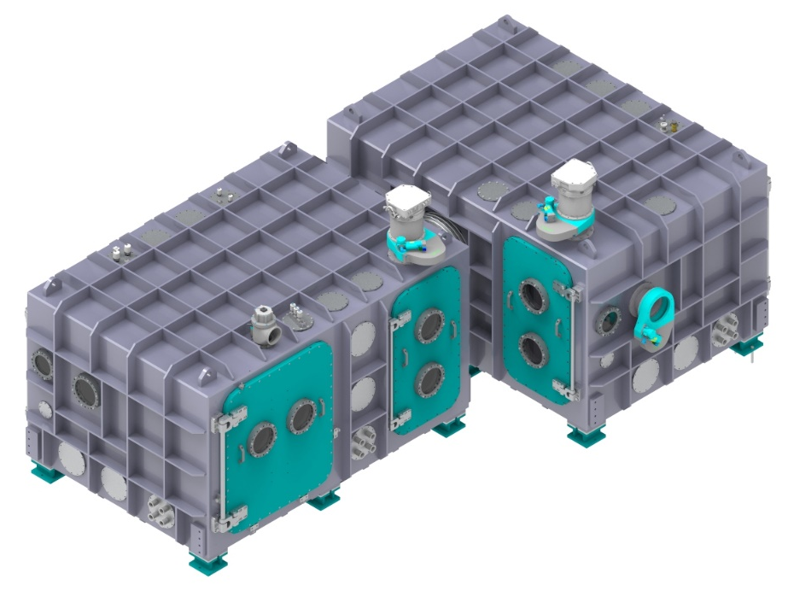
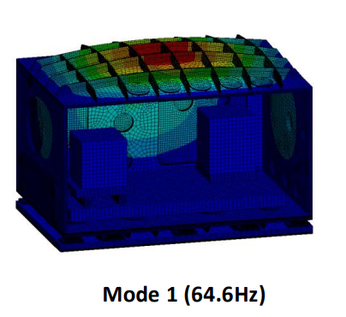
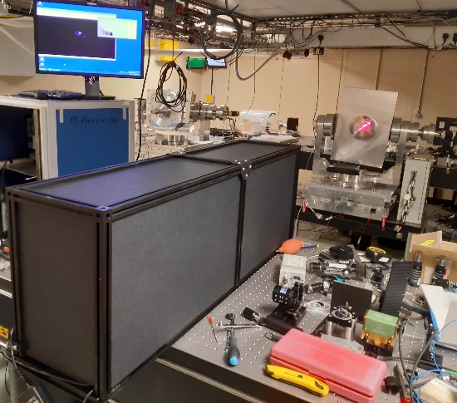
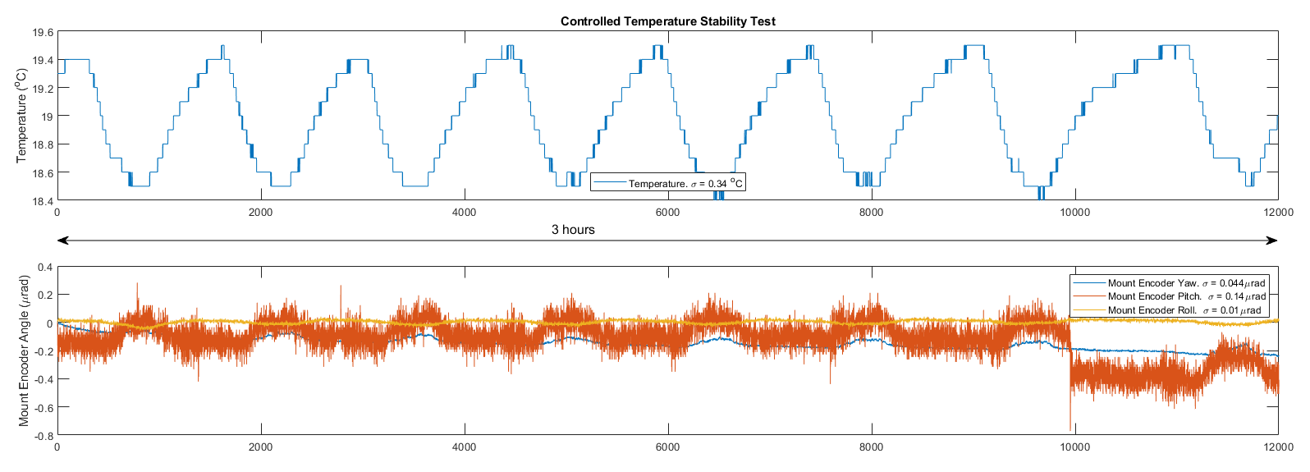
Compressor
Breadboard
Floor Plate
Strengthening
Rib
Resin Base
Loading Rail
Compressor tender closed with no bids – AVS submitted late bid.
Signed-off breadboard and base-plate designs.
Resin base will be applied between floor plate and concrete floor.
Have undertaken vibration modelling to confirm that relative displacements won’t impact on performance.
Rails will be used to install the mounts into the chambers.
VOPPEL grating mounts demonstrating <0.2µRad stability.

Slide 24
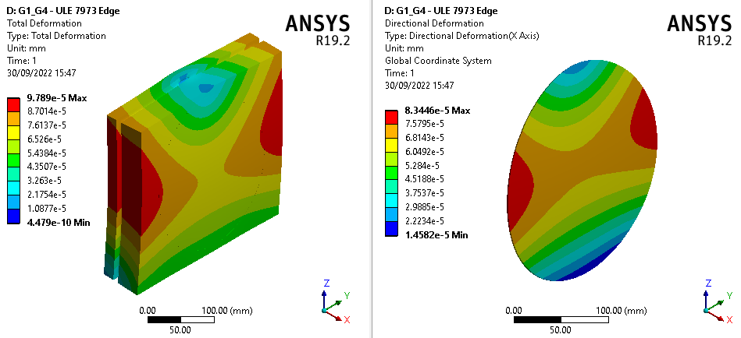
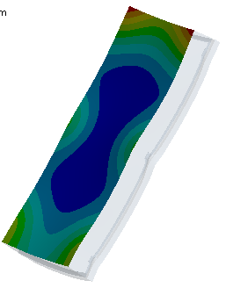
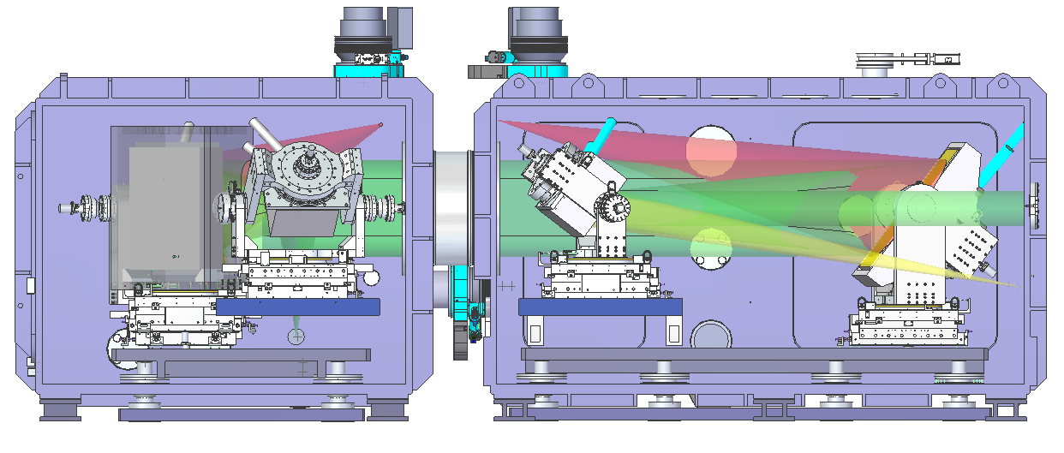
Optic Sag: Structural Modelling
Grooves machined into sides of gratings are used for mounting.
Faces point ±37.24° down/upward -> sag susceptibility.
  300mm square input/output gratings have 3 edge contact points.
  760mm long intermediate gratings have edge 6 contact points.
Further optimisation of mounting locations are planned to minimise structural deformations.
69nm pk-pk
-84nm pk-pk

Slide 25
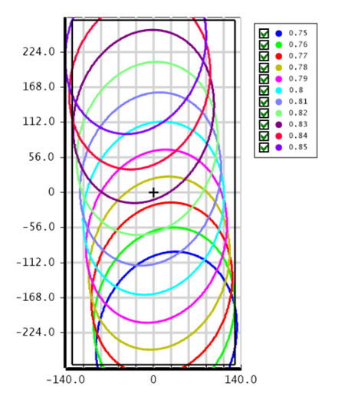
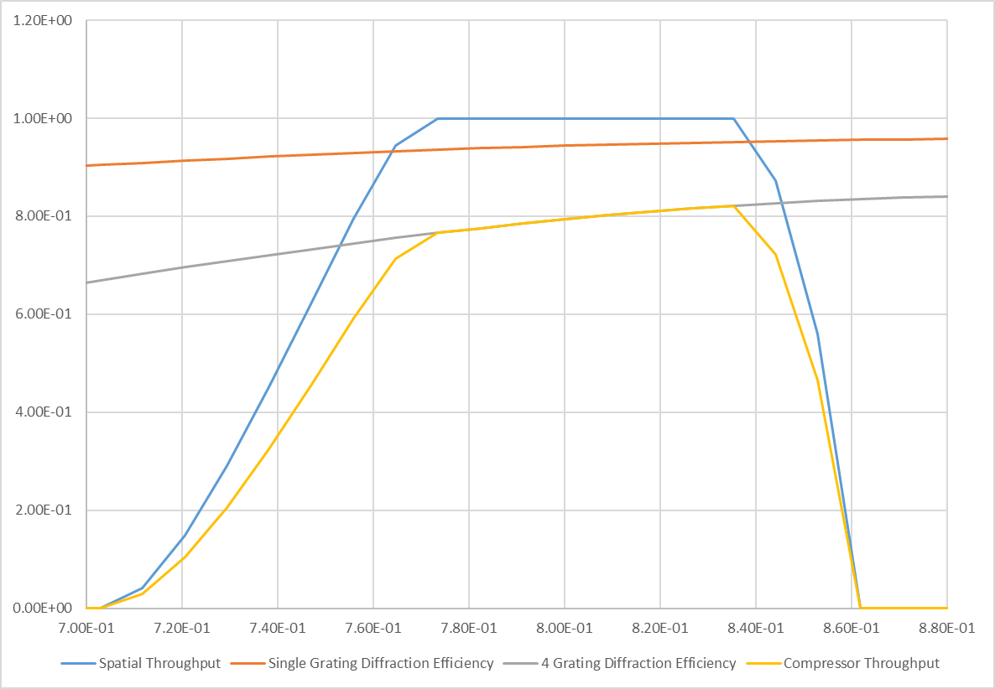
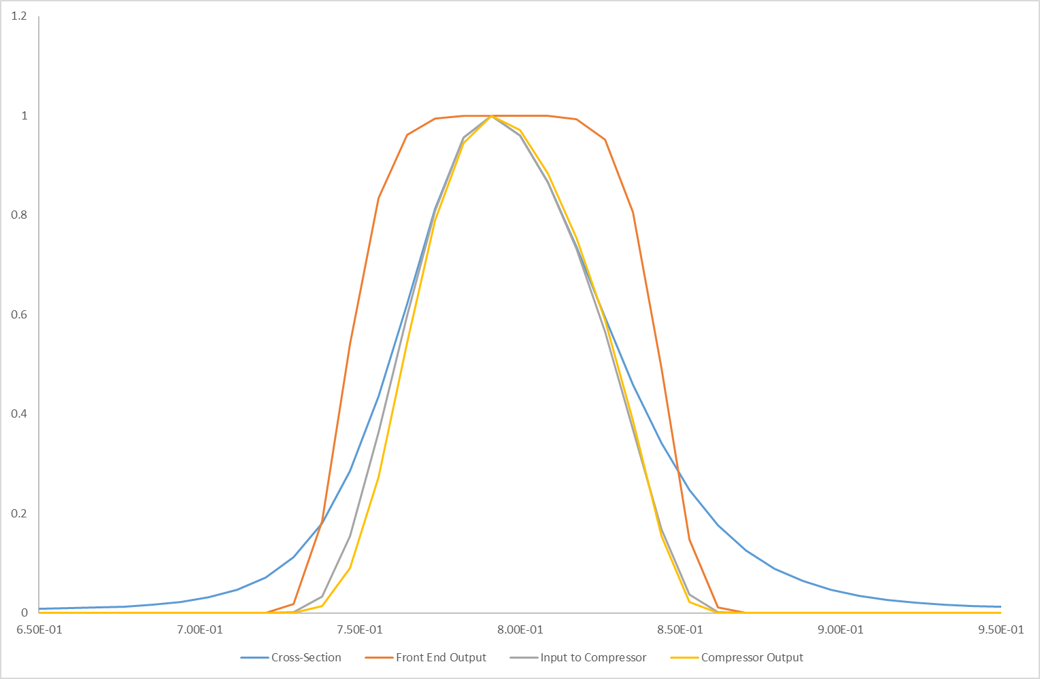
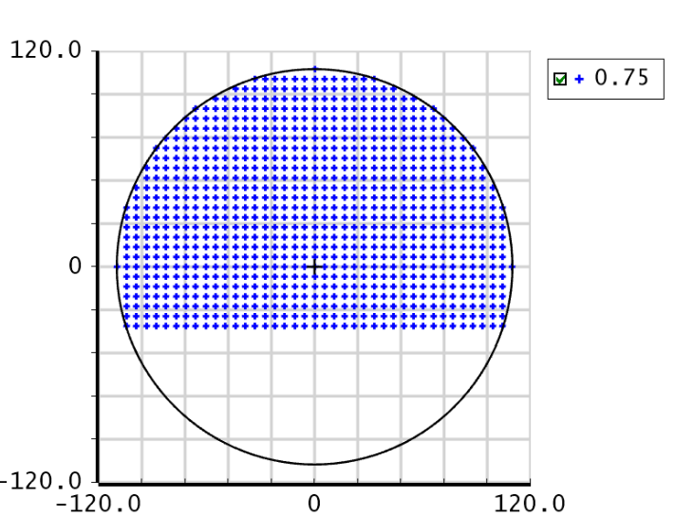
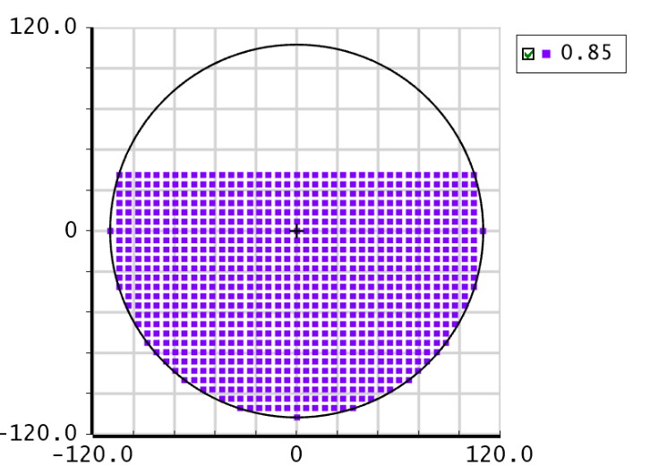
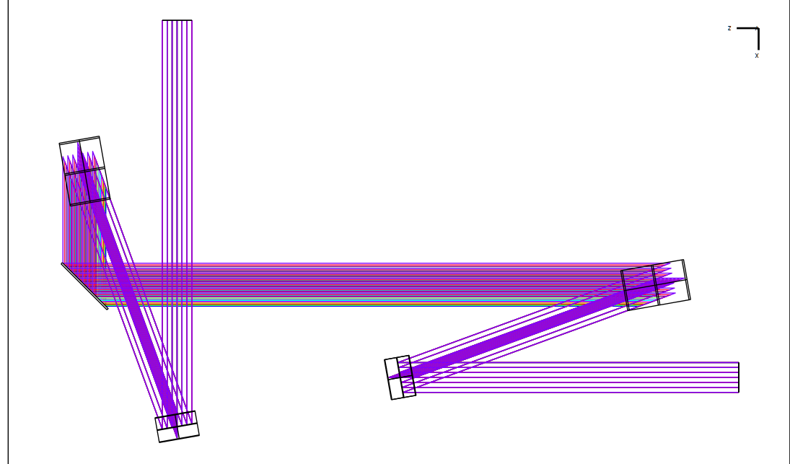
Grating Size
Cooled substrate has a maximum size of 550 x 260 mm leading to spatial apodization between 750 to 850 nm.
However this will have minimal impact on the spectral shape of the pulse.
G3
G2
G1
G4

Slide 26
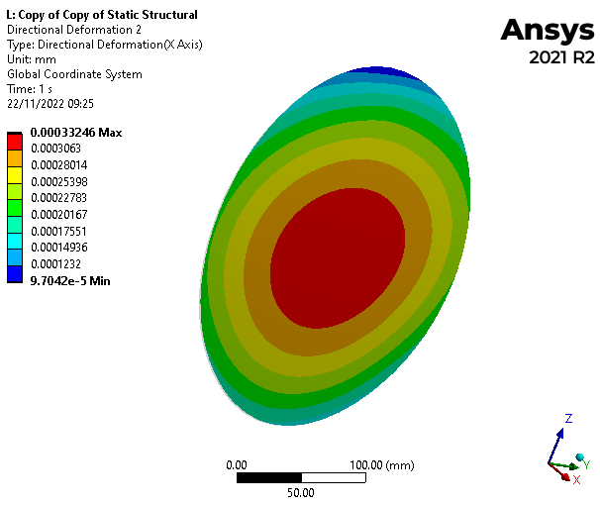
Gold - Thermal Modelling
Modelling (Ansys) to inform 1 Hz and 10 Hz grating performance.
  Grating surface temperature. Aim: < 50°C.
  Surface deformation. Aim: < 80 nm (structural + thermal).
Passive cooling by radiative emission (~80%).
  Investigating high emissivity UHV coatings.
Development of active cooling solutions by forced convection and conduction ongoing.
G2/G3 Thermal deformation.
30W absorbed
Gold Grating, ULE 7973 | G1, G4 (300 x 300mm) |  | G2, G3 (760 x 300mm)
 | 1Hz | 10Hz | 1Hz | 10Hz
Thermal Eq. Temp | 33°C | 118°C | 25°C | 59°C
Thermal (pk-pk) | 13nm | 233nm | 3nm | 184nm
Structural (pk-pk) | 69nm |  | 84nm
Combined (pk-pk) | 70nm | 280nm | 82nm | 136nm
G1/G4 Thermal deformation.
30W absorbed
Notes:
Quote thermal only

Slide 27
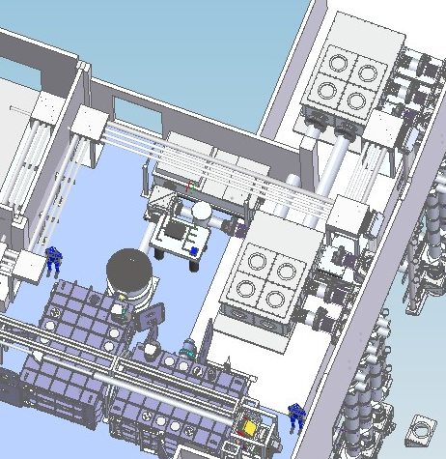
Post - Compressor
Switch-Yard
The periscope after compressor to reduce height to 650mm – for access to optics.
There is only enough space for a single level horizontal motorised translation
BL3 can pass over top of BL1,BL2.
Diagnostics
Beam Dump
Periscope
Switch-Yard

Slide 28
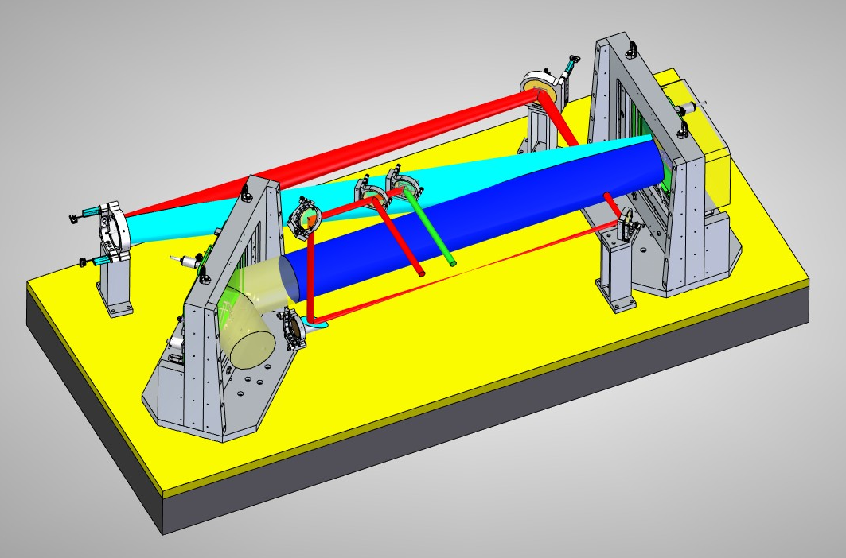
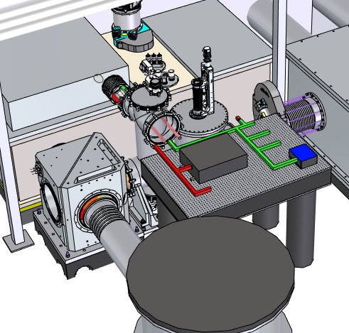
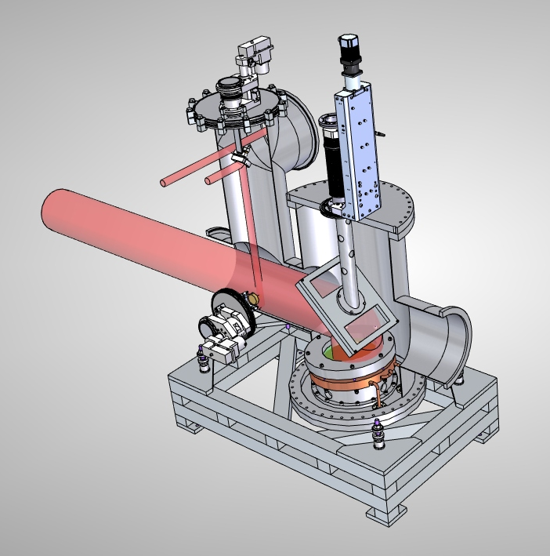
Diagnostics
Leakage transmitted through a mirror.
OAPs then used to downsize beam to ϕ30mm.
Wedged mirror then used to separate a high energy and low energy mode with 2 beams going into diagnostics suite.
Option for a pick-off mirror to be inserted into beam for sub-aperture diagnostics line.

Slide 29
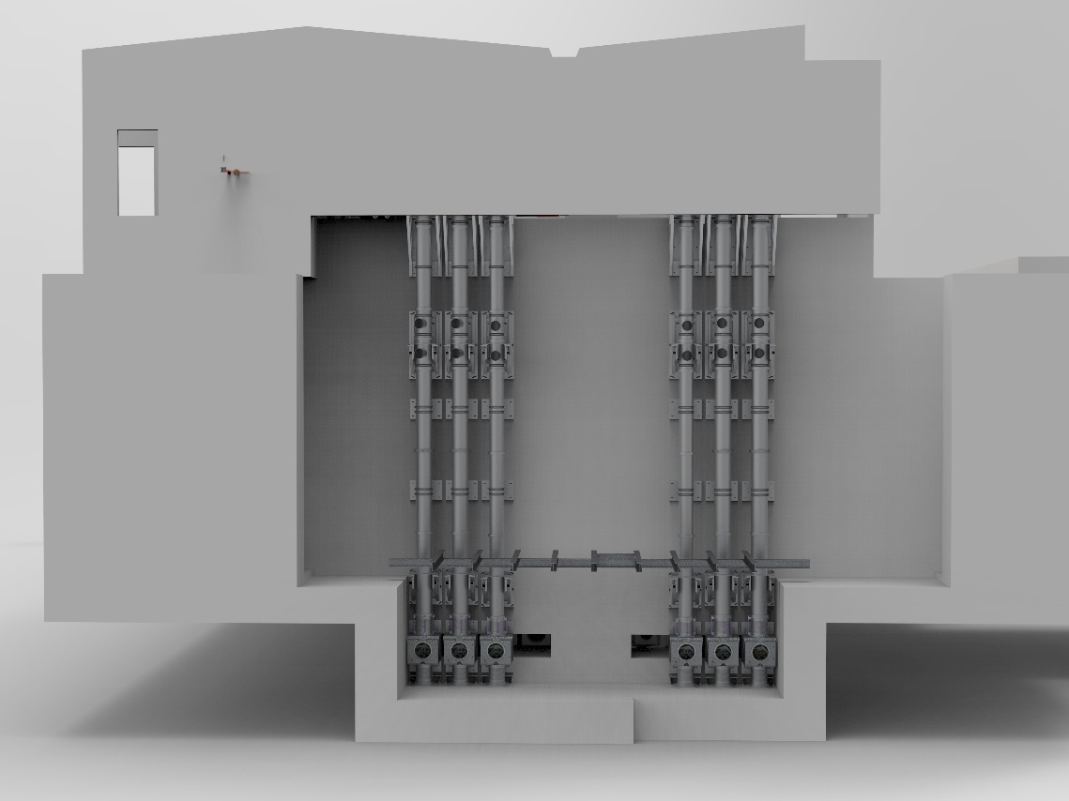
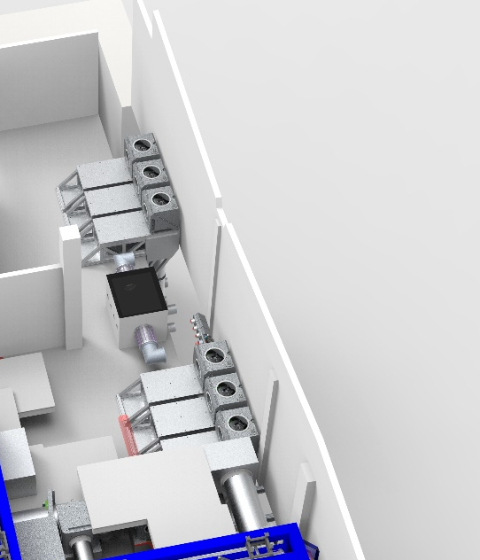
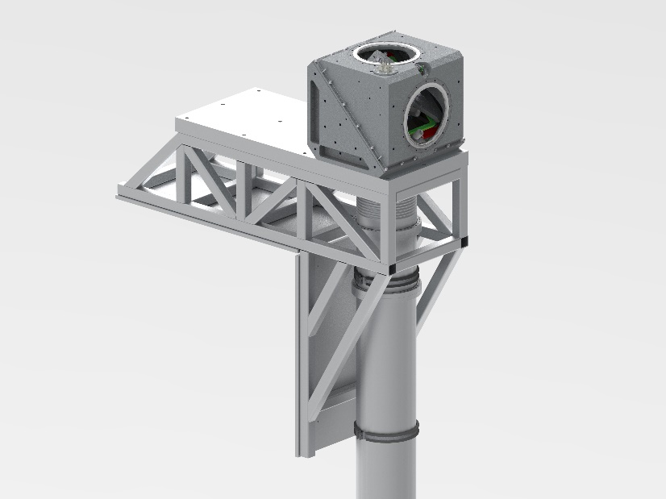
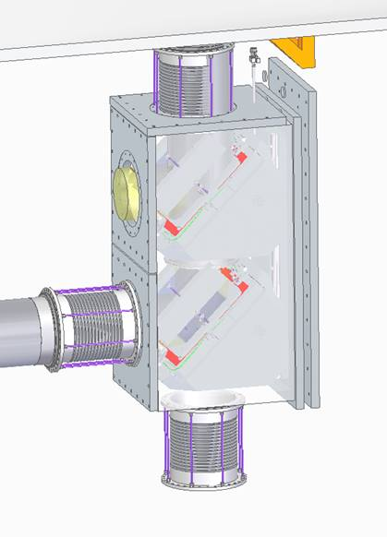
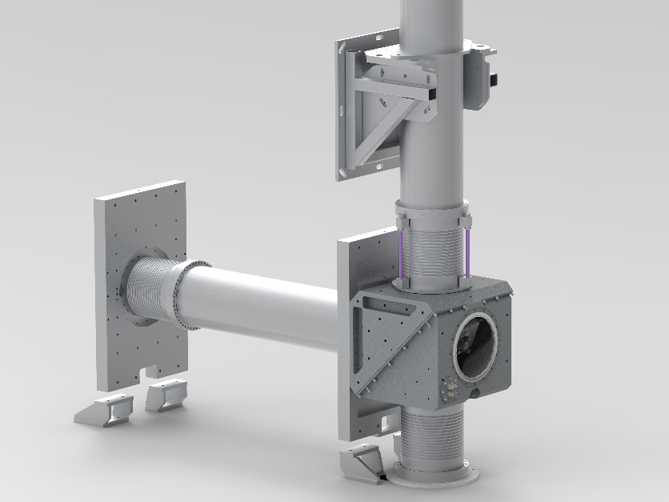
Delivery
Laser Areas
2nd Floor
Laser Areas
1st Floor
EA1
Ground Floor
EA2

Slide 30
Pre-Compressor CW beam expanders

Slide 31
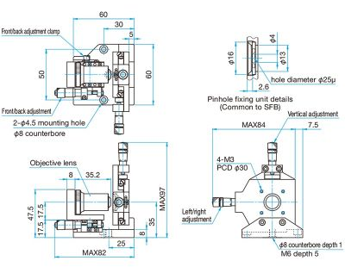

IR CW beam expander scheme
Fl= 2 m Achromatic lens, identical to Output diagnostic lens, also same overall design as VSF lenses with difference surface radii (same diameter and surface thicknesses)
Fibre combiner?
Spatial filter
10 deg
LASER
~750 nm
LASER
~800 nm
LASER
~850 nm
Spatial filter
Full aperture
MAKO
COMPRESSOR ALIGNMENT RETRO
ON TO SLIDE IN MIRROR

Slide 32
Blue beam expander + on shot IR Retro
Fl= 2 m Achromatic lens, identical to Output diagnostic lens, also same overall design as VSF lenses with difference surface radii (same diameter and surface thicknesses)
10 deg
FAST STABILIATION MIRROR
FL=500 mm
Spatial filter
Ø ~17 mm
Full aperture
MAKO
ON SHOT RETRO
FL=150 mm
LASER
THROUGH MIRROR

Slide 33
Pre-Compressor Pointing Overlap and Stabilisation Diagnostic
DUMP
4” Beam splitter 0.8° Wedge 90% R
Edmund Optics 6” parabolic mirror fl =1219.2 mm
32-072-522
0.2% LEAKAGE THOUGH MIRROR
Full aperture
20 deg
2.7E¹¹ W/cm² ?
2” 50/50 Beam splitter
Thorlabs - Position Sensitive Detector (PSD) PDP90A
Filter wheels
MAKO
FF f/40
400 & 750-900 nm
MAKO
TTS 0 deg mirror @800 plane parallel AR 900&400
xx deg tilt
400 & 900nm
Camera
WFS
WFS
750-850 nm
IF
MAKO
NF
400 & 750-900 nm

Slide 34

PSD channel
Note: 70 mm beam

Slide 35

Far Field channel
Note: 70 mm beam

Slide 36

Overview
Introduction
  A number of independently mounted optics (in a fixed trajectory) are arranged to direct a low laser beam leakage through a vacuum chamber.
  The highly stable collimated low power laser beam enters at Ø220mm and exits as a collimated beam size of Ø30mm. This requires two of the optics to be parabolic; one is used for beam focussing, the other for beam collimation
  The vacuum chamber and all components must be able to operate at high vacuum level (1 x 10-6 mbar)
  Access to components inside chamber will be from above (chamber will be vented for access)

Slide 37

Laser beam trajectory and optic mount locations
Mount 4
2000
Mount 2
Mount 3
Mount 10
Mount 5
Mount 1
Beam out
Mount 8
Beam in
Mount 6
Mount 7
Mount 9

Slide 38

Vacuum chamber and mirrors
Beam out
Beam in

Slide 39

Suggested Output Diagnostics Layout
φ=3 mm
f=25 mm
f=250 mm
φ=30 mm
Pickoff NF
Pickoff
SEQUOIA
FC/LX
SPIDER
f=1000 mm
f=250 mm
Spectrometer
φ=6 mm
f=-200 mm
SSA
CM Pairs
Pickoff FF
Blue FF
φ=6 mm
f=-200 mm
Blue NF
Polariser
PFT
f=100 mm
f=1000 mm
f=100 mm
FF
Low Energy
f=300 mm
DF
φ=30 mm
f=200 mm
f=200 mm
WFS
f=1000 mm
WP
f=200 mm
f=200 mm
NF
f=1000 mm
f=200 mm
f=200 mm
High Energy
φ=3 mm
f=100 mm
Filter Wheel

