Slide 1
EPAC Front End
ISTAC Technical Meeting 2022
Nicholas Stuart

Slide 2
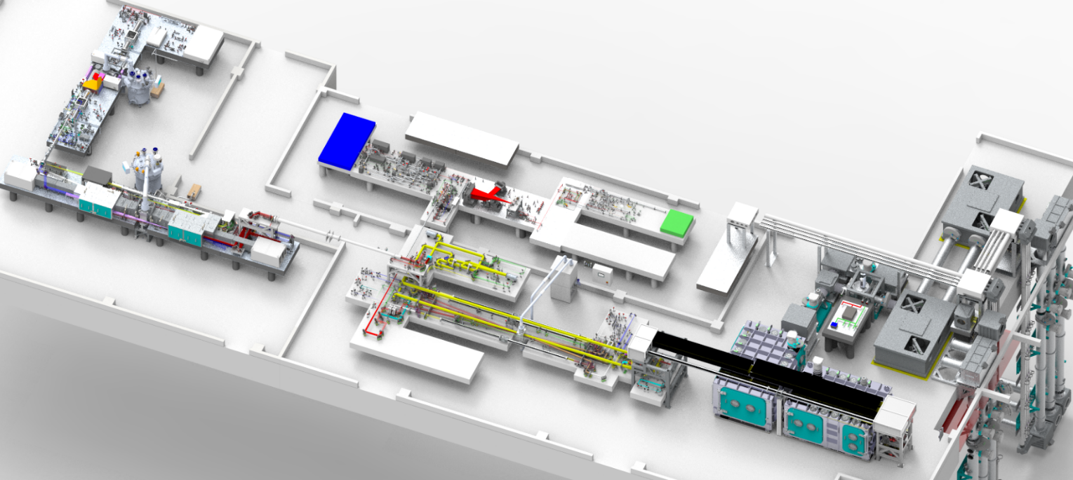
Introduction
The EPAC front end has 10⁸ net amplification, split between ps-pumped and ns-pumped OPCPAs to deliver a 1.5 J seed to the Ti:Sapphire amplifier.
EPAC Front End
Output pulse energy | 1.5 J full spectrum; > 0.5 J shaped spectrum
Output pulse duration | 4 ns FWHM
Output Bandwidth | > 100 nm FWHM
Central wavelength | 800 +/- 10 nm
Repetition rate | 10 Hz, 1 Hz, Shot on Demand
Shot‐to‐shot pulse energy stability | < 2 % RMS

Slide 3
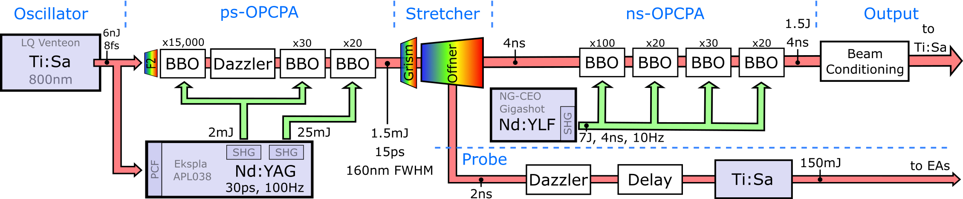
EPAC Front End Schematic
Picosecond-pumped OPCPAs. Optically locked to Ti:Sa master oscillator. 30 ps pump, 1.5 mJ signal.
Stretcher. Tuneable 70-120 ps stretcher before injection into Offner stretcher. 4 ns pulses out.
Nanosecond-pumped OPCPAs. 7 J total pump energy from synchronised pump laser. 1.5 J signal.
Front End Output. Spectral shaping (static), energy mode selection, rep-rate control, optical isolation, fast beam stabilisation injection + correction.
Image-relayed all FE amplifiers to Ti:Sa, with < λ/20 total chromatic aberration across 110 nm bandwidth.

Slide 4
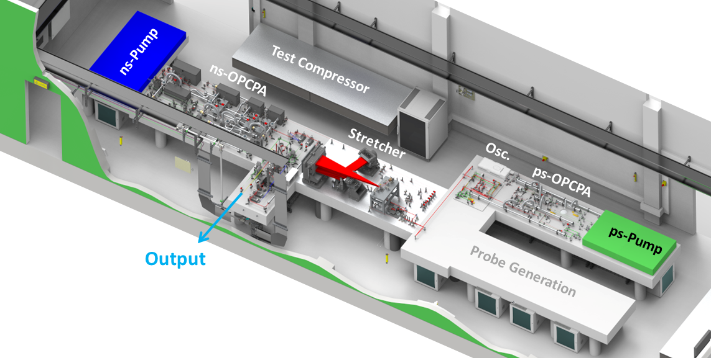
EPAC FE Room Layout

Slide 5
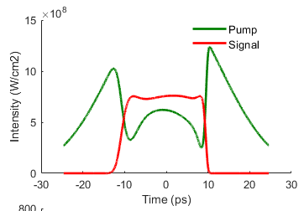
Picosecond-Pumped OPCPAs
Completed optical design. Three amplifiers operate at ¼ LiDT.
Spec | Required | Designed
Pump Energy | 25 mJ | 20 mJ
Pump stability | 1% | 1%
Signal energy | 1.5 mJ | 5.4 mJ
Signal bandwidth | 110 nm | 160 nm
Signal stability | 2% | 1%
ASE Contrast | 10⁹ | 6 x 10⁹
Facility Operations Features:
Near-field, far-field (seed + pump) & spec. per amp.
Auto-align ps-OPCPA injection + output to stretcher.
Pump + crystal motorised alignment tuning for gain.
Pump timing auto-align (spectrometer feedback).
Remote laser turn-on/off.
Eye-safe warm-up/standby considerations.
1D Model

Slide 6
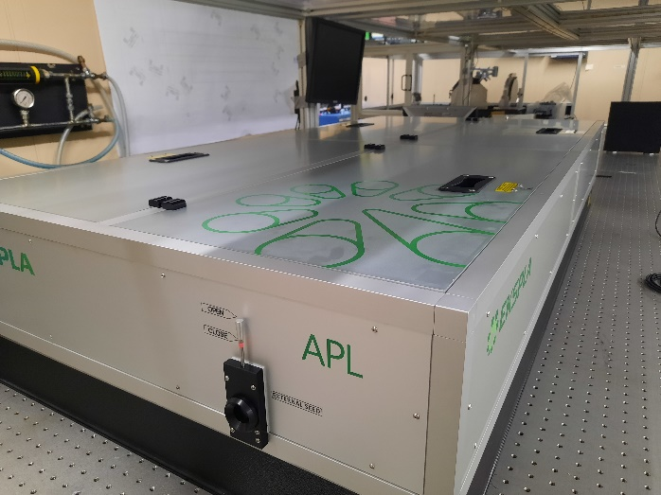
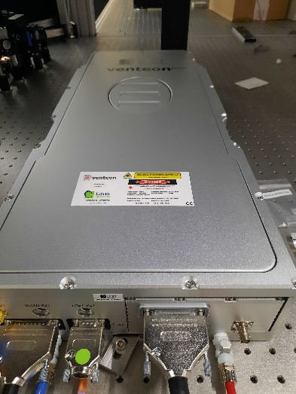
PS-OPCPA Lasers
The Ti:Sa oscillator (Laser Quantum) and ps-pump (Ekspla) have arrived and successfully tested.
SEED
PS OPCPA PUMP
Pump FAT:
Max pump energy 34mJ
Stability (covers off) = 0.44%
A pre-build of the ps-OPCPA system components is scheduled in Jan-23.

Slide 7
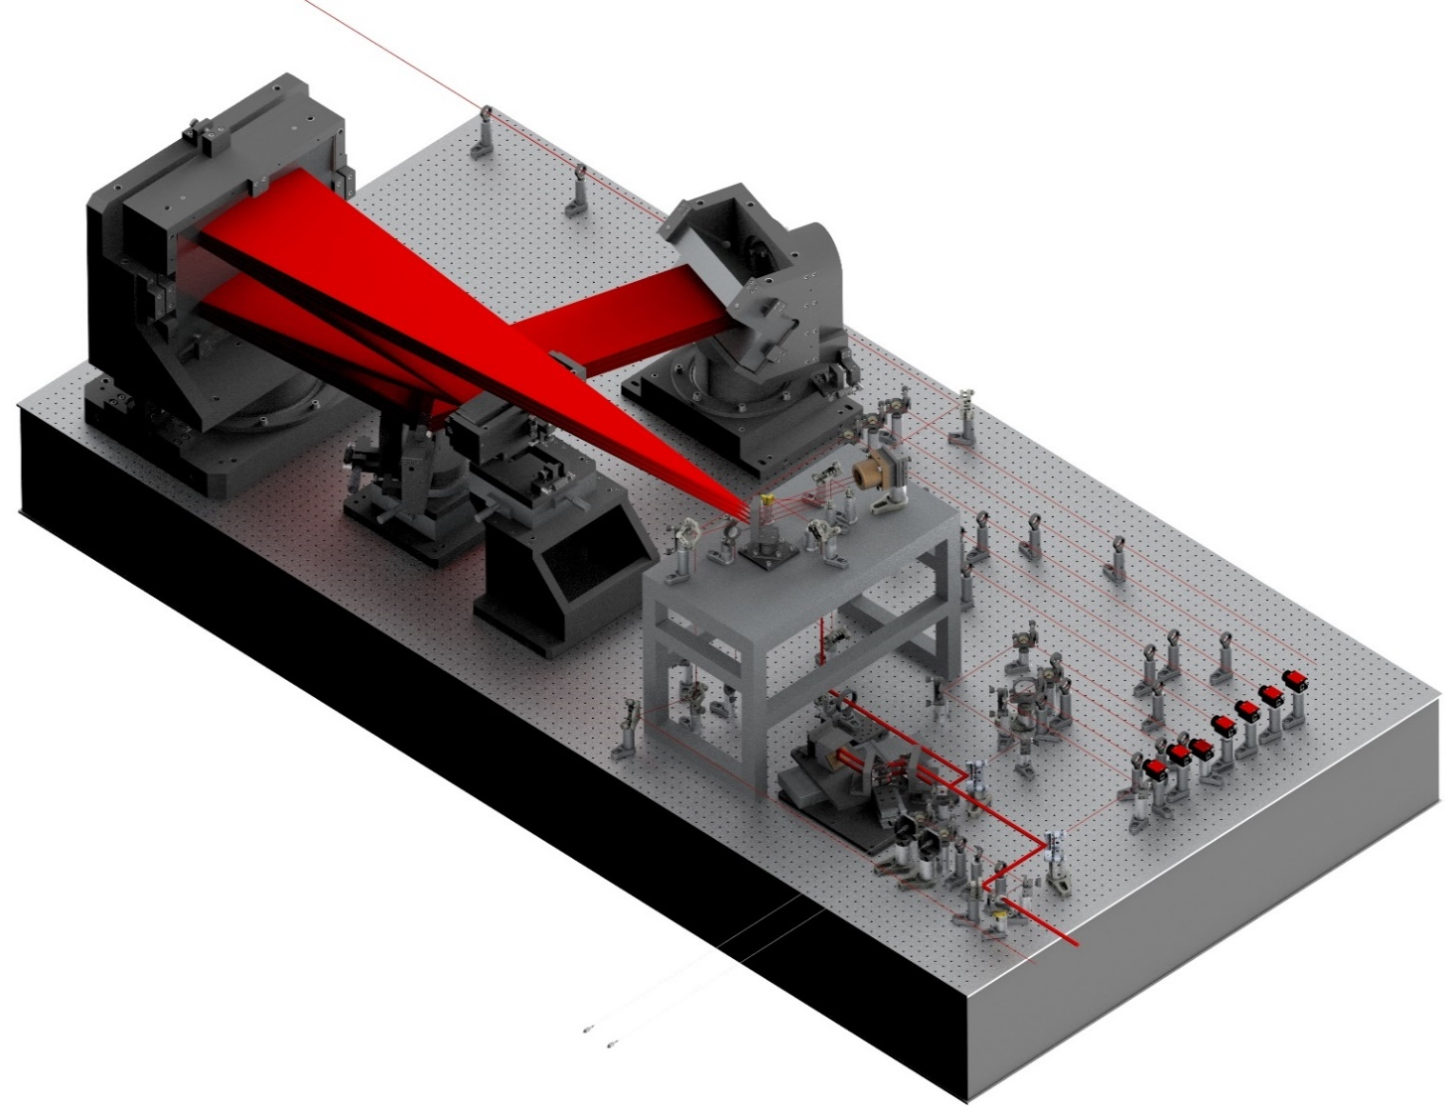
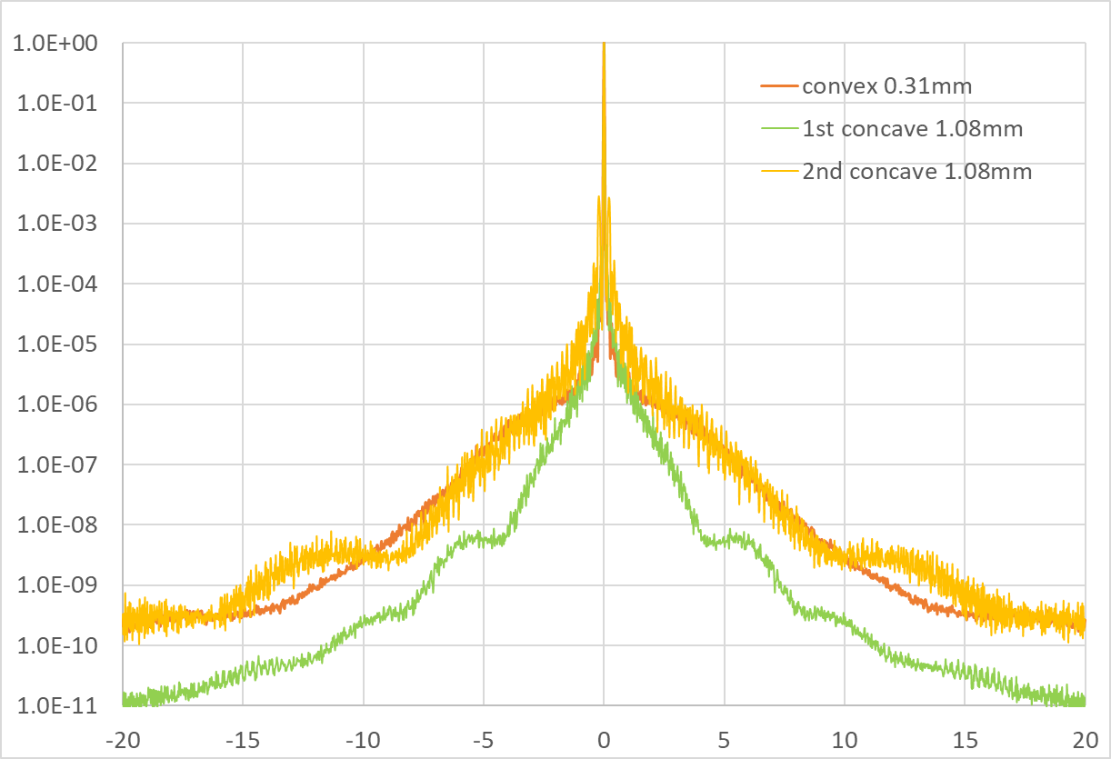
Stretcher Section
The ps-OPCPA output will be stretched to 4ns duration to inject into the ns-OPCPA amplifiers. Compressed pulse length tuning in experimental areas will be performed with a 50 ps scanning range tuneable stretcher before the primary Offner stretcher.
Stretcher spherical imaging optics in manufacture (Aperture Optical Sciences).
  λ/40 p-v, λ/250 RMS target specification.
  Scatter & wavefront aberrations in the stretcher significantly contribute to pulse pedestal noise.
Tender out for 1500 l/mm transmission gratings.
Starting manufacture of large optic mounts.
4 ns
Output
Diagnostics
Offner Stretcher
2ns Probe
Tuneable Stretcher
15 ps
Input
Notes:
We aim for EPAC to have a better pulse temporal contrast than Gemini.

Slide 8
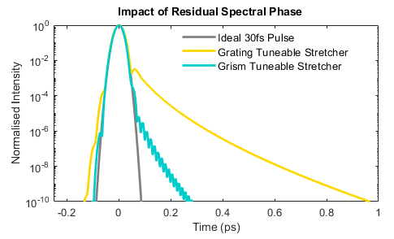
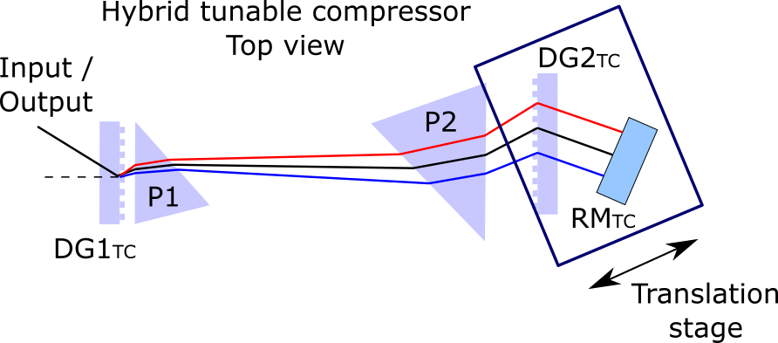
Tuneable Stretcher
Change of design from two-grating (Treacy) to a grism (grating +prism) pair in a folded geometry.
  Better management of high-order spectral phase. Compensation upto FiOD included.
  Higher tolerance to material dispersion in the beamline. From 30cm to 3m of fused silica.
  1350l/mm to 1500l/mm gratings. Total diffraction efficiency increased from 20% to 60%.
Prototype testing on the Vulcan OPPEL beamline to verify alignment procedure and measurement of the tuneable stretcher spectral phase contribution (SPIDER, spectral interferometry).

Slide 9
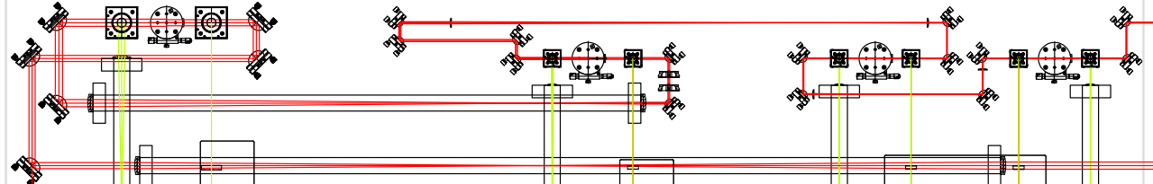
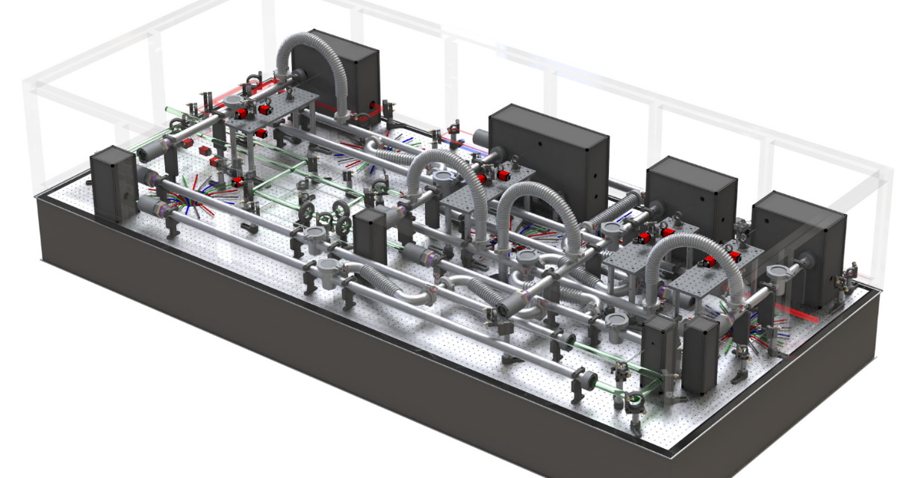
Nanosecond-pumped OPCPA
Design of ns-OPCPAs now final and in manufacture.
Current 1D amplification model predicts 2.8 J signal with 5 J pump. (1.5 J requirement)
OPA4
Input
OPA3
OPA2
OPA1
Output
OPA4 output ~17mm diameter and expanded to 20mm.
Facility Operations Features:
NF + FF every amplifier, spec. every two amplifiers.
Auto-align ns-OPCPA injection + output.
Auto-align pump output + crystal motorised tuning.

Slide 10
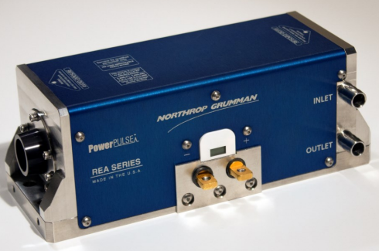
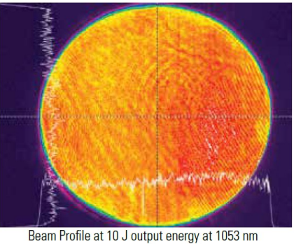
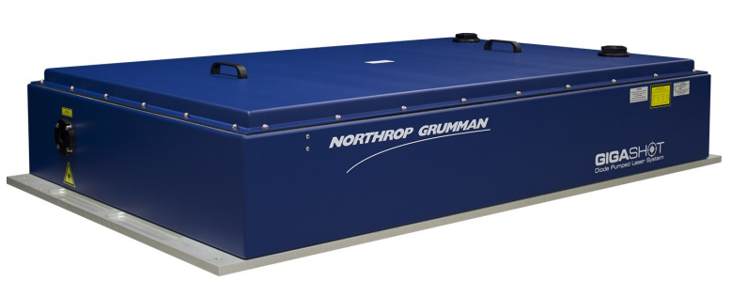
Ns-OPCPA Pump
Custom diode-pumped Nd:YLF ‘Gigashot’ pump laser in manufacture (Northrop Grumman Core Edge Optronics). Delivery scheduled Jul-23.
  7 J, 527 nm, 10 Hz top-hat spatial profile.
  Top-hat 4ns FWHM, 100ps rise/fall pulse, 25ps jitter with shaping.
  <0.5% RMS energy will ensure we meet our 2% stability spec.
  Customised design improves their existing design to create a stable and reliable long-life pump laser.
  Remote laser turn-on/off and monitoring (EPICS).
  Eye-safe warm-up/standby considerations to maintain laser readiness when not in use for long periods.
Example
Uses NG-CEO Nd:YLF amplifier modules up to 22mm rod diameter.

Slide 11
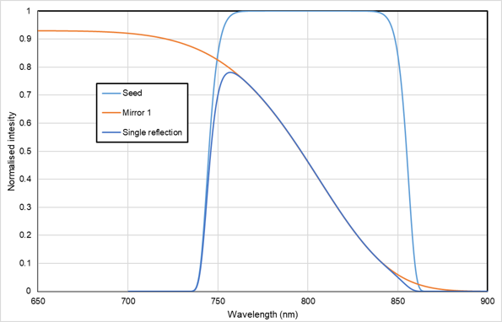
Front End Output
Spectral/temporal shaping. The top-hat temporal profile of the ns-OPCPA will need to be shaped to compensate pulse-front gain saturation shaping in the Ti:Sa.
  Shaping attenuates energy from 1.5 J to 0.5 J.
Energy attenuation (modes 3 & 4), to reduce intensity in experimental areas for set-up.
  99% reflector & 95% reflector + variable waveplate polariser for continuous coverage.
  AR compensator window of same thickness is inserted when energy attenuation is not used.
Fast beam pointing stabilisation mirror and CW injection.
Repetition-rate control. 10Hz, 1Hz, single-shot.
Optical isolation of the front-end (Pockels Cell).
Spectral shaping of ns-OPCPA output

Slide 12
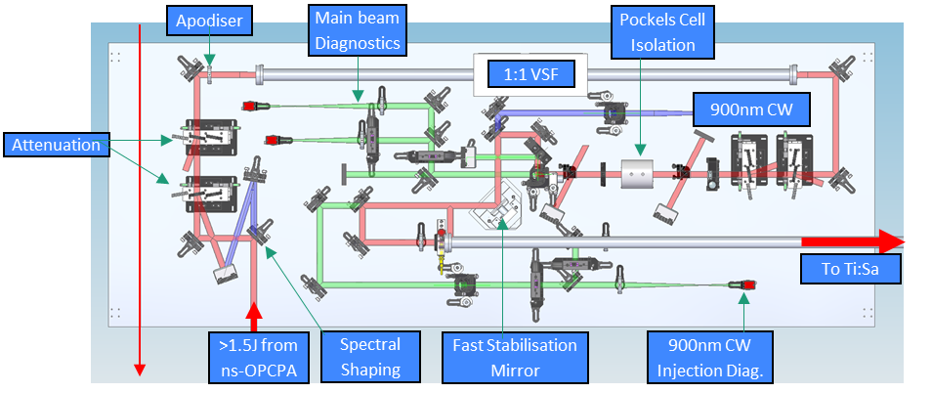
Front End Output Layout
Current status: Final detailing and manufacture. Provision has been made for an interchangeable pinhole array in 1:1 VSF. We are currently assessing expected ns-OPCPA output profile to inform this requirement.

Slide 13
EPAC Probe Laser
A portion of the stretcher output (double-pass, 2ns) provides an optically locked seed for to a Ti:Sa amplifier system.
Amplification from 3 μJ to ~150 mJ, ~Gaussian spatial profile.
Commercial Ti:Sa system. Tender in preparation.
Compression performed in air, in experimental areas.
  Compressor will use same Littrow + out-of-plane angle design as main EPAC compressor.
  30 fs probe pulses required for plasma mirror triggering and transverse + longitudinal probing.
  Ti:Sa gain narrowing and compressor modelled to predict a 21 fs FTL.
    Does not include spectral amplitude shaping from the Dazzler AOPDF.
Optical path length will need to precisely match the main beam to probe at the interaction time, with delay adjustment .
  Current scheme provisions a delay cavity on the seed for coarse adjustment.

Slide 14
Summary
95% sign-off of the PW seed design detail.
Both ps and ns OPCPA design optimised for stability, with high confidence specification can be achieved.
Dispersion management scheme evolved for greater phase error compensation.
Front End Output section implemented to include spectral shaping, energy control, optical isolation,
rep-rate control and fast stabilisation features.
Installation in EPAC lab scheduled to start Mar-23.

Slide 15




Thank you
Extreme Photonics Applications Centre (EPAC)
Notes:
The abstract pattern can be removed or repositioned if required. Be careful to ‘Send to Back’ so that it does not obscure any important information.

Slide 16
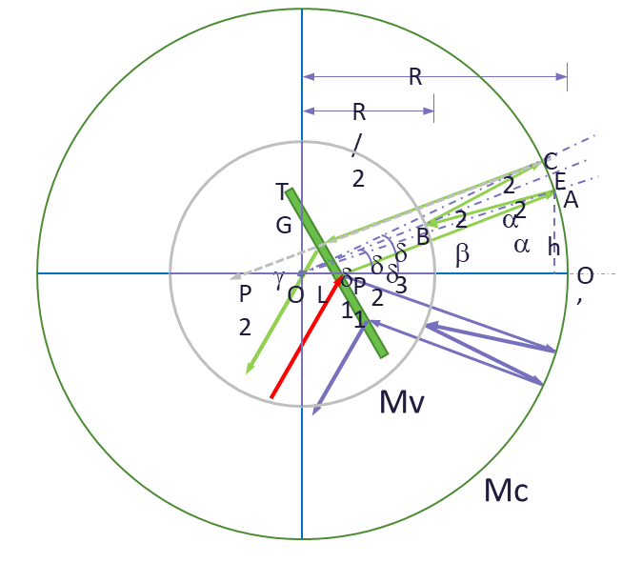
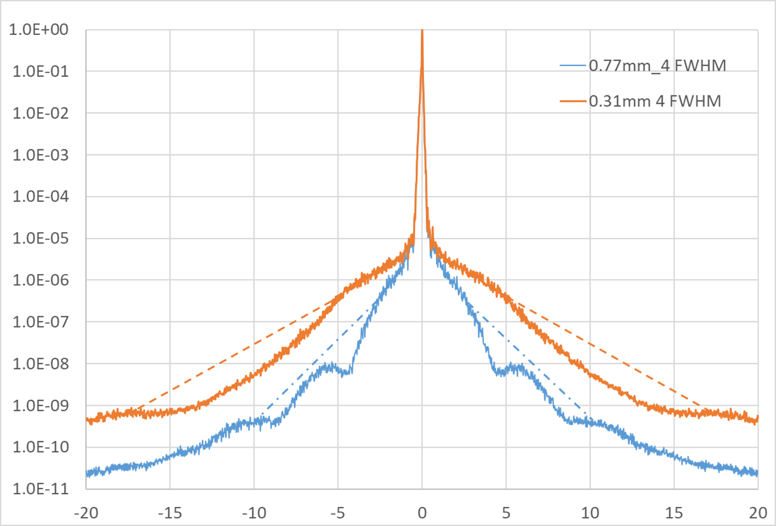
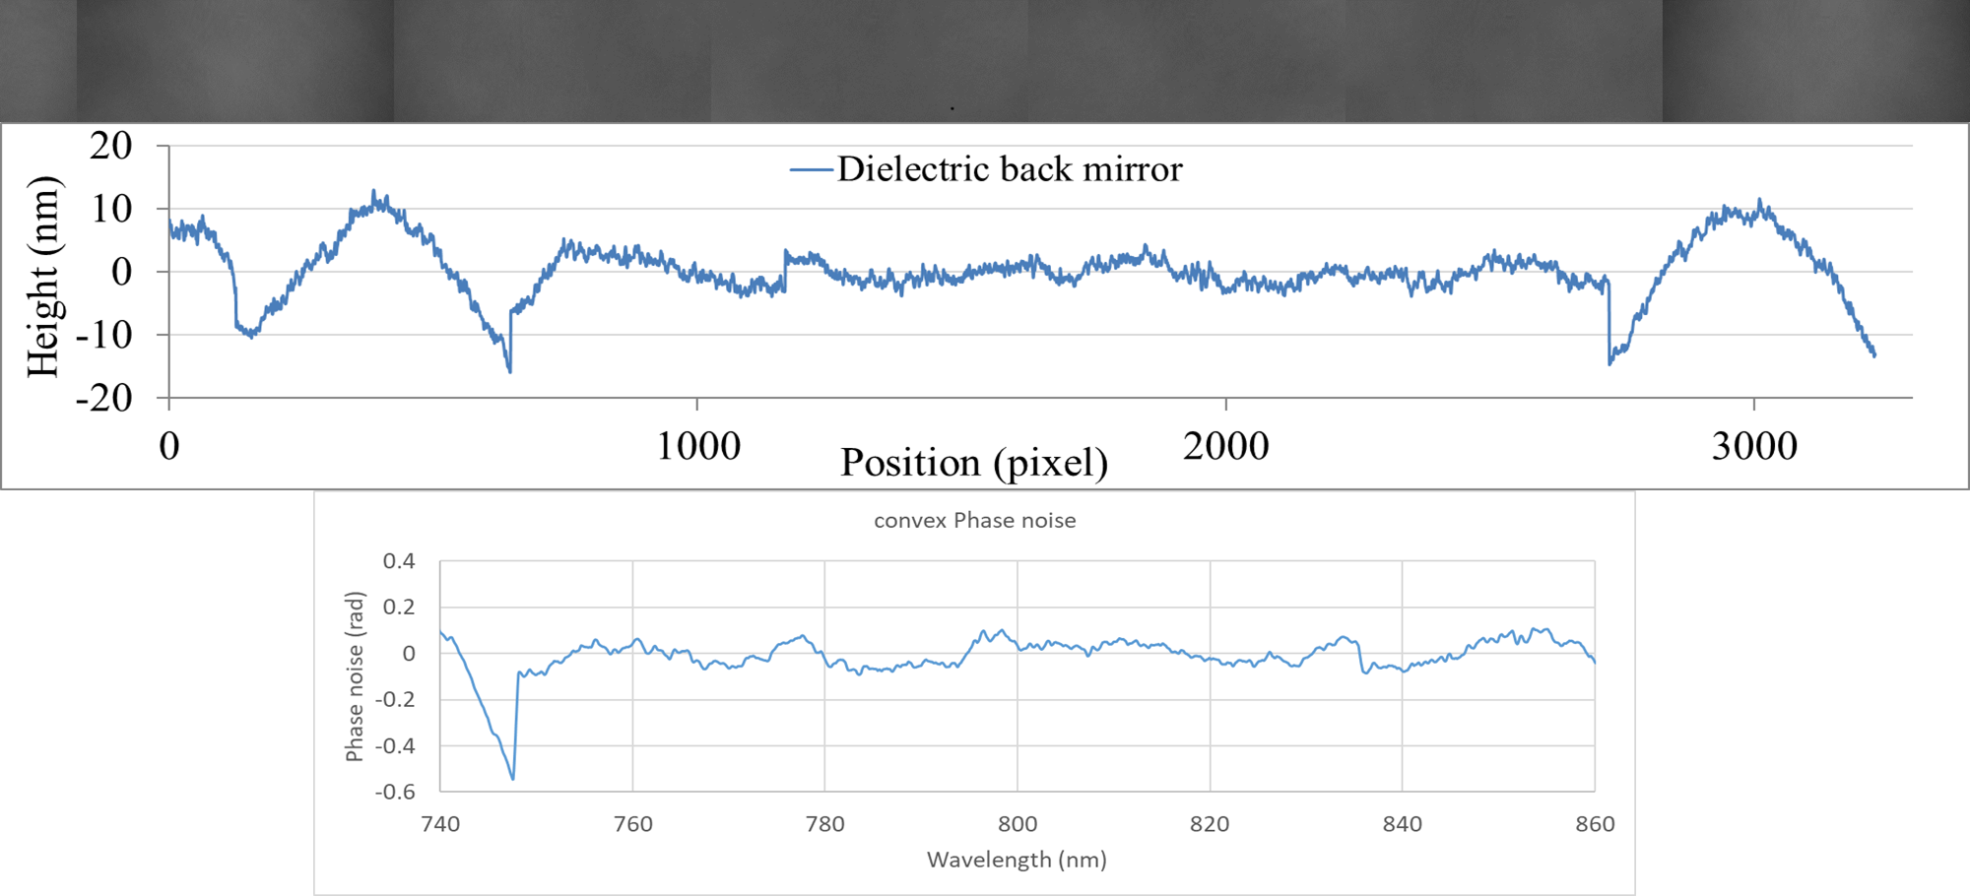
Phase Noise -20 ps Contrast
Modified the model developed to simulate the Gemini contrast to predict contrast for EPAC stretcher.
Used measured interferometer data from current optics for EPAC optics.
Clear that larger size of beam on –ve mirror better the contrast.

Slide 17
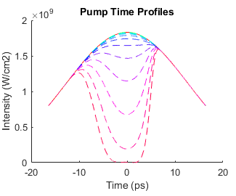
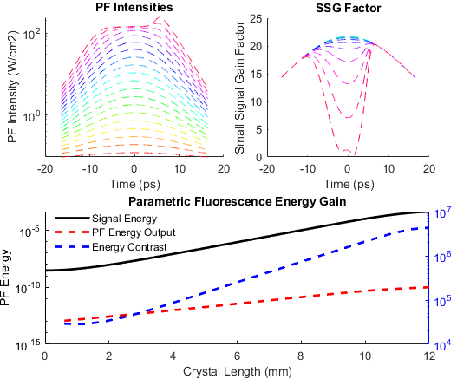

PF-100 ps Contrast
OPA
Developed a model to predict the PF generated in the PS OPCPA running in the saturated regime.
Ran the model in seeded mode to calculate the pump profile as a function of crystal length.
Used this to calculate the SSG as a function of length in the crystal.
Calculate PF based on seeding with single photon per mode.

