Slide 1
EPAC ISTAC
Technical Report
Pump Laser
Jonathan Phillips
30th November / 1st December 2022
Notes:
The abstract pattern can be removed or repositioned if required. Be careful to ‘Send to Back’ so that it does not obscure any important information.

Slide 2
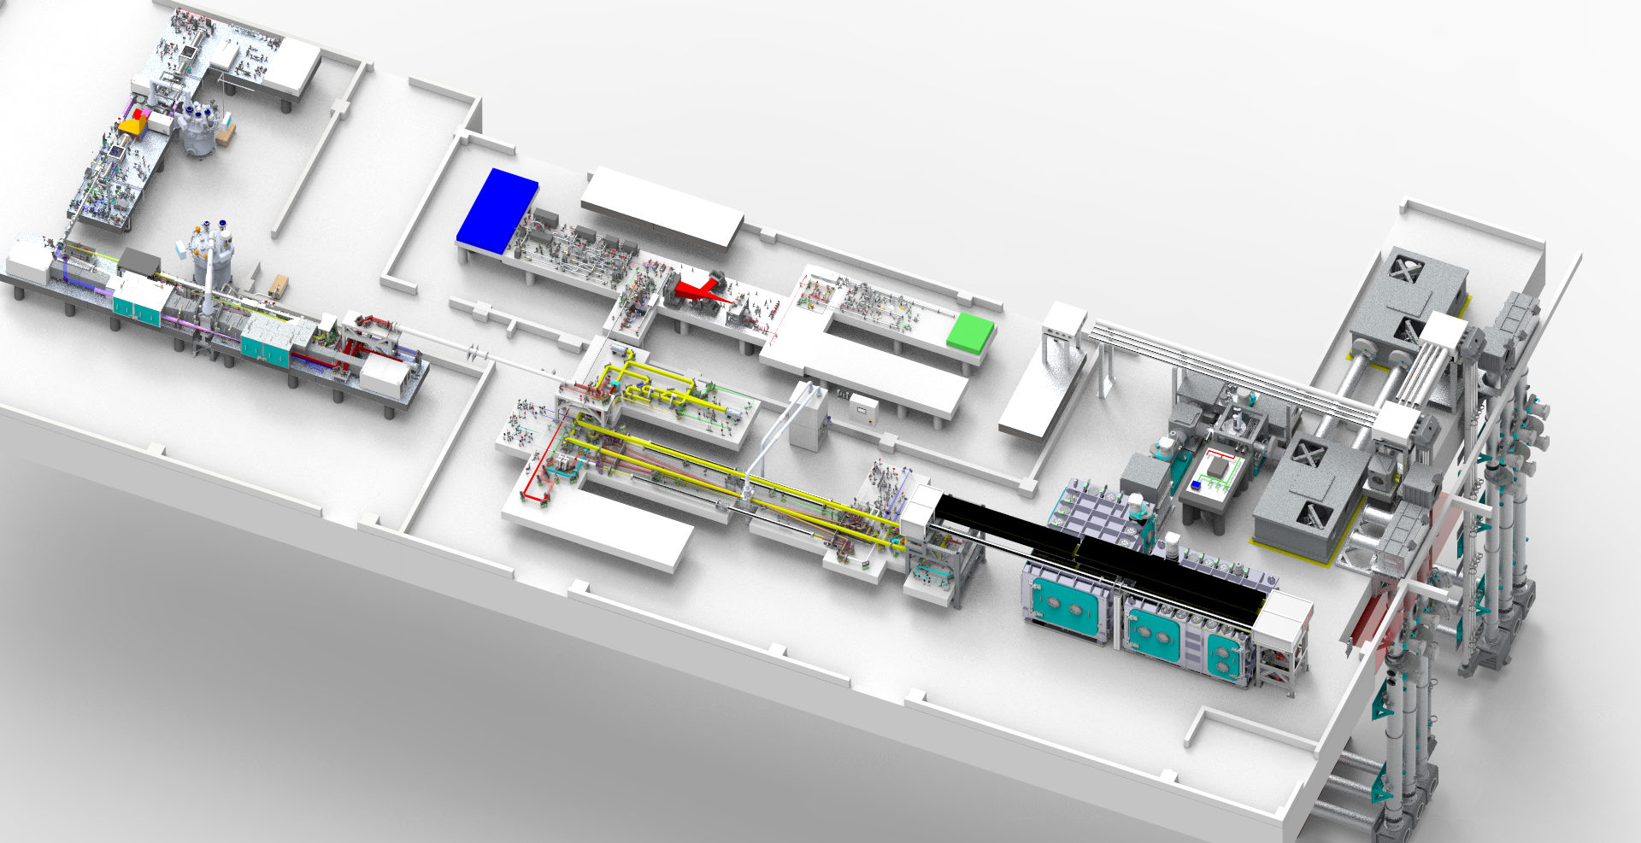
Pump laser layout
Layout of the EPAC Pump Laser and Rack Rooms
Rack Room
Front End
10J Amplifier
120 J Amplifier
Pump Room
Pump Laser Parameter | Design requirement
Pulse energy | 200 J with pump A & B Day 1 = 120 J with pump A only
Pulse duration FWHM | 15 ns FWHM
Central wavelength | 1030 nm
Repetition rate | 1 Hz and 10 Hz
Notes:
Add slide on FE with pulse shapes?

Slide 3
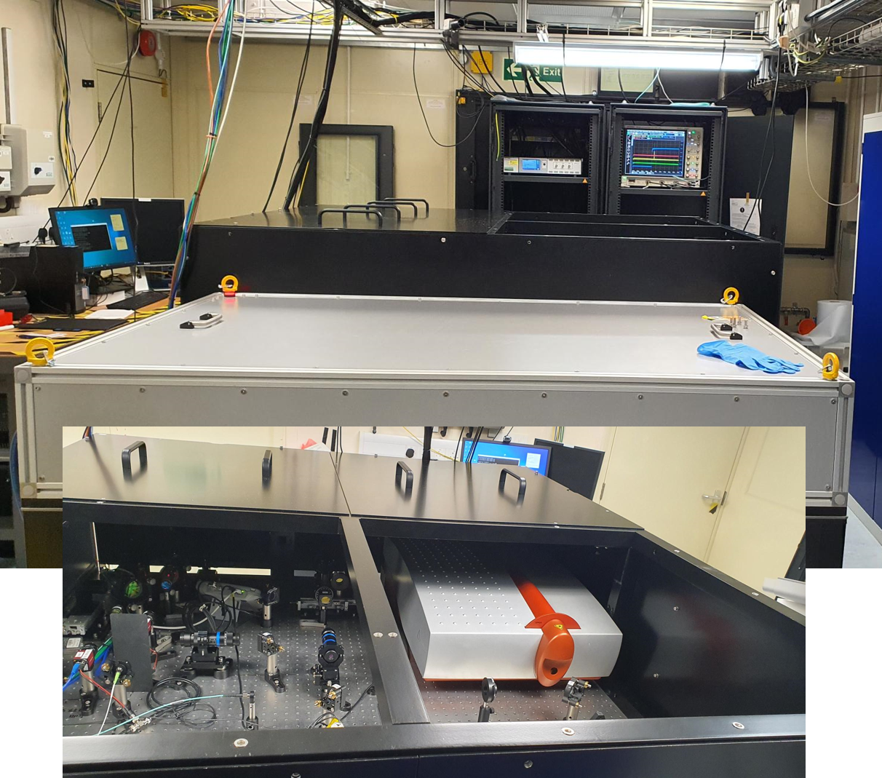
Front End Pre-build
Pre-amplifier 2
Built and commissioned in advance
Fibre seed installed
Pre-amplifier 1 installed
Pre-amplifier 2 installed
Opto-mechanics and optics delivered
Software Development
Fibre seed – software complete
Pulse shaping software – to be tested
Pre-amplifier 1 – software complete
Pre-amplifier 2 – software complete
Pre-amplifier 1
Output to 10 J

Slide 4
Output of Front End
Site Acceptance Test
Output Energy Specification 100 mJ
Measured Output energy 100 mJ for 6 + Hours
Output polarization Specification 20 dB
Measured Polarisation extinction ratio (PER) >20.3 dB

Slide 5
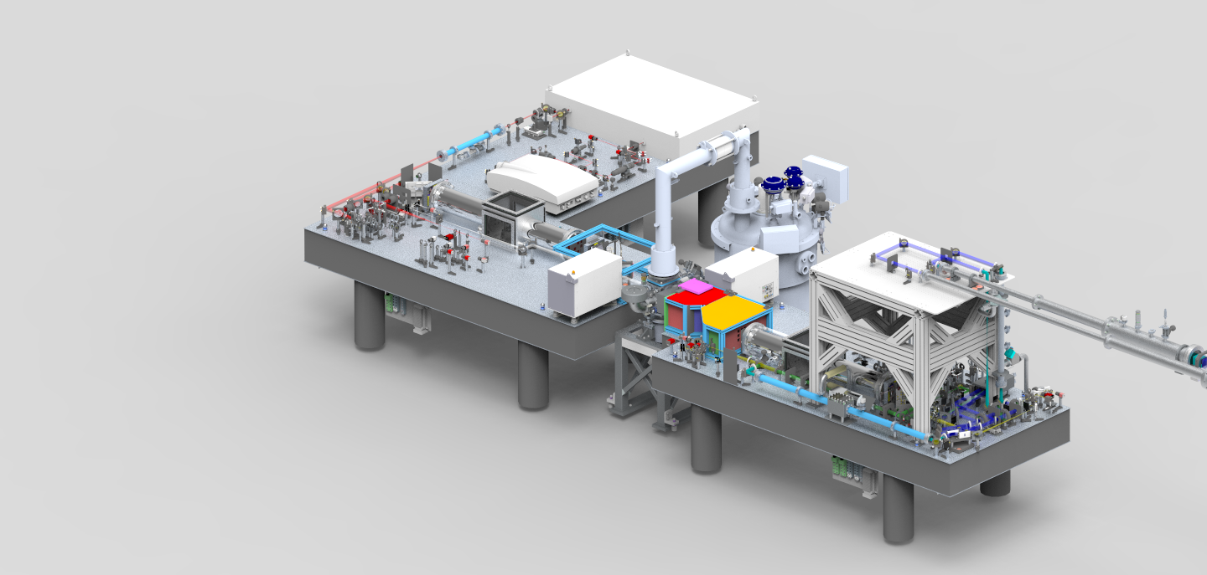
10 J Amplifier Progress
All major optics and opto-mechanics delivered
10 J Cryostat FAT and delivered
Cryo full loop (inc amp head) tested in Cryo manufactures factory
Pump diodes FAT completed
Debris shield designed
Support structure designed and ordered
Notes:
Add image of amp head?

Slide 6
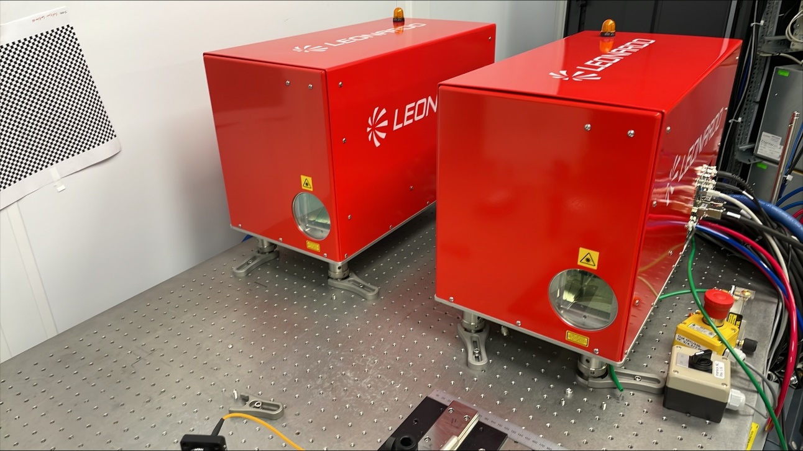
10 J Pumps FAT Complete
Successful completion of FAT
Output energy per Pump 35 J @10 Hz, 1.2 ms
Delivery in December 2022
Installation and SAT in the EPAC Pump room in January 2023
Beam profile of Module A
10 Pump modules

Slide 7
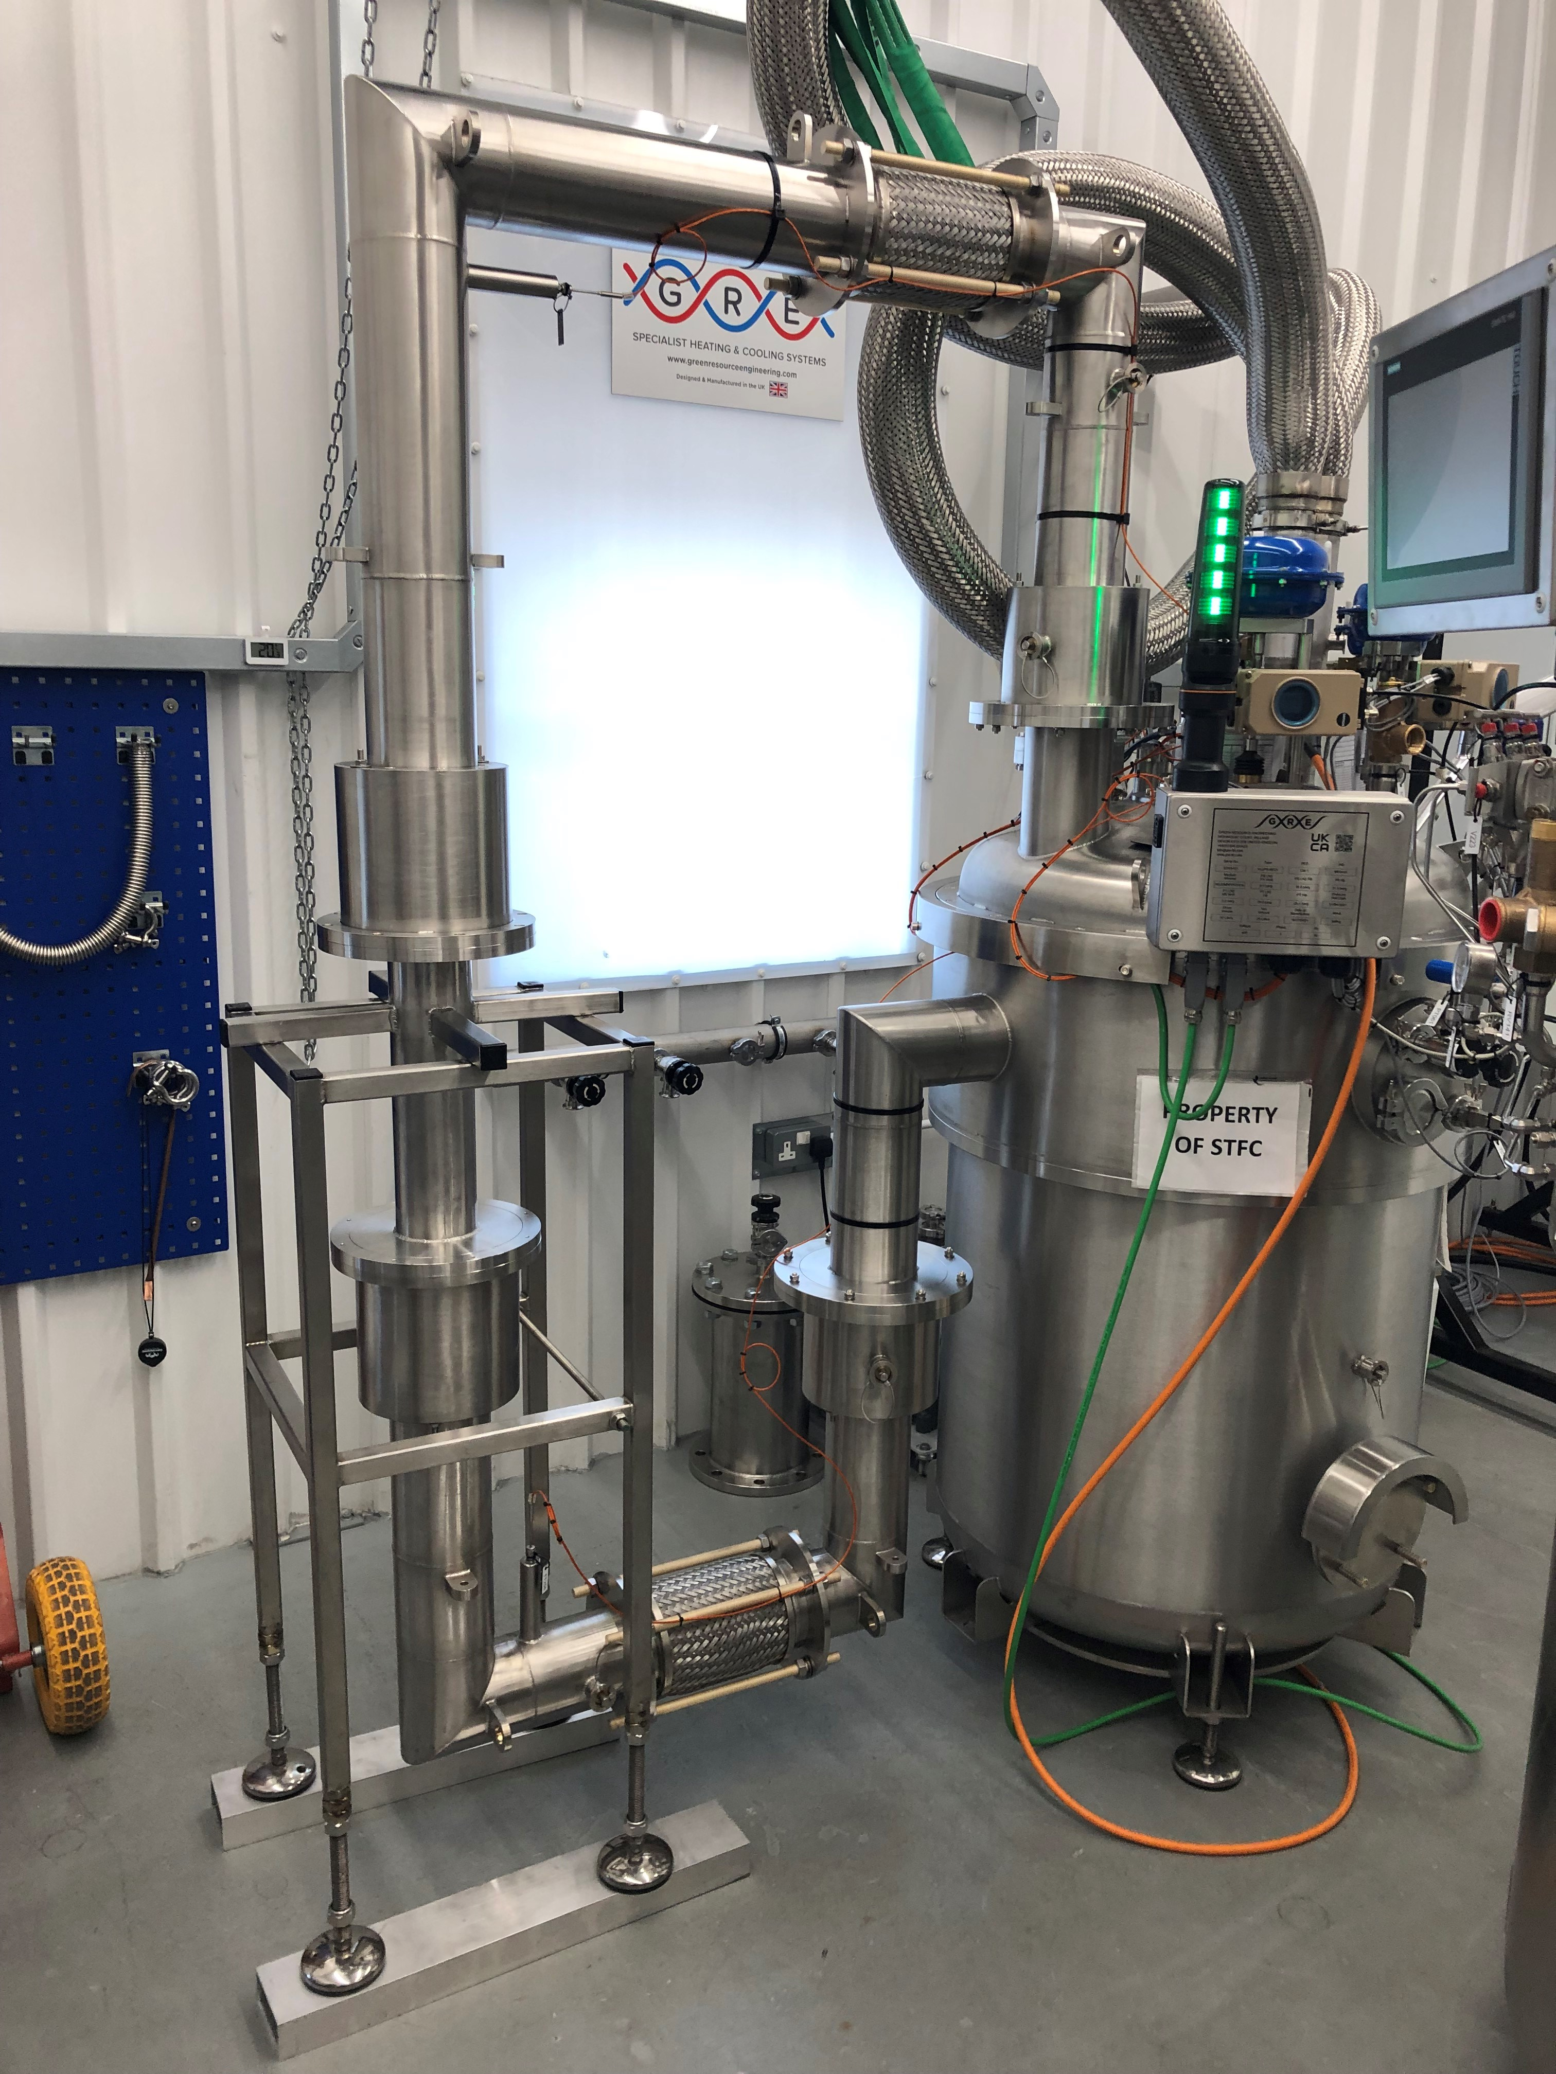
Installation in EPAC
10 J cryostat
(GRE)
10 J Cryo
Fully commissioned at manufacturing company
Leak tested with 10 J Amplifier Head
Moved to EPAC building
10 J Cryo cooling system to be commissioned in
January 2023 in the EPAC building
Location of amplifier head and support structure
(CLF design)

Slide 8
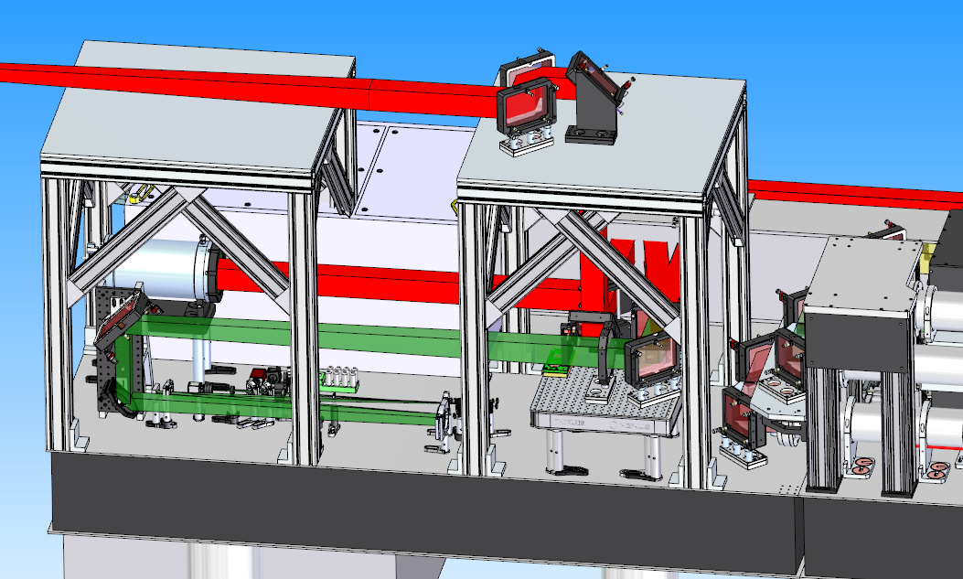
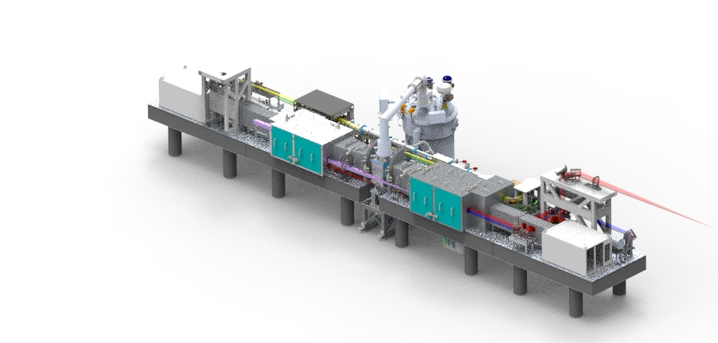
120 J Amplifier
Output beam
Input structure design completed
Output structure designed completed
Debris shields designed completed
General enclosure design to be finished
Polarisation insensitive diagnostics

Slide 9
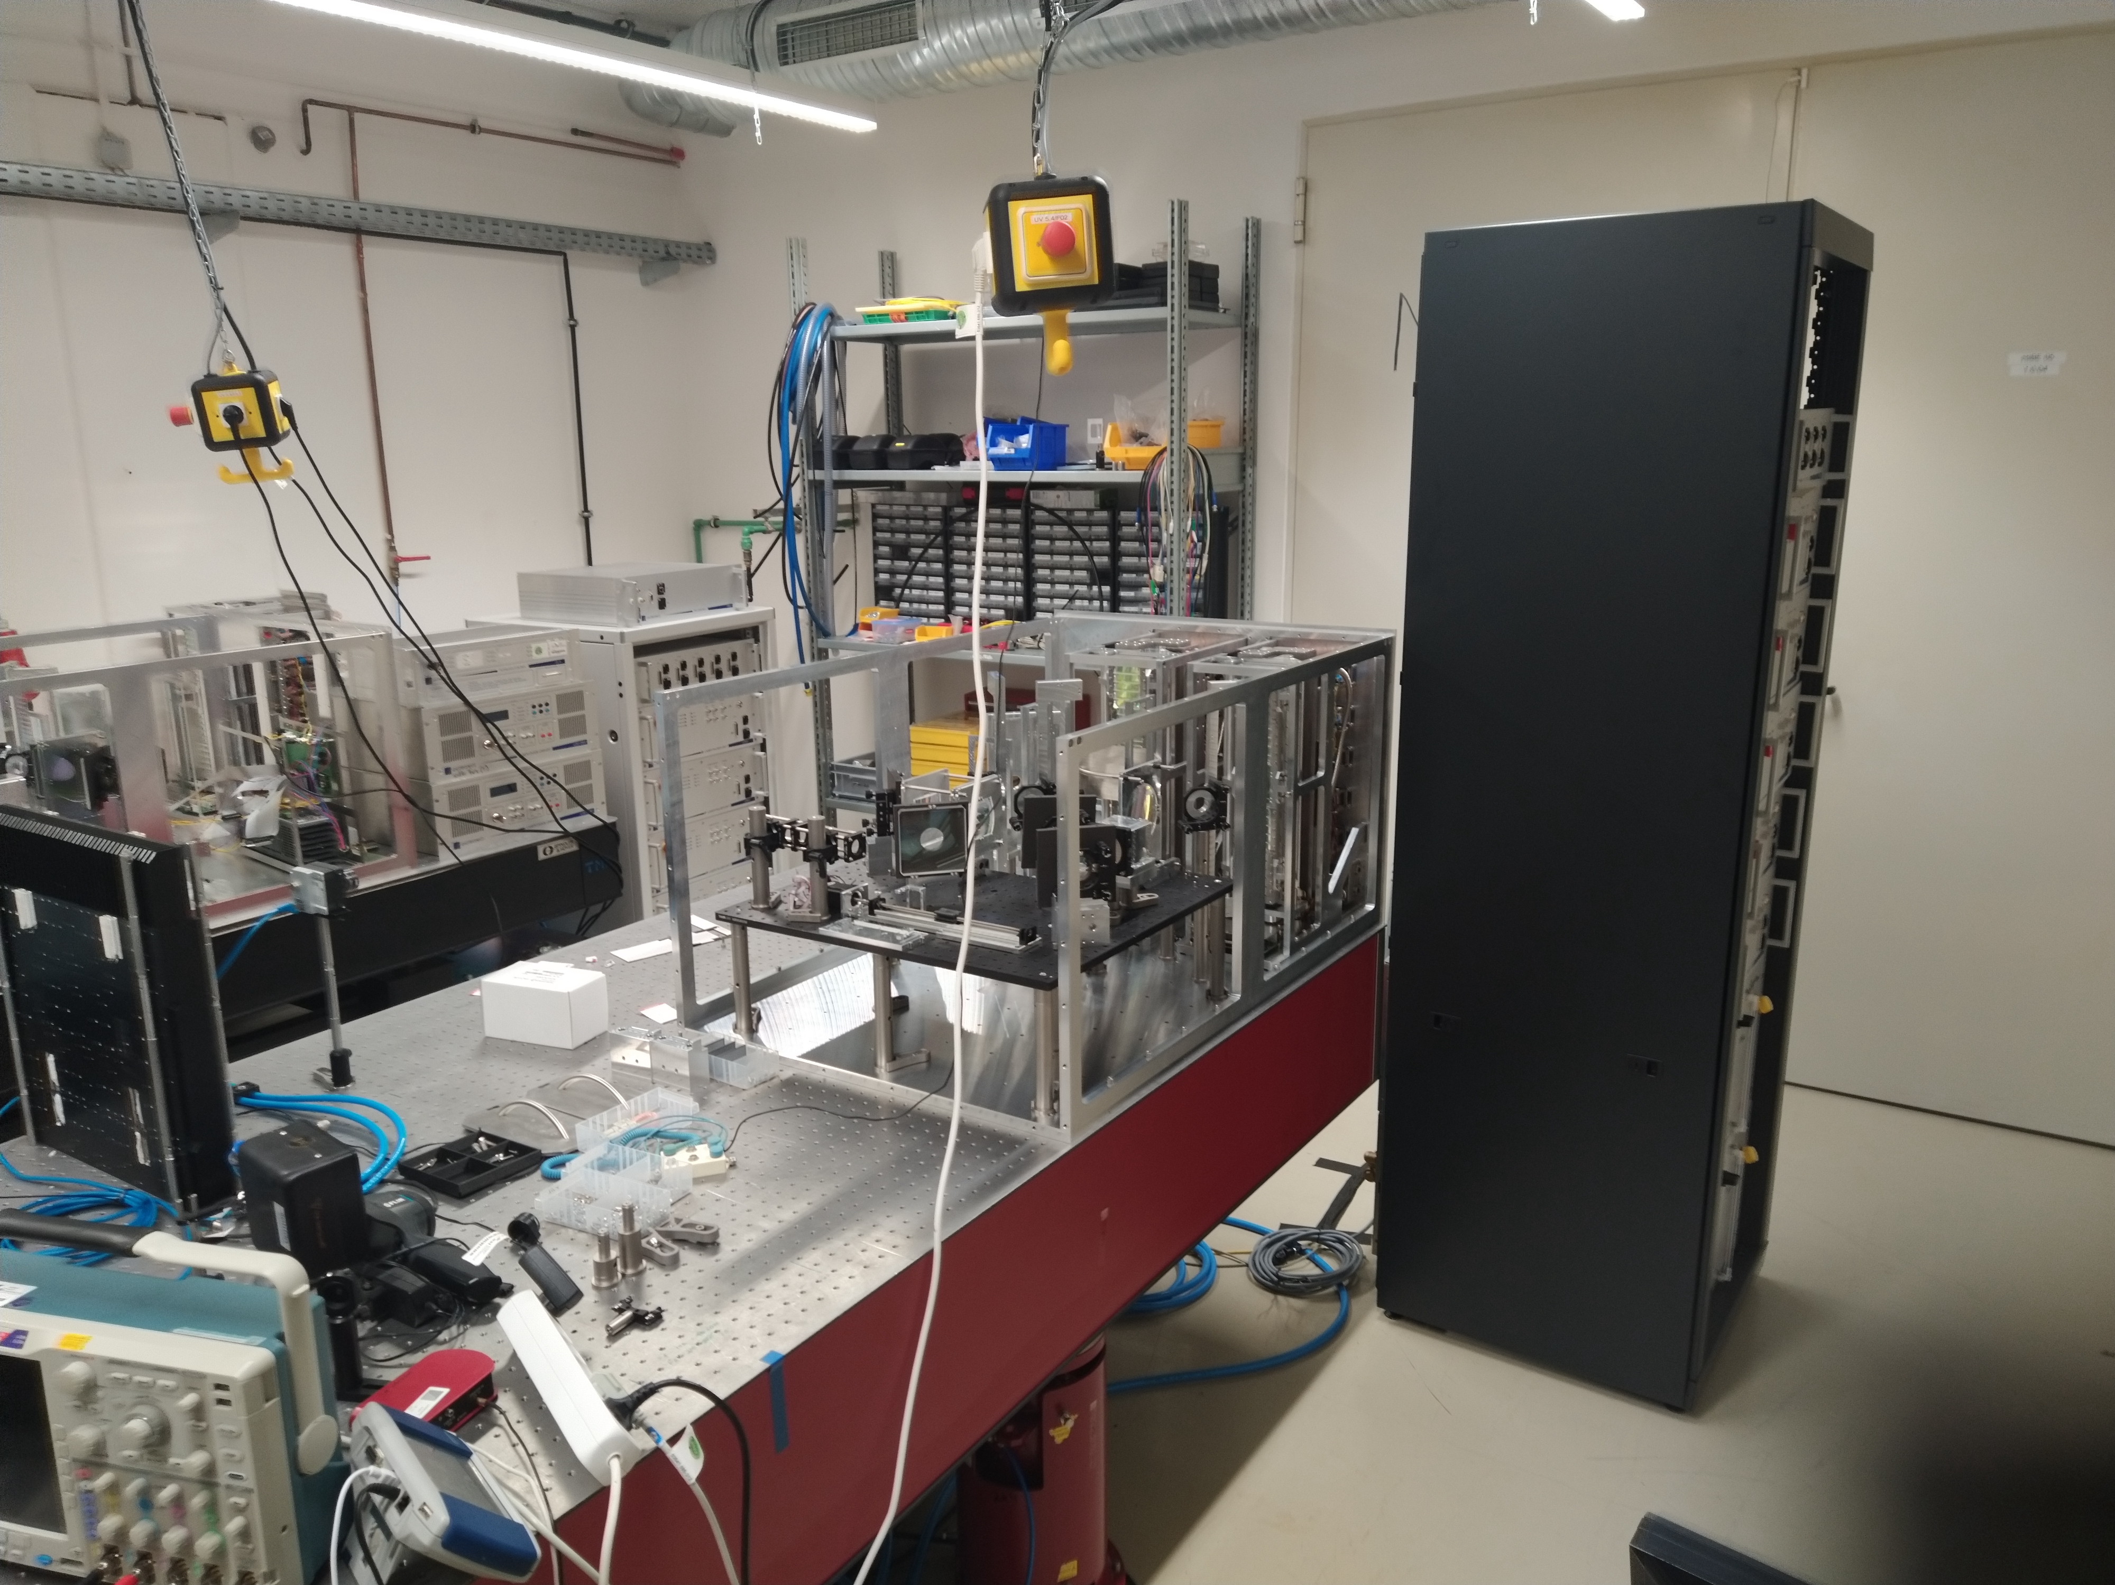
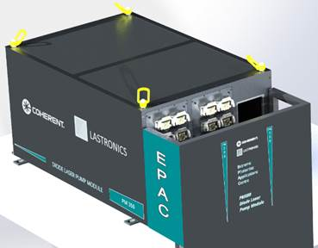
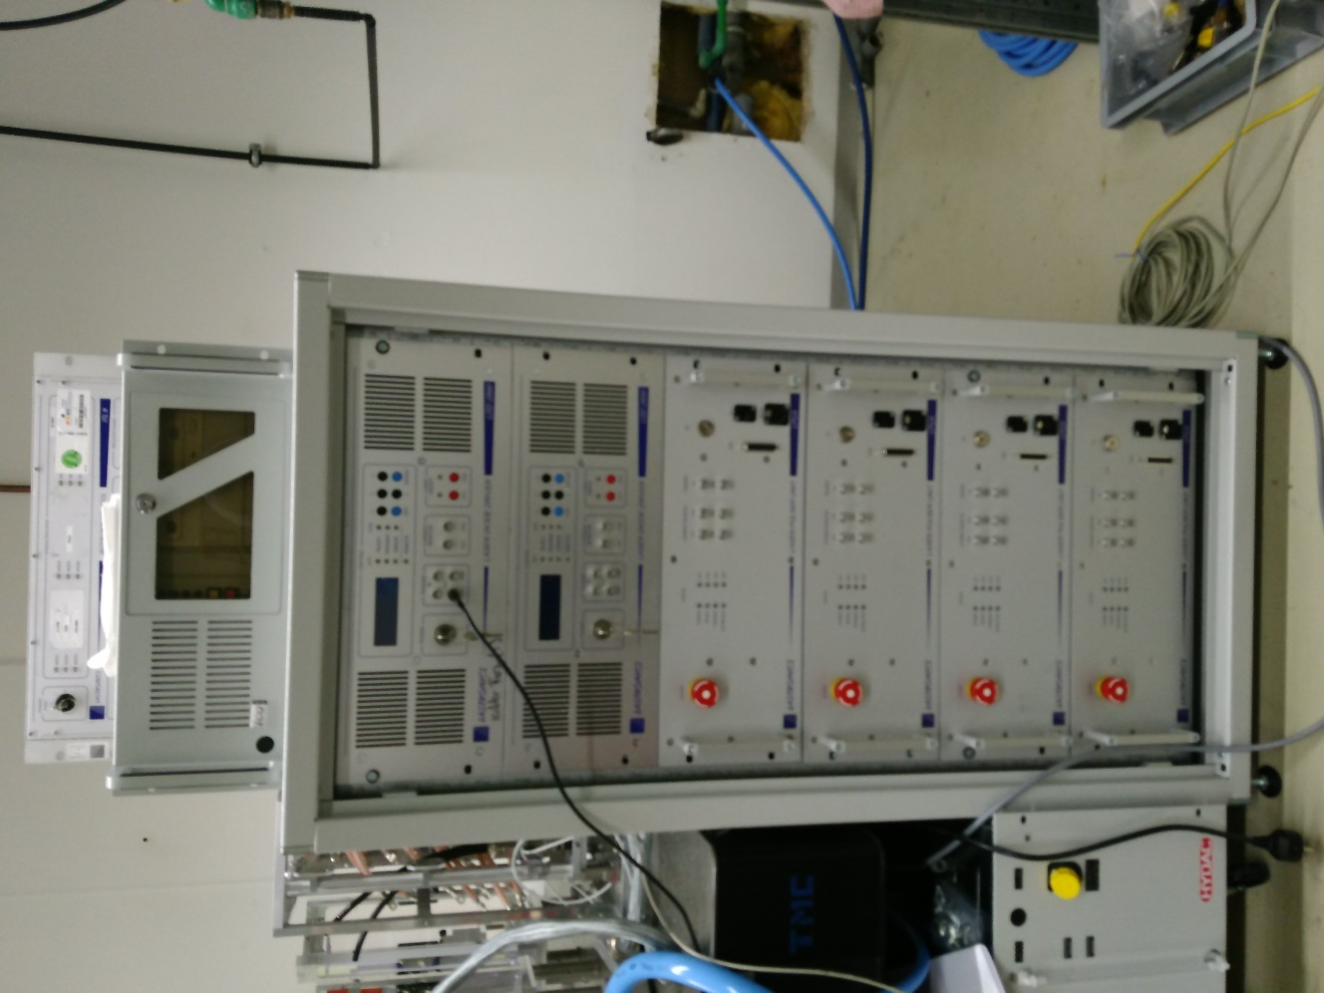
Update on 120 J Pumps
120 J Pump diode
All optics for pump diodes have been received
Pump engine 1 and 2 built
1 Year late, headroom for delay as currently not impacting commissioning plans
FAT due for 3rd week of January 2023
Software Interface / Protocols still to be tested

Slide 10
Installation in EPAC
120 J cryo-cooling systems
Fully commissioned at manufacturing company
Leak tested with 120 J Amplifier head
Moved to EPAC building
120 J Cryo cooling system to be commissioned this January 2023 in the EPAC building

Slide 11
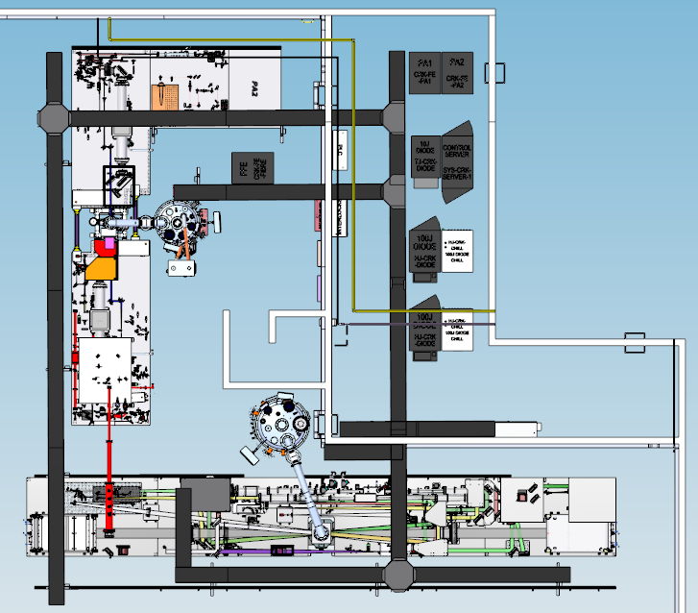
Status of Services
Rack room
10 J Pump and server
120 J Pump and server
PA1 and PA2 racks
Cryostat racks
Vacuum pumps
Pump room
Trunking for services
Distribution control systems
Power
Data
Water
Gas
Turbos backing pump in lab
LN2 feed and exhaust installed
Laser Interlocks
On track for Dec 2022

Slide 12
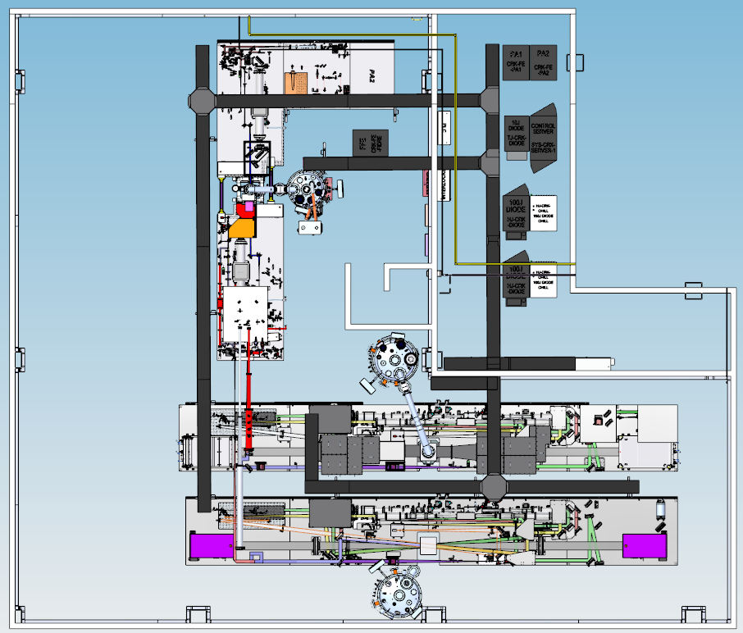
Future provision; two 120J sections
Provision included in services design, space in 209, TJ-HJ-2 beam transport and wall apertures for delivery to Ti:S Room (202)

Slide 13
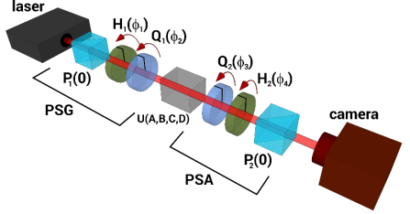
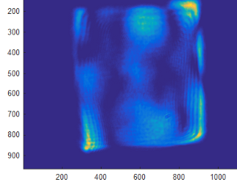
Depolarisation
Status
D100-X at HiLASE has increased energy to 145 J at 10 Hz
Operated stably @100 J at 10 Hz for extended periods
Deplorisation: extensive characterisation and modelling, concepts for mitigation
Reduced depolarization losses to 8%
New results indicate that 3% depolarization can be achieved
Input polarisation optimised,
nominal pumping parameters
Depolarisation Loss = 7.9%

Slide 14
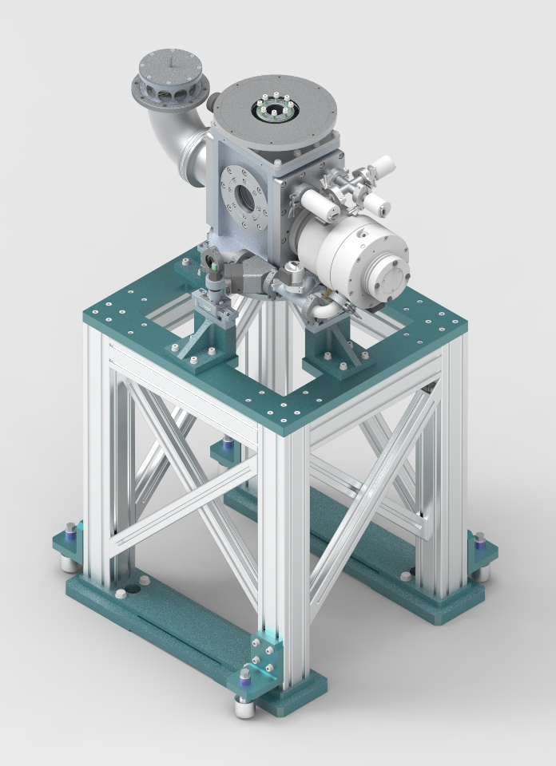
Current status of EPAC Pump Room
Current installation
FE Optics and table
Service trays
10 J Cryo and 120 J Cryo
10 and 120 J Cryo Amplifier heads
Cable racks
Commissioning starts in March 2023

Slide 15
Thank you
Extreme Photonics Applications Centre (EPAC)
Science and Technology Facilities Council
@STFC_Matters
Science and Technology Facilities Council
Notes:
The abstract pattern can be removed or repositioned if required. Be careful to ‘Send to Back’ so that it does not obscure any important information.

