Slide 1


EPAC ISTAC
Detectors
C. D. Armstrong
30/11/2022
Notes:
The abstract pattern can be removed or repositioned if required. Be careful to ‘Send to Back’ so that it does not obscure any important information.

Slide 2
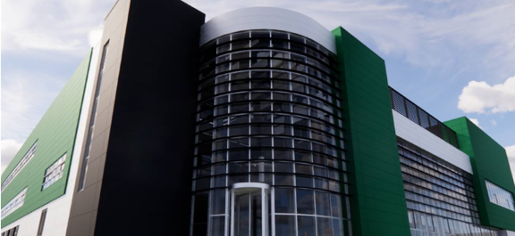
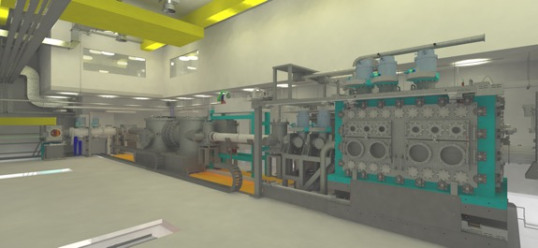
Overview
Overview
Project Scope
  Summary of project
  Outline of detector projects
Diagnostic Updates
  Sub-micron imager
  Large area panel
  MeV Imager
  THz CTR Spectroscopy
Modelling update
User Engagement
Notes:
Outline the scope/challenge of the project and then talk about what the key radiation types we expect from each area in EPAC to give context to the detector designs I’m going to show.
I’ll run through the concepts we’ve come up with for each detector and then run through where our technical risks are and how they’ve changed since last year.
Then to wrap up I’ll show off some of the prototyping results in a few areas and talk about what it means going forward for each design.

Slide 3
Project Scope

Slide 4
Concept
Design
Commission
Detectors for laser plasma interactions at 10 Hz
Notes:
So this is the same challenge statement I showed last time, basically breaking down that core sentence into parts.
We need detectors that can resolve the right stuff, be that radiation type or to the desired specification be that spectral or spatial
We need to account for some of the unicity that comes with LPI, handle EMP emission, handle the multiple synchronous radiation sources, handle that its such a bright source with everything arriving at ones
Then we need to adapt it to 10Hz, everything we’ve done in the past is at the 1/min rate we need to think about the secondary problems that might creep up
And part of that challenge is the wide radiation types we’re able to generate

Slide 5
Concept
Design
Commission
Detectors for laser plasma interactions at 10 Hz
1. Sensitive to generated radiation:
< 100 keV betatron
>MeV bremsstrahlung
>MeV neutron
Broadband Thz
2. Able to characterise at sufficient resolution:
Sub-micron imaging
Wide FOV imaging
Spectroscopy
Notes:
So this is the same challenge statement I showed last time, basically breaking down that core sentence into parts.
We need detectors that can resolve the right stuff, be that radiation type or to the desired specification be that spectral or spatial
We need to account for some of the unicity that comes with LPI, handle EMP emission, handle the multiple synchronous radiation sources, handle that its such a bright source with everything arriving at ones
Then we need to adapt it to 10Hz, everything we’ve done in the past is at the 1/min rate we need to think about the secondary problems that might creep up
And part of that challenge is the wide radiation types we’re able to generate

Slide 6
Concept
Design
Commission
Detectors for laser plasma interactions at 10 Hz
1. Sensitive to generated radiation:
< 100 keV betatron
>MeV bremsstrahlung
>MeV neutron
Broadband Thz
3. Unique challenges for LPI:
Diverse source characteristics
Ultra-short pulse durations (~ps)
Bright/Brilliant emissions
Multi-modal emission
2. Able to characterise at sufficient resolution:
Sub-micron imaging
Wide FOV imaging
Spectroscopy
Notes:
So this is the same challenge statement I showed last time, basically breaking down that core sentence into parts.
We need detectors that can resolve the right stuff, be that radiation type or to the desired specification be that spectral or spatial
We need to account for some of the unicity that comes with LPI, handle EMP emission, handle the multiple synchronous radiation sources, handle that its such a bright source with everything arriving at ones
Then we need to adapt it to 10Hz, everything we’ve done in the past is at the 1/min rate we need to think about the secondary problems that might creep up
And part of that challenge is the wide radiation types we’re able to generate

Slide 7
Concept
Design
Commission
Detectors for laser plasma interactions at 10 Hz
1. Sensitive to generated radiation:
< 100 keV betatron
>MeV bremsstrahlung
>MeV neutron
Broadband Thz
3. Unique challenges for LPI:
Diverse source characteristics
Ultra-short pulse durations (~ps)
Bright/Brilliant emissions
Multi-modal emission
4. Unique challenges for 10 Hz:
Film/Solid state detectors are out
Leaving scintillators
Decay time
Afterglow
Longevity
Yield… etc.
2. Able to characterise at sufficient resolution:
Sub-micron imaging
Wide FOV imaging
Spectroscopy
Notes:
So this is the same challenge statement I showed last time, basically breaking down that core sentence into parts.
We need detectors that can resolve the right stuff, be that radiation type or to the desired specification be that spectral or spatial
We need to account for some of the unicity that comes with LPI, handle EMP emission, handle the multiple synchronous radiation sources, handle that its such a bright source with everything arriving at ones
Then we need to adapt it to 10Hz, everything we’ve done in the past is at the 1/min rate we need to think about the secondary problems that might creep up
And part of that challenge is the wide radiation types we’re able to generate

Slide 8
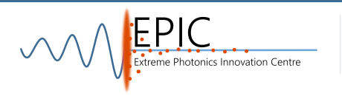
Underpinning Methodology
Scintillator
Optical Imaging
Detector
Betatron
Hard X-ray
Neutron
X-ray
Particle
THz
Bayer Ross-Pair
Neutron
Shaped
Scintillators
Sub-micron
imager
MeV+ Imager
Interferometer CTR
Linear Spectrometer
Fast Decay
3-Colour
High Rep-Activation
Electron Cherenkov
Splitting Spectrometer
Multi-Modal
High Flux CZT
Large area panel
2D Active Thomson
Imaging
Spectroscopy

Slide 9
Underpinning Methodology
Scintillator
Optical Imaging
Detector
Betatron
Hard X-ray
Neutron
X-ray
Particle
THz
Bayer Ross-Pair
Neutron
Shaped
Scintillators
Sub-micron
imager
MeV+ Imager
Interferometer CTR
Linear Spectrometer
Fast Decay
3-Colour
High Rep-Activation
Electron Cherenkov
Splitting Spectrometer
Multi-Modal
High Flux CZT
Large area panel
2D Active Thomson
Imaging
Spectroscopy

Slide 10
Project Updates
Notes:
Okay with that outlined, I’ll dive into the designs. As I mentioned there are now concepts outlined for each detector area, some of them have progressed to a prototyping stage this year and I’ll address that at the time.

Slide 11
Progress at 2021 ISTAC
Concept
Design
Prototyping
Procurement
Characterisation
Commissioning
Sub-micron,
<100 keV x-ray
Imaging
MeV Imager,
MeV x-ray
Multi-modal,
>100 keV x-ray, N
Bayer Mask
<100 keV x-ray
LAS,
MeV x-ray
Spectroscopy
nTOF
< 100 MeV Neutron
THz
0.1-50 Thz
Development

Slide 12
Progress at 2022 ISTAC
Concept
Design
Prototyping
Procurement
Characterisation
Commissioning
Sub-micron,
<100 keV x-ray
Imaging
MeV Imager,
MeV x-ray
Multi-modal,
>100 keV x-ray, N
Large Area Panel,
High sensitivity
Bayer Mask
<100 keV x-ray
LAS,
MeV x-ray
Spectroscopy
nTOF
< 100 MeV Neutron
THz
0.1-50 Thz
Development

Slide 13
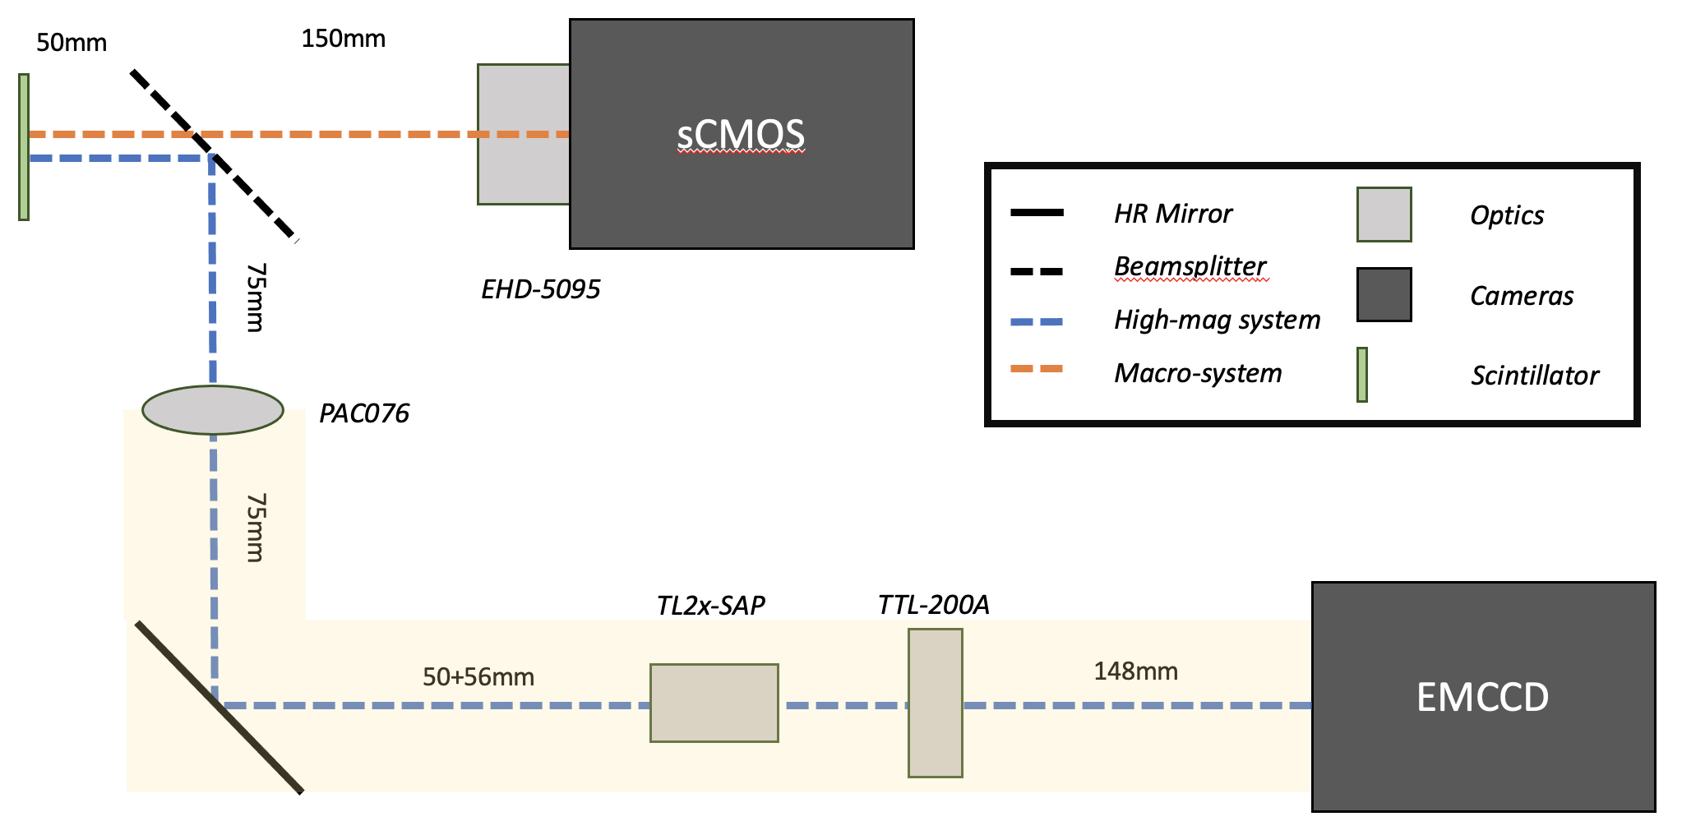
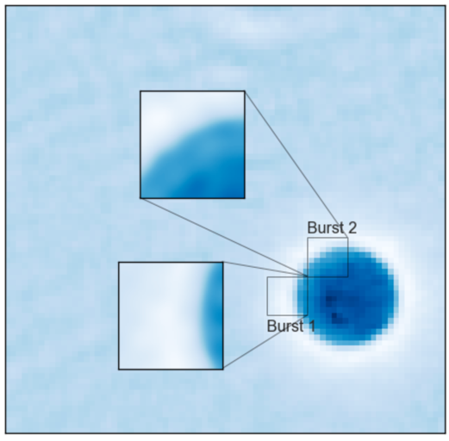
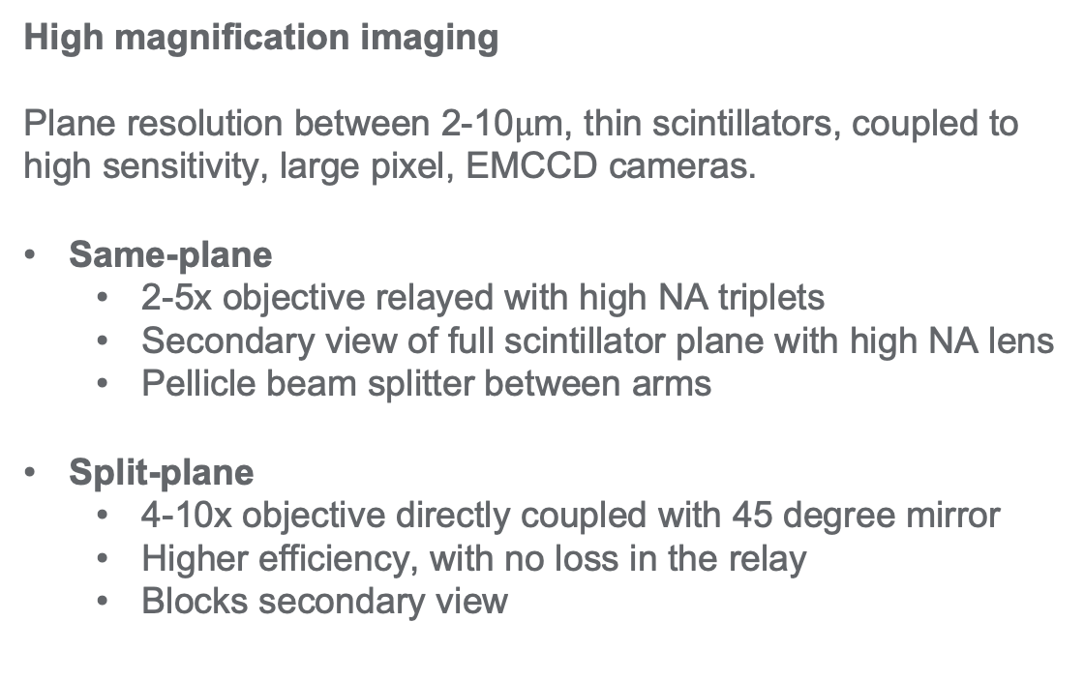
Sub-micron Imager
Same-plane
High magnification imaging
Plane resolution between 2-10$μ$m, thin scintillators, coupled to high sensitivity, large pixel, EMCCD cameras.
Same-plane
  2-5x objective relayed with high NA triplets
  Secondary view of full scintillator plane with high NA lens
  Pellicle beam splitter between arms
Split-plane
  4-10x objective directly coupled with 45 degree mirror
  Higher efficiency, with no loss in the relay
  Blocks secondary view
Split-plane

Slide 14
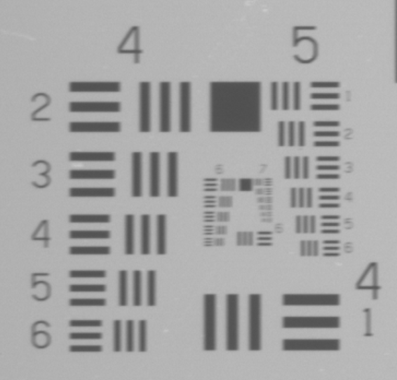
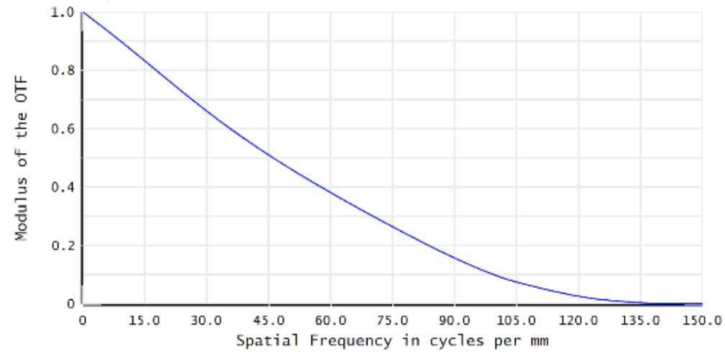

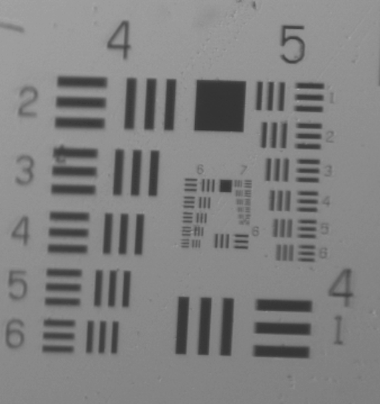
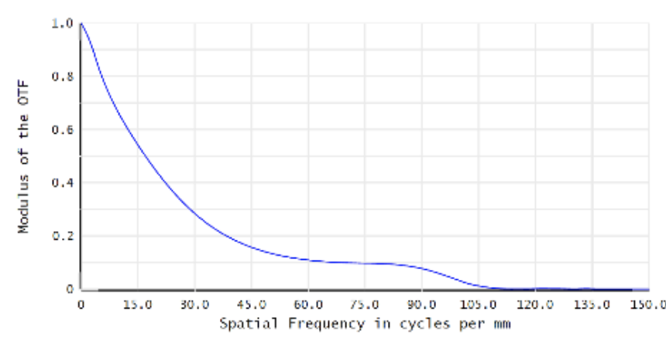
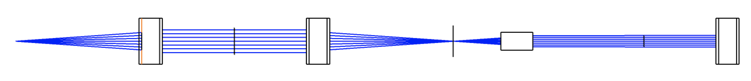
Objective only
Sub-micron Imager
High magnification imaging
Objective only (split-plane)
  1-4um plane resolution
  25-36mm working distance
  1-3mm FOV (100x100mm travel)
Split-plane
  3-10um plane resolution
  125-250mm working distance
  2-4mm FOV (25mm OD total)
Objective
Tube lens
Objective + relay
Relay lenses
Objective
Tube lens

Slide 15
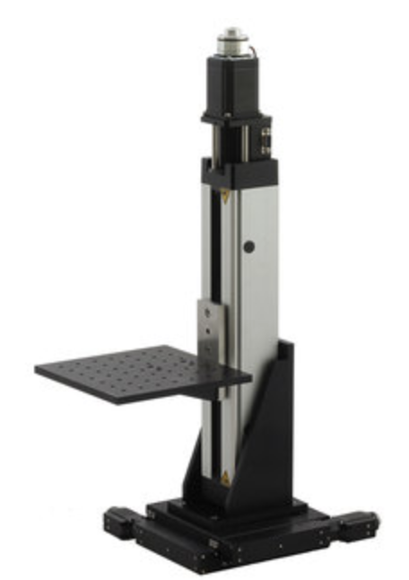
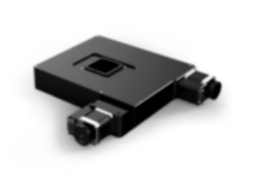
Sub-micron Imager
Entire camera + objective fit on stage for full 100x100x100mm travel within x-ray beam.
Objective + shielding block partially block beam from independent macro-view.
High resolution translates independently. Providing a ”pick and zoom” feature around the macro-view scintillator plane.
100x100x100 mm
>25x25 mm

Slide 16
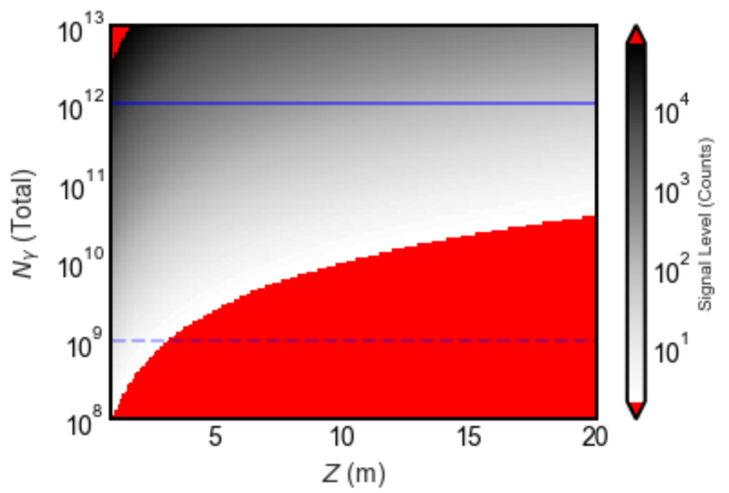
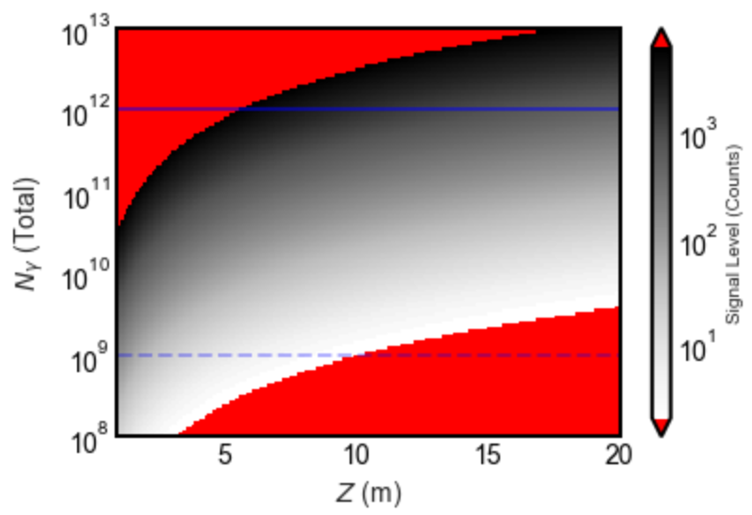
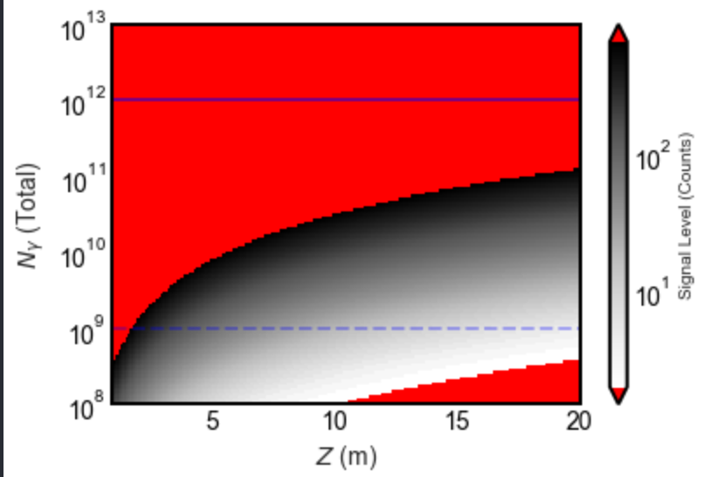
Sub-micron Imager
EMCCD - No Gain
EMCCD - 100x Gain
EMCCD - 1000x Gain
Assuming betatron parameters of:
(Modest scaling)
  5 mR divergence
  10¹¹ photons > 1 keV
  50 keV critical energy
  3.5 GeV electrons
Micro
Gain required 150
Z with SNR>10 ~ 13.5m
SNR at 20m ~ 6.76
1um SNR ~ 10.1
Effective DNR ~ 9.5bit
Macro
No gain
Z with SNR>10 ~ 9m
SNR at 20m ~ 4.5
40um SNR ~ 30

Slide 17
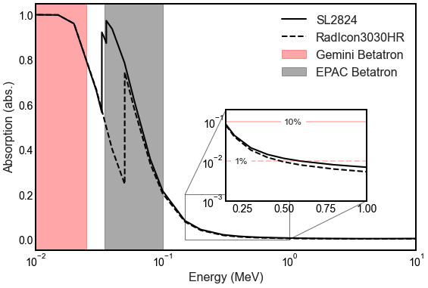
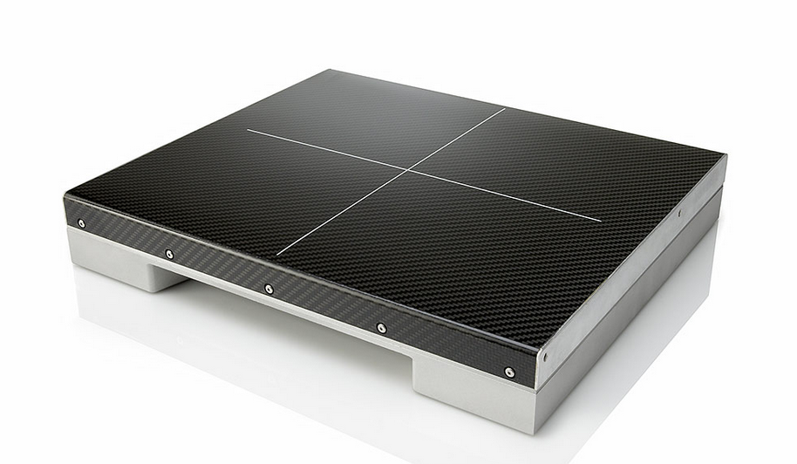
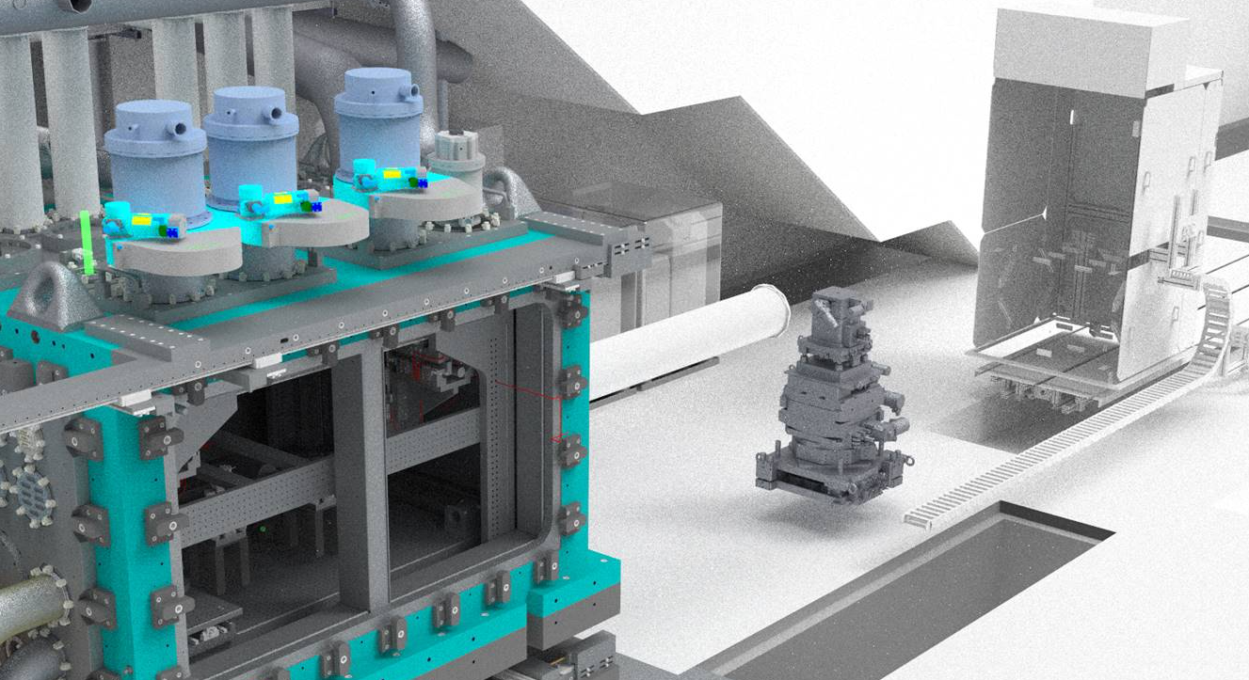
Flat panel detection
Fibre-optic collection
Limited resolution achievable, however high collection efficiency and large area available.
Rad-Icon3030
  300x300mm, 100um pixels
  <1% at 500keV
  Procured and delivered
SL 2824HR
  280x240mm, 50um px
  >1% at 500keV
  FY 23
Rad-Icon3030

Slide 18
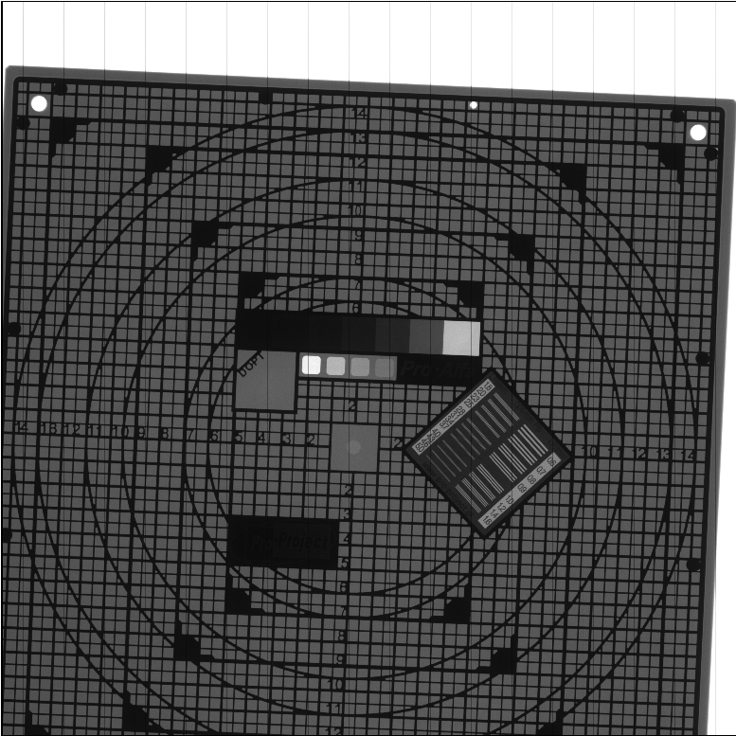
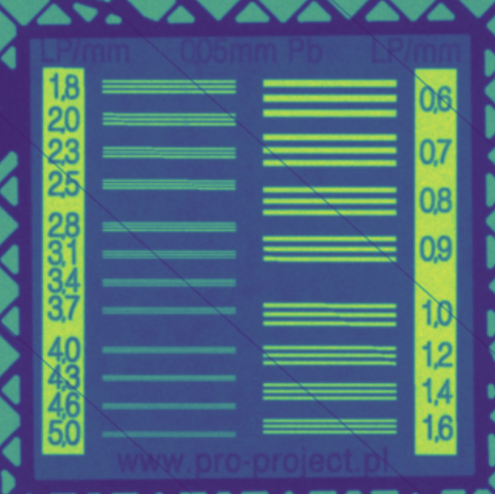
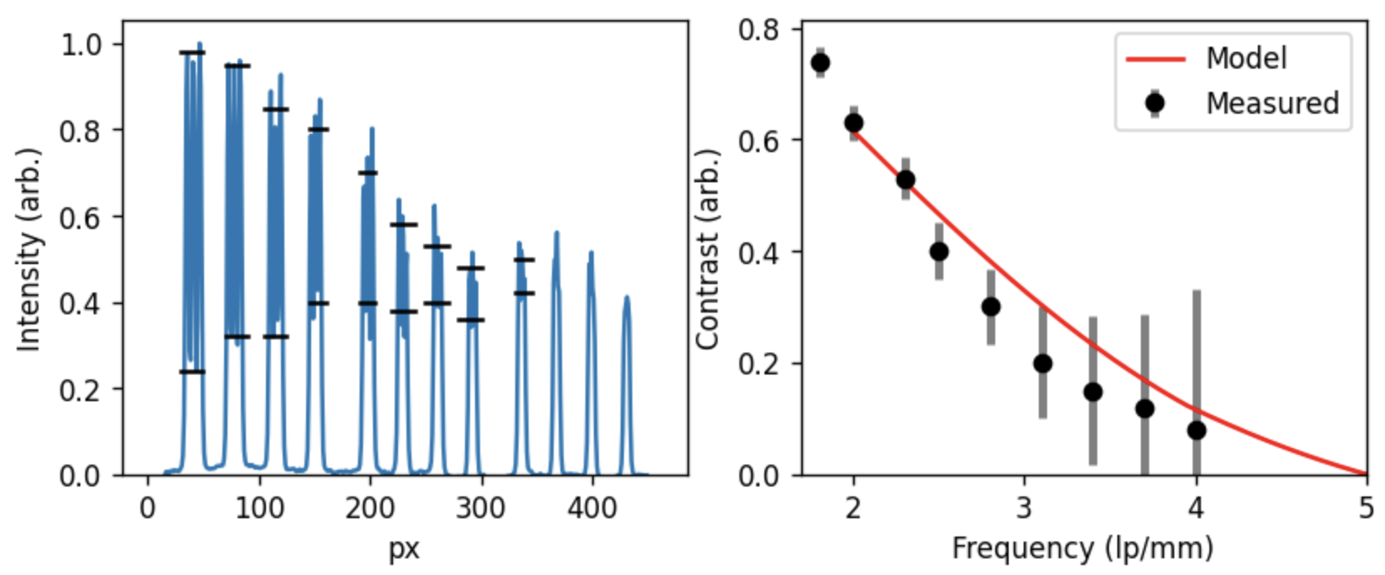
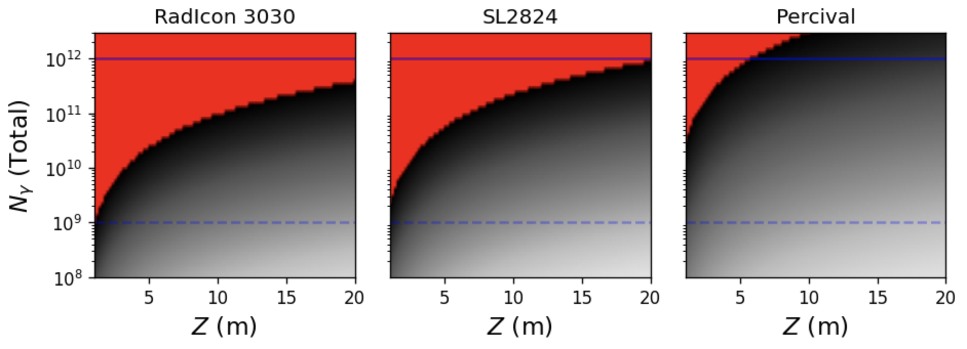
Flat panel detection
Sensitivity + Resolution:
Taking the measured LP/mm data from a large area panel we are able to show the analytical code can apply to more than just lens systems.
Here a FOP panel with a Gadox scintillator screen is accurately reproduced via PODs
Limits:
Development option from STFC Tech

Slide 19
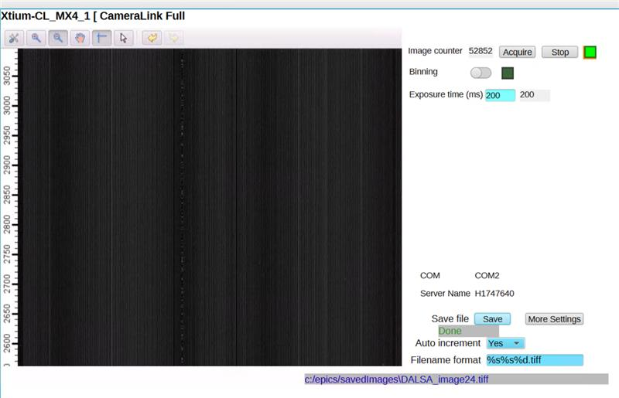
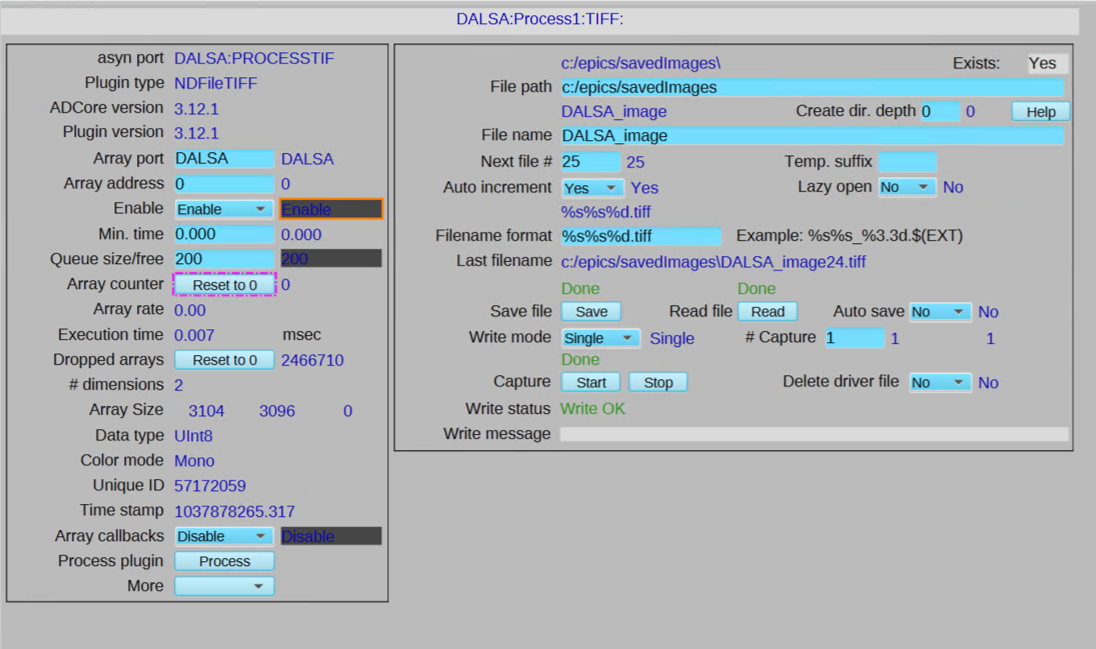
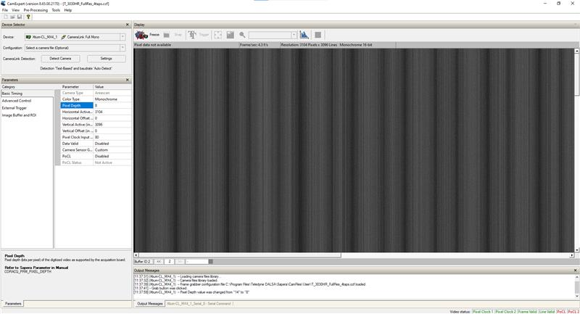
Flat panel detection
EPICs Prototype
Software Development:
Teledyne Dalsa has not been demonstrated on EPICs before, requires dedicated SDK/API to be developed.
Software team have managed to complete initial features, providing connection to the panel, control of bit-depth and ROI as well as full area streaming.
Supplier software has several modes and enables sensitivity testing while developing EPICs backend
Teledyne Dalsa

Slide 20
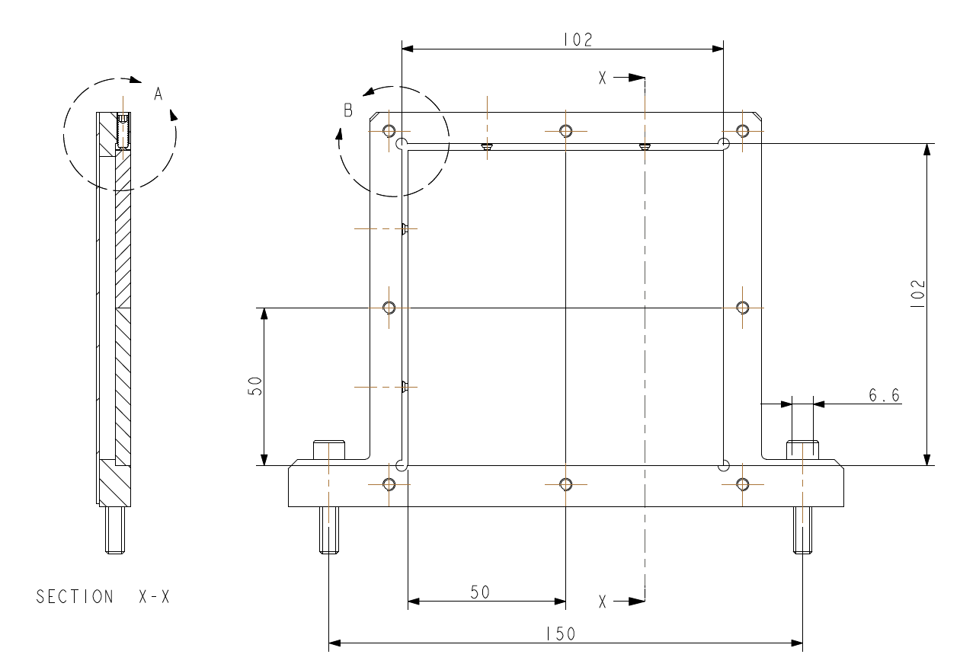
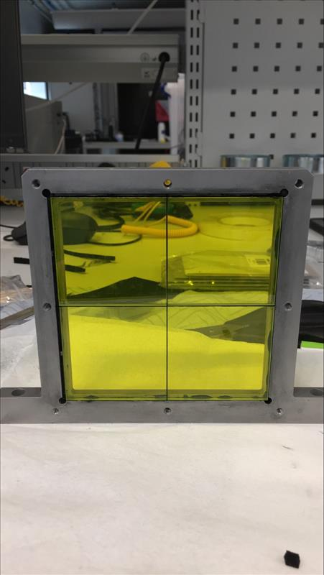
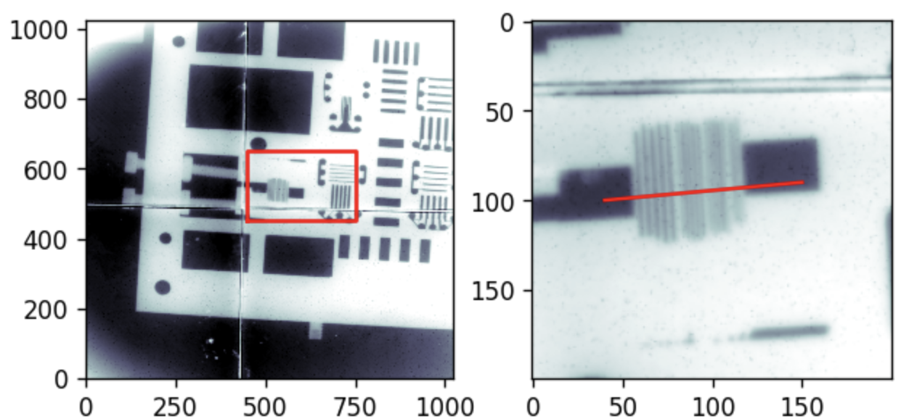
MeV Imager
Black optical grease to minimise optical cross-talk
Stopping power is key here, we need to increase the thickness of the scintillator to achieve high stopping power for penetrative x-rays. Two methods have been trialled for large area MeV detection.
Large area single crystal
  Limited to ~100mm OD
  Procured/Tested 8mm thick AR LYSO
  Conducted PoC experiments with MeV x-ray emission
Scale-able tiled single crystals
  (nx)50x50mm crystals tiled to desired size
  Procured and tested 2x2 layout
  X-ray hutch resolution and sensitivity testing
50x50x5mm YAG:Ce
X-ray hutch tests showing limit of resolution ~150um

Slide 21
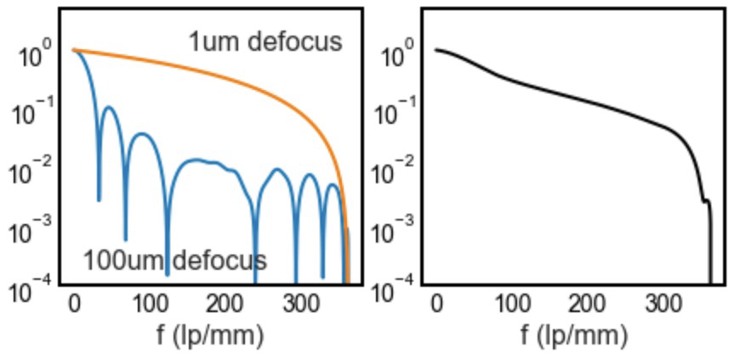
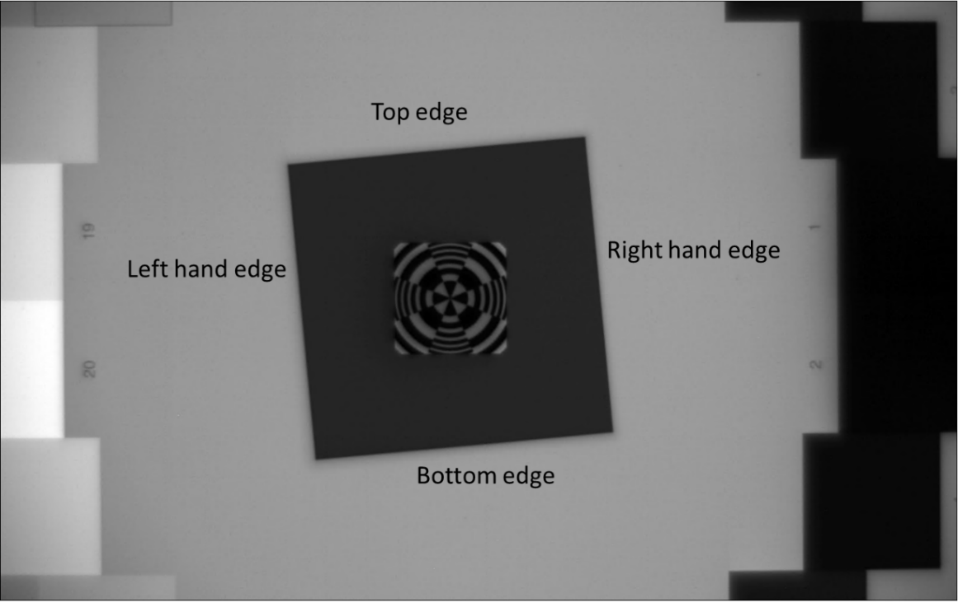
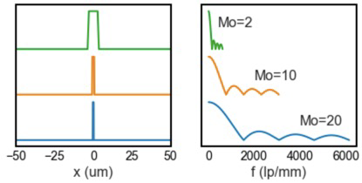
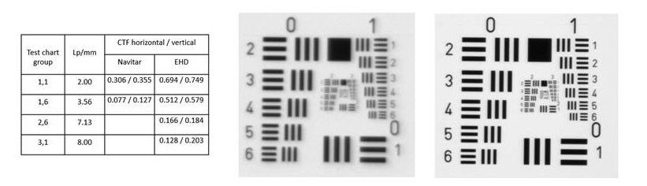
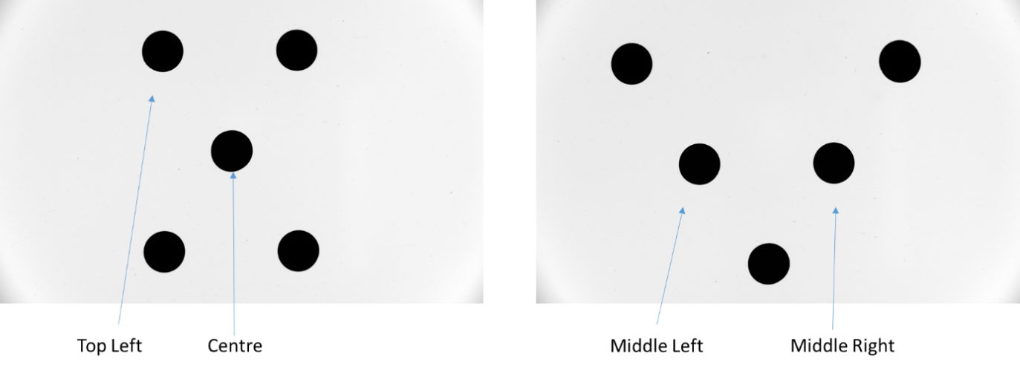

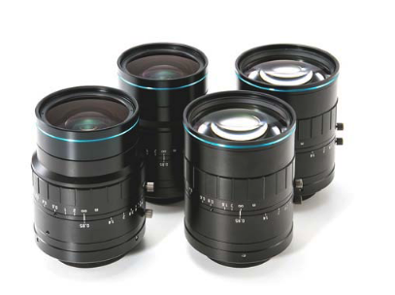

MeV Imager
Resolution and lens quality measurements:
Calibrated light source and ISO standard MTF routine with veiling glare measurements.
Previously identified process used to test new high NA lens – far exceeds old lens choice.
Old
New
Identified new supplier EHD for higher NA and higher quality lens

Slide 22
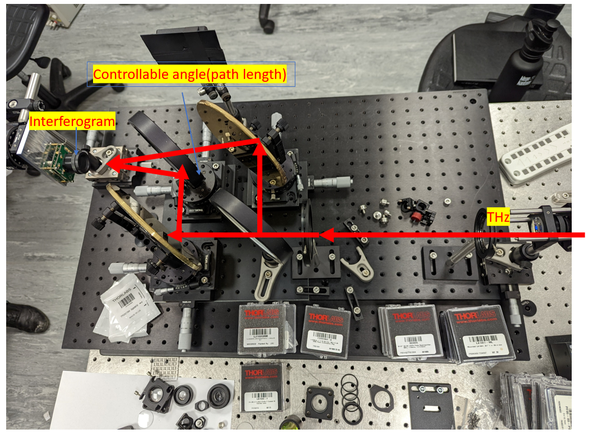
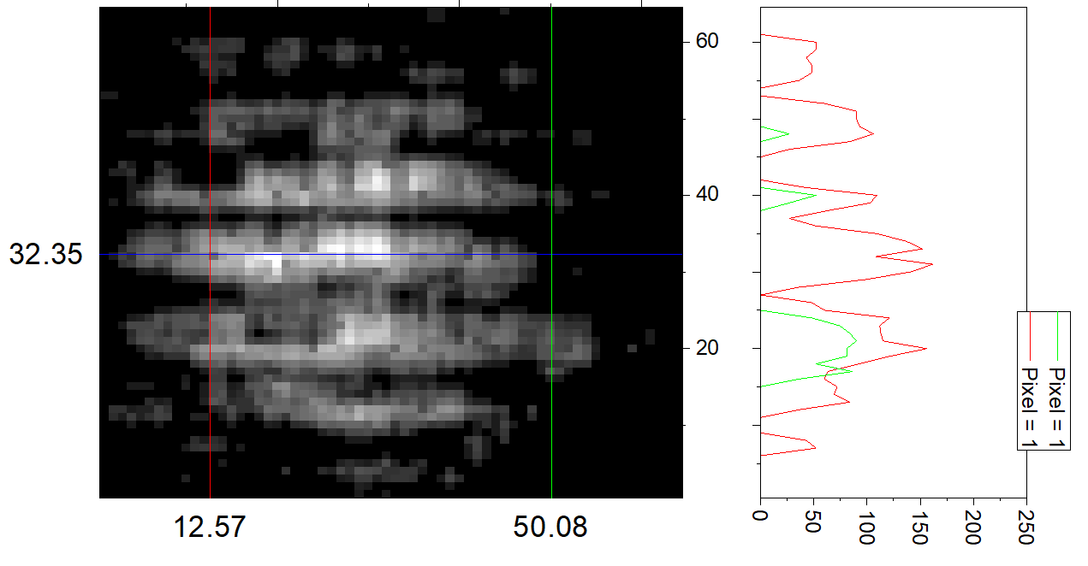
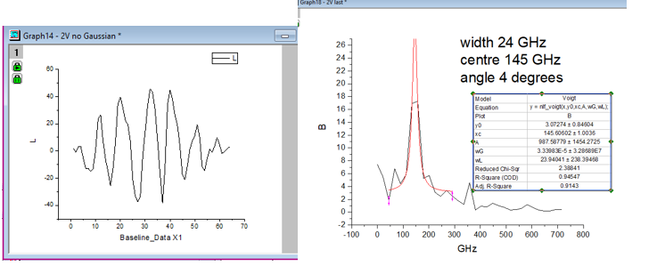
Concept based on Gemini measurements:
S. I. Bajlekov, et al Phys. Rev. ST Accel. Beams 16, 040701 (2013)
THz Detector Testing
Interferometer build:
Working with RAL Space for THz expertise and source access
Interferometer with high reflectivity mirrors and collimating parabola, onto an THz imaging detector.
Follow up tests in TA2 with LWFA beam.

Slide 23
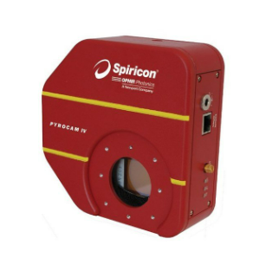
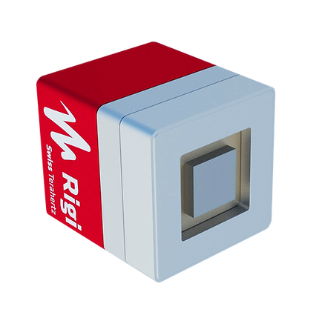
THz Detector Testing
Pyrocam IV
Tested
RIGI M2
On-loan
Sensitivity too low
Chopper induced signal variation
Well documented API
Higher expected sensitivity
No chopper
Poorly documented API, and potential trigger concerns

Slide 24
Modelling Update
Notes:
Okay with that outlined, I’ll dive into the designs. As I mentioned there are now concepts outlined for each detector area, some of them have progressed to a prototyping stage this year and I’ll address that at the time.

Slide 25
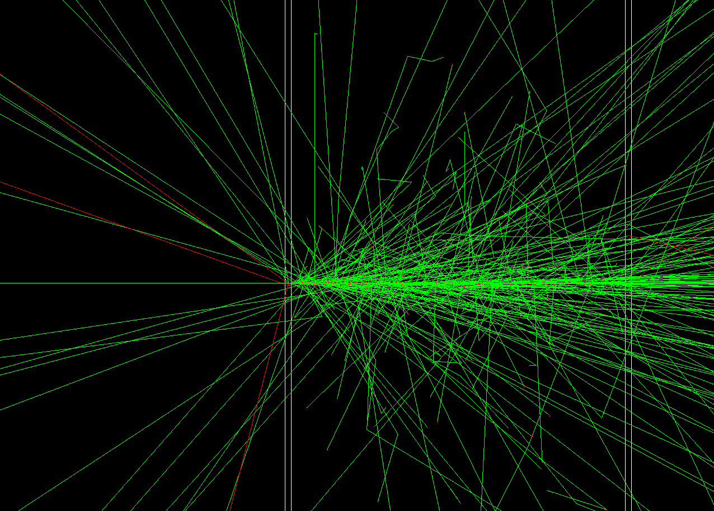
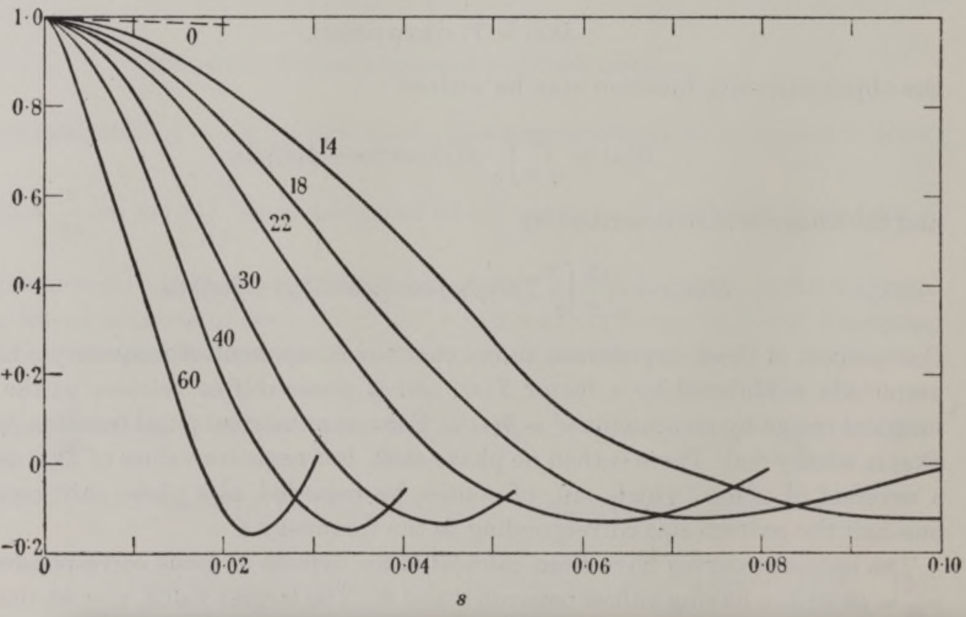

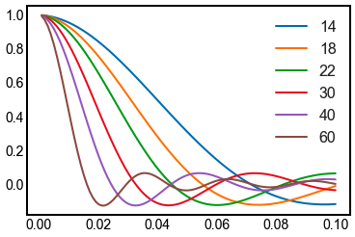
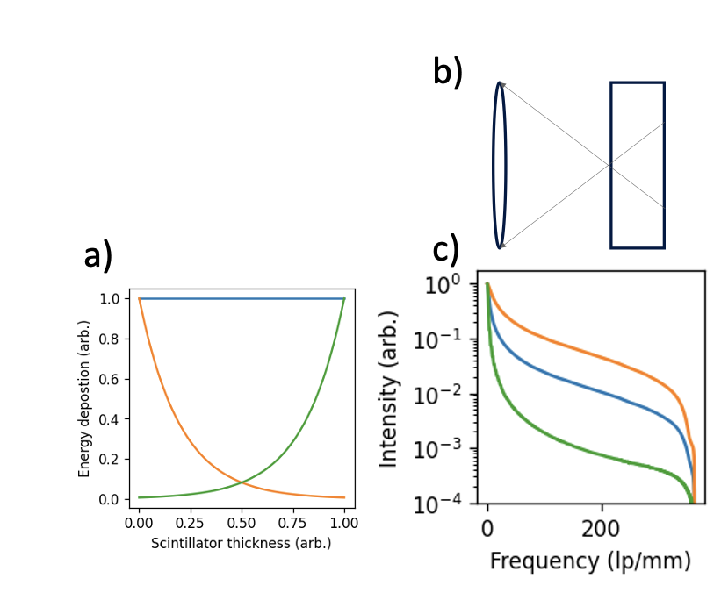
Energetic spread
H. H. Hopkins. Proc R. Soc. Lond. A23191–103 (1955)
Modelling the problem
Design of the radiation detectors is based on two aspects, resolution and sensitivity.
Sensitivity is dependent on both the stopping power of the scintillator and the collection efficiency of the lens, whereas the resolution is dependent on the electron cloud, the DoF of the lens, and the magnification of the system.
To help design detectors considering these competing parameters we developed a dedicated python library:
PODs - Parameterised Optimisation of Detectors
Optical spread
Effect of attenuation
Experimental validation for FOP

Slide 26
Modelling the problem
PODs
Inputs
Spectrum
Scintillator
Lens
Sensor
Sample
2022 IEEE NSS MIC
C.D. Armstrong – Design Principles
08/11/2022

Slide 27
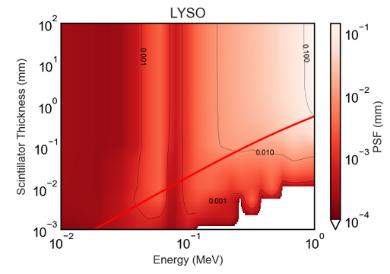
Modelling the problem
PODs
Monte-Carlo simulation
Energy deposited
Lateral spread
Peak sensitivity
Induced scatter
Inputs
Spectrum
Scintillator
Lens
Sensor
Sample
2022 IEEE NSS MIC
C.D. Armstrong – Design Principles
08/11/2022

Slide 28
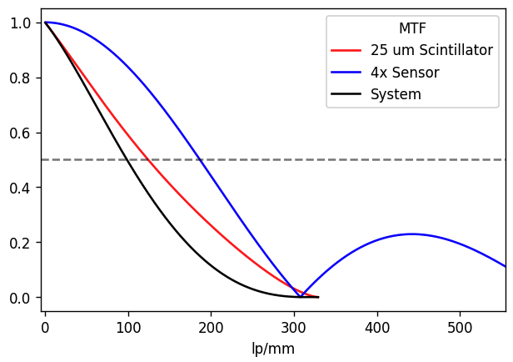
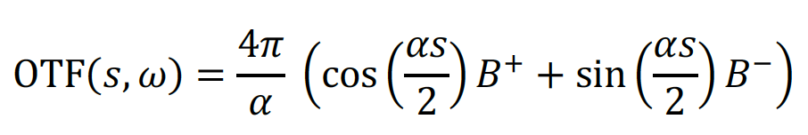

Modelling the problem
PODs
Monte-Carlo simulation
Energy deposited
Lateral spread
Peak sensitivity
Induced scatter
Inputs
Spectrum
Scintillator
Lens
Sensor
$$∫OTF_{s}(NA, η)E_{d}(z,σ) dz$$
Sample
Defect of focus
Attenuation limited OTF integral
Nyquist limited sampling
Nyquist limited optical resolution
2022 IEEE NSS MIC
C.D. Armstrong – Design Principles
08/11/2022

Slide 29
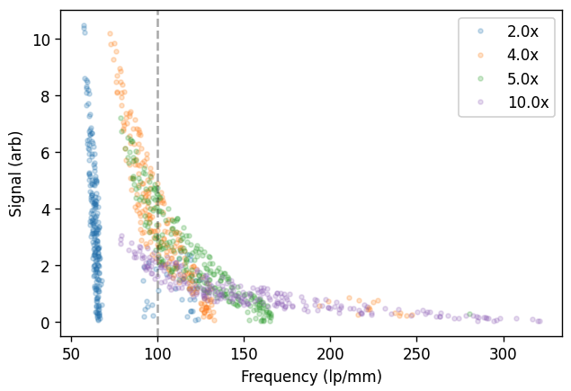
Modelling the problem
Optimisation of signal vs resolution
PODs
Monte-Carlo simulation
Energy deposited
Lateral spread
Peak sensitivity
Induced scatter
Inputs
Spectrum
Scintillator
Lens
Sensor
$$∫OTF_{s}(NA, η)E_{d}(z,σ) dz$$
Sample
Defect of focus
Attenuation limited OTF integral
Nyquist limited sampling
Nyquist limited optical resolution
2022 IEEE NSS MIC
C.D. Armstrong – Design Principles
08/11/2022

Slide 30
User Engagement
Notes:
Okay with that outlined, I’ll dive into the designs. As I mentioned there are now concepts outlined for each detector area, some of them have progressed to a prototyping stage this year and I’ll address that at the time.

Slide 31
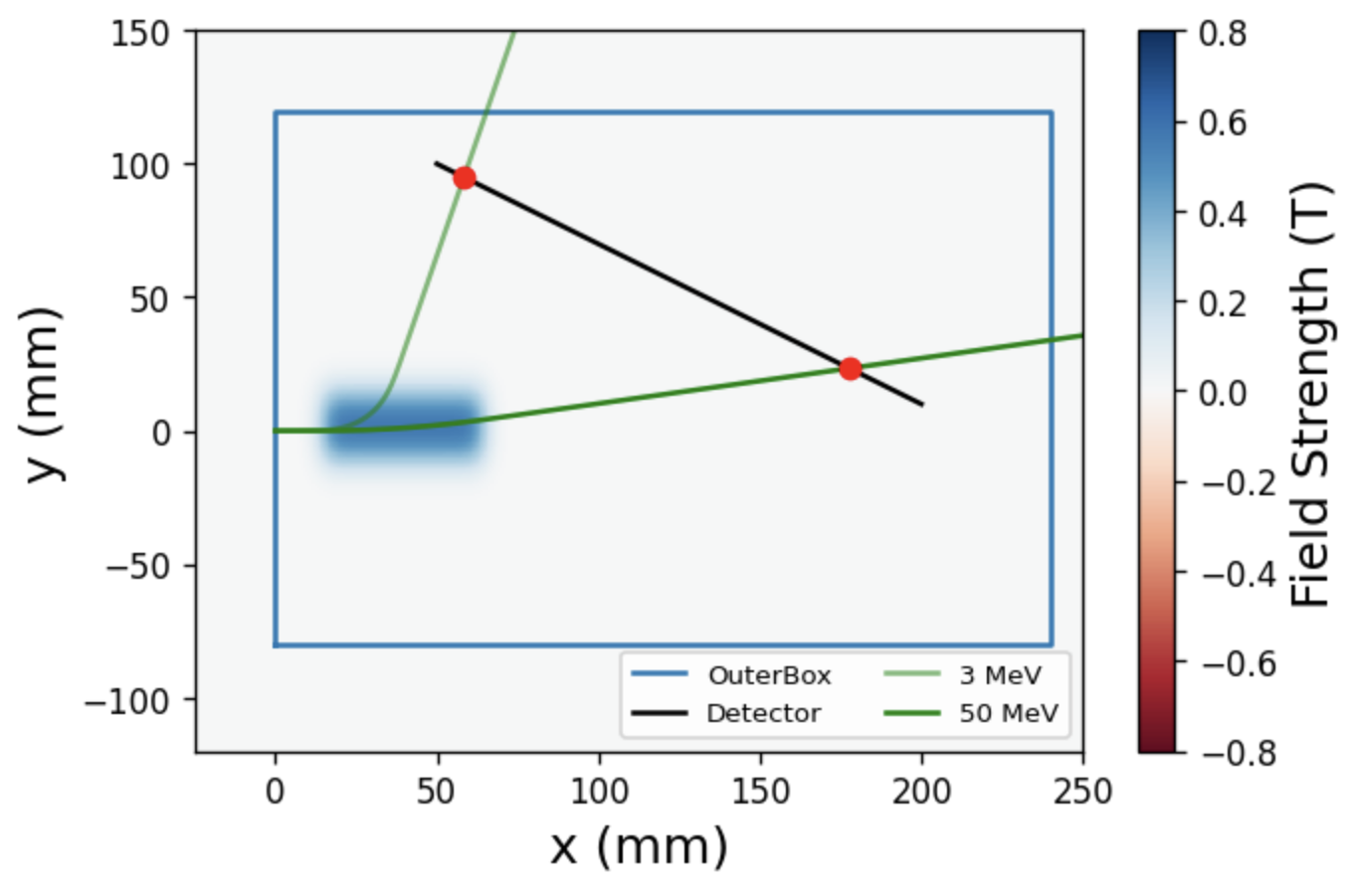
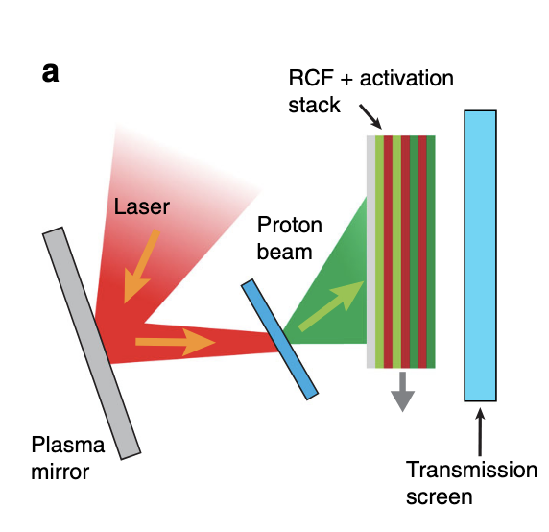

User Engagement
Discussions with users determined two “gaps” in detectors/diagnostics for EPAC.
<100 MeV electron spectroscopy
GeV electron spectroscopy is covered in EA1, but for solid-target interactions users are interested in measuring the escaping electron population with expected temperatures between 5-50 MeV.
Spectro-spatial measurements for protons
RCF stacks have long been a method of measuring proton emission, high spatial resolution with MeV energy resolution and high sensitivity.

Slide 32





Active Electron Spectrometers
Compact shell with variable readout
Magnet variation for energy selection

Slide 33



Active Electron Spectrometers
Compact shell with variable readout
Magnet variation for energy selection
Custom magnetic field structure with discrete energy tracking

Slide 34

Defined spectral sensitivity and resolution
Active Electron Spectrometers
Compact shell with variable readout
Magnet variation for energy selection
Custom magnetic field structure with discrete energy tracking

Slide 35



Proton Spectro-Spatial Measurements
D A Mariscal et al. Plasma Phys. Control. Fusion 63 (2021) 114003
Building on work from the wider community, and working with Uni. Strathclyde and Queens university.
Pixelated structure and multi-layer readout to provide high energy resolution and sub-mm spatial resolution of emitted proton beam.
Chromatic focused image
3 Scintillators
Mixed near collimated light
Macro-pixelated structure with multiple energy bins
Multi-layer, multi-colour readout with matched inf-conjugate lens system

Slide 36

Summary
Final design and procurement for two versions of the sub-micron imager
  Same-plane: Unobstructed dual view
  Split-plane: Higher efficiency and larger raster range
High sensitivity large area panel procured and delivered
MeV Imaging system options tested
  Fixed area single crystal
  Tile-able area multi-crystals
THz Camera Testing
User engagement
  Active Electron Spectrometers
  Proton Spectro-spatial measurements
Notes:
Okay with that outlined, I’ll dive into the designs. As I mentioned there are now concepts outlined for each detector area, some of them have progressed to a prototyping stage this year and I’ll address that at the time.

