Slide 1


EPAC ISTAC 2022
First Experiments
D. Symes
J. S. Green
C. D. Armstrong
Notes:
The abstract pattern can be removed or repositioned if required. Be careful to ‘Send to Back’ so that it does not obscure any important information.

Slide 2
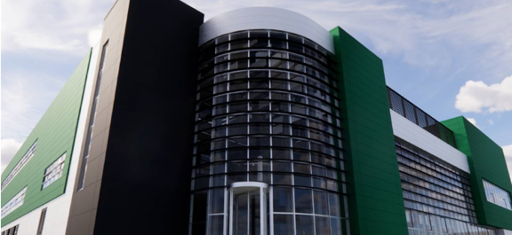
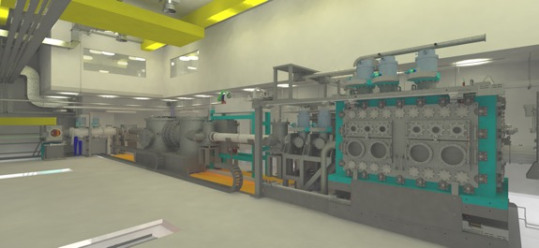
Overview
Expected Radiation Parameters for EA1 and EA2
Initial experiments in EA1
Initial experiments in EA2
Experimental Themes for EPAC going forward
Technical challenges and what we are doing to address them
Notes:
Outline the scope/challenge of the project and then talk about what the key radiation types we expect from each area in EPAC to give context to the detector designs I’m going to show.
I’ll run through the concepts we’ve come up with for each detector and then run through where our technical risks are and how they’ve changed since last year.
Then to wrap up I’ll show off some of the prototyping results in a few areas and talk about what it means going forward for each design.

Slide 3

EPAC Radiation Beam Parameters
Notes:
The abstract pattern can be removed or repositioned if required. Be careful to ‘Send to Back’ so that it does not obscure any important information.

Slide 4
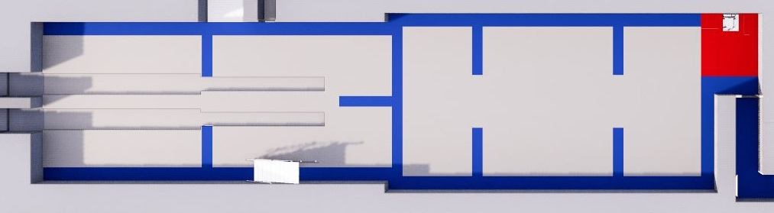
EA1 Beam Parameters
Emitted beam
Focussing
chamber
Target
chamber
Sample position
Maximum source to detector distance: 20m
X-rays:
50-200 keV betatron, 500nm emission area, 10¹¹ photons per shot, mRad divergence
0.5-50 MeV ICS emission, ~10um emission area, 10⁹ photons per shot, narrow collimation, mRad divergence
5-500 MeV Bremsstrahlung, ~100-500 um emission area, few degree divergence,
Leptons:
Tuneable 0.5 – 10 GeV e-beam, ~10-1000pC charge, 1um source size, <mRad divergence
Indirect muon emission, via converter target.

Slide 5
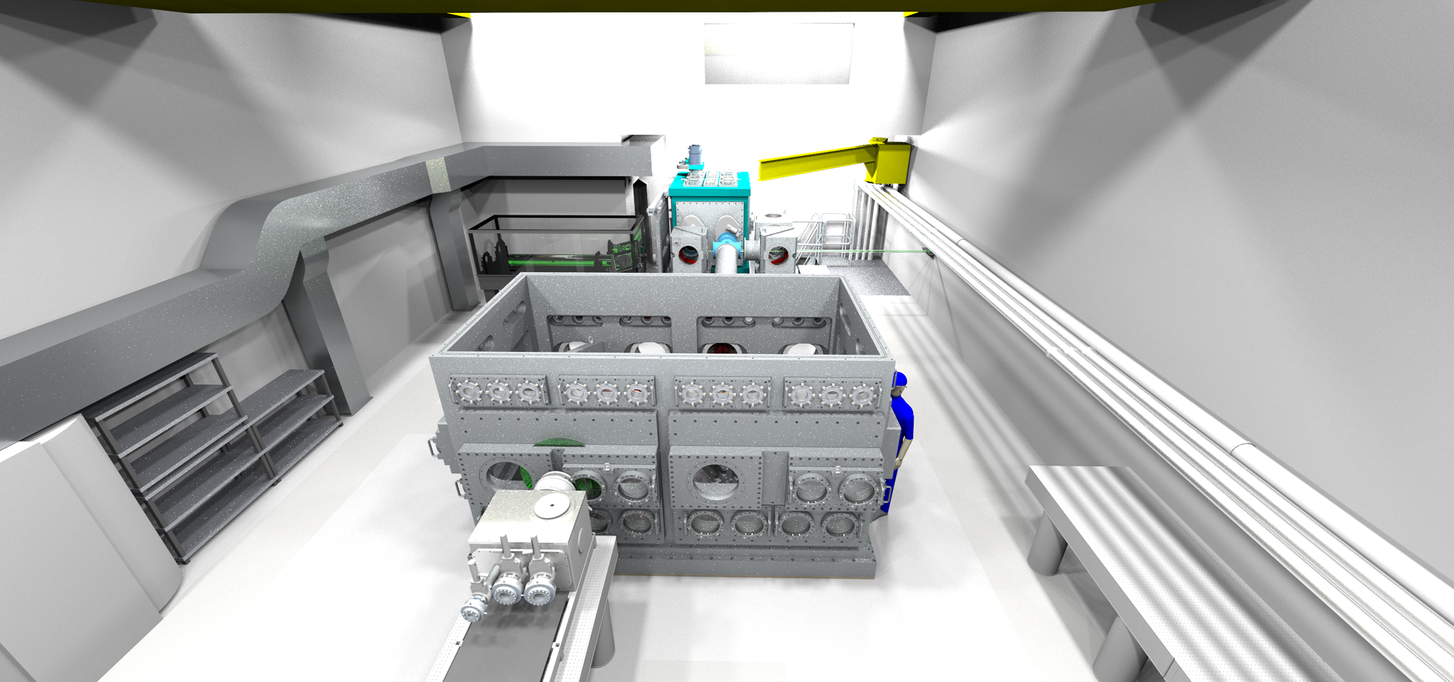
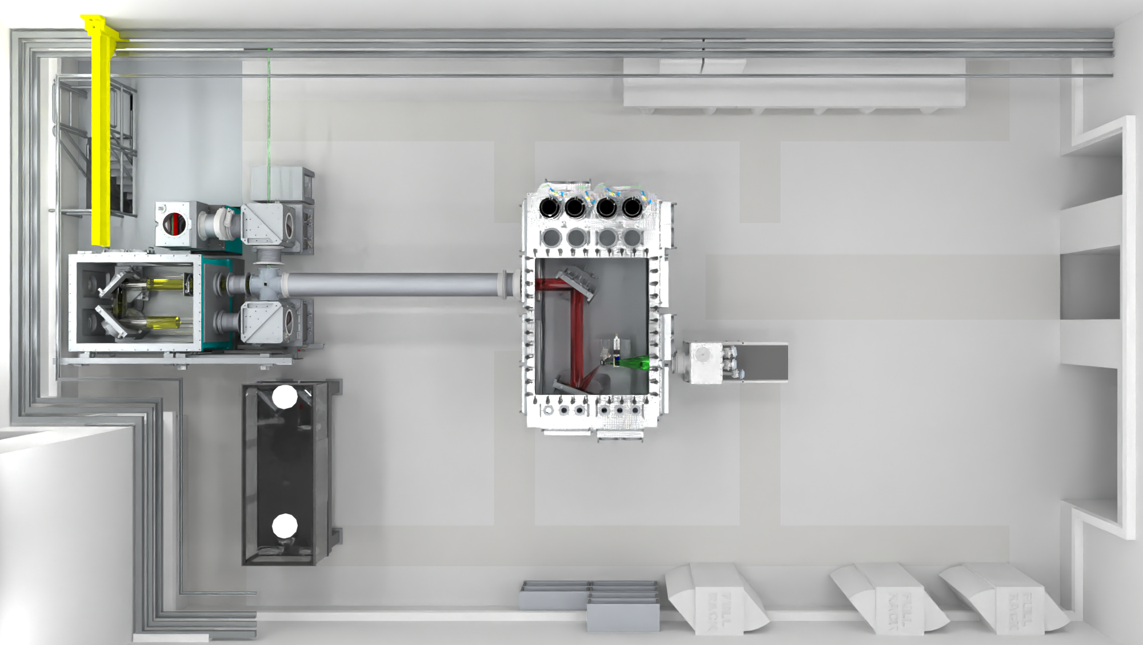
EA2 Beam Parameters
X-rays:
0.1-50 MeV Bremsstrahlung, ~10-500 um emission area, large degree divergence, high conversion efficiency
Leptons:
Escaping 1-50 MeV electrons, ~100s um emission area, 30-40 degree cone
Indirect muon emission, via converter target.
AO chamber
Maximum projection distance: 8m
Interaction chamber
Hadrons:
1-50 MeV protons, ~100s um emission area, 30-40 degree cone, 5-10% laser-proton conversion
Pitcher-catcher neutrons ~10⁸⁻⁹ /shot/sr, up-to 50 MeV emission
Thermalised neutrons via moderator, larger source area
Notes:
Roth Nature Comms

Slide 6
EA1 Initial Experiments
Notes:
The abstract pattern can be removed or repositioned if required. Be careful to ‘Send to Back’ so that it does not obscure any important information.

Slide 7
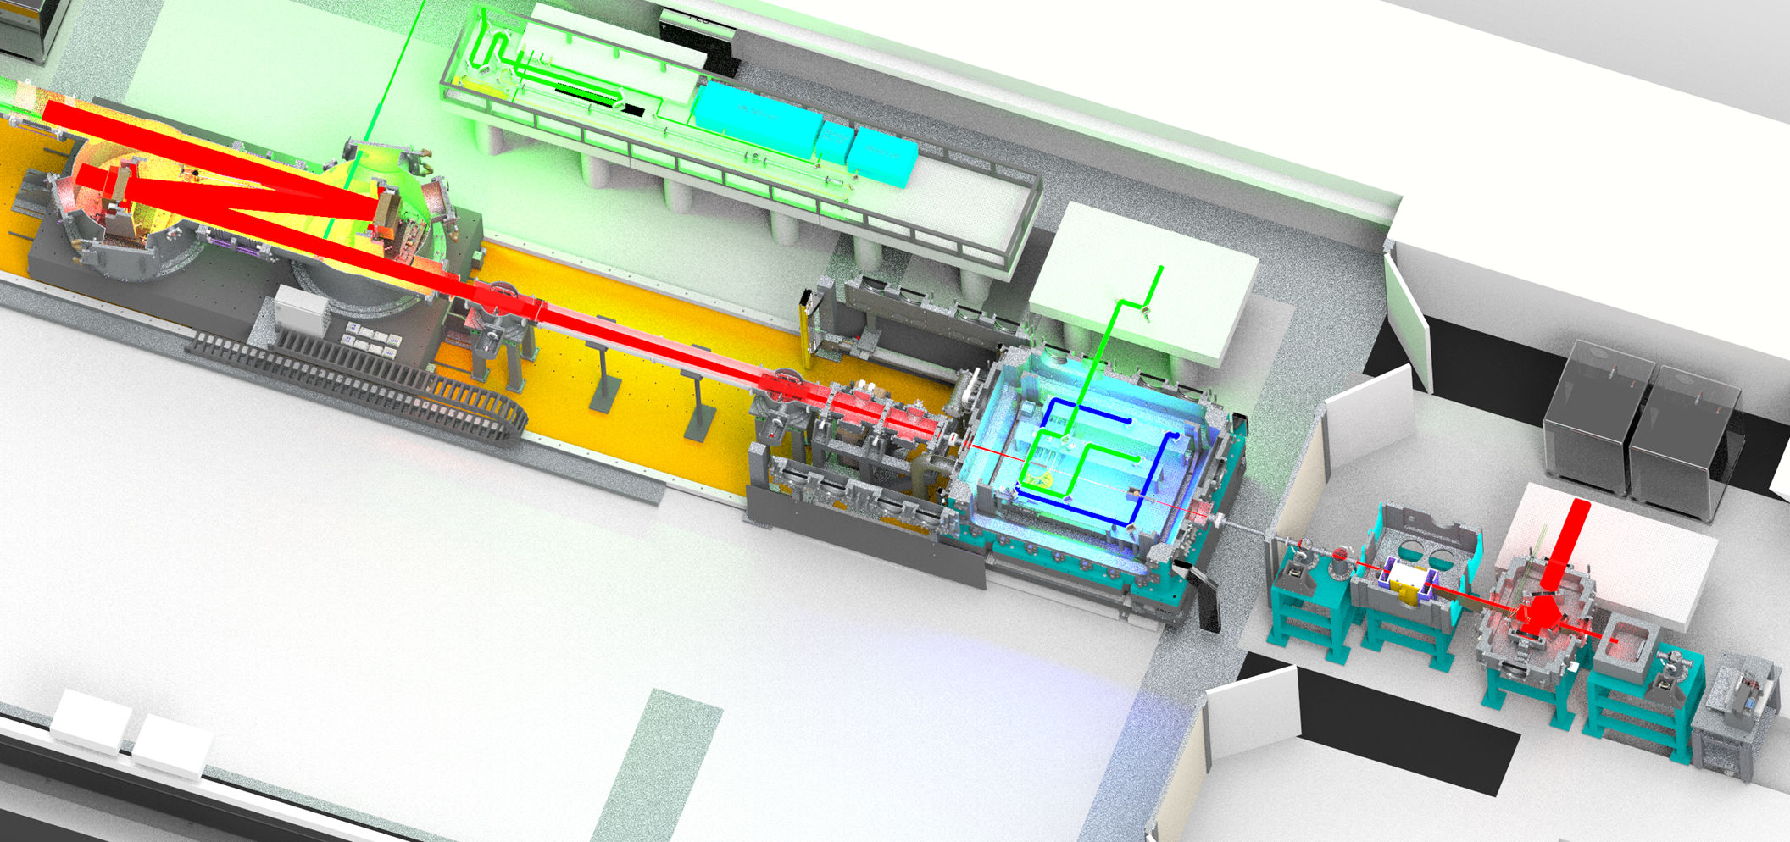
First experiment layout
Probe generation
Plasma imaging
Beam focusing
Electron spectrometer
Exit-mode imaging
Start with Gemini permanent magnet close to source
Scintillator screens to check electron beam profile, divergence, and pointing
Standard exit mode diagnostic arrangement
ICT
Interaction chamber
Scintillator screens
X-ray camera
Notes:
Replace this guidance text with your own bullet pointed content.
For further guidance please see https://www.bdadyslexia.org.uk/advice/employers/creating-a-dyslexia-friendly-workplace/dyslexia-friendly-style-guide

Slide 8
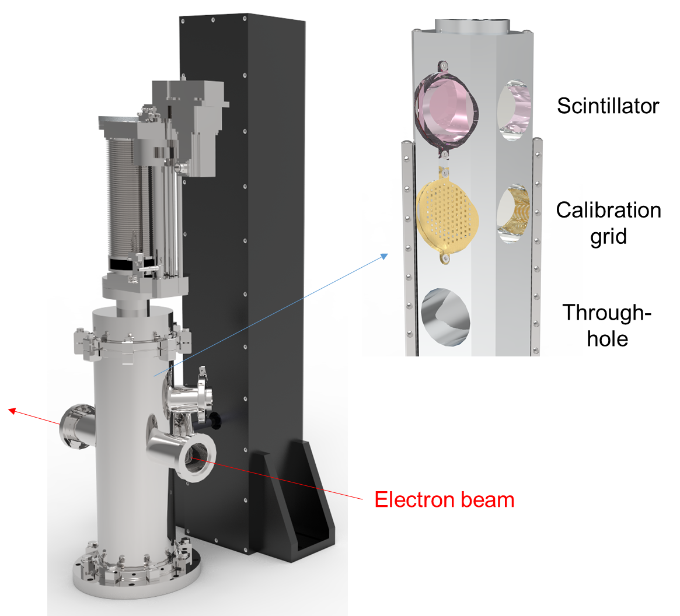
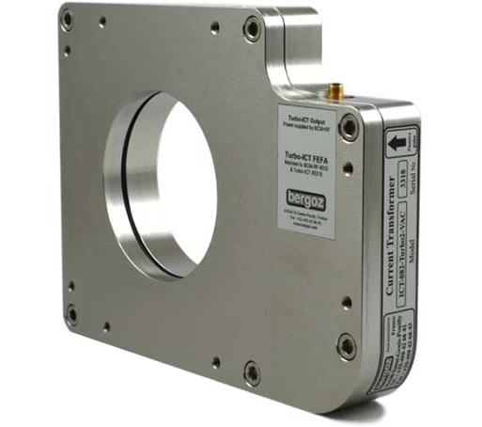
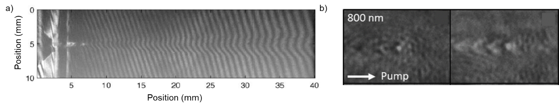
First experiment layout
Electron charge and beam profile
Gas density
Probe generation
4-pass imaging interferometer
CW illumination
Plasma imaging
Bergoz
Turbo-ICT
Scintillator tower
Beam focusing
Karatodorov et al Sci. Rep. 11, 15072 (2021)
Electron spectrometer
Exit-mode imaging
Electron density
High and low magnification imaging
Start with Gemini permanent magnet close to source
Scintillator screens to check electron beam profile, divergence, and pointing
Standard exit mode diagnostic arrangement
ICT
Interaction chamber
Scintillator screens
Schwab et al PRAB 23, 032802 (2020)
X-ray camera
Notes:
Replace this guidance text with your own bullet pointed content.
For further guidance please see https://www.bdadyslexia.org.uk/advice/employers/creating-a-dyslexia-friendly-workplace/dyslexia-friendly-style-guide

Slide 9
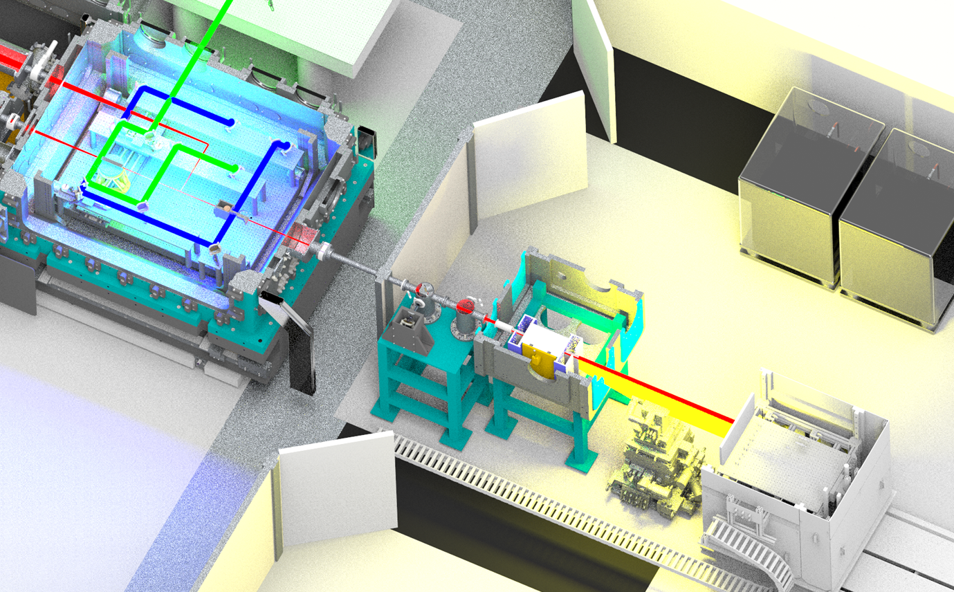
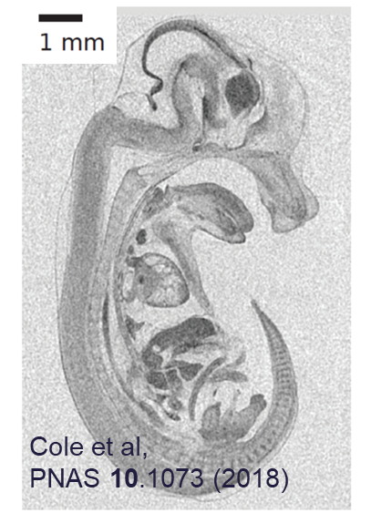
Proof of concept x-ray radiography
High resolution tomography
Optimise phase contrast imaging
Show deep penetration (MeV)
High resolution
  Micron @ 100 keV
  50 micron @ MeV
Demonstrate fast XCT scanning (~ minutes)
Electron spectrometer
Relatively straightforward XCT demonstrations will highlight USPs of LPA x-ray sources
Folded exit-mode imaging
XCT sample stage
X-ray detector module (WP8)
Notes:
Replace this guidance text with your own bullet pointed content.
For further guidance please see https://www.bdadyslexia.org.uk/advice/employers/creating-a-dyslexia-friendly-workplace/dyslexia-friendly-style-guide

Slide 10
LWFA commissioning phase
To deliver applications, we need to fully commission the laser-plasma accelerator
Initial energy ramp and electron acceleration
LWFA stabilisation via infrastructure and feedback
Proof of concept x-ray radiography
Optimisation of LWFA for enhanced parameters
Electron beamline development
Few-cycle probing of wakefield structure
Essential
Beneficial
This phase will be a collaborative effort with user groups and international facilities
Notes:
Replace this guidance text with your own bullet pointed content.
For further guidance please see https://www.bdadyslexia.org.uk/advice/employers/creating-a-dyslexia-friendly-workplace/dyslexia-friendly-style-guide

Slide 11
Demonstration of stable LWFA performance over extended period (8 hr)
High quality LWFA recently shown at DESY
2 J, 1 Hz, 400 MeV [Maier et al PRX 10, 031039 (2020)]
170 mJ, 2.5 Hz, 80 MeV [Bohlen et al PRAB 25 031301 (2022)]
Large datasets show correlations
Mainly shifts in focal plane and gas density
Can stabilise laser parameters and use continuous flow gas cells
Bohlen et al PRAB 25, 031301 (2022)
We aim to achieve this level of performance with multi-GeV beams
Notes:
Replace this guidance text with your own bullet pointed content.
For further guidance please see https://www.bdadyslexia.org.uk/advice/employers/creating-a-dyslexia-friendly-workplace/dyslexia-friendly-style-guide

Slide 12
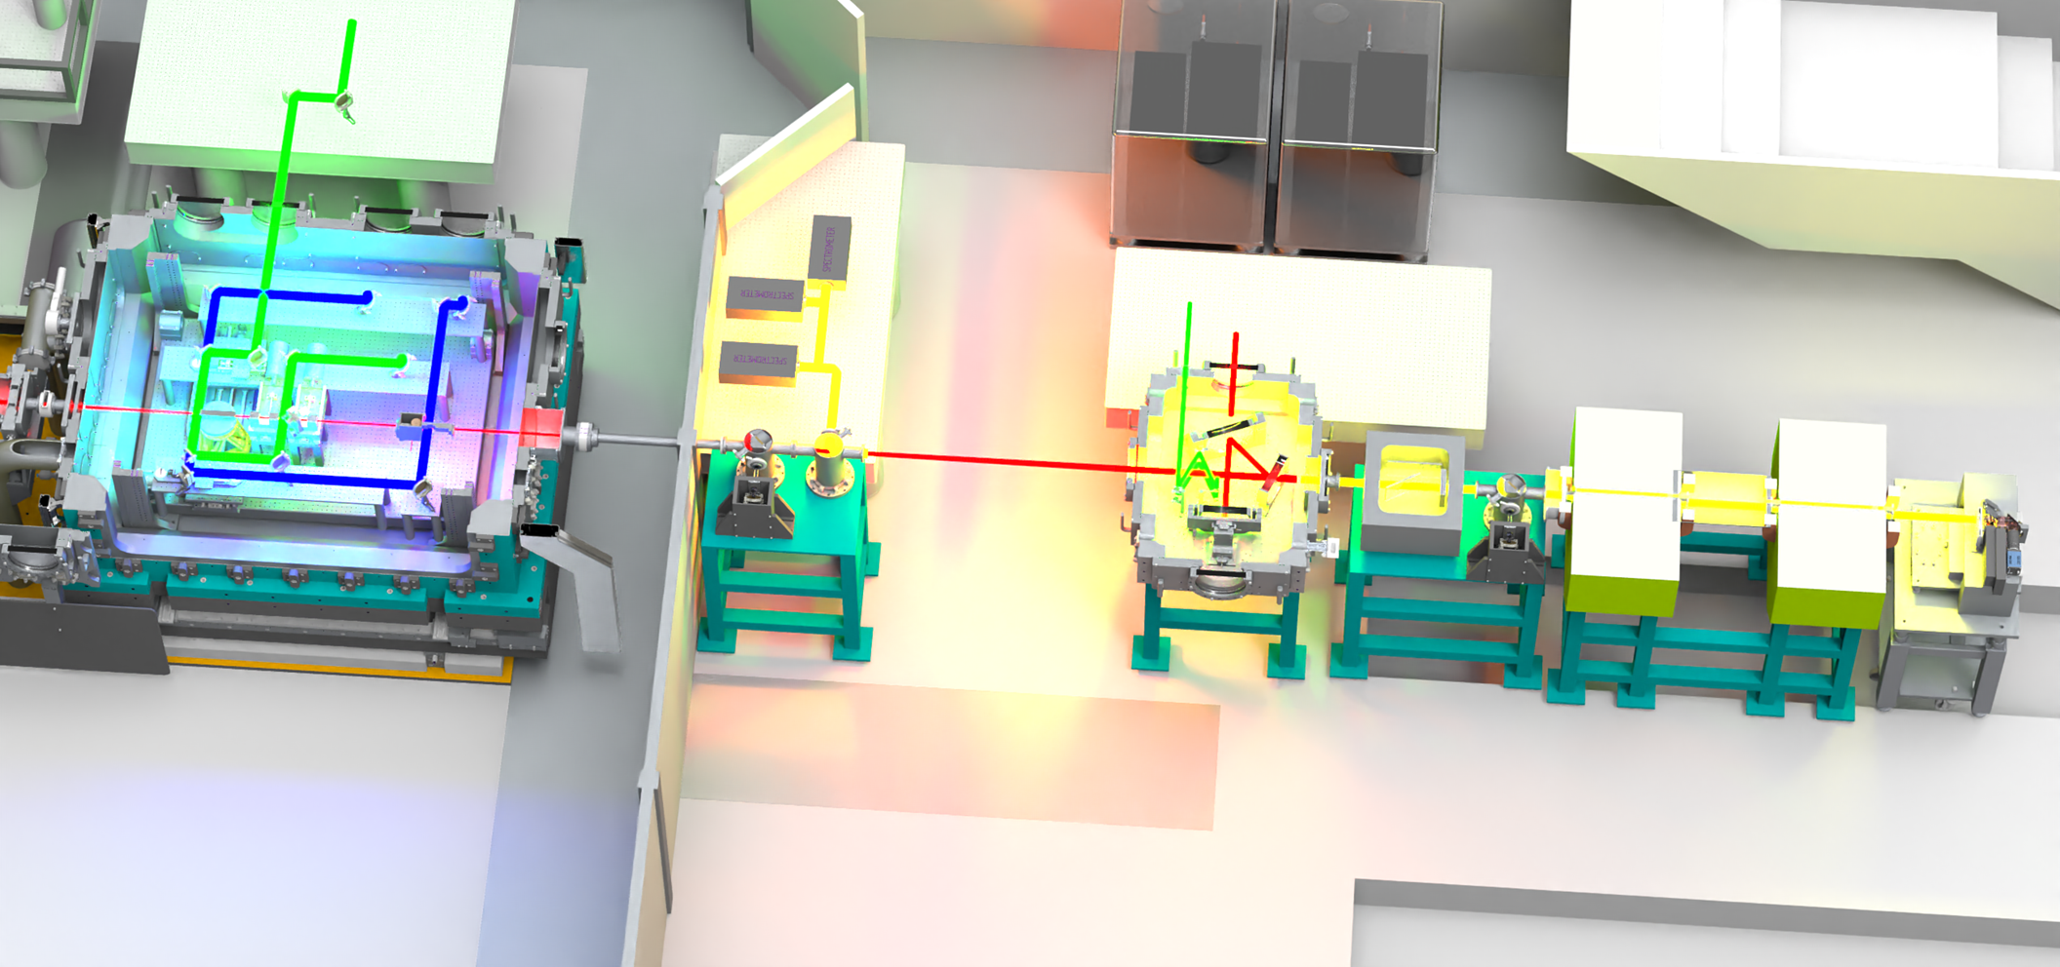
Electron beamline development
Add quadrupole magnet system
Improved spectrum measurement
[Weingartner et al PRST-AB 14, 052801 (2011)]
Single-shot emittance measurement
[Barber et al PRL 119, 104801 (2017)]
Focusing onto samples
Measure transition radiation
Beam profile & emittance
Bunch longitudinal profile (inferred)
Electromagnet spectrometer
Tuneable field strength
Double dipole for energy selection
These components are essential to transition from an experiment to a functioning beamline
Notes:
Replace this guidance text with your own bullet pointed content.
For further guidance please see https://www.bdadyslexia.org.uk/advice/employers/creating-a-dyslexia-friendly-workplace/dyslexia-friendly-style-guide

Slide 13
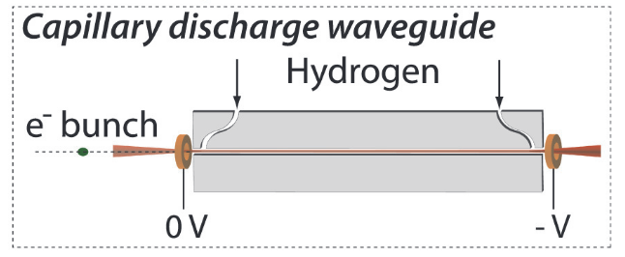
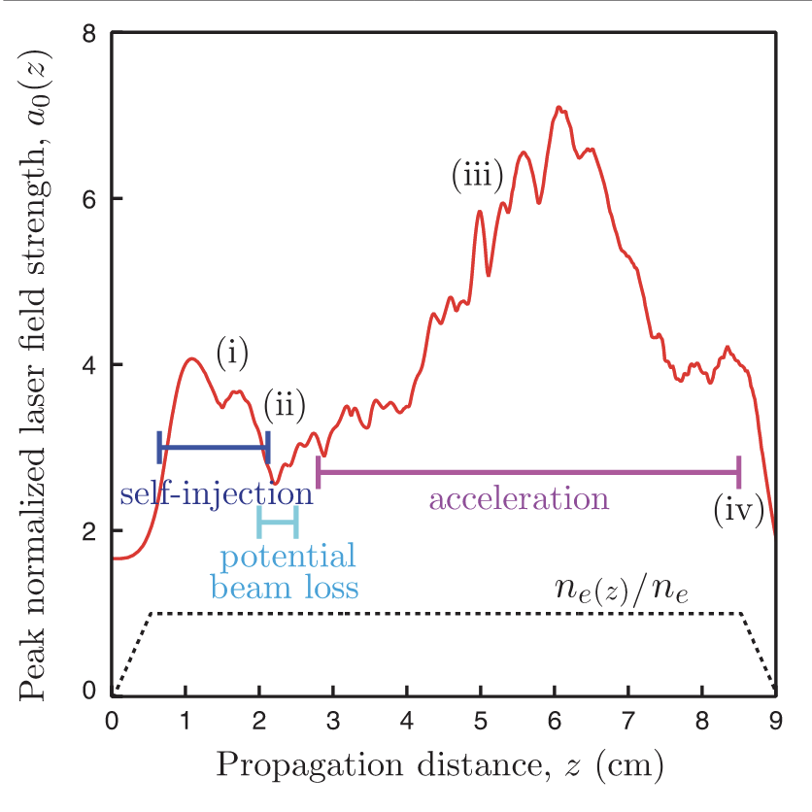
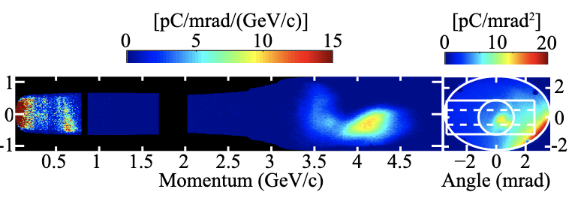
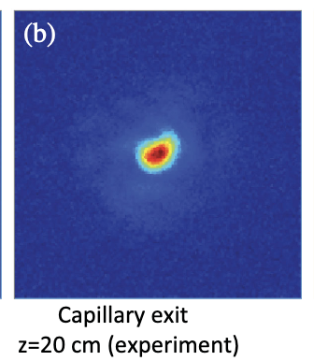
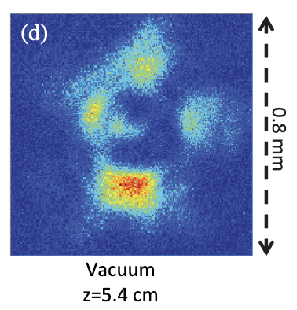
Novel acceleration schemes
Capillary discharge waveguide
W. P. Leemans PRL 113, 245002 (2014)
Guided plasma channels can minimise both laser-diffraction and electron dephasing leading to longer accelerating channels and higher electron energies.
Single stage acceleration with auxiliary beam to initialise plasma channel.
A. J. Gonsalves, et al. IPAC'15,. JACOW, Geneva, Switzerland, 2015.
A. J. Gonsalves et al. PRL 122, 084801 (2019)
Notes:
Replace this guidance text with your own bullet pointed content.
For further guidance please see https://www.bdadyslexia.org.uk/advice/employers/creating-a-dyslexia-friendly-workplace/dyslexia-friendly-style-guide

Slide 14
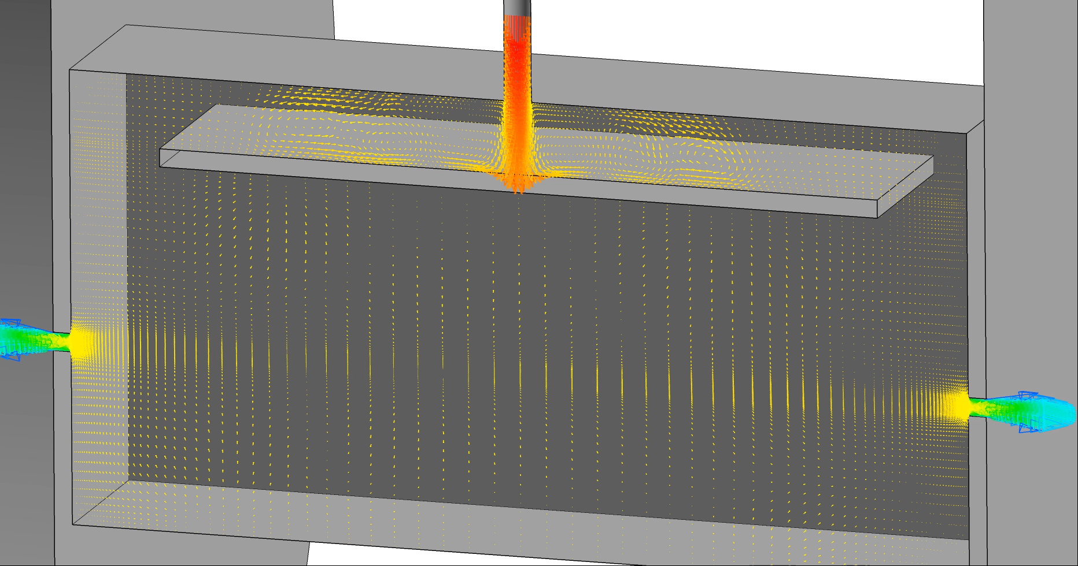
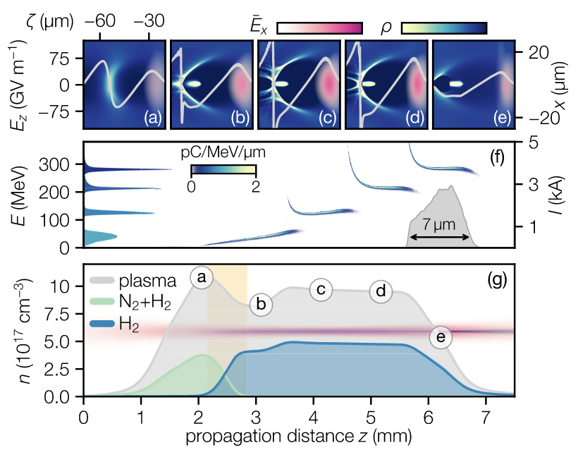
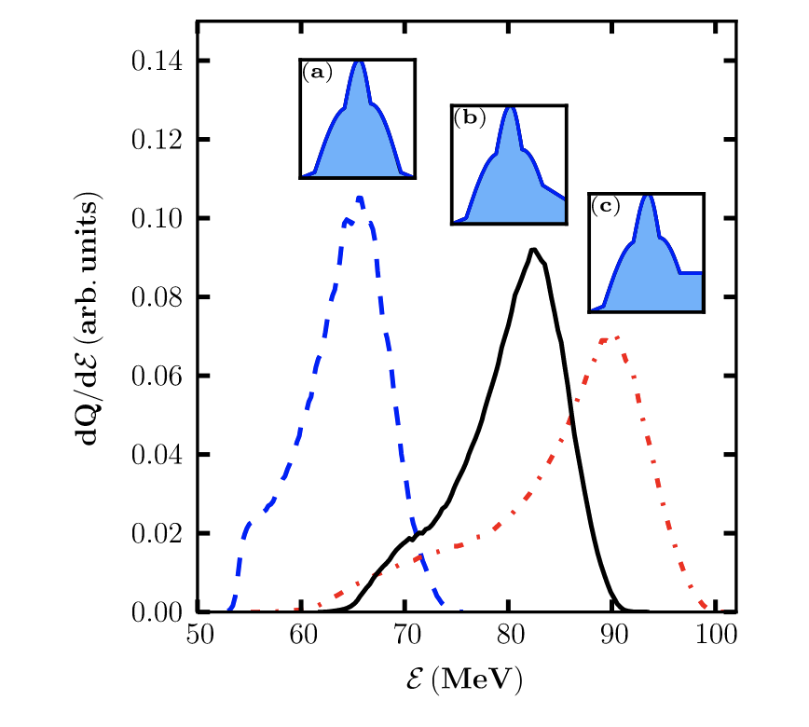
Novel acceleration schemes
Controlled gas-density profiling
Ramped and mixed gas density profiles for advanced injection schemes
Controlled and homogeneous low density gas-cells for efficient acceleration channels.
Variable exit ramp for peak energy tuning in electron acceleration
M. Kirchen et al PRL 126, 174801 (2021)
Lee et al. PHYS. REV. ACCEL. BEAMS 19, 112802 (2016)
Notes:
Replace this guidance text with your own bullet pointed content.
For further guidance please see https://www.bdadyslexia.org.uk/advice/employers/creating-a-dyslexia-friendly-workplace/dyslexia-friendly-style-guide

Slide 15
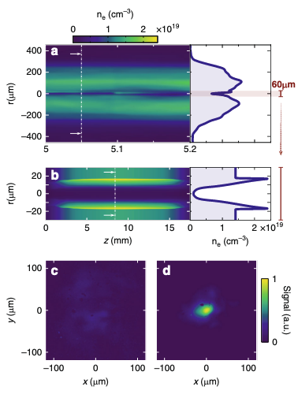
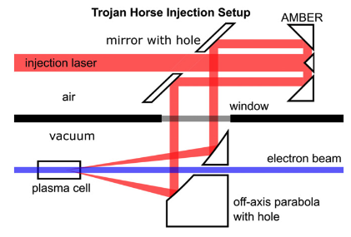
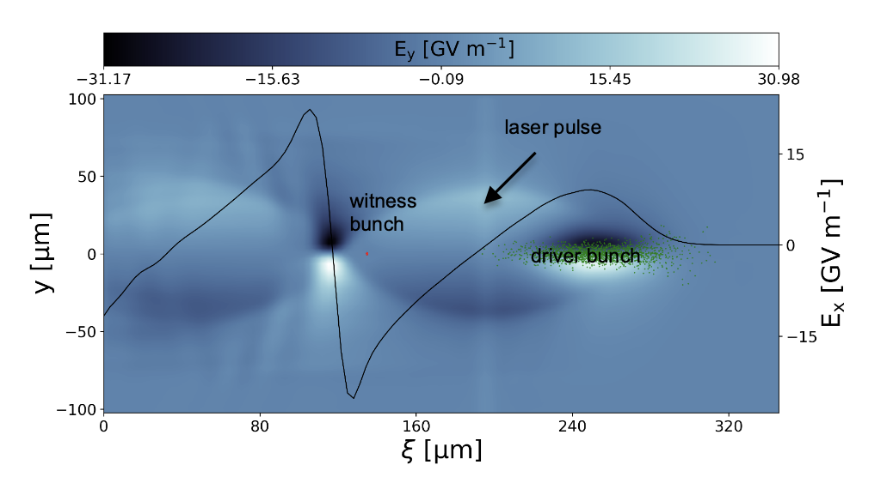
Novel acceleration schemes
M Stumpf et al J. Phys. B: At. Mol. Opt. Phys. 55 (2022) 015401
Hybrid PWFA/LWFA injection schemes
Secondary stage acceleration via LWFA induced PWFA.
mJ auxiliary laser source seeds controlled ionisation injection
Hybrid acceleration concept to control and increase the electron bunch quality.
Oubrerie et al. Light: Science & Applications (2022) 11:180
Notes:
Replace this guidance text with your own bullet pointed content.
For further guidance please see https://www.bdadyslexia.org.uk/advice/employers/creating-a-dyslexia-friendly-workplace/dyslexia-friendly-style-guide

Slide 16
EA2 Initial Experiments
Notes:
The abstract pattern can be removed or repositioned if required. Be careful to ‘Send to Back’ so that it does not obscure any important information.

Slide 17
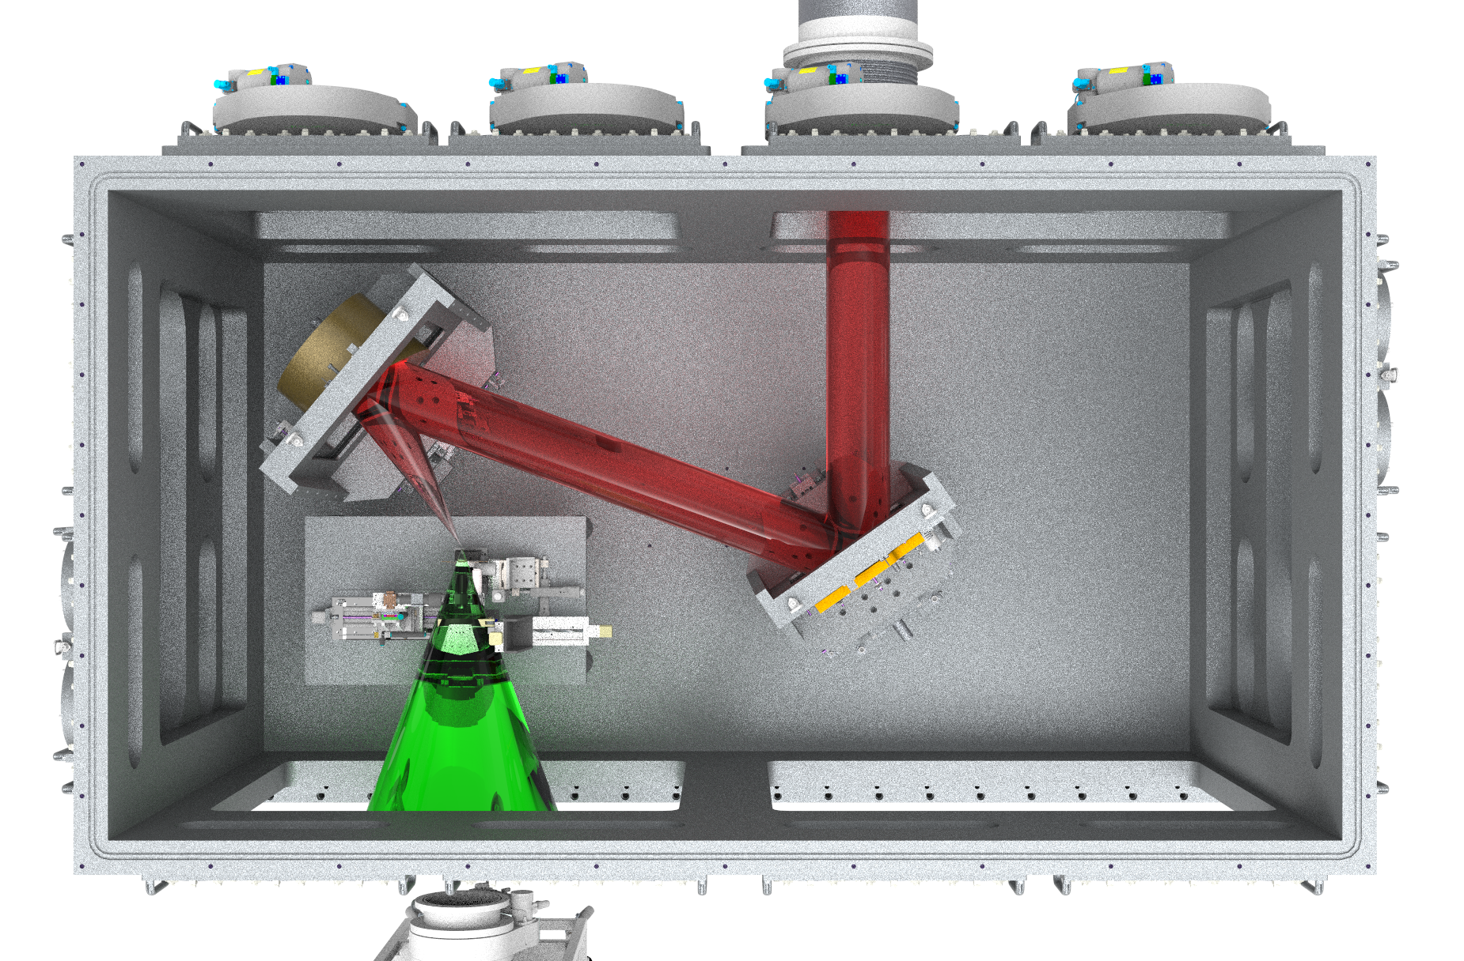
EA2 – Facility commissioning
Priority will be to commission the f/3 short focus set-up (2025 – TBC)
Energy ramp up to 20 J, single shot mode initially
Fundamental system characterisation:
  Laser diagnostic commissioning
  Radiation commissioning
  Debris / EMP measurements
  Interaction conditions
  Ion acceleration optimisation
  Neutron source demonstration
First commissioning experiments in collaboration with user groups
Initial configuration - f/3, 20J, 30fs, ~2x10²¹ Wcm⁻²

Slide 18
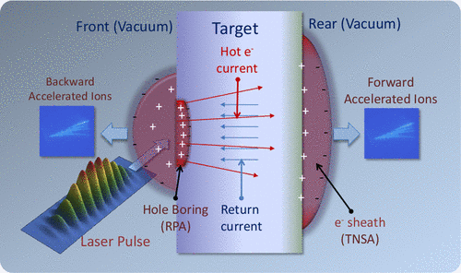
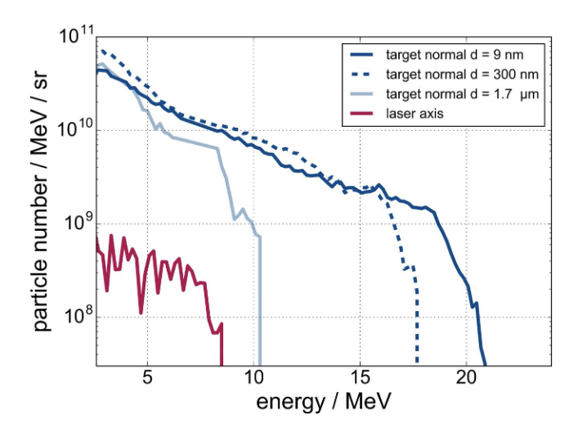

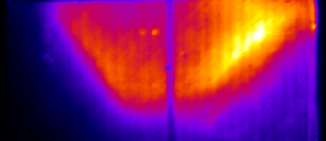
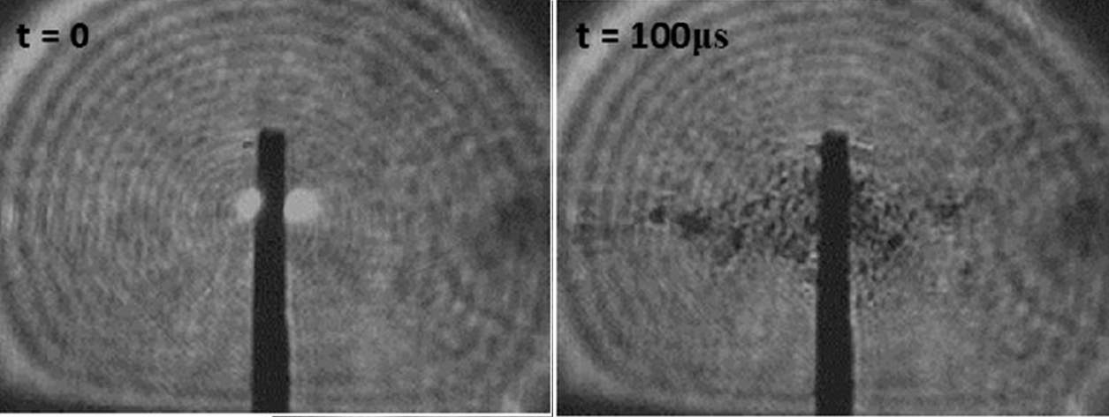
First commissioning experiments
Ion beam optimisation
Optimisation of cut-off energy, flux and beam profile in TNSA regime
Varying laser and target parameters, using single shot mode and solid targetry
Characterisation of interaction conditions, EMP, Debris
Array of ion, electron, optical and x-ray diagnostics
A. Macchi et al. Rev. Mod. Phys (2013)
P. L. Poole et al. New J. Phys. 20 (2018) 013019
RCF
Scintillator
Debris analysis

Slide 19
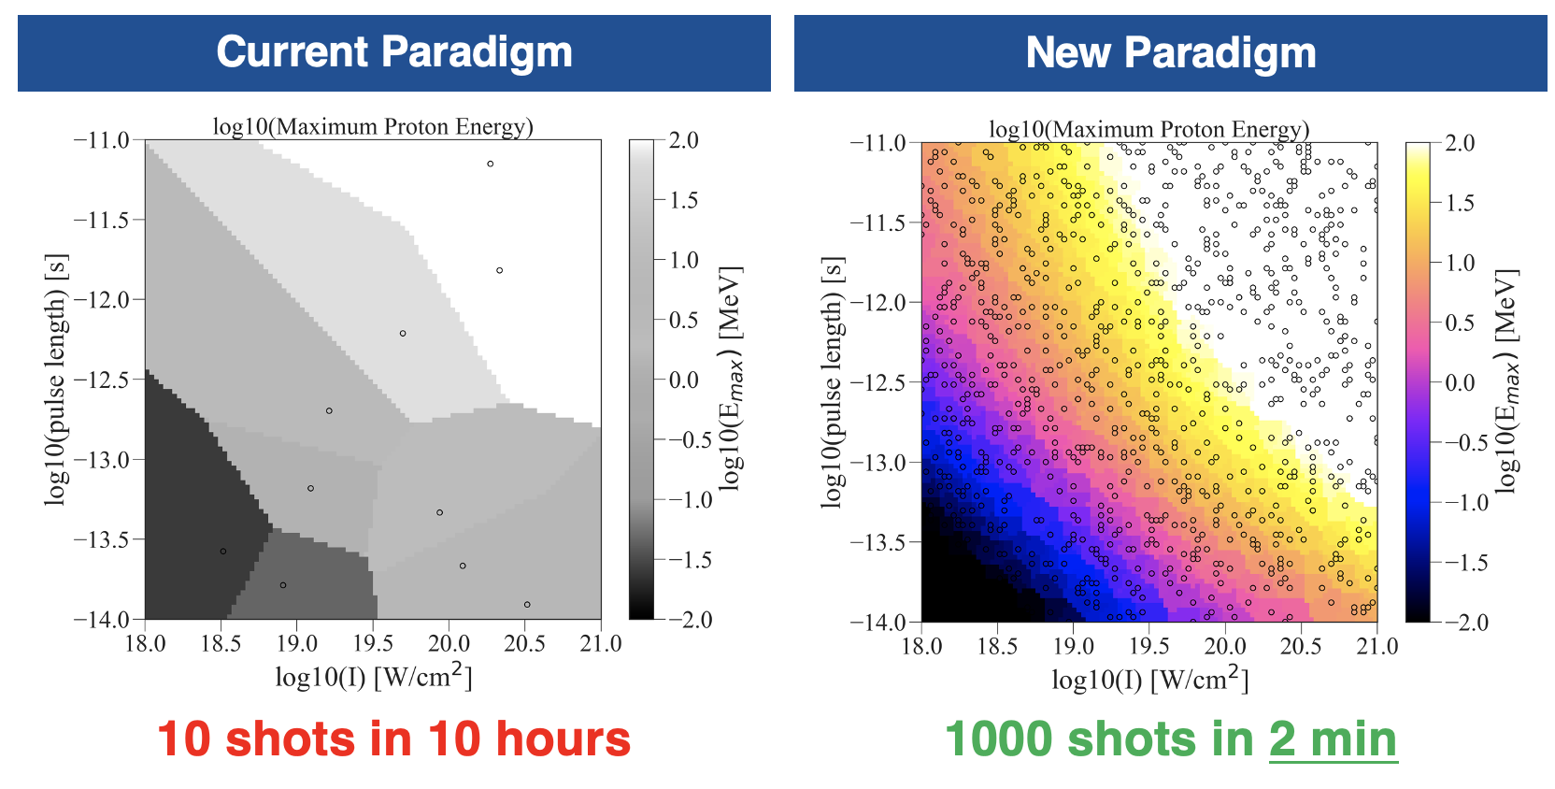
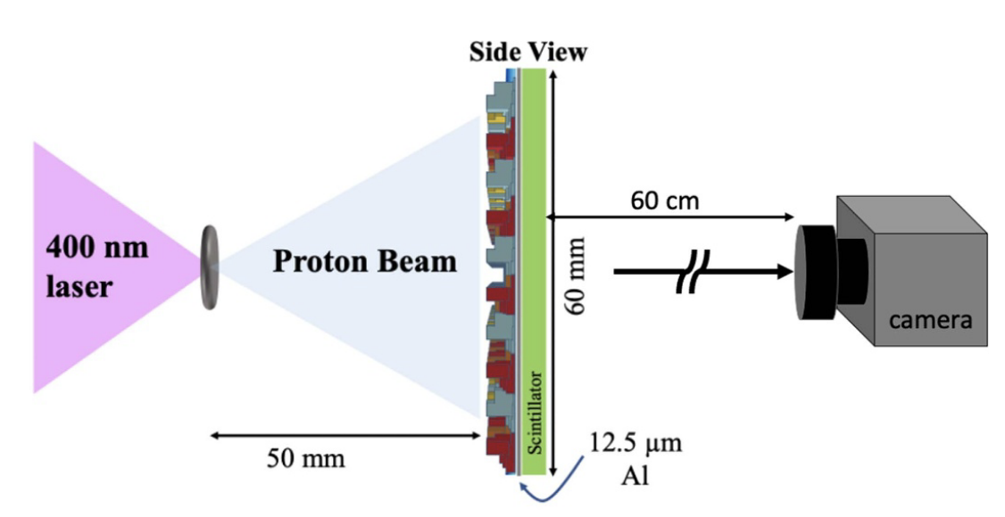
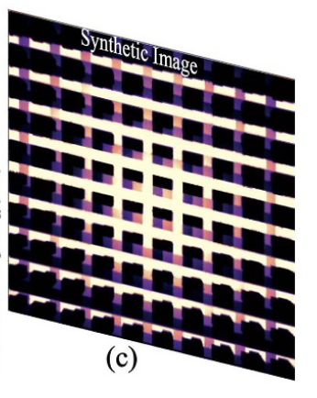
First commissioning experiments
Stable ion beam @ 1 Hz
Demonstration of stable ion acceleration in TNSA regime at 1 Hz
Exploration of large parameter space
Tape drive or liquid targetry
Verification of debris mitigation, data acquisition at 1 Hz
Progressing towards 10 Hz as we develop experience with operation
D A Mariscal et al. Plasma Phys. Control. Fusion 63 (2021) 114003

Slide 20
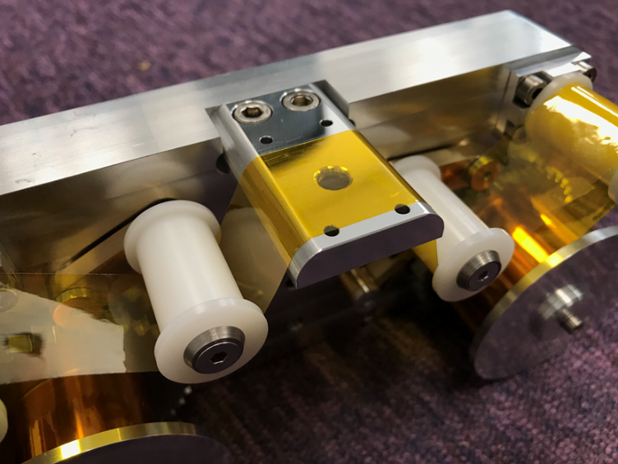
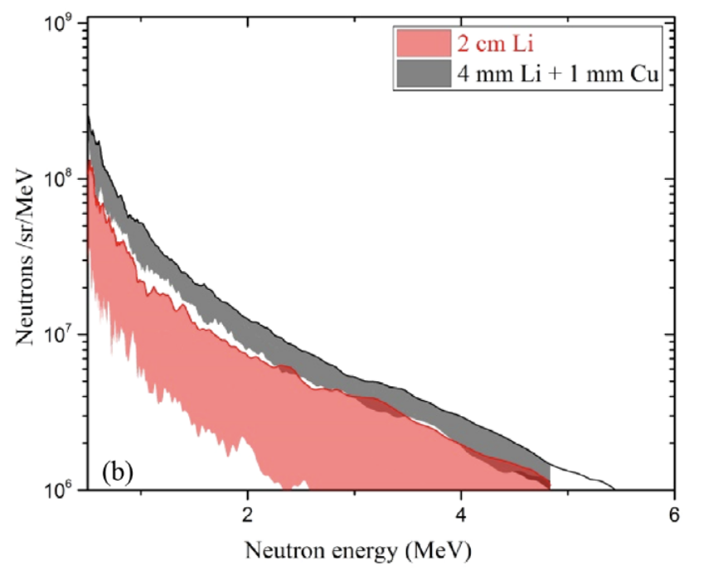
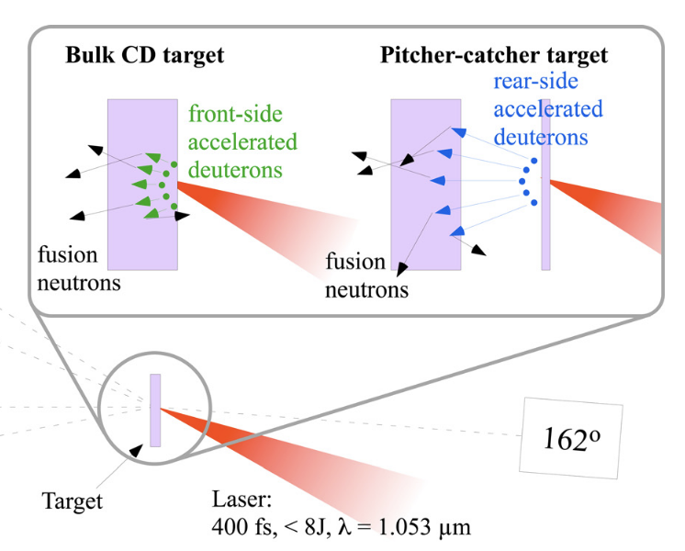
First commissioning experiments
C. M. Brenner et al. Plasma Phys. Control. Fusion 58 (2016) 014039
High rep. neutrons @ 1Hz
Demonstration of high repetition rate neutron source at 1 Hz
Tape drive or liquid targetry ion driver target
Development of neutron target via either bulk target production or replenishable catcher target
Commissioning of neutron diagnostics, moderators
CLF-developed ultra-stable tape target system
L. Willingale et al. Phys. Plasmas 18, 083106 (2011)

Slide 21
First commissioning experiments
Ion beam optimisation
Stable ion beam @ 1 Hz
High rep. neutrons @ 1Hz
Optimisation of cut-off energy, flux and beam profile in TNSA regime
Varying laser and target parameters, using single shot mode and solid targetry
Characterisation of interaction conditions, EMP, Debris
Array of ion, electron, optical and x-ray diagnostics
Demonstration of stable ion acceleration in TNSA regime at 1 Hz
Exploration of large parameter space
Tape drive or liquid targetry
Verification of debris mitigation, data acquisition at 1 Hz
Progressing towards 10 Hz as we develop experience with operation
Demonstration of high repetition rate neutron source at 1 Hz
Tape drive or liquid targetry ion driver target
Development of neutron target via either bulk target production or replenishable catcher target
Commissioning of neutron diagnostics, moderators
Next stage – User-driven proposals aligned to facility priorities

Slide 22
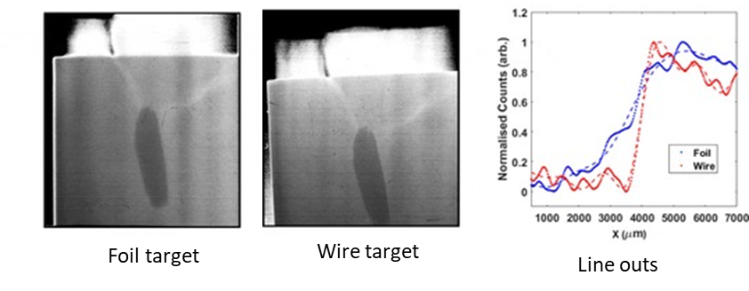
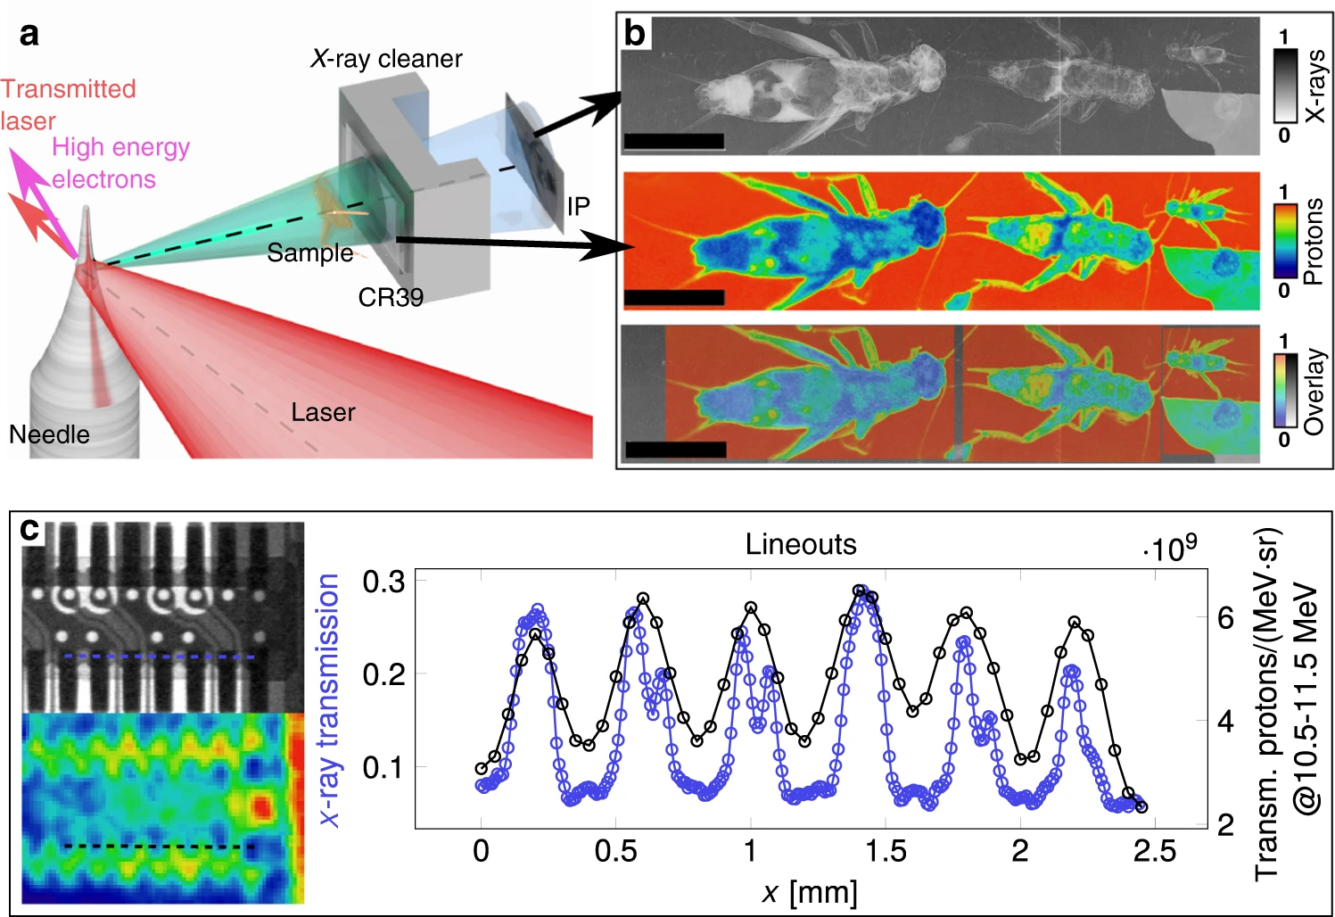
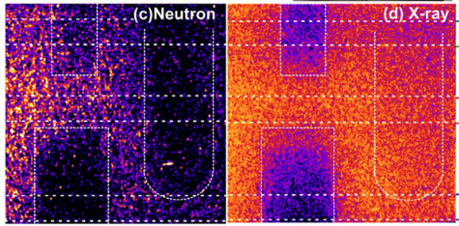
High energy multi-modal radiography
C.D. Armstrong et al. High Power Laser Science and Engineering 7, e24 (2019)
Utilise small source size, large divergence of high energy (~MeV) solid target x-ray source
Characterisation of fast electron source and Bremsstrahlung emission
Large area detectors combined with spectroscopy
Multi-modal inspection – combined with ion or neutron source
X-ray radiographs of a uranium penny encased in grout with foil and reduced area target
Bi-modal X-ray and proton radiography
T.M. Ostermayr et al. Nat Comm. 11, 6174 (2020)
Akifumi Yogo et al 2021 14 106001 – single shot radiography
Notes:
Yogo – Ni-Cd battery – single shot Ni-Cd (bottom left). Ni-Metal Hydride (top left – low neutron cross section) Boron carbide (right).
LFEX onto few um CD, Be convertor. Passive imaging n, x-rays.
Pulse is 10s us after moderation.

Slide 23
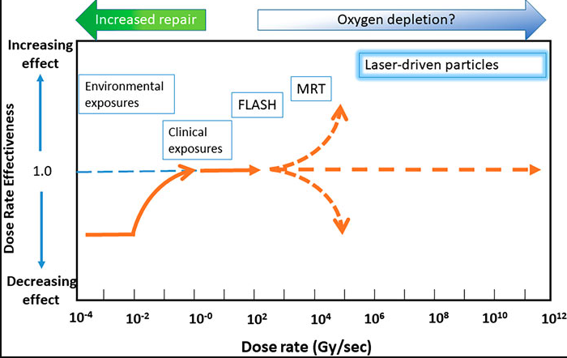
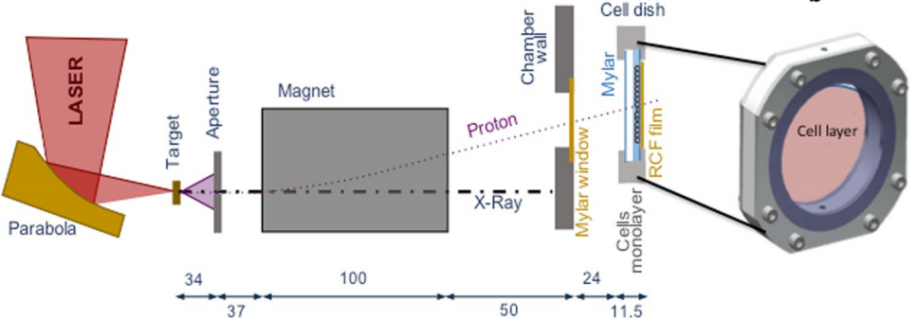
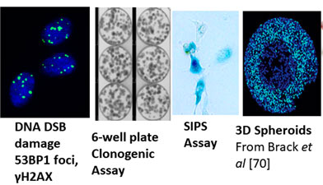
High Dose Rate Radiobiology
High-brightness, short ion bunches can be exploited for radiobiological studies at a high-dose rate.
The first experiment can build on Gemini and Vulcan campaigns by deploying a single dipole magnet setup for
in-vitro studies.
Irradiation at >1Hz would facilitate improving the understanding of the high dose rate radiobiology, where, physical, chemical and biology knowledge is limited.
In-vitro Assays
P. Chaudhary et al. Front. Phys., 10,3389, 2021
Notes:
FLASH above 100 Gy/s
Typical 1Gy / shot – 10^9 / sec, unique regime for radiobiology.
Investigations with different ion species
DREF – Dose Rate Effectiveness Factor – not known for ultra-high dose rates

Slide 24
EPAC Experimental Themes
Notes:
The abstract pattern can be removed or repositioned if required. Be careful to ‘Send to Back’ so that it does not obscure any important information.

Slide 25
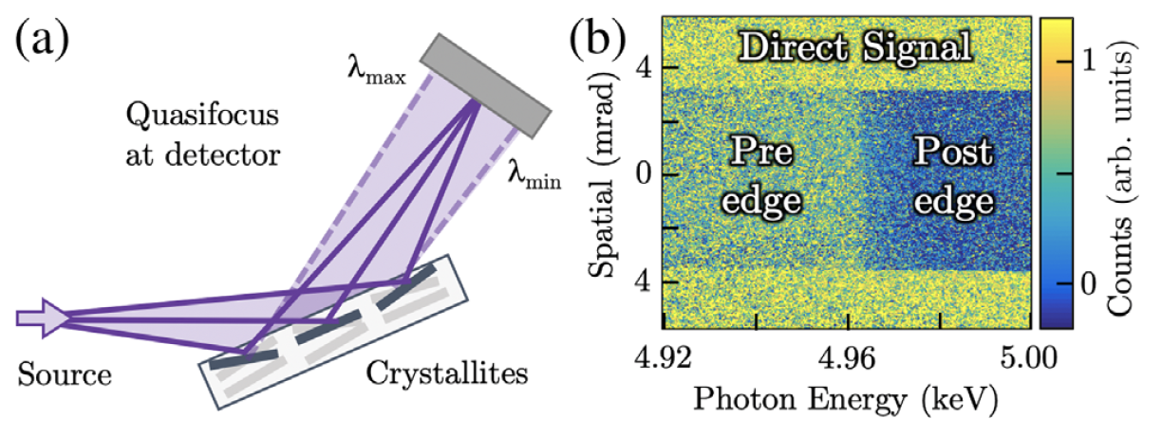
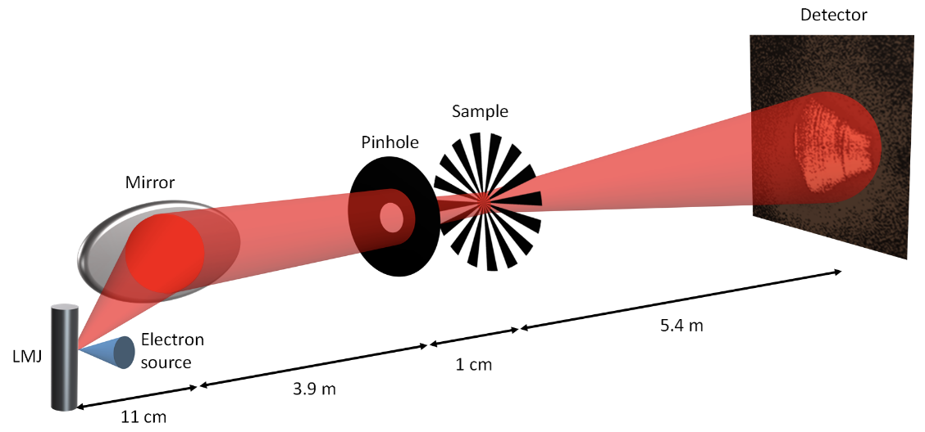
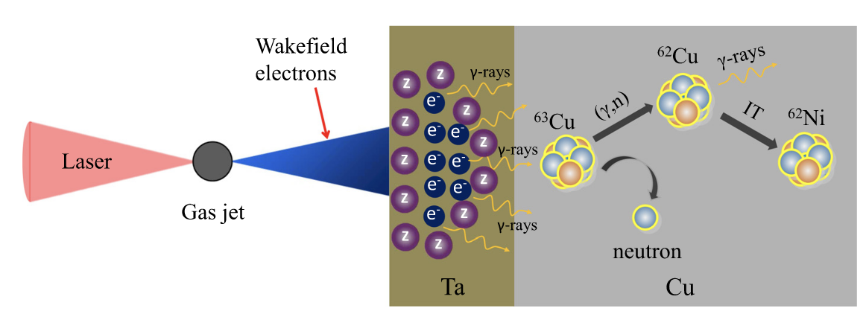
X-ray Applications
B. Kettle et al. PRL 123, 254801 (2019)
Ultra-Fast XANES
  Absorption spectroscopy of dynamic processes
  fs-resolution measurement of the electronic and ionic
  temperatures and structures of samples
Pump/probe dynamic Coherent Diffractive Imaging
  Sub-nm scale diffractive imaging
  Ptychography and Edge-Diffraction microscopy techniques
  Auxiliary beam to induce dynamic effects
“Gamma” induced activation
  Photonuclear synthesis of radioisotopes
  Material inspection via prompt decay emission spectroscopy
D. Batey et al. PRL126, 193902 (2021)
Z. Ma et al. Matter Radiat. Extremes 4, 064401 (2019); doi: 10.1063/1.5100925
Notes:
Outline the scope/challenge of the project and then talk about what the key radiation types we expect from each area in EPAC to give context to the detector designs I’m going to show.
I’ll run through the concepts we’ve come up with for each detector and then run through where our technical risks are and how they’ve changed since last year.
Then to wrap up I’ll show off some of the prototyping results in a few areas and talk about what it means going forward for each design.

Slide 26
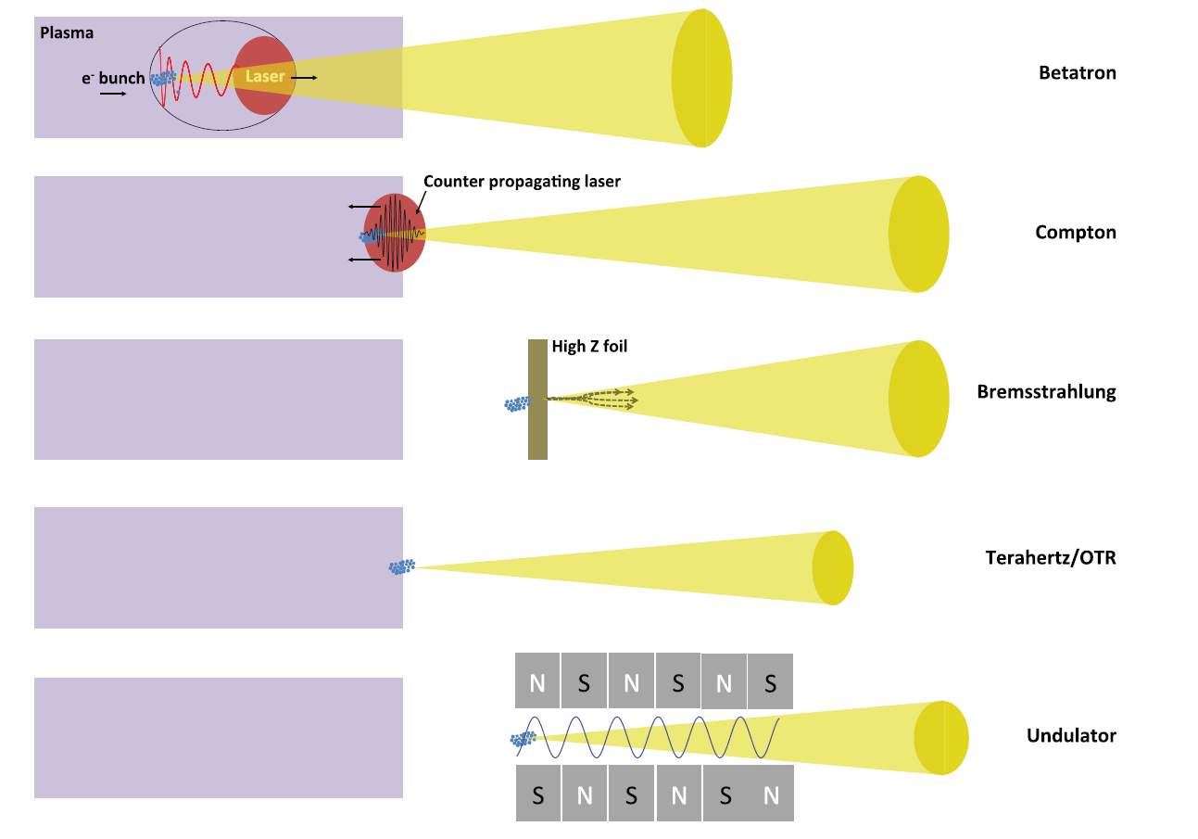
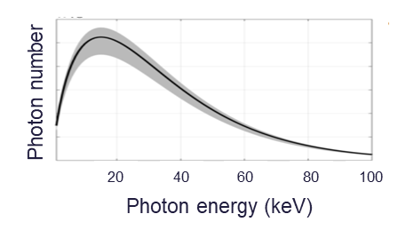
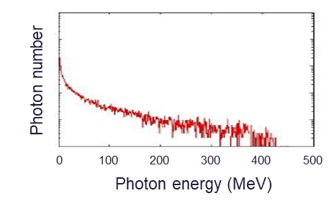
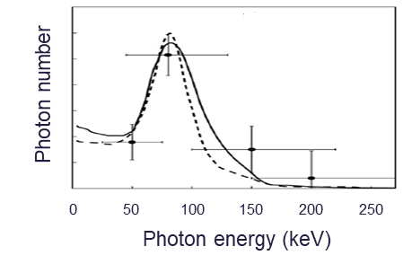
X-ray Radiography Applications
Demonstration of broad x-ray energy sources
High resolution Radiography and CT with Betatron
  Up to 200 keV x-rays
  Sub-micron source
  Phase contrast
High penetration bremsstrahlung imaging
  100s MeV x-rays
  Tuneable source
  Paired with thick sub-mm resolution scintillators
Tunable narrow bandwidth Inverse Compton Scattering
  0.1-10 MeV x-rays with micron level source
  Beam-hardening free CT
  Self-reflection or auxiliary laser as secondary
Notes:
Outline the scope/challenge of the project and then talk about what the key radiation types we expect from each area in EPAC to give context to the detector designs I’m going to show.
I’ll run through the concepts we’ve come up with for each detector and then run through where our technical risks are and how they’ve changed since last year.
Then to wrap up I’ll show off some of the prototyping results in a few areas and talk about what it means going forward for each design.

Slide 27
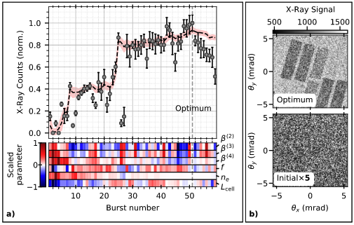
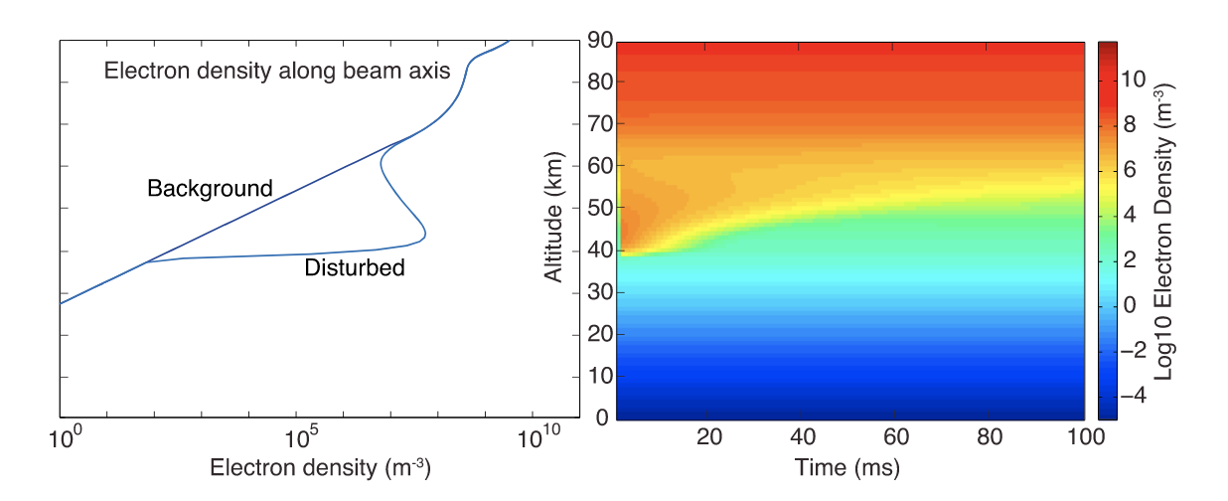
Electron Acceleration Applications
Novel electron acceleration schemes
  Plasma density ramp control
  Capillary guided acceleration
  Hybrid acceleration scheme
  Laser prepulse effect
Multi-parameter scanning
  Thorough parameter scanning across large area to causal multi-dimensional relationships
  Variable laser conditions, variable gas conditions
  Stable acceleration conditions
  Machine learning driven Bayesian optimisation
Electron propagation studies
  Beam filamentation in various mediums
  Standoff disruption events
  Multi-modal secondary generation through static converters – i.e. muons.
M. Kirchen et al PRL 126, 174801 (2021)
R.J. Shalloo et al. Nat Commun 11, 6355 (2020).
Marshall, R. A., et al. Journal of Geophysical Research: Space Physics 119.10 (2014): 8560-8577.
Notes:
Outline the scope/challenge of the project and then talk about what the key radiation types we expect from each area in EPAC to give context to the detector designs I’m going to show.
I’ll run through the concepts we’ve come up with for each detector and then run through where our technical risks are and how they’ve changed since last year.
Then to wrap up I’ll show off some of the prototyping results in a few areas and talk about what it means going forward for each design.

Slide 28
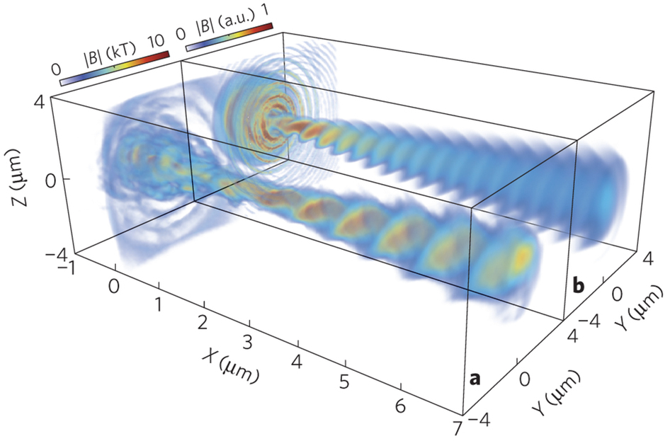


Ion Acceleration Applications
Development of Ion Acceleration Schemes
  Limits of TNSA studies
  RPA / Hybrid acceleration schemes
  Relativistic induced transparency (RIT)
Multi-parameter TNSA Optimisation
  Thorough parameter scanning across large area to causal multi-dimensional relationships
  Variable laser conditions, variable targetry conditions
  Stable acceleration conditions
Ion beam applications
  Radiobiology studies for high average dose proton source
  Ion focusing and selection (passive/active)
  With catcher target development, fast and thermalised neutron generation
Notes:
Outline the scope/challenge of the project and then talk about what the key radiation types we expect from each area in EPAC to give context to the detector designs I’m going to show.
I’ll run through the concepts we’ve come up with for each detector and then run through where our technical risks are and how they’ve changed since last year.
Then to wrap up I’ll show off some of the prototyping results in a few areas and talk about what it means going forward for each design.

Slide 29
Technical challenges going forward
Notes:
The abstract pattern can be removed or repositioned if required. Be careful to ‘Send to Back’ so that it does not obscure any important information.

Slide 30

Technical Challenges
Increased stability of both laser and plasma-accelerator
  Tackling infrastructural causes (50 Hz vibration from site)
  Identifying causes of LWFA instability
X-ray imaging and CT processing for rapid acquisitions
  Higher resolution, higher sensitivity diagnostics
  CT Processing routines
Targetry development
  Controlled gas density profiles
  Solid targetry development for high repetition of complex targetry
  Debris from targets, mitigating effects on optics
High repetition diagnostic development
  Multi-modal sensitivity
  Ion spectro-spatial measurements
  High temporal resolution
Laser feedback + stabilisation
CLF Tape drive development
High speed optical CT processing

Slide 31






Stability Improvements
Combination of engineered stabilisation solutions and active feedback stabilisation to ensure system-wide 5 $\text{μRad}$ stability
Large granite blocks isolating sensitive optic chain and target chamber and table frequency response (engineering)
$\text{μRad}$ stability demonstrated for full aperture turning mirrors (engineering)
Automated fast jitter stabilisation throughout laser via pilot beam feedback routine (active)
Measured on-site frequency

Slide 32


TA2 LWFA Testbed
5 Hz Astra laser is a <J 40fs system capable of laser-wakefield acceleration similar to EPAC. Recommissioning the area as a testbed enables us to:
Demonstrate stable ~100 MeV e- beams
Identify key sources of accelerator instability to inform EPAC design and feedback
Commission diagnostics with ultra-short radiation source
Develop gas target and probing techniques to understand high repetition operation issues

Slide 33






Gas Targetry Development
Measuring target gas pressure:
In house gas-jet and gas-cell development
Fluid modelling of gas profile within cell, minimising input turbulence.
Modelling gas-jet dynamics for high pressure operation.
Variable length gas-cell production
Inteferogram
Plasma density profile

Slide 34






Solid & Liquid Targetry Development
High volume sputtered target processing
Multiple avenues for solid target production
CLF Tape drive being tested in SCAPA at 2.5 Hz repetition for ion production.
Ongoing HAMS targetry system and Liquid target development
Liquid jet and liquid crystal development
CLF-developed ultra-stable tape target system

Slide 35



Diagnostics
Developing diagnostics to match expected challenges
Spectro-spatial measurements of ion emission
  Wide Angle Thomson
  PROBIES Mask
High resolution inspection of variable x-ray emission - (next talk)
Non-destructive electron beam inspection - (next talk)
Ultra-fast timing spectroscopy
Wide-angle multi-sampled Thomson Parabola
Anti-whisper shaped ToF spectroscopy

Slide 36


Diagnostics
Time-gated fast recovery imaging
Developing diagnostics to match expected challenges
Multi-modal sampling for imaging/inspection
High sensitivity x-ray measurements
  Fibre-coupled imaging for low photon sampling – (next talk)
  Bonded SiPM detection of near-single photon spectroscopy
Low stopping power imaging with high resolution – (next talk)
Individual SiPM integration via commercial readout board
More detail with ongoing projects in Detectors talk (after lunch)

Slide 37





TA3 PoC Experiments
Two week campaigns to trial experimental techniques that are key for EPAC.
2022 – Inverse Compton Scattering
Generating quasi-monoenergetic x-rays for CT and radiography
Controlling parameters to increase divergence and reduce peak energy to maximise image contrast.

Slide 38



CT Processing and Operation
Imaging system
Rotational sample stage
Diffuse backlight
Offline optical setup built in TA1 to develop understanding of acquisition routines, reconstruction processes, and signal requirements.
Current optical CT process can acquire and reconstruct a 3D model in a few minutes.
Imaging system
Shadowgram of complex object with diffuse backlight
Binary light sinogram
3D model reconstruction
Line by line conversion to sinogram
“Visible Hull” reconstruction

Slide 39








Collaboration with XCT community is essential for design and operation of EPAC
XCT users
Calibration techniques and standards
Advanced CT methods
Challenges and technology barriers
Expertise across STFC
High power lasers
Synchrotron (and n) radiation and CT
Conventional accelerators
Big data and machine learning
Detectors
Companies with R&D budgets
Rolls Royce – penetrating radiation, flash radiography
Johnson Matthey – battery research, XANES
Notes:
Replace this guidance text with your own bullet pointed content.
For further guidance please see https://www.bdadyslexia.org.uk/advice/employers/creating-a-dyslexia-friendly-workplace/dyslexia-friendly-style-guide

Slide 40





Summary
Collaborations
Initial experiments in EPAC will focus on stability and optimisation of LWFA (EA1) and Ion TNSA (EA2).
We expect a number of technical challenges from targetry and debris to diagnostics and data processing.
We are addressing these challenges with a combination of infrastructural changes to EPAC and experience in operation through experiments in TA2 and TA3.

Slide 41





Science and Technology Facilities Council
@STFC_matters
Science and Technology Facilities Council
Notes:
The abstract pattern can be removed or repositioned if required. Be careful to ‘Send to Back’ so that it does not obscure any important information.

Slide 42
What are the technological challenges?
Notes:
The abstract pattern can be removed or repositioned if required. Be careful to ‘Send to Back’ so that it does not obscure any important information.

Slide 43
EA1 – Challenges
Stability of LWFA:
  Consistent gas targetry
  Known and stable laser conditions
  Large parameter space
X-ray CT
  Rapid acquisition with variable, inconsistent flatfield
  Novel sparse, low signal reconstruction for dynamic process
Plasma Mirior – tape drive
Electron beam pointing

Slide 44
EA2 – Challenges
Solid target delivery:
  Tape targets offer simple targets at 10Hz
  Complex or ultra-thin targetry requires additional development
  Debris from thick targets
X-ray CT
  Rapid acquisition with variable, inconsistent flatfield
  Novel sparse, low signal reconstruction for dynamic process

