Slide 1
EPAC
Experimental Area 2
James Green
Central Laser Facility
Rutherford Appleton Laboratory
30th November 2022
Notes:
The abstract pattern can be removed or repositioned if required. Be careful to ‘Send to Back’ so that it does not obscure any important information.

Slide 2
Experimental Area 2 (EA2)
AO Chamber
Beam entry from pit
Beam diagnostics
Flexible experimental area with primary focus on high density laser-matter interactions
Default short focus set-up with f/3 focusing at 2x10²¹ Wcm⁻²
Full design to be complete within project along with delivery of large scale infrastructure
Interaction Chamber
Notes:
1 min

Slide 3
EA2 – Current timelines
Design work and installation:
2023
Completion of design work for Adaptive Optic and Interaction Chambers
Completion of design of laser diagnostics and CW / alignment systems
Completion of services design
2024
Delivery of Adaptive Optic and Interaction Chambers
Commissioning design work inc. targetry and diagnostics
Research and Development:
2023
Design and testing and prototype ion diagnostics
Off-line and in-situ testing of liquid jet / liquid crystal targetry systems
Initial design work on solid targetry array
Data collection and analysis of debris creation, damage testing, Pellicle tests
2024 –
Final designs for commissioning ion diagnostics
Testing of solid targetry array system
Full experimental testing of liquid jet system
2nd harmonic crystal testing?
Q4 2025 (TBC) – Area completion and Commissioning
Q2 2026 (TBC) – First experiments
Notes:
3 mins

Slide 4
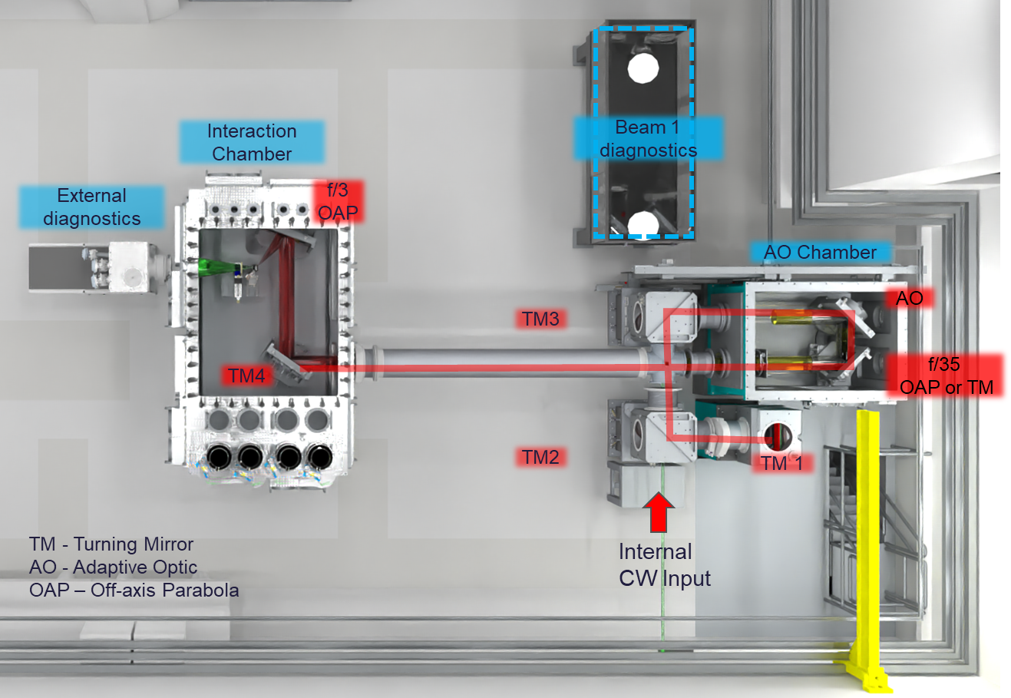
Experimental Area 2 (EA2)
Notes:
1:30

Slide 5
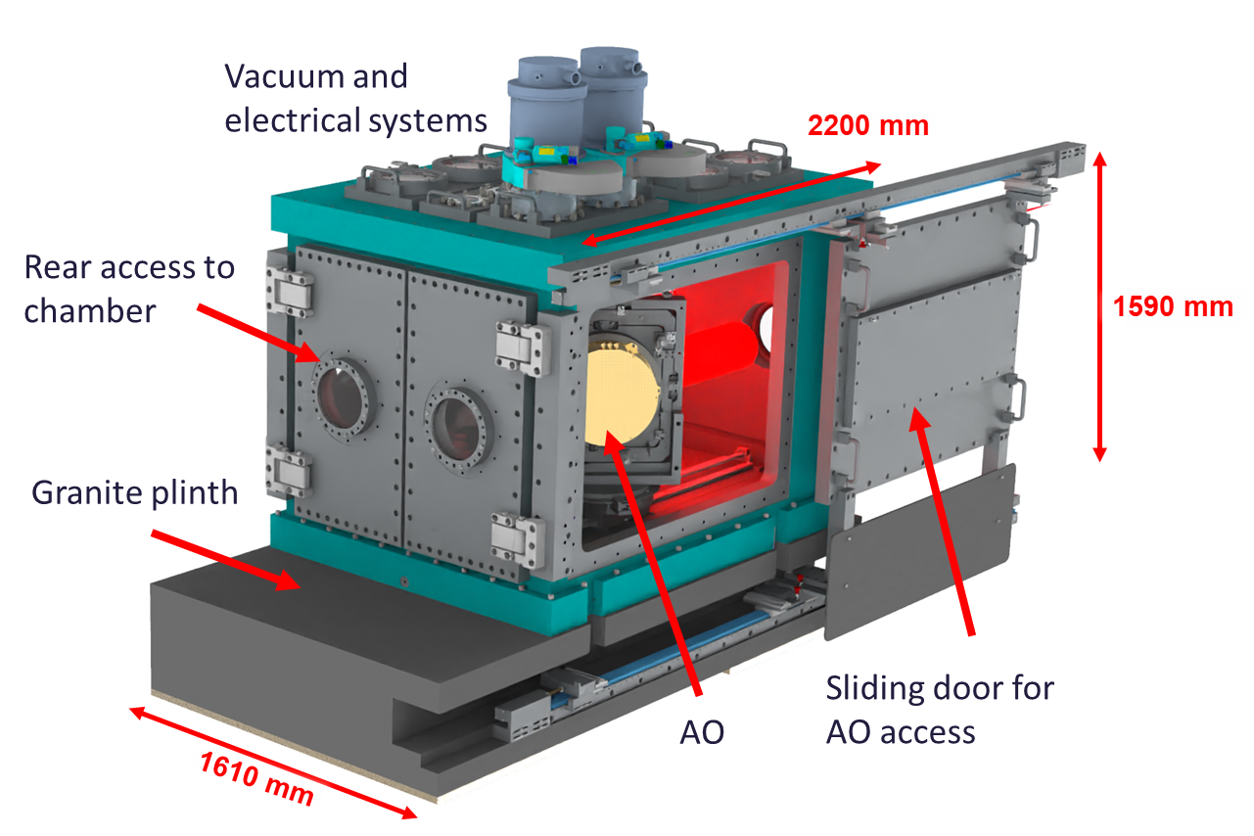
Adaptive Optic chamber
Contains 3 bespoke optical mounts:
Adaptive Optic
Turning mirror / Long focus parabola
Waveplate
Will be delivered as part of large scale infrastructure
Detailed design work nearing completion – aim to issue final specification shortly before tender in 2023
Notes:
1:30

Slide 6
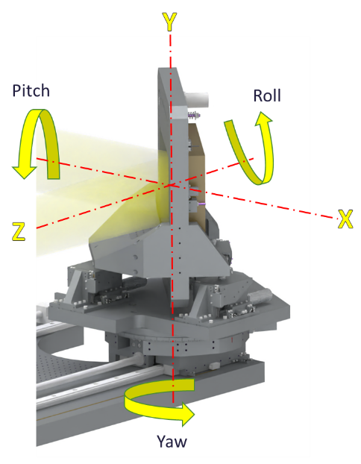
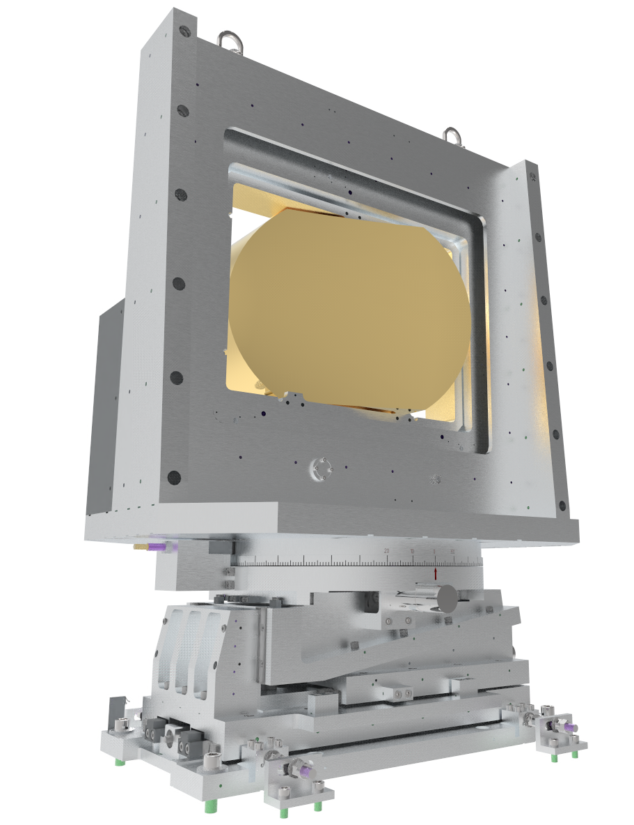
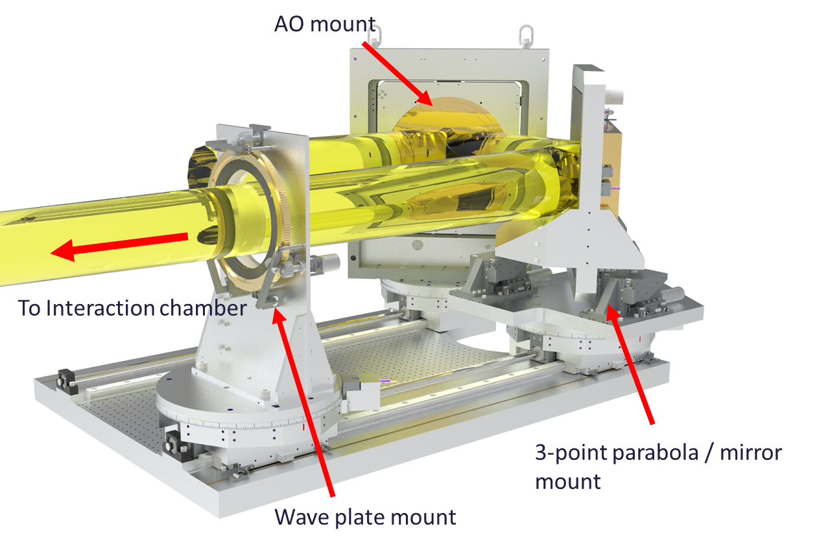
Large optics mounts
AO mounts adapted to fit in narrow footprint of chamber
3-point mount for long focus parabola mount for alignment
Universal interaction chamber mount for parabola or turning mirrors
AO on order for delivery in early 2023
Long focus parabola / mirror mount
Short focus parabola / mirror mount
Design for 4 bespoke mounts for AO and Interaction chambers signed-off
Notes:
2 mins

Slide 7
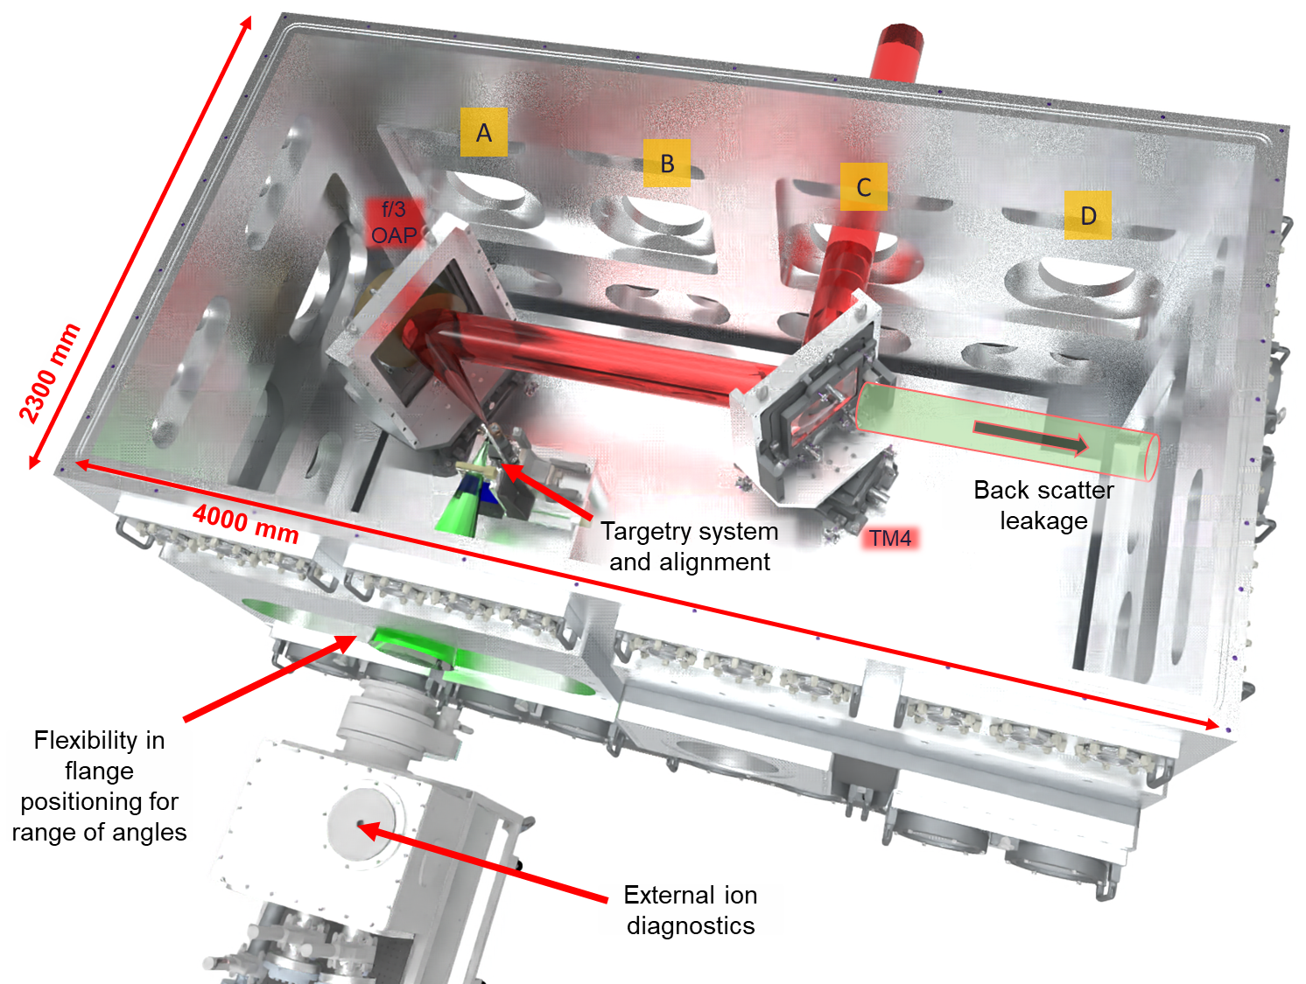
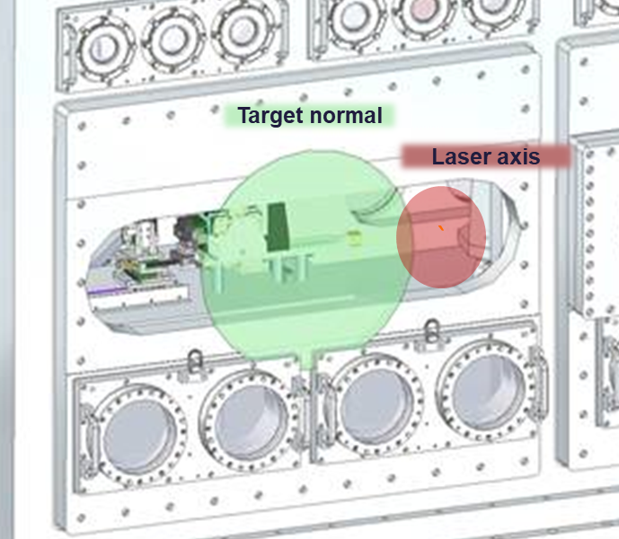
Interaction Chamber
Detailed design work due to start in early 2023
Further user consultations on layouts and chamber access
Standard f/3 geometry updated with new optical mounts, 30º interaction angle
Improved access flexibility for external diagnostics
Notes:
2 mins

Slide 8
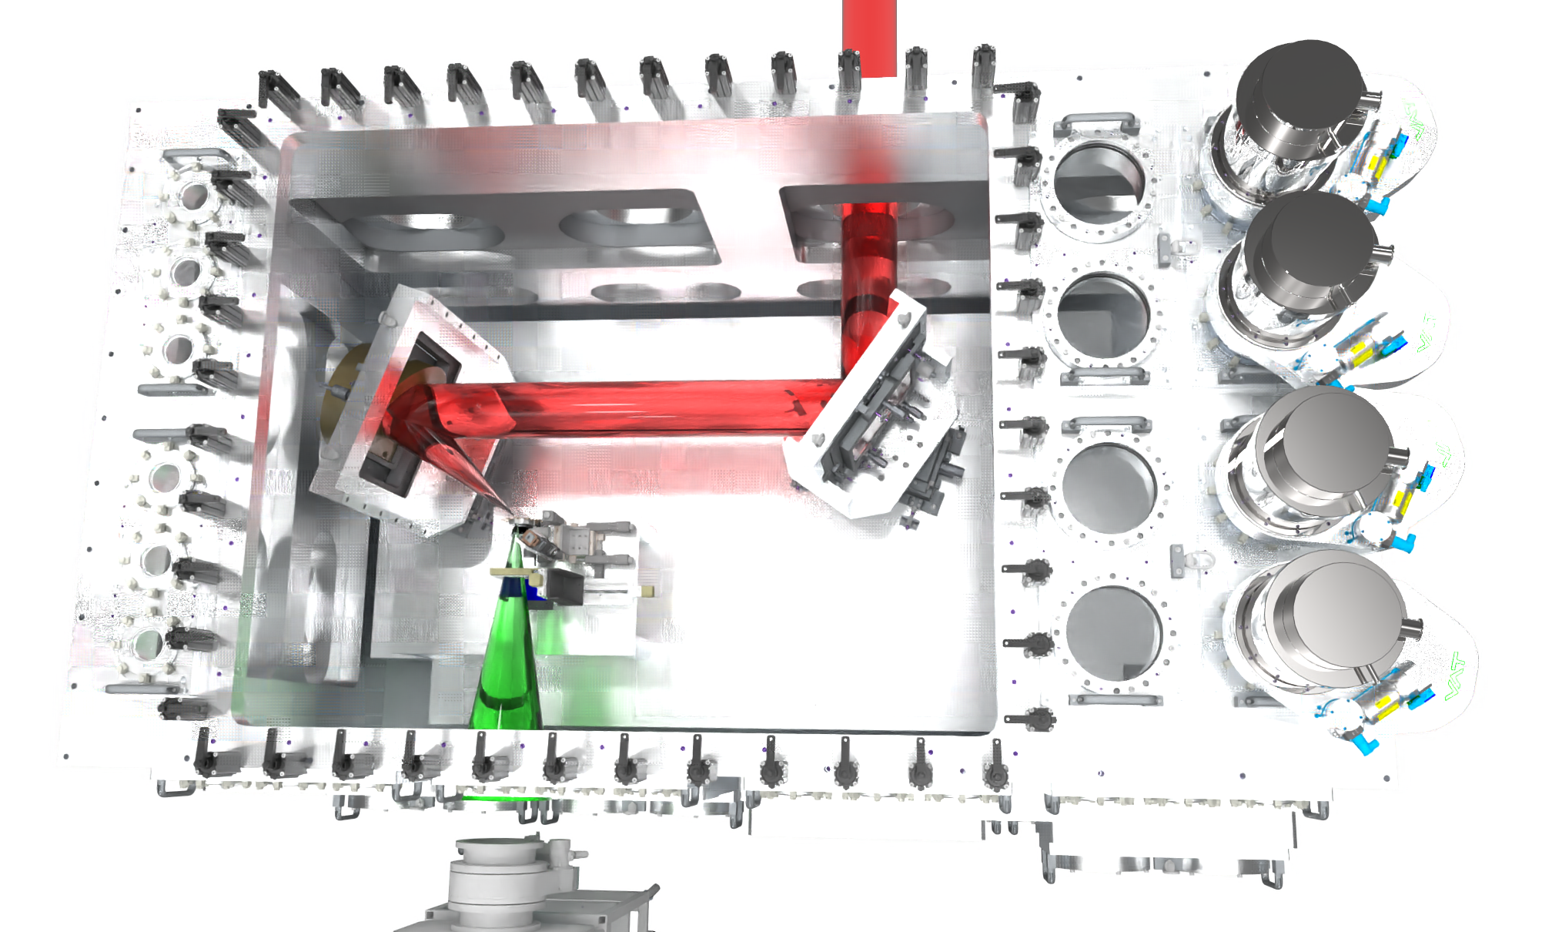
Interaction Chamber continued
Roof design updated to provide improved access to interaction area
Short focus f/3 parabola initial specification has been drafted
Operation at 20º confirmed following optical simulations
Damage testing on coatings in 2023 to determine final coating
Next step:
Integrating diagnostic and targetry system designs
Related design work on services and laser alignment diagnostics
Notes:
2m
(12:30)

Slide 9
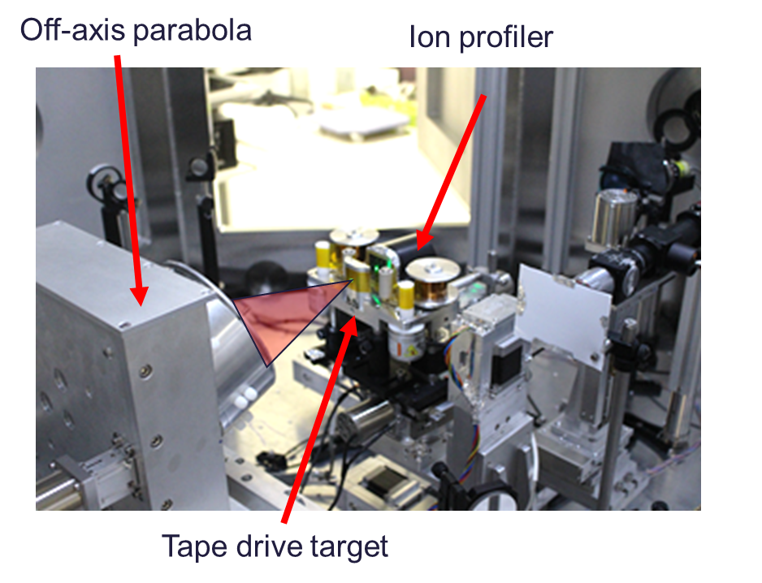
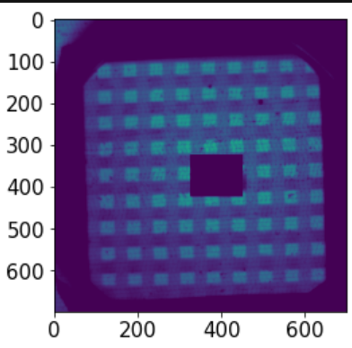
Ion diagnostics
Focus on spectral and spatial ion diagnostics required for initial experiments
Working closely with EPAC detector group to ensure consistent design approach
Main activities in 2022-2023:
Adapting and testing Thomson parabola design for active operations
Development of high resolution ion imager with additional spectral capability
Experimental testing on Gemini, Vulcan, SCAPA @ Strathclyde, ELI
Broad collaboration program with users / projects in the UK and international facilities
Proton beam profile with spectral and spatial data
Notes:
1m 30
(3 min)

Slide 10
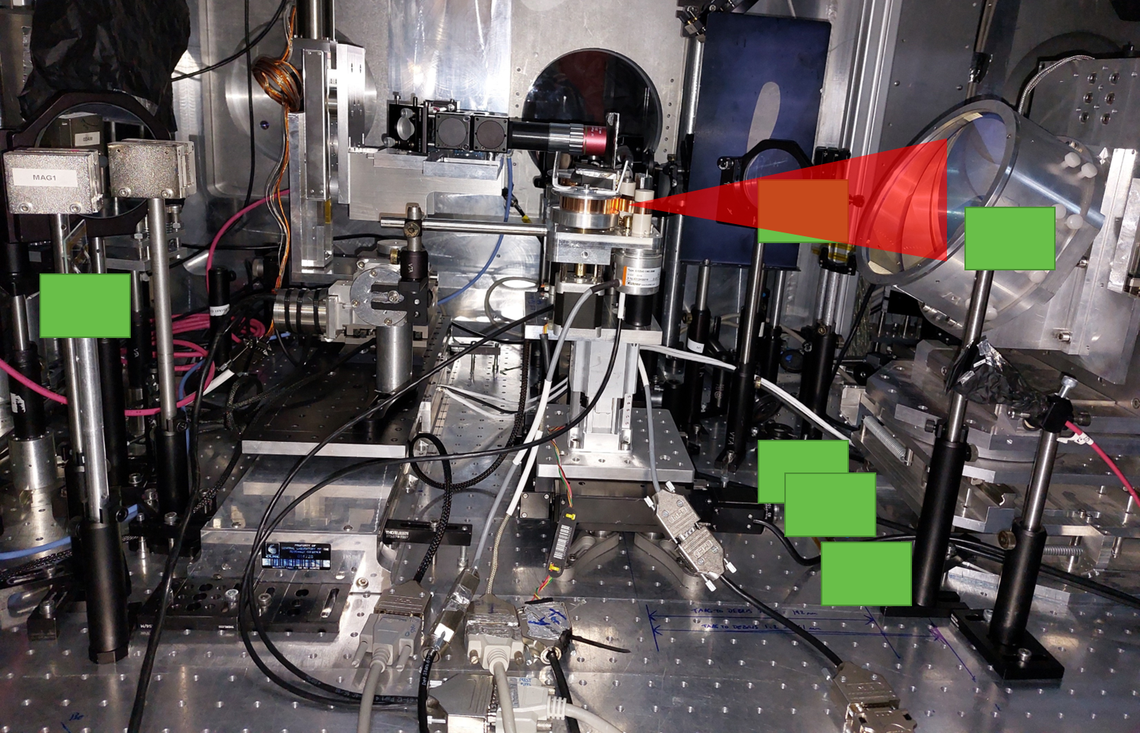
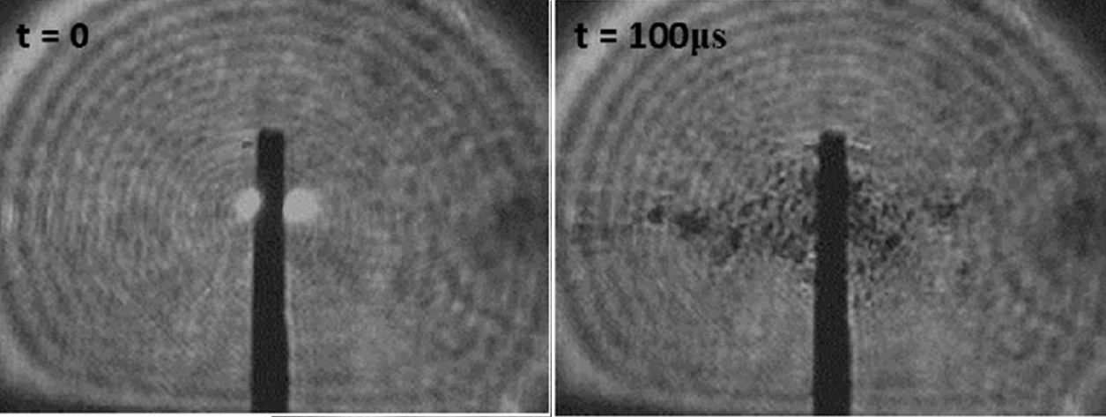
Debris characterisation and mitigation
Significant risk for large optics in EA2
Programme to characterise debris emission from range of solid targetry
Debris measurements on current and upcoming Gemini, SCAPA, EPIC experiments
Working with Target Fabrication to procure high speed camera for further in-situ studies
Looking at possible impact of damage on coatings to inform parabola coating choice
Currently testing large area, thin pellicles (General Atomics / LULI) for parabola protection
Notes:
1m 30
(3 min)

Slide 11
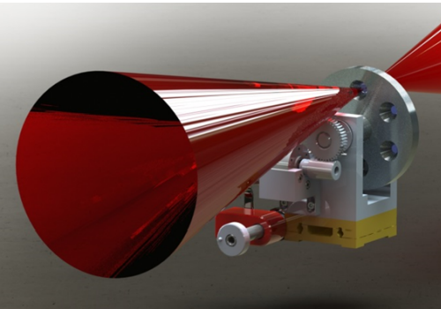
High contrast operations
Work continuing on exploring all options for high contrast operations
Now exploring possibility of using ultrathin SiN targets for low debris plasma mirrors
Re-applying for Lasernet US access to study effects of 2nd harmonic operations
Project being initiated with Ohio State University to develop Liquid Crystal targetry
Improving pointing stability
Improving reproducibility under shot conditions
Liquid crystal Solid substrate 2ω operation
The Spinning Disk Inserter (SDI) for liquid crystal films
Liquid crystal plasma mirrors (P.L. Poole et al. Sci. Rep. 2016)
Notes:
1m 30
(3 min)

Slide 12
Targetry update
Parallel development of several high repetition rate targetry systems
Tape drive
Solid target array
Liquid jet
Liquid crystal
Each system may be required to fulfil certain science or application requirements. May also be coupling of multiple systems e.g. pitcher / catcher for neutron production
Collaborations with a number of institutions critical to delivering sufficient capability in time for initial commissioning
Most systems should operate at up to 10 Hz
EPAC Targetry Working Group
EPAC Tape Targets WG
EPAC Liquid Targets WG
Notes:
1m 30
(3 min)

Slide 13
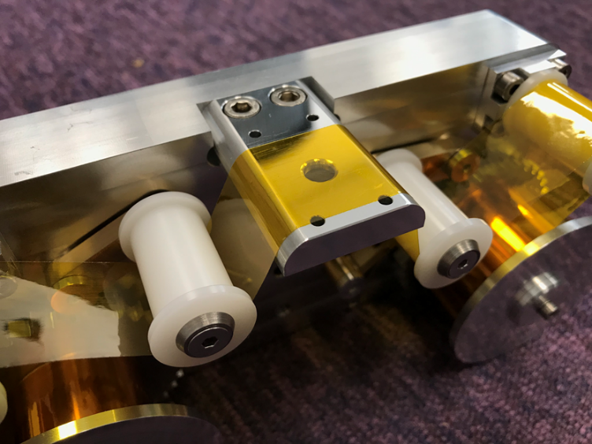
CLF Tape drive
Development continuing on CLF tape drive
Software and control upgrades to allow finer control of tape drive operation
Added rotary potentiometers to measure tension during operation to improve control
Full testing of system @ SCAPA – including over 1000 shots in < 1 week onto Kapton. Very good results for stable and tuneable ion acceleration
Duplicate system in TIFR (via EPIC collaboration) for debris measurement and mitigation.
Progress on integrated tape coating system via EPIC – have a potential supplier for evaluation
Further testing via IMPULSE (ELI), TIFR, SCAPA and Gemini due
CLF-developed ultra-stable tape target system
Notes:
1m 30
(3 min)

Slide 14
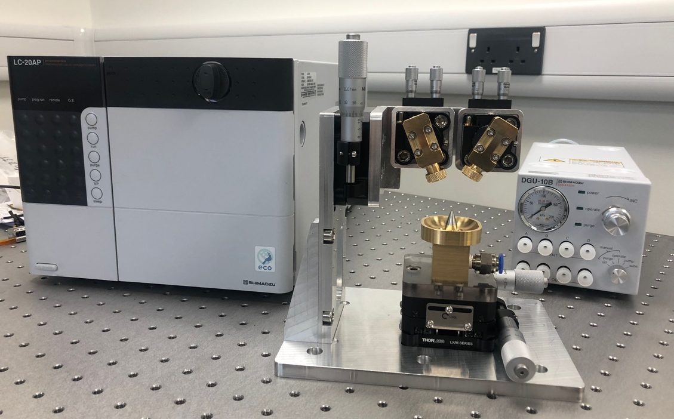
Liquid jet and Liquid crystal targetry
Liquid jet
New collaboration between SLAC, CLF and QUB following on from Gemini 2021
Have identified number of developments required to improve stability and reliability
CLF already purchased prototype colliding jet system for offline testing in Q4 2022 onwards
Working to establish collaboration via UKRI legal to formalise contributions
Liquid crystal
Primary application for high rep-rate plasma mirror
Meetings between OSU and CLF. Also BELLA on their testing
Working with UKRI legal on agreement to permit CLF testing and developments

Slide 15
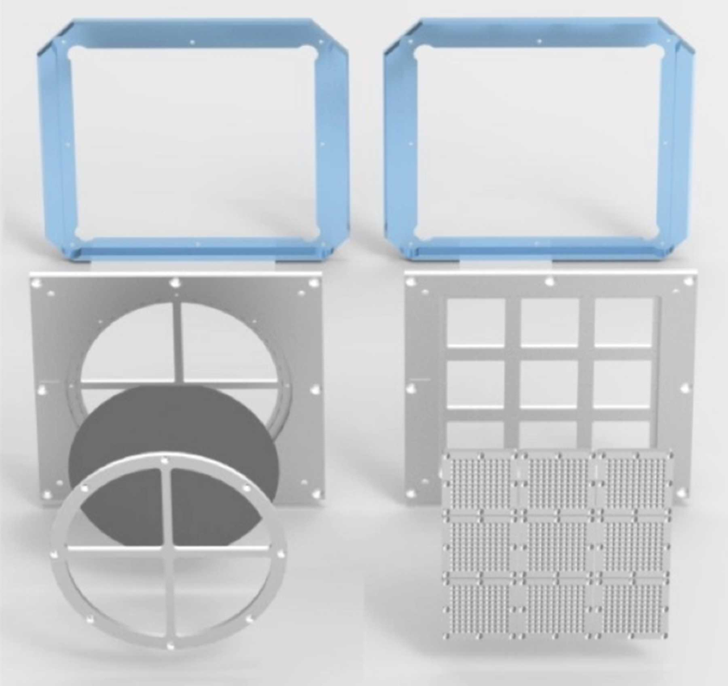
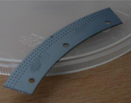
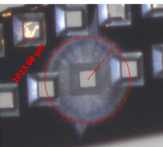
Solid targetry for EA2
Capture of requirements for solid targetry (excluding tape)
Critical for ultra-thin targets, more complex assemblies
Investigating limitations on rep-rate, damage resistance, alignment
Looking at array-based system as well as High Accuracy Microtarget Supply (HAMS)
Parallel research into supporting technology of rapid manufacture and assembly
Deep Reactive Ion Etcher (DRIE)
Robotic pick and place system
EUCALL standard frame design
HAMS targetry testing @ CLF
Notes:
1m 30
(3 min)

Slide 16
EA2 – Summary
Design work for Adaptive Optic chamber nearing completion
Aiming to tender in early 2023 for delivery in 2024
Large optics mounts signed-off, Adaptive Optic ordered
Interaction chamber design updated following internal and external consultations
Detailed design work to start in early 2023, ready for tender later in the year
Associated design work continues on diagnostics, alignment systems, services and targetry
R&D programmes progressing in collaboration with internal and external groups
Ion diagnostics characterisation in preparation for initial commissioning
Studies of debris generation for range of targets and damage mitigation methods
Multiple targetry R&D programmes progressing to address range of scientific and application requirements

Slide 17
Thank you
Extreme Photonics Applications Centre (EPAC)
Notes:
The abstract pattern can be removed or repositioned if required. Be careful to ‘Send to Back’ so that it does not obscure any important information.

