Slide 1



EPAC
Experimental Area 1
Daniel Symes
Central Laser Facility
Rutherford Appleton Laboratory
30 November 2022
Notes:
The abstract pattern can be removed or repositioned if required. Be careful to ‘Send to Back’ so that it does not obscure any important information.

Slide 2
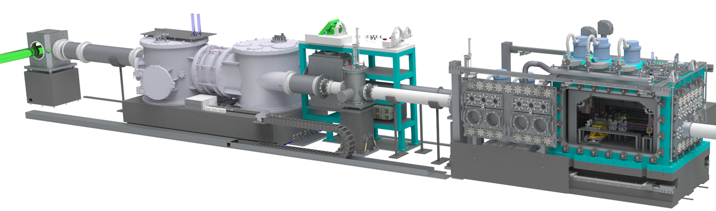
Experimental Area 1 houses a PW-driven laser wakefield electron accelerator
Interaction chamber
Turning chamber
Beam focusing
Timeline:
2023 – Delivery and installation of large equipment
2024 – Commissioning with internal lasers
Q1 2025 – Pulsed beam commissioning and first experiments
Q3 2025 – Operational
Notes:
Replace this guidance text with your own bullet pointed content.
For further guidance please see https://www.bdadyslexia.org.uk/advice/employers/creating-a-dyslexia-friendly-workplace/dyslexia-friendly-style-guide

Slide 3
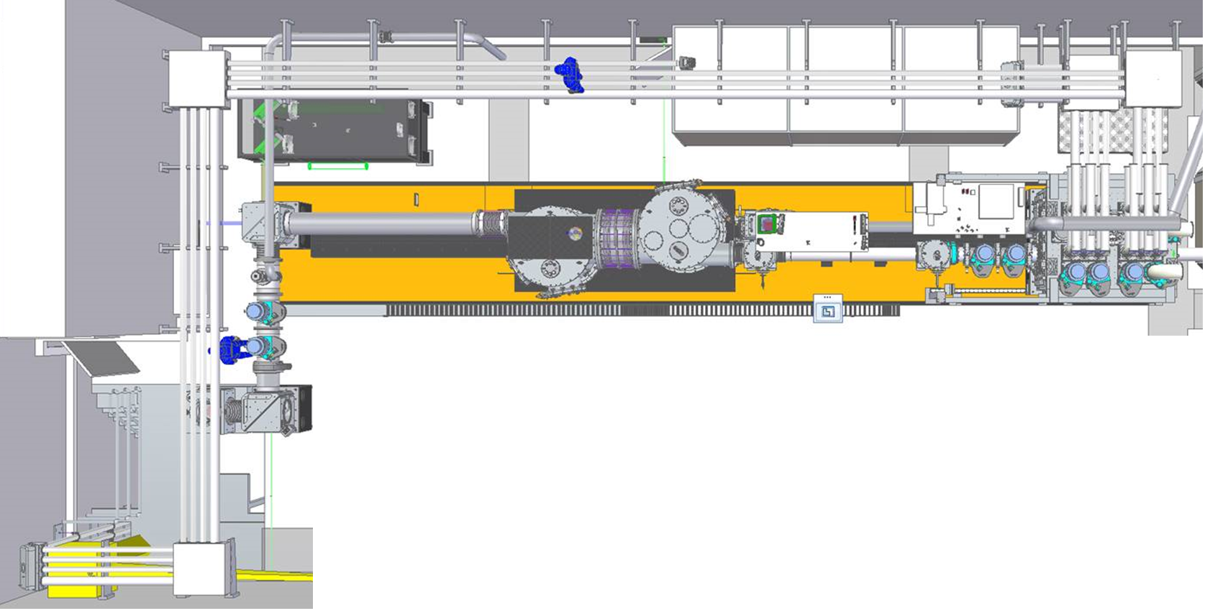
EA1 Beam alignment and stability
On target alignment
Two pneumatic references into target chamber
Wavefront corrected on exit-mode diagnostic
In-chamber camera to characterise focus
Input beam monitoring
Downsize beam with wedge and spherical mirror
Record NF, FF, wavefront, energy
Co-linear blue CW for active stabilisation – aim for < 5 μrad
Stabilisation of beam defocus
Notes:
Replace this guidance text with your own bullet pointed content.
For further guidance please see https://www.bdadyslexia.org.uk/advice/employers/creating-a-dyslexia-friendly-workplace/dyslexia-friendly-style-guide

Slide 4
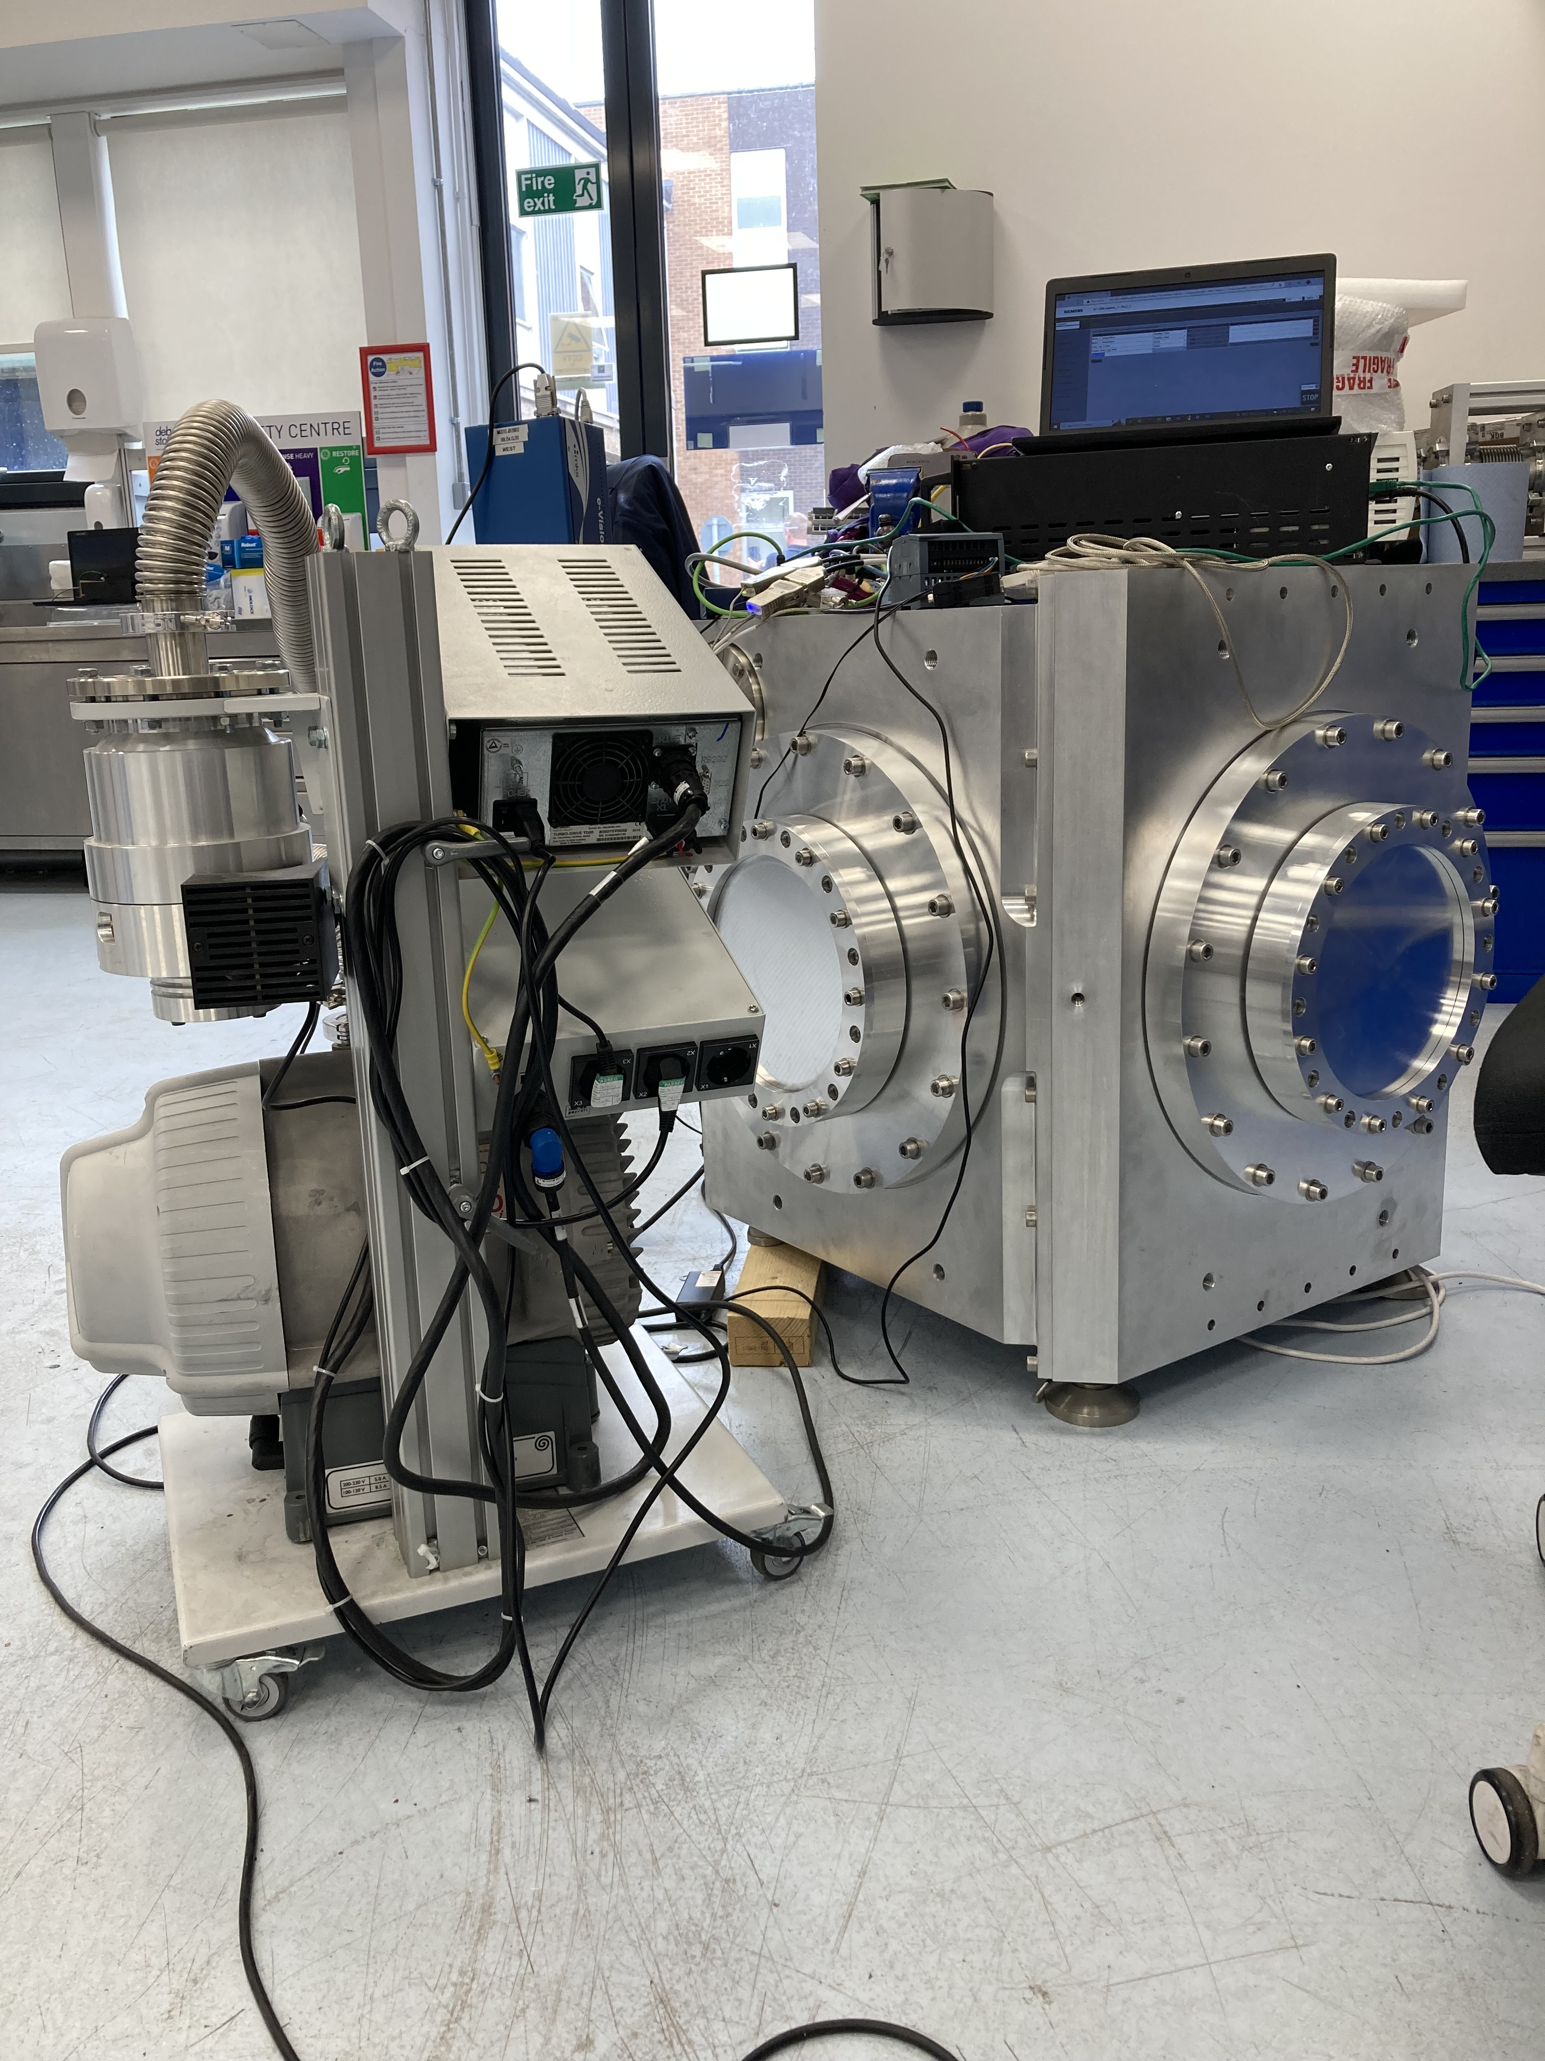
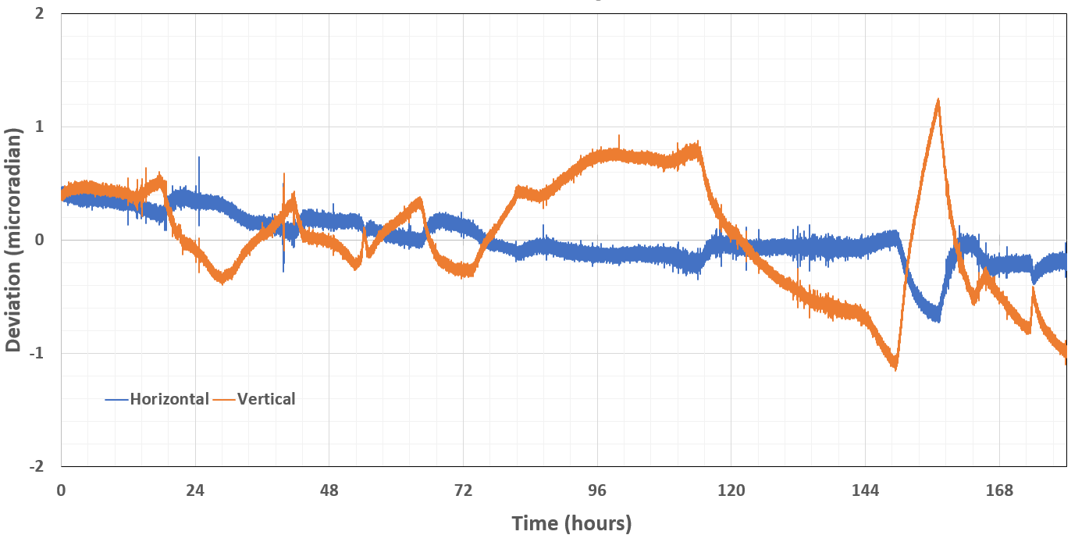
EA1 – Beam turning chambers
FAM (UK) delivered March 21
Tested mount drifts and closed loop operation
EPIC (India) delivered Aug 22
Preliminary test results are good
Mount under vacuum
Pumps off, motors off
Drift within ±1 µrad
Notes:
Replace this guidance text with your own bullet pointed content.
For further guidance please see https://www.bdadyslexia.org.uk/advice/employers/creating-a-dyslexia-friendly-workplace/dyslexia-friendly-style-guide

Slide 5
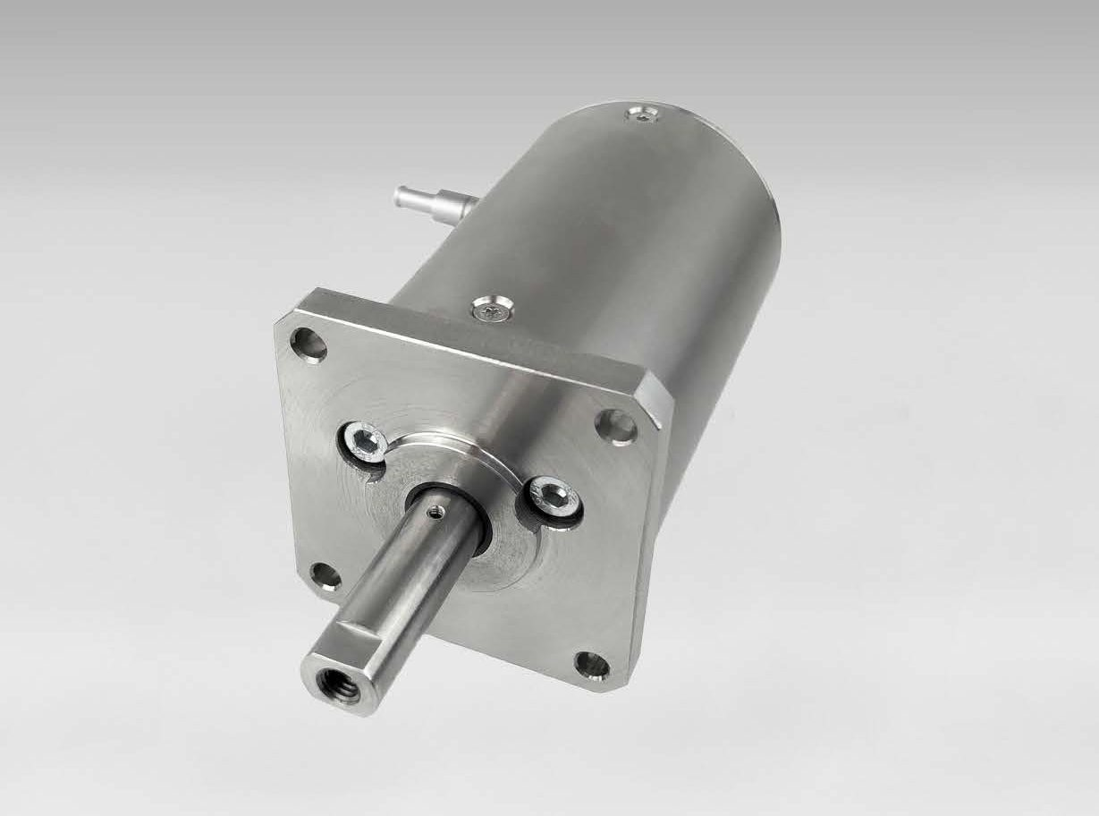
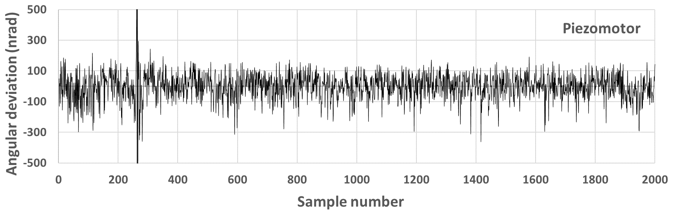
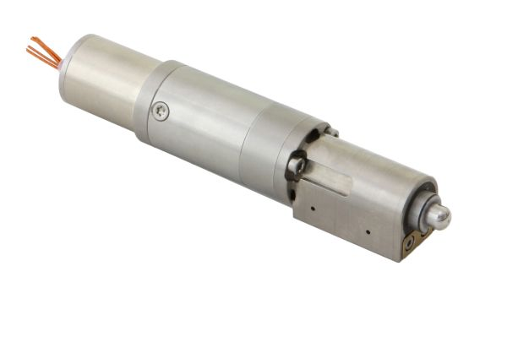
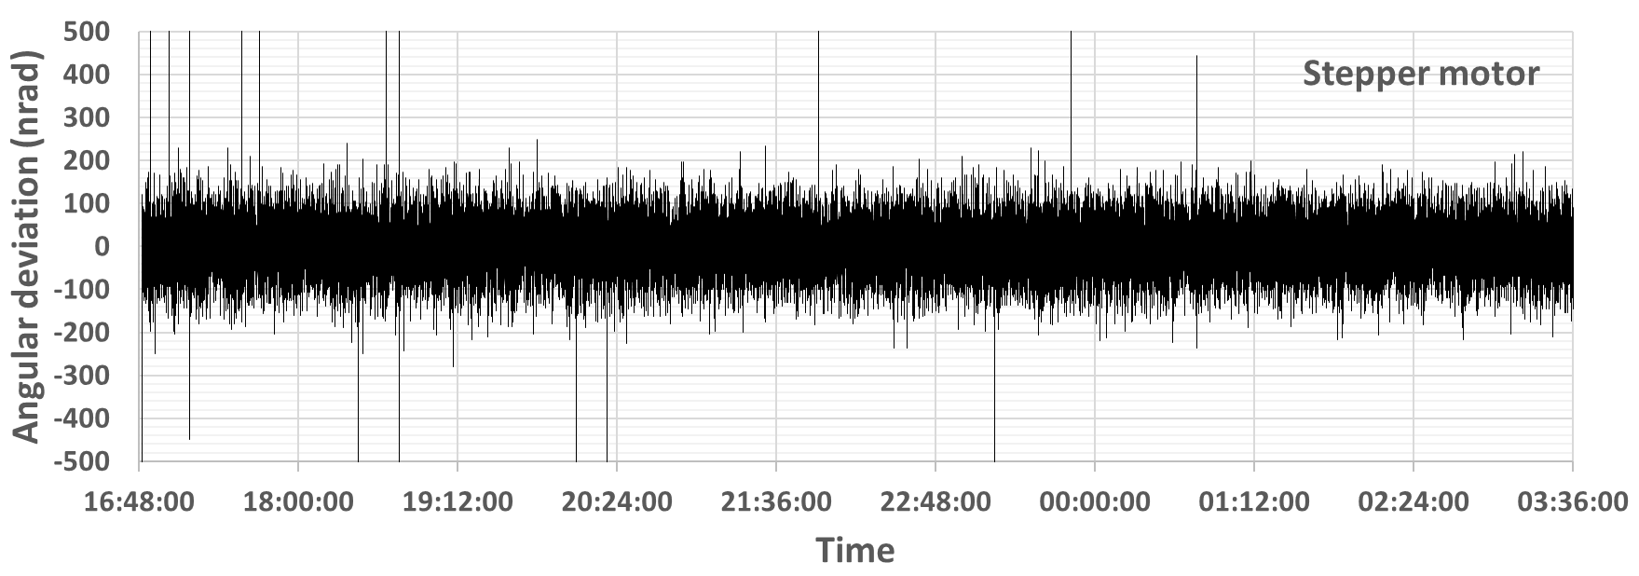
EA1 – Beam turning chambers
a)
In closed loop, mount is stabilised at 100 nrad rms
Piezomotor LTC300
~1 nm resolution
b)
STANDA 8MAV
~50 nm resolution
Lower cost stepper
Notes:
Replace this guidance text with your own bullet pointed content.
For further guidance please see https://www.bdadyslexia.org.uk/advice/employers/creating-a-dyslexia-friendly-workplace/dyslexia-friendly-style-guide

Slide 6
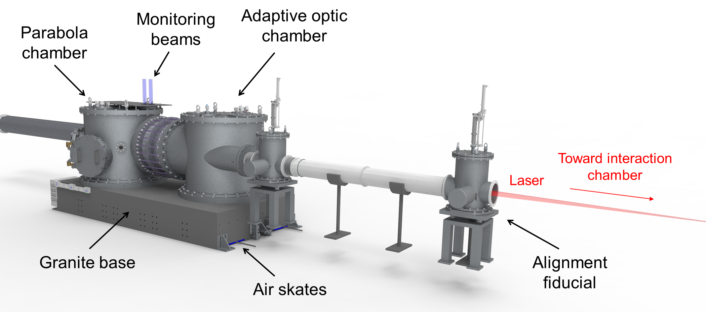
EA1 – Focusing chamber
Supplied by Aeon Engineering Ltd.
Manufacture starting now (subcontracted to Hivac Engineering)
Delivery delayed to June 2023
Mounts delivered (FMB Oxford)
Granite block on order (Oelze GmbH)
Notes:
Replace this guidance text with your own bullet pointed content.
For further guidance please see https://www.bdadyslexia.org.uk/advice/employers/creating-a-dyslexia-friendly-workplace/dyslexia-friendly-style-guide

Slide 7
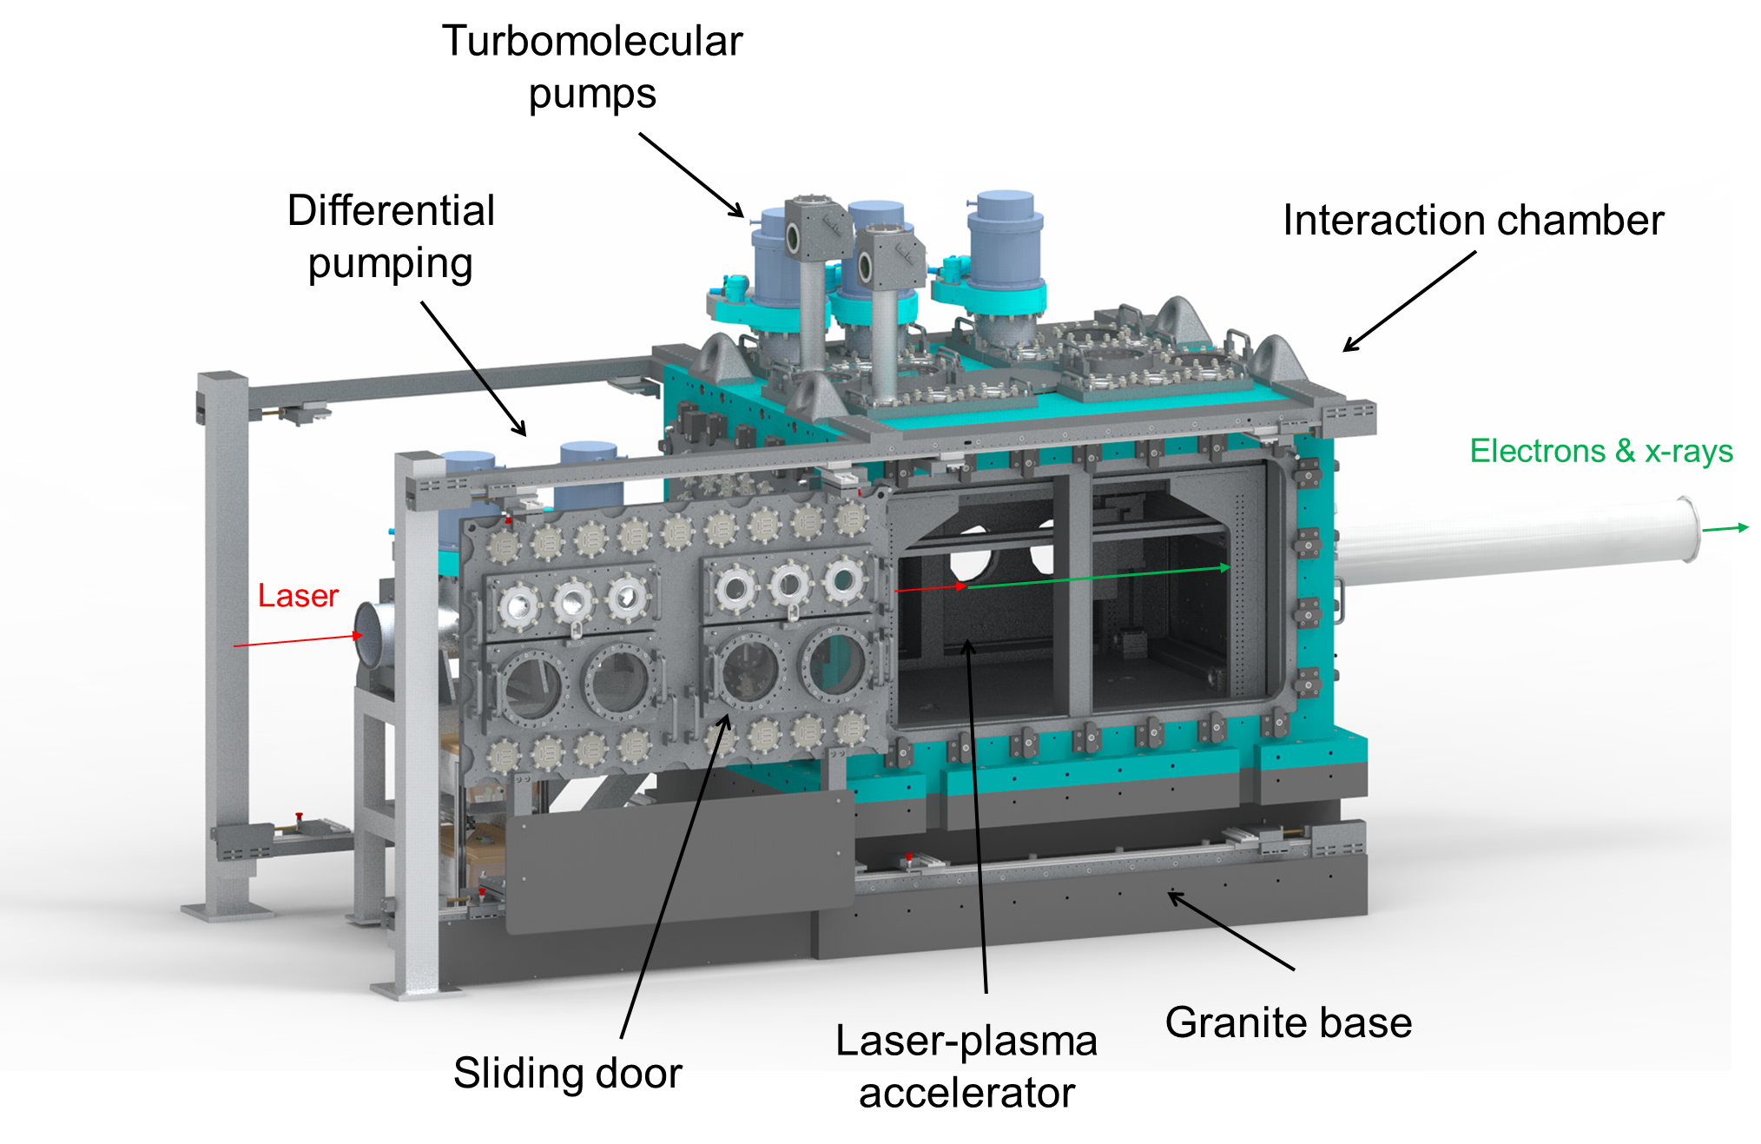
EA1 – Interaction chamber
Supplied by Alca Technology
Kick-off meeting held Oct 2022
Some turbo, roughing, and differential pumping kit on order
Jan 2023: design sign off
Sept 2023: delivery
Notes:
Replace this guidance text with your own bullet pointed content.
For further guidance please see https://www.bdadyslexia.org.uk/advice/employers/creating-a-dyslexia-friendly-workplace/dyslexia-friendly-style-guide

Slide 8
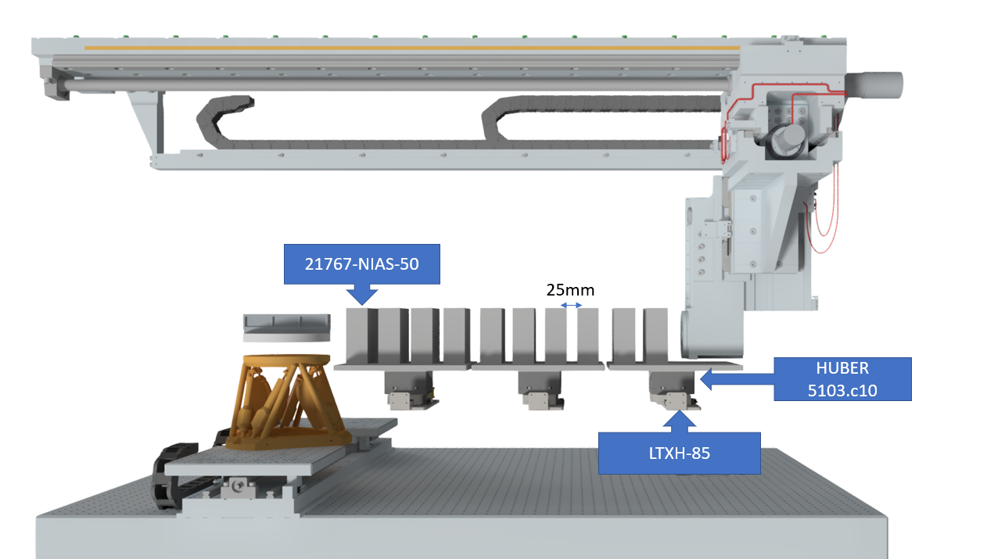
Interaction chamber houses LWFA, diagnostics, and quadrupole magnets
CLF-designed translation stages
Beam and target camera
200 mm gas target
LASER
ELECTRONS
Newport hexapod
HXP100V6
Quadrupole focusing system
Notes:
Replace this guidance text with your own bullet pointed content.
For further guidance please see https://www.bdadyslexia.org.uk/advice/employers/creating-a-dyslexia-friendly-workplace/dyslexia-friendly-style-guide

Slide 9
EPAC Gas Target Working Group
Purpose
Define phase one objectives – decide which targets to focus on
Establish existing knowledge on target design and manufacture
Bring in science expertise as we see fit (eg CALA, DESY etc)
Look at commercial options
Design
CLF mechanical designers and technicians
SCD fluid modelling
Manufacture
STFC in-house and university groups
Precision engineering / 3D printing: commercial and HVM Catapult
Characterisation
Neutral gas density – 4-pass CW interferometry (Gemini TA1)
Electron density – second-harmonic interferometry, wavefront sensor (Gemini TA2; Oxford)
Notes:
Replace this guidance text with your own bullet pointed content.
For further guidance please see https://www.bdadyslexia.org.uk/advice/employers/creating-a-dyslexia-friendly-workplace/dyslexia-friendly-style-guide

Slide 10
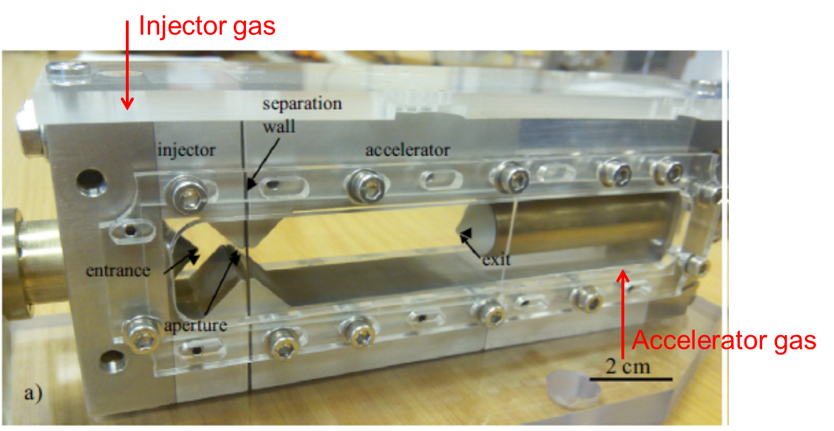
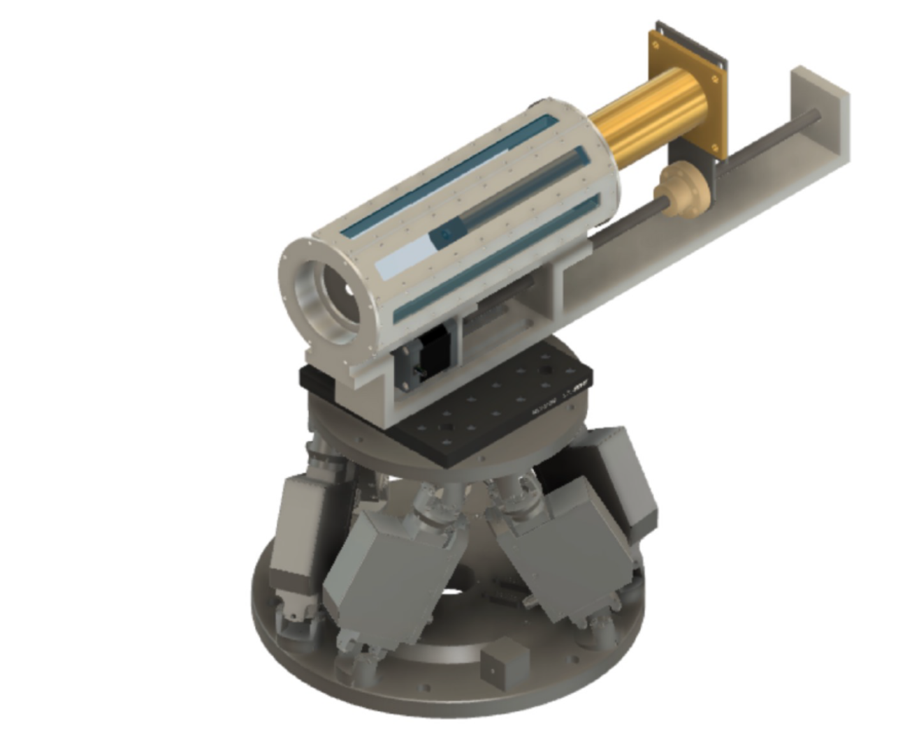
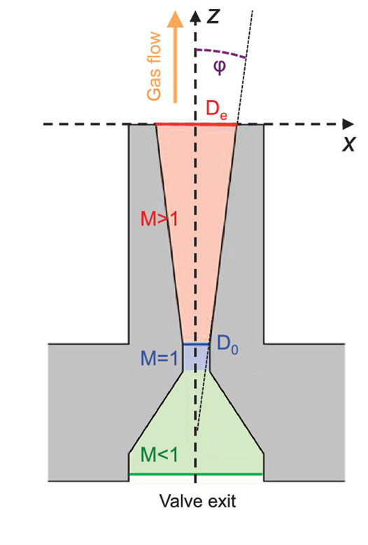
Target development needed for EA1
Gas cell
Multi-compartment continuous-flow gas cell (e.g. O. Kononenko et al NIMA 829, 125, (2016))
Guided cell
HOFI cell: i.e. EPAC-ready version of Oxford cells (A. Picksley thesis (2021))
Gas jet
200 mm slit nozzle (similar to Maryland design – B. Miao et al PRX 12, 031038 (2022))
Notes:
Replace this guidance text with your own bullet pointed content.
For further guidance please see https://www.bdadyslexia.org.uk/advice/employers/creating-a-dyslexia-friendly-workplace/dyslexia-friendly-style-guide

Slide 11
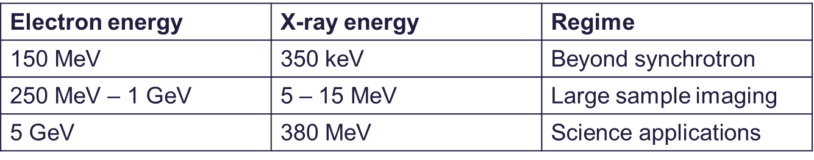
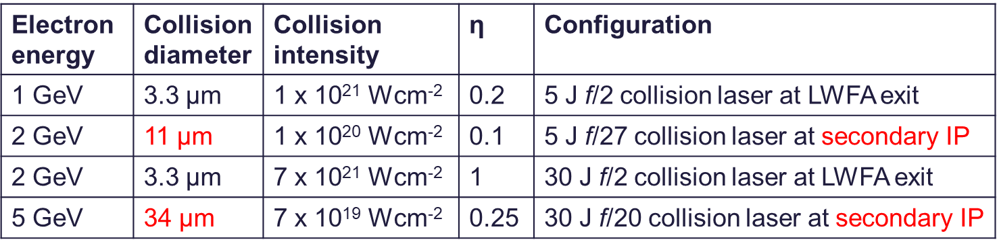
Electron beam focusing requirements
Focusing options
Permanent magnet quadrupoles
Electromagnet quadrupoles
Active plasma lenses
Focusing configurations
Diagnostics – spectrometer resolution
Sample irradiation – electronic disruption
Laser-electron collisions – ICS & QED
FEL
ICS photon source with ~10 µm source size
For QED need highest electron energy and highest intensity possible. Interested in quantum parameter η = E_{RF} / E_{S} > 0.1
FEL uses ~100 µm focus in the undulators
Wang 2021 (SIOM)
500 MeV
Quad doublet 250 Tm⁻¹ + EM + EM doublet
Notes:
Replace this guidance text with your own bullet pointed content.
For further guidance please see https://www.bdadyslexia.org.uk/advice/employers/creating-a-dyslexia-friendly-workplace/dyslexia-friendly-style-guide

Slide 12
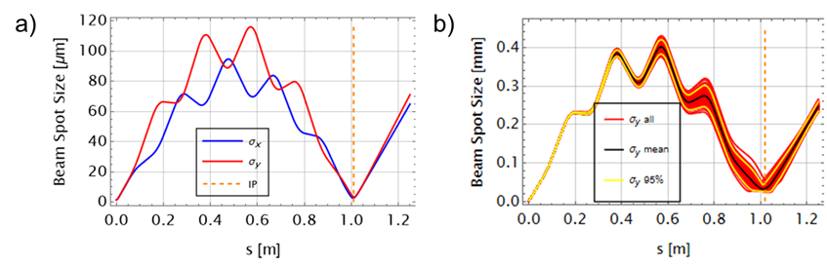
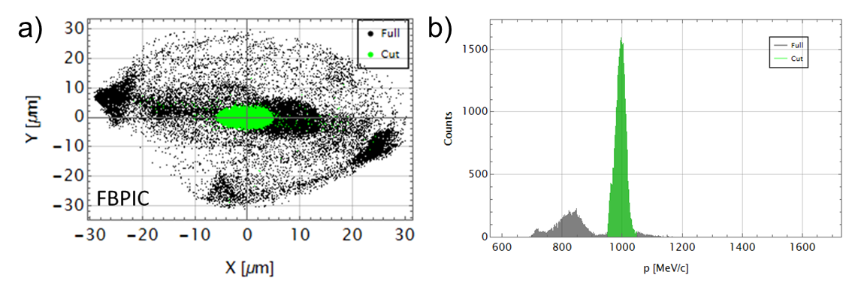
Quadrupole capture and focusing for
1 GeV electron beam
Simulations with FBPIC and Elegant
Set of 10 PMQs focus 1 GeV electrons 1 m from the source
Modelling with a Gaussian beam is not representative
LWFA target energy is contained in a core on the axis – low energy electrons form a halo
Can focus to a spot size ~20 µm
Notes:
Replace this guidance text with your own bullet pointed content.
For further guidance please see https://www.bdadyslexia.org.uk/advice/employers/creating-a-dyslexia-friendly-workplace/dyslexia-friendly-style-guide

Slide 13
Concerns about quality of commercial Halbach quadrupoles
Commercial 500 T/m Halbach quadrupole from Kyma S.p.A. used at SPARC_LAB
Notes:
Replace this guidance text with your own bullet pointed content.
For further guidance please see https://www.bdadyslexia.org.uk/advice/employers/creating-a-dyslexia-friendly-workplace/dyslexia-friendly-style-guide

Slide 14
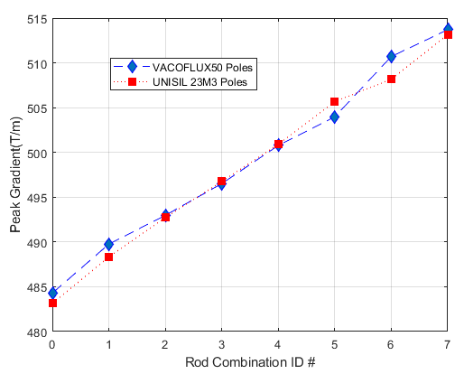
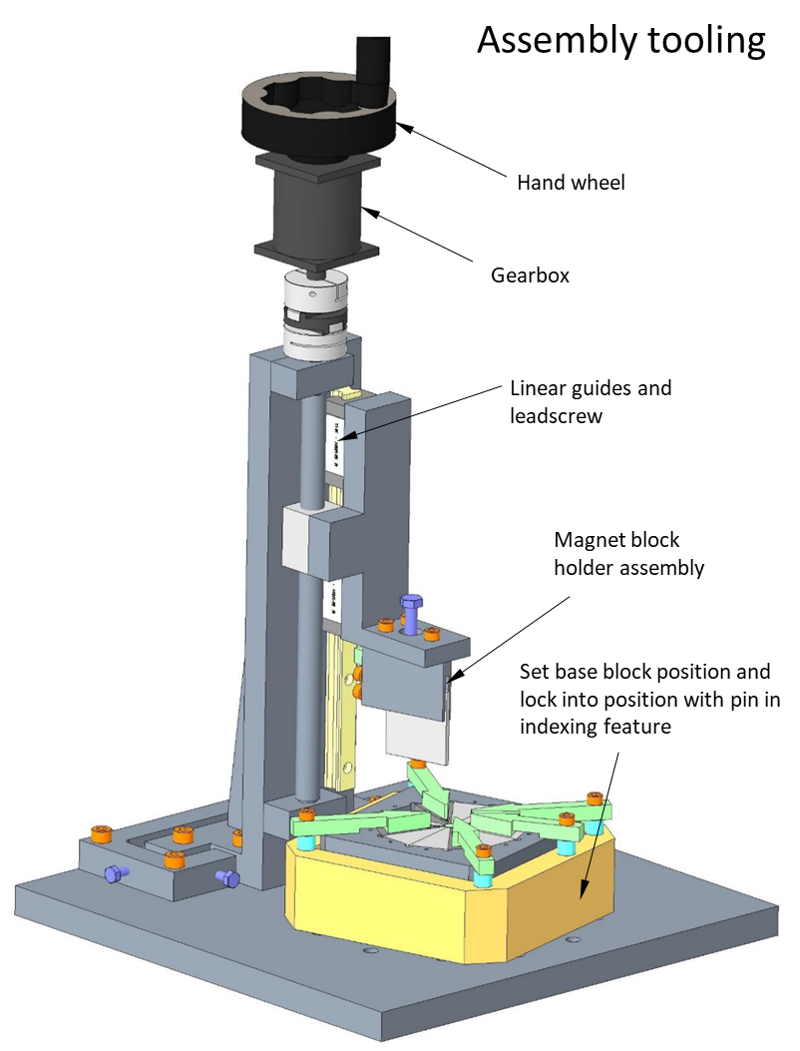
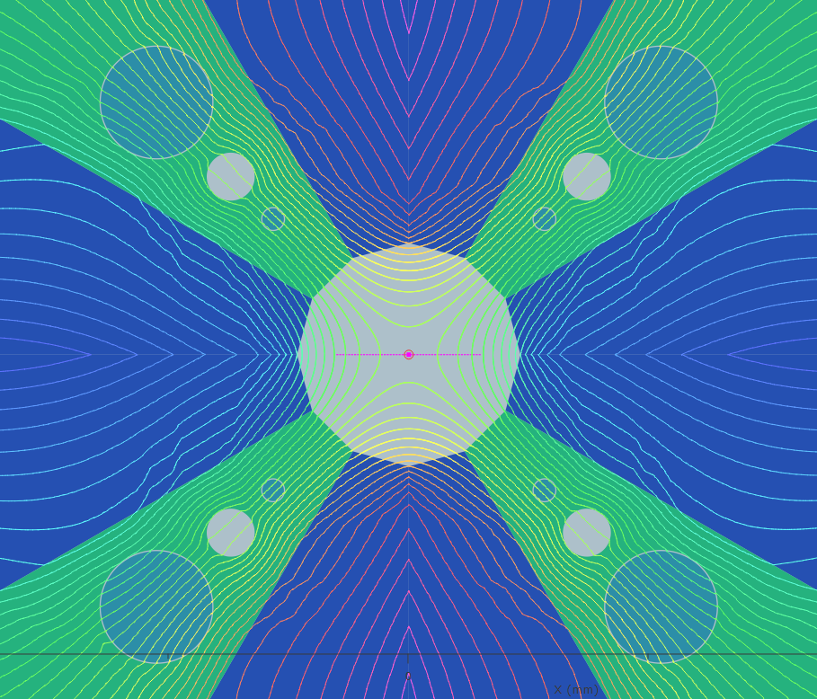
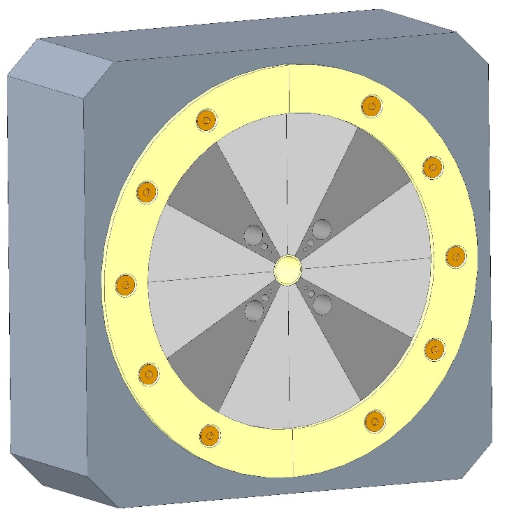
ASTeC propose to buy commercial magnet sections and build array in-house
Notes:
Replace this guidance text with your own bullet pointed content.
For further guidance please see https://www.bdadyslexia.org.uk/advice/employers/creating-a-dyslexia-friendly-workplace/dyslexia-friendly-style-guide

Slide 15
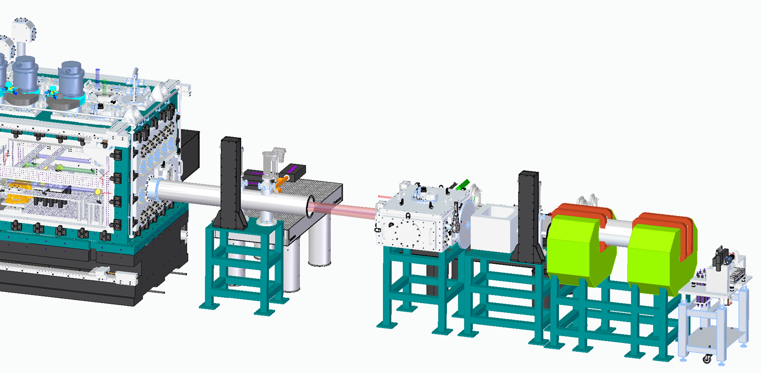
Electron beam diagnostics
Scintillator screens
Exit-mode imaging
ICT
Electron spectrometer
X-ray camera
Interaction chamber
Notes:
Replace this guidance text with your own bullet pointed content.
For further guidance please see https://www.bdadyslexia.org.uk/advice/employers/creating-a-dyslexia-friendly-workplace/dyslexia-friendly-style-guide

Slide 16
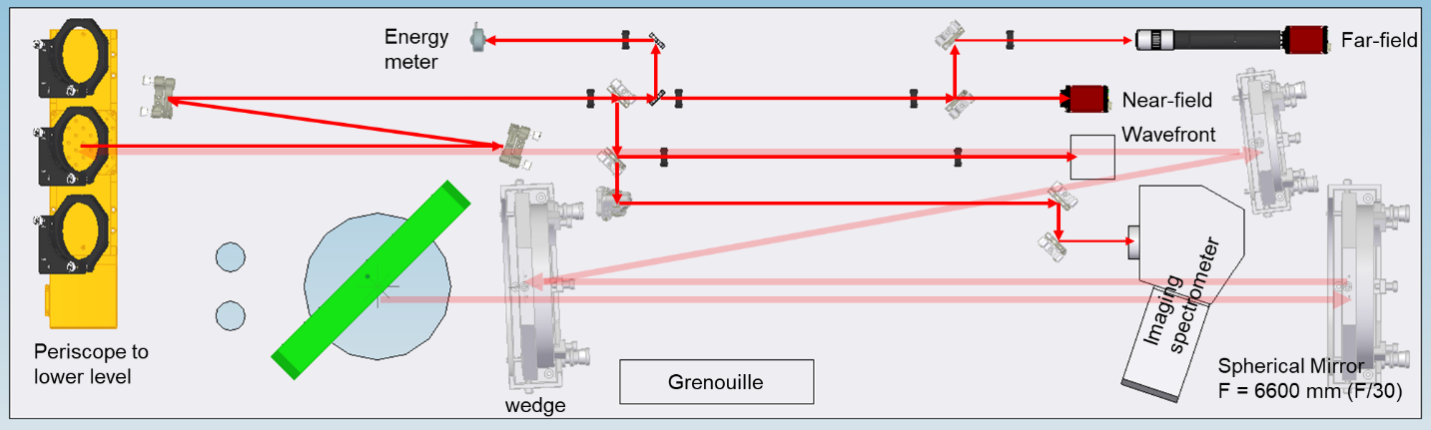
Exit mode characterization
Start with standard exit mode using direct beamline
Procurement has started for large optics and mounts, spectrometer, Grenouille, and cameras
Later the beam can be folded with plasma mirrors to remove obstructions from the applications beamline
Folded configuration uses the same vacuum chamber and optical set up
Notes:
Replace this guidance text with your own bullet pointed content.
For further guidance please see https://www.bdadyslexia.org.uk/advice/employers/creating-a-dyslexia-friendly-workplace/dyslexia-friendly-style-guide

Slide 17
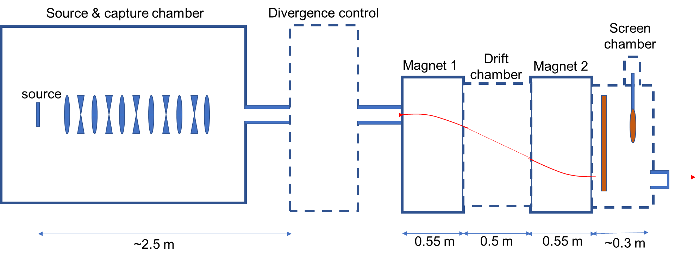
Electron spectrometer
To achieve 1% resolution at 5 GeV, divergence needs to be controlled – could use electromagnets, or a collimator
Drift length and pole height determine bandwidth and resolution – decisions will affect cost, size, weight
Detection with large area Lanex with extra YAG at the target energy
Can add energy-selection to narrow electron spectrum
Notes:
Replace this guidance text with your own bullet pointed content.
For further guidance please see https://www.bdadyslexia.org.uk/advice/employers/creating-a-dyslexia-friendly-workplace/dyslexia-friendly-style-guide

Slide 18
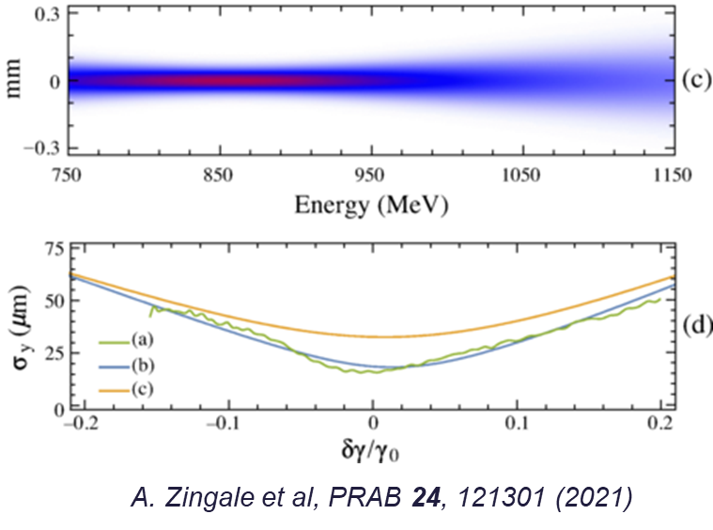
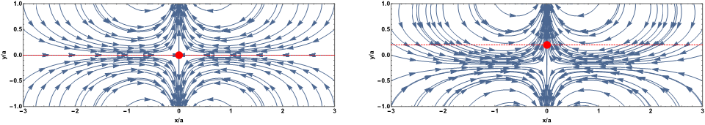
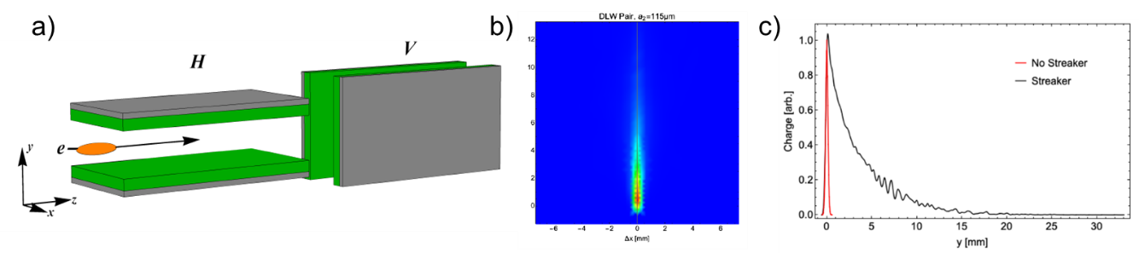
Electron emittance and bunch length
Bow-tie emittance measurement
Transverse wakefield force lines in a planar dielectric structure
Focusing + spectrum also gives “bow-tie” measurement of emittance – method used at LBNL, MPQ, DESY
Developing ASTeC dielectric wakefield streaker to directly measure duration of 10 fs bunches
Notes:
Replace this guidance text with your own bullet pointed content.
For further guidance please see https://www.bdadyslexia.org.uk/advice/employers/creating-a-dyslexia-friendly-workplace/dyslexia-friendly-style-guide

Slide 19
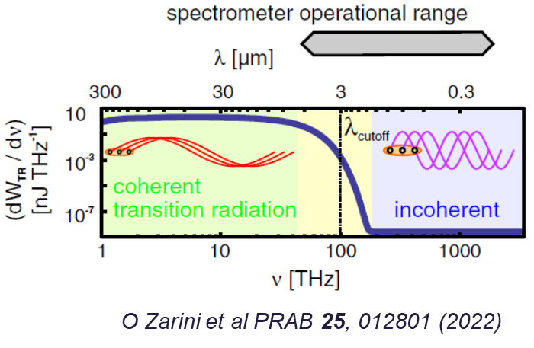
Transition radiation
HZDR transition radiation measurement
Transition radiation needs to be measured in a wide spectral range (250 nm – 12 µm)
Two examples in the literature (MPQ & HZDR)
Long wavelength limited by sensitivity of mercury cadmium telluride (MCT)
Assessing designs and costs of components (MIR detector is ~100k)
Notes:
Replace this guidance text with your own bullet pointed content.
For further guidance please see https://www.bdadyslexia.org.uk/advice/employers/creating-a-dyslexia-friendly-workplace/dyslexia-friendly-style-guide

Slide 20



Thank you
Extreme Photonics Applications Centre (EPAC)
Notes:
The abstract pattern can be removed or repositioned if required. Be careful to ‘Send to Back’ so that it does not obscure any important information.

