Slide 1
EPAC ISTAC
Project Update
Tom Butcher
EPAC Project Manager
Notes:
The abstract pattern can be removed or repositioned if required. Be careful to ‘Send to Back’ so that it does not obscure any important information.

Slide 2
Project Overview
A Project consisting of two key interlinked work streams with the aim of:
Designing and constructing a building with suitable radiological shielding and backbone building infrastructure that supports the installation, integration and operation of the specialist laser and target area equipment and services that are necessary to realise the requirements of the EPAC facility and future anticipated upgrades.
Designing, installing and commissioning specialist engineering infrastructure, electrical control and interlocks, lasers, target area equipment, detectors, data capture and computational tomography systems suitable to support the functionality of the EPAC Facility.
Complete!
Notes:
Replace this guidance text with your own bullet pointed content.
For further guidance please see https://www.bdadyslexia.org.uk/advice/employers/creating-a-dyslexia-friendly-workplace/dyslexia-friendly-style-guide

Slide 3
Project Plan
Process:
Updated monthly by planning and estimating manager
Tiered approach used, top level Gantt flowing through to lower level WP level plans and Installation plan
Summary:
Project end date retained at Nov 2024 in this period
Key contracts have been placed – Compressor vessels and ns OPCPA pump laser
Building is complete
Installation phase has begun
Design and procurement of installed equipment is ongoing
Notes:
Replace this guidance text with your own bullet pointed content.
For further guidance please see https://www.bdadyslexia.org.uk/advice/employers/creating-a-dyslexia-friendly-workplace/dyslexia-friendly-style-guide

Slide 4
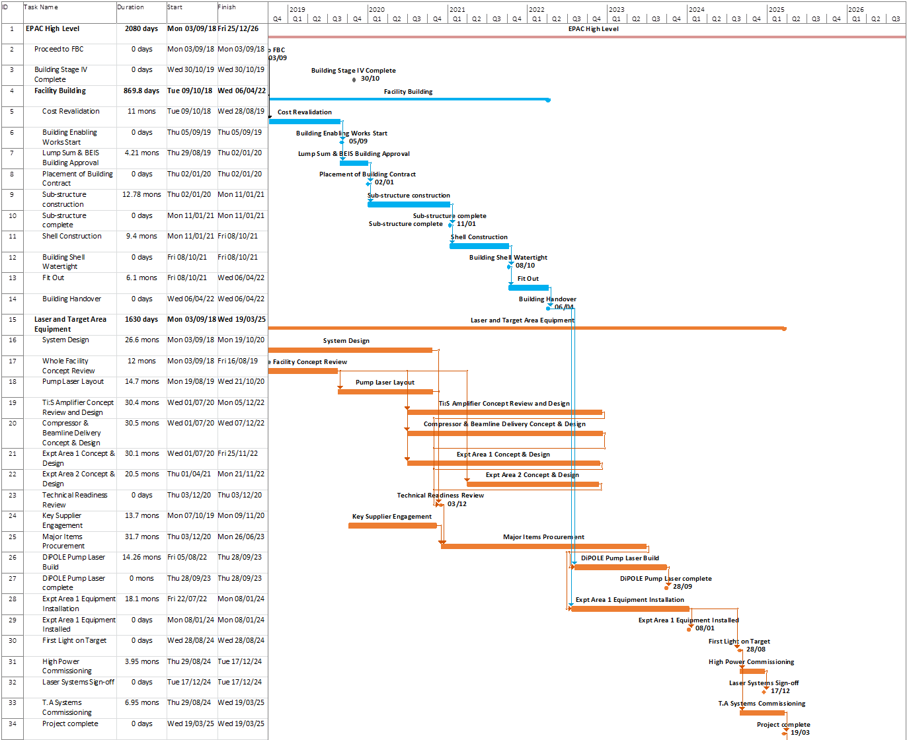
Project Plan

Slide 5
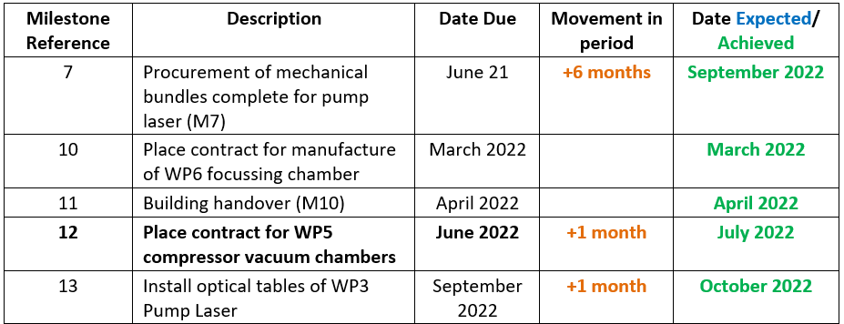
Milestones
Progress:
Milestone 7 was delayed due to complications at Supplier’s factory
Milestones 10, 11, 12 and 13 have been completed
Notes:
Replace this guidance text with your own bullet pointed content.
For further guidance please see https://www.bdadyslexia.org.uk/advice/employers/creating-a-dyslexia-friendly-workplace/dyslexia-friendly-style-guide

Slide 6
Milestones
Progress:
Milestones 14 has slipped by 3 months at present. This due to the decision to prototype aspects of the design, challenges with engineering resource and prioritising other key areas. It is at risk of further slippage
Milestones 15, 16 and 17 have been reconfirmed
Notes:
Replace this guidance text with your own bullet pointed content.
For further guidance please see https://www.bdadyslexia.org.uk/advice/employers/creating-a-dyslexia-friendly-workplace/dyslexia-friendly-style-guide

Slide 7
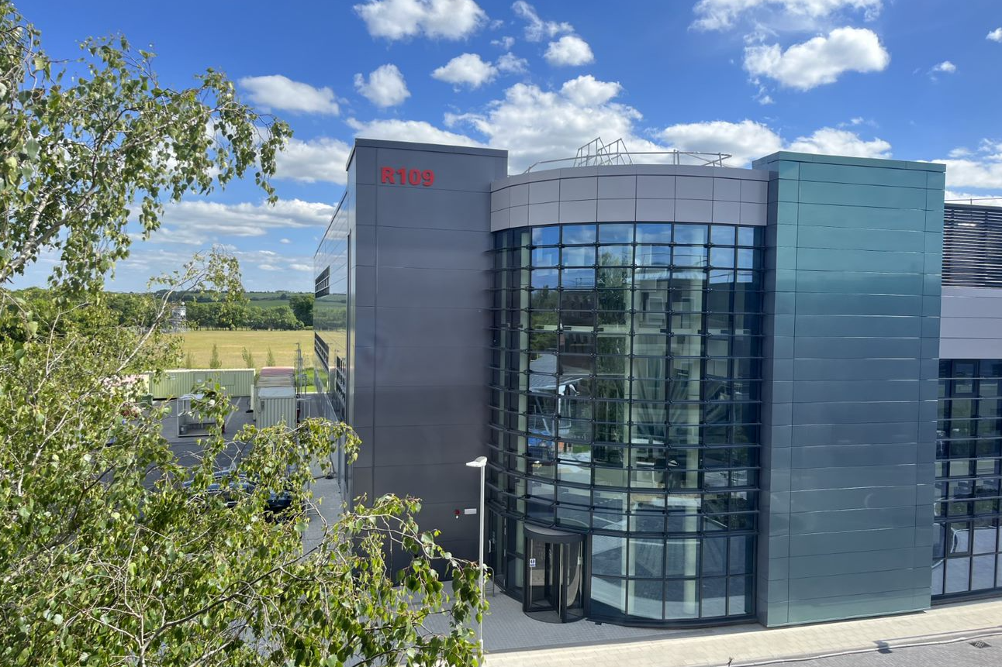
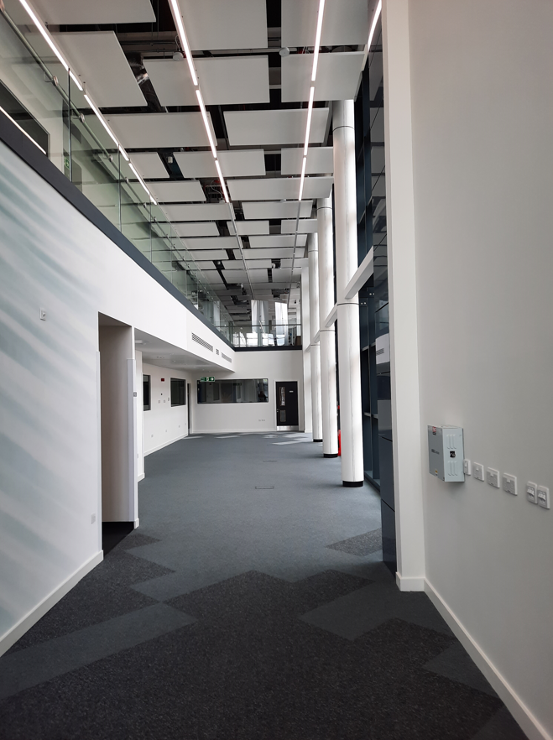
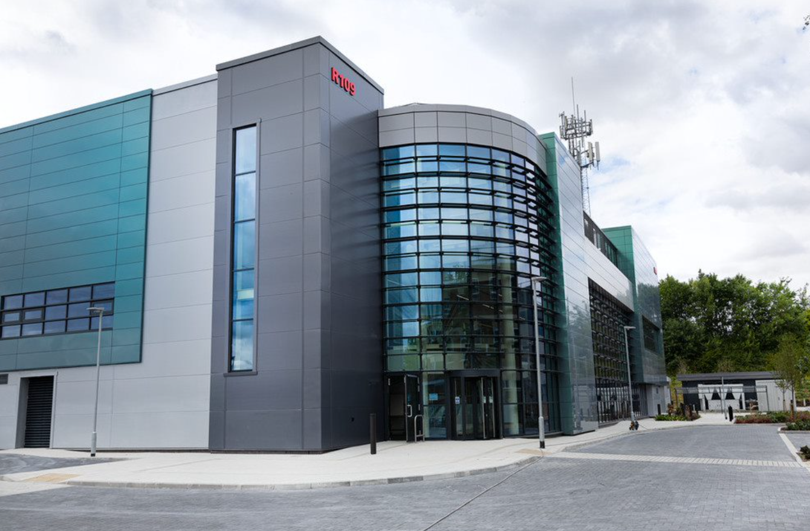
EPAC Building
EPAC Building is complete. Handover was on 9th March and final contract completion on 16th May, both on schedule.
Our thanks to Mace, Lexica, STFC Estates and the CLF team that made it possible.

Slide 8
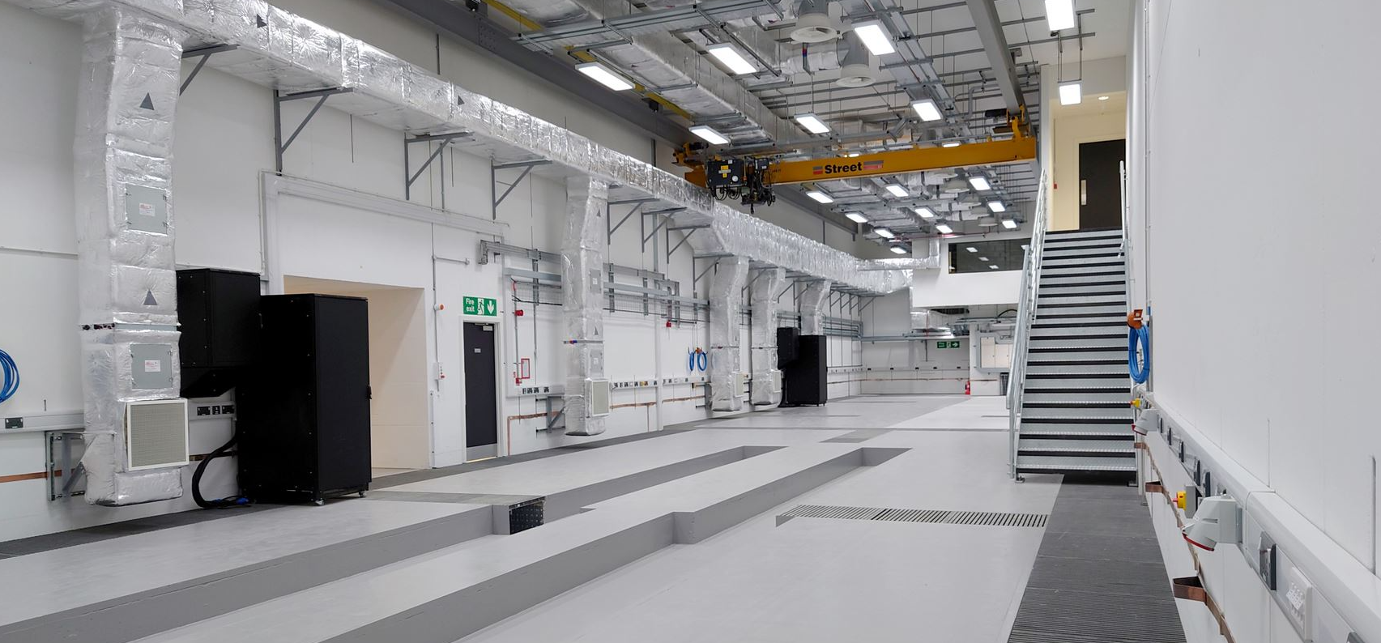
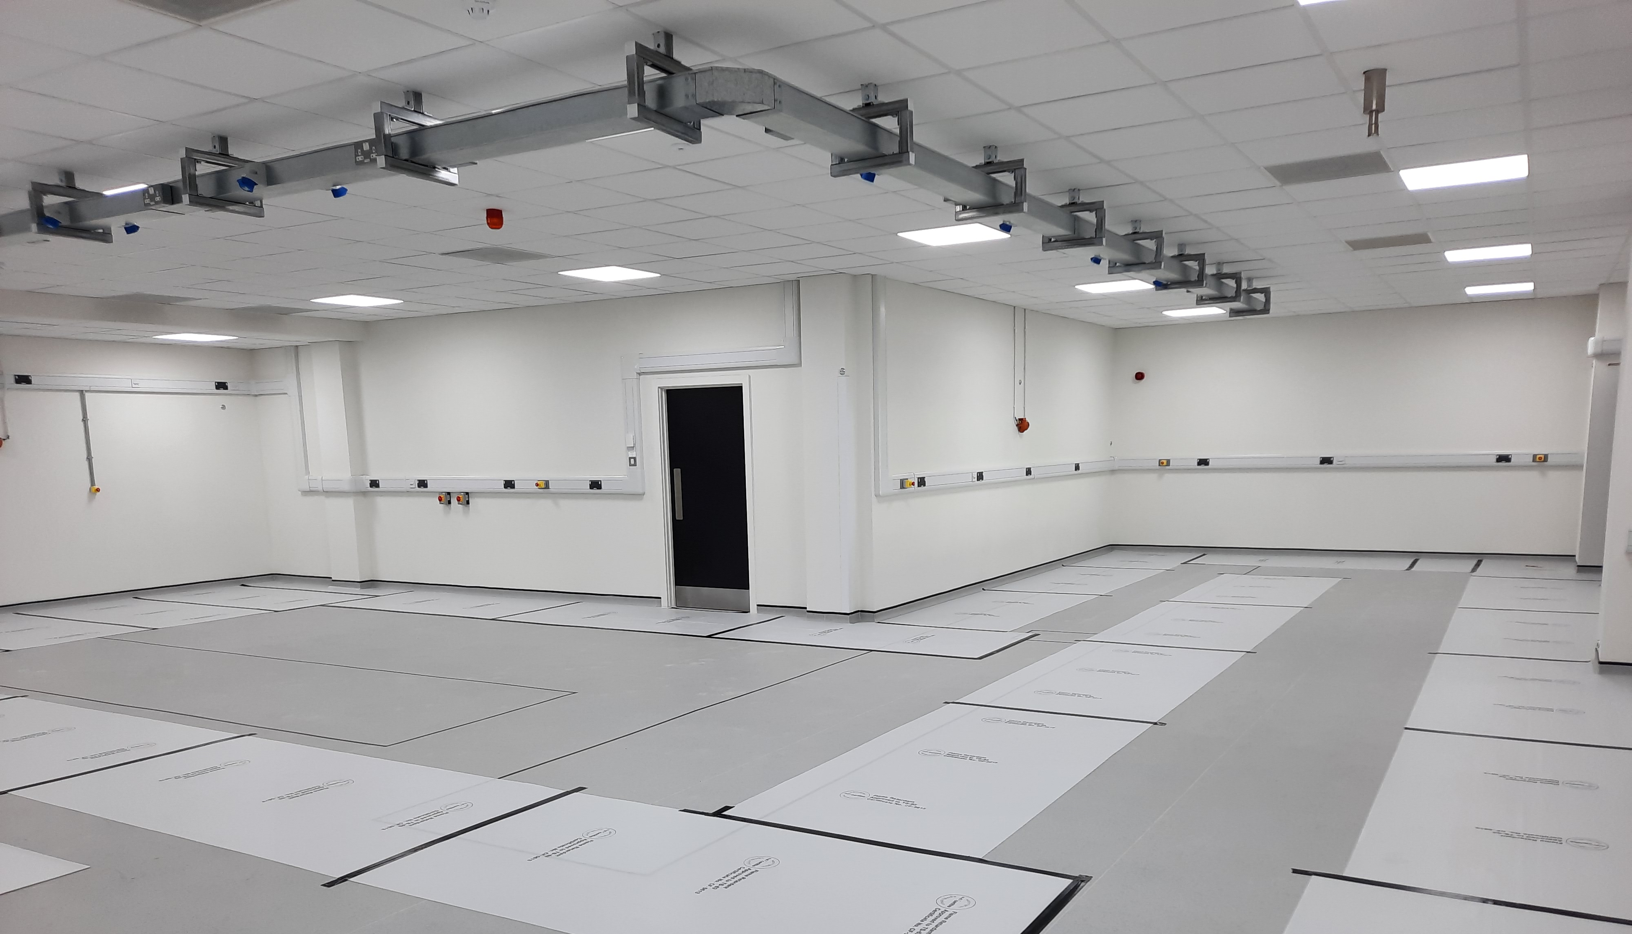
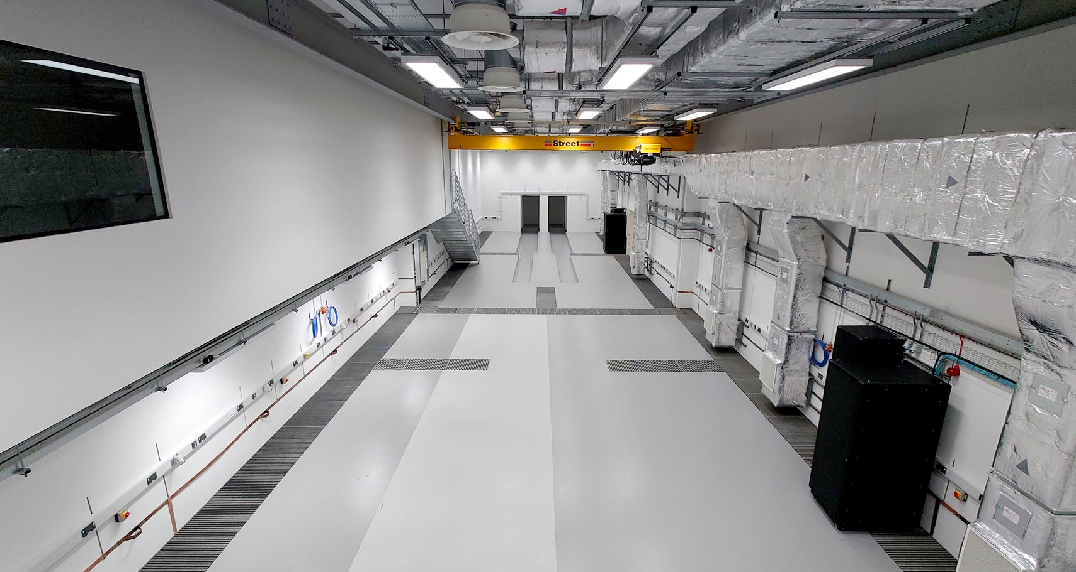
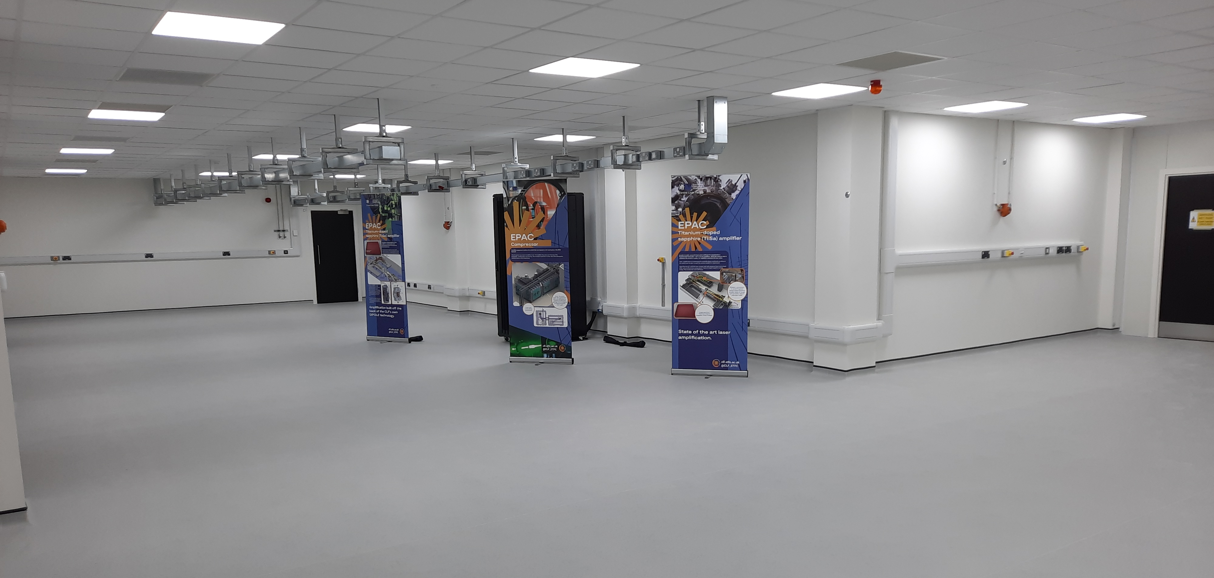
EPAC Building
Experimental Area 1
EPAC Pump Laser Room
Experimental Area 1
Main TiS Amplifier Room

Slide 9
Project Risks
Risk register review and update:
A risk review was held on 6th July 2022, following which the register was updated and remodelled
Next review is planned for January 2023 ahead of next Project Board
Key risks:
Actual cost of hardware exceeds estimates; RED (increased)
Inability to recruit relevant engineers, at the appropriate level; RED
Suppliers of critical components do not deliver to time, cost or quality; RED (increased)
Inability to recruit in a timely fashion and retain scientific staff; AMBER (increased)
Thermal loading at high repetition rate within the compressor; inability to compress the beam; AMBER
Laser material, TiS or other component in laser chain; damage resistance insufficient to support high rep-rate and high power operations; AMBER
Suppliers do not bid for a tender that has been issued; AMBER (increased)
Notes:
Replace this guidance text with your own bullet pointed content.
For further guidance please see https://www.bdadyslexia.org.uk/advice/employers/creating-a-dyslexia-friendly-workplace/dyslexia-friendly-style-guide

Slide 10
Challenges in the Market
Inflation at ~10%, but in the technical fields price increases of 300% have been seen.
Current contract summary (>50k):
35 large contracts signed with 4 more expected within the month
15 contracts already complete
Estimate of a further ~40 remaining to be let
Key contracts to be let:
Main amplifier compressor gratings (~£300k) – in design
General vacuum equipment bundle (~£800k) – in design
Experimental Area 2 Target Chamber (~£600k) – in concept design
Probe beam laser amplifier (~£500k) – tender in preparation
Notes:
Replace this guidance text with your own bullet pointed content.
For further guidance please see https://www.bdadyslexia.org.uk/advice/employers/creating-a-dyslexia-friendly-workplace/dyslexia-friendly-style-guide

Slide 11
Challenges in the Market
Engineering
Pressure equipment seeing major delays to delivery – 12 month lead time on some items
Compressor vessel (contract now signed) – 30% increase on previous quotes
EA1 Focusing chamber – Expected contract breach due to inability to complete work – loss of key technical leadership. Alternative supply required.
Some manufacturers refusing to provide final price or lead time without a PO
Optics
Fused silica (majority of optics) show 35% increase in price and triple the lead time
Recent tender return for 10 specialist lenses originally quoted at £6k last year
Winning bid – £12k per lens
Two other bids (US companies) at £16k and £19k each
Notes:
Replace this guidance text with your own bullet pointed content.
For further guidance please see https://www.bdadyslexia.org.uk/advice/employers/creating-a-dyslexia-friendly-workplace/dyslexia-friendly-style-guide

Slide 12
Challenges in the Market
Sub-systems
Range of laser systems, cooling systems, triggering units, movable stages etc.
HJ Pump diodes – expected 14 month delay
ns OPCPA pump laser – 50% price increase
What are we doing?
Sign-off design and move to procurement as quickly as possible – break down design reviews to speed up process
Order optical substrates (blanks) where possible
Order equipment that is known now to fix price and start manufacture
Majority of spend should be committed within the next 6-12 months, depending on resource
Notes:
Replace this guidance text with your own bullet pointed content.
For further guidance please see https://www.bdadyslexia.org.uk/advice/employers/creating-a-dyslexia-friendly-workplace/dyslexia-friendly-style-guide

Slide 13
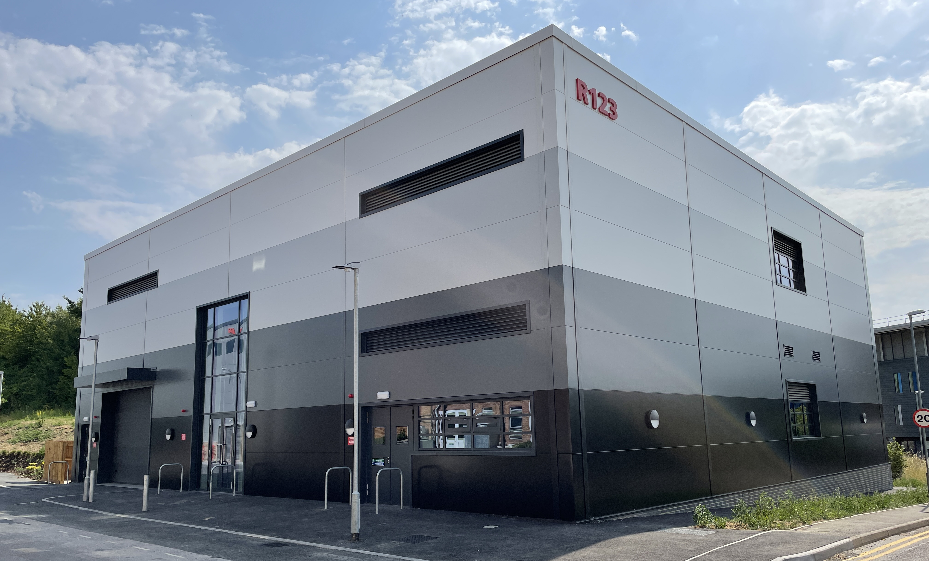
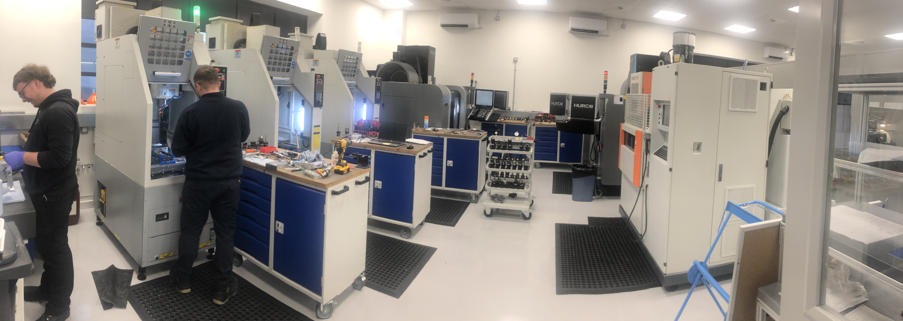
CLF Engineering and Technology Centre (ETC)
Building completion and hand over achieved on schedule on 16th May 2022
Ground floor equipment installation complete, first floor fit-out in progress
Notes:
Replace this guidance text with your own bullet pointed content.
For further guidance please see https://www.bdadyslexia.org.uk/advice/employers/creating-a-dyslexia-friendly-workplace/dyslexia-friendly-style-guide

Slide 14
CLF Engineering and Technology Centre (ETC)
Building completion and hand over achieved on schedule on 16th May 2022
Ground floor equipment installation complete, first floor fit-out in progress
Notes:
Replace this guidance text with your own bullet pointed content.
For further guidance please see https://www.bdadyslexia.org.uk/advice/employers/creating-a-dyslexia-friendly-workplace/dyslexia-friendly-style-guide

Slide 15
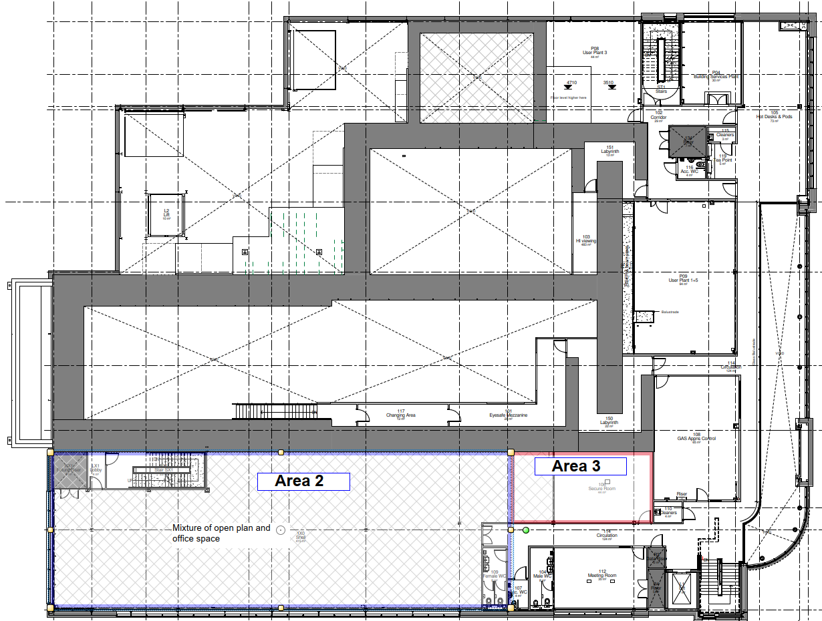
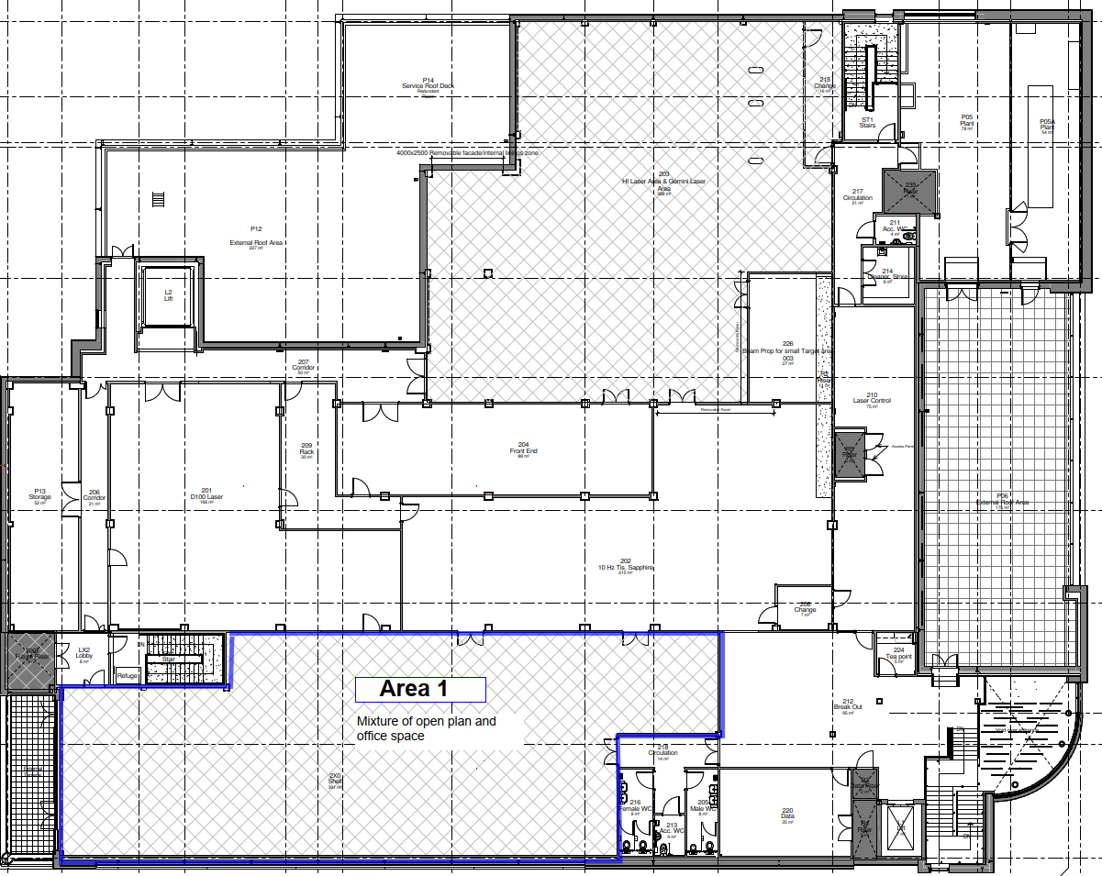
EPAC Offices Fit-Out
Funding secured to complete design and fit-out of 1st and 2nd floor offices in EPAC – completion in Q2 2023
First floor
Second floor

Slide 16
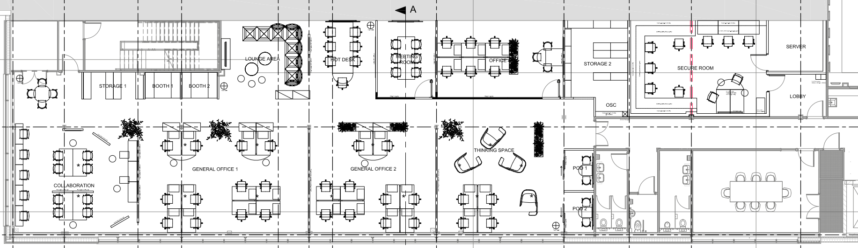
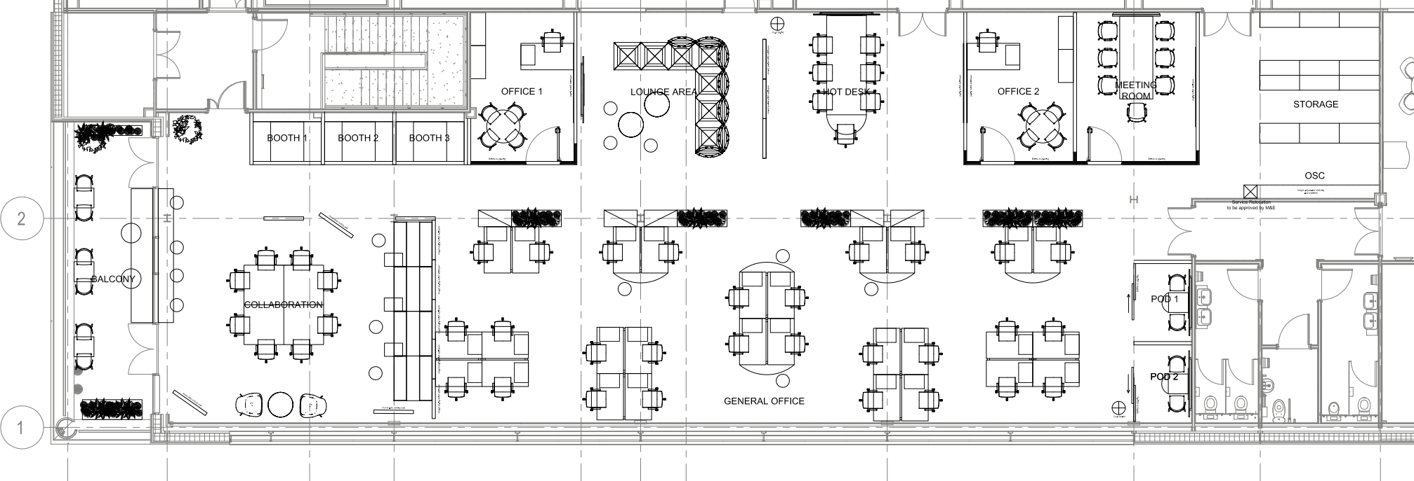
EPAC Offices Fit-Out
First floor
Second floor

Slide 17
Thank you
Extreme Photonics Applications Centre (EPAC)
Science and Technology Facilities Council
@STFC_Matters
Science and Technology Facilities Council
Notes:
The abstract pattern can be removed or repositioned if required. Be careful to ‘Send to Back’ so that it does not obscure any important information.

