Slide 1
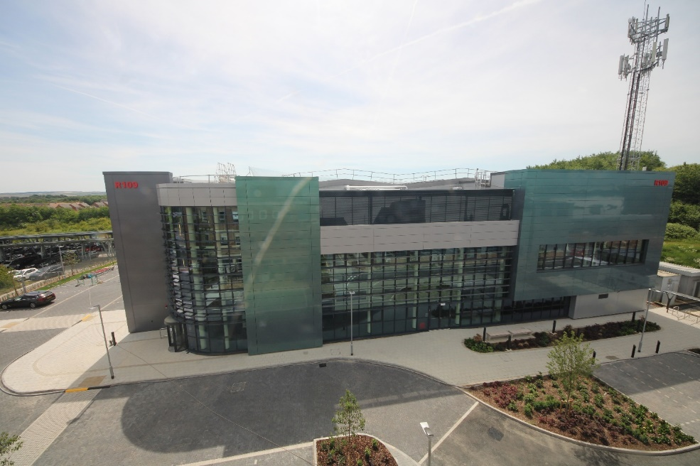
EPAC “Big Picture”
Why has the UK Government agreed to spend at least £100M on building EPAC and then at least a further £200M operating it for the next 20 years?
What will be different – the USP compared to other facilities or approaches internationally ?

Slide 2

HMG Strategies
Innovation Strategy
  “Science Superpower by 2030”
  “Global Hub akin to the Finance Sector”
Integrated Review (Defence, Security, Development and Foreign Policy)
  “Sustaining strategic advance through science and technology”
BEIS Fusion Strategy
  “UK the place in the world for fusion investment”
  Skills and Facilities in plasma / HED physics
Build Back Better
  Strong emphasis on innovation
Industrial Strategy
  Transformative Technologies of the future
……
There is very strong alignment of EPAC with many Government, UKRI and STFC strategies

Slide 3
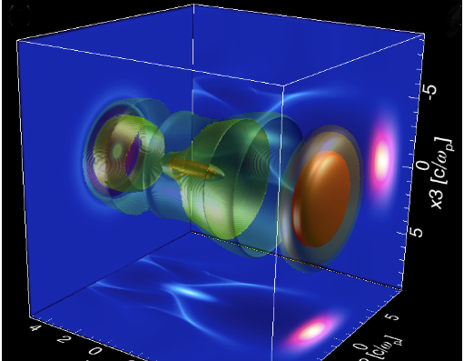

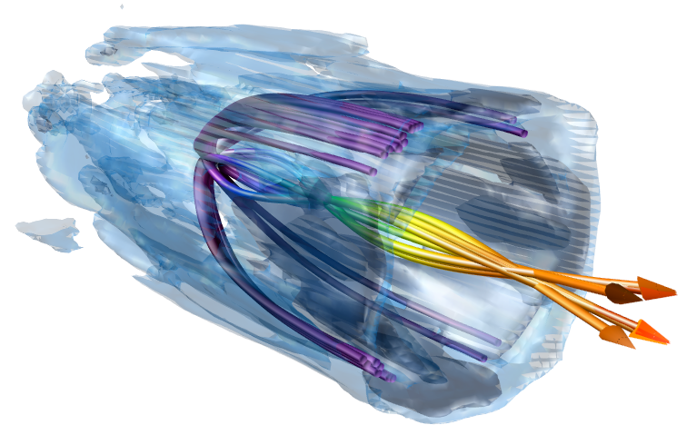
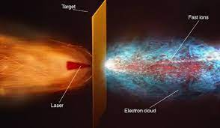
Laser Plasma Accelerators ?
The basis for a potentially transformational technology of global significance that could impact many sectors

Slide 4
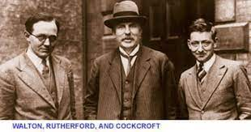

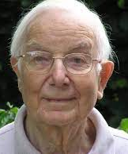

A note from history
Today, 30,000 accelerators in the world
Most are in industry
  1% are research machines with energies above 1 GeV
  44% are for radiotherapy
  41% for ion implantation
  9% for industrial processing and research
  4% for biomedical and other low-energy research
70 synchrotrons
  Would Rutherford, Cockcroft & Walton have imagined 90 years later the rapid structural resolution of the COVID-19 virus to address a pandemic ?
Plasma accelerators were conceived in 1979 (Tajima and Dawson)
Cockcroft and Walton (1932) 400 keV
Today, still 50 years “behind” conventional approaches
Yet, in many ways ahead…

Slide 5
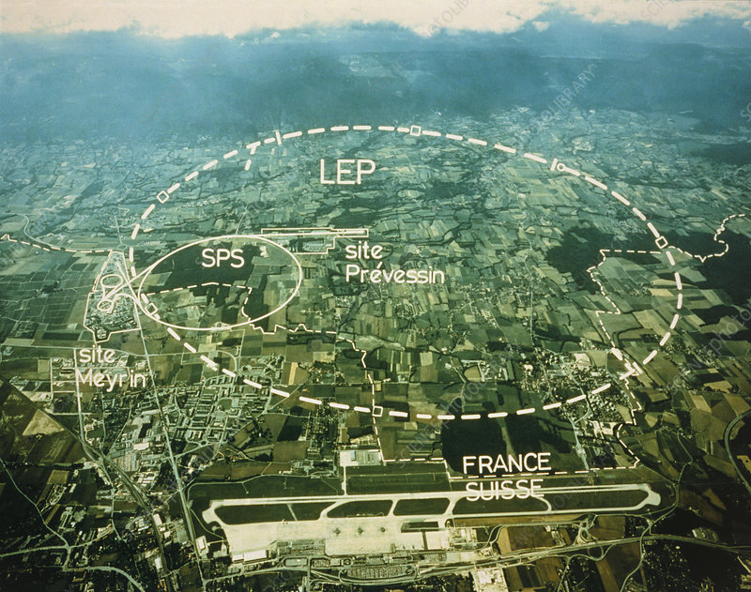
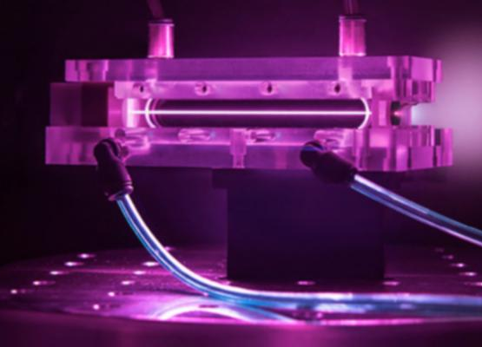
Why do I caveat “potentially” transformational ?
PLUS SIDE
MINUS SIDE
Physical Scale
  Plasma acceleration gradients > 10,000x higher cf RF sources
Properties
  Often much better and unique
Flexibility
  A myriad of “easy” possibilities
  Fund. science to industry in a box
Cost
  Low, in relative terms to the biggest
  TBD in relative terms to the smallest
Physical Scale
  Laser drivers today are also not small – reduces gradient 10-100x
Properties
  Often much worse
Stability & Reliability
  Based on non-linear physics and unstructured environments
Maturity and Complexity
  Laser systems are complex
  Ancillary systems not as mature
Basis of the argument that if the potential is to have a chance to be realised then some form of dedicated National Centre was needed

Slide 6
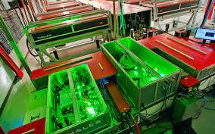
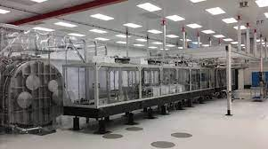
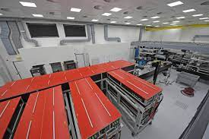
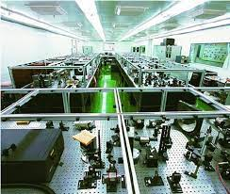
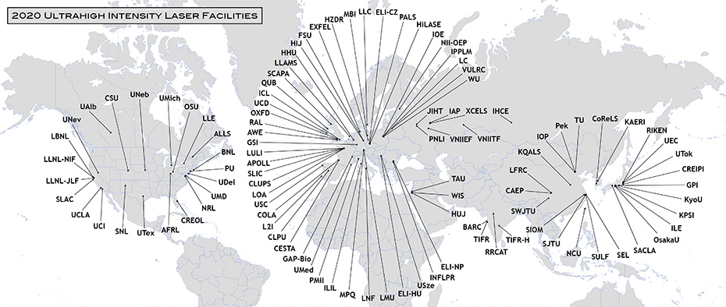
International Context – Laser Driven Accelerators
Virtually all systems are based on commercially sourced, flashlamp driven lasers
ELI-BL is only DPSSL based system, but commercially supplied by LLNL
= Difficult to innovate technologically
Very few are dedicated, most are general HED
Systems above 100 TW
© International Committee on Ultra Intense Lasers, an OECD sub committee through IUPAP
There is strong international competition

Slide 7

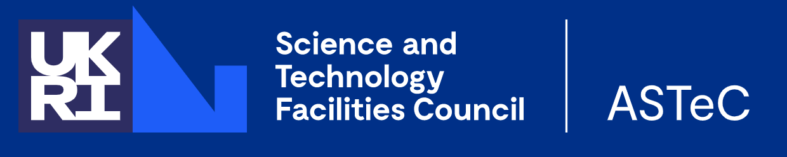
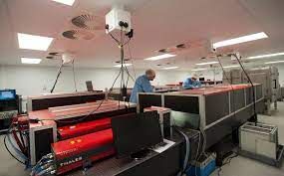

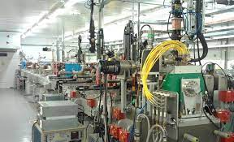
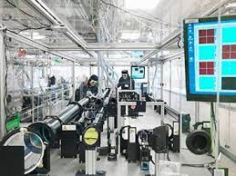

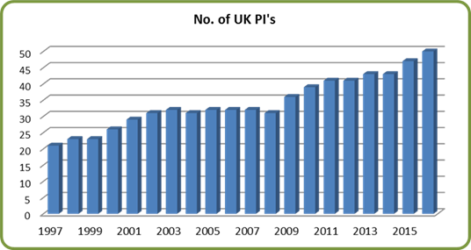
Main UK Centres
300 TW laser / 5Hz (2021)
University / Institute
250 MeV Accelerator (2023)
300 TW / 5Hz laser (2024)
Nat Lab - Development
BELFAST
COCKROFT
JOHN ADAMS
OXFORD
IC
Gemini - 2 x 0.5 PW beams (2007)
Vulcan - 1 PW (2002
EPAC - 1PW / 10Hz (2025) DPSSL
Vulcan 20-20 – 20PW (2029)
Nat Lab - User Facilites
DSTL
The UK has a vibrant and internationally leading community in this area

Slide 8
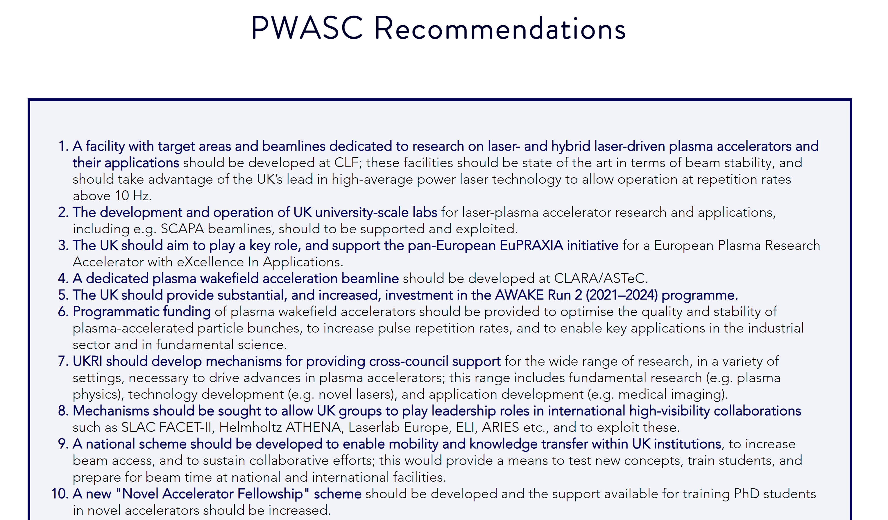
UK Plasma Wakefield Accelerator Steering Committee
The top priority for the UK community was investment in a dedicated facility at RAL
https://www.pwasc.org.uk/uk-roadmap

Slide 9


European Particle Physics Roadmap
Roadmap features 5 pillars where R&D progress need to be assessed by 2026
Plasma accelerators is one of the pillars, along with RF and magnet technologies, energy recovering linacs and muon collider concepts
Activities will include exploring limits and scalability of plasma accelerators, along with development of high-repetition rate laser- and beam-driven plasm accelerators, producing 6D bright beams
Funding opportunities likely to come up across major European funders
STFC Accelerator R&D Framework and funding just announced: few £M/year for projects that align with
  Particle Physics Roadmap
  XFEL technology developments
Particle physics community recognise the potential impact of plasma-based accelerators

Slide 10

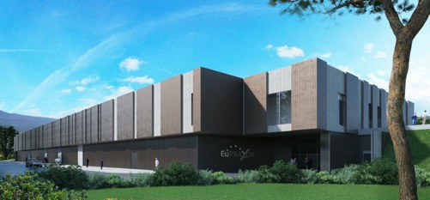
@ EPAC
A flagship international research facility for propelling laser-driven plasma accelerators to transformative real-world applications
EuPRAXIA will drive plasma accelerators producing 10GeV electron beams at 100 Hz that can drive sources with unprecedented properties for industrial and medical applications.
Laser-driven XFEL is one of the primary applications
EuPRAXIA will have two sites:
  Total estimated costs ~ 600M€
  The beam-driven arm will be based in INFN, Frascati
  The site for the laser-driven arm is yet to be decided
  EPAC is one of the four short-listed sites
  Scope for expansion to accommodate EuPRAXIA
  EuPRAXIA Board visit September 2023
The preparatory phase (Nov22– Oct 26) is funded (3.5M€) for choosing the 2nd EuPRAXIA site and develop a pre-TDR.
Decision on the 2nd site to be made by 2024
TIFR-EPIC
EuPRAXIA is now on the ESFRI Roadmap for European Infrastrcutures

Slide 11

Laser Plasma Accelerator Physics
UK has a leading community in this area
Science Developments e.g.
  Energy Spread reduction
  Injection & trapping
  Energy scaling
  New schemes e.g multi-pulse
  Staging / Coupling
Technical Developments e.g.
  Stability (or are there fundamental limits)
  Staging / Coupling
  Machine learning
  Photon production
  Scale reduction schemes
Recently demonstrated on Gemini optimising X-Ray production
[Shalloo et al Nature Comm 11, 6355 (2020)]
EPAC will support the continued leadership of the UK community in the development of laser based accelerators

Slide 12
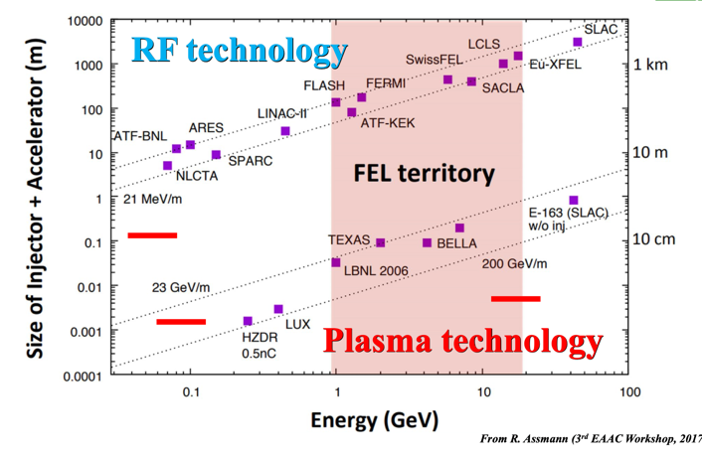
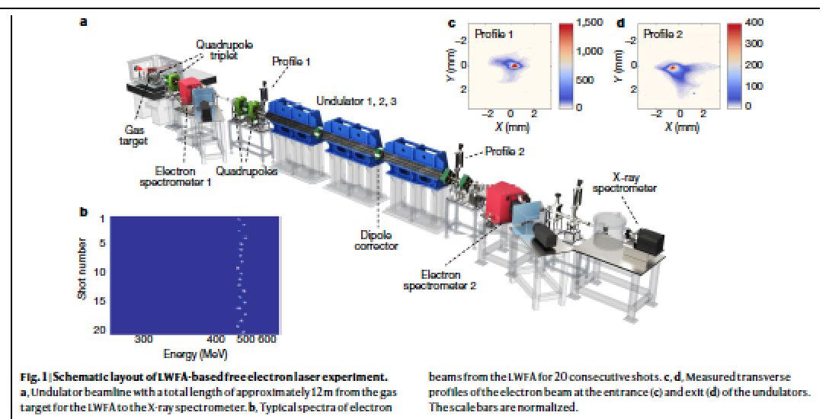
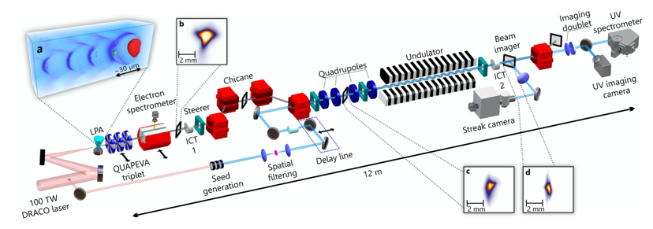

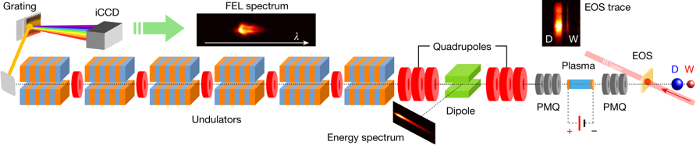
(X)FEL research with LWFA
Lasing from a laser-driven plasma accelerator @SIOM
Nature 595, 516–520 (2021)
Lasing from a laser-driven plasma accelerator @HZDR
LWFA and compact undulators can shrink size and cost but significant R&D is required – three very promising results
Under review
Lasing from a beam-driven plasma accelerator @INFN
EPAC will support strategic research for potential future facilities
Nature 605, 659–662 (2022)

Slide 13

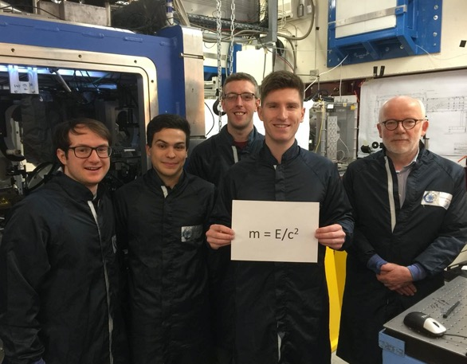




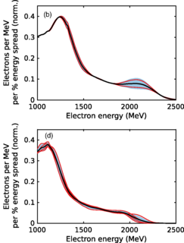





Fundamental Science
CLF experiment provided first demonstration of “radiation reaction”: electrons slowed down by their own radiation
  Imperial College led team used Gemini laser to accelerate electrons to near-light speeds while the second Gemini beam is focused onto the electrons at extreme intensities
  Electrons radiate strongly in intense fields – the back-action causes electrons to loose energy
  Quantum Electro-Dynamics models are required when the electron recoil is large & the emitted frequency is large
Data agrees with the Quantum models, suggesting QED effects
  Radiation reaction such as this is thought to occur around black holes and quasars; it’s the first time this has been recreated in a laboratory
EPAC will enable these sorts of observations with statistically significant data rather than “one off” observations
w/o laser
with laser
EPAC will support curiosity driven fundamental science – with statistics!
Notes:
The emitted radiation exerts a backaction on the electron itself, which has a dampening effect like that of friction. Physicists first studied this “radiation reaction” theoretically in the early 1900s. The effect, however, is only sizable when the electron’s energy loss is large compared with the work done by the accelerating force, which corresponds to the electron being accelerated in its rest frame within a few yoctoseconds While this condition can be met in remote astrophysical environments, such as the plasma surrounding a pulsar, it is much harder to come by in the lab. Whilst an interesting observation, statistics are needed for proper analysis and EPAC will provide this opportunity

Slide 14
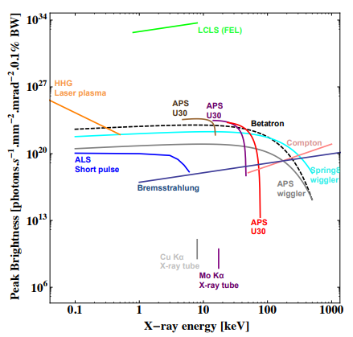
Peak Brightness (keV and MeV)
The peak brightness of EPAC (betatron) per pulse will be similar to synchrotrons like APS and ALS
The peak brightness of betatron x-rays from Gemini has reached >10²³ photons s⁻¹. mrad⁻². mm⁻² (0.1% BW) at between 20 and 150 keV – we expect EPAC to perform similarly if not better
Peak Brightness of LPA Bremsstrahlung sources are the highest of any MeV x-ray technology reaching 10²⁰ photons/(s mm2 mrad2) (0.1% BW)
Both ultra fast and partially coherent (Betatron)
EAPC aims to offer something not available conventionally and improvements in aspects that are – i.e. range and dynamics
Notes:
Laser peak brilliance Albert & Thomas PPCF 58, 103001 (2016)

Slide 15

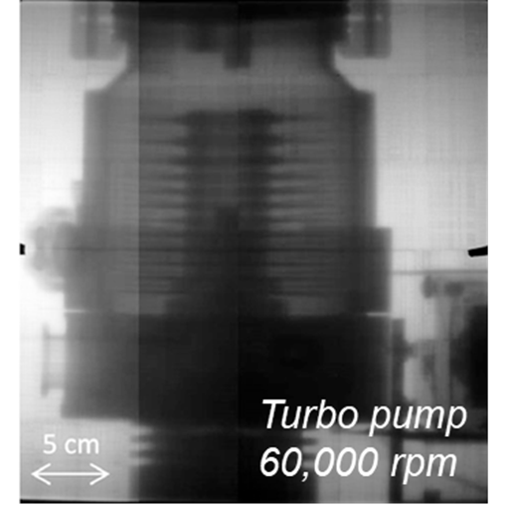
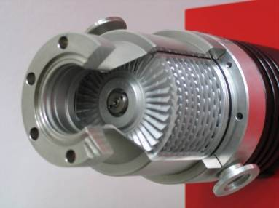
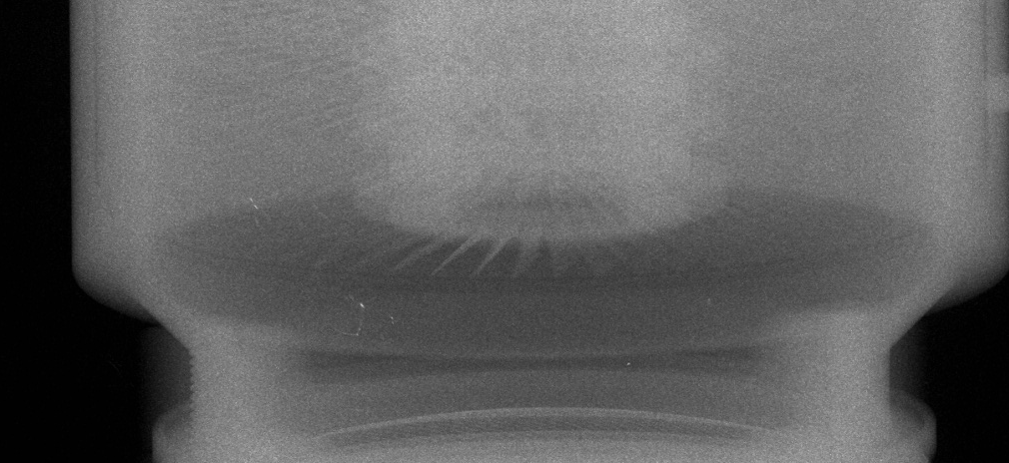
Manufacturing
“That one image was equivalent to 2 generations of development for us”
- CTO
This image shows how a 60,000 rpm turbine can be frozen using penetrating laser driven X-Rays (1 Vulcan laser shot, 1 ps)
1 image “= 2 generations of development” for company involved
A repetitive, bright source of X-Rays would allow real time imaging of dynamics of rapidly moving objects (e.g. engines)
Dynamic, penetrative imaging
200keV+ X-Rays used to penetrate casing and freeze motion of turbines blades

Slide 16
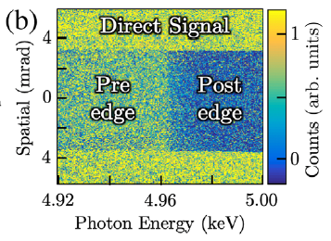
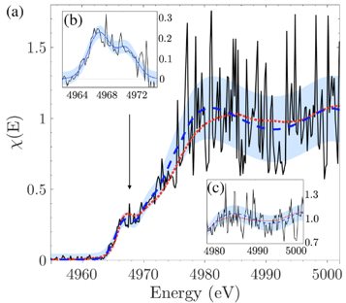
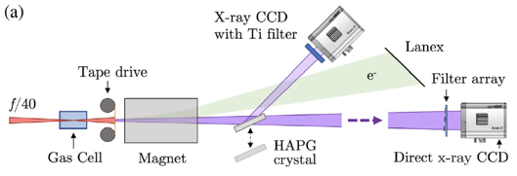

Dynamic XANES
XANES (X-ray Absorption Near-Edge Structure) with laser-driven betatron x-rays provide measurements of temperature and structure of matter in extreme environments
Temporal resolution <100fs, enabling studies of ultrafast transitions in extreme conditions.
Laser-driven XANES has applications in material science, batteries, photovoltaics etc., which will be exploited in EPAC
Kettle et al.,, PRL 123, 254801 (2019)
Shift of absorption edge related to electronic structure
EPAC will support new approaches to conventioinal techniques
Notes:
Replace this guidance text with your own bullet pointed content.
For further guidance please see https://www.bdadyslexia.org.uk/advice/employers/creating-a-dyslexia-friendly-workplace/dyslexia-friendly-style-guide

Slide 17
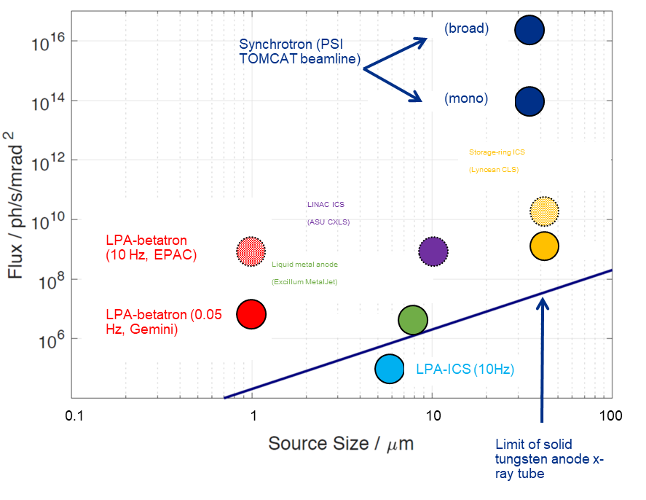
Source Size and Flux (keV)
Source size will be smaller than synchrotons, LINACs and most x-ray tubes
At such a small source size, the flux is several orders of magnitude higher than the nearest rival
Average flux for betatron x-rays will be higher than x-ray tubes, lower than synchrotons, but similar to LINAC ICS
EPAC will provide new opportunities for high resolution imaging – 2D and 3D
Notes:
Laser peak brilliance Albert & Thomas PPCF 58, 103001 (2016)

Slide 18
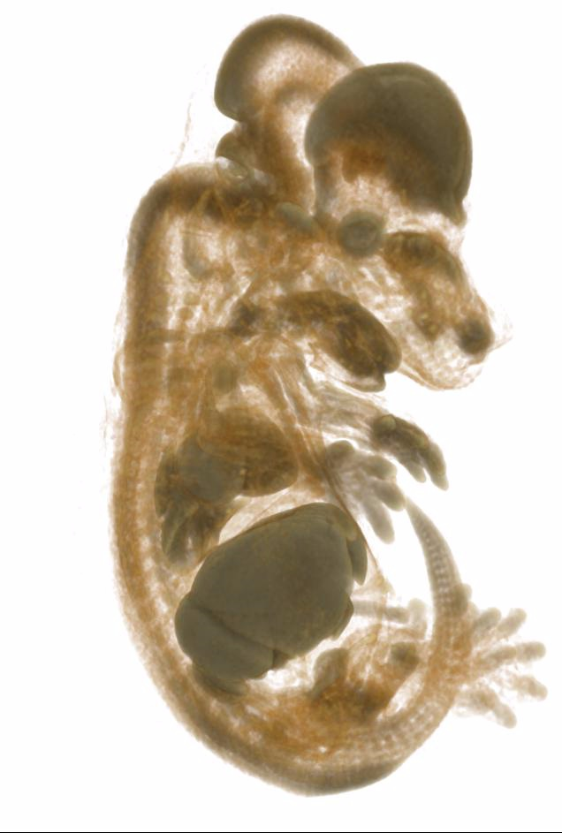



Advanced Manufacturing
Computed Tomography – fs time resolved
Ultra-short pulse flash image opens potential of time resolving in 3D at high resolution
4D Imaging – “3D movies”
  e.g. systems under load or stress
  Ultra-fast process – batteries ?
CT with other particles and MeV Gamma Rays
Mouse embryo also took 400 shots/4 hrs
  Will be done in seconds in EPAC
Potential applications to advanced manufacturing
EPAC will provide new 3D imaging modalities not currently available and a step change in speed
Gemini High Power Laser

Slide 19

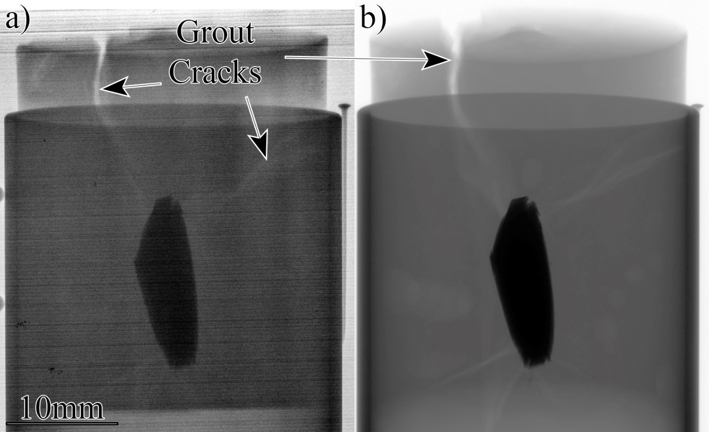
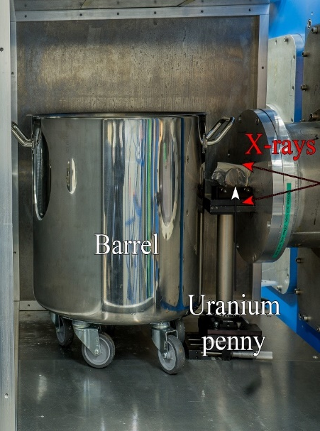

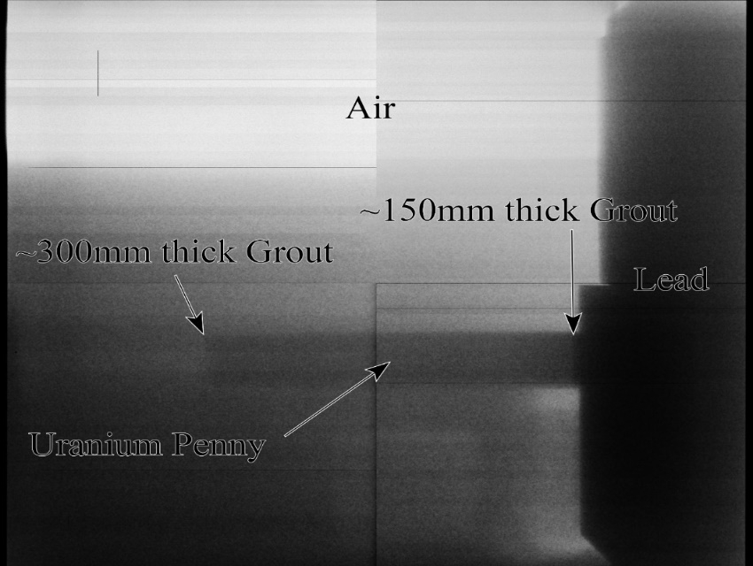
Nuclear Materials
LaDS
XRT
Single Laser Shot Image v strip line source
Potential for substantial increase in verification time and material identification
EPAC will provide new opportunities for the nuclear industry

Slide 20

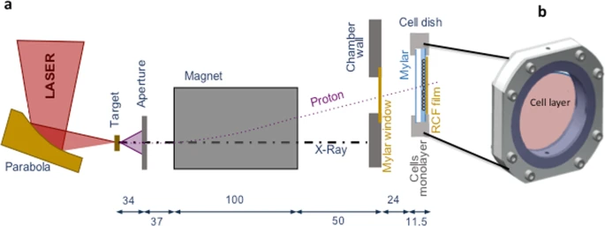


Medical Science
Significant interest in proton based high dose (FLASH) proton therapy – superior features
Ultra-high dose rates (10⁹ Gy per second) could be key to technological development – 150 MeV demonstrated to date
Well-established research programme on Gemini and Vulcan
Complex mechanisms of relative biological effectiveness (RBE) of high dose proton beams, e.g. energy, dose, hypoxia
EPAC will provide new research opportunities in medical diagnostics and treatment
F. Hanton et al. High dose radiobiology on Gemini (2019)
Notes:
f/7 is a good option for most operations that don’t require the highest intensities

Slide 21
Space
Experiments at CLF have shown how the spectra of the Van Allen radiation belt can be reproduced
Hidding et al, Science Reports
ELECTRON
PROTON
EPAC will provide new opportunities for the generation of space weather environment simulants and other challenging environments

Slide 22
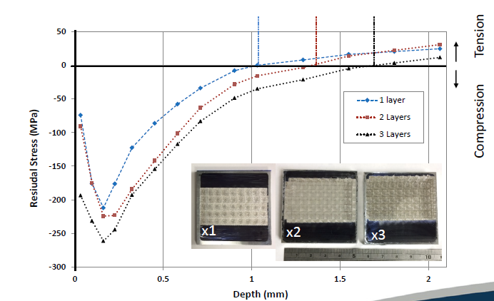
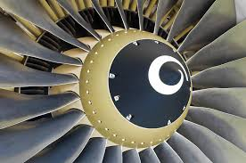
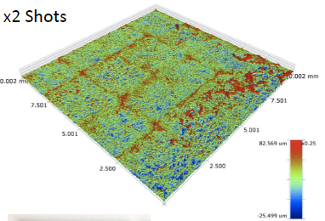
Industrial Processing
Shape control optimises industrial processes e.g.. Peening
EPAC will provide new opportunities in industrial processing
Laser peening is an important industrial process that is little understood and poorly optimised
It is used to harden materials like turbine blades – i,e generate compressive stress in surface layers
Especially important in the aerospace industry

Slide 23
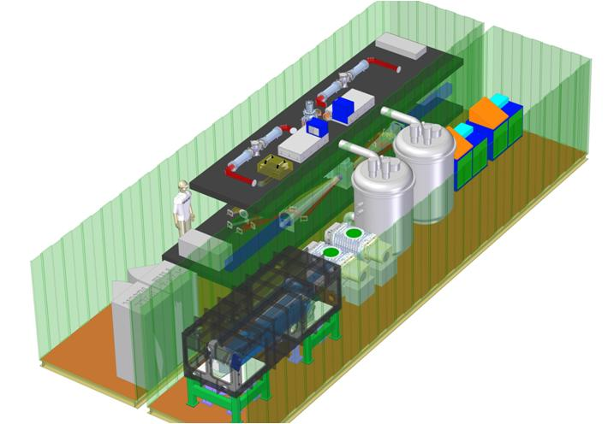
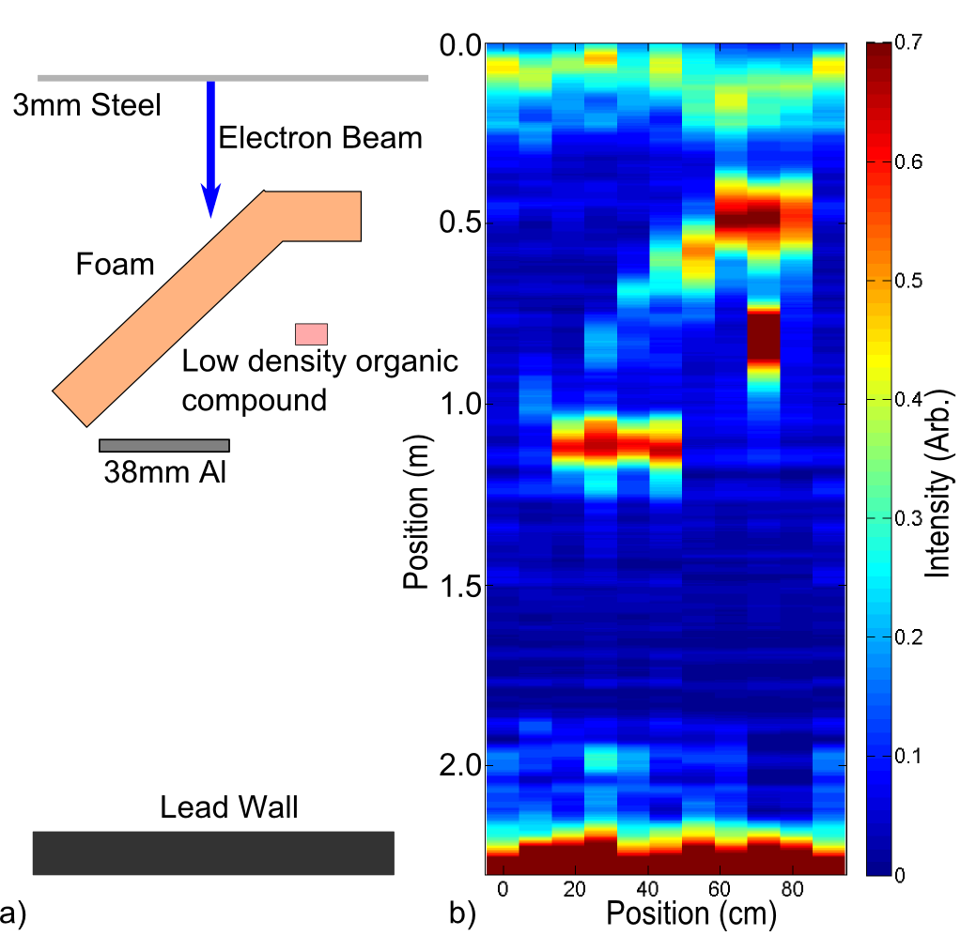





Defence
There are a wide range of potential defence applications
Example : X-Ray Radar
  Can clearly see positions of the different density and atomic number objects.
  Objects behind 14cm foam barrier have strong response
  One sided imaging
  Patented
EPAC will provide new opportunities in defence research with portability in mind
R Deas et al, Journal of X-ray science and Technology 23. 791-797, 2015

Slide 24
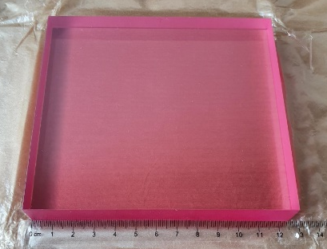
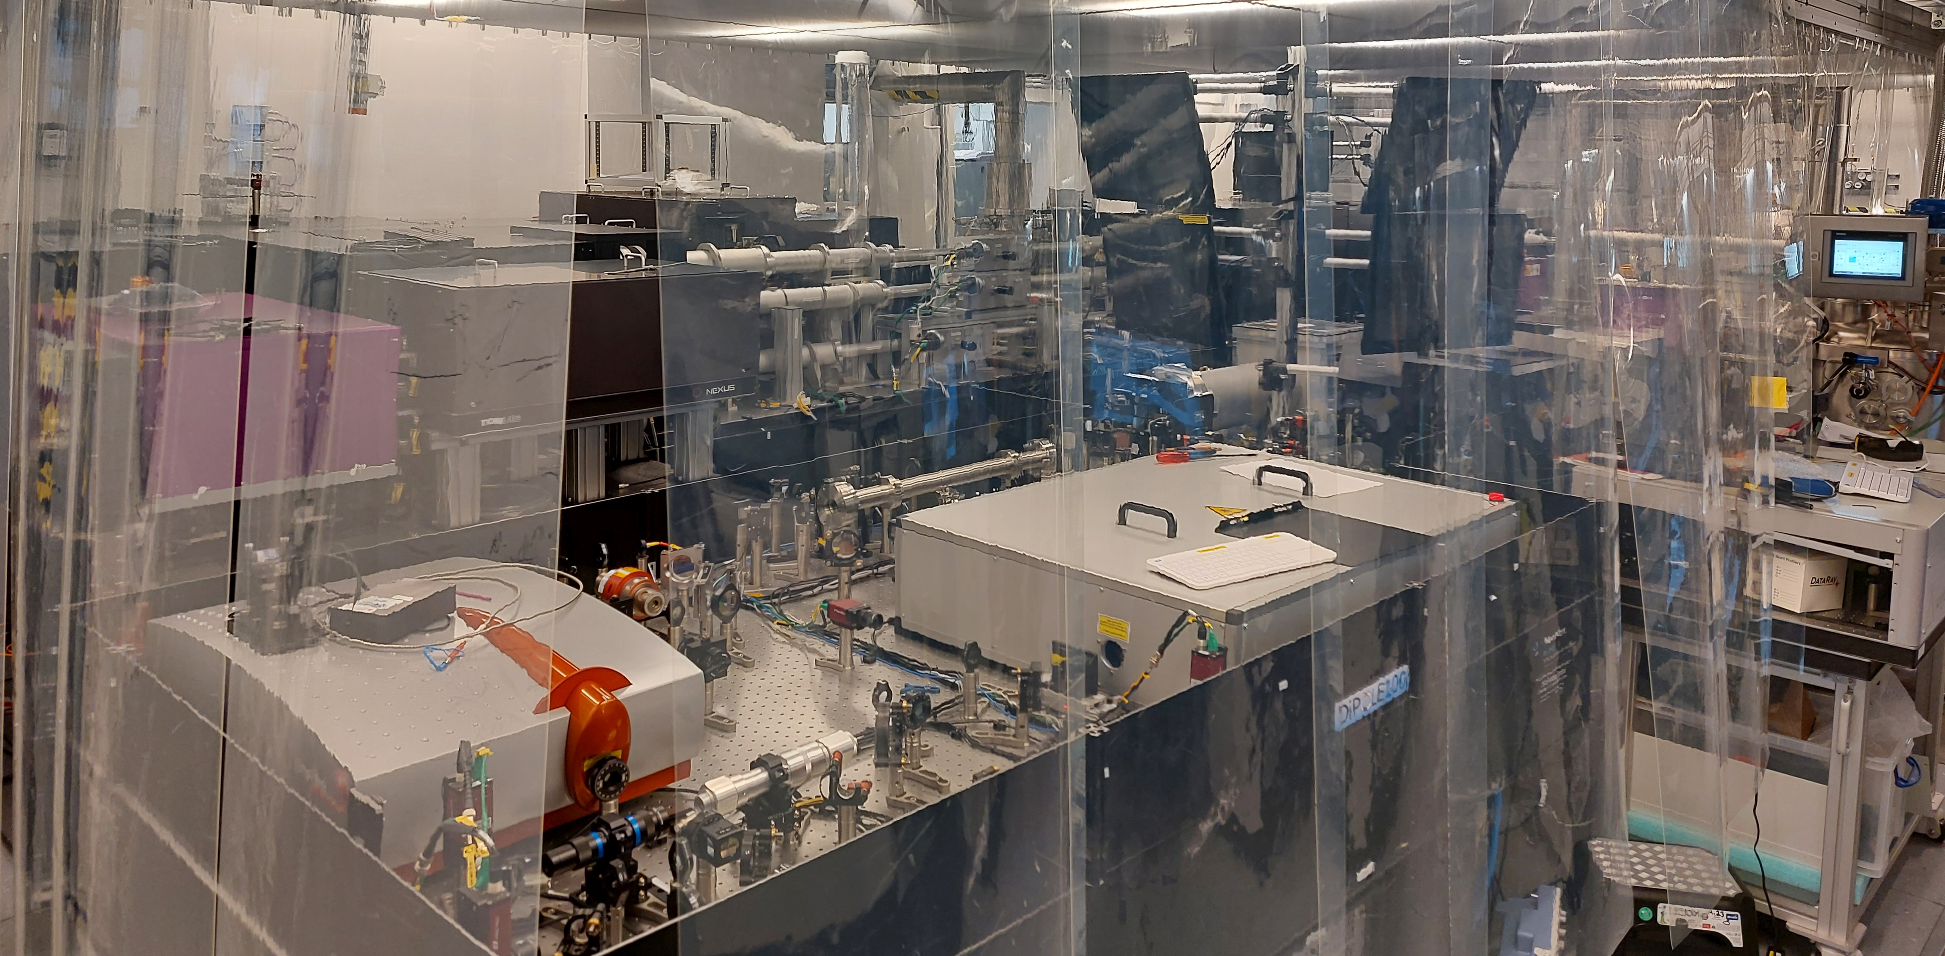
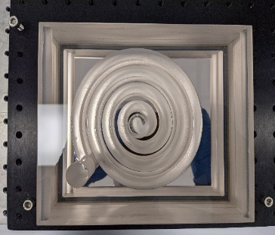
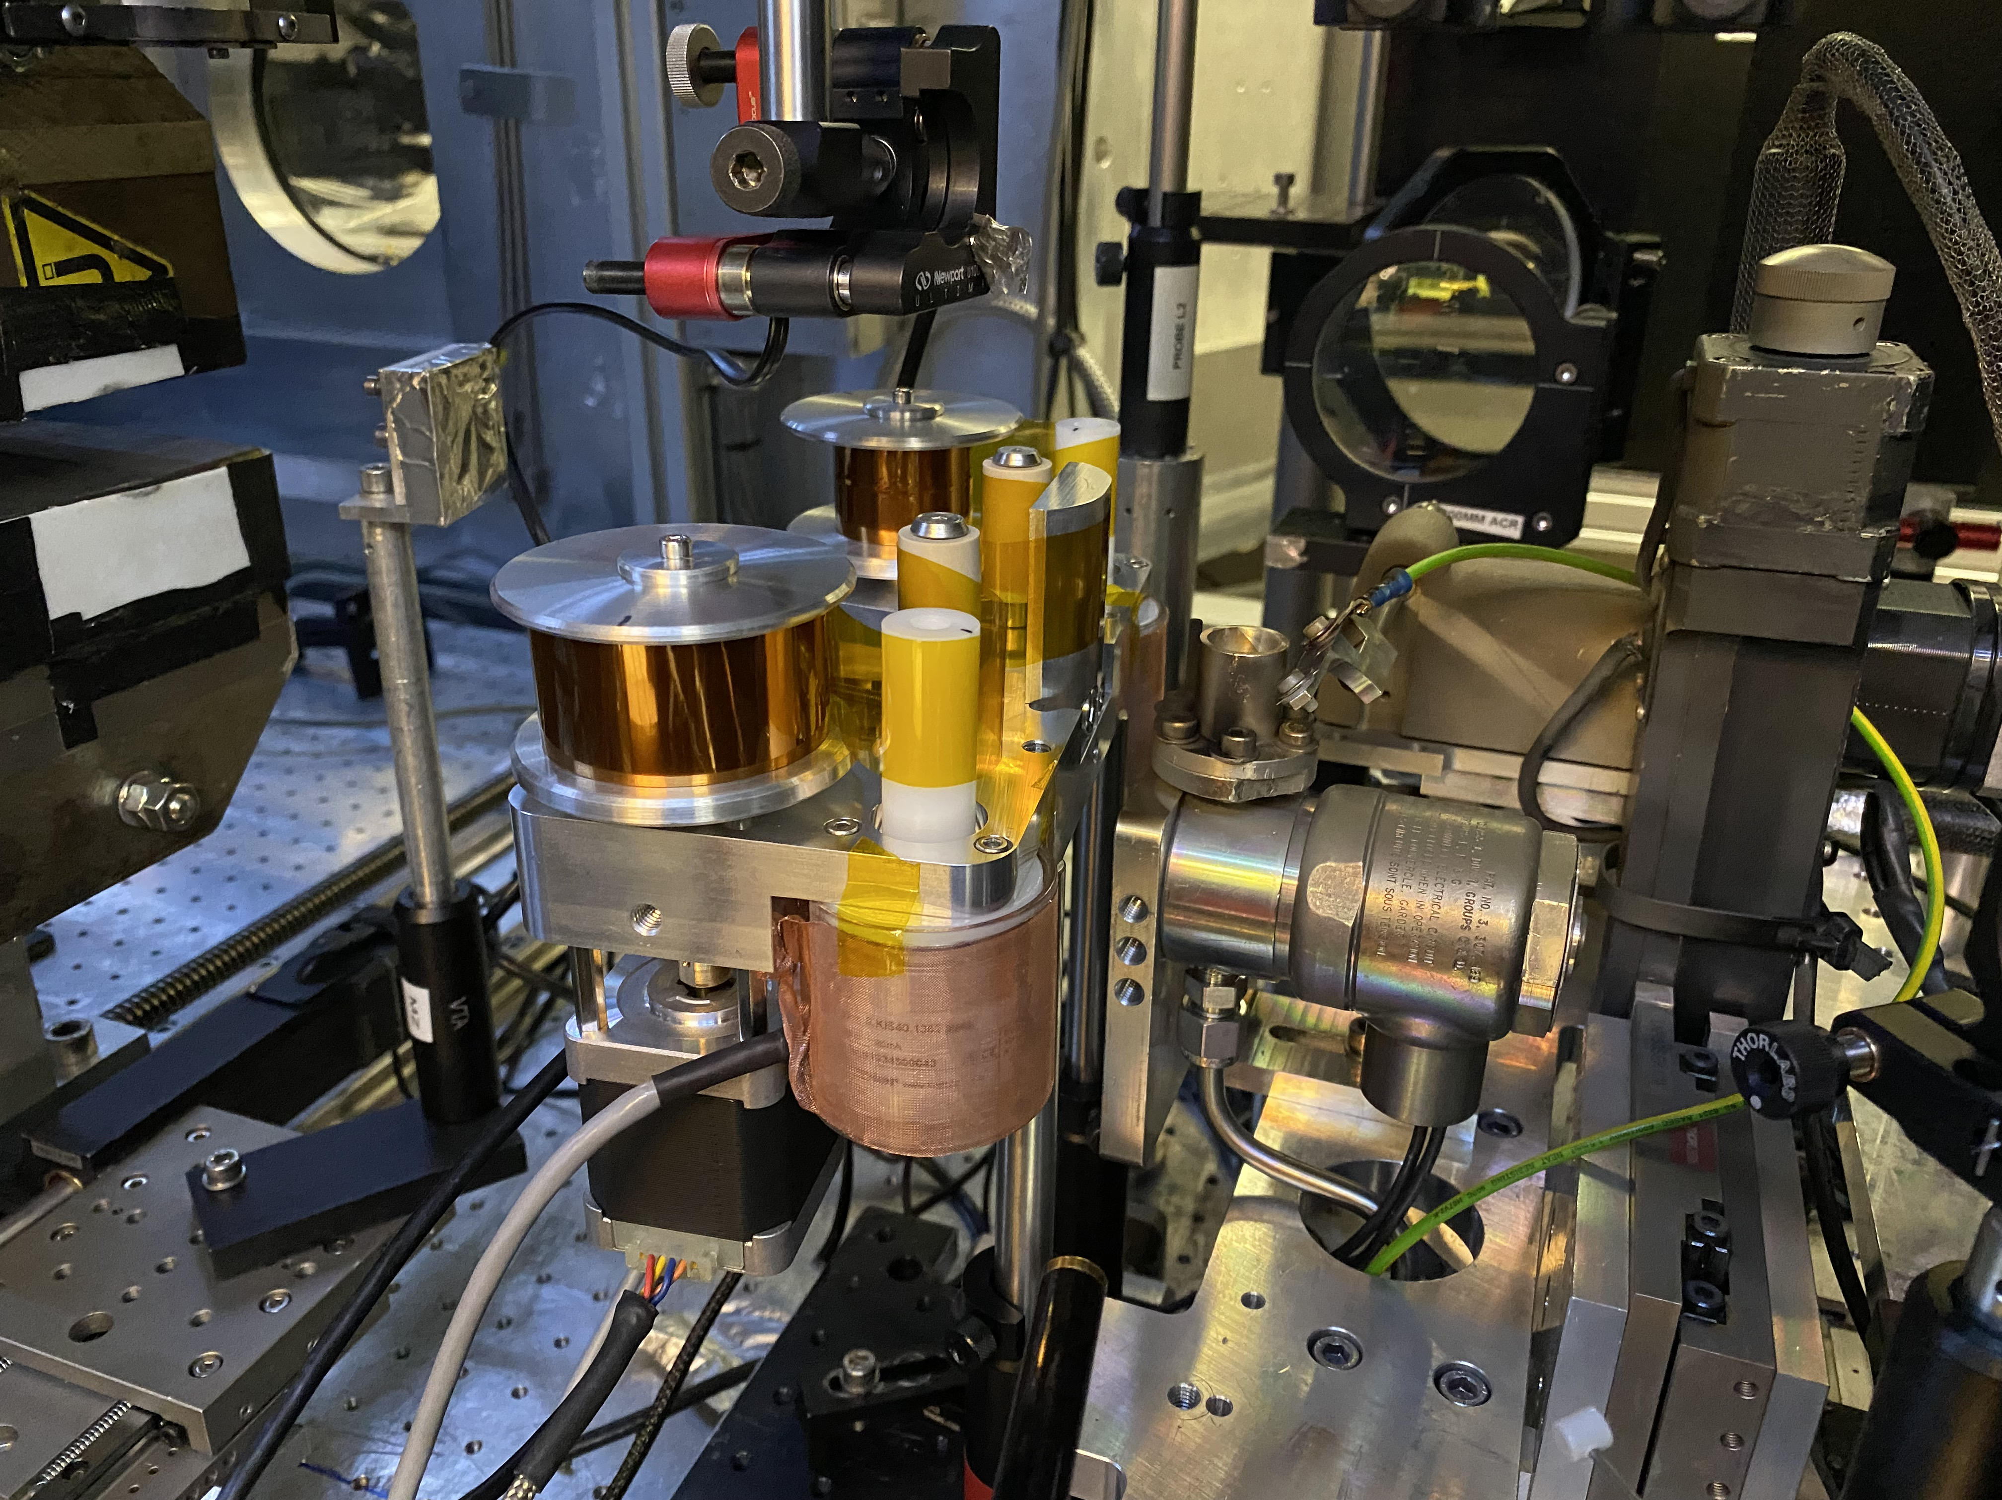
EPAC Technology mainly is ours
Unlike any comparable facility in the world, CLF has developed and is developing its own primary technology and technology concepts for EPAC
  Pump laser, source, amplifier, compression, targetry, diagnostics, data systems, etc
EPAC tech will be continuously developed and outcomes transferred with our partners
EPAC will be able to innovate in ways many others can’t

Slide 25
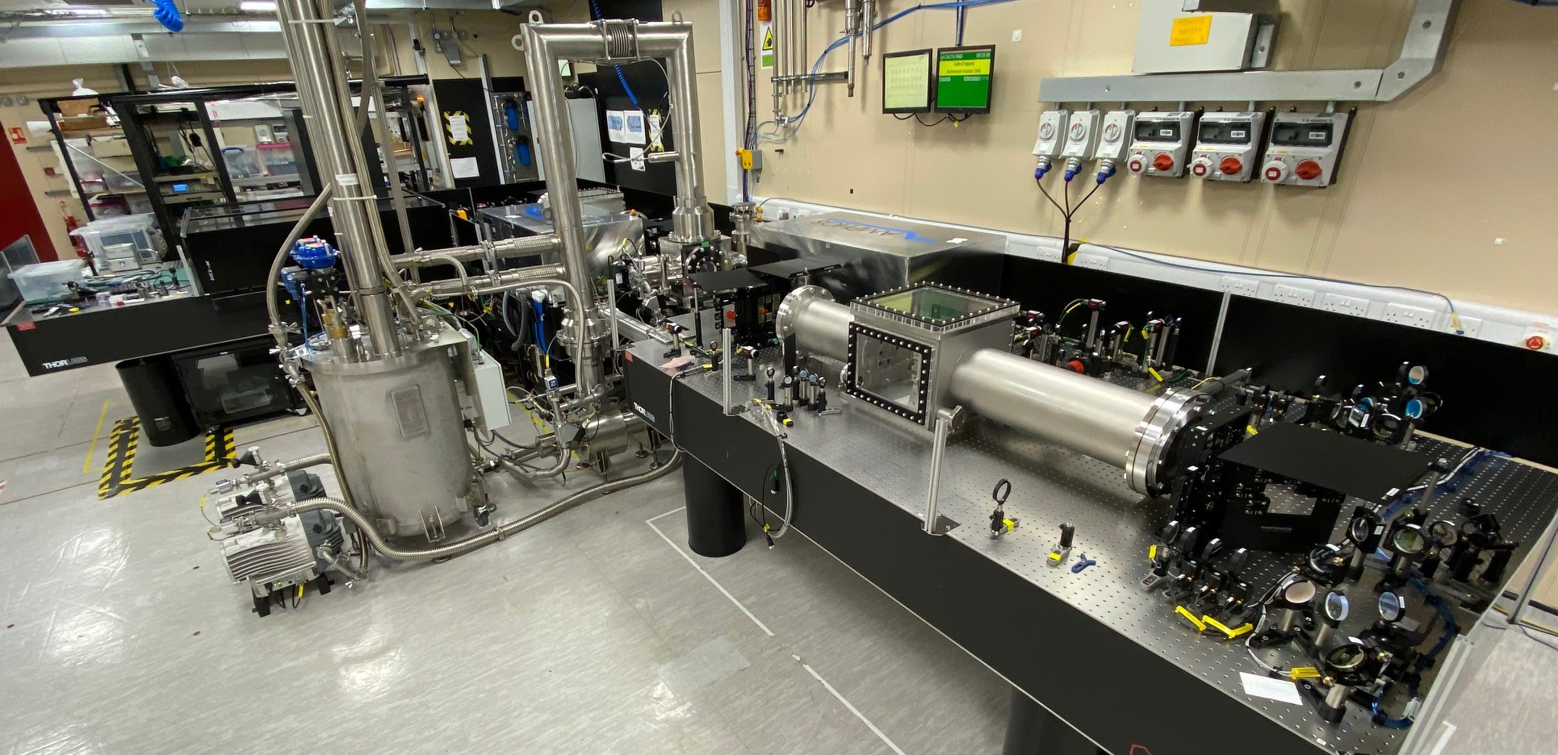
Technology Development Example
DiPOLE S11 – 100Hz
CLF is routinely developing technology through various mechanisms that will feed directly into EPAC
CLF is developing 100 Hz DPSSL based technology
  100 TW driver
  the most likely technology transfer pathway
  kHz under consideration
Compact concepts
(DESY pushing to kHz)

Slide 26
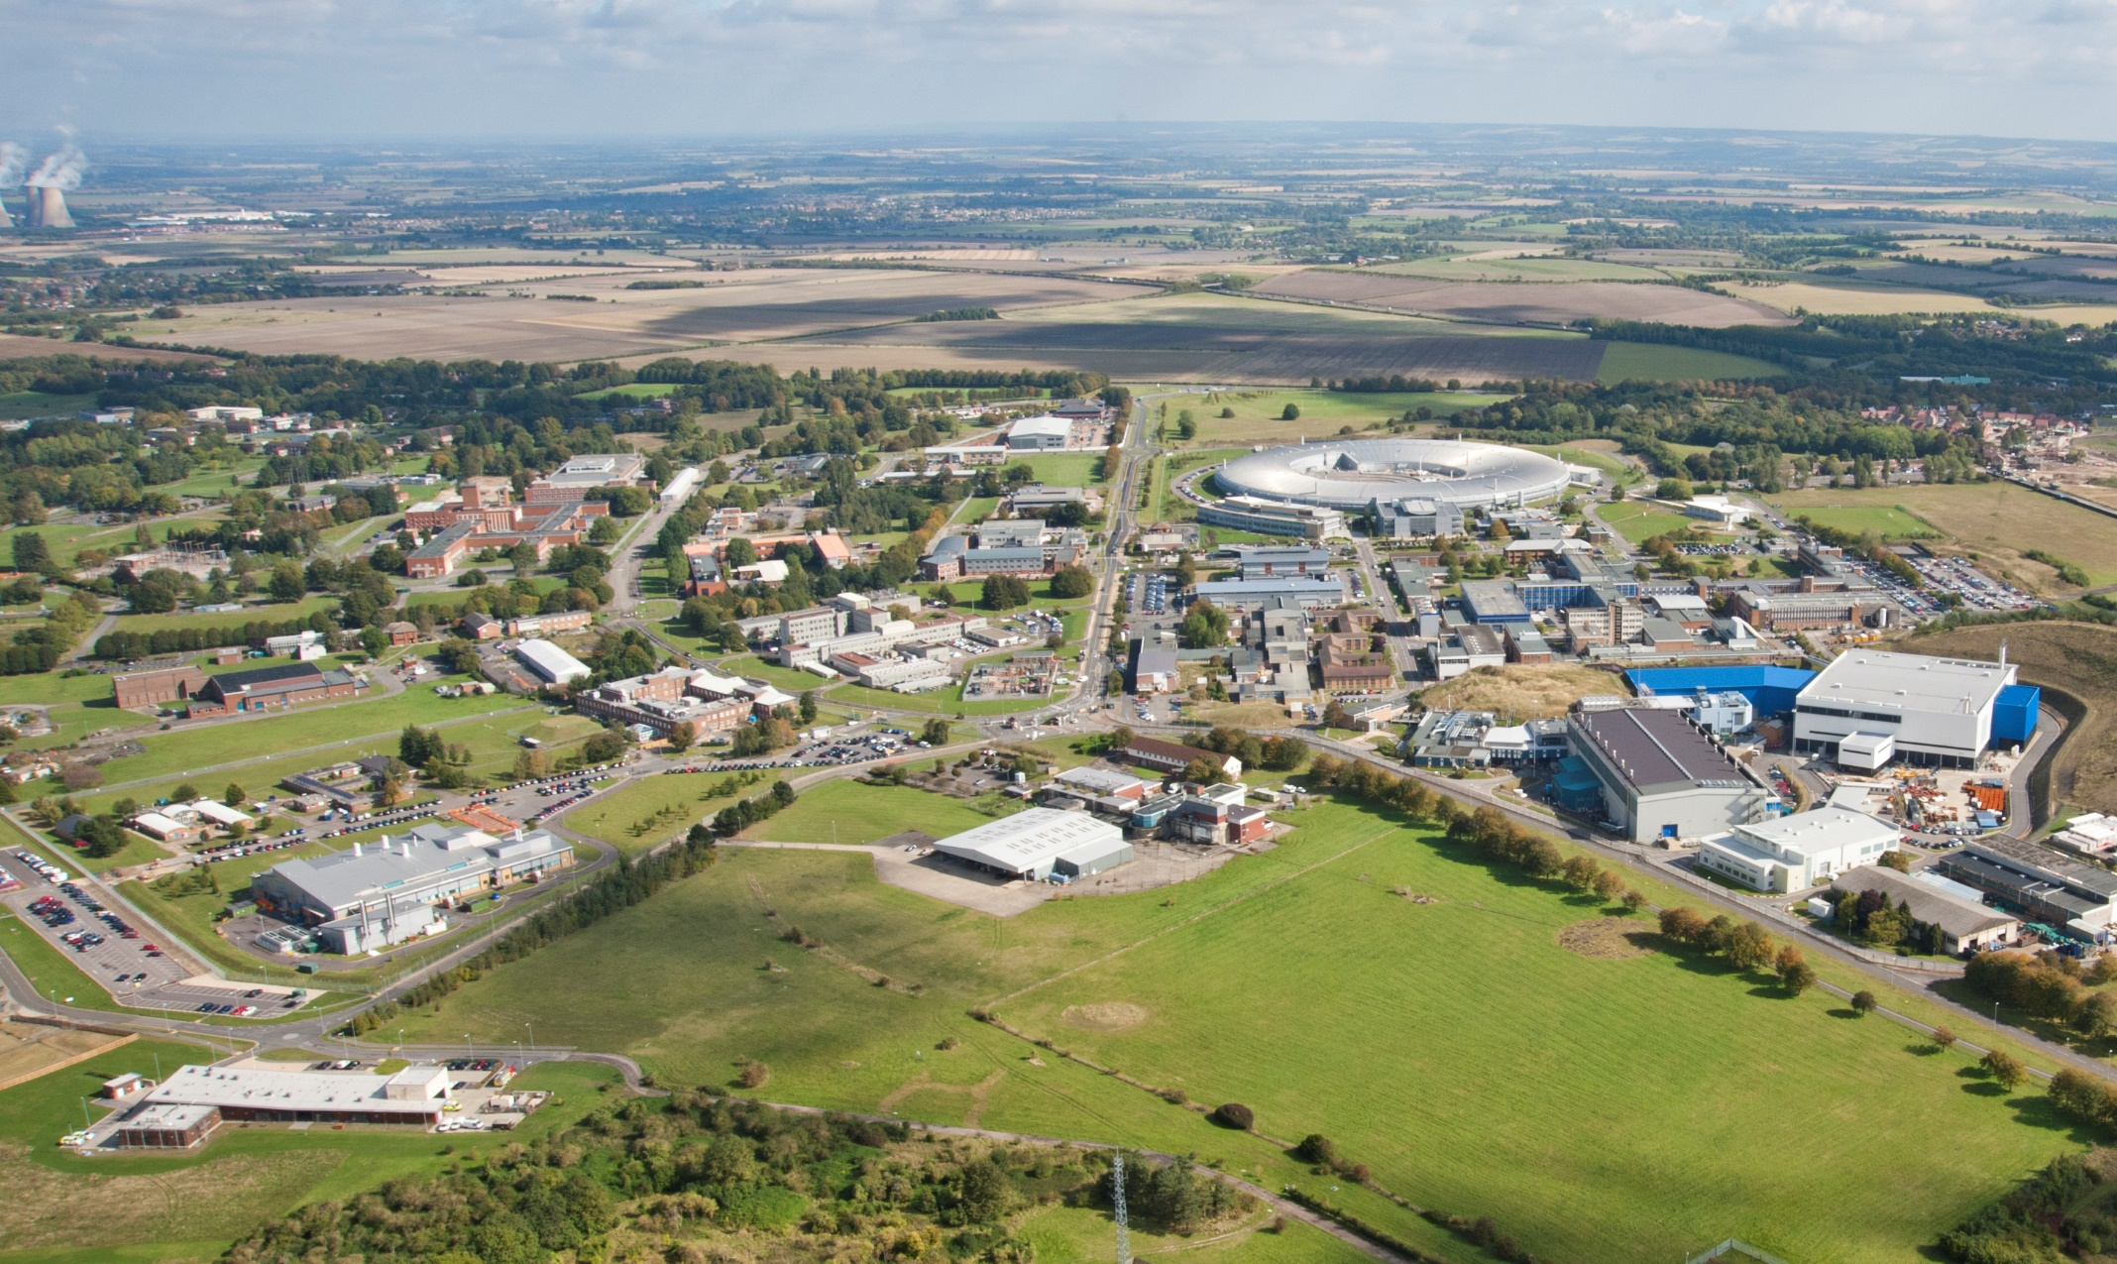


Major strengths of EPAC
Location – superb, expert environment
Engaged community and networks
Unique, flexible, interesting capability
Secure facility
STFC experience handling sensitive data
Diverse, broad in-house expertise
Financial stability
Future proof campus placement and strategy
Integrated technology “ownership”
Forward innovation and tech transfer - BID
International options

Slide 27


