Slide 1


Medical Instrumentation for LhARA
Narender Kumar

Slide 2

Overview
Motivation and clinical benefits of Hadron Therapy
Background and R&D
Measurements at UoB's Scanditronix MC40 cyclotron
NOVEL END-STATION DEVELOPMENT: CONSULTATION 1; 14th Dec. 2022
IOP PABG Annual Conference, Liverpool 25th-26th July 2022

Slide 3
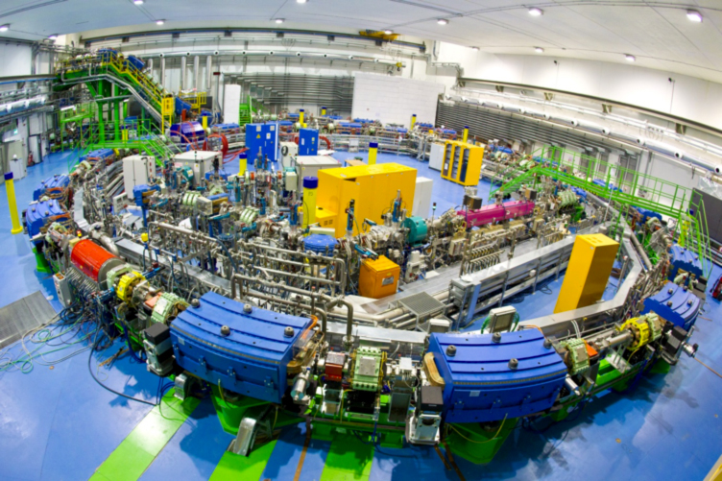
Hadron beam therapy
Clear healthcare benefits for certain cancer types;
Significant investment through NHS and private facilities in the UK;
Optimization of Medical Accelerators (OMA) network identified key R&D challenges:
  Significant time goes into Q&A
  New technology solutions needed for novel treatment modalities such as FLASH, LhARA
  Desirable machine operation modes not currently possible due to lack of non-invasive (online) diagnostics
CNAO Synchrotron, image courtesy CNAO.
NOVEL END-STATION DEVELOPMENT: CONSULTATION 1; 14th Dec. 2022
IOP PABG Annual Conference, Liverpool 25th-26th July 2022

Slide 4
Diagnostics for proton beam overview
Beam monitors and position in M.D. Anderson proton beam nozzle*
Measure beam properties in an accelerator:
  Current, position, profile, emittance, energy
Treatment beam measurements:
  Dose
  Dose profile
Deliver the prescribed amount of dose to the target location!!
*A. Smith et. al. Med. Phys. 36, 2009
NOVEL END-STATION DEVELOPMENT: CONSULTATION 1; 14th Dec. 2022

Slide 5
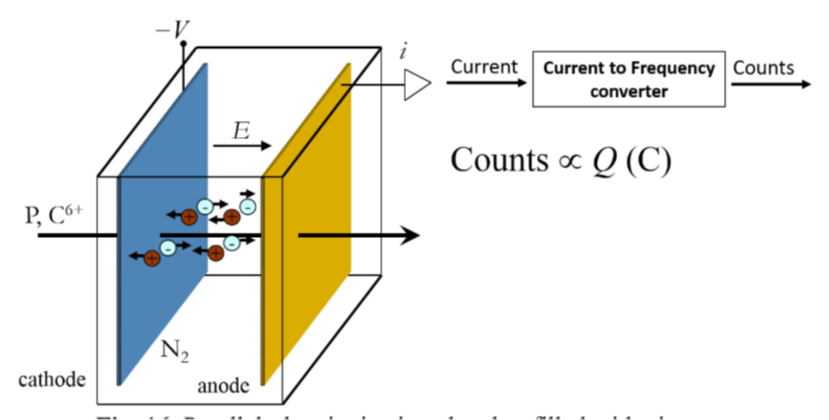
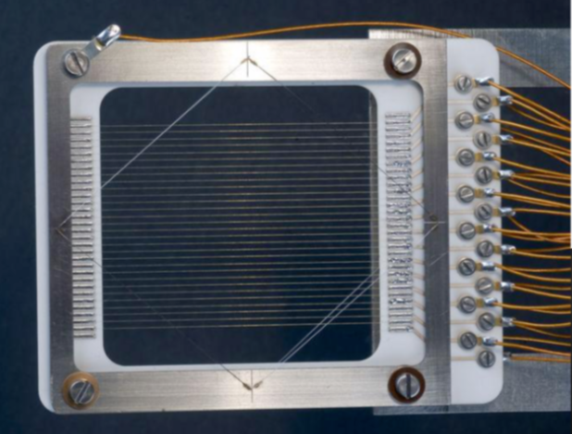
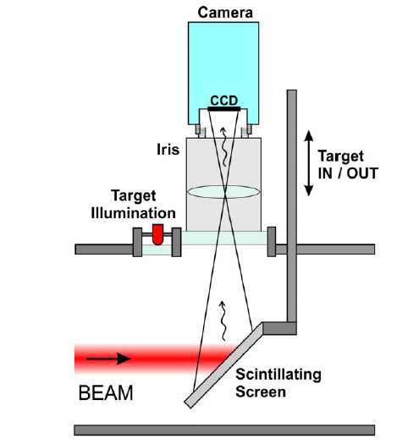
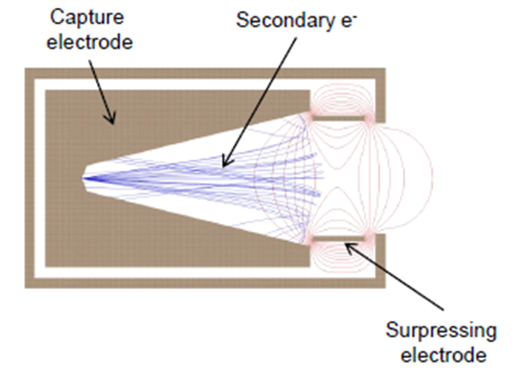
Diagnostics for proton beam overview
SEM Grid
Ionisation chambers
Still the Golden standard for online dose monitor!
Advantages: Robustness, uniformity, easiness of operation, minimal perturbation
IC array: Dose distribution, spatial resolution is not great (5-8mm)
Multi layers IC: Check the beam range, energy, and stability
Scintillating screen
Faraday cup
Credit: B. Walasek-Höhne, GSI and G. Kube, DESY
NOVEL END-STATION DEVELOPMENT: CONSULTATION 1; 14th Dec. 2022

Slide 6

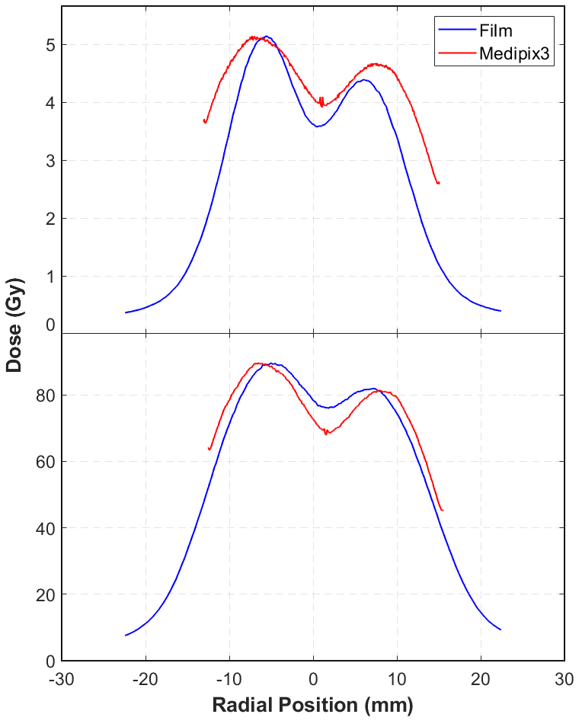
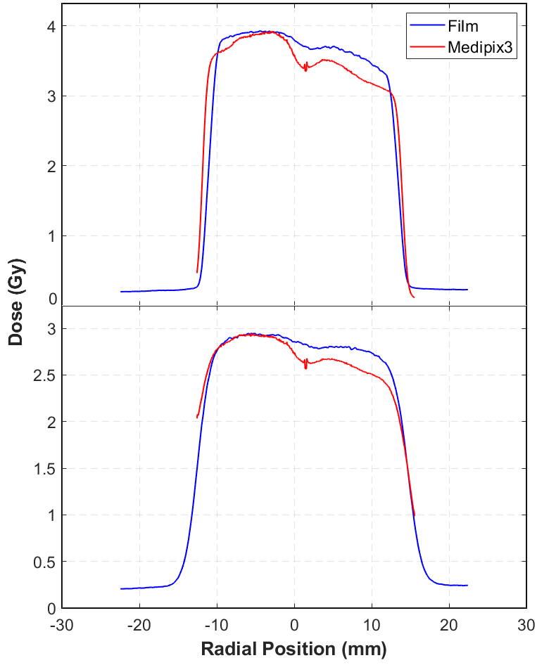
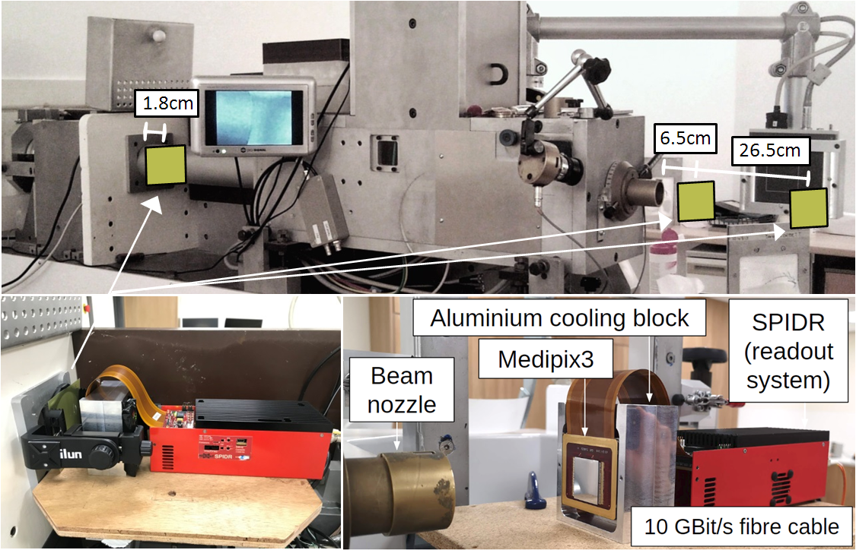
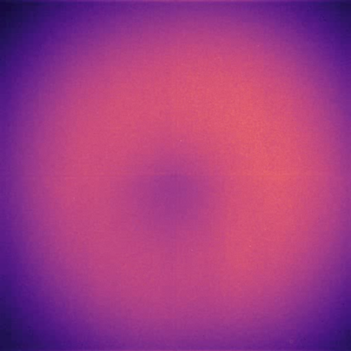
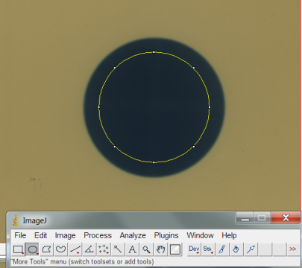
Medipix3
Collaboration with ASI & Nikhef, Netherlands
Medipix3 & EBT3 film comparisons
Medipix3 is a CMOS pixel detector readout chip.
Colour imaging and dead time free operation
First tests with Medipix3 detector in a clinical proton therapy environment
  High proton flux (~10^10 ions/s)
EBT3 Gafchromic films
Result from EBT3 film
NOVEL END-STATION DEVELOPMENT: CONSULTATION 1; 14th Dec. 2022

Slide 7
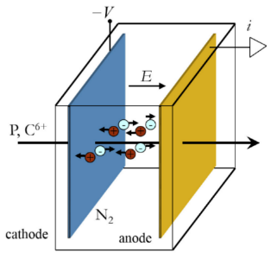

Existing diagnostics
High resolution
Reliability
Validity
Interceptive
Ongoing calibration
Beam perturbation
Limited live feedback
B. Walasek-Höhne, GSI and G. Kube, DESY
S. Giordanengo & M. Donetti, arXiv:1803.00893
NOVEL END-STATION DEVELOPMENT: CONSULTATION 1; 14th Dec. 2022
IOP PABG Annual Conference, Liverpool 25th-26th July 2022

Slide 8


Gas Jet Monitor - Novel diagnostics solution
1
2
No mechanical parts interact with the beam
All key parameters monitored remotely
Significantly reduced maintenance
Minimally invasive
Significantly reduced calibration time
No beam perturbation
Online monitoring
Superior error detection
3
2
Enabling technology for FLASH and Mini-Beam treatments
Active machine regulation based on live feedback becomes feasible
Novel treatments and improved operation
1
USP
3
N. Kumar, C.P. Welsch, et. al, Physica Medica 73, p 173-178 (2020).
S. Jolly, C.P. Welsch, et al., “Technical challenges for FLASH proton therapy“, Phys Med 2020 – Galileo Galilei Award, best paper in 2020
“Non-Invasive Gas Jet In-Vivo Dosimetry for Particle Beam Therapy”, contributed talk at IPAC21
NOVEL END-STATION DEVELOPMENT: CONSULTATION 1; 14th Dec. 2022
IOP PABG Annual Conference, Liverpool 25th-26th July 2022

Slide 9
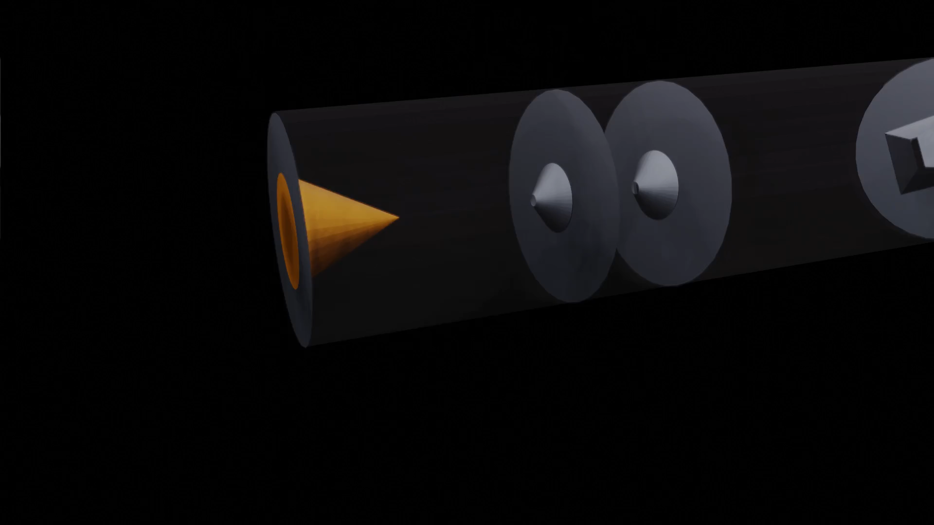
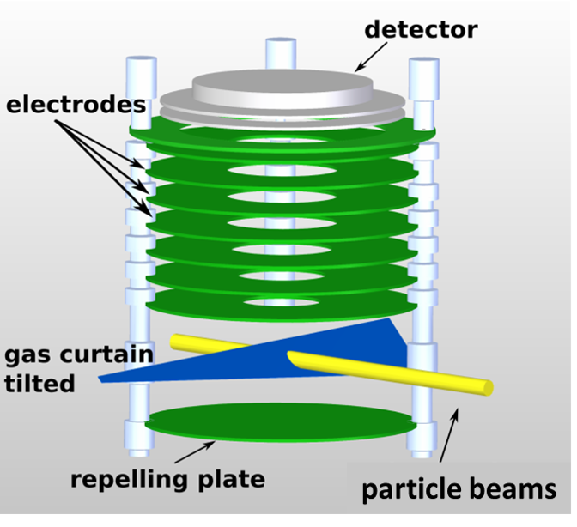
Building up on previous developments
Detector
Visible light
Phosphor screen
MCP
Ion extraction
Ionization
Gas jet shaping
NOVEL END-STATION DEVELOPMENT: CONSULTATION 1; 14th Dec. 2022
IOP PABG Annual Conference, Liverpool 25th-26th July 2022

Slide 10
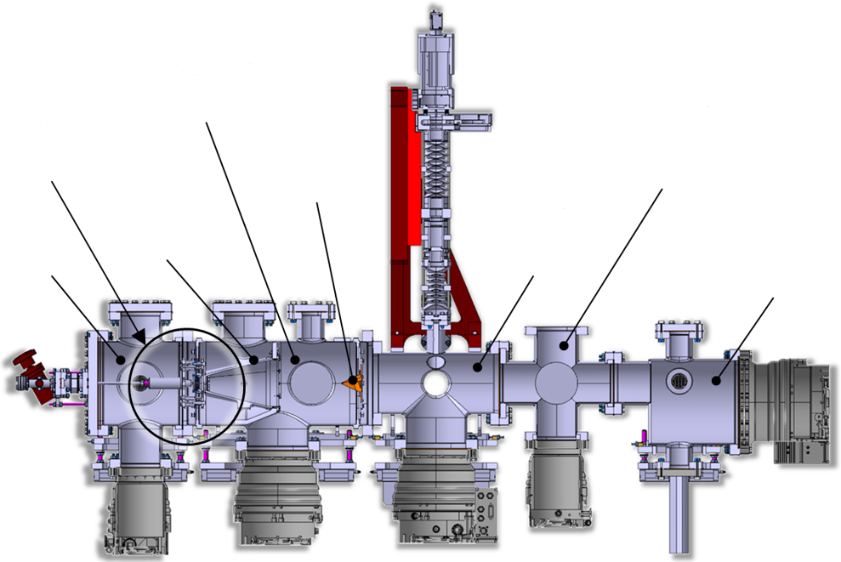
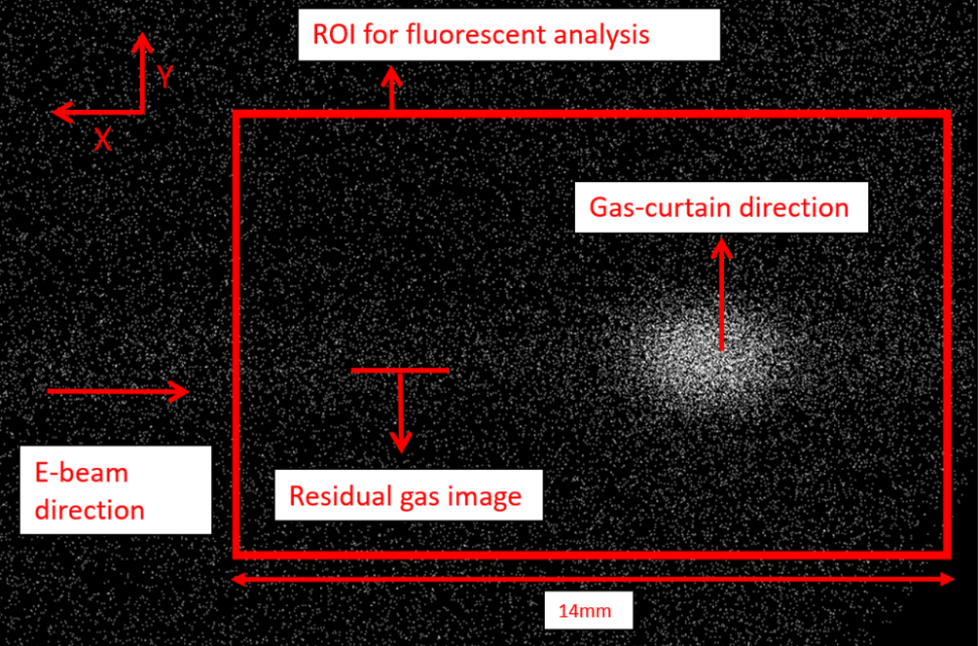
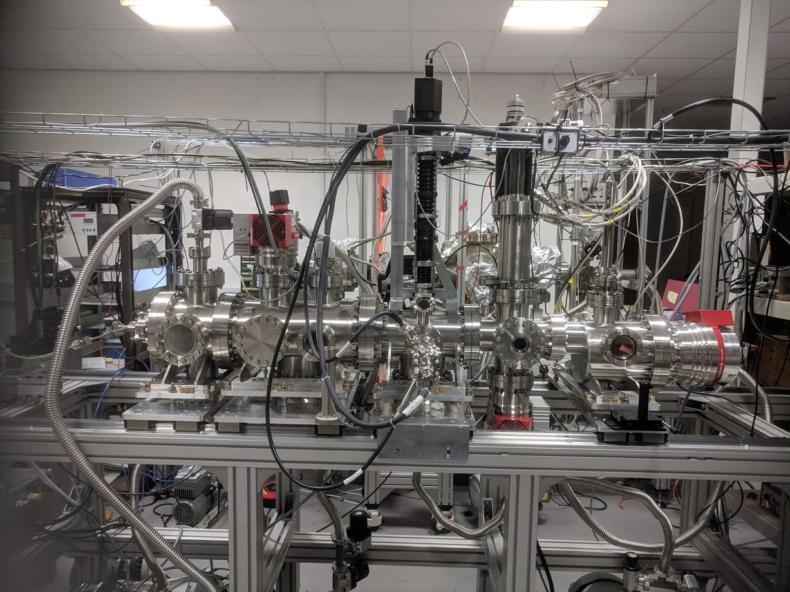

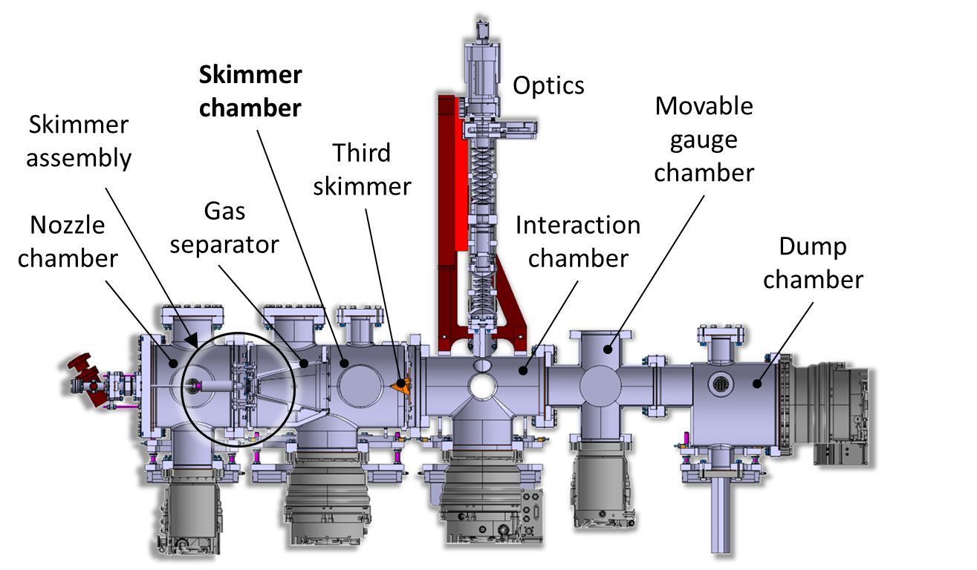



Capitalizing on pioneering STFC-funded technology
Skimmer Chamber
Imaging System
Moveable Gauge Chamber
Skimmer Assembly
Third Skimmer
Nozzle Chamber
Gas Separator
Interaction Chamber
Dump Chamber
~3 m
“Gas jet monitor R&D is world leading” – CI SAC (2019)
NOVEL END-STATION DEVELOPMENT: CONSULTATION 1; 14th Dec. 2022

Slide 11
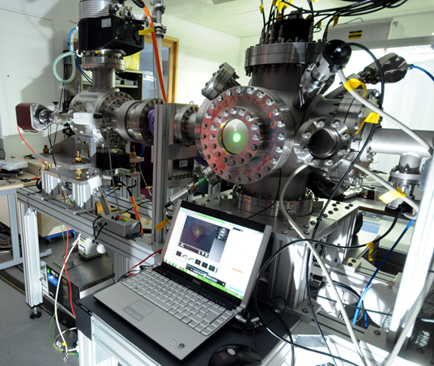
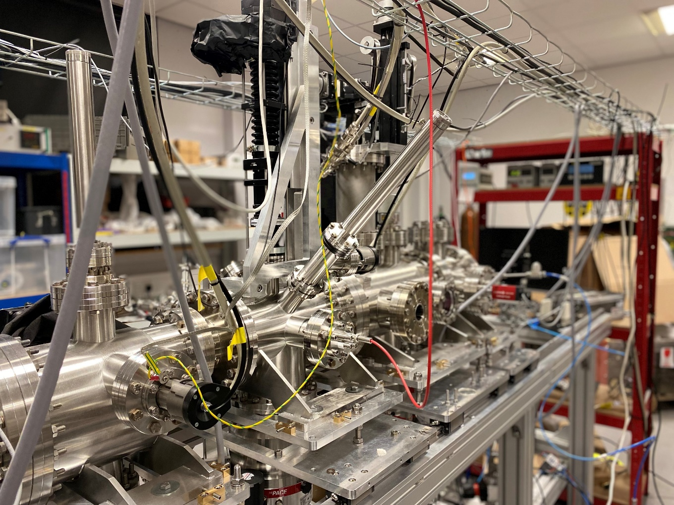
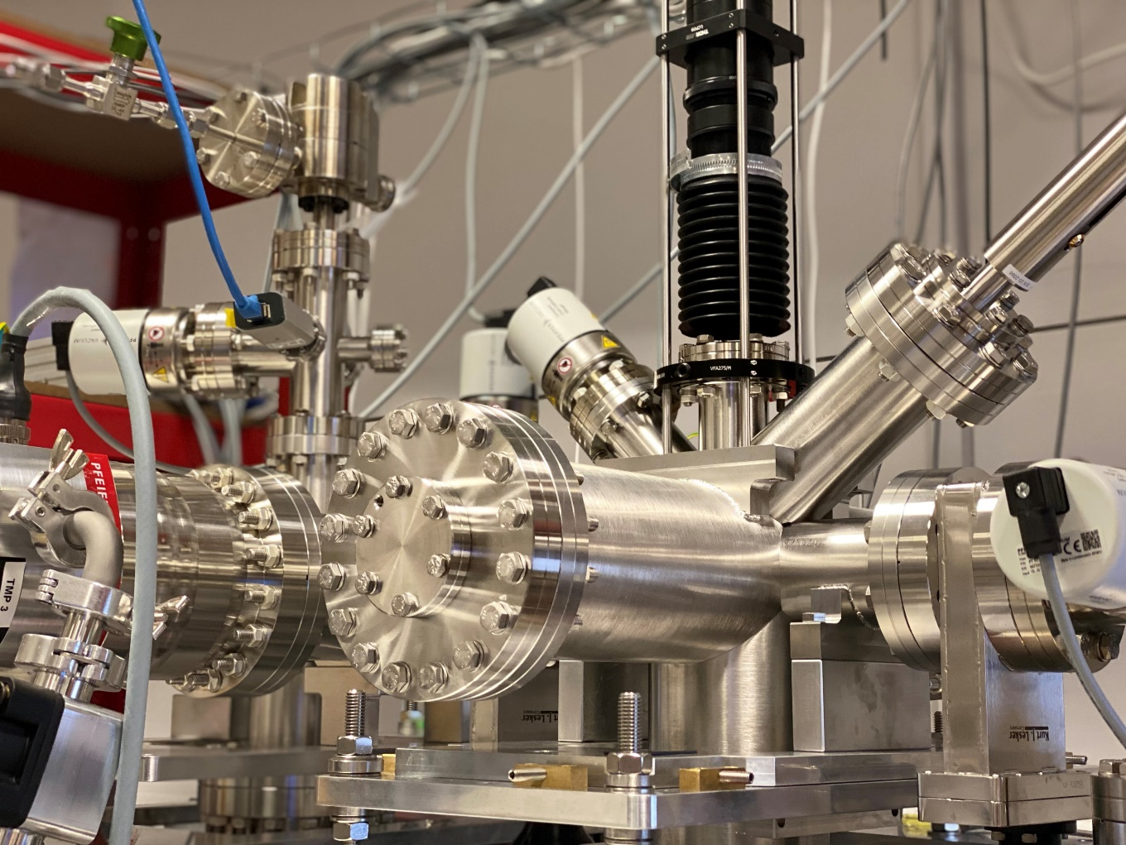
Different setups at the Cockcroft Institute
Monitor for keV beams
HLLHC prototype
HLLHC working instrument
NOVEL END-STATION DEVELOPMENT: CONSULTATION 1; 14th Dec. 2022

Slide 12
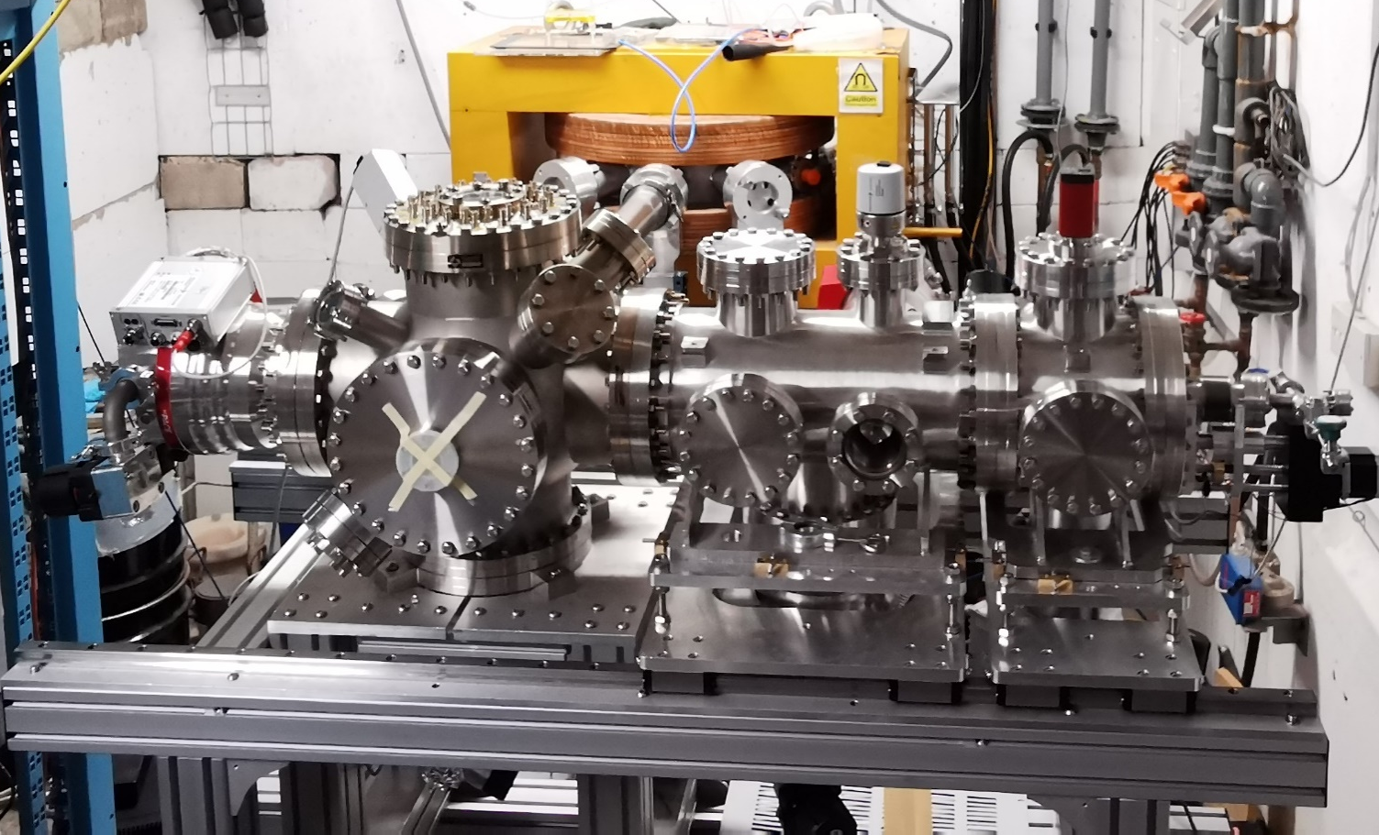

Measurements with protons at UoB MC40 cyclotron
Beamline
(ending with Ti foil)
Beam Parameters
Beam Species: Protons
Beam Energy: 28 MeV
Beam Current: 150-750 nA (on FC1)
Beam Collimator Area: 4-100 mm²
Proton
beam
(in vacuum)
125 µm
Ti foil
Interaction chamber
Beam
dump
125 µm
Ti foil
Proton
beam
(in air)
Proton
beam
(in vacuum)
NOVEL END-STATION DEVELOPMENT: CONSULTATION 1; 14th Dec. 2022
IOP PABG Annual Conference, Liverpool 25th-26th July 2022

Slide 13

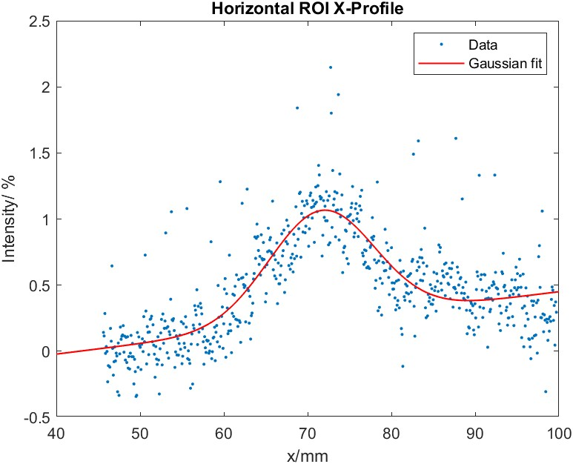
Measurements with protons at UoB MC40 cyclotron
Beam collimator Area= 100 mm²
Integration time = 1second
Gas Pressure in Interaction chamber = 1.2 ×10⁻⁵ mbar
σ = 5.4mm
Beam current at FC1= 150nA
Beam collimator Area= 4 mm²
Integration time = 20seconds
Gas Pressure in Interaction chamber = 1.2 ×10⁻⁵ mbar
σ = 6.4mm
Beam current at FC1= 150nA
NOVEL END-STATION DEVELOPMENT: CONSULTATION 1; 14th Dec. 2022
IOP PABG Annual Conference, Liverpool 25th-26th July 2022

Slide 14
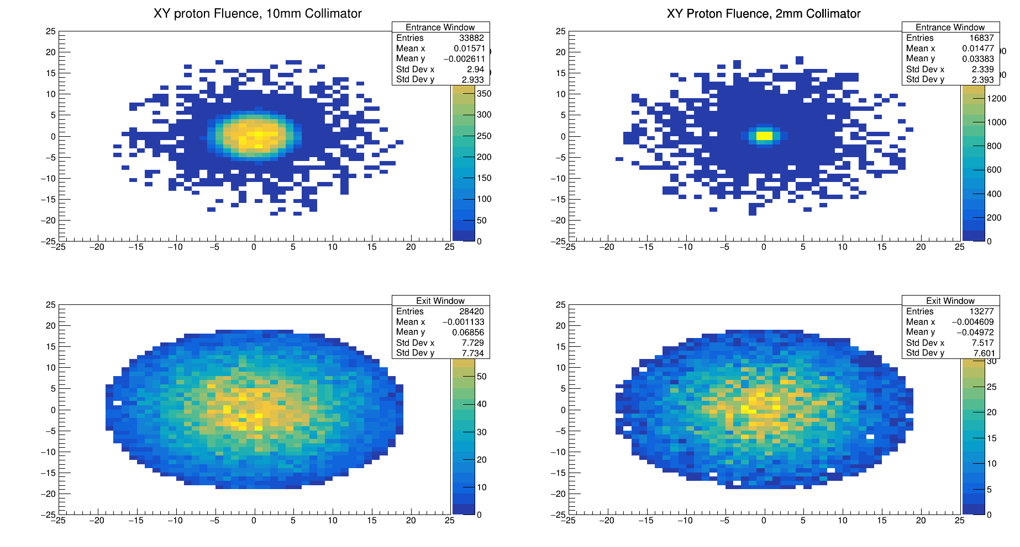
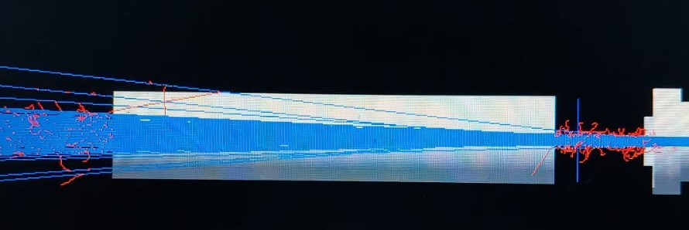
Simulation Results
GEANT4 simulations
NOVEL END-STATION DEVELOPMENT: CONSULTATION 1; 14th Dec. 2022

Slide 15
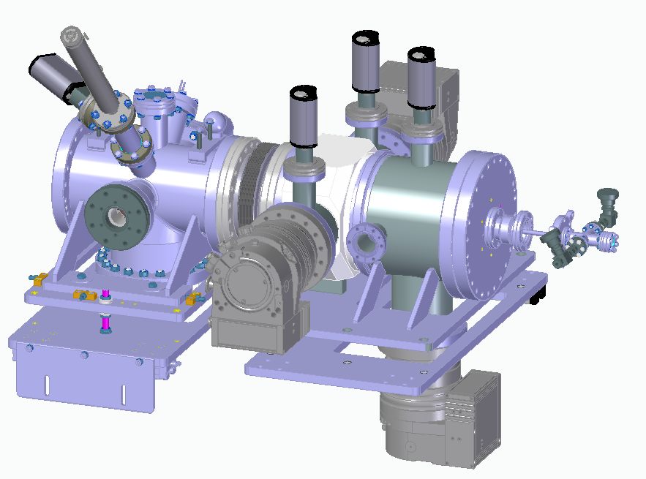
Updated design
More flexible design for nozzle skimmer assembly and tuning
Compact system: total length ≈ 1m
Skimmer Chamber
Interaction Chamber
Nozzle Chamber
Port for Laser Interferometry measurements
NOVEL END-STATION DEVELOPMENT: CONSULTATION 1; 14th Dec. 2022
IOP PABG Annual Conference, Liverpool 25th-26th July 2022

Slide 16
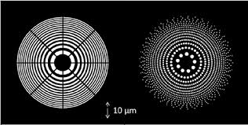


FZP-based QuantumJet: STFC IPS FOF
UHVD Collaboration
Key Features
  Sub-mm gas jet
  Analogous to wire scanner
  Using FZP as central element
  Profiling of high intensity beams
Work in Progress
  Chamber and holder designed for FZP
  Experiments were conducted using pinholes
  Pinhole size varies from 1mm to 50um
  Next step is to test the FZP (atom sieve)
  Test has started from 03rd Oct. 2022
Illustration of Fresnel Zone Plate used for the generation of focused quantum gas jet
Gas Jet
Fresnel Zone Lens
Quantum Gas Jet
Second Skimmer
NOVEL END-STATION DEVELOPMENT: CONSULTATION 1; 14th Dec. 2022

Slide 17
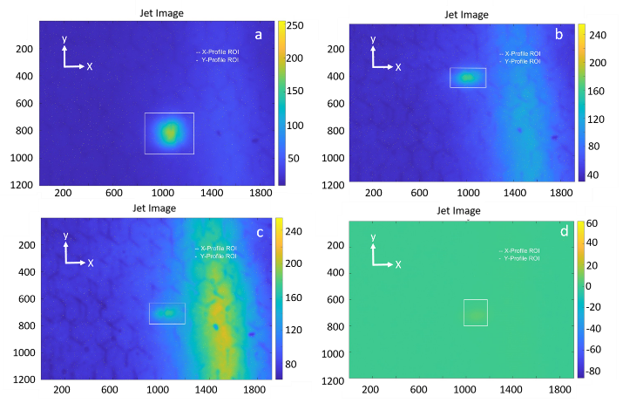
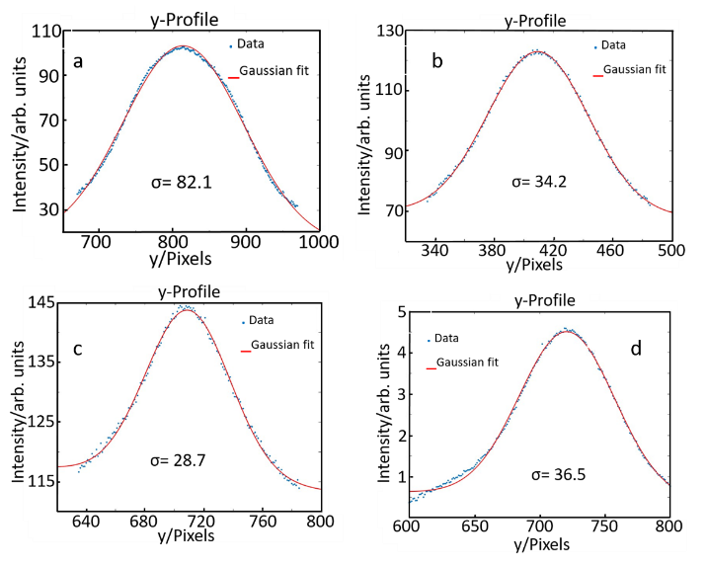
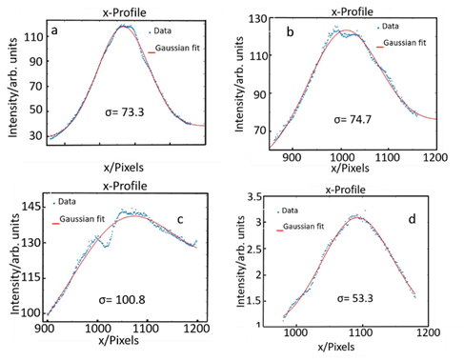
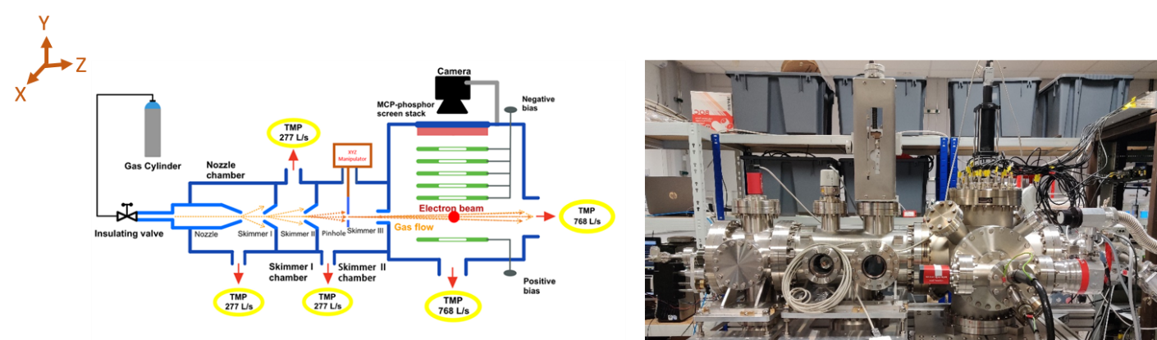
Measurements Results
Beam profile images obtained for various pinholes diameters: (a) 500µm, (b) 200µm, (c) 100µm and (d) 50µm. The integration time for each image is 6, 9, 30 and 300 seconds respectively
X beam profile obtained for various pinholes diameters: (a) 500µm, (b) 200µm, (c) 100µm and (d) 50µm
Y beam profile obtained for various pinholes diameters: (a) 500µm, (b) 200µm, (c) 100µm and (d) 50µm
NOVEL END-STATION DEVELOPMENT: CONSULTATION 1; 14th Dec. 2022

Slide 18
Summary
Advanced instrumentation is key to maximize benefits from proton/hadron beam therapy;
Clearly identified clinical benefits – reduction of QA time, giving medical experts additional safety during treatment;
Significant challenges remain for advanced treatment modalities such as FLASH or the LhARA initiative: There are no solutions at the moment for high dose treatment, high spatial and time resolution. This needs comprehensive R&D between leading academic and clinical groups.
NOVEL END-STATION DEVELOPMENT: CONSULTATION 1; 14th Dec. 2022
IOP PABG Annual Conference, Liverpool 25th-26th July 2022

Slide 19

Thank you for your attention
Special thanks to
I. Maltusch, O. Stringer, J. Wolfenden, H. Zhang, T. Price, C.P. Welsch, J. Yap

Slide 20
