Slide 1
a transformational approach to precision, personalised particle-beam therapy

Slide 2
The LhARA initiative
Vision:
Transform clinical practice of proton/ion-beam therapy by creating a fully automated, highly flexible system to harness the unique properties of laser-driven ion beams

Slide 4
LhARA initiative Programme org chart
Co-chairs: T. Greenshaw (Liv)
Y. Presado (Inst. Curie)
Co-spokes: A. Giacca (OIRO)
K. Long (IC/STFC)
Co-PMs: J. Parsons (Liv)
C. Whyte (Strath)
TBD
J. Parsons
C. Whyte

Slide 5
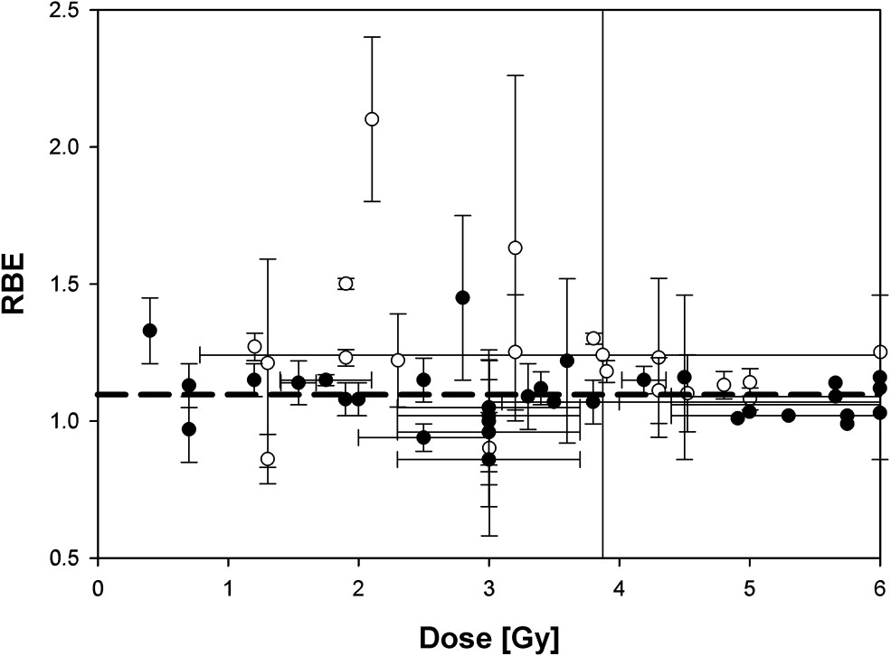
Radiation biology; a necessary way point
Relative biological effectiveness:
  Defined relative to reference X-ray beam
  Known to depend on:
    Energy
    Ion species
    Dose
    Dose spatial distribution
    Dose rate
    Tissue type
    Biological endpoint
Yet:
  All p-treatment planning uses RBE = 1.1
  Effective values are used for C⁶⁺
Maximise the efficacy of PBT now & in future:
  Systematic programme needed to develop
  full understanding of radiobiology
Paganetti,
van Luijk
(2013)
SemRadOncol

Slide 6
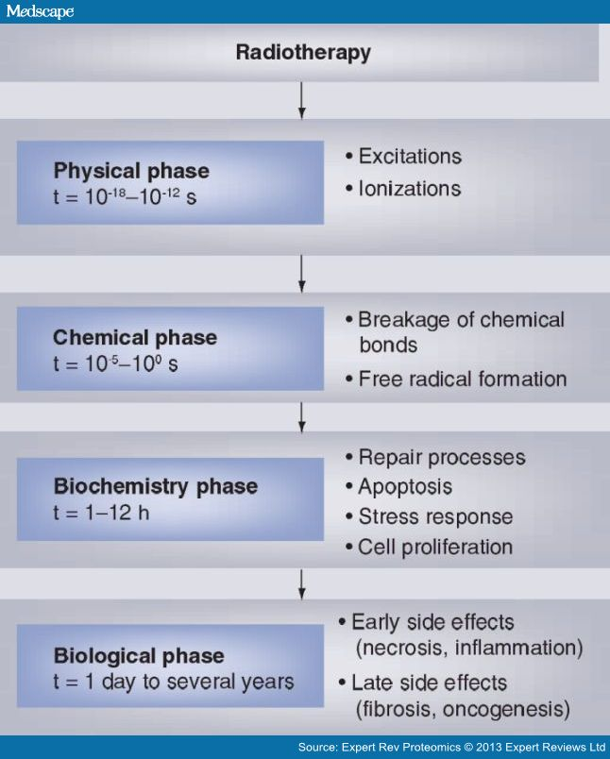
Radiobiology in new regimens
Time
domain
Space
domain
The ideally
flexible beam facility
can deliver it all!
⇒ substantial
opportunity for a
step-change in
understanding!
Ion
species
Energy
Multidisciplinary approach essential
In combination
and with chemo/immuno therapies

Slide 7
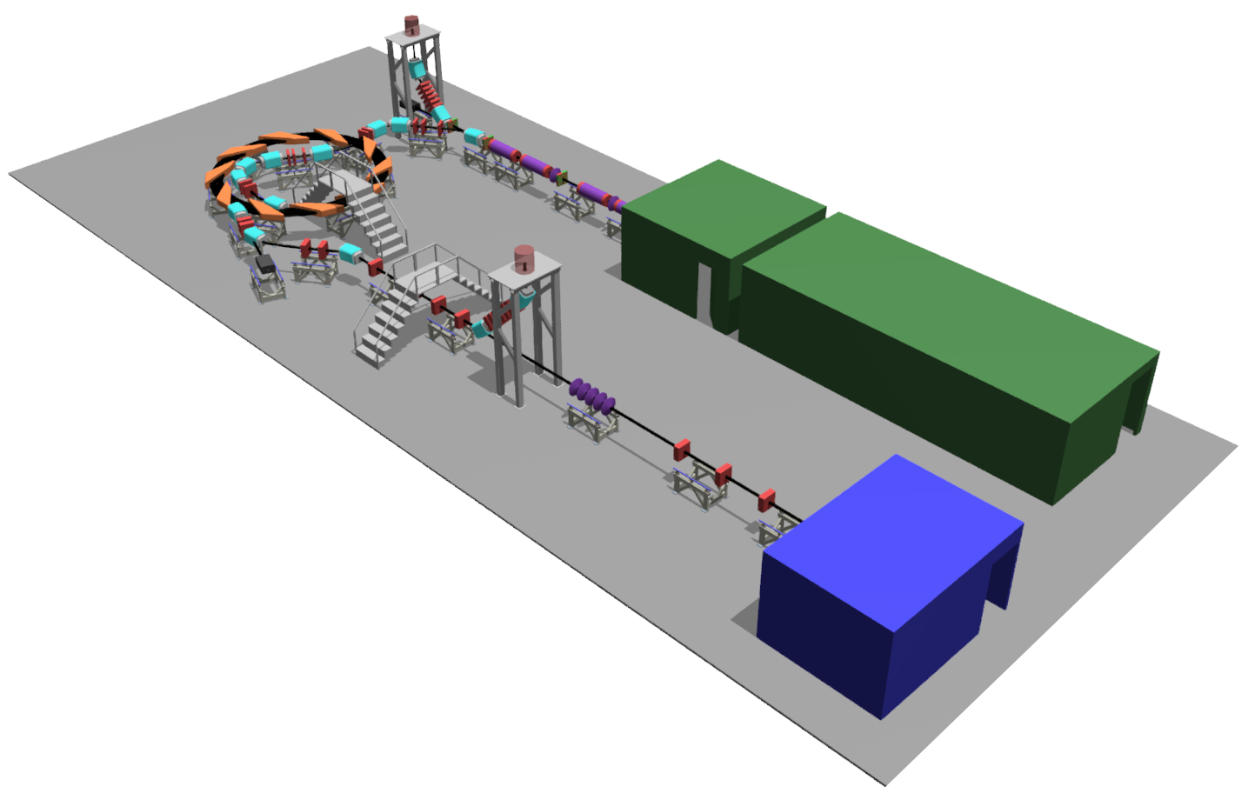

Front. Phys., 29 September 2020; DOI: 10.3389/fphy.2020.567738

Slide 8
Laser-hybrid Accelerator for Radiobiological Applications
A novel, hybrid, approach:
Laser-driven, high-flux proton/ion source
  Overcome instantaneous dose-rate limitation
    Capture at >10 MeV
  Delivers protons or ions in very short pulses
    Bunches as short as 10—40 ns
  Triggerable; arbitrary pulse structure
Novel “electron-plasma-lens” capture & focusing
  Strong focusing (short focal length) without the use of high-field solenoid
Fast, flexible, fixed-field post acceleration
  Variable energy
    Protons: 15—127 MeV
    Ions: 5—34 MeV/u
Front. Phys., 29 September 2020; DOI: 10.3389/fphy.2020.567738

Slide 9
LhARA to serve the Ion Therapy Research Facility
2-year Preliminary Activity – Project start 01Oct22: CCAP-TN-10
To serve ITRF: 2 + 3-year project
in 6 work packages:
  Project Management
  Laser-driven proton and ion source
  Proton and ion capture
  Real-time dose-deposition profiling
  Novel, automated, end-station development
  Facility design and integration
2-year preliminary phase;
Flagged need for further 3-year preconstruction phase

Slide 10
K. Long
A. Giacca
C. Whyte
D. Kordopati

Slide 11
Unique beams:
Triggerable, max rate 10 Hz
Arbitrary pulse structure
  E.g. pump probe
Minimum bunch lengths:
  10 ns at Low-energy in-vitro end station
  40 ns at High-energy in-vitro and In-vivo end stations
Dose distribution:
  Low-energy in-vitro end station:
    Quasi uniform over 3.5 x 3.5 cm²
    Spot to be studied
  High-energy in-vitro and In-vivo end stations:
    Spot ~1 mm
    Uniform distribution over circle with diameter 1—3 cm
  Production of “more conventional” parameters to be studied
End stations must maximise scientific return:
Extended uninterrupted operation:
  In vitro: 16—24 hours
  In vivo: maximum consistent with animal welfare
Advanced, time resolved (<0.1s) instrumentation

Slide 12
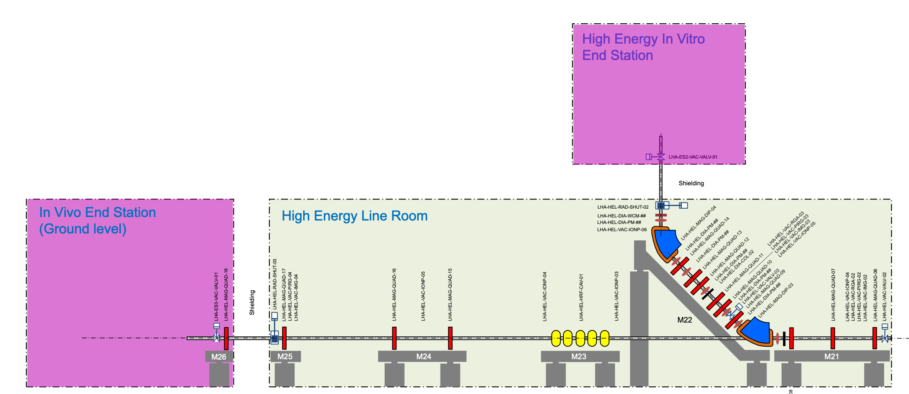
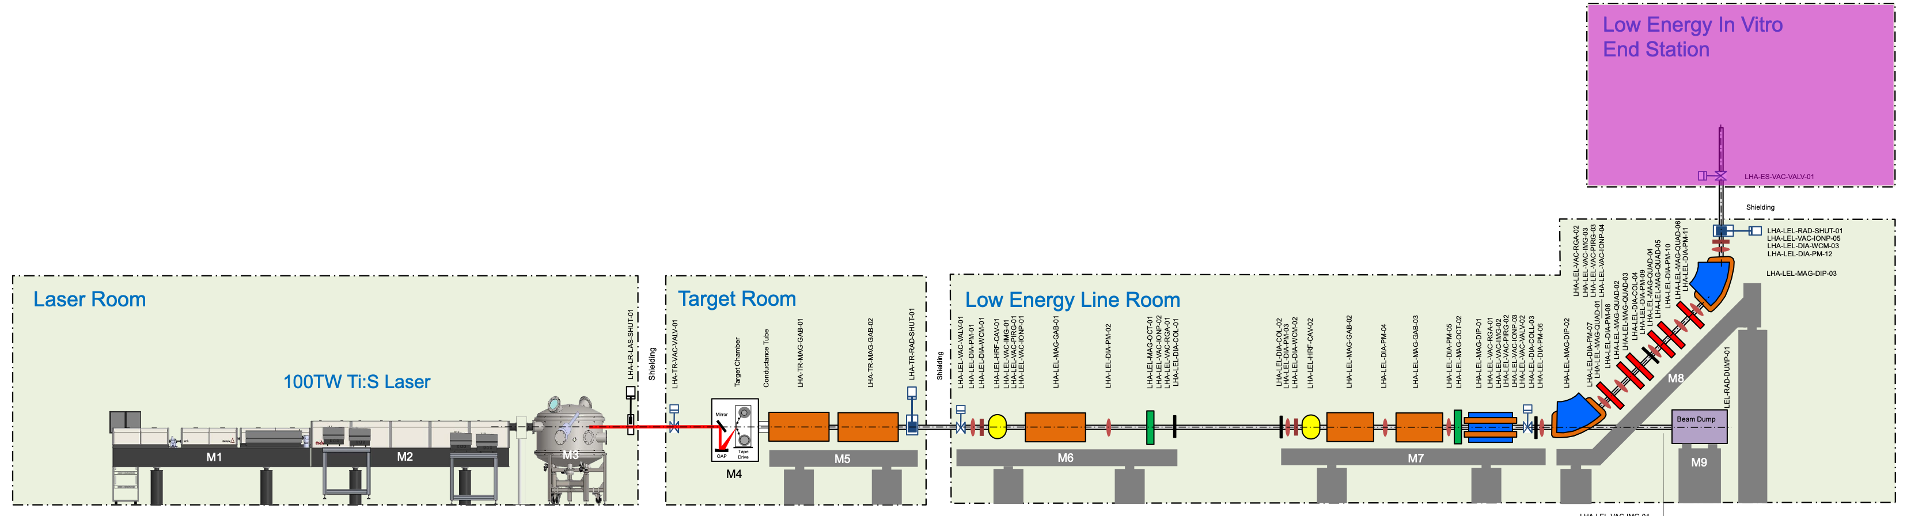
Baseline:
Stage 1
Stage 2
protons
15 –
5 –
to

Slide 13
Instrumentation:
Beam-line instrumentation:
  Variety of challenges:
    Low energy ions
    Short, intense bunches
Irradiation beam measurements:
  Parasitic measurement of dose and dose profile:
    During exposure, at 10 Hz or better
Novel instrumentation for time-resolved studies:
  Exploit triggerable, arbitrary (down to 0.1 s) bunch structure
  E.g.:
    High rep-rate, “ultra-fast” transmission, excitation, or absorption spectroscopy

Slide 14
Operational considerations
(some) Key considerations:
Cell culture
Environment regulation
Animal handling
Exposure using different ion species
Automated sample handling and analysis
Biochemical analysis
Microscopy
…

Slide 15
And so …
Excited now to develop the ideas through these w/s…

