Slide 1
Radioactive Waste in a Sustainable Accelerator Facility:
Lessons from ISIS
Notes:
The abstract pattern can be removed or repositioned if required. Be careful to ‘Send to Back’ so that it does not obscure any important information.

Slide 2
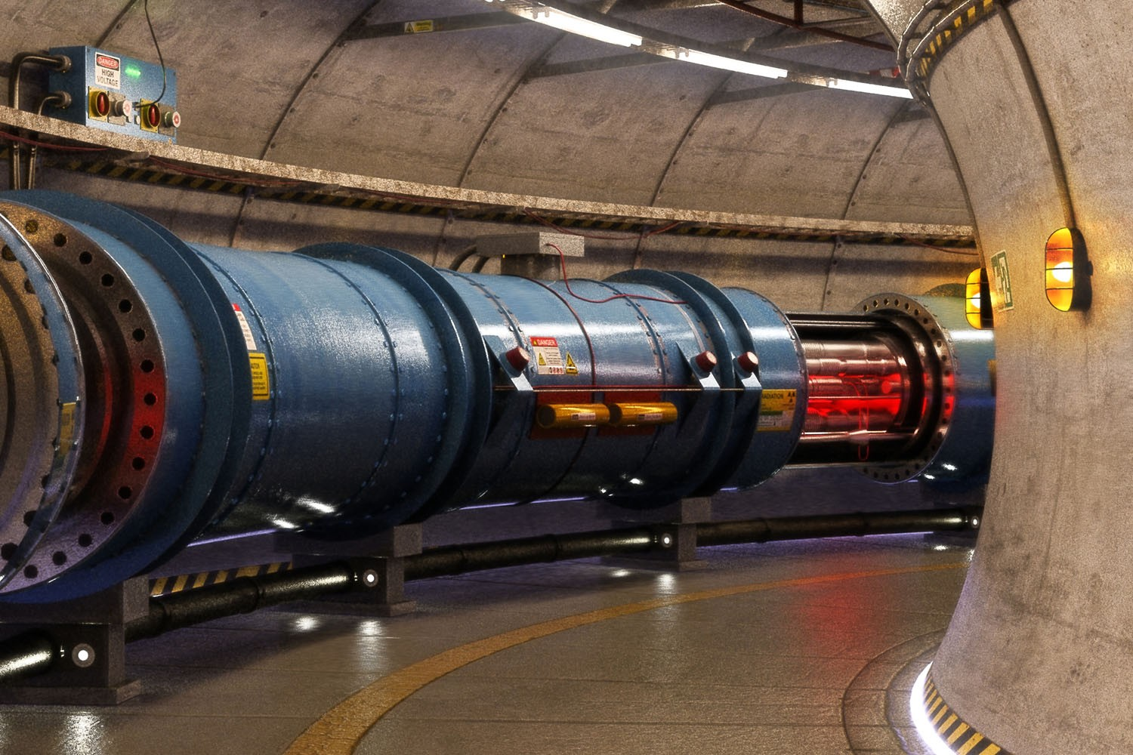
>30,000 particle accelerators in world
Notes:
To edit the background image, select ‘Format’ from the PowerPoint menu and ‘Slide Background’ from the drop-down menu. Within the new list of options that appears on the right of the screen, select the ‘File’ button under ‘Insert picture from’ and select your image from your file browser. Please remove or amend the image credit if you are using a different image to the one provided.

Slide 3
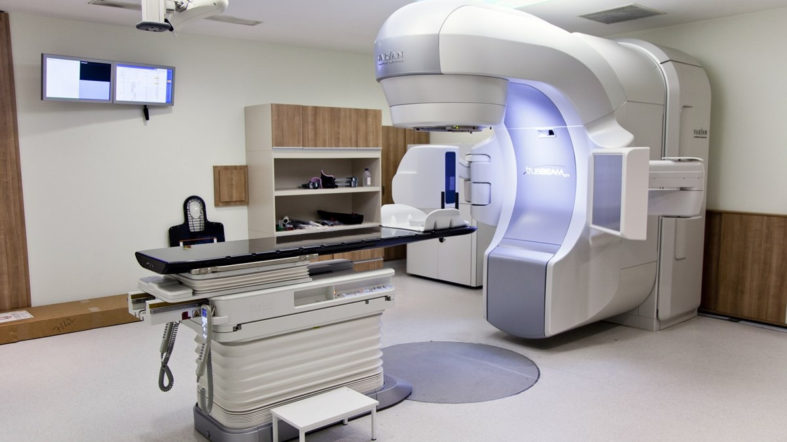

Slide 4
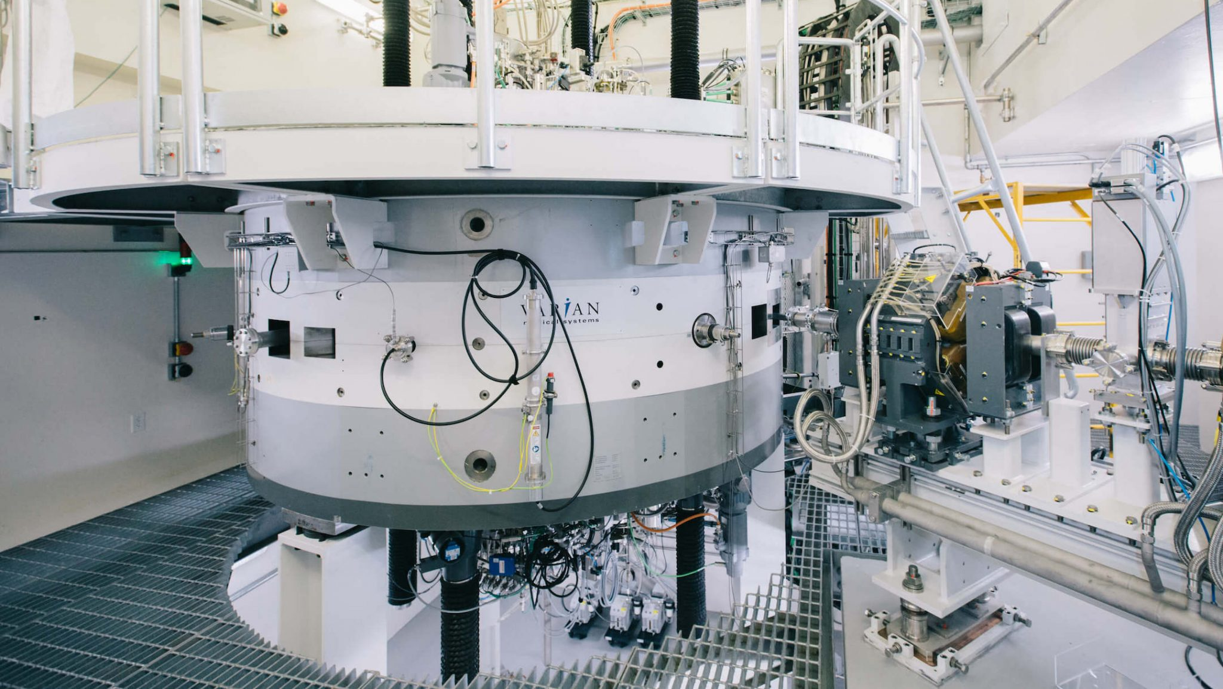

Slide 5
Notes:
To edit the background image, select ‘Format’ from the PowerPoint menu and ‘Slide Background’ from the drop-down menu. Within the new list of options that appears on the right of the screen, select the ‘File’ button under ‘Insert picture from’ and select your image from your file browser. Please remove or amend the image credit if you are using a different image to the one provided.

Slide 6
Formation of Radioactivity
Complex nuclear reactions and nuclear cascades form radioactivity
Long lived radionuclides are relevant for waste management
Electron Accelerators
Not (usually) significant < 13 MeV
radioactivity from secondary photo-nuclear interactions
Generally less significant than proton accelerators
Proton/ion Accelerators
Threshold reactions can occur at almost all energies
- activation of accelerator
At higher energies, spallation and neutron production starts
- activation of surrounding material

Slide 7
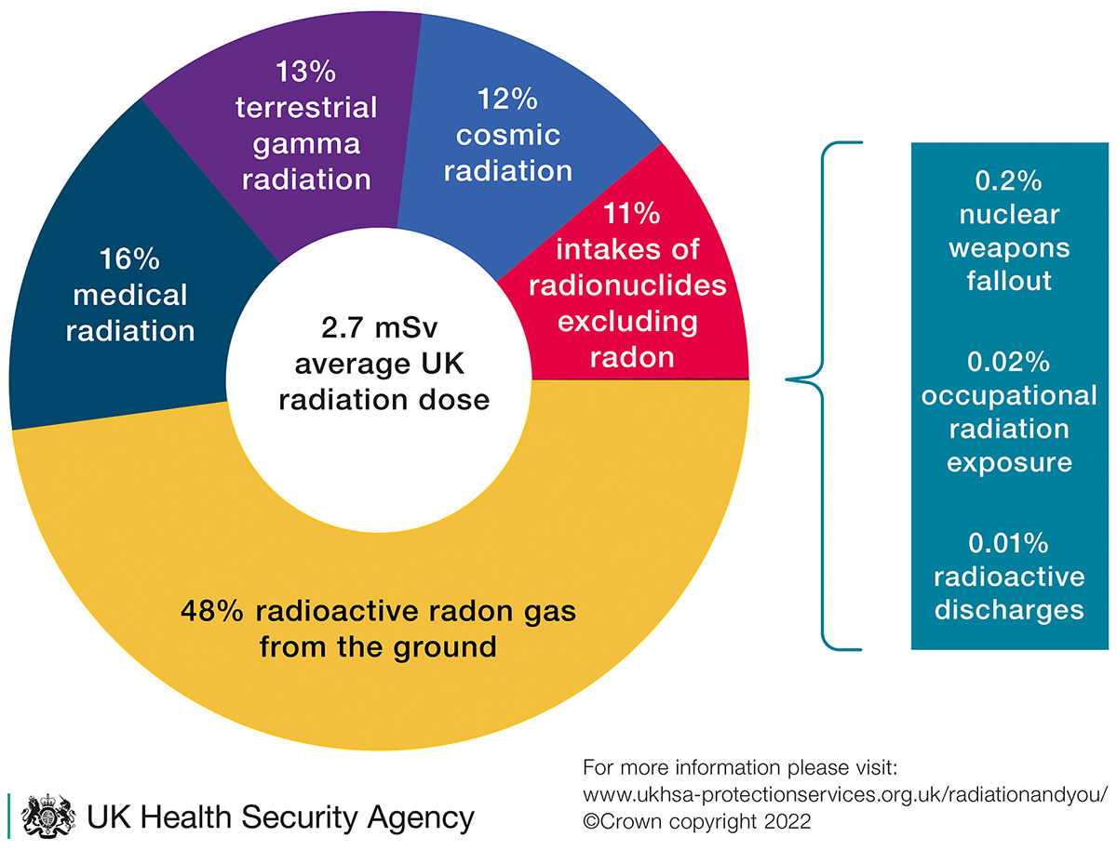
Scale of Radioactivity
Radioactivity is measured in
disintegrations per second, Becquerel (Bq)
Hazard is measured in
Sieverts (Sv)

Slide 8
Impact of Regulation
Germany
Strict and proscriptive regulation system
Risk based approach allows for controlled recycling of radioactive waste
Highly regulated sector
Large differences between national regulation and policies
Optimum solutions will be different for different nations
France
Zoning system
Waste from specified zones always radioactive, regardless of activation
UK
Strict, but goal setting system
Does not allow recycling of radioactive waste
Notes:
Replace this guidance text with your own bullet pointed content.
For further guidance please see https://www.bdadyslexia.org.uk/advice/employers/creating-a-dyslexia-friendly-workplace/dyslexia-friendly-style-guide

Slide 9
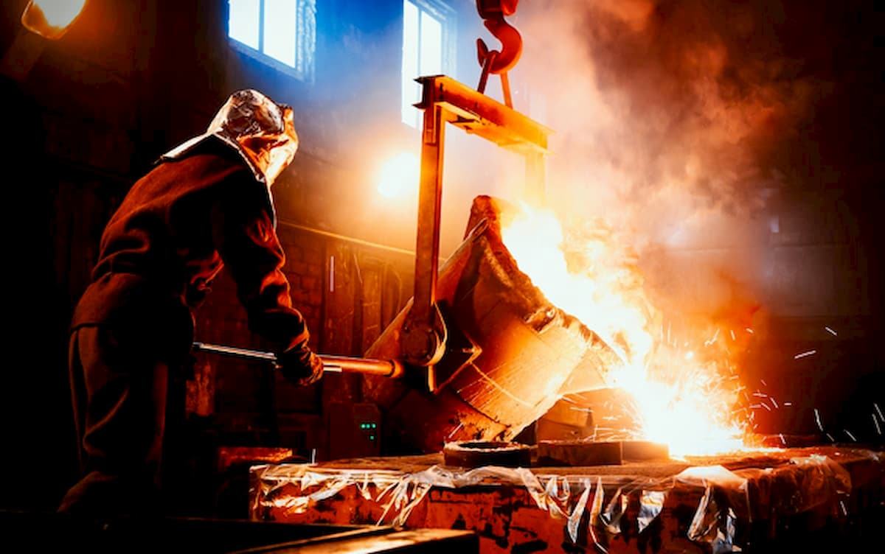
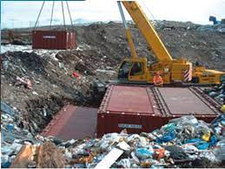
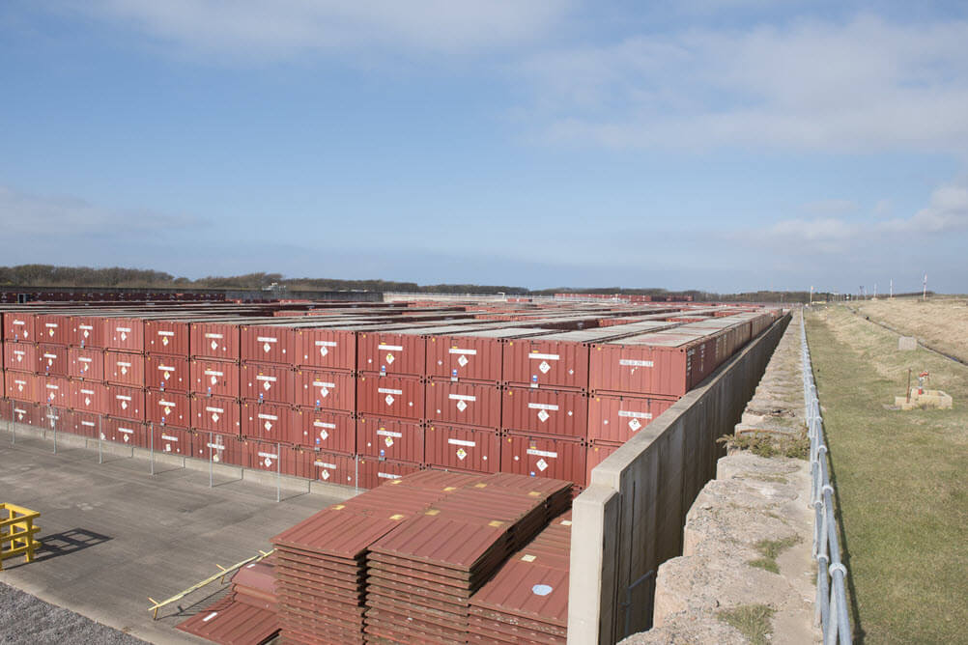
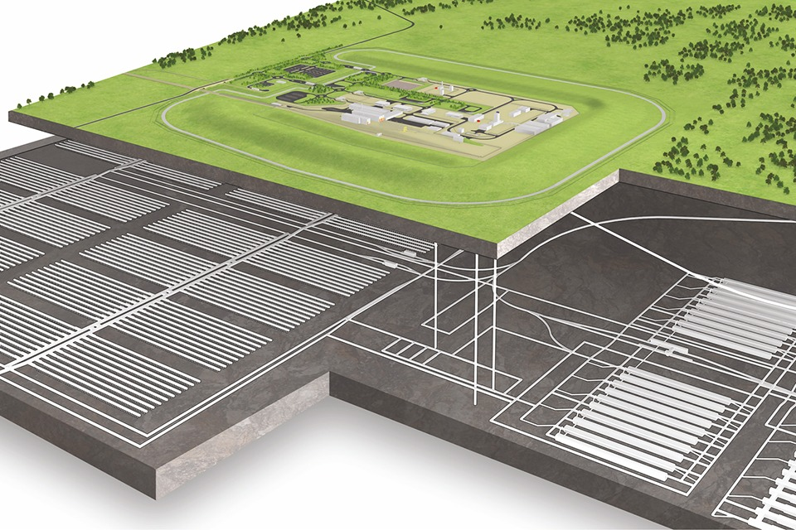
Scale of Radioactive Waste
Quantity
of Waste
Extra Hot
Hot
Mild
Lemon &
Herb
Activity
“legally not
Radioactive”
Low Activity
Low Level Waste
(LA-LLW)
Low Level
Waste (LLW)
Higher Activity
Waste (ILW/HAW)
Recycling
Specialist Landfill
National Repository
Geological Disposal

Slide 10
Environmental
Legal duty to apply Best Available Technique (ALARA) to minimise
Volume
Activity
Harm
Everything above free-release limit either;
Treated get below free-release limit,
Buried in the ground, or
Stored in specialist facilities
Solid waste must be isolated from human environment
Primary harm is lost resource, not radiation
Prevent
Recycle
Reduce
Reuse
Dispose

Slide 11
Social: Public Perception
National & Local Policy
Regulation
Organisational Culture
Often outweighs Economic and Environment considerations
Consequence
Very low limits for recycling or reuse
Poorly optimised regulation
Slow decision making
High Costs

Slide 12
Economic: Cost
What would it cost to dispose ISIS current waste right now?
Waste Category | Current Volume | Disposal Cost
LA-LLW | 1,140 te | ~ £2.2 M
LLW | 100 te | ~ £1.5 M
ILW | 70 te | ~ £ 70 M
LLWR
~£10-20,000/te
Recycle Profit
£100/te –
£8,000/te
Landfill
~£2,000/te
Hell
ILW
>£1,000,000/te
Hot
Spicy
Mild
“legally not
Radioactive”
Low Activity
Low Level Waste
Low Level
Waste
Intermediate
Level Waste
This is just disposal cost

Slide 13
Economic: Capacity
Accelerators can generate some highly active hazardous wastes
ISIS lacks capability to retrieve, sort, size reduced package and immobilise our higher activity wastes.
UK lacks capacity for disposal
GDF in early planning stages
Waste must be safely store for ~20-90 years
GDF schedule 2040 - 2108

Slide 14
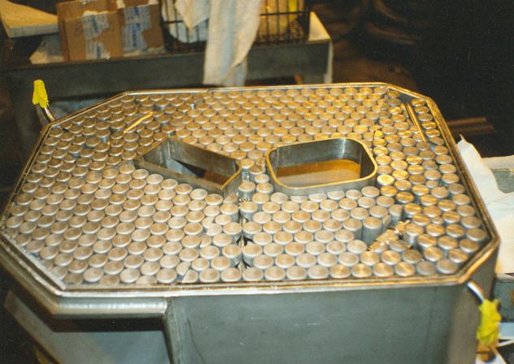
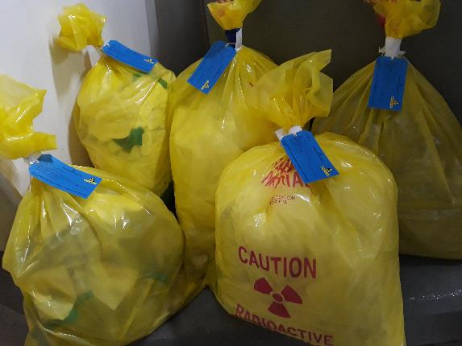
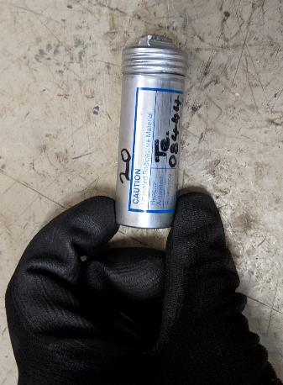
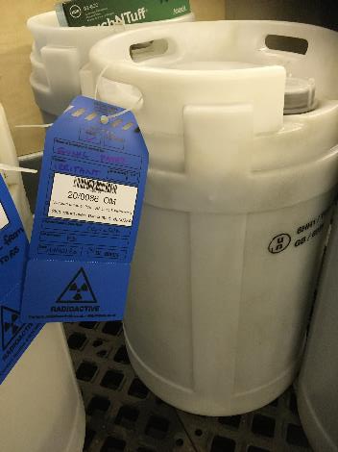
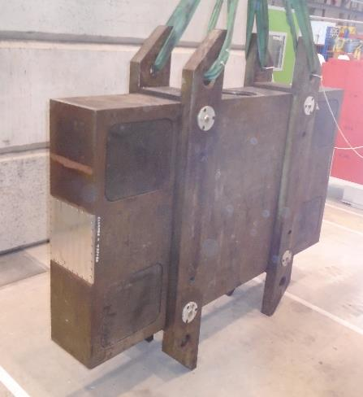
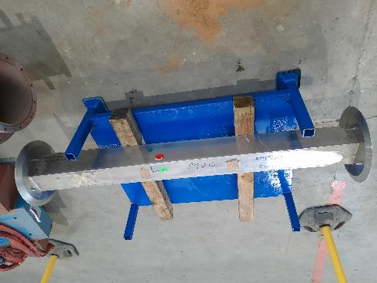
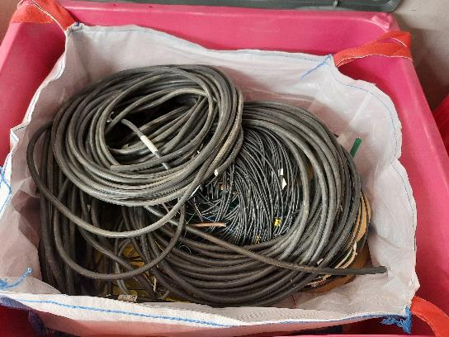
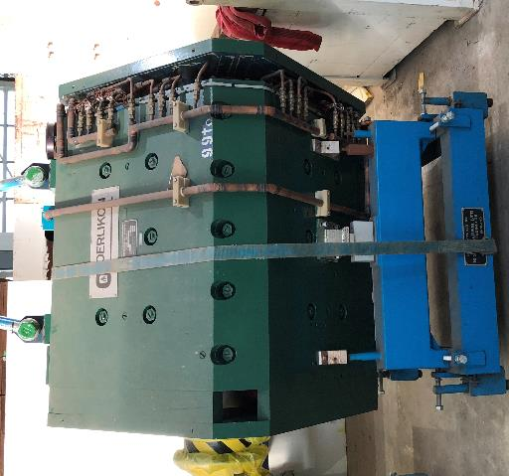
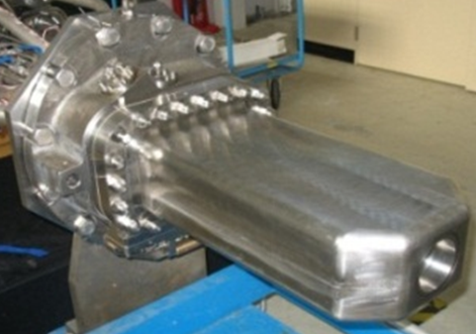
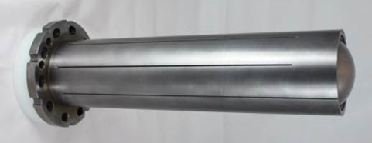
Radioactive Waste at ISIS

Slide 15
Lifetime Radioactive Waste
There are over 30,000 particle accelerators in the world
Typical Medical LINAC | ~0.3 tonne ¹
Typical PET Cyclotron | ~100 – 500 tonnes¹
ISIS Neutron Source | ~40,000 tonnes²
European Spallation Source | ~60,000 tonnes³
UK Nuclear Station | ~30,000 – 60,0000 tonnes²
Total Forecast UK Radioactive Waste | ~5,000,000 tonnes²
ISIS radioactive waste
150 – 300 tonnes of radioactive waste per year
~30,000 – 35,000 tonnes decommissioning
1 – IAEA NW-T-2.9, Decommissioning of Particle Accelerators, 2020 2 – UK Radioactive Waste Inventory, 2022 (Approximations converted from m³) 3 – Decommissioning Plan for European Spallation Source, EPJ Web of Conferences 153, 05022 (2017)
Notes:
To edit the pie chart data. Click on the chart, Chart design, and choose select data or edit chart data in excel.

Slide 16
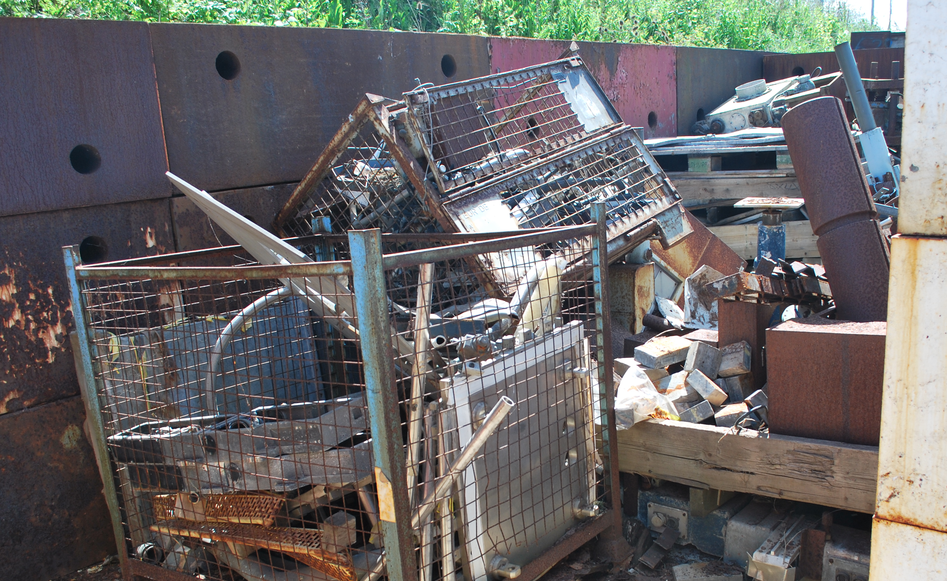
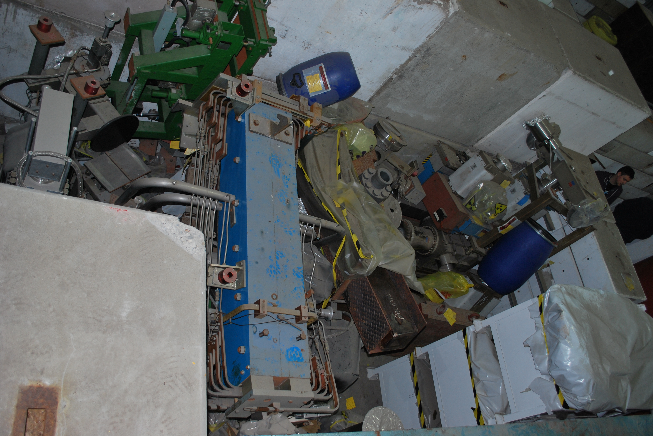
ISIS Waste Problems
Accelerator operation started at RAL in 1950s
ISIS started operation in 1984
By 2017 reached a peak on site of
~2,500 tonnes radioactive waste
~40 PBq waste
Waste not sustainably managed!

Slide 17
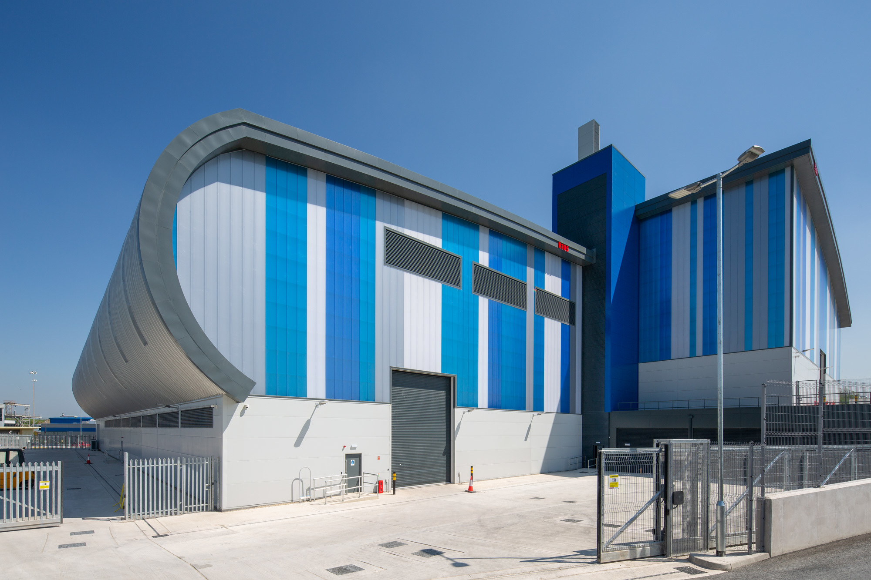
Waste Reduction
Focus on waste reduction started in 2017
Build capability & facilities
Develop methods
Improve standards and culture
Dispose of waste legacy
Establish sustainable waste management systems
To date disposed of 65% of the legacy waste
Average ~100 tonnes/a (60%) diverted to recycling

Slide 18
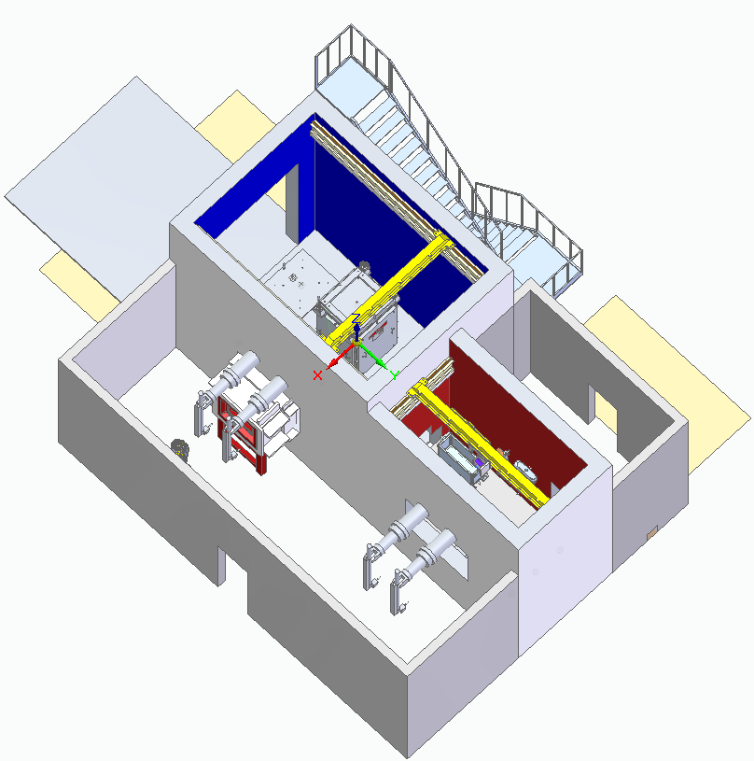
Waste Remote Handling
Investing in remote handling infrastructure
Will provide a long term (sustainable) capability to segregate, characterise and package higher activity wastes
Support ISIS maintenance and re-use of highly active components

Slide 19
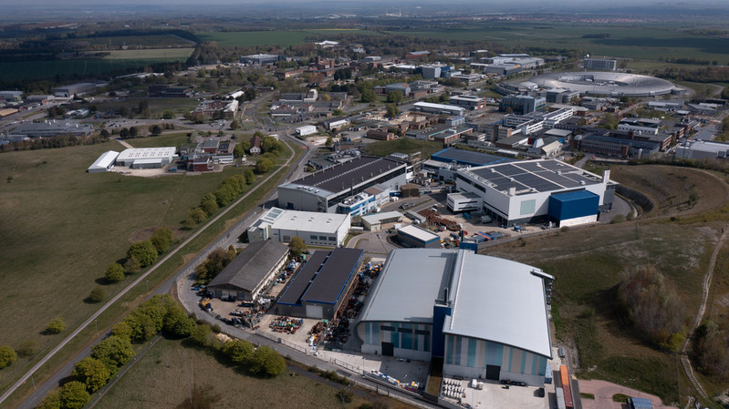
Lessons to Learn
Understand what you expect to generate
Plan and mange through the full lifecycle
Minimise
Segregation
Processing
Storage
Disposal
Adequate facilities
Plan for site legacy after operation

Slide 20
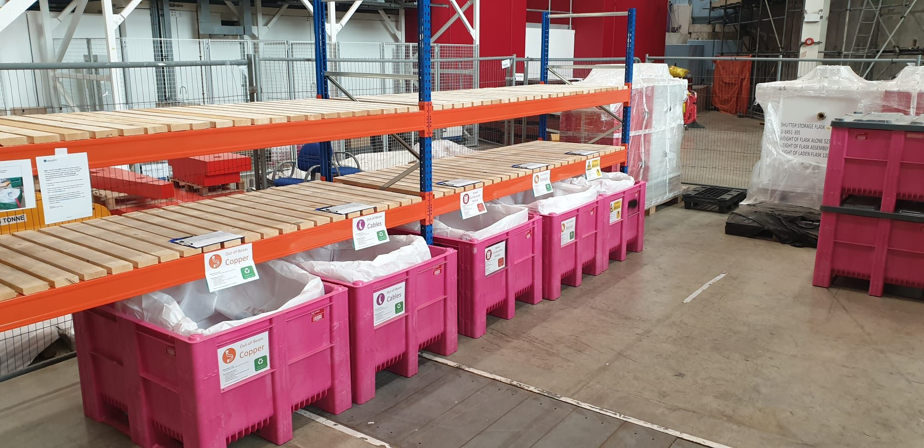
Minimise, Segregate & Divert Waste
Minimise Beam Loses
Reduces incidental activation of materials
Segregation
Separation of non-active or low active materials
Separation of material types
Design for segregation
Material Selection
Choosing the right materials minimises long lived activation
Characterisation
Careful measurement allows release of materials for recycling
Stainless Steel
Iron / Steel
Increasingly Challenging Nuclides
Decay Storage
Storage until short lived radionuclides have decayed
Aluminum
Plastic / Wood

Slide 21
Decay Storage
Typical decay curve for ISIS activated carbon steel
Decay storage is powerful tool
Our regulators limit ISIS to 7 – 15 years storage, depending on material
Challenges to consider
Space
Facilities
Hazard
Future Commitment
Median time for ISIS steel to decay for recycling;
LA-LLW = 15 years
LLW = 50 years
ILW = 3,500 years

Slide 22
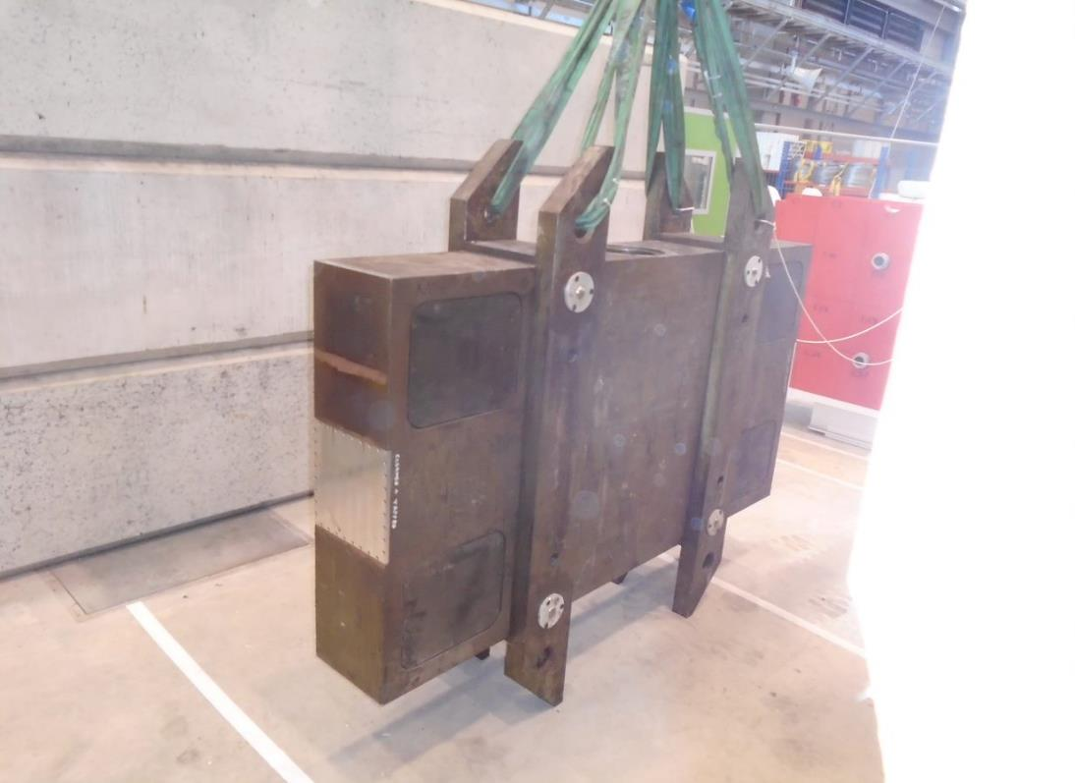
Setting a Challenge: Shutter Design
Highly activated
TS1 Shutter ~9 tonnes
TS2 shutter ~3 tonnes
Don’t have a disposal solution
Potential £millions per shutter
Not uniformly activated
Opportunities
Material selection?
Ease of disassembly?
Re-use shutter?

Slide 23
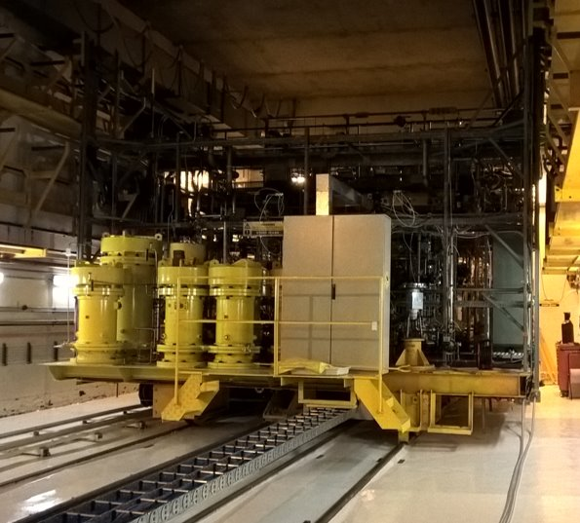
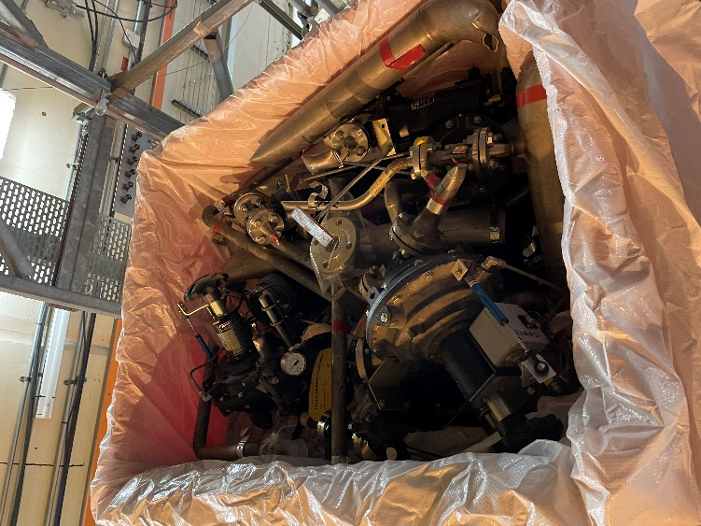
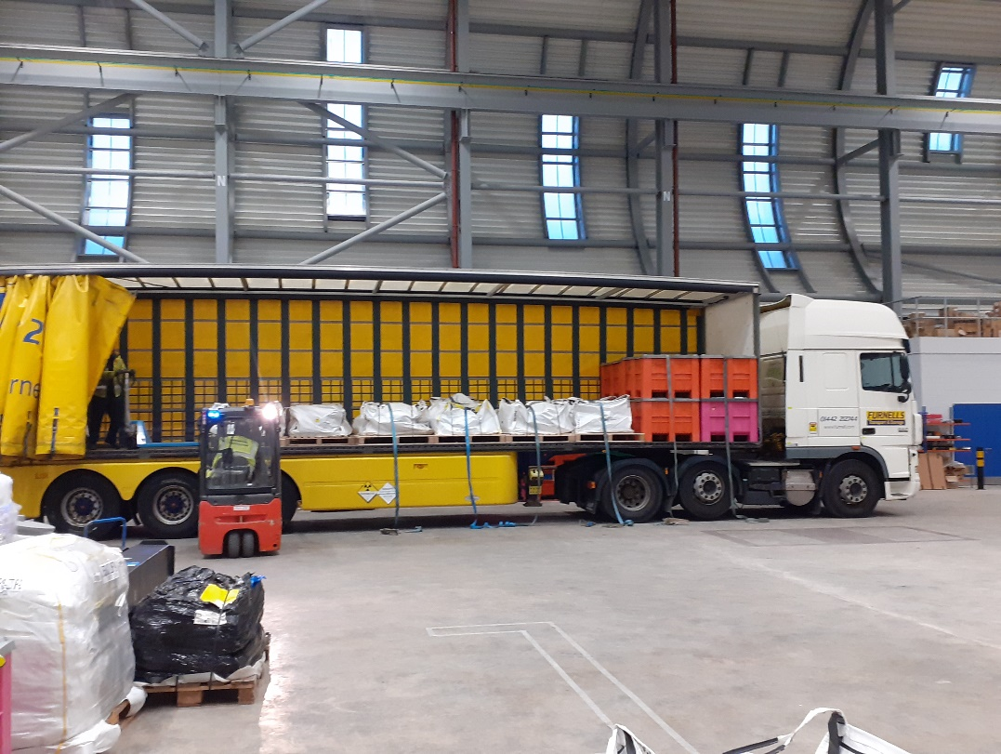
ISIS TS1 Project
Target Services Area
Forecast 192 packages
Created 189 packages
Disposal achieved <18 months
Success due to…
Prior planning
In-situ
- segregation
- packaging
- sampling
Co-operation between waste and project teams
Facilities and capability

Slide 24
isis.stfc.ac.uk
@ISISNeutronMuon
STFC
Notes:
The abstract pattern can be removed or repositioned if required. Be careful to ‘Send to Back’ so that it does not obscure any important information.

