Slide 1
Accelerator Impact Report: RUEDI
A progress update
Katie Morrow
Group members: Ben Shepherd, Louise Cowie, Anthony Gleeson, Gary Hughes, Storm Mathisen, Hywel Owen, Andrew Vick.
Ben Shepherd MaRS
Louise Cowie RF
Anthony Gleeson Business
Gary Hughes Facilities
Storm Mathisen Diagnostics
Hywel Owen Acc Physics
Andrew Vick Vacuum
Katie Morrow Lasers
Notes:
Hi Everyone I’m Katie morrow and today I will be talking to you about the work we’ve been doing in the sustainable accelerator taskforce here at daresbury. Over the last few months., we have been looking into the environmental impact of an accelerator facility and I am here to give you an update on our progress so far and initial findings. Of course not all the work I am presenting today was done by me there are a number of us working on this project so thanks to those who have provided me with slides for this talk

Slide 2
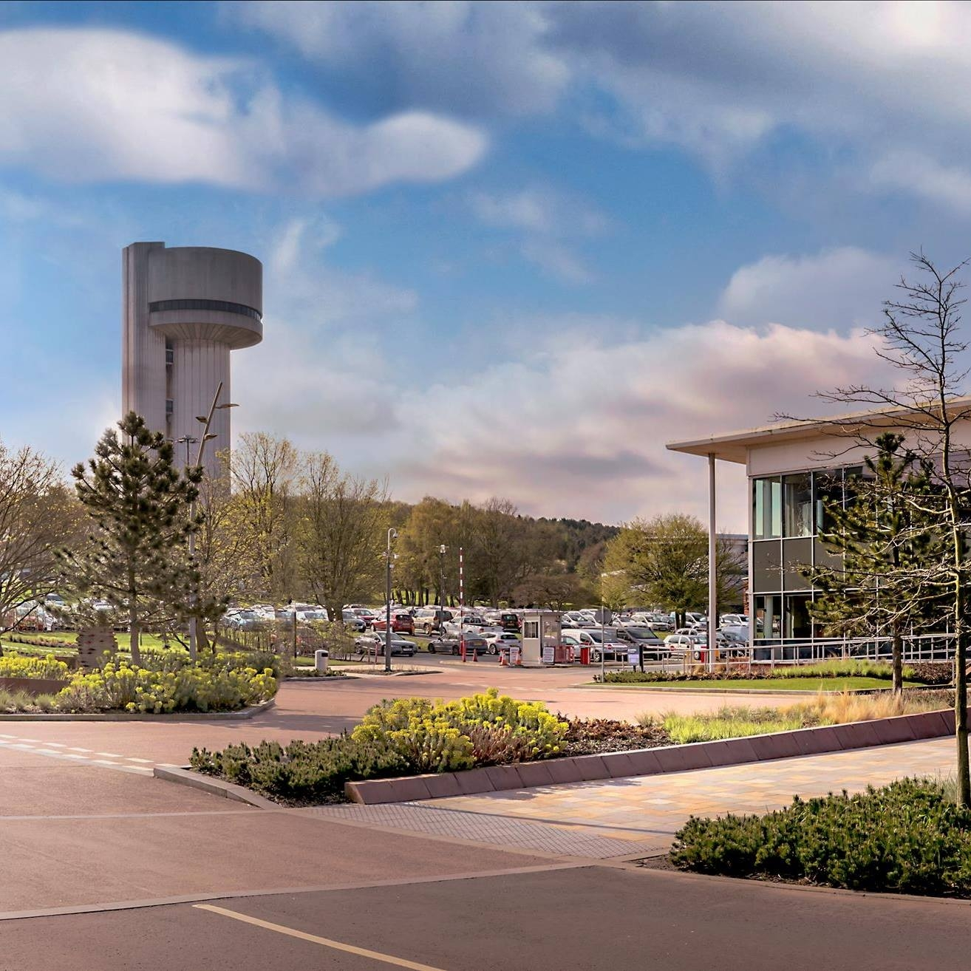
Overview
Introduce: goals, motivation, and the facility.
Share progress on analysis of impact:
RF systems
Laser and timing systems
Magnets
Diagnostics
Vacuum
Controls and computing
Infrastructure
Climate control
Present initial findings
Image © STFC John Dawson
Notes:
So what will I be talking about? First I’ll talk about why we have undertaken this project and what we hope to get out of it. And Of course I will have to tell you a little bit about the facility itself. Then I will detail the work done so far into calculating the carbon footprint of each of these areas. Finally I will show a summary of the carbon footprint of the whole accelerator so we can see what is the largest overall contributor before reiterating the best methods we have found to reduce the carbon footprint

Slide 3
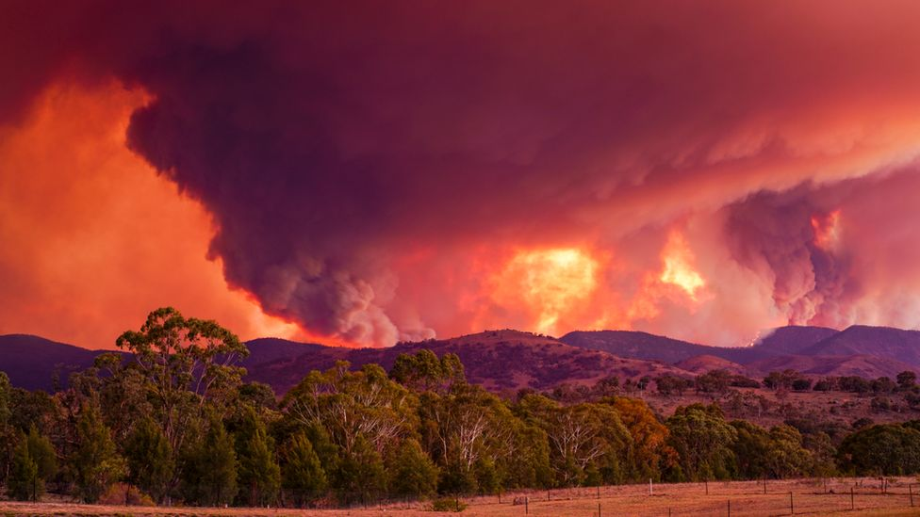
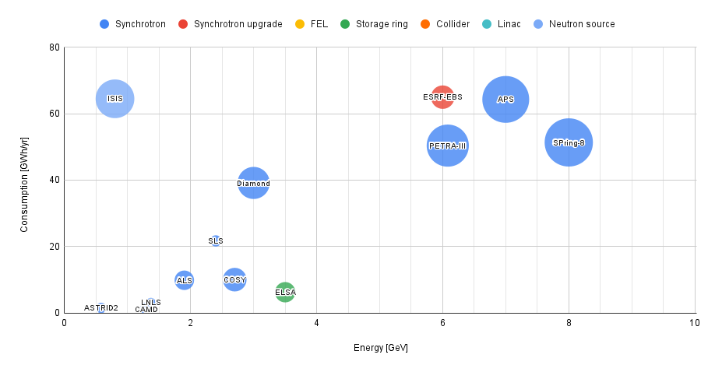
Australian bush fires 2019-2020
Motivation and Goals
Motivation:
The climate crisis!
STFC commitment to net zero by 2040
Accelerators use a lot of electricity and produce a lot of CO₂
Goals:
Analyse carbon footprint of a facility
Identify key areas that contribute
Find the most impactful solutions
Conclusions easily transferrable to other facilities
= x 2 billion
Notes:
Motivation is possibly an obvious one: people are already experiencing the devasting effects of climate change: climate related distasters have tripled in the last 30 years, more than 20 million people a year are being forced from their homes because of it
We all have a responsibility to try to reduce our contribution to climate change if we are to keep it at a manageable level.
As an organisation we are aiming to be net zero by 2040 so we need to start considering how we can reduce our carbon emissions now! 3rd^{nd} bullet. Isis for example uses just over 60 gwh of electricity per year eq to 2 billion cups of tea (amount of tea takes us to drink in 20 days) So are a good palce to start.
The goals of the impact report we are writing are: 1st bullet, using RUEDI as a case study.
Conclusions are applicable to other facilities and hopefully will influence future facilties being built to make more sustainable choices.
Source:
Climate change facts: https://www.oxfam.org/en/5-natural-disasters-beg-climate-action
Australia bushfire image: https://www.abc.net.au/news/2020-01-29/view-of-the-namadgi-bushfire-with-houses-in-the-foreground-1/11909624
Cup of tea: https://www.clipartmax.com/middle/m2i8K9H7i8H7A0d3_cup-of-sweet-tea-cartoon-images-of-tea/

Slide 4
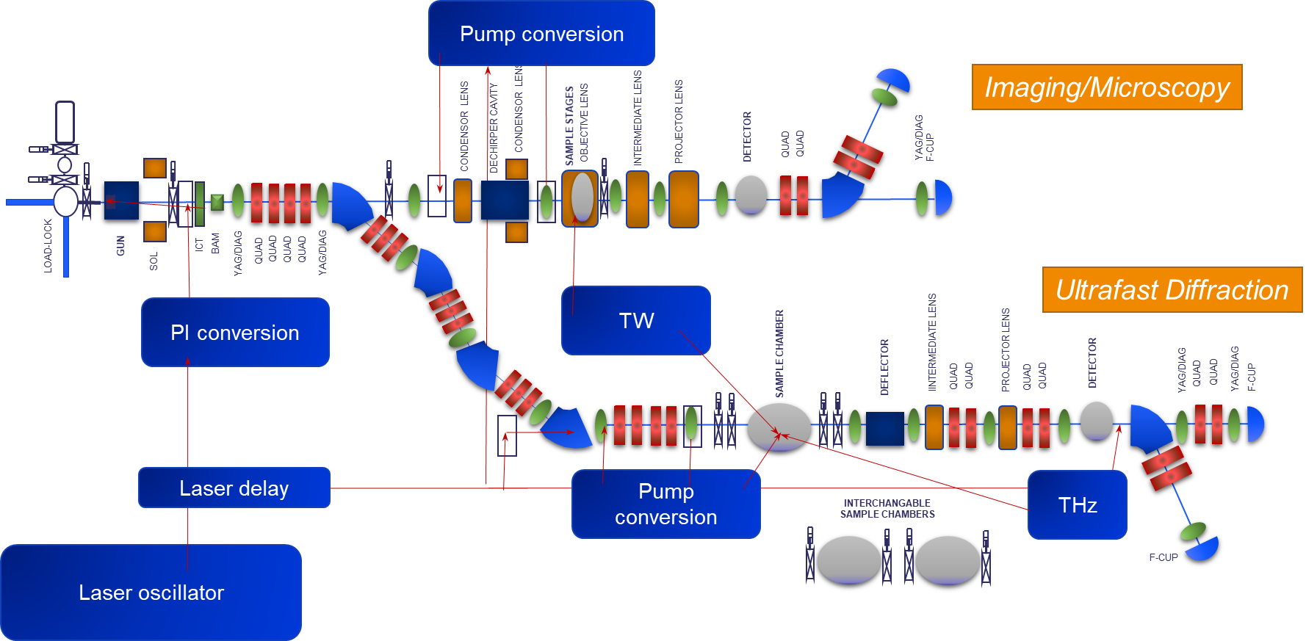
An Introduction to RUEDI
Currently in CDR phase
Produces MeV electron energies
RUEDI: Relativistic Ultra-fast Electron Diffraction and Imaging
Notes:
Can’t really speak to you about the carbon footprint of a facility without first introducing it
RUEDI stands for:…
RUEDI is currently in the CDR phase and is designed to accelerate electrons to MeV energies and so is a mid-range facility

Slide 5
Magnets
A
r
Produce a simple quadrupole model
Sketch out geometry
Interaction of different variables
Mass of copper and steel; power used
2r
A
r
$$m_{cu}∝Gr^{2}L_{mag}$$
$$L_{mag}=length$$
$$G=gradient$$
$$m_{st}∝Gr^{2}L_{mag}$$
$$r=aperture radius$$
$$m_{st}=mass of steel$$
d
$$P∝G^{2}r^{4}L_{mag}$$
$$m_{cu}=mass of copper$$
w_{c}
$$P=power consumption$$
L_{mag}
Aperture size most important to reducing carbon footprint
2r
Slide: Ben Shepherd
Notes:
First thing we will talk about it the carbon footprint of the electromagnets. In order to analyse the impact of the magnets in RUEDI ben has made a simple model of a quadrapole, this model revealed all the factors that effect the power consumption and mass of copper and steel and therefore carbon footprint. It was found that the aperture size of the magnet is quite influential and making aperture sizes as small as possible has the potential to make the biggest impact.

Slide 6
RUEDI has 35 magnets: 29 quadrupoles, 6 dipoles
Manufacturing Magnets
Scenario | kgCO₂e | % change
Baseline | 2324 | 0%
Mexican steel | 1449 | -38%
Rail freight for steel | 2091 | -10%
EU-average for copper | 2393 | +3%
Total 2.3 tCO₂e
(3 kgCO₂e / kg of finished product)
Total 6.2 tCO₂e
(2.9 kgCO₂e / kg of finished product)
Slide: Ben Shepherd
Notes:
Looking at the overall carbon footprint from two magnets one from antec one from telsa we can see that the largest contribution to the overall footprint by far is the steel. Meaning we could make a considerable impact by prioritizing companies that use greener steel sources. For example if sourced from mexico rather than germany We could reduce the magnet carbon footprint by 38% and by using rail freight for steel rather than truck We can reduce carbon footprint by 10%. Meaning almost a 50% reduction in carbon footprint can be made by making more sustainable choices on these two things. Though of course the ability to make these choices will be down to the suppliers available and their transparency with us. Considering there are 35 magnets in the system this could save tens of tonnes of CO2 just in the manufacturing. We can see that the two examples agree on the carbon intensity per kilogram of magnet so we can confidentally use these values to scale for our magnets.

Slide 7
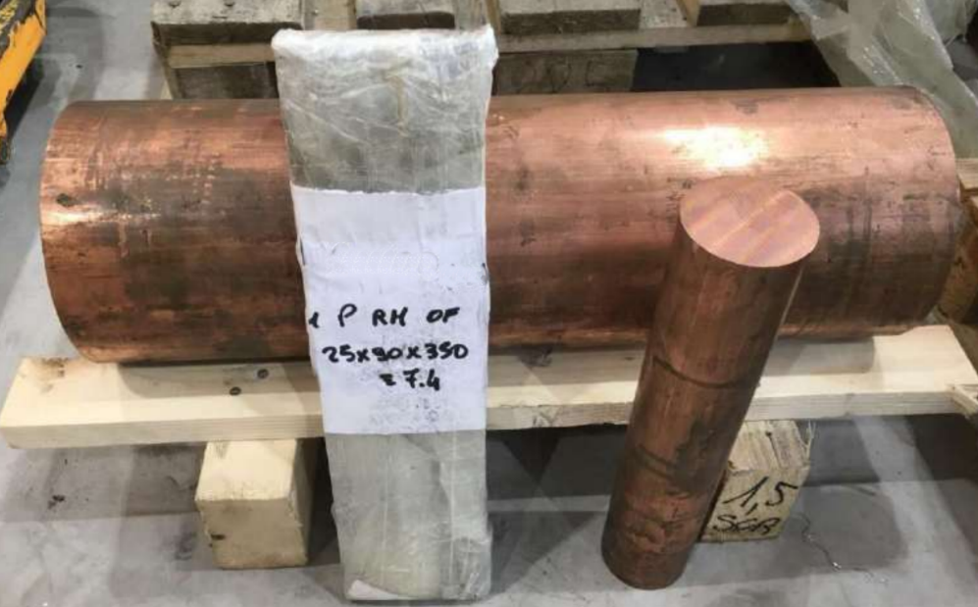
Slide: Louise Cowie
RF Systems
Manufacturing
The majority of the RF system is high purity copper
Estimate 5 tonnes CO₂e for copper parts of one RF system including material and manufacture
This covers 1 out of 3 RF systems
Rest of RF system is mostly electronics, don’t have a good estimate for these yet.
Power consumption
Main power usage: klystron modulator
RUEDI RF photoinjector: approximate energy use is 10 kW
Assuming 16 hours per day 250 days per year
8 tonnes of CO₂ per year
brazing, machining
2.7 tCO₂e
copper 2.3 tCO₂e
RF cavity is turned/milled from bulk copper but less than 50% used in final product
Notes:
Mostly just read through slide

Slide 8
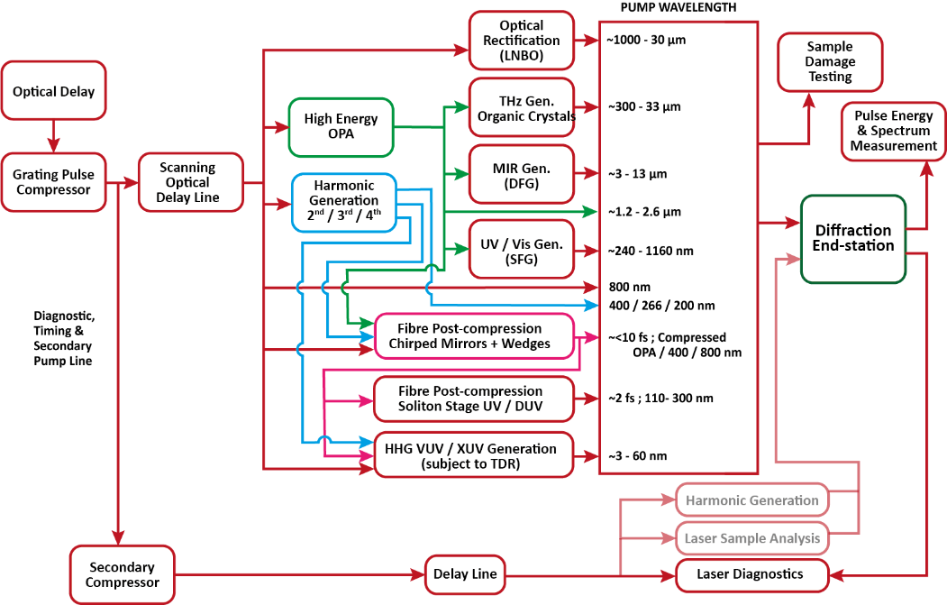
Laser and Timing system
Introduction
Very complex, need pump/probe sources from EUV to THz (3nm to 1mm) at each end station
A terawatt laser
Two UV generating systems for photoinjector
A THz source for diagnostics
All this needs synchronised with the RF!
Notes:
Onto the section I was responsible for: Just wanted to preface this section by saying the RUEDI laser system is very complex for the size of facility. We want to generate wavelengths from 3 nm to 1 mm. This diagram on the right shows all the pump converses for one end station, a similar range of wavelength will also be generated at the other end station meaning there will be multiple of the conversion units seen in the diagram. Outside of the main pump laser conversions there is a terawatt laser, two UV generating systems for the photoinjector and another THZ sources. Not to mention all the components required to synchronise all this with the RF. So I first estimated the materials that made up these systems

Slide 9
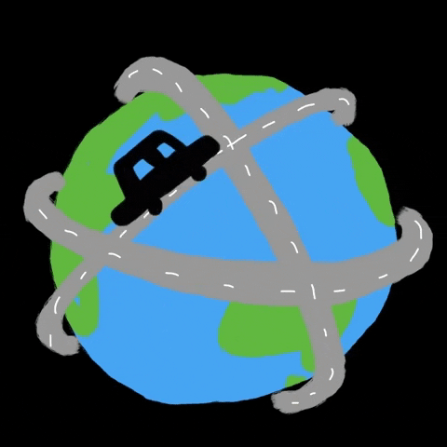
Laser and Timing system
Material | Weight (kg) | GWP (kgCO₂e per kg material) | Carbon footprint (kg)
Aluminium | 847.10 | 20.000 | 16941.93
Steel | 6774.91 | 2.148 | 14552.51
Flash lamp | 3160 input Watts | 1.828 per input W | 5775.01
Diodes | 2700 input Watts | 0.714 per input W | 1927.15
Laser crystal | 0.17 | 942.790 | 158.39
Fiber cables | 2.26 | 7.292 | 16.48
Optical components | 20.58 | 0.720 | 14.82
 |  | TOTAL | 39386.29
Manufacturing
Aluminium: laser units (43%)
Steel: vacuum chambers and optical tables (37%)
Assumed aluminium and steel is from China
Can reduce carbon footprint by 18 tonnes, or 44% by ensuring aluminium and steel come from ‘greener’ countries or recycled sources
European aluminium: 6.7 kg CO₂e/kg, Mexican steel: 1.08 kg CO₂e/kg
Add requests of aluminium and steel manufacturing locations to tenders?
39 tonnes of CO₂ equivalent to:
x39
or
Notes:
The total carbon footprint for manufacturing was estimated to be around 39 tonnes, this is quivalent to…
The largest impact on the carbon footprint of the laser system is the aluminium in laser units and steel in associated vacuum systems and optical tables. I have assumed these metals have both been sourced from china as they make more than 50% of the worlds steel and aluminium.
We could reduce the impact of the steel and aluminium used by ensuring they are from low carbn sources. For example by sourcing aluminium from Europe and steel from mexico rather than china we can reduce the carbon footprint by 18 tonnes! We could reduce the carbon footprint even more by using recycled sources!
I was therefore recommend we add requests to tenders on the location of manufacturing of metals for both laser units and magnets when they contain large amounts of metals like the laser system and magnets
Sources:
Car gif: https://giphy.com/gifs/macchina-guidare-driving-in-my-car-1rsULiUq4iNHyOgNmd
People carbon footprint image: https://www.nytimes.com/guides/year-of-living-better/how-to-reduce-your-carbon-footprint

Slide 10
Laser and Timing System
Item | Power consumption (W) | Power consumption per year (kWh/year) | Total carbon footprint (kgCO₂e/year)
Chillers | 7560 | 66225.6 | 12781.54
Cryo chiller | 7900 | 69204 | 13356.37
Pump power supplies | 11485 | 49581.4 | 9569.21
Vacuum pumps | 3826 | 33515.76 | 6468.542
Controllers | 1910 | 9734.4 | 1878.739
Computers | 1140 | 9986.4 | 1927.375
Total: | 33,821 | 238,247.6 | 46 tonnes
Power consumption
57% from chillers
Water cooled < air cooled
Cryogenic cooling? 25- 30% laser conversion efficiency boost
Ytterbium based systems = 50% more energy available from diodes but very expensive
Best solution: decarbonise our electricity
x 2700
x 2,000
or
Over 10 years: almost 460 tonnes of CO₂
Notes:
Over carbon footprint of the electricity used by the laser system over 10 years will be 460 tonnes. This is quivalent to… Laser are notoriously inefficient and so are always going to use a lot of electricity, because of their inefficiencies they are require a massive amount of cooling. This is why 57% of the total carbon footprint is from the chillers. We could make a small amount of difference by favouring water cooled chillers which are generally slightly more efficient than air cooled.
An interesting topic to look further into would be cryocooling as the inefficiencies in the laser are due to the efficiency of the non-linear processes. The conversion efficiency of ti:sapphire can be improved by 25to30% by cryocooling but an analysis into whether there is overall energy savings would need to be done.
A potential significant improvement to energy usage is through using ytterbium based systems as these can be directly diode pumped unlike ti:sapphire meaning 50% more energy will be going into the final conversion stage. Therefore the best way to reduce the carbon emission in this case is through getting our electricity from carbon neutral sources and national grid decarbonisation
https://giphy.com/gifs/EuropeanSpaceAgency-animation-animated-1rK68yfkG1Q8Aw87Lv
https://www.pixelsquid.com/png/cartoon-led-bulb-2233651610704156605

Slide 11
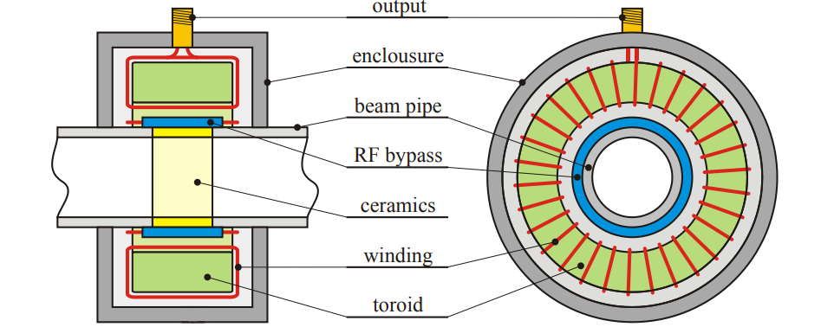
Diagnostics and Controls
Beam current monitor
Focusing on two elements​
Materials – Racks (Aluminum), cables (copper, plastics, aluminum) and physical devices (steel, aluminum, plastics in Faraday cups for example)​
Energy consumption – Rack room computers/processing units​
Quantities – Very rough estimate​
Based on CLARA, scaled to RUEDI by beamline length​
Example: CLARA has 2.3 units per meter of accelerator (~115 racks).
Scaling to RUEDI gives ~46 rack units​
YAG Screen
Slide: Storm Mathisen
Notes:
Diagnostics and controls covers areas like (list materials point +) Beam position monitors, beam current , YAG screen and cameras
So far the bulk of the work has focused on the rack units, through counting how many rack units we have on clara we can estimate how many rack units are needed per unit of accelerator and scale for RUEDI giving us approx. 46 rack units
BPM: Gasior, M., Jones, R., Lefevre, T., Schmickler, H. and Wittenburg, K., 2016. Introduction to beam instrumentation and diagnostics. arXiv preprint arXiv:1601.04907.

Slide 12
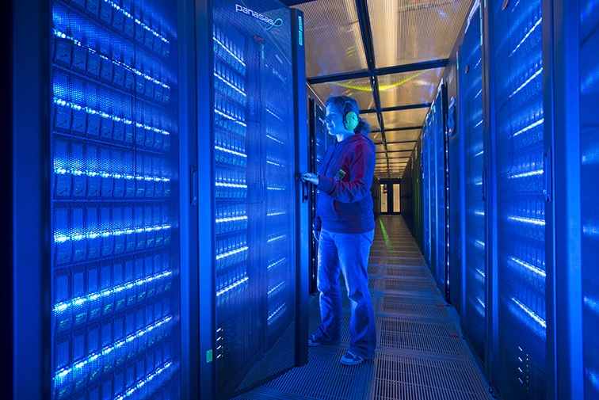
Diagnostics and Controls
Energy consumption – Rack rooms example​
European Commission⁽¹⁾ estimate a notional 2U server uses ~1660 kWh/yr, with <10 kWh required for production and assembly​
Based on this, estimate RUEDI diagnostics and controls will consume 38 MWh/yr = 7.3 tonnes CO₂/yr
Fabrication and assembly becomes negligible over the lifetime of an accelerator​
Ongoing​
Refine estimates for energy consumption​
Compile data from materials analysis​
Mitigation strategies​
Over 10 years: 73 tonnes of CO₂
1 - "Analysis of Material Efficiency Requirements of Enterprise Servers" - Institute for Environment and Sustainability, European Commission Joint Research Center (Sept 2015)
Slide: Storm Mathisen
Notes:
One paper suggested rack services use an average of 1660 kwh/yr meaning in total the racks will require 38 mwh/yr of electricity and over 10 years will produce 73 tonnes the equivalent to the amount of co2 produced by an average households gas and electricity over the same time period.
There is still a bit of work to be done in this section refining energy estimates, calculating the carbon footprints of the materials used and coming up woth mitigation strategies but the rack power usage is likely to be the largest contributor in this area of the machine.
Sources:
Electric and gas image: https://energy.which.co.uk/
House image: http://www.clker.com/clipart-simple-cartoon-house.html

Slide 13
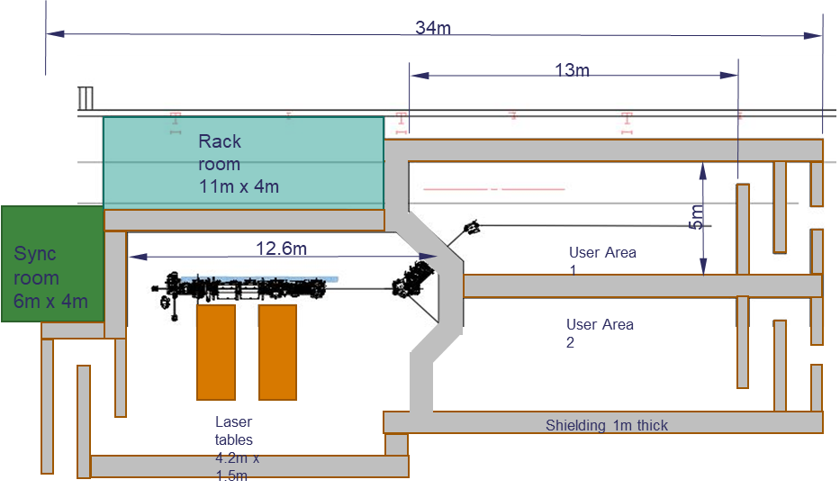
Concrete
RUEDI Layout
Structural materials (‘the building’) and radiation shielding is a major component; these use large quantities of concrete
Today’s cement production accounts for 8% of global CO₂ emissions
30 billion tons of concrete used in the world each year!
CO₂ production during cement manufacture is mainly due to clinker intermediary
Cement is around 15% of concrete mass, but most of CO₂ emissions
Slide: Hywel Owen
Notes:
Image on right is the layout of RUEDI

Slide 14
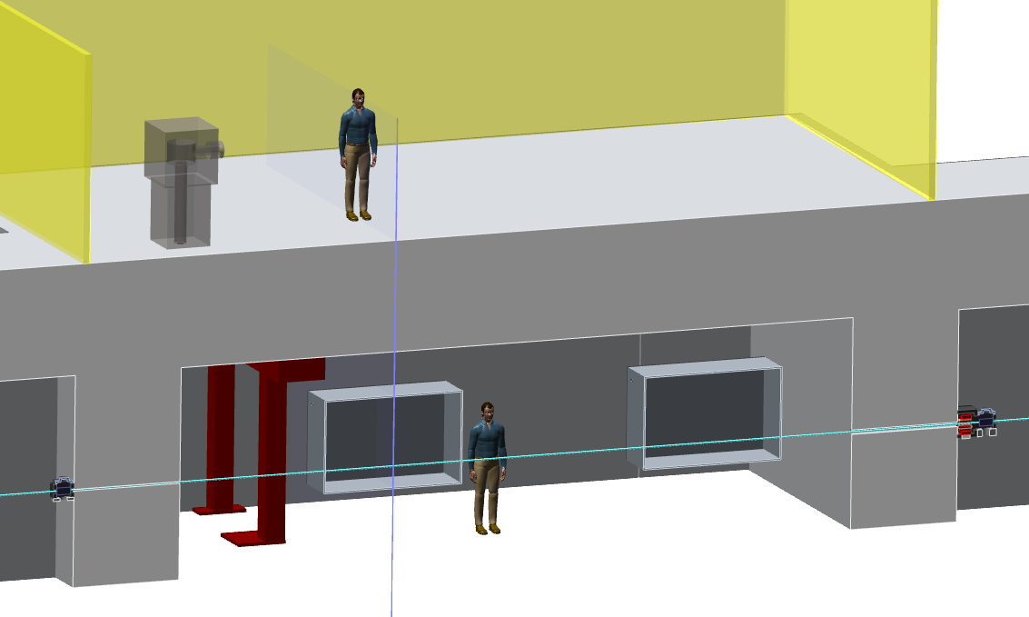
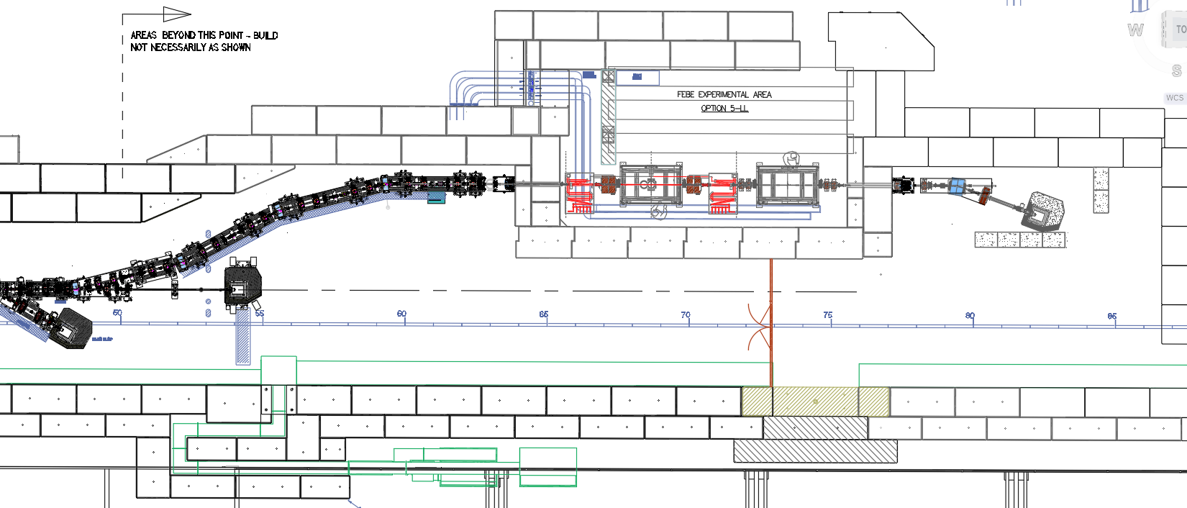
Things to consider:
Manufacturing methods – pre-cast or local pour
Type of construction – above ground vault, earth mount, tunnel, cut and cover
Consideration of sustainable construction e.g. low-CO₂ concrete, other materials
Maximise lifespan and minimizing wastage – standard sizes and volume minimization
Concrete
For Linear Accelerators
1-2m high walls and floor slab/roof
Equals ~ 60-80 tons concrete per metre of accelerator length = 10 tons CO₂ / m
This is a large component of embodied CO₂ in accelerator lifecycle
Example: CLARA walls and roof – 1.6 to 2.0m
CLARA shielding – modular block and beam
Slide: Hywel Owen

Slide 15
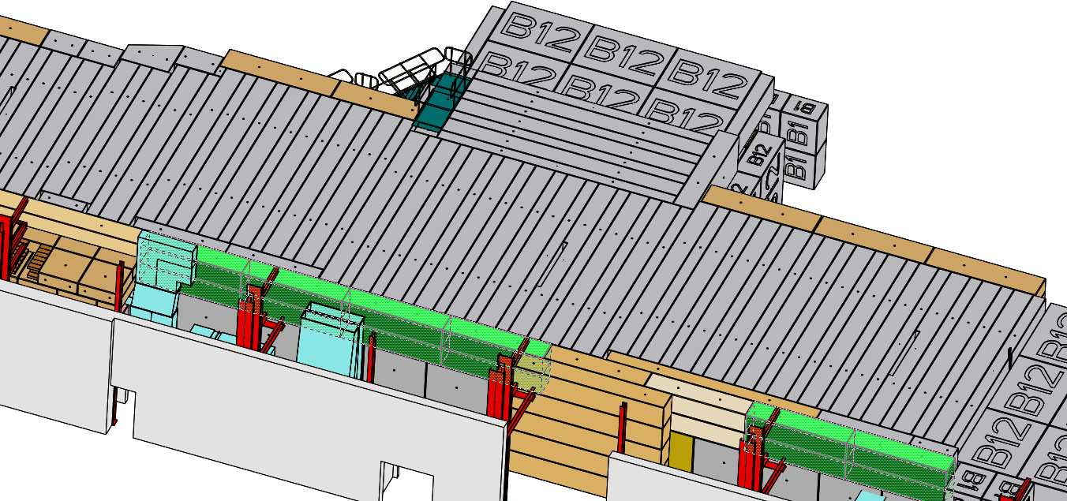
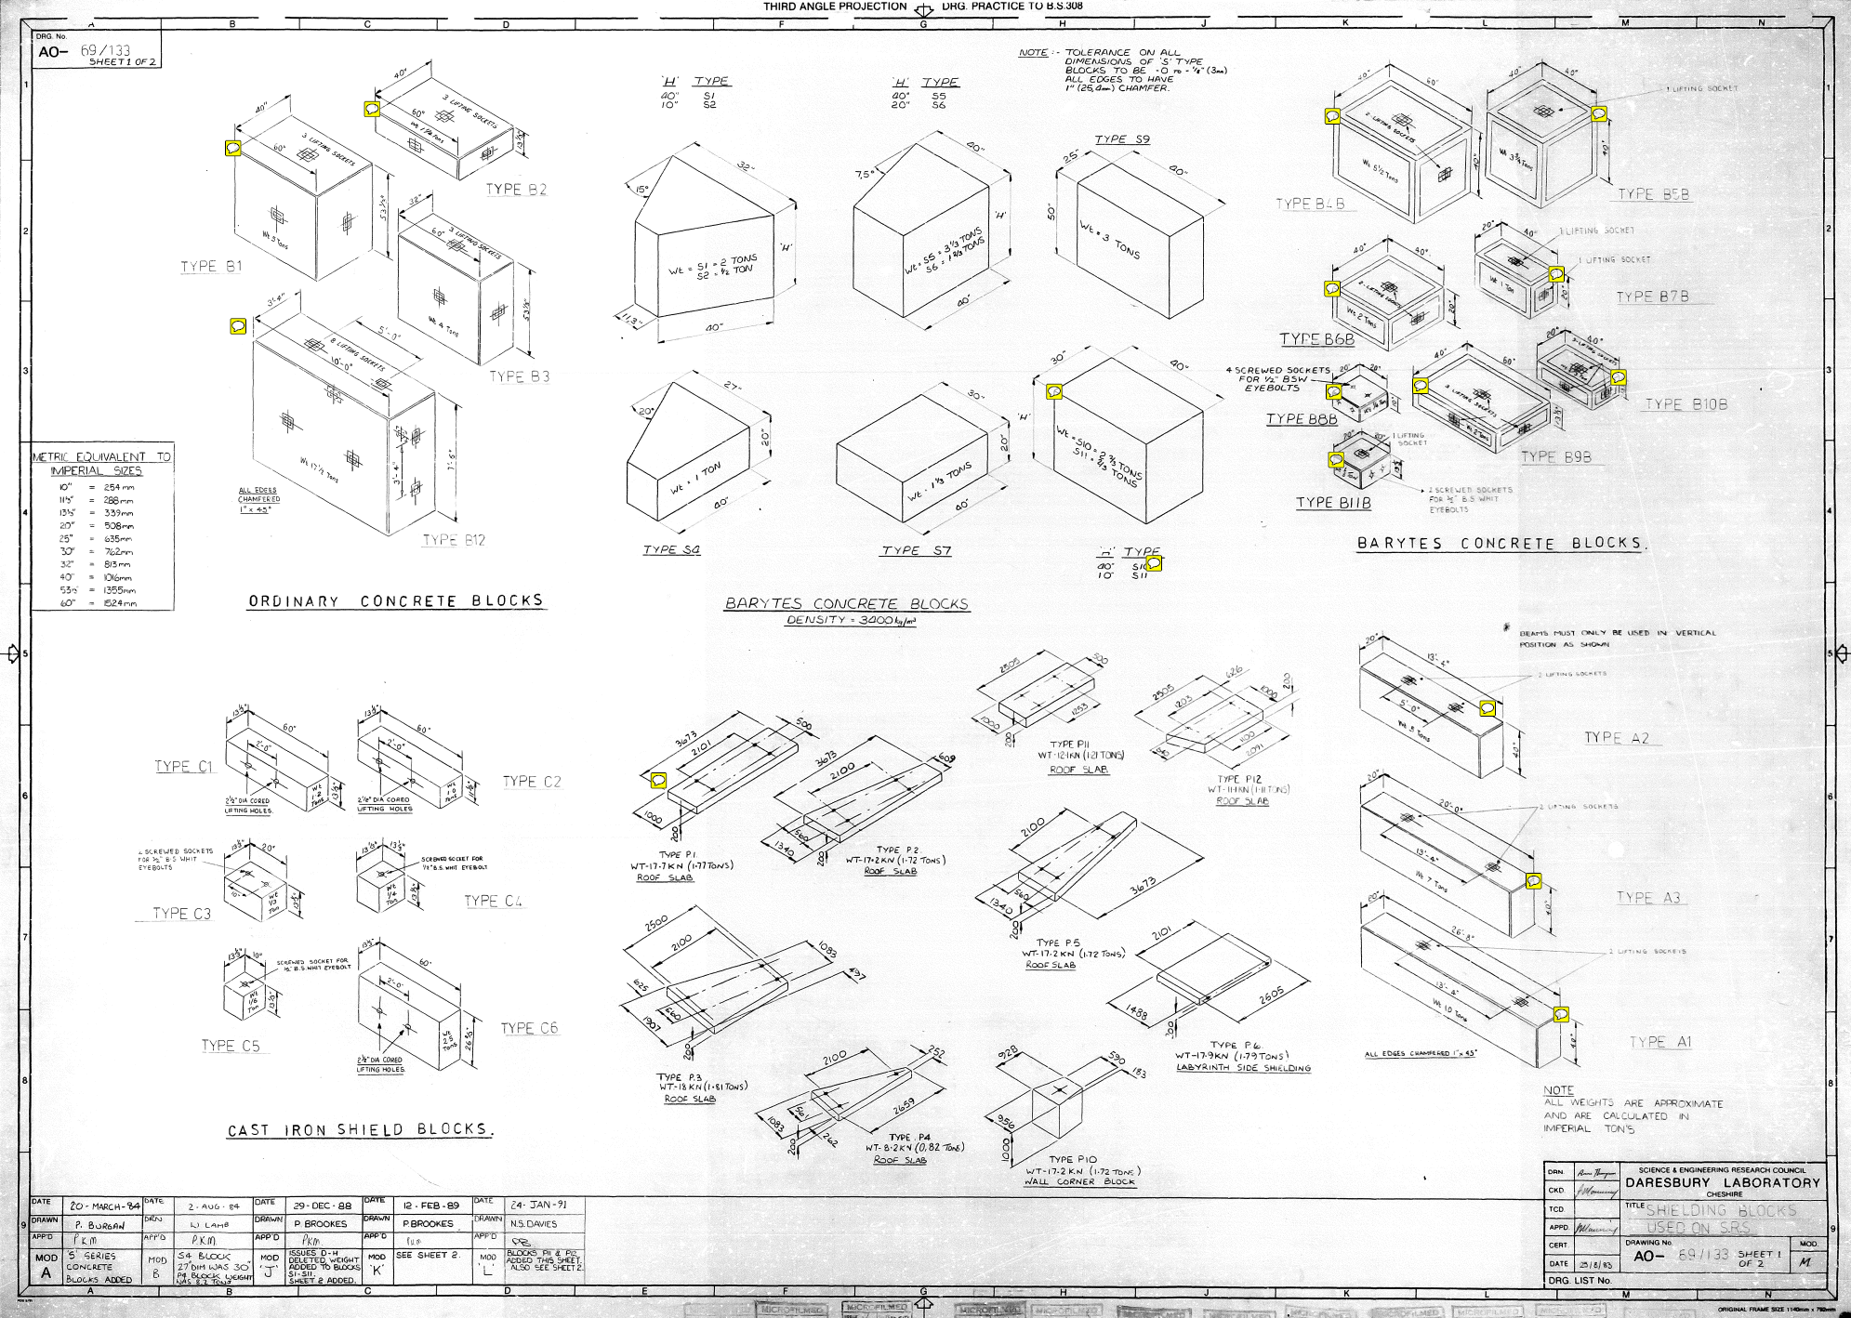
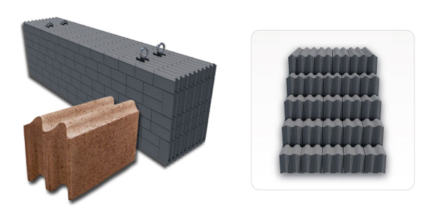
Re-Use of Concrete
Slide: Hywel Owen

Slide 16
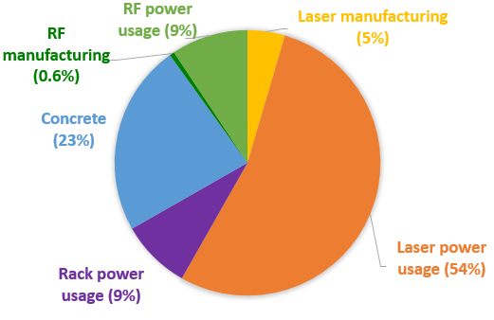
Summary
Over 10 years of operation
Electricity usage is our main issue
Not yet including:
Two RF systems
Magnets
Vacuum systems
Climate controls (potentially a massive emitter)
Manufacturing diagnostics, modulators, klystrons, SF₆ systems
857 tonnes total = weight of 71 x
Notes:
https://www.vectorstock.com/royalty-free-vector/red-double-decker-bus-vector-31286741

Slide 17
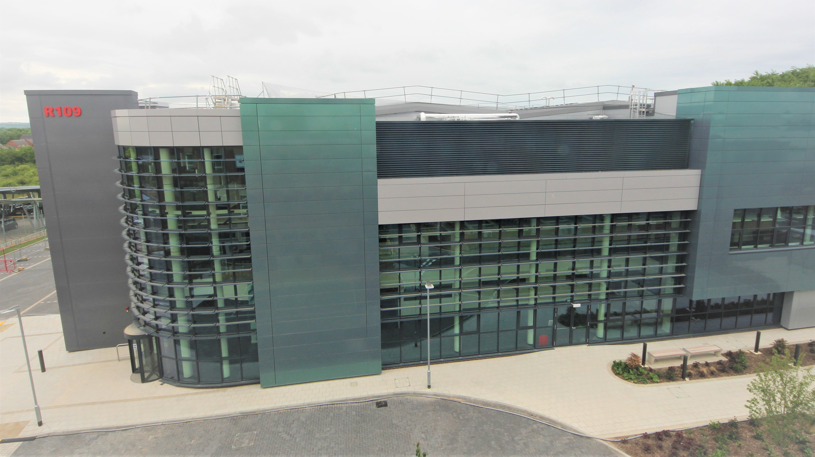
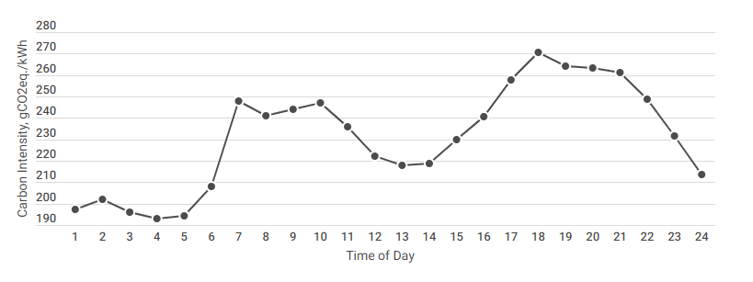
Reduction strategies
EPAC
How do we make shielding more sustainable?
Using different materials? GGBS?
Using ‘greener’ sources of metals
Magnets: Saves 38%
Lasers: Saves 44%
Sustainable electricity sources
Our electricity usage is always going to be large!
Smarter power
Grid intensity (gCO₂e / kWh) depends strongly on time of day and season
Plus more strategies to come…
Notes:
Smart power: vacuum bake outs, helium liquefaction during greener tmes
https://energy.which.co.uk/
http://www.clker.com/clipart-simple-cartoon-house.html

Slide 18
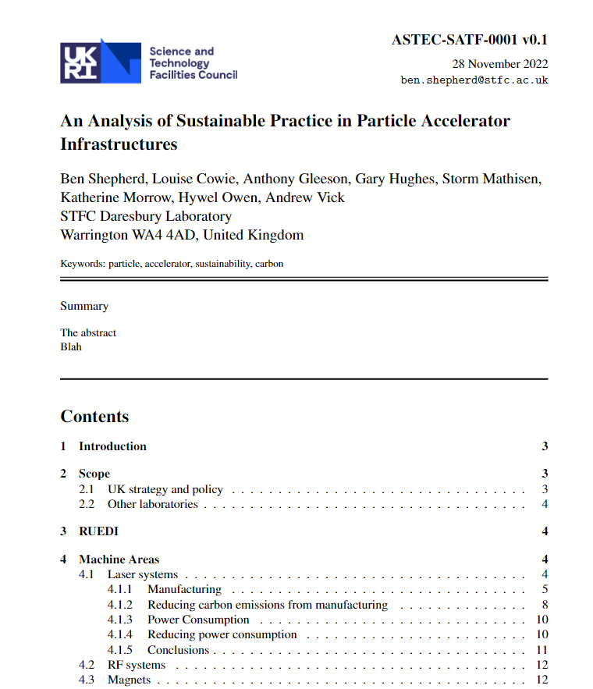
Conclusions
Currently finishing up analysis for all machine areas and exploring mitigation strategies
Many of us writing up report
To be published in the new year!
Hope you are all looking forward to reading and implementing our findings in your own work!
Notes:
Smart power: vacuum bake outs, helium liquefaction during greener tmes
https://energy.which.co.uk/
http://www.clker.com/clipart-simple-cartoon-house.html

Slide 19
Thank you
Any Questions?
Facebook: Science and Technology Facilities Council
Twitter:@STFC_matters
YouTube: Science and Technology Facilities Council

