Slide 1
Ground Water Cooling for Modern Particle Accelerators
ALISON COOPER

Slide 2
Background
Prior to 2008, we abstracted water from the Bridgewater Canal to cool our accelerator systems, but have since moved to closed-circuit chiller systems to reduce dredging and system maintenance impacts.

Slide 3
2017 Investigation
Envireau Water Ltd completed a groundwater cooling feasibility and modelling study for a potential 2MW scheme to support cooling of ASTeC’s RTFs, which anticipated a reduced electricity consumption by ~ 4000 MWh̄ ¹ (>£600k / year).

Slide 4
Trial Borehole
The investigation, involving one trial abstraction borehole and subsequent modelling, confirmed a feasible cooling capacity of 1.6-2MW at 173m3/hour (48l/s).
The scheme also confirmed a fixed temperature differential of 10°C and abstraction temperature rise of ~2.3°C using two (2) abstraction boreholes and six (6) recharge boreholes.

Slide 5
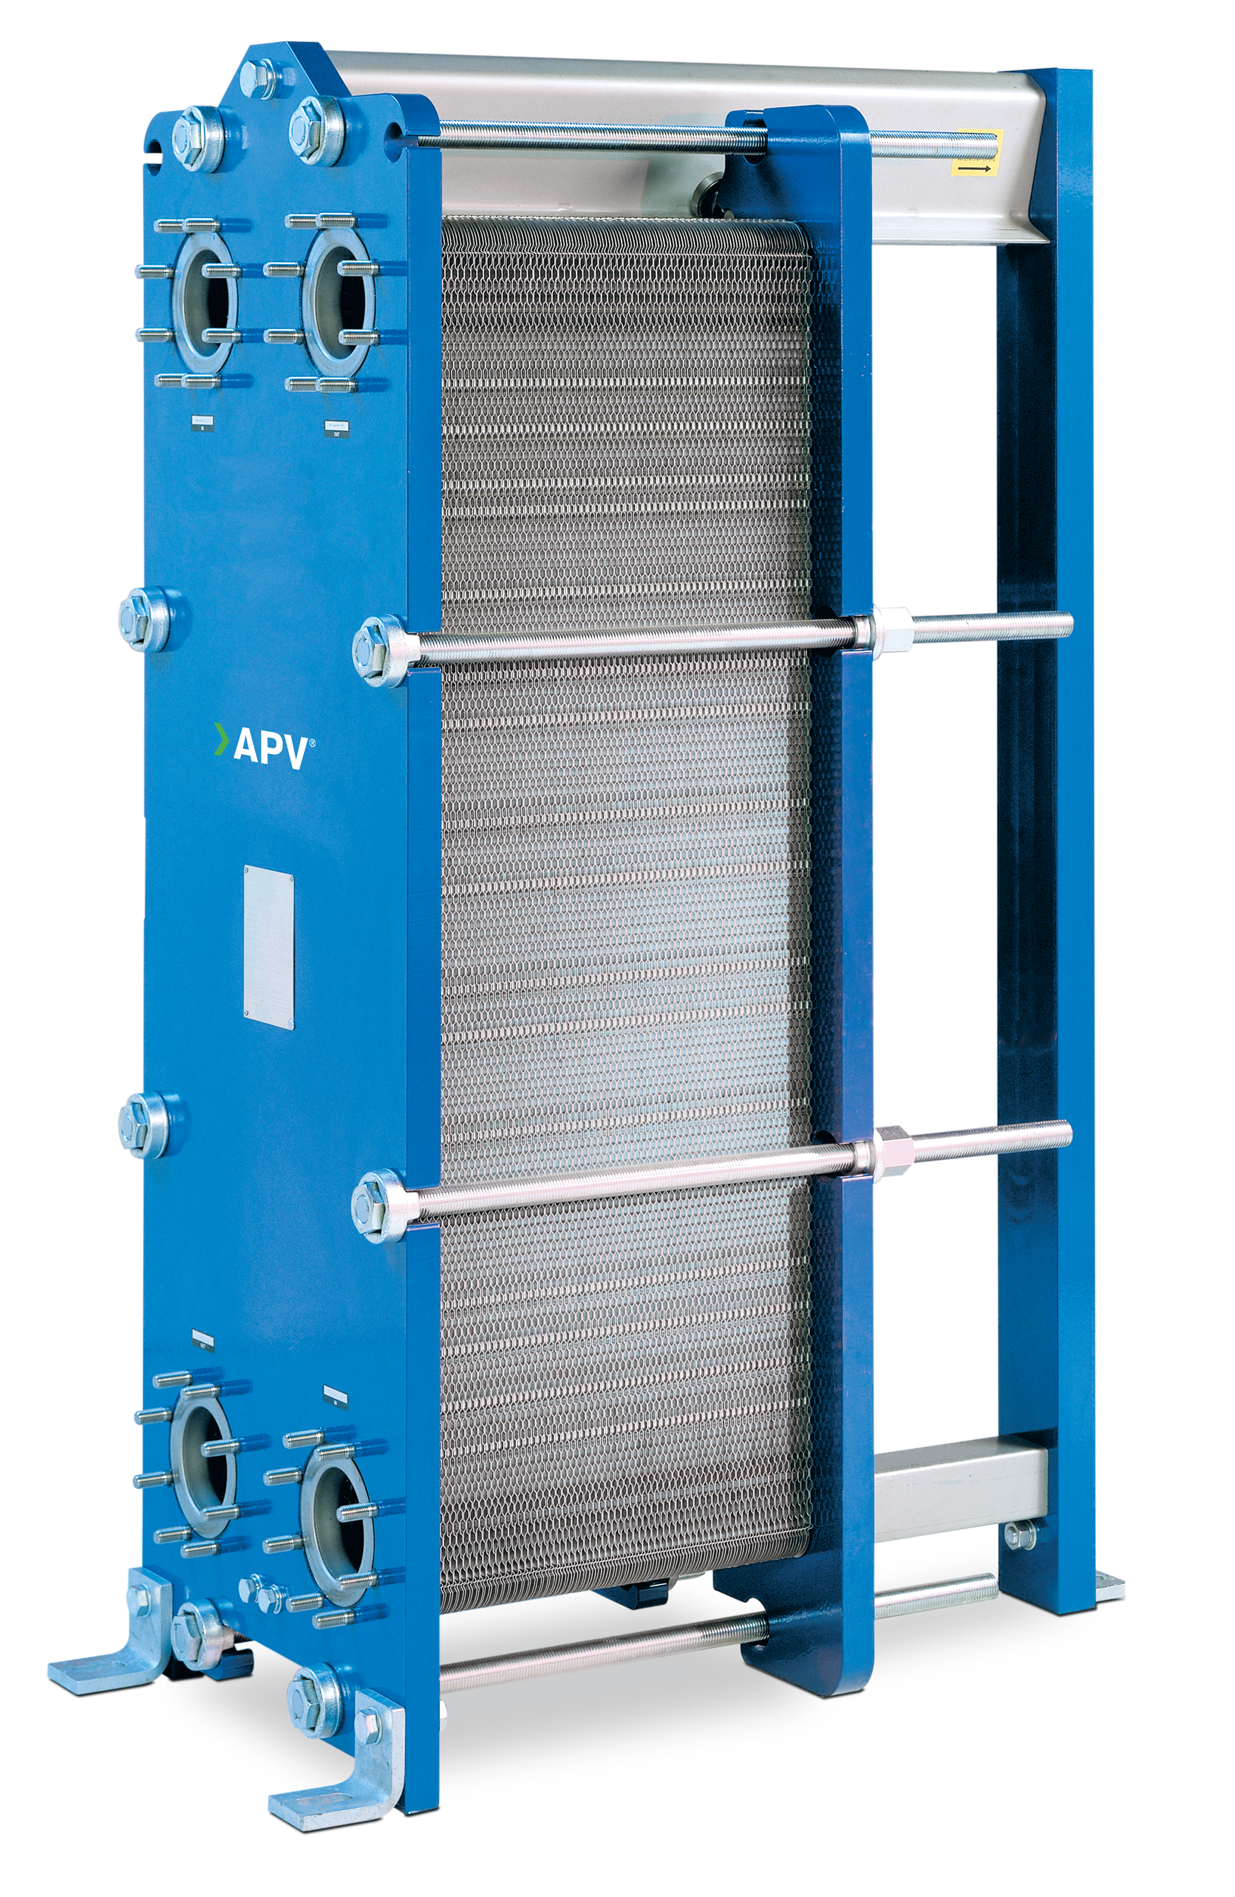
Benefits
Reduced electricity costs/consumption (refrigerant/chillers), maintenance, leaks
Efficient/stable cooling source for 24h operations - using heat exchangers
Reduced carbon footprint and physical footprint for to chiller systems
Supports reduction of STFC Scope 2 Emission goals

Slide 6
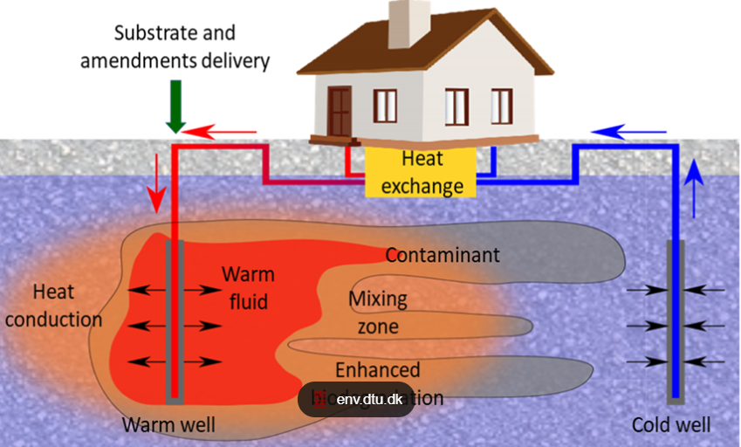
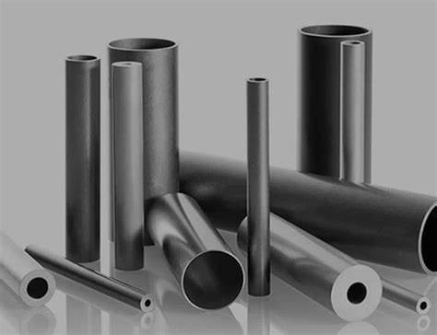
Downsides…
Finding suitable recharge point locations due to access (i.e. railway bridges)
Temperature increases of ~2.3°C, between years 2-6, equalizing at year 14
Expensive materials to resist corrosion and clogging from iron/manganese
Finite resource – could affect other systems (i.e. Vanguard house)

Slide 7
Discussion

