Slide 1
Sustainable Accelerators and environmental sustainability
Jo Colwell
2 December 2022

Slide 2
Notes:
Motivation

Slide 3
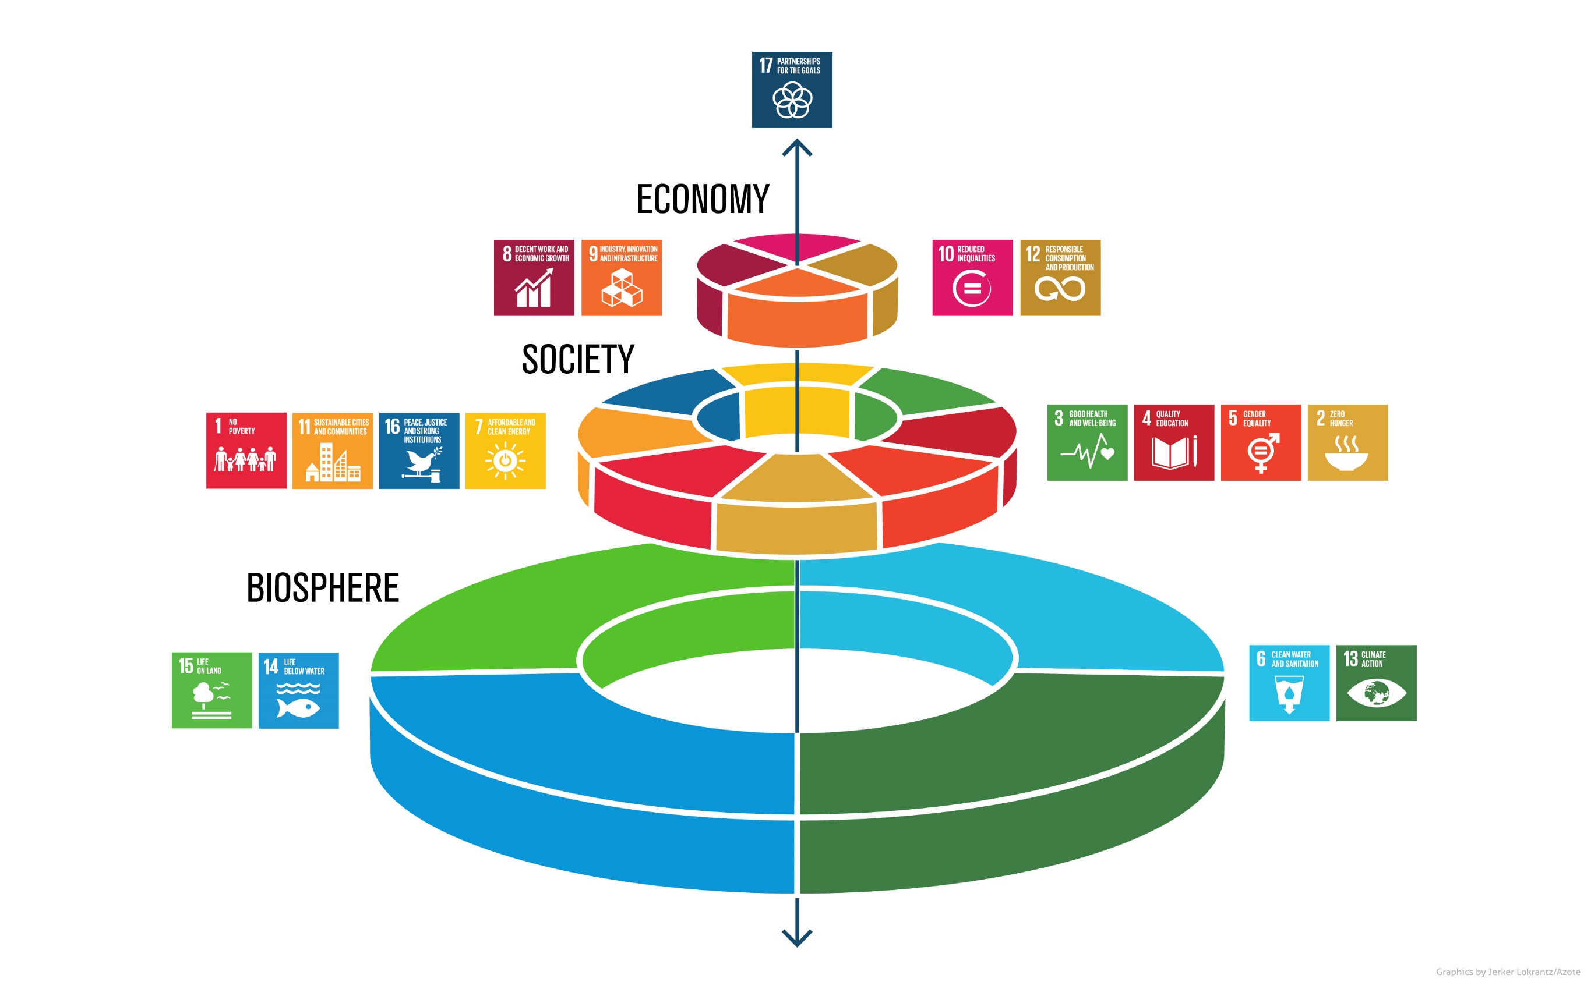
Notes:
I favour this view because society and economy are totally dependent on the environment –
it is the base layer – the foundations - the bottom of the ‘wedding cake’ if you will - that everything else depends upon

Slide 4
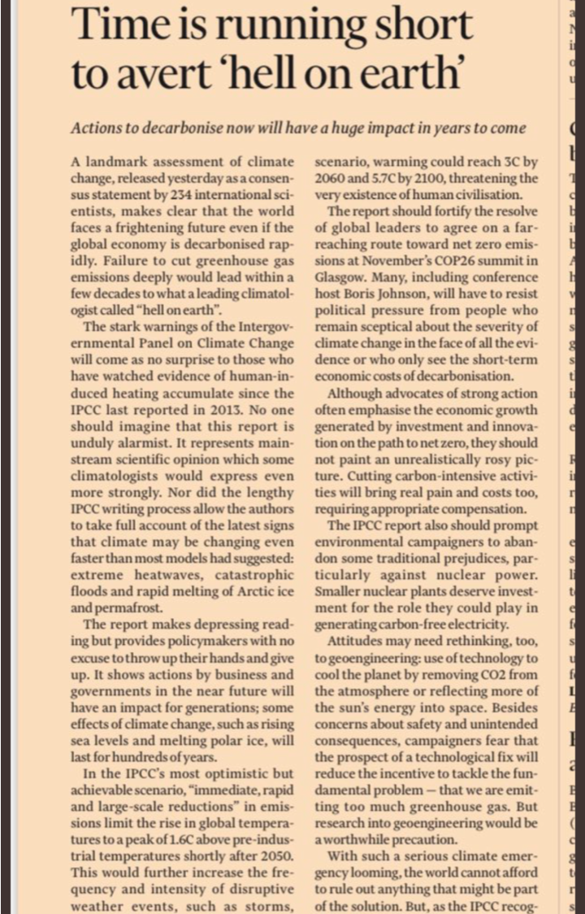
Notes:
Taken to be a key political and policy issue for all organisations and governments.
There is a need for all of us to understand the level of jeopardy there is.
It’s not in the future, its now – wildfires, flooding, extremes of heat, loss of biodiversity, sea level rises
Intergovernmental Panel on Climate Change (IPCC) Need for IMMEDIATE RAPID and LARGE SCALE REDUCTIONS

Slide 5
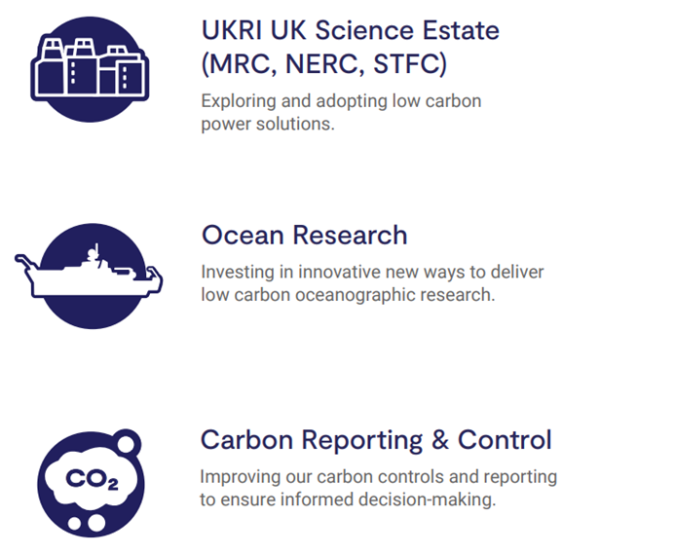
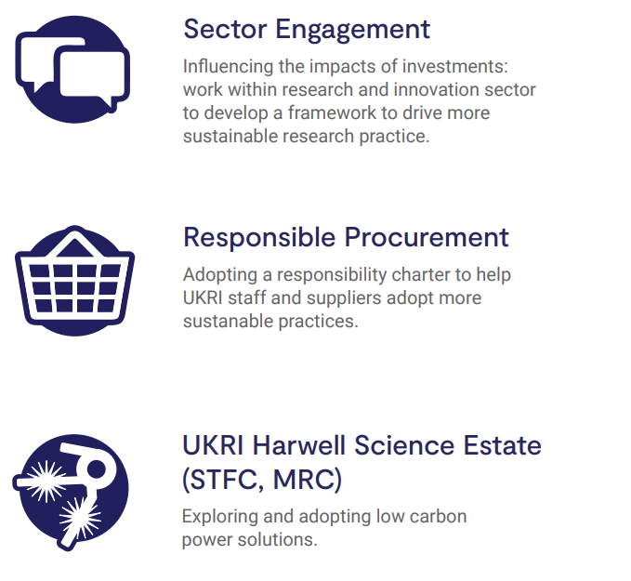
Notes:
UKRI net zero by 2040 – challenging but not impossible
Will require sustained effort and doing things differently
If we keep doing what we’re doing we’re going to keep getting what we are getting
Colleagues in Estates have done lots across all campuses – Whole host of activity at sites to reduce energy consumption (lighting upgrades, building upgrades including windows, cladding, chillers) and increase renewable energy (solar PV at DL and RAL).
Complicated by windfall sums of money in single financial years but masses of improvements which has helped that line in the graph go downwards
Thanks to Carly and Laura in Estates for helping with intranet
Action Plan is there and sets out what I am doing in year 1 and how it dovetails with the Estates Strategy who deliver the on the ground changes.

Slide 6
“If we knew what we were doing, it would not be called research, would it?”
Albert Einstein
https://ukri.sharepoint.com/sites/thesource-stfc/Shared%20Documents/ES/STFCSustainabilityActionPlan.pdf?cid=177884f0-70df-478e-8950-de45c9fdb487
Notes:
So there is a challenge about emissions. However, there is also the high value of the research and technology from across STFC
Great thing about STFC is the quantity and quality of research going into climate solutions.
We are an organisation that is delivering climate solutions and has been for a number of years
In purpose terms I want to see our organisation leading on this agenda
There is balance to be struck about our work outputs and the energy we use along with our emissions
Optimistic that we can aim HIGH to see STFC develop and grow whilst also contributing to climate solution and doing that in an environmentally conscious manner
Not binary not one or the other but both although as a said this is a journey and we are still in relatively early stages

Slide 7
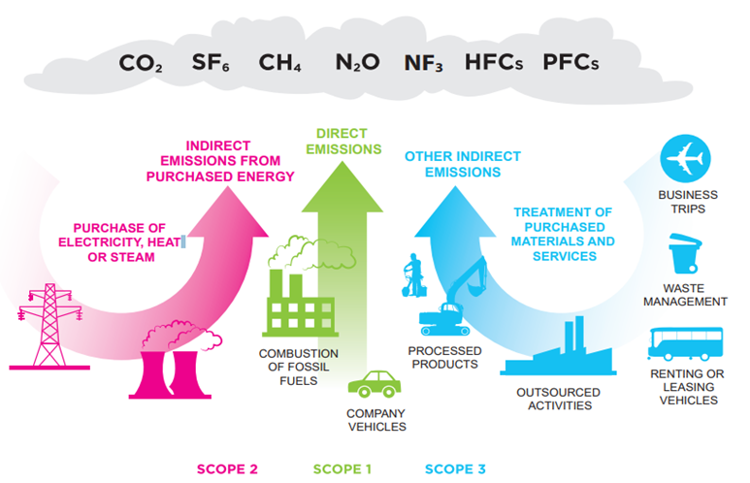
Notes:
Basket of greenhouse gases – CO2 is talked about the most but thee are others
Scope 1 Direct emissions – fossil fuels burning gas for heating or petrol/diesel for transport
Scope 2 Indirect emissions from energy – purchase of electricity
Scope 3 – Indirect emissions from things we buy/procure
Report on these for STFC for Government Scope 1 and 2 reliable information but lacking in granularity – so can’t tell a building or department what they use
Scope 3 not great – business travel but getting better because of new contracts and better data collection.

Slide 8
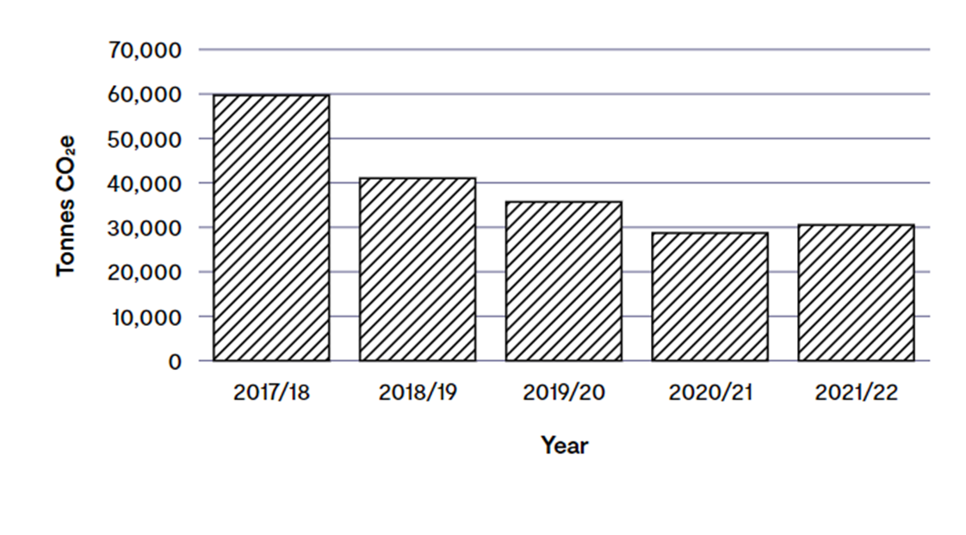
C02e emissions from STFC
Notes:
Historic emissions picture from Scope 1 and 2
Projected to grow – though the cost of utilities, especially electricity may temper that growth
Even if electricity were cheaper we still need to ask the question can this be done with less energy

Slide 9
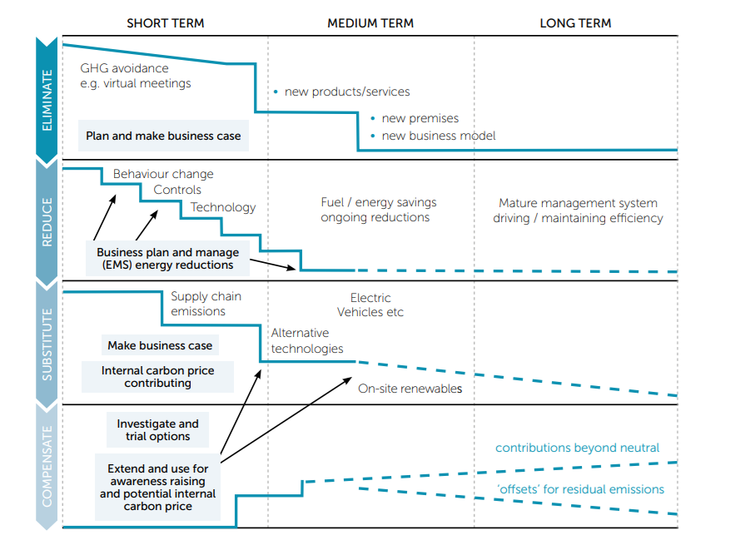

Slide 10
Thank you. Any questions?

