Slide 1
Reduction in wall-plug power for high power RF systems
Graeme Burt
Lancaster University

Slide 2
Acknowledgements
This presentation will cover two key technologies to reduce the wall plug power required by RF systems, as part of two separate projects involving CERN and Lancaster
HE Klystrons
Igor Syratchev (CERN/ Project Leader), Nuria Catalan Lasheras, Zaib Un Nisa (CERN), Anis Baig (Lancaster), Jinchi Cai (UESTC)
FRT
Alick MacPherson (CERN/Project Leader) Nick Shipman, Amelia Edwards (Lancaster), Ilan Ben Zvi (CERN)

Slide 3
High Efficiency Klystrons

Slide 4
FCC-ee: Energy Conversion
Grid to DC:
RF power generation!
Note: largest impact by RF power generation
RF distribution!
losses in cavities
RF to beam
From E Jensen

Slide 5
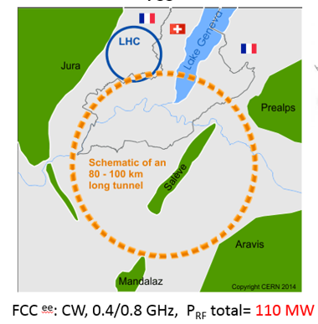
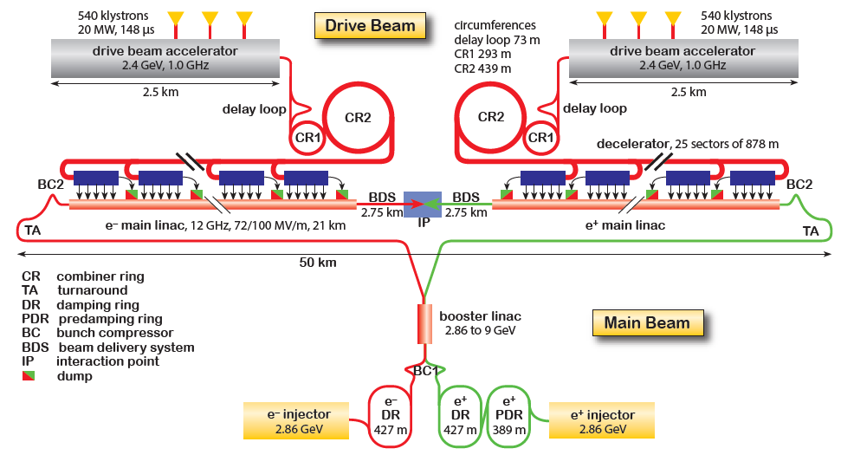
Average RF power needs of the large-scale HEP Accelerators Studies.
The klystron efficiency impact on the FCC^{ee} power consumption.
Example of the efficiency upgrade from existing 65% to 80%.
 | Klystron eff. 65% | Klystron eff. 80% | Difference
RF power needed for 3TeV CLIC | 105 MW
DC input power | 161.5MW | 131.25MW | -30.25MW
Waste heat | 56.5MW | 26.25MW | -30.25MW
Annual consumption (5500 h assumed) | 888 GWh | 721.9GWh | -166.1 GWh
Annual cost (50MCHF/MWh assumed) | 44.5 MCHF | 36.1 MCHF | -8.4 MCHF
Electricity installation dimensioned for | 161.5MW | 131.25 MW | -20.6%
CV installation dimensioned for | 56.5 MW | 26.25 MW | -53.54%
105 MW
Potential saving are 1.04 TWh in 10 years (84 MCHF in 10 years).
Reduced environmental impact (cooling and ventilation)
Reduced installation cost (stored energy in modulators).
Reduced maintenance cost (klystron life time).
R&D on increasing the useable efficiency is worth every penny/cent invested!
3.0 TeV CLIC^{e+e-} ; pulsed, 1.0 GHz, P_{RF} total = 180 MW

Slide 6

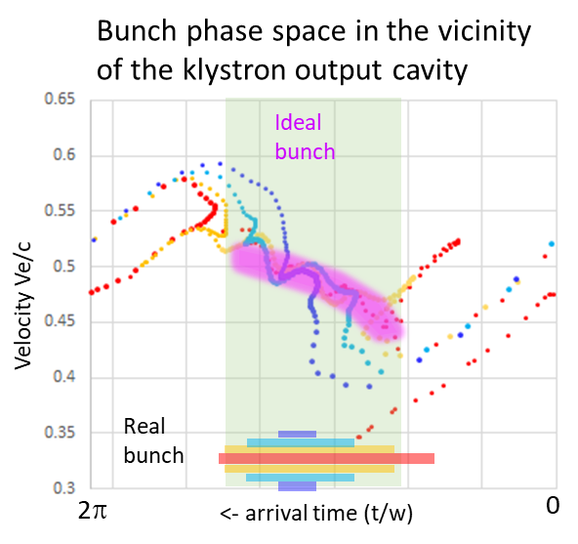
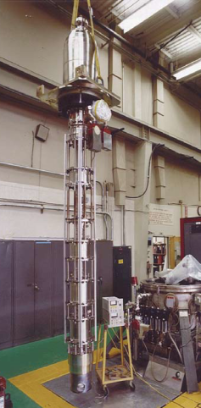
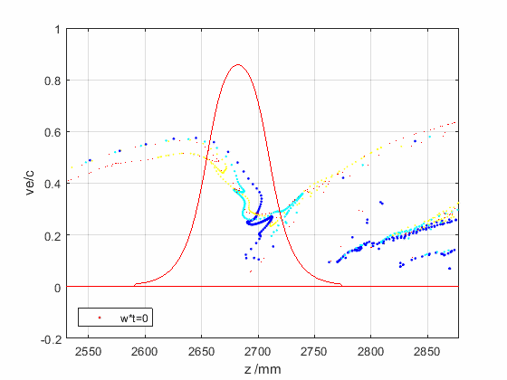
Factors limiting efficient RF power extraction
E field expansion in the drift tubes causes beam reacceleration when it leaves the output cavity.
Ohmic loses are proportional to the operating frequency.
Space charge depression is a partial conversion of the beam kinetic energy into the potential DC energy of beam traveling in the drift tube.
Bunch saturation is optimal, when all the elections populate only the useful RF phase bucket leaving the anti-bunch empty.
Bunch congregation is a normalized elections velocity spread along the bunch. It has an optimal value for every given bunch length.
Bunch stratification is a radial dependence of the bunch length and congregation. The ideal bunch should not have such a dependency.
Radial bunch expansion happens during beam deceleration in the output cavity in the presence of external solenoidal magnetic field.
Reflected electrons could be generated if some of the above effects are not balanced.
SLAC B-factory CW
0.478GHz, 1.25 MW
Arrival plane
Efficiency 61%
Driven by klystron general parameters.
Driven by RF design and space charge effects.

Slide 7
New Klystron Concepts
How do we achieve bunch saturation? We cause the core of the bunch to oscillate while focusing the anti-bunch electrons slowly. There ae 4 ways to do this:
Bunch-Align-Collect (BAC): Using lots of RF cavities closely spaced
Core oscillation method (COM): Using the beams space charge forces
Core stabilization method (CSM): Using higher harmonic cavities
Two stage (TS): Making COM shorter by using a low beam energy and post-accelerating

Slide 8
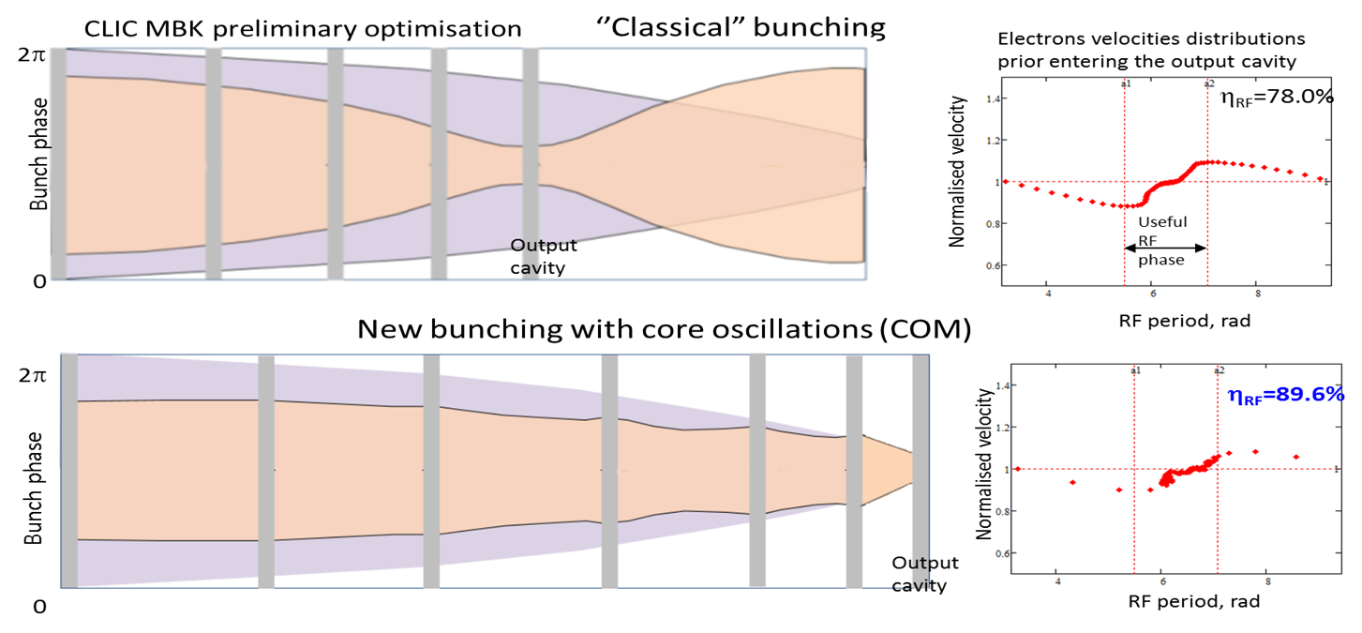
New Klystron Concepts
How do we achieve bunch saturation? We cause the core of the bunch to oscillate while focusing the anti-bunch electrons slowly. There ae 4 ways to do this:
Bunch-Align-Collect (BAC): Using lots of RF cavities closely spaced
Core oscillation method (COM): Using the beams space charge forces
Core stabilization method (CSM): Using higher harmonic cavities
Two stage (TS): Making COM shorter by using a low beam energy and post-accelerating

Slide 9
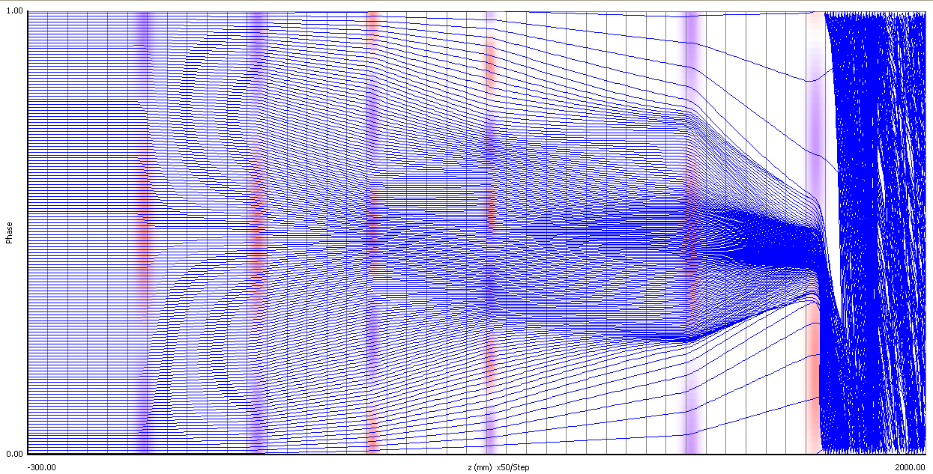
New Klystron Concepts
How do we achieve bunch saturation? We cause the core of the bunch to oscillate while focusing the anti-bunch electrons slowly. There ae 4 ways to do this:
Bunch-Align-Collect (BAC): Using lots of RF cavities closely spaced
Core oscillation method (COM): Using the beams space charge forces
Core stabilization method (CSM): Using higher harmonic cavities
Two stage (TS): Making COM shorter by using a low beam energy and post-accelerating
2nd & 3rd harmonic cavities
Anti-bunch strongly focused

Slide 10
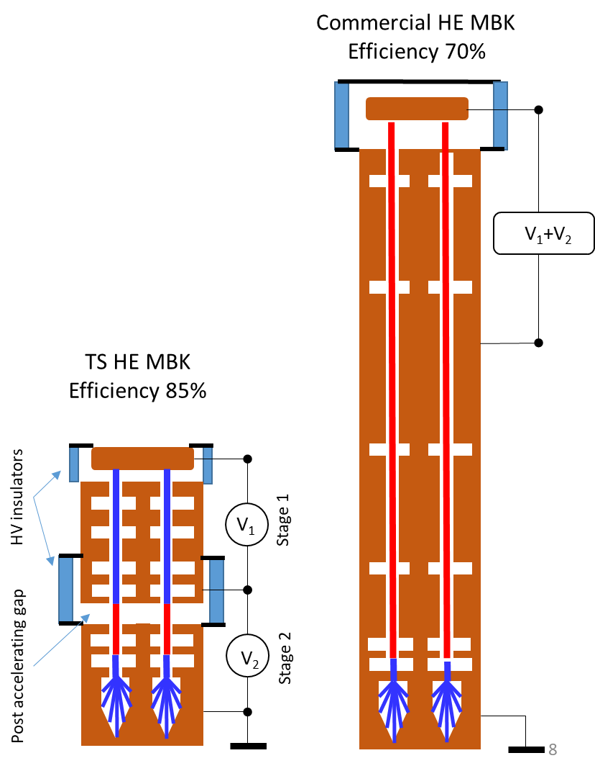
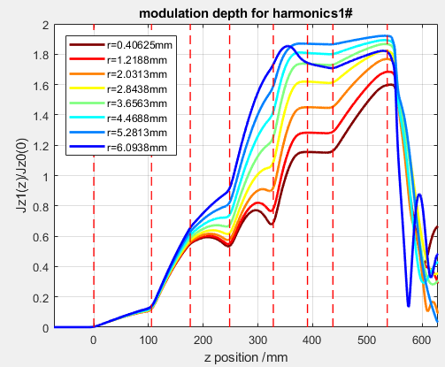
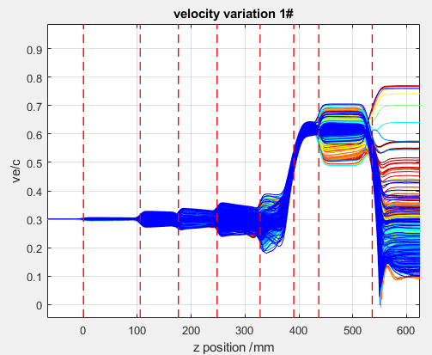
New Klystron Concepts
How do we achieve bunch saturation? We cause the core of the bunch to oscillate while focusing the anti-bunch electrons slowly. There ae 4 ways to do this:
Bunch-Align-Collect (BAC): Using lots of RF cavities closely spaced
Core oscillation method (COM): Using the beams space charge forces
Core stabilization method (CSM): Using higher harmonic cavities
Two stage (TS): Making COM shorter by using a low beam energy and post-accelerating

Slide 11
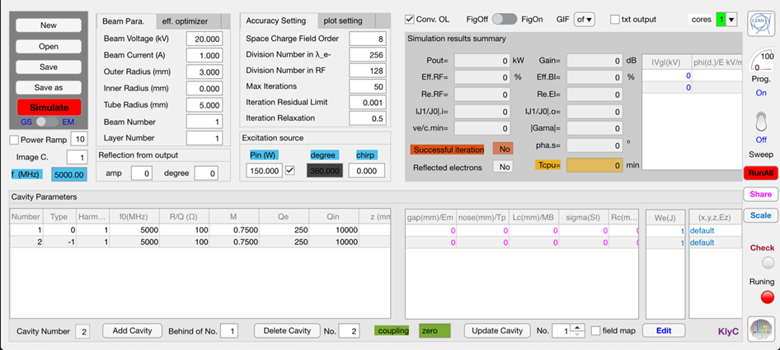
Fast and accurate klystron simulation tools developed at CERN/Lancaster
KlyC: Large signal 1/1.5D klystron simulator [1].
1/1.5D Wave-beam interaction module. Beam dynamic simulation (single beam and MBK).
Klystron optimizer module.
CGUN (electron beam tracking)
Parameters scaling module.
Electrostatics module.
Bunched beam generator module.
Simulation of IOT and output couplers with bunched beam
Electro-Magnetic module.
Magnetostatics module.
Coupled cavities module.
Special EM simulator of the coupled cavities with or without external loading. Coupled eigen frequencies and 2D field maps.
Monotron oscillations module.
Simulates the threshold of monotron oscillations in the RF cavities (klystron stability issues)
Electron beam tracking module.
[1] J. Cai, I Syratchev, G. Burt ‘KlyC. The 1D/1.5D large signal computer code for the Klystron simulations. User Manual. Version 6. (included CGUN for the 2D electron beam optics simulation).
CERN-ACC-2022-0008 ; CLIC-Note-1177, Link: https://cds.cern.ch/record/2812568?ln=en.

Slide 12
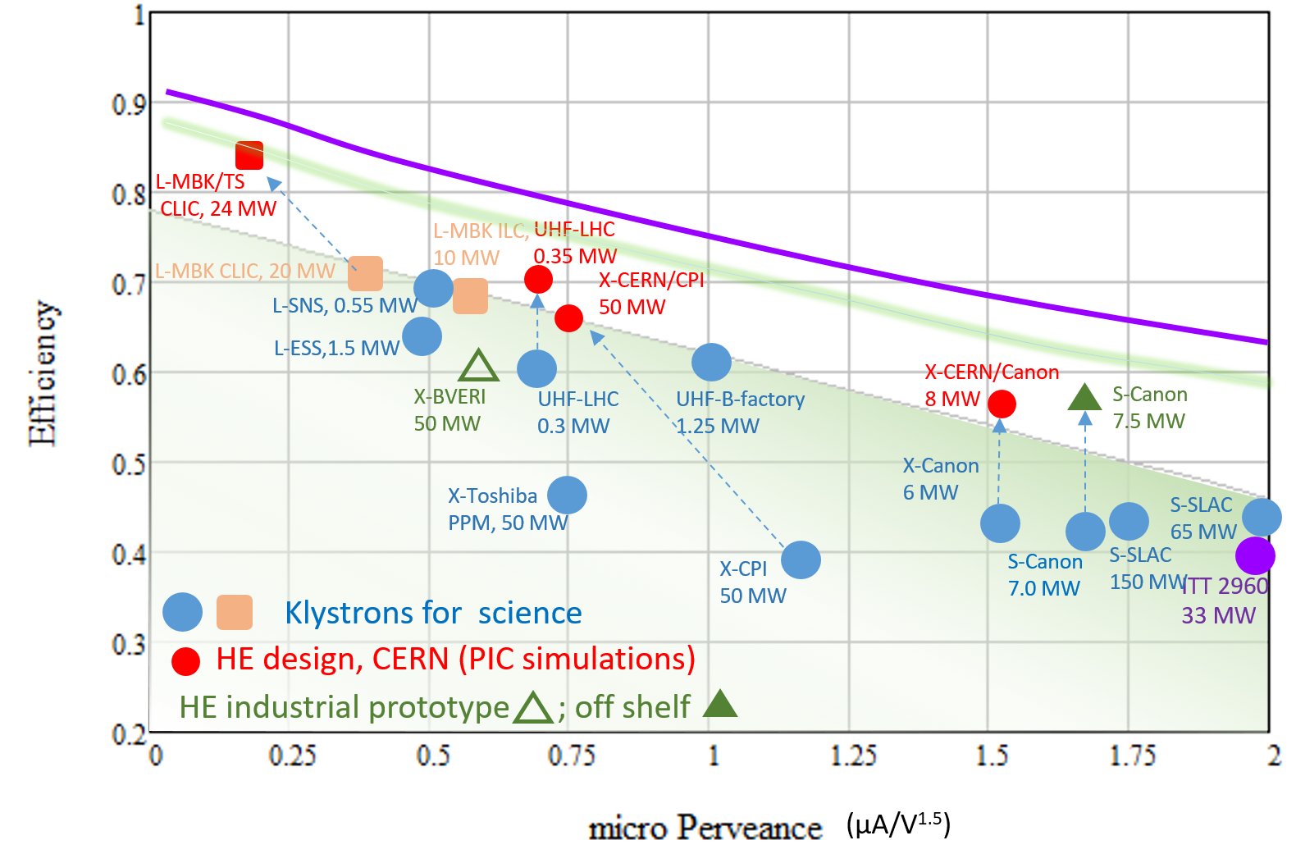
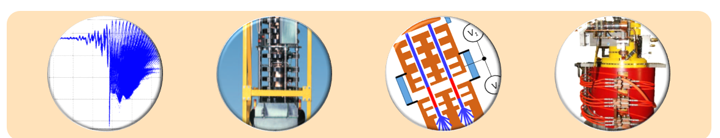
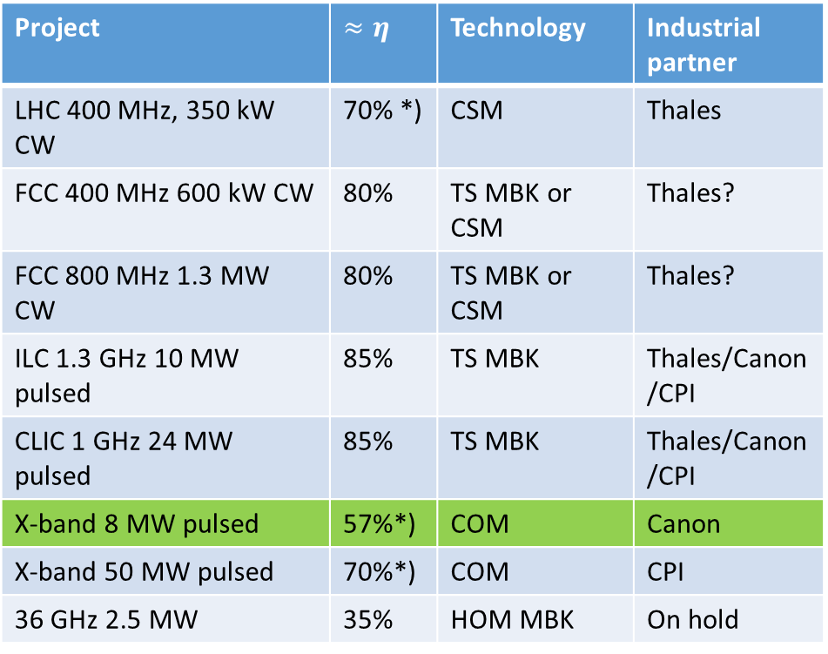
Efficiency performance of the selected commercial klystrons and the new HE klystrons.
Project | $≈η$ | Technology | Industrial partner
LHC 400 MHz, 350 kW CW | 70% *) | CSM | Thales
FCC 400 MHz 600 kW CW | 80% | TS MBK or CSM | Thales?
FCC 800 MHz 1.3 MW CW | 80% | TS MBK or CSM | Thales?
ILC 1.3 GHz 10 MW pulsed | 85% | TS MBK | Thales/Canon/CPI
CLIC 1 GHz 24 MW pulsed | 85% | TS MBK | Thales/Canon/CPI
X-band 8 MW pulsed | 57%*) | COM | Canon
X-band 50 MW pulsed | 70%*) | COM | CPI
36 GHz 2.5 MW | 35% | HOM MBK | On hold
Ultimate limit?
*) Means retrofitting an existing tube

Slide 13
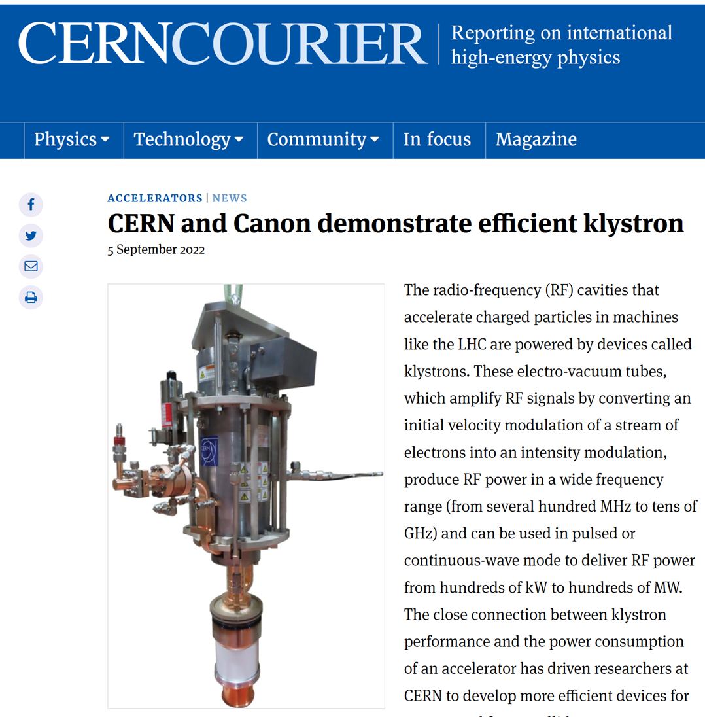
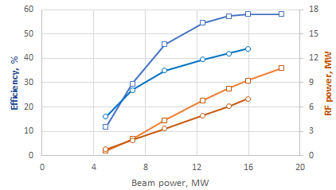

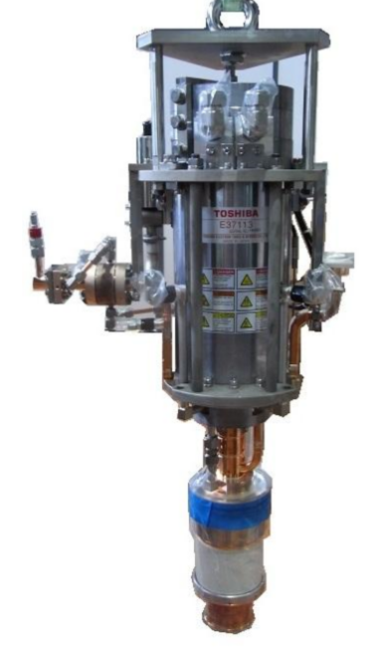
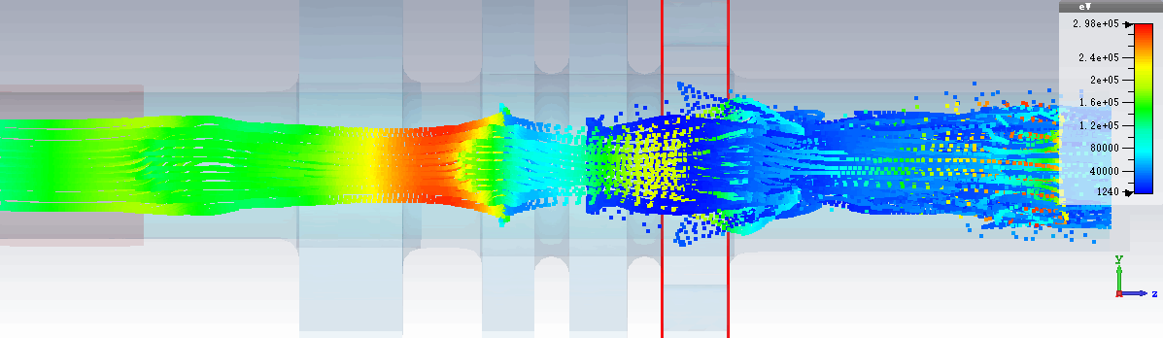
Retro-fit High Efficiency (57%), 8 MW 12 GHz klystron (Canon)
Retrofit design
E37113
 | E37113 at factory | E37117 design
Voltage, kV | 154 | 154
Current, A | 93 | 94
Frequency, GHz | 11.994 | 11.994
Peak power, MW | 6.2 | 8.16
Sat. gain, dB | 49 | 58
Efficiency, % | 42 | 57/ FCI
Life time, hours | 30 000 | 30 000
Solenoidal magnetic field, T | 0.35 | 0.4
RF circuit length, m | 0.127 | 0.127
HEX8
HEX8
E37113
Re-used solenoid.
Re-used cathode
Increased power gain (10 dB)
VKX-8311A

Slide 14
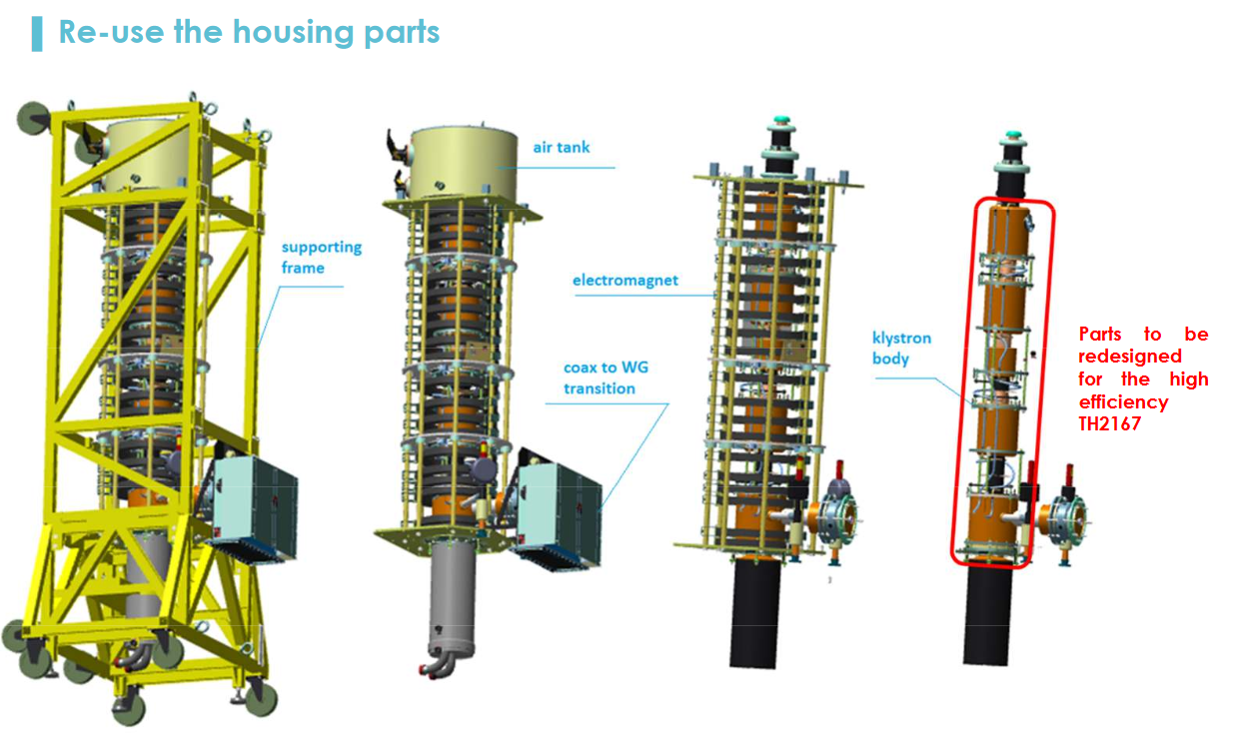
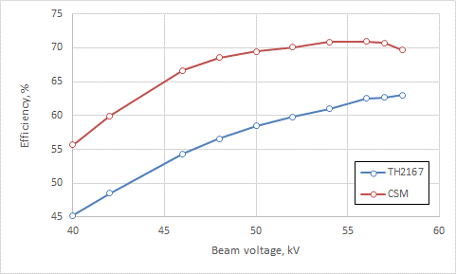
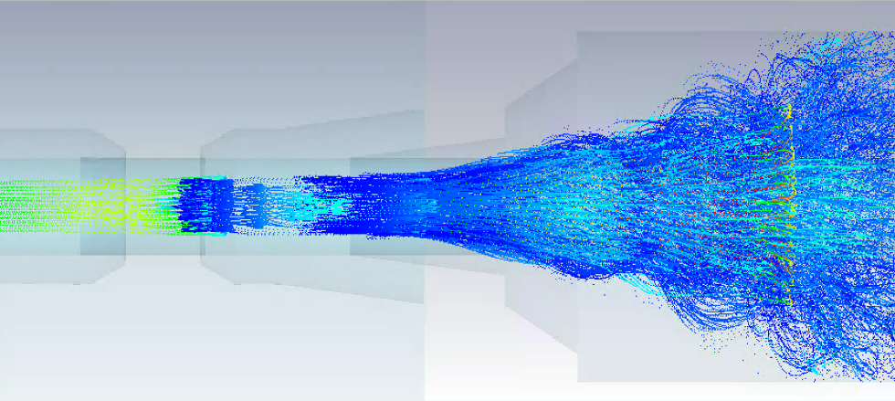
LHC CSM RF System – a 1st step for validation
KlyC simulations
TH2167HE
TH2167
CST PIC Simulation:
output cavity to collector
A. Beunas: “Towards High Efficiency Klystrons for LHC”, FCC Week, Brussels, 2019
A. Buenas, I. Syratchev, J. Cai

Slide 15
Fast Reactive Tuners

Slide 16
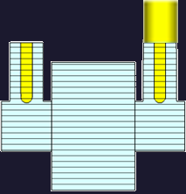
FRT Concept
Circulator
HV Line
FRT
RF Amplifier
FPC
FRT Antenna
Load
An Fast reactive Tuner (FRT) is a shorted co-axial structure containing a ferro-electric element
RF power flows into the FRT and is reflected back to the cavity
Voltage applied to the ferro-electric changes its permittivity
Permittivity change → Phase change of the reflected power → Cavity frequency change
Usually, the FRT would require its own port, although other arrangements have been proposed
Operates outside cryomodule at room temperature and does not mechanically deform cavity
Tuning speed measured at less than 600ns, limited by HV circuit

Slide 17

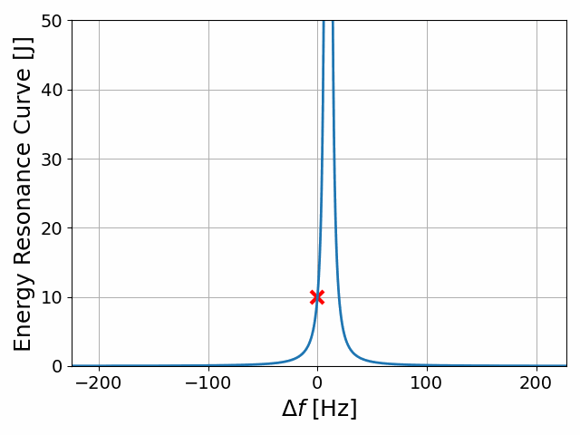
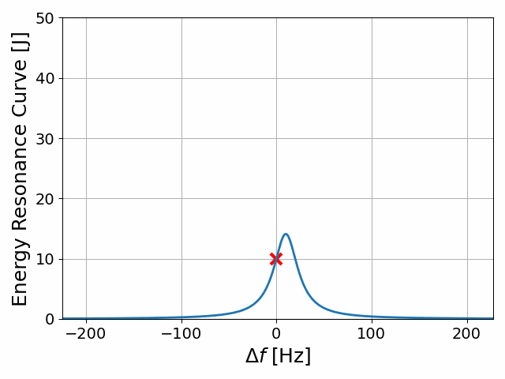
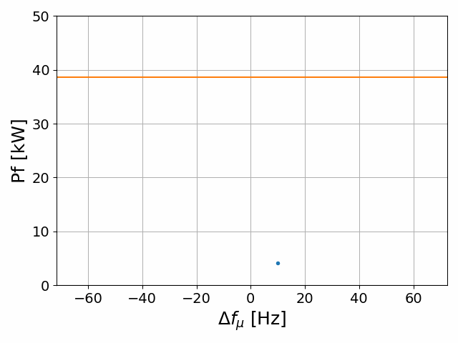
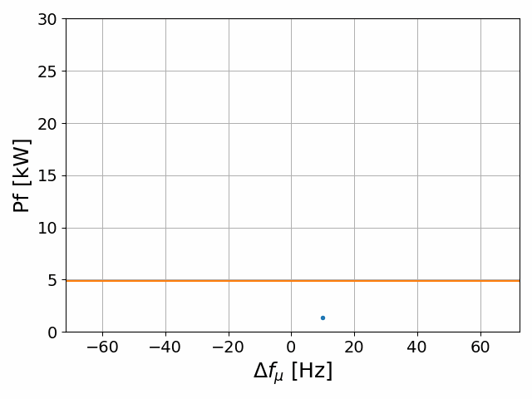
Use cases: microphonics suppression
For low beam loading machines RF power is dominated by microphonics
The effect of microphonics can be reduced passively or actively
  Stiffening of cavity
  Isolation of noise sources
  Active feedback e.g. piezo tuners
Residual microphonics require over-coupled FPC
Typically, RF power required is still many times larger than for critical coupling case
Decreasing Q_{L}

Slide 18
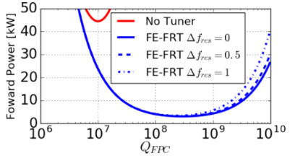


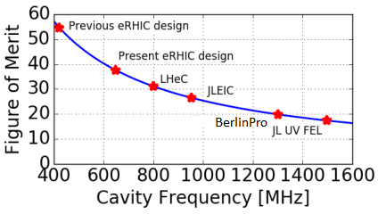
Use cases: microphonics suppression
FRTs are an excellent tool for microphonics suppression
  High Tuning speed ~600ns measured limited by external HV circuit
  No excitation of mechanical modes
  Simple transfer function/negligible phase delay at frequencies of interest
Peak and average RF power reduced by and respectively
Increased dielectric and conductor losses at higher RF frequencies reduce effectiveness
FRTs can be combined with other suppression technologies
  E.g. piezo tuners
Estimate FRTs could still beneficial up to ~2-3 GHz
  Not experimentally verified
Case study: RF power for PERLE vs QL with and without FRT
Estimated FRT FoM vs RF frequency

Slide 19
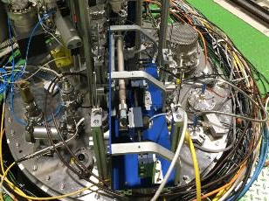
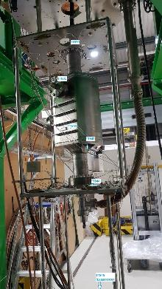
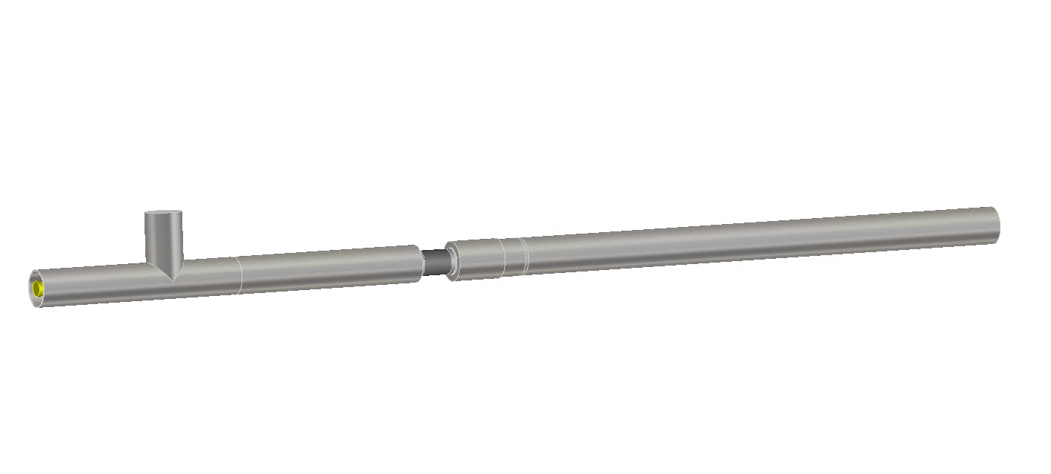
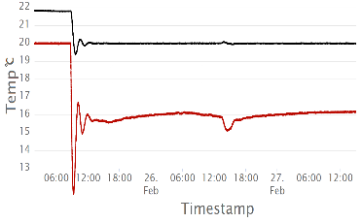
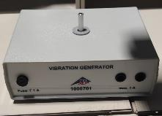
Microphonics suppression results
Lower order Mode of UK4R crab cavity at 374MHz
  Very stiff → very low levels of microphonics → used vibration generator
Euclid designed prototype FRT
No slow tuner → operated in SEL mode
Chiller, phase shifter, vibration generator
Deliberately simple purely integral feedback used
  More performant solutions surely possible
Phase shifter on top plate
FE-FRT temp.
UK4R on insert
regulation on
Bath temp.
bunker opened
Euclid FE-FRT prototype
Temperature regulation with chiller
Vibration generator

Slide 20
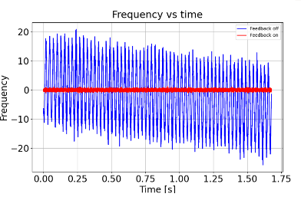
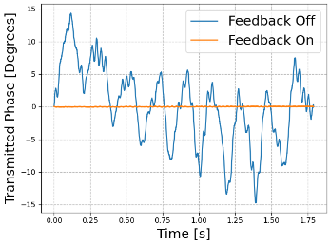
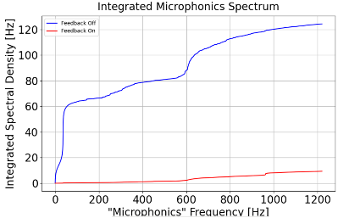
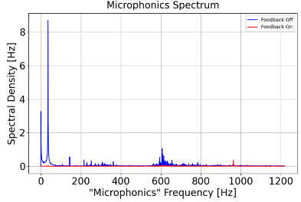
Microphonics suppression results
Vibration generator set to 37Hz
Spectral density also shows good suppression at higher frequencies e.g. ~600Hz
Peak deviation with correction 1.2Hz
N.B. long transmission line, lossy brazing
  Low FoM
  Little to no RF power reduction
F
No correction
With correction

Slide 21
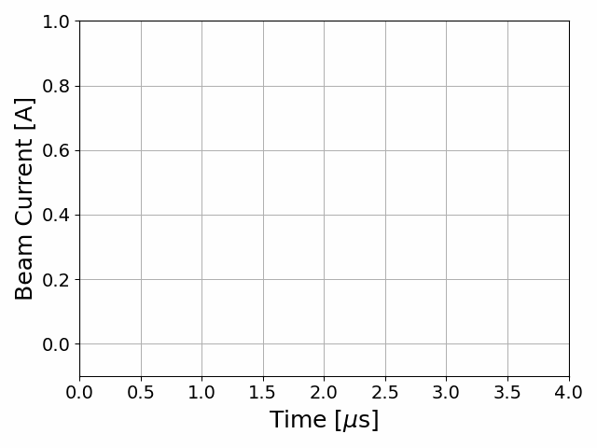
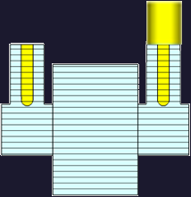
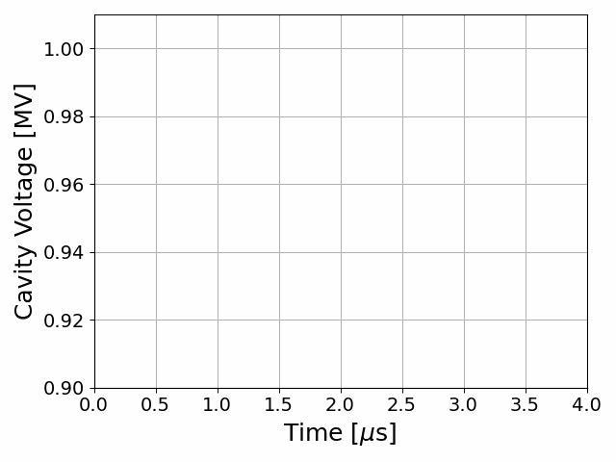
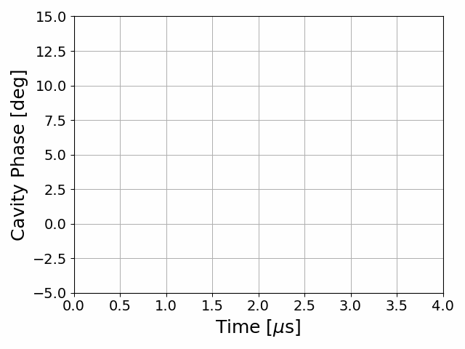
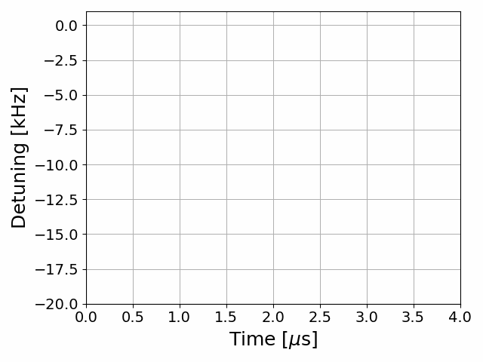
Use cases: transient detuning
Beam + fixed detuning
Circulator
HV Line
FRT
RF Amplifier
FPC
FRT Antenna
Load

Slide 22
Use cases: transient detuning
Beam + transient detuning
Circulator
HV Line
FRT
RF Amplifier
FPC
FRT Antenna
Load

Slide 23
Conclusion
With better cavity tuning and improved klystron efficiency significant reductions in the required wall-plug power to drive RF systems can be achieved
Klystron efficiency can be improved by an additional 10-15% which could reduce the power need of a collider by 166 GW-hr per year (100 times the yearly output of the solar cells in the DL car-park)
Fast reactive tuners can reduce power demands
  for low beamloading machines by reducing the overhead needed for microphonics
  For machines with reactive beamloading by switching the frequency during abort gaps

