Slide 1
Thin Film Superconducting RF Cavities
Andrew Vick
On behalf of the TF SRF team at DL
Notes:
The abstract pattern can be removed or repositioned if required. Be careful to ‘Send to Back’ so that it does not obscure any important information.

Slide 2
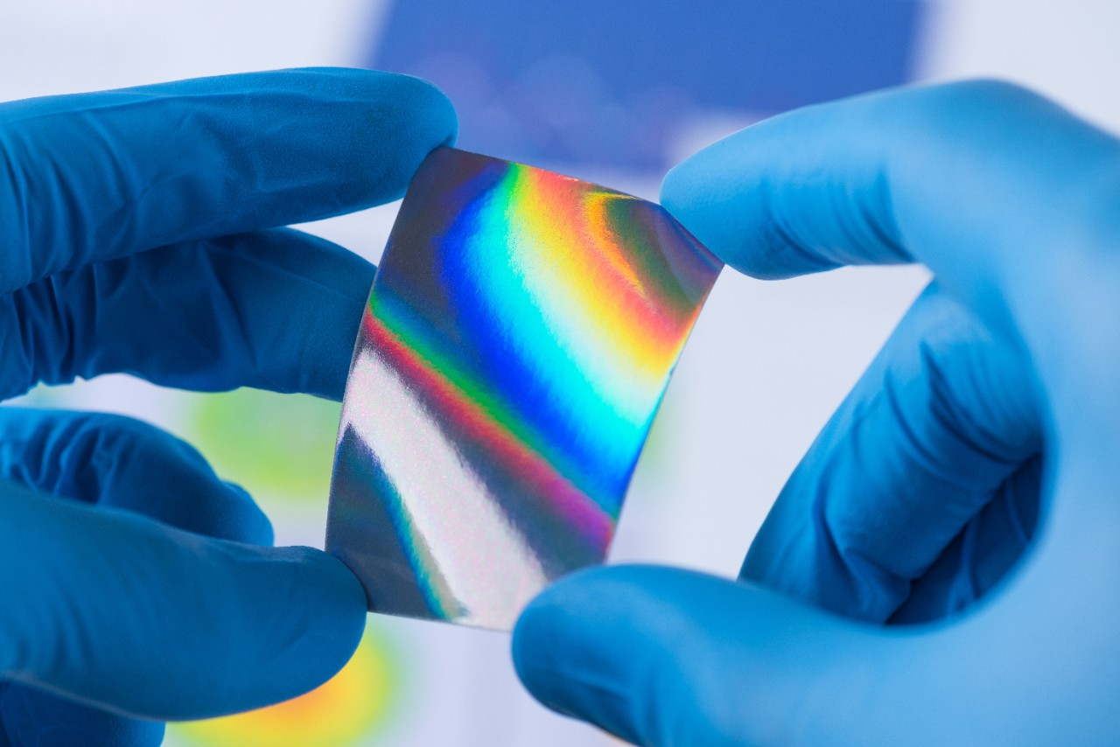
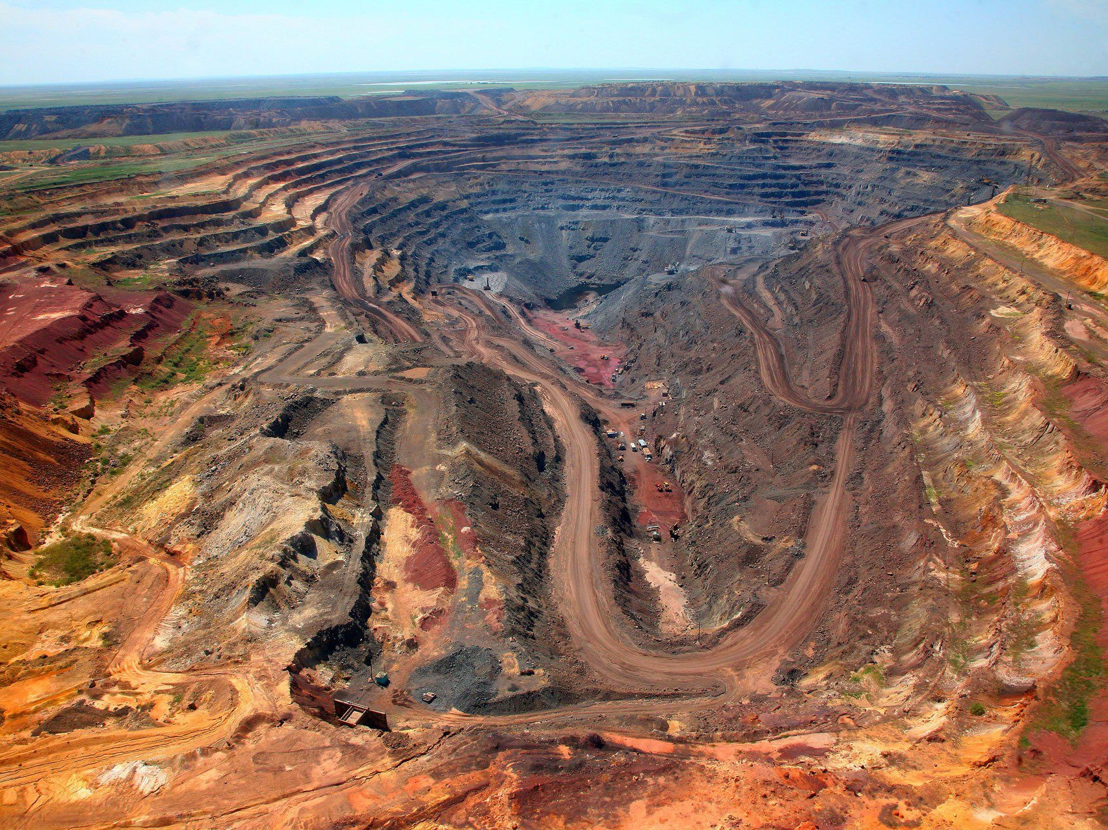
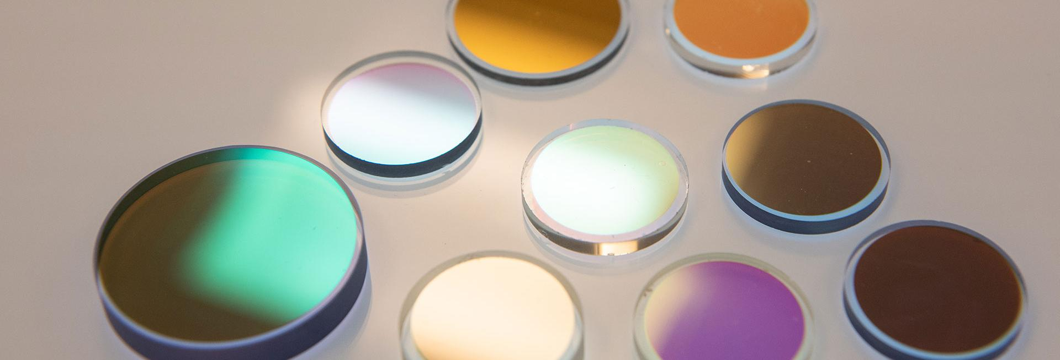
Why Thin Films?
Reduction of material use
New phases of materials – enhanced properties
Complex alloys with unfavourable mechanical properties
Multilayer possibilities to harness different material strengths
Notes:
Please replace photo of presenter with a portrait of your own. 1) Send the geometric shape overlay to the back – Right-Click > Send to Back > Send to Back. 2) Replace image – use the guides provided to correctly position it. 3) Send your portrait to the back so that the geometric overlay re-appears over the portrait.

Slide 3
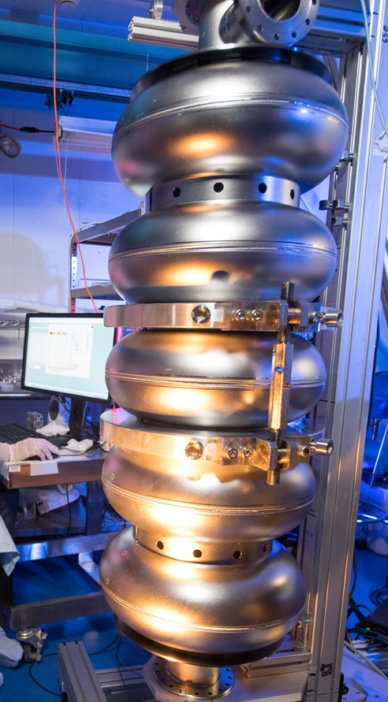
SRF cavities
Bulk niobium cavities have been the choice for SRF for the last 50 years.
Not only do these use a considerable amount of natural material they have reached the performance limit of niobium and are costly to produce.
Bulk Nb cavities are run at 2 Kelvin! A considerable cryogenic demand and energy load.

Slide 4
Replacing Nb bulk
Use Of Thin Films On Copper
Improve Accelerator Performance
More Sustainable Accelerators
Reduce costs
Easier to machine
Higher thermal conductivity than Nb
Reach higher Q₀ and E_{acc}
Utilise various high T_{c} materials (e.g. Nb₃Sn, V₃Si, NbN, NbTiN, MgB₂)
Multilayers
Bulk Cu vs Bulk Nb
Reduce cryogenic power consumption
Shorter accelerator structures
Up-cycling existing cavities

Slide 5
Nb₃Sn: A very promising material
Higher critical temperature $T_{c}$:
lower losses
higher operating temperature
can operate at higher frequency
Higher superheating field $B_{sh}$= higher accelerating gradients: $E_{acc, max}∝B_{sh}$

Slide 6
Nb₃Sn potential
 | Nb | Nb₃Sn
Superheating Field ($B_{sh})$ | 240 mT | 420 mT
Max. $E_{acc}$ | 55 MV/m | 100 MV/m
Critical Temperature ($T_{C})$ | 9 K | 18 K
$Q_{0}$ at 4.2K | $$6 ×{10}^{8}$$ | $$6 ×{10}^{10}$$
$Q_{0}$ at 2K | $$3 ×{10}^{10}$$ | >${10}^{11}$
Higher energy gain
Shorter accelerators
Lower cooling cost and complexity
4.2K operation with high cryo-efficiency (!!)
No superfluid helium
Q₀ given for 1.3 GHz single-cell ILC-shape cavities
Parameter | LCLS-II: Bulk-Nb | TF-SRF | Variance
Frequency (GHz) | 1.3 | 1.3 | No variance
Gradient (MV/m) | 16 | 20 | 4 MV/m increase
Qo | 2.7 x 10¹⁰ | 4 x 10¹⁰ | ~35% increase
Temperature (K) | 2 | 4.2 | >50% increase
Normalised Cryo Power | 1 | 0.5 | 50% reduction
Normalised Linac Active Length | 1 | 0.8 | 20% reduction
L. Shpani: https://indico.classe.cornell.edu/event/2018/contributions/1854/attachments/1459/1977/ERL_talk.pptx

Slide 7
Bulk niobium cavities will become history!
Notes:
To edit the background image, select ‘Format’ from the PowerPoint menu and ‘Slide Background’ from the drop-down menu. Within the new list of options that appears on the right of the screen, select the ‘File’ button under ‘Insert picture from’ and select your image from your file browser. Remember to delete the image credit if using your own image.

Slide 8
A path towards the goal
Superconducting thin film development
Notes:
The abstract pattern can be removed or repositioned if required. Be careful to ‘Send to Back’ so that it does not obscure any important information.

Slide 9
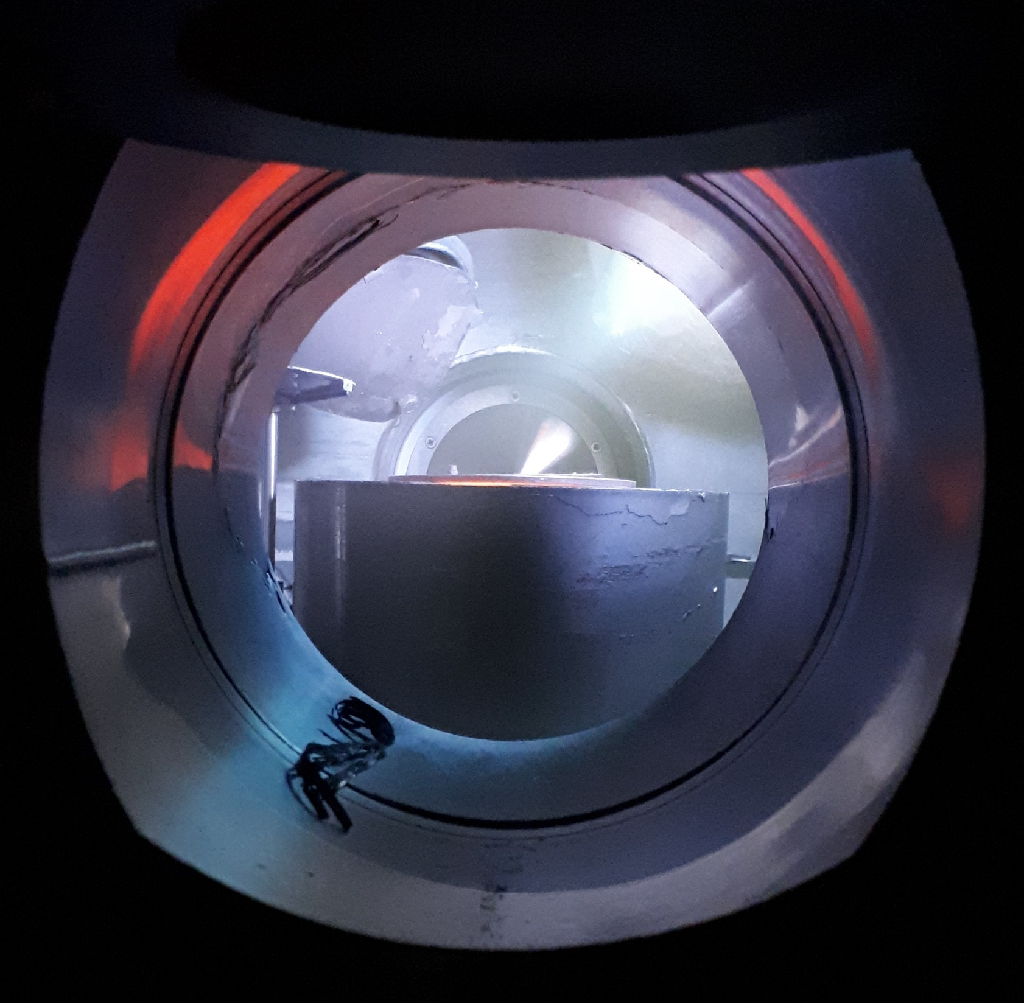
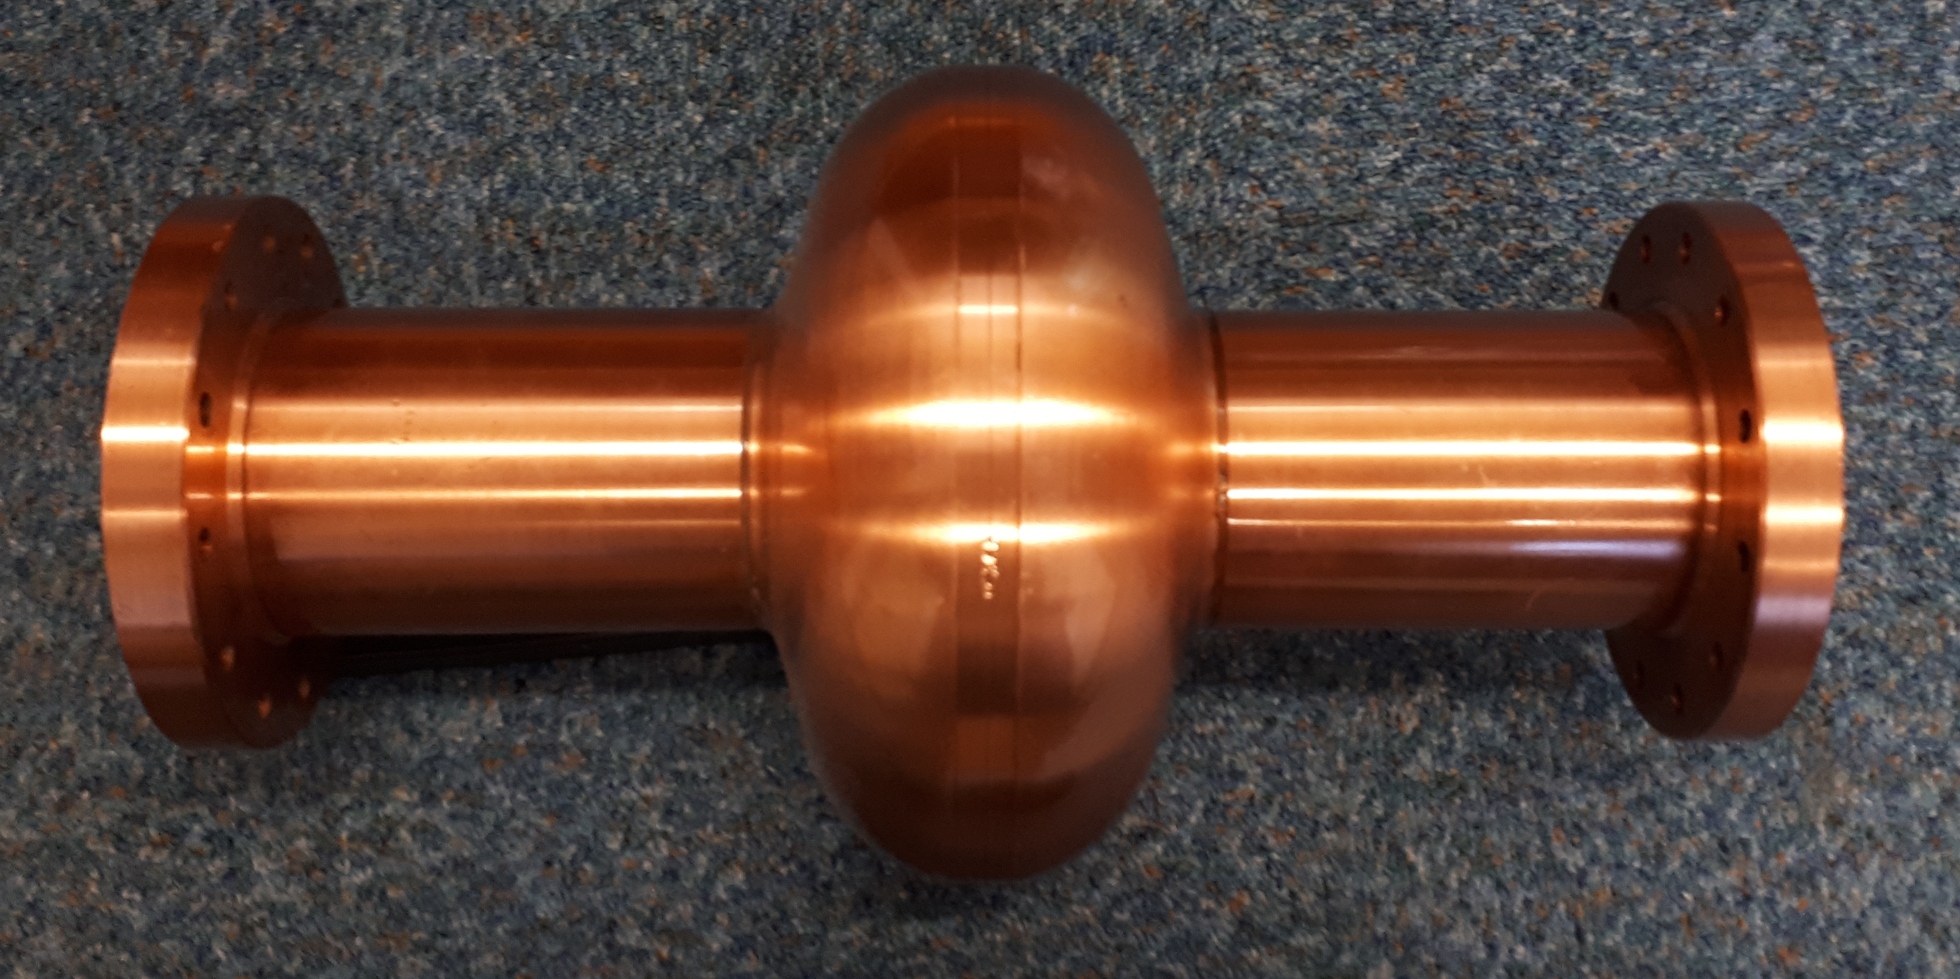
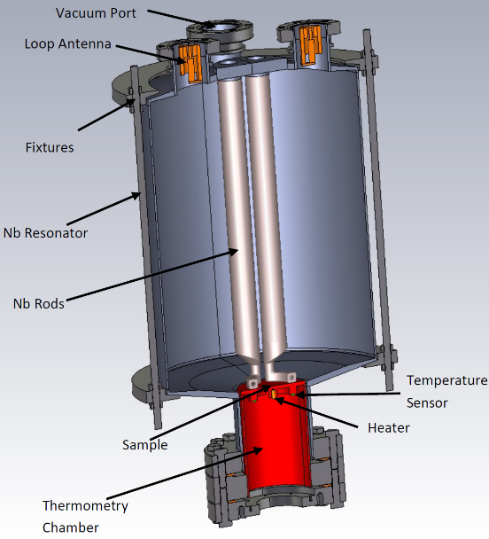
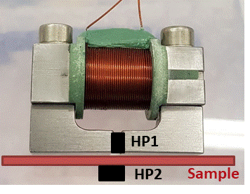
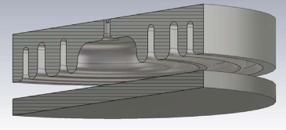
I.FAST WP9: Innovative superconducting cavities
The main emphasis is on applying the result of ARIES to RF cavity deposition and testing
Thin film deposition
PVD: DC, pulsed, HIPIMS…
Film characterisation
SEM, FIB, AFM,
Real cavity measurement
Cavity deposition
(PE)CVD, (PE)ALD
XPS, XRD, RBS, TEM…
Superconducting RF properties evaluation
Superconducting properties measurement
RRR, H_{c}, H_{fp}, H_{sh}, …
QPR at CERN
QPR at HZF
HW cavity at ASTeC
Nb, NbN, Nb₃Sn, MgB₂, SIS, etc.
Surface preparation
Cleaning, etching,
Polishing, passivating
DC magnetic susceptibility,
Field penetration
Nb film laser treatment
Film deposition
1.3 GHz cavity for STF deposition
SEM image of a NbN thin film
QPR
DC magnetisation
Test cavity
Notes:
ARIES is going to the end by 30th April this year.
A new H2020 funded collaboration is starting on 1st May for another 4 year.
It is call IFAST: Innovation Fostering in Accelerator Science and Technology.
Our team has successfully applied for further development of superconducting thin films for SRF applications.
We will continue all activities started with ARIES,
In addition to Physical Vapour Deposition methods, an Atomic Layer Deposition will be explored.
However the main emphasis will be shifted on applying the result of ARIES to the deposition and testing of the half-wave RF cavities at 6, 3 and 1.3 GHz.

Slide 10
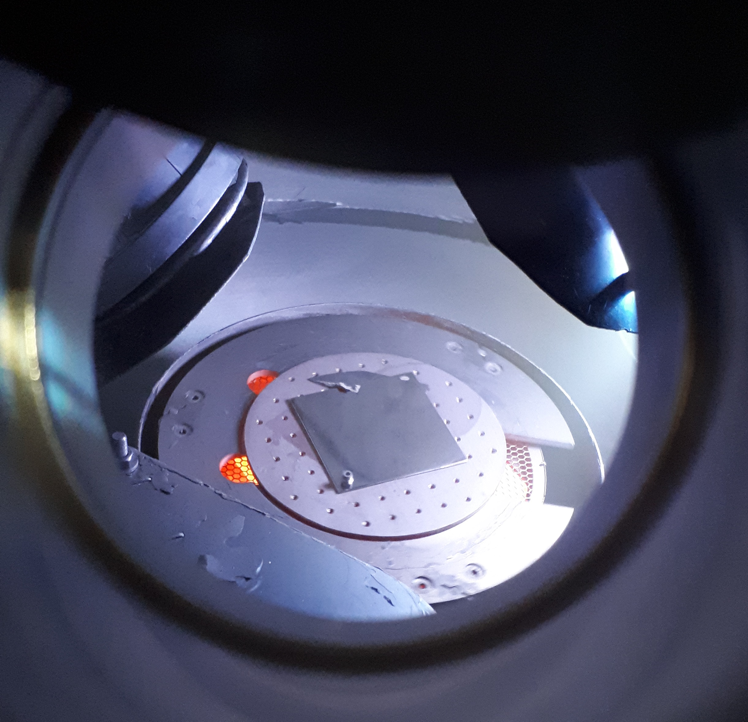
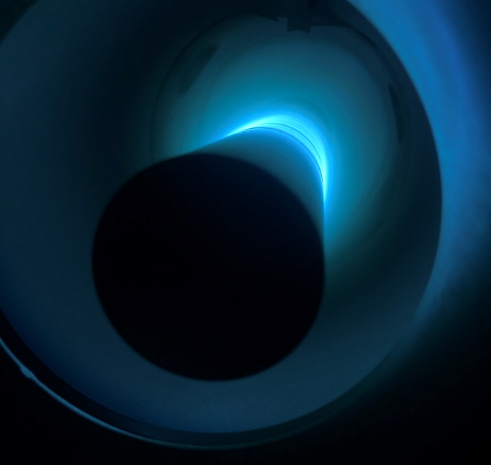
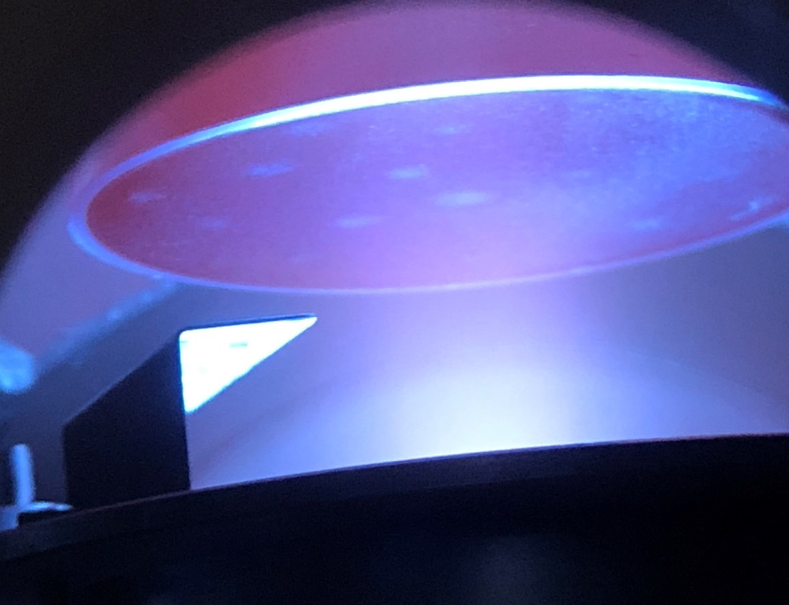
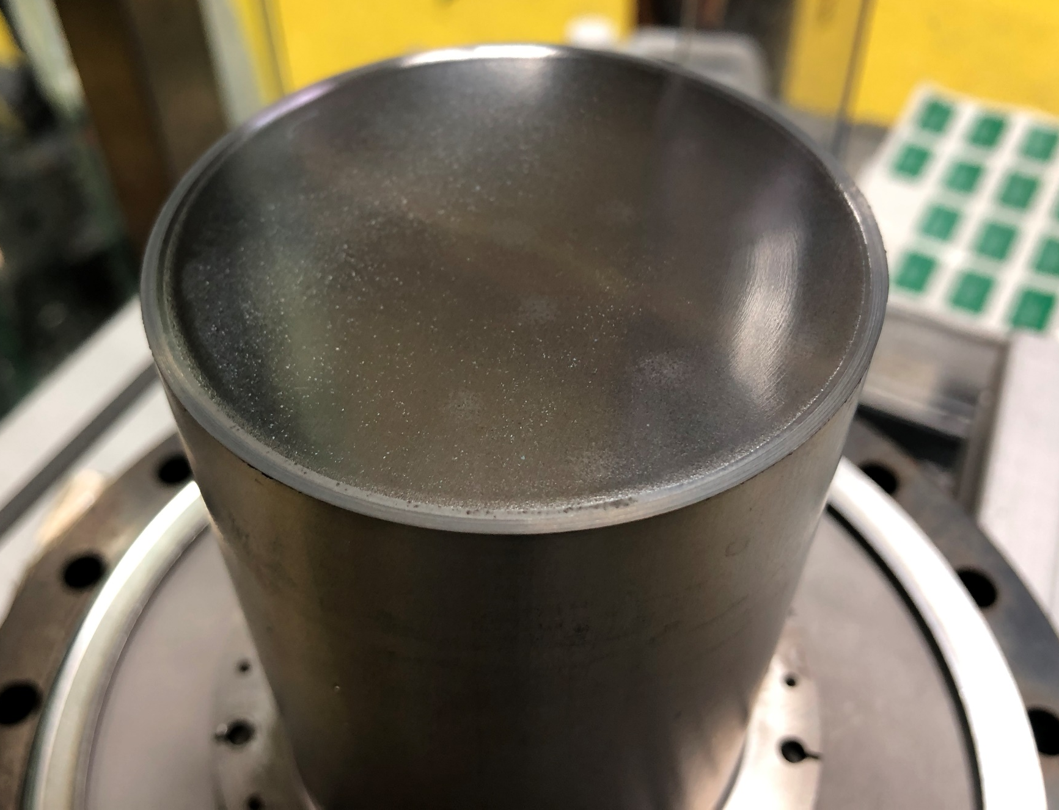
Thin film development
Techniques:
PVD: DC, pulsed, HIPIMS…
(PE)CVD, (PE)ALD – under development
Combined: PCVD
Materials:
Nb
NbN, Nb₃Sn, NbTiN, V₃Sn, MgB₂, etc.
SIS structures
A sample during the Nb deposition
Courtesy of R. Valizadeh (STFC)
A QPR sample during and after the Nb TF deposition
Courtesy of R. Valizadeh (STFC)

Slide 11
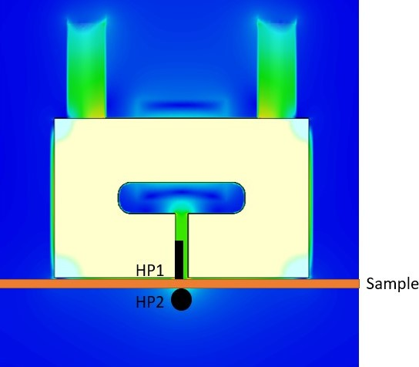
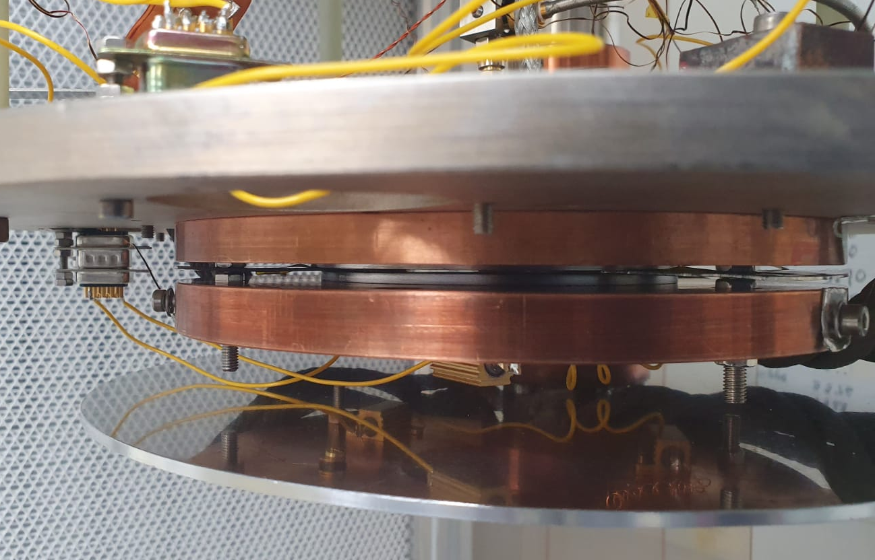
Thin film Superconducting properties
Magnetic field penetration facility for the planar samples
TF samples can be compared in conditions similar to ones in the cavity
Field local to the sample surface
Applied and penetrated field measured by Hall probe sensors
A radiofrequency (RF) cavity and cryostat dedicated to the measurement of superconducting coatings at 7.8 GHz
Low power measurements with an emphasis on fast turn-around time (~2 days for each sample).
Cavity Plate
Sample
Sample Plate

Slide 12
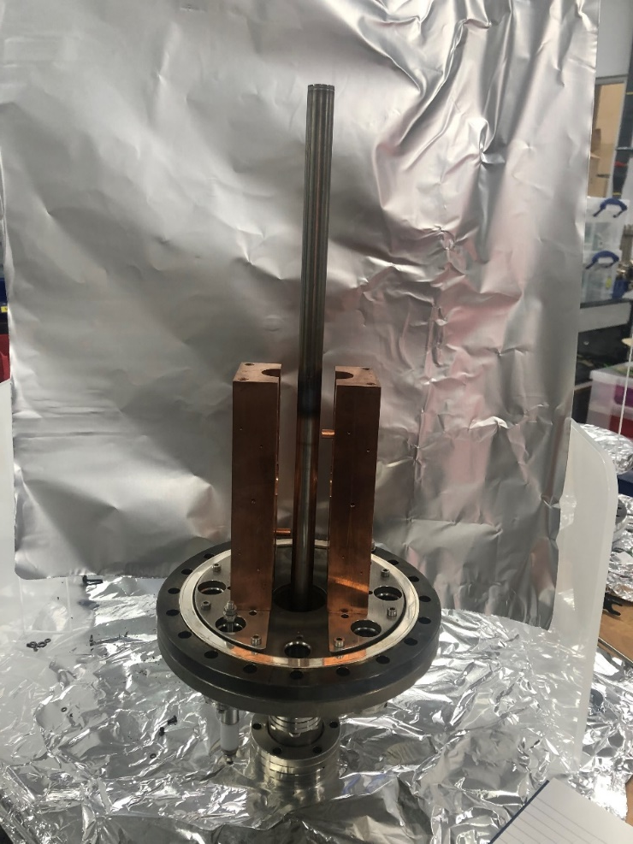
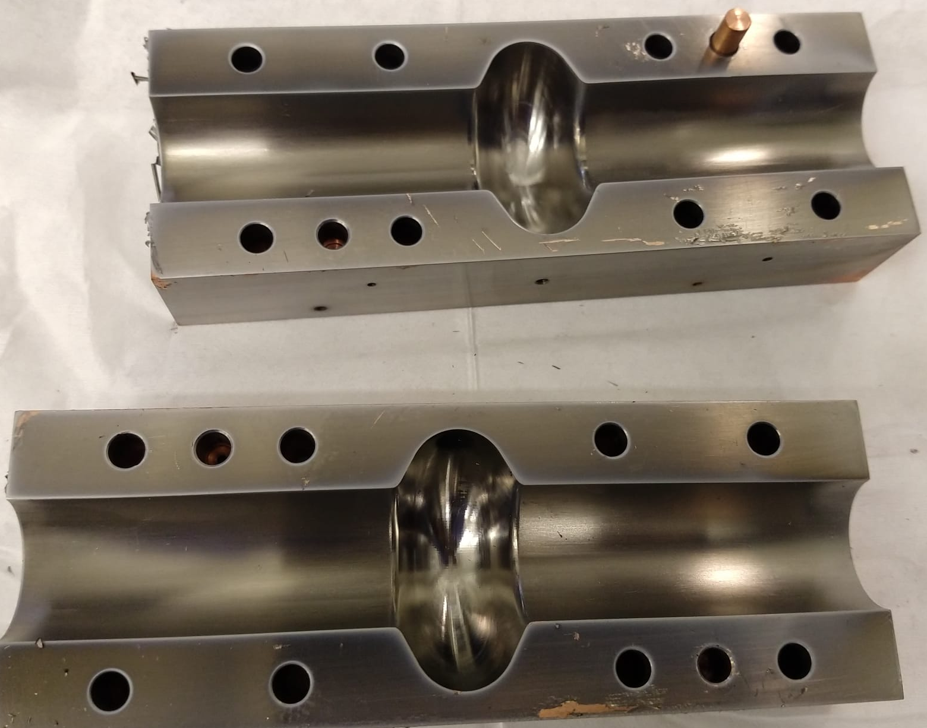
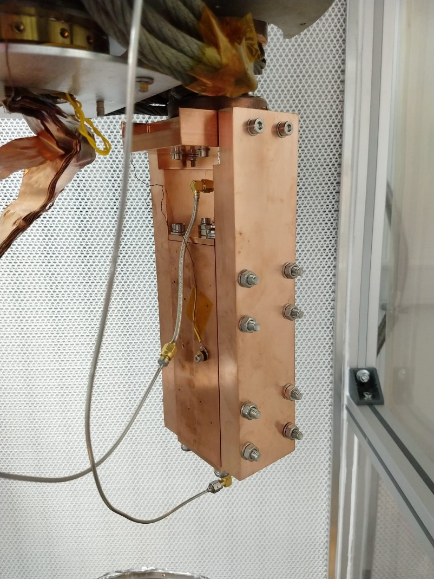
Split cavities for thin film testing
Easy to coat with either conventional planar magnetron or in tubular geometry used for RF cavities
Easy to inspect

Slide 13
Cavity A Superconducting Preliminary Results
Clear superconducting transition at the correct transition temperature range.
Measured Rs =1.13 mΩ at 4.2 K .
R_{BCS} = 1.15 × 10⁻² mΩ.
2 orders of magnitude higher than theoretical Rs.
Maybe due to imperfection of the thin film as it was a trial coating.
This was the first RF cavity coated with a superconducting thin film at DL and in UK.
The first RF test of thin film coated SRF cavity at DL.
First split cavity coated and tested in UK

Slide 14
A path towards the goal
TF SRF cavities – the real deal
Notes:
The abstract pattern can be removed or repositioned if required. Be careful to ‘Send to Back’ so that it does not obscure any important information.

Slide 15
Cavity Testing – the future
High power tests at DL
Upgrade to SuRF lab 2023
Multicell cavity coating
Select cavity frequency relevant to future infrastructure
Prototype Cryomodule

Slide 16
The End Goal….
Where this technology could be applied?
In UK based accelerators: UK-XFEL, ISIS upgrade, …
As a part of UK participation in the international and overseas projects

Slide 17
Science and Technology Facilities Council
@STFC_matters
Science and Technology Facilities Council
Notes:
The abstract pattern can be removed or repositioned if required. Be careful to ‘Send to Back’ so that it does not obscure any important information.

