Slide 1



Permanent magnet technology for sustainable particle accelerators
Alex Bainbridge
ASTeC, UKRI-STFC Daresbury Laboratory
Sustainable accelerators workshop
2 Dec 2022
Daresbury Laboratory, UK

Slide 2

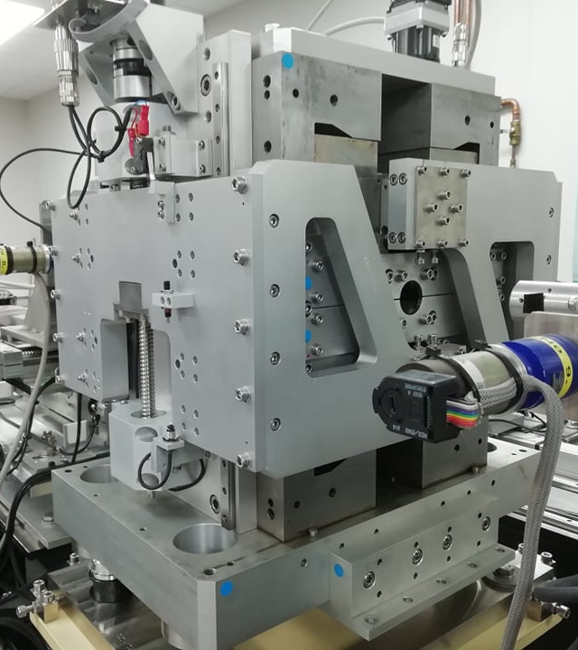
Agenda
1 Introduction to permanent magnets
2 PM CUBE-ECRIS Dipole
3 FEBE spectrometer
4 EPAC Halbach quadrupoles
5 HEPTO combined function
6 ZEPTO tunable quadrupole
7 Conclusions

Slide 3
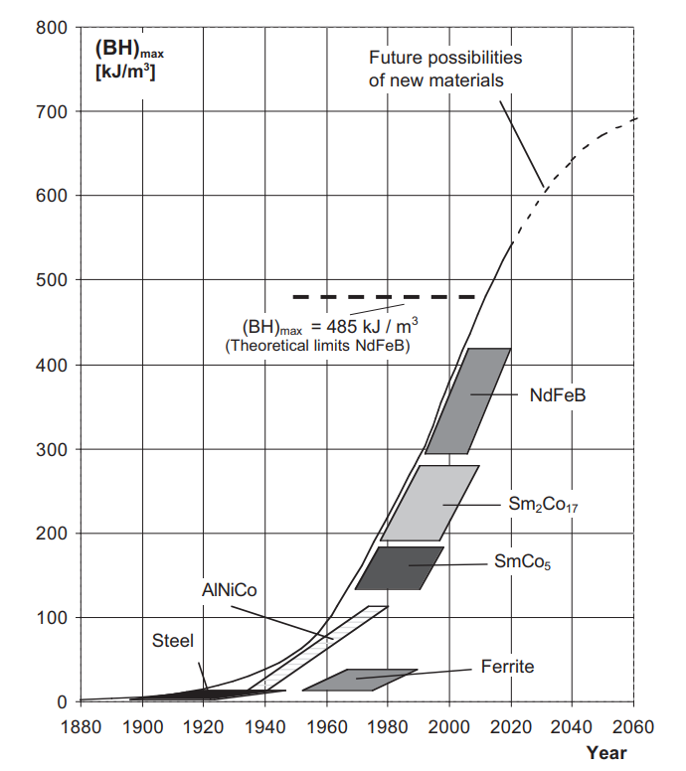

Introduction to permanent magnets
Materials with a highly hysteretic BH curve store energy within and generate their own magnetic field
B [T]
Material development has been rapid – stored energy limit roughly doubles every 12 years!
Coercivity H_{c}
Remanent field B_{r}
H [A/m]
Free space $B=μ_{0}H$
Source: Vacuumschmeltze

Slide 4
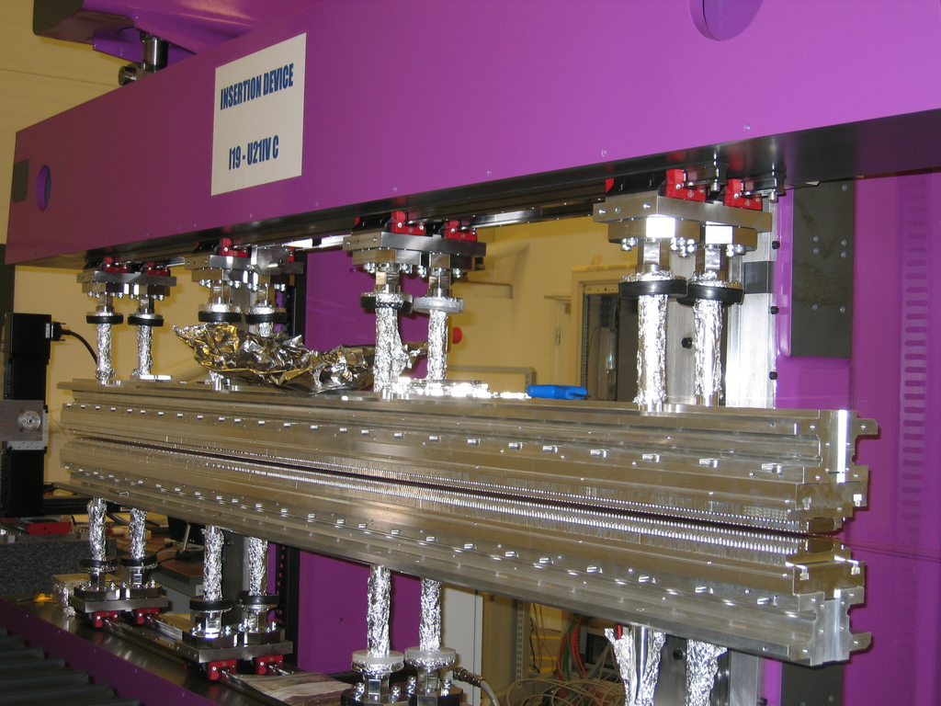
Permanent magnets in accelerators
Permanent magnets have featured in accelerators via undulators for decades – first proposed in 1947 by Ginzburg and regularly used since the 1970’s.
PM’s make perfect sense for the short period and small gaps of undulators, but 3 major barriers to other uses:
1) Lack of strength – can now be overcome by modern rare-earth magnetic materials SmCo and NdFeB
2) Cost and supply of large amounts of material – less of an issue now demands of modern technologies such as electric vehicles have driven production tech forward
3) Lack of versatility – But recent projects have proven that tunable permanent magnet technology is possible…

Slide 5
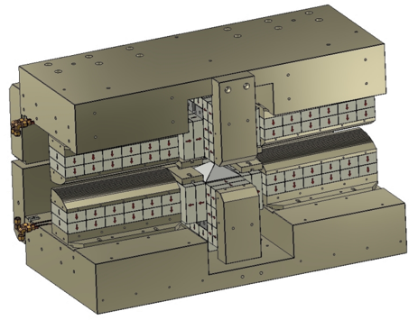
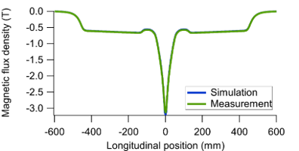
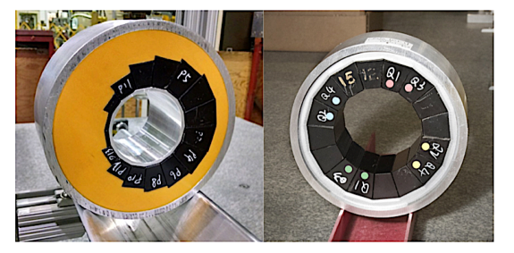
Permanent magnets in accelerators
Example 1: The Sirius superbend gradient dipole achieves 3.2 T in the magnet centre and 0.5 T + 9.5 T/m in the entry and exit sections. 4% adjustability in B and G.
Example 2: CBETA combined function Halbach dipole-quadrupole magnets. Achieves 0.27 T central field with 19.19 T/m gradient.

Slide 6
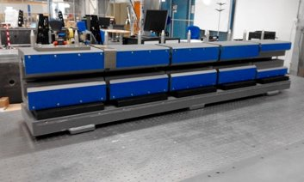
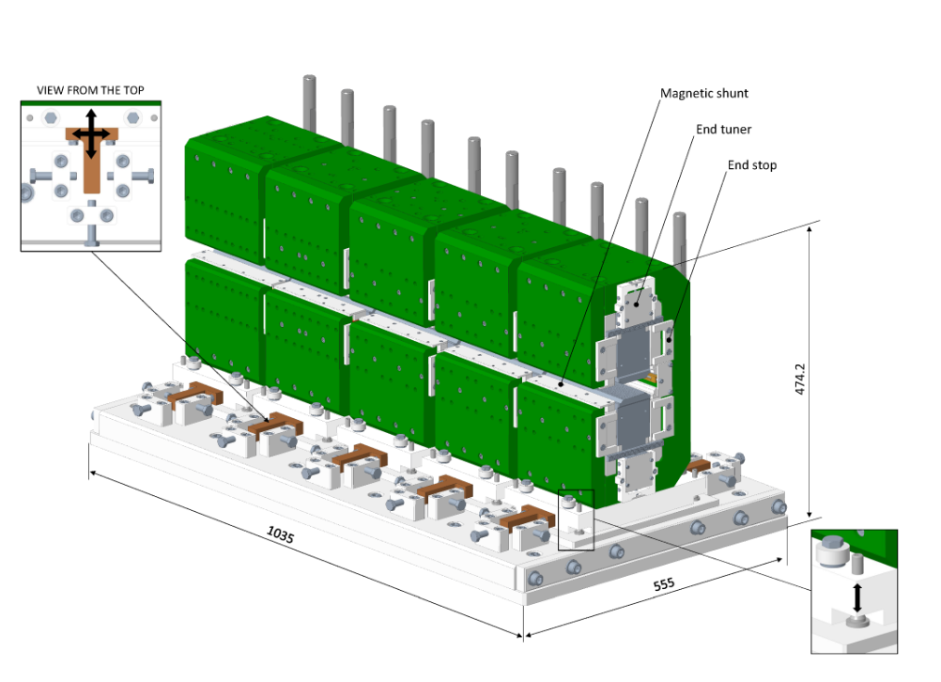
Permanent magnets in accelerators
Example 3: ESRF-EBS upgrade includes 128 longitudinal gradient dipoles using Sm₂Co₁₇ blocks, producing 0.64 T at one and decreasing to 0.17 T at the other. 4/5 Modules are identical except for the number of blocks defining the field strength.
Example 4: Diamond-II planned to include longitudinal gradient dipoles producing 0.75 T at one end decreasing to 0.33 T at the other using Sm₂Co₁₇ blocks. Features thermal shunts and end tuners for minor corrections.

Slide 7
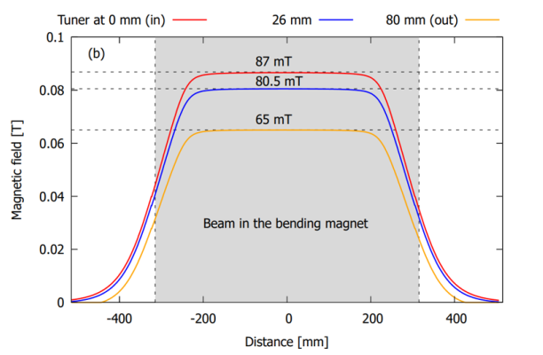
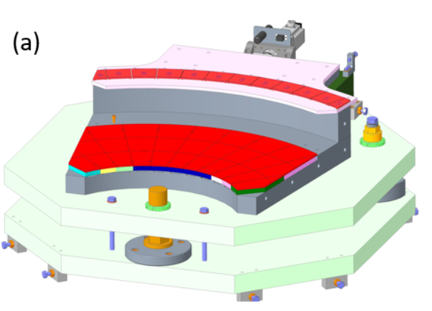
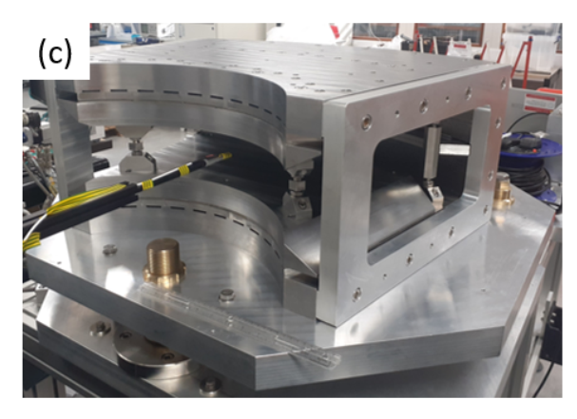
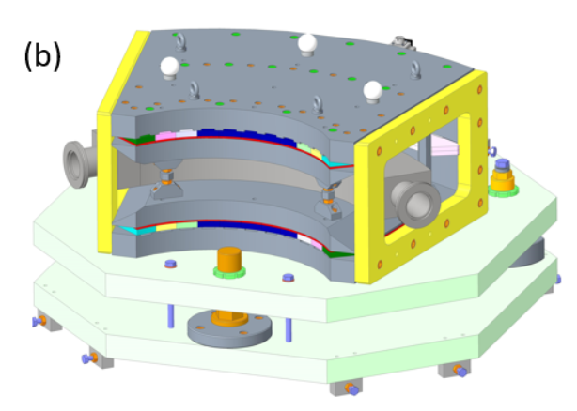
CUBE-ECRIS Dipole
Tunable low strength large dipole developed by ISIS and TD for use on the CUBE-ECRIS experiment, an Ion Time-of-Flight Elastic Recoil Detection Analysis facility at the University of Jyväskylä, Finland.
Uses 4mm thick NdFeB blocks above and below the beam to generate ~60 mT, with more blocks in a moving tuner cartridge in yoke boosting the field to between 65 and 87 mT based on position. Steel poles define the field homogeneity.

Slide 8
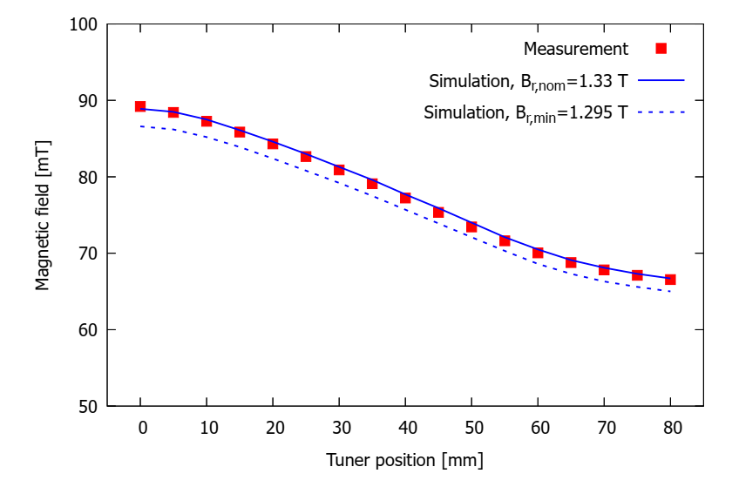
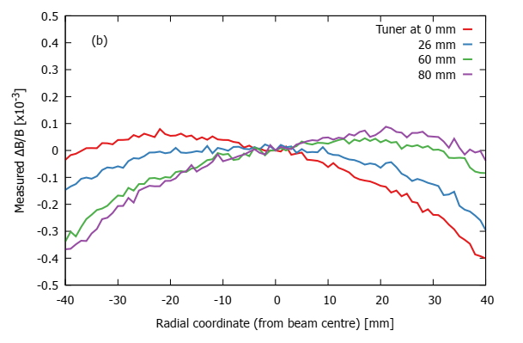
CUBE-ECRIS Dipole
Measurement results show field strength matches simulation well, field homogeneity remains in spec regardless of tuner position!
The magnet is due for installation on the CUBE-ECRIS experiment in February 2023.

Slide 9
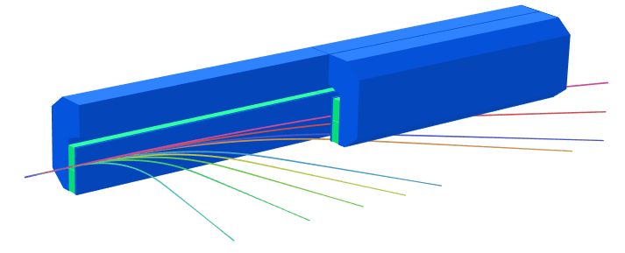
FEBE spectrometer
1m
The new FEBE extension to CLARA will feature an in-vacuum permanent magnet spectrometer to record the results of novel acceleration experiments.
A perfect scenario for using permanent magnets - not needing power and cooling makes permanent magnets preferable for in-vacuum solutions from a practical perspective as well as an environmental one!
Suitable for measurements from CLARA base energy (250 MeV) up to 2 GeV using screens below and end-on to the spectrometer.
A relatively conventional design, C core yoke, NdFeB magnet blocks (Br 1.41 T), steel pole tip for homogeneity, central field 0.72 T…..but with a slight twist.

Slide 10
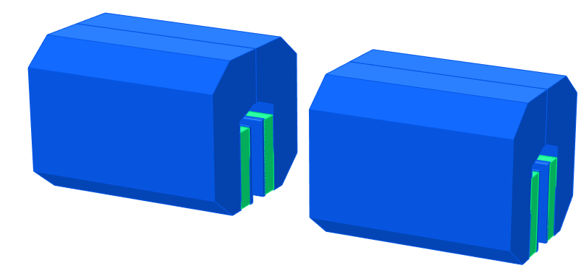
FEBE spectrometer
The spectrometer is designed to be built in 5 identical modular sections of 20 cm each.
When expecting energies up to 2 GeV the full 1m length is used, but if only expecting up to 600 MeV, only 3 segments are needed, freeing up space for additional diagnostics!

Slide 11
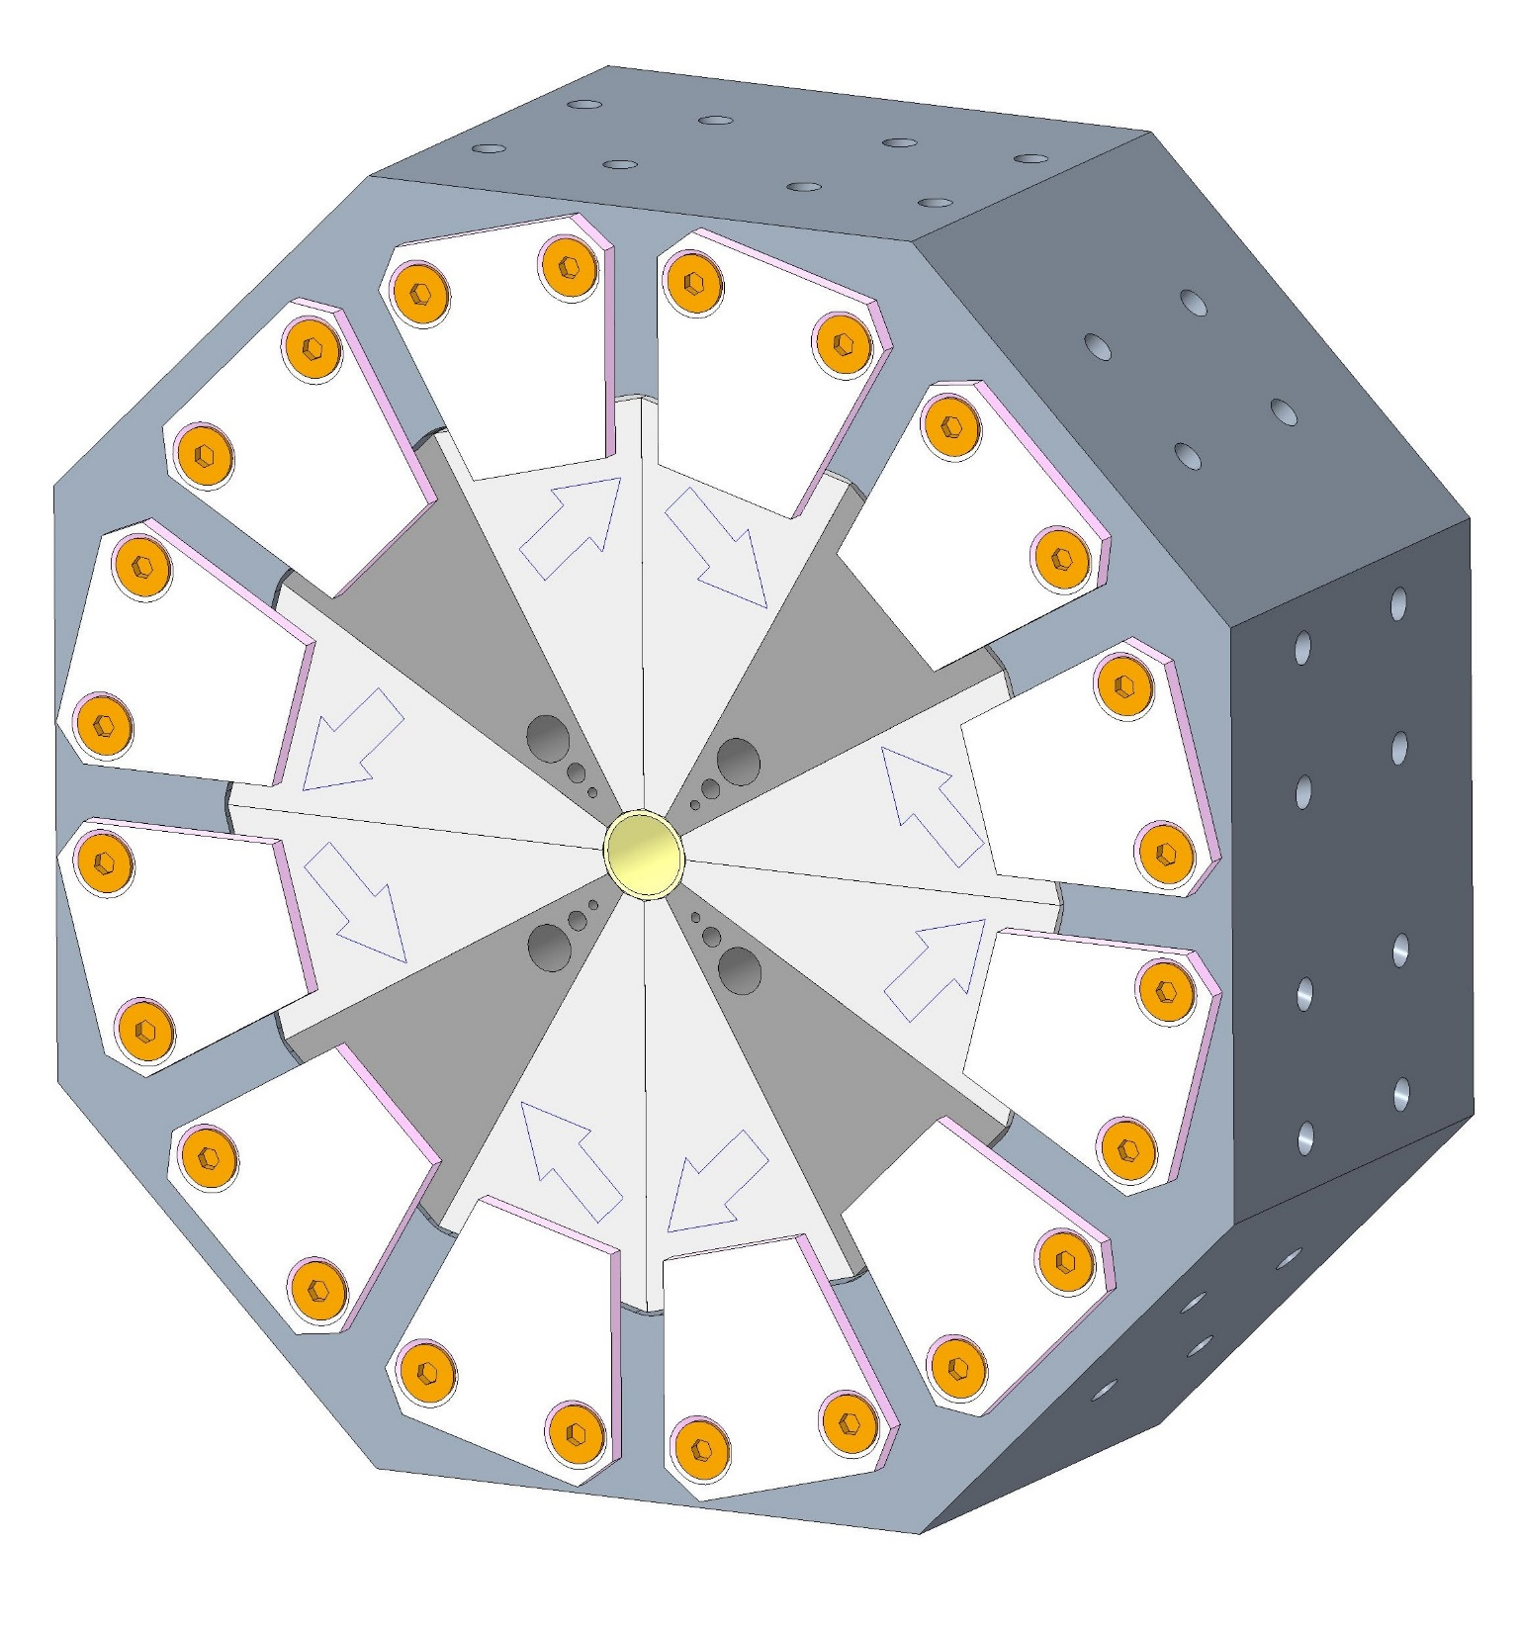
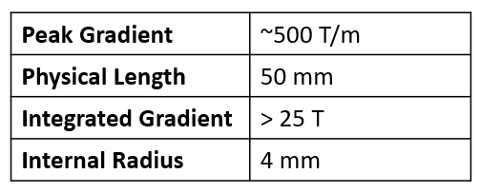
EPAC Halbach quadrupoles
Halbach array quadrupoles with small gaps can provide field gradients far higher than EM counterparts in a compact package, all whilst drawing no power.
ASTeC is designing and building a stack of hybrid Halbach array quadrupoles for the EPAC facility at RAL.
The quads will be used to capture highly divergent electron bunches as they exit a plasma acceleration stage at up to 5GeV.
They are mountable in two orientations so can be used as F-Quads and D-Quads
1006 steel poles
NdFeB
Br=1.37 T
Tuning holes

Slide 12
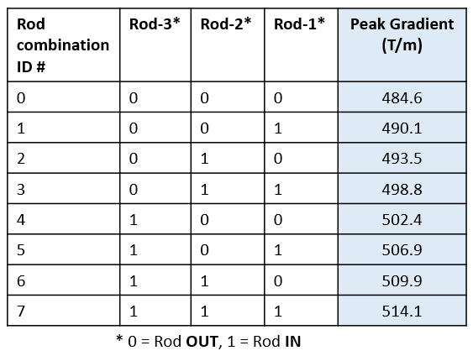
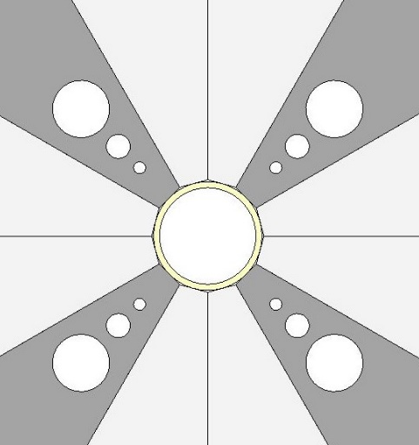
EPAC Halbach quadrupoles
Due to Br and angle variations, even for perfectly assembled magnets the gradient variation over 4 quads will be up to 1.8%
The specification, from beam dynamics studies, is that maximum allowed variation is 1%
Problem solvable with a novel a 3-Bit Tuning System, using 3 insertable steel rods, that allows the gradient to be varied in 8 steps of 0.8% over a full range of 6% - this should allow all quads to be brought within specification.
Rod/Hole 3
Rod/Hole 2
Rod/Hole 1

Slide 13
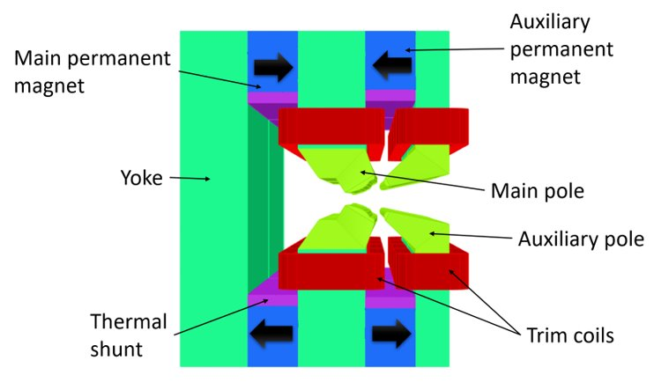
HEPTO Combined function magnet
Hybrid Electromagnet-Permanent magnet Tunable optics
Part of the I.FAST collaboration, with contributions from STFC Daresbury, Diamond Light Source and Kyma, to meet the needs of Diamond-II upgrade.
The concept is a combined-function dipole-quadrupole using NdFeB blocks to drive the field and trim coils to adjust the quadrupole and sextupole components.
Thermal shunt material accounts for temperature fluctuations.

Slide 14
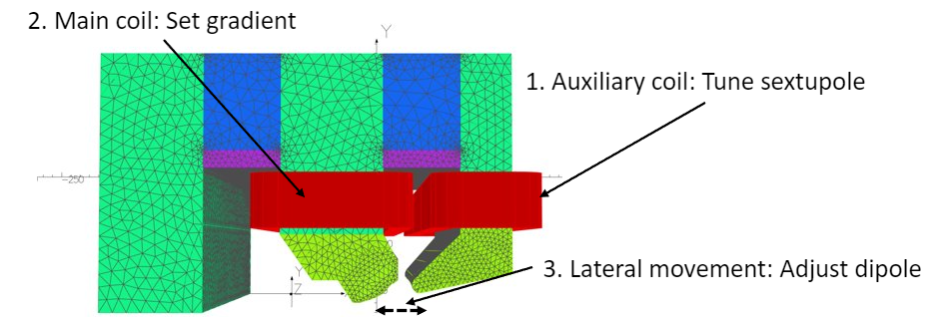
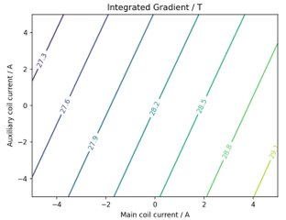
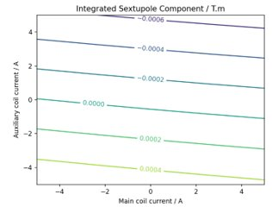
HEPTO Combined function magnet
Hybrid Electromagnet-Permanent magnet Tunable optics
Parameter​ | Value​
Central Field​ | -0.695​ T
Central Gradient​ | 33.24​ T/m
Integrated Field​ | -0.605​ Tm
Integrated Gradient​ | 28.19​ T
Effective length dipole (gradient)​ | 870 (849)​ mm
Half gap​ | ~13.5​ mm
Radius of curvature​ | 16.8​ m
Iron length​ | 835 ​ mm
Good field region radius​ | 7​ mm
Dipole tuning range​ | ±2.5​ %
Gradient tuning range​ | ±2.5​ %
Maximum power draw | 75.3 W
Equivalent electromagnet draw | 2.56 kW

Slide 15
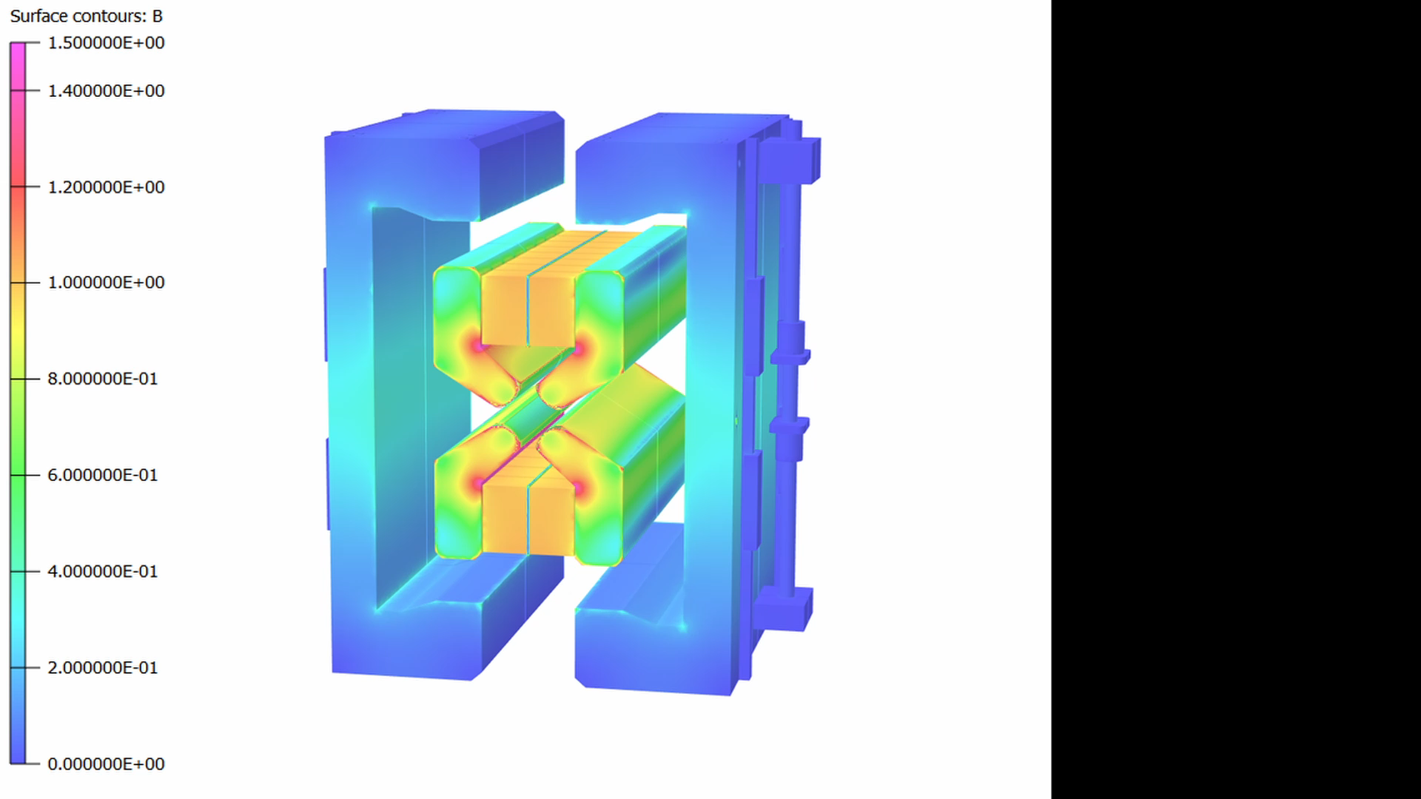
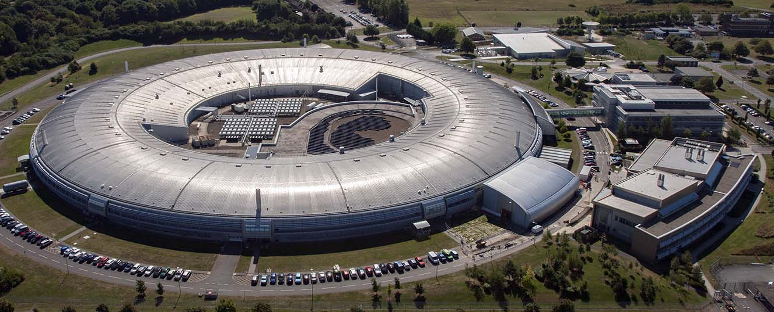
ZEPTO tunable quadrupole
The Zero Power Tunable Optics (ZEPTO) project aims to solve the problem of tuning PM’s by moving magnet blocks relative to fixed steel yokes.
We have developed a new ZEPTO quadrupole for the booster-to-storage ring section of Diamond Light Source.

Slide 16
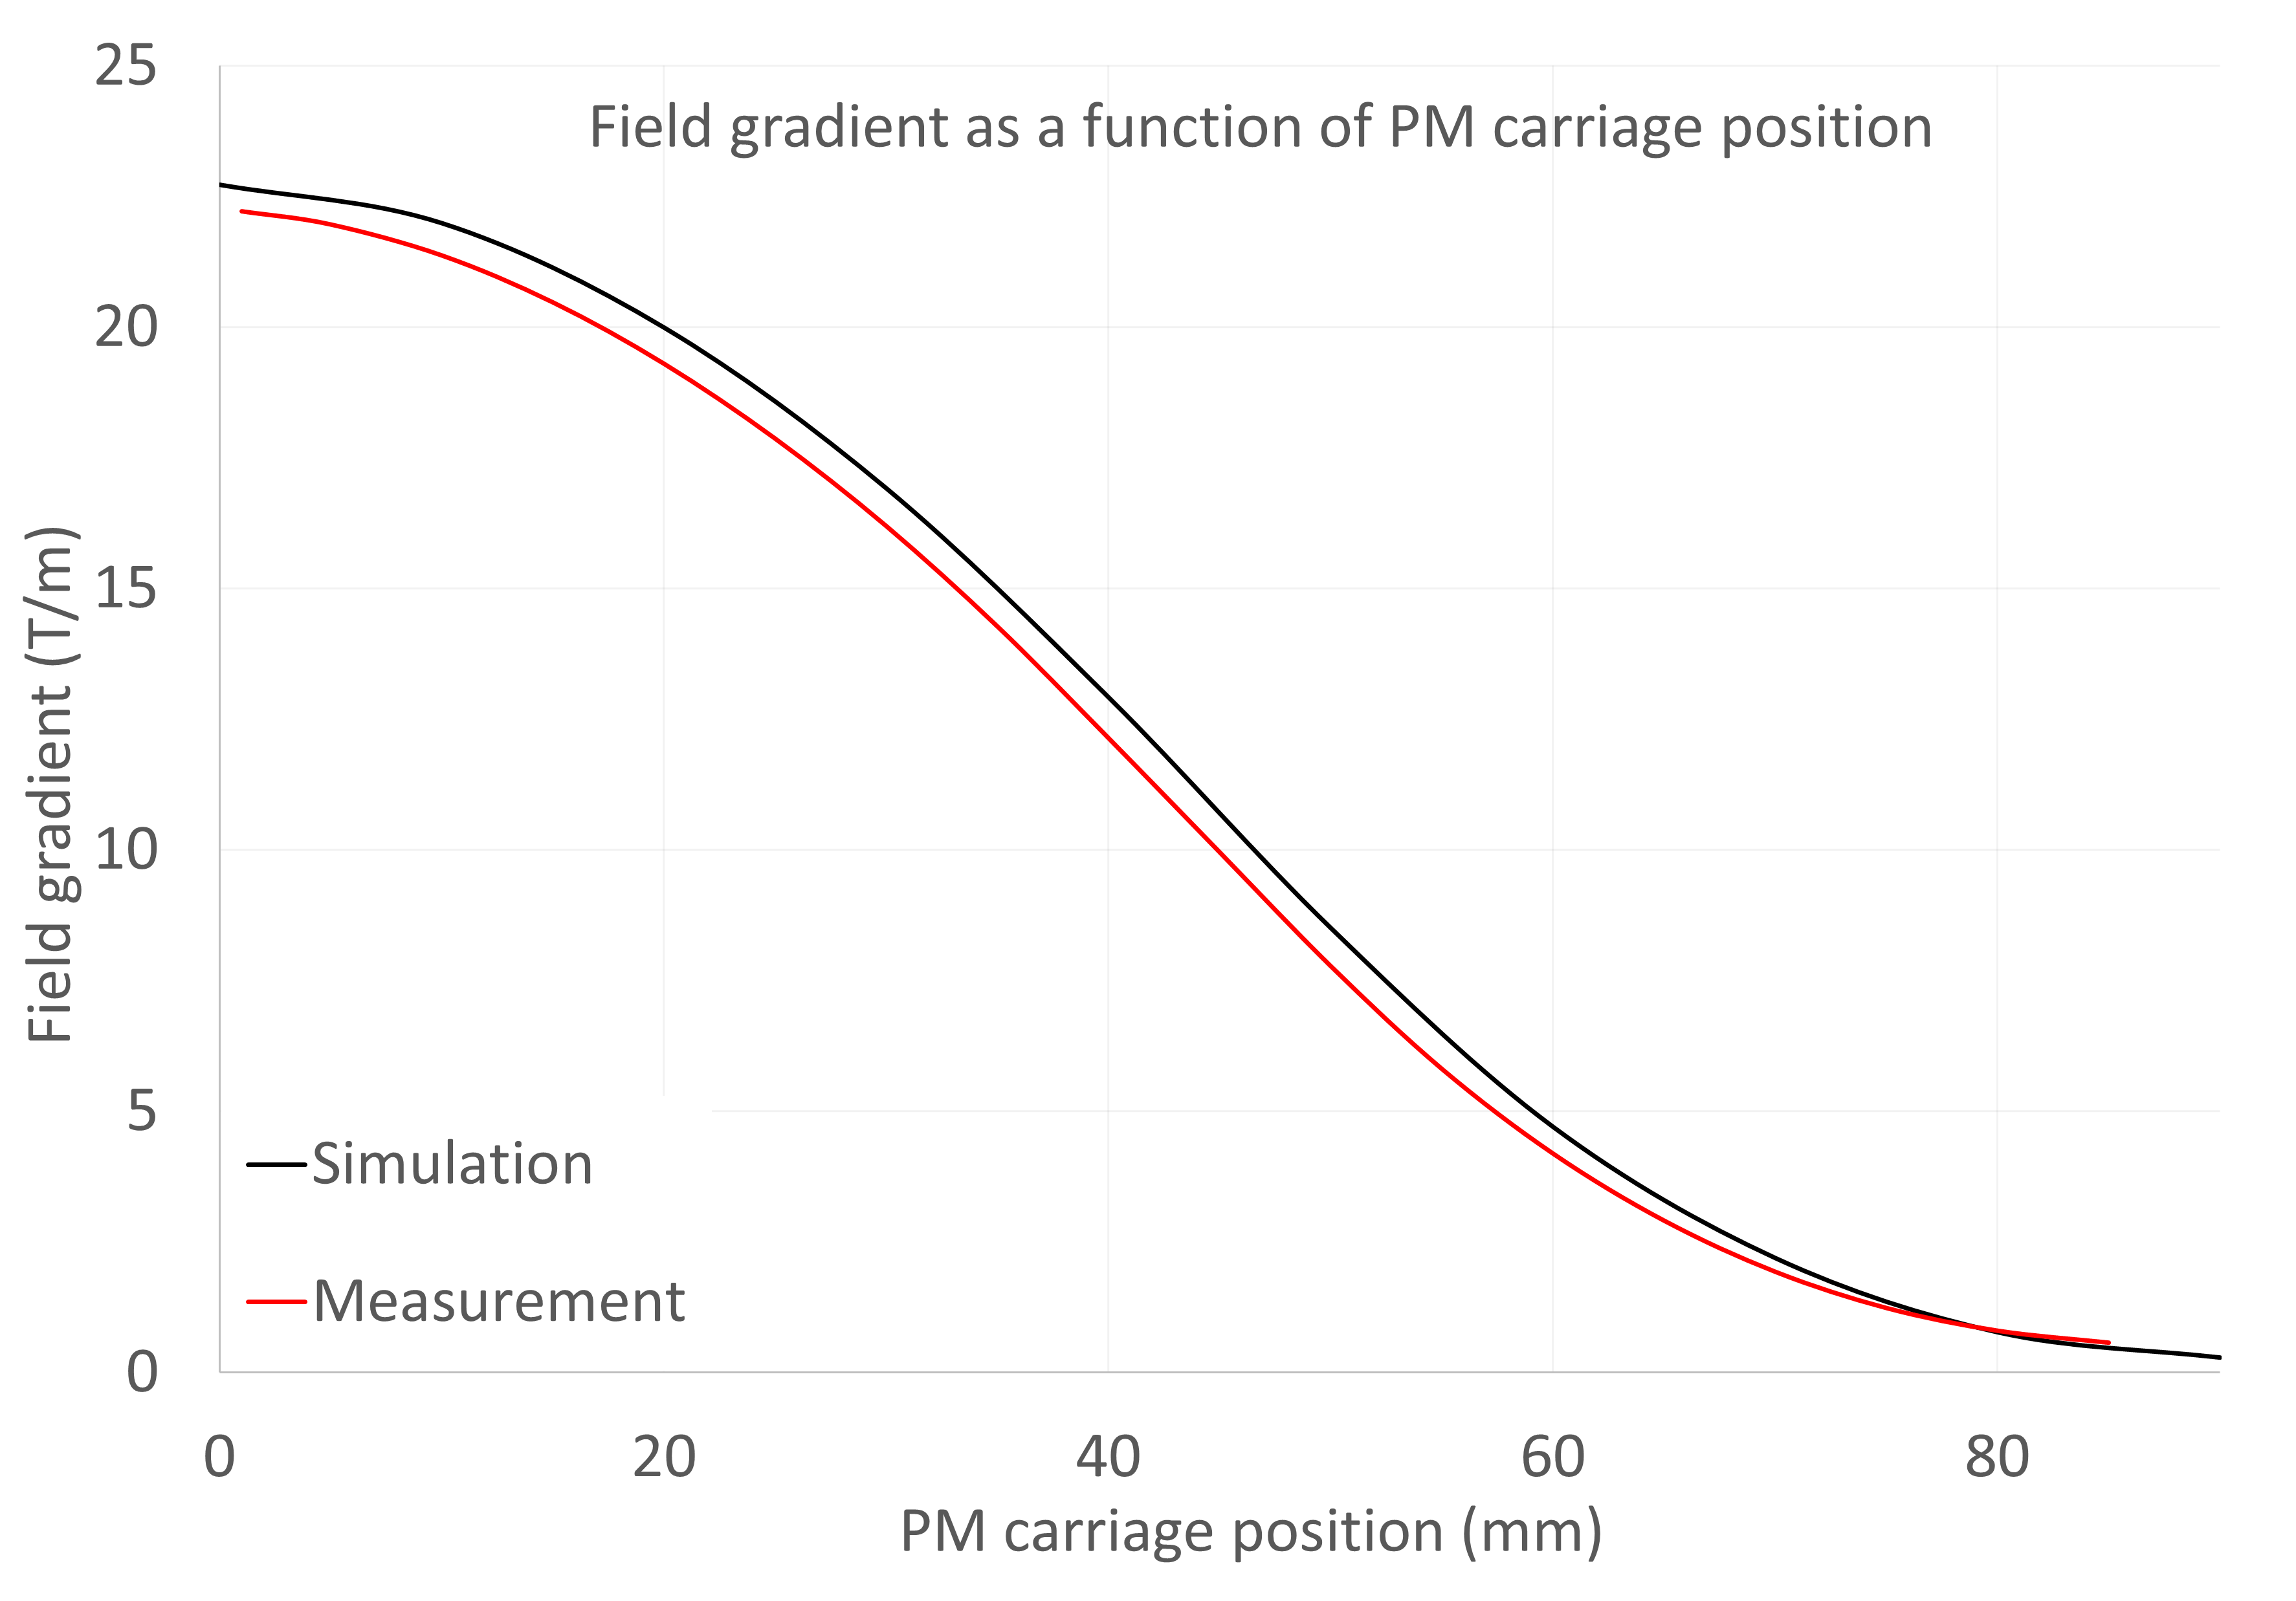
Gradient vs gap
Some variation between simulated and measured gradients observed.
Gradient lower than predicted but still within requirements (19 to 0.5 T/m normal operation)
Actual range of sweep is 1-85 mm (instead of 0-90 mm) due to limit switch positions.
Tuneability 22.37 to 0.47 T/m
Predicted range was 22.72 T/m to 0.3 T/m

Slide 17
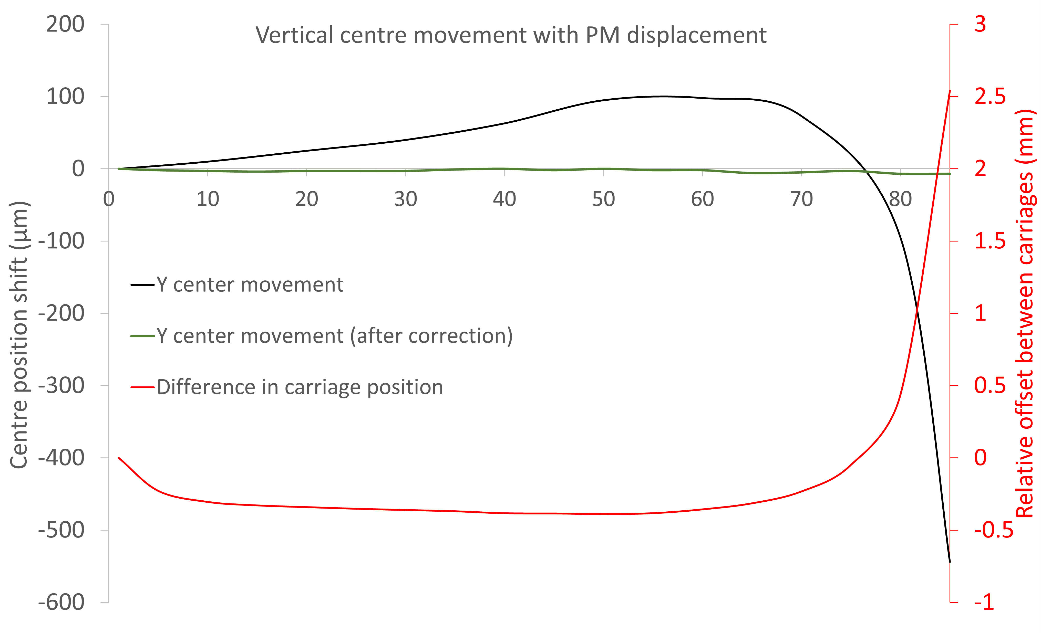
Vertical centre position
By applying the look-up table we can effectively counter all vertical movement of the magnetic centre!
Dataset shown has 7 µm drop in centre position, with 5 µm drop expected from temperature variation alone (contraction of magnet pedestal).

Slide 18
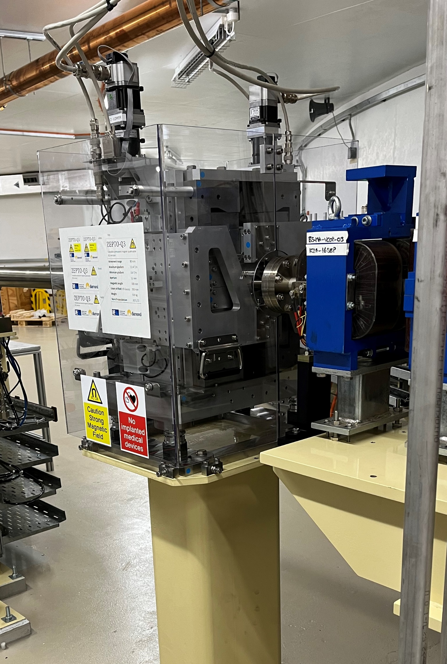
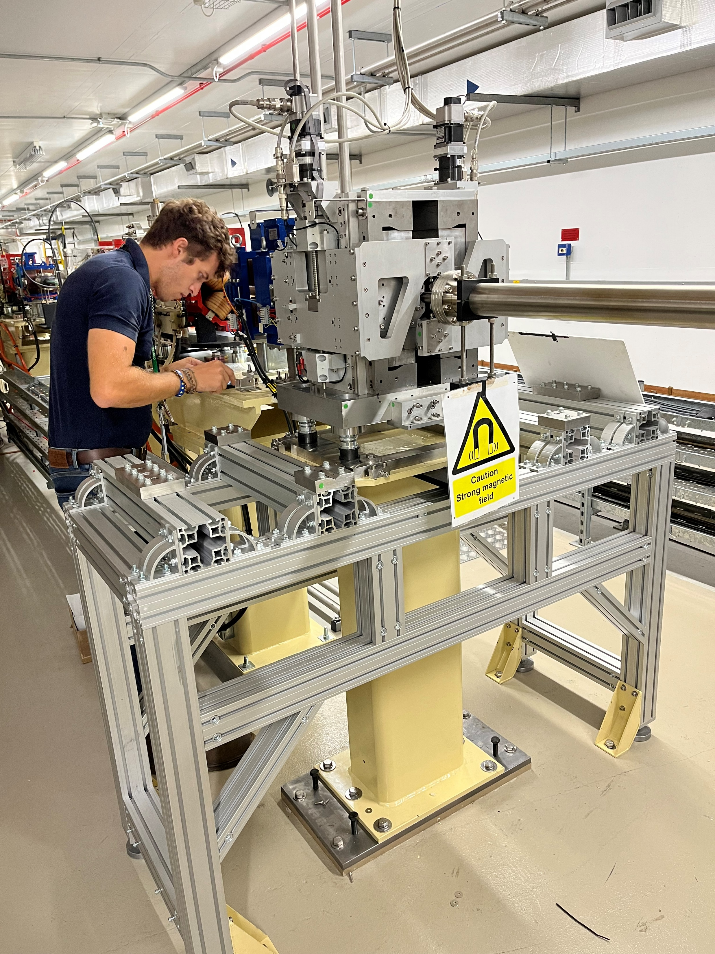
Installation on Diamond
The magnet has now been successfully installed on the booster to storage ring transfer line at Diamond alongside the electromagnet it is “replacing”.
This represents the first use of the ZEPTO technology on a real accelerator, and we hope long term testing will show the viability of the technology for widespread commercial use.
One magnet is currently saving 136 kg of CO2 per year.

Slide 19
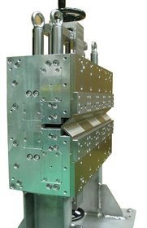
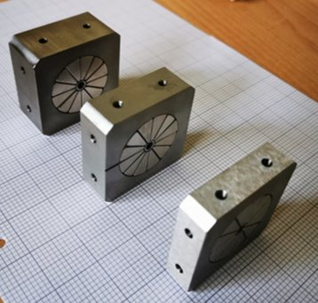
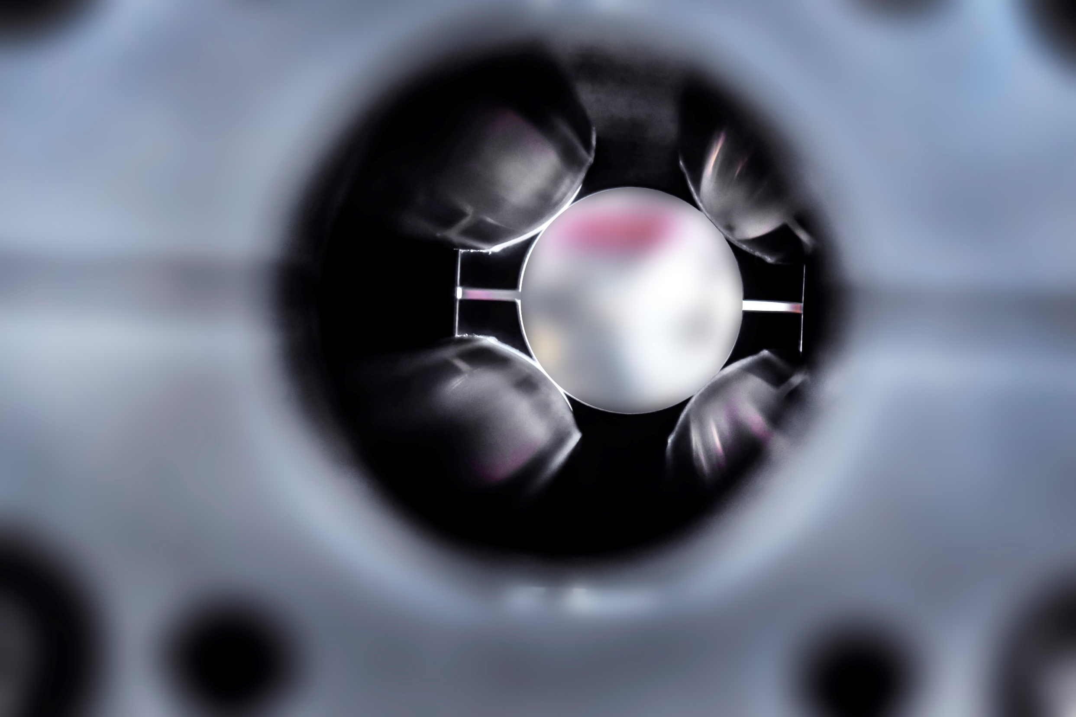
Conclusions
Permanent magnet technologies have developed to the point where they are now often viable replacements for resistive electromagnets!
There are multiple facilities around the world now using or planning to use permanent magnet systems.
Traditional limitations of the technology are being successfully overcome.
Permanent magnets have the potential to dramatically reduce the power consumption of accelerator facilities.

