Slide 1


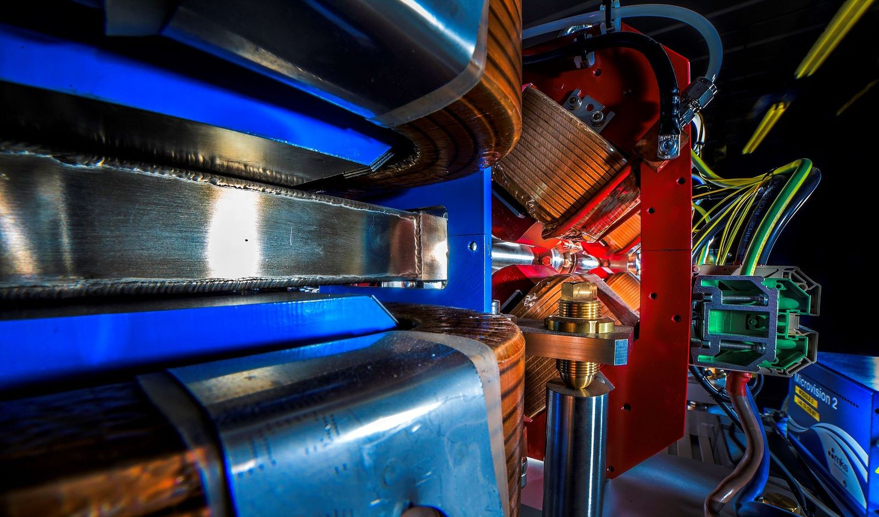
Making a brighter future through advanced accelerators
Centre of Excellence in Sustainable Accelerators
Jim Clarke
2nd December 2022

Slide 2
Context
Numerous discussions across all parts of STFC concerning our Sustainable Accelerators activities have reaffirmed our own view that this programme must expand and flourish to ensure UKRI’s future accelerator based facilities are as sustainable as possible
Subsequently the 2022-2025 STFC Strategic Delivery Plan has actioned us to write the Business Case for CESA
https://www.ukri.org/publications/stfc-strategic-delivery-plan/

Slide 3
STFC’s Strategy for Accelerators
STFC has very recently published it’s Strategic Framework for Future Accelerator Science and Technology Development
Sustainability is a major thread running through the document – ‘sustainability’ is mentioned 15 times in only 16 pages!
The STFC strategy supports the ESPP Accelerator R&D Roadmap which is similarly motivated by future sustainability
https://www.ukri.org/publications/stfc-strategic-framework-for-future-accelerator-science-and-technology-development/

Slide 4
CESA – The Motivation and Benefits
Our motivation is to seize the opportunity and take the UK’s strong position in sustainable accelerator technologies and take it to the next level
To make the UK the ‘go to’ place for the global accelerator community when they are building sustainability into their new and existing accelerator facilities
To achieve this aim and take our R&D to the next level we need a significant increase in resources and the physical space to carry out the R&D – this is CESA

Slide 5
CESA – The Options
There are several options for CESA which need to be assessed as part of the Business Case, some of which are:
  A ‘virtual’ centre, which brings all relevant STFC-funded R&D under one banner
  A ‘hub and spoke’ centre, with a physical centre of mass at one location complemented by activities elsewhere
  A ‘single site’ centre, with the majority of activities taking place at one site with off-site activities sitting either inside or outside the centre
  A ‘single building’ centre, with the majority of activities in one building with off-site activities sitting either inside or outside the centre
  And so on…

Slide 6
CESA – Next Steps
ASTeC is leading the development of the Business Case
This will start in earnest after today’s workshop, taking on board the feedback received, and building the collaboration
We have agreed to take our initial proposal through the STFC Visions process early in 2023
We will then iterate the case, taking on board the feedback received
We will likely go through STFC Visions a second time with our full proposal late in 2023
The route to funding (nor the scale) is not clear yet – possibly UKRI Infrastructure or a specific NetZero fund
If the case is compelling then funds will follow !

Slide 7
Discuss !

