Slide 1
Sustainable Accelerator Workshop
Wrap-up session
Ben Shepherd
2 December 2022

Slide 2
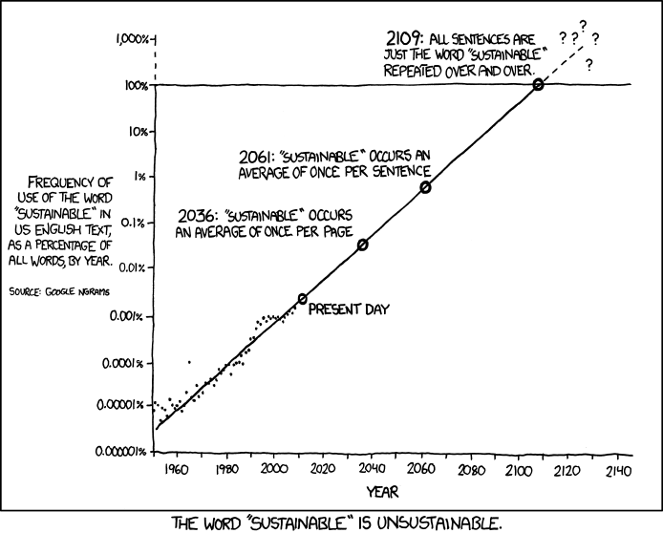
Had enough of this word yet?
xkcd.com

Slide 3
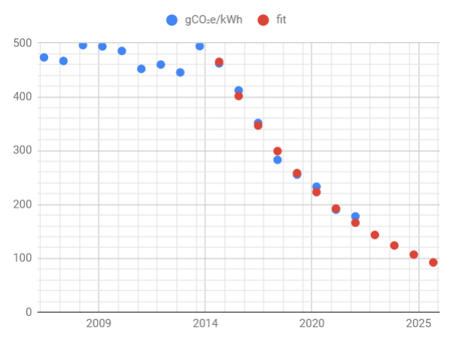
Where to focus efforts with limited resources?
Manufacturing
Sometimes hard to get data
Conflicting numbers
Can we influence manufacturers to change sources?
Operation
Increase efficiency (but beware Jevons!)
How to baseline against greening grid?
Disposal
Don’t neglect it!
Means repair/replacement not just end of life

Slide 4
Notes from Hywel
LCA principles used at different laboratories
Policy on 'science washing' - okay or not?
Common standards and baselines, e.g. which sustainability and environmental standards
Database on CO2 intensity of components - consideration of country-specific factors (e.g carbon intensity)
Principles of infrastructure lifespans - construction vs operation trade-off
Need to explore decommissioning factors, e.g. energy/CO2 cost, recycling methodologies, separability of components
Develop a 'factsheet' on CO2 and energy usage
Identification of key technologies - e.g. DC/DC, PM systems etc.
Identify material types where common grades can be specified, e.g. aluminium grades
Explore impact of radiation activation on component material choice and its disposal
Cost of computing and data infrastructure

Slide 5
More events
Sustainable computing workshop • 1-4pm, 5 and 6 December 2022 • https://forms.office.com/r/QBwJjvna3W
Workshop at DESY 6th-8th February 2023
Critical Materials and Rare Earths https://indico.desy.de/event/35655/
Another Sustainable Accelerators Workshop??

