Slide 1

Approach to sustainability at DESY
A sustainable accelerator and high research performance? How can we manage it?
Concepts and first steps taken
Andrea Klumpp
Daresbury 02.12.2022

Slide 2
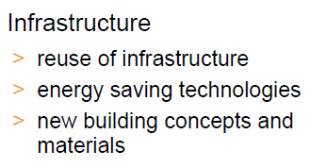
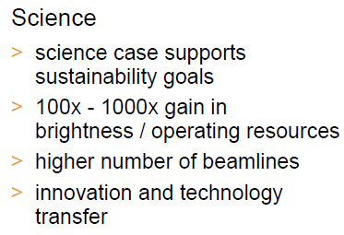

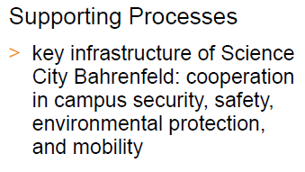
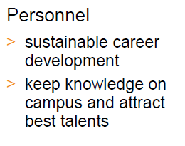
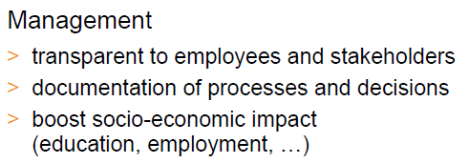
What is Sustainability at DESY
Broad approach with focus on energy efficiency
Science
science case supports sustainability goals
high number of beamlines
innovation and technology transfer

Slide 3
What is Sustainability at DESY
Broad approach with focus on energy efficiency
Science
science case supports sustainability goals
high number of beamlines
innovation and technology transfer

Slide 4
Concepts presented here
Pyramide to a sustainable DESY
Basis
Energy monitoring
Civil construction
LCA for technical components
At work
Infrastructure
Operation
Finale
Research
Research
Infrastructure
Operation
LCA for technical components
Energy monitoring
Civil construction

Slide 5
Concepts presented here
Pyramide to a sustainable DESY
Basis
Energy monitoring
Civil construction
LCA for technical components
At work
Infrastructure
Operation
Finale
Research
Research
Infrastructure
Operation
LCA for technical components
Energy monitoring
Civil construction

Slide 6
Concepts presented here
Pyramide to a sustainable DESY
Basis
Energy monitoring
Civil construction
LCA for technical components
At work
Infrastructure
Operation
Finale
Research
Research
Infrastructure
Operation
LCA for technical components
Energy monitoring
Civil construction

Slide 7
Concepts presented here
Pyramide to a sustainable DESY
Basis
Energy monitoring
Civil construction
LCA for technical components
At work
Infrastructure
Operation
Finale
Research
Research
Infrastructure
Operation
LCA for technical components
Energy monitoring
Civil construction

Slide 8
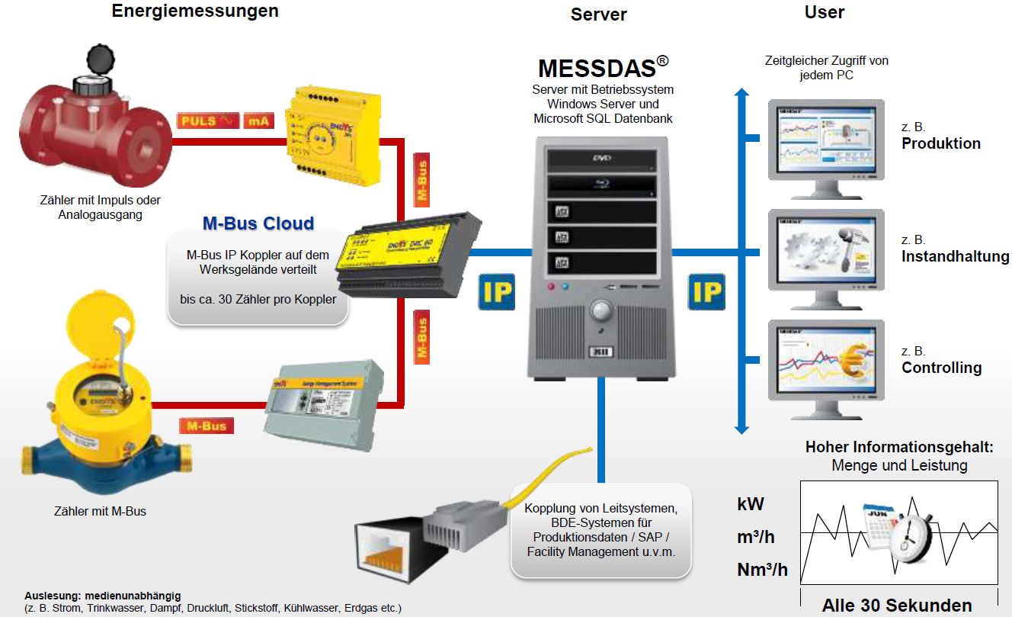
DESY Energy approach
Energy Monitoring System
Basis
Energy monitoring
Civil construction
LCA for technical components
At work
Infrastructure
Operation
Finale
Research
detailed, unified meter marking, centralized data collection and analysis, meters directly connected to database
for Electricity, Water, Heat, Cooling
enables for user-based/source-related accounting, identification of efficiency potentials and therefore more awareness

Slide 9
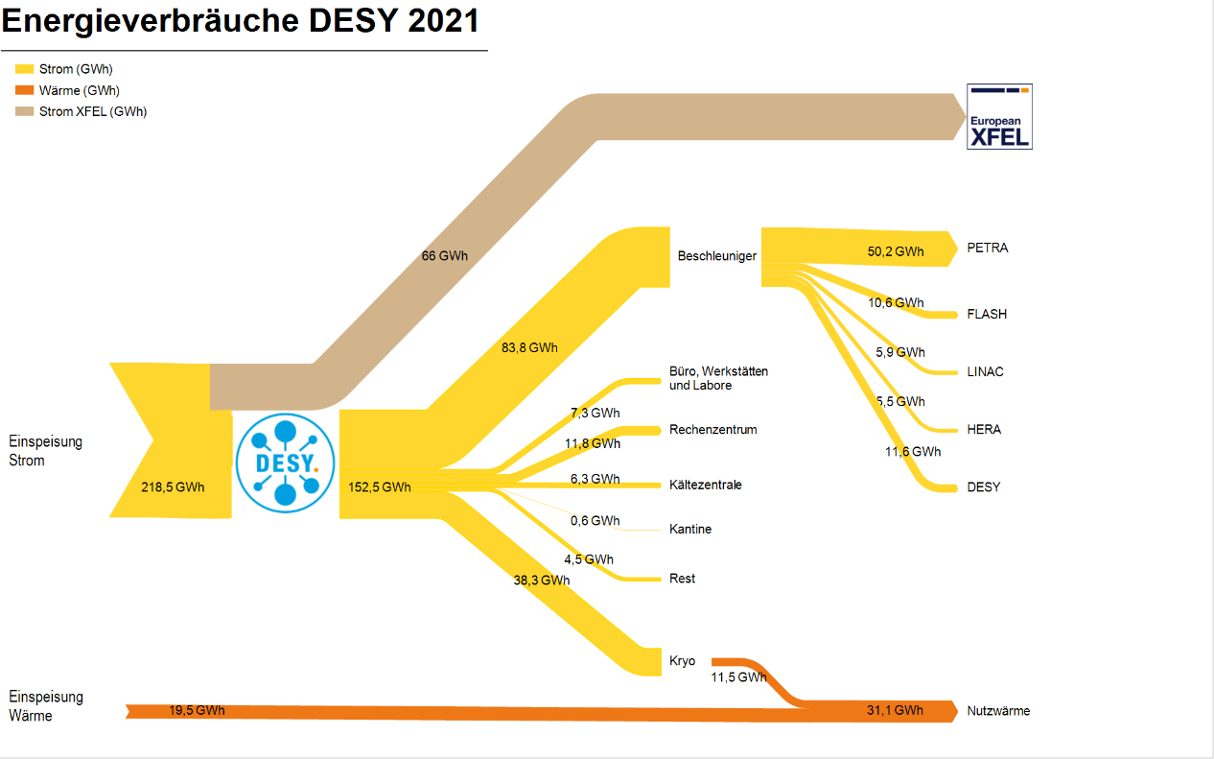
Energy consumption at DESY 2021
Accelerators including cryogenic plant make ca. 85% of total
Electricity (GWh)
Heat (GWh)
Electricity XFEL (GWh)
Basis
Energy monitoring
Civil construction
LCA for technical components
At work
Infrastructure
Operation
Finale
Research
Accelerator
Offices, workshops Labortories
Electricity supply
Data centre
Cooling system (without Kryo)
Canteen
Others
Heat
supply
Used heat

Slide 10

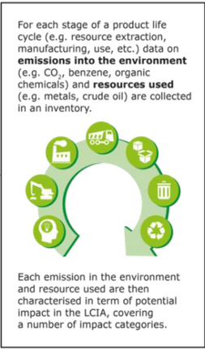
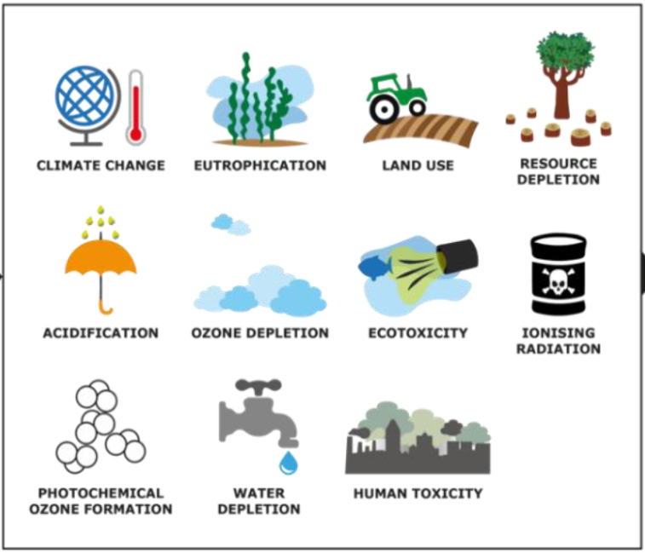
Sustainable construction and operation
Life Cycle Assessment (LCA)
Basis
Energy monitoring
Civil construction
LCA for technical components
At work
Infrastructure
Operation
Finale
Research
  consider entire life meaning:
  from the cradle to the cradle/grave
  LCA contains:
    Life Cycle Inventory (LCI)
    Life Cycle Impact Assessment (LCIA)
    Life Cycle Interpretation phase
  Cost analysis
    lower operation cost justify higher investment cost, not to forget costs for decommissioning
    to lose high level materials is not only an ecological but also an economical problem
    Life Cycle Inventory (LCI)
    Life Cycle Impact Assessment (LCIA)
Example: Content of a Life Cycle Inventory
Source: https://eplca.jrc.ec.europa.eu/lifecycleassessment.html
Notes:
10
Life cycle analysis or life cycle assessment -> Construction - Operation - Dismantling.
All environmental impacts caused by a product are considered.
We have:
Inventory - Identification and quantification of required resources and environmental impacts.
Impact Assessment -> Quantitative evaluation of the environmental impact.
Interpretation phase -> Combining and linking the stages of the Life Cycle Assessment -> Decision support
Cost analysis
Lower operating costs justify higher investment costs, not to mention decommissioning costs
Loss of high value materials is not only an environmental problem, but also an economic one.
---------------------------------------------------
Lebenszyklus-Analyse oder Ökobilanzierung -> Bau - Betrieb - Rückbau
Es werden sämtliche Umwelteinwirkungen betrachtet, die ein Produkt verursacht.
Wir haben:
Inventory – Identifizierung und Quantifizierung der benötigten Ressourcen und der Umweltwirkungen
Impact Assessment – Folgenabschätzung -> Quantitative Bewertung der Umweltauswirkungen.
Interpretation phase -> Kombination und Verbindung der Stufen der Ököbilanz -> Entscheidungshilfe
Kostenanalyse
Geringere Betriebskosten rechtfertigen höhere Investitionskosten, nicht zu vergessen die Kosten für die Stilllegung
Der Verlust hochwertiger Materialien ist nicht nur ein ökologisches, sondern auch ein ökonomisches Problem.
--------------------------------------------------------
Hintergrund: Phasen Lebenszyklusanalyse: Sachbilanz, Zieldefinition, Wirkungsabschätzung, Interpretation

Slide 11
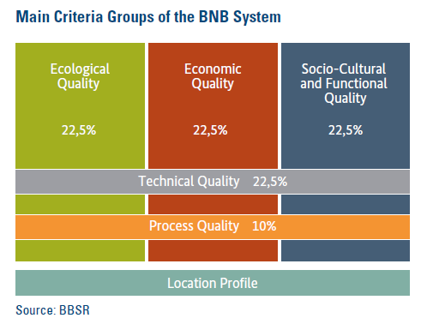
Civil Construction
LCA for building
Basis
Energy monitoring
Civil construction
LCA for technical components
At work
Infrastructure
Operation
Finale
Research
National certification system for sustainable building (BNB):
consideration of the whole life cycle of the building (LCA)
ecological, economic, socio-cultural and technical qualities are rated equally
end of life and recycling are included

Slide 12
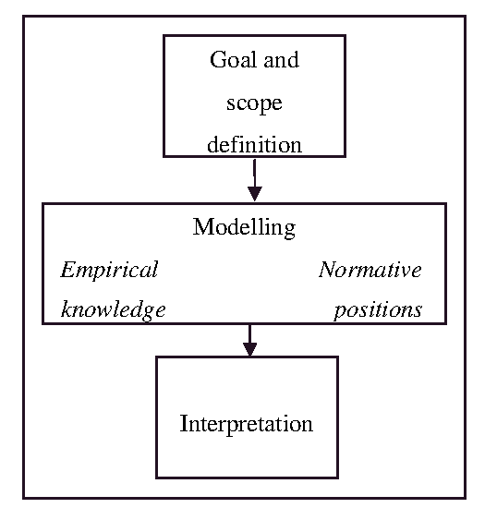
Systematical validation of sustainability for technical components on the example of magnets
Basis
Energy monitoring
Civil construction
LCA for technical components
At work
Infrastructure
Operation
Finale
Research
LCA framework: LCA for magnets:
Goal and
scope
Definition
Modeling
Empirical
knowledge
Normative positions
Interpretation
Heijungs R., Huppes G., Guinèe J.
A scientific framework for LCA. Deliverable (D15) of work package 2 (WP2)
CALCAS project. ENEA, 2009.

Slide 13
Systematical validation of sustainability for technical components on the example of magnets
Basis
Energy monitoring
Civil construction
LCA for technical components
At work
Infrastructure
Operation
Finale
Research
LCA framework: LCA for magnets:
Goal and
scope
Definition
energy consumption/ CO₂ footprint
socio-economic impact
recycling
comparismen of permanent and electro magnets
Modeling
research to the socio-economic impact of mining and processing of the required material (Rare Earth)
calculations of the energy consumption
workshop
(certification and recycling- Rare Earths)
Empirical
knowledge
Normative positions
Interpretation
Decision: electro or permanent magnets
Heijungs R., Huppes G., Guinèe J.
A scientific framework for LCA. Deliverable (D15) of work package 2 (WP2)
CALCAS project. ENEA, 2009.

Slide 14
Electro vs. Permanent magnets
Discussion for deflection magnets at PETRA IV
Basis
Energy monitoring
Civil construction
LCA for technical components
At work
Infrastructure
Operation
Finale
Research
Electromagnets Permanentmagnets
Material Copper, Iron, Epoxy, sinter material Samarium/Cobalt,
alloy Cobalt/Iron Iron, Aluminium
Life span 40-50 years 20-30 years?
Recycling Epoxy: burn off Aluminium and Iron can be recycled
Copper and Iron can be 10-20% magnetic material ???
recycled
Energy/Power
consumption approx. 1.6 MW cooling and heating of the
during operation (for 6000 hours operation time tunnel
per year: 9.6GWh)

Slide 15
Electro vs. Permanent magnets
Draft
Open for inspirations and hints
Discussion for deflection magnets at PETRA IV
Basis
Energy monitoring
Civil construction
LCA for technical components
At work
Infrastructure
Operation
Finale
Research
Electromagnets Permanentmagnets
Material Copper, Iron, Epoxy, sinter material Samarium/Cobalt,
alloy Cobalt/Iron Iron, Aluminum
Life span 40-50 years 20-30 years?
Recycling Epoxy: burn off Aluminium and Iron can be recycled
Copper and Iron can be 10-20% magnetic material ???
recycled
Energy/Power
consumption approx. 1.6 MW cooling and heating of the
during operation (for 6000 hours operation time tunnel
per year: 9.6GWh)

Slide 16


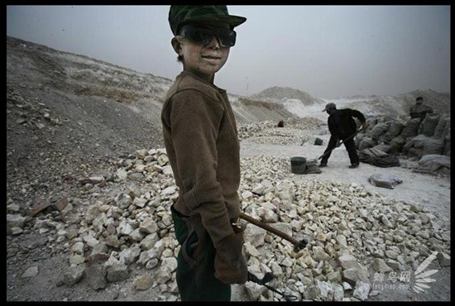
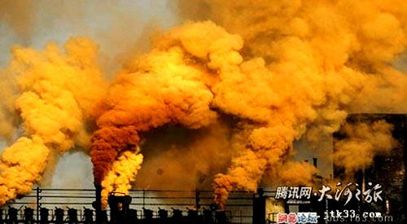
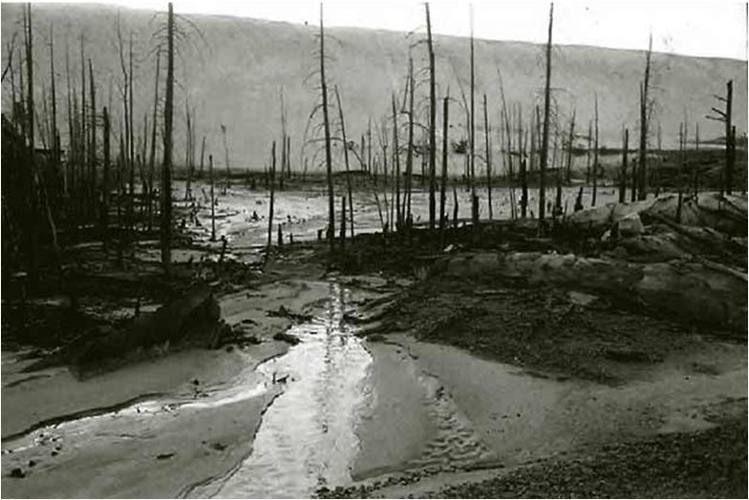
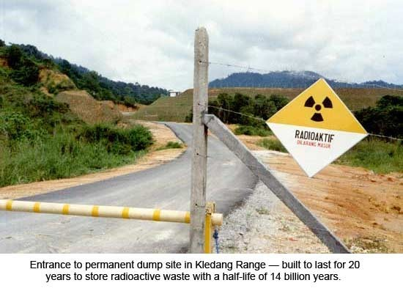

PETRA IV Critical Materials
Permanent Magnets and the Rare Earth Problem
Basis
Energy monitoring
Civil construction
LCA for technical components
At work
Infrastructure
Operation
Finale
Research
Problem:
rare earths are mined and processed under destructive social and environmental conditions
no alternative sources or certified mining and processing available
so far no sufficient progress on recycling of old PM
How to solve:
combine science, industry and NGO forces to tackle problem
find best practice for recycling of these materials
implement life cycle management already in planning phase of new RIs
support development of certification system for mining and processing of critical materials
Workshop at DESY 6th-8th February 2023
https://indico.desy.de/event/35655/
“
This project has received funding from the European Union’s Horizon 2020 research
and innovation programme under grant agreement No 101004730”.
a)
b)
c)
d)
a) Private, illegal minning in China; http://www.chinahush.com/2009/10/21/amazing-pictures-pollution-in-
china/; 2009 - 2011 ChinaHush is licensed under a Creative Commons License Copyright: Lu Guang;
b) air pollution by heavy industries; Quelle: china-digital-times Copyright: My Essentia com blog;
c) In-Situ-Leaching; Quelle: Web-Page Bellona
Copyright: Andrej Ozharovsky;
d) Entrance to waste disposal for radioactive waste from REE production in Bukit Merah
in Kledang mountains; built for 20 years storage of radioactive waste (14 Mrd years radioactive
half-life); 1985 Copyright: Consumer Assciation Penang
Beitrag: Collector
Lizenz: Creative Commons (CC-BY-NC-SA) V.3.0

Slide 17
Sustainability at work
Basis
Energy monitoring
Civil construction
LCA for technical components
At work
Infrastructure
Operation
Finale
Research
technical components with less power consumption (eg. permanent magnets)
reduction of redundancies
optimization of operation parameters
discussions for cooling agents
waste heat
reliability
efficient use of beamtime
reduction of traveling

Slide 18
Tunnel temperature
Problem: technical components produce heat but need constant temperature
Basis
Energy monitoring
Civil construction
LCA for technical components
At work
Infrastructure
Operation
Finale
Research
status quo in PETRA III ( inhomogenous tunnel enviroment)
3 dimensional calculations of tunnel heat distribution and optimization of cooling system
optimal distribution of cooling devices?
finding the optimal operation temperature in the tunnel and temperature of cooling water and air
optimal Shutdown terms

Slide 19
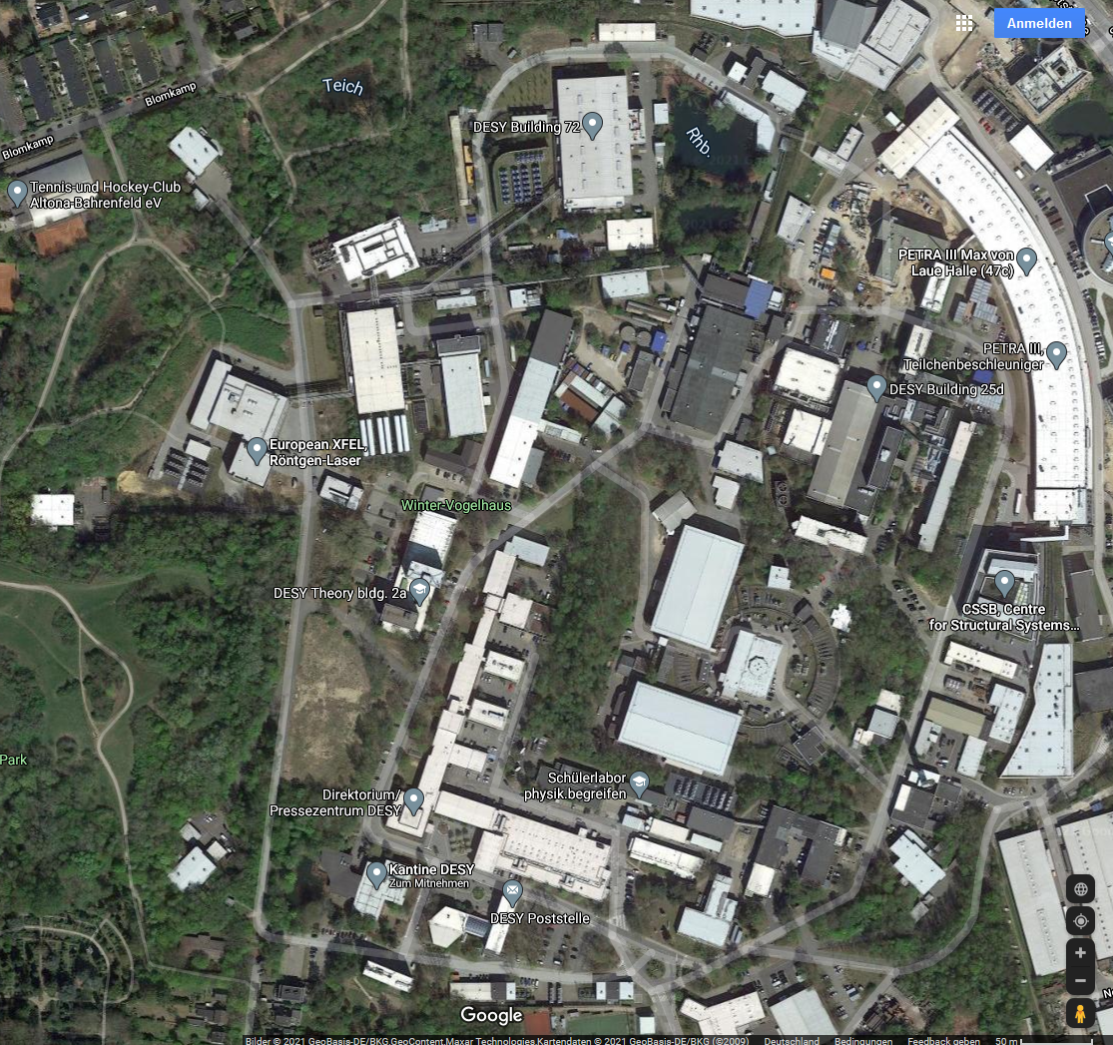

Heritage from PETRA I
PETRA I Tunnel reused for PETRA IV
Basis
Energy monitoring
Civil construction
LCA for technical components
At work
Infrastructure
Operation
Finale
Research
PETRA IV Tunnel
outside the experimental halls the old PETRA I tunnel will be reused
6 old sections, 100 – 300 m long, in total ~1 km
the old sections of the tunnel are below streets, buildings, a park.
the tunnel is covered by 3 – 10 m of soil.
|Temp.Calc.Kickoff| PETRA IV
Michael Bieler

Slide 20
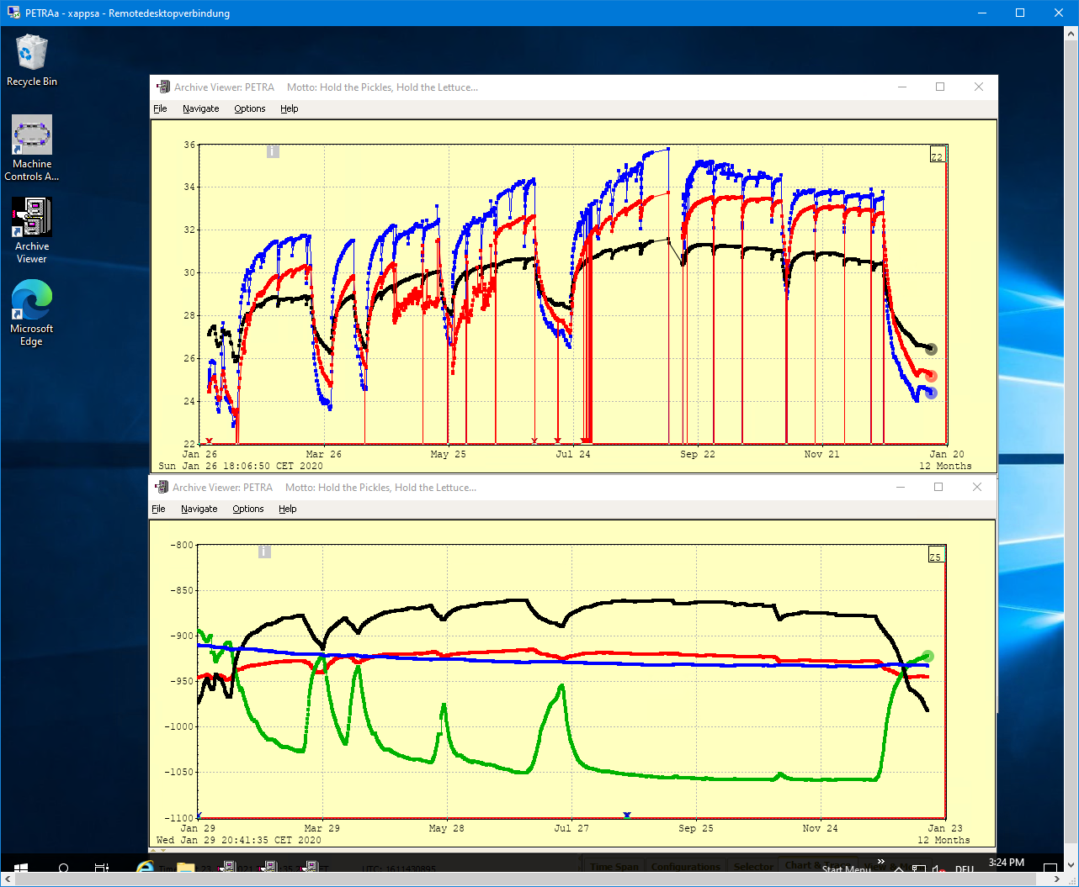
Tunnel Temperature PETRA III
Heated and unheated sections
Basis
Energy monitoring
Civil construction
LCA for technical components
At work
Infrastructure
Operation
Finale
Research
Tunnel Climatization today:
air (25º C) blown in every 300/600 m
cooling water inlet: 25º C
Temperature over one year
Temperature difference between
positions up to 5°C
operating schedule of PETRA clearly visible
summer and winter time visible
Temperature
Black curve, 26º – 31º C: Concrete floor, OR59, air temperature regulated (30º C)
Red curve, 23º – 34º C: Concrete floor, SOR87, air temperature unregulated
Blue curve, 23º – 36º C: Air temperature, SOR85, air temperature unregulated
|Temp.Calc.Kickoff| PETRA IV WP 1.12 - Michael Bieler

Slide 21
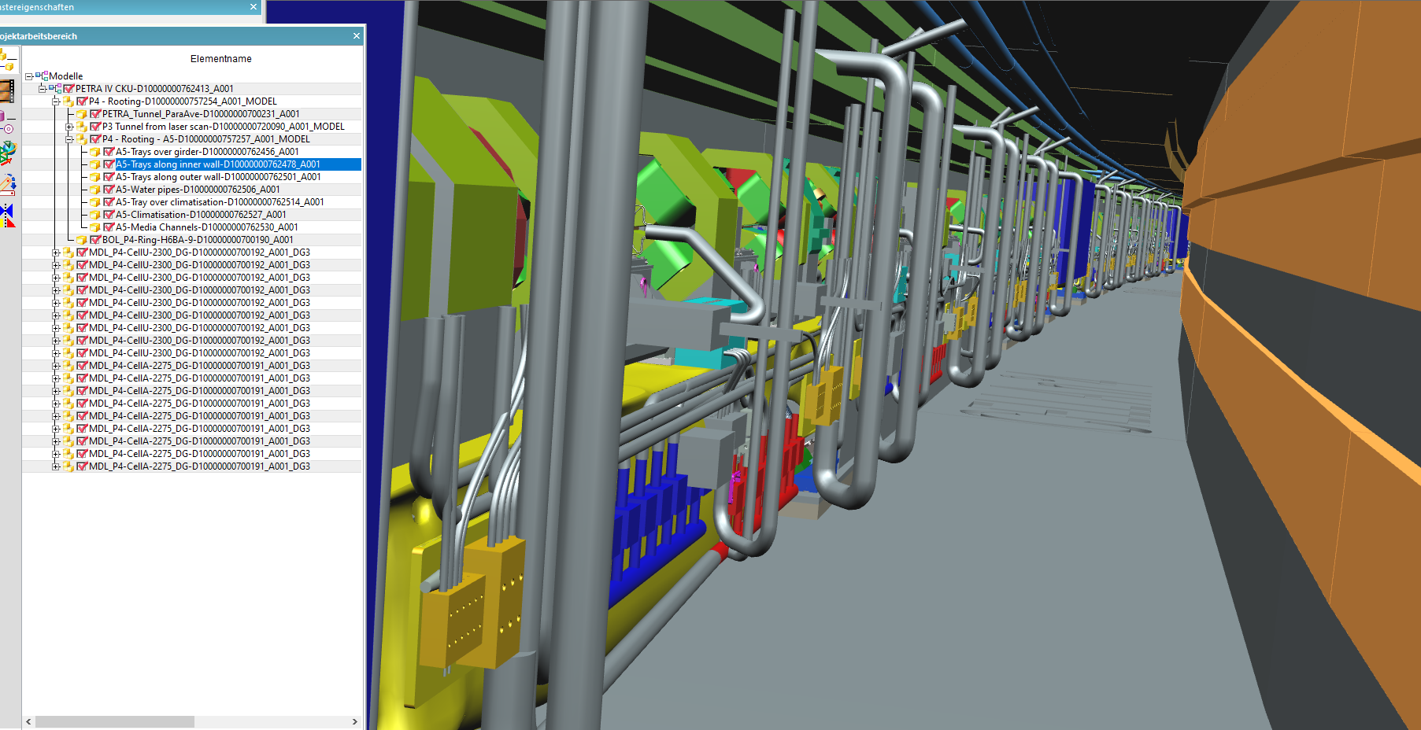
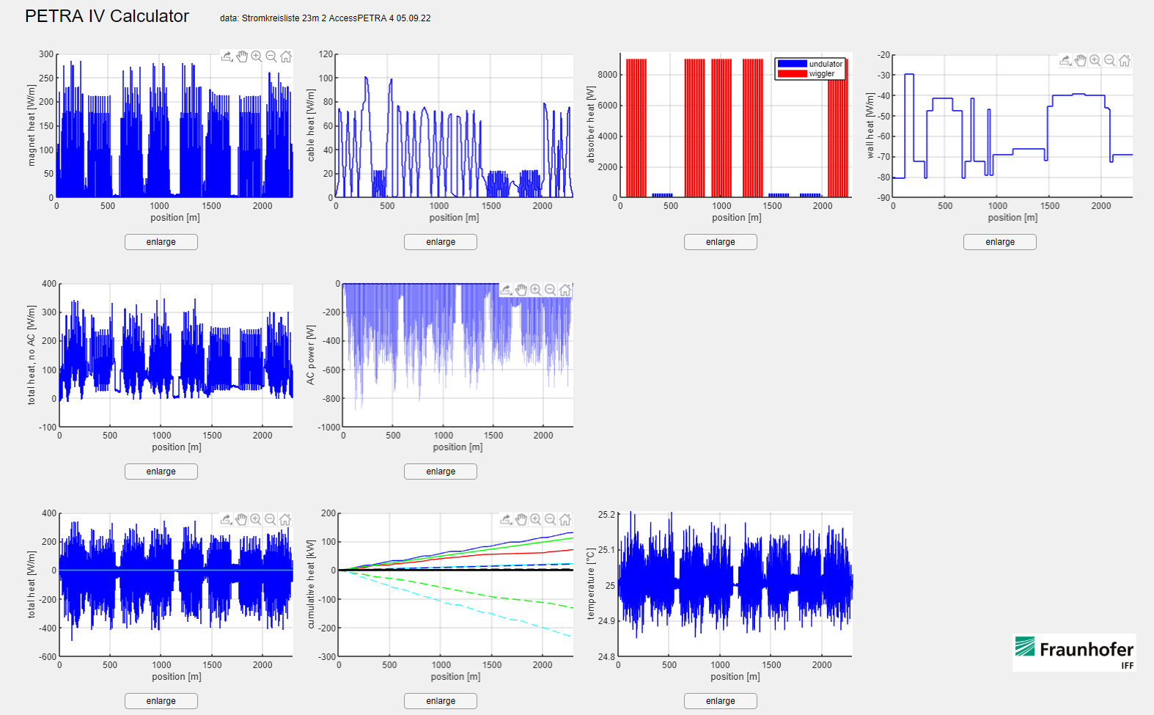
3D calculation of the tunnel air and heat flows
Cooperation with Fraunhofer Magdeburg for a CFD- simulation (fluid dynamic)
Basis
Energy monitoring
Civil construction
LCA for technical components
At work
Infrastructure
Operation
Finale
Research
Digital Twin of the tunnel in CAD (not yet completed)
Single parts can be selected and hidden
It can be rotated etc.
a list with all consumer of electricity with their heat input
(called Stromkreisliste)
including the cooling capacity and the position
of air conditioners
Fluid dynamical simulations:
  heat distribution also for corners and hidden places
  optimization for cooling and heating (in shutdowns)
  optimization of cabeling
(Cedric Kula TAC)
screenshot of the app
and first test results
(R. Zimmermann)

Slide 22
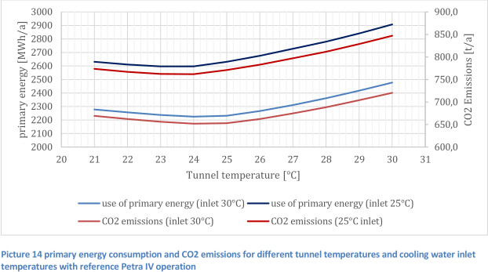
Energy consumption for different tunnel temperatures
Basis
Energy monitoring
Civil construction
LCA for technical components
At work
Infrastructure
Operation
Finale
Research
including shutdowns, when we have to heat for a constant temperature.
optimal temperature in the tunnel are:
Water: 30°C
Air: 25°C
Primary energy consumption and CO₂ emission for different tunnel temperatures and cooling water inlet temperatures with reference PETRA IV operation
(T. Warnecke „Report on thermal parameters of PETRA IV”)

Slide 23
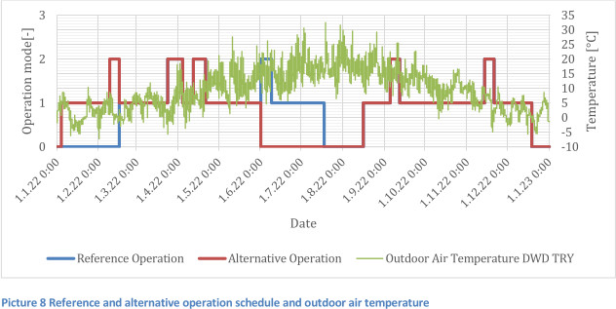
Temperature vs operation mode
operation mode 1: beam time
2: machine studies
0: shutdown
Basis
Energy monitoring
Civil construction
LCA for technical components
At work
Infrastructure
Operation
Finale
Research
Reference and alternative operation schedule and outdoor air temperature
(T. Warnecke „Report on thermal parameters of PETRA IV”)

Slide 24
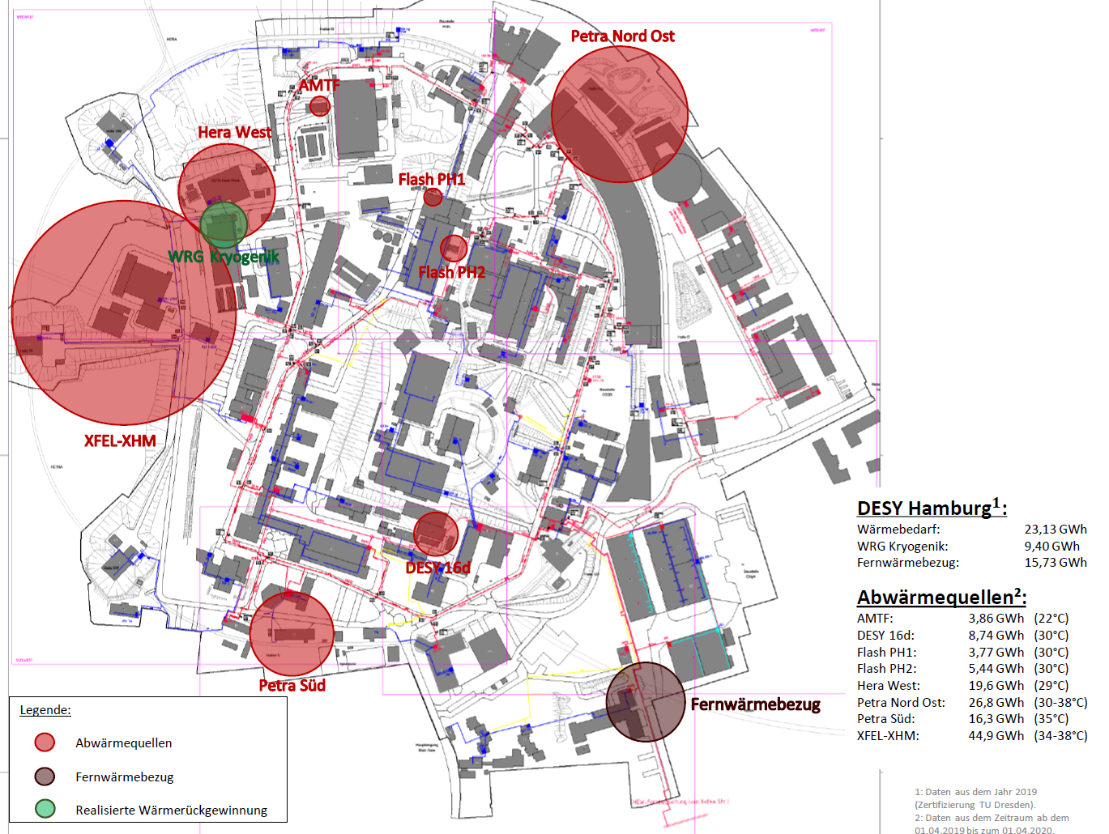
Waste Heat Usage
Potential at DESY Campus in Hamburg
Basis
Energy monitoring
Civil construction
LCA for technical components
At work
Infrastructure
Operation
Finale
Research
currently heating is DESYs 3rd biggest CO₂ emission source
project with University of applied science in Hamburg (HAW) to identify potential
result: 129 GWh/y of waste heat available at a temperature level of 30°C - 40°C
possible CO₂ savings at DESY campus of about 4.000 tons/y
surplus can be used in neighborhood; if we get the 129GWh in use saving will be up to 40.000 tons CO₂/y

Slide 25
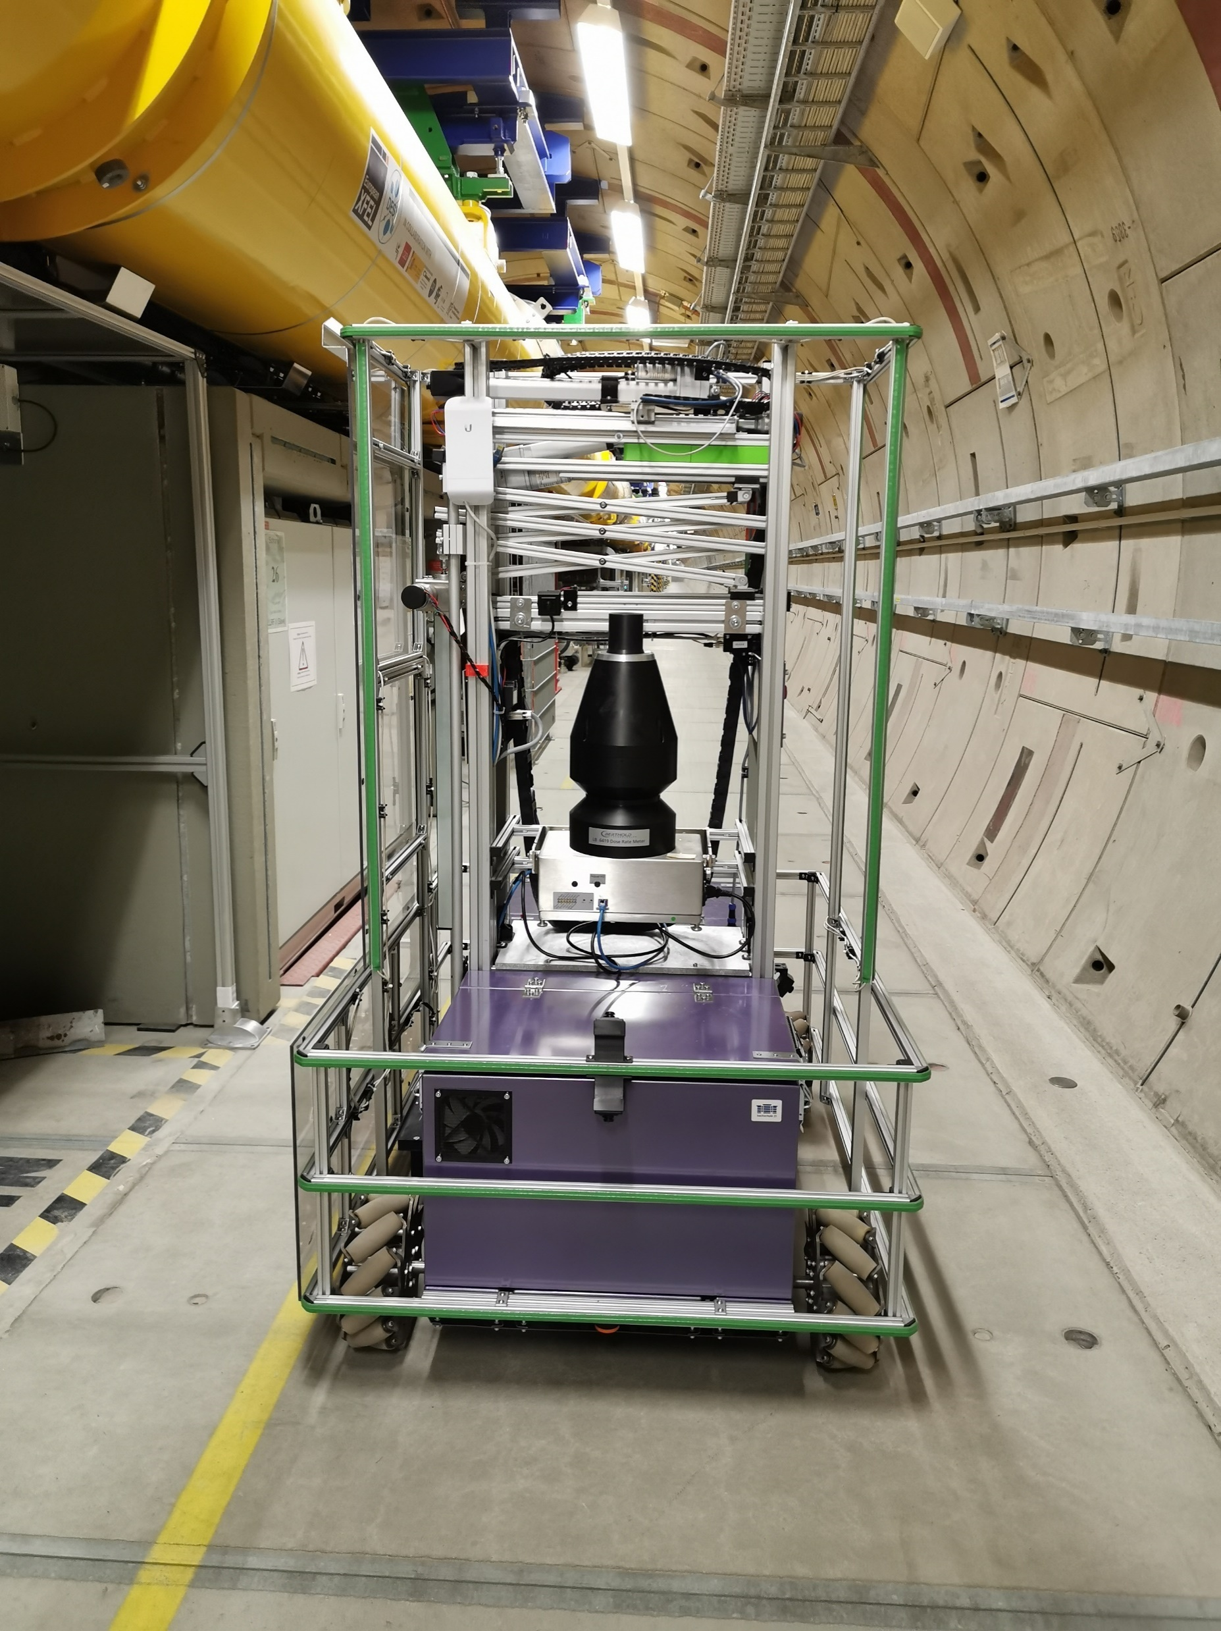
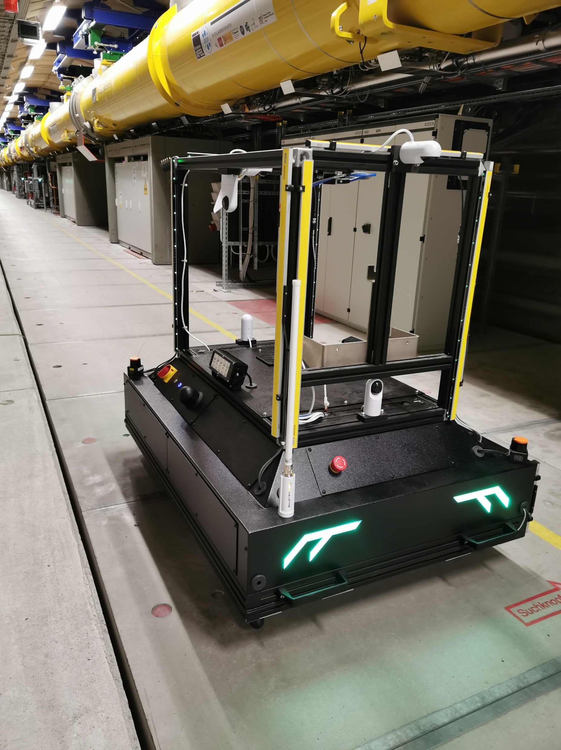

Reliability in operation
Use of Robotics & Telepresence of Experts:
A possible way out to avoid operation interruptions that require people on site
Basis
Energy monitoring
Civil construction
LCA for technical components
At work
Infrastructure
Operation
Finale
Research
MARWIN: Mobile Autonomous Robot for Maintenance and Inspection
routinely used for radiation measurements with the EuXFEL accelerator switched on
Project Proposal RobotiX: Robotics and Immersive User Experience
versatile platform based on MARWIN3 that provides
  multiple sensors
  multi-axis manipulators
immersive remote control interface using mixed reality technologies
project partners: Hochschule21, HAW, UHH, DESY
MARWIN2
MARWIN3
(Reinhard Bacher)
| Andrea Klumpp| Sustainability at DESY |02/12/2022

Slide 26
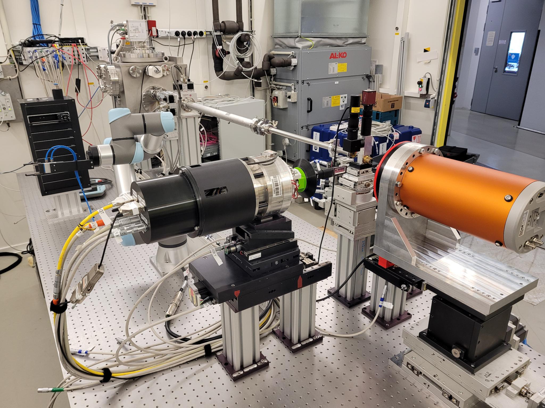


HiPhax: Highly automated pharmaceutical screening beamline for room temperature measurements
Efficient use of beamtime - every photon counts
Basis
Energy monitoring
Civil construction
LCA for technical components
At work
Infrastructure
Operation
Finale
Research
designed for high-throughput pharmaceutical screening at cryogenic temperatures and room temperature
>1000 samples/24 h
goal: Fully automatic, AI- supported data collection
multicrystal samples holders (Si-chips) for highest throughput
robotic exchange of chips
hotel for chip storage
sample delivery format compatible with installation at SPB/SFX at EuXFEL
First successful test experiments in June/July 2022 at beamline P09 at PETRA III
(Alke Meents ,Pontus Fischer
Massive X-ray screening )
Hardware installation of automatic sample changer:
HIR3X milestone M1.1
| Andrea Klumpp| Sustainability at DESY |02/12/2022

Slide 27
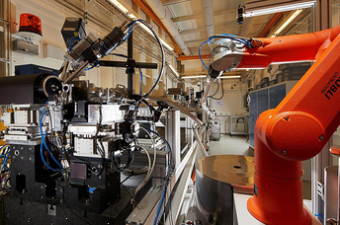
PETRA IV – Remote Access – High-throughput MX
PETRA IV will enable remote access for mature and highly standardized X-ray techniques
Basis
Energy monitoring
Civil construction
LCA for technical components
At work
Infrastructure
Operation
Finale
Research
Prime example P11 beamline PETRA III:
experienced users have the possibility to
collect data remotely
  no travel of persons, just sending samples
  access via remote session from internet browser
  guidelines for remote access (safety aspect)
  need to register for access
If all scheduled beamtimes would be remote (example):
users just from EU (only single P11 beamline)
ca. 17 tons CO₂ savings from flight travels / year (https://www.carbonfootprint.com)
The technical equipment at PETRA III’s P11 beamline includes a robotic arm that can execute fully automated sample changes
(Johanna Hakanpää)

Slide 28
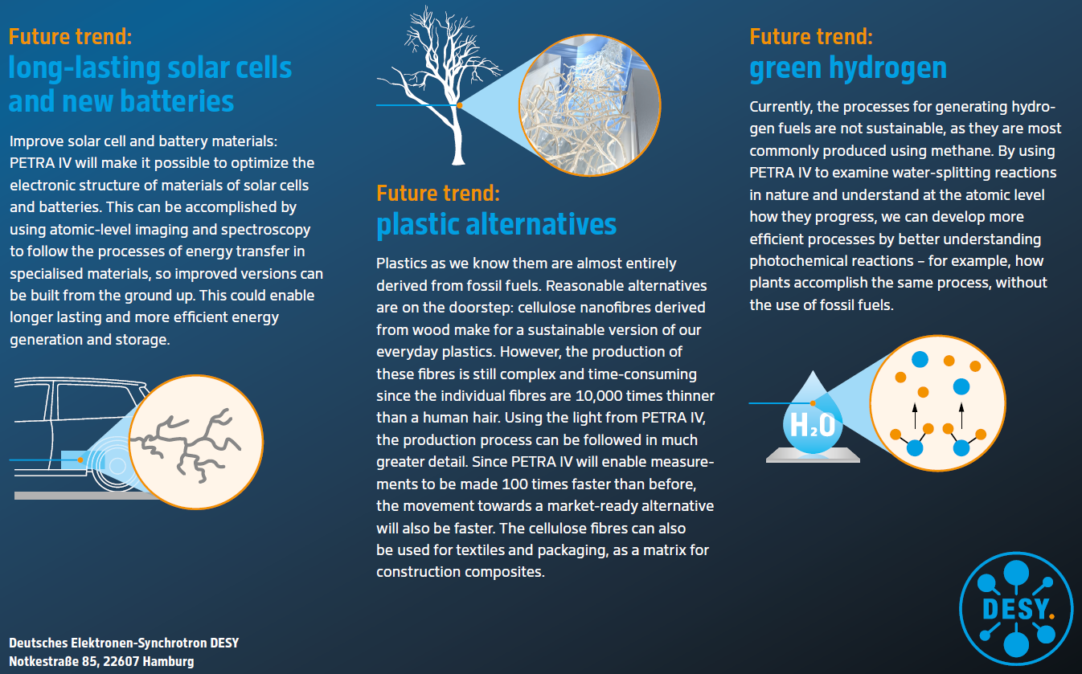
PETRA IV – Research for Sustainability
PETRA IV enables research to tackle sustainability challenges and develop global solutions
Basis
Energy monitoring
Civil construction
LCA for technical components
At work
Infrastructure
Operation
Finale
Research

Slide 29
A sustainable accelerator
Basis
Energy monitoring
Civil construction
LCA for technical components
At work
Infrastructure
Operation
Finale
Research
Energy monitoring
LCA
  for Civil constructions
  for technical components

Slide 30
A sustainable accelerator
Basis
Energy monitoring
Civil construction
LCA for technical components
At work
Infrastructure
Operation
Finale
Research
Energy monitoring
LCA
  for Civil constructions
  for technical components
Waste heat usage
Optimal operation parameter (eg. tunnel temperature)
Use of Robotics & Telepresence of Experts
Remote access and automated beamlines

Slide 31
A sustainable accelerator
Basis
Energy monitoring
Civil construction
LCA for technical components
At work
Infrastructure
Operation
Finale
Research
Energy monitoring
LCA
  for Civil constructions
  for technical components
Waste heat usage
Optimal operation parameter (eg. tunnel temperature)
Use of Robotics & Telepresence of Experts
Remote access and automated beamlines
Research for a sustainable future

Slide 32
A sustainable accelerator
Basis
Energy monitoring
Civil construction
LCA for technical components
At work
Infrastructure
Operation
Finale
Research
Energy monitoring
LCA
  for Civil constructions
  for technical components
Waste heat usage
Optimal operation parameter (eg. tunnel temperature)
Use of Robotics & Telepresence of Experts
Remote access and automated beamlines
Research for a sustainable future
Never finished!

Slide 33
A sustainable accelerator
Basis
Energy monitoring
Civil construction
LCA for technical components
At work
Infrastructure
Operation
Finale
Research
Energy monitoring
LCA
  for Civil constructions
  for technical components
Waste heat usage
Optimal operation parameter (eg. tunnel temperature)
Use of Robotics & Telepresence of Experts
Remote access and automated beamlines
Research for a sustainable future
Never finished!
Thank you for your attention!

Slide 34

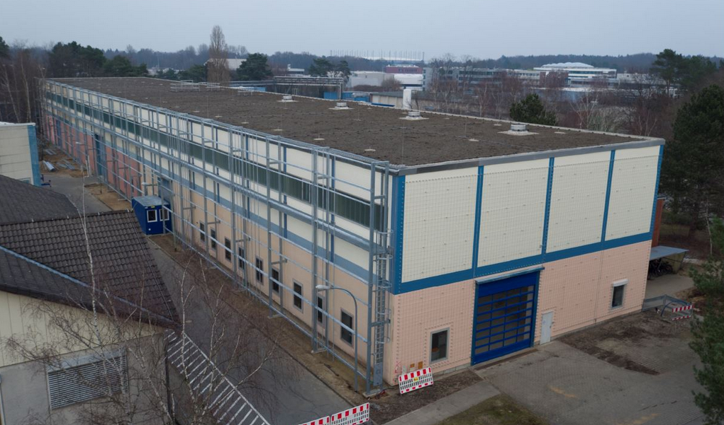
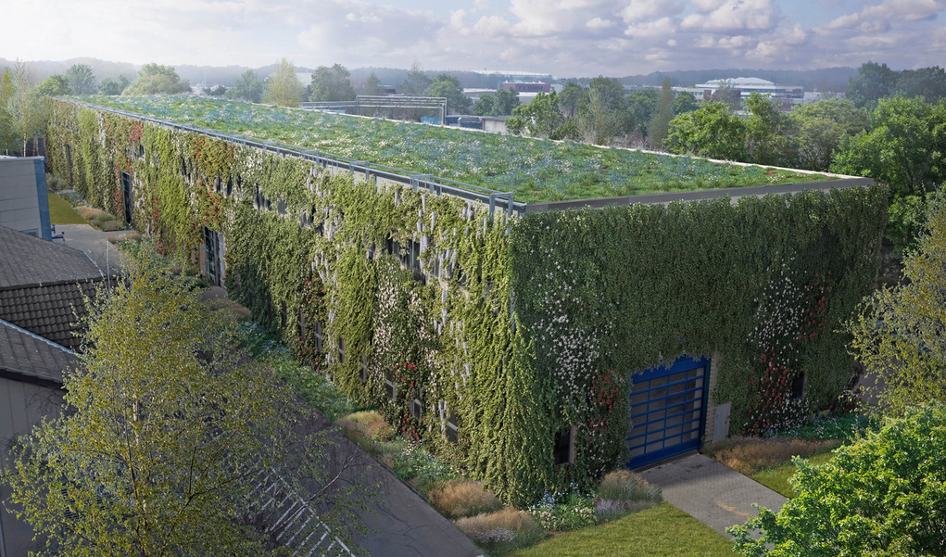
Sustainability at DESY
Green DESY
Building 36 – Total area of greening 4,570 m² = half a hectare (roof and 3 walls)
Bird's eye view at the beginning and in a few years
Draft: L+ Landschaftsarchitekten
Visualization: luminousfields
Benefits:
more efficient rainwater management through retention by increasing water seepage and evaporation opportunities
Healthy microclimate
Reduction of the heat island effect (cooling down of the city heat in summer)
Air pollution control / Respirable dust absorption
Breeding and foraging habitats for birds and insects
Contribution to biodiversity

Slide 35
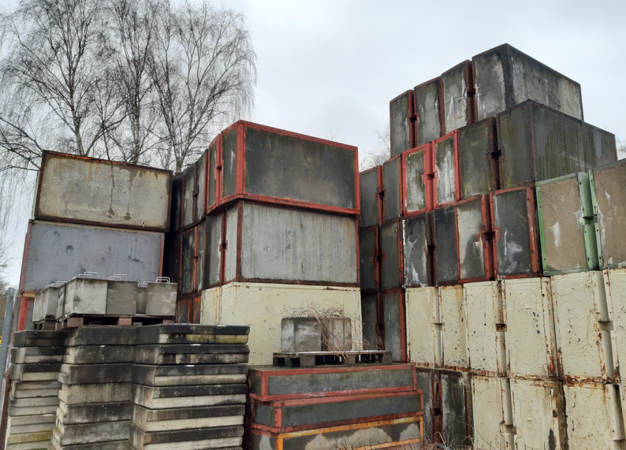
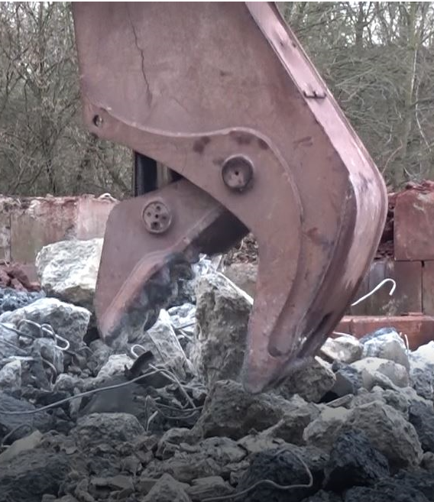
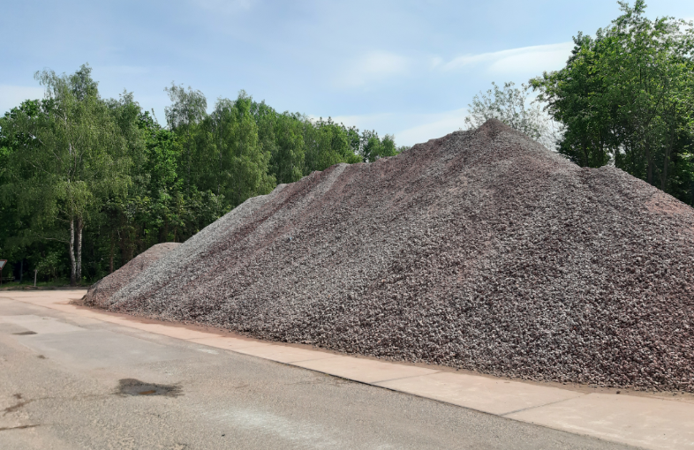
Sustainability at DESY
Shielding Stone Recycling
500 old shielding stones (of about 6.000 tons) being shredded and used again for foundation of new buildings on campus

Slide 36
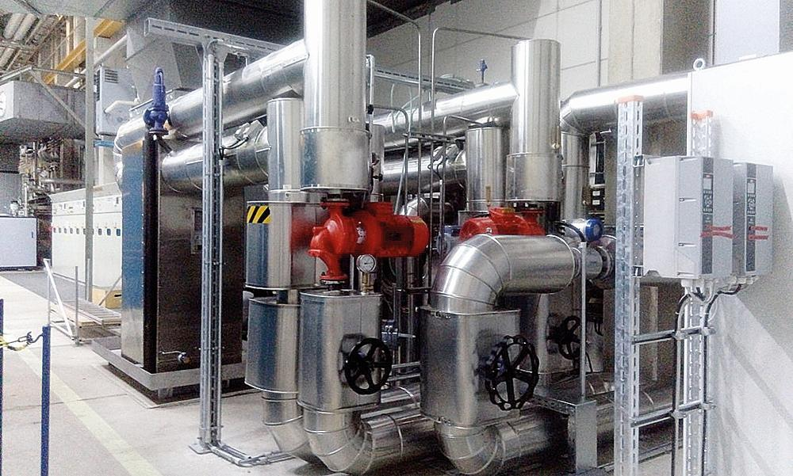
Waste Heat Usage 1
Cryogenic Plant - in use since 2017
Basis
Energy monitoring
Civil construction
LCA for technical components
At work
Infrastructure
Operation
Finale
Research
waste heat recovery from cryogenic plant commissioned in June 2017
helium cooled down to minus 271 degrees Celsius (2 Kelvin) for operation of the superconducting accelerators
process generates waste heat at a temperature of about 70°C
two heat exchangers that connect the cooling system of the oil-cooled screw compressors with the local heating network
Yearly heat extraction of >10 GWh (gigawatt hours)
>1/3 of the total heat demand at DESY

Slide 37
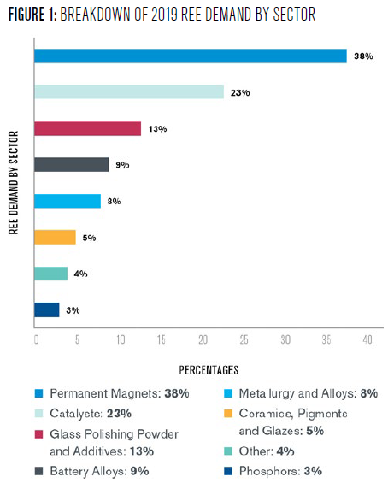
PETRA IV Critical Materials 2
Permanent Magnets and the Rare Earth Problem
Basis
Energy monitoring
Civil construction
LCA for technical components
At work
Infrastructure
Operation
Finale
Research
Possible solutions:
more and better recycling of PM materials to reduce demand for “fresh” material (Economical benefits)
global certification system for mining and processing
How:
industry has same challenge ahead (i.e. wind power stations)
combine science, industry and NGO forces to tackle problem
find best practice for recycling of these materials
implement life cycle management already in planning phase of new RIs
support development of certification system for mining and processing of critical materials
Workshop at DESY 6th-8th February 2023
https://indico.desy.de/event/35655/
“This project has received funding from the European Union’s Horizon 2020 research
and innovation programme under grant agreement No 101004730”.
Source: https://kleinmanenergy.upenn.edu/research/publications/rare-earth-elements-a-resource-constraint-of-the-energy-transition/

