Slide 1


A Green Next Generation Ion Beam Analysis Facility
Dan Faircloth
Low Energy Beams Group Leader
Olli Tarvainen
Ion Source Physicist
STFC Rutherford Appleton Laboratory,
ISIS Neutron and Muon Source

Slide 2
Ion Beam Analysis (IBA)
IBA uses MeV ion beams to measure elemental depth profiles in the near-surface layer of solids
The perfect tool for studying thin films and ion implantation technologies for:
            Microelectronics
            Opto-electronics
            Sensors
            Batteries
            Polymers (deuteration)
            Material modification

Slide 3
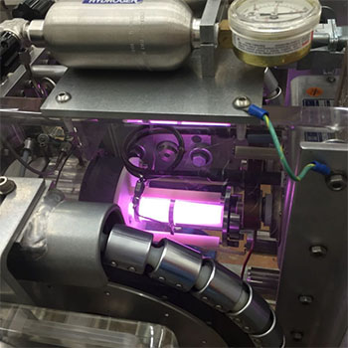
Typical IBA Acceleration Schemes and Sources
“single ended”
high voltage terminal
e.g. He⁺
sample
RF ion source or
duoplasmatron
MV
detector
5-8 bar SF₆
Very compact and hard to access ion source

Slide 4
Typical IBA Acceleration Schemes and Sources
“tandem”
high voltage terminal
e.g. H⁻
sample
stripper
(gas cell or foil)
A zoo of difficult to use and unstable negative ion sources:
Caesium sputter
Charge exchange
Volume
MV
detector
5-8 bar SF₆

Slide 5
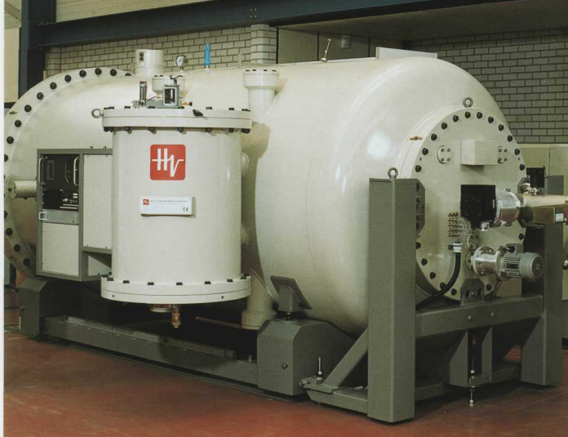
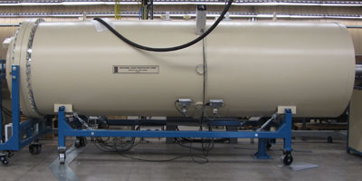

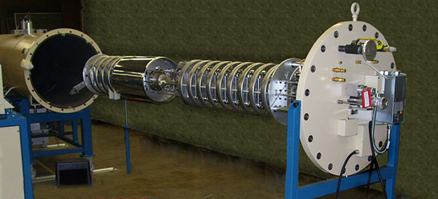
Large tanks full of high pressure SF₆ requiring regular access

Slide 6

SF₆ is the most potent greenhouse gas known. It is 22,800 times more effective at trapping infrared radiation than an equivalent amount of CO₂ and stays in the atmosphere for 3,200 years
1 kg SF₆ “lost” = 23 tonnes of CO₂
Approximate mass of SF₆ in one IBA system = 50-500 kg
Approximate loss of SF₆ each maintenance access = 3-50 kg
Between 1 and 10 maintenance accesses per year

Slide 7
How to remove SF₆?
high voltage terminal
e.g. He⁺
sample
RF ion source or
duoplasmatron
up to +5 MV
detector
5 bar SF₆

Slide 8
How to remove SF₆: An RFQ?
Acknowledgement to Alan Letchford
e.g. He⁺
sample
detector
Pros:
Compact
Positive ion sources
High energy no problem
Variable frequency complex but allows variable energy
Cons:
Expensive
Uses 100’s of kW

Slide 9
How to remove SF₆?
high voltage terminal
e.g. He⁺
sample
RF ion source or
duoplasmatron
up to +5 MV
detector
5 bar SF₆

Slide 10
How to remove SF₆: Air insulation?
high voltage terminal
e.g. He⁺
sample
RF ion source or
duoplasmatron
MV ?
detector

Slide 11
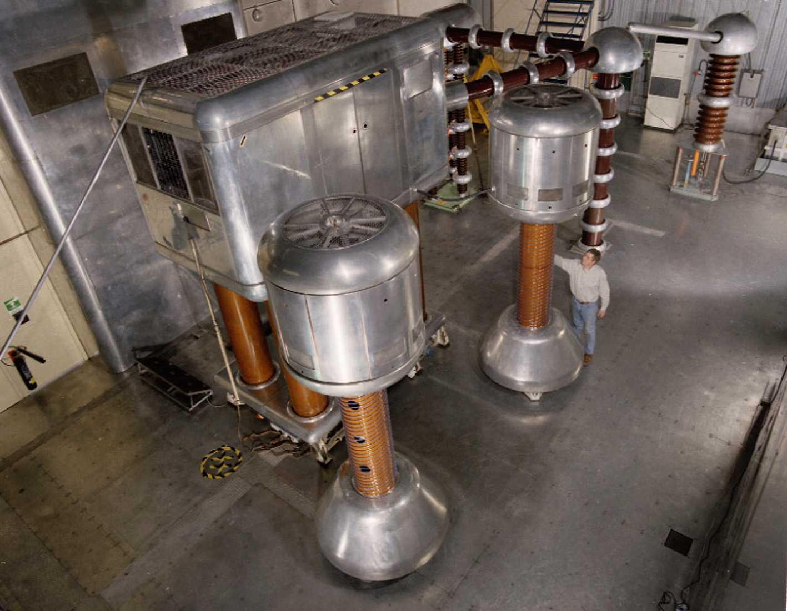
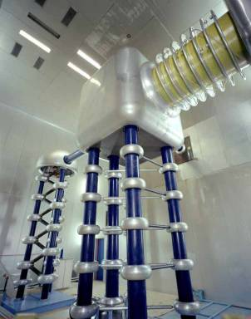
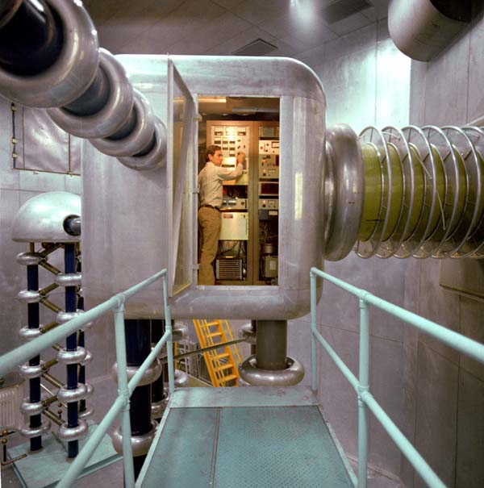
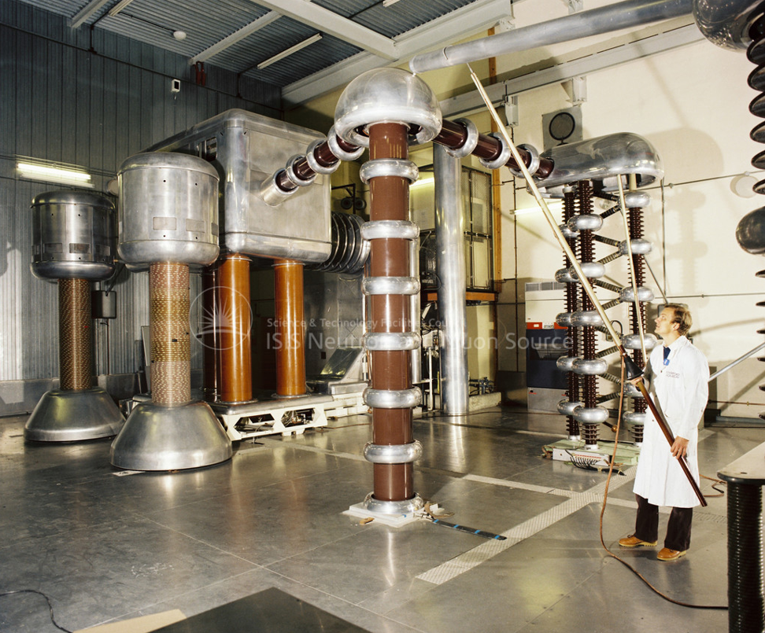
FNAL 750 kV column
665 kV to 750 kV in approximately 2-3 m
ISIS (NIMROD) 665 kV column
SF₆ still used in column!

Slide 12
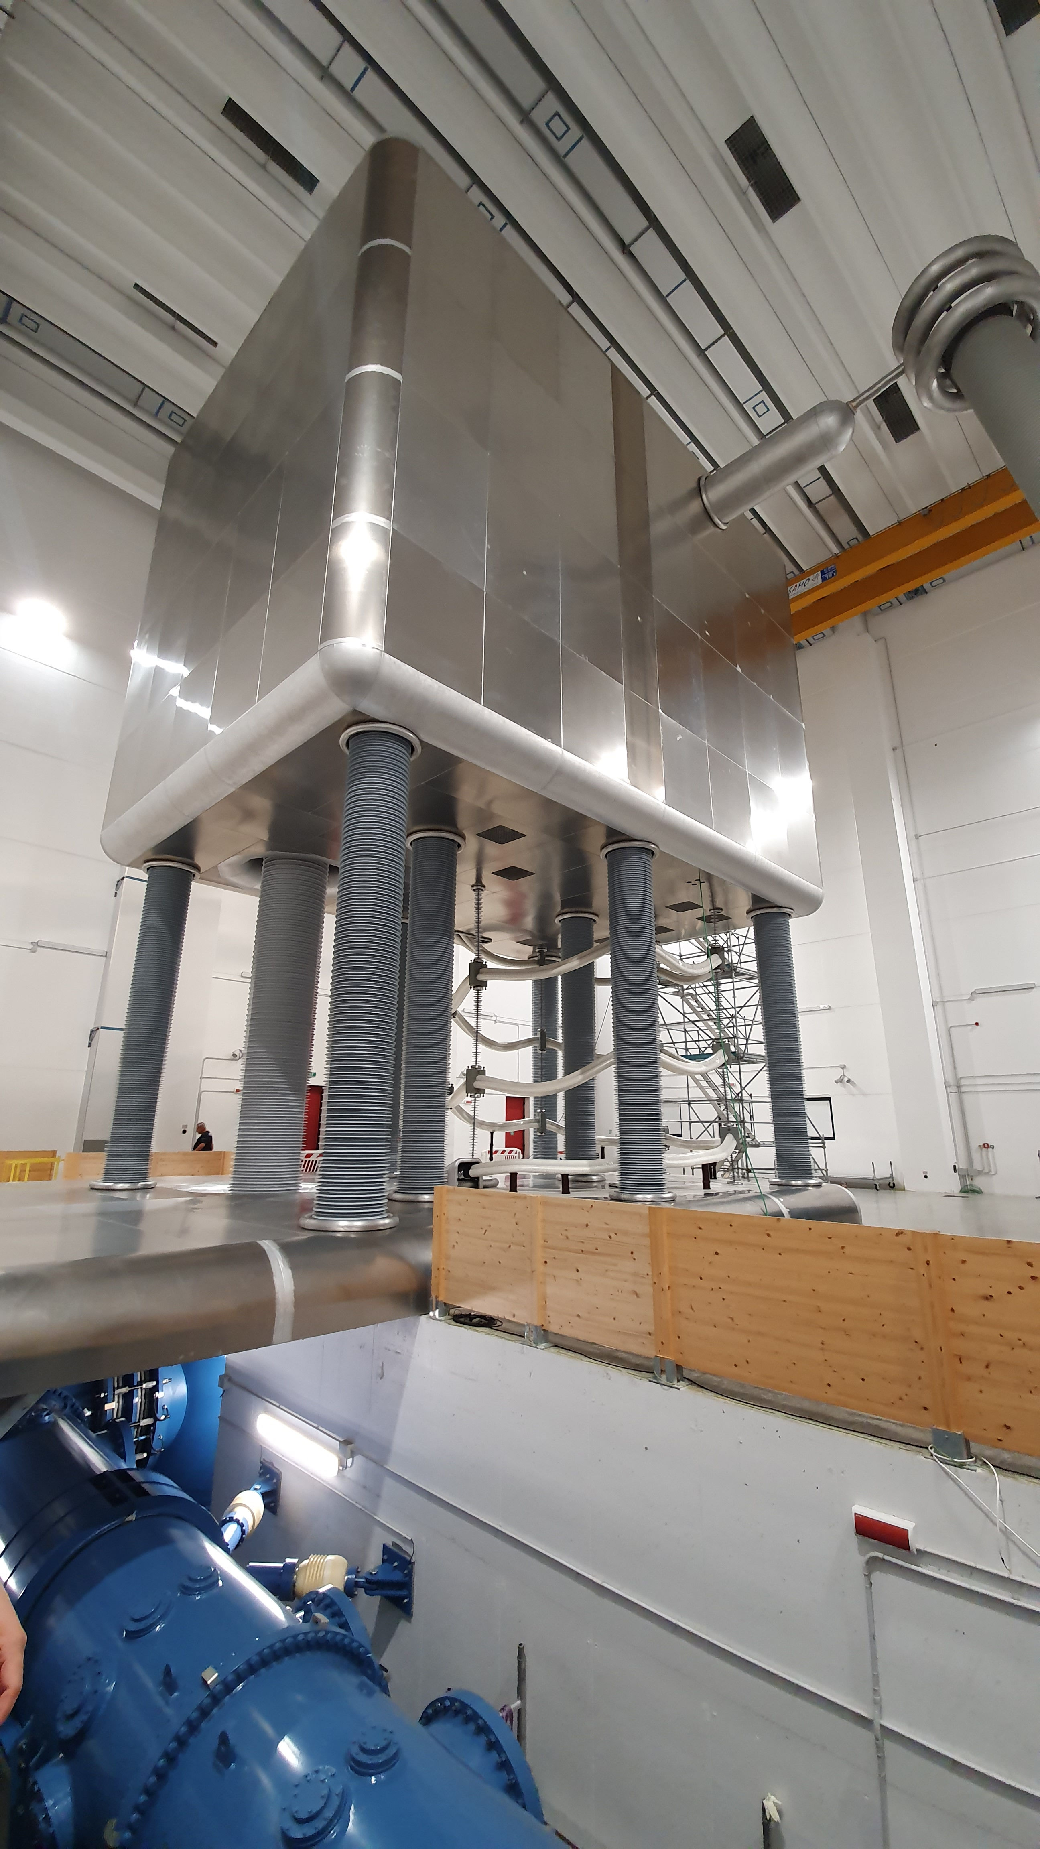
1 MV DC HV Platform for ITER NBI-
6.25 m high insulators
5 m clearance
SF₆ still used in feed line!

Slide 13
How to remove SF₆: Air insulation?
high voltage terminal
MV systems are impractical without SF₆
e.g. He⁺
sample
RF ion source or
duoplasmatron
detector

Slide 14
How to remove SF₆: Air insulation + high charge state ions
high voltage terminal
By using high charge state ions the required accelerating voltage can be greatly reduced
e.g. Xe27⁺
sample
+500 kV
detector
This approach obviously rules out using light ions, however ToF ERDA and material modification are still possible

Slide 15
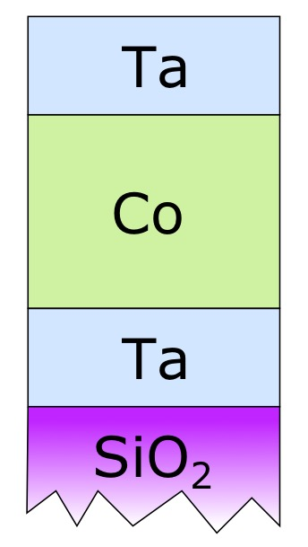
Time-of-Flight Elastic Recoil Detection Analysis (ToF-ERDA)
ToF-ERDA is a material characterisation method revealing the depth profile of the elemental composition of materials.
Many uses:
Electronic devices sensors
Functional surface coatings Catalytic surface chemistry Energy applications
Battery technology
etc.
Example: metal tri-layer on silicon-oxide substrate

Slide 16
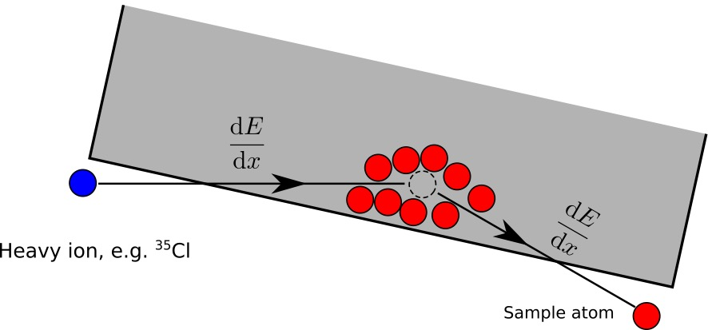
Time-of-Flight Elastic Recoil Detection Analysis (ToF-ERDA)
Simple principle:
Bombard the sample with heavy ions
Measure the velocity and energy of the recoiling particles
Use known energy loss in material to obtain depth profile
Lighter than beam particles are ejected, scattered beam
provides information on heavier elements.
Best suited for light elements including H, Li, C, N and O.
These elements cannot be detected using photon-based (x-ray) methods.
Hydrogen is “invisible” to Rutherford Backscattering Spectrometry (RBS), which makes ToF-ERDA unique.

Slide 17
Time-of-Flight Elastic Recoil Detection Analysis (ToF-ERDA)
Gas-filled co-incidence
detector to measure
recoil energy
Elemental depth
profile including
impurities
Time-of-Flight “gates” for timing signals –> recoil velocity

Slide 18
Typical low-energy ToF-ERDA ion beams
Beam | Energy
^{35/37}Cl | 3 - 6 MeV
^{79/81}Br | 8 - 11 MeV
¹²⁷I | 9 - 16 MeV
The required particle flux at the sample is 1-10 pnA
Lower limit: Reasonable measurement time, typically less than an hour / sample.
Upper limit: The maximum count rate of the energy detector.

Slide 19
Limit the platform voltage to 500 kV for an SF₆ free design
Beam | Energy
^{35/37}Cl | 3 - 6 MeV
^{79/81}Br | 8 - 11 MeV
¹²⁷I | 9 - 16 MeV
we need
Ion | Charge state | Energy
⁴⁰Ar | 6+ … 12+ | 3 - 6 MeV
⁸⁴Kr | 16+ … 22+ | 8 - 11 MeV
¹³⁶Xe | 18+ … 32+ | 9 - 16 MeV
1-10 pnA of
these charge states
we need an Electron Cyclotron Resonance (ECR) ion source

Slide 20
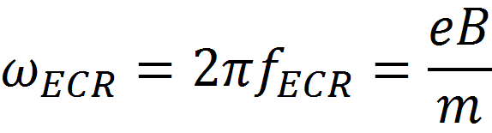
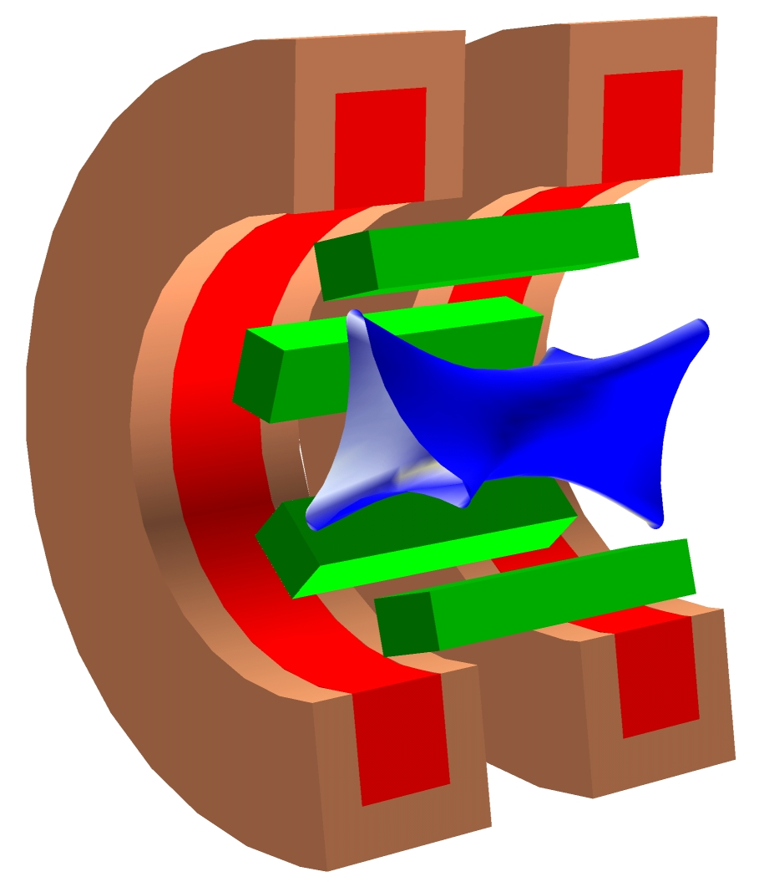
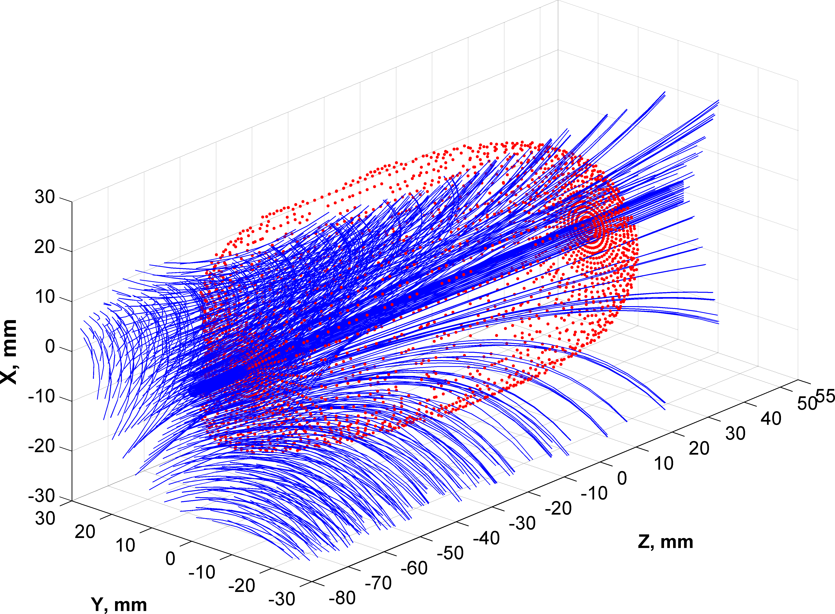
ECR Ion Source Magnetic Fields
Superposition of solenoid and sextupole fields

Slide 21
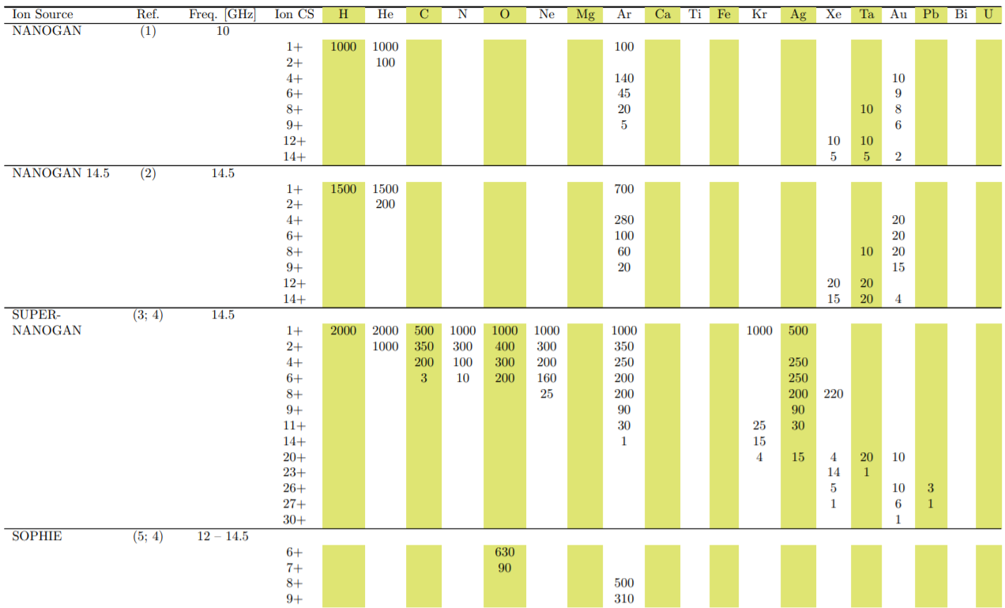
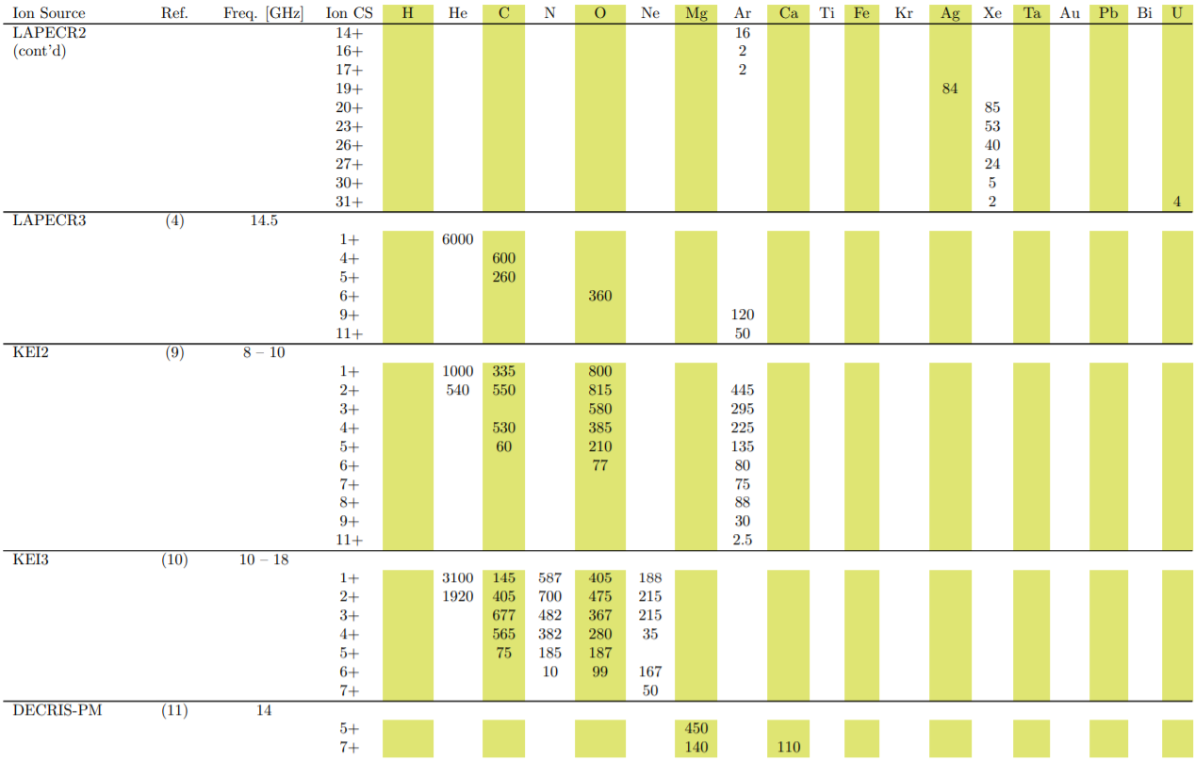
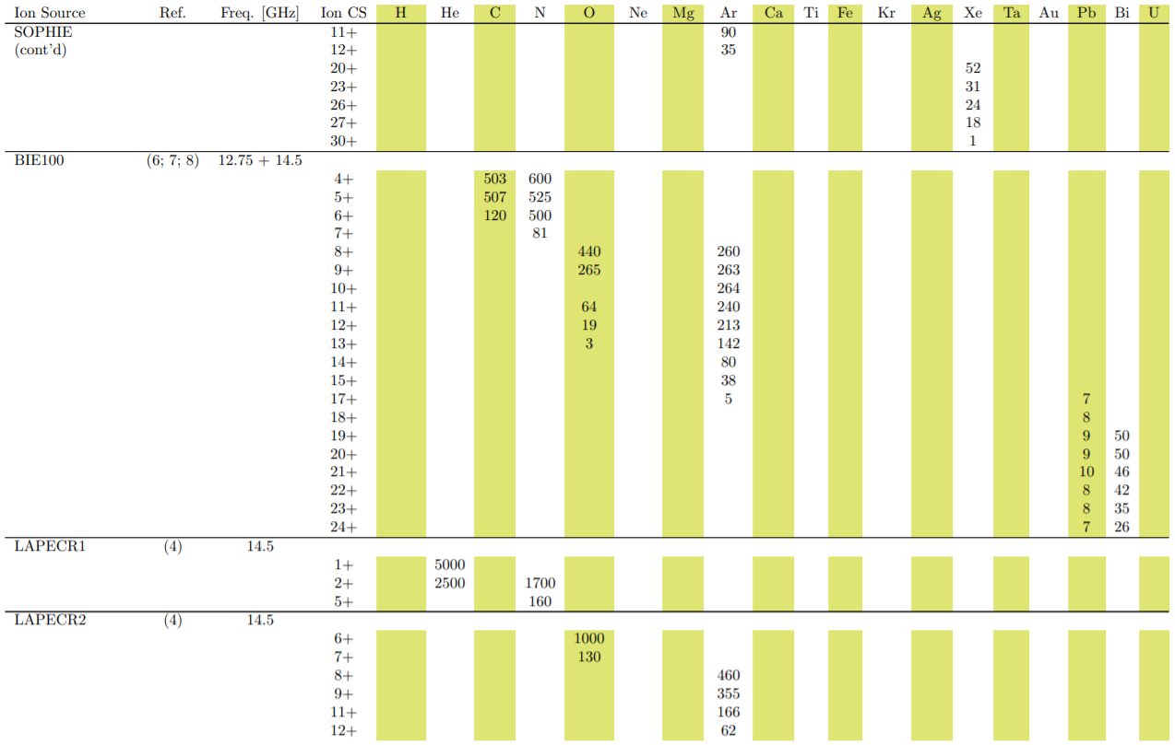
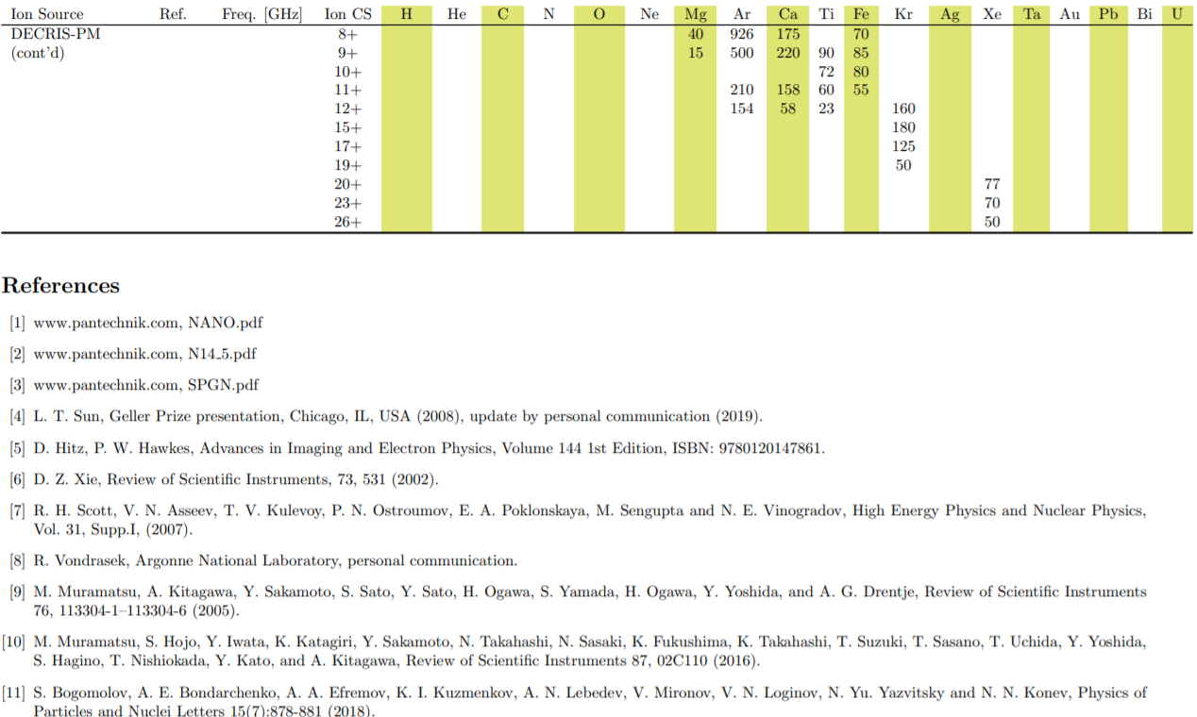
Permanent magnet ECR ion sources
SUPERNANOGAN
DECRIS-PM

Slide 22
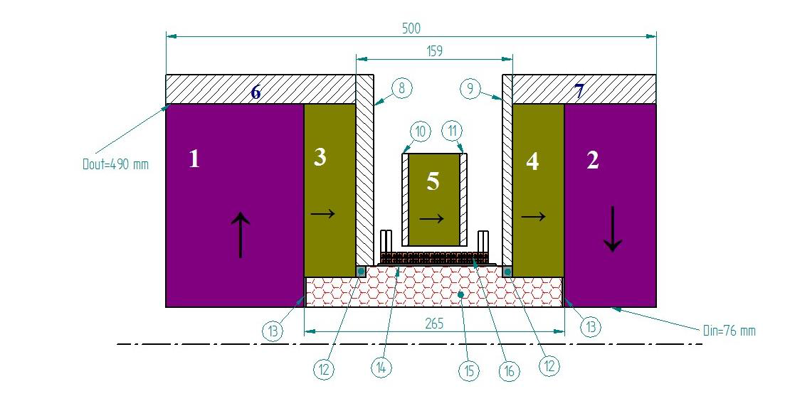
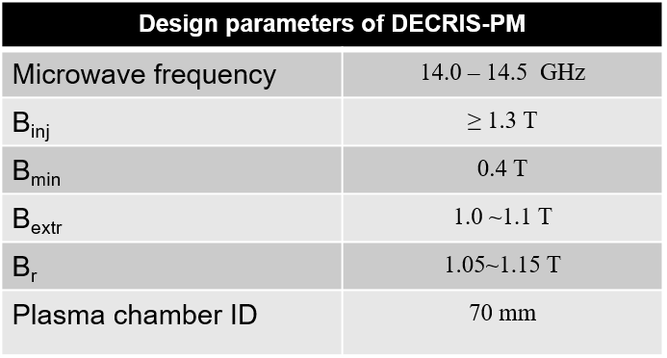
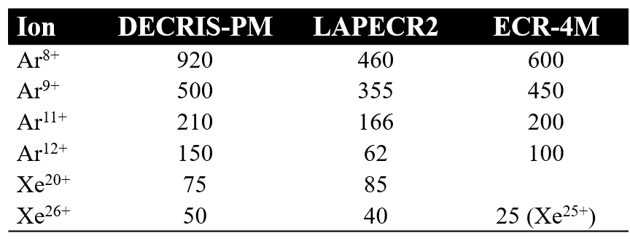
Dubna ECR Ion Source
1~5：PM rings
6, 7：soft iron rings
8~11：soft iron plates
12~14：auxiliary elements,
15：hexapole
16：coil
525 kg of PM material

Slide 23

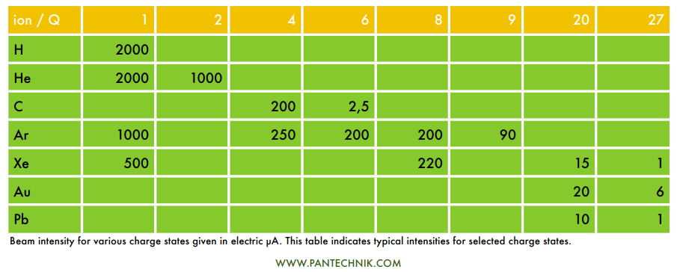
Commercial permanent magnet ECRIS
Costs approx. £1M

Slide 24

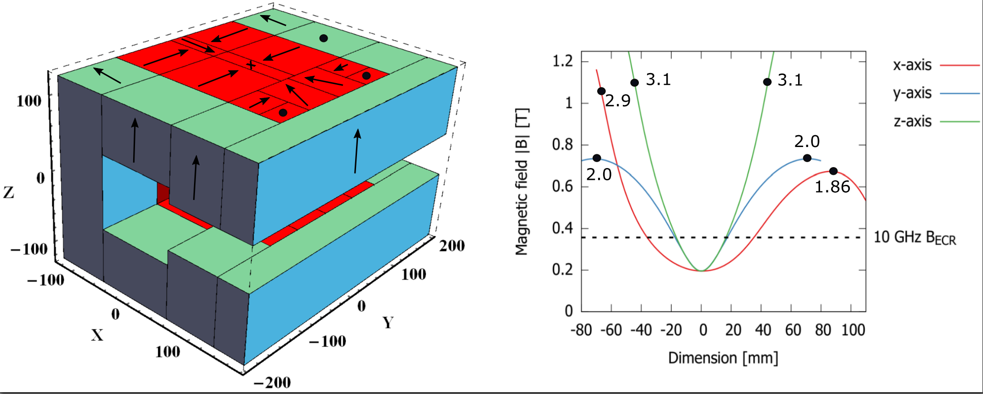
Permanent magnet CUBE-ECRIS
Quadrupole minimum-B structure with very simple PM array fulfilling so-called ECRIS scaling laws
160 kg of PM material

Slide 25
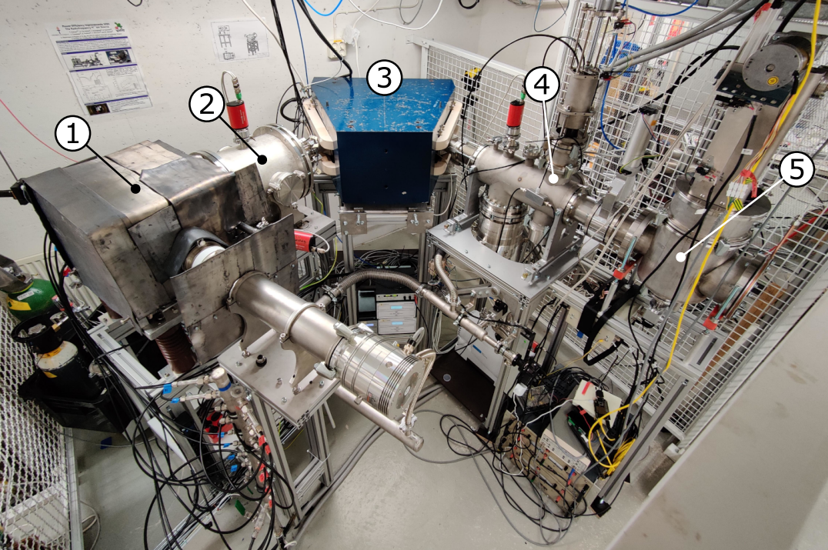
Permanent magnet CUBE-ECRIS
CUBE-ECRIS
Electrostatic quadrupole doublet
m/q-analysis magnet
(4) Faraday cup
(5) Emittance scanner

Slide 26
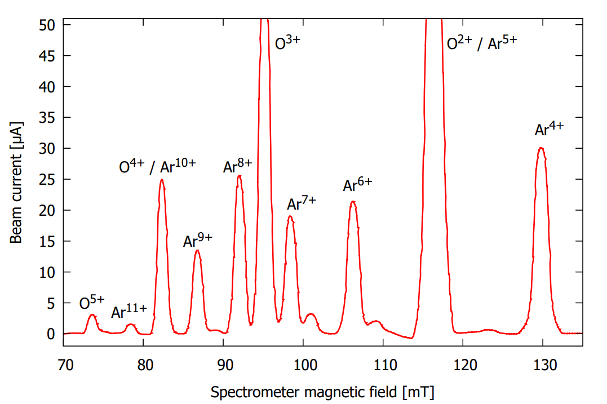
Permanent magnet CUBE-ECRIS
Argon charge state distribution with oxygen buffer gas
Unpublished data
Charge state | Current [μA] | Flux [pnA]
6+ | 21 | 3500
7+ | 18 | 2570
8+ | 25 | 3130
9+ | 14 | 1560
10+ | - | -
11+ | 1.5 | 140
12+ | 0.3 | 25
All argon particle fluxes > 10 particle nano-Ampere!
The CUBE-ECRIS ion source exceeds the IBA-concept requirement for 3-6 MeV argon.

Slide 27
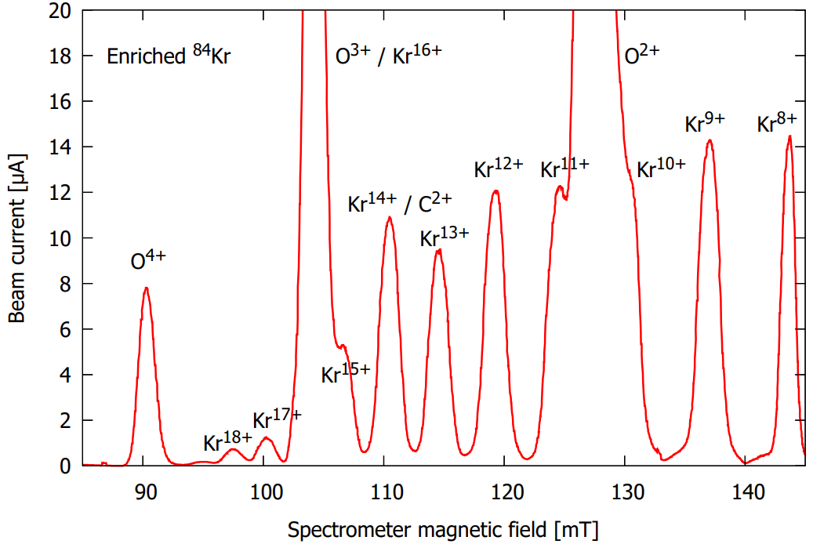
Permanent magnet CUBE-ECRIS
Krypton (enriched 84-isotope) charge state distribution
Unpublished data
Charge state | Current [μA] | Flux [pnA]
17+ | 1.25 | 100
18+ | 0.73 | 40
19+ | 0.23 | 12
Krypton particle fluxes > 10 pnA for charge states < 19+
At the moment the CUBE-ECRIS ion source at
500 kV platform can reach 9.5 MeV
energy with krypton.
Already relevant for the IBA-application!

Slide 28
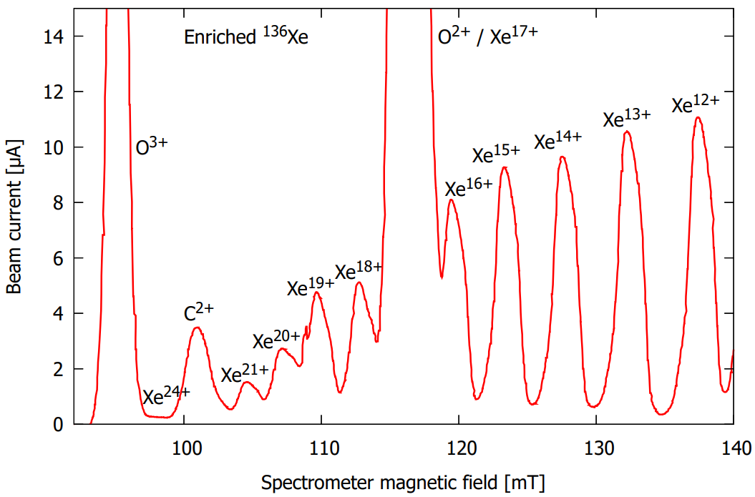
Permanent magnet CUBE-ECRIS
Xenon (enriched 136-isotope) charge state distribution
Unpublished data
*Enriched 131-isotope
Charge state | Current [μA] | Flux [pnA]
18+ | 4.9 | 270
19+ | 4.55 | 240
20+ | 2.7 | 135
21+ | 1.5 | 70
22+ | - | -
23+ | 0.5* | 22*
24+ | 0.2 | 8
Xenon particle fluxes > 10 pnA for charge states < 21+ and > 1 pnA for charge states < 24+
At the moment the CUBE-ECRIS ion source at
500 kV platform can reach 12 MeV
energy with xenon.
Already relevant for the IBA-application!

Slide 29
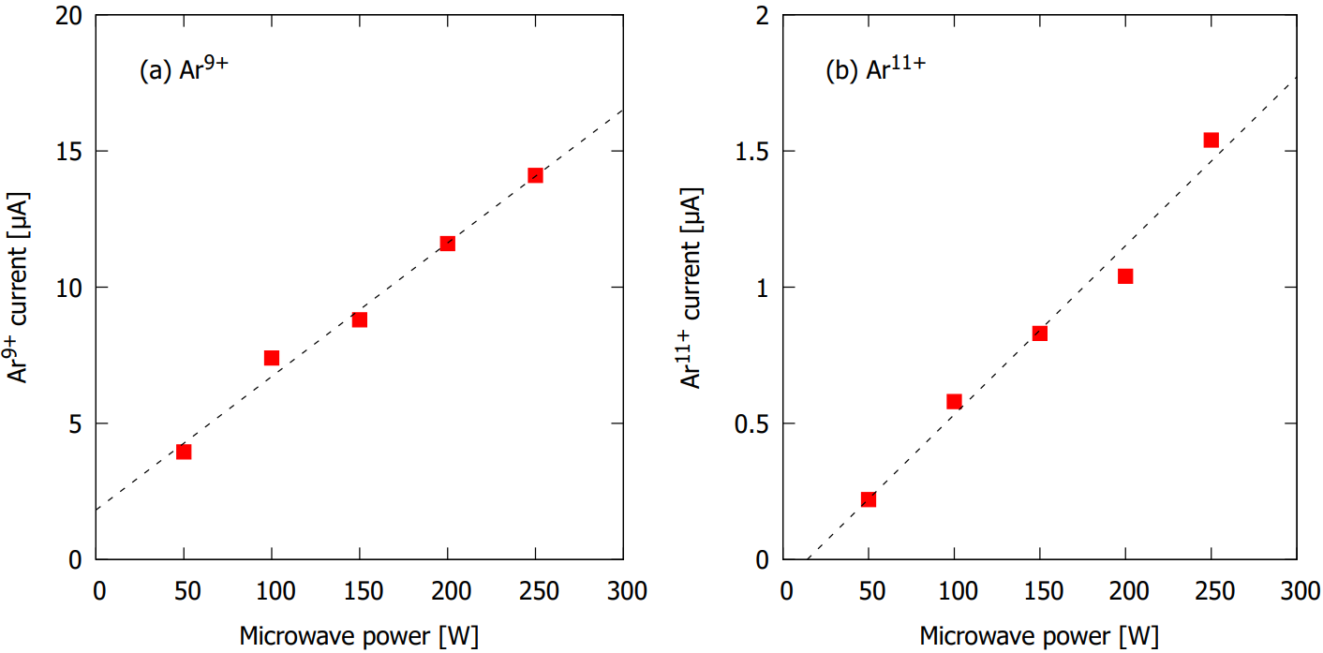
Permanent magnet CUBE-ECRIS
One possibility to increase the beam currents of high charge state Kr and Xe beams is to increase the microwave power.
The high charge state currents are power limited as shown here for argon.
Unpublished data

Slide 30
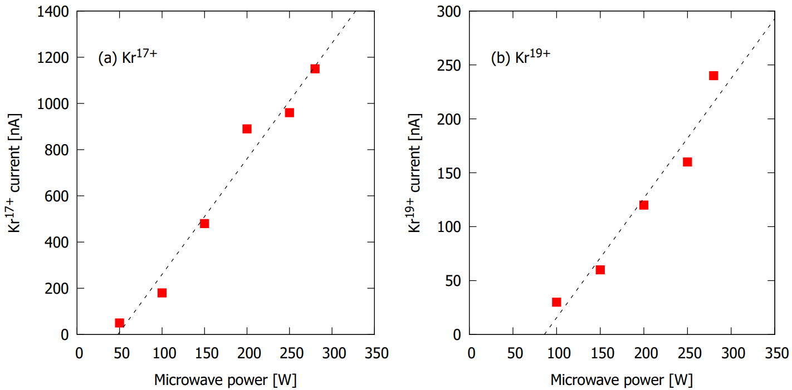
Permanent magnet CUBE-ECRIS
One possibility to increase the beam currents of high charge state Kr and Xe beams is to increase the microwave power.
The high charge state currents are power limited as shown here for krypton (enriched ⁸⁴Kr isotope).
Unpublished data

Slide 31
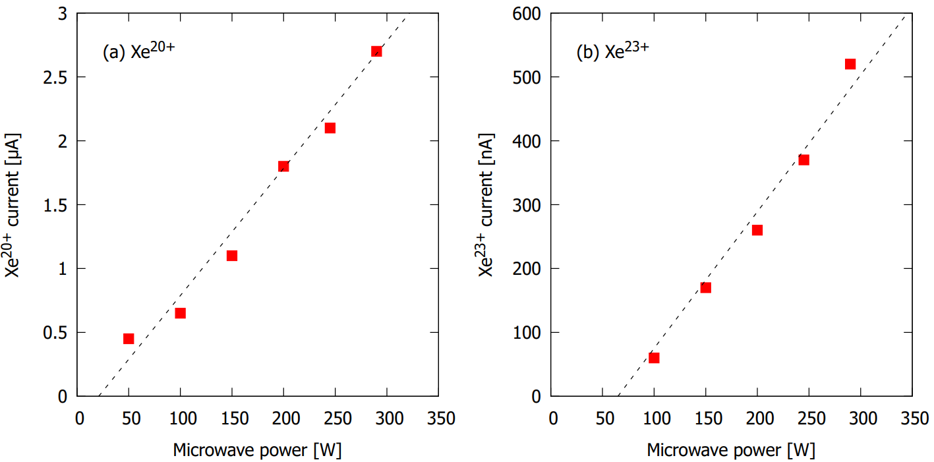
Permanent magnet CUBE-ECRIS
One possibility to increase the beam currents of high charge state Kr and Xe beams is to increase the microwave power.
The high charge state currents are power limited as shown here for xenon (enriched ¹³¹Xe isotope).
Unpublished data

Slide 32
CUBE-ECRIS
Electrostatic quadrupole doublet
m/q-analysis magnet
(4) Faraday cup
(5) Emittance scanner
Between 1-2 kW
burnt in the dipole

Slide 33
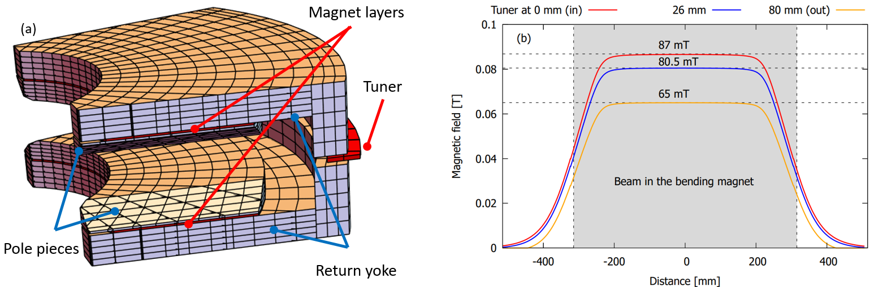
Adjustable field permanent magnet dipole for charge state selection
Allows selecting charge states at ion source potential of ∼ 10 kV

Slide 34

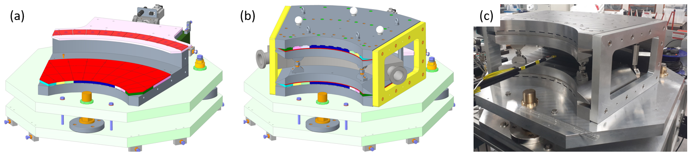



More details in Alex Bainbridge’s Talk
Physics design and simulation
Engineering design and assembly
Field measurement and validation

Slide 35
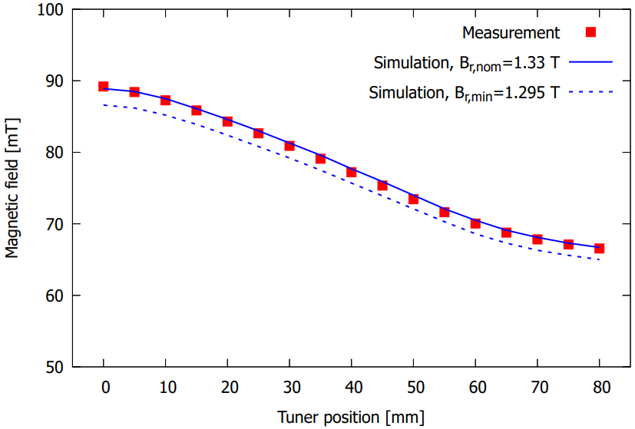
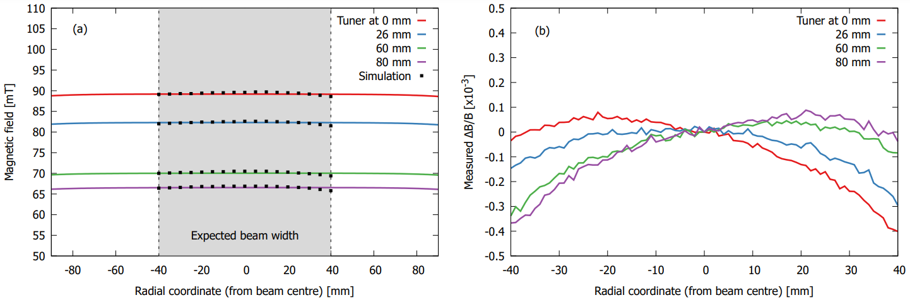
Adjustable field permanent magnet dipole for charge state selection
More details in Alex Bainbridge’s Talk
Perfect match between simulation and
measured field with varying tuner position
Excelllent field uniformity radially across the magnet pole,
ΔB/B < 5x10^⁻⁴ (the specification is 1x10⁻³)
This “net zero dipole magnet” has other applications:
Accelerator mass spectrometry
Isotope separation

Slide 36
Novel ToF-ERDA accelerator concept – status and next steps
Beam transport tests with CUBE-ECRIS in 2023

Slide 37
Novel ToF-ERDA accelerator concept – status and next steps
500 kV high voltage platform
e.g. Xe27⁺
sample
ECR ion source
Accelerating column
detector
ToF-ERDA

Slide 38
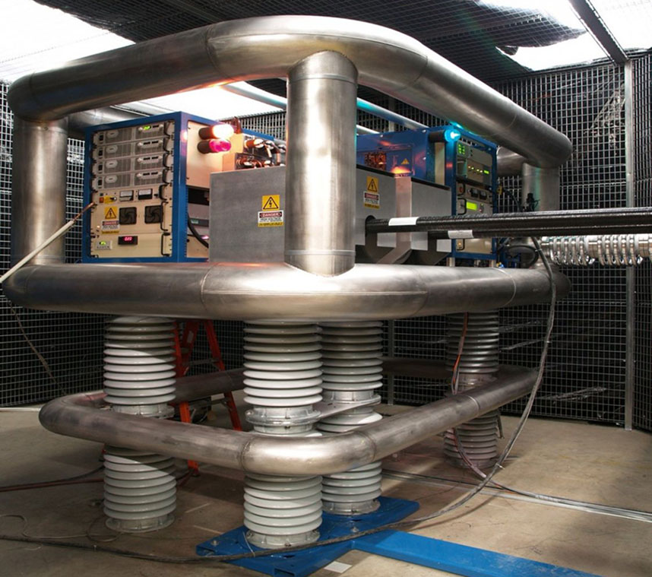
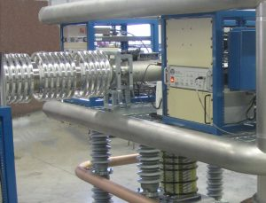
Novel ToF-ERDA accelerator concept – status and next steps
500 kV high voltage deck and air-insulated acceleration column commercially available
www.pelletron.com

Slide 39
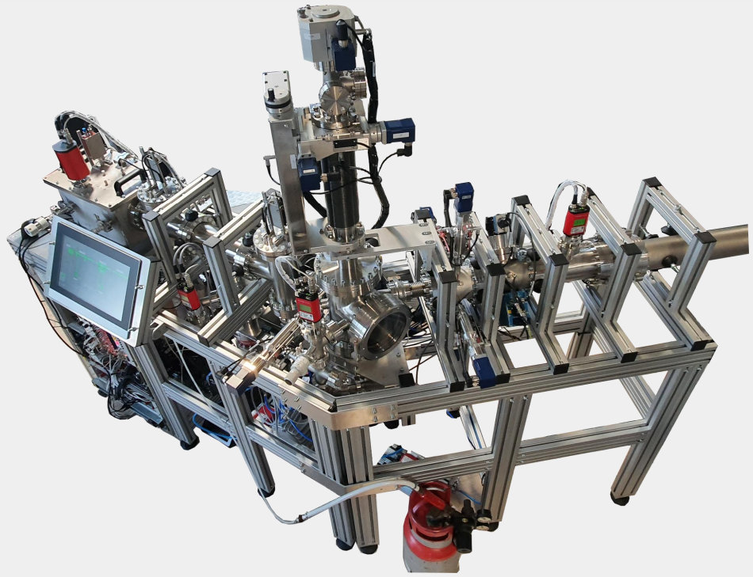
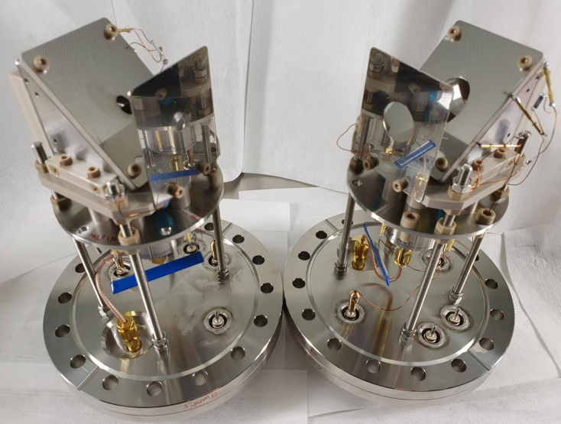
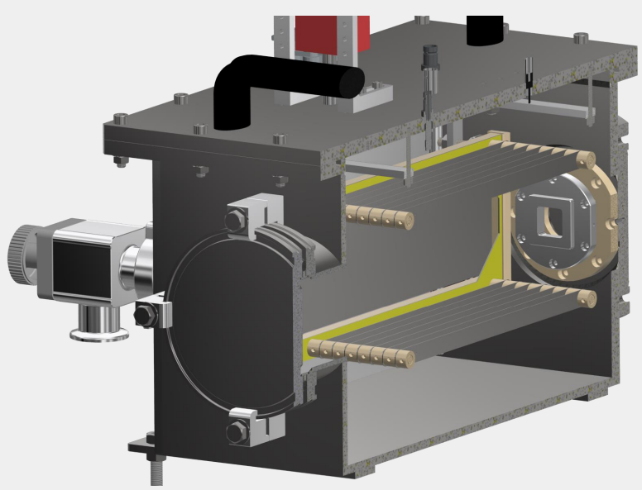
Novel ToF-ERDA accelerator concept – status and next steps
Modern ToF-ERDA tool, with state-
of-the-art hydrogen detection
efficiency and automation options
available for purchase from the
University of Jyvaskyla
Courtesy of Mikko Laitinen, University of Jyvaskyla

Slide 40
All building blocks for a green ToF-ERDA facility exist.
We plan to apply for funding for the next phase in 2023

Slide 41

Opportunities for STFC and the UK?
National Thin Film Deposition and Characterisation Centre
(Proposed large-scale project on STFC priority projects list)
ISIS Materials Characterisation Laboratory
Surrey Ion Beam Centre and EPSRC
UK Accelerator Institutes (Cockroft and John Adams)
STFC is a unique organisation at the forefront of science and technology
STFC is the natural leader for this project
We have all the technical capabilities required

Slide 42
Benefits Summary
Increased reliability and stability of the ion source
Reduced operational effort (turn-key system)
Reduced ion source maintenance effort
Reduced laboratory footprint of the equipment
Vastly reduced emissions
Reduced power consumption

Slide 43



Notes:
The abstract pattern can be removed or repositioned if required. Be careful to ‘Send to Back’ so that it does not obscure any important information.

Slide 44





Science and Technology Facilities Council
@STFC_matters
Science and Technology Facilities Council
Notes:
The abstract pattern can be removed or repositioned if required. Be careful to ‘Send to Back’ so that it does not obscure any important information.

