Slide 1
ISIS Sustainability Strategy
Notes:
Title Page

Slide 2
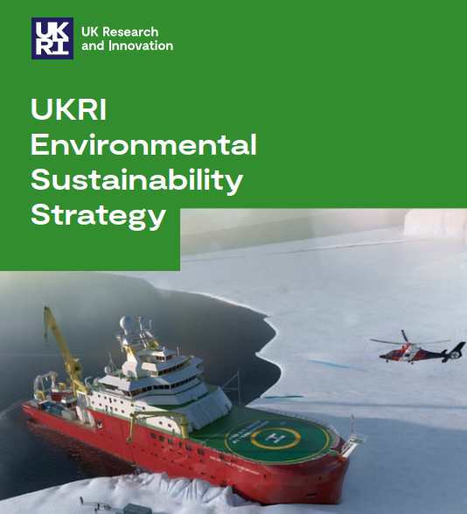
Background
UKRI Plans to :
Achieve NET-ZERO by 2040.
Embed environmental sustainability across all their investment decisions.
The STFC Action Plan is focused on a series of high-level interventions that STFC will have responsibility for, and will undertake within its own jurisdiction. It supports the UKRI Strategy.
Notes:
From the UK governments Net Zero commitment UKRI and STFC have developed their strategy and action plan. Note that UKRI is committed to Net Zero 10 years sooner than UK gov.

Slide 3
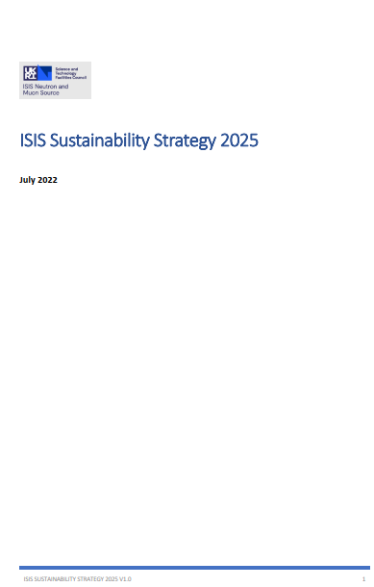
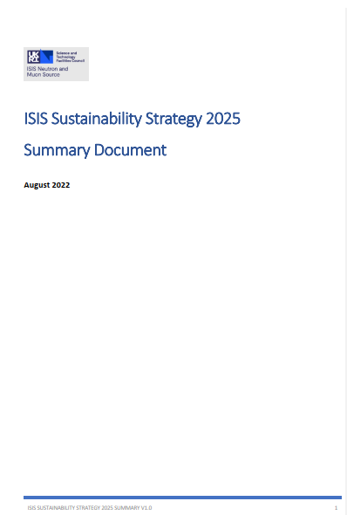
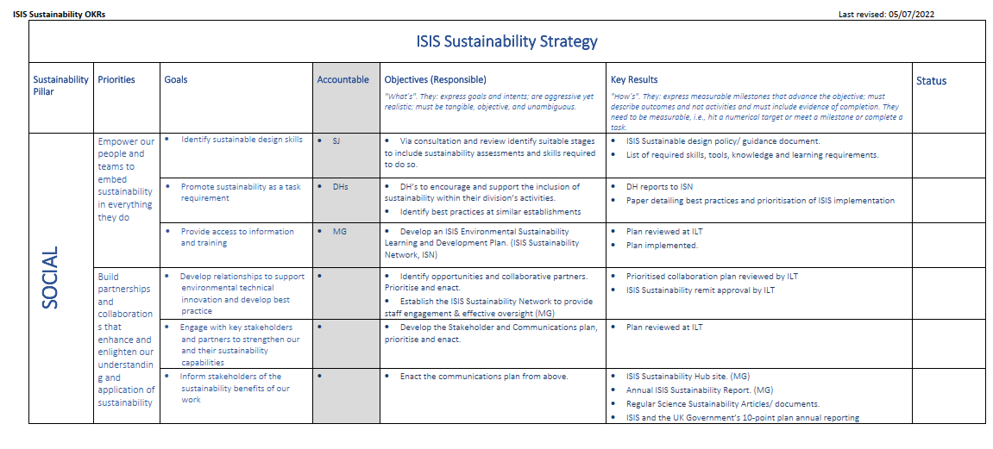
ISIS Sustainability Strategy 2025
Notes:
3 Documents that make up the overall ISIS strategy. All available on the ISIS Sustainability Hub. OKR’s Priorities – Goals – Objectives and Key Results.

Slide 4
ISIS Sustainability Strategy
The ISIS sustainability strategy is intended to implement priorities that address both sides of the carbon neutral equation.
CO₂ released into the atmosphere from ISIS activities is balanced by an equivalent amount removed by those activities.
We will implement priorities that address both sides of the carbon neutral statement.
It recognises the benefits of ISIS’s research to develop materials that will help us with the climate challenge, whilst also reducing our own carbon footprint.
ISIS Vision:
Our vision is to develop the environmental sustainability skills, knowledge and processes that will allow us to minimise our emissions, maximise our science output and work towards balancing the carbon neutral statement.
Notes:
Key aspects of the strategy. Mention difference/ similarities between Carbon Neutral and Net Zero. (Net Zero all GHGs)

Slide 5
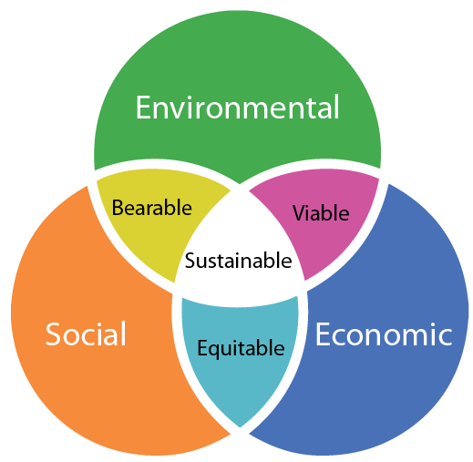
The Three Pillars of Sustainability
In 1987 the World Commission on Environment and Development WCED, released the Brundtland report that introduced the concept of sustainable development based on three fundamental pillars.
SOCIAL:
For ISIS this means you, our users, STFC colleagues, partners and the public.
ISIS will ensure that you have the skills and training necessary to carry out your roles sustainably.
We will work with our STFC colleagues and external partners to advance wider understanding, knowledge and capability.
We will inform the public of the carbon benefits of our research.
ECONOMIC:
ISIS will develop our carbon footprint awareness to include all ISIS activities.
Identify how and where we can target resource reductions.
Publish the impact of our experimental activities that align to the UK government’s Ten point plan.
ENVIRONMENTAL:
ISIS will minimise the resources that it uses in all activities.
Adopt the principles of circular economy where feasible to ensure that our waste adheres to the principles of re-use, recycle and recovery.
Work with the STFC Environmental Sustainability team to improve the biodiversity of our estate.
Notes:
Introduce the concept of 3 pillars of sustainability and how this maps to ISIS.

Slide 6
ISIS FIVE Strategic Priorities
Empower
Partnerships
Operate sustainably
Optimise
Improve
You to embed sustainability in everything you do.
That enhance our understanding and application of sustainability.
Minimise our carbon footprint.
Green economic impact from our science.
our environment and Biodiversity
Our Knowledge & Skills
Notes:
Graphical representation of the five strategic priorities. Mention further information on this mapping within the strategy.

Slide 7
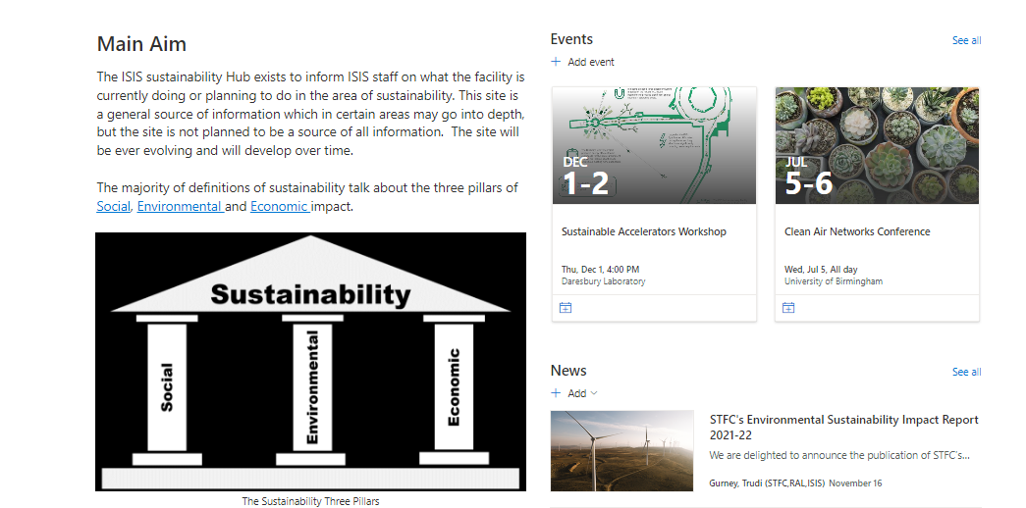
ISIS Sustainability Site
Notes:
ISIS Sustainability site on the ISIS Hub. Thanks to Heather Evans for editing and maintain the site. A source of general and ISIS specific information as well as useful links. Please let us know if there is anything you would like to see on the site. It will include Live updates on ISIS electricity usage and PV generation. Widgets are under development. This information will also be displayed at main entry points into the MCR and R80.

Slide 8
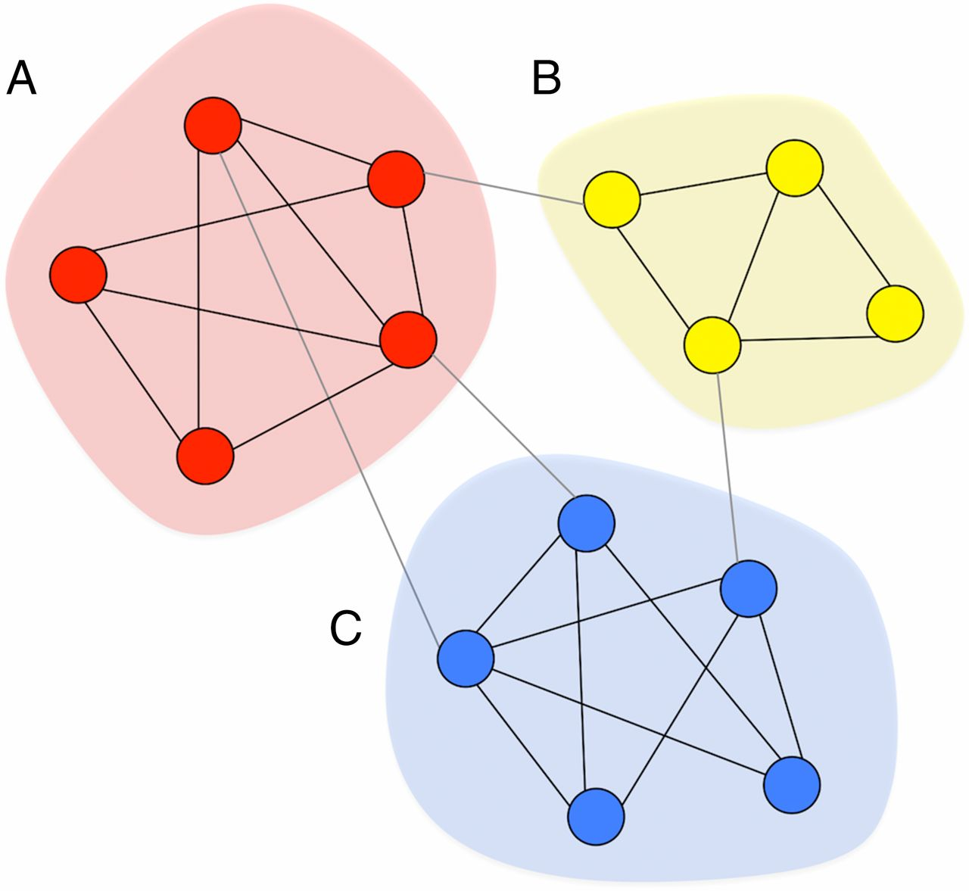
ISIS Sustainability Network
The ISIS Sustainability Network will:
Have representation from all divisions.
Have representation that covers the full lifecycle of ISIS assets. (Concept through to end of life)
Help to monitor progress and report to, recommend and advise the ISIS Leadership Team.
Assist in producing the annual ISIS Sustainability Report.
Help to raise awareness and promote behaviour change.
Deliver practical actions and input to ways of working within ISIS.
Be part of the wider STFC community of Environmental Networks.
Kick Off Meeting 9th December.
38 ISIS staff expressed an interest to join.
Notes:
Need to discuss with ILT

Slide 9
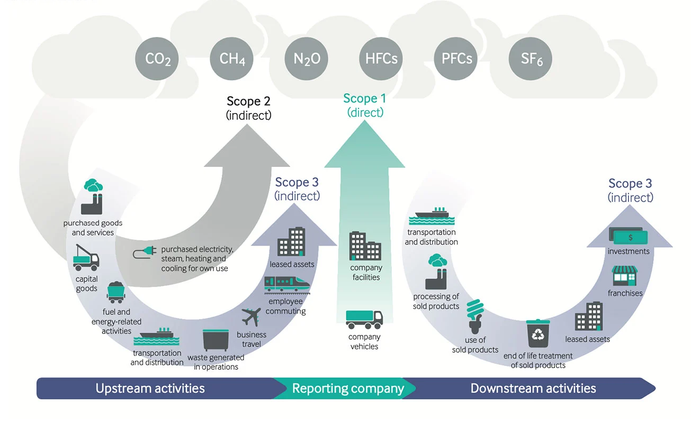
ISIS Environmental Sustainability
CO₂ released into the atmosphere from ISIS operations is balanced by an equivalent amount removed by those activities.
Scope 1: More work required.
Scope 2: Purchased Energy dominates.
Scope 3: More work required.
Not just about reducing ISIS Energy usage.
Embedding sustainability in everything we do:
Sustainable Design, Operations, end-of-life and Science.
Sustainable travel and working.
Include sustainability in your requirements, meetings and your working practices.
Notes:
ISIS Sustainability site on the ISIS Hub. Thanks to Heather Evans for editing and maintain the site. A source of general and ISIS specific information as well as useful links. Please let us know if there is anything you would like to see on the site. It will include Live updates on ISIS electricity usage and PV generation. Widgets are under development. This information will also be displayed at main entry points into the MCR and R80.

Slide 10
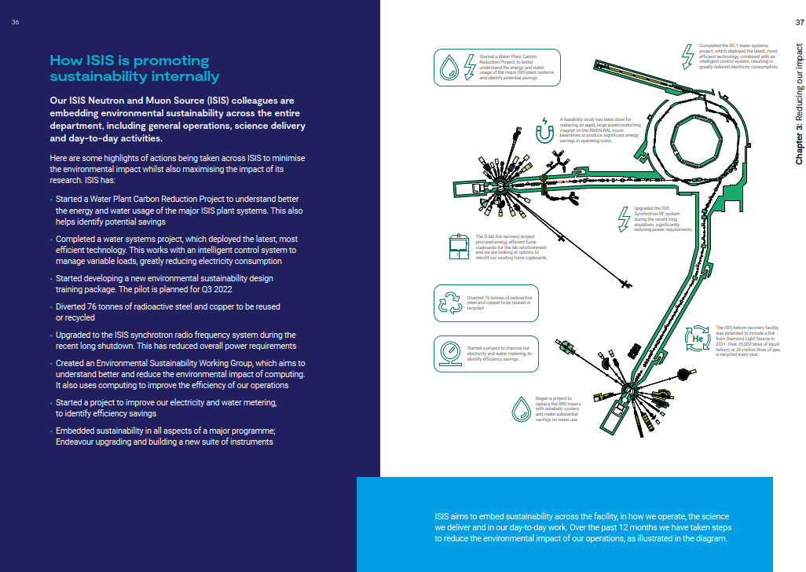
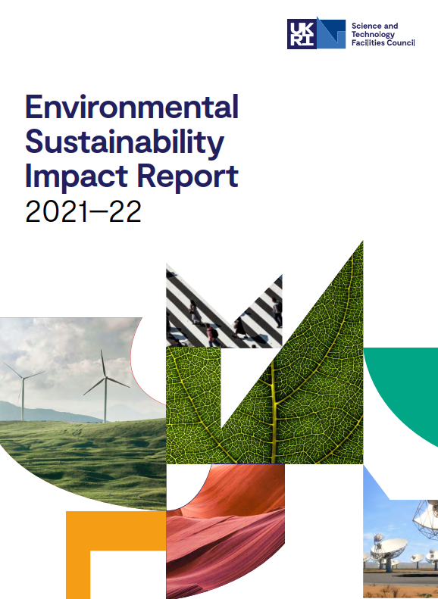
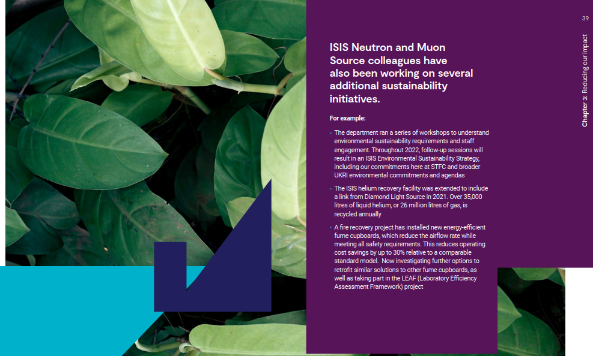
ISIS Environmental Sustainability Reporting
ISIS Facility
2022-23
Notes:
ISIS Sustainability site on the ISIS Hub. Thanks to Heather Evans for editing and maintain the site. A source of general and ISIS specific information as well as useful links. Please let us know if there is anything you would like to see on the site. It will include Live updates on ISIS electricity usage and PV generation. Widgets are under development. This information will also be displayed at main entry points into the MCR and R80.

Slide 11
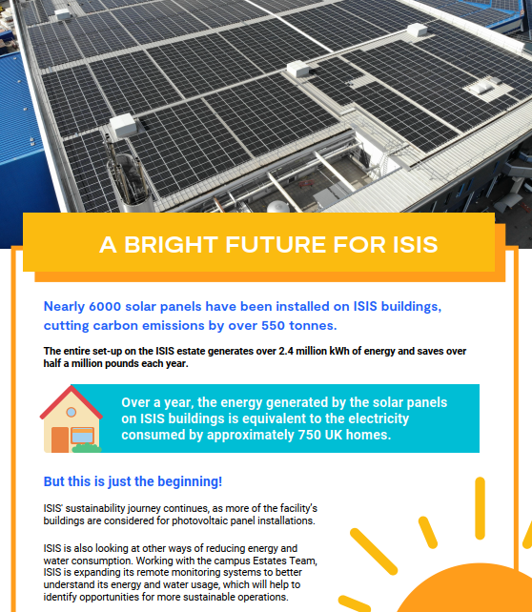
A few things we have already done
Notes:
Mian Points: Science mapped to the UK Government 10 point plan: right hand side of the carbon neutral statement.
PV Panels: Reducing the left hand side of the carbon neutral equation. Poster refers to R6 and R6A. R105/106, R40 & R78 coming online. R55 under discussion but may require roof strengthing. For those interested the carbon footprint of PV panels is approximately 5 tonnes of CO₂e for a 4kW domestic array. Within UK 1.2 tonnes of CO₂e annual saving. Roughly 5 year carbon payback period. Average lifespan of 25-30 years. Current manufacturing techniques are not aligned to the circular economy though.

Slide 12
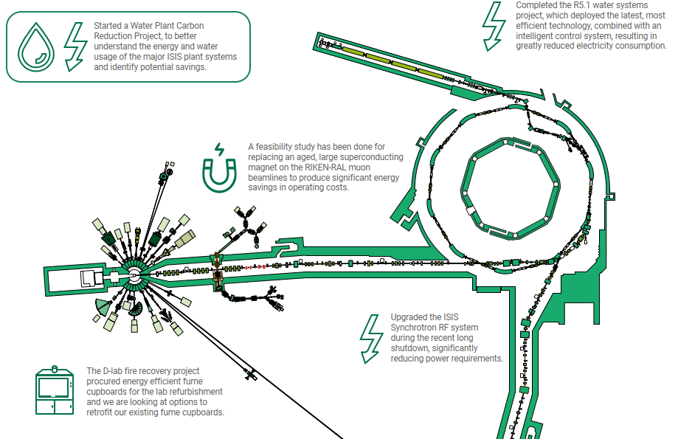
A few things we have or are doing
Notes:
Don’t go through all. Mention one from each. 1. Sustainable design training package. 2: 76 tonnes of active steel and copper reused or recycled. 3. Sync RF cavity upgrade. 4.Computing sustainability working group. 5. D Lab recovery project.

Slide 13
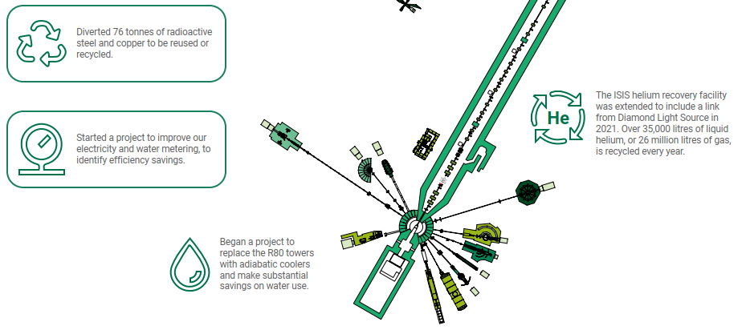
A few things we have or are doing
Notes:
Don’t go through all. Mention one from each. 1. Sustainable design training package. 2: 76 tonnes of active steel and copper reused or recycled. 3. Sync RF cavity upgrade. 4.Computing sustainability working group. 5. D Lab recovery project.

Slide 14
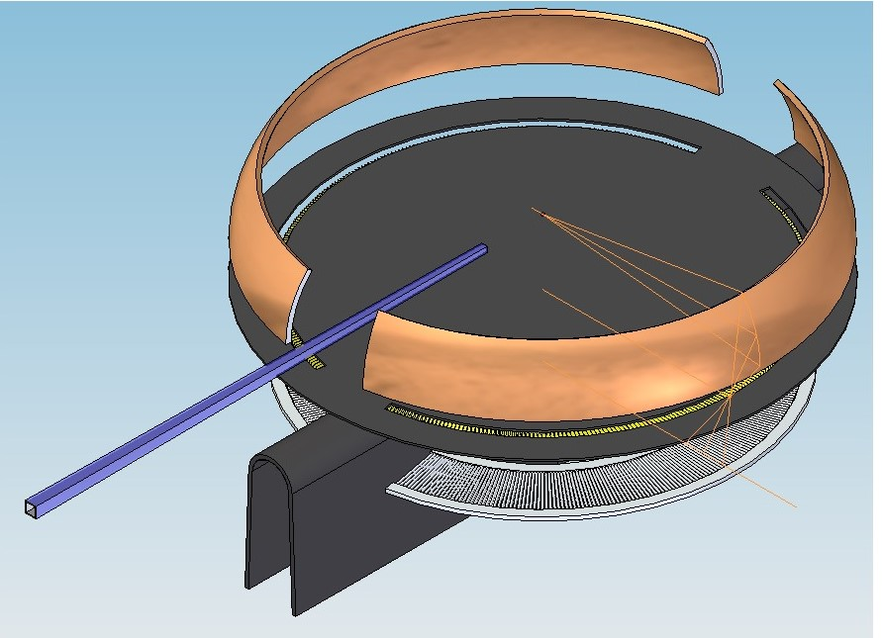
Science Divisions and Sustainability
Science Strategy
ISIS Science strategy highlights importance of sustainability research
Endeavour
Embedded sustainability in all aspects of the next ISIS large scale programme:
Science and Balancing Net Zero
Contracted a consultancy to develop a pilot study to evaluate the impact of ISIS research on the drive to Carbon Net Zero, in collaboration with Jo Colwell and the central impact team.
Tender awarded to Fraser Nash.
Kick off meeting held, and the project is expected to last 12 months.
This is as much about establishing a methodology for evaluating our research impact on various aspects of sustainability (including UN goals) as about the figures.
If successful we hope this approach will be rolled out more widely within STFC.
Research to Demonstrator
Concept of using ISIS Facility to demonstrate practical applications of ISIS Research
Example:
Thermoelectrics: Turning waste heat back into useful power, waste heat 70 C recovering 1-2% of energy. David Voneshen Excitations Group.
Notes:
Don’t go through all. Mention one from each. 1. Sustainable design training package. 2: 76 tonnes of active steel and copper reused or recycled. 3. Sync RF cavity upgrade. 4.Computing sustainability working group. 5. D Lab recovery project.

Slide 15
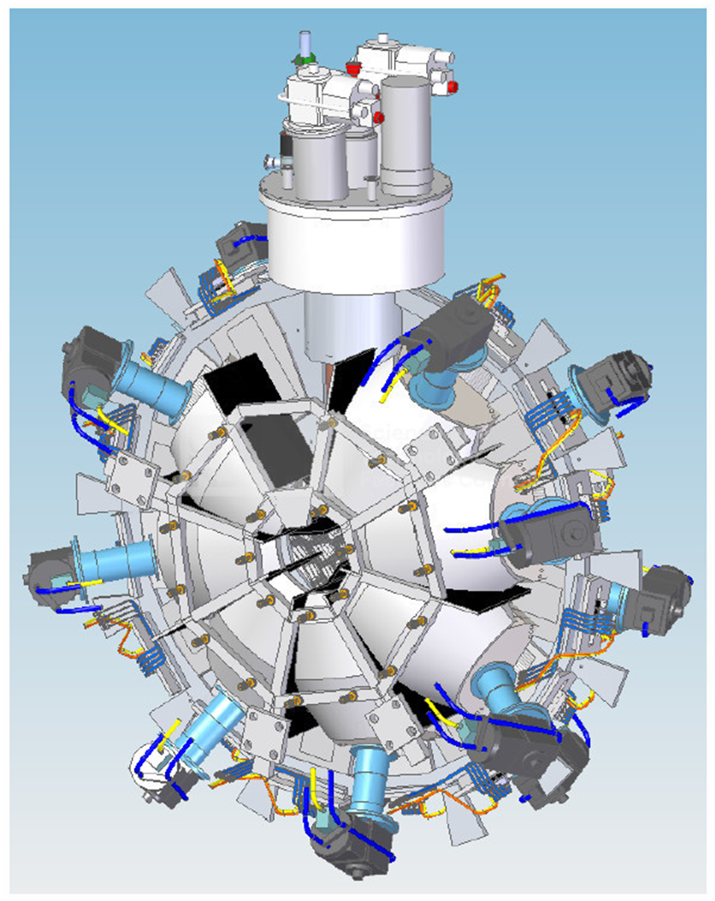
Sustainable Design
ISIS Design Division
Working with PDR consultancy to develop a training course to support engineers to work in a more sustainable way.
Prime Focus on the design process.
Collaborating with STFC Environmental Sustainability
Pilot course early 2023
Under development three sessions:
Designers role in delivering sustainability at STFC
What is sustainable design?
What does the design process look like at STFC
Lifecycle design strategies
Circular Economy, Net Zero and Critical raw materials
Designing for Behaviour change
Measuring and communicating sustainable design.
Supporting application of lifecycle thinking
Developing goal, scope and functional units for LCAs on specific designs.
Notes:
Don’t go through all. Mention one from each. 1. Sustainable design training package. 2: 76 tonnes of active steel and copper reused or recycled. 3. Sync RF cavity upgrade. 4.Computing sustainability working group. 5. D Lab recovery project.

Slide 16
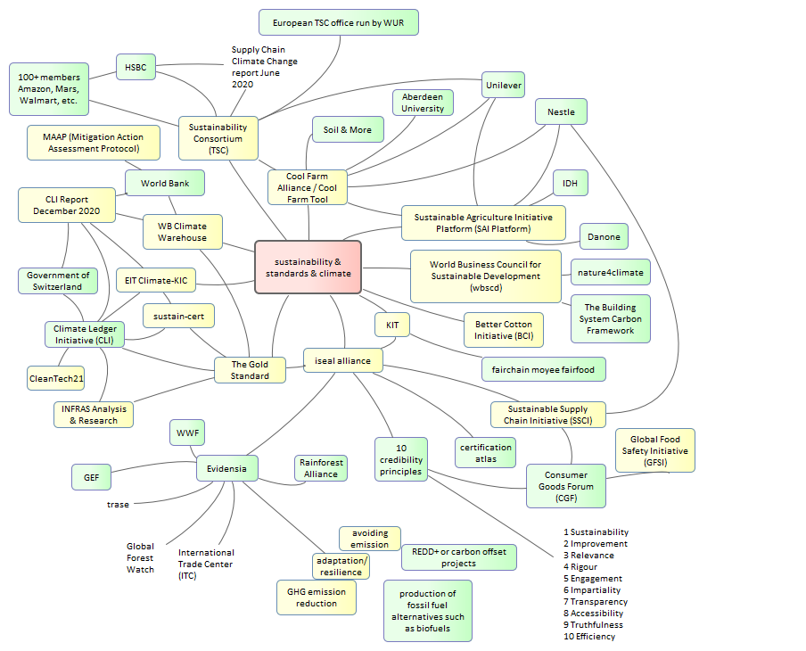
SPADE Sustainable Principles and Advice for Design Engineers.
Materials and Lifecycle Analysis Session: SPADE Harry Sullivan
SPADE is a project at STFC looking to compile a set of design guidelines, as a resource to help engineers make environmentally sustainable choices on projects.
Graduate Project within ISIS
Main Objective: Compile a set of sustainable design guidelines to help engineers make environmentally sustainable choices on projects
Create a platform where design tips, general guidelines and best practice about different aspects of sustainable design
Achieved by:
Conducting research into selected areas to identify standards and collate associated information.
Topics to be covered:
Reducing machining waste
Specifying electrical components,
Circular economy of parts
Sustainable materials tool
Notes:
Don’t go through all. Mention one from each. 1. Sustainable design training package. 2: 76 tonnes of active steel and copper reused or recycled. 3. Sync RF cavity upgrade. 4.Computing sustainability working group. 5. D Lab recovery project.

Slide 17
Software & Sustainability
Materials and Lifecycle Analysis Session: Sustainable Computing Sam Tygier
Information & Communications Technology, ICT is responsible for ~2-4% of global CO2 emissions and the footprint from computing in research is significant and growing. The ESWG in the ISIS Computing Division is looking at the current impact of our software and hardware and also at how computing can be used to improve efficiency of ISIS operations.
ISIS Computing Division
We have created an ICD Environmental Sustainability Working Group which aims to better understand and reduce the environmental footprint of computing within ISIS and to use computing to improve the efficiency of ISIS operation. We have been collecting existing success stories, investigating the costs and benefits of moving services to the cloud, and started discussions on software best practices for efficient computing.
1st Workshop 5th December 2022
Notes:
Don’t go through all. Mention one from each. 1. Sustainable design training package. 2: 76 tonnes of active steel and copper reused or recycled. 3. Sync RF cavity upgrade. 4.Computing sustainability working group. 5. D Lab recovery project.

Slide 18
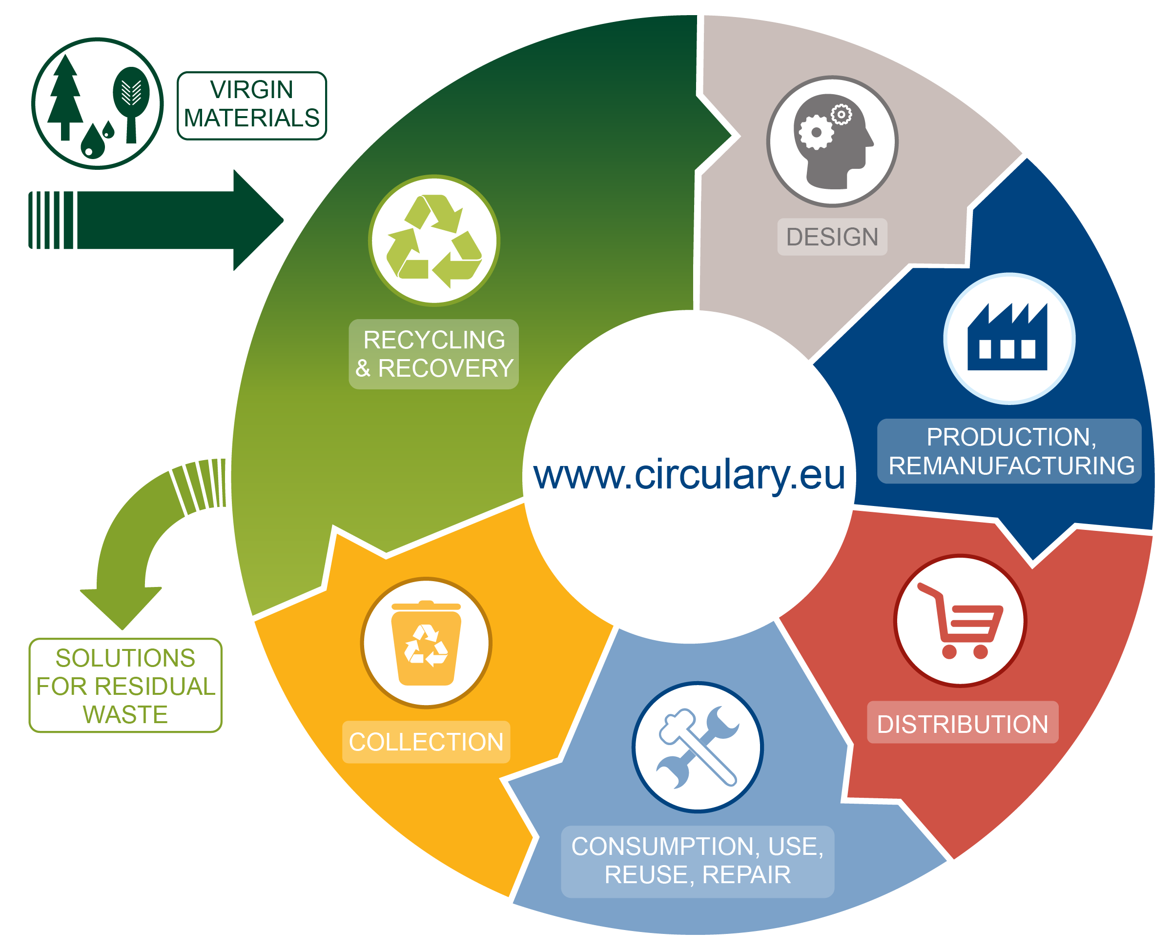
Circular Economy: Active Waste
Materials and Lifecycle Analysis Session: Radioactive Waste in a Sustainable Accelerator Facility: Chris McKay
An Introduction to the legal, economic, social and environmental challenges of radioactive waste in making a sustainable accelerator, including the lessons learnt from the ever-changing landscape of solutions from 40 years of ISIS operations.
The ISIS facility has diverted 76 tonnes of radioactive steel and copper from the historical active disposal routes.
Via appropriate routes this 76 tonnes can now enter the circular economy to be reused or recycled.
Notes:
Don’t go through all. Mention one from each. 1. Sustainable design training package. 2: 76 tonnes of active steel and copper reused or recycled. 3. Sync RF cavity upgrade. 4.Computing sustainability working group. 5. D Lab recovery project.

Slide 19
Notes:
The abstract pattern can be removed or repositioned if required. Be careful to ‘Send to Back’ so that it does not obscure any important information.

Slide 20
isis.stfc.ac.uk
@ISISNeutronMuon
STFC
Notes:
The abstract pattern can be removed or repositioned if required. Be careful to ‘Send to Back’ so that it does not obscure any important information.

