Slide 1
WP5 Beamline Instrumentation
23/11/2021

Slide 2
0-2 Year Plan
Deliverables
List of R&D requirements to enable development of monitors during years 3-5
Endstations designed for integration with beam line, monitoring systems and acoustic imaging with automated stages for cell irradiations
Wishlist/requirements from imaging group to study cellular level changes
Commisioned beamline for phase 2 experiments
Methodology
Assess current beam monitoring technology and identify the required R&D for Lhara beams
SciWire 1D planes (JM)
Gas profiler (CW)
IRRAD BPM (FR) ← contacted over the weekend
Pot of money for emerging groups
Dosimetry such as alanine, calorimeters etc. (NPL/TP)
Design environmental end stations for cell irradiations and automated handling which allow hypoxia, gas changes, automation, integration with beamline, monitoring with ionacoustic imaging (JP)
Engage with Cell Imaging community to specify requirements on in vivo cell imaging via two workshops and a white paper (RFI)
Design and construct vertical beam line and beam delivery system for testing. Will require funding external to this proposal (TP/CW/TzW)

Slide 3
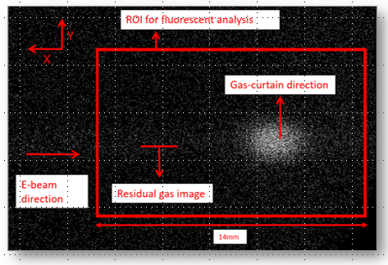
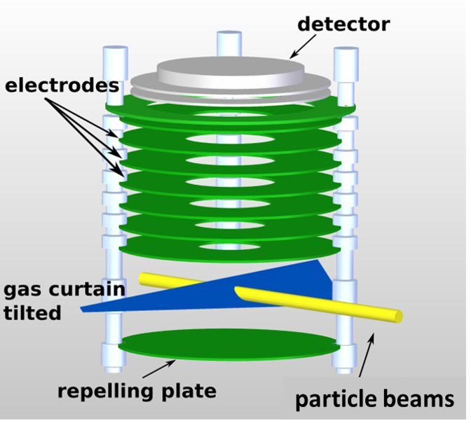
Gas profile monitor – HLLHC/Medical (CW et al)
Camera
Detector
Visible light
Phosphor screen
Phosphor screen
MCP
MCP
Electrodes
Gas jet
Proton beam
Ion extraction
High E-field
Ionization

Slide 4
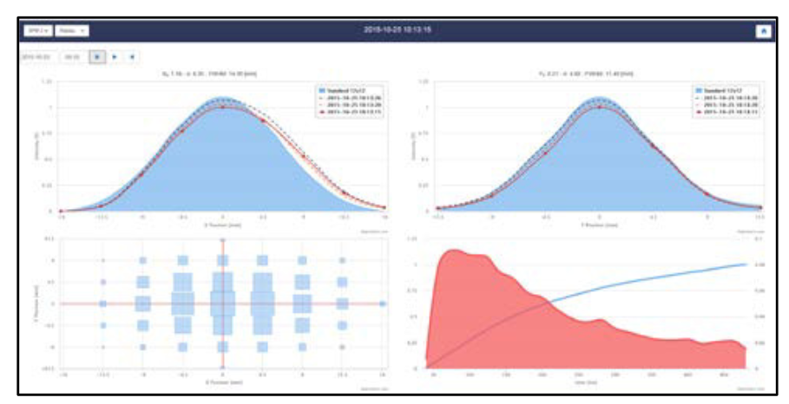
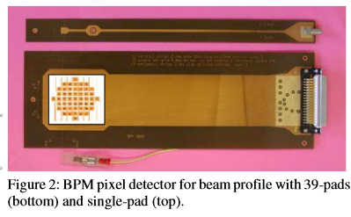
IRRAD BPM

Slide 5
3-5 Year Plan
Deliverable
Layout of Lhara beam delivery system with BPMs, magnets, dosimetry equipment locations identified and technology developed
Proven technology developed and tested which capable of monitoring Lhara beams on a pulse-by-pulse basis in real time with a plan for integration into the accelerator feedback
Demonstrate experiments using the in vivo end stations including cells and dose monitoring from WP4
Cell imaging capabilities identified and room designed to encorporate these
UoB beam line development to enable a vertical beam line with chopped/pulsed beams
Identify Phase III requirements and technical challenges.
Methodology
….. TBC

Slide 6
WP5
3-5 Year Deliverables
Layout of Lhara beam delivery system with BPMs, magnets, dosimetry equipment locations identified and technology developed
Technology developed and tested capable of monitoring Lhara beams on a pulse-by-pulse basis in real time with a plan for integration into the accelerator feedback
Demonstrate experiments using the end stations including cells and dose monitoring from WP4
Cell imaging capabilities identified and room designed to incorporate these
UoB beam line development to enable a vertical beam line with chopped/pulsed beams
Identify Phase III requirements and technical challenges.
0-2 Year Deliverables
List of R&D requirements to enable development of monitors and dosimetry during years 3-5
Endstations designed for integration with beam line, monitoring systems and acoustic imaging (WP4) with automated stages for cell irradiations
Wishlist/requirements from imaging group to study cellular level changes
Commissioned beamline for years 3-5 experiments
Camera
Phosphor screen
MCP
Electrodes
Gas jet
Proton beam
High E-field

