Slide 1






LhARA Collaboration Meeting:
Current/Future Radiobiology Research
Prof Jason Parsons
Department of Molecular and Clinical Cancer Medicine
University of Liverpool

Slide 2
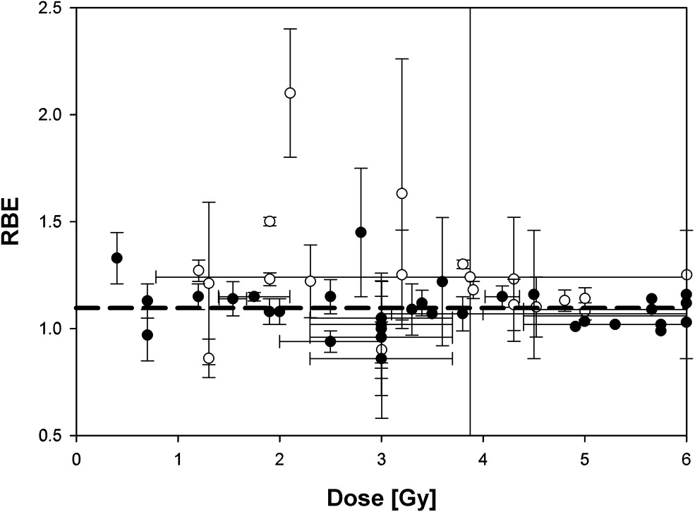
The advantages but also biological uncertainties following proton beam therapy
Tumour
Bragg peak
-in vitro
-in vivo
X-rays
Distal fall-off
Relative dose
Protons
LET (protons)
Depth in tissue
Taken from Paganetti and van Luijk (2013) Sem Rad Oncol
  Further research exploiting the biological impact of PBT is vital for establishing biological effectiveness (RBE) and optimal clinical treatment for tumours.
Vitti and Parsons (2019) Cancers

Slide 3
Current projects investigating the radiobiological impact of protons and high-LET particles
Realizing the radiobiological impact of protons and high-LET particles in head and neck cancer and glioblastoma models (NIH).
New insights into the cellular responses to complex DNA damage induced by proton beam therapy (MRC).
Improving the biological response of proton beam therapy in head and neck cancer (NWCR).
R01CA256854-01

Slide 4
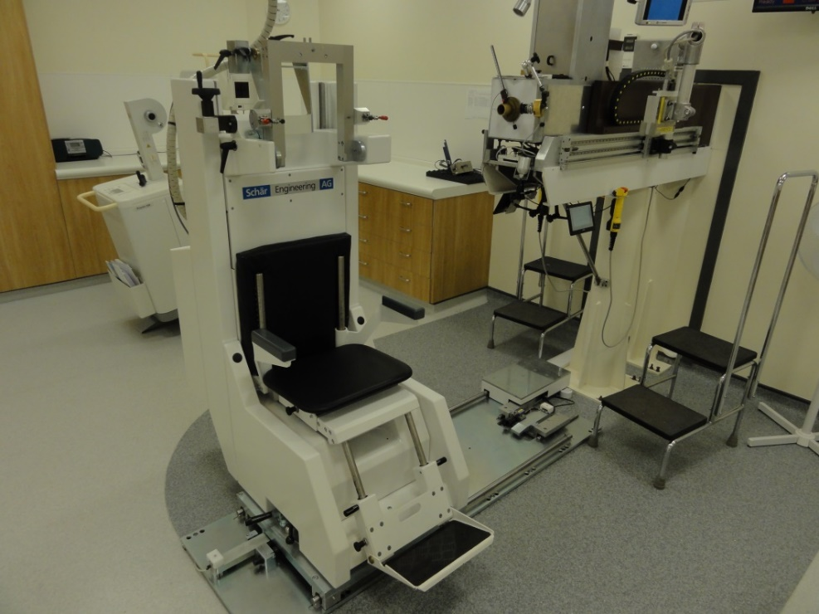
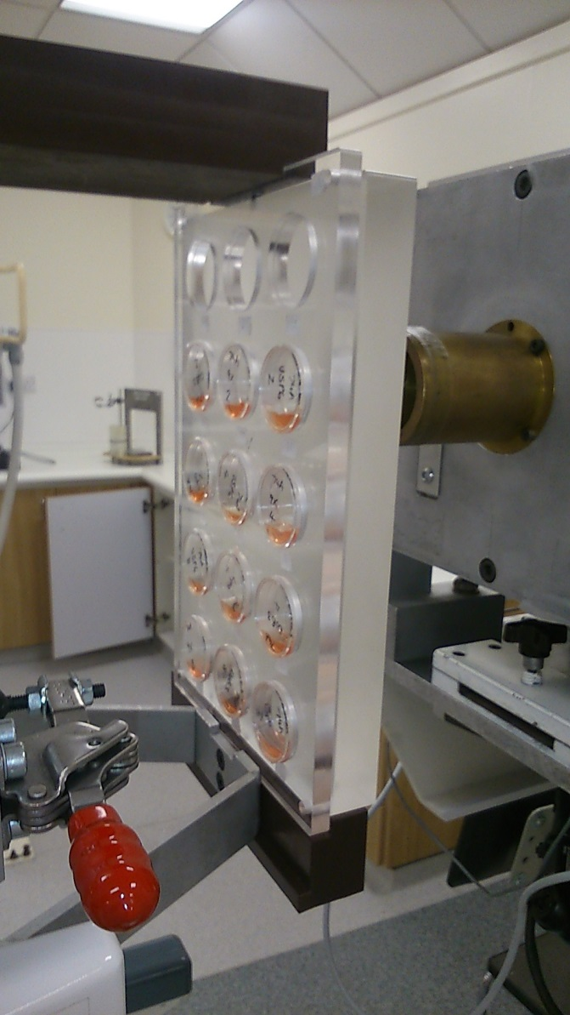
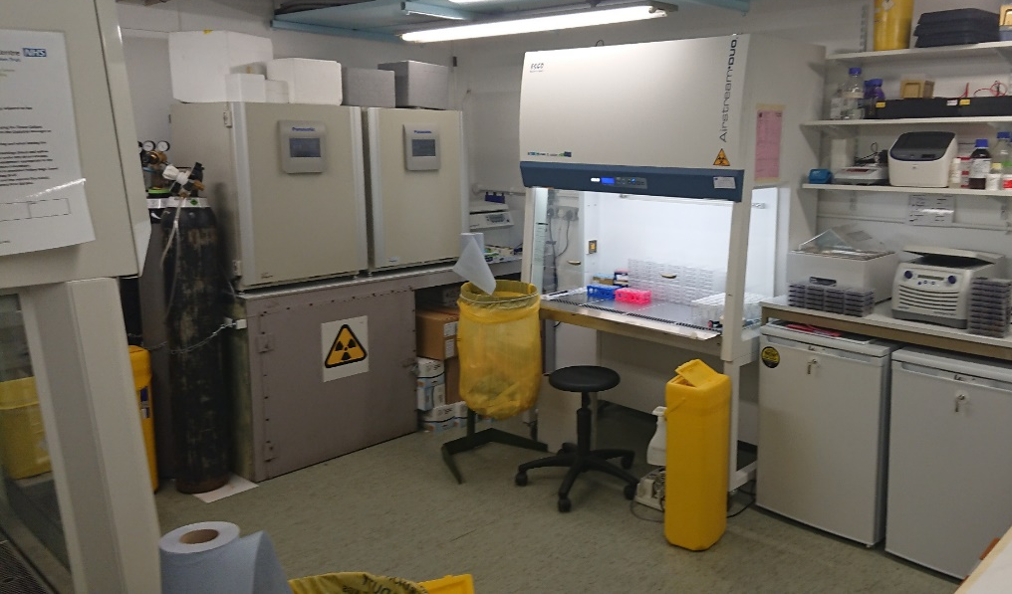
  Proton beam and radiobiology facilities at the Clatterbridge Cancer Centre (CCC)

Slide 5
  “Relatively” high-LET protons cause a decrease in HNSCC cell survival due to CDD formation compared to low-LET protons
  UMSCC74A
Alkaline (SSB)
Enzyme-modified (DSB+CDD)
160
*
****
140
*
120
***
CDD
100
*
80
**
***
  SF2, p<0.02; RBE=1.7
60
**
  UMSCC6
40
20
0
  *p<0.005, **p<0.002, ***p<0.001
  *p<0.02, **p<0.01, ***p<0.005, ****p<0.001
  SF2, p<0.01; RBE=1.9
  58 MeV (1 keV/μm); 11 MeV (12 keV/μm)
  Carter et al., (2018) Int J Rad Oncol Biol Phys
  Fabbrizi et al., (2021) Methods Protoc

Slide 6
Modulation of proton-induced cellular sensitivity following DUB siRNA knockdown
58 MeV protons
  HeLa
11 MeV protons
  Carter et al., (2019) Int J Rad Oncol Biol Phys
  Nickson, Fabbrizi et al., (2021) Front Oncol

Slide 7
Targeting PARP-1 synergies with relatively high-LET protons in promoting cancer cell killing
  HeLa
11 MeV
  *p<0.01, **p<0.005, ***p<0.001
58 MeV
  Carter et al., (2019) Int J Rad Oncol Biol Phys

Slide 8
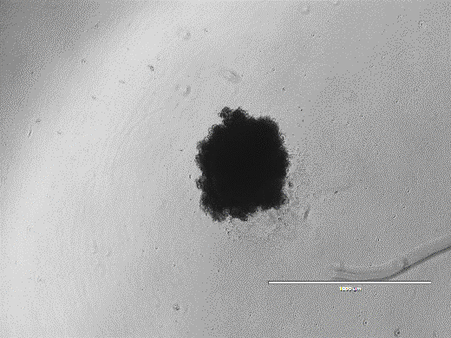
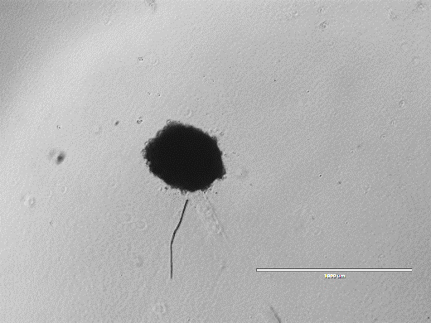
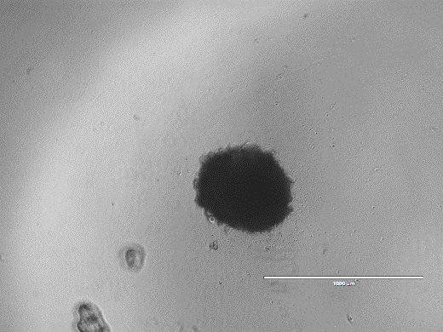
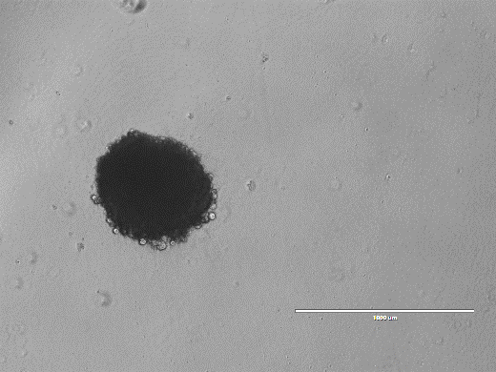
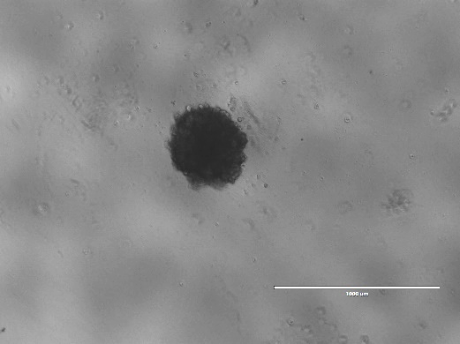
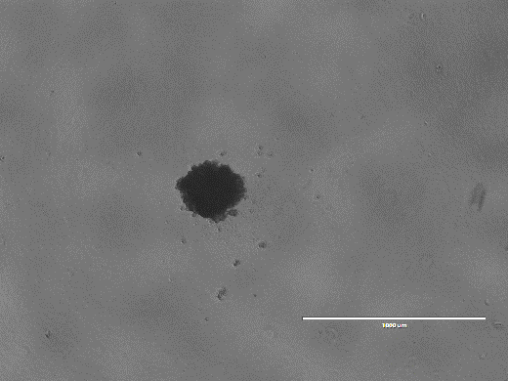
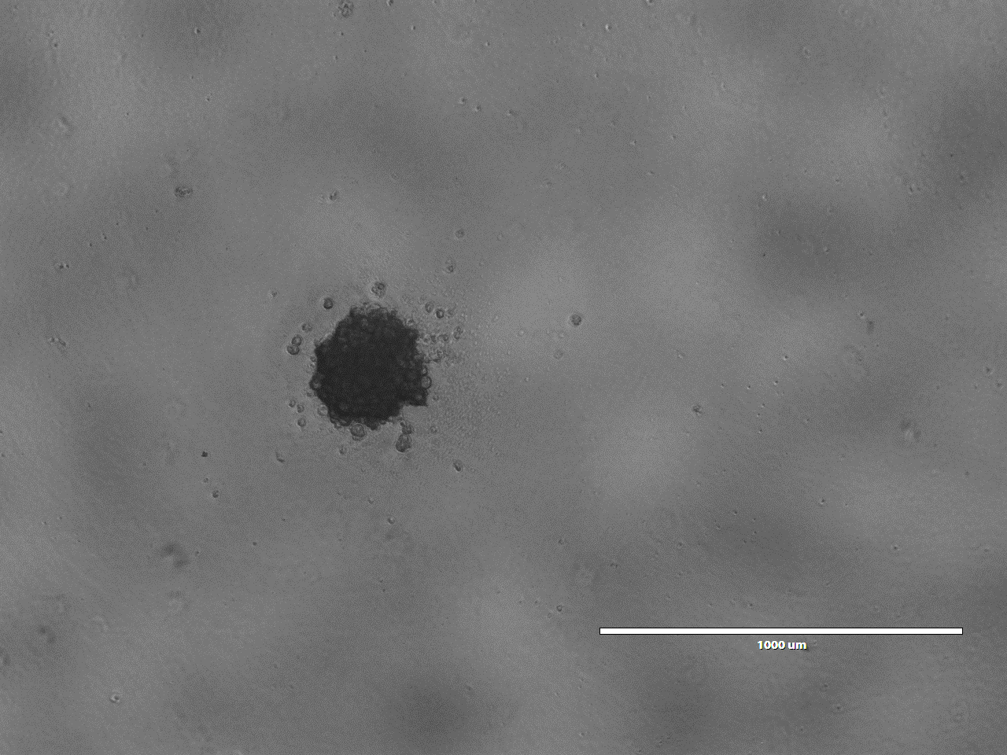
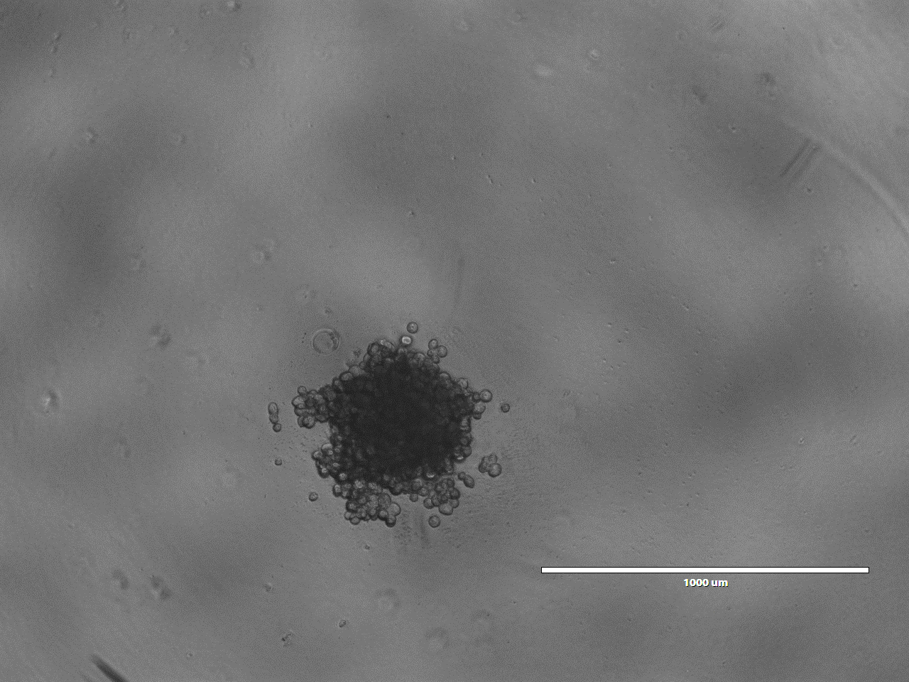
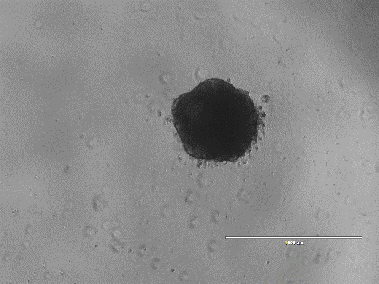
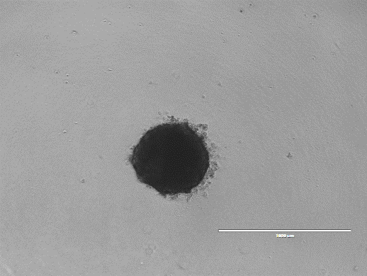
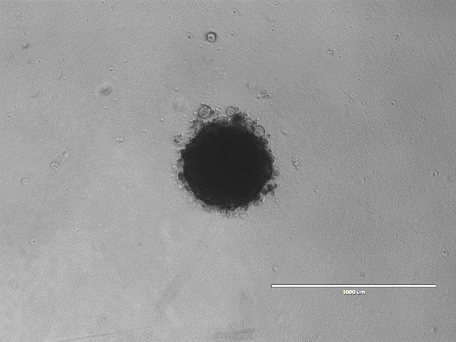
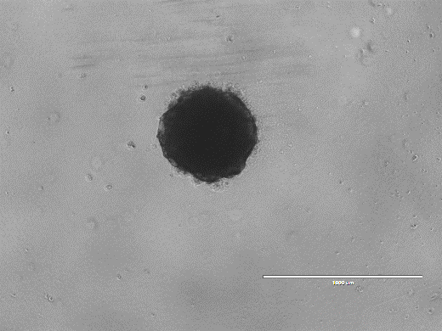
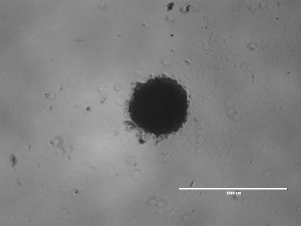
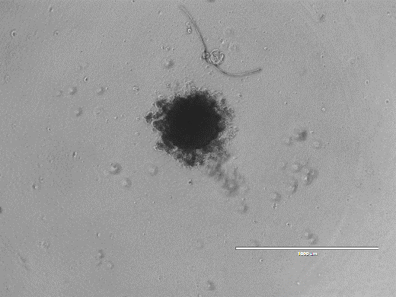
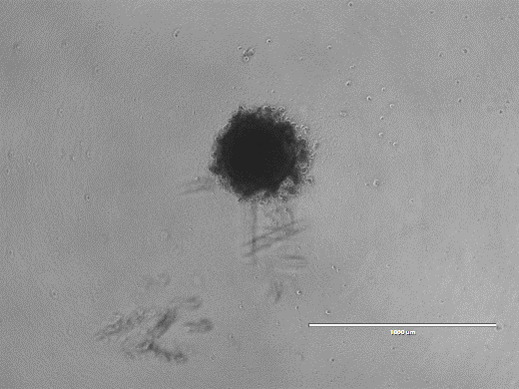
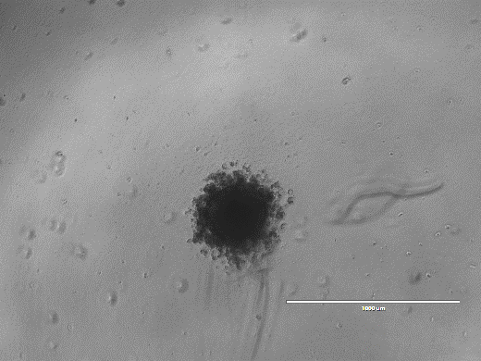
Targeting DNA double strand break repair can enhance radiosensitivity of 2D/3D HNSCC models to photons and protons
X-rays
Protons
  UMSCC6
  UMSCC74A
  UMSCC6
  UMSCC74A
Day 10
Day 10 + X-rays
Day 3
Control
DMSO
ATMi
ATRi
DNA-Pkcsi
DMSO
ATMi
ATRi
DNA-Pkcsi
UMSCC74A
UMSCC6
Vitti and Parsons (2020) Cancers

Slide 9
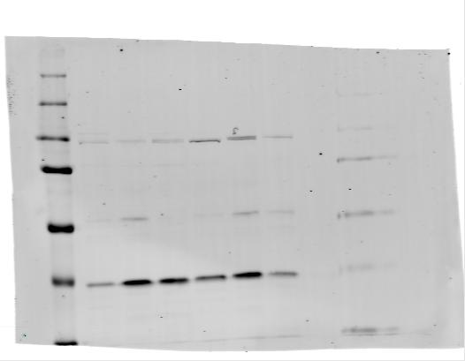
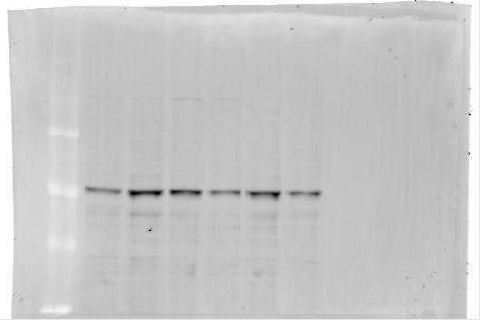
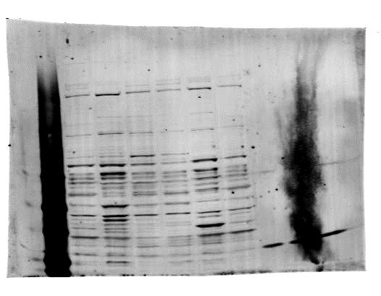
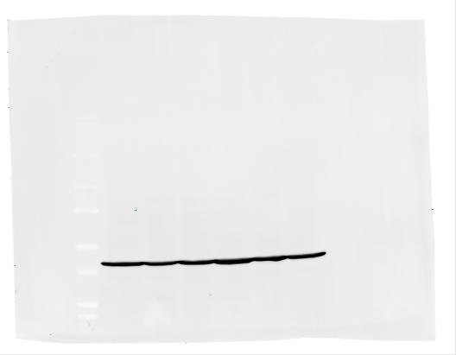
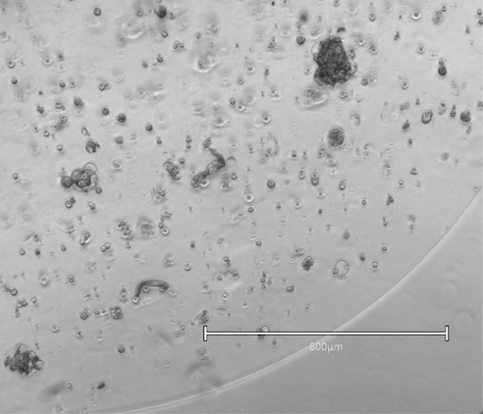
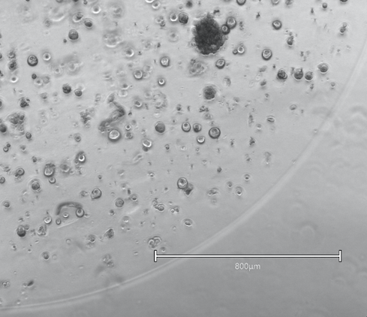
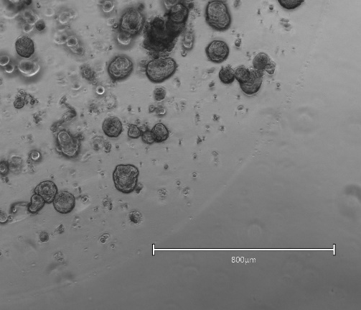
PARP inhibitors can enhance radiosensitivity of 3D spheroids of HNSCC to photons and protons
X-rays
Protons
  Detroit 562
  UMSCC74A
  Detroit 562
  UMSCC11B
  ****p<0.001
  FaDu
  UMSCC6
  A253
RAD51
CHK1
ATR
Actin
1.0
4.9
2.9
1.4
3.4
1.1
RAD51/ actin ratio
*
**
***
***
**
*
***
**
  *p<0.05, **p<0.001, ***p<0.0001
Day 1
Day 4
Day 8
T1 organoid at Days 1-8 (Emma Melia) Collaboration with Else Driehuis and Hans Clevers
Zhou et al (2022) Front Oncol

Slide 10
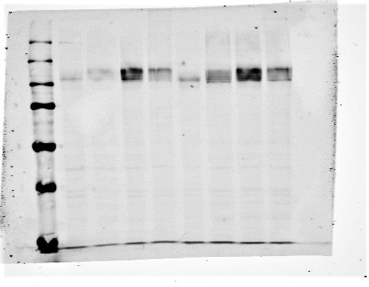
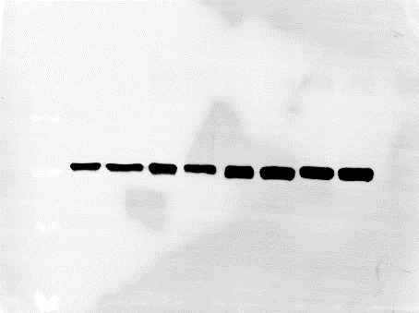
Hypoxia induces significant radioresistance in HNSCC and GBM cells in a HIF-dependent manner
UMSCC6
FaDu
E2
R15
UMSCC6
UMSCC6
FaDu
UMSCC6
UMSCC74A
N
3
6
24
N
3
6
24
HIF-1α
Tubulin
  Hill et al., (2022) Cancers
  Hill, Frost, Rocha et al., (Unpublished)
R01CA256854-01

Slide 11
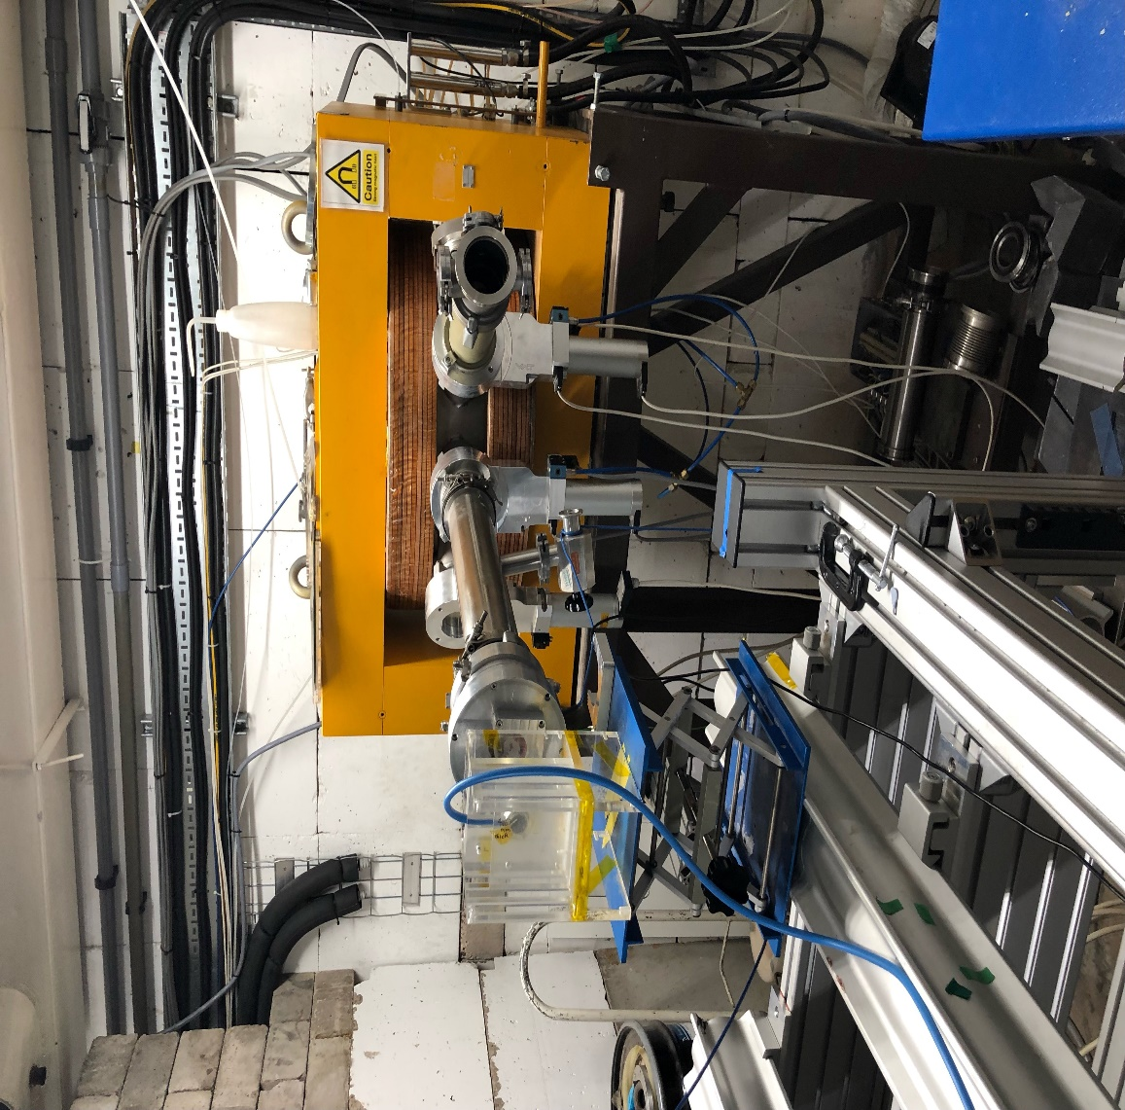
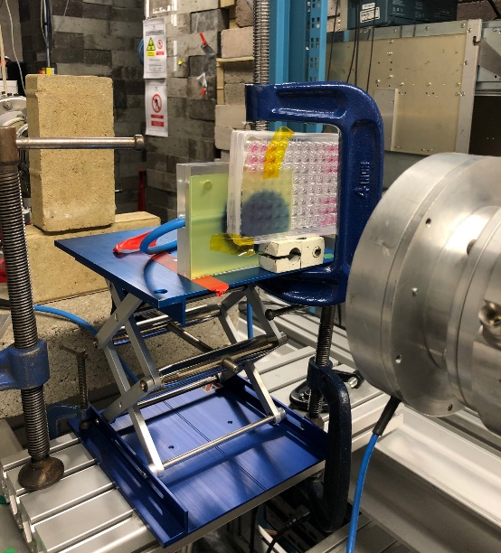
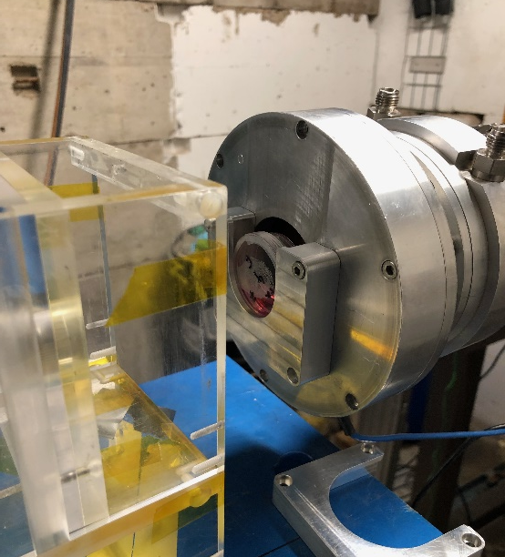
Examining the radiobiology of FLASH high-LET radiation.
Using ultra high-dose rates (>40 Gy/s; versus ~5 Gy/min).
FLASH stimulates normal tissue sparing.
Mechanism of action unclear (oxygen, radicals or metabolism?).
Opportunity for utilisation of FLASH protons/particles.
  Collaborations with Stuart Green, Tzany Wheldon, Ben Phoenix and Kristoffer Petersson
  Favaudon et al (2014) Sci Trans Med
  Bourhis et al (2019) Radiother Oncol
  Vozenin et al (2018) Clin Cancer Res
R01CA256854-01
  Hughes and Parsons (2020) Int J Mol Sci

Slide 12
Some key biological questions to be addressed
More substantial investigations into the radiobiology of particle ions with increasing LET in defined 2D/3D preclinical normal/tumour model systems.
To investigate novel beam delivery (e.g. FLASH and minibeams) and to define the biology behind these phenomenon.
Examine clinically-relevant dose fractionation experiments in relevant in vitro and in vivo preclinical models.
Investigate combinatorial treatments (e.g. targeted DDR/IO drugs and inhibitors, perform high-throughput screening experiments) for tumour radiosensitisation and normal tissue radioprotection.
More effective and efficient translation of radiobiology research into particle ions from the lab and into the clinic for patient benefit.

