Slide 1
LhARA IAB Review Accelerators and Technology WP3: Proton and ion capture
Christopher Baker
(on behalf of WP3)

Slide 2
Capture work package
Holistic approach to project, with feedback and synergy
Take output from upstream components, laser source (see WP2), as input
Tailor beam as required for transfer line capabilities (see WP6) and end-station requirements (WP4, WP5)

Slide 3
Beam parameters for Capture section
See WP2 & WP6 for details
 | Input | Output
Energy range | 0 – 20 MeV | 13 – 17 MeV
Divergence | 50 mrad | ~1E-6 mrad
Flux (proton no. / pulse) | 10¹⁰ | >10⁹
Radius | <1 cm | <4 cm
Length | ~8ns | ~8ns
Repetition rate | 10 – 1000 Hz | 10 – 1000 Hz

Slide 4
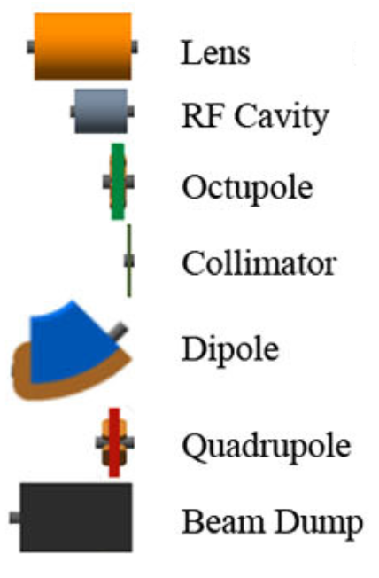
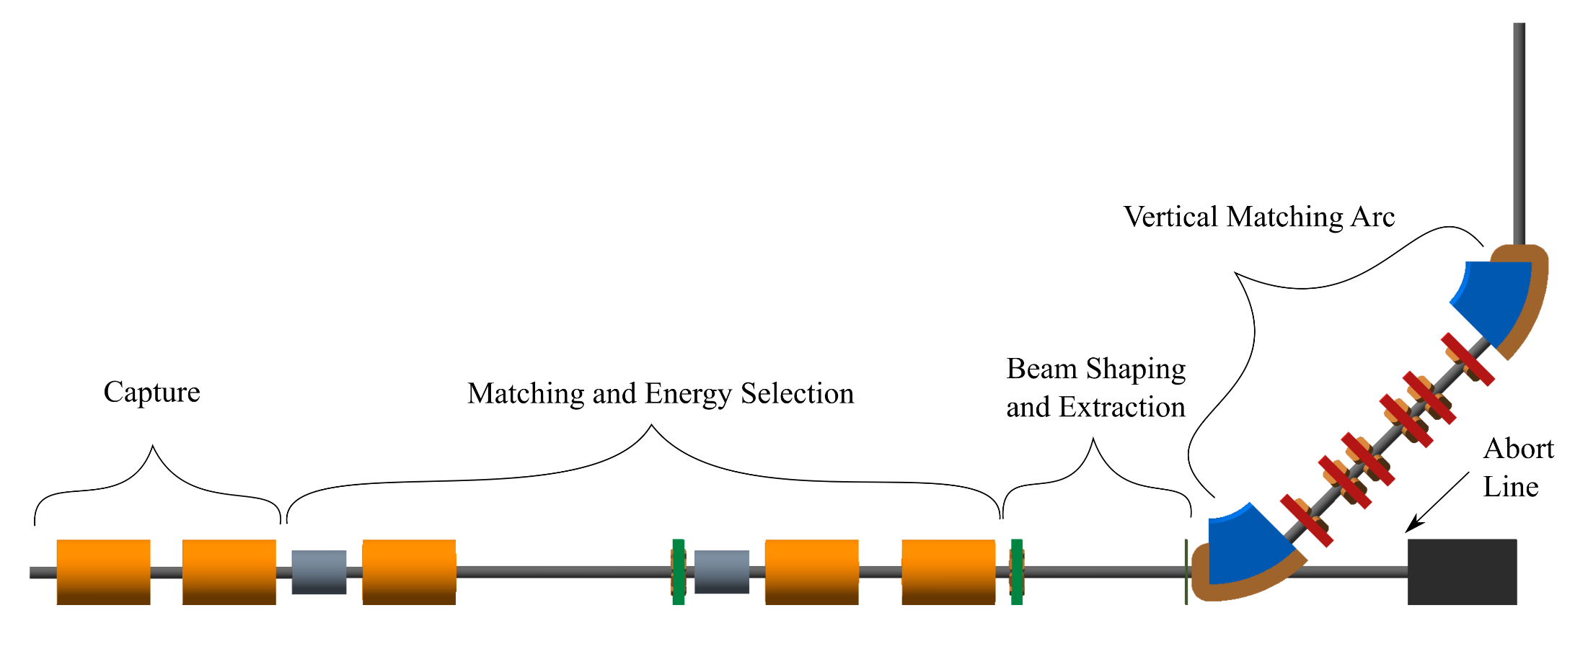
Capture system overview (see WP6)

Slide 5
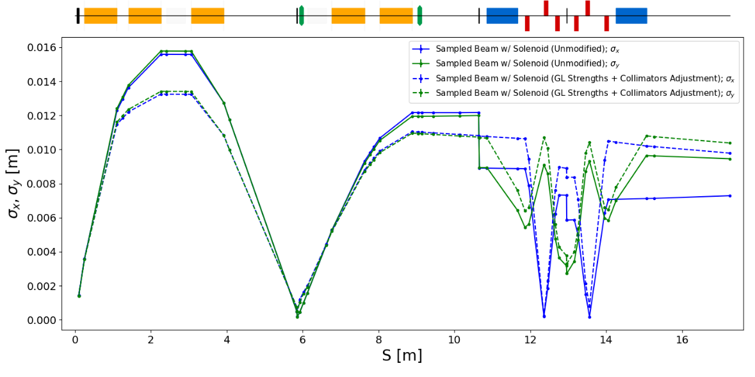
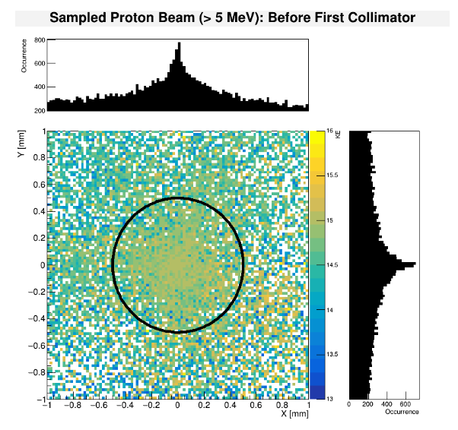
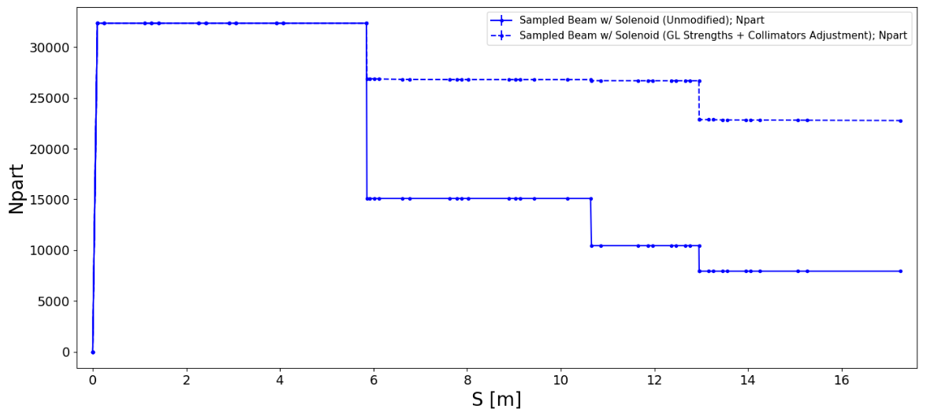
Simulations - Beam
Particle tracking
BDSIM, GPT, VSIM
Ideal behaviour, approximated, & simulated fields
HT Lau PhD Thesis Imperial College London (2021)

Slide 6
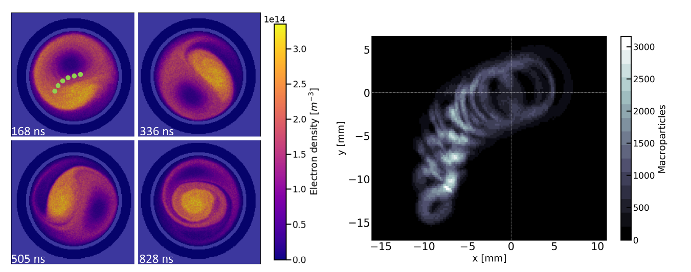
Simulations – Plasma
Appl. Sci. 11 4357 (2021)

Slide 7
Lenses - Magnetic field (solenoid)
Focussing strength proportional to magnetic field strength (current density)
Normal conducting or Superconducting options
Non-trivial design – Windings, thermal, jackets, etc.
Financially expensive – Materials, specialists
Power intensive – Electrical and cooling
Limited flexibility
Well known technology
Commercially available
Risk mitigation programme includes preliminary solenoid design efforts

Slide 8
Lenses - Electric field (plasma), Gabor Lens
Focussing strength proportional to plasma density
V. high E-fields (& hence focussing strengths) possible
Dictated predominantly by applied voltages
Existing Gabor lens attempts use high-temperature discharge plasma
Shot-by-shot synchronised with ion source
Each plasma is quasi-stable
Plasma established by limited control of initial conditions
No known successful implementation despite many decades of effort
Proposed Gabor lens will take a different approach & build upon knowledge of equilibrated non-neutral plasmas

Slide 9
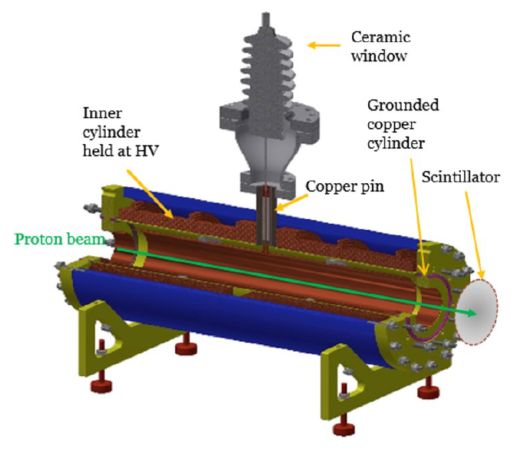
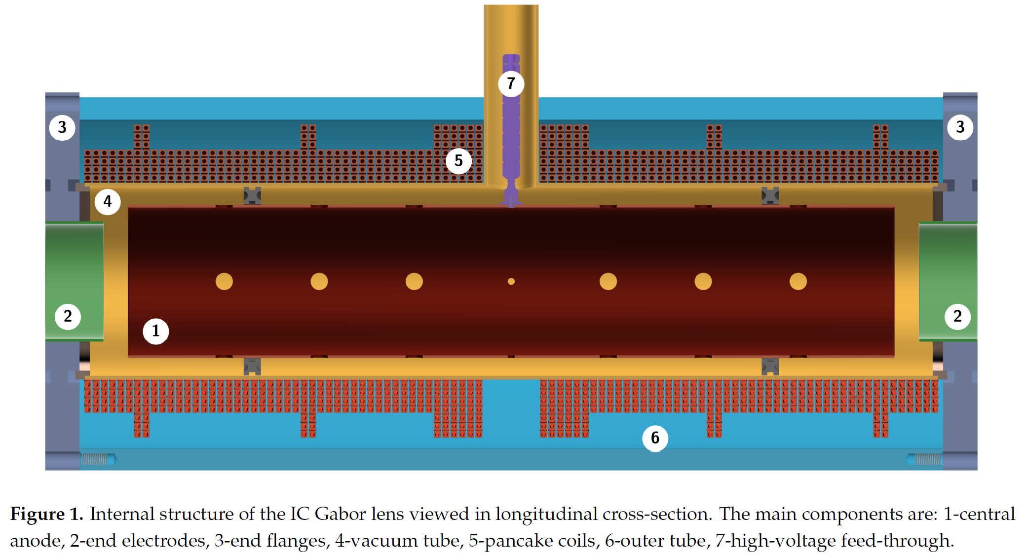
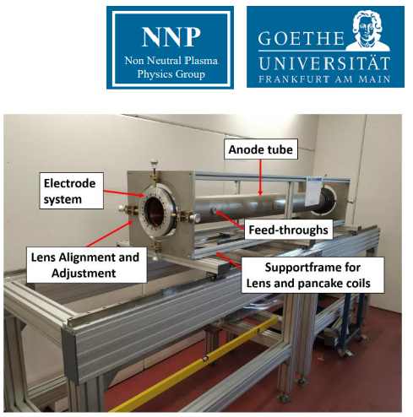
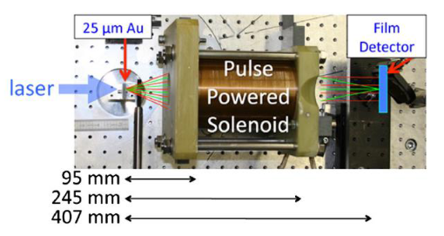
Existing experimental lens efforts
Appl. Sci. 11 4357 (2021)
Proc. IPAC2016 TUPMY024
Ecloud ‘18 Proc. 143 (2020)
Phys Rev STAB 14 121301 (2011)

Slide 10
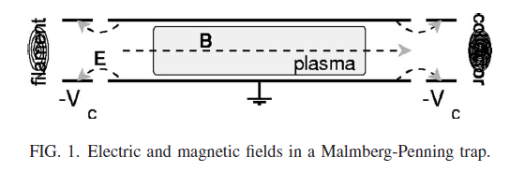
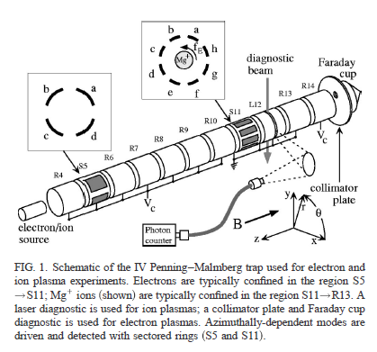
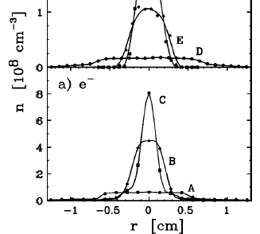
Existing non-neutral plasma
Rw = 2.86cm
(Rp/Rw < 0.2)
10¹⁴ – 10¹⁵ m⁻³

Slide 11
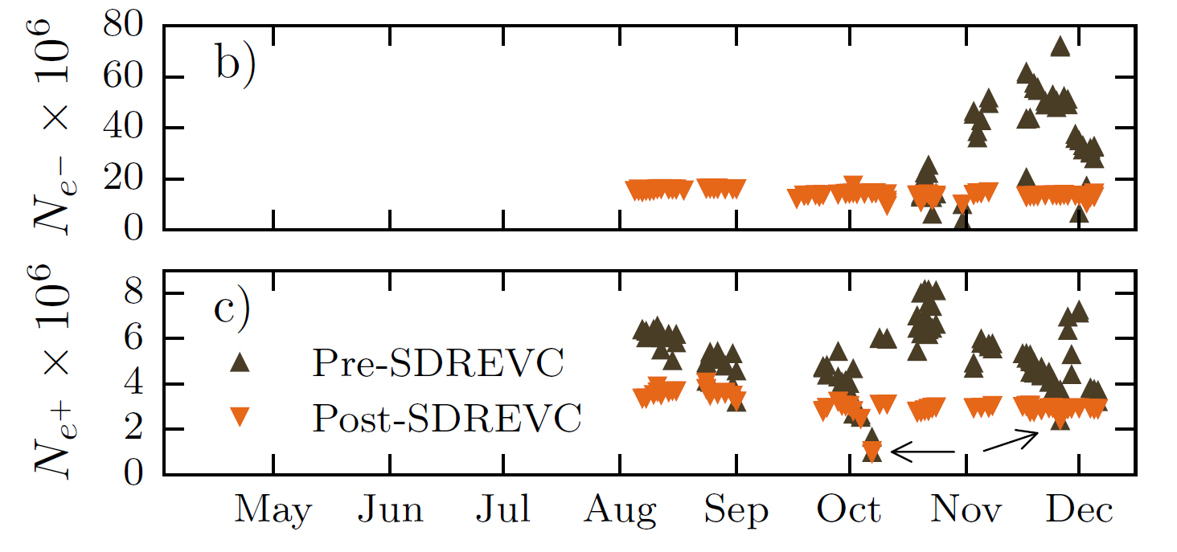
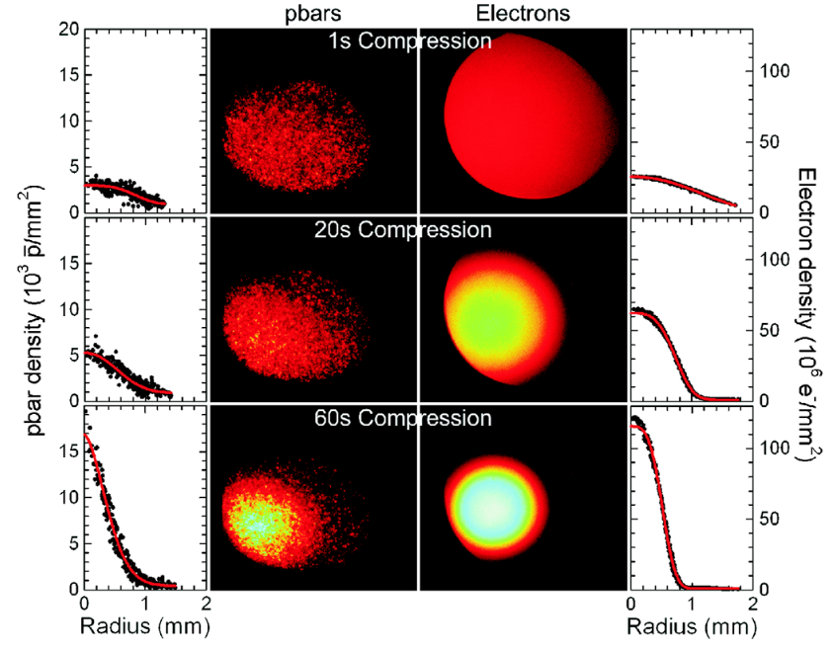
Existing plasma in ALPHA at CERN
10¹³ – 10¹⁴ m⁻³
Length ~ 10 cm
Radius ~ 0.5 mm (at 1T)
Density 10¹² -10¹⁴ m⁻³
Phys Rev Lett 120 025001 (2018)

Slide 12
Plasma parameters
 | Preliminary | Pre-construction | Final
Diameter | 1 cm | 3 cm | 3.5 cm
Plasma Length | 10 cm | 1 m | 1.2 m
Density | ~10¹³ m⁻³ | 5x10¹⁴ m⁻³ | 5x10¹⁵ m⁻³
Space-charge potential | 20 V | 2 kV | 50 kV
Focal length | 1000’s m | 10’s m | 1 m
B-field | 0.03 T | 0.1 T | 0.15 T
Iterative & parameterised approach in preliminary & pre-construction phases

Slide 13
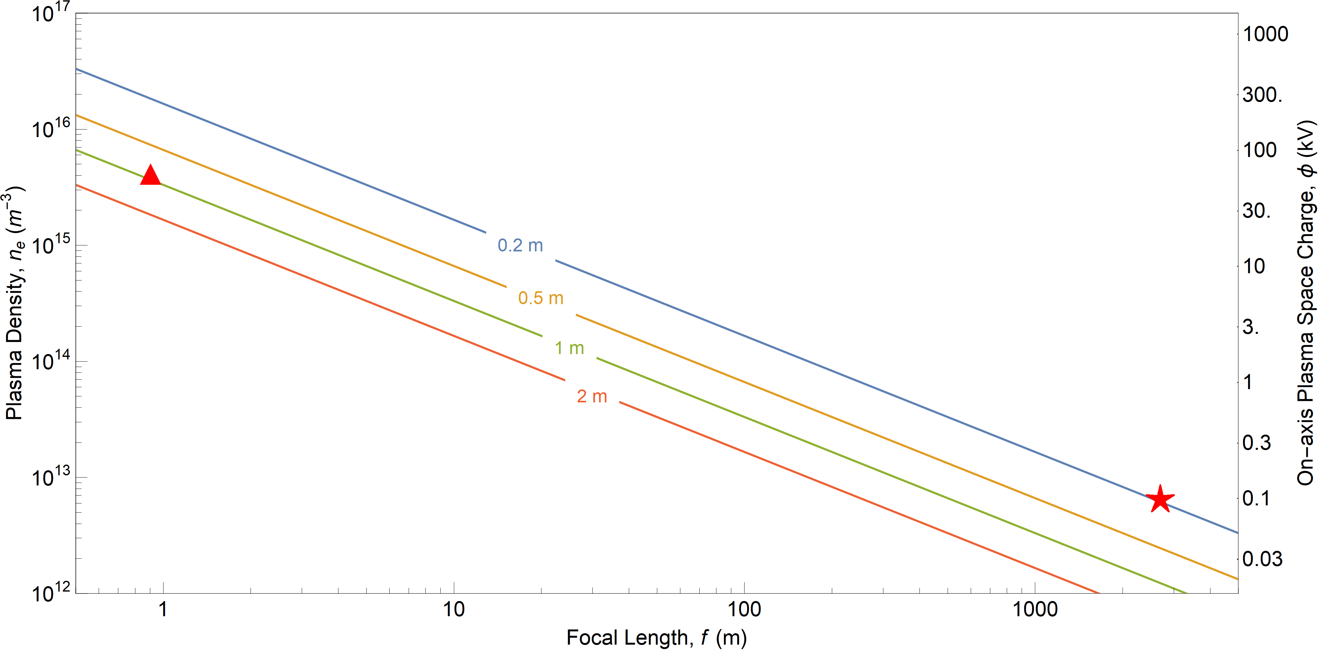
Plasma parameters
final
preliminary

Slide 14
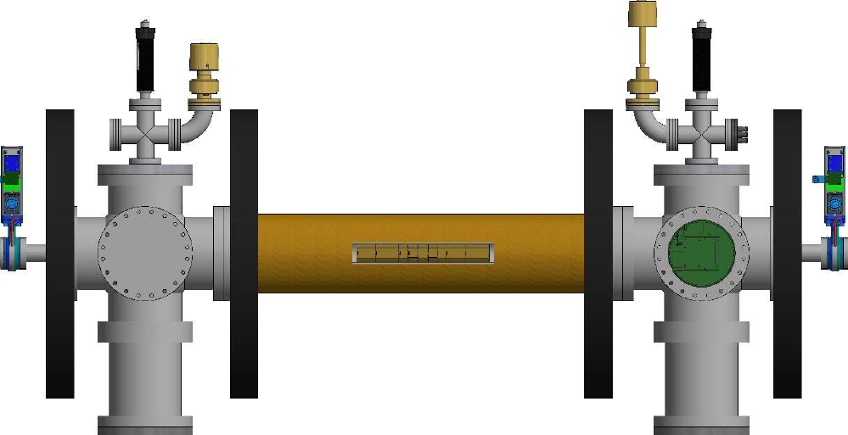
Current Apparatus (preliminary activity)
MCP/P-screen
$e^{−}$ source
$e^{−}$ source
Solenoid
B$\sim 30 mT$
Electrodes
4.1 cm
28.1 cm

Slide 15
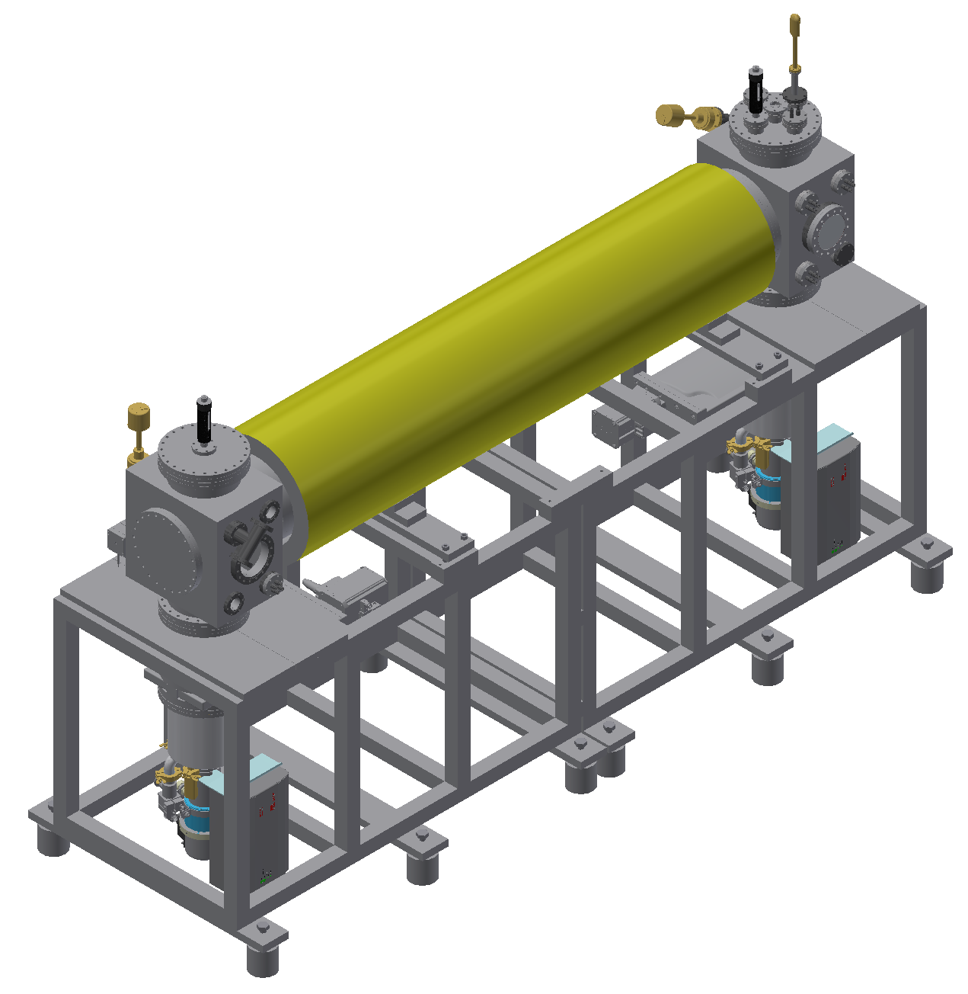
Proposed Apparatus (preconstruction phase)
$e^{−}$ source
B~0.1T
P-screen
~2m
Electrodes

Slide 16
R&D Philosophy
Cautious approach
Built upon decades long experiences
Iterative approach
Confirm simulation methods & feedback into multiple designs & apparatus upgrades
Vary single parameter (as far as possible)
Analyse using Machine Learning due to correlations
Confirm ‘known physics’ (scaling laws) in new apparatus

Slide 17
Risks / mitigations
Being unable to create a suitable plasma:
Density
Size (radius, length)
Timescales
Possible technical/engineering solutions
Utilise inbuilt redundancy – e.g. Increase confining fields, compartmentalise plasma
Modify designs – e.g. Increase apparatus size
Should be identified in simulations!

Slide 18
Lens options
End of preconstruction phase report to provide recommendation
Why not implement magnetic from outset?
Magnetic lens implementation as challenging as electric lens
Electric lens lay some groundwork (magnet design)
Limited magnetic vs. significant electric flexibility
Significant lifetime cost savings using electric
Significant technology transfer opportunities for electric

Slide 19
Resources
Current ITRF Scoping project provides limited preliminary activity resources
Enables profitable studies for preconstruction phase apparatus design
Limited by one junior postdoctoral researcher
Enough for 4 FTE personnel!
Existing apparatus at Swansea (& internationally) to be employed for studies
Existing international expertise employed for efficiency
Timeline identifies years 2, 5 (& 7) as critical
Resource shortfall early can be recovered at later stage (at non-linear & higher integrated cost)

Slide 20
WP3 Personnel
W. Bertsche
M. Charlton
S. Eriksson
T. Dascalu
J. Fajans
J. Wurtele
B. Bingham
R. Hugtenburg
J. Purden
A. Knoll
E. Bennet
PDRA, etc.

Slide 21
Summary
Breadth of personnel & support to ensure success of work package
Experimental, theoretical, medical, plasma, and accelerator physicists
HPC and supercomputer engineering support
Mechanical engineering support
No known fundamental issues foreseen
Decades of large project experience
Significant experience developing non-neutral plasma, and techniques, for both study and use
Recognise risks and challenges (and opportunities)
associated with taking different approach
associated with advancing individual non-neutral plasma aspects
associated with combining many state-of-the-art aspects
current non-ideal funding profile also increases overall risk

Slide 22
Questions?

Slide 23
Additional slides

Slide 24
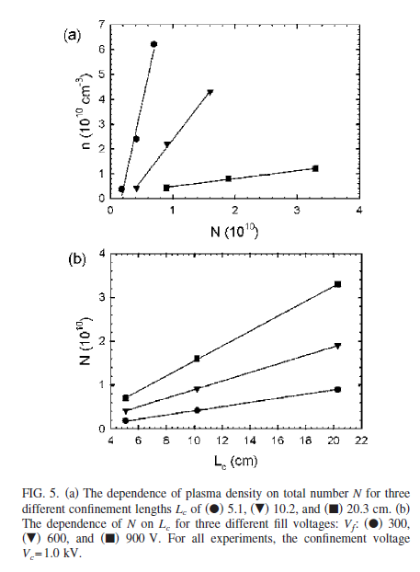
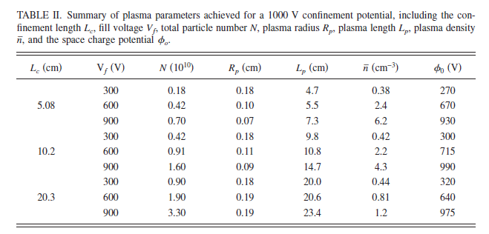
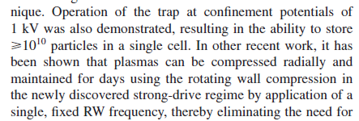
Storage
10¹⁵ – 10¹⁶ m⁻³
Rw = 1.27cm
(Rp/Rw<0.2)
Notes:
Densities comparable to Gabor lens, but at shorter lengths!
20% fill factors
Stored ‘unchanging’ for days at ~kV, Tesla fields

Slide 25
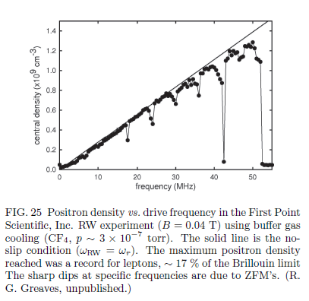
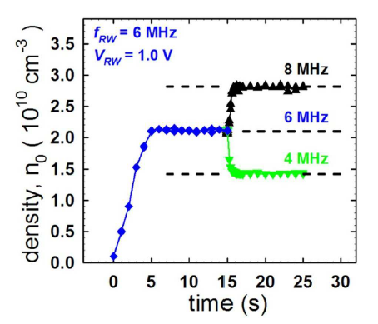
Interrogation & control
10¹⁴ – 10¹⁵ m⁻³
Notes:
Densities comparable to Gabor lens, long lifetime (although unspecified, likely annihilation limited by cooling gas)

Slide 26
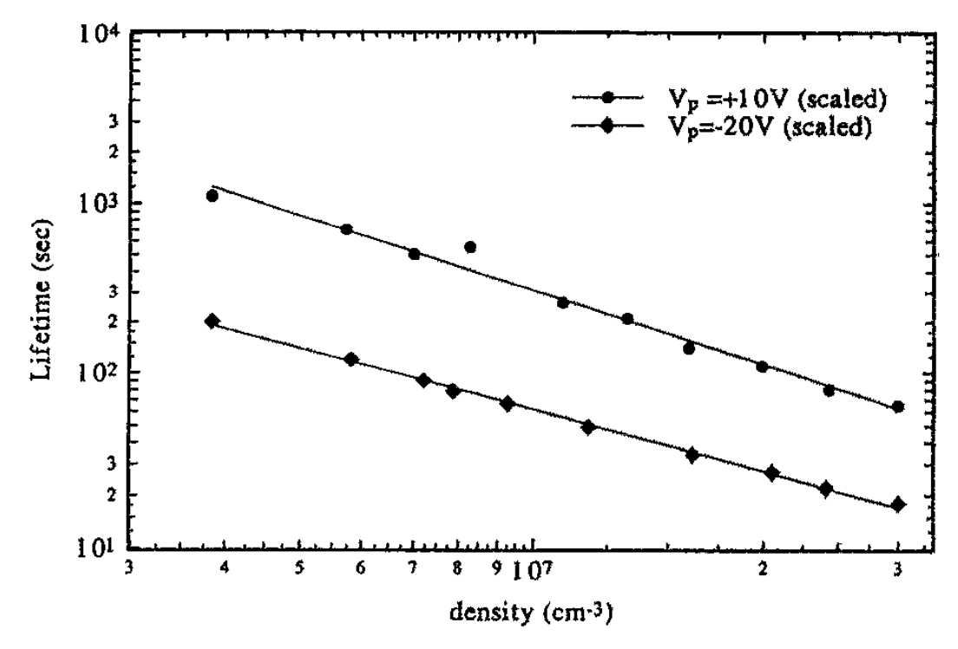
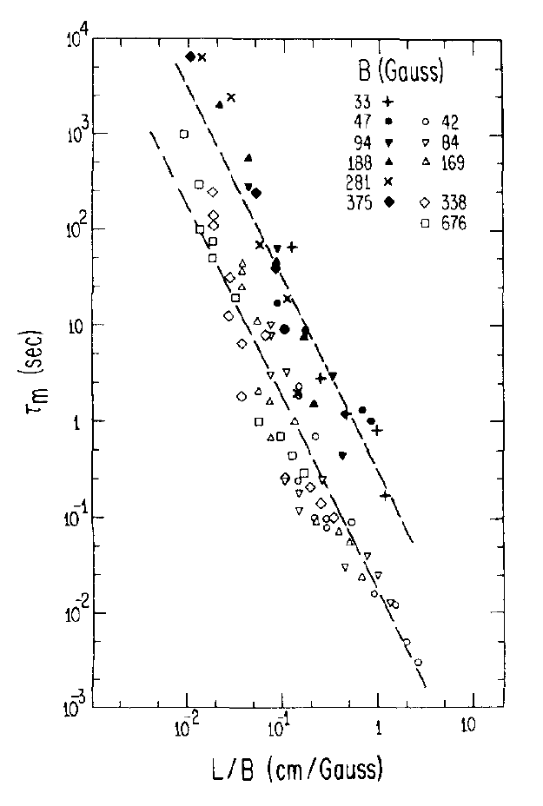
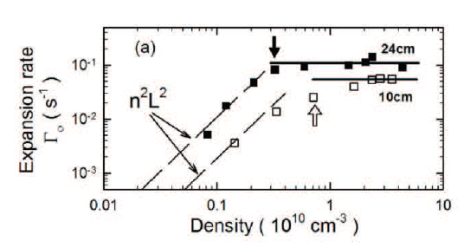
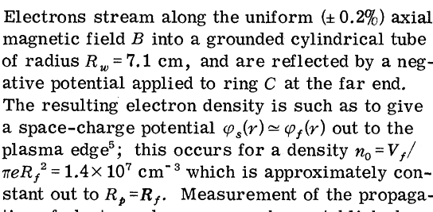
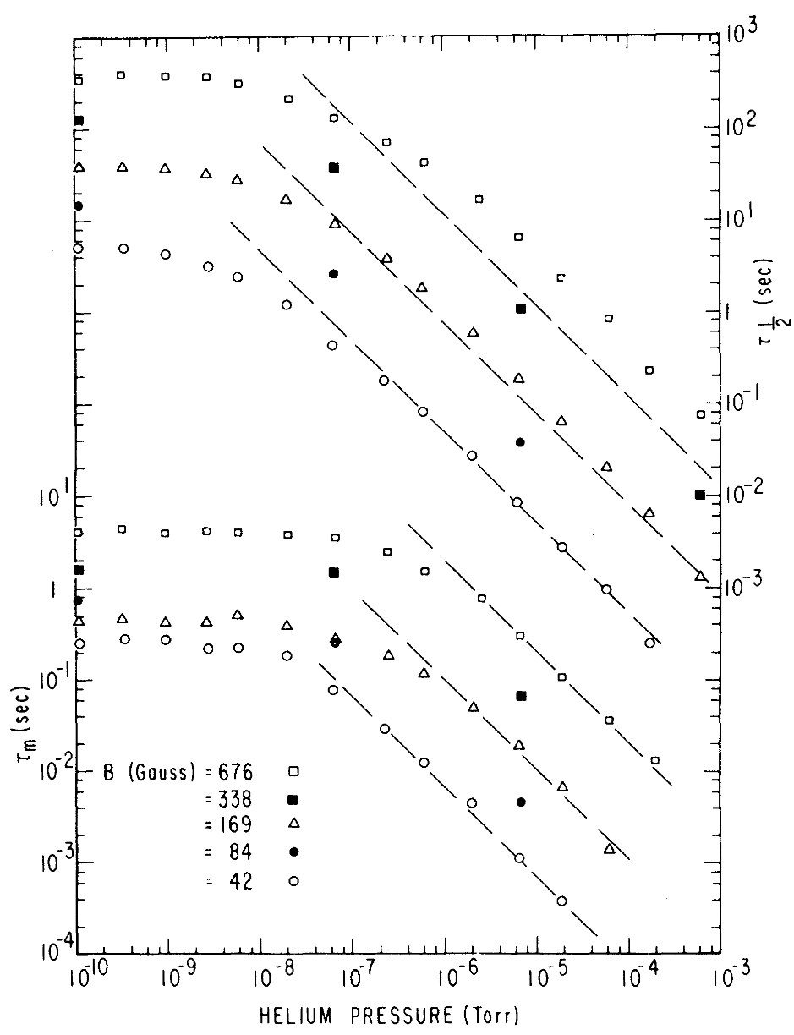
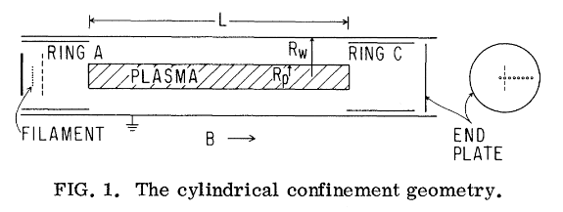
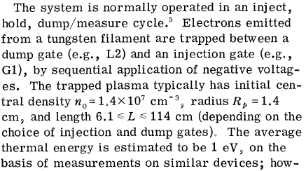
Lifetimes (static)
Rp/Rw ~0.2
Phys. Rev. Lett. 50 167 (1983)
Phys. Plasmas 1 1123 (1994)
Phys. Rev. Lett. 44 654 (1980)
Phys. Fluids 29 2015 (1986)
Notes:
Low density (~10^13 m^-3), low field (<kG), low pressure, low fill-factors (<20%)
Metre-lengths studied
Previously illustrated homogeneity improvement (somewhat uncharacterised) x50 lifetime

Slide 27
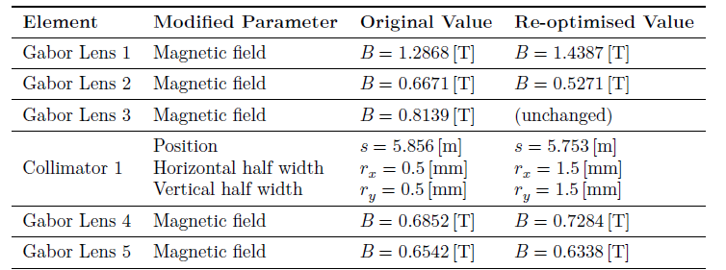
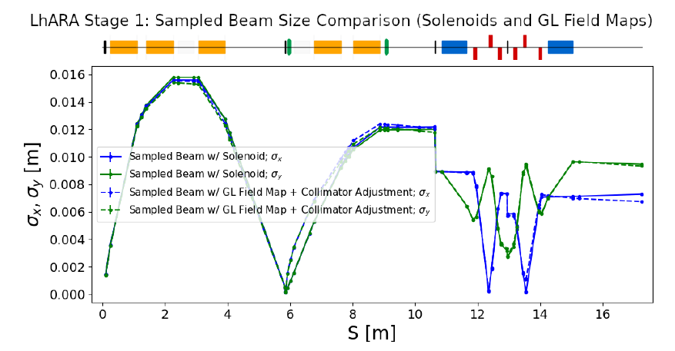
Solenoid requirements
1st solenoid most demanding
$\int{Bdz=1.233 Tm}$
Choose nominal design with 1 m long coil (Gabor lens flange-to-flange space is 1.157 m)
Solenoids 2 to 5
Different design (for lower material cost, power consumption)
$\int{Bdz≤0.8 Tm}$
Equivalent field of a solenoid

Slide 28
Choice of material
Normal conducting
Superconducting
(Hollow copper conductor)
Very common design in many accelerator magnets
Efficient cooling
water in direct contact with the source of heat
Coils potted in resin are typically very robust
Each cable has to be insulated
adds complexity and requires more space
Weight of the coils is typically high
Cooling and electric circuits are interwoven, but need separation at the their ends
pressure drop leads to complex cooling circuits for large coils + increased risk of water leakages
Very high current density compared to conventional conductors
Negligible power consumption
Complicated structure: rigid coil former + insulating cryostat (large space requirement around the coil)
The cryostat/cooling infrastructure needs careful maintenance
Cost of superconducting coils is significantly higher than the cost of conventional conductor
Aim of this design exercise: evaluate the requirements and performance of a normal-conducting solenoid that is suitable for LhARA

Slide 29
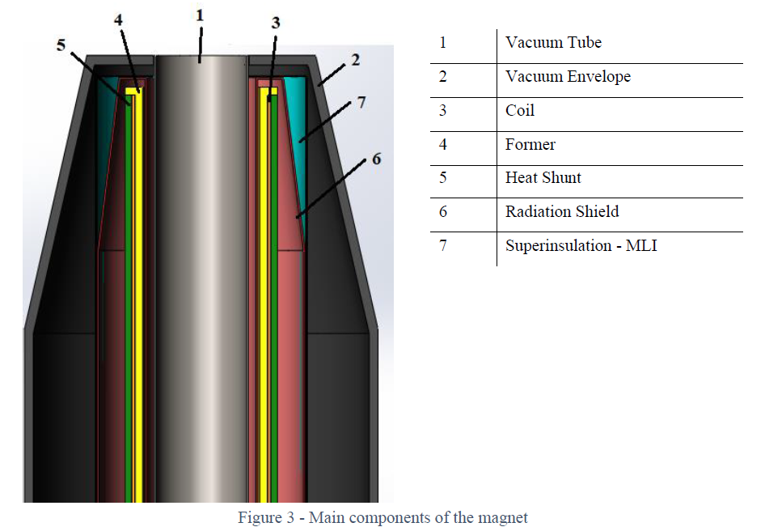
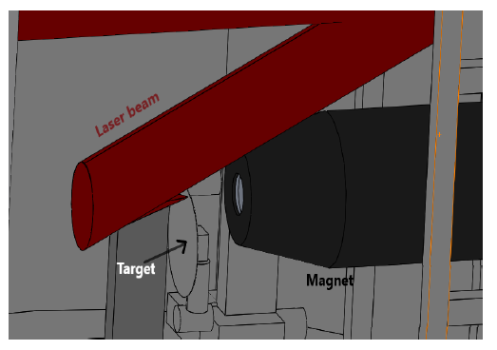
SC solenoid for LhARA
Preliminary design and analysis (A. Beqiri)
Nb-Ti
2-stage cryo-cooler ($\sim$45 W)
Coil: 1 m, 1.3 T, 250 A, 2 layers

Slide 30
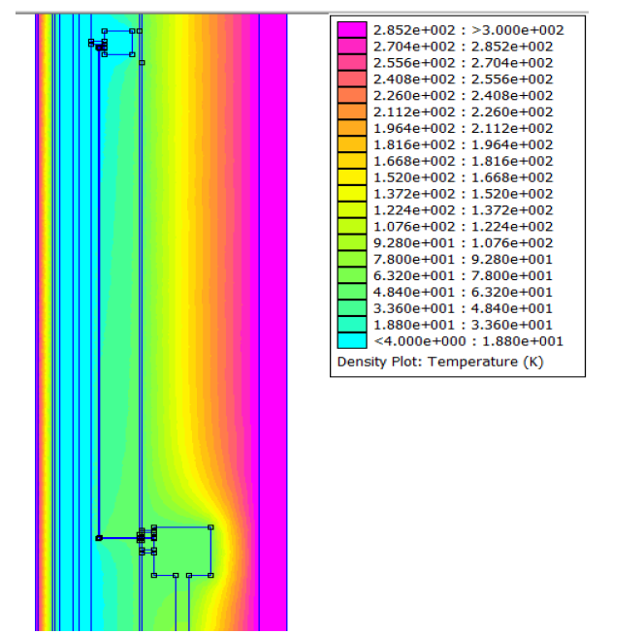
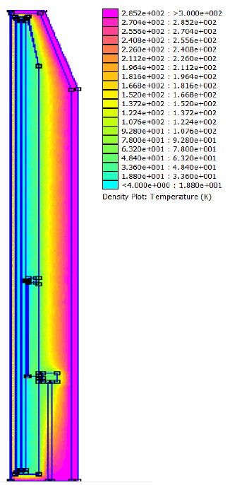
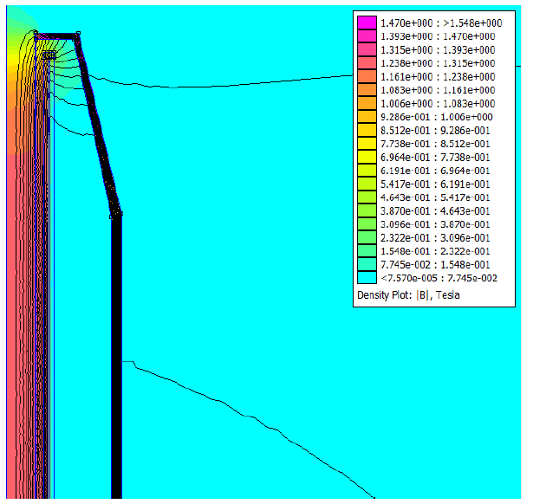
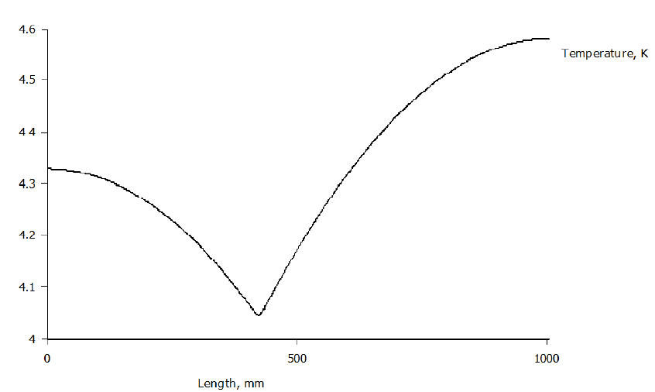
SC solenoid for LhARA
2-D magnetic and thermal model

Slide 31
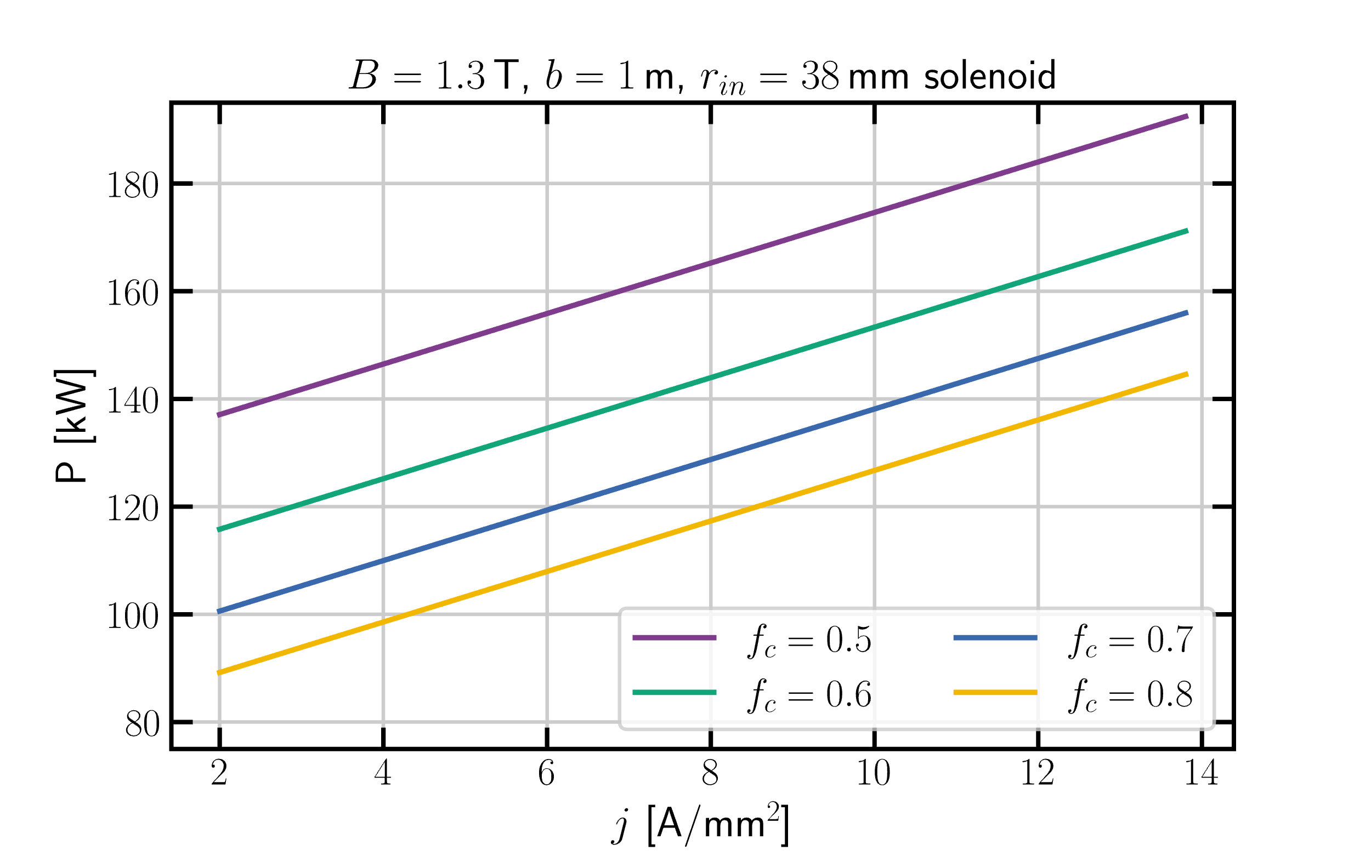
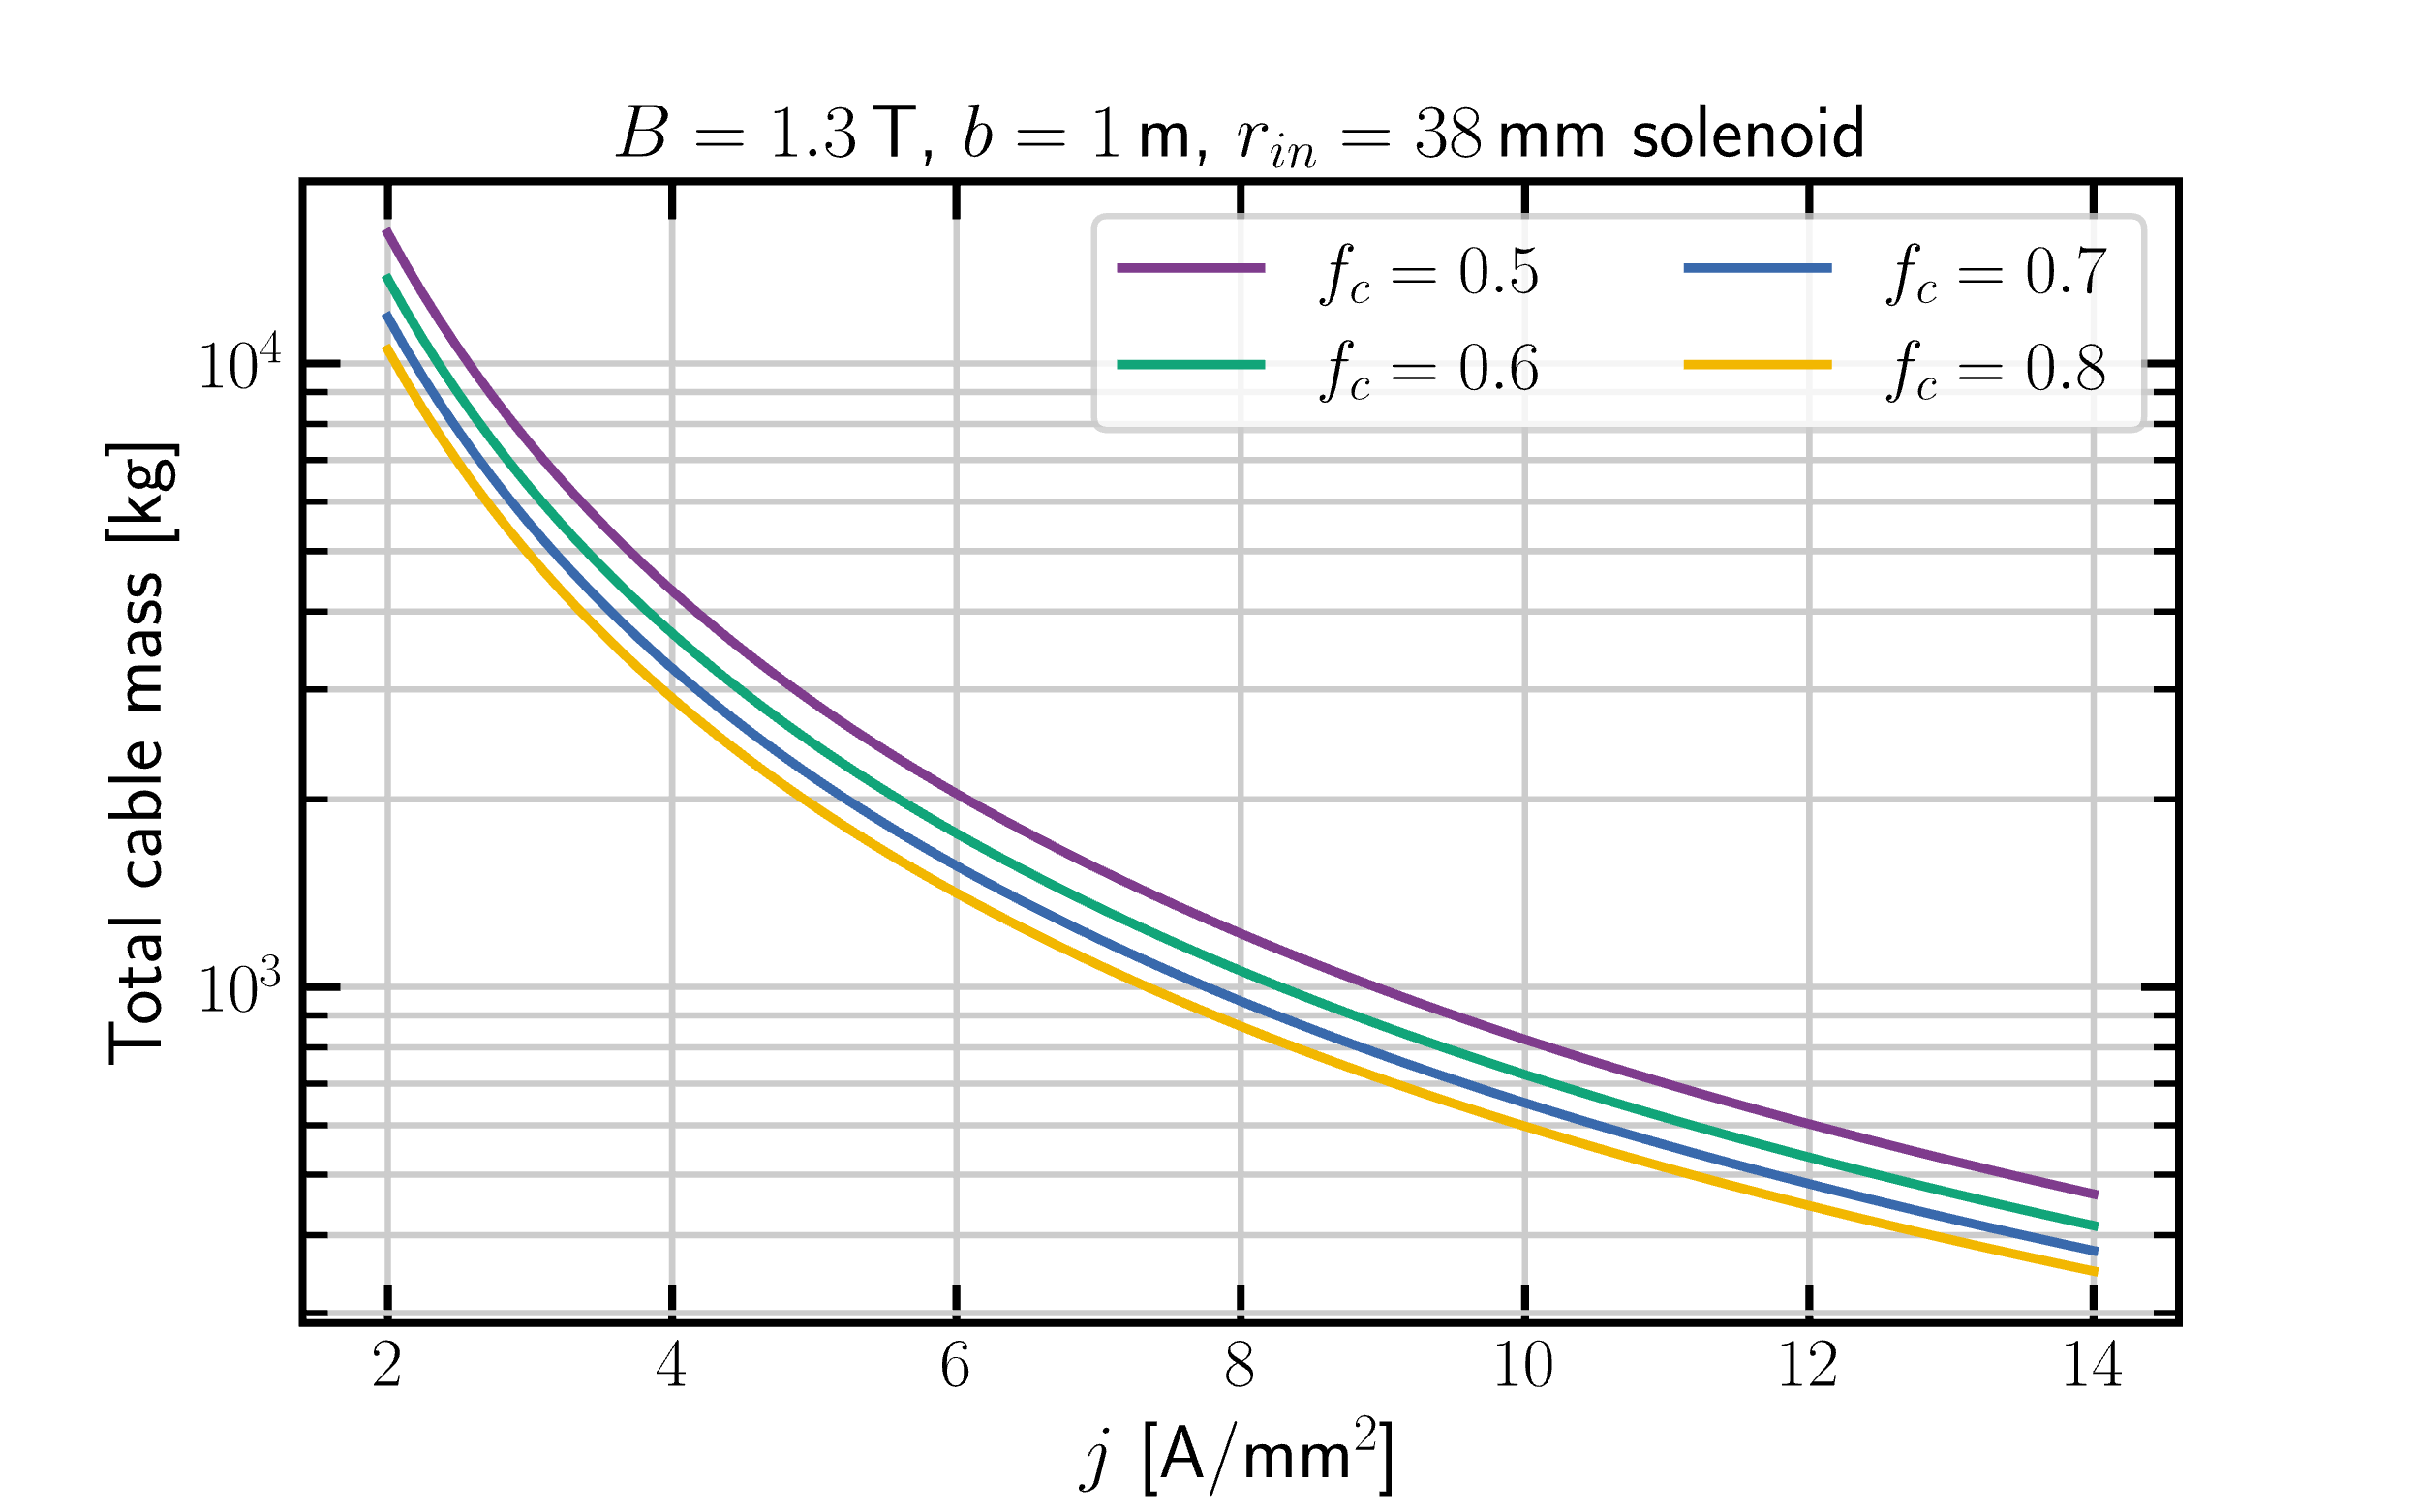
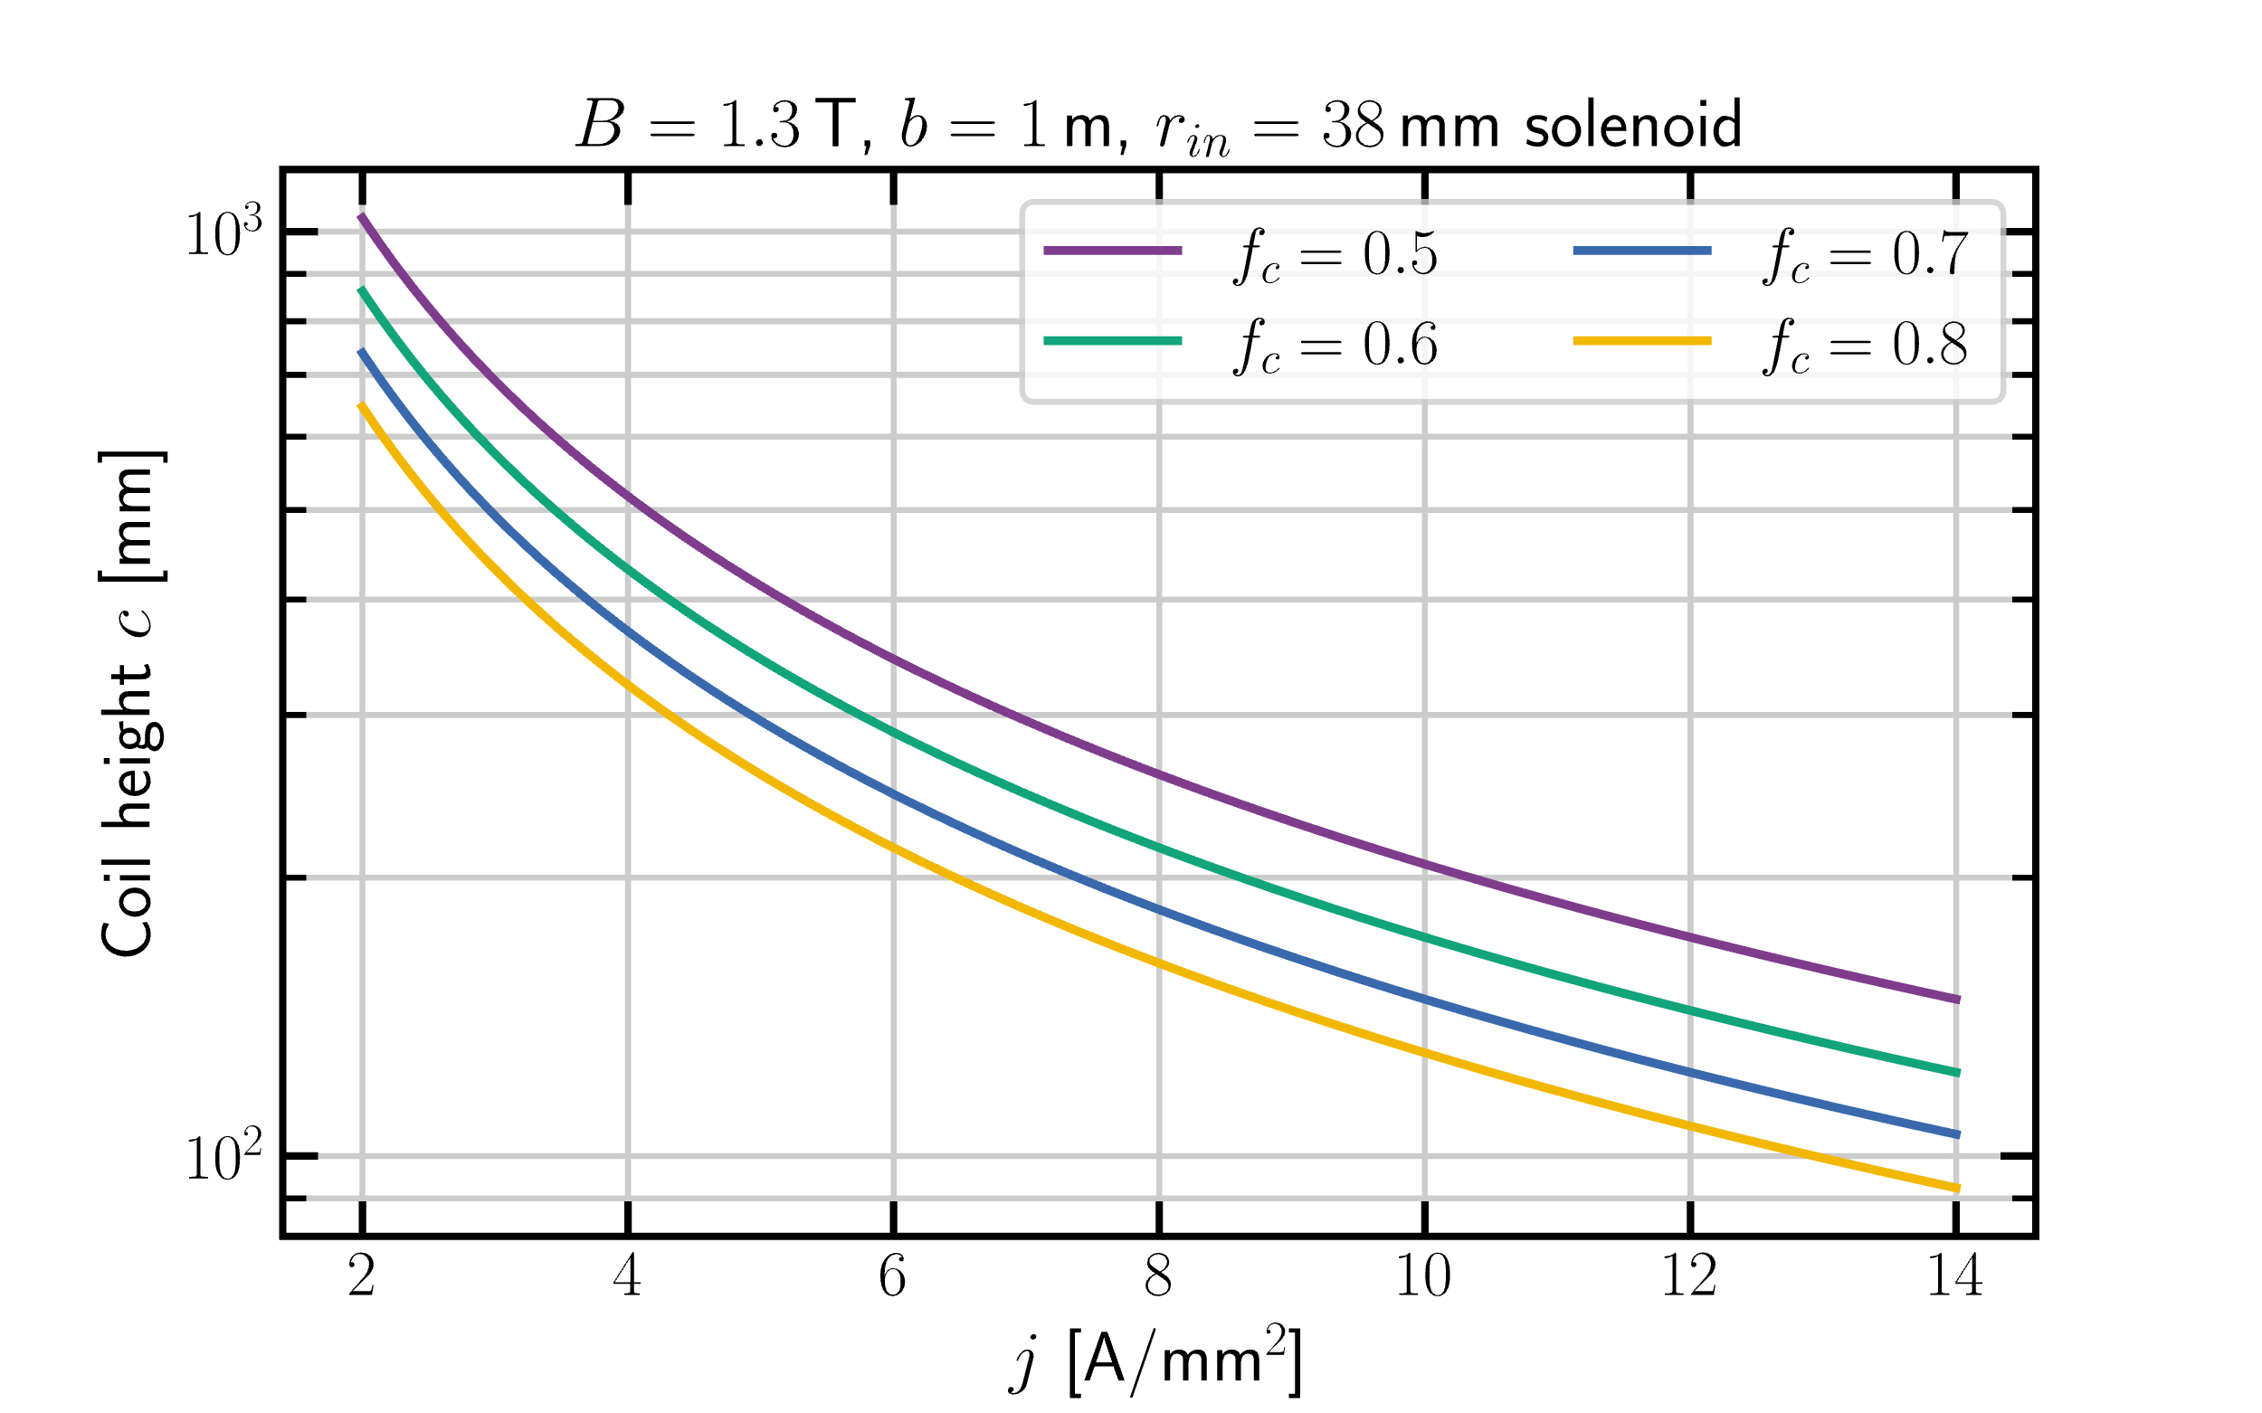
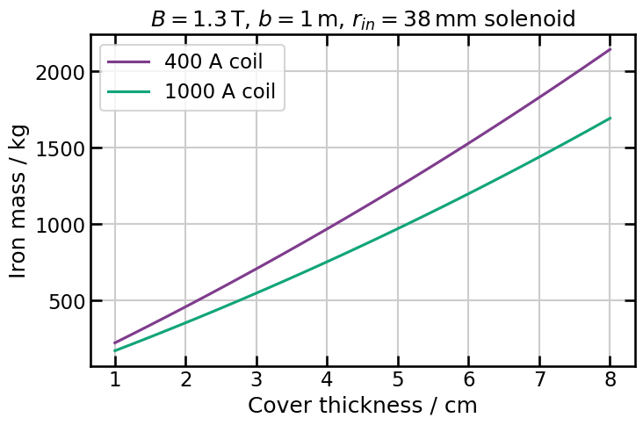
NC Solenoid–param. space

Slide 32
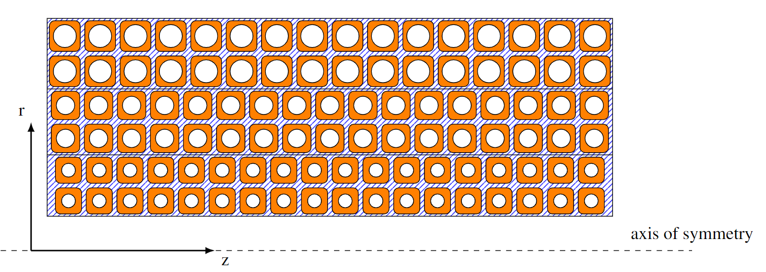
NC Solenoid–Graded coil design
C
A
B
Use more than one transverse size for the copper cable
Increase the diameter of the cooling channel in the layers further away from the bore
by keeping the conducting area constant
2 layers, cable size C
2 layers, cable size B
2 layers, cable size A

Slide 33
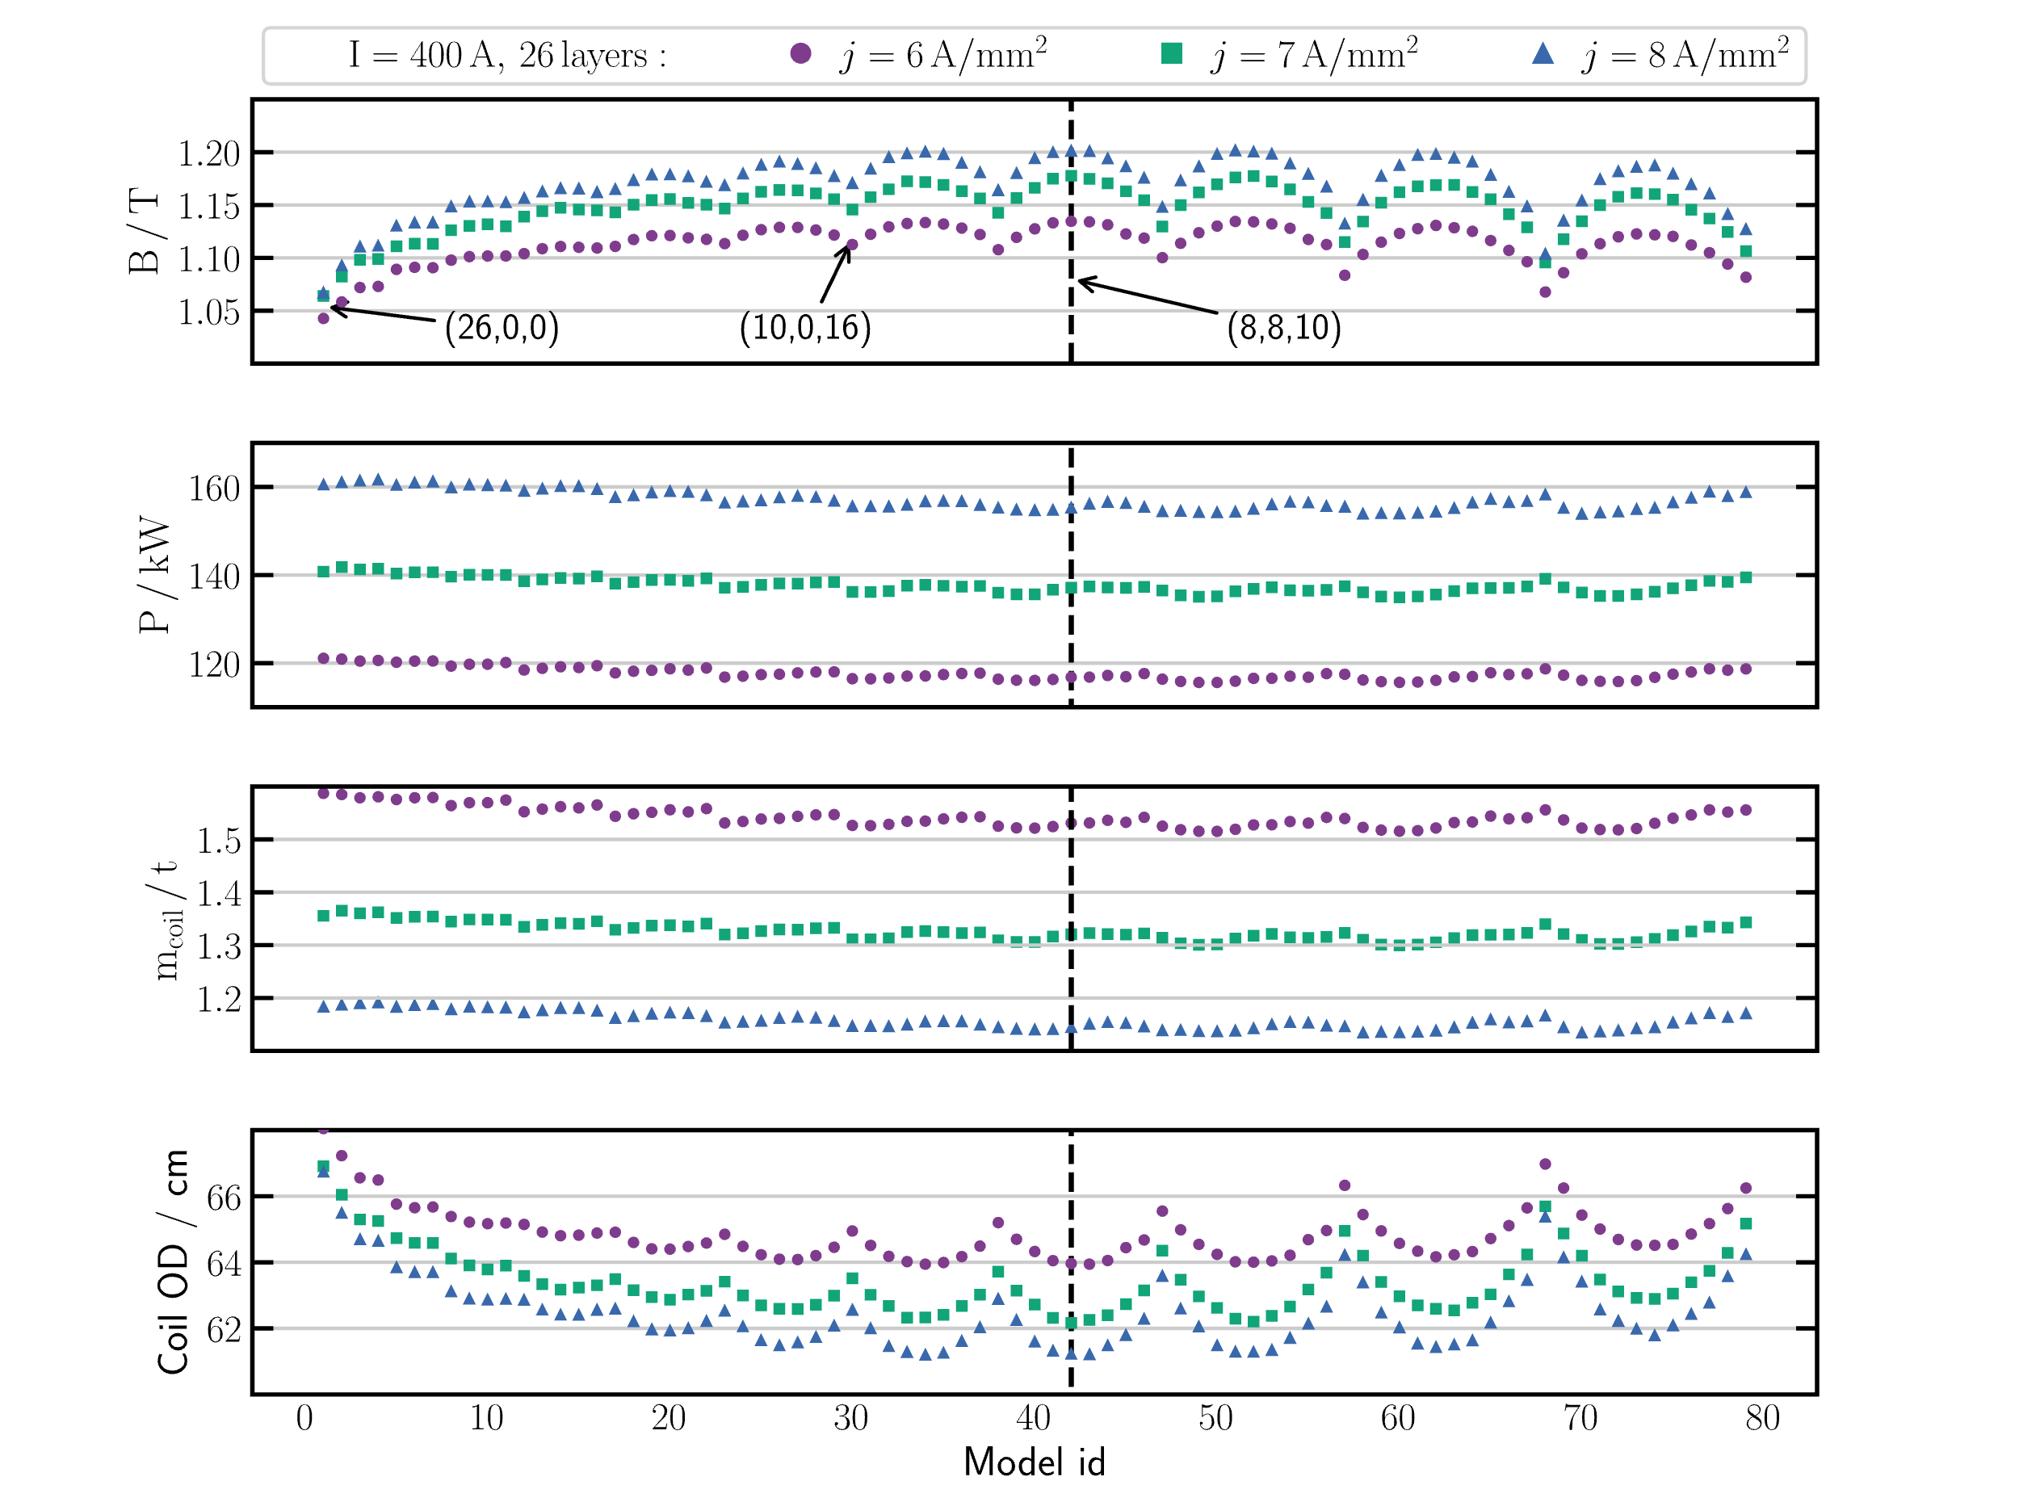
400 A NC Solenoid
26 total layers
Graded coil
3 types of cable
Each point is a different configuration $\left(m,n,l\right)$ with
$m$ layers, cable type A
$n$ layers, cable type B
$l$ layers, cable type C

Slide 34
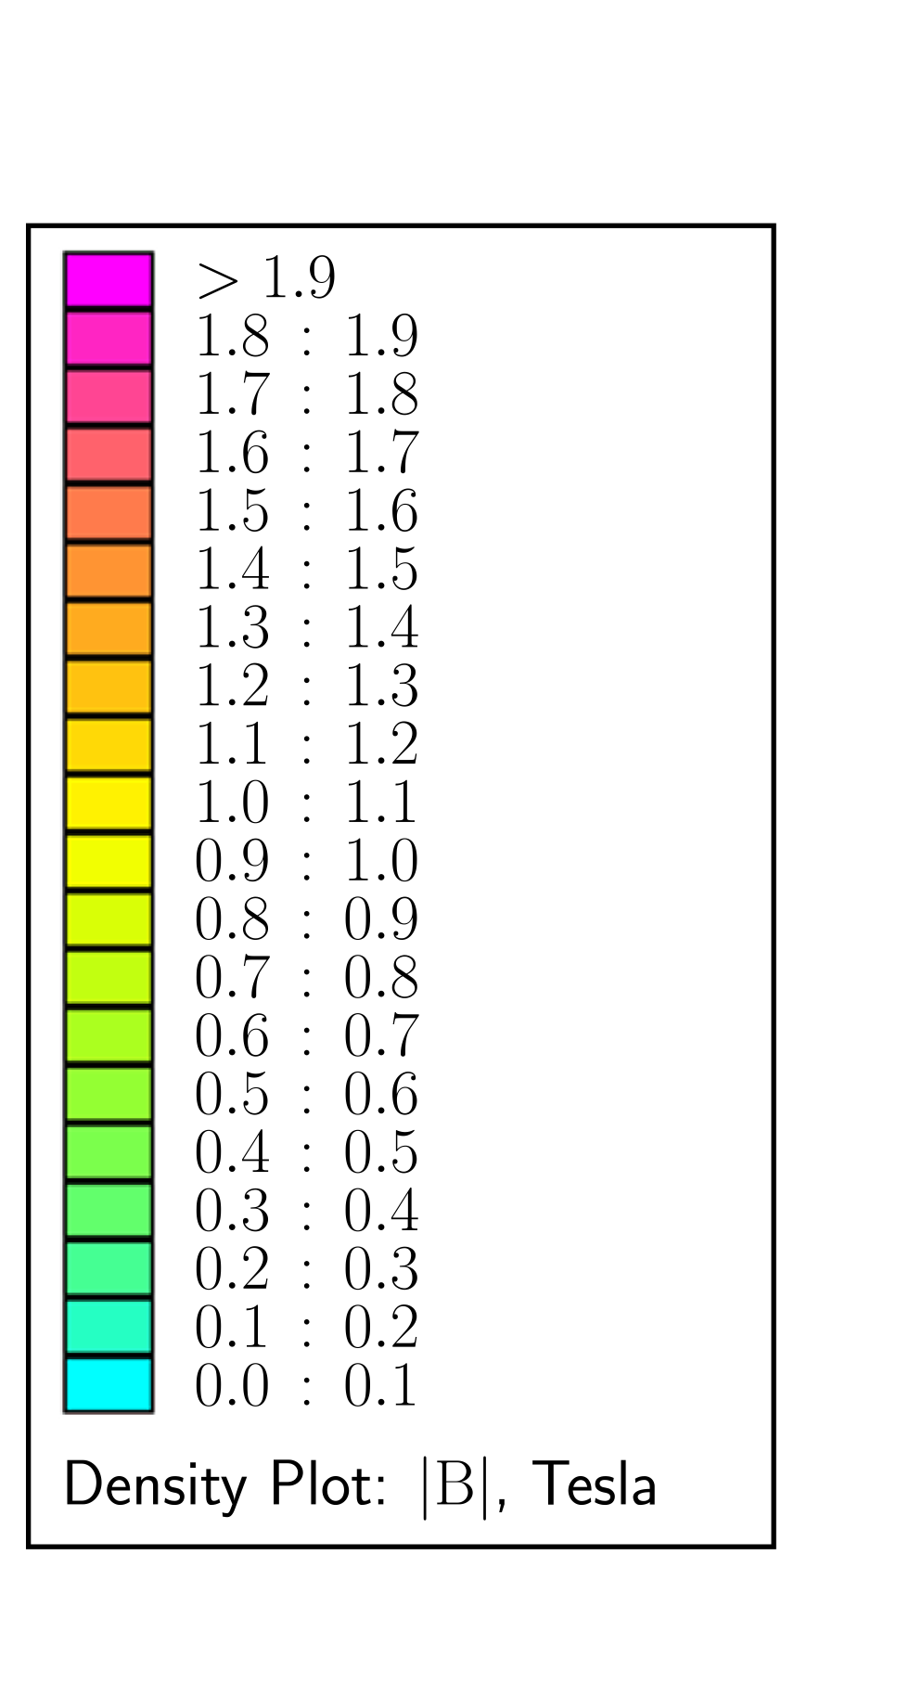
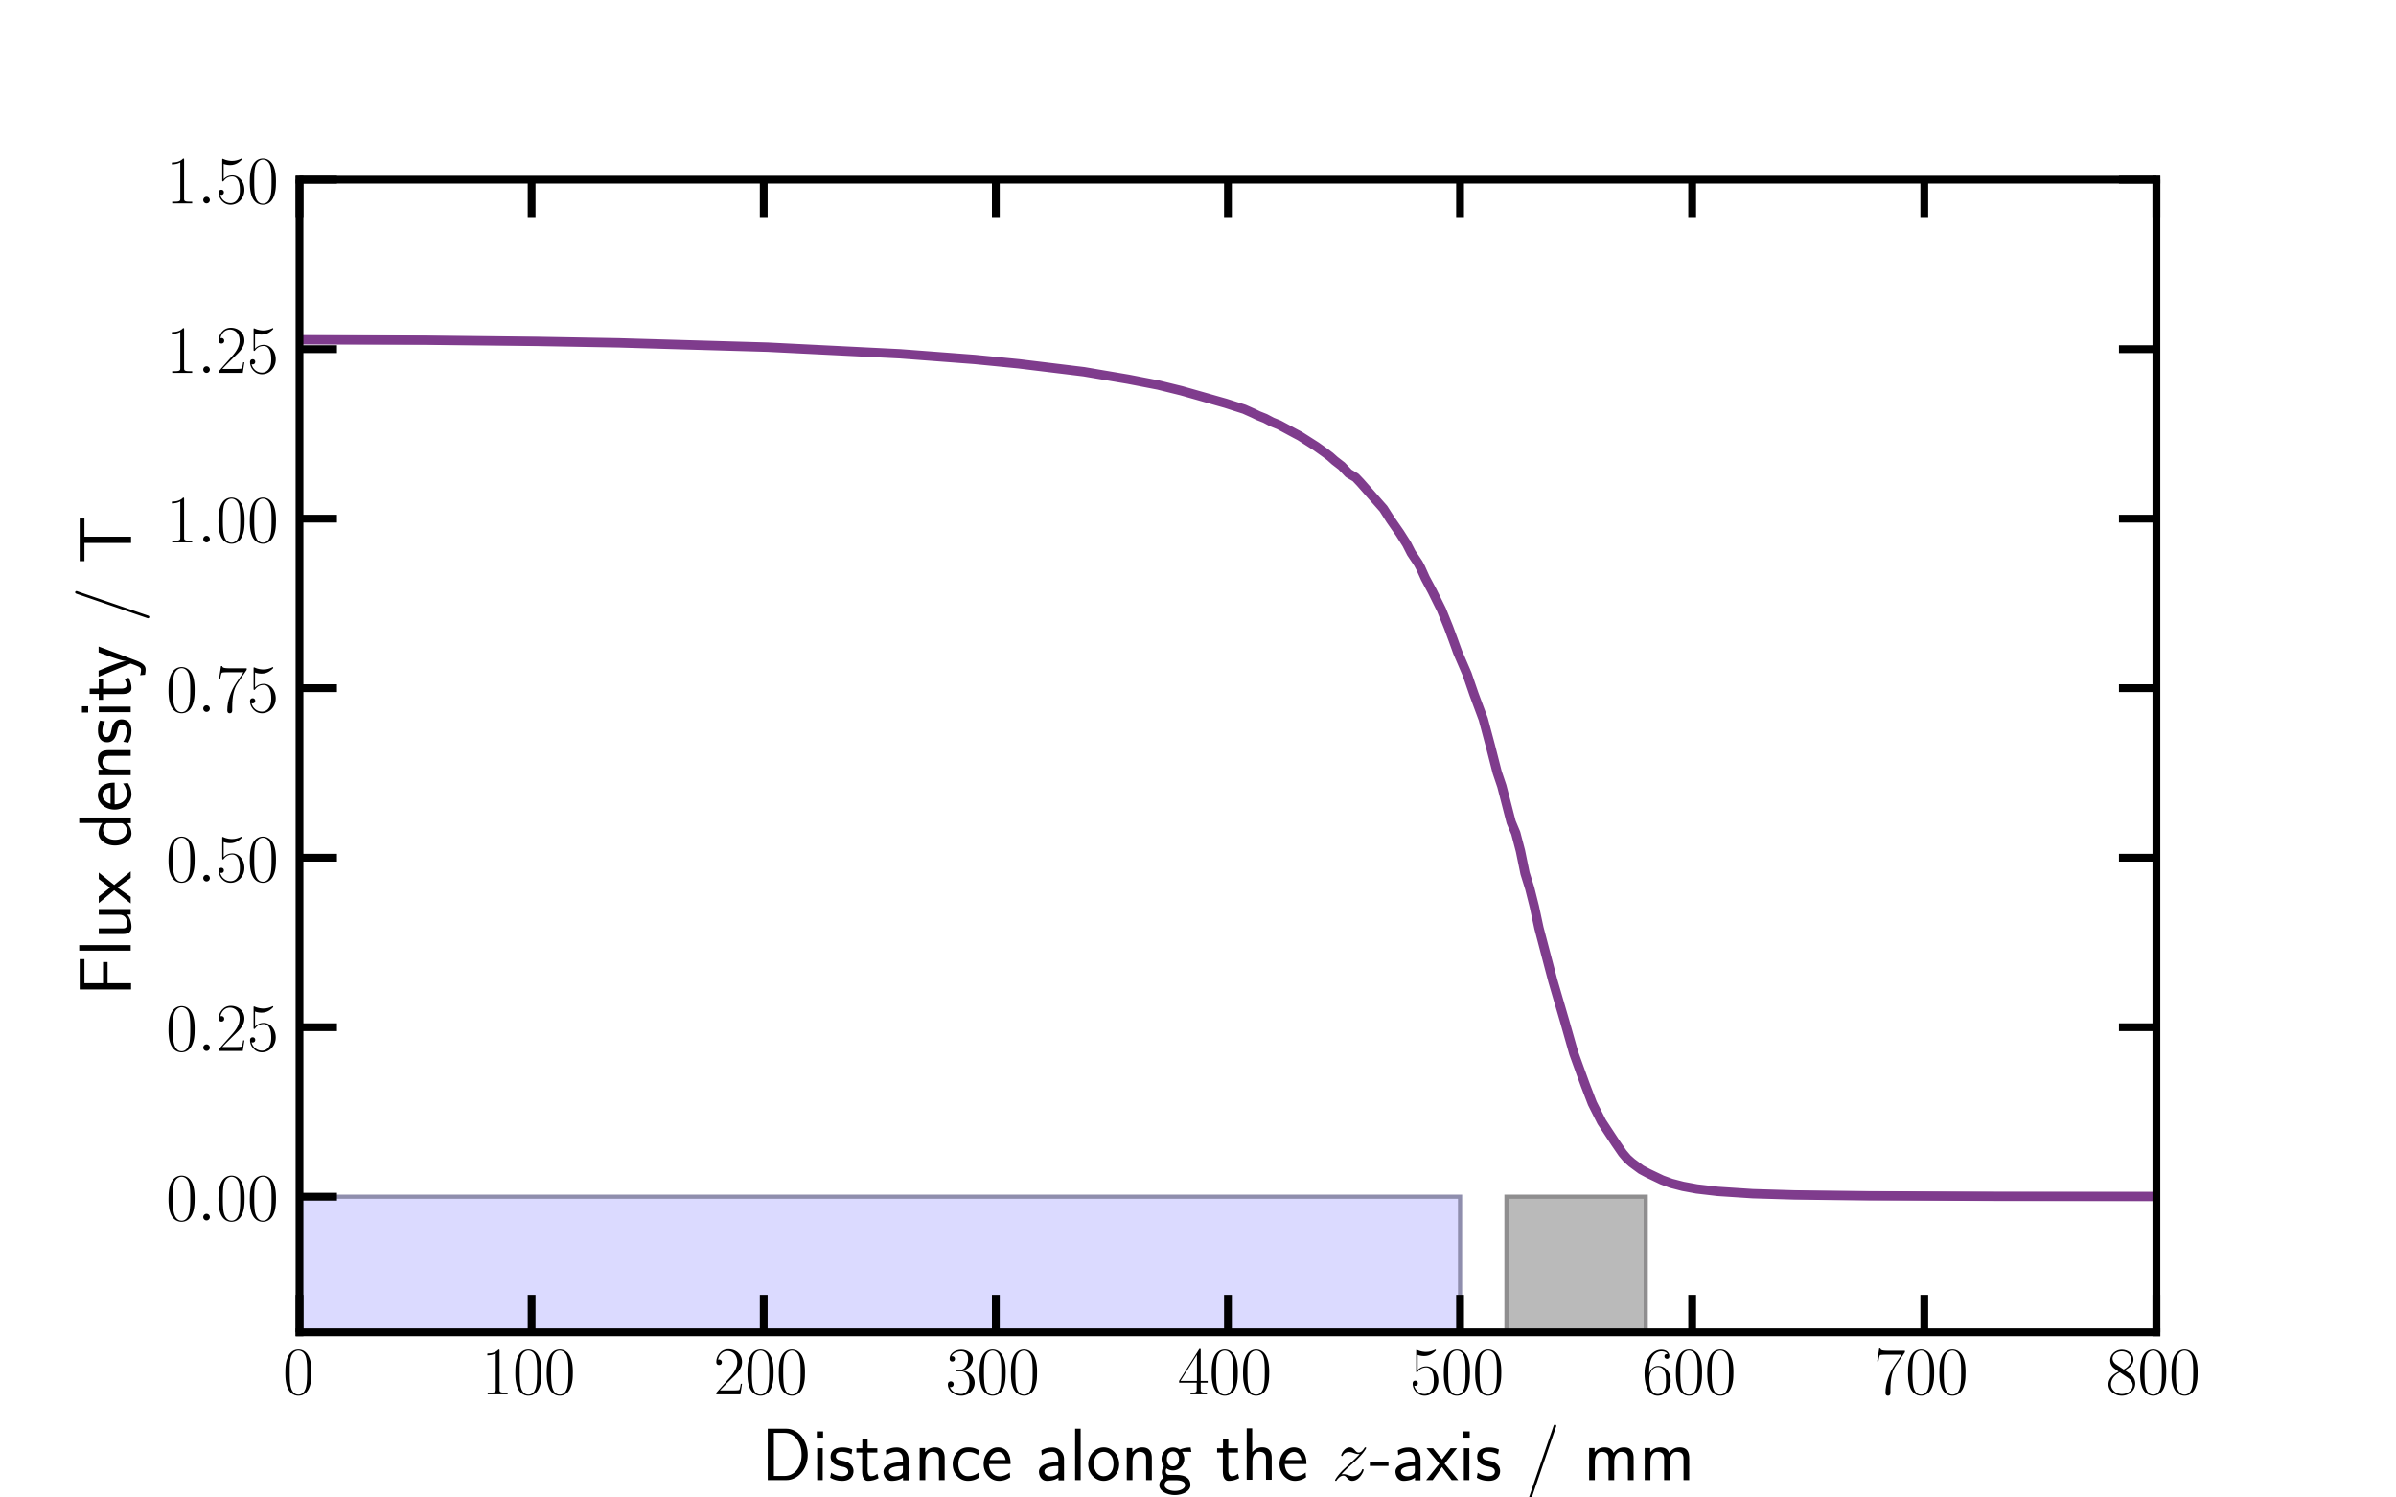
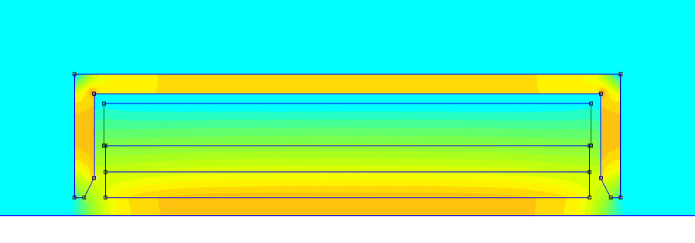
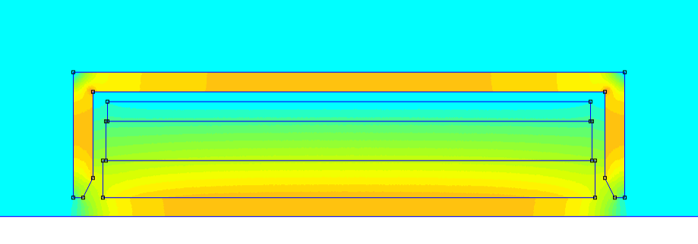
NC Solenoid–2D FEMM Models
Field on axis
400 A
400 A
coil
cover
1000 A
1000 A
2000 A

Slide 35
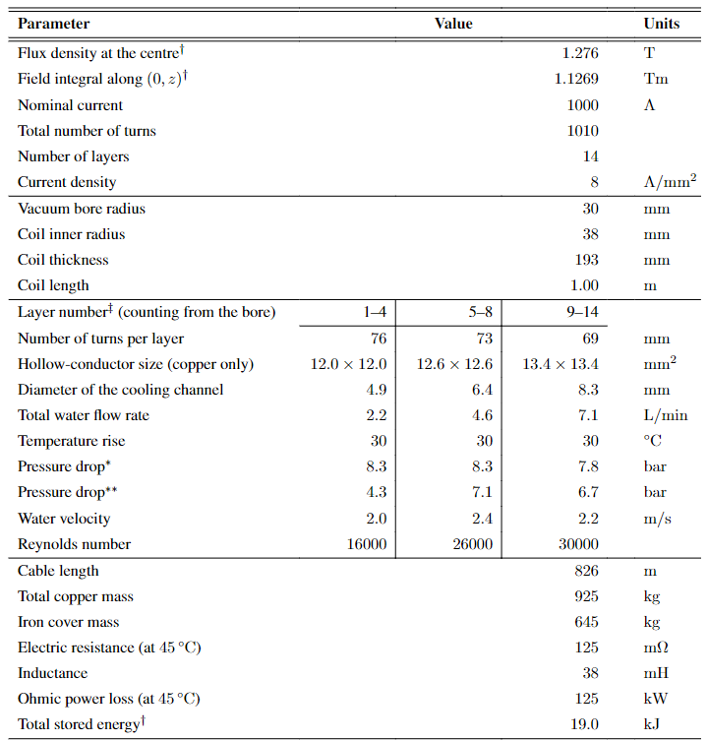
1000 A NC Solenoid–specifications
$B=1.28$ T
19 cm thick coil
925 kg
125 kW

Slide 36
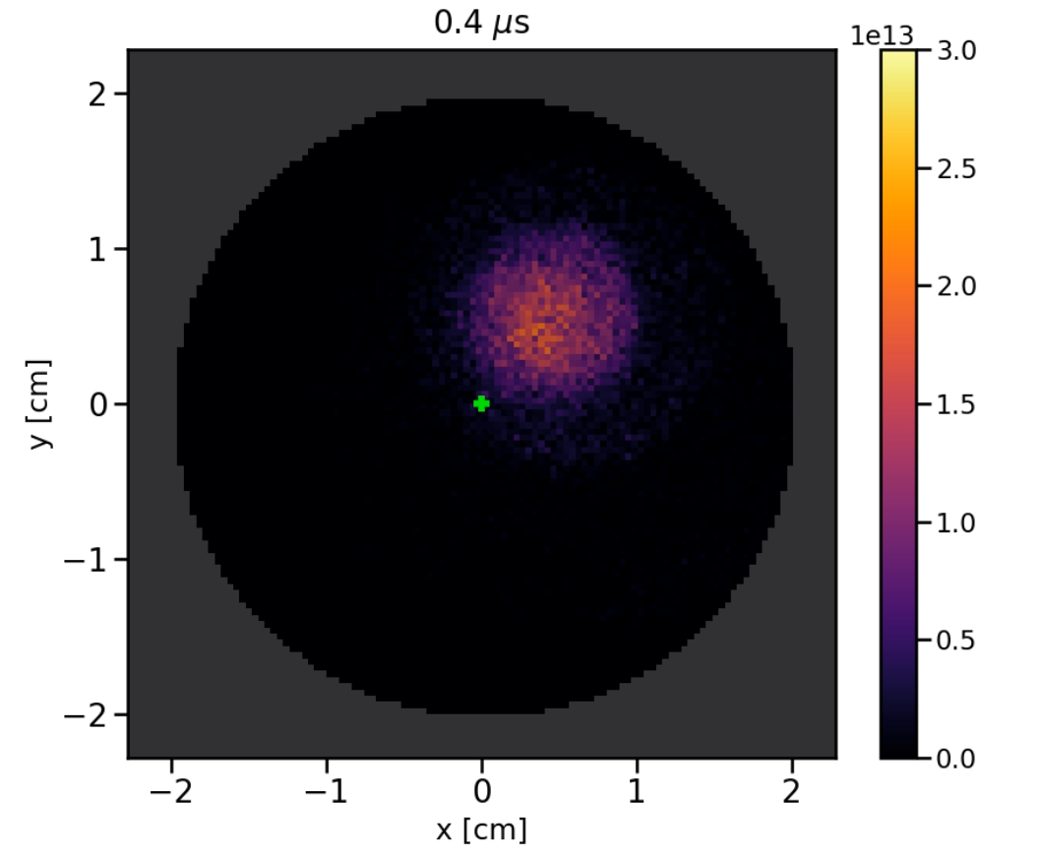
Plasma Simulations
(A) Diocotron mode
Simulation capabilities
The instability was observed in PIC simulations
Range of plasma lengths and densities limited by CPU time
Analytical model also available
Several critical parameters
Number of electrons
Plasma length and radius
Plasma temperature

Slide 37
Plasma Simulations
(B) Stable electron plasma
Simulation capabilities
Transverse/Longitudinal plasma profile
Can provide field maps for beam tracking
Simulation times limited to 10s of $μ$s
Analytical models also available:
Plasma radial profile
Plasma length

Slide 38
Plasma Simulations
(C) Instabilities

Slide 39
>20 years of investigations in Frankfurt
Aim: focus high intensity ion beams–improve focusing quality and reduce the emittance growth
(+ space-charge compensation)
GL tested so far:
<30 keV Ar-, He- beams
<130 keV, 35 mA Ar1 beams
$$φ_{A}$$
6 kV
6.5 kV
50 kV
(r_{p}=5 cm)
30 kV
“The formation of an electron cloud in the GL2000 is expected to take at least longer than in the previously investigated lenses.”
http://dx.doi.org/10.23732/CYRCP-2020-007.143

Slide 40
Types of lenses at IAP, Frankfurt
O. Meusel, 2010
K. Schulte, 2006

Slide 41
Beam transport measurements
1.2 mA, 440 keV, He⁺ beam
Lens filling degree
Beam emittance growth
O. Meusel, HIAT2012

Slide 42
Beam transport measurements
GSI, 2012
IPAC2013, THPWO021
aberrations
He⁺ beam, emittance dominated transport (test performance of the lens as focusing device)

Slide 43
Pulsed high-field solenoids
$5.7×{10}^{9}$ protons at source (25$±$1 MeV)
Particle loss due to single solenoid
Limited aperture
Spherical aberrations (highly divergent protons travel closer to the windings)
< 19.5 T, 2 or 3 pulses/min.
S1, S2: 40 mm bore diameter
14° half-angle geometrical acceptance
Measured transmission (18.6 MeV protons)
50.6% (dual solenoid)
28.6% (single solenoid)
GPT sim.
https://doi.org/10.1038/s41598-020-65775-7

Slide 44
Active plasma lenses
https://www.nature.com/articles/s41598-022-05181-3
1 mm-diameter Ar gas-filled capillary, 33 mm length
13 mm behind the tape drive target
$\sim 0.2\%$transport efficiency through the APL (protons >1.5 MeV)
APL
DOI: 10.1103/PhysRevLett.115.184802

