Slide 1
LhARA KICK-OFF MEETING
Maria Maxouti
14/10/2022

Slide 2
Monitoring system
To minimize damage on the surrounding healthy cells we need to develop an on-the-fly, non-invasive, range verification system
Bragg peak localization
Dose deposition profile
Real-time exact dosimetry
Solution: ion-acoustic imaging

Slide 3
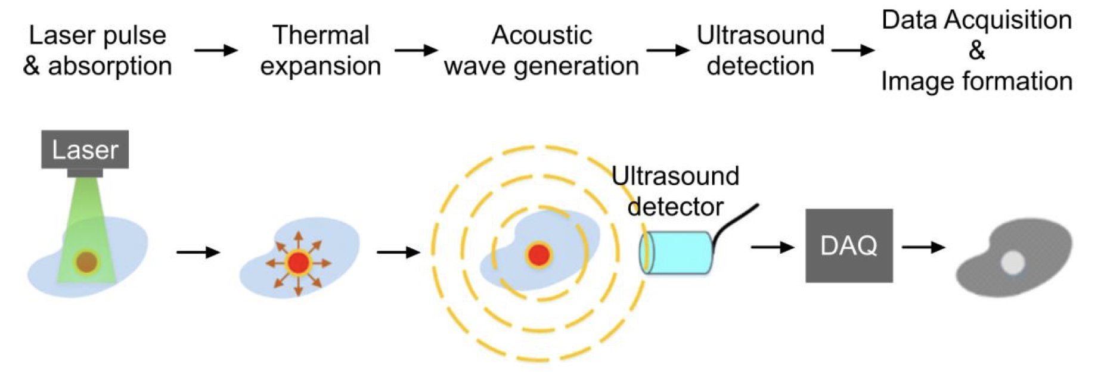
ION-acoustic imaging
As the beam penetrates the tissue, it is scattered & absorbed
Increase in temperature
Thermoelastic expansion
Increase in pressure
An acoustic wave is emitted (thermoacoustic effect)
Can be detected by a transducer
Image reconstruction → dose deposition profile

Slide 4
Smartphantom
10 cm square tank filled with water
The energy distribution (energy as a function of distance) of the particle while propagating in the medium can be obtained

Slide 5
K-wave
Open-source MATLAB toolbox designed for the simulation of propagating linear and non-linear acoustic waves
Can simulate signals in 1D, 2D and 3D
Works in both homogeneous and heterogeneous media
Considers attenuation and reflections
Can be used to simulate the ion-acoustic process

Slide 6
Simulation pipeline

Slide 7
current Results

Slide 8
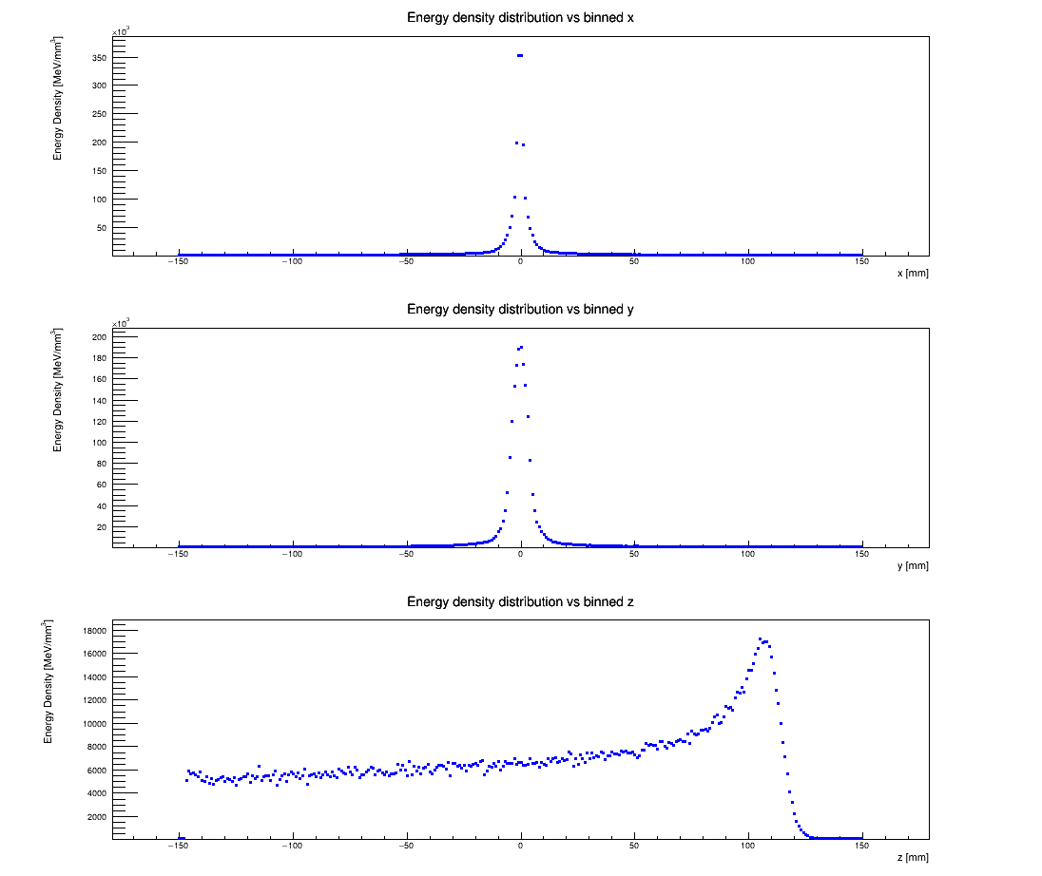
From Geant4:
x
y
z
(200 MeV proton beam)

Slide 9
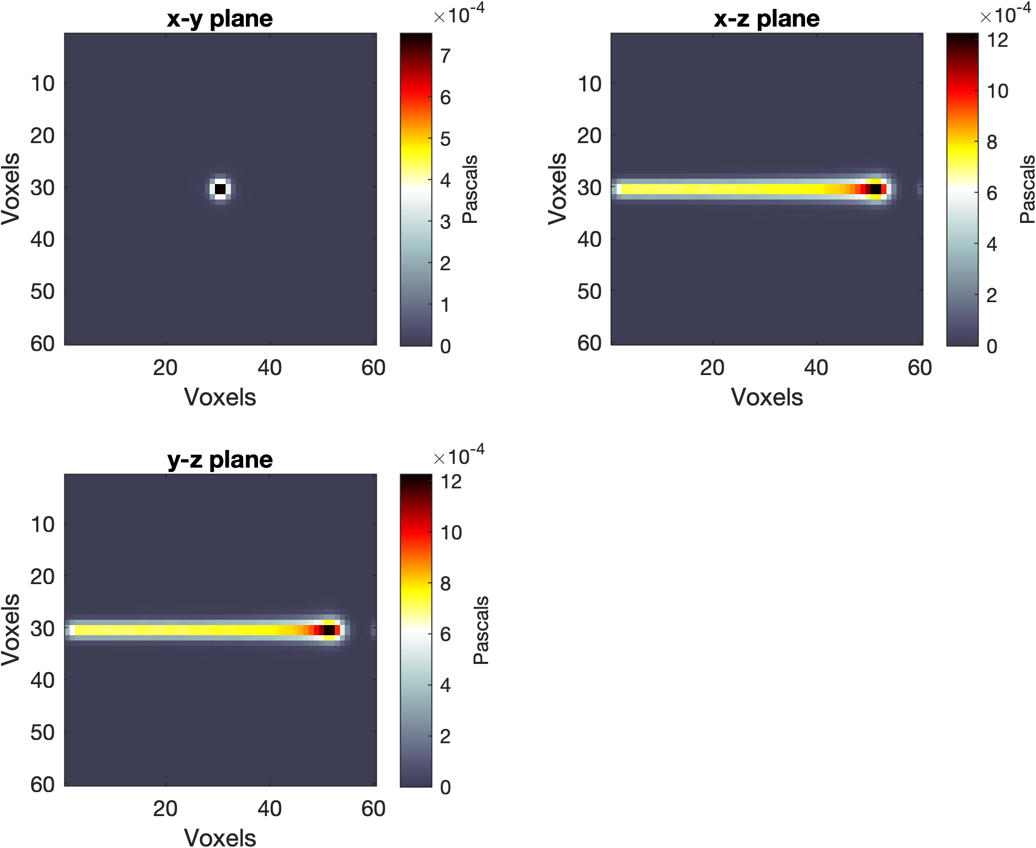
Initial pressure distribution
(from the imported Geant4 energy data)

Slide 10
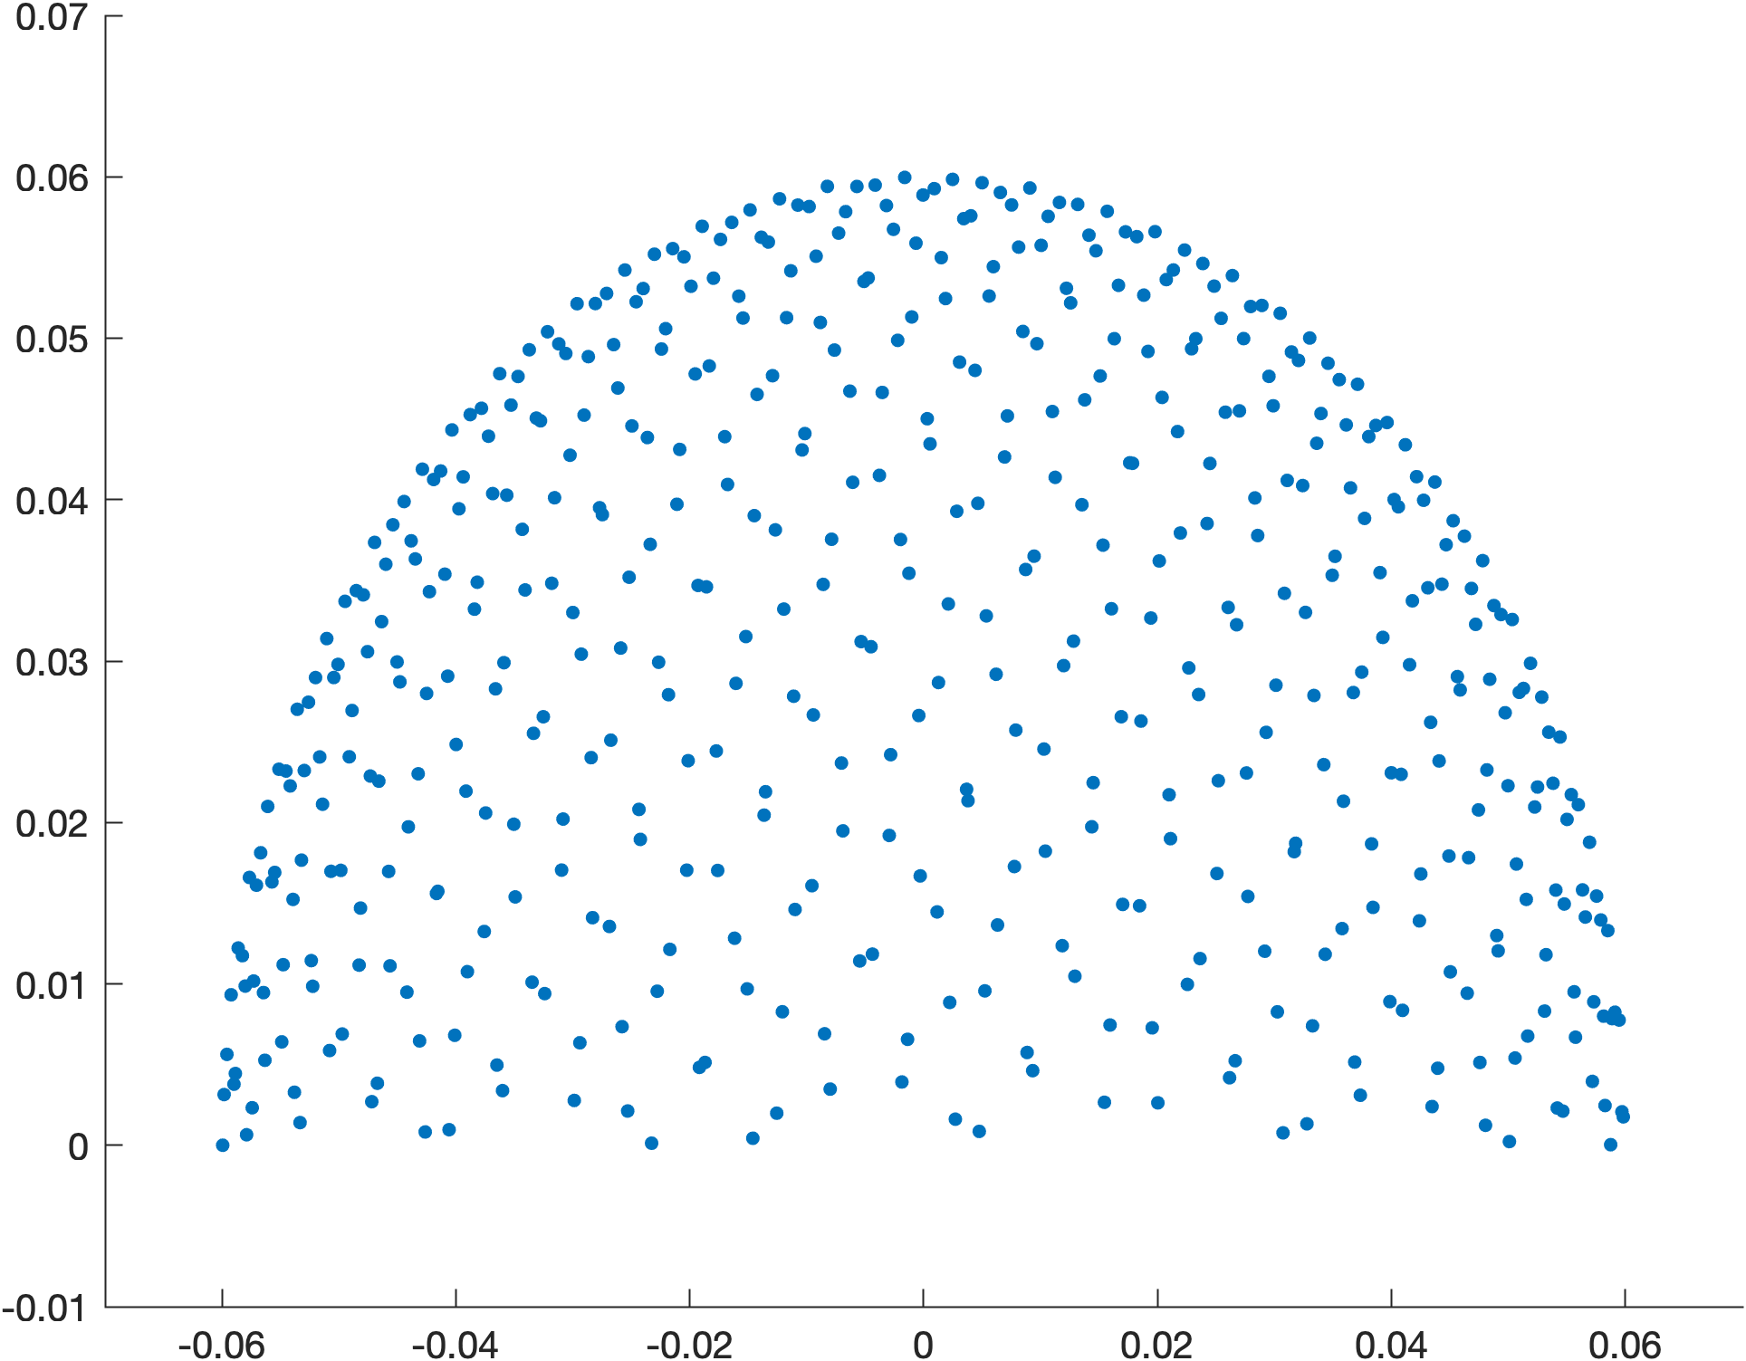
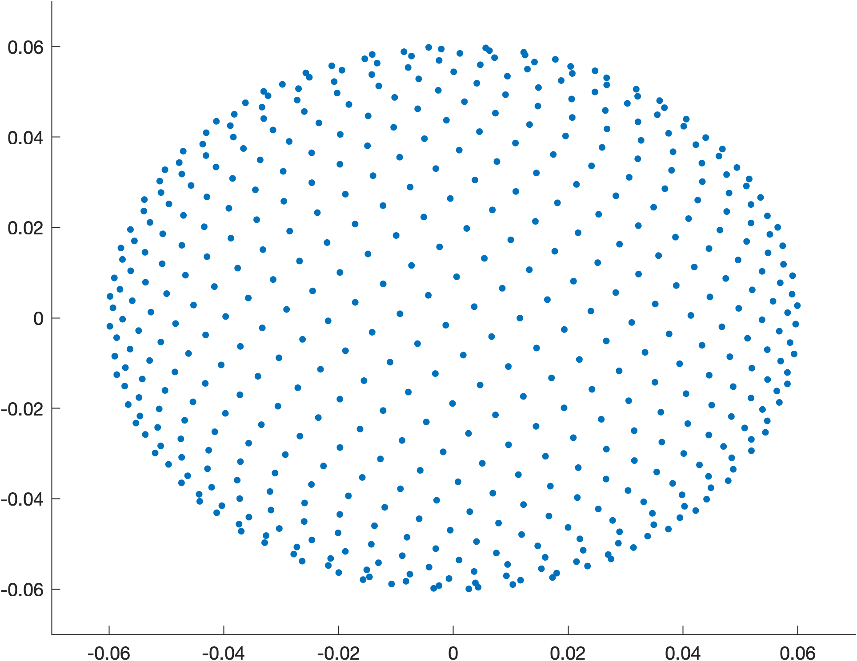
Transducer array – k-Wave
Golden spiral lattice – evenly distributed & closely packed transducer elements
Side view
Top view

Slide 11
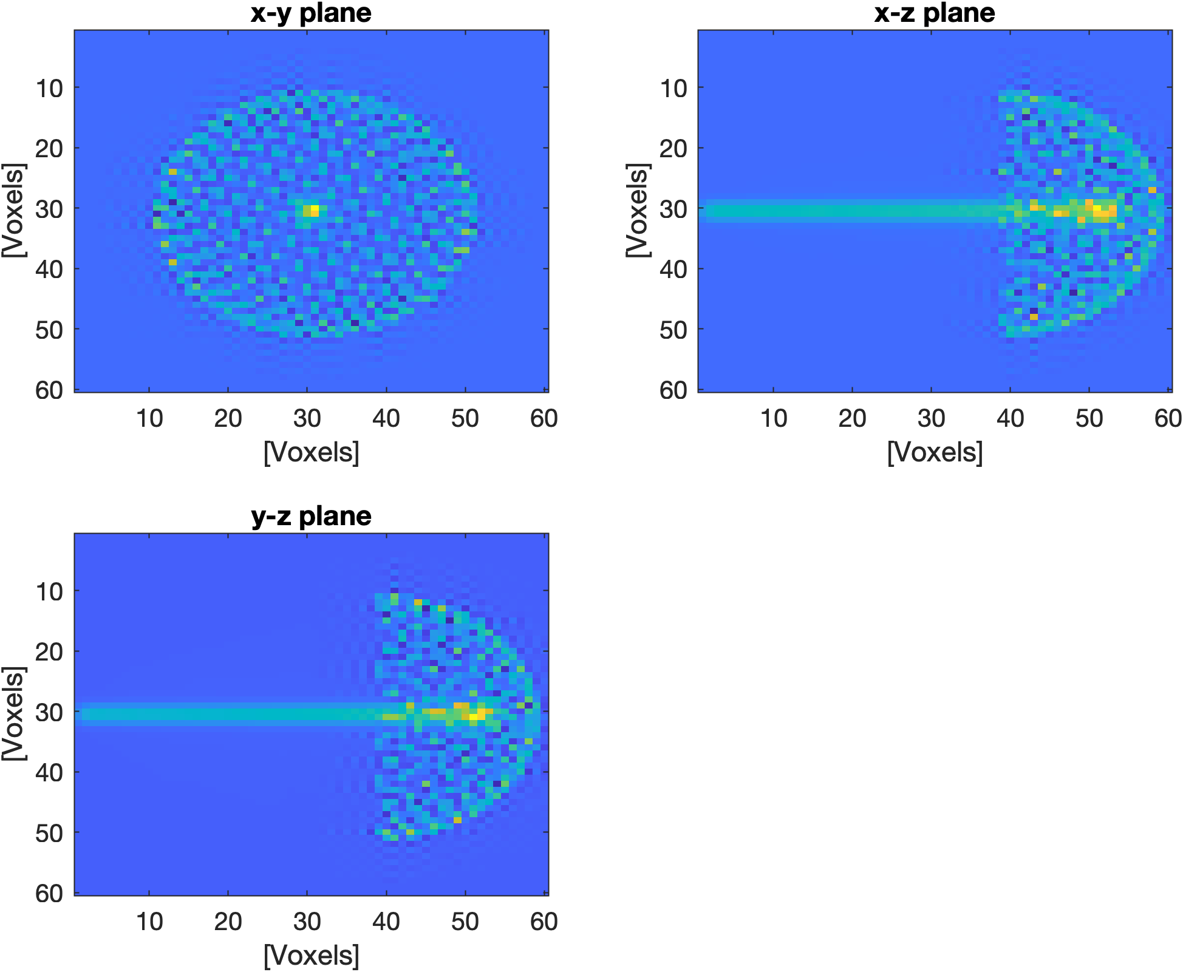
proton beam
sensor array
(200 MeV proton beam)

Slide 12
IMAGE Reconstruction methods
Iterative time-reversal
Model-based minimization
Back-projection

Slide 13
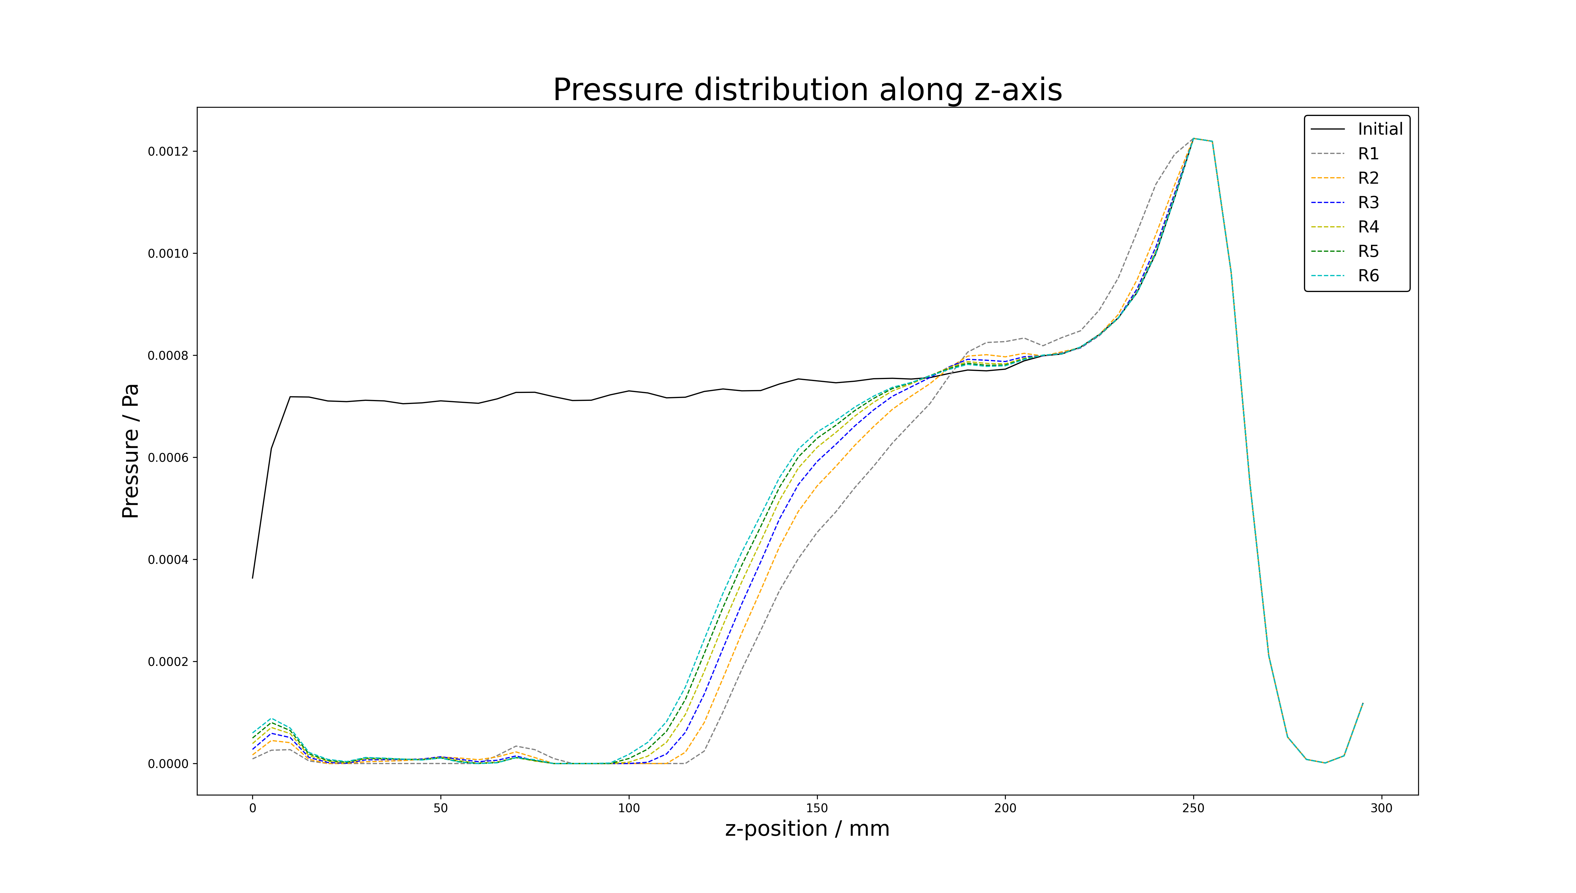
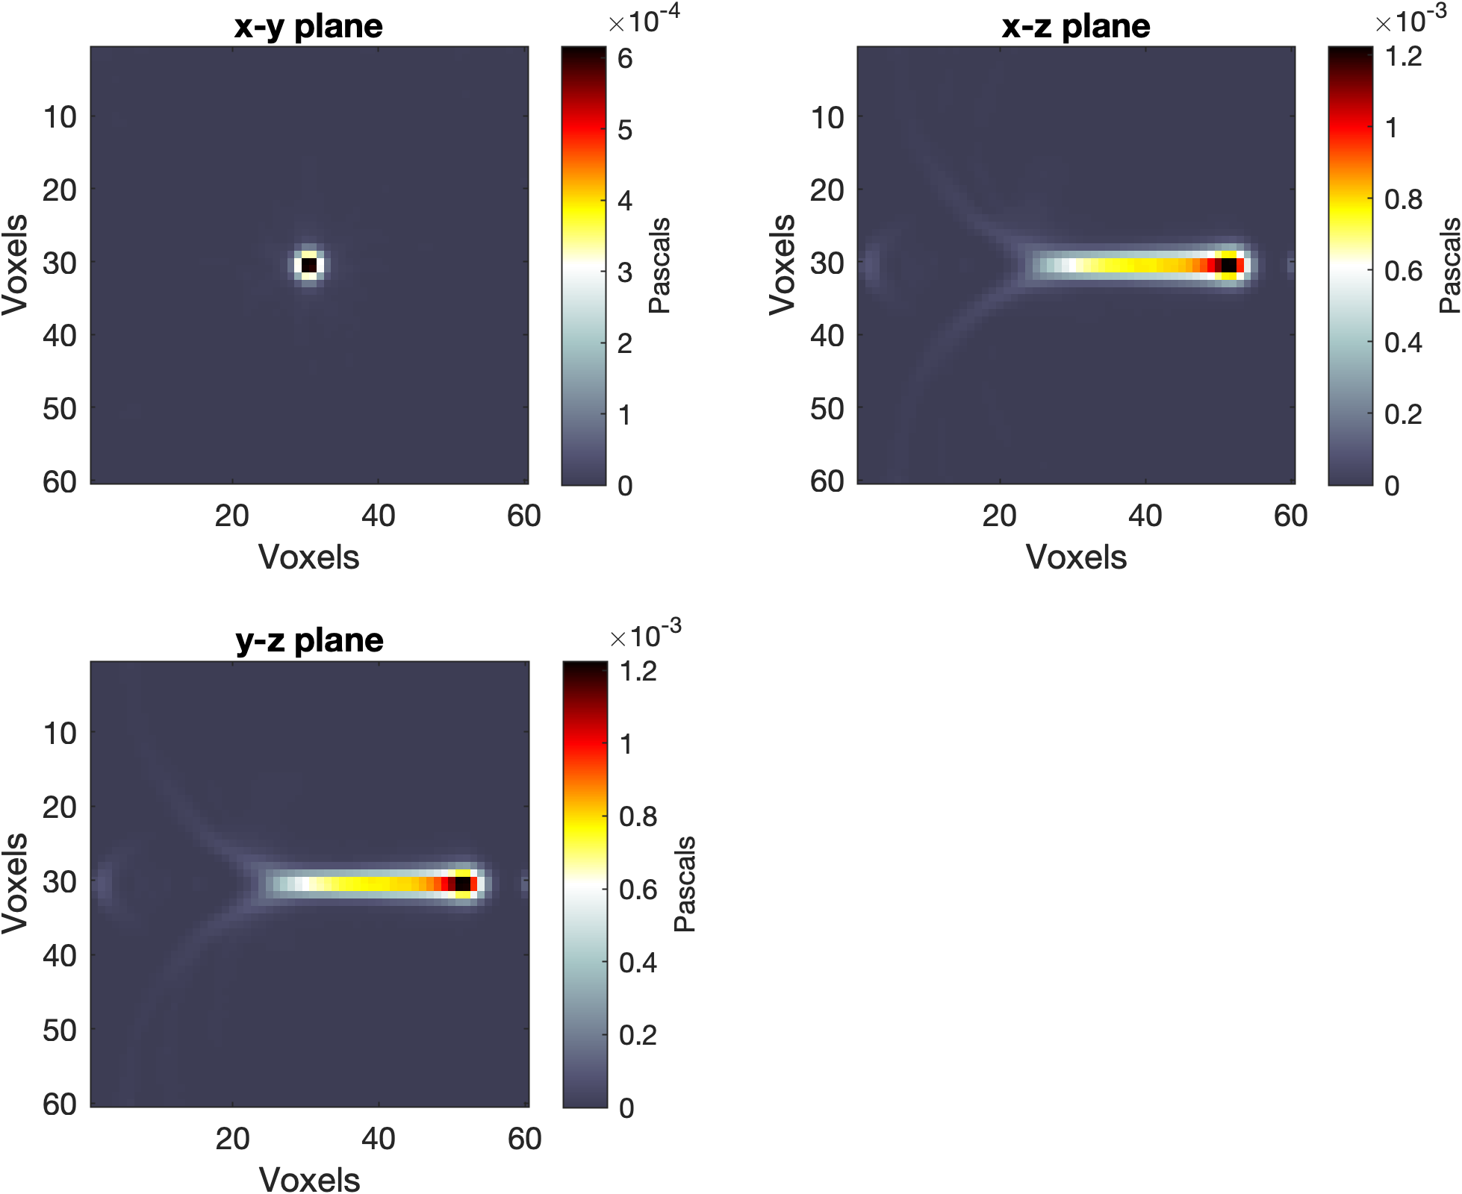
ITERATIVE TIME REVERSAL RECONSTRUCTION

Slide 14
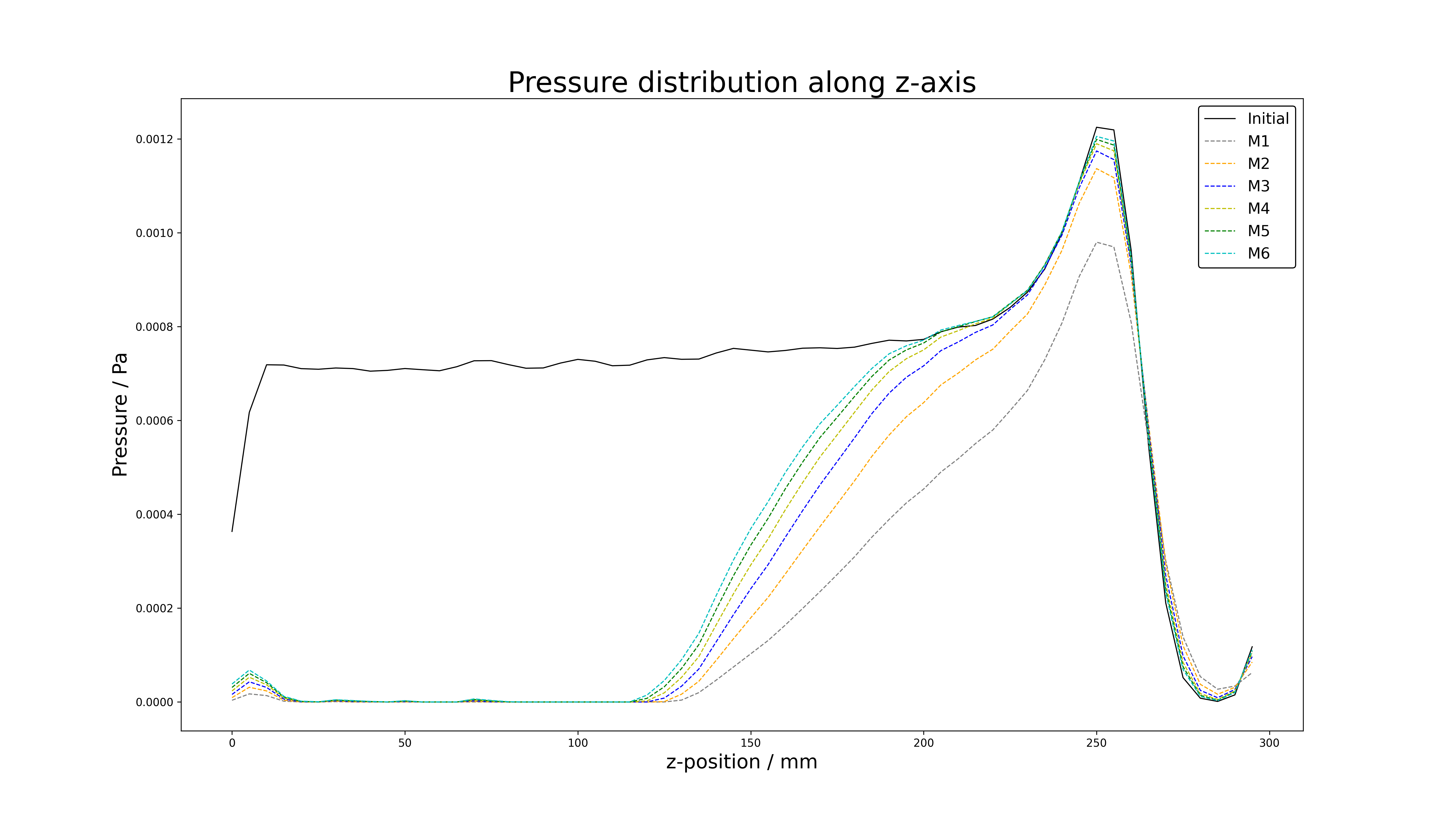
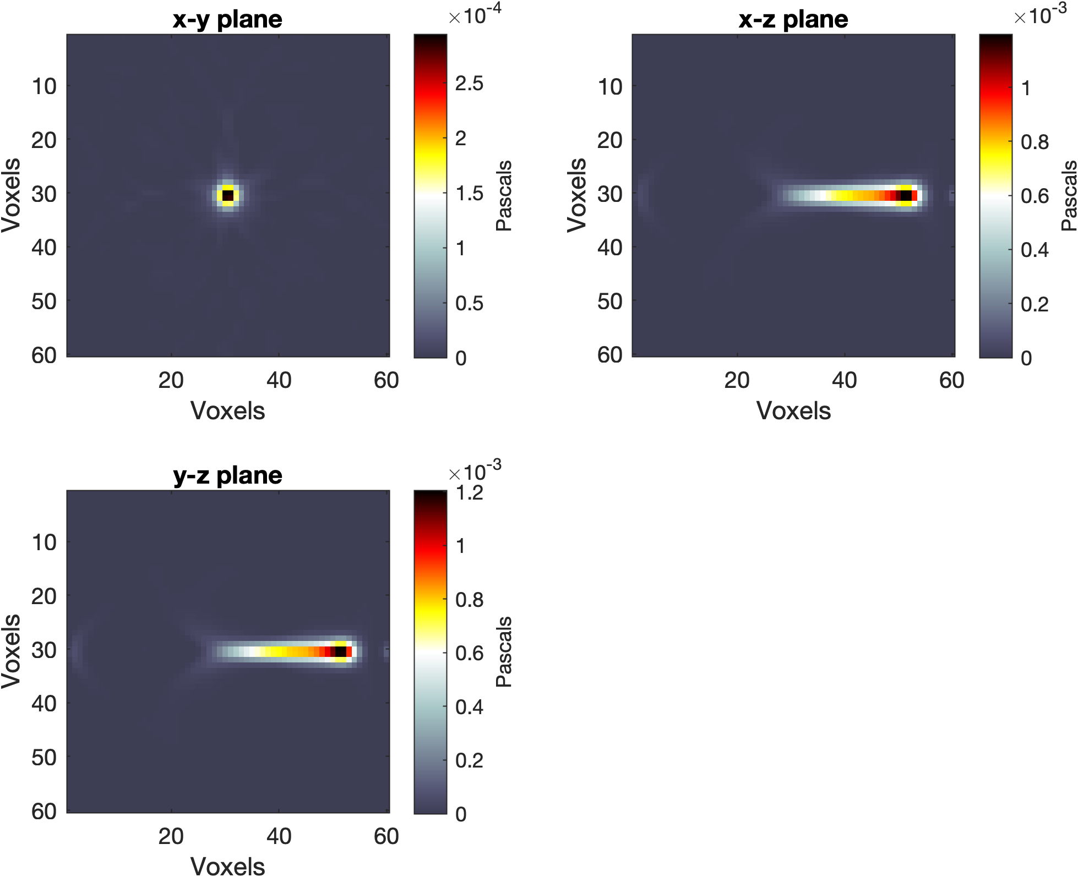
Model-based minimization reconstruction
Uses gradient descent to minimise an error functional consisting of the difference between the data (the measured time series) and the output of a simulation

Slide 15
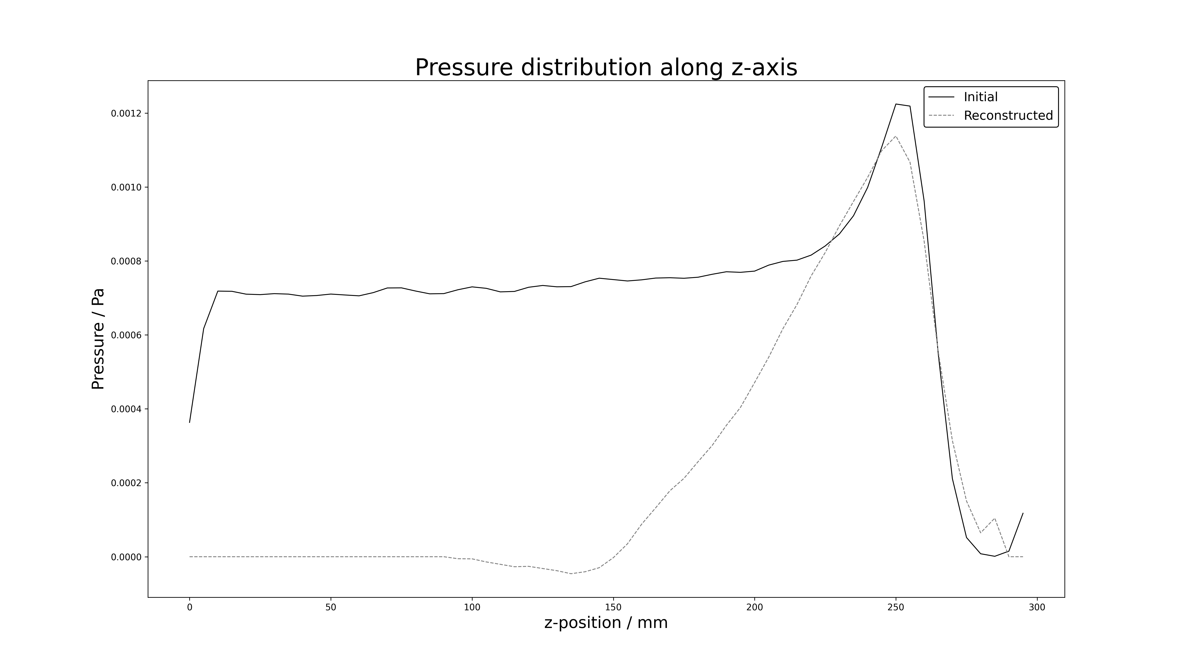
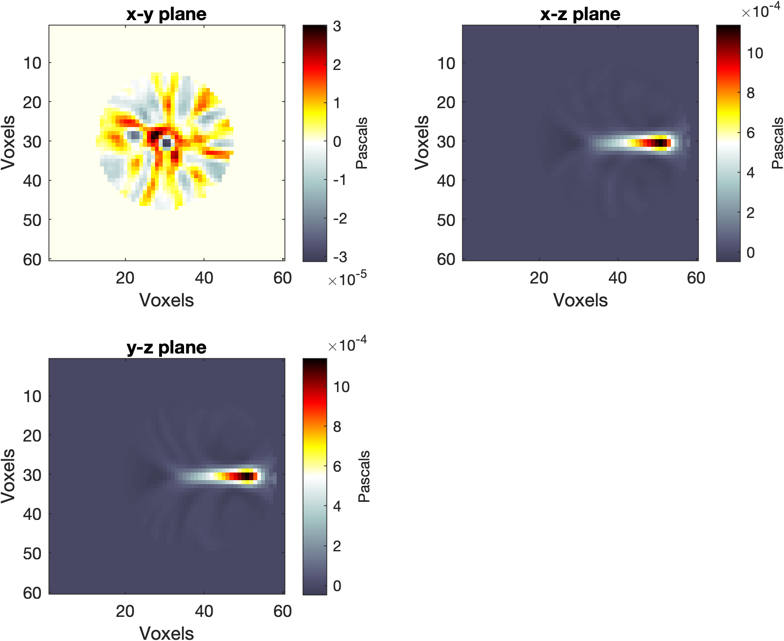
Back-projection reconstruction

Slide 16
Future work
Investigate the effect of varying the:
Number of elements
Size of elements
Position of sensor with respect to the beam
Radius of the sensor
Apply machine learning to remove artefacts and improve speed
Fibre plane construction
Perform the experiment

Slide 17
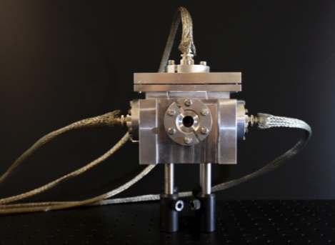
Change of design?
LMU set-up:

Slide 18
Questions?

