Slide 1
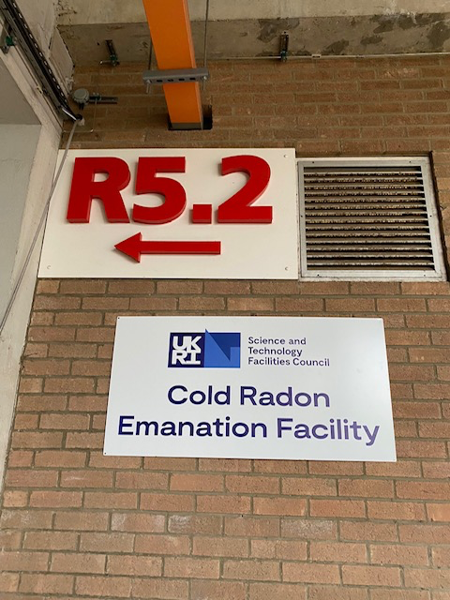
Cold Radon Emanation Facility PPD R&D talk 28 Sep 2022
Outline
CREF motivation & technologies
Funding arrangements past-current-future
Status of facility
Time schedule

Slide 2
Cold Radon Emanation Facility
What do we do?
Study radon emanating from sample material
Do this as a function of temperature
Do this at high volume capacity
Who is involved?
RAL-PPD
Maurits vd Grinten
Andrei Khazov
Emily Perry
Mark Tucker
UCL
Cham Ghag
Ruben Saakyan
Andrew Stevens
University of Edinburgh
Xin-Ran Liu (now left academia)

Slide 3
Radon: not a friend of DM searches
Cryogenic Radon Emanation Facility:
Conduct assays under cryogenic conditions
Operate with a large chamber volume
Radon
Radon originating from Uranium and Thorium chains
Radon-222 has half-life of 3.82 days, once in Xenon it disperses throughout
Background mimics WIMP signal
Temperature considerations
Radon diffusion suppressed in some materials at cryogenic temperatures
Radon recoiling out from surfaces not suppressed
Limited data available on the overall temperature dependence of radon outgassing from materials
Very limited data available distinguishing surface from bulk emission
Calibration test tube
This facility:
Sensitivity of < 50 μBq/sample envisaged
Side view

Slide 4
Facility consist of:
Large cryogenic vacuum vessel & cryostat
ISO Class 7 controlled environment
Large (~ 200l) test chamber
Radon concentration line
Radon detector
UCL & PPD operational running resources
Following MSSL arrangements
Funding Path:
Past - STFC Capital Equipment grant with UCL
Current - Xenon Futures
Next - Next Generation G3 LXe observatory

Slide 5
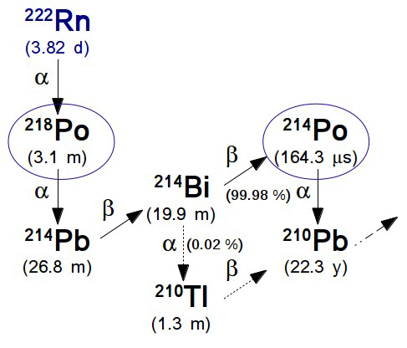
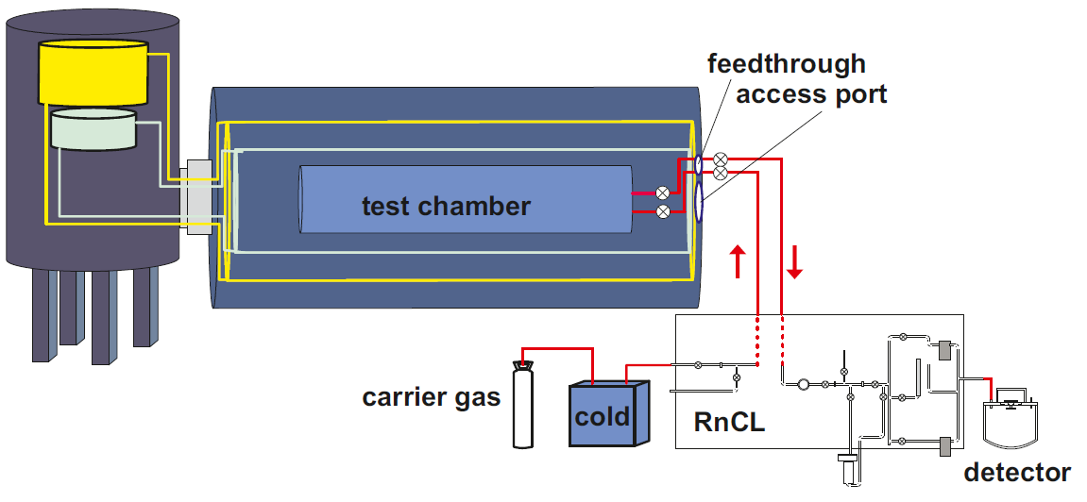
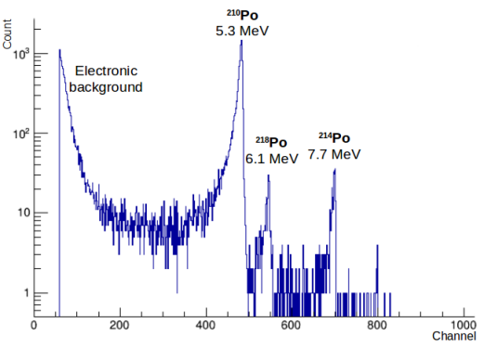
Operations scheme
RnCL Operation principle
Drive purified carrier gas through test chamber
Detector operation
²²²Rn directed into vessel
Trap radon in cold carbon traps
Accumulate radon over a set period
Warm up and release radon into detector
Detect Rn decay
Positive decay ions collected on pin diode
Po alphas identified by energy
gas in
gas out

Slide 6
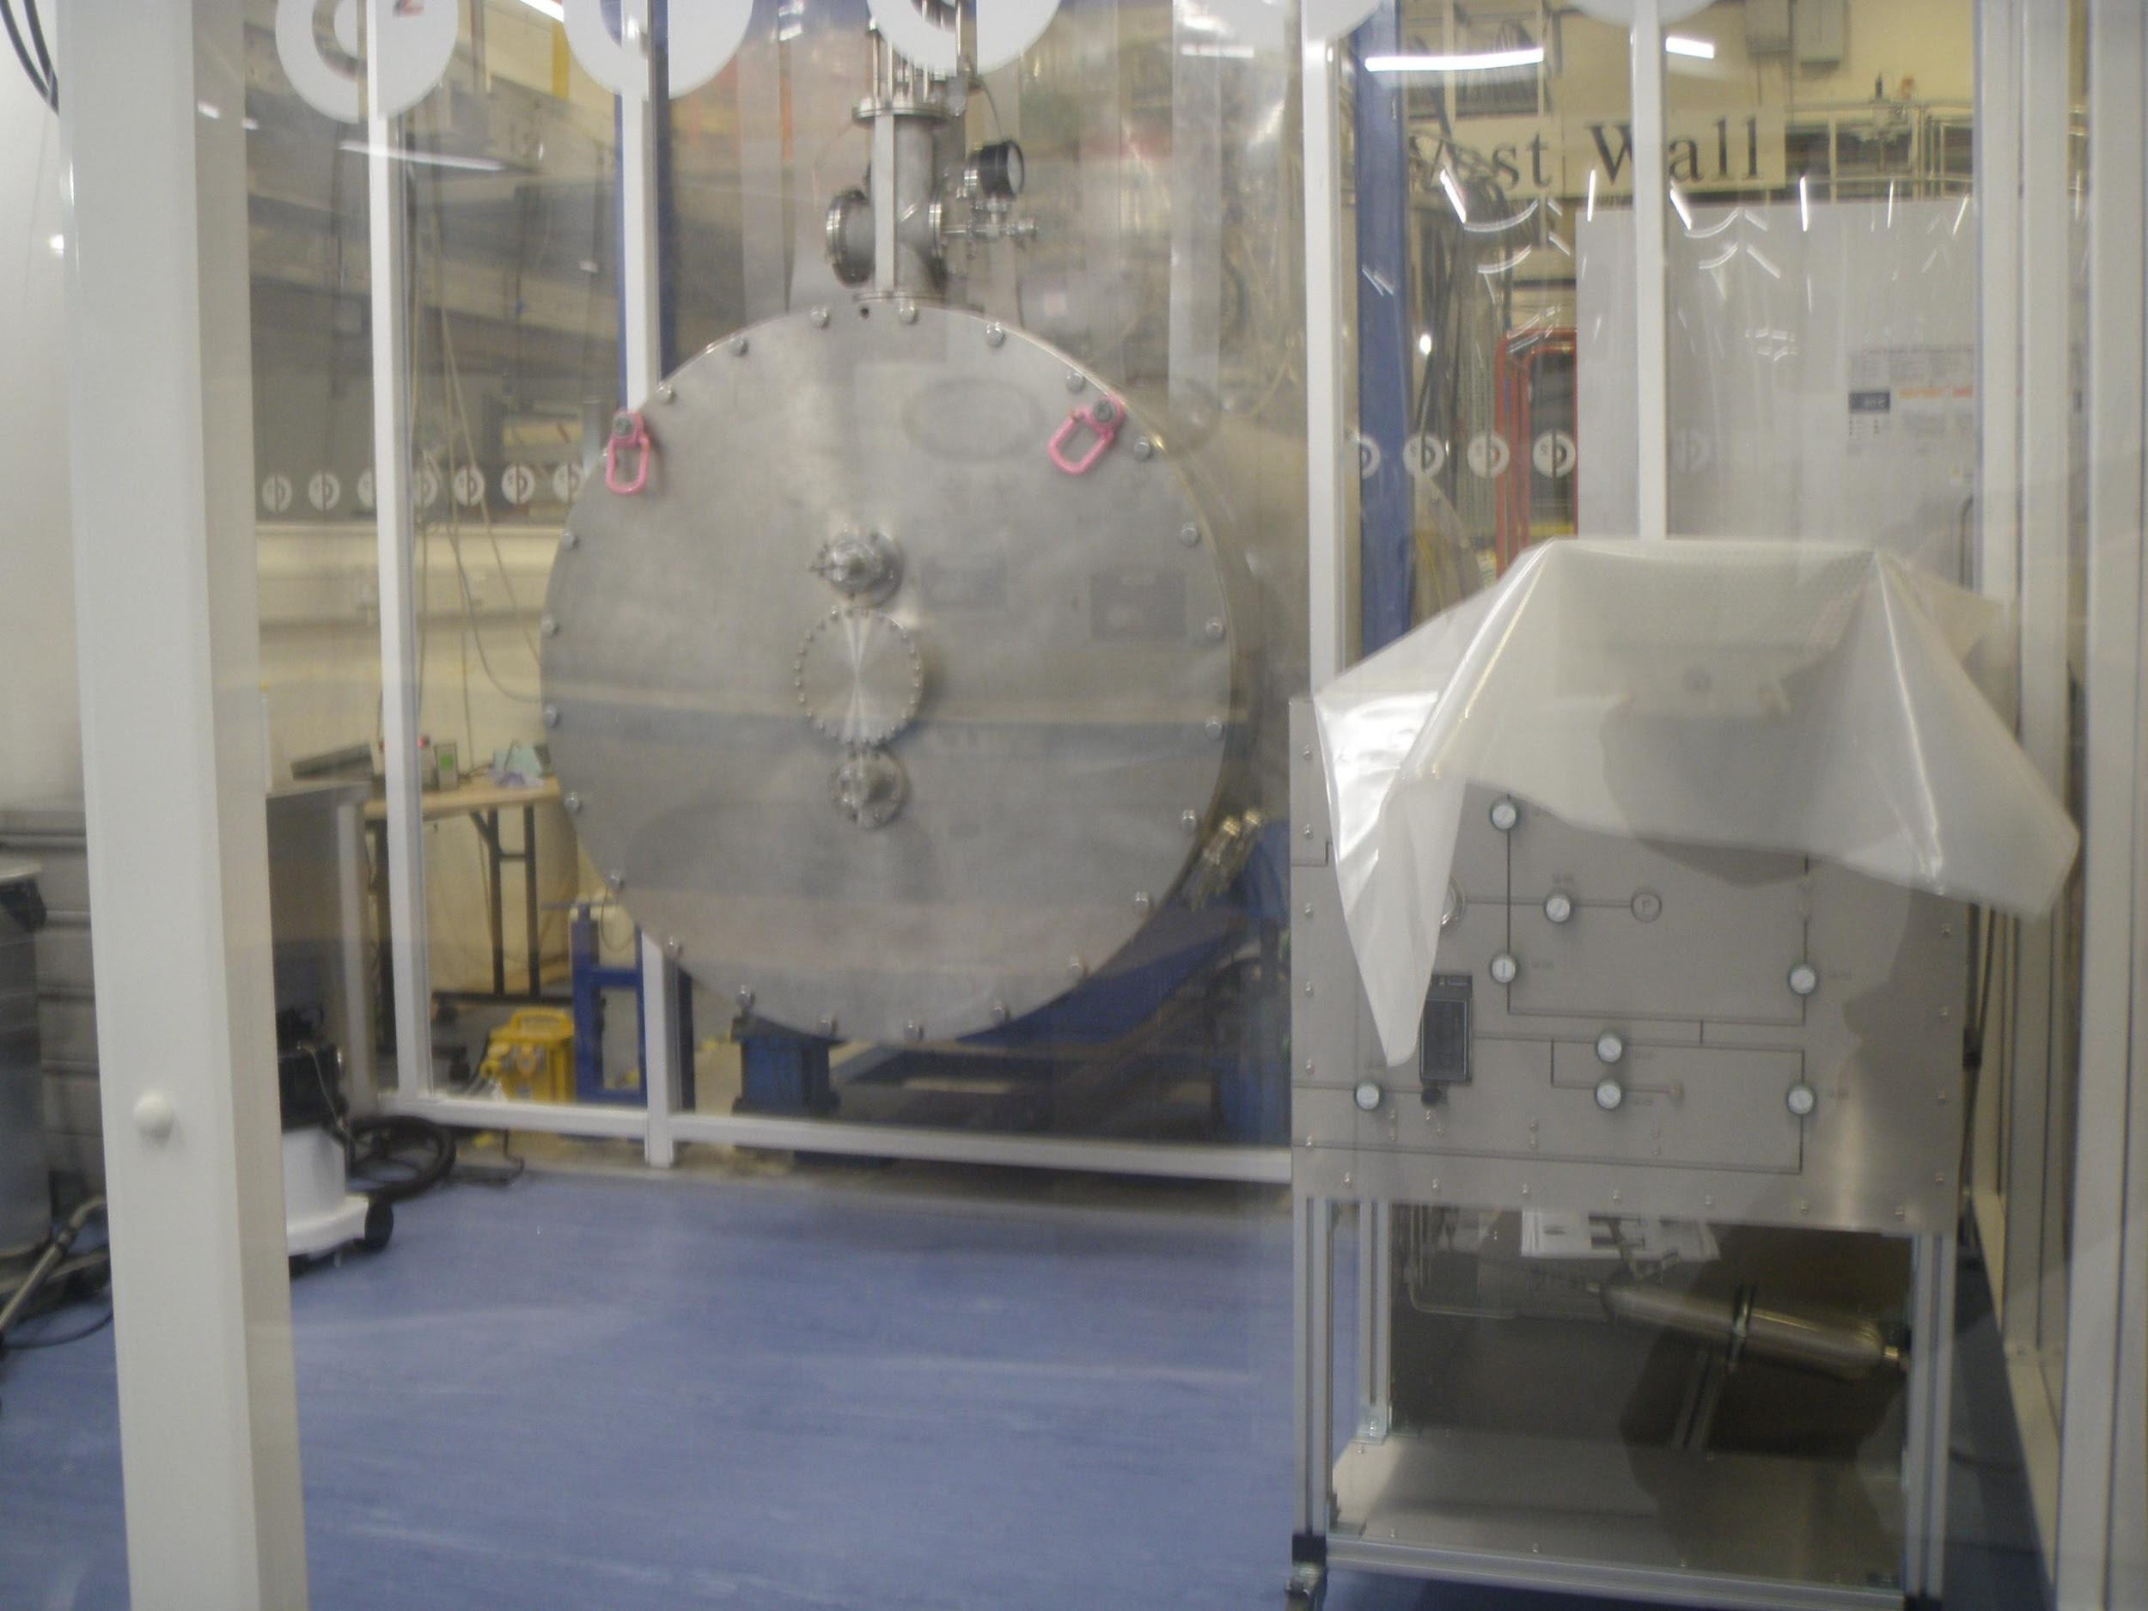
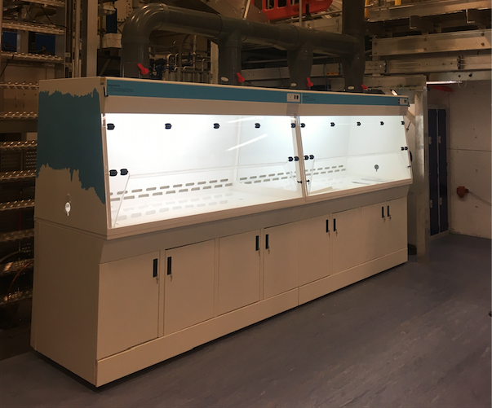
Experimental Hall R5.2
Cold Radon Emanation Facility

Slide 7
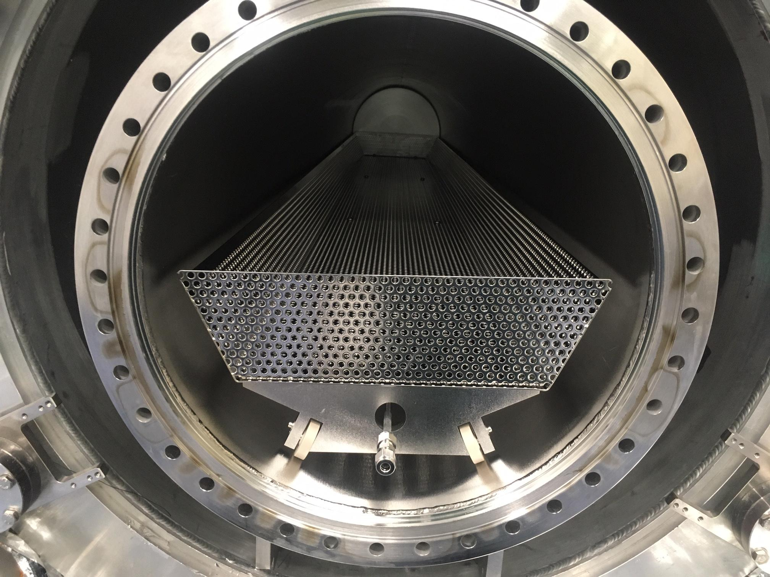
Radon vessel installation

Slide 8
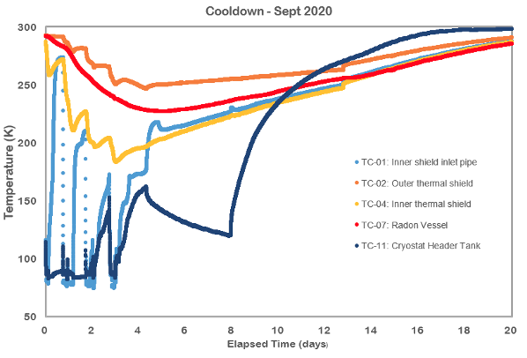
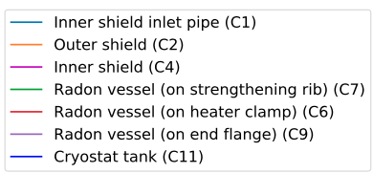
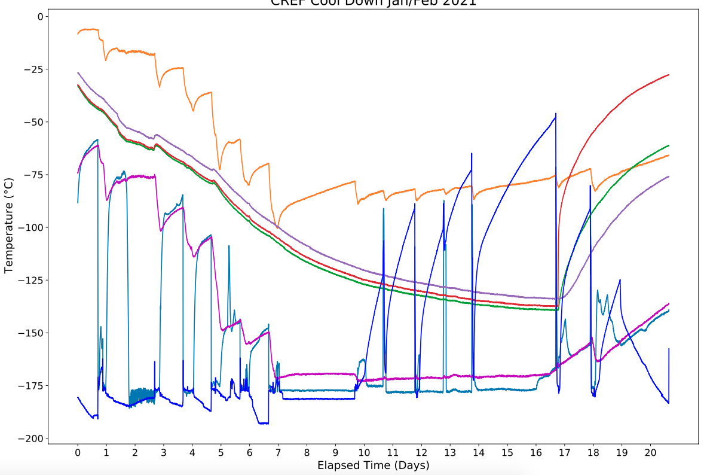
Cryogenic Cooldowns
Cool down 1
LN₂ cooldown of main tank and Rn vessel
Cool down 2
LN₂ cooldown of main tank and Rn vessel
“bare” cooldown: filling with cryogens only
Heaters installed operated on Rn vessel

Slide 9
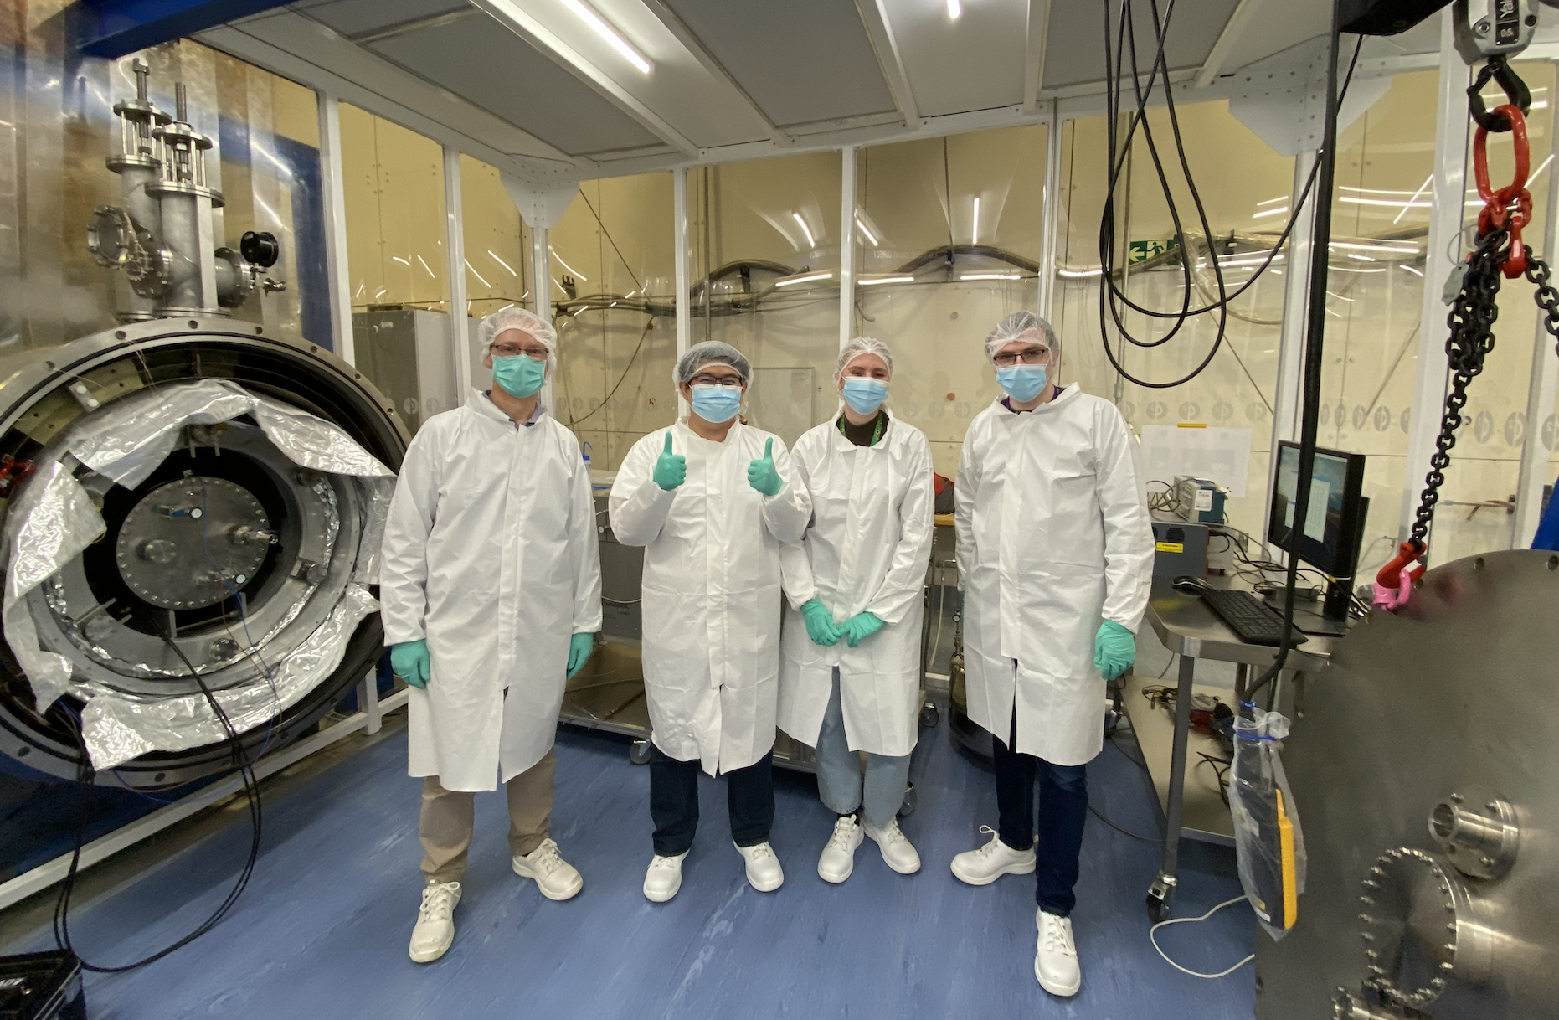
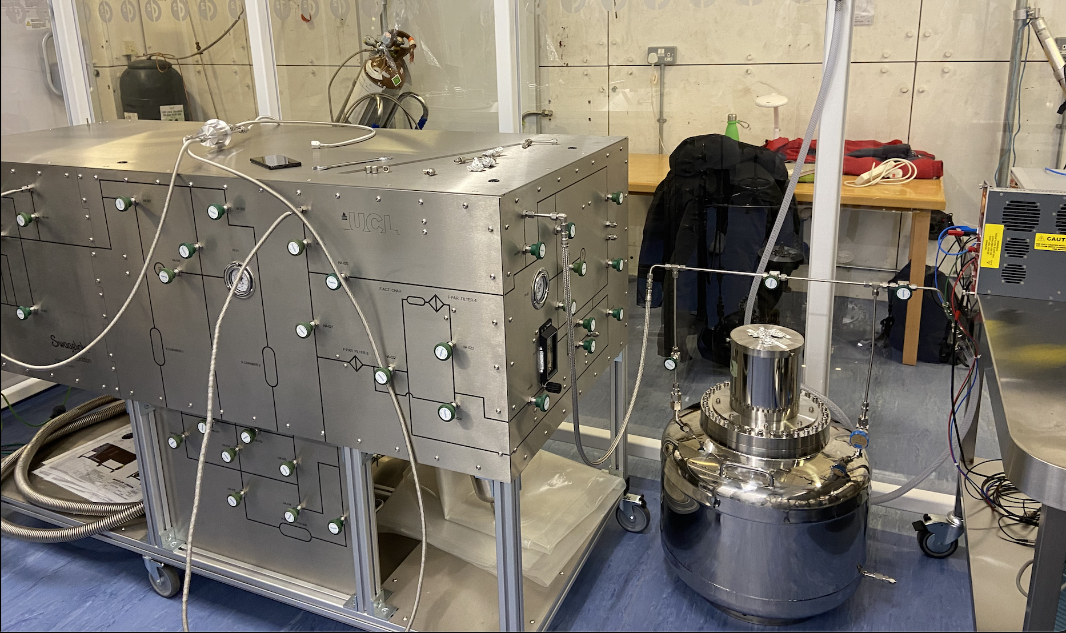
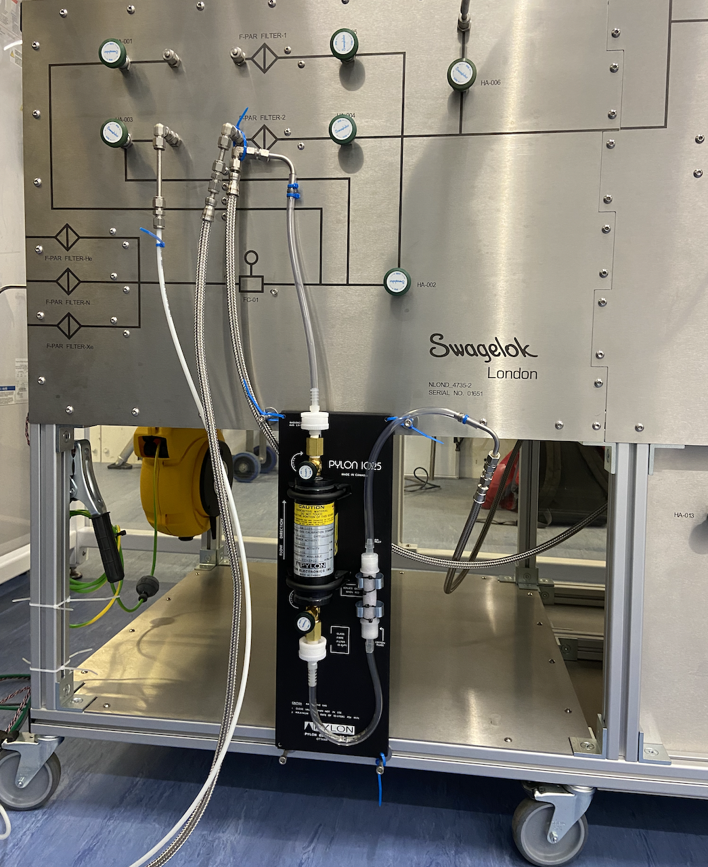
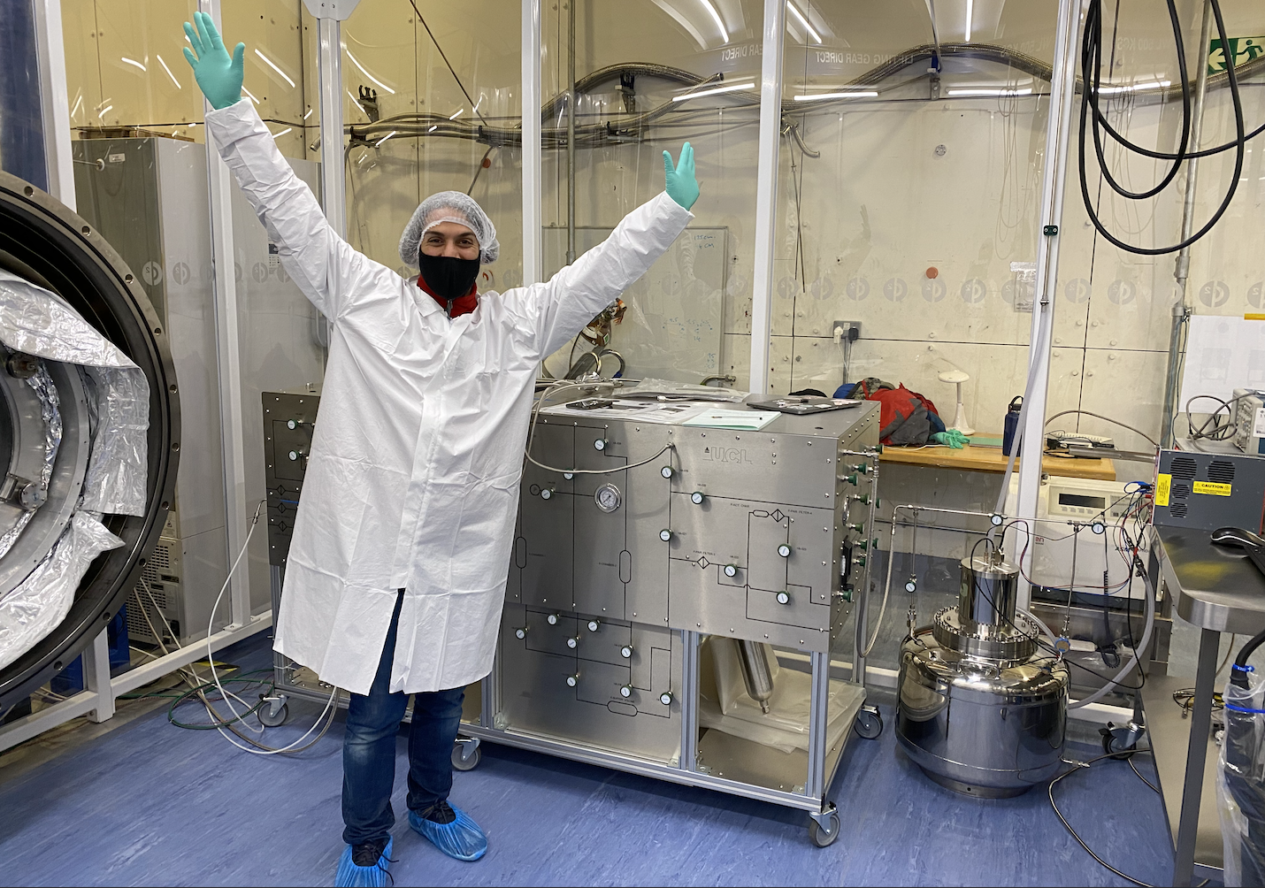
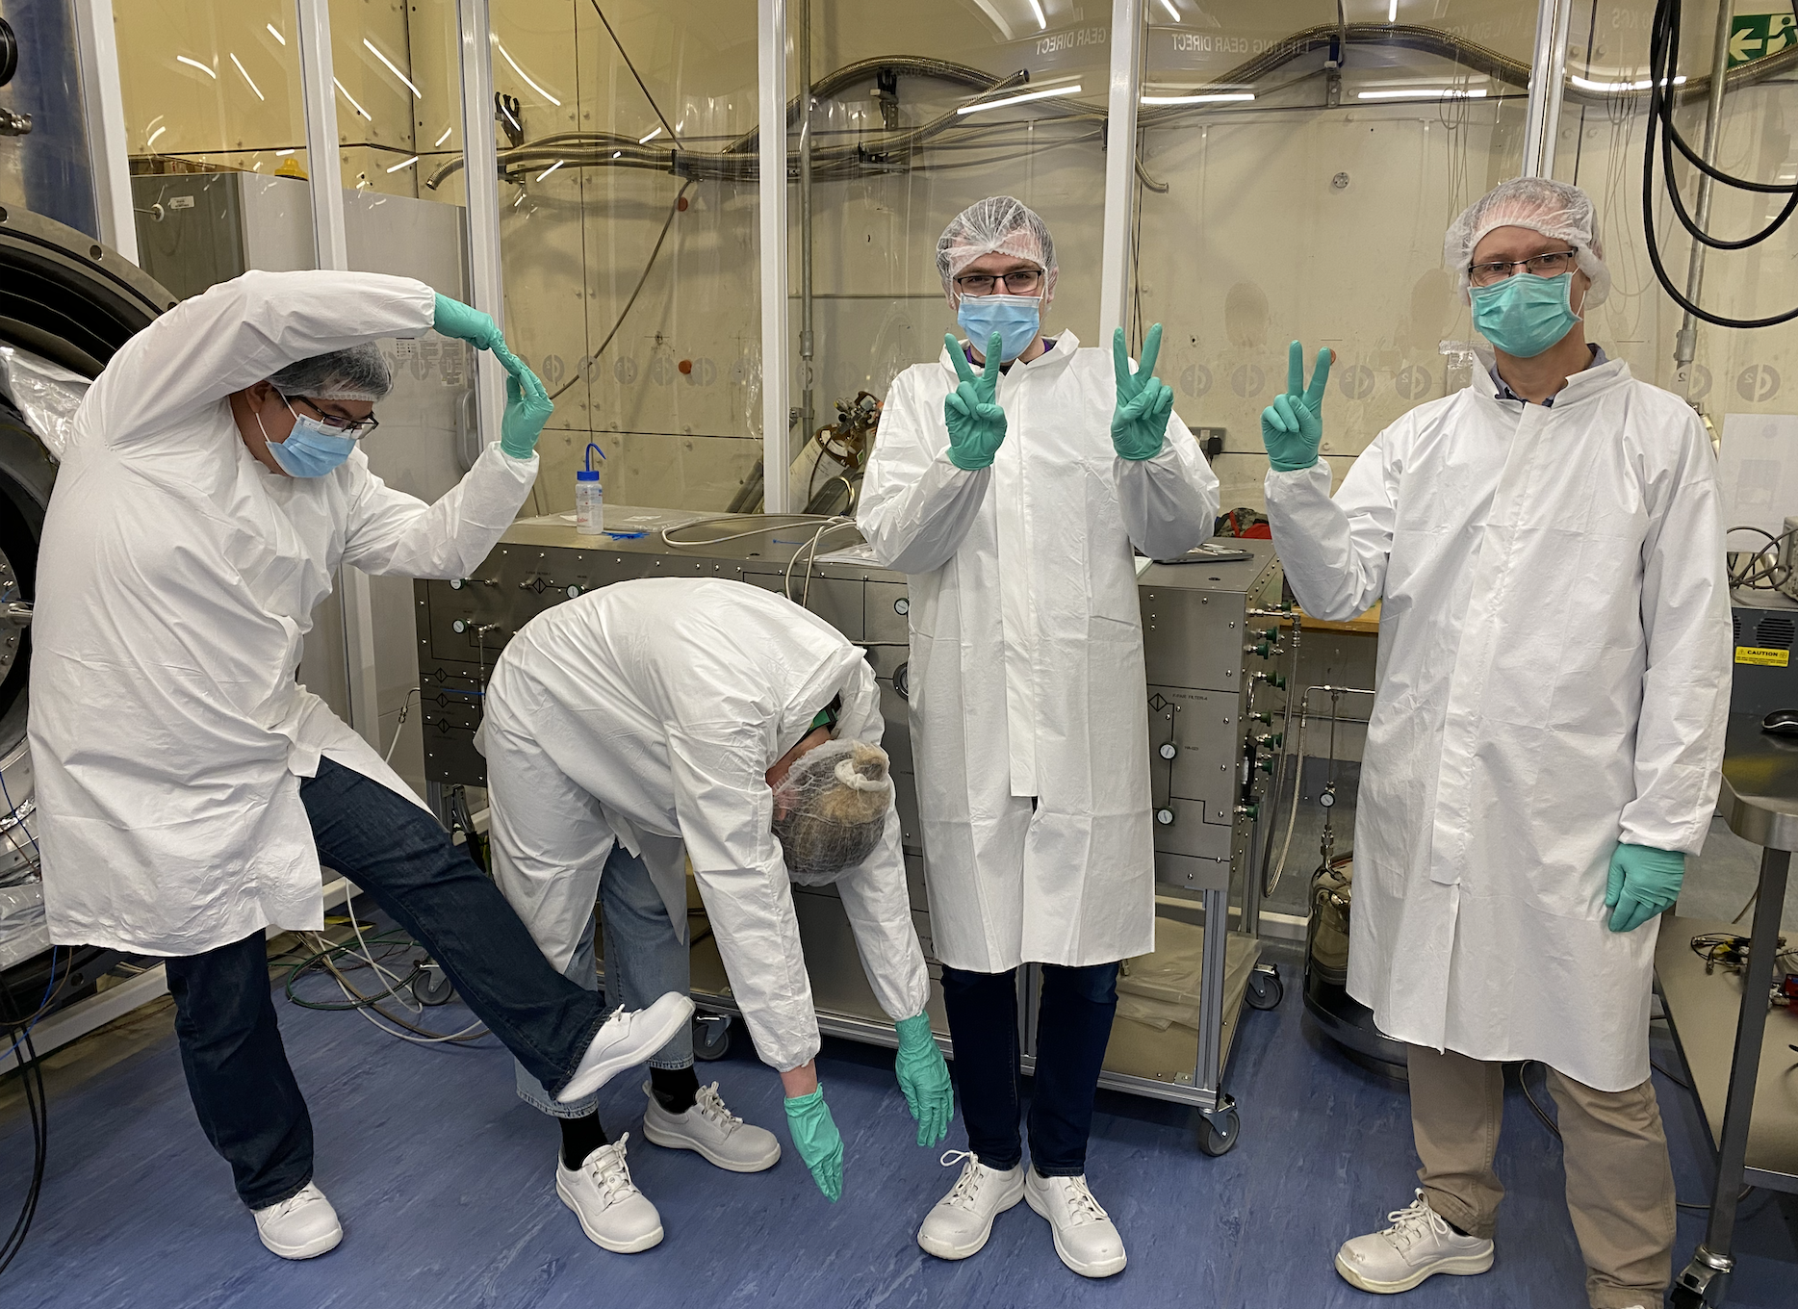
Detector calibration

Slide 10
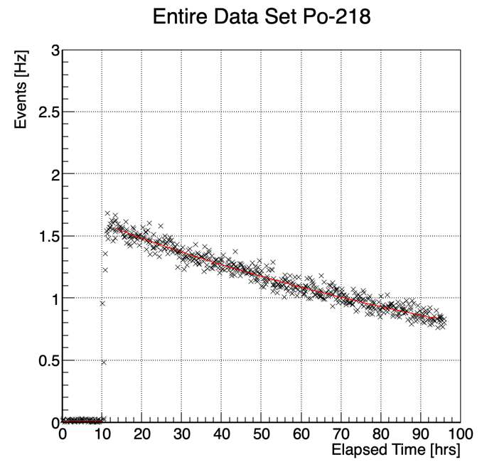
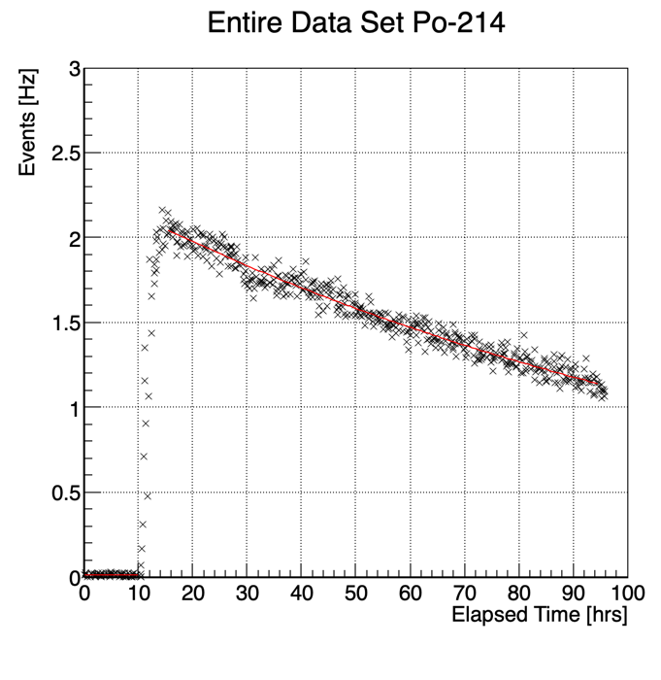
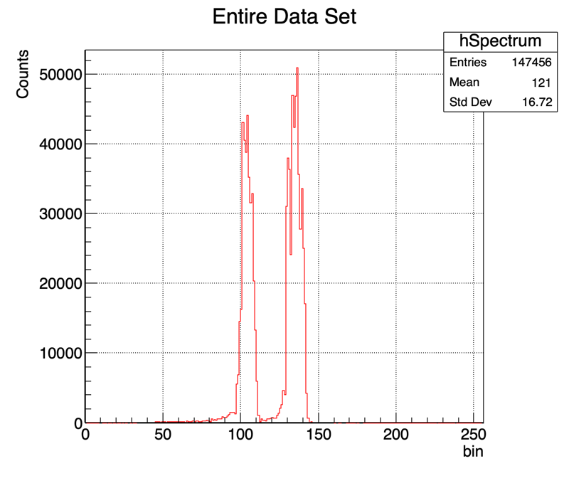
First Detector Calibration at CREF – May 2022
Transfer a known amount of radon into the detector to determine its detection efficiency.
Po218 (6.1 MeV)
Po214 (7.8 MeV)
Everything appears as expected:
Peak energy positions agree with values seen in UCL calibration.
Po218 and Po214 activity curves corresponds to Rn222 half life and distribution as expected.

Slide 11
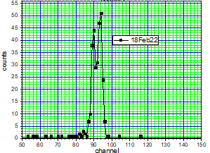
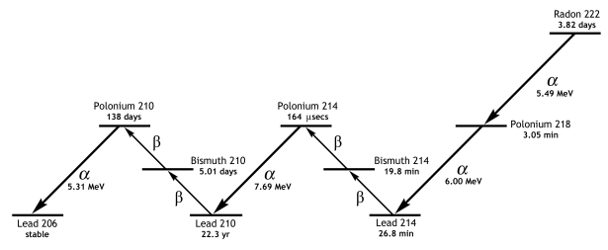
Some energy spectra post Rn injection
²²²Rn moved-to/kept-in detector
²²²Rn flushed out of detector

Slide 12
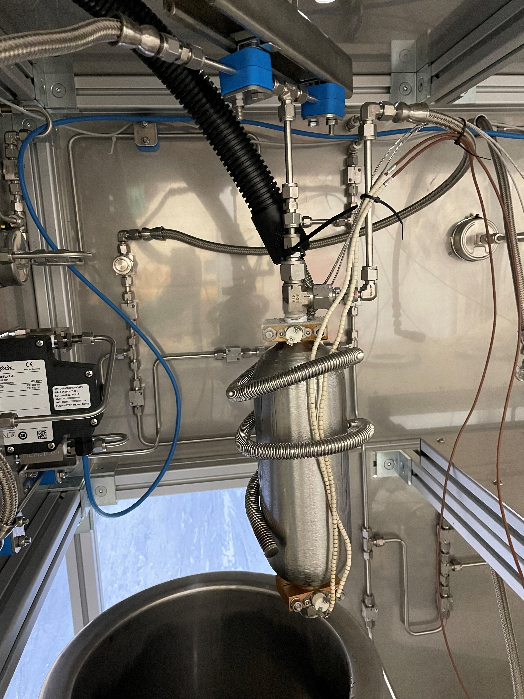
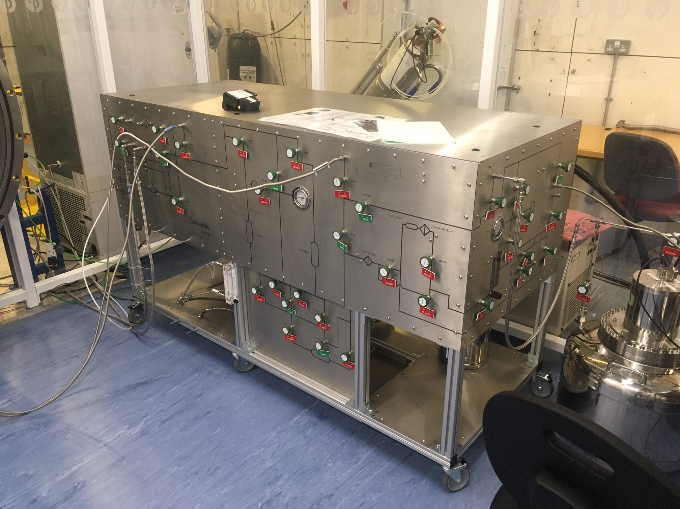
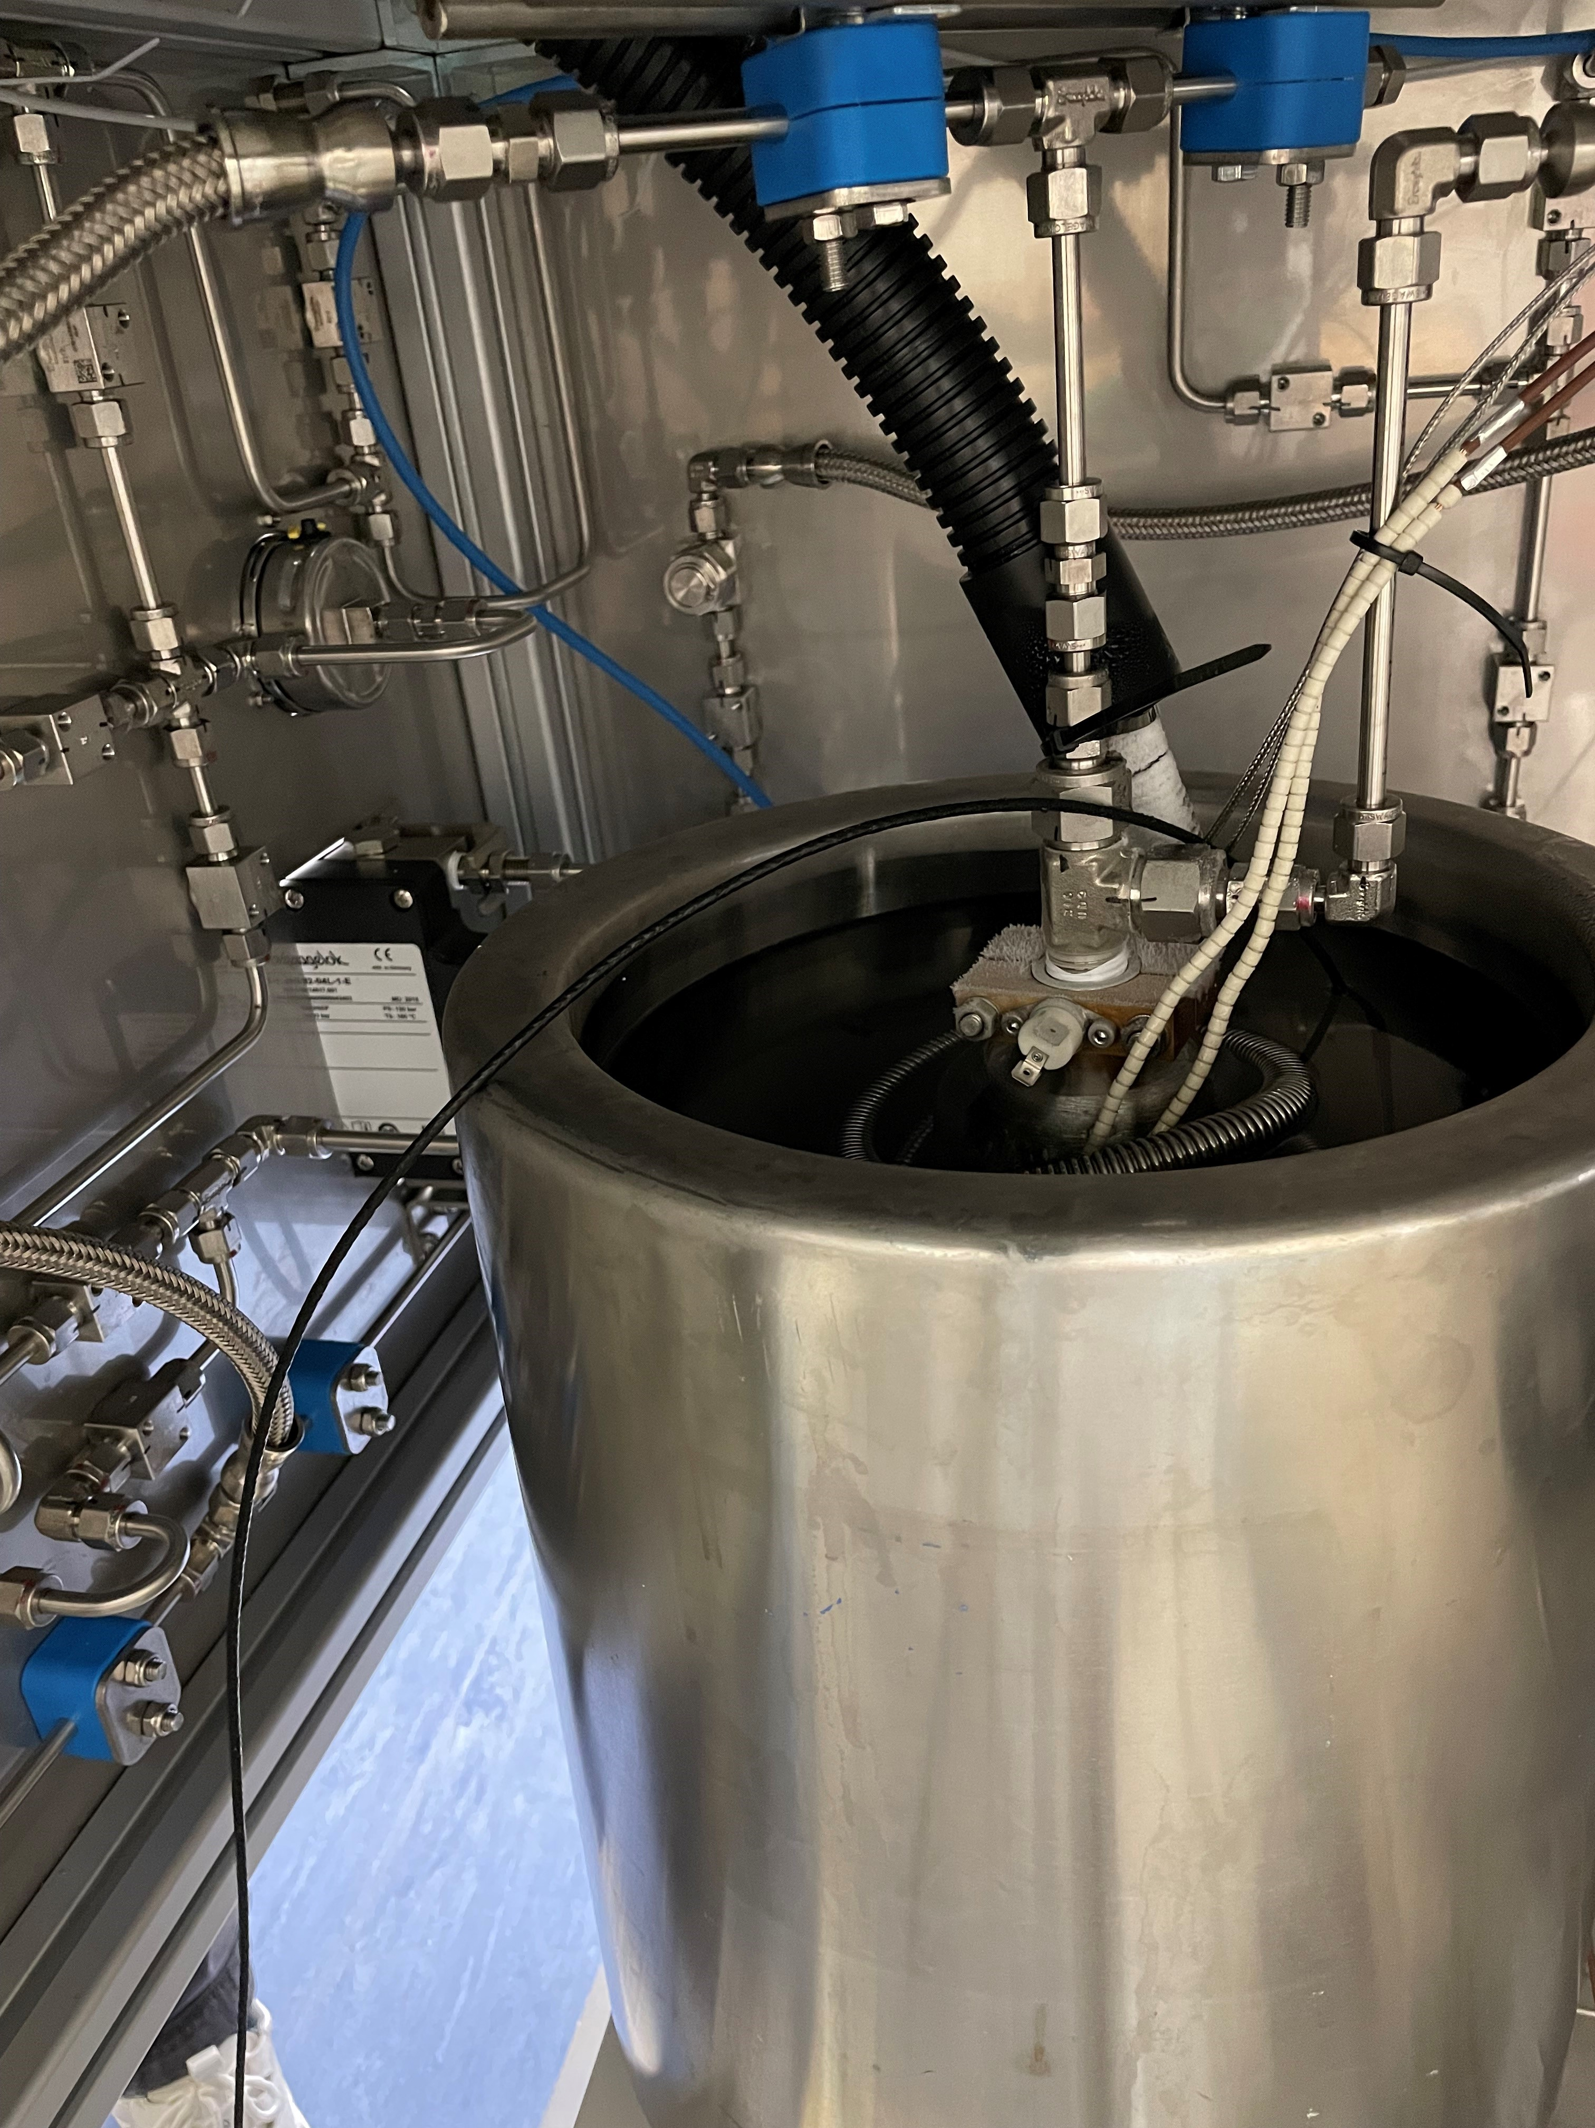
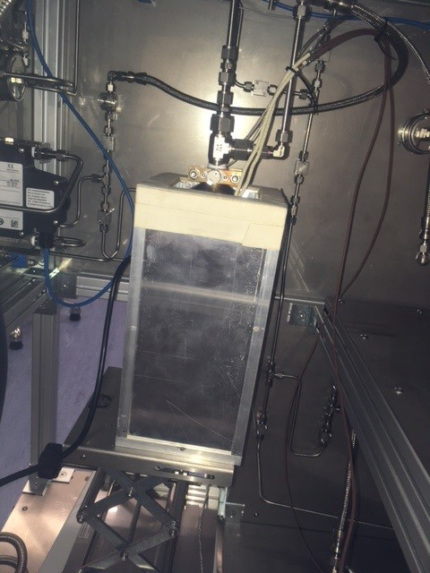
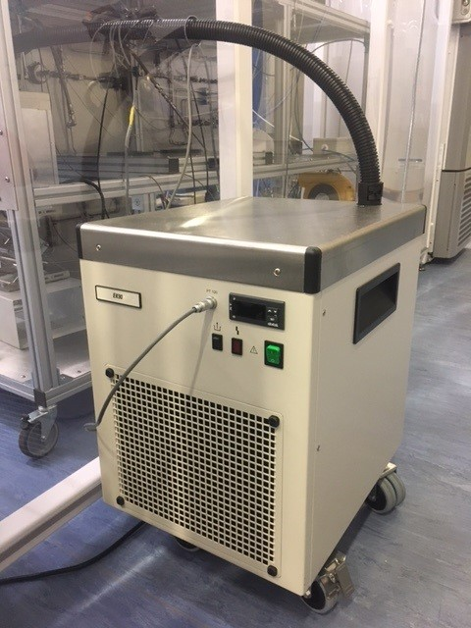
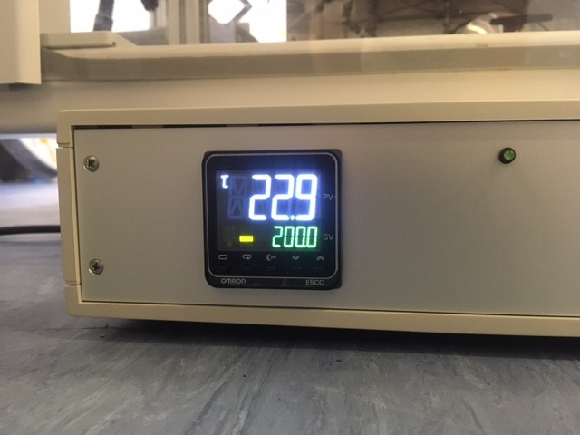
Gas trap
Trap with
cooling coil
Radon concentration line with detector
Trap in
heating box
OMRON
temperature controller
Trap in cooled
ethanol
EK90 chiller
(to –90 C)

Slide 13
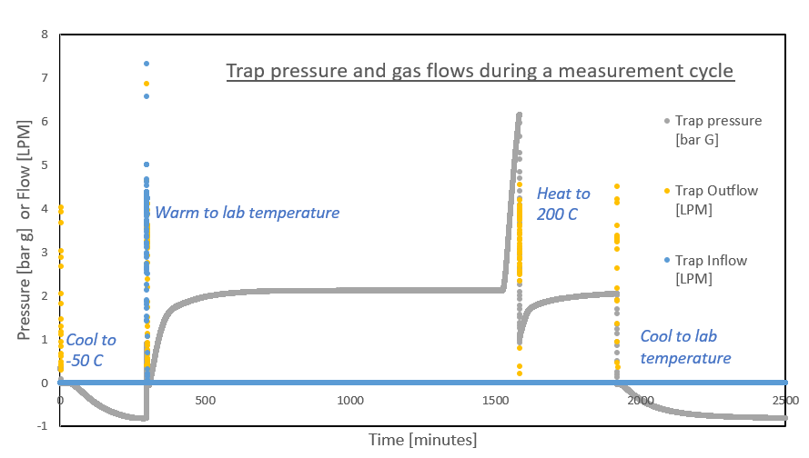
A typical measurement cycle Start with trap at lab temperature, flushed with N2 gas, and at atmospheric pressure

Slide 14
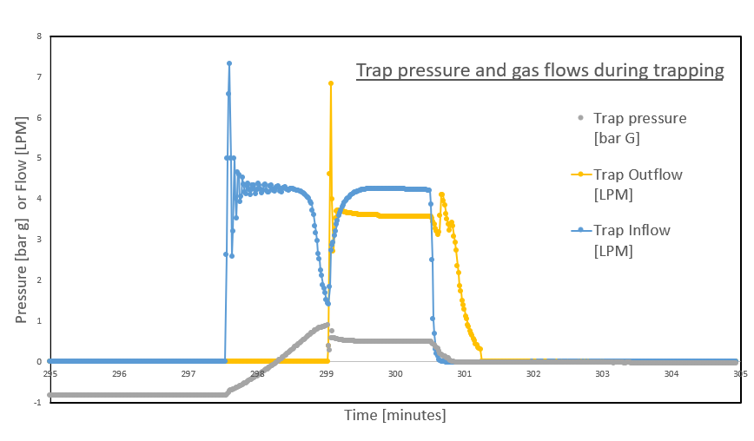
Gas trapping at T = -50 C

Slide 15
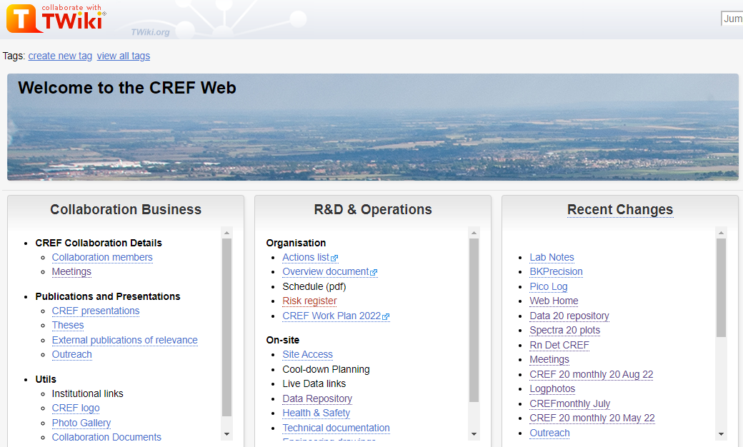
Cold Radon Emanation Facility TWiki

Slide 16
Outlook
By end of 2022: first cold emanation run
2023: further characterising/optimising operational specs
2024: fully operational as facility
Part of G3 programme (post Xenon Futures)
Soon: measure Rn trapping efficiency
Currently looking into apprenticeship for CREF, joint with TD

Slide 17
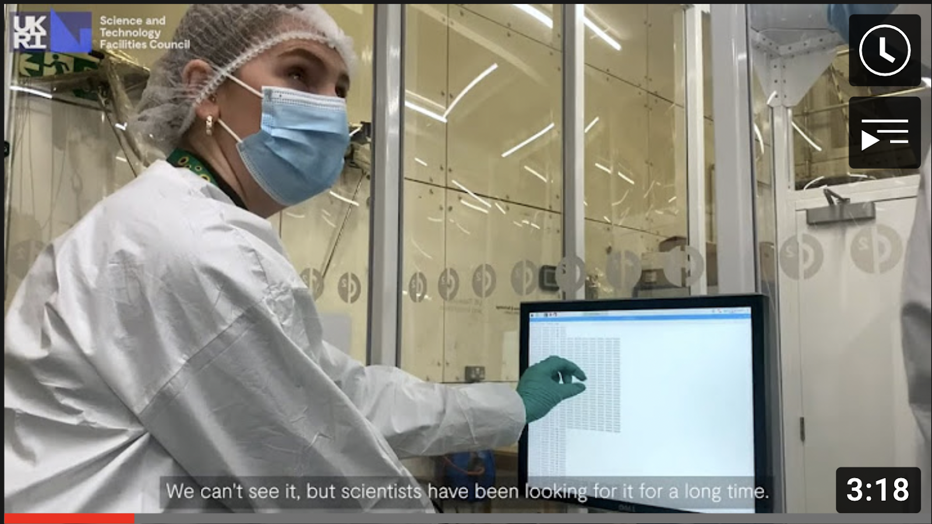
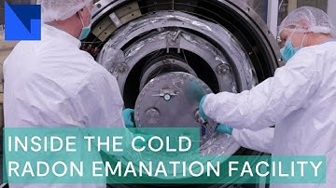
Reasons to be cheerful (x3)
Facility on track to deliver sensitive cold Rn emanation measurement:
Cryogenics tested & operational
Detector calibrated and performing to spec
RnCL, cold trap, calibrations being conducted
Community building around Facility
Facility to be centre-stage in the design of next generation rare-event searches: G3, 0ν2β, …

