Slide 1

CI-Mag-106 - Conventional Magnets for Accelerators
Lecture 3
Dr Alex Bainbridge
Magnetics and Radiation Sources Group
ASTeC
Daresbury Laboratory
alex.bainbridge@stfc.ac.uk

Slide 2
Contents – Lecture 3
Moving from DC to AC magnets
  Eddy current effects
  Skin depth
  Material properties and choices
Fast magnets
  Correctors
  Kickers
  Septums
Beam injection and extraction
  Single turn
  Multi-turn
  Magnet Requirements

Slide 3
From DC to AC

Slide 4
Why do we need AC?
Important note: The definition of AC here is not just a sin/cos wave, it includes any rapidly changing magnet including pulsed magnets!
Typical reasons why AC magnets are important:
Synchrotrons and booster rings need to ramp up the magnetic field strength as beam energy increases
Injection and extraction of bunches from rings without disturbing other bunches needs fast on/off switching of magnets
Magnetic correctors that may need to suddenly change their field strength/direction to compensate for rapid changes in the beam
Where a magnet is extremely strong and causes a high heat load, pulsing the current can help reduce average power dissipation

Slide 5
Differences to DC Magnets
There are major differences between DC and AC magnets:
Magnet excitation now includes an inductive component. Magnet yokes are now inductors, how much this matters depends on frequency/rise time.
Eddy currents are now a significant factor in both the magnet steel and the beam pipe. These generate perturbing fields that may affect the beam.
As well as DC resistance in the coils there are now ‘AC’ losses, where we must design to account for losses including hysteresis and eddy currents.

Slide 6
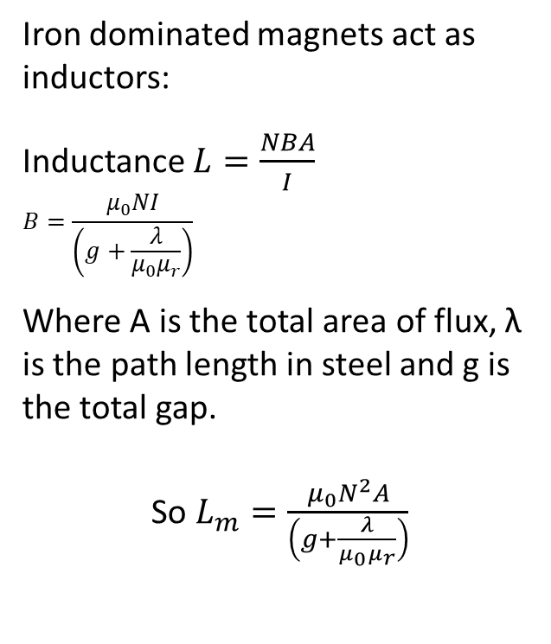
AC circuit
Iron dominated magnets act as inductors:
Inductance $L=\frac{NBA}{I}$
$$B=\frac{μ_{0}NI}{\left(g+\frac{λ}{μ_{0}μ_{r}}\right)}$$
Where A is the total area of flux, λ is the path length in steel and g is the total gap.
So $L_{m}=\frac{μ_{0}N^{2}A}{\left(g+\frac{λ}{μ_{0}μ_{r}}\right)}$
Equivalent circuit of an AC magnet
Rac
Rdc
Lm
Im
Cleakage

Slide 7
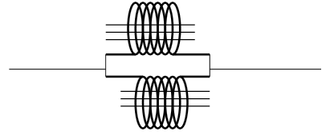


Inductance stacking
Beware of powering multiple AC coils!
2 coils with no mutual coupling behave like resistors:
Inductance in series = 2L Inductance in parallel = L/2
Coils on the same yoke will couple:
Inductance in series = 4L (as L α N²!) Inductance in parallel = L

Slide 8
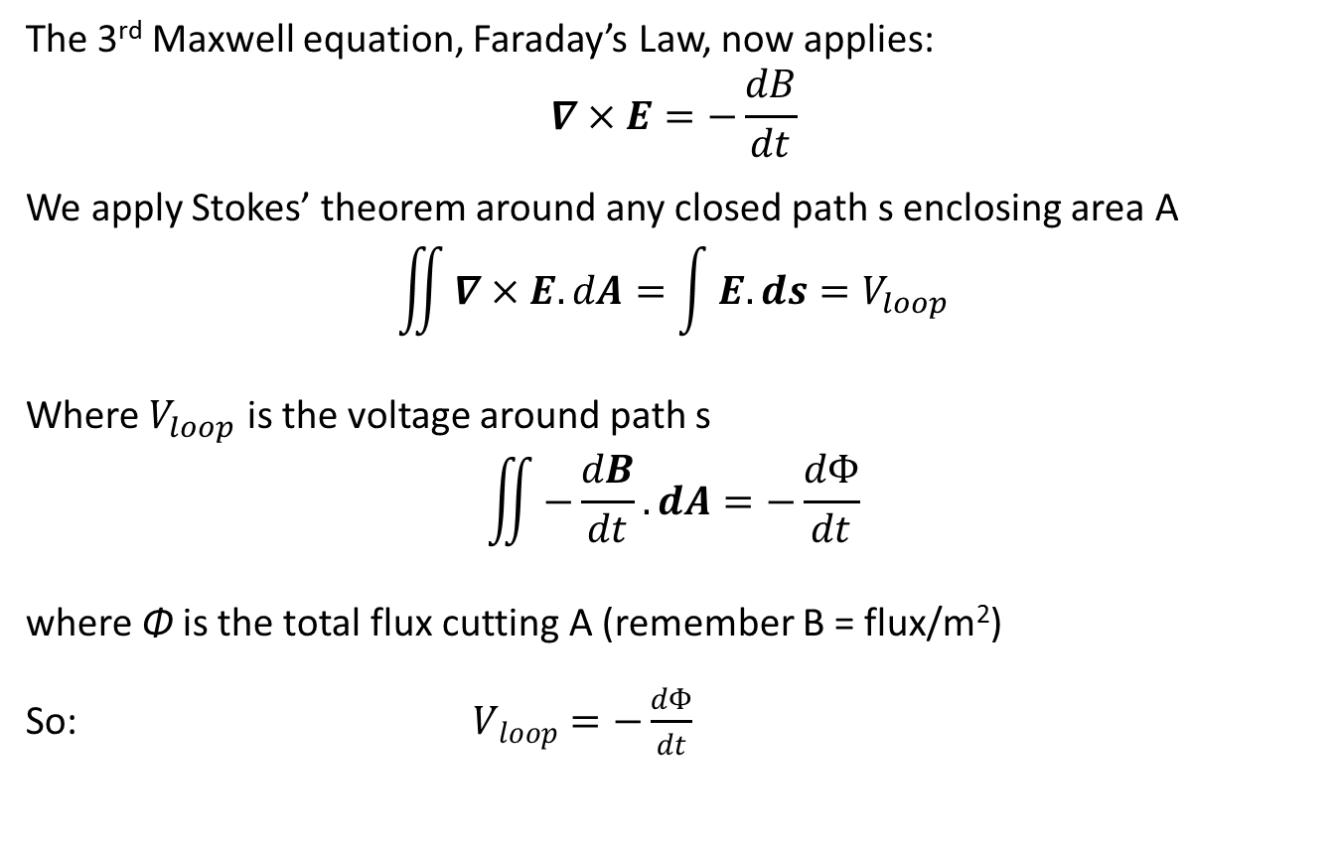
Maxwell in AC
The 3rd Maxwell equation, Faraday’s Law, now applies:
$$∇×E=−\frac{dB}{dt}$$
We apply Stokes’ theorem around any closed path s enclosing area A
$$\iint{∇×E.dA}=\int{E.ds}=V_{loop}$$
Where $V_{loop}$ is the voltage around path s
$$\iint{−\frac{dB}{dt}.dA}=−\frac{dΦ}{dt}$$
where Φ is the total flux cutting A (remember B = flux/m²)
So: $V_{loop}=−\frac{dΦ}{dt}$

Slide 9
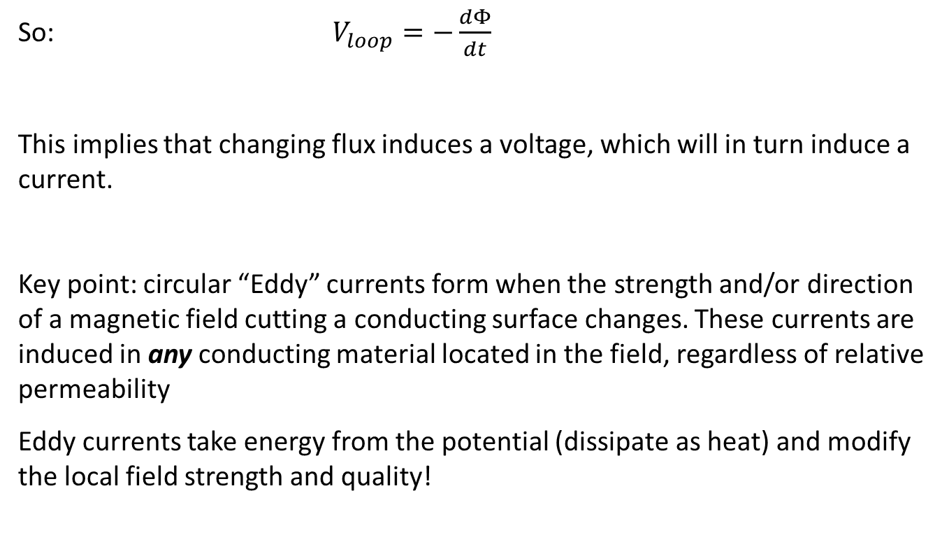
Maxwell in AC
So: $V_{loop}=−\frac{dΦ}{dt}$
This implies that changing flux induces a voltage, which will in turn induce a current.
Key point: circular “Eddy” currents form when the strength and/or direction of a magnetic field cutting a conducting surface changes. These currents are induced in any conducting material located in the field, regardless of relative permeability
Eddy currents take energy from the potential (dissipate as heat) and modify the local field strength and quality!

Slide 10
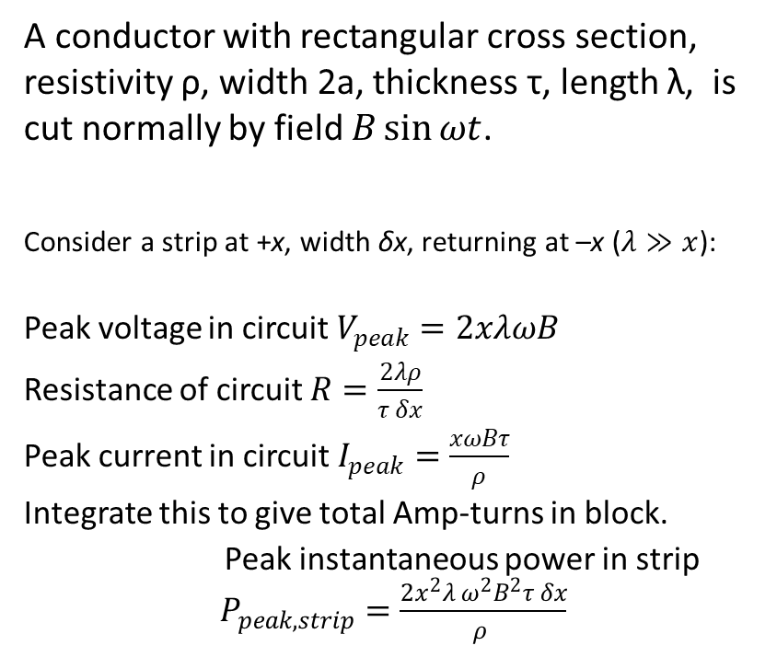

Conductor eddy currents
A conductor with rectangular cross section, resistivity ρ, width 2a, thickness τ, length λ, is cut normally by field $B\sin{ωt}$.
Consider a strip at +x, width δx, returning at –x ($λ≫x$):
Peak voltage in circuit $V_{peak}=2xλωB$
Resistance of circuit $R=\frac{2λρ}{τ δx}$
Peak current in circuit $I_{peak}=\frac{xωBτ}{ρ}$
Integrate this to give total Amp-turns in block.
Peak instantaneous power in strip $P_{peak,strip}=\frac{2x^{2}λ ω^{2}B^{2}τ δx}{ρ }$
δx
$$Bsin ωt$$
τ
λ
-a -x 0 x a
Cross section A

Slide 11
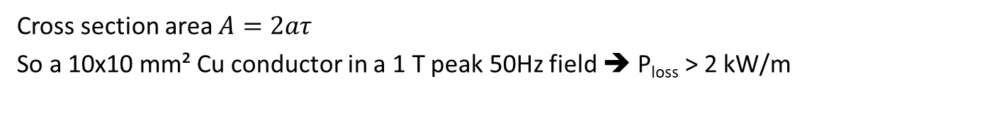
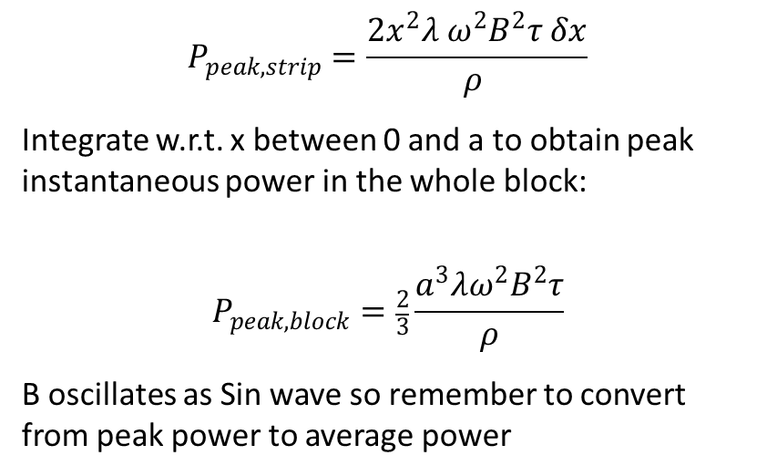
Conductor eddy currents
$$P_{peak,strip}=\frac{2x^{2}λ ω^{2}B^{2}τ δx}{ρ }$$
Integrate w.r.t. x between 0 and a to obtain peak instantaneous power in the whole block:
$$P_{peak,block}=\frac{2}{3}\frac{a^{3}λω^{2}B^{2}τ}{ρ}$$
B oscillates as Sin wave so remember to convert from peak power to average power
δx
$$Bsin ωt$$
τ
λ
-a -x 0 x a
Cross section A
Cross section area $A=2aτ$
So a 10x10 mm² Cu conductor in a 1 T peak 50Hz field ➔ P_{loss} > 2 kW/m

Slide 12
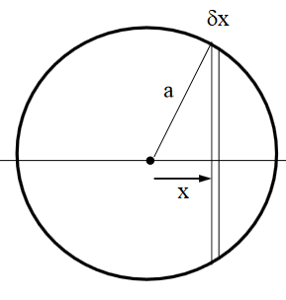
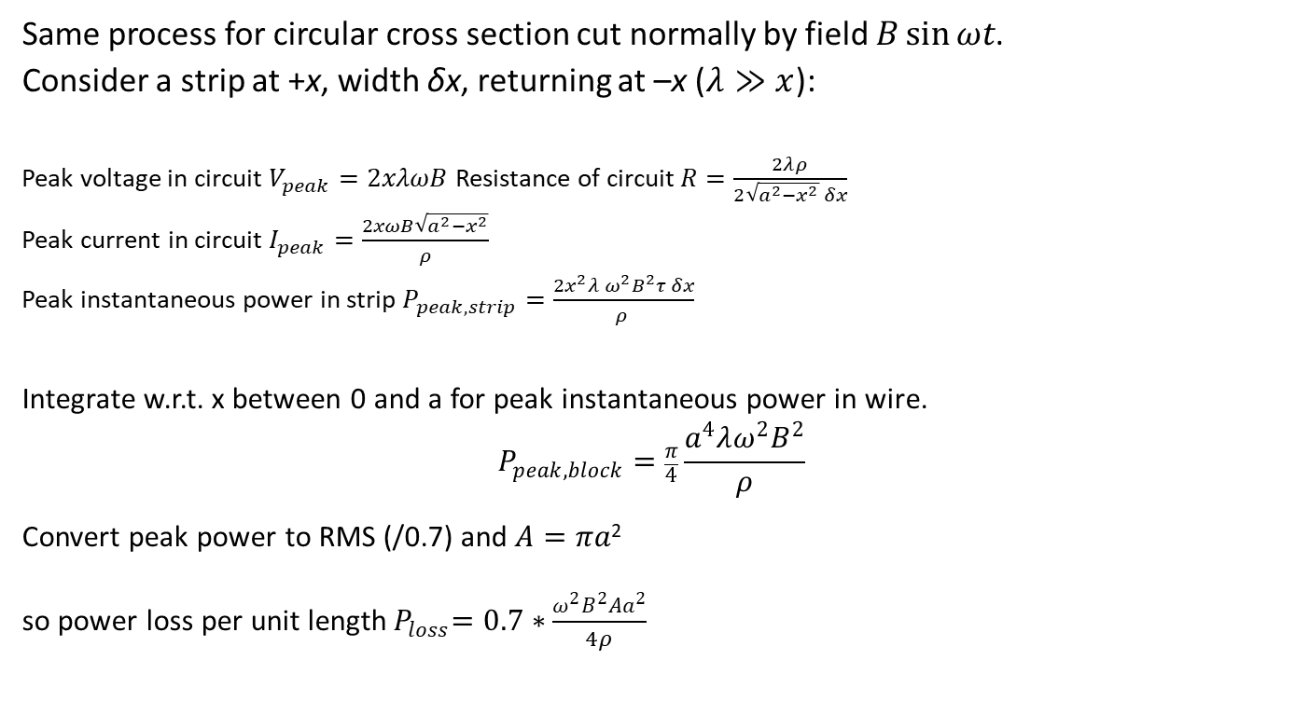
Conductor eddy currents
Same process for circular cross section cut normally by field $B\sin{ωt}$.
Consider a strip at +x, width δx, returning at –x ($λ≫x$):
Peak voltage in circuit $V_{peak}=2xλωB$Resistance of circuit $R=\frac{2λρ}{2\sqrt{a^{2}−x^{2}} δx}$
Peak current in circuit $I_{peak}=\frac{2xωB\sqrt{a^{2}−x^{2}}}{ρ}$
Peak instantaneous power in strip $P_{peak,strip}=\frac{2x^{2}λ ω^{2}B^{2}τ δx}{ρ }$
Integrate w.r.t. x between 0 and a for peak instantaneous power in wire.
$$P_{peak,block}=\frac{π}{4}\frac{a^{4}λω^{2}B^{2}}{ρ}$$
Convert peak power to RMS (/0.7) and $A=πa$²
so power loss per unit length${ P}_{loss}=0.7∗\frac{ω^{2}B^{2}Aa^{2}}{4ρ}$

Slide 13
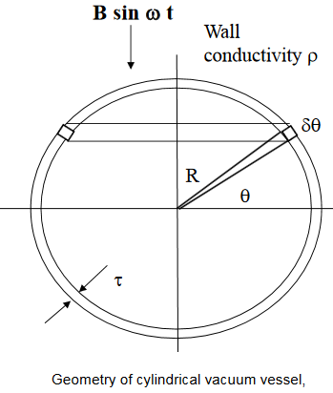
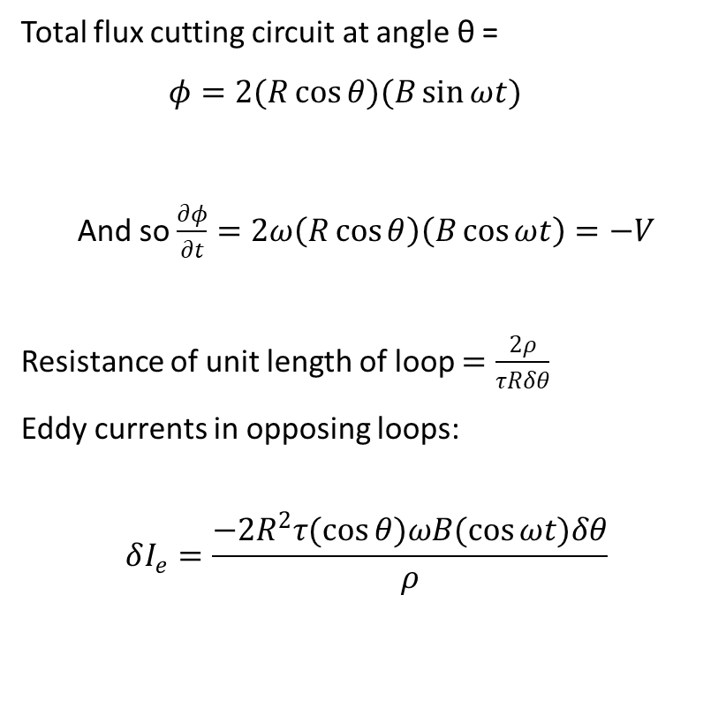
Eddy currents in a cylindrical vacuum vessel
Total flux cutting circuit at angle θ =
$φ=2(R\cos{θ})(B\sin{ωt})$
And so $\frac{∂φ}{∂t}=2ω\left(R\cos{θ}\right)\left(B\cos{ωt}\right)=−V$
Resistance of unit length of loop $=\frac{2ρ}{τRδθ}$
Eddy currents in opposing loops:
$$δI_{e}=\frac{−2R^{2}τ(\cos{θ)ωB(\cos{ωt)δθ}}}{ρ}$$

Slide 14
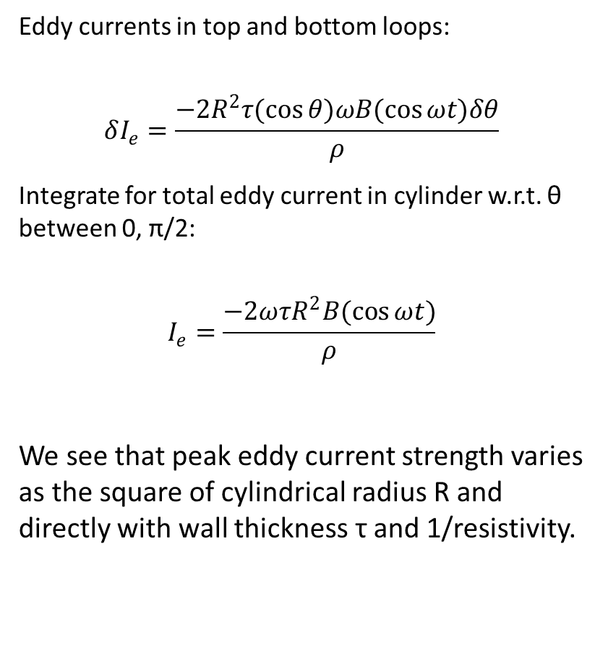
Eddy currents in a cylindrical vacuum vessel
Eddy currents in top and bottom loops:
$$δI_{e}=\frac{−2R^{2}τ(\cos{θ)ωB(\cos{ωt)δθ}}}{ρ}$$
Integrate for total eddy current in cylinder w.r.t. θ between 0, π/2:
$$I_{e}=\frac{−2ωτR^{2}B(\cos{ωt})}{ρ}$$
We see that peak eddy current strength varies as the square of cylindrical radius R and directly with wall thickness τ and 1/resistivity.

Slide 15
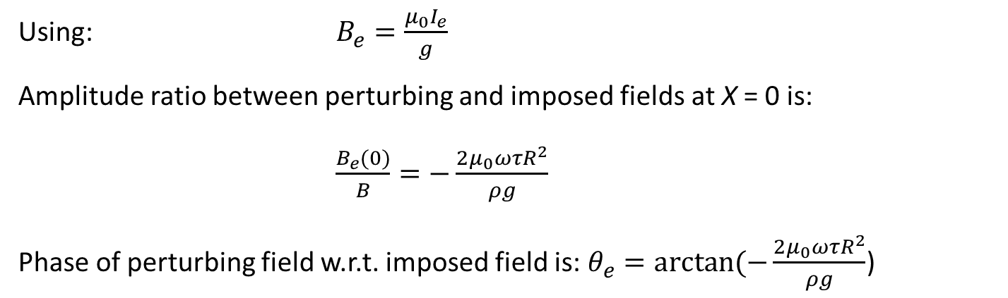
Eddy current perturbations
μ = ∞
If the vacuum vessel is between the poles of a magnet yoke, the eddy currents will couple to that yoke. The yoke geometry therefore determines the perturbing fields.
This analysis assumes that the perturbing field is small compared to the imposed field.
g
R
0
x
Magnet geometry around vessel, radius R
Using: $B_{e}=\frac{μ_{0}I_{e}}{g}$
Amplitude ratio between perturbing and imposed fields at X = 0 is:
$\frac{B_{e}(0)}{B}=−\frac{2μ_{0}ωτR^{2}}{ρg}$
Phase of perturbing field w.r.t. imposed field is: $θ_{e}=\arctan{(−\frac{2μ_{0}ωτR^{2}}{ρg}}$)

Slide 16
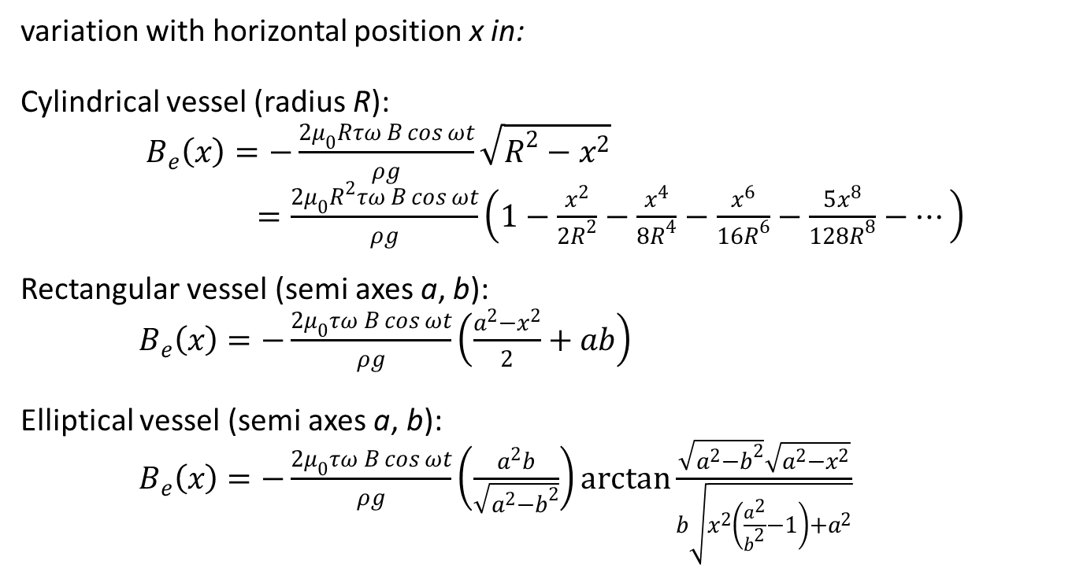
Perturbation distribution
variation with horizontal position x in:
Cylindrical vessel (radius R):
$B_{e}\left(x\right)=−\frac{2μ_{0}Rτω B\cos{ωt}}{ρg}\sqrt{R^{2}−x^{2}}$
$=\frac{2μ_{0}R^{2}τω B\cos{ωt}}{ρg}\left(1−\frac{x^{2}}{2R^{2}}−\frac{x^{4}}{8R^{4}}−\frac{x^{6}}{16R^{6}}−\frac{5x^{8}}{128R^{8}}−⋯\right)$
Rectangular vessel (semi axes a, b):
$B_{e}\left(x\right)=−\frac{2μ_{0}τω B\cos{ωt}}{ρg}\left(\frac{a^{2}−x^{2}}{2}+ab\right)$
Elliptical vessel (semi axes a, b):
$B_{e}\left(x\right)=−\frac{2μ_{0}τω B\cos{ωt}}{ρg}\left(\frac{a^{2}b}{\sqrt{a^{2}−b^{2}}}\right)\arctan{\frac{\sqrt{a^{2}−b^{2}}\sqrt{a^{2}−x^{2}}}{b\sqrt{x^{2}\left(\frac{a^{2}}{b^{2}}−1\right)+a^{2}}}}$

Slide 17
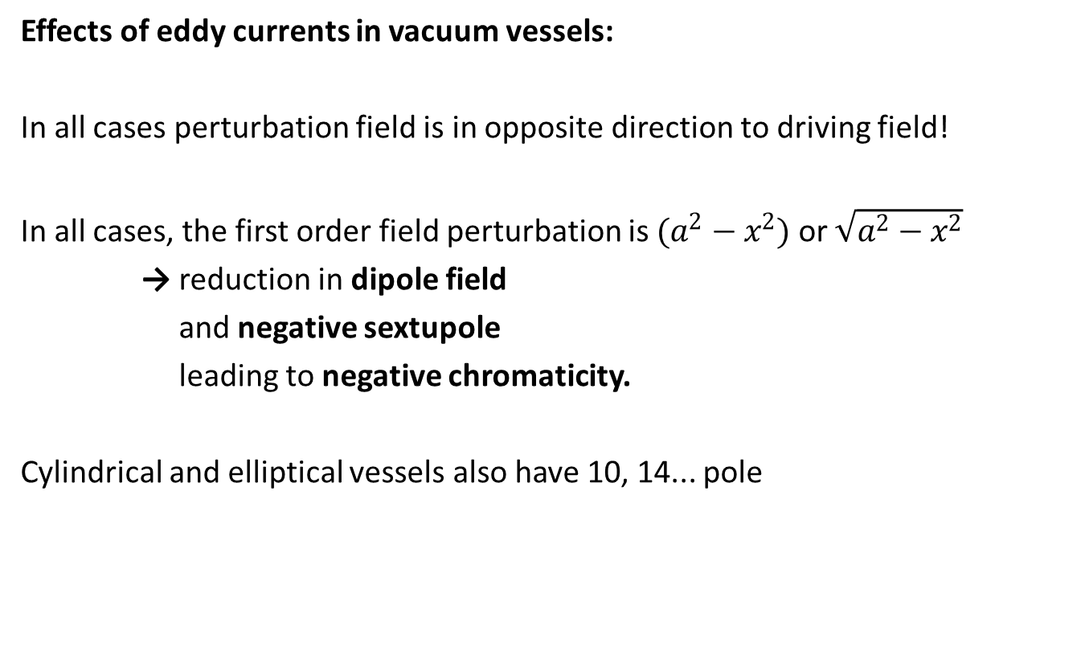
Perturbation effects
Effects of eddy currents in vacuum vessels:
In all cases perturbation field is in opposite direction to driving field!
In all cases, the first order field perturbation is $(a^{2}−x^{2})$ or $\sqrt{a^{2}−x^{2}}$
→ reduction in dipole field
and negative sextupole
leading to negative chromaticity.
Cylindrical and elliptical vessels also have 10, 14... pole

Slide 18

Stainless steel vessels
Example: Ratio of amplitude of perturbing eddy current dipole field to amplitude of imposed field as a function of frequency for three values of stainless steel vessel wall thickness ($R=g/2$)
Calculation invalid in this region

Slide 19

Stainless steel vessels
Phase change (lag) of dipole field applied to beam as a function of frequency for three values of vessel wall thickness ($R=g/2$)
Calculation invalid in this region

Slide 20
“Skin Effect”
Why are our calculations invalid at higher frequencies? AC currents produce their own changing magnetic field, resulting in a counter-electromotive force, a.k.a. a voltage that opposes the change in current that produced it.
This force is strongest at the conductor centre, leading to an effective resistance that decreases radially – AC currents prefer to flow on or close to the surface of the material. This is the “Skin effect”.
The current density J will typically decrease exponentially from the surface to the interior, the distance at which J falls to 1/e is called the “skin depth” δ!

Slide 21
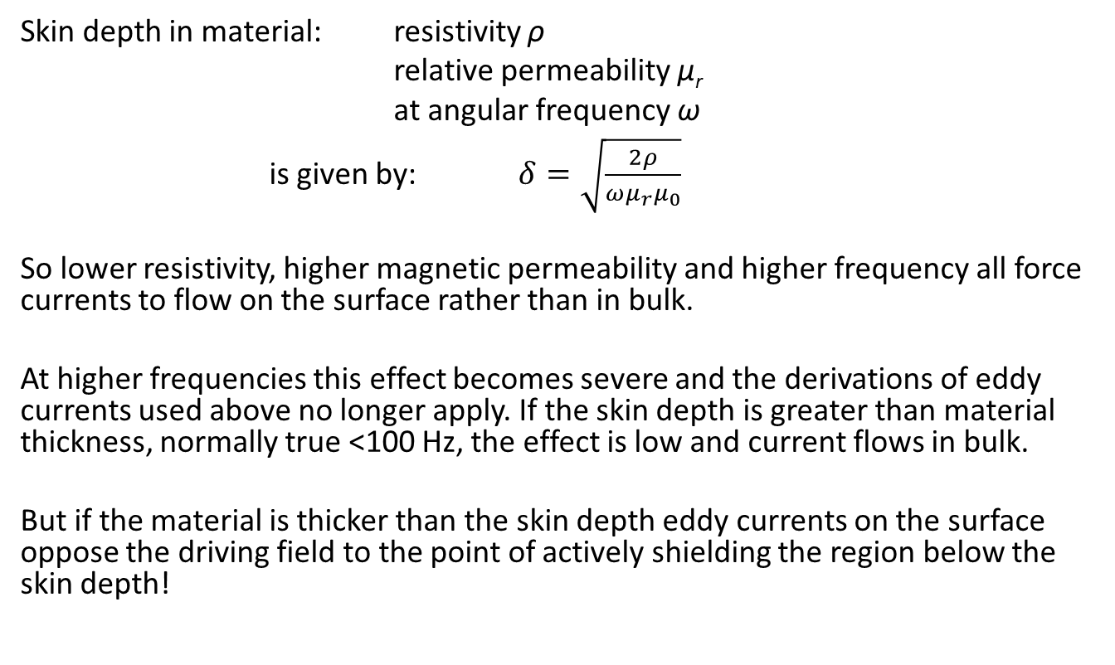
Skin depth
Skin depth in material: resistivity ρ
relative permeability µ_{r}
at angular frequency ω
is given by: $δ=\sqrt{\frac{2ρ}{ωμ_{r}μ_{0}}}$
So lower resistivity, higher magnetic permeability and higher frequency all force currents to flow on the surface rather than in bulk.
At higher frequencies this effect becomes severe and the derivations of eddy currents used above no longer apply. If the skin depth is greater than material thickness, normally true <100 Hz, the effect is low and current flows in bulk.
But if the material is thicker than the skin depth eddy currents on the surface oppose the driving field to the point of actively shielding the region below the skin depth!

Slide 22
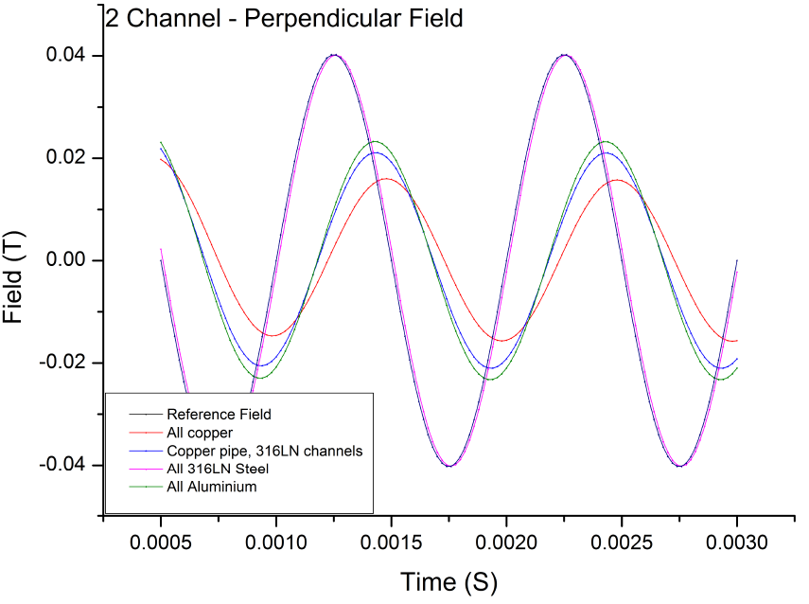
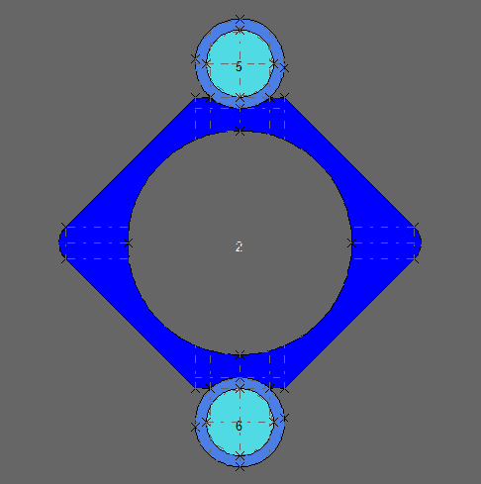
Skin depth example
See this example from FEA software driving a 1KHz sinusoidal B field through a complex beam pipe design. Field is recorded at center of beam pipe, black is driving field (no pipe), all others for materials of different conductivities.

Slide 23
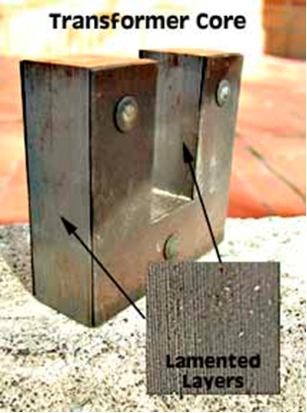
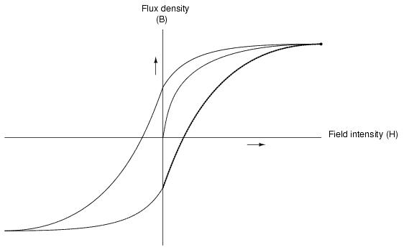
AC effects in steel yokes
Steel yokes will have:
  eddy current power loss - with distortion of B
  hysteresis losses
So have to be ‘laminated’ like a mains transformer

Slide 24
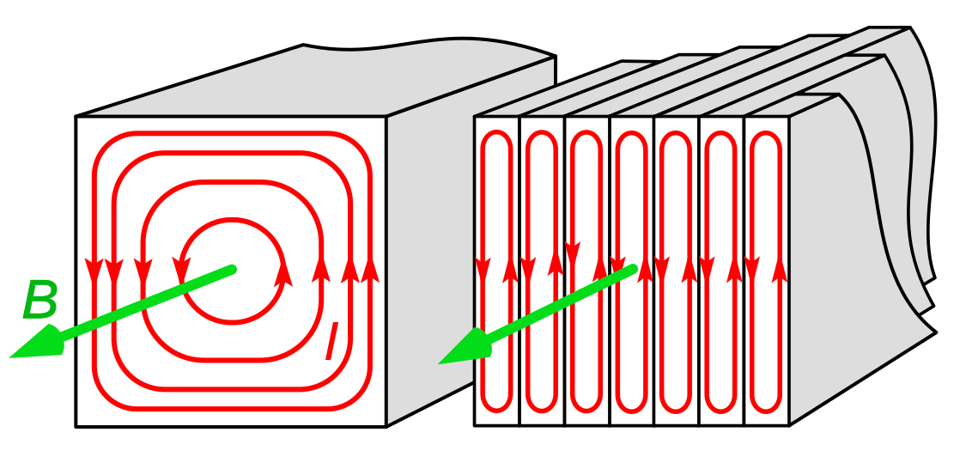
Yoke Eddy losses
To limit eddy losses, the laminations in the steel core are coated with a thin layer (few µm) of insulating material, usually just on one side of each lamination to keep the packing factor as high as possible. This forces eddy currents to oscillate back and forth over the width of one lamination rather than forming a proper eddy and producing a counter-field.
At 10 Hz lamination thicknesses of 0.5mm to 1 mm can be used.
At 50Hz, lamination thicknesses of 0.35mm to 0.65mm are standard.

Slide 25
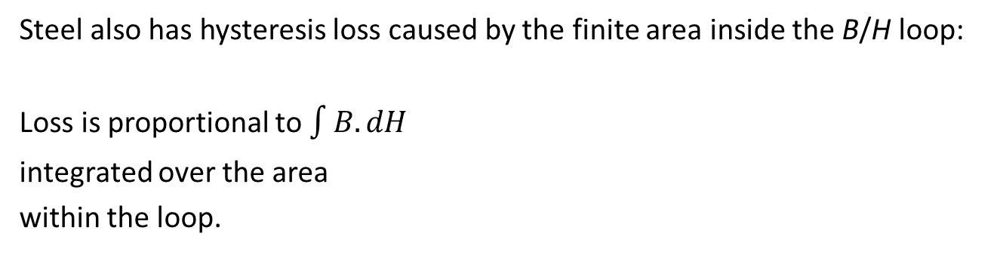
Hysteresis loss
Steel also has hysteresis loss caused by the finite area inside the B/H loop:
Loss is proportional to $\int{B.dH}$
integrated over the area
within the loop.

Slide 26
Total loss
Variation with | Eddy loss | Hysteresis loss
AC frequency | Square law | Linear
AC amplitude | Square law | Nonlinear, depends on level
DC bias | No effect | Increases nonlinearly
Total volume of steel | Linear | Linear
Lamination thickness | Square law | No effect

Slide 27
Yoke material choice
Grain oriented steel:
Strongly anisotropic
Very high silicon content
Very high quality magnetic properties and very low AC losses in the rolling direction
Normal to rolling direction is much worse than non-oriented steel
Stamping and machining causes loss of quality and the stamped laminations must be annealed before final assembly – relatively soft material
Non-oriented steel:
Mostly isotropic (some anisotropy <5%)
Properties mostly affected by the percentage of Si and C in the mix
High silicon gives low losses, higher permeability at low flux density but poorer magnetic performance at high field
Low (but not zero) silicon gives good performance at high B
Silicon mechanically ‘stabilises’ the steel, prevents aging
Lower carbon gives better magnetic properties and less rust but worse mechanical properties and more expensive

Slide 28
Grain orientation
Despite having higher permeability and saturation field (~2T) and lower AC losses, grain oriented is seldom used in accelerator magnets because of the mechanical problem of keeping B in the direction of the grain.
In sections where the field flows perpendicular to the grain magnetic properties are much worse (permeability may be lower by factor of 10 or more).
Rolling
direction
B
Difficult to make each limb out of separate strips of steel. How do we join limbs whilst keeping the whole yoke stiff against magnetic forces?

Slide 29
Fast magnet types

Slide 30
Correctors
An accelerator never behaves exactly as intended. Anything from magnet errors, movement of the laser, RF phase drift to temperature variations can cause a beam to wander off the intended path.
All accelerators include ‘correctors’, dipoles that can steer horizontally or vertically (normally both directions combined into 1 magnet) that can be used to nudge the beam back onto the correct path.
Correctors may be connected to beam position monitors further downstream and adjust the strength and correction of steering in real-time. In high repetition rate machines fast and unpredictable adjustments may be needed to keep the beam on track!

Slide 31
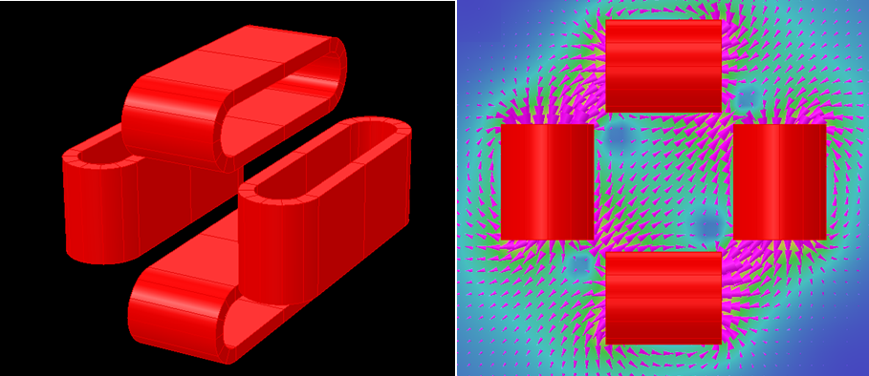
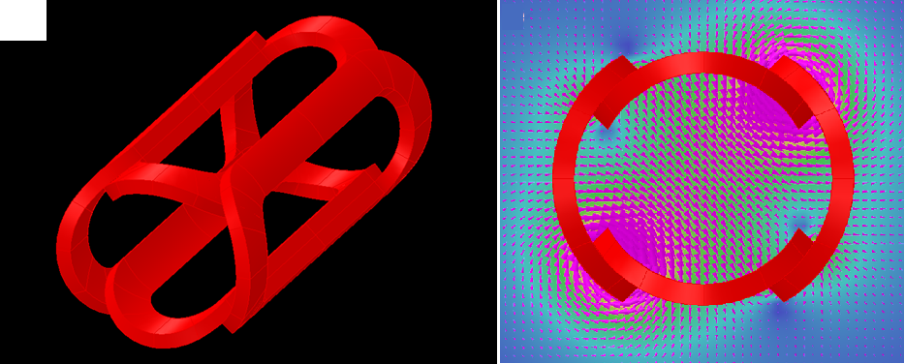
Correctors
In many systems correctors do not need to be strong – can we get away with an inefficient current-dominated system without a yoke at all? Often yes!
Double racetrack designs are not very efficient but allow for very bulky and short coils, a large gap and are extremely versatile – most common type.
Constant Perimeter End (CPE) wrap-around coils are more efficient but often weaker and longer. Bulky coils are difficult as the inner radius of one set often depends on the outer radius of the other.

Slide 32
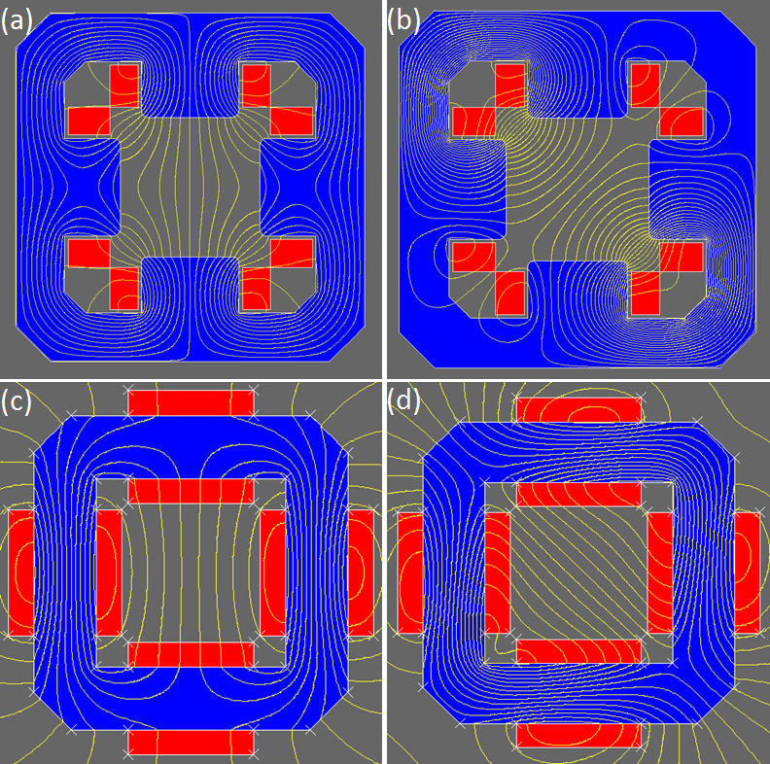
Yoked correctors
Where higher efficiency and/or slower variations are needed yoked correctors become viable options – yokes are often laminated.
The “skew quadrupole” type corrector acts like a H-dipole in each direction but has some field homogeneity issues and skew quad coupling.
The transformer core style corrector is slightly less efficient but provides better field quality in all directions.

Slide 33
Kickers
Kicker Magnets are dipoles that switch on and off very quickly:
  used for rapid deflection of beam for injection or extraction
  Often located inside the vacuum chamber (eddy currents in walls)
  rise/fall times << 1µs
  yoke assembled from high-frequency ferrite
  Often single-turn coil
  pulse current ∼ 10⁴ A
  pulse voltages of many kV
yoke
beam
Conductors

Slide 34
EMMA injection kicker

Slide 35
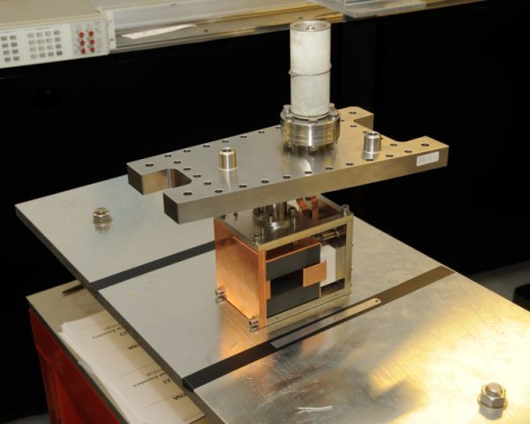
EMMA injection kicker

Slide 36
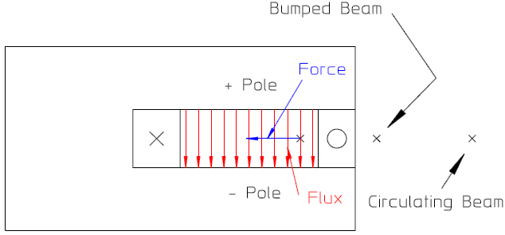
Septum magnets
Septums are magnets that create a strong localised dipole field whilst keeping a strict “zero-field” region nearby. Often (not always) located inside the vacuum and used to deflect part of the beam for injection or extraction, or outside the chamber as magnets on an injection line near entry without disturbing the beam in the ring. A kicker may be used to ‘bump’ a single circulating bunch nearer to the septum for extraction.
The thin 'septum' coil on the front face gives:
high field within the gap
low field externally
Problems:
The thickness of the septum must be minimised to limit beam loss
the front septum has very high current density and major heating problems

Slide 37
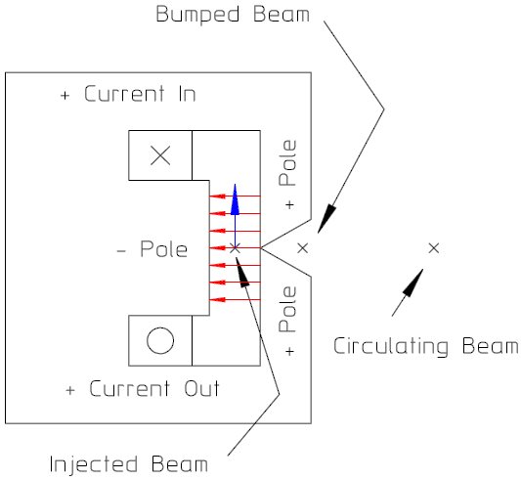
Lambertson septum
Used in the LHC injection line, the Lamberston septum can be DC or pulsed AC and provides extra shielding via the yoke for beams outside the desired field.
These are bulky but rugged devices and are highly useful where the injection or extraction line is at a vertical offset to the main storage ring (surprisingly common)!

Slide 38
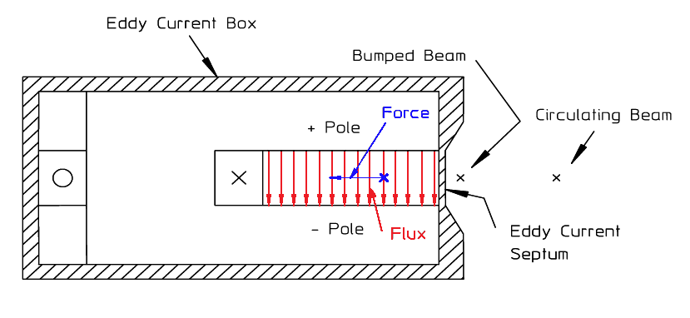
Eddy current septum
Resembles a C-dipole with a single coil on the “back leg” surrounded by a copper box. The current is provided in a pulse (or sin wave contained in a pulse). At this frequency the thickness of the copper >> skin depth and so acts as a magnetic shield.
Eddy currents have slow decay time but act as an extremely effective shield to protect the circulating beam, field on outer surface of septum ~1% of gap field

Slide 39
Comparison
 | Classical septum | Lambertson septum | Eddy current septum
Excitation | DC or low frequency pulse | DC or low frequency pulse | Pulse at >10 kHz
Coil | Single turn including front septum | Single turn few turns in compact single coil | Single or multi-turn on backleg, room for large cross-section
Cooling | Complex water spirals in thermal contact with septum coil | Water cooled coil or water spirals in thermal contact with coil | Heat generated in shield is conducted away through base plate.
Yoke | Conventional steel (laminated if in air) | Conventional steel (Conventional steel (laminated if in air) | High frequency material (ferrite or thin steel laminations)

Slide 40
Beam injection/extraction

Slide 41
The problem
Single turn injection/extraction:
  A magnet steers the beam into the ring and turns off before the beam completes the first turn (extraction is the reverse).
Multi-turn injection/extraction:
  A magnet steers the beam into the ring with an existing beam circulating without producing excessive disturbance or loss to the circulating beam
Accumulation in a storage ring:
  A common case of multi-turn injection - continues over many turns (with the aim of minimal disturbance to the stored beam)
straight section
magnet
injected beam
In cases where the energy of the injected beam << stored beam we can use a DC magnet i.e. injection in ALICE, but mostly we need to avoid disturbing the stored beam i.e. injection in EMMA

Slide 42
Single turn
A kicker magnet with fast turn-off (injection) or turn-on (extraction) can be used for single turn injection
Problems:
rise or fall time will always be non-zero → loss of beam
single turn inject does not allow the accumulation of high current
in small accelerators revolution times can be << 1 µs
magnets are inductive → fast rise (fall) means (very) high voltage
B Field
injection – fast fall
extraction – fast rise
Time

Slide 43
Multi-turn
Beam can be injected by phase-space manipulation
(a) Inject into an unoccupied outer region of phase space with non-integer tune which ensures many turns before the injected beam re-occupies the same region (electrons and protons):
e.g. – Horizontal phase space at Q = ¼ integer:
x’
septum
x
0 field deflect. field
turn 1 – first injection
turn 2
turn 3
turn 4 – last injection

Slide 44
Accumulation
(b) Inject into outer region of phase space - damping coalesces beam into the central region before re-injecting (high energy lepton rings only):
dynamic aperture
stored beam
injected beam
next injection after 1 damping time
(c) inject negative ions through a bending magnet and then ‘strip’ to produce a proton after injection (H⁻ to p⁺ only)

Slide 45
Multi-turn extraction
‘Shave’ particles from edge of beam into an extraction channel whilst the beam is moved across the aperture:
extraction channel
septum
beam movement
Points:
Some beam loss on the septum cannot be prevented
Efficiency can be improved by ‘blowing up’ on 1/3rd or 1/4th integer resonance

Slide 46
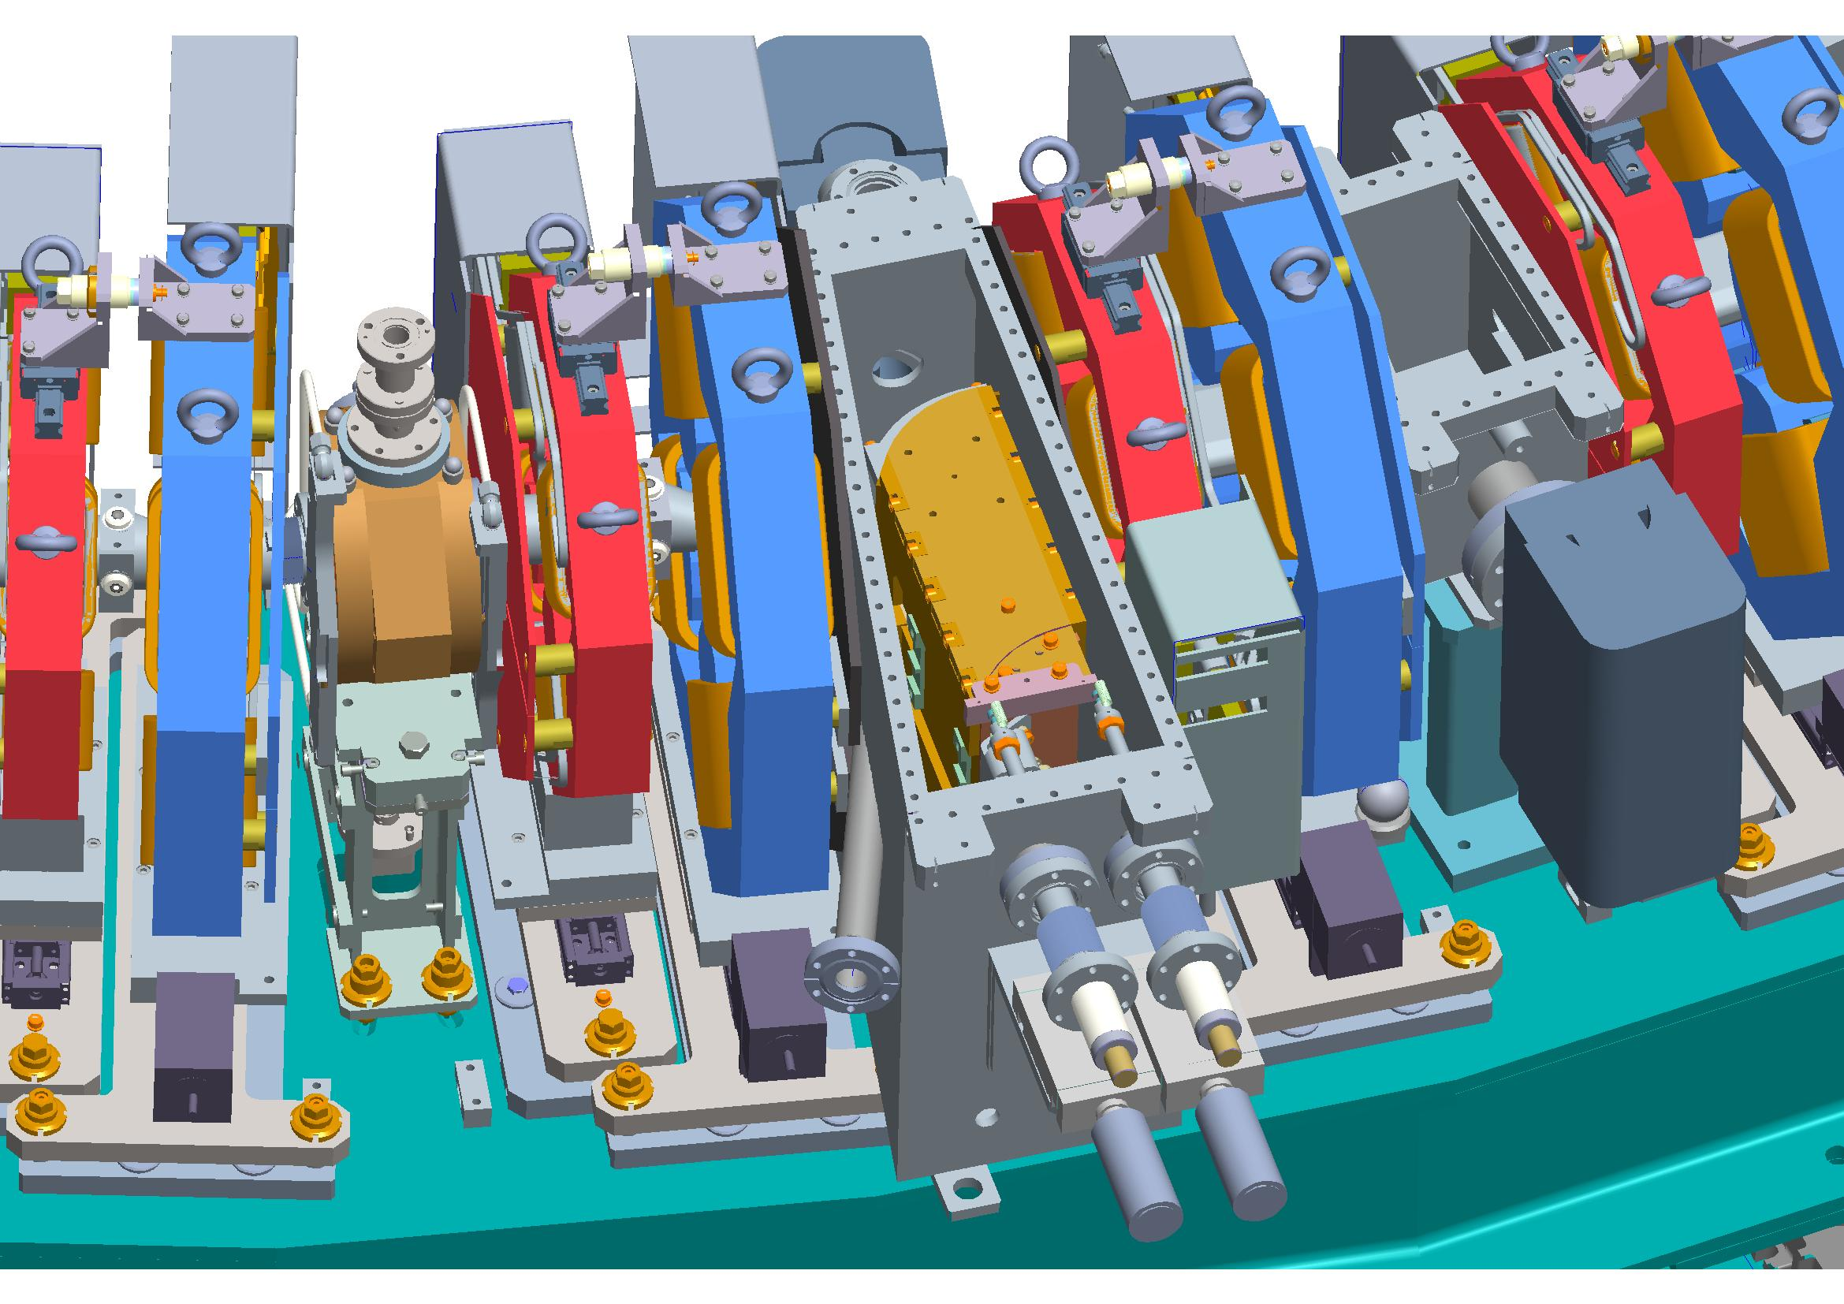
EMMA Septum

Slide 47
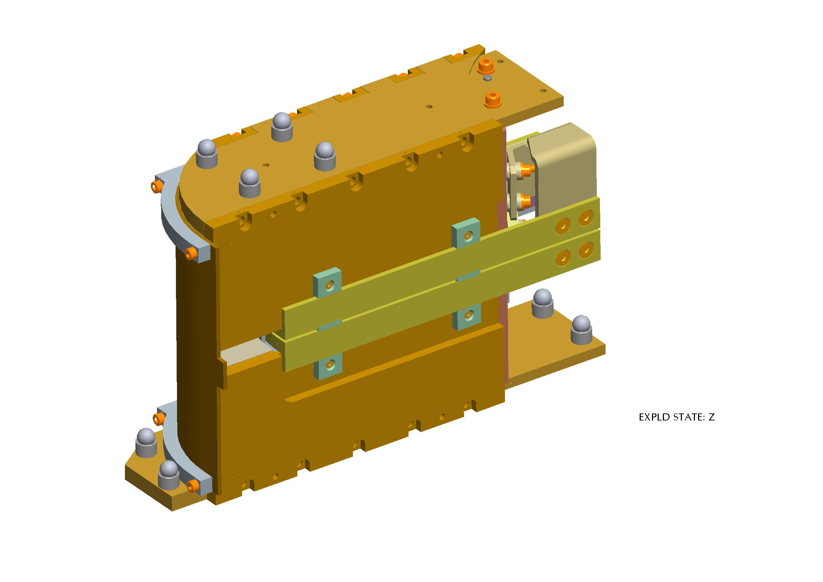
EMMA septum
Inner steel yoke is assembled from 0.1 mm thick silicon steel laminations, insulated with 0.2 µm coatings on each side.
Copper shielding produces eddy currents to contain the field within the gap.

Slide 48
Magnet requirements
Magnet requirements for injection and extraction systems:
Kicker magnets:
  pulsed waveform
  rapid rise or fall times (usually << 1 µs)
  flat-top for uniform beam deflection
Septum magnets:
  pulsed or DC waveform
  spatial separation into two regions
  one region of high field (for injection deflection)
  one region of very low (ideally 0) field for existing beam
  septum to be as thin as possible to limit beam loss

Slide 49
Fast magnet power supplies
Because of the demanding performance required from these systems (rise time and voltage), the magnet and power supply must be strongly integrated and designed as a single unit.
Two alternative approaches to powering these magnets:
  Distributed circuit: magnet and power supply made up of delay line circuits
  Lumped circuits: magnet is designed as a pure inductance; power supply can be use delay line or a capacitor to feed the high pulse current

Slide 50
Distributed system
Standard (CERN) delay line magnet and power supply:
L, C
L, C
Z0
dc
⎮ Power Supply ⎮ Thyratron⎮ Magnet ⎮Resistor
The power supply and interconnecting cables are matched to the surge impedance of the delay line magnet

Slide 51
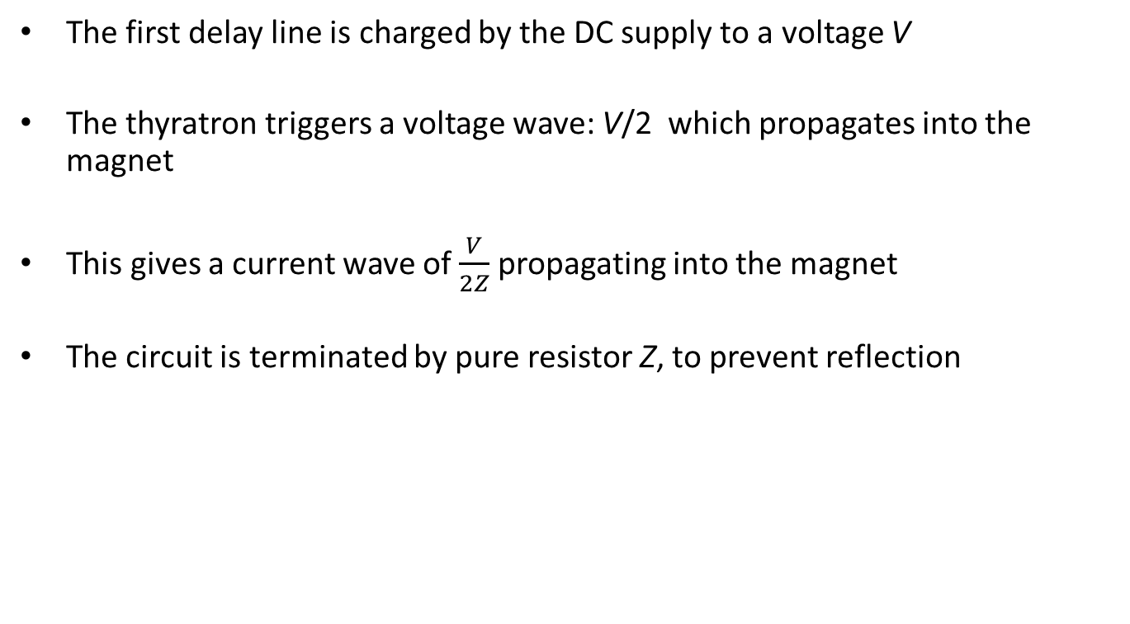
Distributed system
The first delay line is charged by the DC supply to a voltage V
The thyratron triggers a voltage wave: V/2 which propagates into the magnet
This gives a current wave of $\frac{V}{2Z}$ propagating into the magnet
The circuit is terminated by pure resistor Z, to prevent reflection

Slide 52

Lumped circuits
The magnet is (mainly) inductive - no added distributed capacitance
The magnet must be very close to the supply (minimises inductance)
C
R
$$I=\frac{V}{R}\left(1−e^{−\frac{Rt}{L}}\right)$$
dc
L
Remember how L stacks if powering multiple magnets!
i.e. the same waveform as distributed power supply, lumped magnet systems. The extra capacitor C improves the pulse substantially but is optional.

Slide 53
Resulting waveform
Example calculated for the following parameters:
mag inductance L = 1 µH
rise time t = 0.2 µs
resistor R = 10 Ω
trim capacitor C = 4 nF
The impedance in the lumped circuit is twice that needed in the distributed! The voltage to produce a given peak current is the same in both cases.
Performance: at t = 0.1 µs, current amplitude = 0.777 of peak
at t = 0.2 µs, current amplitude = 1.01 of peak
The maximum ‘overswing’ is 2.5%.
This system is much simpler and cheaper than the distributed system.

