Slide 1

CI-Mag-106 - Conventional Magnets for Accelerators
Lecture 2
Dr Alex Bainbridge
Magnetics and Radiation Sources Group
ASTeC
Daresbury Laboratory
alex.bainbridge@stfc.ac.uk

Slide 2
Contents – Lecture 2
Advanced magnetostatic theory
  Scalar and Vector potentials
  Field lines and potential for dipole, quadrupole, sextupole
Iron dominated electromagnets
  Pole shapes for different magnet functions
  Practical poles and symmetries
  Field harmonics and multiple orders
  Realistic pole optimisation
Permanent magnets
  Theory
  Examples
Real designs & computer modelling

Slide 3
Advanced magnetostatic theory

Slide 4
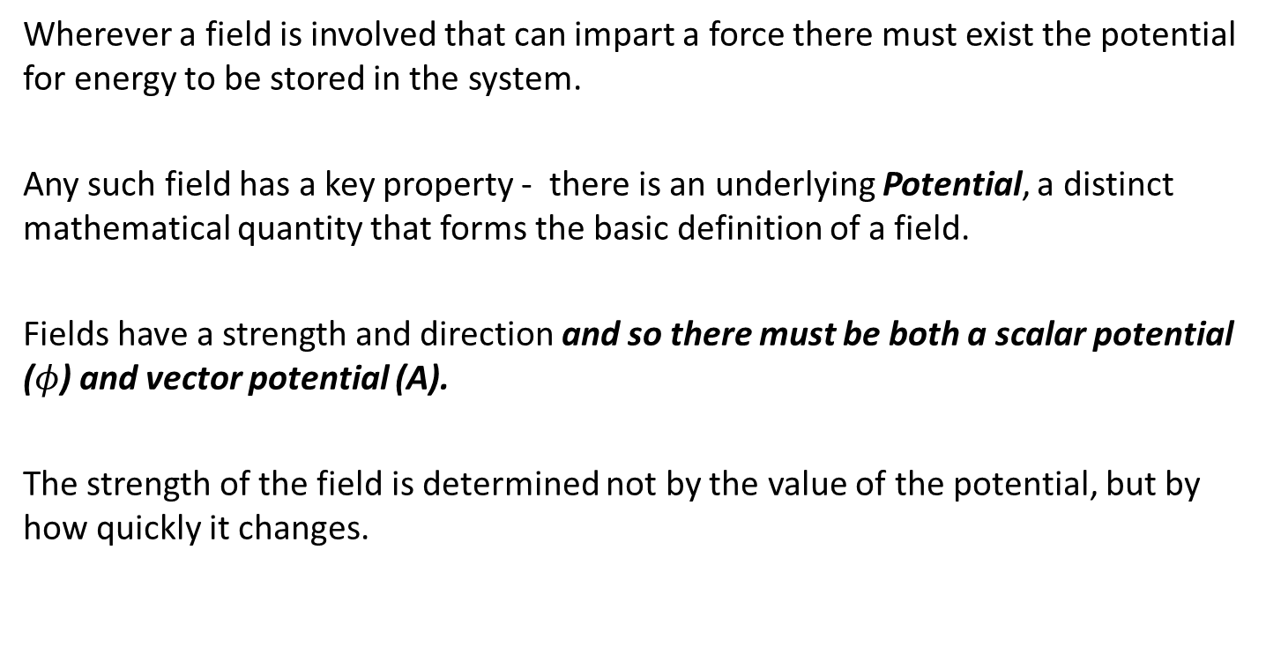
Field theory
Wherever a field is involved that can impart a force there must exist the potential for energy to be stored in the system.
Any such field has a key property - there is an underlying Potential, a distinct mathematical quantity that forms the basic definition of a field.
Fields have a strength and direction and so there must be both a scalar potential ($φ$) and vector potential (A).
The strength of the field is determined not by the value of the potential, but by how quickly it changes.

Slide 5
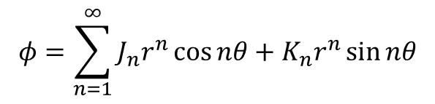
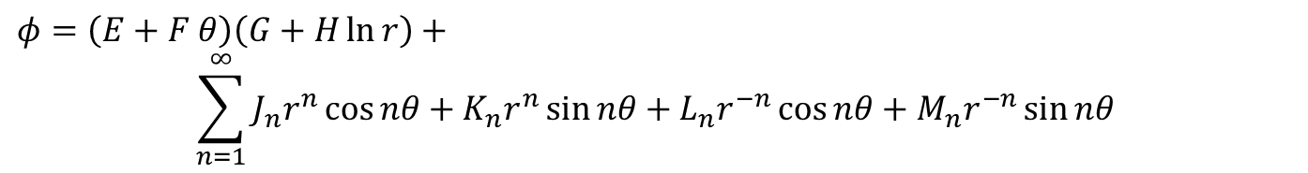
Scalar potential
Taking the two dimensional case (i.e. constant in the z direction) and solving for polar coordinates (r, θ):
(This equation, and the process of getting to it, is an absolute monstrosity).
Fortunately we can simplify it a bit to:
With n=integer, and J_{n}, K_{n} highly generic functions of geometry.
$$φ=\left(E+F θ\right)\left(G+H\ln{r}\right)+$$
$$\sum_{n=1}^{∞}{J_{n}r^{n}\cos{nθ}+K_{n}r^{n}\sin{nθ}+L_{n}r^{−n}\cos{nθ}+M_{n}r^{−n}\sin{nθ}}$$
$$φ=\sum_{n=1}^{∞}{J_{n}r^{n}\cos{nθ}+K_{n}r^{n}\sin{nθ}}$$

Slide 6
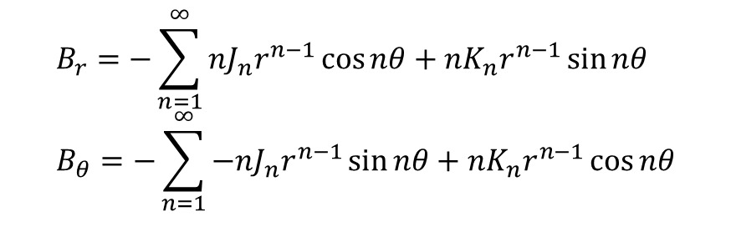
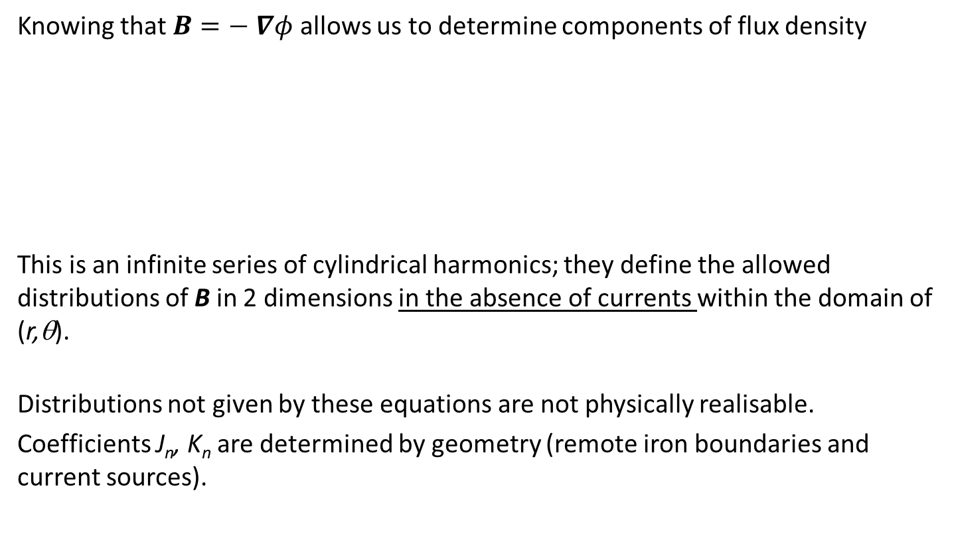
B from scalar potential
Knowing that $B=− ∇φ$ allows us to determine components of flux density
This is an infinite series of cylindrical harmonics; they define the allowed distributions of B in 2 dimensions in the absence of currents within the domain of (r,θ).
Distributions not given by these equations are not physically realisable.
Coefficients J_{n}, K_{n} are determined by geometry (remote iron boundaries and current sources).
$$B_{r}=−\sum_{n=1}^{∞}{nJ_{n}r^{n−1}\cos{nθ}+nK_{n}r^{n−1}\sin{nθ}} \\ B_{θ}=−\sum_{n=1}^{∞}{−nJ_{n}r^{n−1}\sin{nθ}+nK_{n}r^{n−1}\cos{nθ}}$$

Slide 7







Cartesian coordinates
We can expand the equations using trig relationships and differentiate to obtain flux densities
And using that
We get
We can also follow a similar technique for the vector potential A which gives
$$\cos{2θ}=\cos^{2}{θ}−\sin^{2}{θ} \\ \sin{2θ}=2\sin{θ}\cos{θ}$$
$$\cos{3θ}=\cos^{3}{θ}−3\cos{θ}\sin^{2}{θ} \\ \sin{3θ}=3\sin{θ}\cos^{2}{θ}−\sin^{3}{θ}$$
$$\cos{4θ}=\cos^{4}{θ}+\sin^{4}{θ}−6\cos^{2}{θ}\sin^{2}{θ} \\ \sin{4θ}=4\sin{θ}\cos^{3}{θ}−4\sin^{3}{θ}\cos{θ}$$
$$x=r\cos{θ}$$
$$B_{x}=−\frac{∂φ}{∂x}$$
$$y=r\sin{θ}$$
$$B_{y}=−\frac{∂φ}{∂y}$$
$$B_{y}=−\frac{∂A}{∂x}$$
$$B_{x}=\frac{∂A}{∂y}$$

Slide 8
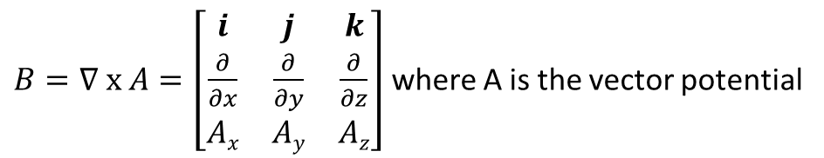
Complex functions
$B=∇ x A=\left[\begin{matrix}i & j & k \\ \frac{∂}{∂x} & \frac{∂}{∂y} & \frac{∂}{∂z} \\ Ax & Ay & Az\end{matrix}\right]$ where A is the vector potential
$∇ x B=∇ x (∇ x A)=∇(∇.A)−∇2A=0 A$ satisfies the Laplace equation
=0, Coulomb gauge
$B=−∇φ=−\left(i\frac{∂φ}{∂x}+j\frac{∂φ}{∂y}+k\frac{∂φ}{∂z}\right)$ where $φ$ is the scalar potential
$∇.B=∇.\left(−∇φ\right)=−∇2φ=0 φ$ also satisfies the Laplace equation
Let $F=A+iφ$ The complex function F must also satisfy $∇2F=0$

Slide 9
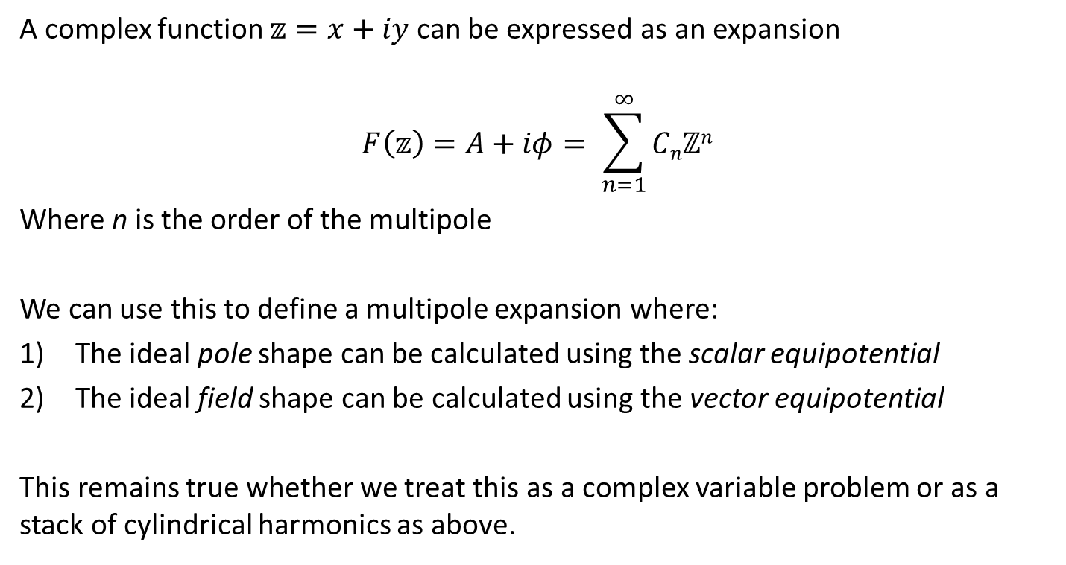
Why does this matter?
A complex function $𝕫=x+iy$ can be expressed as an expansion
$$F\left(𝕫\right)=A+iφ= \sum_{n=1}^{∞}{Cnℤn}$$
Where n is the order of the multipole
We can use this to define a multipole expansion where:
The ideal pole shape can be calculated using the scalar equipotential
The ideal field shape can be calculated using the vector equipotential
This remains true whether we treat this as a complex variable problem or as a stack of cylindrical harmonics as above.

Slide 10

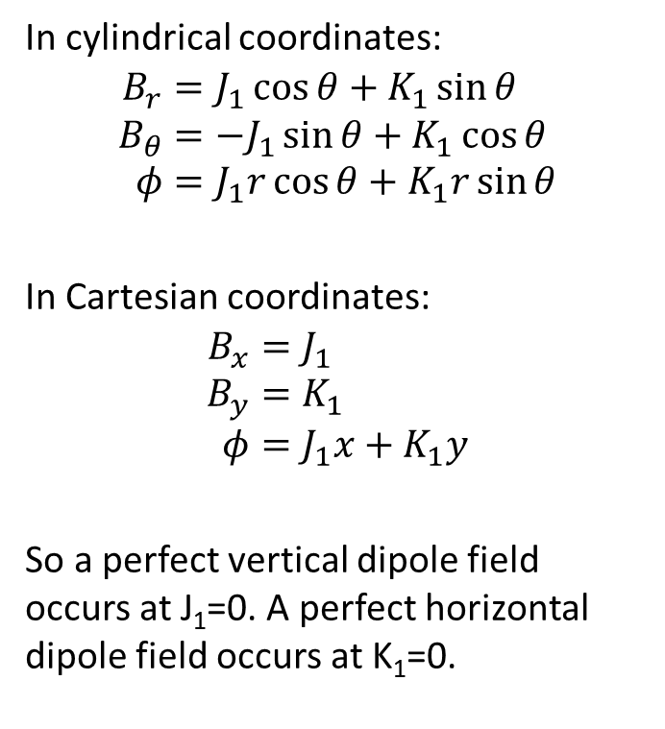
Dipole field, n=1
In cylindrical coordinates:
$$B_{r}=J_{1}\cos{θ}+K_{1}\sin{θ} \\ B_{θ}=−J_{1}\sin{θ}+K_{1}\cos{θ} \\ φ=J_{1}r\cos{θ}+K_{1}r\sin{θ}$$
In Cartesian coordinates:
$$B_{x}=J_{1} \\ B_{y}=K_{1} \\ φ=J_{1}x+K_{1}y$$
So a perfect vertical dipole field occurs at J₁=0. A perfect horizontal dipole field occurs at K₁=0.
Using a complex function
$A+iφ$ = $C1ℤ1$ = $C1(x+iy)$
And so
$$x=\frac{A}{C1}$$
$$y=\frac{φ}{C1}$$
C is a constant!

Slide 11
Dipole field, n=1
J₁ = 0 gives vertical dipole field
B
Flux lines at x=A/C
Scalar equipotentials (φ=constant) at y=φ/C

Slide 12
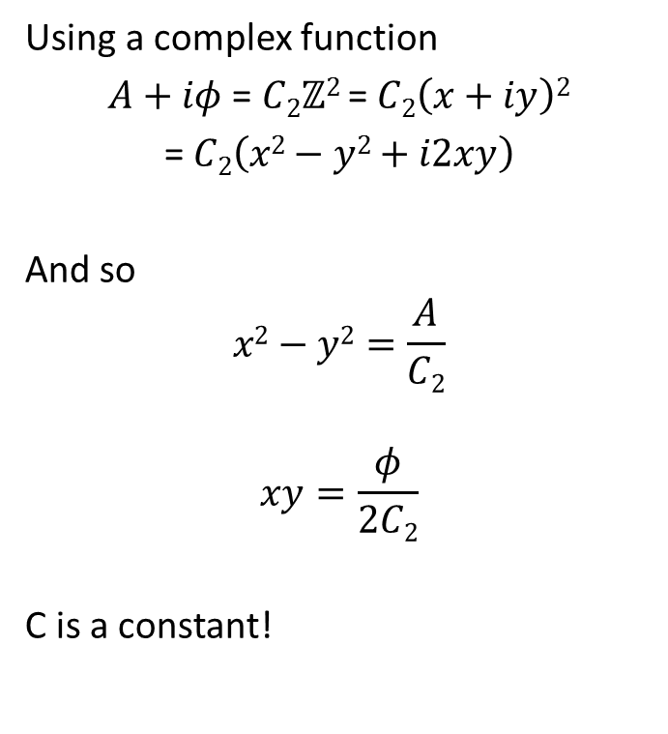
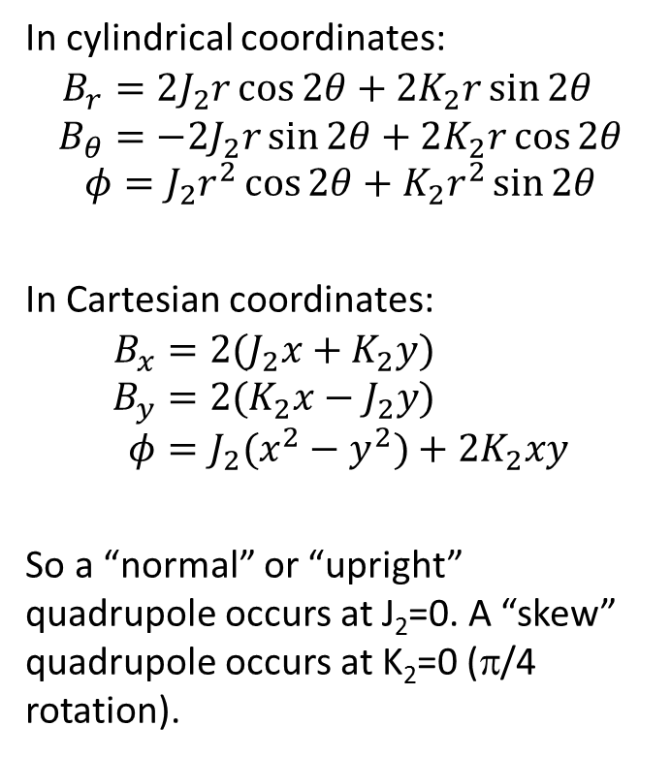
Quadrupole field, n=2
In cylindrical coordinates:
$$B_{r}=2J_{2}r\cos{2θ}+2K_{2}r\sin{2θ} \\ B_{θ}=−2J_{2}r\sin{2θ}+2K_{2}r\cos{2θ}$$
$$φ=J_{2}r^{2}\cos{2θ}+K_{2}r^{2}\sin{2θ}$$
In Cartesian coordinates:
$$B_{x}=2(J_{2}x+K_{2}y) \\ B_{y}={2(K}_{2}x−J_{2}y) \\ φ=J_{2}(x^{2}−y^{2})+2K_{2}xy$$
So a “normal” or “upright” quadrupole occurs at J₂=0. A “skew” quadrupole occurs at K₂=0 (π/4 rotation).
Using a complex function
$A+iφ$ = $C2ℤ2$ = $C2\left(x+iy\right)2$
= $C2\left(x2−y2+i2xy\right)$
And so
$$x2−y2=\frac{A}{C2}$$
$$xy=\frac{φ}{2C2}$$
C is a constant!

Slide 13
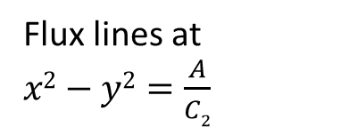
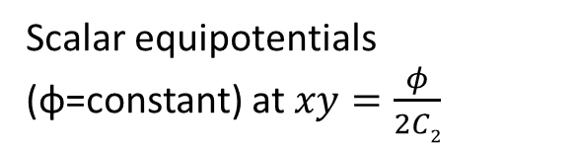
Quadrupole field, n=2
J₂ = 0 gives a normal field
Lines of flux density
Flux lines at $x2−y2=\frac{A}{C2}$
Scalar equipotentials (φ=constant) at $xy=\frac{φ}{2C2}$

Slide 14
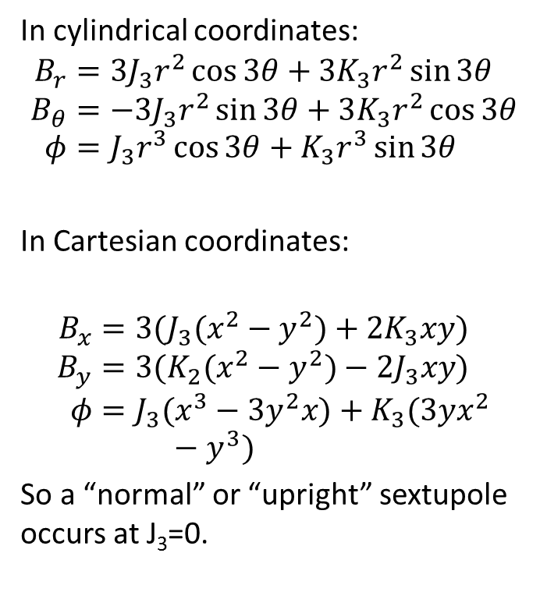
Sextupole field, n=3
In cylindrical coordinates:
$$B_{r}=3J_{3}r^{2}\cos{3θ}+3K_{3}r^{2}\sin{3θ} \\ B_{θ}=−3J_{3}r^{2}\sin{3θ}+3K_{3}r^{2}\cos{3θ} \\ φ=J_{3}r^{3}\cos{3θ}+K_{3}r^{3}\sin{3θ}$$
In Cartesian coordinates:
$$B_{x}=3(J_{3}(x^{2}−y^{2})+2K_{3}xy) \\ B_{y}=3(K_{2}(x^{2}−y^{2})−2J_{3}xy) \\ φ=J_{3}(x^{3}−3y^{2}x)+K_{3}(3yx^{2}−y^{3})$$
So a “normal” or “upright” sextupole occurs at J₃=0.
Line of constant scalar potential
Lines of flux density

Slide 15
Summary fields
Dipole - constant field
Quad - linear variation
Sextupole - quadratic variation
B_{y}
B_{y}
x
x

Slide 16
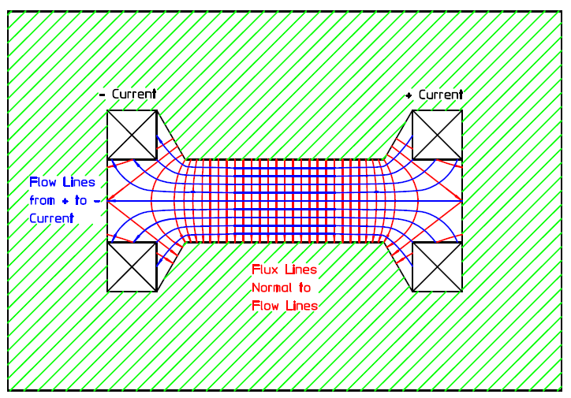
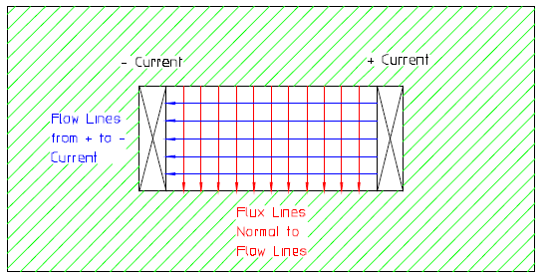
Orthogonal Analog model
We can use what we just learned to visualise the field from a magnet of arbitrary pole shape using the Orthogonal Analogue Model by Klaus Halbach.
Rule 1: “Flow lines” a.k.a. equipotentials go from + to – coils
Rule 2: Flux lines will be orthogonal to flow lines
Rule 3: Flow lines my only pass through free space

Slide 17

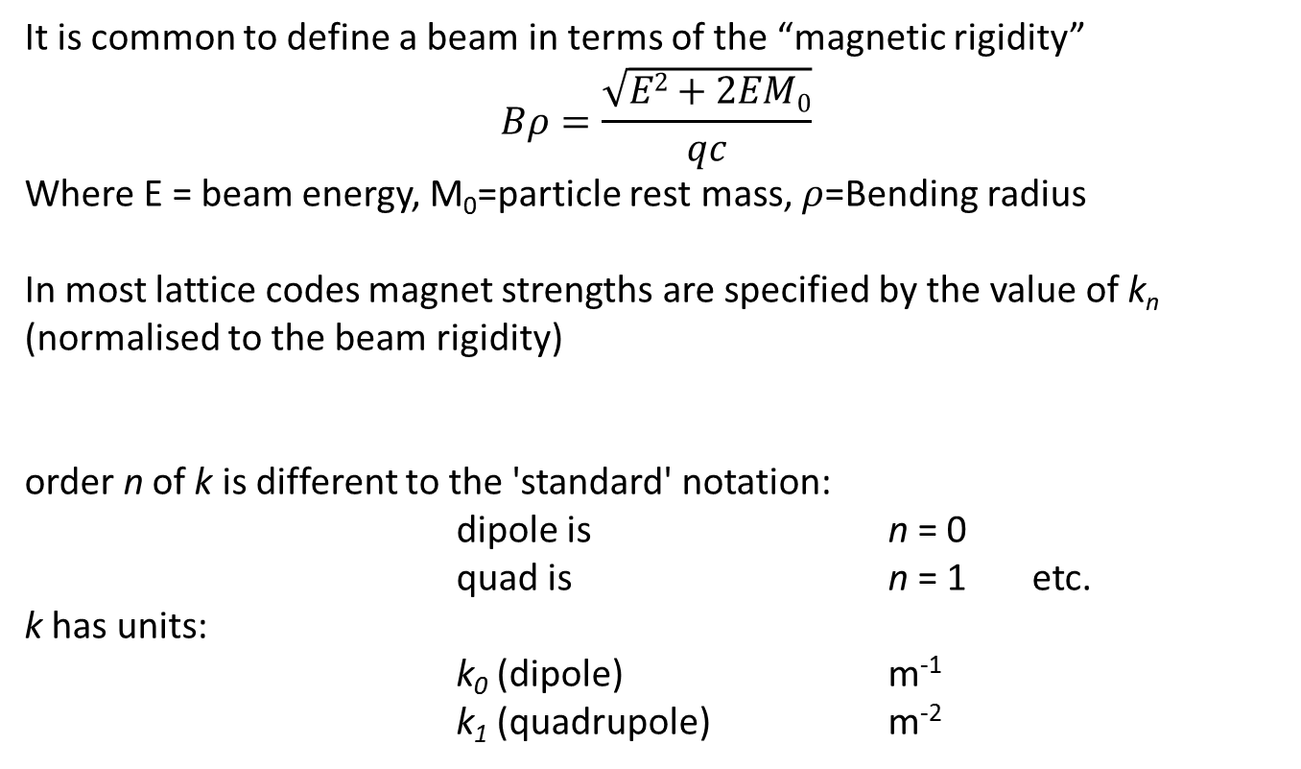
Lattice notation
It is common to define a beam in terms of the “magnetic rigidity”
$$Bρ=\frac{\sqrt{E2+2EM0}}{qc}$$
Where E = beam energy, M₀=particle rest mass, $ρ$=Bending radius
In most lattice codes magnet strengths are specified by the value of k_{n}
(normalised to the beam rigidity)
order n of k is different to the 'standard' notation:
dipole is n = 0
quad is n = 1 etc.
k has units:
k₀ (dipole) m⁻¹
k₁ (quadrupole) m⁻²
$$B\left(x\right)=Bρ\sum_{n=0}^{∞}{\frac{k_{n}x^{n}}{n!}}$$

Slide 18
Iron dominated electromagnets

Slide 19
The perfect pole shape
Flux is normal to a ferromagnetic surface with infinite µ:
This is a natural consequence of curl H = 0 in the absence of current
therefore ∫ H.ds = 0
in steel H = 0 if infinite µ
therefore parallel H air = 0
therefore B is normal to surface.
µ = ∞
µ = 1
Flux must be normal to lines of scalar potential: $B = −$
So the lines of scalar potential are the perfect pole shapes! (but these are infinitely long!)

Slide 20
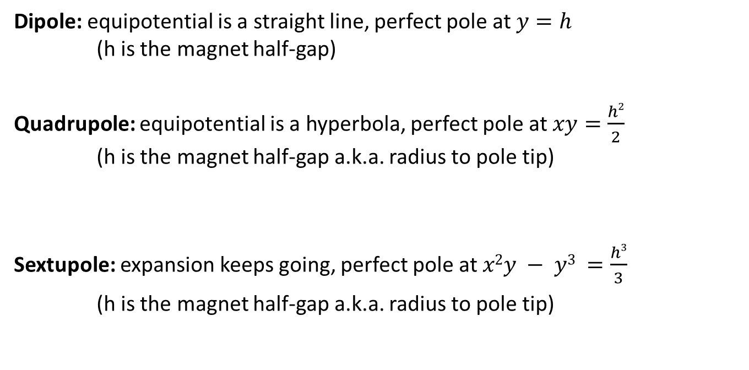
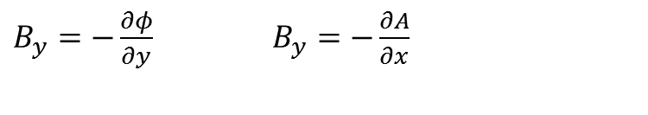
Ideal Dipole
$B_{y}=−\frac{∂φ}{∂y}$ $B_{y}=−\frac{∂A}{∂x}$
Dipole: equipotential is a straight line, perfect pole at $y=h$
(h is the magnet half-gap)
Quadrupole: equipotential is a hyperbola, perfect pole at $xy=\frac{h2}{2}$
(h is the magnet half-gap a.k.a. radius to pole tip)
Sextupole: expansion keeps going, perfect pole at $x2y − y3 =\frac{h3}{3}$
(h is the magnet half-gap a.k.a. radius to pole tip)

Slide 21
Extrapolation
We can use the idea of magnetic potentials to determine the ideal pole contour for any desired field- allows combined function magnets.
The most common type is a combined dipole-quadrupole, where the desired B field has a value at a given point and a linear gradient.
dipole with curved pole or quadrupole with beam center shifted from magnet center
Given the central field on the magnet axis and gradient, along with the half gap at the axis, we can calculate the ideal pole contour.

Slide 22
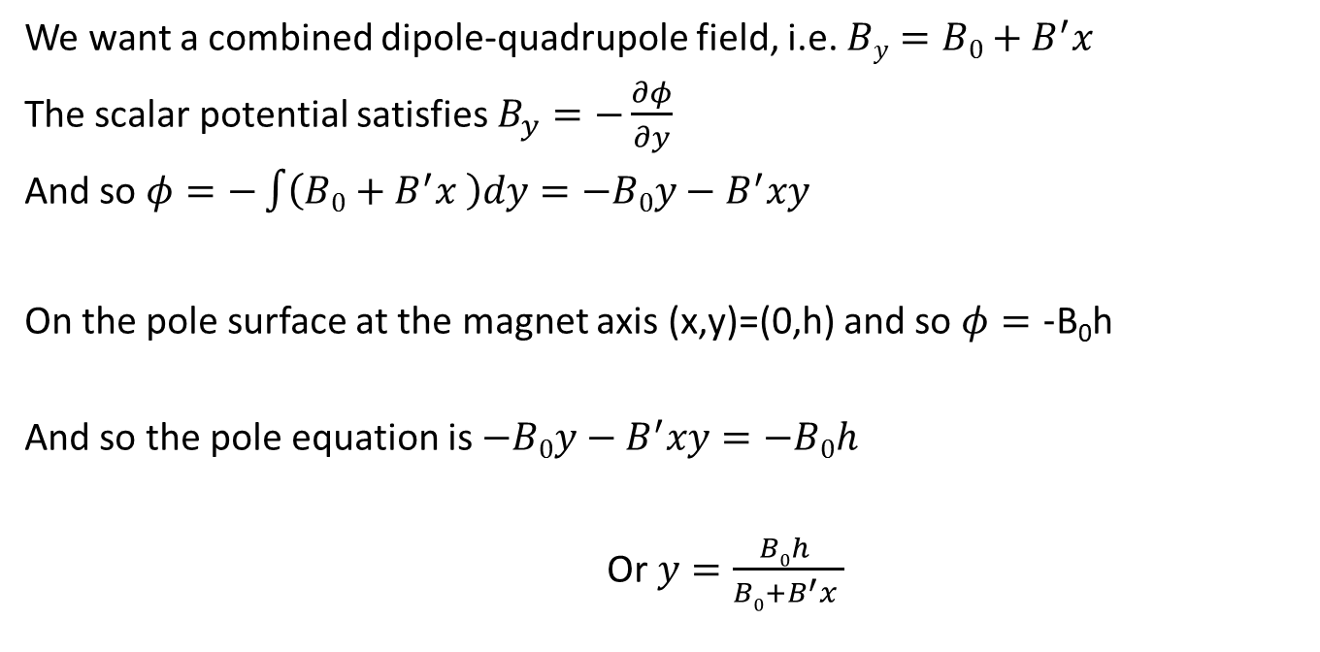
Combined functions
We want a combined dipole-quadrupole field, i.e. $By=B0+B^{′}x$
The scalar potential satisfies $B_{y}=−\frac{∂φ}{∂y}$
And so $φ=−\int{\left(B0+B^{′}x \right)dy}=−B0y−B^{′}xy$
On the pole surface at the magnet axis (x,y)=(0,h) and so $φ=\text{−}\text{B}\text{0}\text{h}$
And so the pole equation is $−B0y−B^{′}xy=−B0h$
Or $y=\frac{B0h }{B0+B^{′}x }$

Slide 23
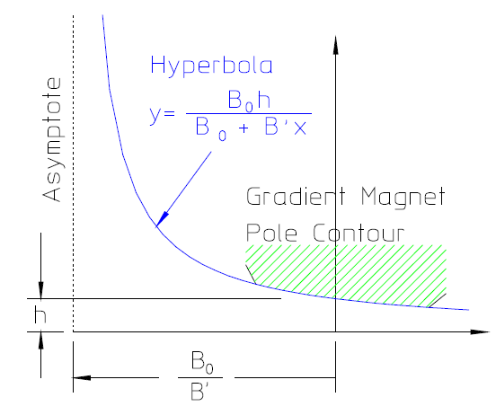
Combined functions
Pole is hyperbola $y=\frac{B0h }{B0+B^{′}x }$ with asymptote offset from magnet center by $x=\frac{B0 }{B^{′} }$

Slide 24
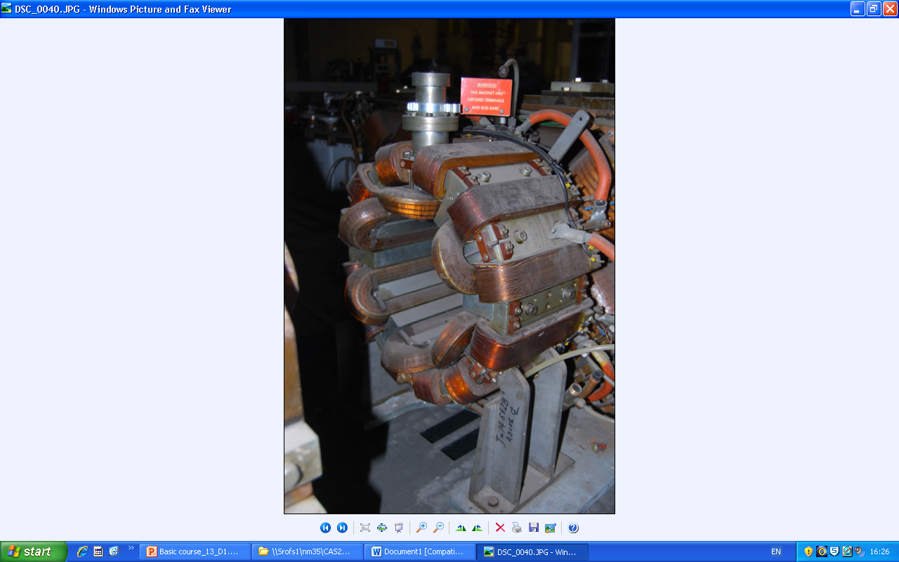
Other combinations
Can in theory generate any combination by sum of correct scalar potentials:
build relative amplitudes into pole geometry – not variable
mount multiple coils on yoke – independently vary coil currents
SRS multiple magnet could develop:
vertical dipole
horizontal dipole
upright quad
skew quad
sextupole
octupole
others

Slide 25

Practical poles
Practically, poles are finite, introducing errors. These appear as higher harmonics which degrade the field distribution.
However, the iron geometries have certain symmetries that restrict the nature of these errors.
$$F\left(𝕫\right)=A+iφ= \sum_{n=1}^{∞}{Cnℤn} →CNℤN+\sum_{n≠N}^{∞}{Cnℤn}$$
Dipole:
Quadrupole:
Where the first tern N is the “fundamental” and “n” represents error fields

Slide 26
Possible symmetries
Lines of symmetry:
Dipole Quad
Pole orientation y = 0 x = 0
determines whether pole y = 0
is normal or skew.
Additional symmetry x = 0 y = ± x
imposed by pole edges.
The additional constraints imposed by the symmetrical pole edges limits the values of n that have non-zero coefficients.

Slide 27
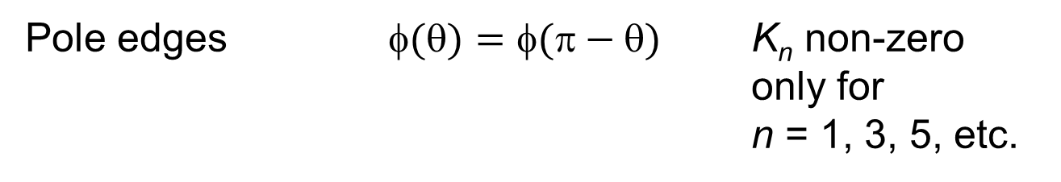
Dipole symmetries
Type Symmetry Constraint
Pole orientation $\left(θ\right)=−φ(−θ)$ all J_{n} = 0
Pole edges $()=(−)$ K_{n} non-zero only for
n = 1, 3, 5, etc.
+φ
+φ
+φ
-φ
So, for a fully symmetric dipole, only 6, 10, 14 etc. pole errors can be present. (asymmetric manufacturing errors can introduce others)

Slide 28
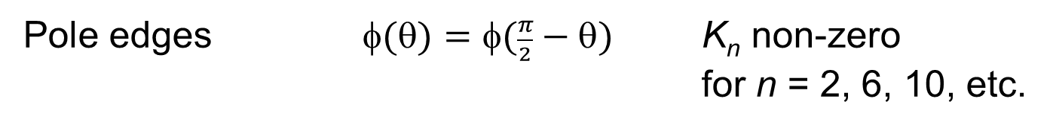
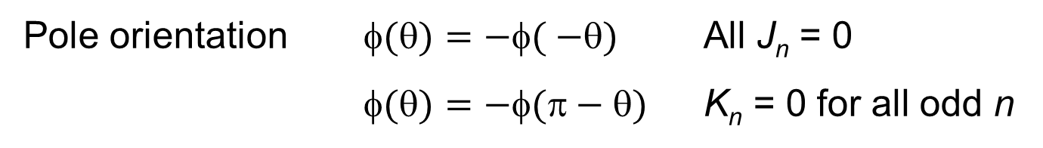
Quadrupole symmetries
Type Symmetry Constraint
Pole orientation $()=−( −)$ All J_{n} = 0
$()=−(−)$ K_{n} = 0 for all odd n
Pole edges $(θ)=φ(\frac{π}{2}−θ)$ K_{n} non-zero for n = 2, 6, 10, etc.
So, for a fully symmetric quadrupole, only 12, 20, 28 etc. pole errors can be present. (asymmetric manufacturing errors can introduce others)

Slide 29
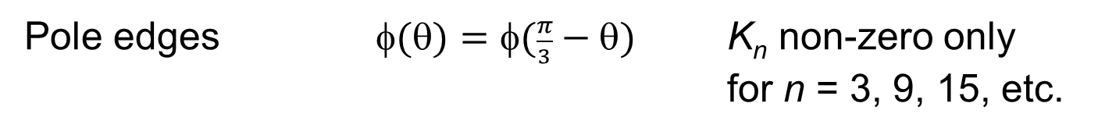
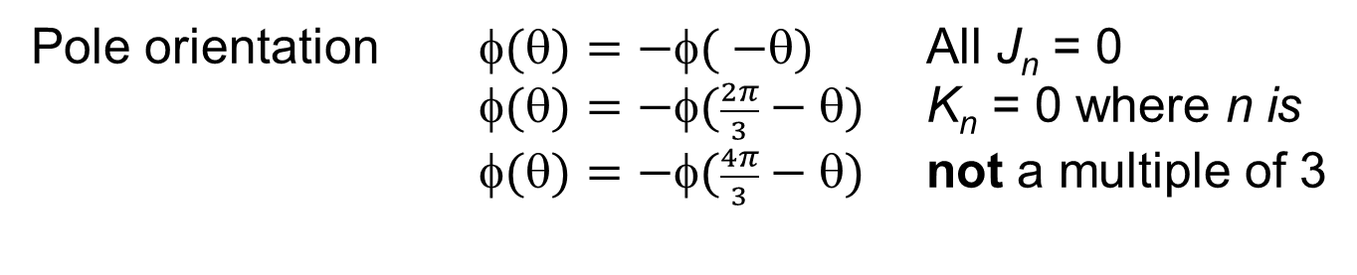
Sextupole symmetries
Type Symmetry Constraint
Pole orientation $()=−( −)$ All J_{n} = 0
$(θ)=−φ(\frac{2π}{3}−θ)$ K_{n} = 0 where n is $(θ)=−φ(\frac{4π}{3}−θ)$ not a multiple of 3
Pole edges $(θ)=φ(\frac{π}{3}−θ)$ K_{n} non-zero only for n = 3, 9, 15, etc.
So, for a fully symmetric sextupole, only 18, 30, 42 etc. pole errors can be present. (asymmetric manufacturing errors can introduce others)

Slide 30

‘Allowed’ Harmonics
Summary of ‘allowed harmonics’ in fully symmetric magnets:
$nallowed=N(2m+1)$ where m=all integers
Fundamental geometry | ‘Allowed’ harmonics
Dipole, n = 1 | n = 3, 5, 7, ...... (6 pole, 10 pole, etc.)
Quadrupole, n = 2 | n = 6, 10, 14, .... (12 pole, 20 pole, etc.)
Sextupole, n = 3 | n = 9, 15, 21, ... (18 pole, 30 pole, etc.)
Octupole, n = 4 | n = 12, 20, 28, .... (24 pole, 40 pole, etc.)

Slide 31
Forbidden harmonics
Two sources of asymmetry generate ‘forbidden’ harmonics:
i) magnetic asymmetries - significant at low permeability:
e.g. C core dipole not completely symmetrical about pole centre, but negligible effect with high permeability.
Generates n = 2,4,6, etc.

Slide 32
Forbidden harmonics
ii) asymmetries due to small manufacturing errors in dipoles:
n = 2, 4, 6 etc.
n = 3, 6, 9, etc.

Slide 33
Forbidden harmonics
ii) asymmetries due to small manufacturing errors in quadrupoles:
n = 3
n = 2 (skew)
n = 3
n = 4 -ve
n = 4 +ve
These errors are bigger than the finite µ type; can seriously affect machine behaviour and must be controlled (see magnets measurement lecture 4)

Slide 34
Field Uniformity
The perfect pole contour is infinitely long- in practise this is impossible and the edges of the pole will introduce errors outside the magnetic center.
The easiest way to minimise this effect is to increase the amount of excess pole beyond the boundary of our so-called “good field region”
The amount of excess pole needed can be reduced by adding little bumps, or “shims” at the edges of the pole – more on this lecture 2!
For a dipole we want a constant field out to ±x from the magnet center to ensure that off-axis particles receive the same bending force as on-axis particles.

Slide 35
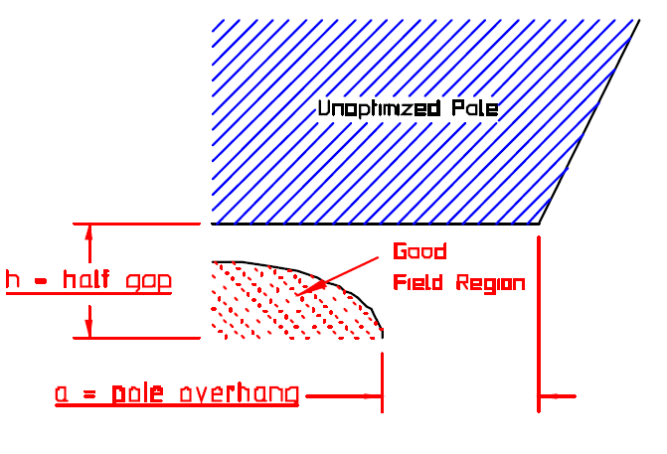
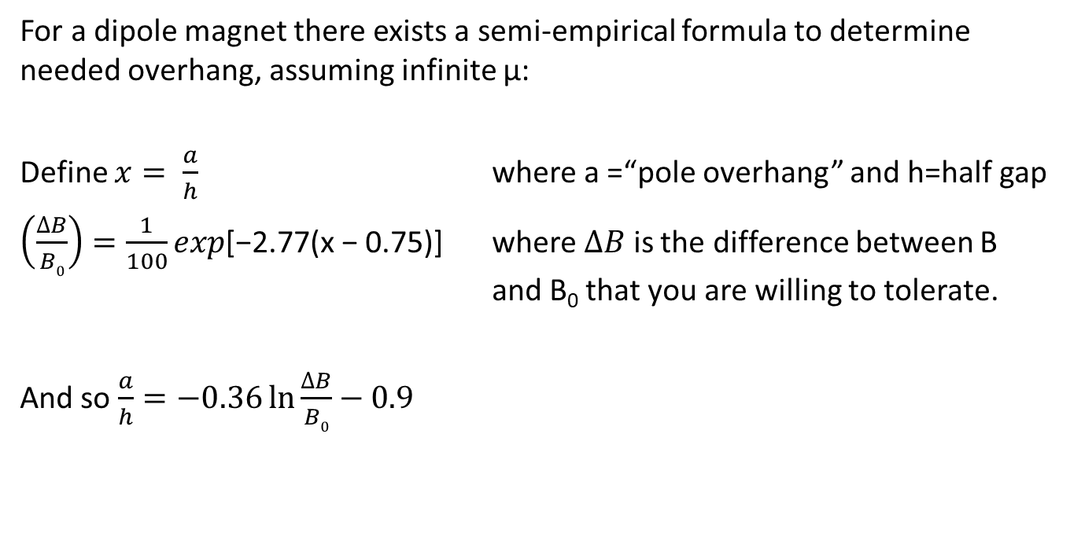
Field Uniformity
For a dipole magnet there exists a semi-empirical formula to determine needed overhang, assuming infinite µ:
Define $x= \frac{a}{h}$ where a =“pole overhang” and h=half gap
$\left(\frac{∆B}{B0}\right)=\frac{1}{100}exp\text{[−2.77(}\text{x}\text{ − 0.75)]}$ where $∆B$ is the difference between B and B₀ that you are willing to tolerate.
And so $\frac{a}{h}=−0.36\ln{\frac{∆B}{B0}}−0.9$

Slide 36
Pole designs
To compensate for the non-infinite pole, shims are added at the pole edges. The area and shape of the shims determine the amplitude of error harmonics which will be present.
Dipole
Quadrupole
We optimise the pole by ‘predicting’ the field resulting from a given pole geometry and then adjusting it to give the required quality.
When high fields are present,
chamfer angles must be small, and tapering of poles may be necessary.

Slide 37
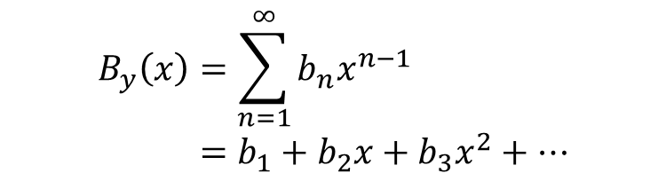
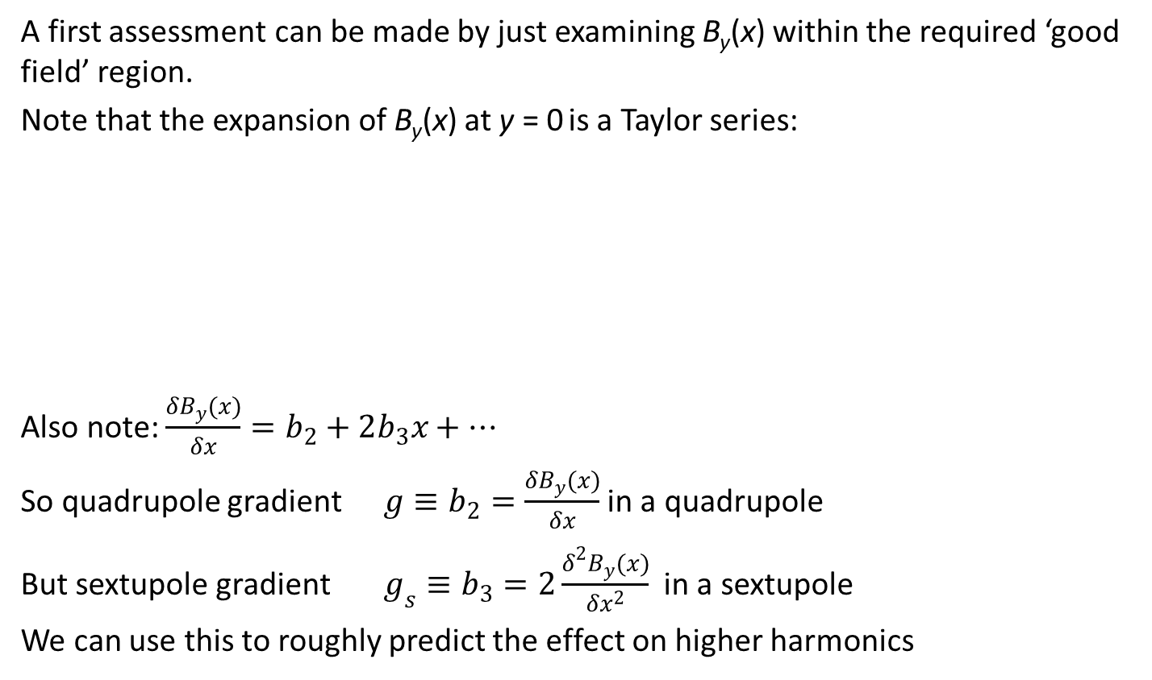
Assessing pole design
A first assessment can be made by just examining B_{y}(x) within the required ‘good field’ region.
Note that the expansion of B_{y}(x) at y = 0 is a Taylor series:
Also note: $\frac{δB_{y}(x)}{δx}=b_{2}+2b_{3}x+…$
So quadrupole gradient $g≡b_{2}=\frac{δB_{y}(x)}{δx}$ in a quadrupole
But sextupole gradient $g_{s}≡b_{3}=2\frac{δ^{2}B_{y}(x)}{δx^{2}}$ in a sextupole
We can use this to roughly predict the effect on higher harmonics
$$B_{y}\left(x\right)=\sum_{n=1}^{∞}{b_{n}x^{n−1}} \\ =b_{1}+b_{2}x+b_{3}x^{2}+…$$
dipole
quadrupole
sextupole

Slide 38
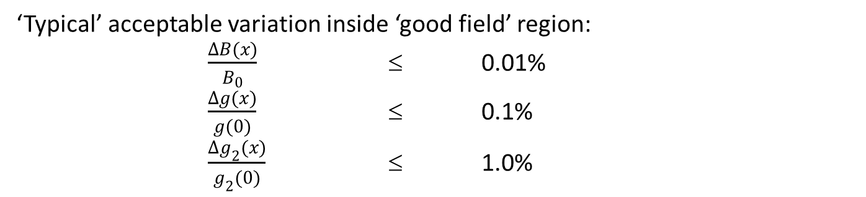
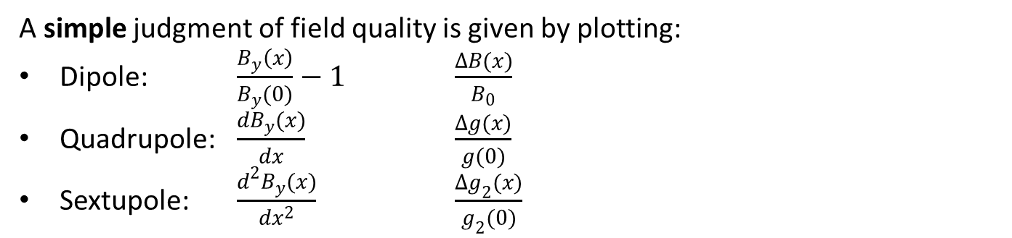
Assessing pole design
Shimming allows us to adjust the field homogeneity or “quality” in a given region, improving it or expanding the region over which we achieve it.
A simple judgment of field quality is given by plotting:
Dipole: $\frac{B_{y}\left(x\right)}{B_{y}(0)}−1$ $\frac{ΔB(x)}{B_{0}}$
Quadrupole: $\frac{dB_{y}(x)}{dx}$ $\frac{Δg(x)}{g(0)}$
Sextupole: $\frac{d^{2}B_{y}(x)}{dx^{2}}$ $\frac{Δg_{2}(x)}{g_{2}(0)}$
‘Typical’ acceptable variation inside ‘good field’ region:
$\frac{ΔB(x)}{B_{0}}$ ≤ 0.01%
$\frac{Δg(x)}{g(0)}$ ≤ 0.1%
$\frac{Δg_{2}(x)}{g_{2}(0)}$ ≤ 1.0%

Slide 39
Pole end termination
Even in magnets normally well below saturation for their material, field builds in sharp corners and non-linear behaviour may result if a square end is used:
A smooth ‘roll-off’ is needed at pole edges (transverse); and at the magnet ends (in the longitudinal direction).
But what is the perfect shape?
Solution provided by Walter Rogowski

Slide 40
Rogowski curve
Rogowski calculated electric potential lines around a flat capacitor plate:
The central heavy line is for ϕ = 0.5.
Rogowski showed that this was the fastest changing line along which the field intensity was monotonically decreasing.

Slide 41
Magnet ends
Recall that a high µ steel surface is a line of constant scalar potential.
A magnet pole end using the ϕ = 0.5 potential line provides the maximum rate of increase in gap with a monotonic decrease in flux density at the surface, i.e. no saturation.
A Rogowski roll-off is not always necessary and is a difficult curve to machine – approximations are often used to save cost.

Slide 42
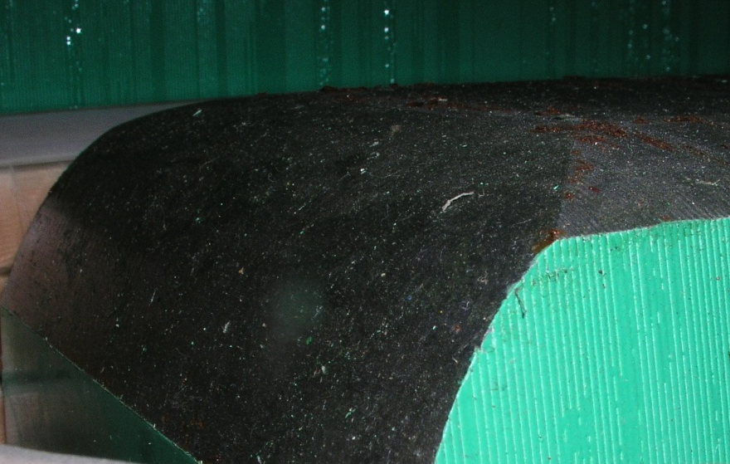
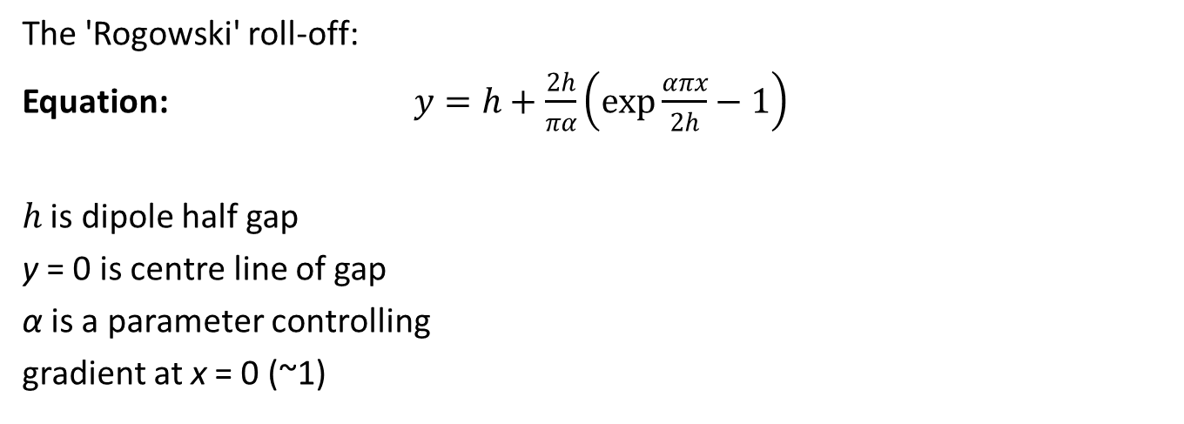
The equation
The 'Rogowski' roll-off:
Equation: $y=h+\frac{2h}{πα}\left(\exp{\frac{απx}{2h}}−1\right)$
$h$ is dipole half gap
y = 0 is centre line of gap
α is a parameter controlling
gradient at x = 0 (~1)
This is generally only needed on dipoles, quadrupoles and higher order magnets often just have a straight angles cut at the pole ends
Diamond dipole end

Slide 43
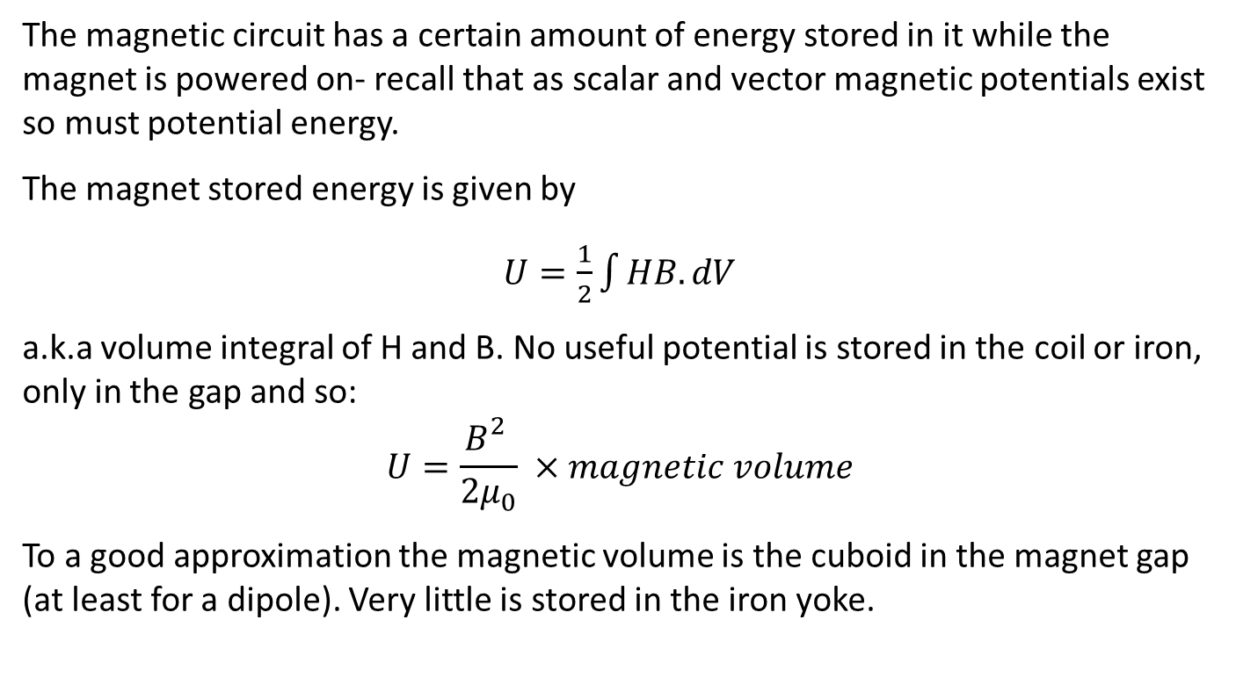
Stored energy
The magnetic circuit has a certain amount of energy stored in it while the magnet is powered on- recall that as scalar and vector magnetic potentials exist so must potential energy.
The magnet stored energy is given by
$U=\frac{1}{2}\int{HB.dV}$
a.k.a volume integral of H and B. No useful potential is stored in the coil or iron, only in the gap and so:
$$U=\frac{B_{}^{2}}{{2μ}_{0}} ×magnetic volume$$
To a good approximation the magnetic volume is the cuboid in the magnet gap (at least for a dipole). Very little is stored in the iron yoke.

Slide 44
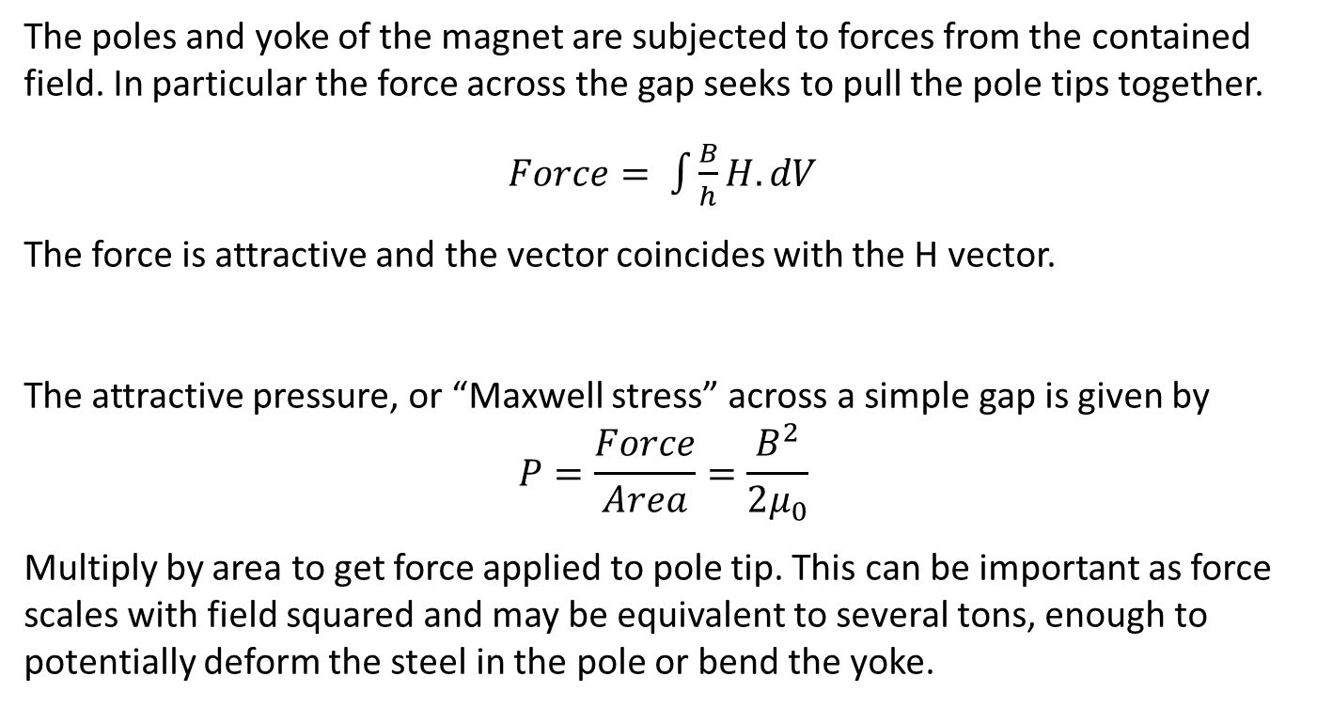
Force on a pole
The poles and yoke of the magnet are subjected to forces from the contained field. In particular the force across the gap seeks to pull the pole tips together.
$Force= \int{\frac{B}{h}}H.dV$
The force is attractive and the vector coincides with the H vector.
The attractive pressure, or “Maxwell stress” across a simple gap is given by
$$P=\frac{Force}{Area}=\frac{B^{2}}{2μ_{0}}$$
Multiply by area to get force applied to pole tip. This can be important as force scales with field squared and may be equivalent to several tons, enough to potentially deform the steel in the pole or bend the yoke.

Slide 45
Permanent magnets

Slide 46
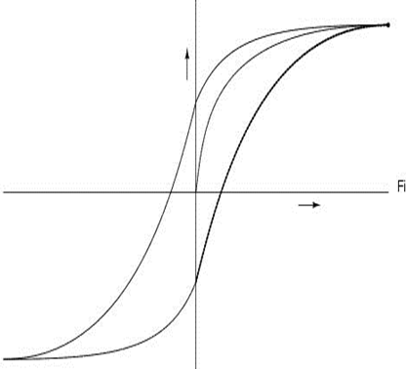
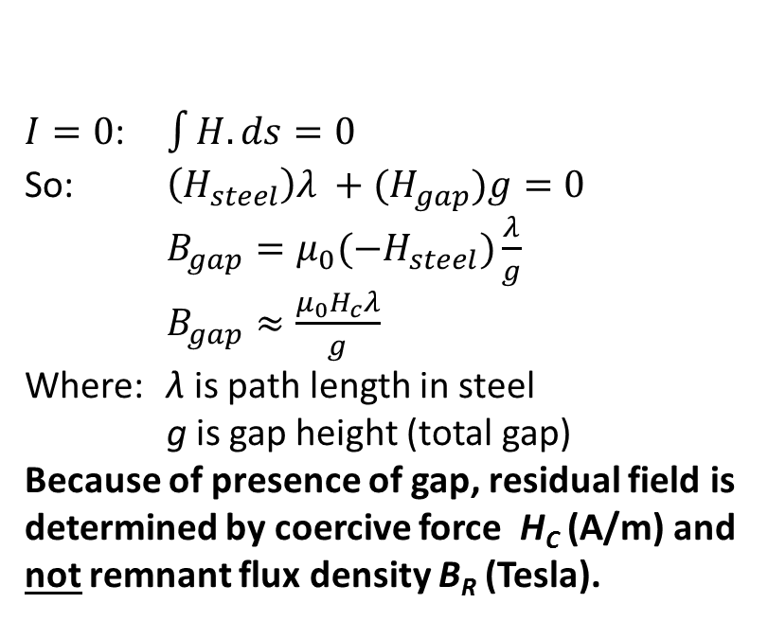
Residual fields
Remnant field B_{R}: value of B at H = 0
Coercive force H_{C}: negative value of field at B = 0
Residual field: the flux density in a gap at I = 0
$I=0$: $\int{H.ds}=0$
So: $\left(H_{steel}\right)λ +(H_{gap})g=0$
$B_{gap}=μ_{0}(−H_{steel})\frac{λ}{g}$
$B_{gap}≈\frac{μ_{0}H_{c}λ}{g}$
Where: λ is path length in steel
g is gap height (total gap)
Because of presence of gap, residual field is determined by coercive force H_{C} (A/m) and not remnant flux density B_{R} (Tesla).
B_{R}
-H_{C}

Slide 47
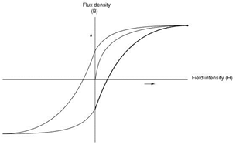

Use of permanent magnets
$B_{gap}=μ_{0}(−H_{PM})\frac{λ}{g}$;
so the PM material
operates in the 2nd quadrant
of the hysteresis loop.
PM is polarised -
magnetised only in the ‘easy’ direction!
PM
material
B
H
B_{r}
Optimum B, H to give maximum energy density
= BH
H_{c}
H

Slide 48
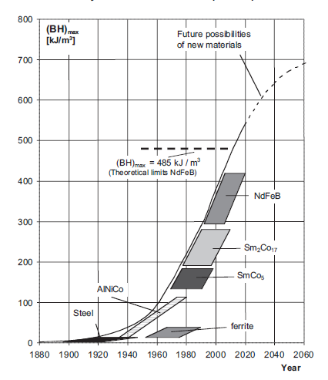
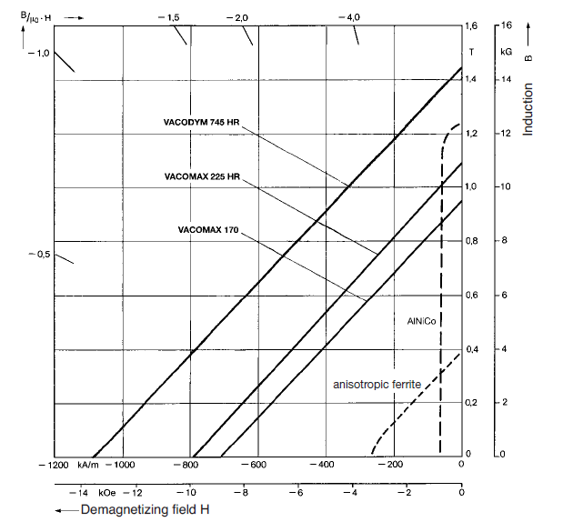
Typical materials

Slide 49
Why?
ASTeC has been working with CERN on the design of 42,000 quadrupoles and 576 dipoles for the drive beam in CLIC:
The power consumption for the EM version will be ~8 MW quads + 12 MW dipoles
Total power load limit to air within the tunnel is only 150 W/m
A PM magnet would potentially have many advantages:
  Vastly reduced electrical power
  Ecologically ‘green’
  Very low operating costs
  No cooling water needed
  Very low power to air
Problem: how to vary the strength of the quadrupole by a factor of 12 and dipole by factor of 2?
Solution: mechanical change to the PM geometry
Problem: pole position is fixed and must be stable to a few 10’s of microns

Slide 50
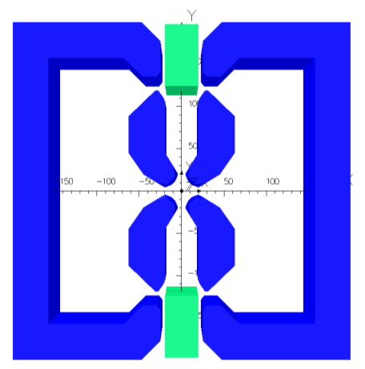
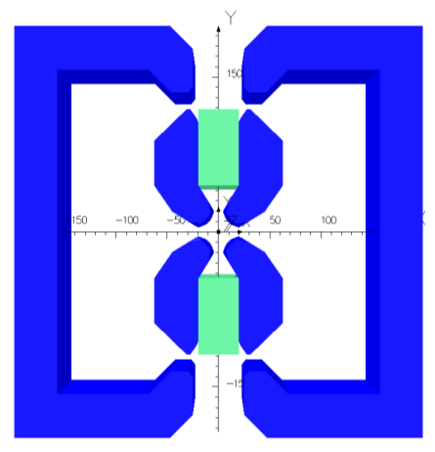
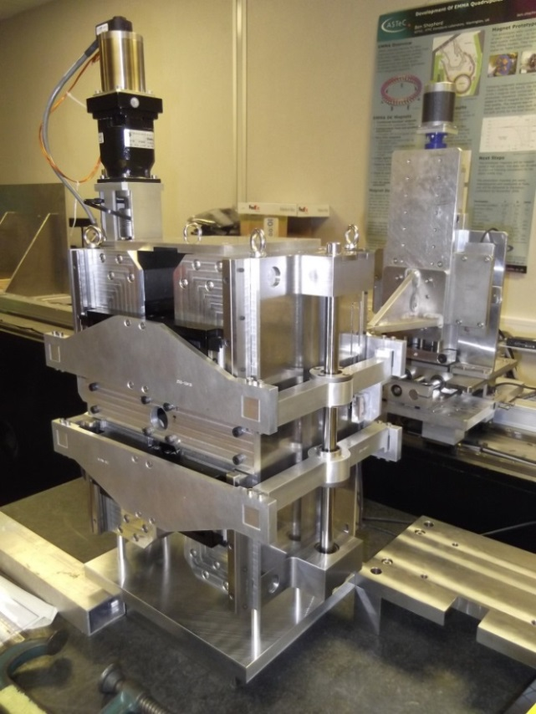
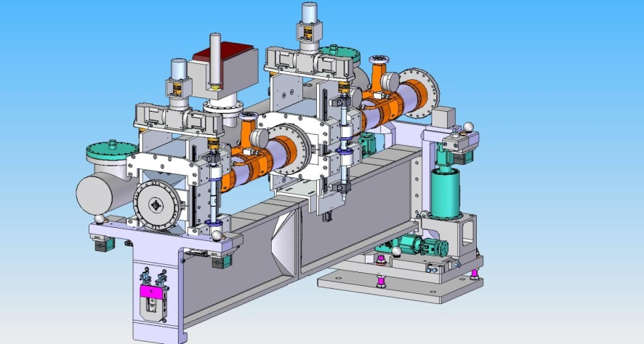
PM quadrupoles
Pole and yoke fixed,PM moves
At 8% strength (3.5 T/m)
At 100% strength (43 T/m)
Lab prototype meets specification
Design for mounting in CLIC drive beam

Slide 51

PM quadrupole

Slide 52

PM dipole

Slide 53
Magnet Design

Slide 54
Computer codes
A number of computer codes are available, we like Opera 2D and 3D. These have:
  finite elements with variable triangular (2D) or tetrahedral/hexahedral (3D) mesh
  multiple iterations to simulate steel nonlinearity
  extensive pre- and post-processors
  cross-platform compatibility
  multiple solvers for static, transient, steady state e.t.c.
Technique is iterative:
  calculate flux generated by a defined geometry
  adjust the geometry until required distribution is achieved

Slide 55
Computer codes
The model is first set up in 2D using a GUI to define ‘regions’:
  steel regions
  coils (including current density)
  a ‘background’ region which defines the physical extent of the model
  the symmetry constraints on the boundaries
  the B-H curves for the steel and other materials
  mesh is generated and data saved

Slide 56

Alice quadrupole
steel yoke
coil
symmetry lines
background region

Slide 57

Alice quadrupole
coarse mesh
fine mesh

Slide 58

Alice quadrupole
Flux lines
(equipotentials)
Central gradient:
1.79 T/m

Slide 59
Solving
Solver - either:
  linear, using a predefined constant permeability for a single calculation
    Useful for coil-only models
  nonlinear, which is iterative with steel permeability set according to B in steel calculated on previous iteration
    Essential for iron-dominated magnets
Post-Processor:
Uses pre-processor model for many options for displaying field amplitude and quality:
  field lines
  graphs
  contours
  gradients
  harmonics (from a Fourier analysis around a pre-defined circle)

Slide 60

e.g. gradient quality

Slide 61

3D-CLARA quad
3 symmetry planes,
1/8th of magnet modelled

Slide 62

3D-CLARA quad

Slide 63
Harmonics
Magnets are often designed to limit the presence of higher harmonics.
The amplitude and phase of the harmonic components in a magnet provide are important when:
  when accelerator physicists are calculating beam behaviour in a lattice
  when designs are judged for suitability
  when the manufactured magnet is measured
  to judge acceptability of a manufactured magnet
Tweaking fine features in the geometry to adjust the harmonics is one of the hardest and most intricate parts of magnet design and is something of a “black art”.

Slide 64

Magnet ends
Fringe flux will be present at the magnet ends so beam deflection continues beyond magnet end:
z
B₀
B_{y}
The magnet’s strength is given by $\int{B_{y}\left(z\right)dz}$ along the magnet, the integration including the fringe field at each end.
The magnetic length is defined as $\frac{1}{B_{0}}\int{B_{y}\left(z\right)dz}$ over the same integration path, where B₀ is the field at the azimuthal centre.

Slide 65
Magnet end geometry
Necessary to terminate the magnet in a controlled way:
to define the length (strength)
to prevent saturation in a sharp corner (see diagram)
to maintain length constant with x, y
to prevent flux entering normal to lamination (AC)
The end of the magnet is therefore
chamfered (a Rogowski roll-off if high field), increasing the gap (or inscribed radius) and lowering the field as the end is approached.

Slide 66
Pole profile
As the gap is increased, the size (area) of the shim may be increased, to give some control of the field quality at the lower field. This is far from perfect!
Transverse adjustment at end of dipole
Transverse adjustment at end of quadrupole

Slide 67

NINA magnet ends

