Slide 1
ICS at FEBE
Outline:
Summary of experiment
Electron Beam parameters
Laser parameters
Collimation of gamma beam
Gamma source parameters
Optical Cavities future work
Alex Morris
University of Liverpool
29/09/2022
ICS - Inverse Compton Scattering
CLARA - Compact Linear Accelerator for Research and Applications
FEBE - Full Energy Beam Exploitation

Slide 2
Summary of experiment
ICS experiment using the upgraded FEBE parameters at Daresbury Laboratory to produce a low bandwidth gamma source
Head on collision between a 250 MeV electron bunch and pulse from a Ti:Sapphire laser (800 nm) to produce 1.48 MeV gammas
Gamma source will be collimated to reduce the bandwidth
Initially the collimated number of photons will be reduced to ~1000 photons per interaction, therefore for a detector with ~0.1% efficiency there will be only 1 photon detected per interaction. This will allow us to fully characterise the source

Slide 3
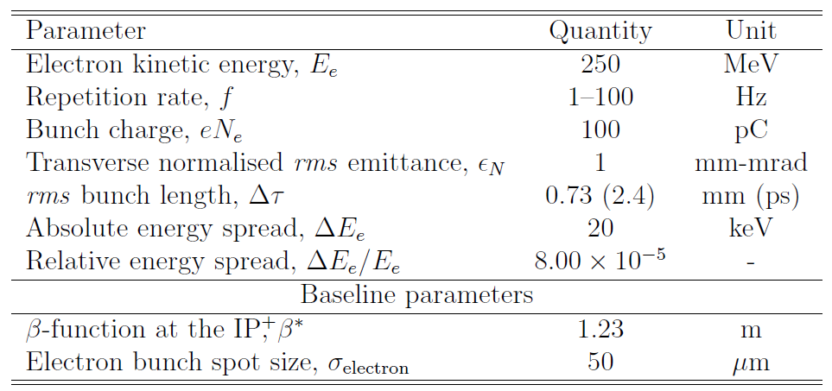
Electron Beam
Electron beam parameters
CLARA accelerator & FEBE upgrade
Angal-Kalinin, D. et al. (2020). Physical Review Accelerators and Beams, 23(4), 44801. https://doi.org/10.1103/PhysRevAccelBeams.23.044801

Slide 4
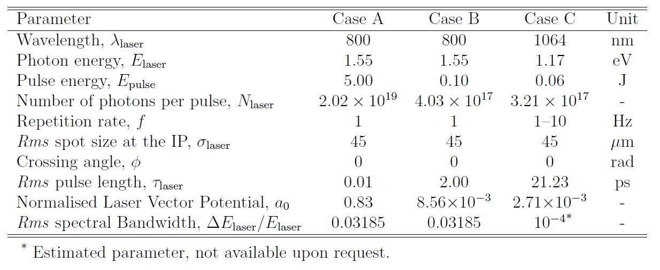
Laser
Ti:Sapphire laser
Nd:YAG laser

Slide 5
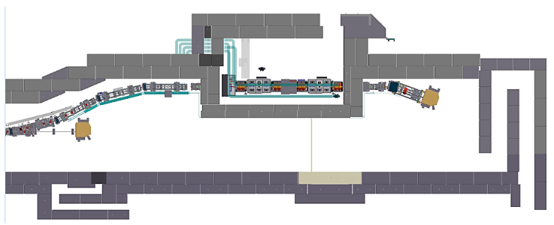
Collimation of Gamma Source
Gamma source will be collimated to reduce the bandwidth of the source and to reduce the flux before impinging on a detector 10 m away.
The flux is reduced so that a detector would not be saturated and single photons events can detected, ~1000 photons per interaction event (assuming an efficiency of detector of 0.1%). The detector will have an energy resolution of ~1 keV to characterise the source over many interactions.
Interaction point
Detector

Slide 6
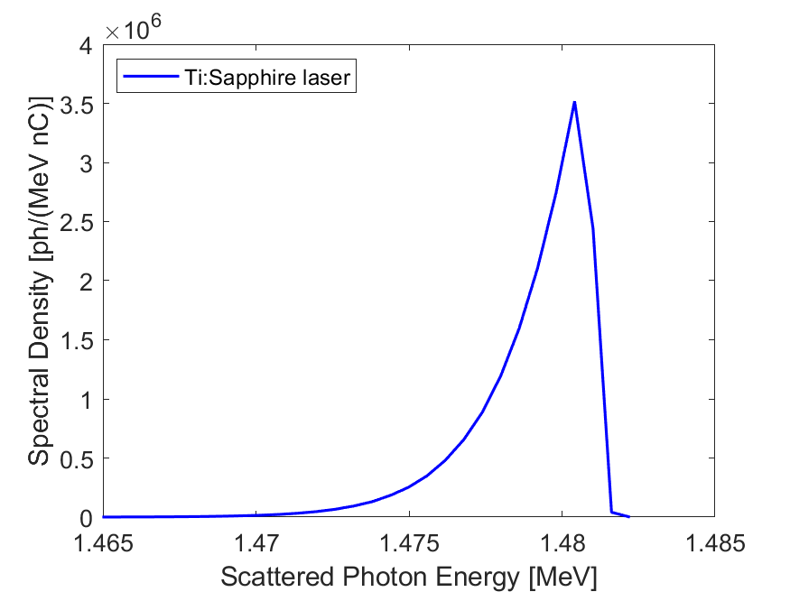
Gamma source parameters

Slide 7
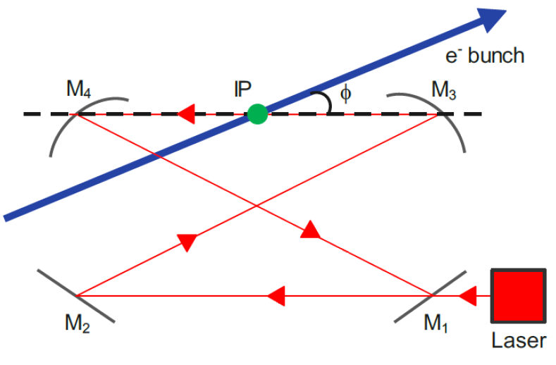
Optical Cavities future work
Optical cavities recirculate the laser pulses to store power in the cavity
Can be used to increase the effective repetition rate of the laser pulses
Carstens, H. (2016). Enhancement cavities for the generation of extreme ultraviolet and hard x-ray radiation.
Joe Crone, thesis

Slide 8
