Slide 1
ERL Driven ICS Sources Overview, Theory, ICARUS
Joe Crone, Hywel Owen, Bruno Muratori, Peter Williams
Electron – Photon Interactions Meeting
[27/09/2022]

Slide 2
Contents
Inverse Compton Scattering
Scattered Photon Energies
Cross Section
Luminosity & Flux
BACKUP: Luminosity Reduction Factors
ICS Sources & Accelerator Drivers
Analytical Collimated Flux
ICARUS
BACKUP: ICARUS Model
ICARUS Code & Benchmarking
CBETA ERL ICS Source
DIANA ERL ICS Source

Slide 3
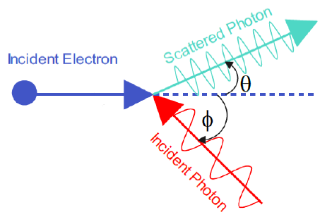
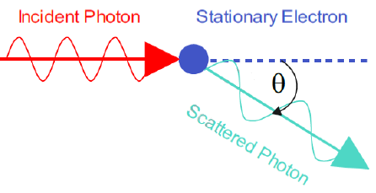
Inverse Compton Scattering
In Compton scattering a photon is incident upon a stationary electron, the electron gains energy and the photon recoils with lower energy (longer wavelength).
Inverse Compton scattering is the process where an incident photon gains energy from a high energy (relativistic) electron and the photon is then scattered to high energy (shorter wavelength) via a ‘double Doppler boost’ (E_{γ} ∝ γ²) and the electron recoils.
Classically (but not entirely correctly!), this can be thought of as the incident photon causing the electron to oscillate in it’s reference frame (first Lorentz transform). The electron is accelerated and emits radiation, which is Lorentz transformed back into the laboratory frame.
→ Doesn’t account for electron recoil
Inverse Compton Scattering
Compton Scattering
Classical depiction of inverse Compton scattering.

Slide 4
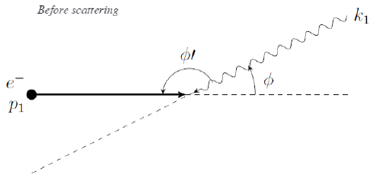
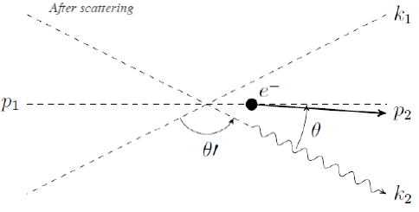
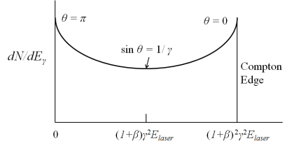
ICS: Scattered Photon Energies
The scattered photon energy from an inverse Compton scattering interaction is
Which can be simplified, assuming a small scattering angle θ, to
With the electron recoil parameter X.
The highest energy photons are produced when θ = 0, known as the Compton edge energy.
More photons are produced in the forward or backward directions because of the final Lorentz transform.
Photons are produced in the forward direction into a θ = 1/γ cone.
2D geometry of an electron-photon ICS interaction. Top: Before interaction. Below: After interaction.
Scattered photon energy distribution of scattered radiation

Slide 5
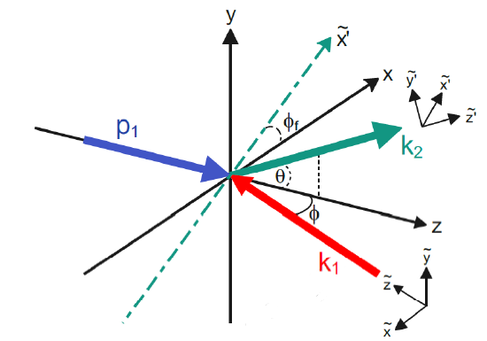
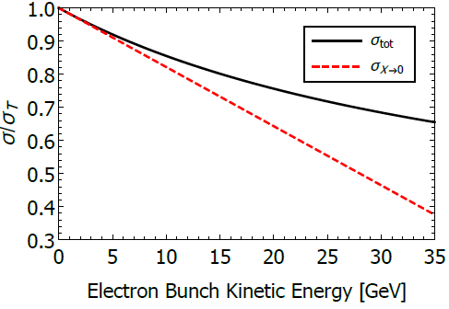
ICS: Cross Section
The probability of an ICS interaction occurring can be calculated using the cross section, requiring that the dynamics are taken into account in 3D and that polarisations are considered.
The full double differential cross section, including polarisation (Stokes parameters) is:
Full 3D geometry of the ICS interaction with p₁ (blue) the incident electron, k₁ (red) the incident photon and k₂ (green) the scattered photon.
Integrate over full azimuthal angle, with all possible polarisations.
Differential cross section w.r.t. Y Lorentz invariant (derived from Mandelstam variables).
Final interaction cross section, which becomes the Thomson cross section in the small recoil limit.
Cross section normalised to Thomson cross section as a function of incident electron energy.

Slide 6
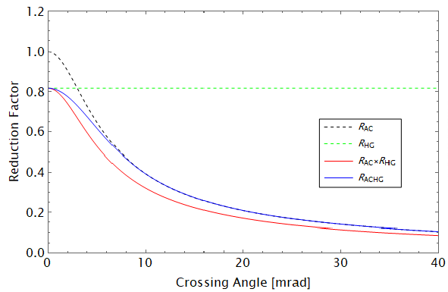
ICS: Luminosity and Flux
The luminosity of the ICS interaction between a bunch of electrons and an incident photon pulse is given by the typical collider luminosity assuming Gaussian pulse + bunch.
The flux – no. photons scattered per second - is then a product of the total cross section and the repetition rate of the collisions.
Luminosity reduction. Left: Diagram of an angular crossing – overlap reduced, luminosity reduced. Right: Hourglass effect – beam sizes increased by divergence, luminosity reduced.
The R_{ACHG} factor is the combined luminosity reduction due to
the angular crossing of the electron bunch and laser pulse.
the hourglass effect – non-negligible divergence of the electron bunch and laser pulse.
Plot of reduction factors as a function of crossing angle. Reduction factors should be combined properly.

Slide 7
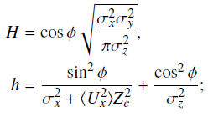
BACKUP: Luminosity Reduction Factors
Angular Crossing
Hourglass Effect
Combined Angular Crossing & Hourglass Effect

Slide 8
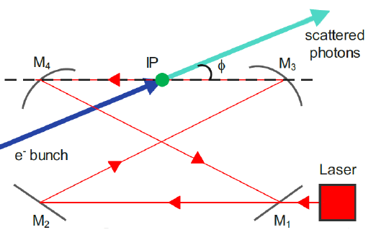
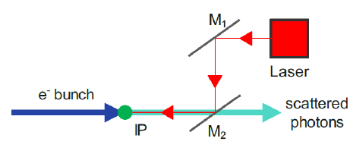
ICS Sources + Accelerator Drivers
ICS sources (broadly) come in two varieties:
‘Single Shot’ – Laser pulse and electron bunch are used a single time
‘Re-circulated Pulse’ – Laser pulse and electron bunch are re-circulated and repetitively used.
Single shot ICS sources typically have higher peak brilliance, higher no. photons produced per shot and use more powerful lasers.
Re-circulated pulse ICS source typically have higher average brilliance and flux (ph/s) and use less powerful lasers re-circulated in Fabry-Perot optical cavities.
Re-circulated ICS sources benefit from small emittance and high beam current.
Low emittance storage ring designs
Energy recovery linacs
‘Single Shot’ ICS sources favour accelerators with a very small emittance and large bunch charge i.e. Linacs
Re-circulated pulse ICS sources are favoured because ~100 MHz repetition rates @ 10’s μJ produce similar flux to 10’s Hz repetition rates @ 10’s J.
The first option is more technically feasible – CoReLs laser used for comparison.
First option avoids non-linear inverse Compton scattering.
Re-circulated pulse style ICS source where the electron beam is re-circulated in the accelerator and the laser pulse in the optical cavity.
Single shot ICS source where a high bunch charge (electron dense) electron beam is interacted with a high pulse energy (photon dense) laser pulse a single time.

Slide 9
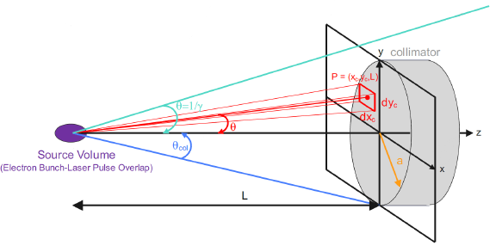
Analytical Collimated Flux
Aim to derive an equation that allows the flux of photons from an ICS source that passes through a downstream circular collimator – collimated flux - to be calculated by modifying the flux. Collimator used for energy selection.
Valid for Gaussian electron bunch and incident photon pulse. Doesn’t account for electron bunch energy spread or spectral bandwidth of incident photon pulse.
Useful for characterising ICS sources on-the-fly, benchmarking spectrum codes or for lengthy optimisations.
First step is to derive a cross section for photons that pass through a circular collimator with collimation angle θ_{col} – fully general for all polarisations, recoil and angular collisions.
Diagram of collimation of an ICS source post electron beam – laser pulse interaction.
Then the collimated flux, with hourglass effect and angular crossing luminosity reduction, is just a modified version of the flux

Slide 10
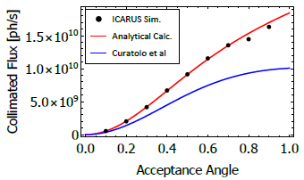
Analytical Collimated Flux
Benchmarked against the only other existing ICS source collimated flux calculation (to authors knowledge) by Milan group.
Derivation of this formula unclear. Has been modified to account for the angular crossing and hourglass effect identically to my calculation – the R_{ACHG} factor.
Uses the acceptance angle Ψ, which is the collimation or scattering angle normalised by 1/γ.
Clearly, there is a variation between the two calculations in the angular term. The ICARUS code agrees with the analytical model derived here, potentially the Curatolo et al derivation uses a small angle approximation.
Collimated flux as a function of acceptance angle for the analytical calculation (red), Curatolo’s calculation (blue) and the ICARUS spectrum code (black).
Curatolo et al Collimated Flux
JC Collimated Flux

Slide 11
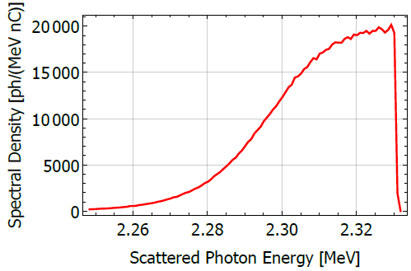
ICARUS
ICARUS (Inverse Compton scattering semi-Analytical Recoil-corrected Spectrum code) is a code I developed using an ICS spectrum model by Sun and Wu which has been corrected and modified.
A Gaussian electron bunch and laser pulse interact and the scattered photons then pass through a circular/rectangular collimator downstream. ICARUS produces the spectrum of scattered photons at the exit of the collimator.
Main features of ICARUS
Only valid for linear ICS (a₀ << 1).
Accounts for recoil of the electron beam.
Emittance effects of the electron beam are modelled.
Energy spread of the electron bunch is accounted for.
DIANA
Incident photon spectral bandwidth modelled.
Only valid for head-on interaction (φ = 0)*
Only valid for gaussian electron beams and laser pulses.**
Rectangular and circular collimation modelled.
ICARUS spectrum of the DIANA ICS source with E_{e} = 362 MeV and Nd:YAG laser.
Diagram of collimation of an ICS source post electron beam – laser pulse interaction.

Slide 12
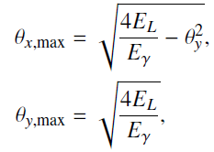
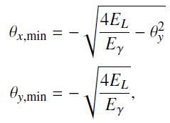
BACKUP: ICARUS Model
Electron emittance and divergence terms
Cross section term
Collimation terms
Electron energy spread term
Incident photon pulse spectral bandwidth term

Slide 13
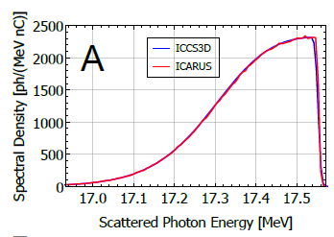
ICARUS Code & Benchmarking
The ICARUS spectrum is characterised as a spectral density as a function of scattered photon energy plot. Post processing can calculate the collimated flux of the spectrum.
ICARUS is implemented as a Mathematica script (currently!) that uses parallel processing to calculate the spectral density at a set no. intervals across a possible range in scattered photon energy.
ICARUS has been benchmarked against the ICCS3D code which takes a different semi-analytical approach to predicting ICS spectra.
ICCS3D has been benchmarked against a Monte Carlo EM interactions code CAIN – an early version of ICARUS was benchmarked using CAIN too.
In addition, ICARUS has also been compared to the analytical collimated flux with good agreement when energy spread of the electron bunch and incident photon pulse is small.
Benchmarking of ICARUS (red) and ICCS3D (blue) for a DIANA-ish ERL example case.
Collimated flux benchmarking of ICARUS (black), analytical collimated flux (red) and Curatolo et al analytical calculation (blue) for a DIANA-ish ERL example case.

Slide 14
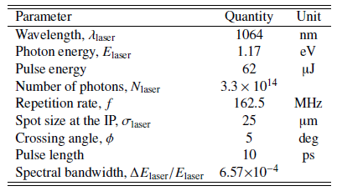
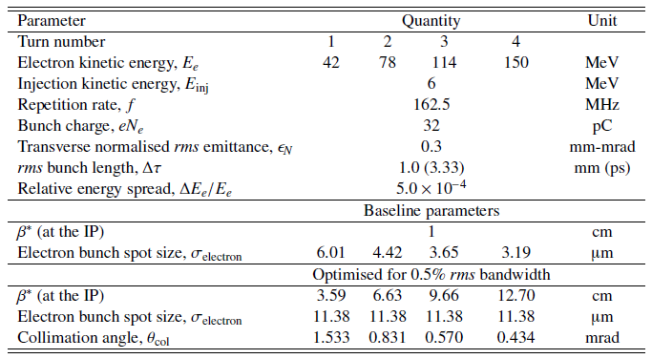
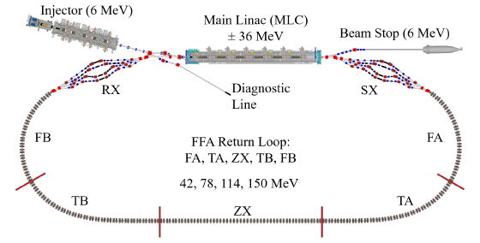
CBETA ERL ICS Source
The CBETA ICS source is based upon the 4-turn CBETA ERL (Cornell – Brookhaven ERL Test Accelerator) – the first demonstration of a multi-turn SRF energy recovery linac.
Aimed to produce high energy x-rays to extend the photon energy range of the CHESS synchrotron.
Electron beam parameters for the ICS source are based upon multi-turn commissioning run and design parameters. Laser parameters based on cERL ICS source demonstration @ KEK.
Unique non-scaling FFA transport leaves no possibility of an ICS source interaction point within the existing accelerator and a bypass had to be designed.
Nd:YAG laser and optical cavity parameters of the CBETA ICS source.
Schematic of the CBETA 4-turn ERL with non-scaling FFA return loop.
Electron beam parameters of the CBETA ICS source.

Slide 15
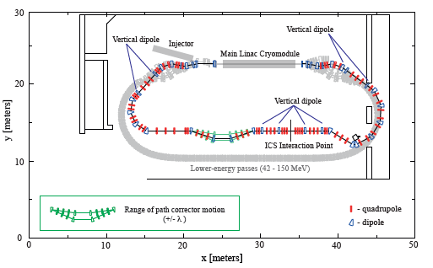
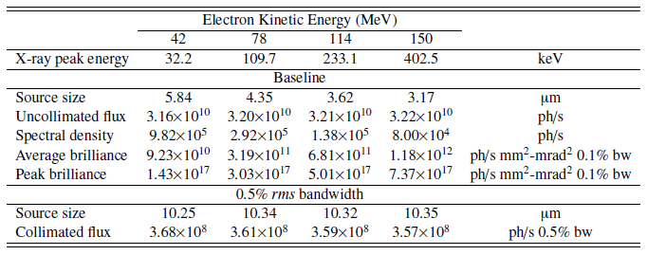
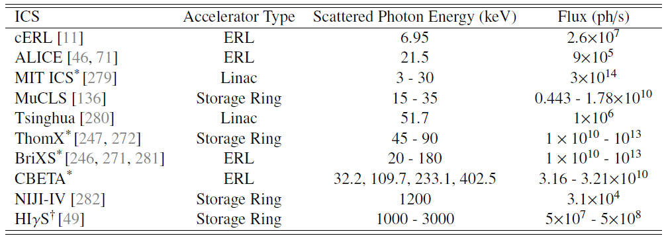
CBETA ERL ICS Source
Bypass beamline designed above the existing FFA return loop for the 150 MeV maximum energy. Extra design work required for lower energy passes.
Challenging to design ICS IP for multi-energy common transport – highly constrained!
Flux up to ~10¹⁰ ph/s, with ~10⁸ ph/s in 0.5% rms bandwidth.
High average brilliance, moderate peak brilliance.
Maximum photon energy beyond most x-ray ICS sources and below most γ-ray sources.
Higher flux than any demonstrated ICS source. Designs with higher flux assume at least 10x stored laser power.
Schematic of the CBETA ICS source bypass line design.
Comparison of various x-ray ICS source projects.
Spectral output parameters of the CBETA ICS source.

Slide 16
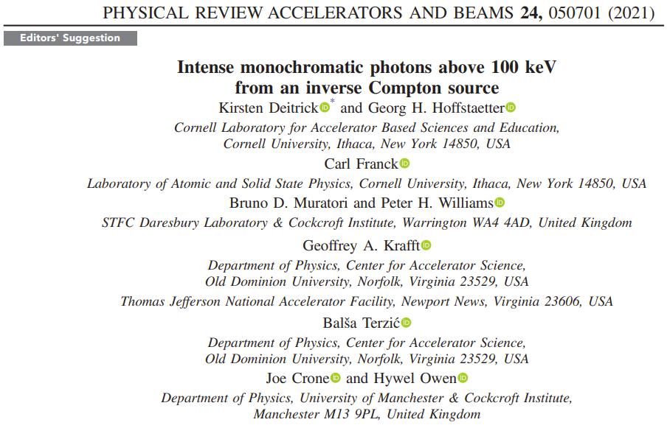
CBETA ERL ICS Source
Schematic of the CBETA ICS source bypass line design.
Spectral output parameters of the CBETA ICS source.

Slide 17
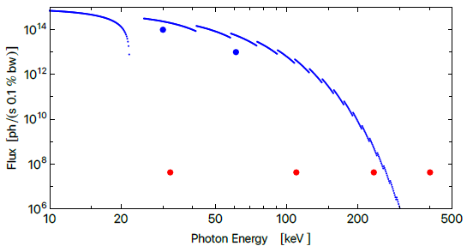
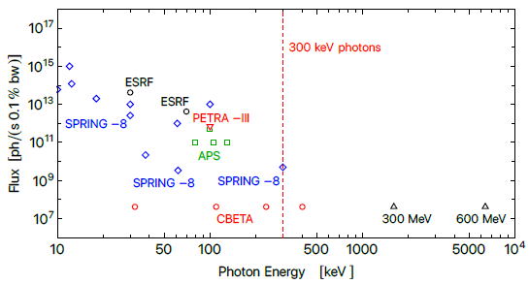
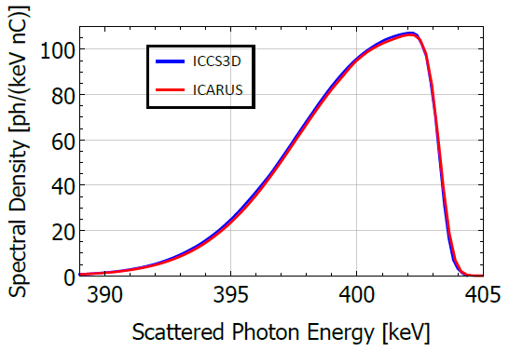
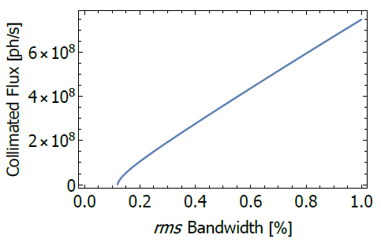
CBETA ERL ICS Source
CBETA ICS source has been optimised for maximum collimated flux in a given bandwidth to produce collimated flux-rms bandwidth tuning curves.
ICARUS spectrum for CBETA benchmarked with ICCS3D. Used to confirm collimated flux predictions.
The CBETA ICS source was compared with major synchrotron radiation sources worldwide, with focus on Spring-8 the highest energy synchrotron source.
ICS sources become advantageous above ~300 keV – contrary to existing literature - so < 300 keV they are not competitive with synchrotron sources in terms of flux.
High energy x-ray photons are useful for some atomic physics studies, imaging of thick samples (EV batteries etc.) and x-ray fluorescence.
Flux as a function of scattered photon energy for Spring-8 (blue) and CBETA ICS source (red).
Flux as a function of scattered photon energy for surveyed synchrotron facilities.
CBETA ICS source spectrum, ICARUS (red) and ICCS3D (blue).
Max collimated flux as a function of rms bandwidth for CBETA ICS Source at 402.5 keV.

Slide 18
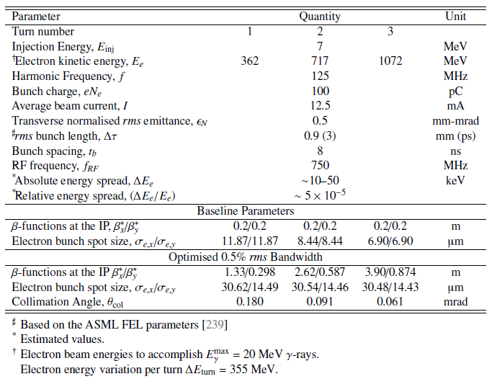
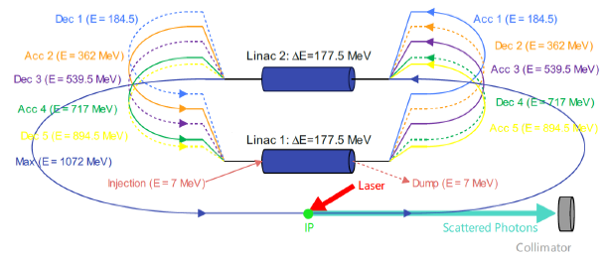
DIANA ICS Source
DIANA (Daresbury Industrial Accelerator for Nuclear Applications) is a conceptual 3-turn GeV-scale ERL designed to drive both a high power EUV FEL and a narrowband γ-ray ICS source (E_{γ} > 20 MeV).
γ-ray ICS source is applicable to nuclear photonics, security, within the nuclear industry (waste assay, reactor studies, …) and medical isotope production.
Multiple energy electron beams in DIANA may allow for a range of photon energies to be produced, which means a multi-colour ICS source can be built.
High average beam current (12.5 mA) means a re-circulated ICS source is favoured. Small stored laser power can create large number of photons.
Electron beam parameters of the conceptual DIANA 3-turn ERL and γ-ray ICS source.
Schematic of the 3-turn DIANA ERL with γ-ray ICS source.

Slide 19
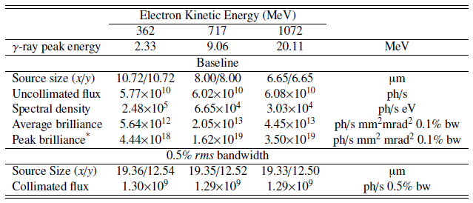
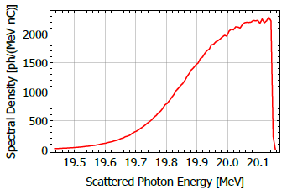
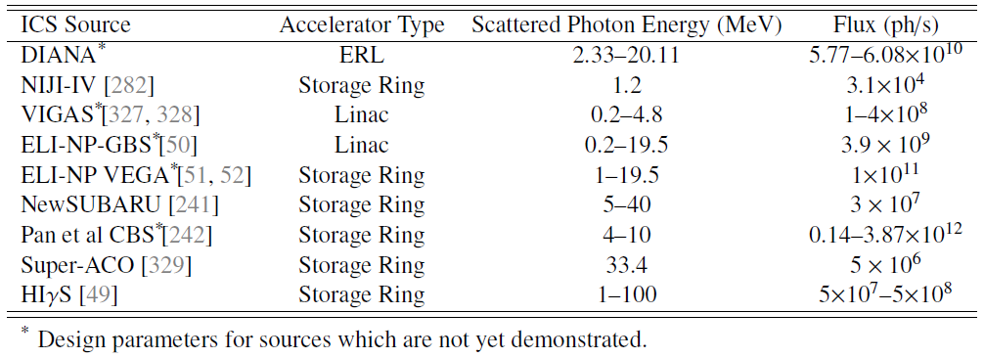
DIANA ICS Source
DIANA is the only current ERL driven proposal for a γ-ray ICS source.
Predict to generate ~10⁹ ph/s in a narrow 0.5% rms bandwidth with demonstrated laser parameters (cERL ICS @ KEK).
On par with the proposed EU flagship ELI-NP-GBS (VEGA) γ-ray ICS source. Factor ~1000 greater flux than current demonstrated source (HIγS) which has a larger bandwidth (~3% FWHM).
Higher photon energies are available using frequency doubled lasers, an FEL as incident radiation or by using higher electron energies.
Predicted spectral output of the DIANA ICS source.
Comparative table of γ-ray ICS sources.
ICARUS spectrum for the DIANA ICS source at E_{e} = 1072 MeV.

Slide 20
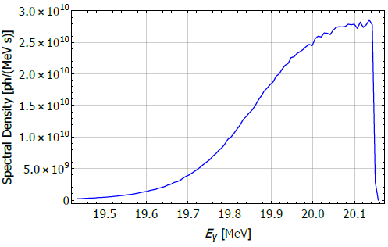
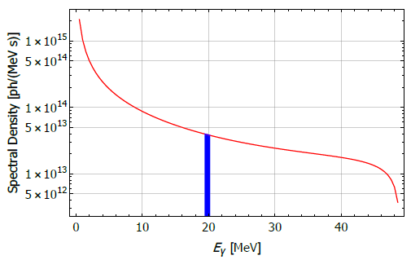
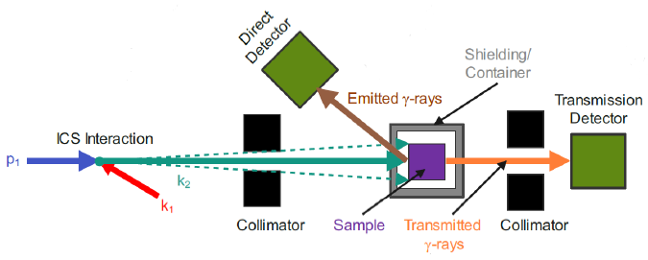
DIANA ICS Source
DIANA has been compared to radiation production by bremsstrahlung sources via calculation of a bremsstrahlung spectrum from a 1 mA, 50 MeV electron linac using a Tungsten (Z = 74) convertor.
Bremsstrahlung is capable of producing far more photons than ICS sources but can not produce these photons in a narrowband. Simple collimation is insufficient in bremsstrahlung because there is no simple scattering angle – scattered photon energy correspondence in bremsstrahlung production.
Several application areas have also been investigated, such as NRF experiments and medical isotope production of samarium 153 and terbium 155.
NRF experiments with DIANA can discriminate isotopes of uranium and plutonium.
Potential for production of medical isotopes without contaminants, or for those that can’t be produced by conventional methods.
Spectral density of the DIANA ICS source at E_{e} = 1072 MeV.
Comparative bremsstrahlung spectrum from 50 MeV electron linac at 1 mA with a Tungsten convertor. Blue region highlights bandwidth of DIANA ICS source.
Schematic of an example nuclear resonance fluorescence measurement with an ICS source with two measurement approaches – direct and transmission.

Slide 21
Questions?
Acknowledgements
Hywel Owen, Peter Williams, Bruno Muratori (Cockcroft Institute, Daresbury Laboratory)
Kirsten Deitrick (Thomas Jefferson National Accelerator Facility)
Carl Franck, Georg Hoffstaetter (Cornell University)
Balša Terzić (Old Dominion University)
Geoff Krafft (Old Dominion University & Thomas Jefferson National Accelerator Facility)
The CBETA Collaboration (Cornell University & Brookhaven National Laboratory)

