Slide 1
Introduction to LhARA and SmartPhantom
John Matheson
PPD
Rutherford Appleton laboratory
LhARA – Laser hybrid Accelerator for Radiobiological Applications
What is it and why do we need it ?
Overall Layout
Proton/Ion acoustic dose mapping
SmartPhantom - instrumented water phantom for test beam work
Central aim – verify simulations against measurements
Based on scintillating fibre
Calibration against dosimetric standards
Transducers for proton acoustic measurements to be added later

Slide 2
Who is working on the SmartPhantom ?
Jeff Bamber Institute of Cancer Research, Sutton
Liam Cooper RAL TD
Ben Cox UCL Biomedical Ultrasound
Emma Harris Institute of Cancer Research, Sutton
Hin Tung Lau Imperial College - PhD student (graduated)
Ken Long Imperial College, RAL PPD
Josie McGarrigle Imperial College
John Matheson RAL PPD
Maria Maxouti Imperial College, RAL PPD - Joint PhD student

Slide 3
The LhARA Collaboration

Slide 4
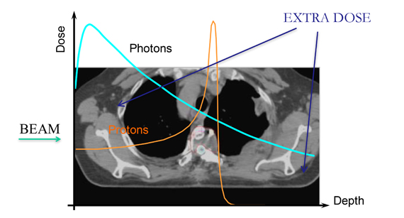
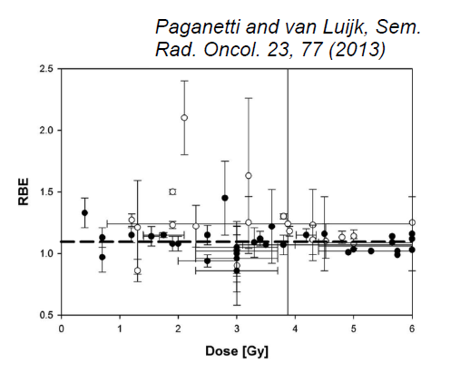
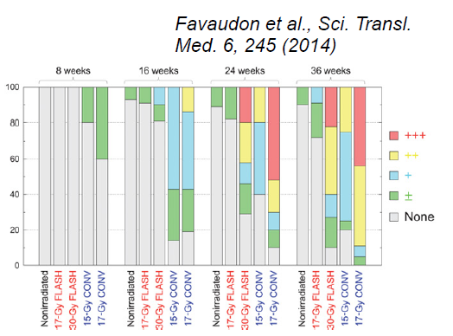
Why do we need LhARA ?
LhARA is a facility to study the radiobiology of proton and ion beams
Growing requirement for radiotherapy globally
Proton & ion radiotherapy are growing modalities
UK: Christie, UCL - More provision will be needed
Development of new technologies and cost effective systems
Systematic study of radiobiology of proton/ion beams
Accurate treatment planning relies on RBE
Uncertainty due to: energy, dose, dose rate, spatial distribution, ion species….
Novel beams for radiobiology
Therapeutic benefits for ultrahigh dose rates
FLASH RT and microbeam therapy
Needs extensive further study in vitro and in vivo
Paganetti, Proton Beam therapy (IOP Publishing)

Slide 5
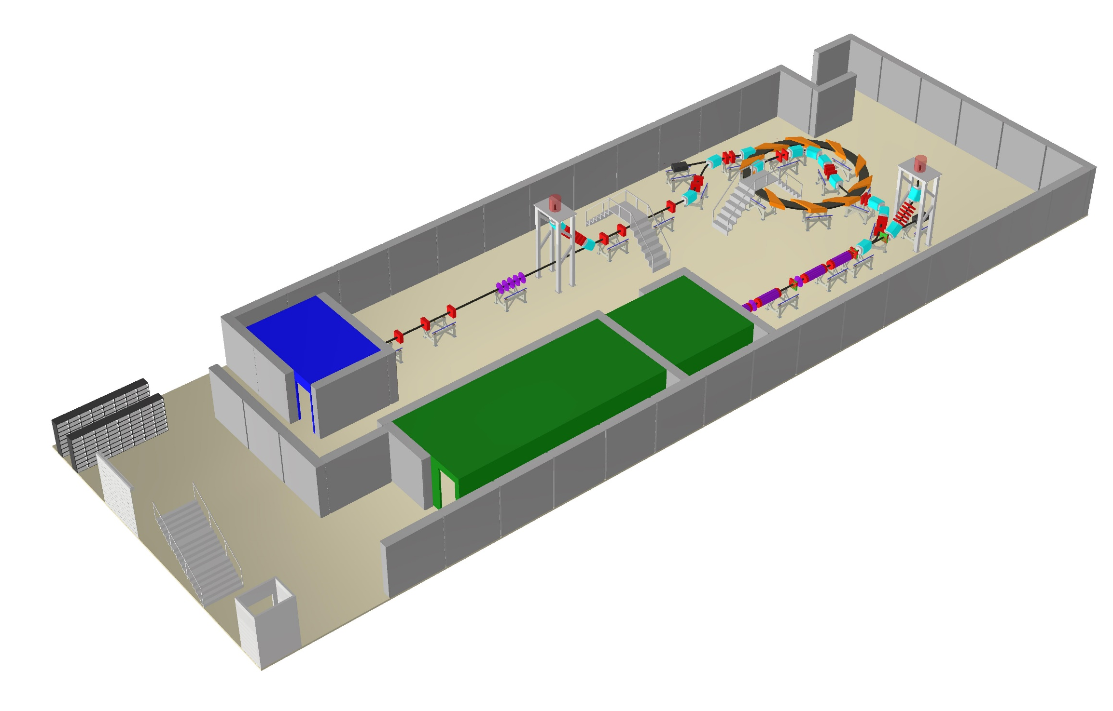
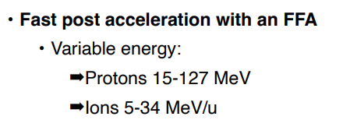
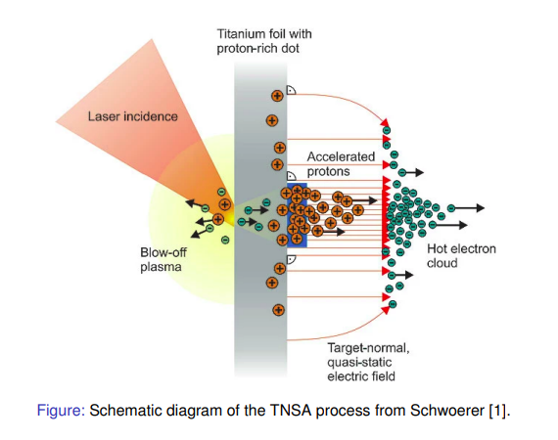
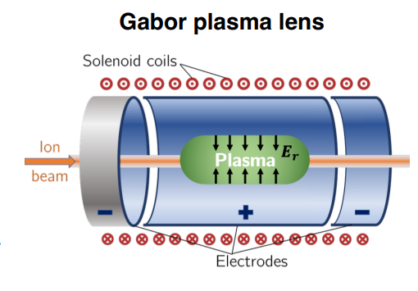
What is the LhARA facility ?
Raison d’être:
To study the radiobiology of proton and ion beams
High energy in vitro end station
In vivo end station
Low energy in vitro end station
Laser target
Laser
Up to 1e9 Gy/s
Rep rate 10Hz

Slide 6
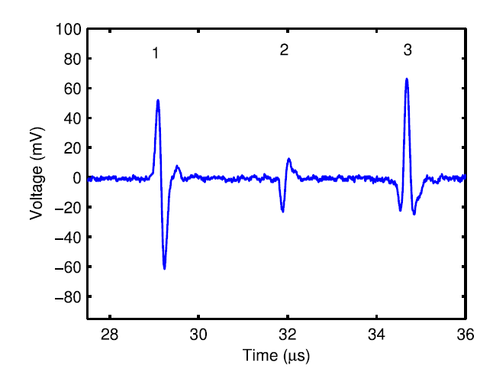
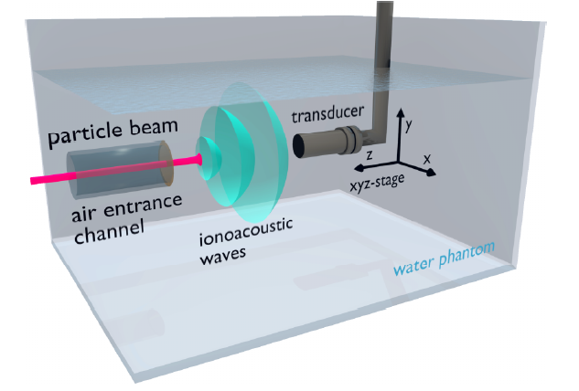
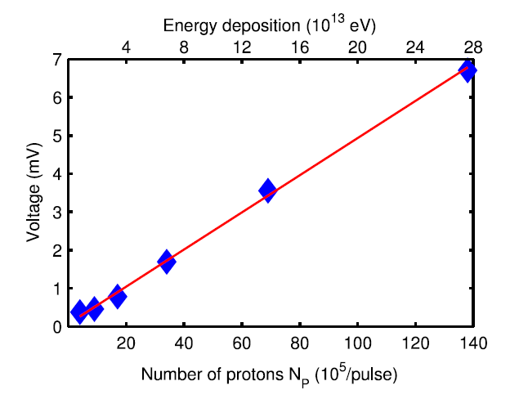
Aside: What is Ion Acoustic Dose Mapping ?
Is it possible to get the deposited dose using acoustic measurements ?
Compatibility with medical ultrasound and possibility of use in vivo

Slide 7
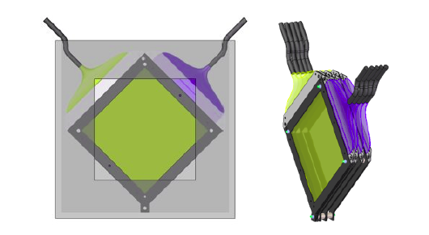
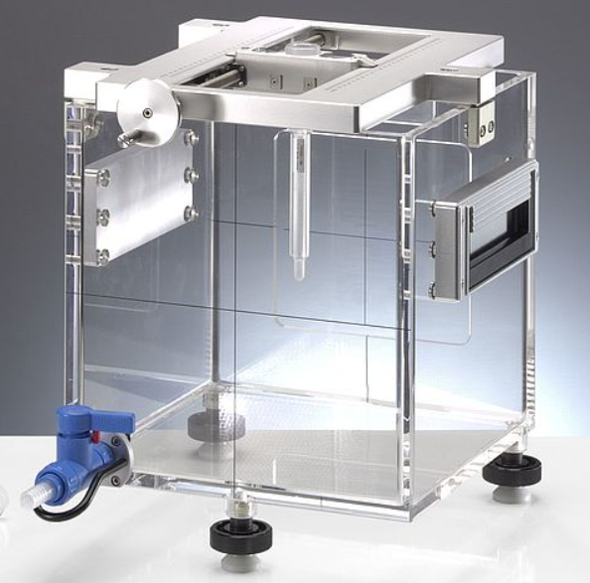
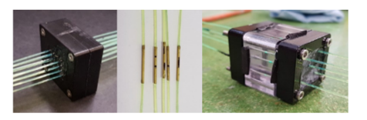
The SmartPhantom
Aim is to compare measurements:
proton acoustic
scintillating fibre
dosimetry
Compare measurements & simulations:
protons in water (GEANT4)
protons in detectors (GEANT4)
acoustic signals (k-Wave)
Beam is measured using scintillating fibre planes
Scintillating fibre -> clear fibre -> detector
Aiming to use the edge of the plane as a connector
Clear fibres bundled and sent to CMOS camera
For faster readout, could use photodiodes
Water-filled phantom useful for protons, few 10s of MeV up
SmartPhantom is a tool go on the endstations, to compare simulations of beam interactions with experiment
www.ptwdosimetry.com
http://www.k-wave.org/
https://geant4.web.cern.ch/
From: Medical Applications for Particle Physics (PhD Thesis), H.T.Lau, Imperial College (2021)
Methods of joining fibres – Jeff Sykora, ISIS

Slide 8
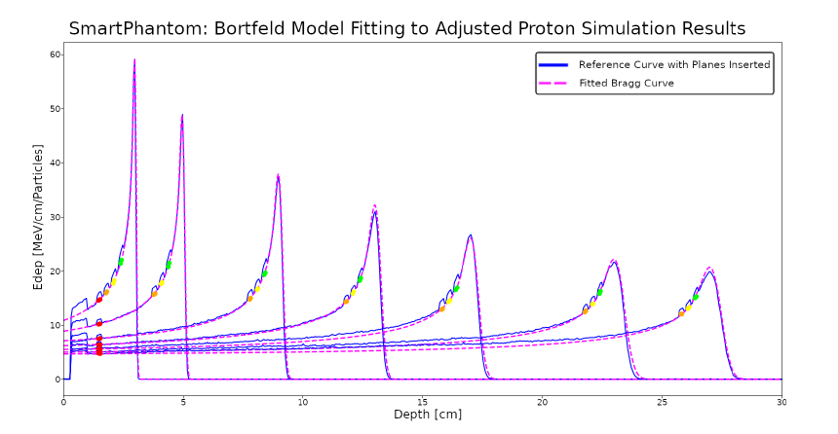
SmartPhantom Simulations (GEANT4)
Solid curves – GEANT4 simulated Bragg Peaks at various energies
Coloured points – energy deposited in the scintillating fibres
Dashed curves – Bortfield model used to reconstruct the B.P. from the fibre data
H.T.Lau, Maria Maxouti

Slide 9
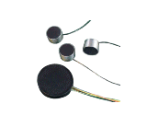
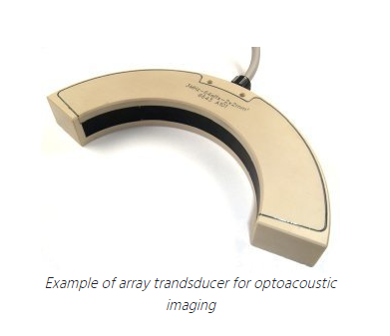
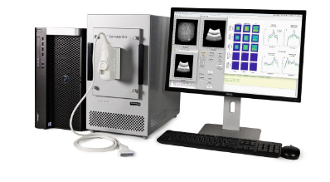
Ion acoustic kit for integration to SmartPhantom
https://verasonics.com/vantage-systems/
https://www.imasonic.com/en/home/
Currently Maria Maxouti is running simulations with GEANT4 and k-Wave
The simulations will allow the choice of transducer array geometry for SmartPhantom

Slide 10
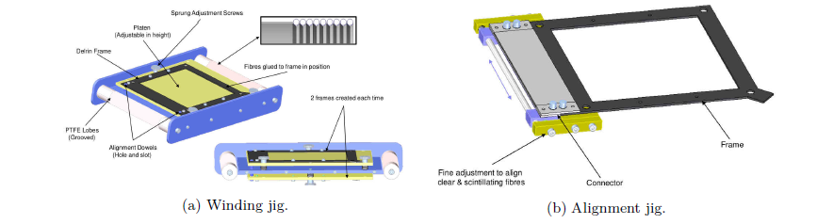
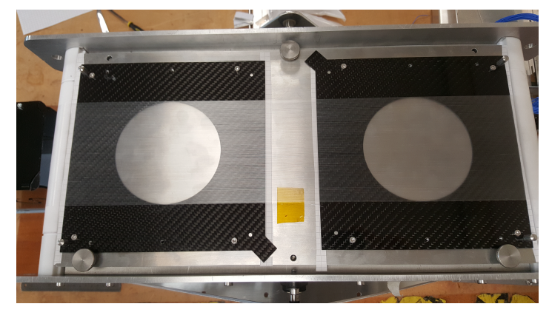
SmartPhantom construction trials
Prototype planes, wound with fishing line on the winding jig
Maria Maxouti IC / RAL PPD
Josie McGarrigle IC
Liam Cooper RAL TD

Slide 11
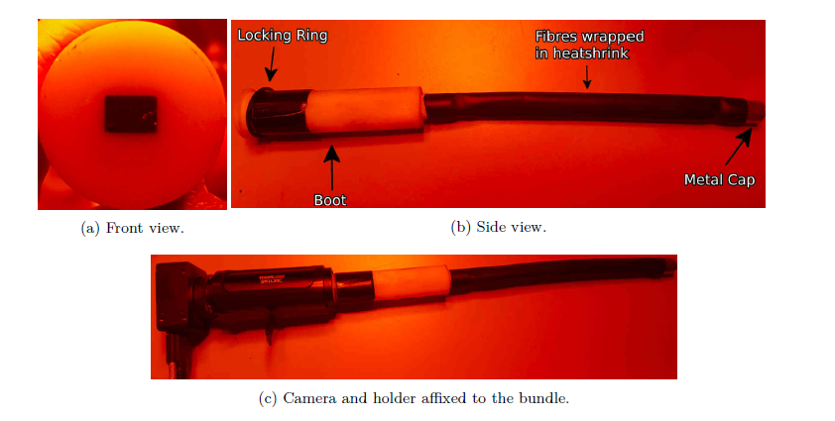
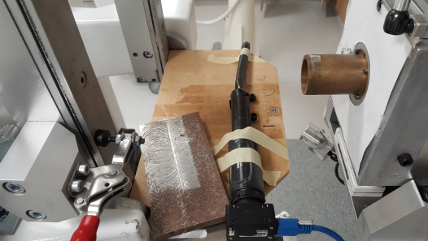
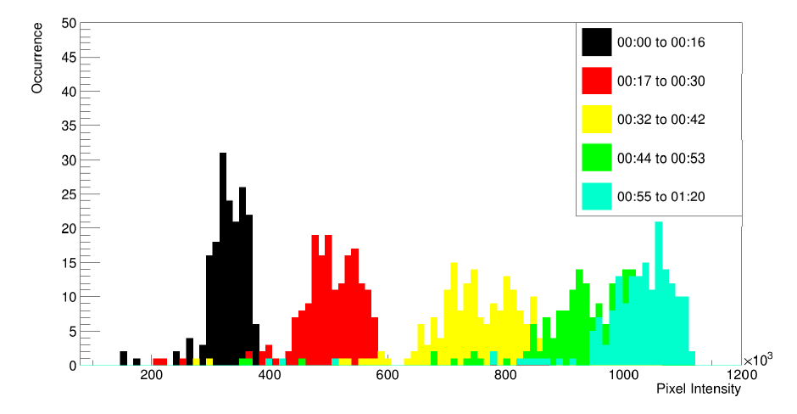
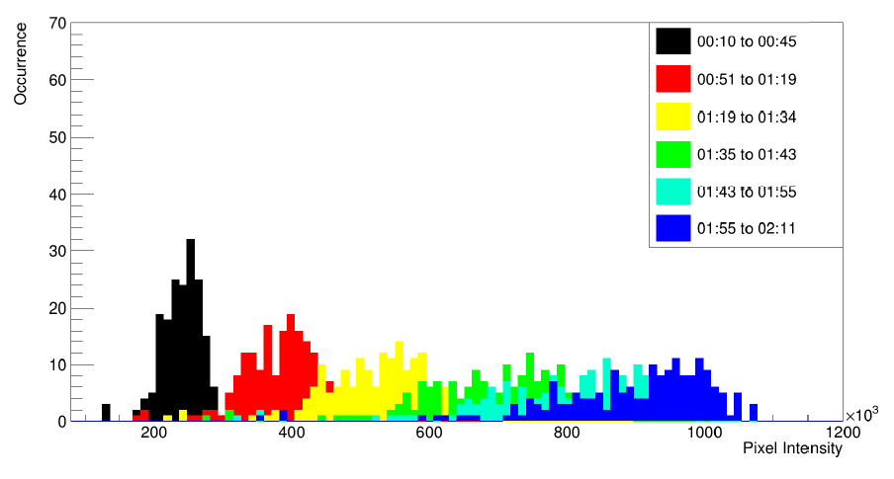
SmartPhantom Scintillating Fibre Tests
Preliminary tests of scintillating fibre bundle at Clatterbridge
Beam intensity increasing with time: 59 MeV beam
Beam intensity increasing with time: 11 MeV beam
H.T.Lau

Slide 12
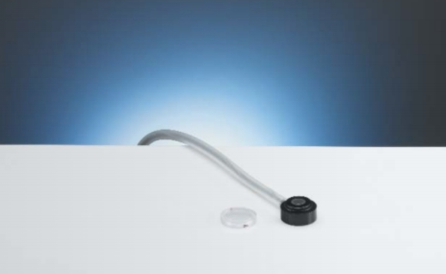
Calibration of SmartPhantom for dosimetry
PTW Markus chamber www.ptwdosimetry.com
Plane parallel ion chamber
Secondary standard
Calibrated against primary standard at NPL
Waterproof - can be used in water phantoms
Available at Birmingham Univ. cyclotron
Use to calibrate a transmission ion chamber
Transmission chamber used in routine monitoring
Can be coupled with RCF or alanine dosimetry (relative measurement of dose distribution)

Slide 13
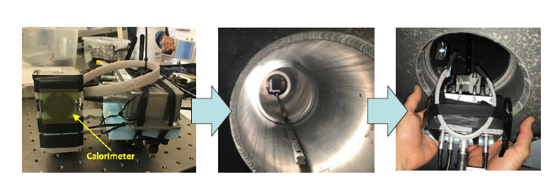
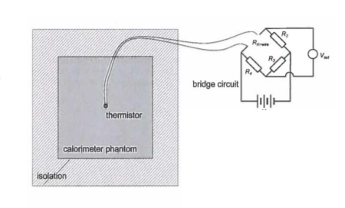
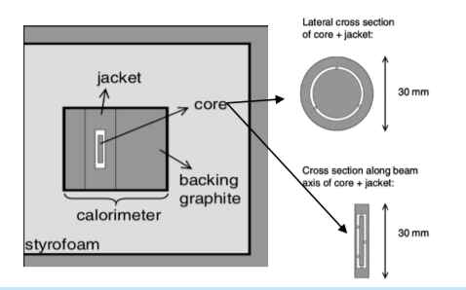
NPL – small portable graphite calorimeter
NPL is developing SPGC
Portable primary standard
Prototype tested at RAL CLF
Can be brought to test beams
francesco.romano@ct.infn.it

Slide 14
Next steps for SmartPhantom
Near Future
Finalise assembly methods for fibre planes
Complete SmartPhantom first fibre plane and readout assembly
Beam test SmartPhantom, comparing with dosimetric standards
UK possibilities – Clatterbridge Hospital, Birmingham University
Comparison of SmartPhantom beam test results with GEANT4 simulations
More Distant Future
Integrate proton acoustic measurements into SmartPhantom
Next round of beam tests to check GEANT4 and k-Wave simulations against beam test data
Ultimate Goal
Demonstrate dosimetry by acoustic measurements in vivo

Slide 15
Spare Slides

Slide 16
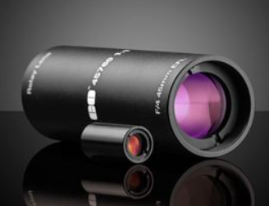
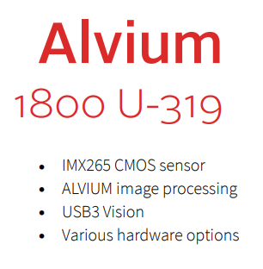
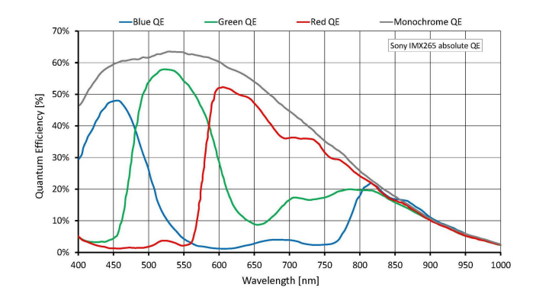
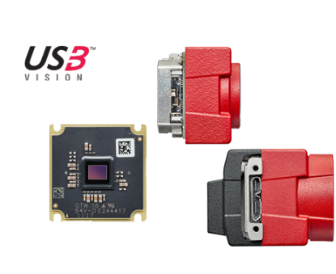
Preparations for testing the first SmartPhantom planes
Currently assembling a kit of parts for a single plane with 2 orthogonal layers of fibres. Includes:
Edmund 45760 Relay lens x 2
Alvium 1800 cameras x 2
Carbon fibre sheets
Optomechanics

Slide 17
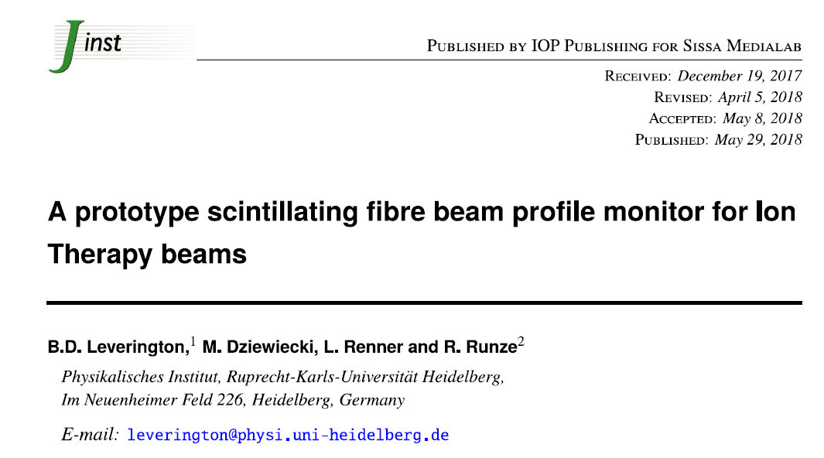
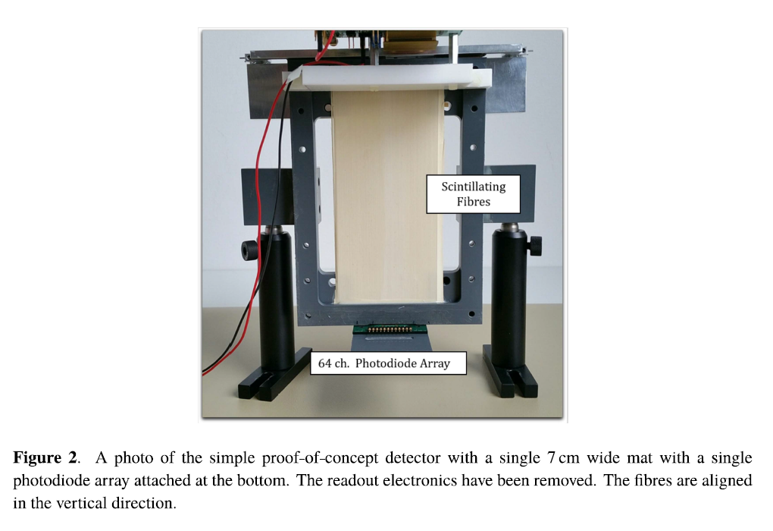
Scintillating Fibre Plane from Literature
Proof of principle
Needs to be waterproof….

Slide 18
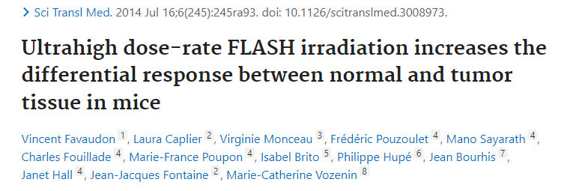
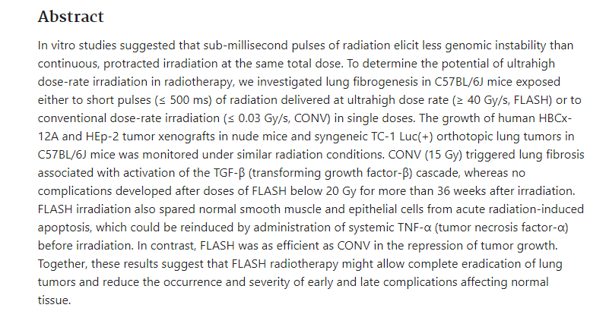

Slide 19
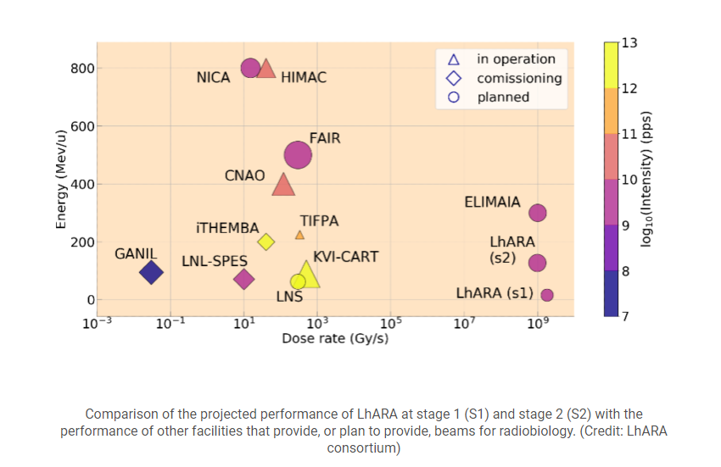

Slide 20
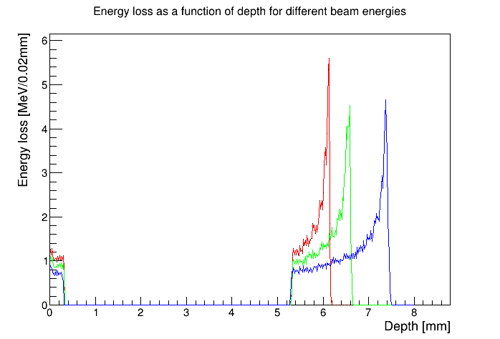
Stage 1 end station
Energy loss in the end station using the beam tracked from after the capture section.
10 MeV
12 MeV
10 MeV
12 MeV
15 MeV
15 MeV
beam
0.075 mm vacuum window
0.25 mm scintillating fibre layer
5mm air gap
1.15 mm sample
container base
0.03 mm cell layer
15 mm cell nutrient
solution

Slide 21
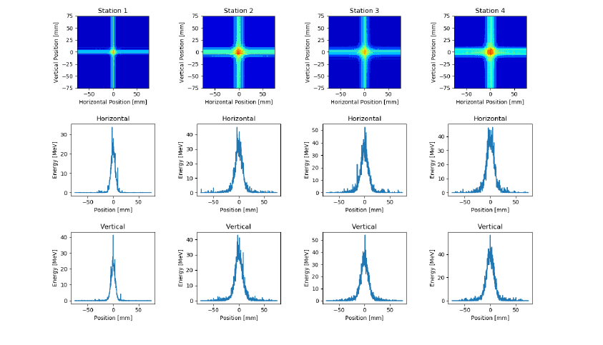
SmartPhantom Simulations (GEANT4)
Sample output from GEANT4 Simulations showing the energy deposited in each fibre at each plane
H.T.Lau

Slide 22
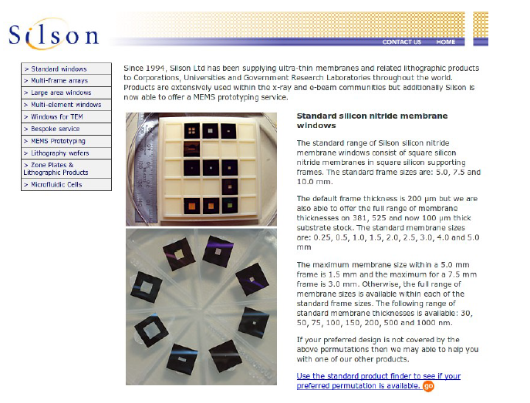
Thin ceramic monitors
AlN or SiN membrane 50-150 micron
Chemically etched and metal electrodes deposited
Beam induces currents on the electrodes
Needs some work to define diameter, thickness, mechanics, electrode geometry, readout
Available from industry (Silson, Ametek/HSFoils)
Thanks to Alex Howard

Slide 23
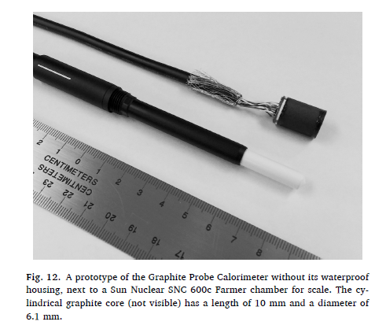
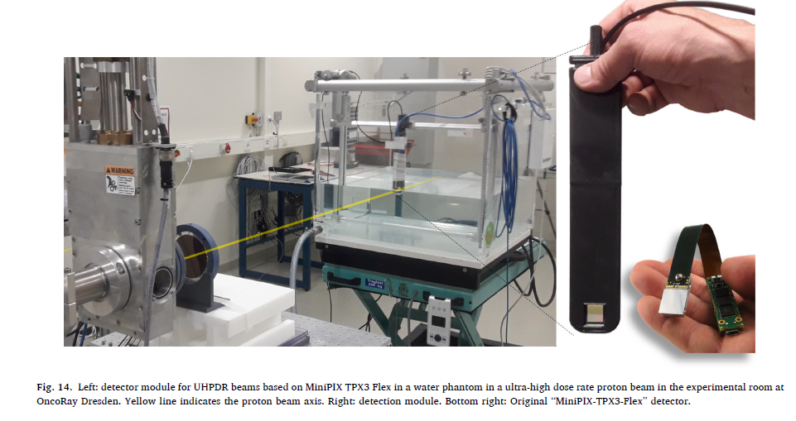
Based on TimePix3

Slide 24
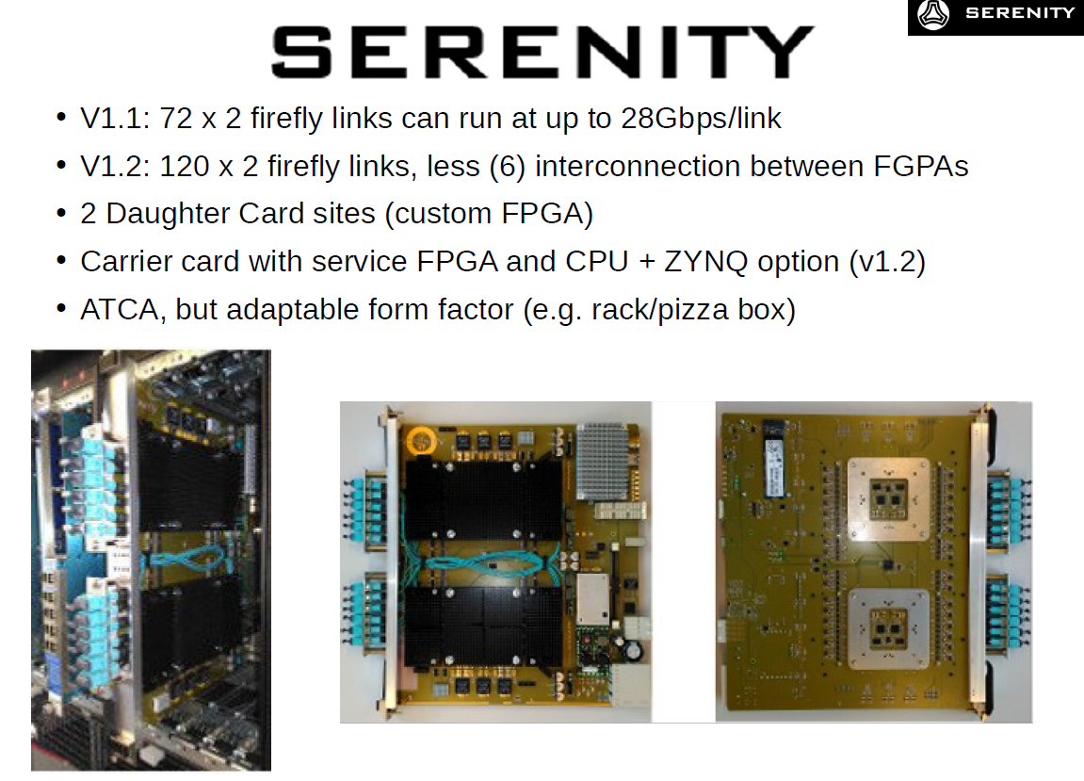
Alex Howard

