Slide 1
Lightning Talk - NetBox
Derek Ross

Slide 2
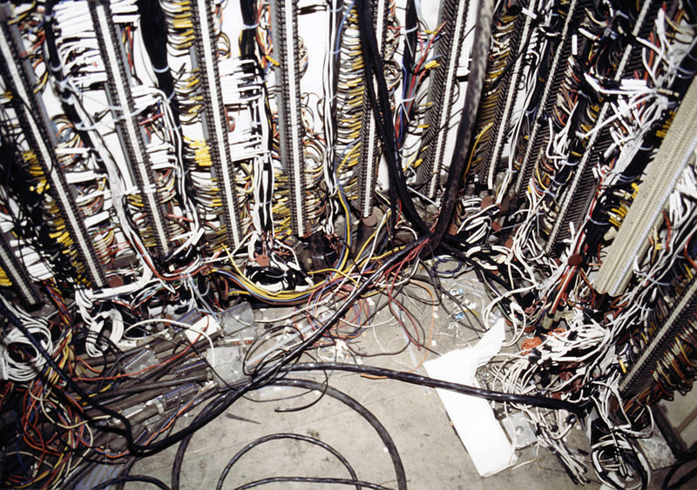
What is NetBox?
“NetBox is the leading solution for modeling and documenting modern networks. By combining the traditional disciplines of IP address management (IPAM) and datacenter infrastructure management (DCIM) with powerful APIs and extensions, NetBox provides the ideal "source of truth" to power network automation.”
https://github.com/netbox-community/netbox
Image © STFC John Dawson
Notes:
Please remove or amend the image credit if you are using a different image to the one provided.

Slide 3
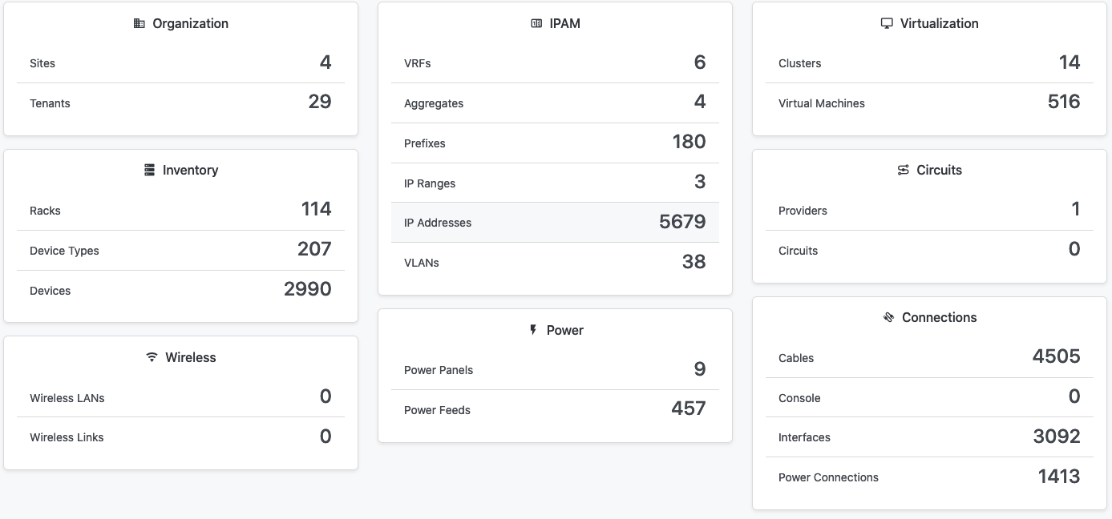
What data are we putting in?

Slide 4
MagDB to NetBox migration:
7-21 Nov (TBC)
Why change?
Netbox
ipv6 support
Widely used
Actively developed and maintained
Documents devices, ip, power and network connections
2 APIs, full UI
Easily extensible
IPPlan
No ipv6 support
Not maintained
Doesn’t work on centos 7
Limited API
IP management only
MagDB
Locally developed and maintained (theoretically)
No user interfaces to some functionality so direct DB access required

Slide 5
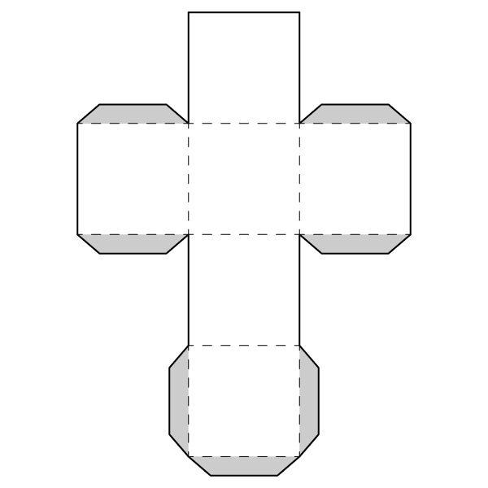
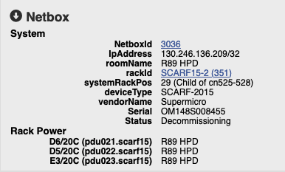
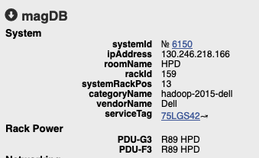
What does it integrate with?
2 APIs: REST based and GraphQL
Has a python library (pynetbox)
Has an ansible module
Webhooks
RIG System Team building icinga config using Icinga director
LibreNMS
Scripts to generate aquilon config (in development)
Integrated into MIMIC

Slide 6
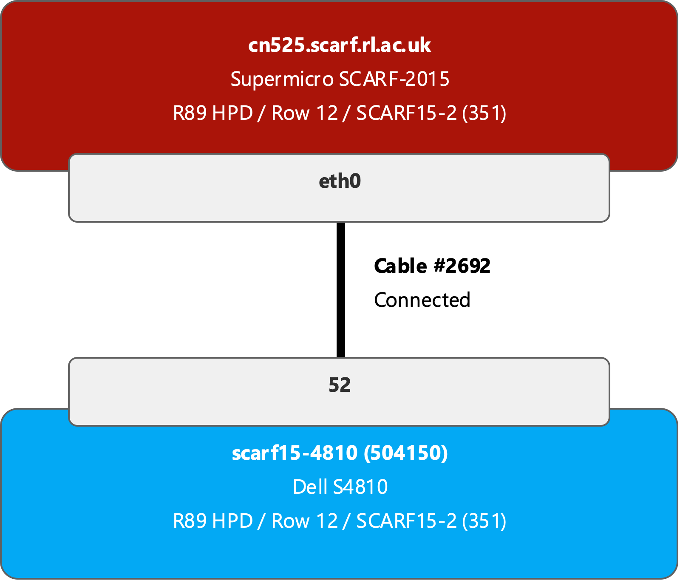
What does it integrate with?
2 APIs: REST based and GraphQL
Has a python library (pynetbox)
Has an ansible module
Webhooks
RIG System Team building icinga config using Icinga director
LibreNMS
Scripts to generate aquilon config (in development)
Integrated into MIMIC

Slide 7
What are the benefits
End goal is to use NetBox to reduce number of places devices need to be manually added (and removed)
RIG can add a new switch (of an existing type, appropriately configured) and in 24 hours it will be monitored by Icinga and LibreNMS and config backed up with Oxidized with no admin intervention
Unification is a good thing
If rack space is tight and services need to share racks its important to be aware of whether there is sufficient space for expansion for a service
Less places to look for those who need global view (Management, Security…)

Slide 8
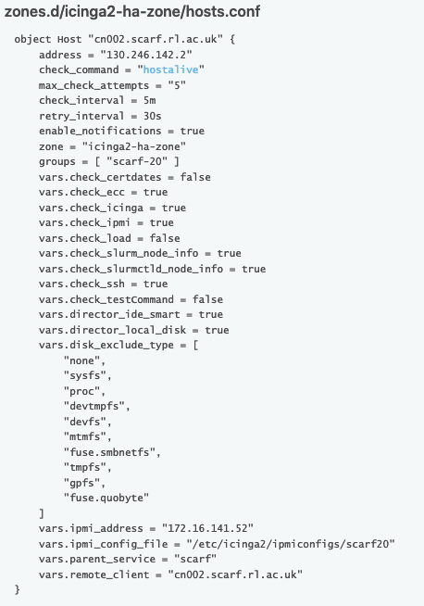
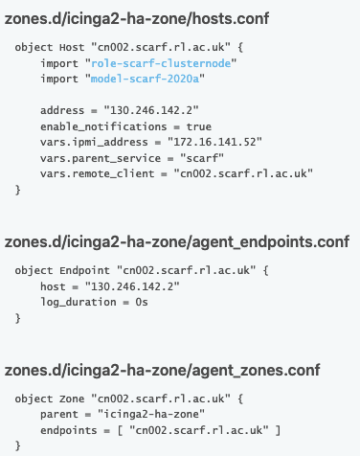
Example: NetBox to Icinga
NetBox Device
Name
Tenant
Device Role
(Device Type)
Primary IP
Status
Interface
Management Only
IP address
Notes:
Similar import that does VMs (which don’t have a device type) which are in a separate part of the REST API

Slide 9
Example: NetBox to Icinga
NetBox Device
Name
Tenant
Device Role
(Device Type)
Primary IP
Status
Interface
Management Only
IP address
Notes:
Similar import that does VMs (which don’t have a device type) which are in a separate part of the REST API

Slide 10
Example: NetBox to Icinga
NetBox Device
Name
Tenant
Device Role
(Device Type)
Primary IP
Status
Interface
Management Only
IP address
Assumes that if an interface is marked as management only and the ip address assigned to it is not the same as the primary address, its an ipmi ip address
Notes:
Similar import that does VMs (which don’t have a device type) which are in a separate part of the REST API

Slide 11
More info
https://netbox.esc.rl.ac.uk
https://stfc.atlassian.net/l/cp/9Ea1AYcp
https://gitlab.stfc.ac.uk/netbox
https://github.com/netbox-community/netbox
https://github.com/netbox-community/devicetype-library
https://demo.netbox.dev – Demo instance
#magdb2netbox on Tier 1 Slack

Slide 12
Thanks, any questions?
scd.stfc.ac.uk
@SciComp_STFC

Slide 13
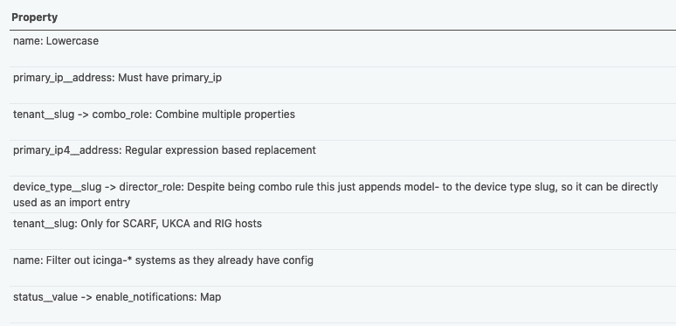
Example: Netbox to Icinga – Stage 1
Netbox Device
Name
Device Type
Device Role
Tenant
Primary IP
Status
Consistency
Filter
Transform
Transform
Transform
Filter
Filter
Transform
https://icinga2-master.esc.rl.ac.uk/icingaweb2/director/importsource/modifier?source_id=5

Slide 14
Example: Netbox to Icinga – Stage 1
Netbox Device
Name
Device Type
Device Role
Tenant
Primary IP
Status
Consistency
Filter
Transform
Transform
Transform
Filter
Filter
Transform
https://icinga2-master.esc.rl.ac.uk/icingaweb2/director/importsource/modifier?source_id=5
Notes:
Similar import that does VMs (which don’t have a device type) which are in a separate part of the REST API

Slide 15
Then interfaces with the mgmt_only flag set are imported
Then it gets complicated…

Slide 16
Example: Netbox to Icinga – Stage ??
Importing IP range which we know contains addresses which are used for management
Transform
Consistency
Join
Join
Transform
Filter
Filter
Filter
Filter
Filter
https://icinga2-master.esc.rl.ac.uk/icingaweb2/director/importsource/modifier?source_id=7

