Slide 1
LHCb Mighty Tracker and VELO mechanics and cooling
Oscar Augusto de Aguiar Francisco
on behalf of the Mighty tracker and VELO Upgrade UK groups
Future UK Silicon Vertex & Tracker R&D Workshop
Birmingham – UK
September 7th-8th , 2022

Slide 2
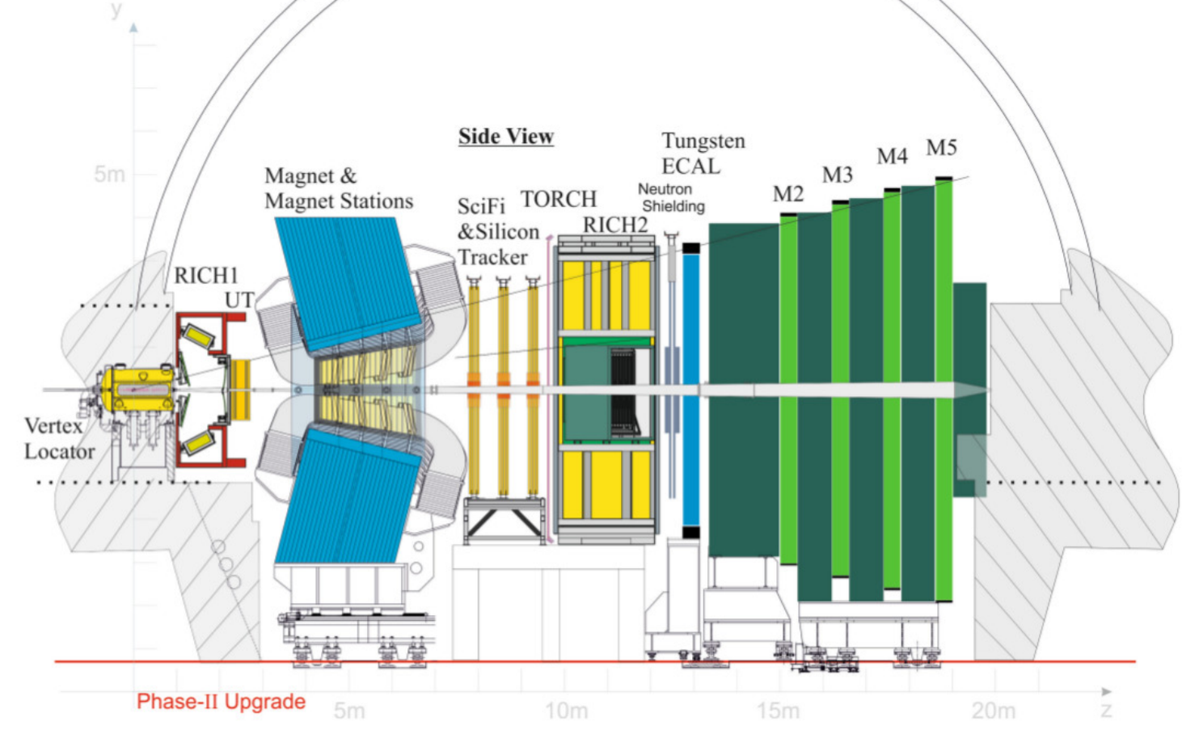
LHCb Upgrade II
Mighty Tracker:
Silicon inner area + scintillating fibers
Focuses of this talk
Schedule
2021-2024: Research and Development phase
2024: Technical design reports
2024-2026: LHCb Upgrade Ib
2025-2030: (R&D+) Production phase
2030-2031: LHCb Upgrade II
Better resolution
Low momentum tracking
high granularity inner region and additional shielding
Smaller pixels with timing
high granularity inner region with timing
Timing and better resolution
Low momentum PID

Slide 3
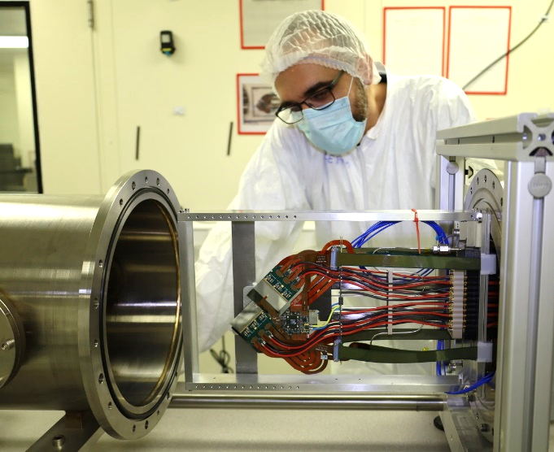
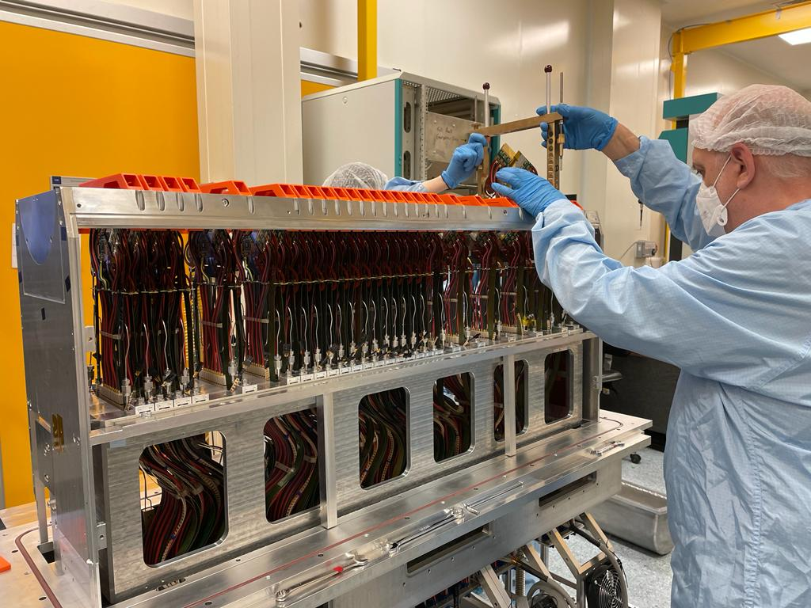
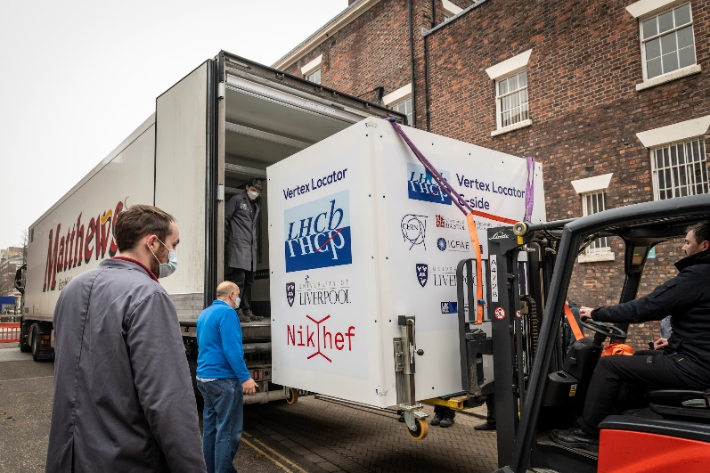
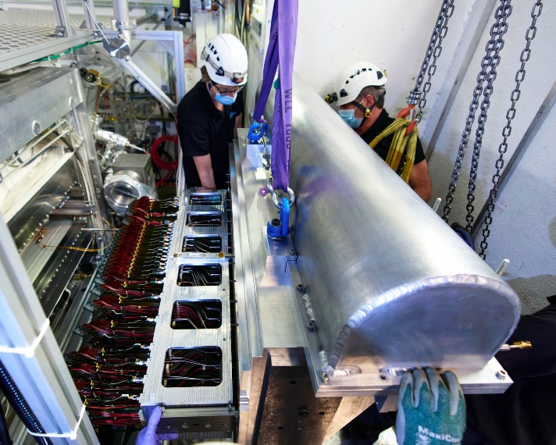
LHCb VELO Upgrade 1 (Mechanics/Cooling)
*only mentioning the UK contributions
Module production
Detector assembly
Module production (talk)
Cooling (Oxford/Manchester)
Glueing, cabling and wire-bonding (Manchester)
Quality control (Manchester)
Detector assembly
Base (Oxford)
Detector mechanics (Liverpool)
Module Installation and testing (Liverpool/Manchester/Oxford)
Transport to CERN (Liverpool)
Commissioning at CERN
Metrology (Liverpool/Manchester)
Alignment and reconstruction (Manchester)
credit: Amy O’Connor/STFC UKRI
Detector transport
Detector installation
Credit: McCoy Wynne
© 2022 CERN

Slide 4
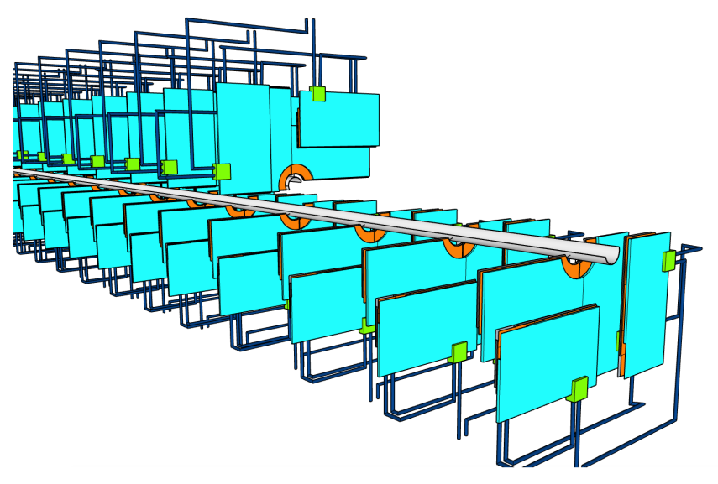
LHCb VELO Upgrade 2
Scenario A:
Similar layout to U1
5.1 mm distance to the beam
RF shield similar to U1
Possibility of module replacement (yearly) if modules can resist up to ${10}^{16}$ neq/cm² (50fb⁻¹)
Possibility of module replacement (yearly) if modules can resist up to 10^¹⁶ neq/cm² (50fb⁻¹)
Scenario B:
12.5 mm distance to the beam
much lighter shield (or no shield)
Smaller pixel (~42$μm$ with binary readout)
Smaller pixel (~42μm with binary readout)
Material before the second hit needs to be reduced (0.5% X₀) to keep VELO U1 performance
${10}^{16}$ neq/cm² for 350 fb⁻¹
10^¹⁶ neq/cm² for 350 fb⁻¹
Conceptual design VELO Upgrade II with small microchannels cooling plates and RF shield integrated to the modules

Slide 5
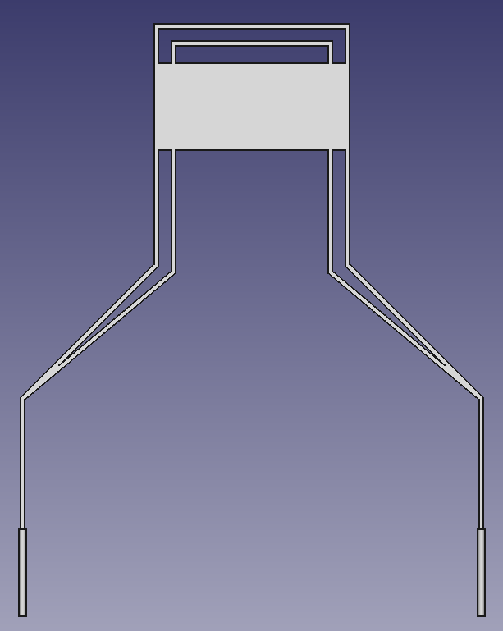
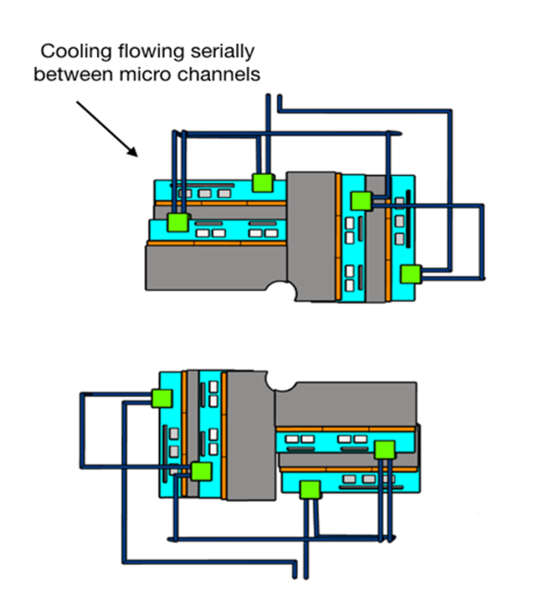
VELO Cooling (Manchester/Oxford)
Smaller microchannel coolers to reduce the overall cost
More challenging to integrate (interface between pipes and coolers)
Cooling structure could be potentially re-used (NA62 talk)
Potentially better cooling performance
Potential collaboration Oxford and 3T (?)
Simplified prototype
for early studies
Cheaper and more flexible design
Easier to integrate (cooling plant)
Another idea: integrated with high thermal conductivity materials (link)
Potential collaboration with Royce Institute (Sheffield) and University of Manchester (MECD - Mechanics department)

Slide 6
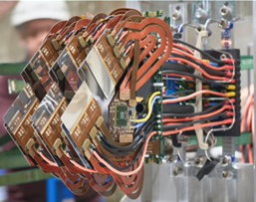
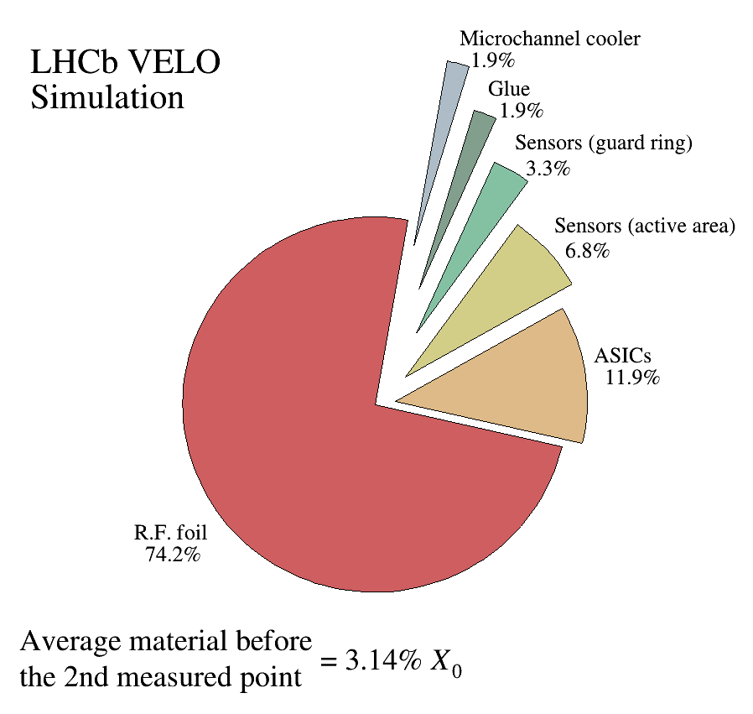
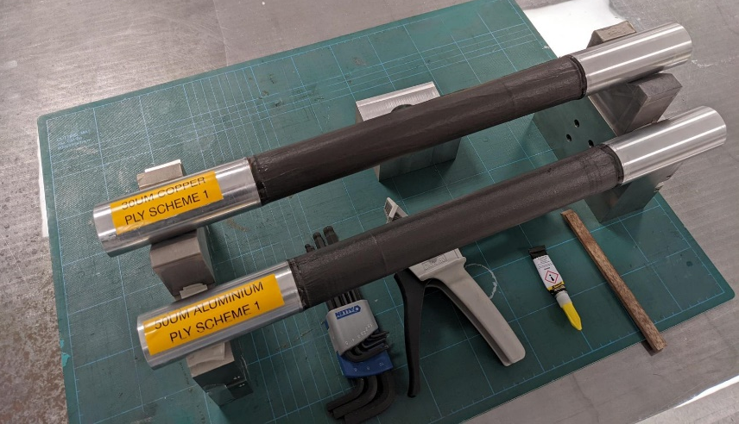
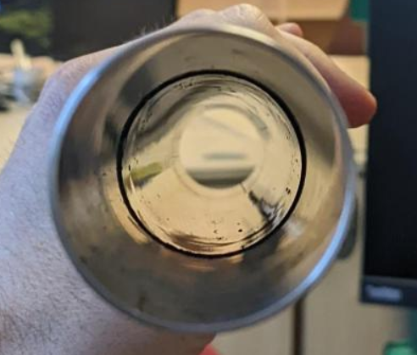
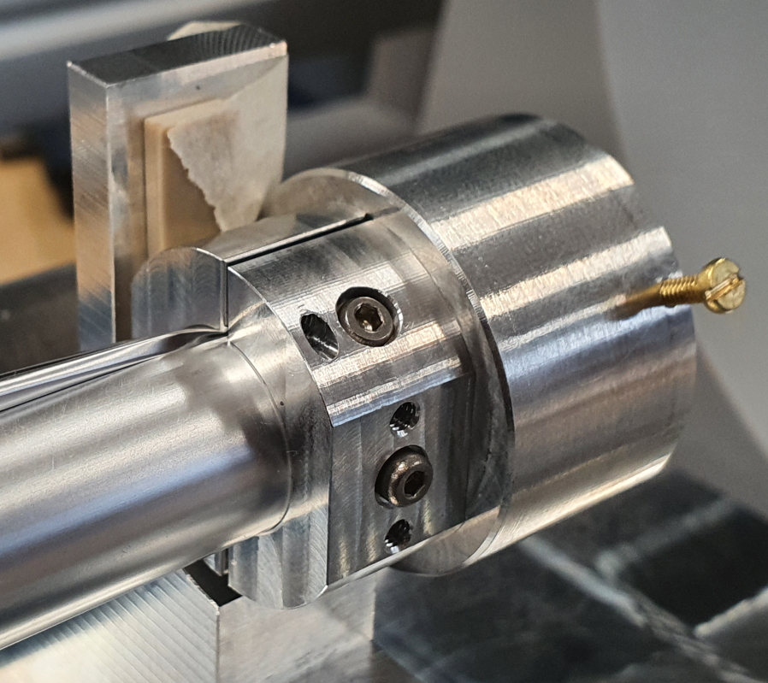
VELO RF shield (Oxford)
*More information can be found here
Carbon copper or aluminum composite
Next steps: Optimization of the minimum Cu/Al thickness and impedance, Radiation tests
Ultra-thin
Merged primary/secondary volumes
Innermost region reduction in thickness from 150 um to 20-30 um
Kept under tension and moves with electronics
Next steps: Stress-relieving in the foil to allow cylindrical shape, tensile breaking load, baking, impedance
Could have the same radiation length as an ultra-thin aluminum shield
Main goal
Reduce the dominant contribution to the material budget before the second hit
Carbon copper or aluminium composite to replace beam-facing section (or maybe all) of RF box
Tested prototypes:
Copper-Carbon Composite (0.07 mm total)
Aluminium-Carbon Composite (0.09 mm total)
Instrumentation end-collar
Developed shape maintained in first ~100 mm from collar
Single foil

Slide 7
LHCb Upgrade II
Mighty Tracker:
Silicon inner area + scintillating fibers
Focuses of this talk
Schedule
2021-2024: Research and Development phase
2024: Technical design reports
2024-2026: LHCb Upgrade Ib
2025-2030: (R&D+) Production phase
2030-2031: LHCb Upgrade II
Better resolution
Low momentum tracking
high granularity inner region and additional shielding
Smaller pixels with timing
high granularity inner region with timing
Timing and better resolution
Low momentum PID

Slide 8
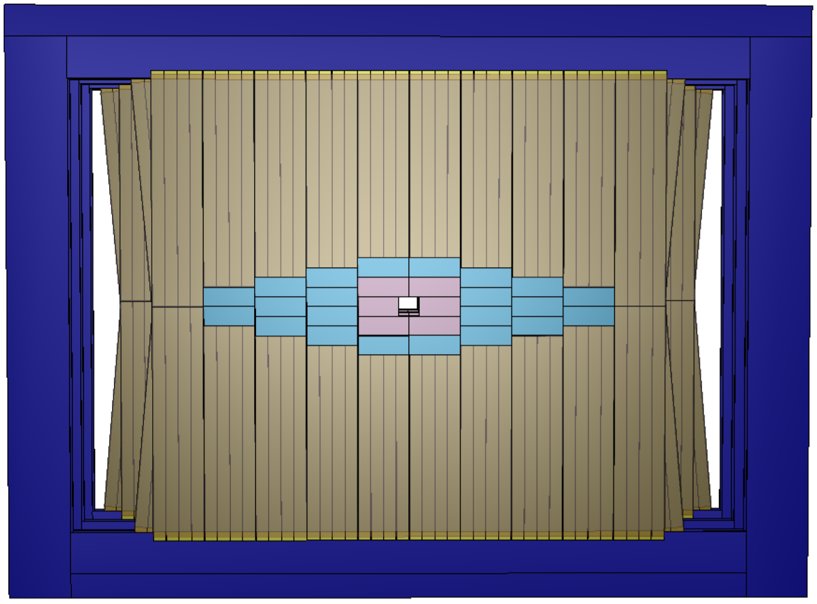
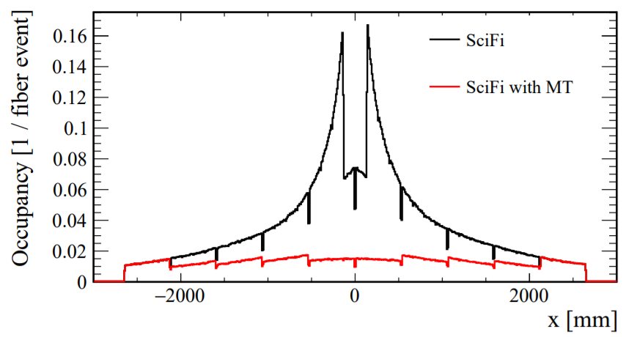
LHCb Mighty Tracker
LHCB-TDR-023
Mighty Tracker = Silicon + Scintillating fibre
*More information can be found here
Upgrade 1b
(1080mm x 600 mm)
Run 5 and 6
$$L_{inst}=1.5×{10}^{34}cm^{−2}s^{−1}$$
𝐿_𝑖𝑛𝑠𝑡=1.5×〖10〗^34 𝑐𝑚^(−2) 𝑠^(−1)
7.5 times higher than Upgrade 1 luminosity
Radiation up to $6×{10}^{14}$ MeV neq/cm²
Radiation up to 6×〖10〗^14 MeV neq/cm²
Sizeable radiation damage to the fibres in the inner region
High occupancy (up to 20%/fiber)
Solution
Scintillating fibres to cover most of the surface
UK institutes are involved with the development of the inner region based on silicon detector technology (HV-CMOS, Eva’s talk)
Schedule
An intermediate upgrade is being considered for the Run 4 (Upgrade Ib, 2025/26, purple region)
Fibres must be replaced in the inner region to keep same performance during LS3
Full geometry upgrade on 2031
Module
(528 mm x 200 mm)
Upgrade 2
Geometry
2-3-4-5-5-4-3-2
Upgrade 2

Slide 9
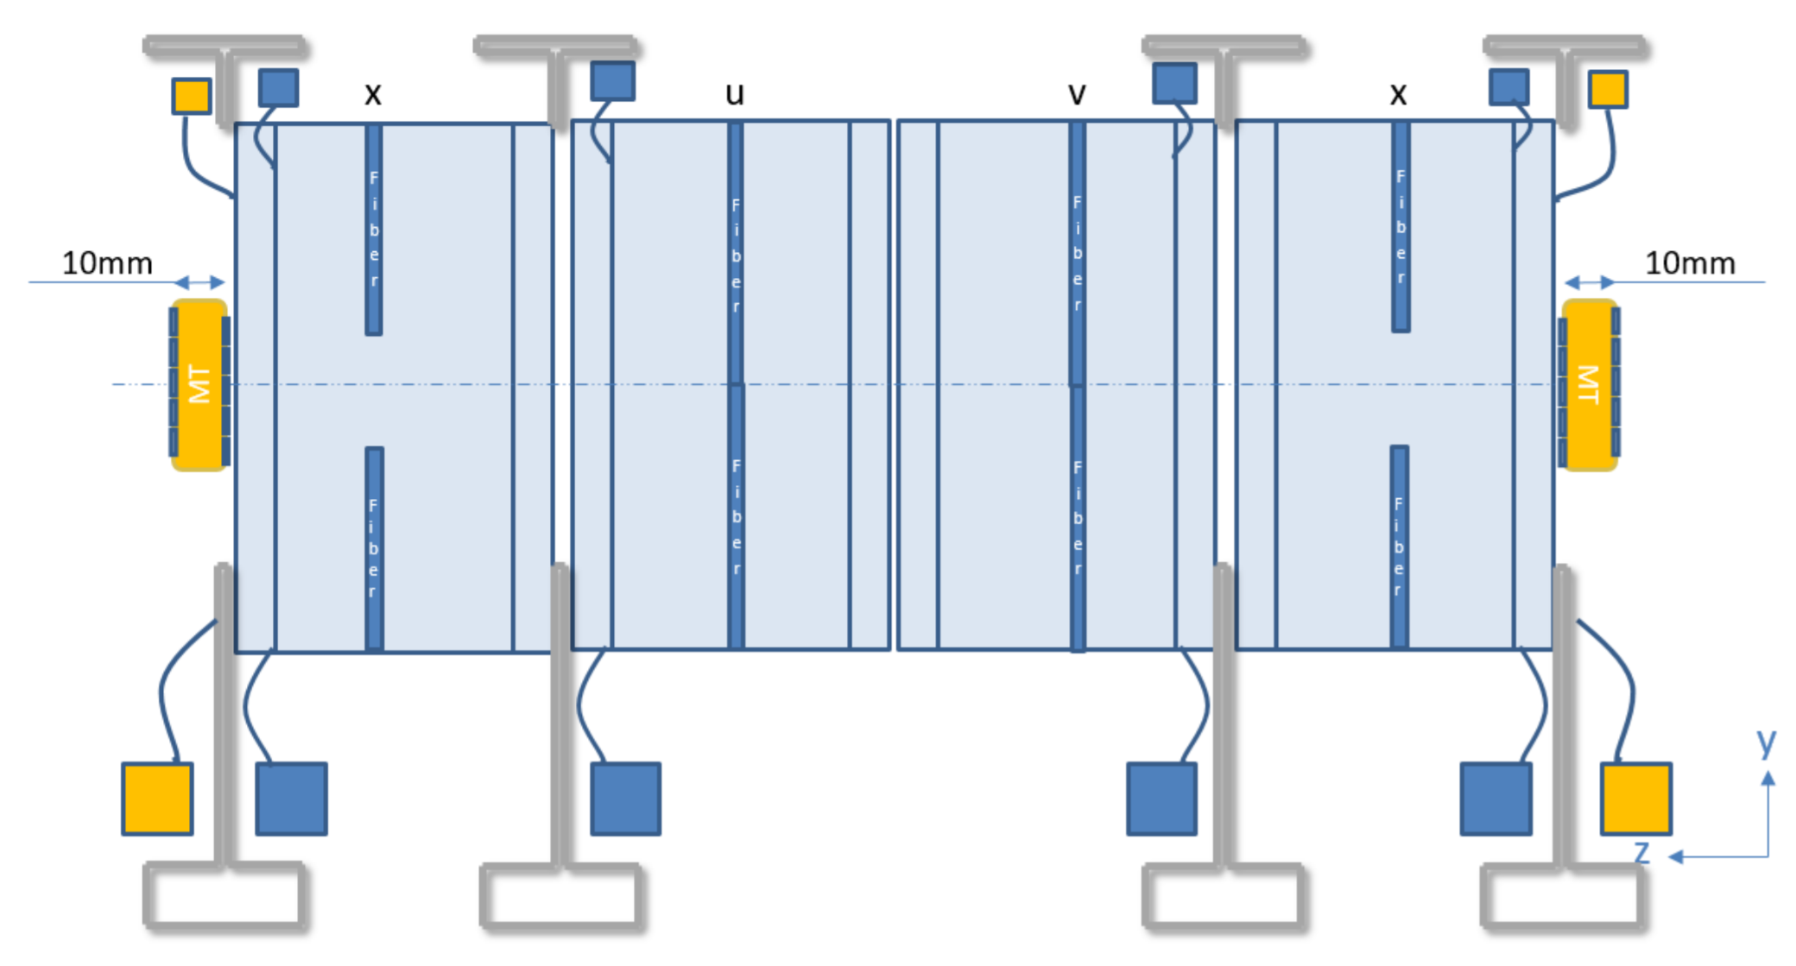
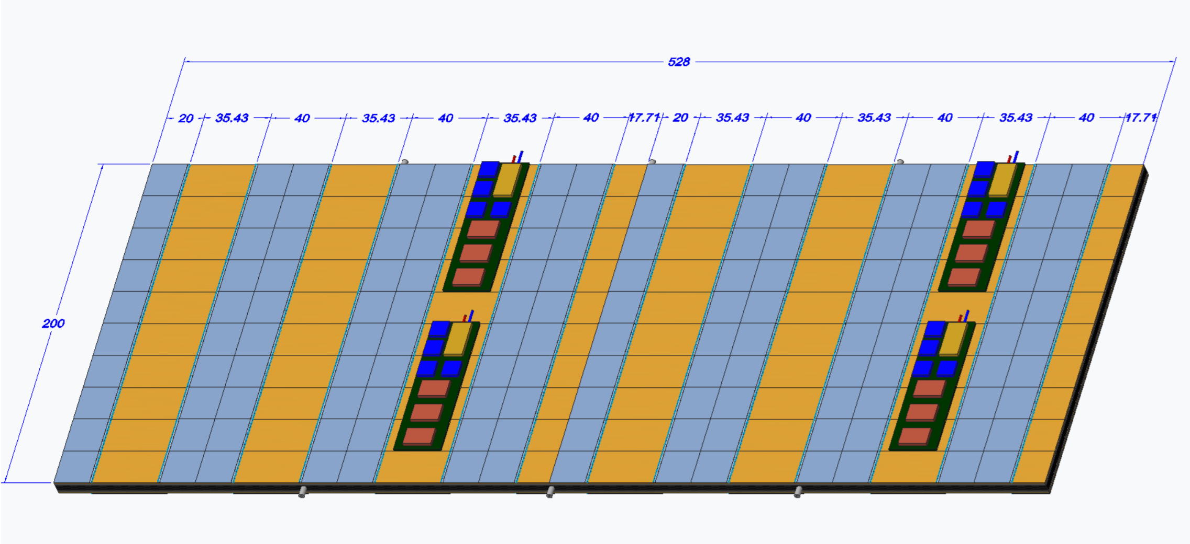
Layer Design
SciFi station
28 modules per layer
26 long modules and 2 short
Front and back of the modules are populated
~3$m^{2}$ per layer (18$m^{2}$ in total)
Silicon layers

Slide 10
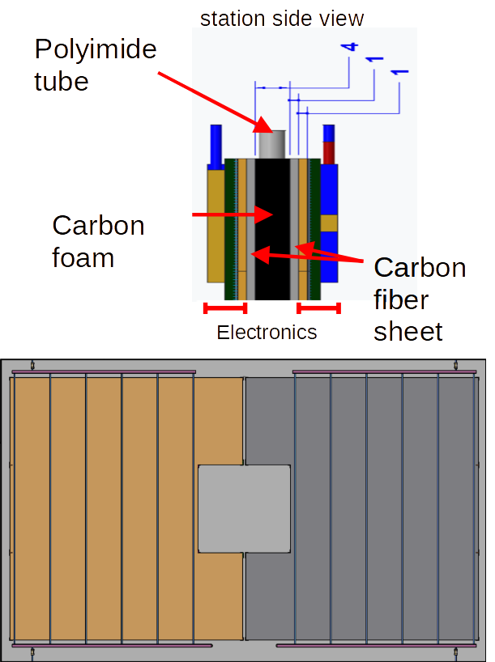
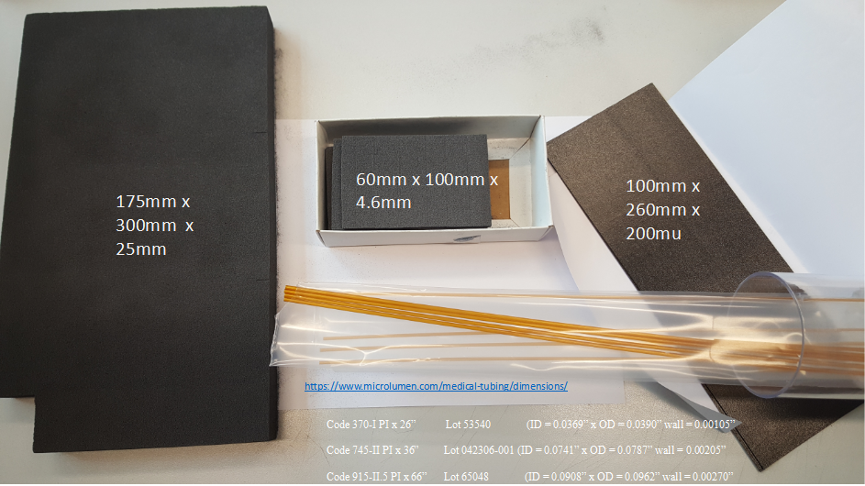
Cooling
Baseline solution based on polyimide tubes embedded in a carbon foam
The operating temperature is driven by the chip operation requirements ($≤0^{∘}C$)
Several cooling options are being considered depending on the operation temperature
Novec 649, Ethylene Glycol
$CO_{2}$ is not excluded but it would require metal pipes (additional material budget)
Carbon foam
Carbon fiber
Polyimide tubes

Slide 11
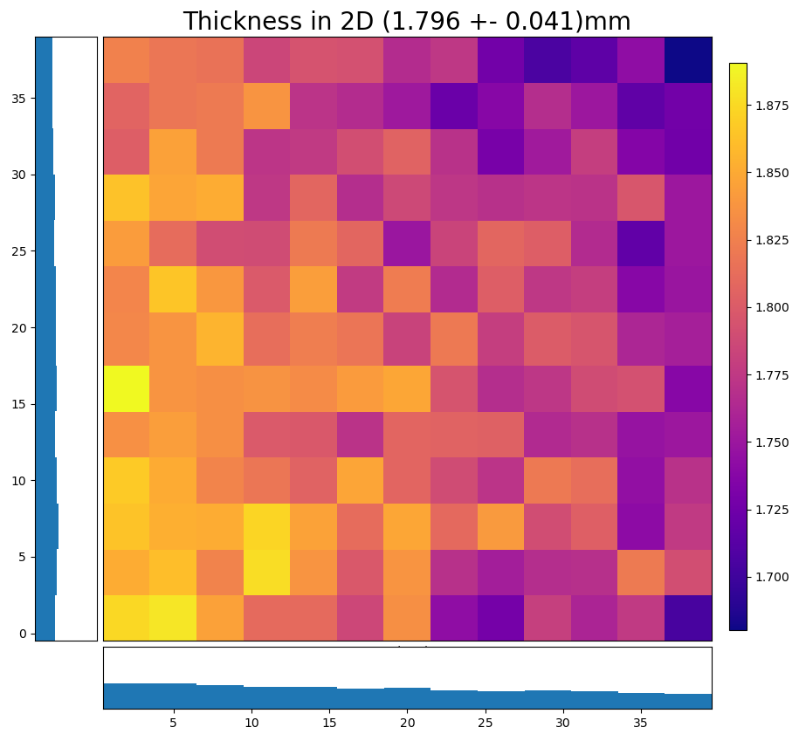
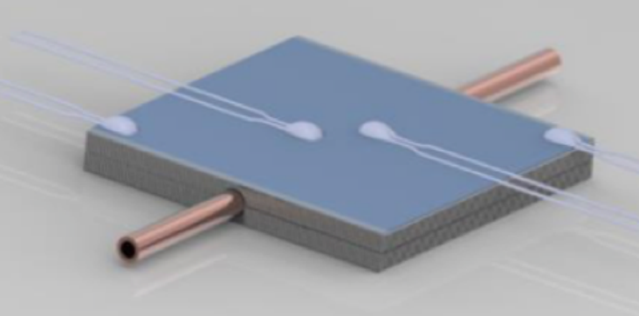
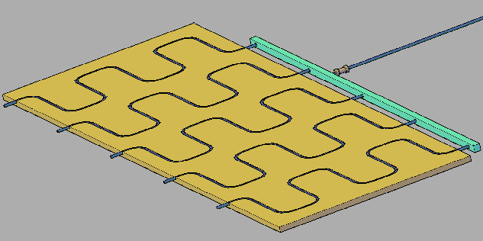
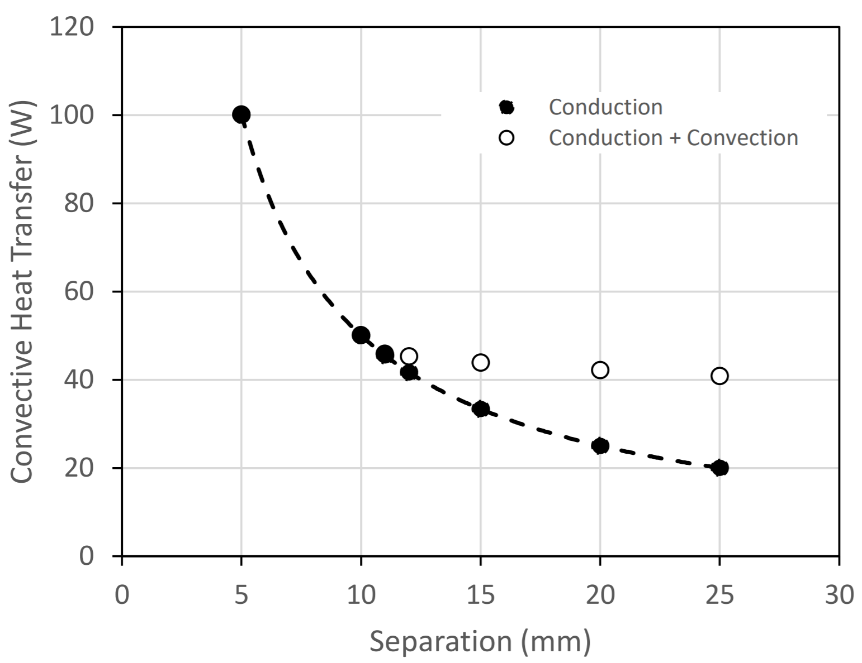
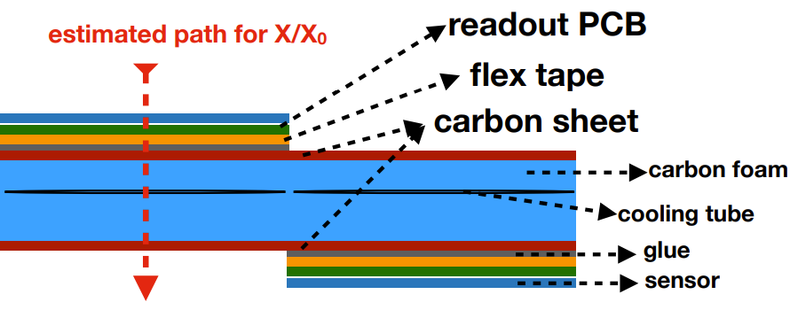
On going activities in UK
Metrology
Small carbon foam sample
Small prototypes
*only mentioning the UK contributions
Mechanics
Chip arrangement (Manchester/Imperial)
Mechanical support/integration (Manchester/Imperial)
Detector enclosure/Thermal insulation (Liverpool/Imperial/Manchester)
Mechanics/Thermal finite element analysis (Manchester/Liverpool)
Cooling
Small prototypes (Manchester/Liverpool)
Thermal performance studies (Manchester/Liverpool)
Carbon fibre integration to the carbon foam (Liverpool)
Samples assembly (Manchester/Liverpool)
Module assembly and metrology (Manchester/Liverpool)
Material Budget (RAL)
40mm x 40mm x 2 mm
Cooling routing
Insulation separation
Material budget
X/X0 = 0.845%-2.761%

Slide 12
Summary
LHCb VELO Upgrade 2
Mighty Tracker
Two scenarios with different cooling/mechanics implications
A: Modules 5.1 mm from the beam, High radiation (10¹⁷ neq/cm²)
B: Modules 12.5 mm from the beam, Lower radiation (10¹⁶ neq/cm²)
More strict material budget for a similar performance (U1)
R&D in cooling exploring 3D printing techniques
Focus on the inner region R&D based on silicon detector
Potentially replaceable modules due to high radiation
Single body 3D printed or with integrated smaller microchannels plates
R&D in RF shield to reduce the material budget contribution
Mechanical design and integration concepts well stablished
Cooling baseline solution based on polyimide tubes embedded into carbon foam
Assembly/cooling progressing from small samples to (sub-)module size
CO2 based solution as back-up plan depending on the final operational temperature
Material budget contributions well understood
Consolidation based on the mechanics/cooling optimization and services
Ultra-thin
Carbon copper or aluminum composite
Thank you for your attention!

Slide 13
Backup slides

Slide 14
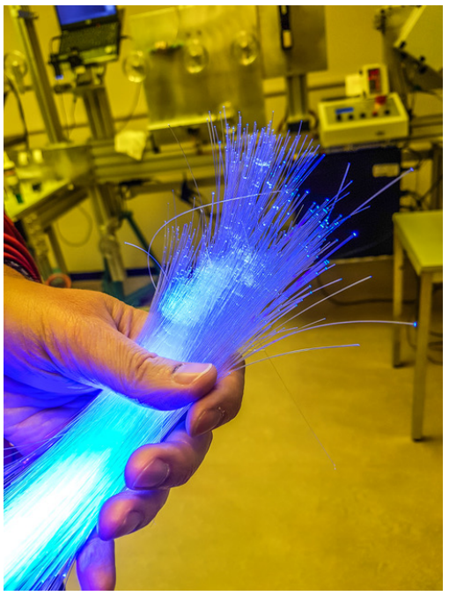
LHCb SciFi: Fibre
Excellent talk presented last year (link)
The scintillating fibres are 250 um diameter
Charged particles excited the electrons in the fibre which decays in order of nanoseconds producing light (400-550 nm)
6 fibres layers are combined to create a module layer
CERN

Slide 15
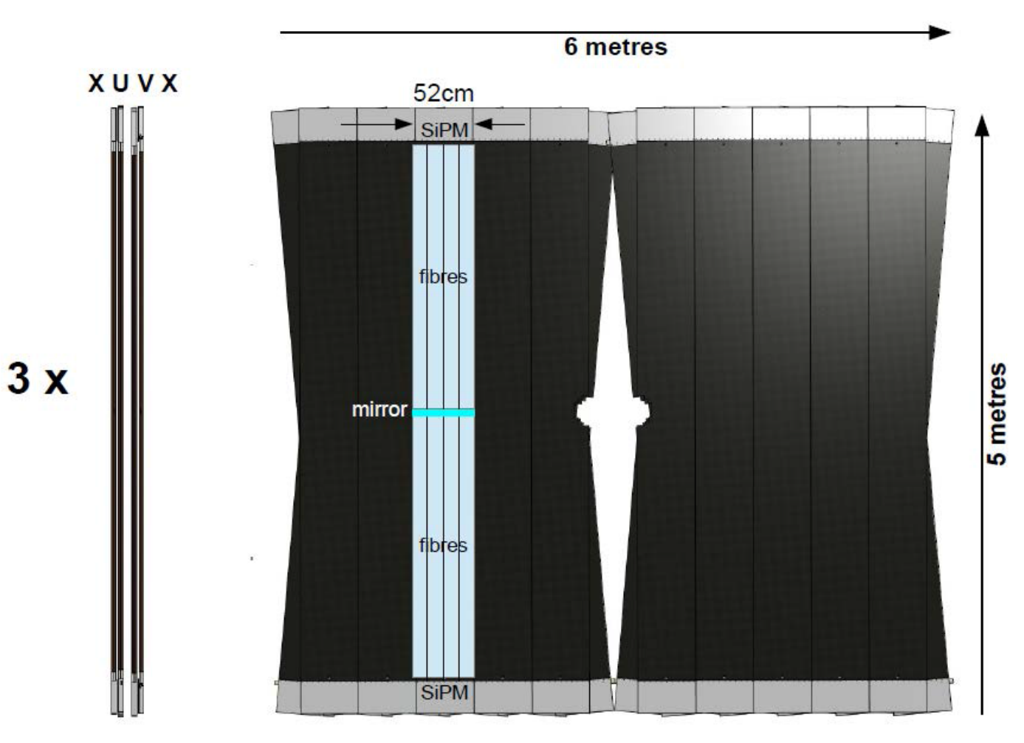
LHCb SciFi: Station
128 modules ($∼$50 cm by 5 m) are organized in the xuvx geometry in 3 tracking stations
u- and v-layers are tilted by $+5^{∘}$ and $−5^{∘}$ respectively
The position over y is estimate based on the x-layer and the stereo layers
Order of 1% $X_{0}$ per layer
Mirror at the around y=0 reflects the light back to the SiPM located at the top and bottom of the modules
Covers a large area (30 m2 per layer)

Slide 16
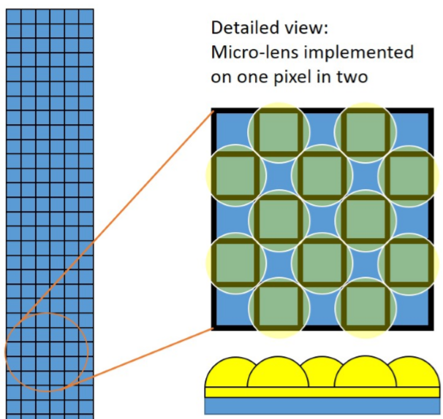
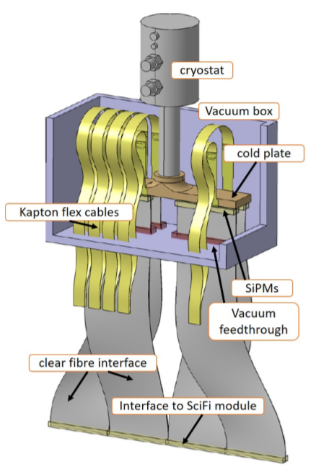
LHCb SciFi (U2)
Main goal of the scintillating fibres R&D is the mitigation of the radiation damage
Silicon photomultiplier with reduced pixel area to minimize cross talk, minimize noise, lower dark current and shorter the recovery time
Micro-lenses recover light that would go to a dead area (+20% light yield)
Reduced number of fibre per detector plane (smaller cluster and lower material budget)
Cryogenic cooling (-150C) to reduce the SiPM noise by around 3 orders of magnitude with respect to Run 3

Slide 17
LHCb Mighty Tracker (Performance)
LHCB-TDR-023
In Upgrade 2 conditions:
Considering the Silicon and SciFi regions, an overall efficiency above of 90% and ghost rate below 30% is obtained using standalone algorithms for long tracks with momentum higher than 5 GeV
The silicon region brings improvements in the reconstruction efficiency and ghost rate. The ghost rate is expected to be significantly improve with algorithm optimizations

Slide 18
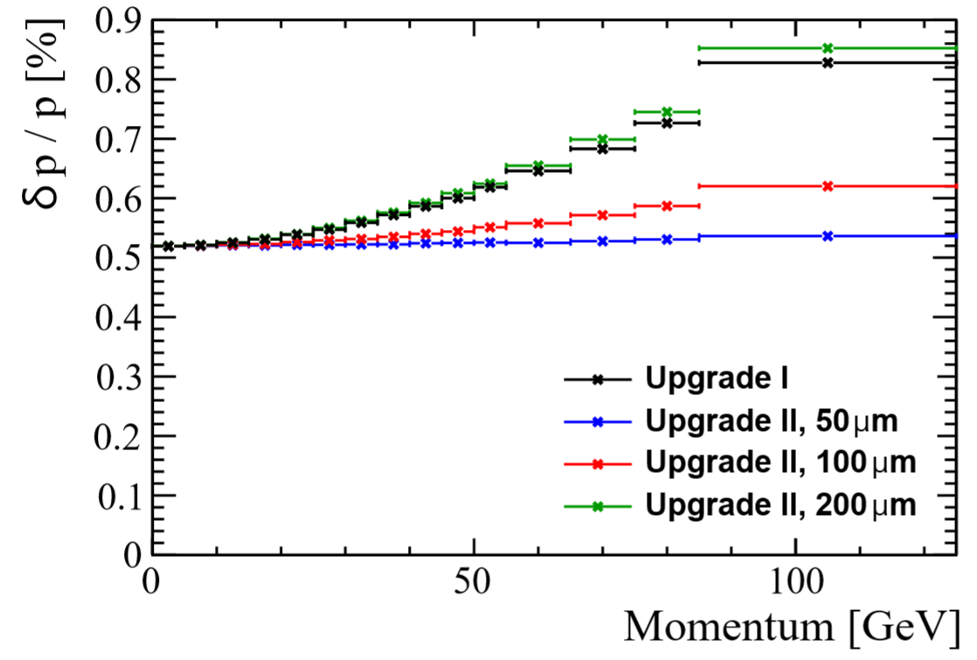
LHCb Mighty Tracker (Performance)
LHCB-TDR-023
The momentum resolution is dominated by the resolution over the bending plane (LHCb x axis)
Performance comparable with U1 is obtained with pixels with $200 μm$
The baseline pixel width $50 μm$ brings an improvement up to 50% for high momentum long tracks
Smaller pixels are also important to distinguish different tracks in high occupancy areas

Slide 19
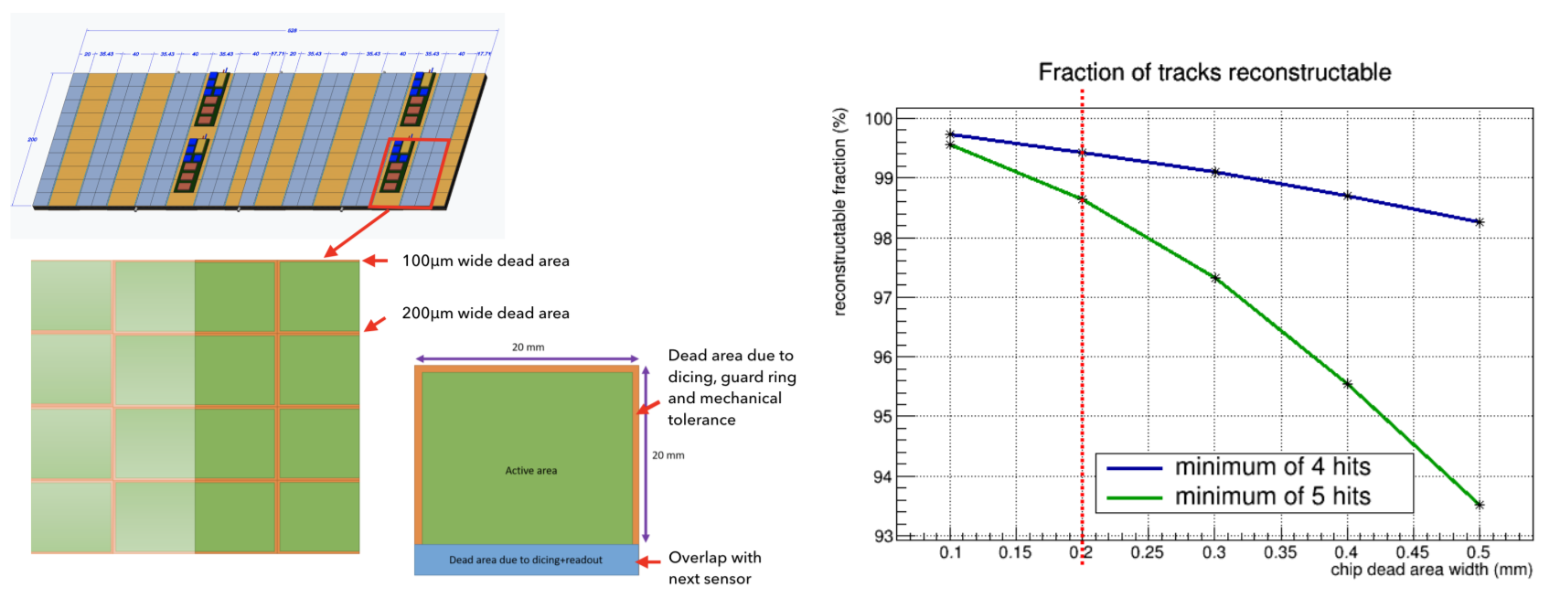
Dead areas

Slide 20
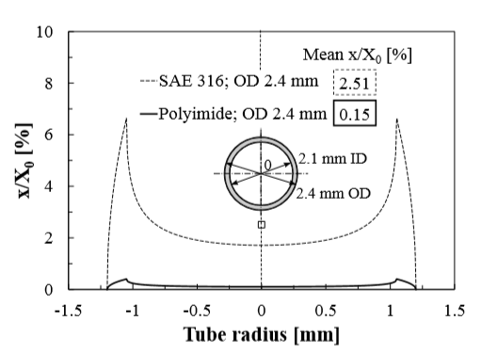
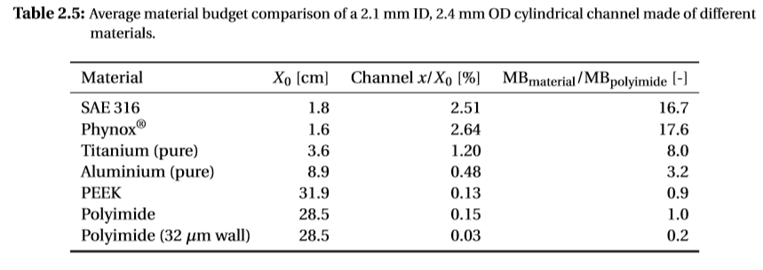
Cooling
Comparison of the material budget
(Ph.D Thesis M. G. Marzoa)
Single phase allows operation at lower pressures
Polyimide pipes (density: 1.42 g/cm2) suitable to relative low pressure (e.g.: water cooling, order of 1 bar or lower (ALICE ITS))
Titanium pipes (density: 4.5 g/cm2) suitable to relative higher pressure (e.g.: CO2 evaporative cooling, safety pressure validation 183 bar (LHCb VELO/UT))
Polyimide offers a lower material budget compared to stainless steel or titanium tubes
Relatively smaller surface power dissipation per area compared to the other detectors
~1W/cm² VELO U1 vs 0.16 W/cm² MT CMOS
No need to install additional capillaries or orifices to equalize the flow distribution

Slide 21
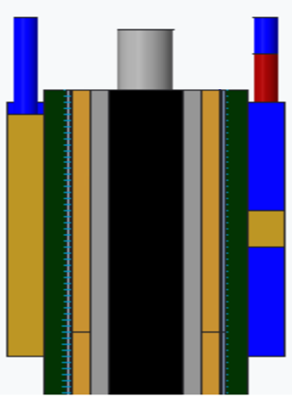
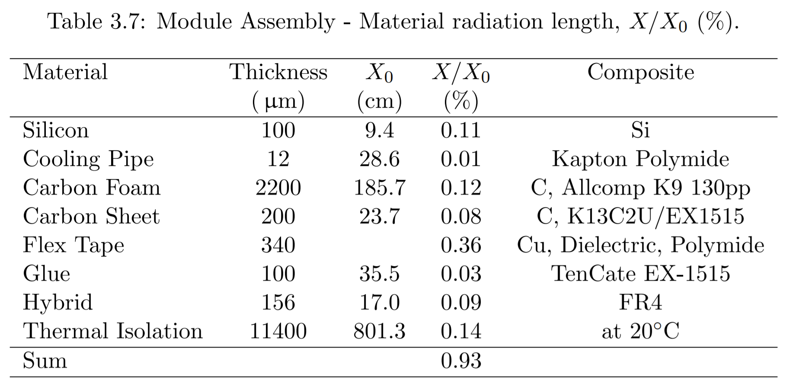
Radiation length
Cooling tube
Service
Hybrid
Wire
bonds
Flex tape
Silicon sensor
More information can be found here
Carbon Sheet
Carbon foam

Slide 22
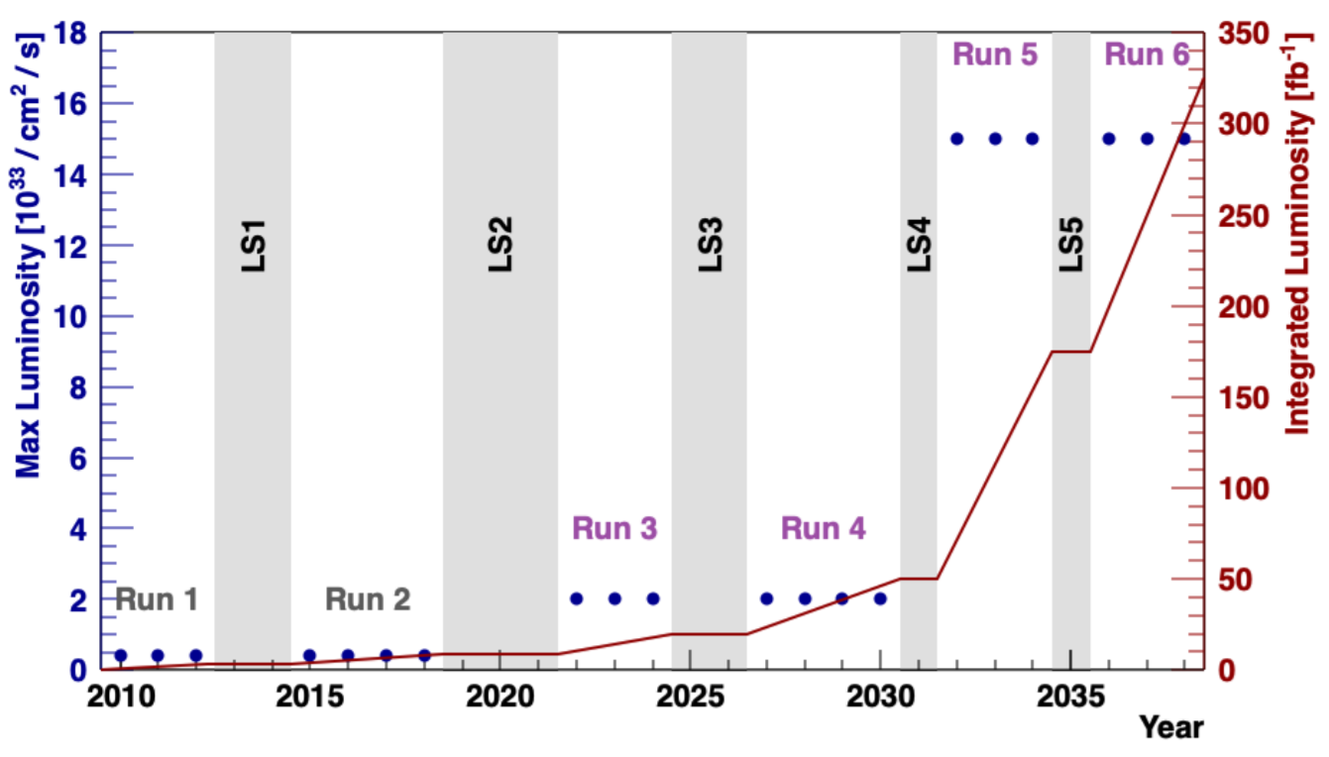
LHCb Upgrade Schedule
Now
Upgrade II
Current: Upgrade I being finalised/commissioning
2017: Expression of interest
2018: Physics case
2022: Framework Technical design report
2021-2024: Research and Development phase
2024: Technical design reports
2024-2026: LHCb Upgrade Ib
2025-2030: (R&D+) Production phase
2030-2031: LHCb Upgrade II

Slide 23
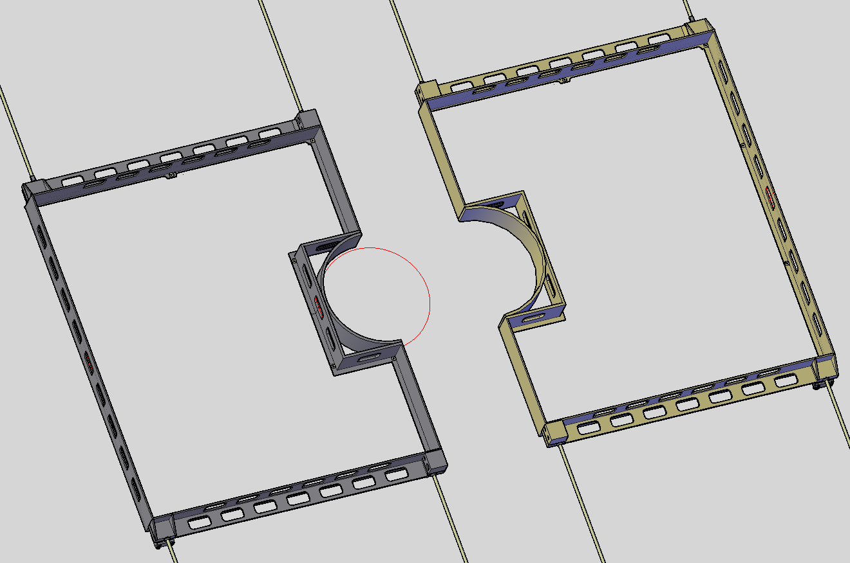
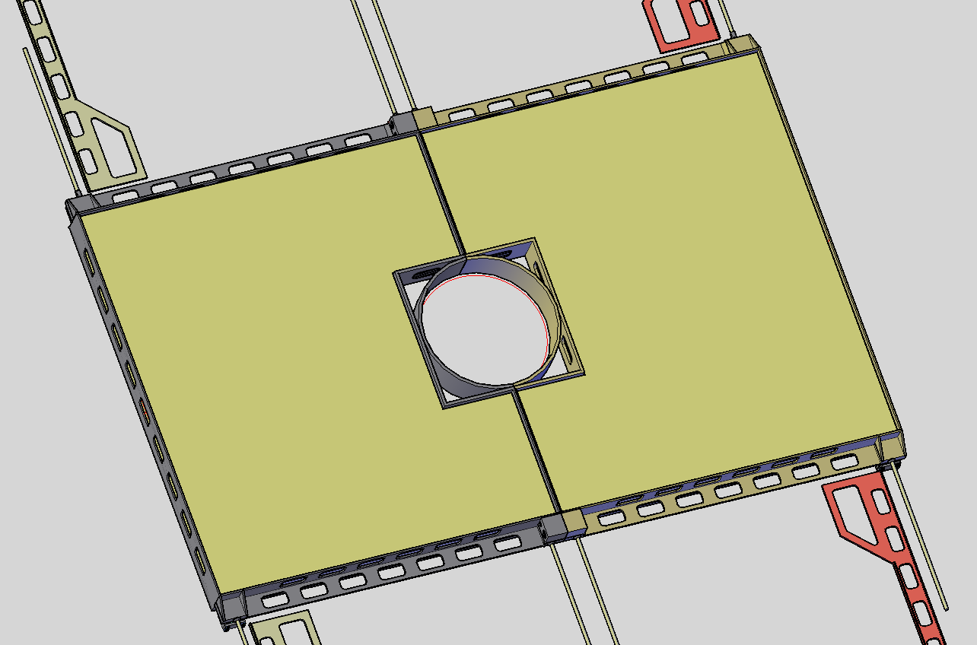
Mechanics
Carbon Fibre Mounting Frames
Inner station will require its on mechanical support and thermal insulation due to its operational temperature (0C or below)
Initial calculations indicate that an additional ~10% power due to the convection and radiation (amounting to a total of ~60kW for 6 layers)
A carbon fiber mounting frame will be required to provide the stiffness while the insulation will be provided by Armaflex or Airex. Further FEA studies are on going, to minimize the contribution from the insulation
Upgrade Ib layout

