Slide 1
UKRI People Survey
SC - Systems
Tom Griffin, Director, Scientific Computing
3rd August 2022
Notes:
The abstract pattern can be removed or repositioned if required. Be careful to ‘Send to Back’ so that it does not obscure any important information.

Slide 2
UKRI People Survey – Systems Division View
71% response rate in SCD
70% response rate in systems (33 / 47*)
I will focus on the areas where Systems is different to UKRI, STFC or SCD norms
* Yes, there are more than 47 in the division. Some ex-grads and some new starters were not allocated properly

Slide 3
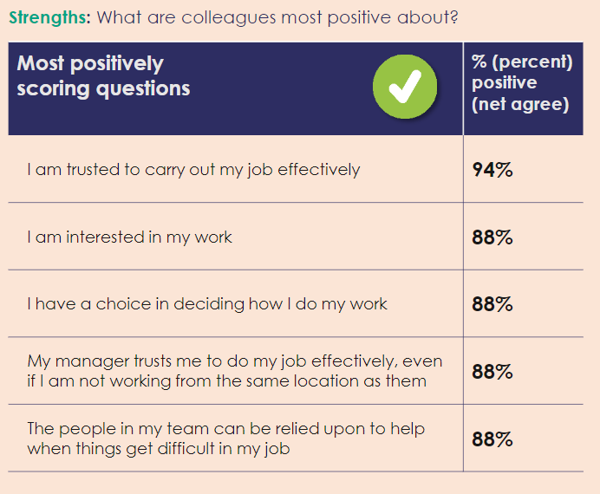
Some positives

Slide 4
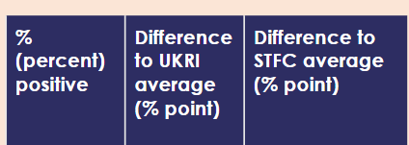
Some positives

Slide 6
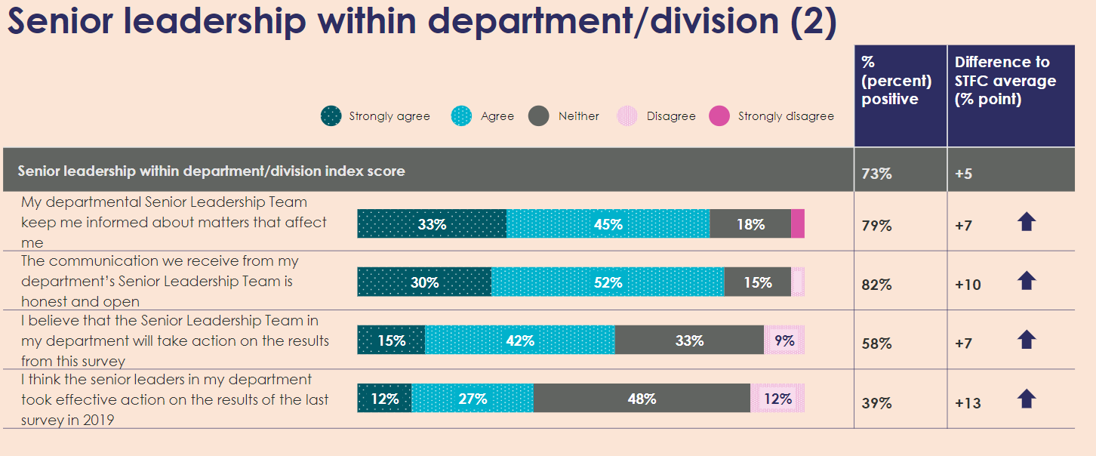

Slide 7
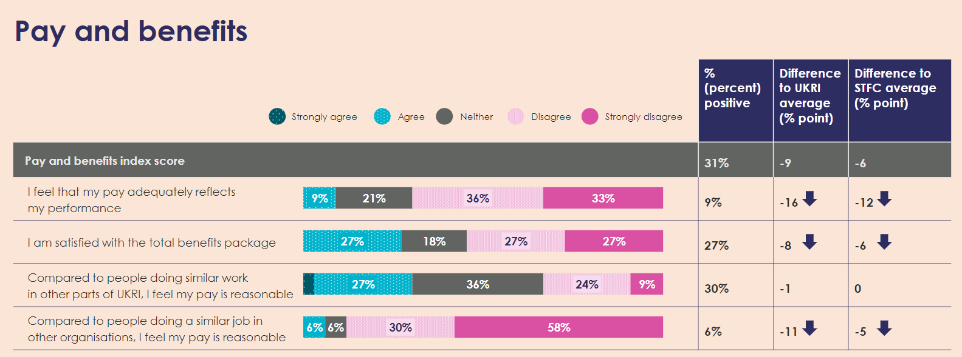
Pay and Benefits
Please see Mark T’s and the SCD webinars

Slide 8
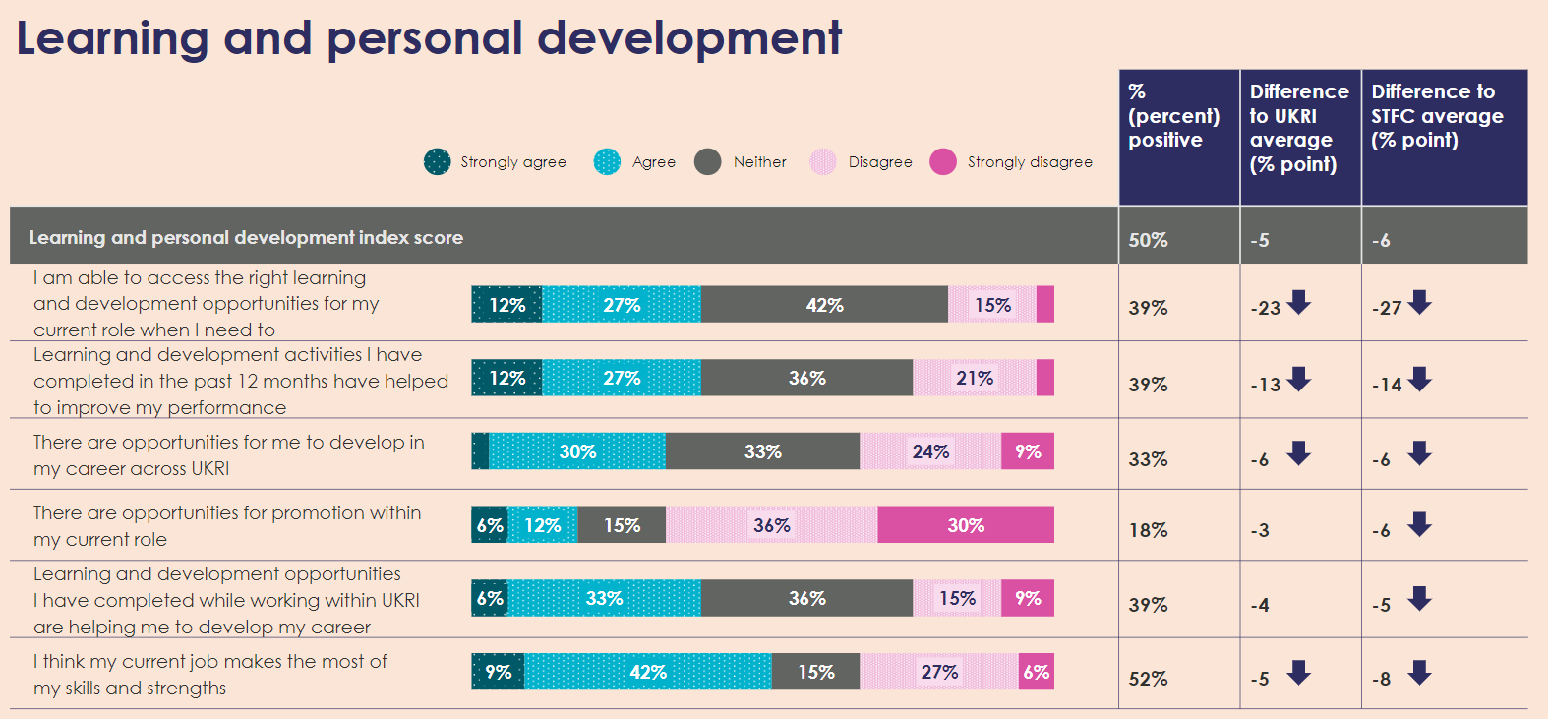
Learning and Development
A cross department issue – we will develop training frameworks and will need your input to that

Slide 9
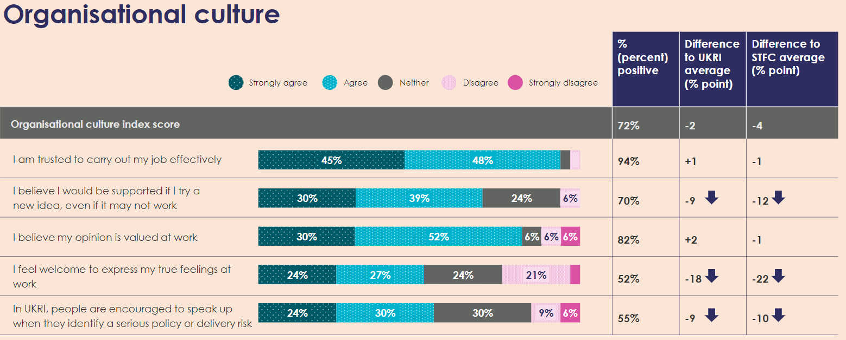
Opportunity to discuss later on the day

Slide 10
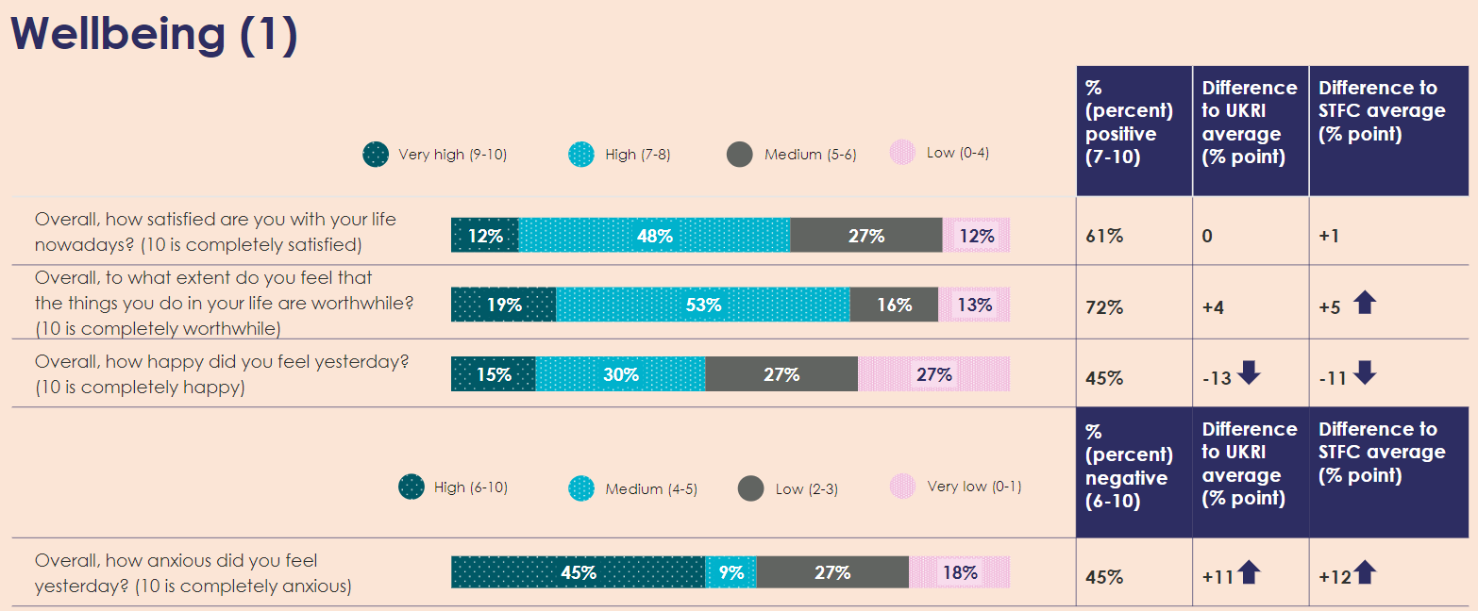
Wellbeing

Slide 11
Discussion
What might some of the underlying issues be?
What interventions would be welcome and effective to improve physical health across the division?

Slide 12
scd.stfc.ac.uk
@SciComp_STFC
Notes:
The abstract pattern can be removed or repositioned if required. Be careful to ‘Send to Back’ so that it does not obscure any important information.

