Slide 1
SCD 2025 Strategy

Slide 2
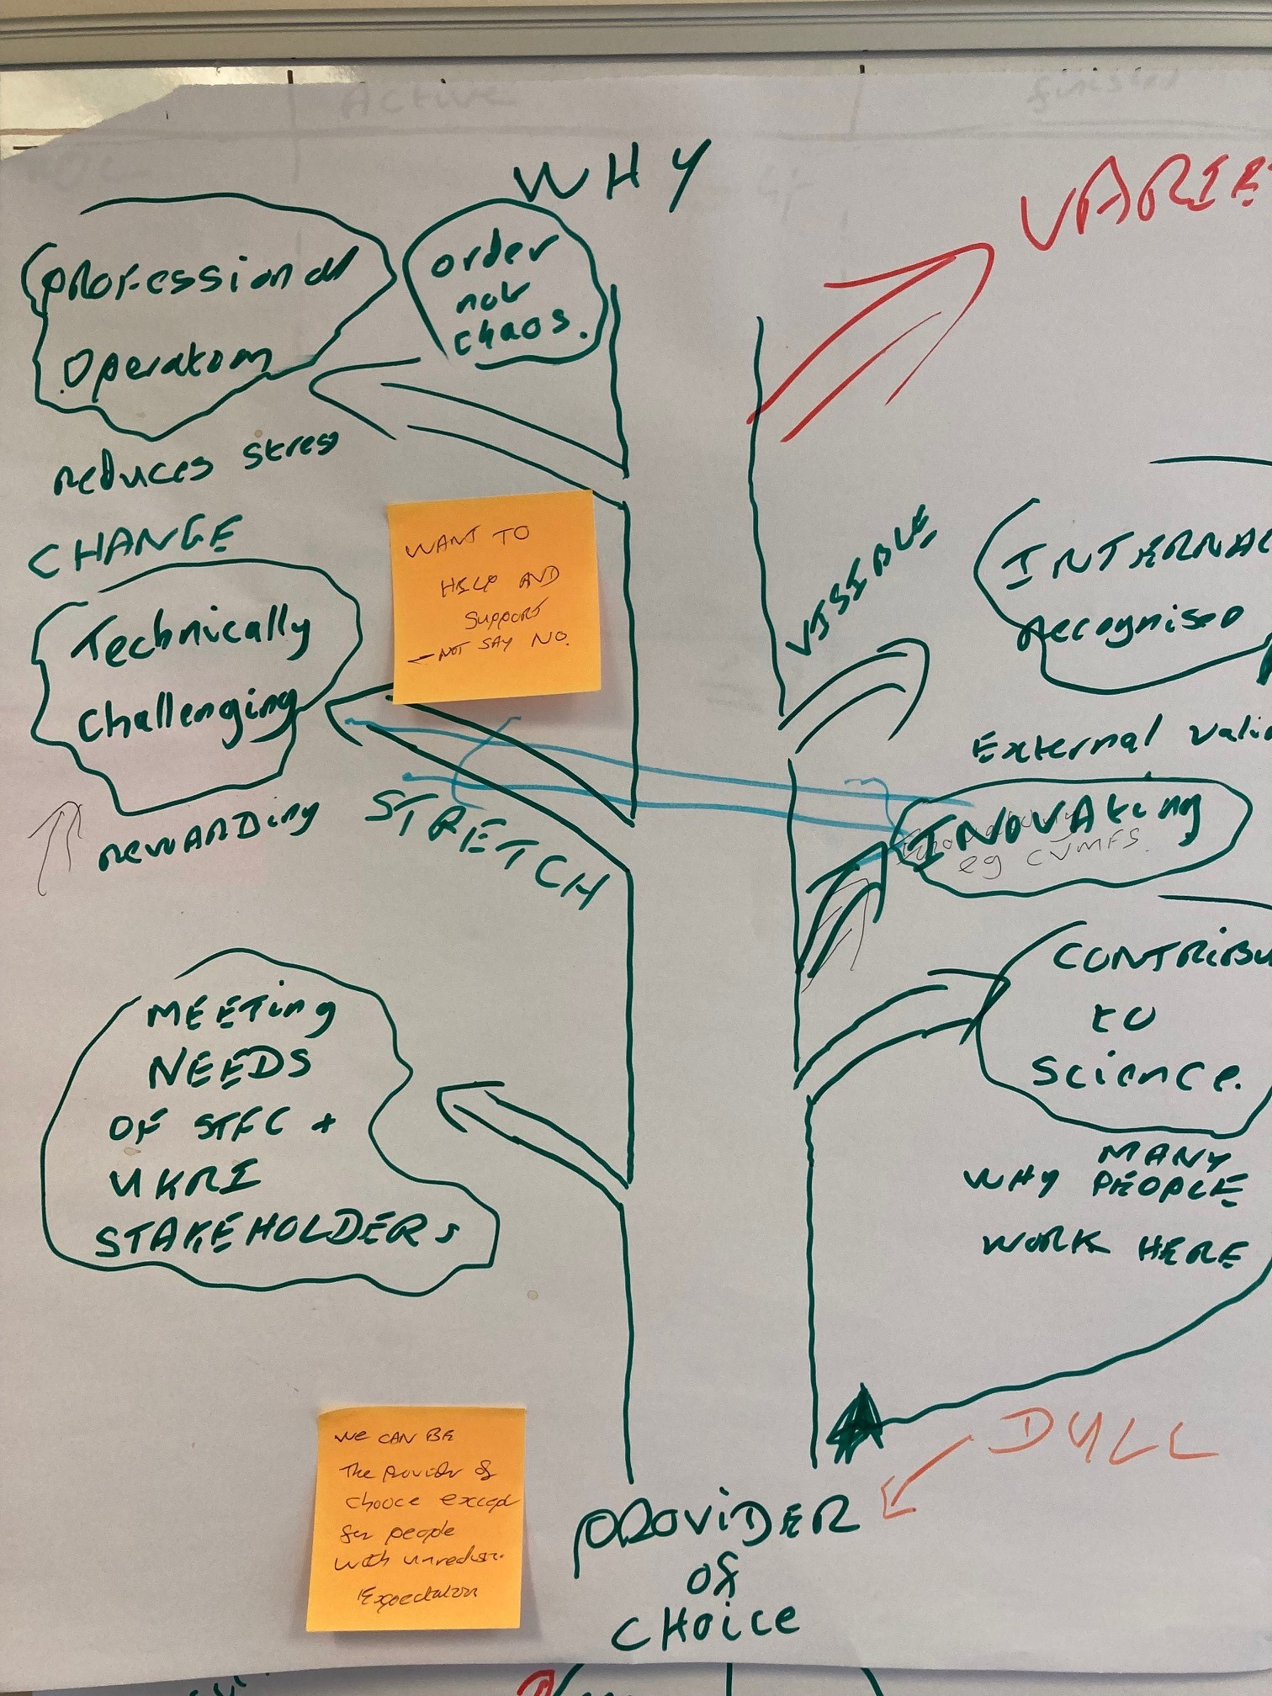

Slide 3
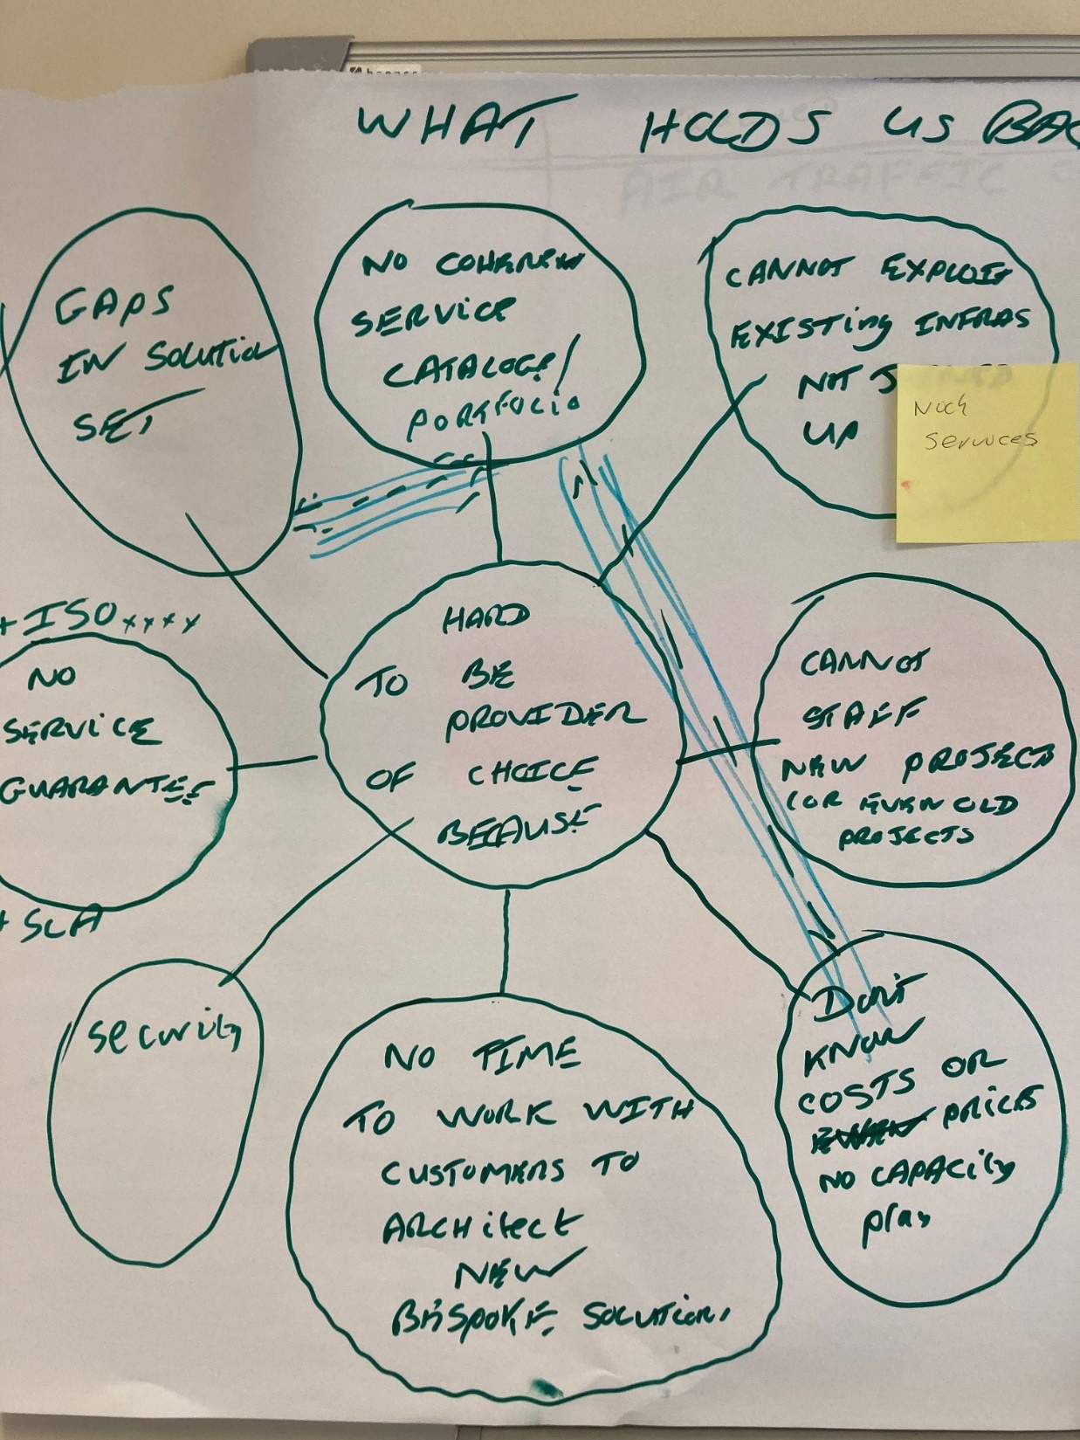

Slide 4
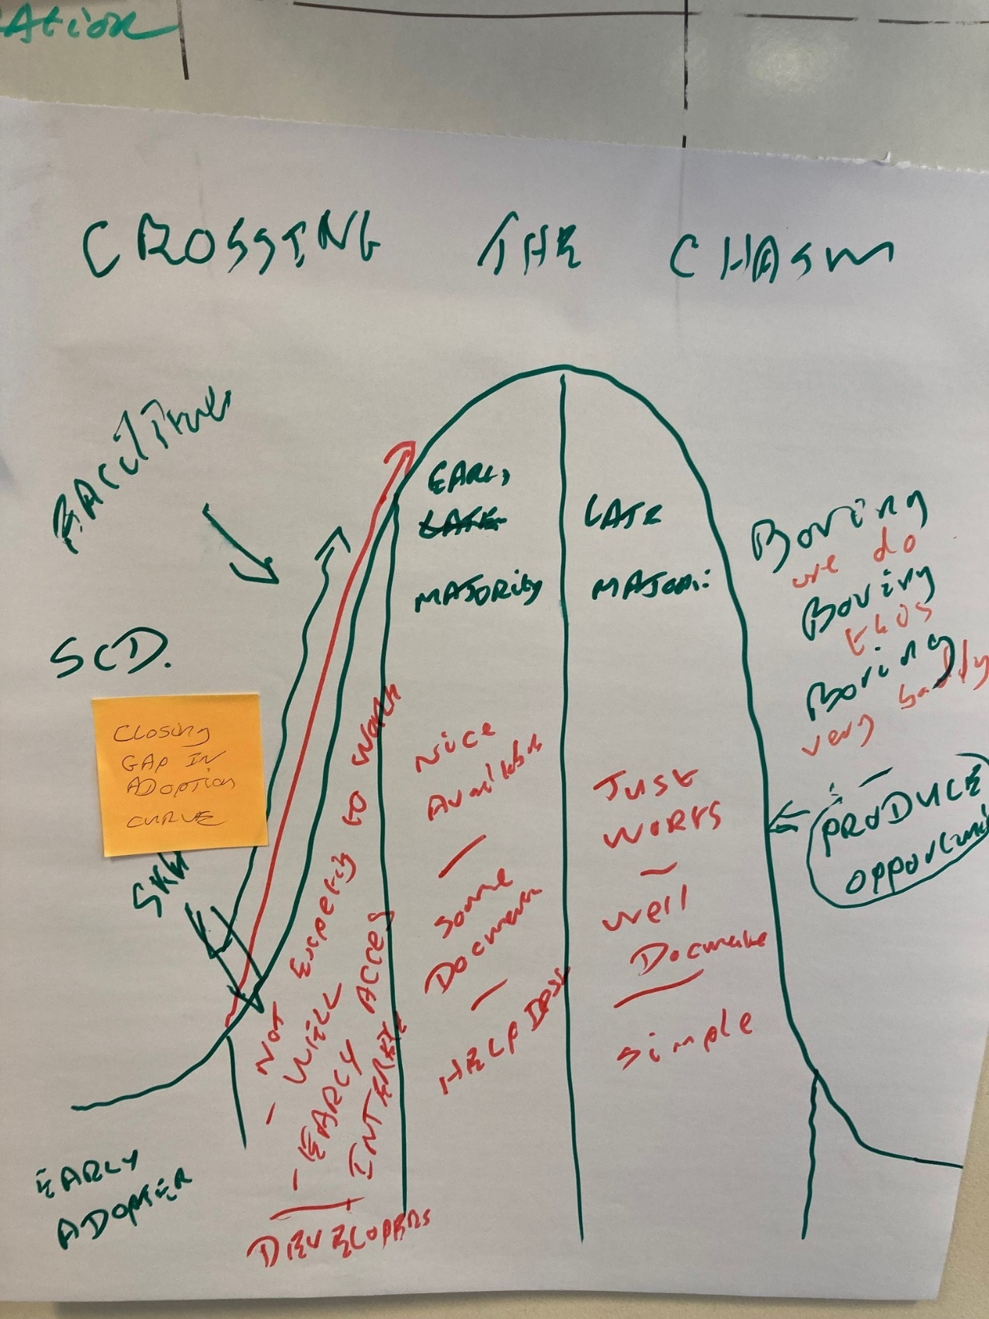

Slide 5
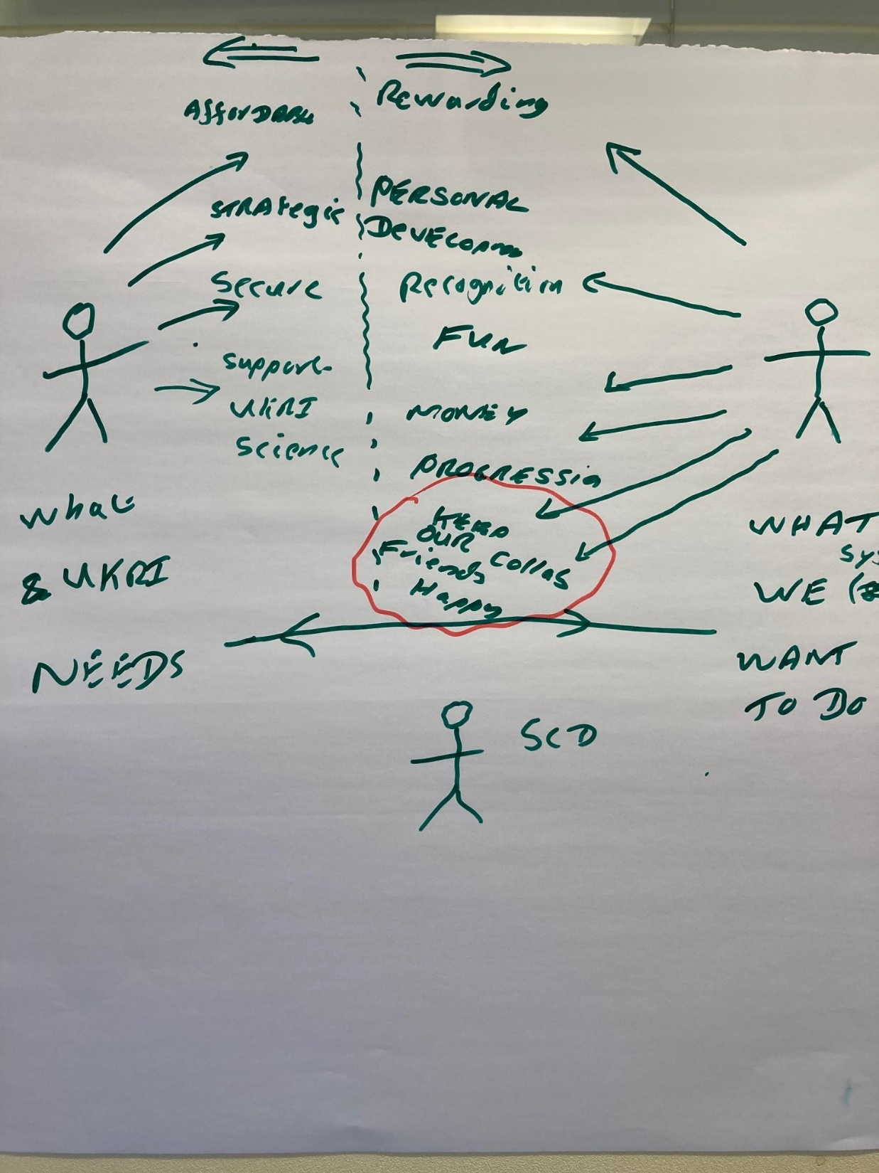

Slide 6
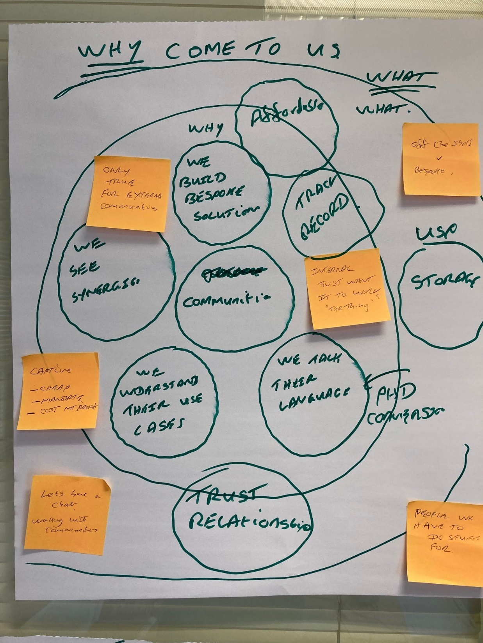

Slide 7
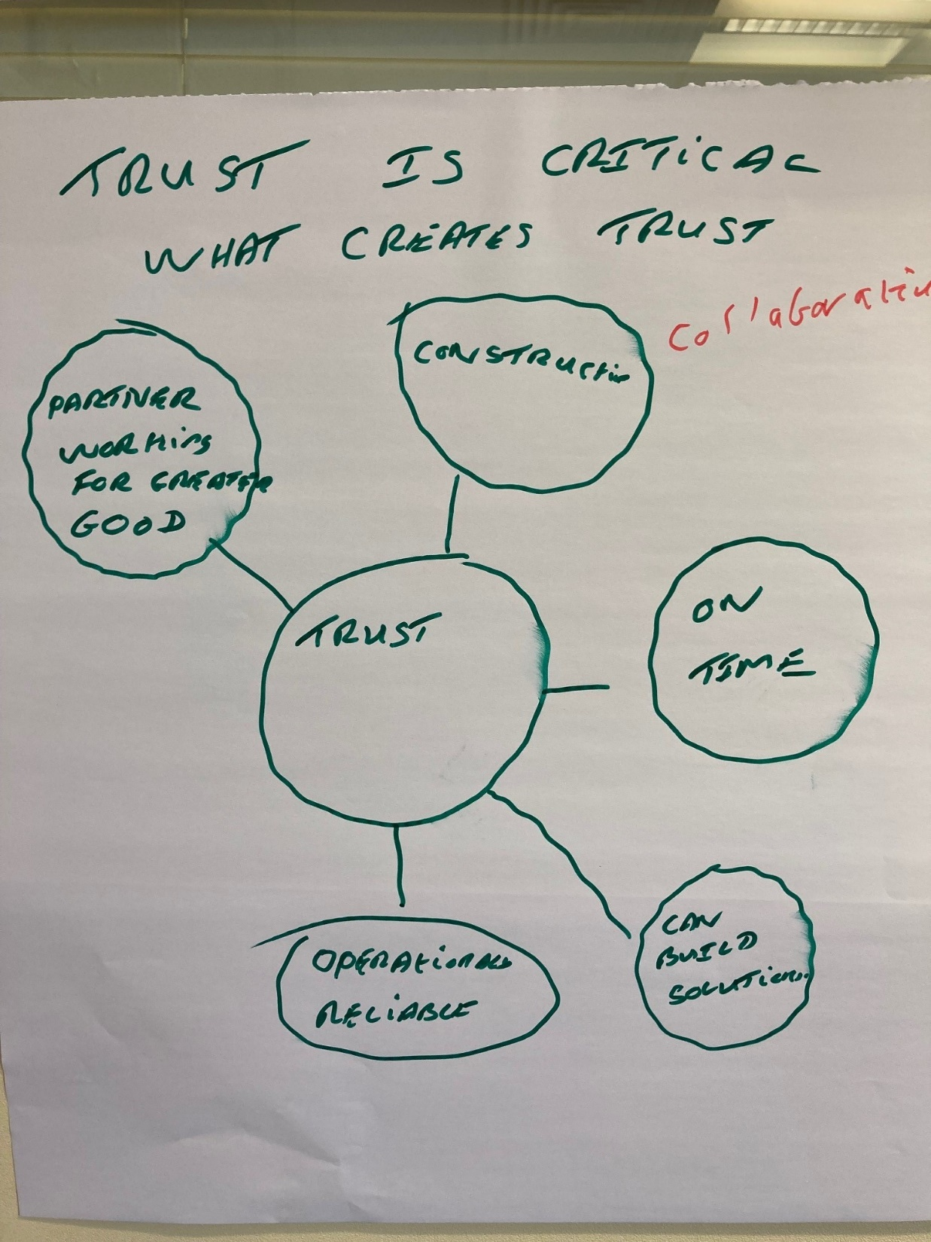

Slide 8
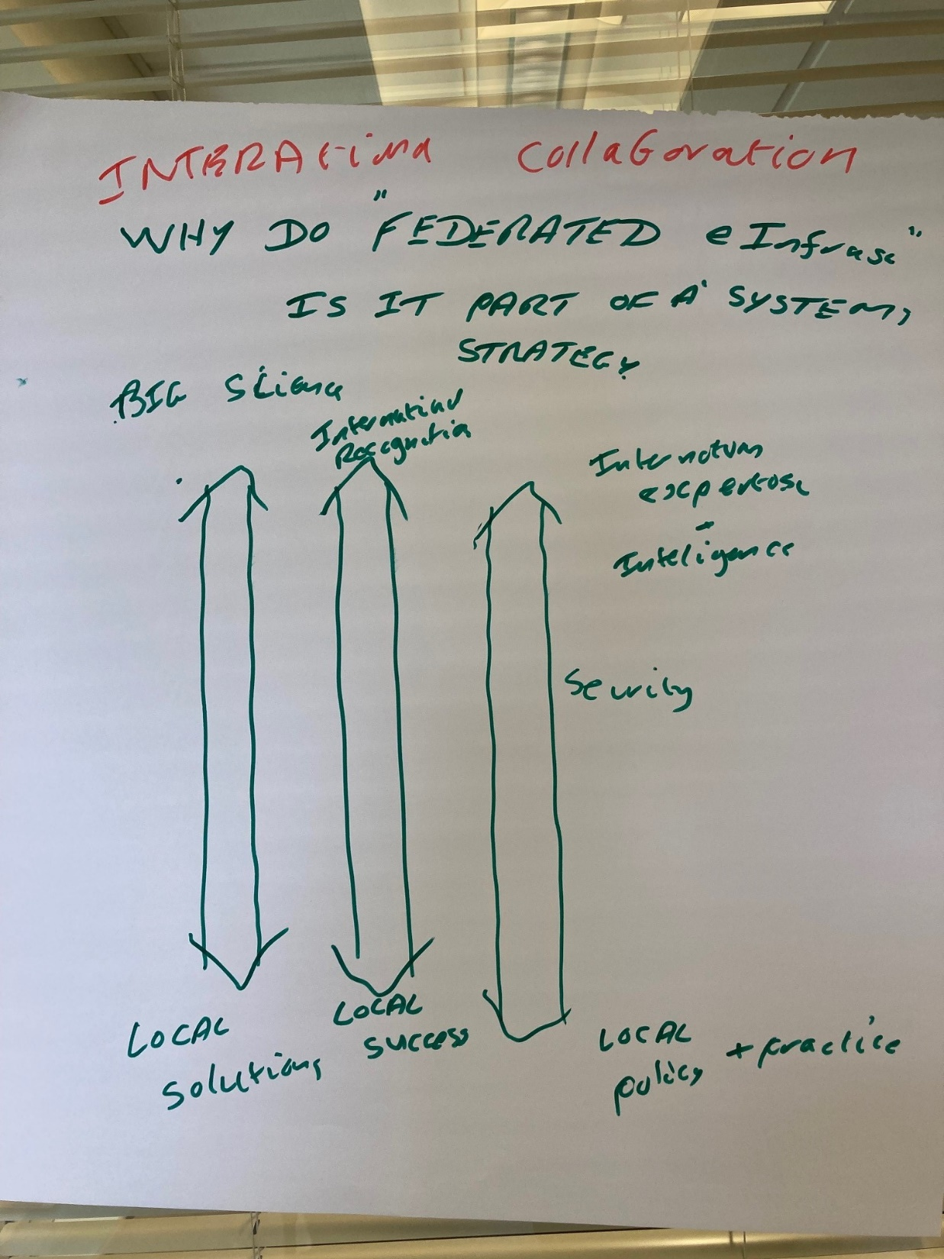

Slide 9
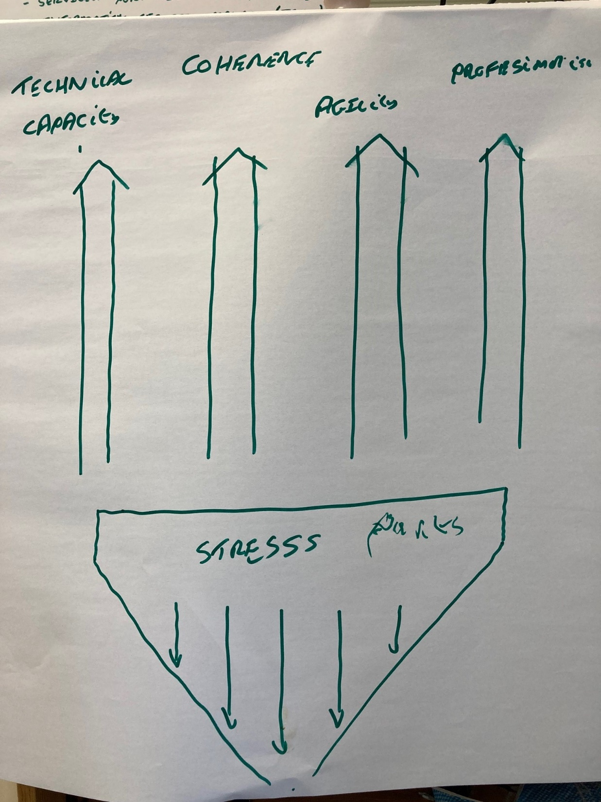

Slide 10
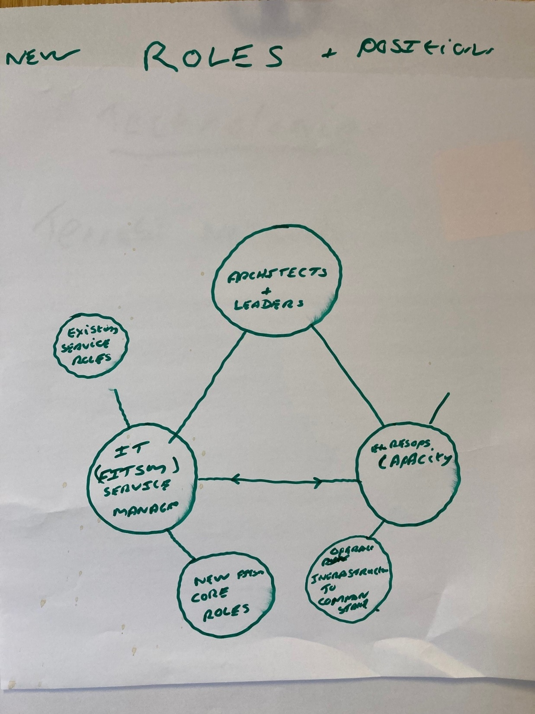

Slide 11
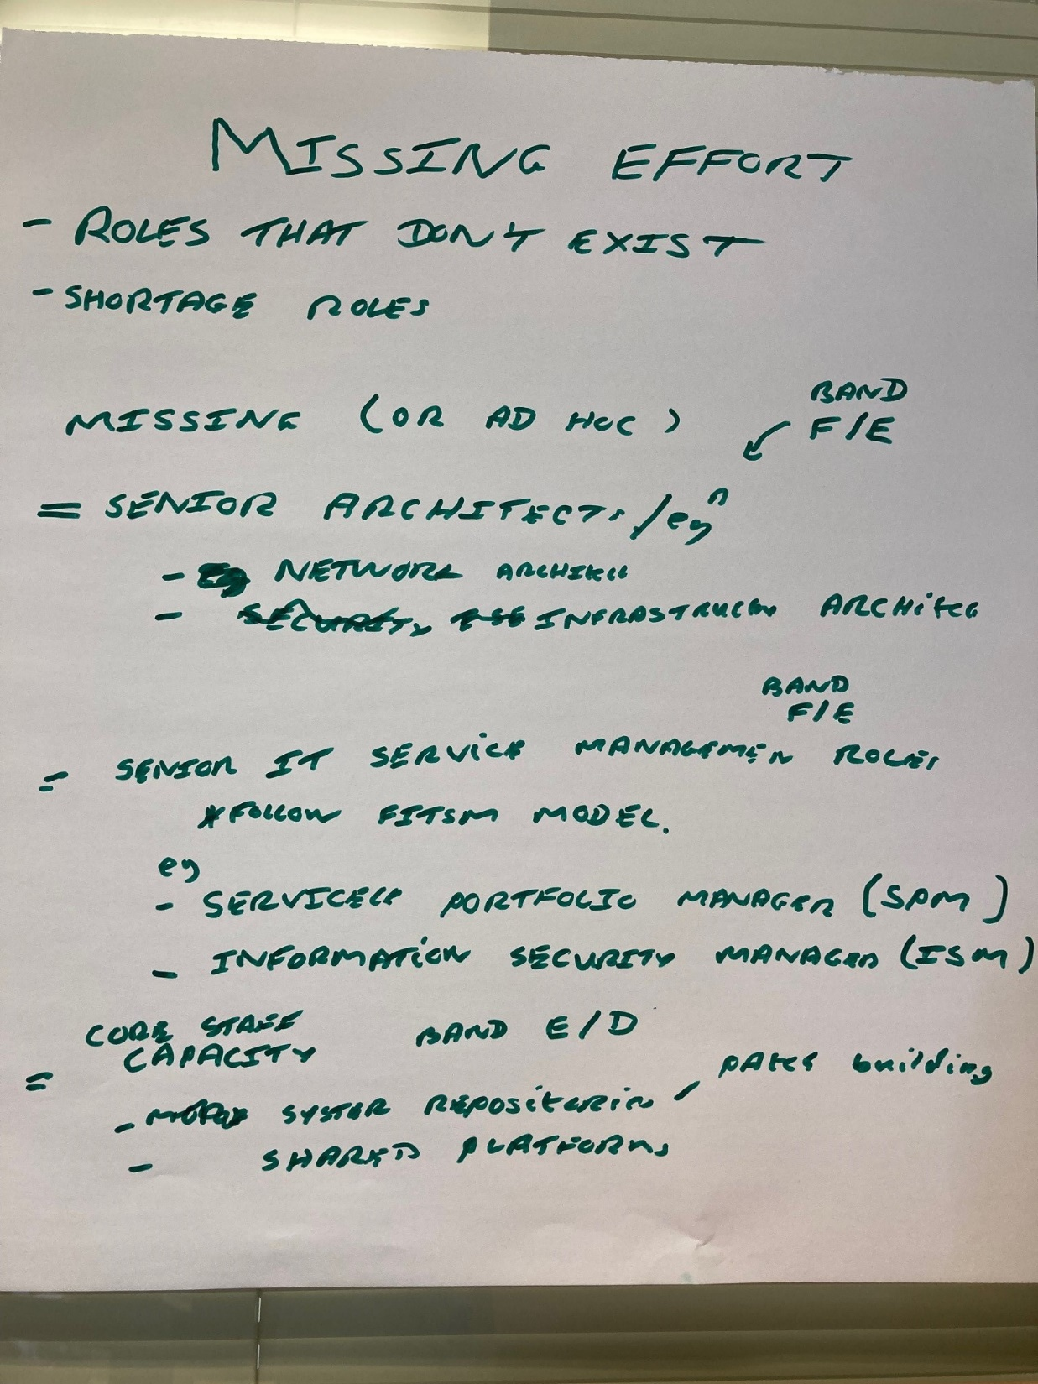

Slide 12
Questions for each Group
Nominate a speaker
Nominally 10 minutes discussion in group
10 minutes discussion together

Slide 13
Additional Staff/Roles – Risks and Complications
Adding an additional 10-15(?) FTE of effort into our area of work is a huge opportunity and “should” benefit most/all existing staff. BUT:
What might individual staff be concerned about?
What negative impact might be experienced by our existing groups and teams?
What other risks might there be?
How can we mitigate these risks?

Slide 14
IT Service Management: FITSM
Both ITIL and FITSM provide a framework for managing IT Services in a coherent and professional manner. While we don’t formally follow these standards, many aspects of the standard are familiar to us, but may be applied partially, not at all or incoherently across our services.
What would be the benefit of adhering to a single service management operating model?
What would be the downside?
On balance should we ignore this, fully adopt FITSM or do something in between?

Slide 15
Corporate rebels suggest:
From
To
Profit
Hierarchical
Directive Leadership
Plan and predict
Rules and control
Centralized authority
Secrecy
Job descriptions
Purpose
Network of Teams
Supportive Leadership
Experiment and adapt
Freedom and Trust
Distributed decision making
Transparency
Talents and mastery

Slide 16
FITSM Roles – All, part or Nothing
FitSM provides a structure of roles that may part map onto our “missing” capabilities. Eg Capacity Manager (CAPM), Information Security Manager (ISM) . System Architects introduce further capabilities and additional finance and project management support take yet more burden from senior (GL like) activities
Do you think this may lead to a more “decentralised” structure
Is this beneficial
Where does this leave the groups
What should be the role of group leaders

Slide 17
Homework
Think about what we have discussed
Think abut following questions also
I’d welcome input from anyone – not just group leaders etc
Grab me in my office (if door open) and tell me your thoughts
Send me an email with your ideas
Ask Mandy to arrange a zoom chat (bring some friends if you want)

Slide 18
Our Service Support Infrastructure
Behind each externally facing capability available to users are a bunch of underpinning tools and technologies that enable a service to function.
What technical parts of our service support infrastructure would it be better to do in common – what would be the benefit.?
What parts are best left to individual services – why?
What roles (if any) does nobody fill (or does on a shoe string) that would be better created as a stand alone post at >=40% FTE

Slide 19
Our External facing Service Offering USP
In terms of technical service offering, what category of services does SCD offer (if any) that makes us uniquely attractive to existing and potentially future customers:
What technical service offerings (our strengths) should we build on?
What challenges do we need to address to ensure that this offering is available to anyone, anywhere, anytime(asap)
What significant gaps in capability for our strengths do we need to fill
What aren’t we doing in other areas that we should be

