Slide 1
Candidate Proposal
INTERNATIONAL LINEAR ACCELERATOR CONFERENCE
LIN C
2026
In DAEJEON, REPUBLIC of KOREA
Aug. 2022

Slide 2
CONTENTS
PART 1. Overview of LINAC 2026
PART 2. Introduction of Daejeon
PART 3. Introduction of RISP
PART 4. Stay and Tour
PART 5. Conference Budget
PART 6. Strong Support
Summary

Slide 3
OVERVIEW OF LINAC 2026
TITLE
International Linear Accelerator Conference (LINAC)
DATE
August or September, 2026 / 5 days
VENUE
Daejeon Convention Center (DCC)
CITY
Daejeon Metropolitan City, Republic of Korea
HOST
Organizing Committee of LINAC 2026
CONTENTS
Oral Sessions, Poster Sessions, Social Events, etc.

Slide 4
PART 2.
Introduction of Daejeon

Slide 5
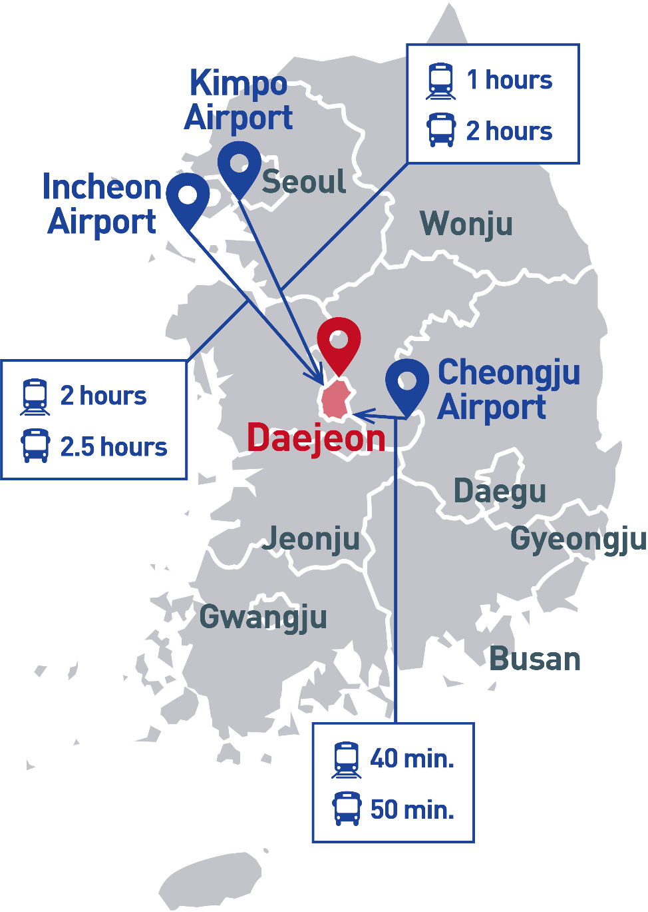
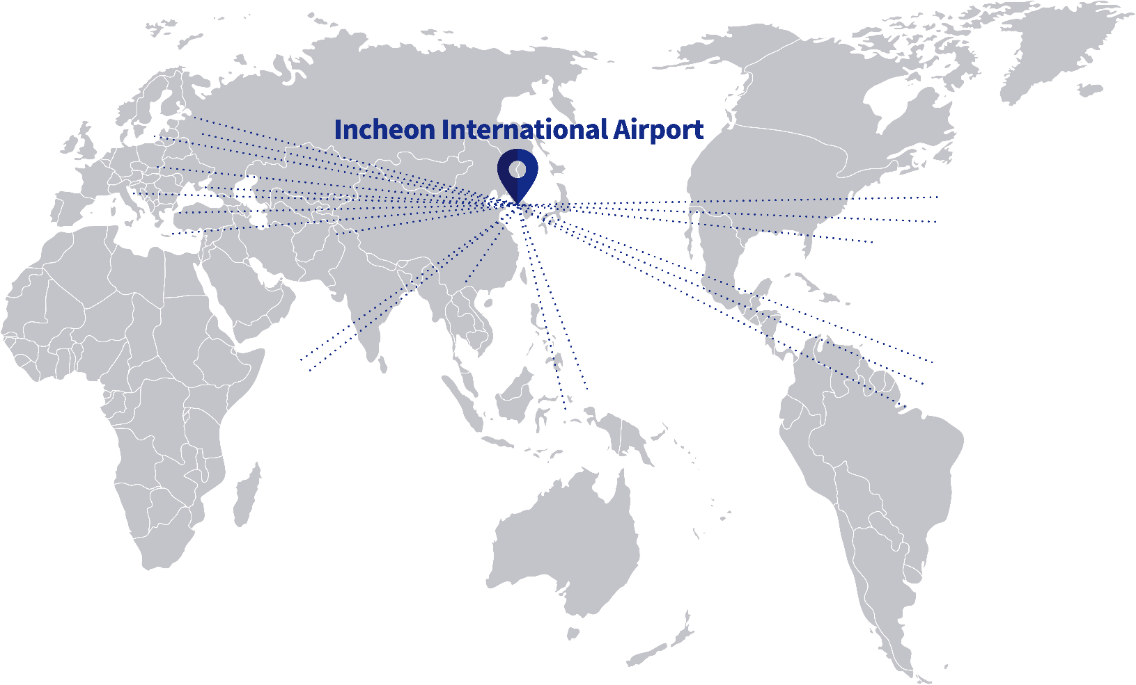
KOREA, THE NEXT DESTINATION OF LINAC 2026
VISA
88⁺
59⁺
188⁺
103
Airlines
Countries
Cities
Countries
Visa-free
Notes:
Some of you may have been to Daejeon once or more. But some of you may have not.
And I would briefly give you an overview of the city.
First of all, it is geographically located in the heart of South Korea with 1.5 million population.
As you see on the map, you have an easy access to anywhere in Korea from Daejeon within 2 hours.

Slide 6
DAEJEON, THE HEART OF SOUTH KOREA
A capital city for
Science and Technology in Korea
26
21
2,600⁺
30,000⁺
Government-funded
Research Institutes
Universities
Hi-tech
Companies
R&D Researchers

Slide 7
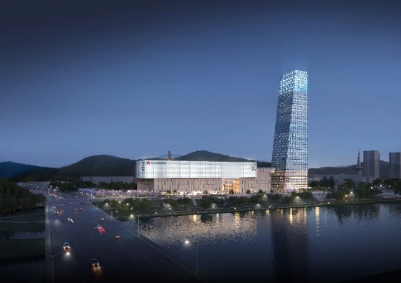
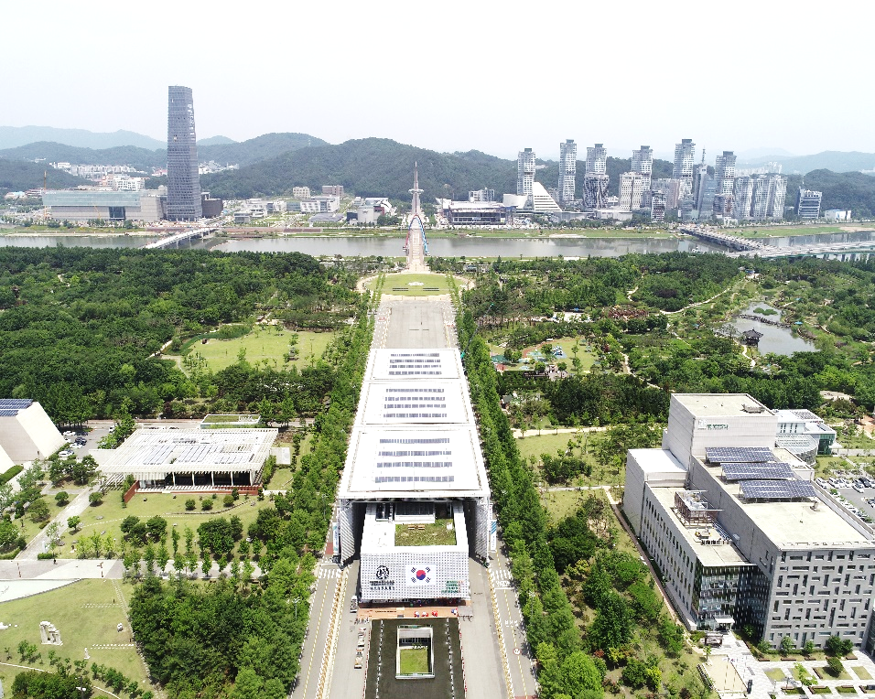
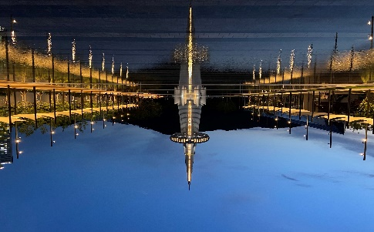
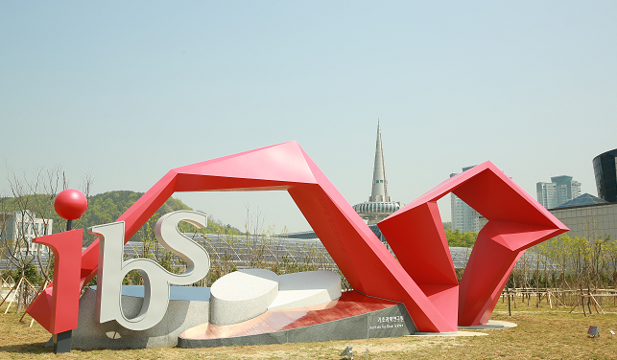
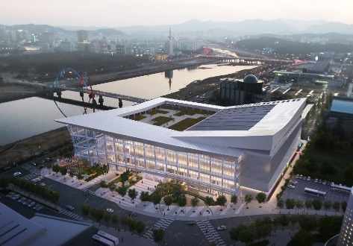
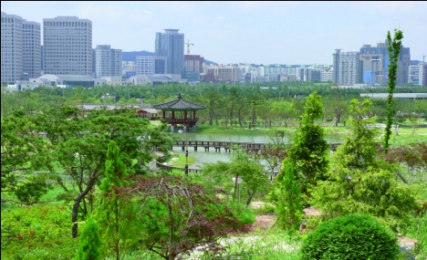
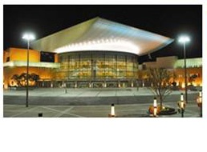
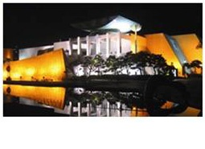
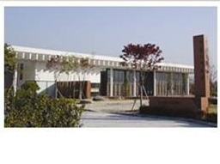
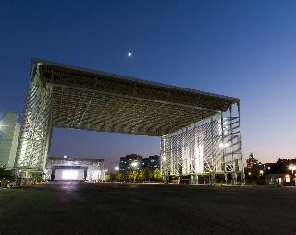
ATTRACTIVE CONVENTION DESTINATION
1
3
1
3
2
4
Science Complex (Shopping mall, hotel)
5
5
Hanbit Tower & Square
2
←6
8
4
7
9
ibs
Daejeon Convention Center
5
6
7
8
9
Hanbat Arboretum
Daejeon Art Center
Daejeon Museum of Art
Leeungno Museum
EXPO Square

Slide 8
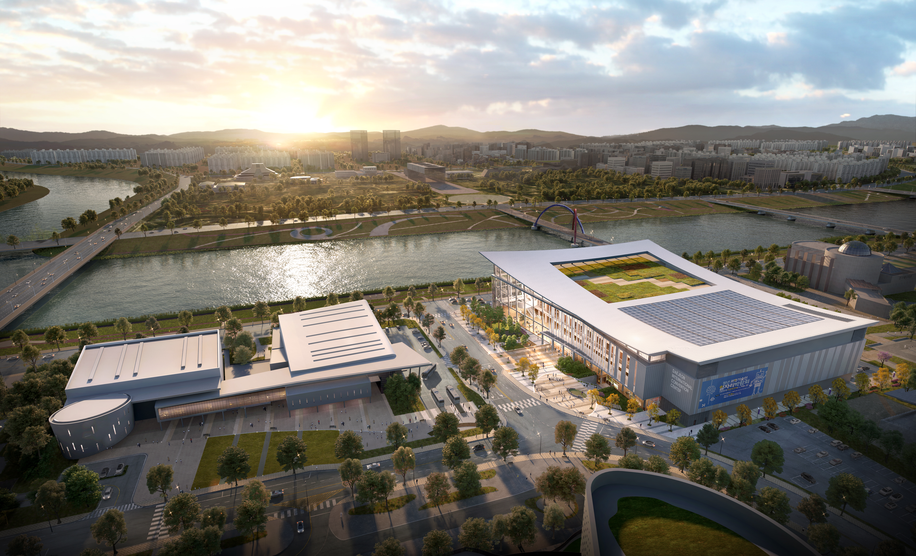
Venue: Daejeon Convention Center
DCC Ⅱ
IBS
DCC Ⅰ
5,000⁺
10,151m²
8,000⁺
Free
Wi-Fi
International Conference
Exhibition Hall
Capacity
Notes:
I
II

Slide 9
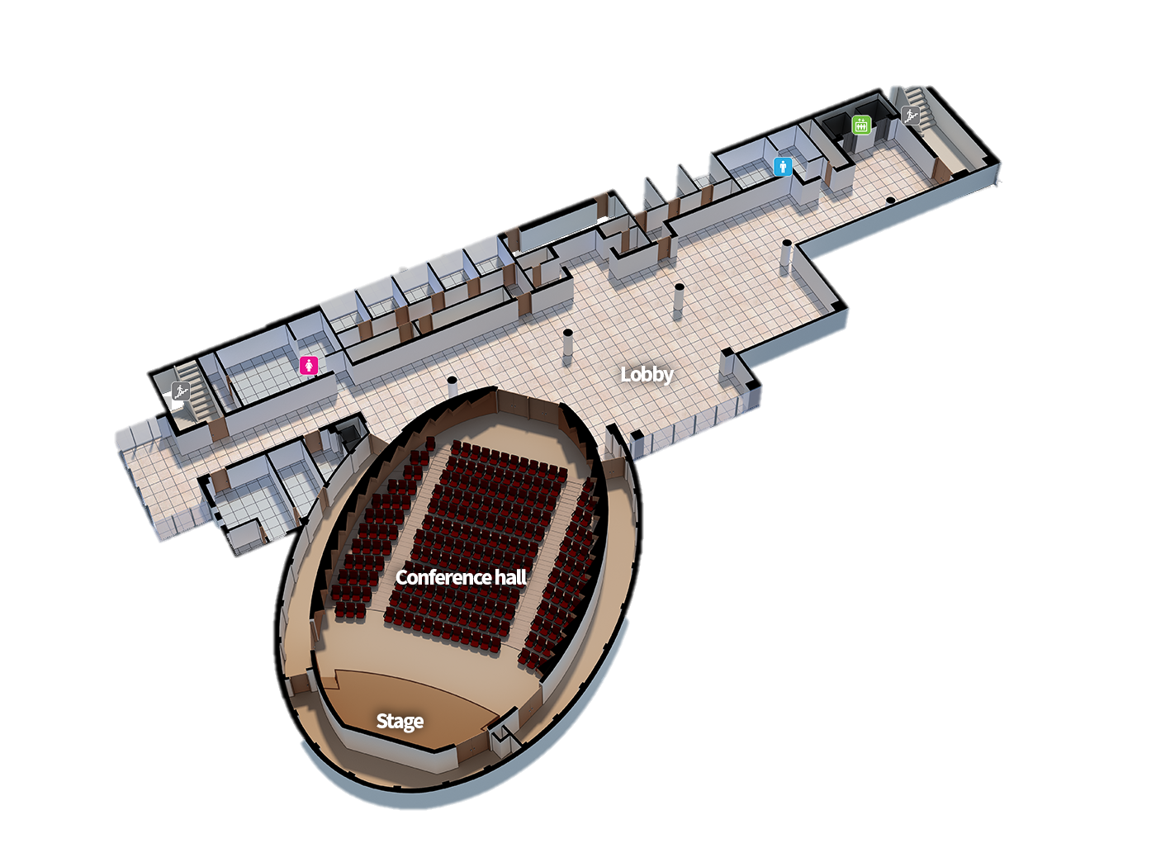
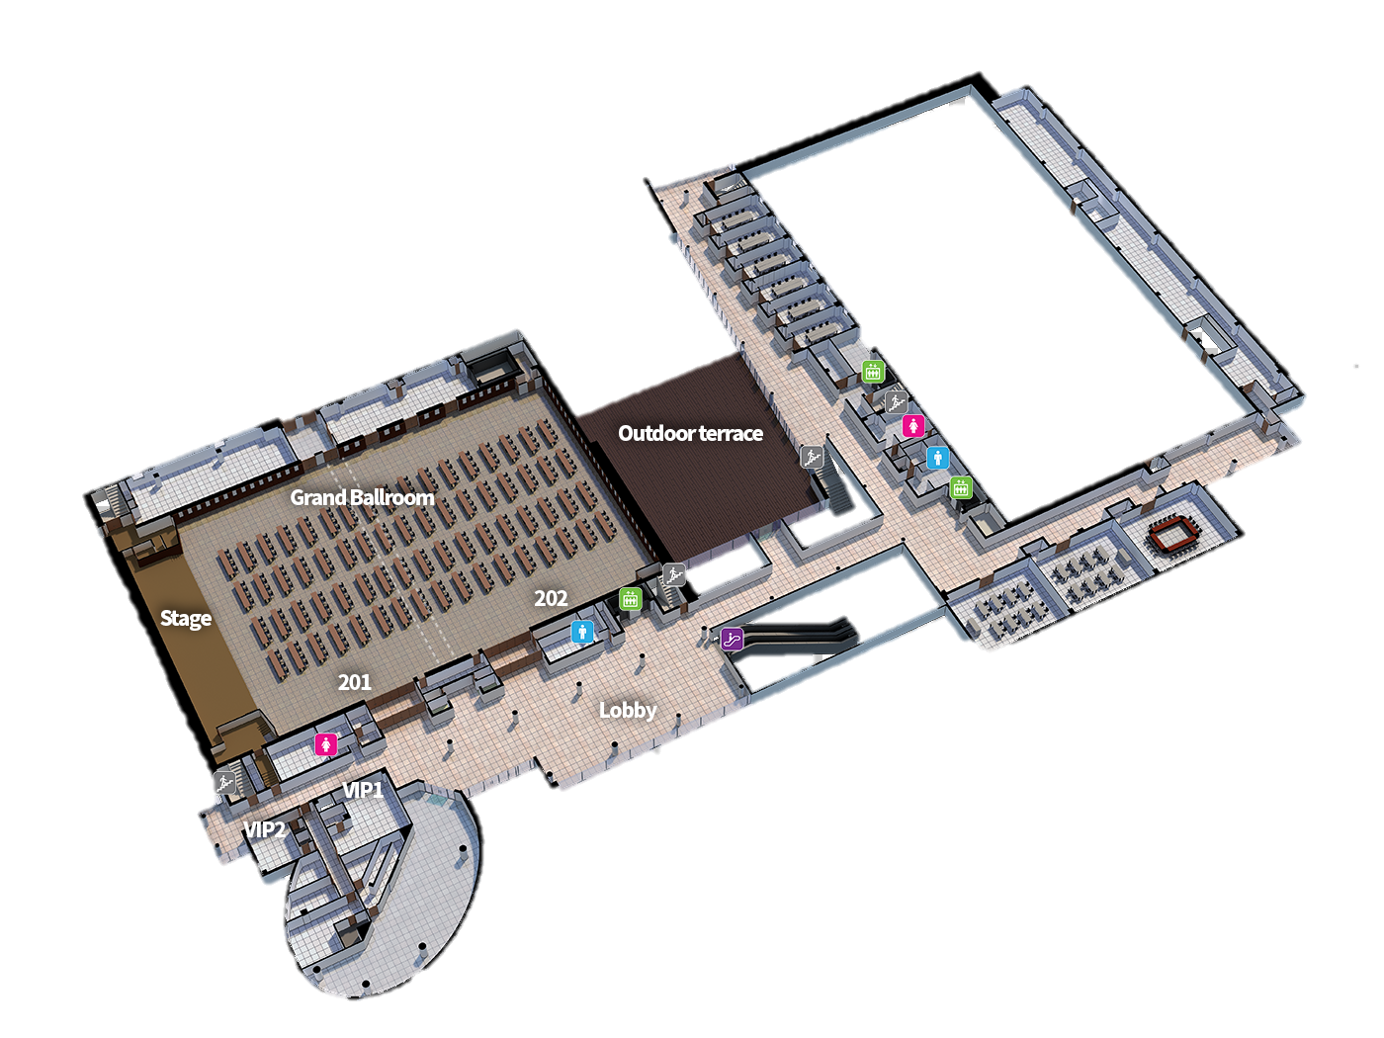
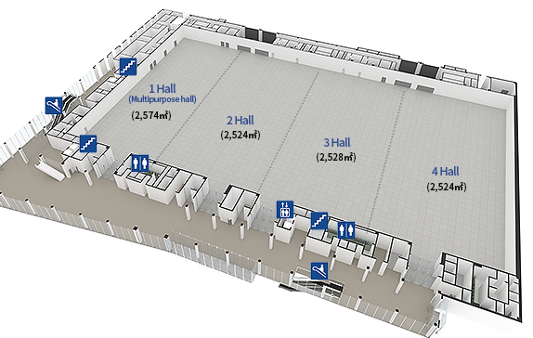
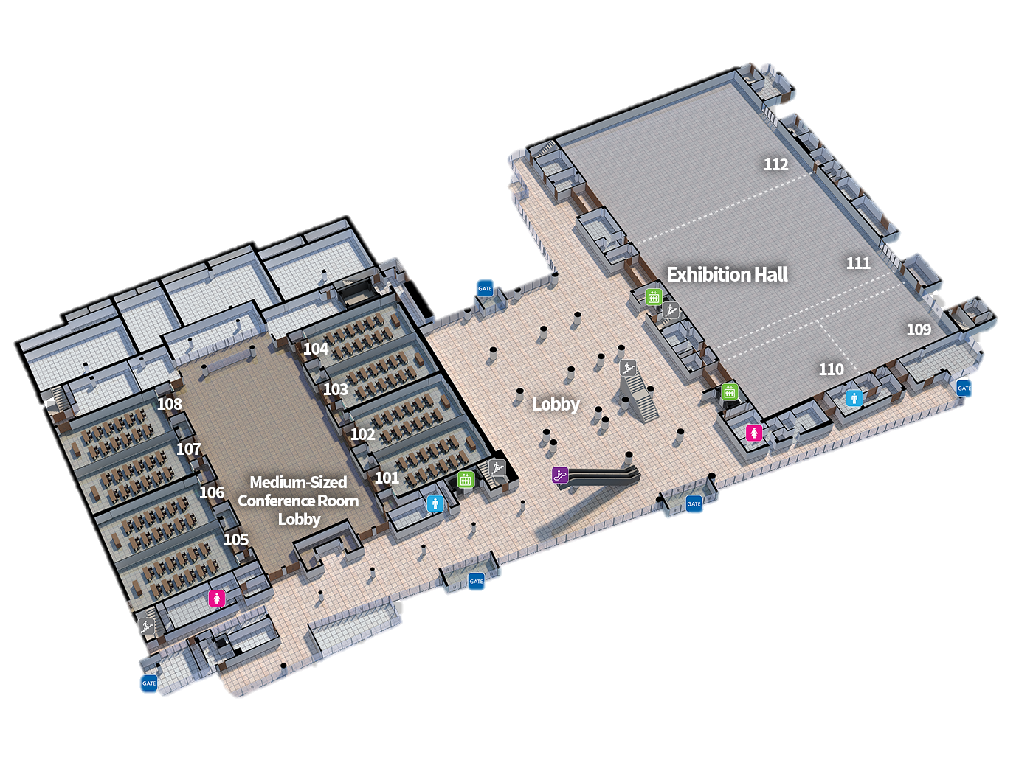
Venue: Daejeon Convention Center
3F
Conference Room
2F
DCCⅡ
Grand-Ballroom
9 Meeting Rooms
Exhibition Hall
10,151m²
1F
8 Meeting Rooms
Exhibition Hall
DCCⅠ

Slide 10
PART 3.
Introduction of RISP

Slide 11
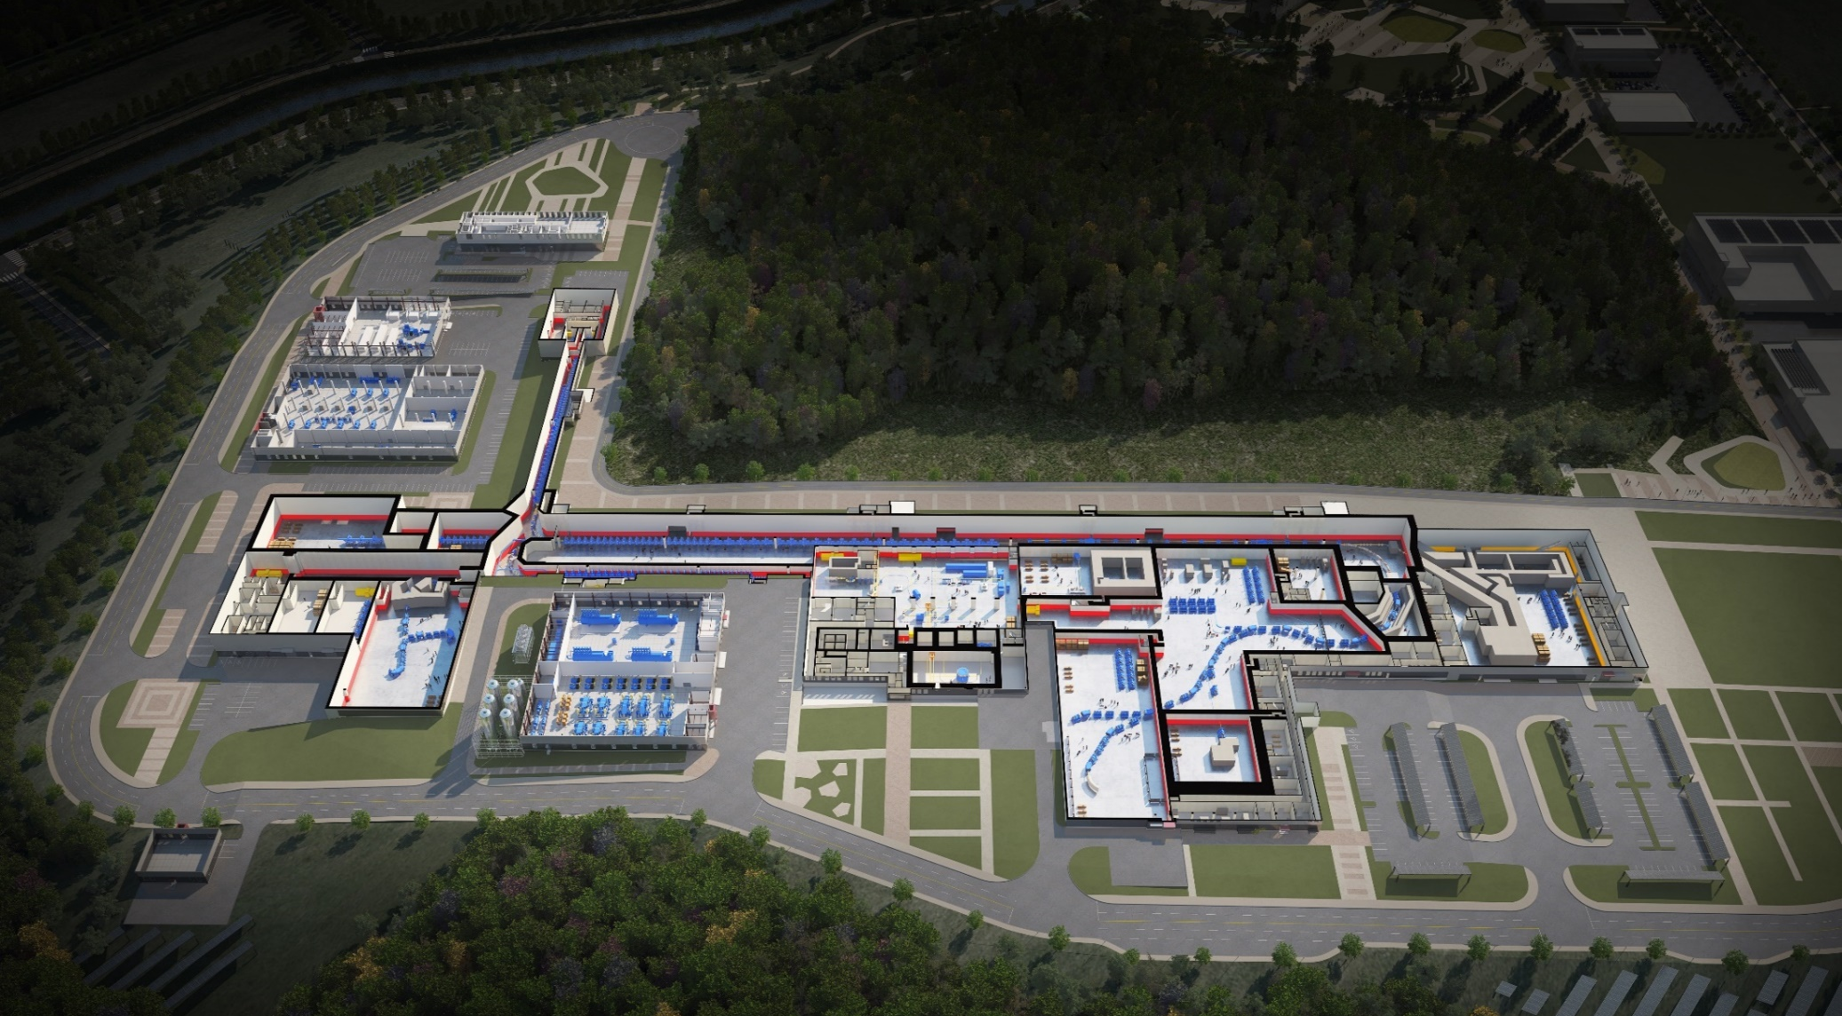
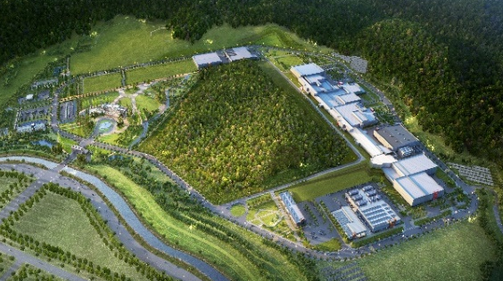
Heavy Ion Accelerator Facility : RAON
Control
Center
ECR IS
Utility
ISOL System
SCL1
HPMMS/
CLS
IF System
SCL3
SCL2
BIS
μSR
NDPS
KOBRA
Cyclotron
HRS
LAMPS

Slide 12
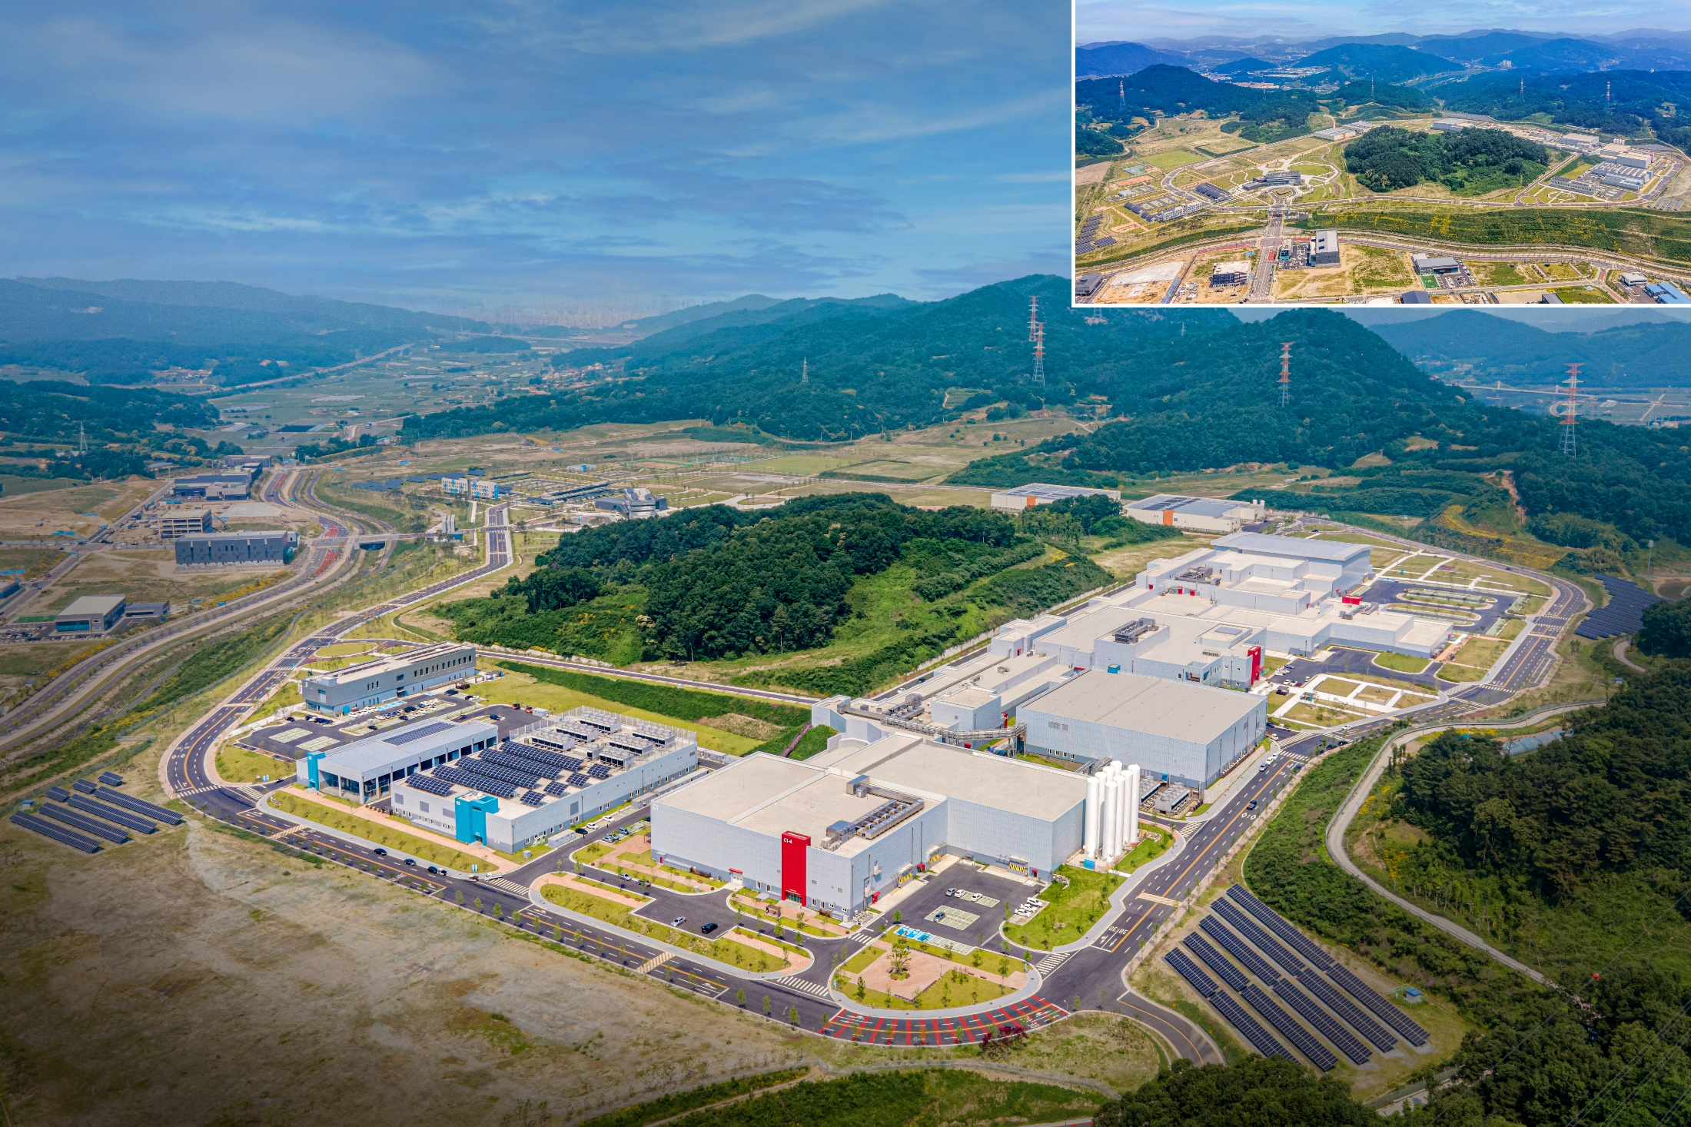
RAON Layout
● Accelerator System
● RI producing System
● Conventional Utilities
● Experimental System
Waste Storage
Guest House
Assembly Bd.
SRF Test Bd.
High Energy B
IF
HQ Office
Accelerator
ISOL
Control Center
SCL2
SCL3
High Energy A
Low Energy B
Low Energy A
Cryogenics Bd.
Utility Bd.
Electricity Bd.
Campus Area : 952,066㎡ (including the reservation area of 144,640㎡)
Building Area : 76,259㎡(11 bldgs) with total bldgs. Area of 116,252㎡

Slide 13
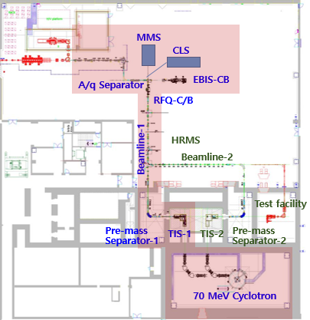
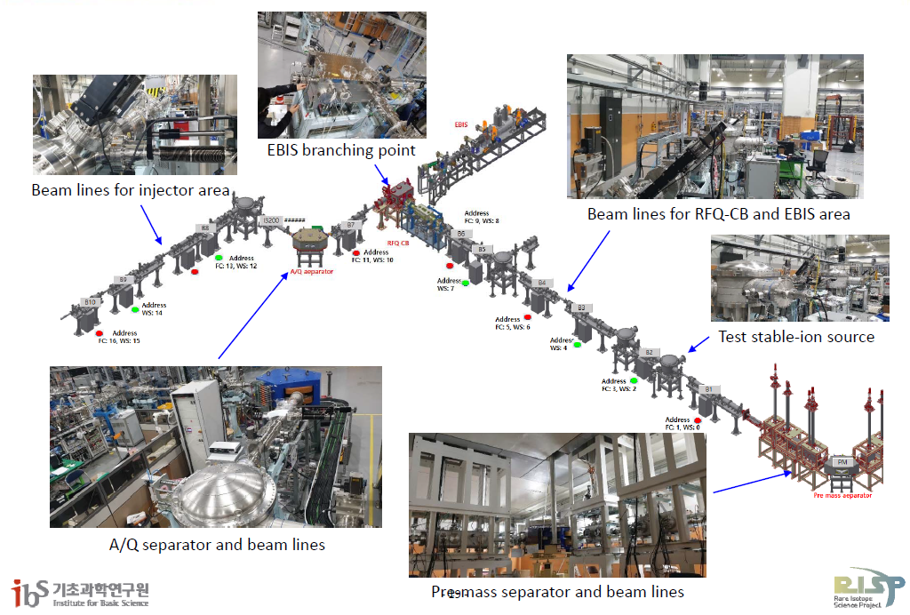
ISOL system
• Driver beam : proton 35<K<70 MeV, up to 70 kW
• Target : UCx, MgO, BN, CaO, BeO, SiC, etc
• Ion Source : Surface, RILIS, Plasma
• RIB : 6< A < 250, 10<K< 80 keV, 10^8 pps(Sn), >90% purity @Exp. • incident to RFQ of Post accelerator 10 keV/u
• full remote maintenance system with TIS modularization
- ISOL beam lines including sub-systems are commissioned in 2021
- RI beam commissioning using SiC target (Dec 2022)

Slide 14
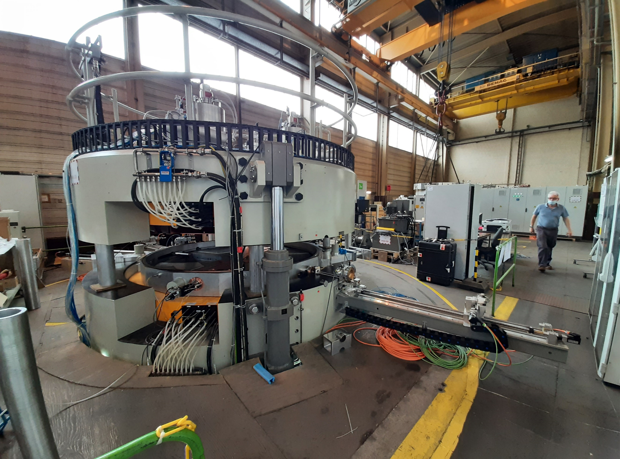
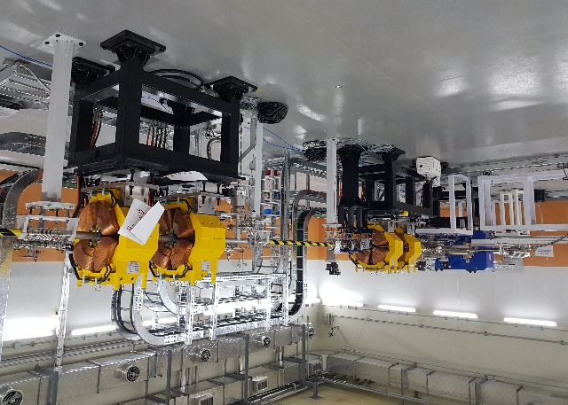
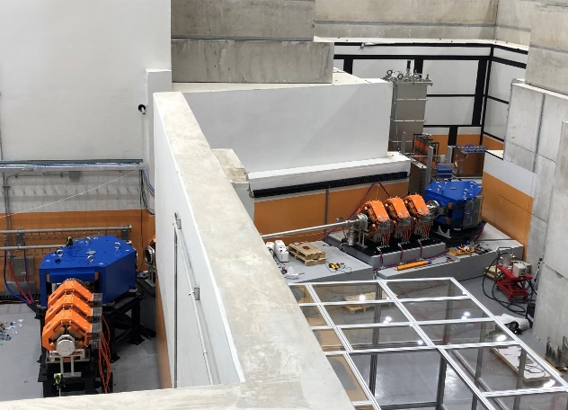
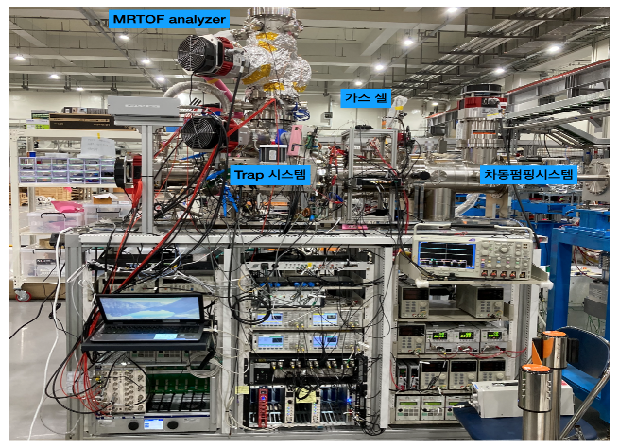
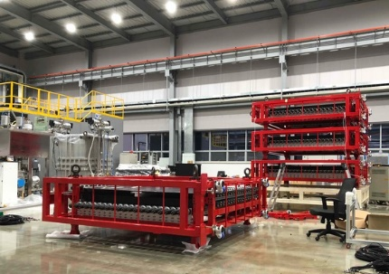
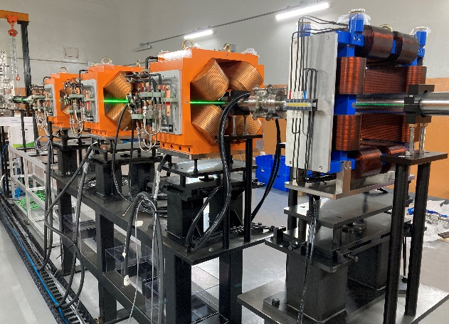
Experimental Systems
(IF Separator)
(Cyclotron)
(NDPS)
(muSR)
(MMS)
(LAMPS)
(BIS)
ISOL system installed in 2021 and RI beam test on 2022 & All Exp. Systems are to be installed by 2022 and machine commissioned

Slide 15
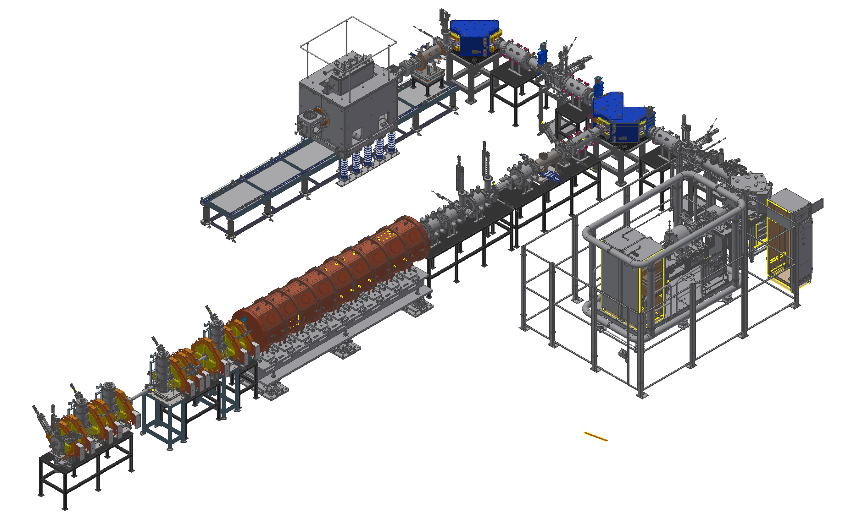
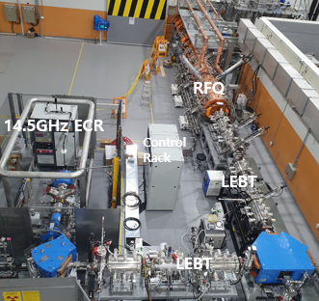
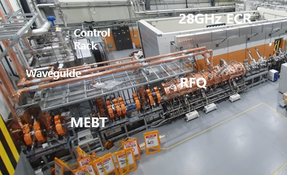
RAON Injector System
Two ECR-IS on high voltage platforms
14.5 GHz ECR ion source
28 GHz superconducting ECR ion source
LEBT (E = 10 keV/u)
10 keV/u, Dual bending magnet
Chopper & Electrostatic quads, Instrumentation
RFQ (E = 500 keV/u)
81.25 MHz, Transmission Eff. ~98%
CW RF Power 94 kW (SSPA: 150 kW)
MEBT (E = 500 keV/u)
Four RF bunchers (SSPA: 20, 15, 4×2 kW)
Simple quadrupole magnets, Instrumentation
SC ECRIS
LEBT
ECRIS
MEBT
RFQ
Ar⁸⁺ 10uA @ Beam Viewer(‘21)
Installation completed and beam commissioning from October, 2020

Slide 16
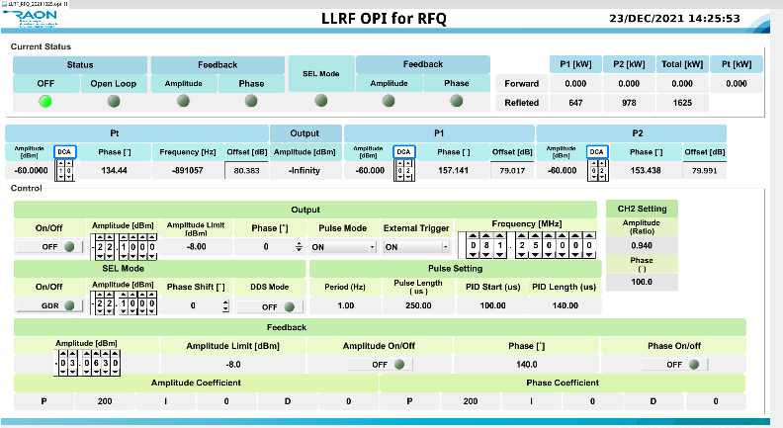
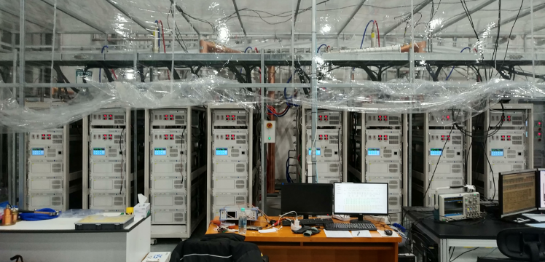
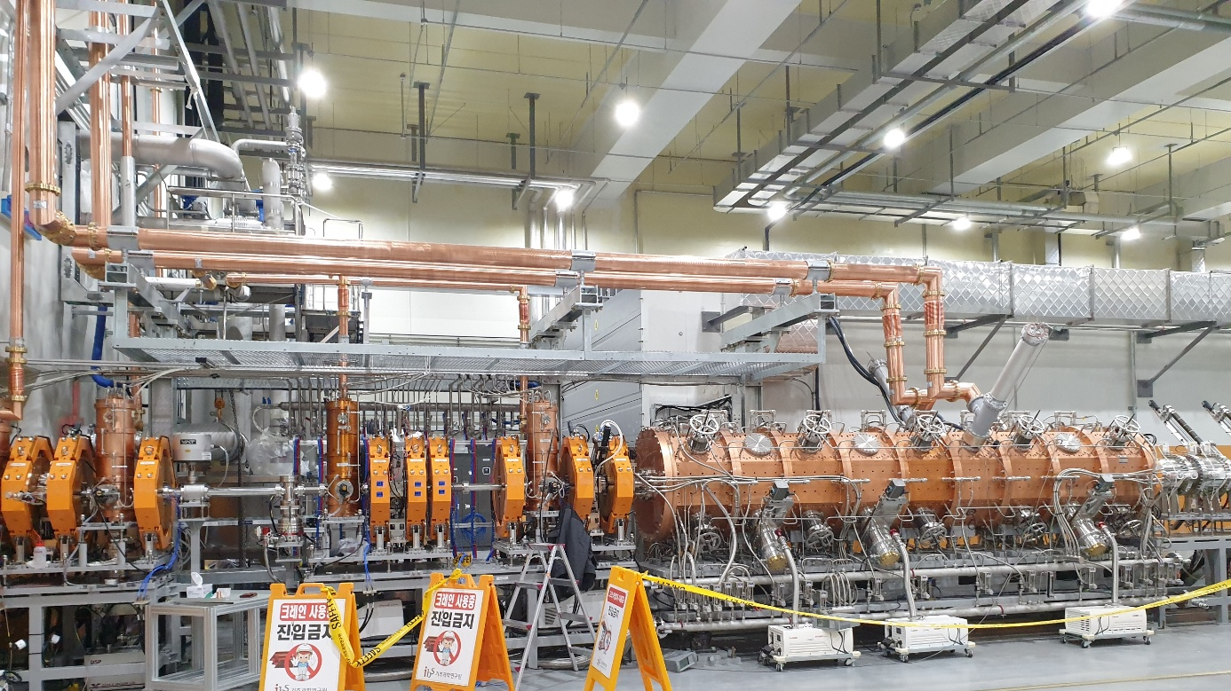
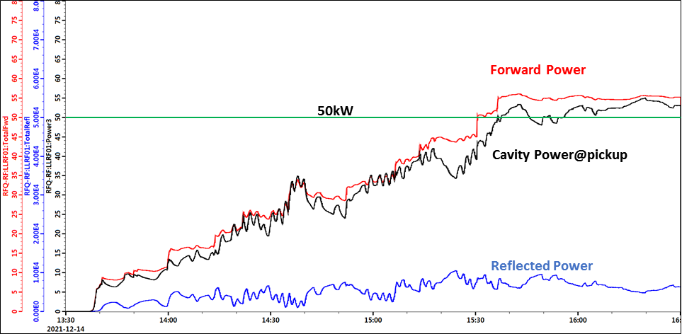
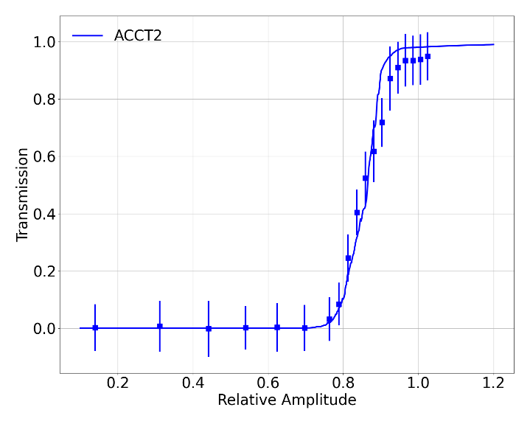
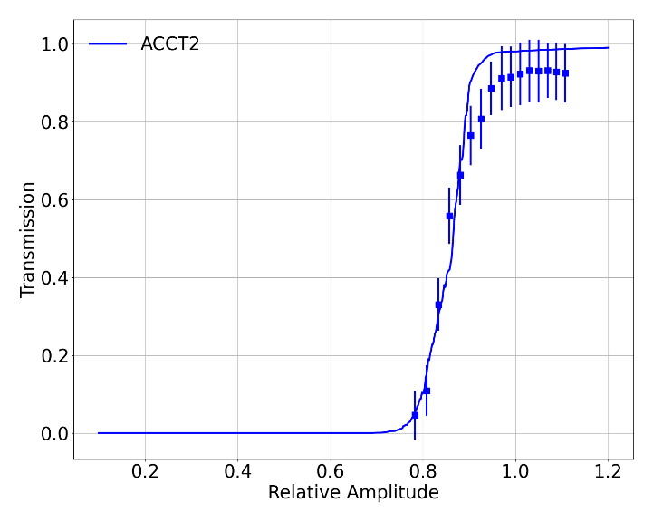
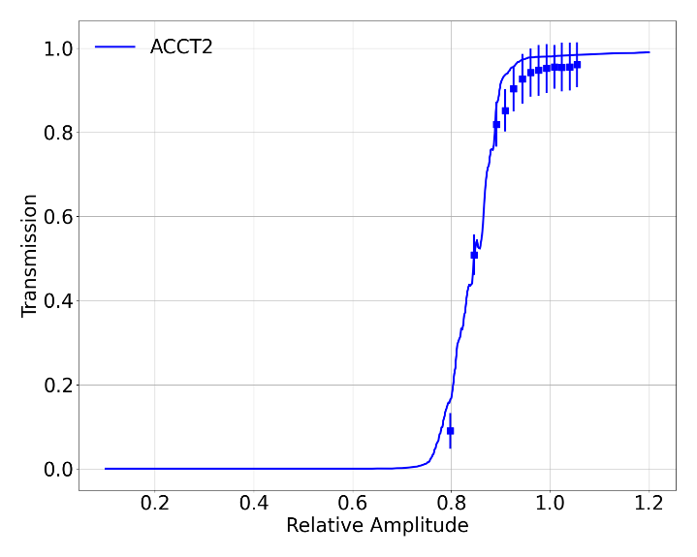
Injector Beam Commissioning
PARAMETER | VALUE
Beam Properties:
Frequency | 81.250 MHz
Particle | H⁺¹ to U₂₃₈⁺³³
Input Energy | 10 keV/u
Input Current | 0.4 mA
Input Emittance | 0.012 .cm. mrad
Output Energy | 0.507 MeV/u
Output Emittance | 0.0125 .cm. mrad ~26 keV/u-Degree
Transmission | ~98 %
Duty Factor | 100%
SSPA(60kW*2EA)
[ Ar9+, 2021]
[ Ar9+, 2022]
[ Ar8+, 2022]
[ RFQ transmission (error bar: 3σ) ]

Slide 17
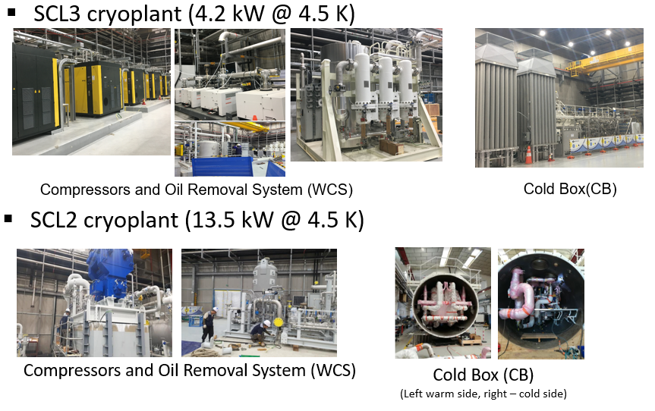
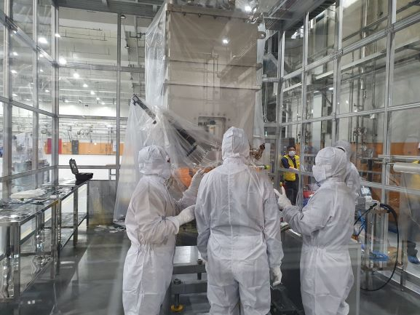
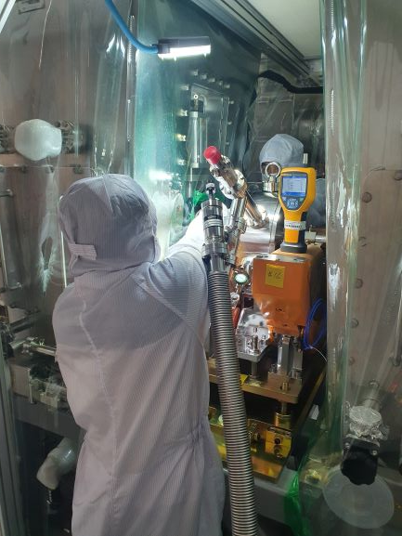
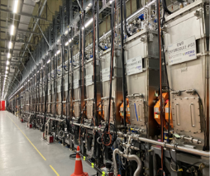
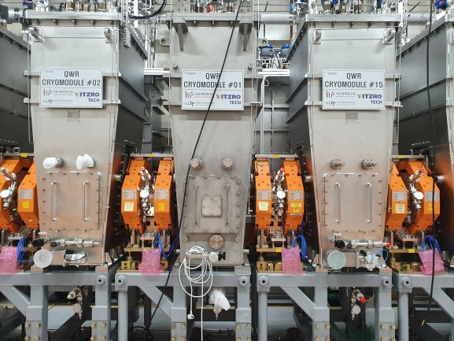
SRF Linac Commissioning
SCL3 and Cryo-plant Installation completed 2021 & Beam commissioning starts from Oct, 2022
-Cryomodule(CM) & Warm section is clean assembled in the clean booth@tunnel
-Total particle counts(size=0.5um above/10 mins) were less than 30 counts
SSPA(60kW*2EA)
CM
CM
CM
Warm section
SCL3 LINAC installed on 2021

Slide 18
PART 4.
Pleasant Stay and Tour

Slide 19
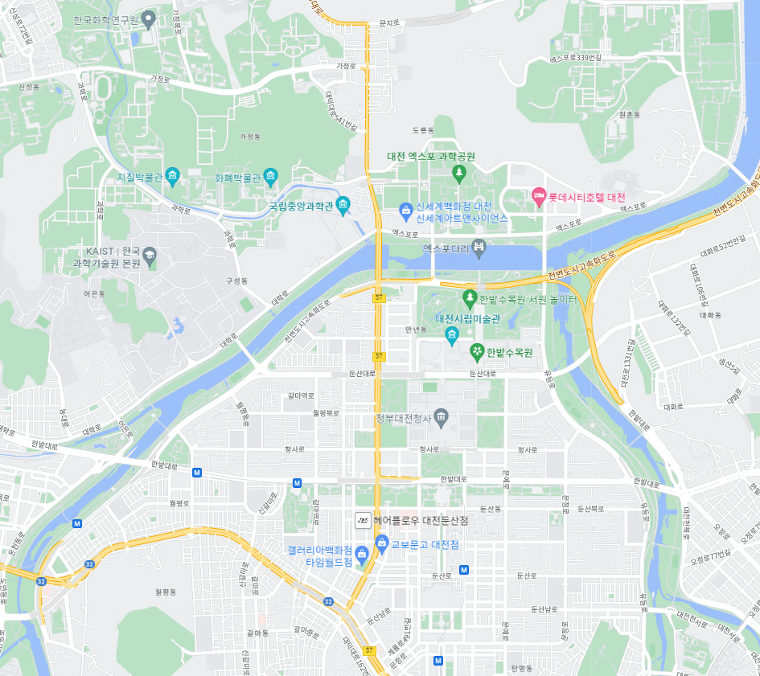
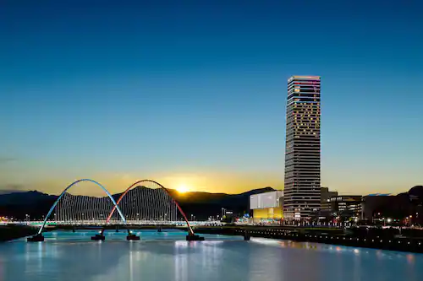
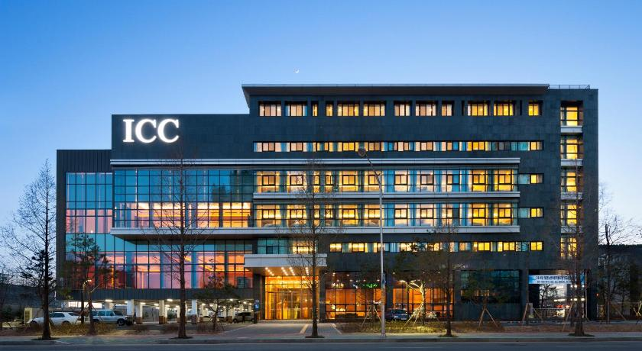
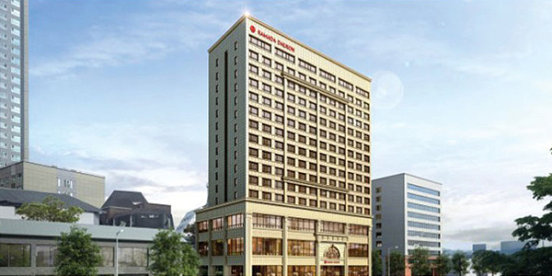
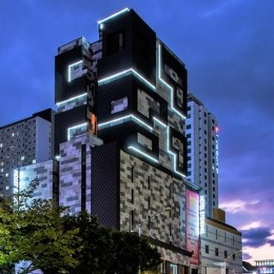
Accommodations
Zone 1.
647 Rooms
Venue
Zone 3.
2,520 Rooms
Zone 2.
1,338 Rooms
+
Others
715 Rooms

Slide 20
Variety of Accommodation Options
Location | Hotel | No. of Rooms | Room Rack Rates (USD) | Corporate Room Rates (USD) | Remark | Distance to the DCC
DCC Area | Hotel Onoma (★★★★) | 171 | $360~$420 | $200 ~ $260 | · Room only · Plus 10% VAT | On site
 | Lotte City Hotel (★★★★) | 306 | $150~$200 | $120 ~ $170 | · Room only · Plus 10% VAT
 | Business Hotel (★★★) | 90 | $90~$100 | $80 ~ $90 | ·VAT and Breakfast included
 | Guest-house | 80 | $50~$110 | $35 ~ $70 | · VAT included
Dunsan Area | Toyoko-inn (★★★) | 300 | $60~$90 |  | ·VAT and Breakfast included | 5 min. by driving
 | Business Hotels | 505 | $50 ~ $60 |  | · VAT included
 | Budget Hotels | 533 | $50 |  | · VAT included
Yuseong Spa Area | Hotel Intercity (★★★★) | 204 | $200~$230 | $90 ~ $120 | · Breakfast included · Plus 10% VAT and service fee | 15 min. by driving
 | Ramada Hotel (★★★★) | 222 | $210~$240 | $100 ~ $130 | · Breakfast included · VAT included
 | Budget Hotels | 2,094 | $50 |  | · VAT included
TOTAL |  | 4,505
※ Room rates are based on 2022 and are subject to change without notice.
International conferences hosted in Daejeon benefit from the strong relationship between the city’s public and private sectors.

Slide 21
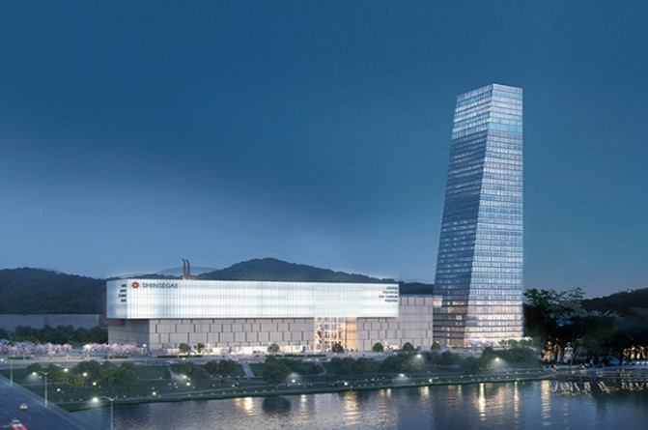
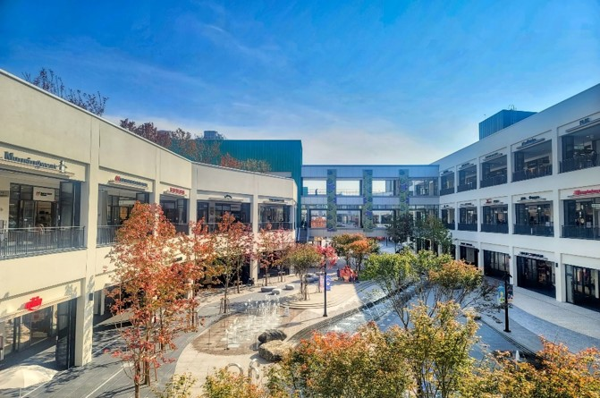
Pleasant Stay and Tour
SHINSEGAE Art & Science
The urban science complex space
Shinsegae Department store,
Hotel Onoma, Aquarium, observatory,
Science Experience Facility, etc.
※ 10 mins walk from DCC
Luxurious & trendy mall embracing culture, shopping, gourmet and accommodation
Hyundai Premium Outlet
Luxurious Shopping Mall
100+ brand mall, theaters, restaurants,
hotel, etc.
※ 15 mins driving distance from DCC

Slide 22
LINAC2026 Social Events (activities)
LINAC Morning run in Gap-river side
K-Pop dance tutorial for young attendees
Banquet at Hanbit Square
Barefoot trail in Mt. Gyejok

Slide 23
LINAC Social Events (excursion)
Daecheongho Obaekri-Gil
(Lakeside Trekking)
Cafeteria Alley in Soje-dong
Event in Korean Traditional House
Local Bakery Tour

Slide 24
UNESCO Cultural Heritage Sites
UNESCO World Heritage - Gongju, Buyeo
(within 40 mins by car)

Slide 25
Tour for Traditional Korean Village
GUNSAN
DAEJEON
JEONJU
Jeonju: Hanok Village / Gunsan: Modern Culture & Restaurant Tour
(within an hour by car)

Slide 26
SEOUL Tour
Royal Palace, Mt. Namsan, DDP, Shopping, Cultural Events, Museums
(within an hour by train)

Slide 27
PART 5.
Conference Budget

Slide 28
CONFERENCE BUDGET (1/2)
Registration Comparison
* KRW Rate : 1USD = 1,200KRW
Registration Comparison | Participants (Estimated) | Regular |  | Late
 |  | USD | KRW | USD | KRW
LINAC 2014 (Geneva) | 484 | 780 | 936,000 | 880 | 1,056,000
LINAC2016 (East Lansing) | 353 | 680 | 816,000 | 780 | 936,000
LINAC 2020 (-) | Postponed due to COVID-19
LINAC 2022 (Liverpool) | 350 | 663 | 795,600 | 728 | 873,600
LINAC 2024 (Chicago)
LINAC 2026 (Daejeon) | 350 | 650 | 780,000 | 750 | 900,000

Slide 29
CONFERENCE BUDGET (2/2)
Income
* KRW Rate : 1USD = 1,200KRW
INCOME | Registration | Number | Rate | Total (USD) | Total (KRW)
Registration | Regular | 250 | 650 | 162,500 | 195,000,000
 | Late | 50 | 750 | 37,500 | 45,000,000
 | Students | 20 | 200 | 4,000 | 4,800,000
 | Exhibitors | 30 | 3,000 | 90,000 | 108,000,000
Sponsorship | Daejeon | 1 | TBD | TBD | TBD
Total |  |  |  | 294,000 | 352,800,000

Slide 30
PART 6.
Strong Support from Local Government

Slide 31
STRONG SUPPORT FROM LOCAL GOVERNMENT
Financial & Administrative Support
Daejeon Tourism Organization
Financial Support: 50 million Korea won
Cooperation with other teams under DJTO (Tourism Promotion Team, Medical Tourism Team, City Marketing Team, Festival Operation Team)
Administrative support: cooperate with government
Promoting and advertising support: Domestic advertisement campaign
Cooperation with MICE Alliance for LINAC 2026 (Hotel, Venue, DMCs)
Support System
Venue Operation Support
Operation by Professional technicians (AV, Setting)
Free wireless Internet for all delegates

Slide 32
SUMMARY
Easy
Accessibility
Strong
Government
Support
Center of
Science &
Technology
LINAC2026
DAEJEON
Convenient
Convention
Infra
Experienced
Destination
Professional
Local Service

Slide 33
Welcome to DAEJEON in 2026
Thank you for your attention!

